Slide 1
Bonne pratique des outils de monitoring regional
Workshop France Grille 12-14 Octobre
Carlos Carranza, Nadia LAJILI, Emmanuel Medernac, Christine Leroy

Slide 2
Plan
1 Architecture Monitoring EGI
2 Architecture Monitoring France Grille
3 Fonctionnement de la Nagios BOX
3.1 Descriptif des sondes CE, SE et BDII (seuls tests critiques)
4 Calcul de Fiabilité/Disponibilité des sites
5MYEGEE
6 Astuces et Bonne pratique
7 Installer une nagios BOX pour un site ou une VO

Slide 3
Architecture Monitoring EGI (1/3)
NGI
NGI
NGI

Slide 4
Architecture Monitoring EGI (2/3)
Nagios :
Système de monitoring, Open Source http://www.nagios.org/
Revisité durant le projet EGEE pour arriver avec le module NCG à une Nagios Box adaptée au monitoring des sites de grilles .
Nagios supervise les différents services et nœuds des sites enregistrés dans la GOCDB.
Une interface web permet de visualiser les résultats et l’historique.
Il envoie des notifications de changements d’états via un bus de message basé sur les technologies AMQ
Une infrastructure complète de monitoring à plusieurs niveaux s’est construire autour des Nagios Boxes

Slide 5
Architecture Monitoring EGI (3/3)
Des modules annexes sont utilisés dans l’architecture de monitoring .
Metric Description Database (MDDB)
Base de données qui contient la description des métriques utilisées par Nagios, et aussi les métriques calculées pour la disponibilité des services.
Metric Results Store (MRS)
Base de données qui contient les résultats utilisés sur du long terme (historique ) des tests Nagios .
ATP (Aggregated Topology Provider)
Base de données toplogiques. Elle contient l’aggrégation des données provenant de la GOC DB , du BDII , de OIM (Information Management System – projet OSG) et des VOs .

Slide 6
Architecture Monitoring France Grille
Nagios France : https://ccnagboxli01.in2p3.fr/nagios/
Instance française validée
Instance hébergé au CC sur un cluster VMWARE avec la fonctionnalité High Availability
Groupe de travail et documentation fournie :
https://francegrid.in2p3.fr/index.php?title=MonitoringRegionalUser

Slide 7
Fonctionnement de la nagios BOX
see next slide + 1
see next slide

Slide 8
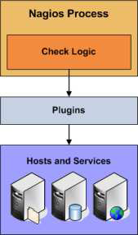
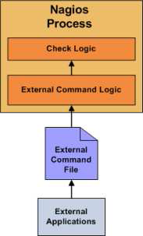
Nagios: Active/passive checks
Passive checks are initiated and performed external applications/processes
Passive check results are submitted to Nagios for processing
Passive checks are useful for monitoring services that are:
Asynchronous in nature and cannot be monitored effectively by polling their status on a regularly
scheduled basis
Active checks are initiated by the Nagios process
Active checks are run on a regularly scheduled basis

Slide 9
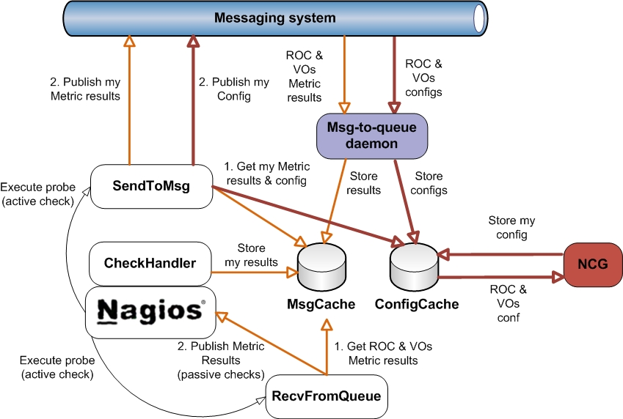
Détail sur le fonctionnement de la nagios BOX avec MSG
msg-to-handler
daemon

Slide 10
Sondes critiques
(SRMv2, hr.srce.SRM2-CertLifetime)
(SRMv2, org.sam.SRM-Put)
(SRMv2, org.sam.SRM-LsDir)
(SRMv2, org.sam.SRM-Get)
(SRMv2, org.sam.SRM-Ls)
(SRMv2, org.sam.SRM-GetTURLs)
(SRMv2, org.sam.SRM-GetSURLs)
(SRMv2, org.sam.SRM-Del)
(CE, hr.srce.GRAM-CertLifetime)
(CE, org.sam.CE-JobSubmit)
(CE, org.sam.WN-RepCr)
(CE, org.sam.WN-CAver)
(CE, org.sam.WN-RepISenv)
(CE, org.sam.WN-Rep)
(CE, org.sam.WN-Bi)
(CE, org.sam.WN-RepGet)
(CE, org.sam.WN-RepDel)
(CE, org.sam.WN-RepFree)
(CE, org.sam.WN-Csh)
(CE, org.sam.WN-RepRep)
(CE, org.sam.WN-SoftVer)
(Site-BDII, org.bdii.Entries)
(Site-BDII, org.gstat.SanityCheck)

Slide 11
Détail sur le fonctionnement de la nagios BOX pour les CE
Carlos Carranza
Nagios CE (and creamCE) metrics

Slide 12
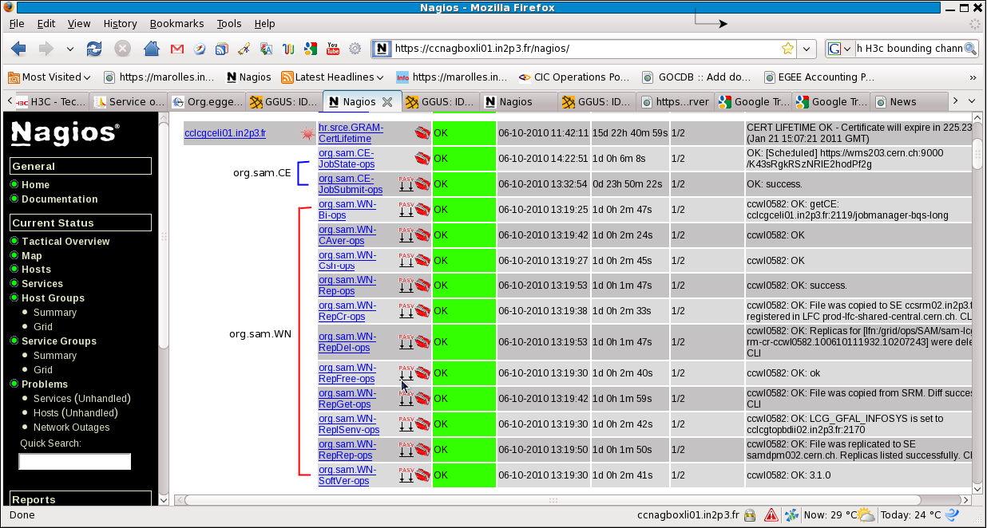
Nagios CE (and creamCE) metrics
12

Slide 13
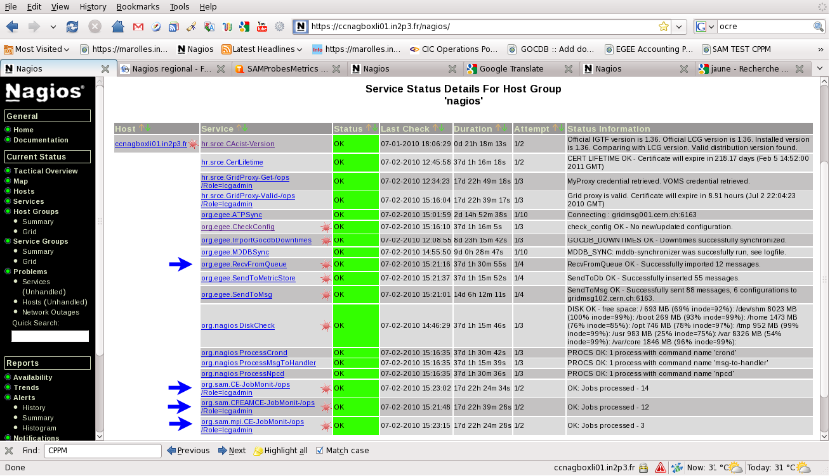
Nagios Box metrics

Slide 14
The org.sam.CE metrics
14
org.sam.CE-JobState (active + passive)
Run hourly.
Submit grid job in active mode.
accepts passive check results for the submitted grid jobs
holds a status of the grid (activejob.map).
org.sam.CE-JobMonit (active)
Run each five minuts.
Checks statuses of all submitted jobs and updates CE-JobState and CE-JobSubmit (acts as a babysitter for all grid jobs submitted by CE-JobState service instances).
CE-JobState and CE-JobSubmit are updated (as passive checks) either via Nagios command file or NSCA.
Update the status of the grid job(activejob.map).
org.sam.CE-JobSubmit (passive)
Holds terminal status of job submission, mapping from gLite job terminal states ['Done','Aborted','Canceled'] to Nagios status
[Ok Warning,Critical,Unknown].

Slide 15
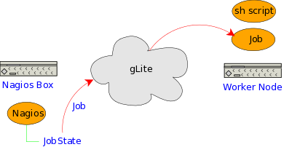
org.sam.CE-JobState (active)
15

Slide 16
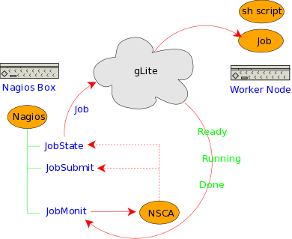
org.sam.CE-JobMonit and JobSubmit
16

Slide 17
org.sam.CE-JobMonit and JobSubmit
17

Slide 18
18
A JDL Job
[
Type="Job";
JobType="Normal";
Executable = "script.sh";
StdError = "gridjob.out";
StdOutput = "gridjob.out";
Arguments = "<jdlArguments>";
InputSandbox = {"script.sh", "file.tar.gz"};
OutputSandbox = {"gridjob.out"};
RetryCount = <jdlRetryCount>;
ShallowRetryCount = <jdlShallowRetryCount>;
Requirements = other.GlueCEInfoHostName == "<jdlReqCEInfoHostName>";
]
A tarball including ...
The Nagios binary
Some tools
nagiostats
msg-brokers
send_to_msg
The Nagios conf
The WN's probes

Slide 19
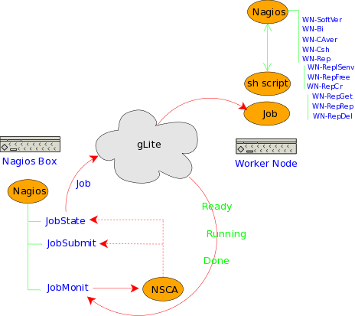
19

Slide 20
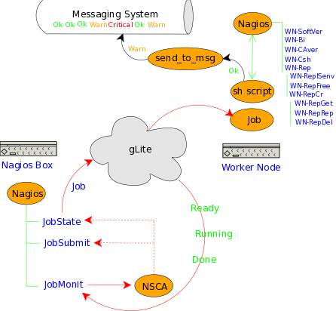
Publishing WN's metrics
20

Slide 21
21
[root@ccnagboxli01 marce01.in2p3.fr]# cat jobOutput_h0F2Xra2ZJINX3nX02hT_g/gridjob.out
=== [Wed Jun 16 15:06:06 CEST 2010] ===
=== Running on ===
=== Site: IN2P3-CPPM
=== CE: marce01.in2p3.fr:2119/jobmanager-pbs-ops
=== WN: marwn72.in2p3.fr
=== WN arch: x86_64
CPython 2.4.3
Traceback (most recent call last):
File "<string>", line 1, in ?
ImportError: No module named _lcg_util
bin/python
Can we import Python LDAP ...
YES.
Can we import _lcg_util now?
lcg_util version
lcg_util-1.7.6-2
GFAL-client-1.11.8-3
Message Broker URI was not given. Trying to obtain it from IS.
Brokers found in 'PROD' network [BDII cclcgtopbdii01.in2p3.fr:2170]:
stomp://gridmsg102.cern.ch:6163/
stomp://gridmsg101.cern.ch:6163/
stomp://msg.cro-ngi.hr:6163/
stomp://broker.afroditi.hellasgrid.gr:6163/
Brokers were sorted by min access time. Taking the first one.
Message Broker URI: stomp://gridmsg102.cern.ch:6163/
Message Broker destination: /queue/grid.probe.metricOutput.EGEE.a23827b5aeb12d21d3a4c987d1941a1c
Setting Nagios configuration.

Slide 22
22
Nagios Core 3.2.1
Copyright (c) 2009-2010 Nagios Core Development Team and Community Contributors
Copyright (c) 1999-2009 Ethan Galstad
Last Modified: 03-09-2010
License: GPL
Website: http://www.nagios.org
Nagios 3.2.1 starting... (PID=22809)
Local time is Wed Jun 16 15:06:07 CEST 2010
Nagios pid: 22809
_send_to_msg [Wed Jun 16 15:06:16 CEST 2010]: Successfully published 1 messages
_send_to_msg [Wed Jun 16 15:06:21 CEST 2010]: Successfully published 6 messages
_send_to_msg [Wed Jun 16 15:06:30 CEST 2010]: Successfully published 1 messages
_send_to_msg [Wed Jun 16 15:06:38 CEST 2010]: Successfully published 1 messages
_send_to_msg [Wed Jun 16 15:06:54 CEST 2010]: Successfully published 1 messages
_send_to_msg [Wed Jun 16 15:06:57 CEST 2010]: Successfully published 2 messages
>>>>>>>>>>>>>>>>>> Wed Jun 16 15:06:59 CEST 2010
T |S |c |U |O |W |C |A |P |
12 |6 |12 |0 |10 |2 |0 |0 |6 |
Services Total 12 Checked: 12
All services were checked. Killing Nagios.
Nagios was successfully killed.
Successfully shutdown... (PID=22809)
Wed Jun 16 15:07:01 CEST 2010
================== Wed Jun 16 15:07:01 CEST 2010
[root@ccnagboxli01 marce01.in2p3.fr]#

Slide 23
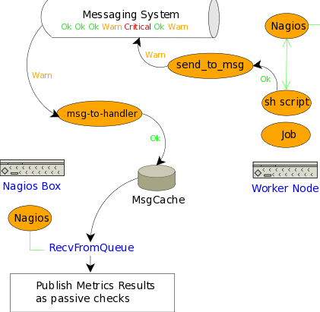
23

Slide 24
Détail sur le fonctionnement de la nagios BOX pour les SEs
org.sam.SRM-All-ops Wrapper metric to launch the other metrics and publish passive checks results to Nagios.
org.sam.SRM-GetSURLs Get full SRM endpoint(s) and storage areas from BDII. org.sam.SRM-LsDir List content of VO's top level space area(s) in SRM. org.sam.SRM-Put Copy a local file to the SRM into default space area(s). org.sam.SRM-Ls List (previously copied) file(s) on the SRM. org.sam.SRM-GetTURLs Get Transport URLs for the file copied to storage. org.sam.SRM-Get Copy given remote file(s) from SRM to a local file. org.sam.SRM-Del Delete given file(s) from SRM

Slide 25
Détail sur le fonctionnement de la nagios BOX pour les SiteBDII
org.bdii.Entries: measure the response time as well as the number of entries returned.
org.gstat.SanityCheck :This probe is used to connect to the BDII - TopBDII and check the value of main attributes published to see if the publication of the site is consistent https://francegrid.in2p3.fr/index.php?title=Org.gstat.SanityCheck

Slide 26
Calcul de Fiabilité/Disponibilité des sites
Availability : Availability of a service instance, service or a site over a given period
is defined as the fraction of time the same was UP during the known interval in the given period.
Availability= UP period / (Total period – UNKNOWN period)
Availability= Up fraction / (Up fraction + Down fraction + Scheduled Down fraction)
Reliability : Reliability of a service instance, service or a site over a given period is
defined as the ratio of the time interval it was UP over the time interval it was
supposed (scheduled) to be UP during the known interval in the given period.
Reliability = UP period / (Total period – UNKNOWN period – Scheduled Downtime)
Reliability = Up fraction / (Up fraction + Down fraction)

Slide 27
Calcul de Fiabilité/Disponibilité des sites
(SRMv2, hr.srce.SRM2-CertLifetime)
(SRMv2, org.sam.SRM-Put)
(SRMv2, org.sam.SRM-LsDir)
(SRMv2, org.sam.SRM-Get)
(SRMv2, org.sam.SRM-Ls)
(SRMv2, org.sam.SRM-GetTURLs)
(SRMv2, org.sam.SRM-GetSURLs)
(SRMv2, org.sam.SRM-Del)
(CE, hr.srce.GRAM-CertLifetime)
(CE, org.sam.CE-JobSubmit)
(CE, org.sam.WN-RepCr)
(CE, org.sam.WN-CAver)
(CE, org.sam.WN-RepISenv)
(CE, org.sam.WN-Rep)
(CE, org.sam.WN-Bi)
(CE, org.sam.WN-RepGet)
(CE, org.sam.WN-RepDel)
(CE, org.sam.WN-RepFree)
(CE, org.sam.WN-Csh)
(CE, org.sam.WN-RepRep)
(CE, org.sam.WN-SoftVer)
(Site-BDII, org.bdii.Entries)
(Site-BDII, org.gstat.SanityCheck)
-Uniquement basé sur les sondes critiques ci dessus
-beaucoup plus d’état UNKNOWN depuis qu’on est passé à nagios: il peut manquer des résultats des tests (on passe en unknown pour gridview seulement au bout de 24 heures de non résultat)
-pour les calculs d’availability/reliability la période de temps utilisé ne prend pas les périodes UNKNOWN: si beaucoup d’état UNKNOWN les calculs ont beaucoup moins de sens.

