Slide 1
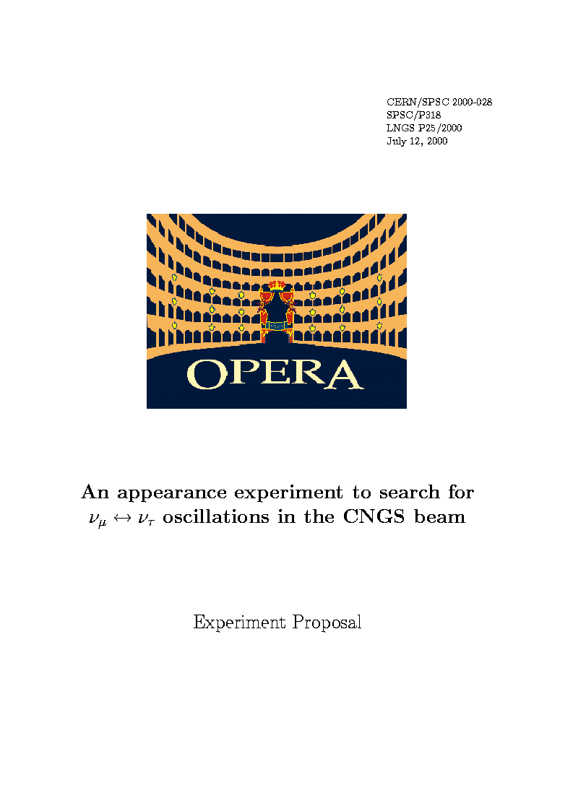
Détection d'un premier candidat dans la recherche d'une preuve directe de l'oscillation des neutrinos
Amina Zghiche
Pour la Collaboration OPERA
Séminaire LAPP 02 juillet 2010

Slide 2
The present picture
Neutrino oscillation experiments
  Natural neutrino sources:
• solar neutrinos
Homestake, SAGE+GNO, Super-K, SNO, Borexino
• atmospheric neutrinos
Super-Kamiokande
  Artificial neutrino sources:
• reactor neutrinos
Chooz (1 km), KamLAND (180 km)
• long-baseline accelerator experiments
K2K (250 km), MINOS (735 km)

Slide 3
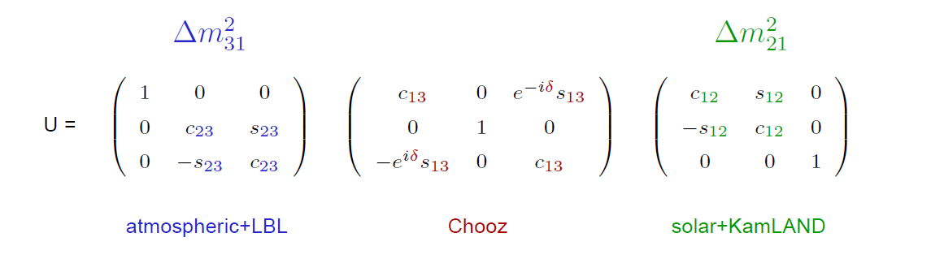
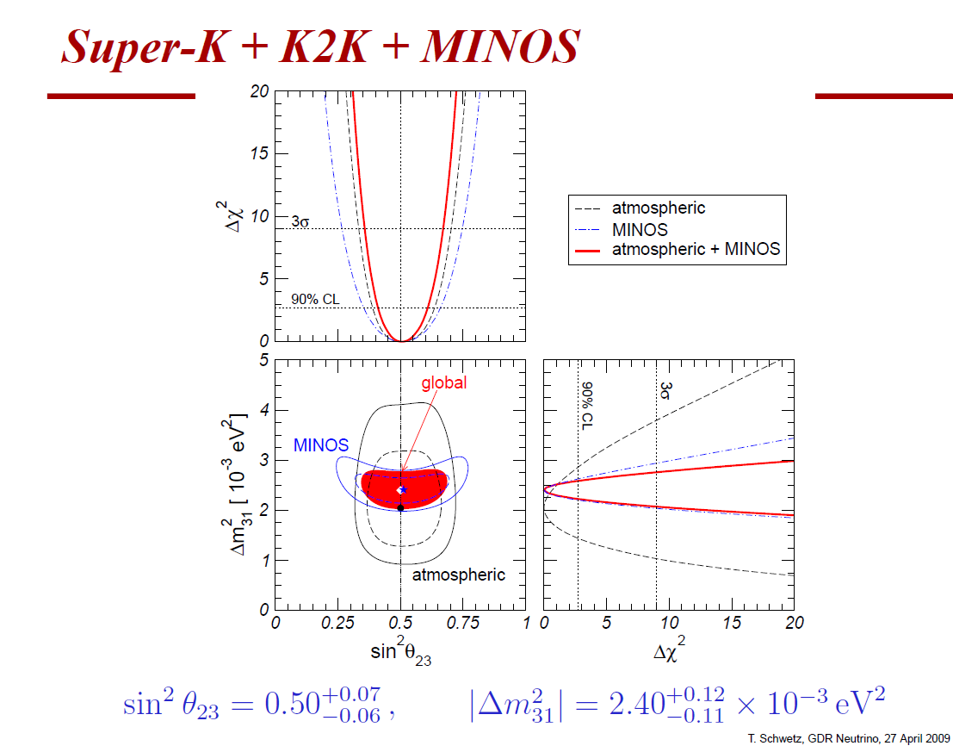

Three Flavour Oscillation parameters
OPERA
3-flavour effects are suppressed because
Δm²21 ≪ |Δm²31| and θ13 ≪ 1
⇒ dominant oscillations are well described by effective two-flavour oscillations
SK (1998): atmospheric neutrino anomaly interpretable as ν_{μ}  ν_{τ} oscillation
CHOOZ: no ν_{μ} → ν_{e} oscillation
SK ν_{μ} disappearance oscillation signal confirmed by K2K and MINOS

Slide 4
OPERA: first direct detection of neutrino oscillations in appearance mode
following the Super- Kamiokande discovery of oscillations with atmospheric neutrinos and the confirmation obtained with solar neutrinos and accelerator beams. Important, missing tile in the oscillation picture.
The PMNS 3-flavor oscillation formalism predicts:
P(ν_{μ}→ν_{τ}) ~ sin²2θ₂₃cos⁴θ₁₃sin²(Δm²₂₃L/4E)
Requirements:
1) long baseline, 2) high neutrino energy, 3) high beam intensity, 4) detect short lived τ’s
μ⁻
ν_{μ}
ν_{μ}
ν
decay “kink”
μ⁻
, h⁻
, e⁻
ν_{μ}
oscillation
τ⁻
ν_{τ}
~1 mm
plus 3-prong decay modes

Slide 5
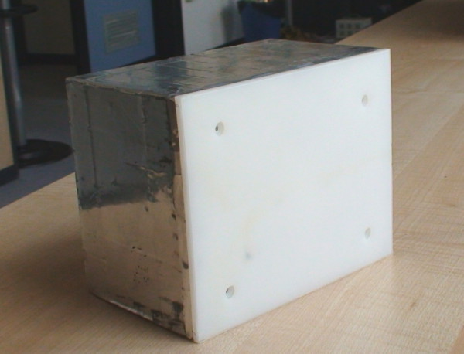
THE PRINCIPLE OF THE EXPERIMENT: ECC + ELECTRONIC DETECTORS
ECC brick
1 mm
neutrino
electronicstrackers
τ
ν_{τ}
10.2 cm
Pb
emulsion layers
7.5 cm
10 X0
12.5 cm
interface films (CS)
Intense, high-energy muon-neutrino beam
Massive active target with micrometric space resolution
Detect tau-lepton production and decay
Use electronic detectors to provide “time resolution” to the emulsions
and preselect the interaction region

Slide 6
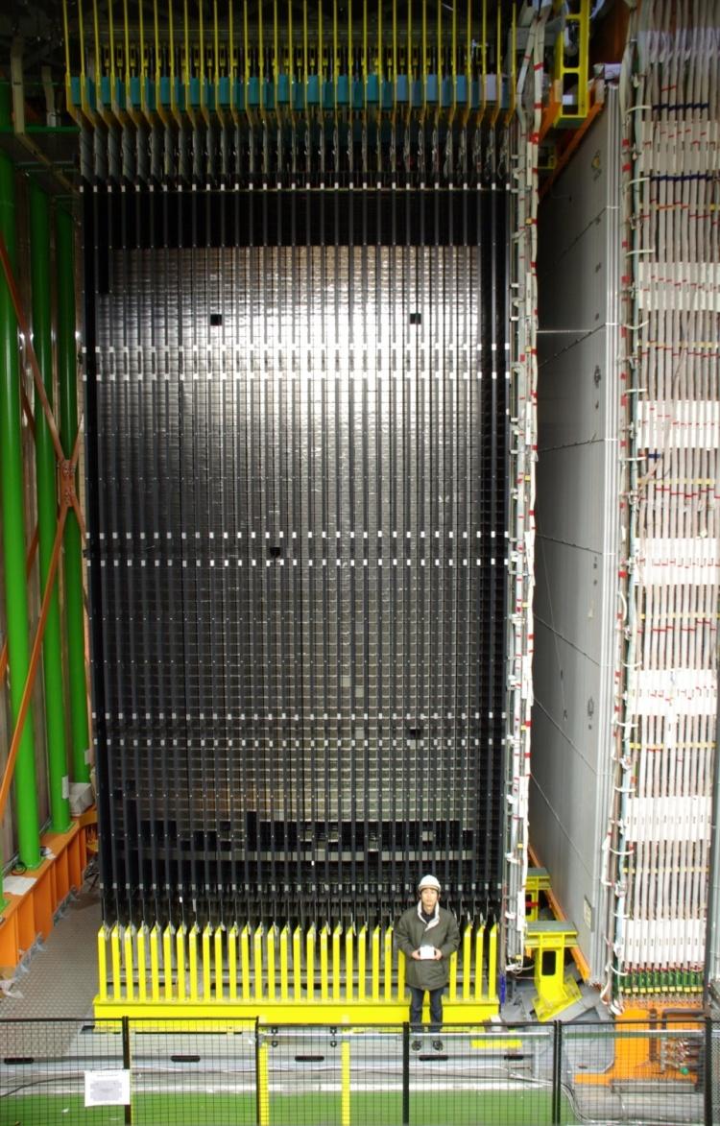
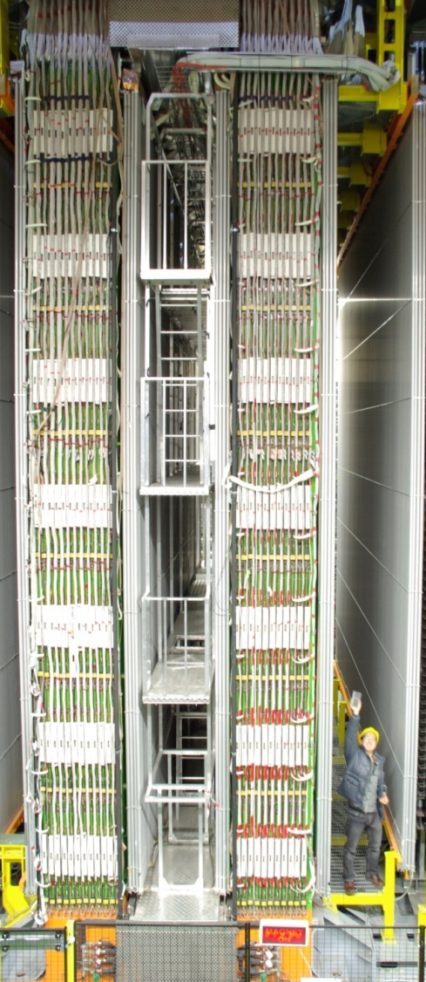
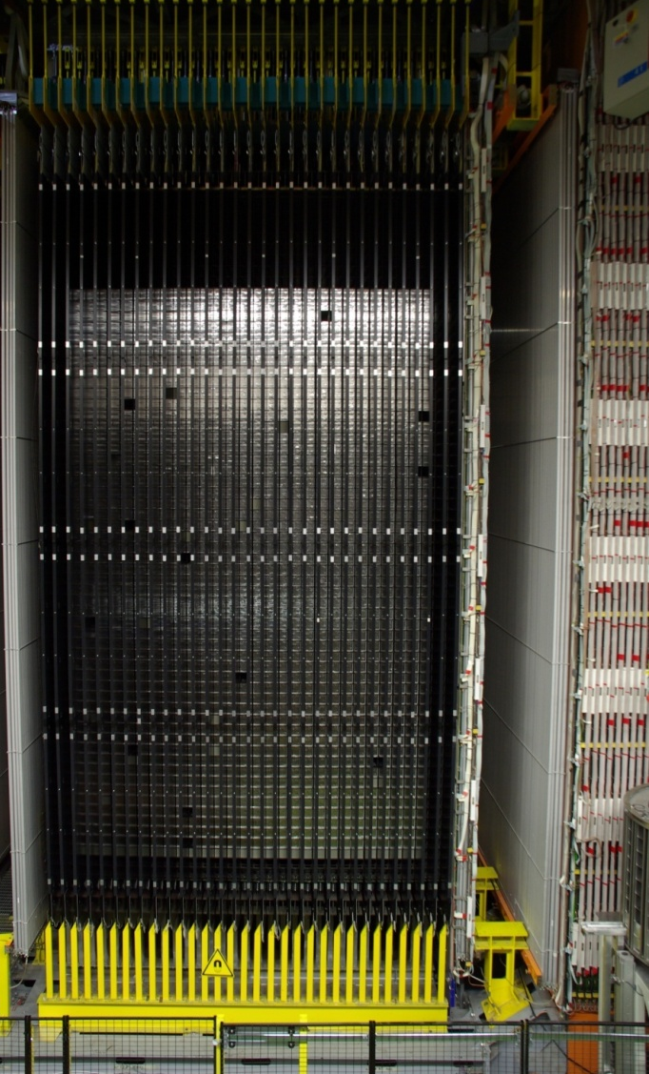
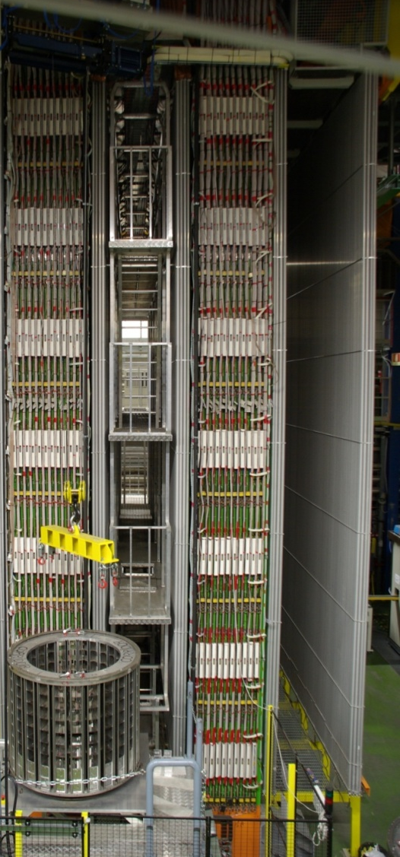
THE IMPLEMENTATION OF THE PRINCIPLE
SM1
SM1
SM2
SM2
Target area
Muon spectrometer
size~10x10x20m³

Slide 7
OPERA expected performance (Proposal)
τ decay channel | B.R. (%) | Signal Δm² = 2.5 x 10⁻³ eV² | Background
τ → μ | 17.7 | 2.9 | 0.17
τ → e | 17.8 | 3.5 | 0.17
τ → h | 49.5 | 3.1 | 0.24
τ → 3h | 15.0 | 0.9 | 0.17
Total |  | 10.4 | 0.75
Main background sources:
Production and decay of charmed particles
Hadron reinteractions
Large angle muon scattering
Assume 22.5x10¹⁹ pot
Example: charm BG to tau decays
Signal
Background
ν_{μ} CC+ charm production
μ, e, hadron
ν_{τ} CC
τ
charm
muon misidentified
μ

Slide 8
Interactions courants chargés et courants neutres
Interactions CC(~75%),NC(~25%)
l, ν_{l}
ν_{l}
W,Z
Y,X
X

Slide 9
CNGS BEAM AND LNGS

Slide 10
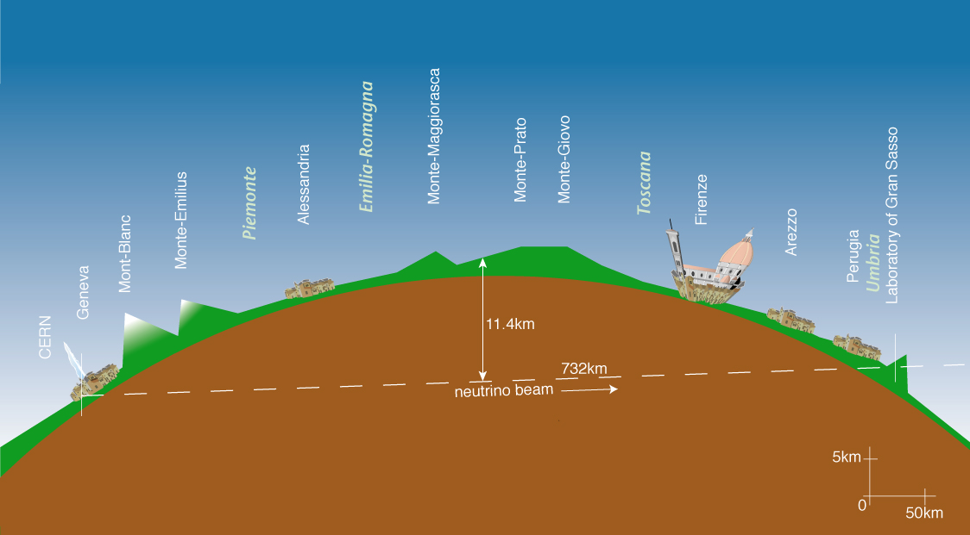
CNGS beam: tuned for ν_{τ}-appearance at LNGS (730 km away from CERN)
L = 730 km
LNGS
CERN
T_{flight} = 2.44 ms
< E > | 17 GeV
L | 730 km
( ν_{e} + ν_{e}) / ν_{μ} (CC) | 0.87%
ν_{μ} / ν_{μ} (CC) | 2.1%
ν_{τ} prompt | negligible
Expected neutrino interactions for 22.5x10¹⁹ pot:
~ 23600 ν_{μ} CC + NC
~ 160 ν_{e} + ν_{e} CC
~ 115 ν_{τ} CC (Δm² = 2.5 x 10⁻³ eV²)

Slide 11
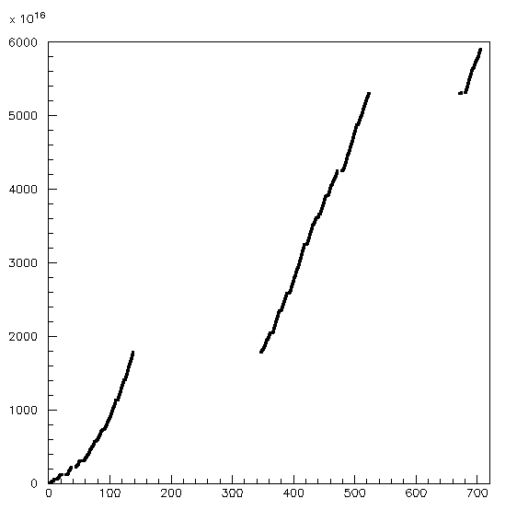
2006 | 0.076x10¹⁹ pot | no bricks | Commissioning
2007 | 0.082x10¹⁹ pot | 38 ev. | Commissioning
2008 | 1.78x10¹⁹ pot | 1698 ev. | First physics run
2009 | 3.52x10¹⁹ pot | 3693 ev. | Physics run
2010 | 0.60x10¹⁹ pot (23 May) | 579 ev. | Physics run
CNGS performance
5970 events collected until 23 May 2010 (within 1σ in agreement with expectations)
Improving features, high CNGS efficiency (97% in 2008-2009)
2010: close to nominal year;
Multi Turn Extraction routinely running
Aim at high-intensity runs in 2011 and 2012
2010
2009
2008
Days
Notes:
MTE

Slide 12
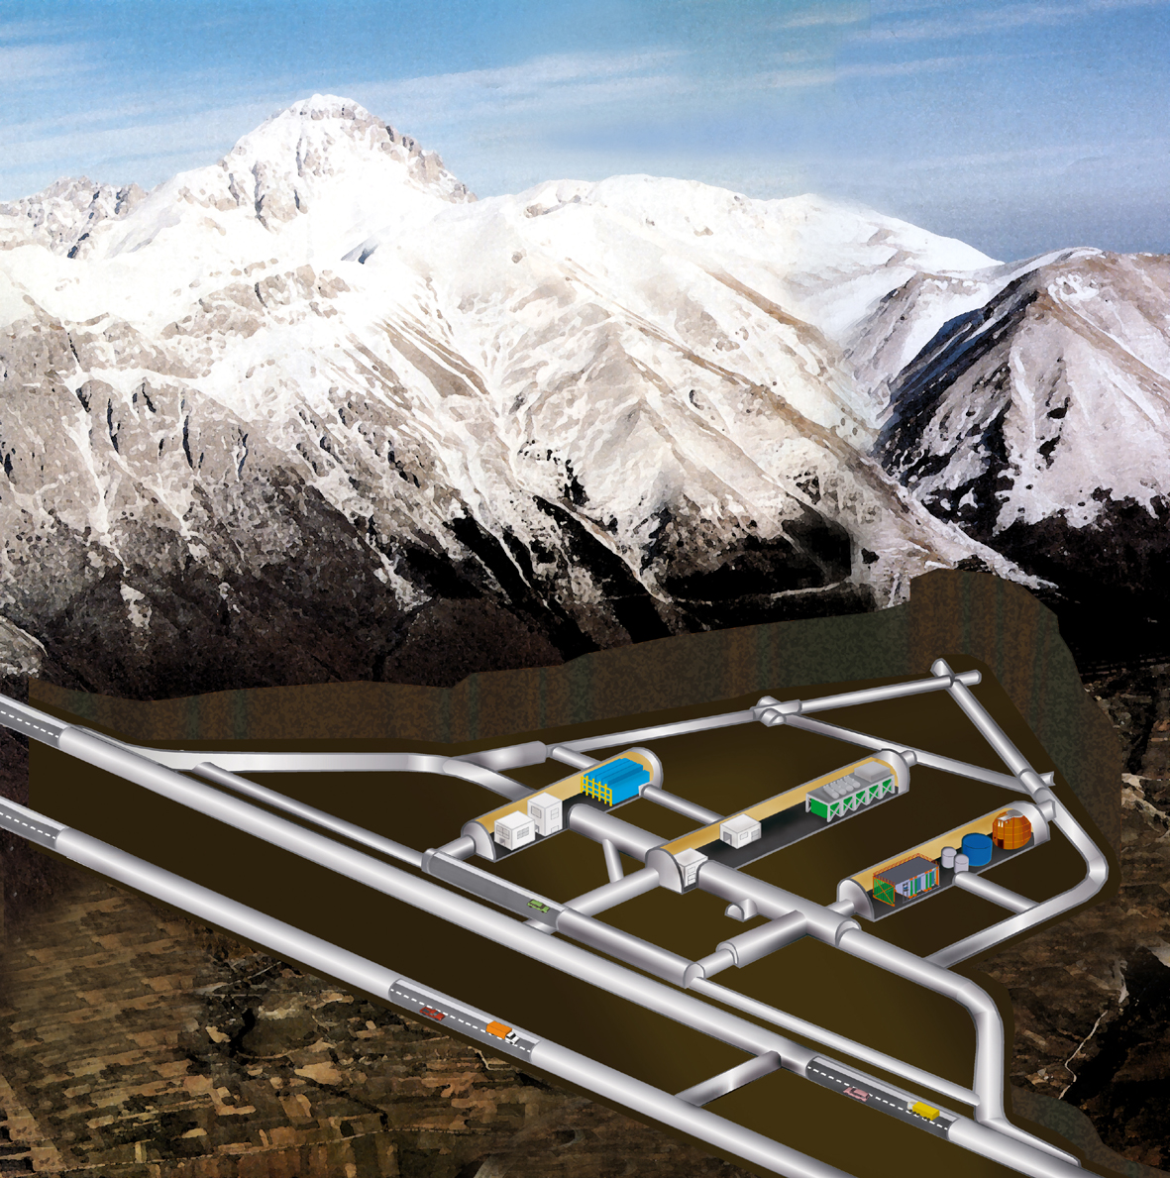
LNGS of INFN
~180’000 m³ caverns’ volume, ~3’100 m.w.e. overburden, ~1 cosmic μ / m² x hour, experimental infrastructure, variety of experiments. Perfectly fit to host detector and related facilities, caverns oriented towards CERN.
Corno Grande peak 2912m
Gran Sasso Chain
LNGS under 1400m of rock
CNGS
OPERA

Slide 13
DETECTORS AND FACILITIES:
A very complex experiment…

Slide 14
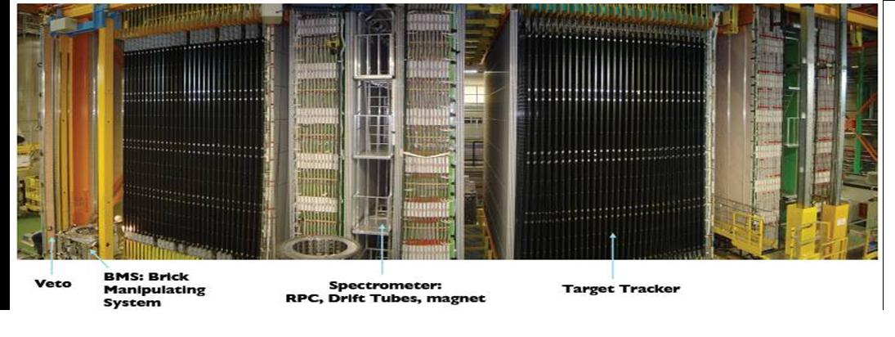
Two target super-modules, each with an iron spectrometer for muon detection (BG rejection and tau-into-muon decay channel)

Slide 15
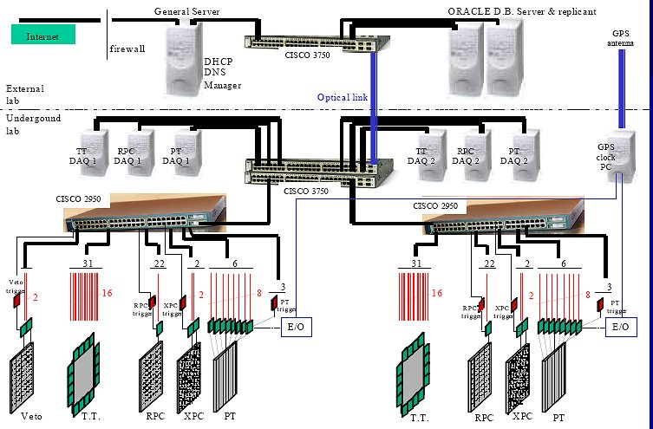
DATA ACQUISITION
  Trigger-less scheme: hits from single detectors with GPS time stamp
  About 1200 sensors for controlling groups of pixels, strips or wires
  All hits recorded in the DB
  Events extracted offline from DB
Remote controls
Ethernet switch
Sensors
Detectors

Slide 16
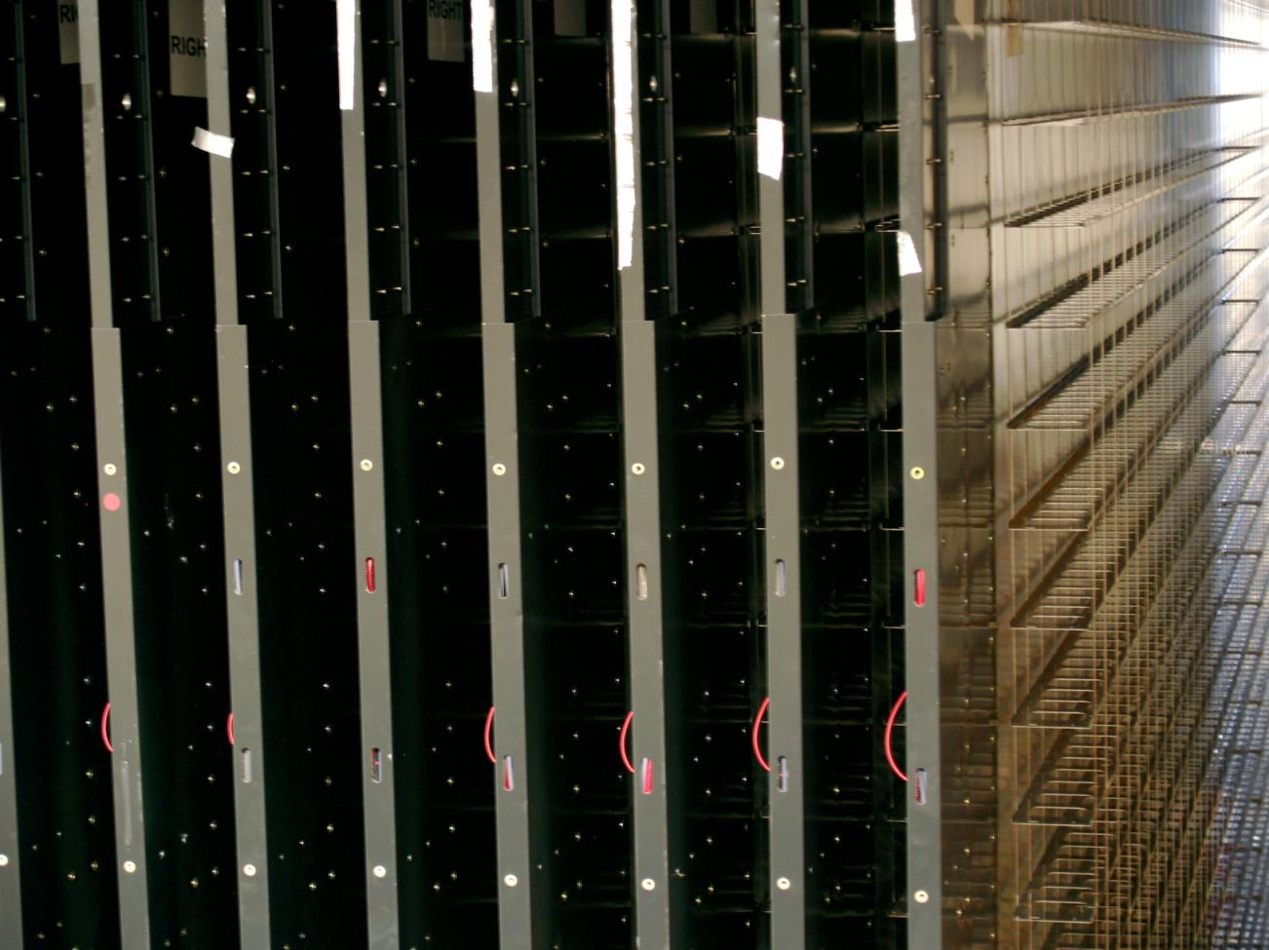
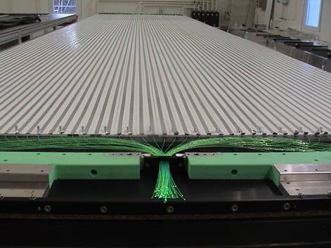
SCINTILLATOR STRIPS TARGET TRACKER AND BRICK TRAYS
Hybrid target structure.
(CS)
> 5 p.e. for a m.i.p.
~ 99% detection efficiency ⇒ trigger
position accuracy: ~8 mm
angular accuracy: ~ 20 mrad
mechanical structure:
brick trays: only 0.5% of target mass

Slide 17
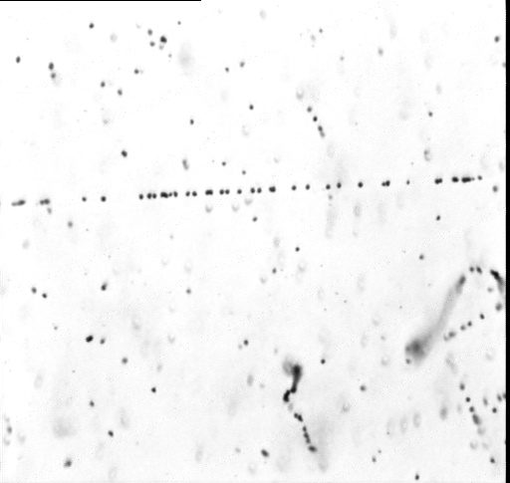
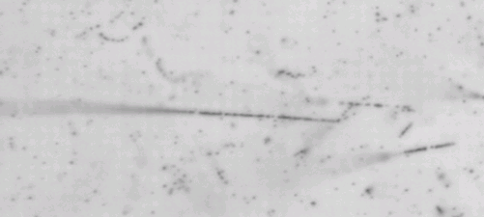
The heart of the experiment:
THE ECC TARGET BRICKS
sensitivity 15 grains/44 microns
mip
neutrino
electron ～100 keV
10.2 cm
20 μm
(CS)
7.5 cm
10 X0
high dE/dx tracks
from nuclear evaporation
12.5 cm
0.3mm
1mm
The OPERA target consists of 150’000 ECC bricks.
Total 105’000 m² of lead surface
and 111’000 m² of film surface
(~ 8.9 million films)
Total target mass: 1.25 kton
Lead plate
57 OPERA films, 56 lead plates

Slide 18
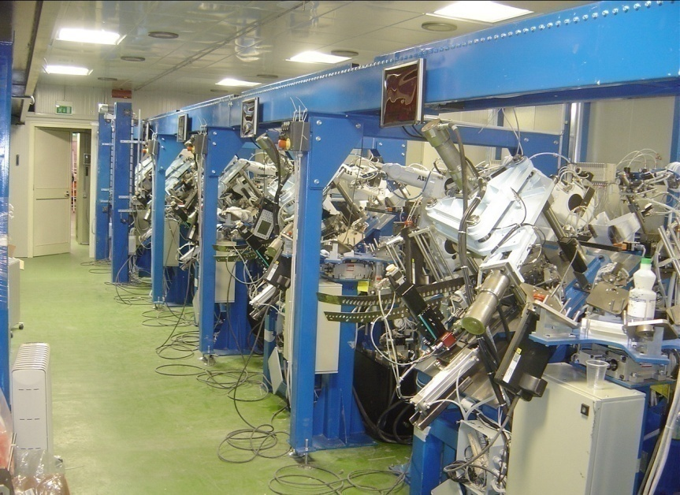
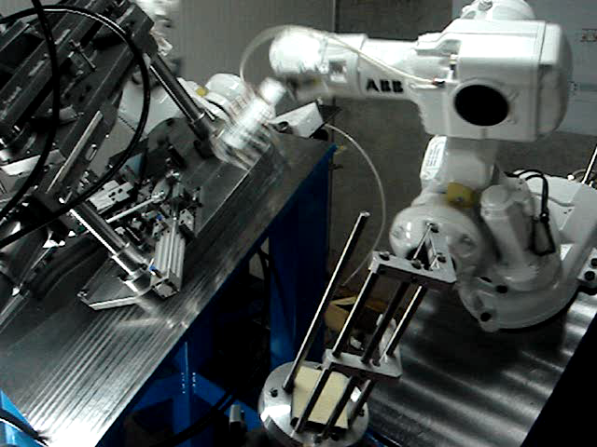
BRICK ASSEMBLY MACHINE (BAM)
Major engineering infrastructure: automatic production of 150’000 bricks (2006-2008)
~9x10⁶ emulsion plates and about 8.5x10⁶ for lead plates at a rate of 1000 bricks/day
Jun 08
Mar 07

Slide 19
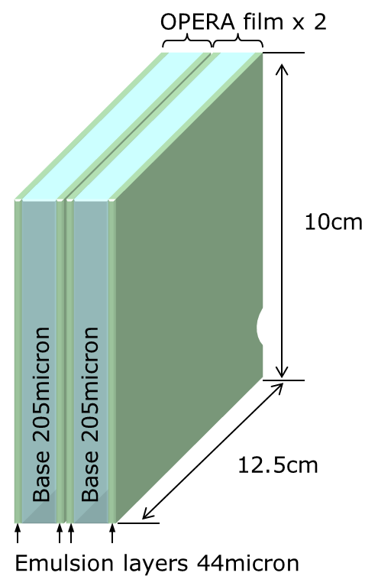

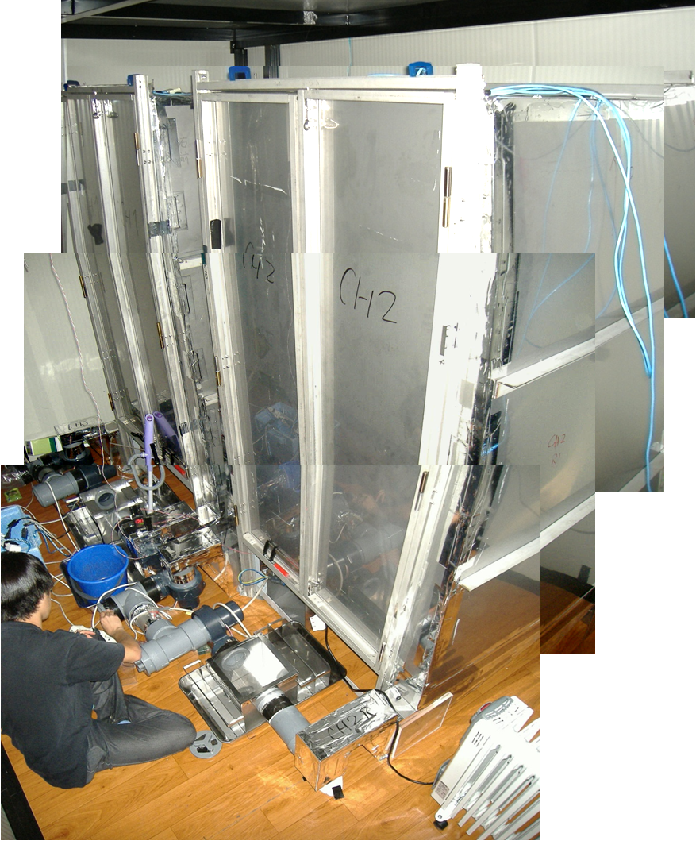
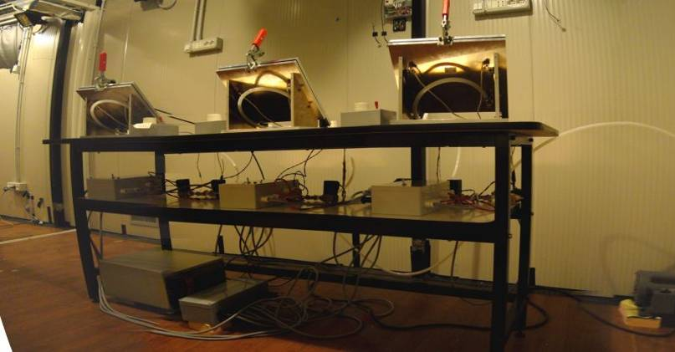
Changeable Sheet (CS) assembly facility at LNGS underground
To pick up event related tracks.
On-site refreshing and doublet packing: very low background emulsion tracker.
160’000 CS produced in 2006-2008.
Side view of a CS doublet
muon track
160micron
600 microns
Packing machines
Refreshing chambers

Slide 20
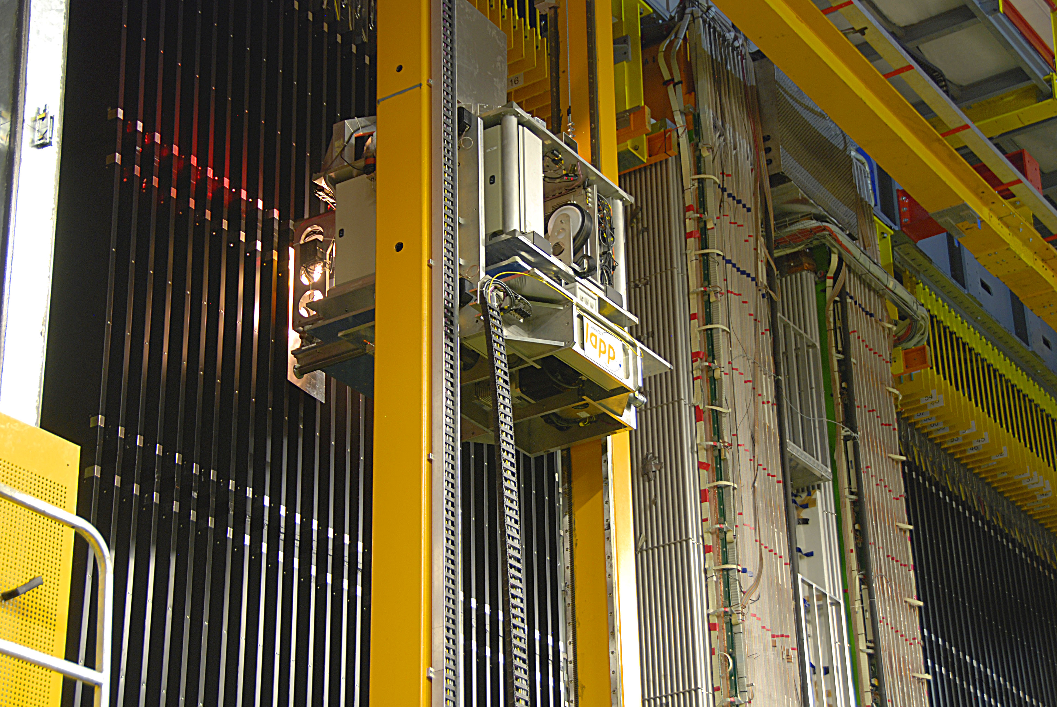
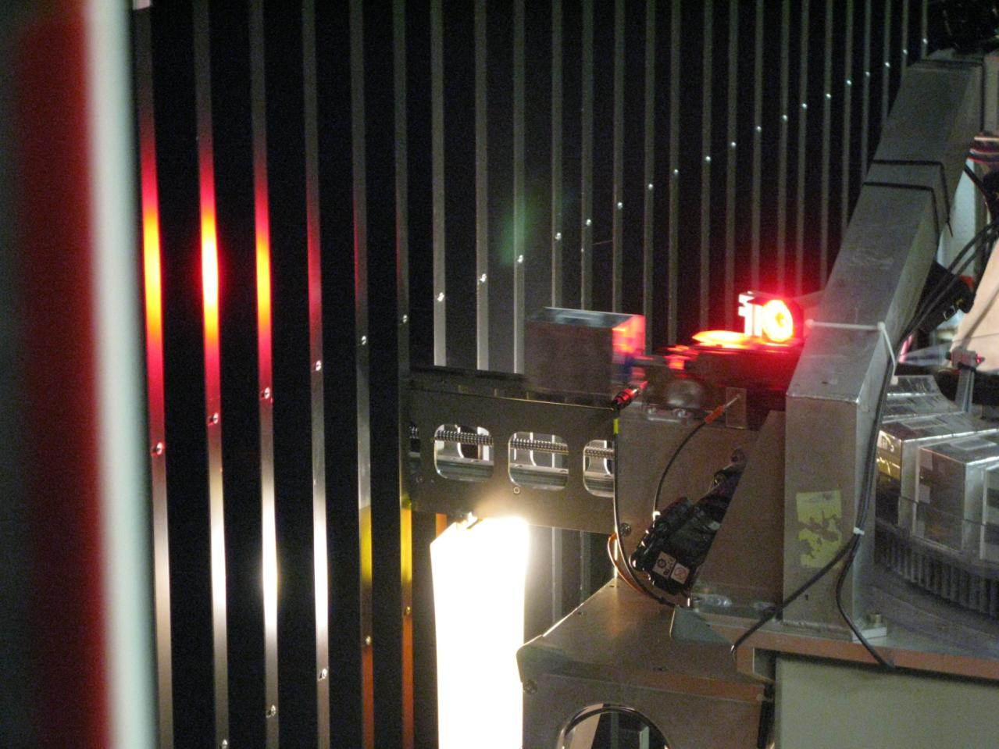
BRICK MANIPULATOR SYSTEM (BMS)
Built by LAPP with a precision in position of 0.1 mm
A total of 1.25kton target
Extraction of “hit” bricks in parallel with CNGS data taking:
initially used to fill the brick target (two twin devices at either detector sides)
fully automatic extraction of 25 bricks/8 hour shift (neutrino interactions)
~90’000 bricks handled until 2009 for the extraction of ~7000 event bricks

Slide 21
Event selection flowchart: Brick finding
Use data from the real-time detectors (scint hits, # p.e., identified tracks in the target and spectrometers) to build a probability map of the bricks where the interaction might have occurred
Are the tracks found compatible with the expectations from the real time detectors ?
YES(60%)
NO
The most probable brick is extracted and the corresponding Changeable Sheet is detatched developped and scanned (sample=700)
the brick is put back in the detector with new cs-pair
the brick is developed (70% success in event location)
Volume scan for vertex location and event reconstruction
try again with the second most probable brick (80%)

Slide 22
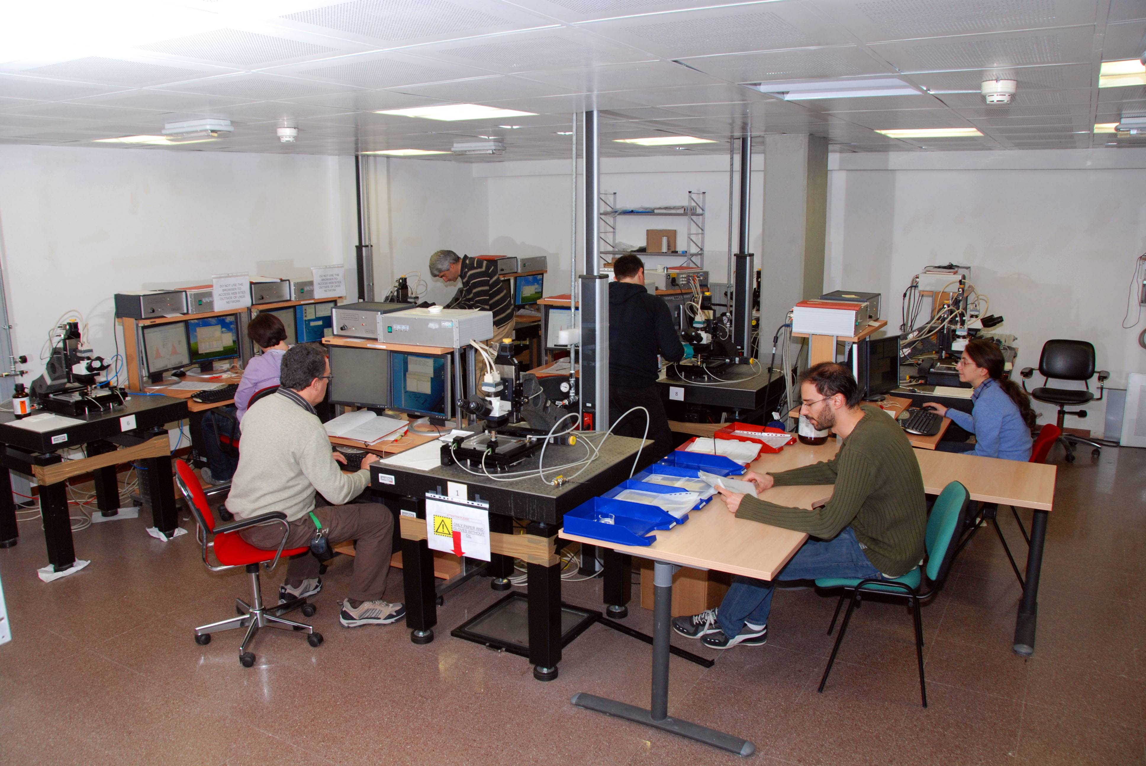
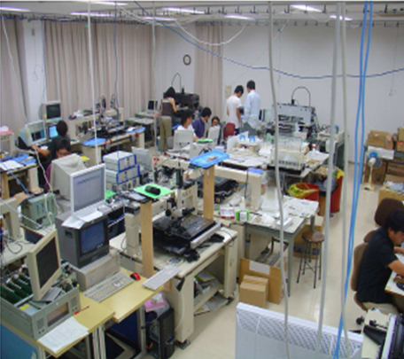
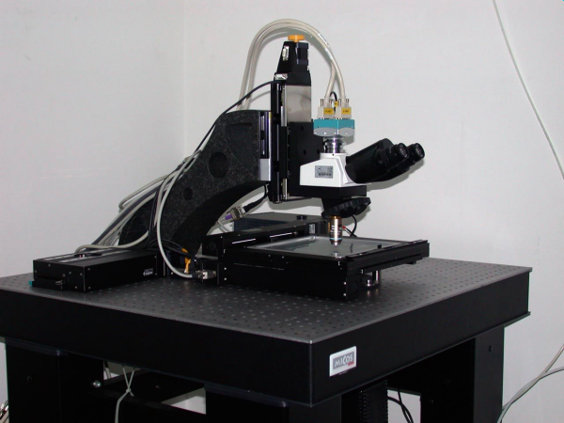
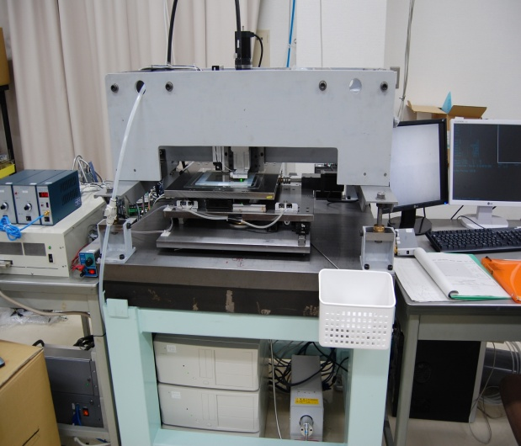
CHANGEABLE SHEET SCANNING STATIONS
LNGS
Nagoya
High speed automatic microscopes:
~ 200 cm² emulsion film surface/hour/facility
Based on state of the art technologies:
precision mechanics, stepping motors, CCD readout, pattern recognition, image analysis,…
European Scanning System
Super-UltraTrack Selector (Japan)

Slide 23
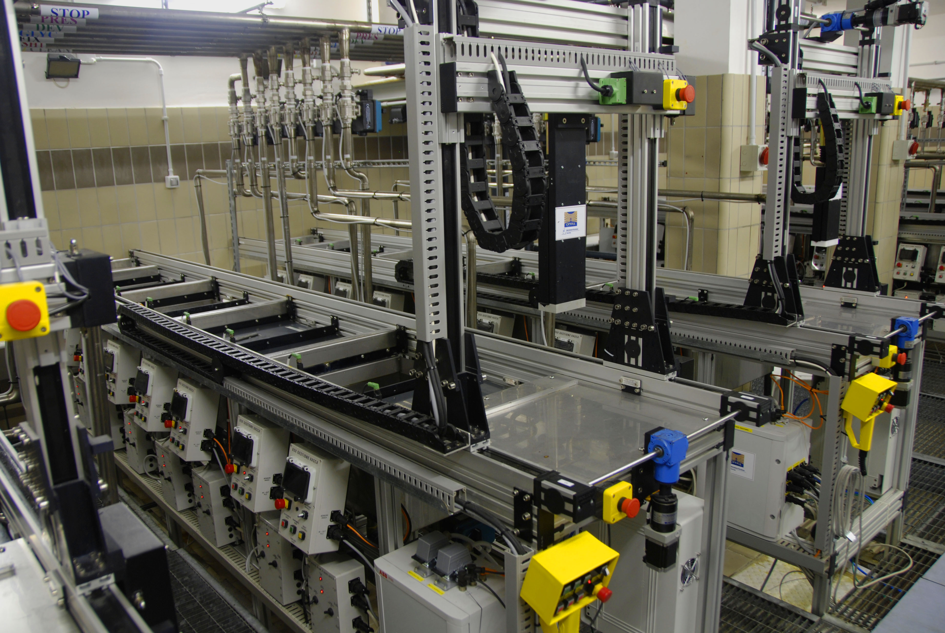
FILM DEVELOPMENT FACILITY
6 automatic lines running in parallel, in dark
maximum rate: 150 bricks/week
additional facility underground for CS: max 300 CS/week

Slide 24
DETECTOR OPERATION

Slide 25
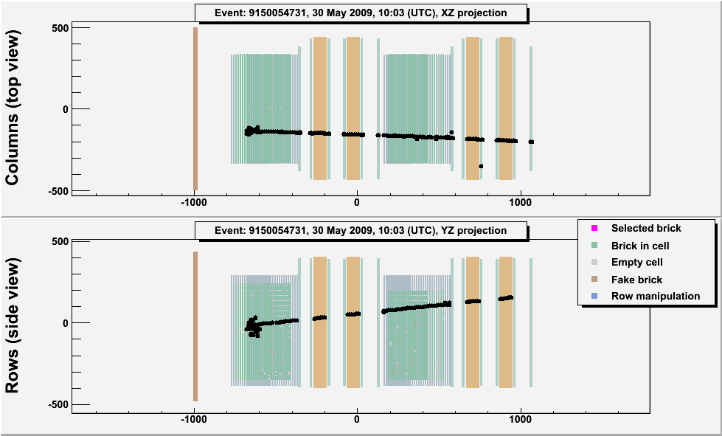
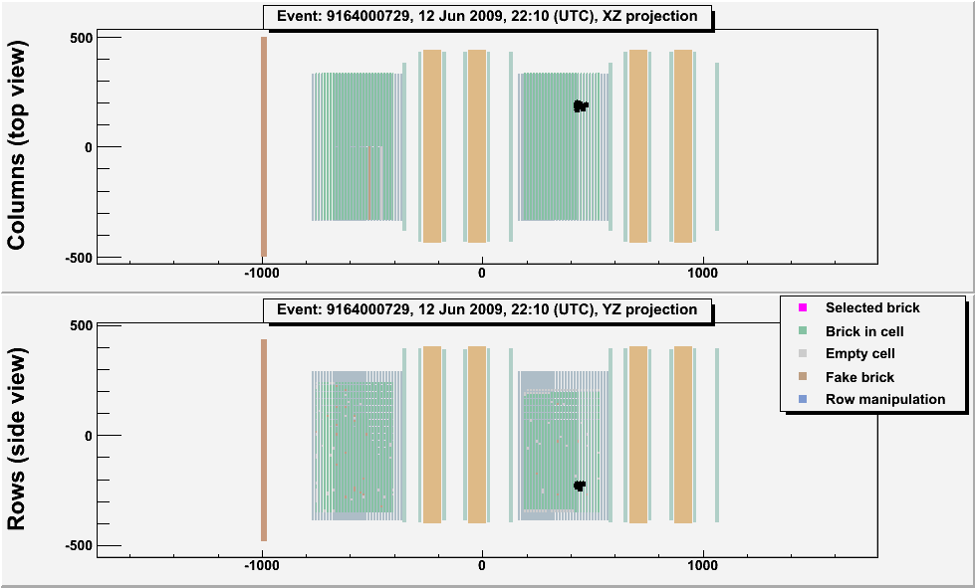
Typical ν_{μ}CC- and NC-like events
The measured ratio of NC-like/CC-like events after muon ID and event location is ~20%, as expected from simulations
20 m

Slide 26
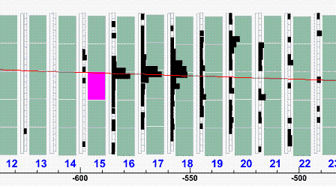
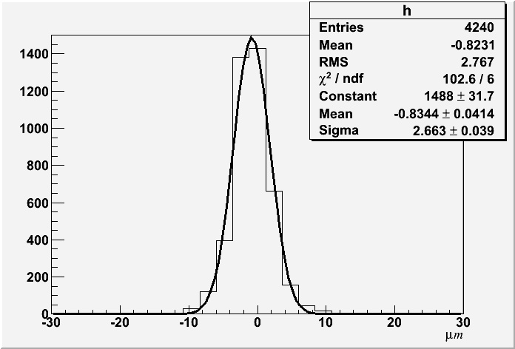
BRICK VALIDATION BY THE CS
Develop this brick
CS
CS doublet alignment by Compton electrons: 2.5 microns
Scanning effort/event: CHORUS 1x1 mm²
DONUT 5x5 mm²
OPERA 100x100 mm²
So far, 640’000 cm² of CS surface have been scanned in OPERA

Slide 27
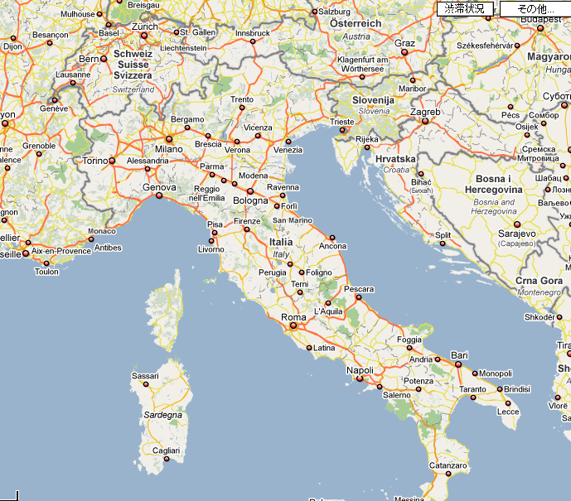
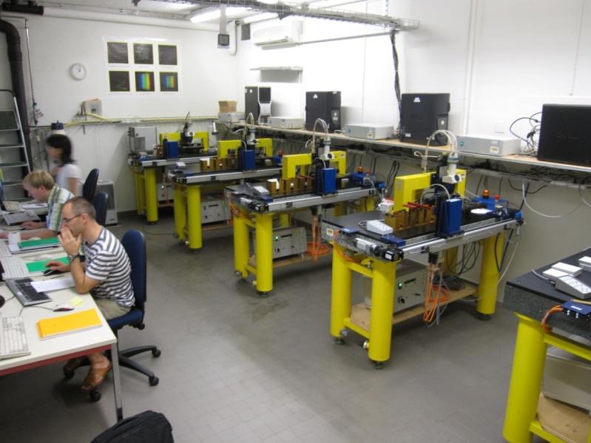
PARALLEL ANALYSIS
OF BRICKS
To Dubna
Bern
Padova
Bologna
selected bricks sent to scanning labs (presently 12)
To Japan
Roma
LNGS
To Ankara
LNF
Bari
Napoli
Salerno
one of the brick scanning labs

Slide 28
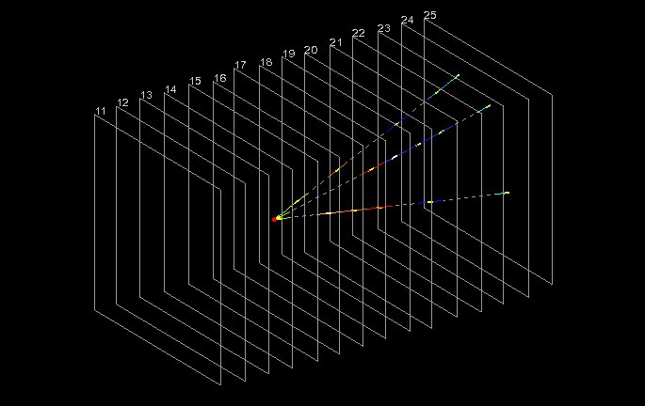
Located neutrino interaction
Emulsions give 3D vector data, with micrometric precision of the vertexing accuracy.
The frames correspond to the scanning area. Yellow short lines → measured tracks.
Other colored lines → interpolation or extrapolation.
1 cm

Slide 29
Event statistics
Brick tagging efficiency times vertex location efficiency: ~ 60%
Total found neutrino vertices: 1617
Events for which “decay search” was completed: 1088 (187 NC)
This is ~35% of the total 2008-2009 run statistics,
corresponding to 1.85 x 10¹⁹ pot
With the above statistics, and for Δm²₂₃ = 2.5 x10⁻³ eV² and full mixing, OPERA expects:
~ 0.5 ν_{τ} events

Slide 30
GLOBAL ANALYSIS PERFORMANCE

Slide 31
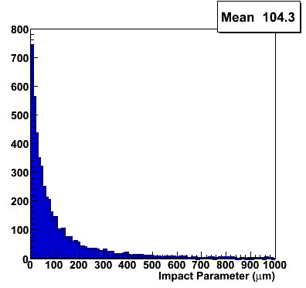
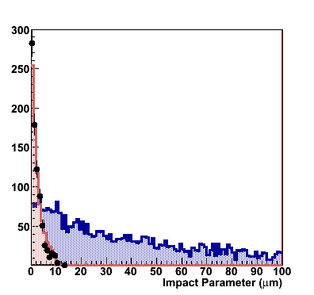
Impact parameter measurement
μm
IP distribution for:
ν_{τ} events (MC)
NC+CC ν_{μ} events (MC),
NC+CC ν_{μ} events (Data)
IP distribution for ν_{τ} events (MC)
expanded scale

Slide 32
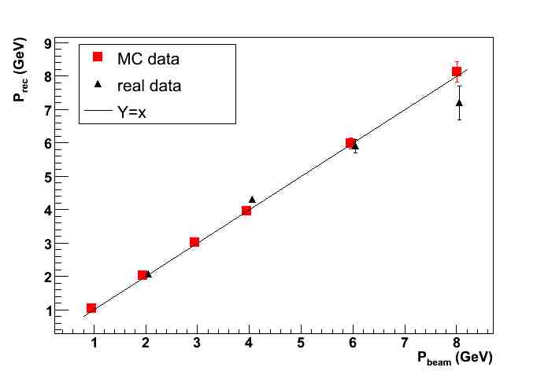
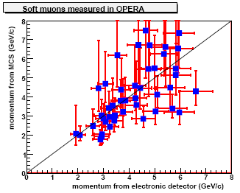
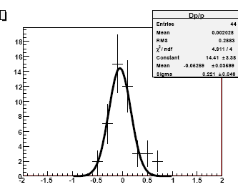
Momentum measurement by Multiple Coulomb Scattering…
…in the lead/emulsion film sandwich and comparison with electronic detector measurements
π test beam
Δp/p
σ = (22±4)%
Pmcs error bar: 68% CL

Slide 33
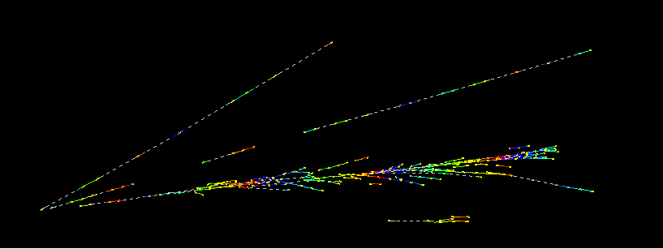
γ detection and π⁰ mass reconstruction
2 EM showers give a reconstructed mass ~ 160 MeV
E = 8.1 GeV
E = 0.5 GeV
EM shower energy measured by shower shape analysis and Multiple Scattering method

Slide 34
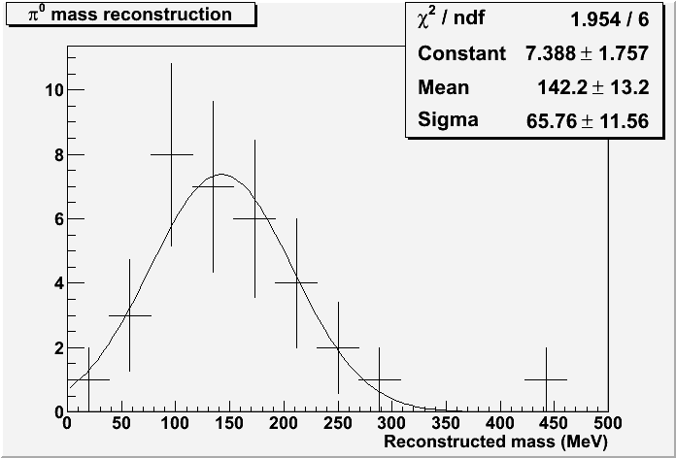
π⁰ mass resolution (real data)
35 gamma pairs
1 σ mass resolution: ~ 45%

Slide 35
CHARM EVENTS: A calibration procedure for the OPERA detector

Slide 36
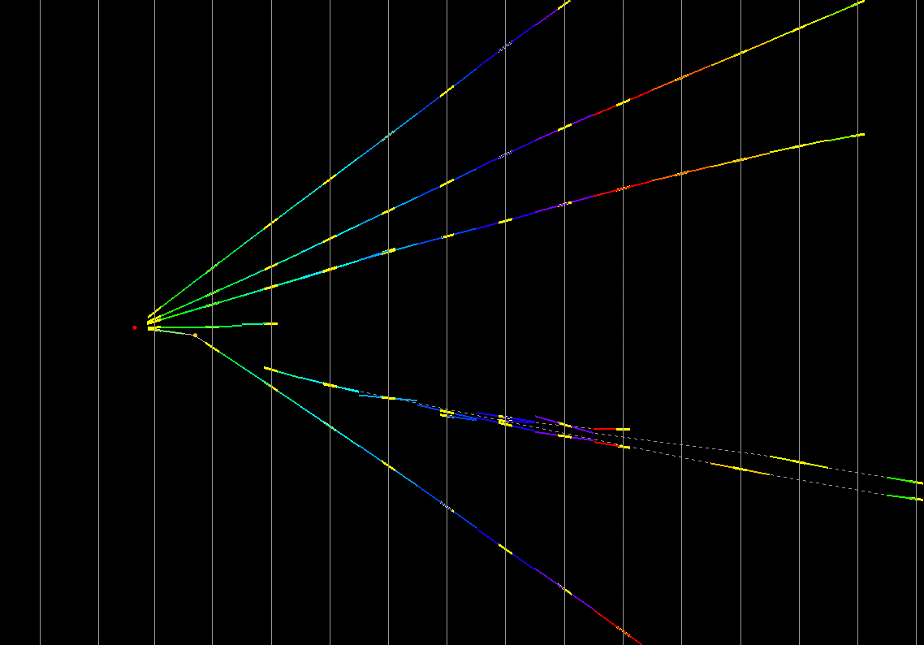
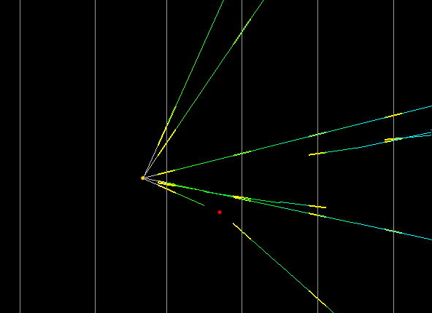
Charm candidate event (dimuon)
flight length: 1330 microns
kink angle: 209 mrad
IP of daughter: 262 microns
daughter muon: 2.2 GeV/c
decay Pt: 0.46 GeV/c
x-view
1ry muon
1ry
vertex
4 mm
kink
daughter muon
1.3 mm

Slide 37
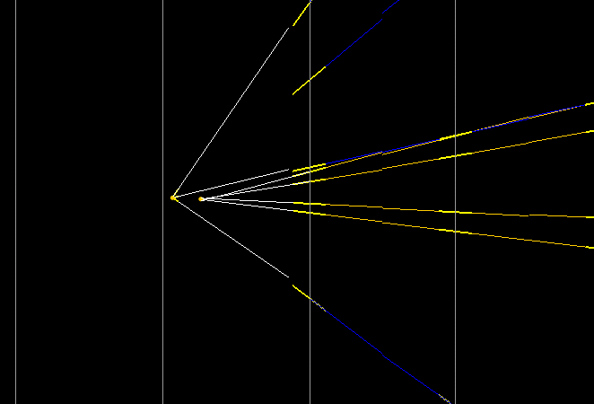
Charm candidate event (4-prong)
D₀ hypothesis: F.L.: 313.1 μm, φ : 173.2⁰, invariant mass: 1.7 GeV

Slide 38
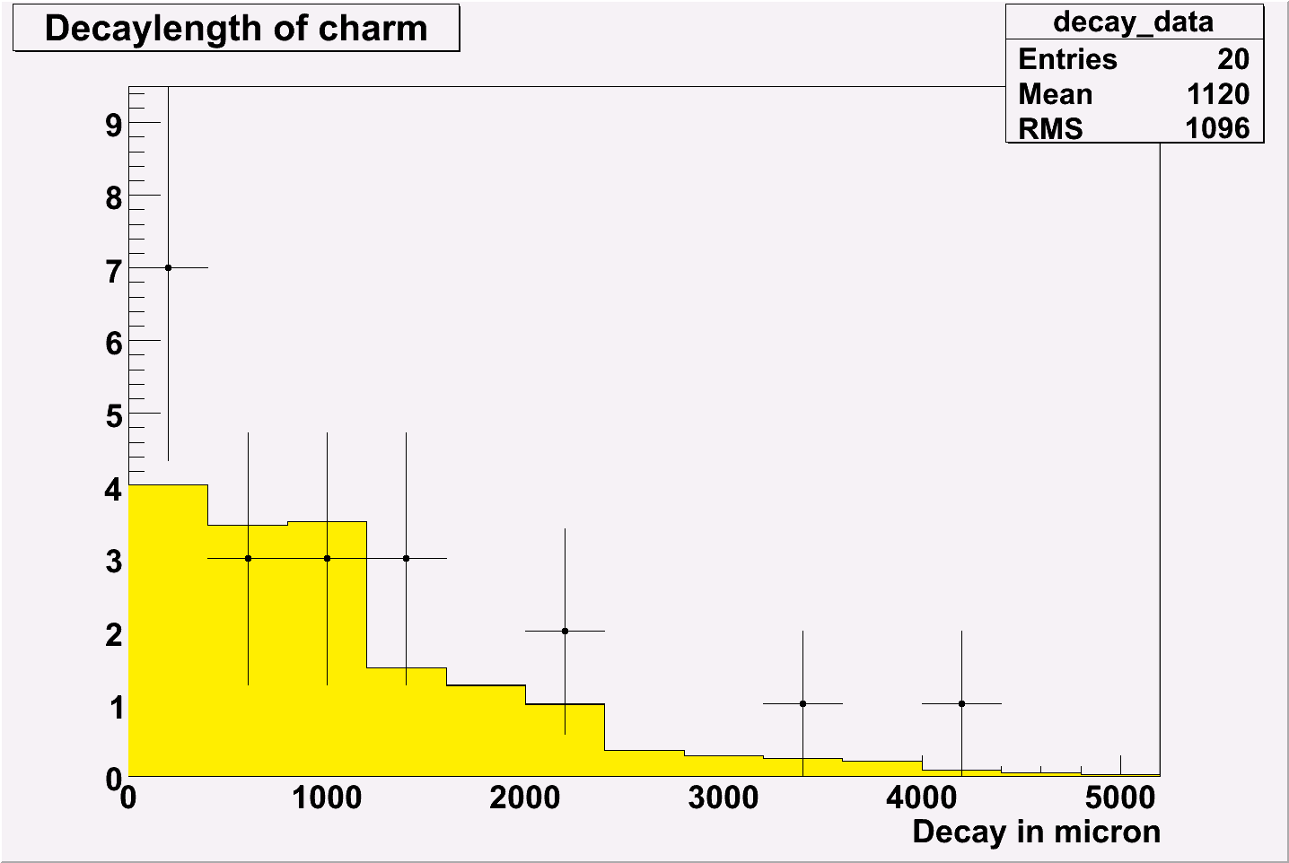
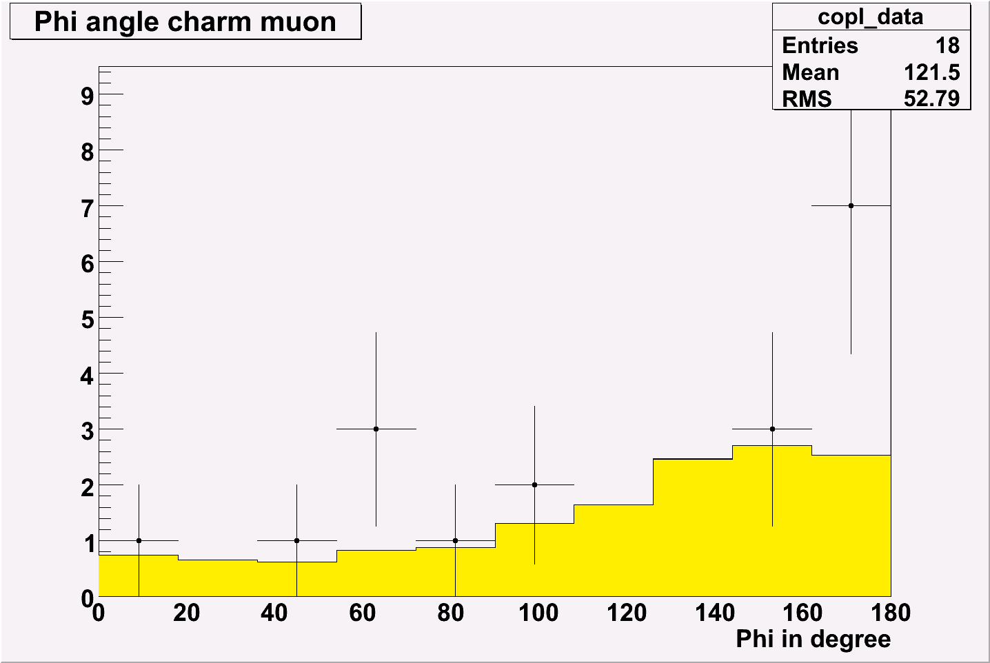
Main kinematical cuts for charm events:
P daughter >2.5 GeV/c, kink Pt > 0.5 GeV/c (for kink events)
looser cuts for multi-prong events
20 charm candidate events selected by the kinematical cuts,
3 of them with 1-prong kink topology.
Expected: 16.0 ± 2.9 out of which 0.80 ± 0.22 with kink topology
Expected BG: ~2 events (loose cuts: work in progress to reduce BG)
Examples of distributions:

Slide 39
OTHER TYPICAL EVENTS

Slide 40
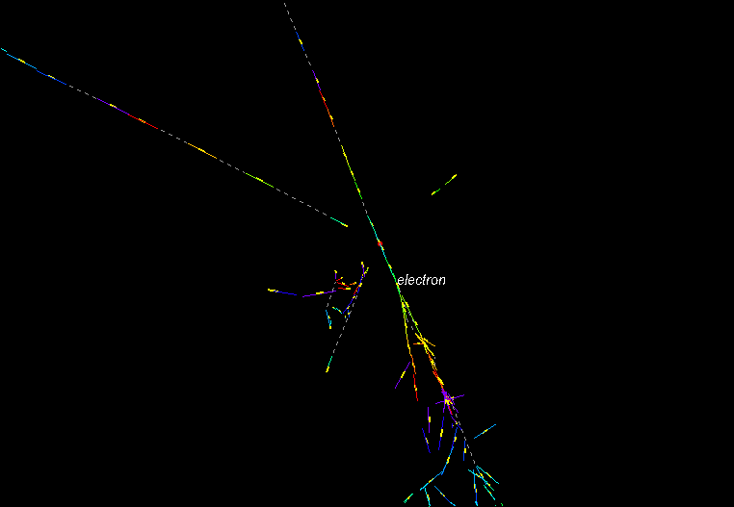
ν_{e} candidate event
From a subsample of ~ 800 located events we detected 6 ν_{e} candidates
Additional physics subject:
study ν_{μ}-ν_{e} oscillations

Slide 41
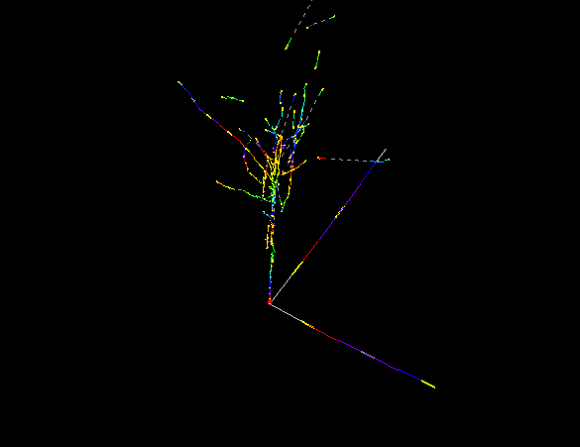
ν_{e} candidate event (2)

Slide 42
A VERY INTERESTING EVENT…

Slide 43


Muonless event 9234119599, taken on 22 August 2009, 19:27 (UTC)
(as seen by the electronic detectors)

Slide 44





From CS to vertex location
Large area scanning
Full reconstruction of vertices and gammas
a kink is detected
CS predictions
CS predictions
Scan-back in ECC

Slide 45

Event reconstruction (1)

Slide 46

Event reconstruction (2)
Zoom

Slide 47

Event topological features (1)
Beam view
7
1
5
2
3
γ2
γ1
6
8
daughter

Slide 48

Event topological features (2)
Side view
7
1
5
3
γ2
4
γ1
2
8 daughter
6

Slide 49
PL17
PL18
PL19
PL20
PL21
5
1
7
3
Primary vertex
γ1
kink point
4
8
careful visual inspection of the films behind/in front the secondary vertex:
no “black” or “evaporation” tracks. Support topological hypothesis of a particle decay
2
6
1mm lead

Slide 50
Event tracks’ features
TRACK NUMBER | PID | Probability | MEASUREMENT 1 |  |  |  | MEASUREMENT 2
 |  |  | tan Θ_{X} |  | tan Θ_{Y} | P (GeV/c) | tan Θ_{X} | tan Θ_{Y} | P (GeV/c)
1 | HADRON range in Pb/emul=4.1/1.2 cm | Prob(μ)≈10⁻³ | 0.177 |  | 0.368 | 0.77 [0.66,0.93] | 0.175 | 0.357 | 0.80 [0.65,1.05]
2 | PROTON | range, scattering and dE/dx | -0.646 |  | -0.001 | 0.60 [0.55,0.65] | -0.653 | 0.001
3 | HADRON | interaction seen | 0.105 |  | 0.113 | 2.16 [1.80,2.69] | 0.110 | 0.113 | 1.71 [1.42,2.15]
4 (PARENT) |  |  | -0.023 |  | 0.026 |  | -0.030 | 0.018
5 | HADRON: range in Pb/emul=9.5/2.8 cm | Prob(μ)≈10⁻³ | 0.165 |  | 0.275 | 1.33 [1.13,1.61] | 0.149 | 0.259 | 1.23 [0.98,1.64]
6 | HADRON: range in Pb/emul=1.6/0.5 cm | Prob(μ)≈10⁻³ |  |  |  |  | 0.334 | -0.584 | 0.36 [0.27,0.54]
7 | From a prompt neutral particle |  | 0.430 | 0.419 |  | 0.34 [0.22,0.69] | 0.445 | 0.419 | 0.58 [0.39,1.16]
8 (DAUGHTER) | HADRON | interaction seen | -0.004 | -0.008 |  | 12 [9,18] | -0.009 | -0.020
muonless event (favored hypothesis)

Slide 51

Vertex tracks followed down (through several bricks) to assess the muonless nature of the event. Residual probability of ν_{μ}CC event (due to a possibly undetected large angle muon) ~1%. “Nominal” value of 5% assumed
5
3
8
5
3
8

Slide 52
ANALYSIS
OPERA nominal analysis flow applied to the hadronic kink candidates:
(more refined selection criteria being developed were not considered here not to bias our analysis)
kink occurring within 2 lead plates downstream of the primary vertex
kink angle larger than 20 mrad
daughter momentum higher than 2 GeV/c
decay Pt higher than 600 MeV/c, 300 MeV/c if ≥ 1 gamma pointing to the decay vertex
missing Pt at primary vertex lower than 1 GeV/c
azimuthal angle between the resulting hadron momentum direction and the parent track direction larger than π/2 rad

Slide 53

γ detection
γ2
γ1
8
daughter
total radiation length downstream the vertices: 6.5 X₀
gamma search performed in the whole scanned volume
careful visual scanning checks
 | Distance from 2ry vertex (mm) | Energy (GeV)
1st γ | 2.2 | 5.6 ± 1.0 ± 1.7
2nd γ | 12.6 | 1.2 ± 0.4 ± 0.4

Slide 54
γ attachment to the vertices
 | Distance from 2ry vertex (mm) | IP to 1ry vertex (μm) <resolution> | IP to 2ry vertex (μm) <resolution> | Prob. of attach. to 1ry vtx* | Prob. of attach. to 2ry vtx* | Attachment hypothesis
1st γ | 2.2 | 45.0 <11> | 7.5 <7> | <10⁻³ | 0.32 | 2ry vertex
2nd γ | 12.6 | 85.6 <56> | 22 <50> | 0.10 | 0.82 | 2ry vertex (favored)
* probability to find an IP larger than the observed one
γ2
2ry vertex
1ry vertex
γ1
Pointing resolution (1σ) for a given gamma: function of scattering and distance

Slide 55
Kinematical variables
VARIABLE | AVERAGE
kink (mrad) | 41 ± 2
decay length (μm) | 1335 ± 35
P daughter (GeV/c) | 12 ⁺⁶₋₃
Pt daughter (MeV/c) | 470 ⁺²³⁰₋₁₂₀
missing Pt (MeV/c) | 570 ⁺³²⁰₋₁₇₀
ϕ (deg) | 173 ± 2
The kinematical variables are computed by averaging the two sets of track parameter measurements
We assume that:
γ1 and γ2 are both attached to 2^{ry} vertex
The average values are used in the following kinematical analysis
The uncertainty on Pt due to the alternative γ2 attachment is < 50 MeV

Slide 56



Features of the decay topology
red bands: values for the “interesting” event with uncertainties
Decay length
mm
Kink angle
Daughter momentum
reject < 20 mrad
cut
GeV/c
rad
A. Ereditato - LNGS - 31 May 2010

Slide 57


Kinematical cuts to be passed
Blue: MC NC
Black: MC - τ
Missing Pt at primary vertex
Missing Pt at primary vertex
Reject NC events with
larger missing Pt (neutrino)
cut
cut
GeV/c
Pt at decay vertex
Reject hadron interactions
cut
GeV/c
57

Slide 58


X (hadron shower)
BG:
small φ
Signal :
φ =180º
φ
kink
τ-decay
τ⁻
x
Azimuthal angle between
the resulting hadron momentum
direction and the parent track direction
ν_{τ}
π⁻
φ
π⁻
π⁻
ν_{τ}N τ⁻X
ν_{μ}
ν_{μ}N ν_{μ}π⁻X
Blue: MC - NC
Black: MC - τ
cut
58
rad

Slide 59
Event nature and
invariant mass reconstruction
The event passes all cuts, with the presence of at least 1 gamma pointing to the secondary vertex, and is therefore a candidate to the τ ➔ 1-prong hadron decay mode.
The invariant mass of the two detected gammas is consistent with the π⁰ mass value (see table below).
The invariant mass of the π⁻ γ γ system has a value (see below) compatible with that of the ρ (770). The ρ appears in about 25% of the τ decays: τ ➔ ρ (π⁻ π⁰) ν_{τ}.
πº mass | ρ mass
120 ± 20 ± 35 MeV | 640 ⁺¹²⁵₋₈₀ ⁺¹⁰⁰₋₉₀ MeV

Slide 60
BACKGROUND SOURCES
Prompt ν_{τ} ~ 10⁻⁷/CC
Decay of charmed particles produced in ν_{e} interactions ~ 10⁻⁶/CC
Double charm production ~ 10⁻⁶/CC
Decay of charmed particles produced in ν_{μ} interactions ~ 10⁻⁵/CC
Hadronic reinteractions (UPDATE) ~10⁻⁵/CC

Slide 61


Simulation of the reinteraction BG
Background evaluation by using state-of-the-art FLUKA code, upgrade of the Proposal simulations.
160 million events (0.5-15 GeV/c) of π⁺,π⁻,K⁺,K⁻,p impinging 1 mm of lead, equivalent to 160 km of hadronic track length.
Kink probabilities evaluated by applying the same cuts as for the tau analysis.
Typical scattering distributions for : 5 GeV π⁺
Pt of secondary pion
Pion angular
deflection
20 mrad
300 MeV/c
mrad
GeV/c
61
tails of the distributions

Slide 62

kink probabilities for 1 mm Pb
x 10⁻⁴
x 10⁻⁴
π⁺
π⁻
Momentum GeV/c
Momentum GeV/c
x 10⁻⁴
x 10⁻⁴
K⁺
K⁻
Momentum GeV/c
Momentum GeV/c
x 10⁻⁴
p
kink probabilities integrated over the ν_{μ} NC hadronic spectrum yield a BG probability of:
(1.9 ± 0.1) x 10⁻⁴ kinks/NC (2 mm Pb)
Momentum GeV/c

Slide 63

Measure interaction BG far from the τ-decay region
Search for “kinks” and interactions along a total of 9 m of hadron track measured for scanned events. This is about a factor 8 larger than the so far scanned track length for NC events (number of NC x hadron multiplicity x 2 mm decay length).
Goal: ~100 m as needed to fully validate (eventually replace) the MC information
1 cm

Slide 64

signal region
no events in the signal region
90% CL upper limit of 1.54 x 10⁻³ kinks/NC event
the number of events outside the signal region is confirmed by MC (within the ~30% statistical accuracy of the measurement)

Slide 65
Charm background
primary lepton not identified
Charmed particles have similar
decay topologies to the τ
μ,e⁻
ν_{μ,e}
μ⁺
e⁺
h⁺
D⁺
charm production in CC events represents a background source to all tau decay channels
this background can be suppressed by identifying the primary lepton
→ ~ 95% muon ID
for the 1-prong hadronic channel 0.007±0.004 (syst) background events are expected for the analyzed statistics
further charm BG reduction is under evaluation by implementing the systematic follow-down of low energy tracks in the bricks and the inspection of their end-range, as done for the “interesting” event. For the latter we have 98-99% muon ID efficiency.

Slide 66
STATISTICAL CONSIDERATIONS

Slide 67
We observe 1 event in the 1-prong hadron τ decay channel,
with a background expectation (~ 50% error for each component) of:
0.011 events (reinteractions)
0.007 events (charm)
0.018 ± 0.007 (syst) events 1-prong hadron
all decay modes: 1-prong hadron, 3-prongs + 1-prong μ + 1-prong e :
0.045 ± 0.020 (syst) events total BG
(here we add up the errors linearly)
By considering the 1-prong hadron channel only, the probability to observe 1 event
due to a background fluctuation is 1.8%, for a statistical significance of 2.36 σ on the
measurement of a first ν_{τ} candidate event in OPERA.
If one considers all τ decay modes which were included in the search, the probability
to observe 1 event for a background fluctuation is 4.5%.
This corresponds to a significance of 2.01 σ.

Slide 68
By assuming that Δm²₂₃ = 2.5 x 10⁻³ eV² and full mixing, we expected:
0.54 ± 0.13 (syst) ν_{τ} CC events in all τ decay channels and
0.16 ± 0.04 (syst) ν_{τ} CC events in the 1-prong hadron τ decay channel
and we observed 1 event.
This result allows us to exclude at the 90% CL
Δm²₂₃ values > 7.5 x 10⁻³ eV² (full mixing)

Slide 69
CONCLUSIONS AND OUTLOOK (1)
The OPERA experiment at LNGS is aimed at the first detection of neutrino oscillations in appearance mode through the study of the ν_{μ}− ν_{τ} channel.
The Collaboration has conducted the analysis of a sub-sample of the neutrino data taken in the CERN CNGS beam in the 2008-2009 runs.
Decay event topologies due to charmed particles have been observed, in agreement with expectations, as well as events induced by prompt ν_{e} present in
the ν_{μ} beam.
One muonless event showing a τ ➔ 1-prong hadron decay topology has been detected and studied in detail. It passes all kinematical cuts required to reduce the physics background. It is the first ν_{τ} candidate event in OPERA.

Slide 70
CONCLUSIONS AND OUTLOOK (2)
The observation of 1 candidate signal event within the analyzed sample allows us to exclude at the 90% CL Δm²₂₃ values > 7.5 x 10⁻³ eV² (full mixing).
By considering the 1-prong hadron channel only, the probability to observe 1 event due to a background fluctuation is 1.8%, for a statistical significance of 2.36 σ on the measurement of a first ν_{τ} candidate event in OPERA.
If one considers all decay modes included in the search, the probability to observe 1 event for a background fluctuation is 4.5%. This corresponds to a significance of 2.01 σ.
This result is an important step towards the long awaited discovery of neutrino oscillations in direct appearance mode.
To meet this goal we will require to successfully complete data taking in the CNGS beam and perform the analysis of the full data sample.

Slide 71
Backup

Slide 72

PHYSICS: from neutrino mixing to oscillations
OPERA

Slide 73

Measurement of the oscillation parameters in the atmospheric neutrino sector: present situation
Full mixing and
Δm²₂₃ ~ 2.4 x 10⁻³ eV²
The grey band indicates
the OPERA allowed region (90% CL) for the above parameter values for
22.5 x 10¹⁹ pot

Slide 74

MINOS Neutrino2010 News

Slide 75

MINOS Neutrino2010 News

Slide 76







The OPERA Collaboration
180 physicists, 33 institutions in 12 countries
Belgium
IIHE-ULB Brussels
Italy
Bari
Bologna
LNF Frascati
L’Aquila,
LNGS
Naples
Padova
Rome
Salerno
Russia
INR RAS Moscow
LPI RAS Moscow
ITEP Moscow
SINP MSU Moscow
JINR Dubna
Croatia
IRB Zagreb
France
LAPP Annecy
IPNL Lyon
IPHC Strasbourg
Switzerland
Bern
ETH Zurich
Japan
Aichi
Toho
Kobe
Nagoya
Utsunomiya
Germany
Hamburg
Münster
Rostock
Tunisia
CNSTN Tunis
Turkey
METU Ankara
Israel
Technion Haifa
Korea
Jinju
http://operaweb.web.cern.ch/operaweb/index.shtml

Slide 77



INDUSTRIAL EMULSION FILMS BY FUJI FILM
Emulsion Layer (44 microns)
basic detector: AgBr crystal,
size = 0.2 micron
detection eff.= 0.16/crystal
10¹³ “detectors” per film
Plastic Base (205 microns)
Emulsion Layer
sensitivity 15 grains/44 microns
intrinsic resolution: 50 nm
mip
deviation from linear-fit line. (2D)
electron ～100 keV
20 μm
high dE/dx tracks
from nuclear evaporation
77
Notes:
77

Slide 78




Tono-mine film refreshing
facility in Japan
9 million films treated from Jun 2004 to Apr 2007
before refreshing after
Refreshingat 30ºC and 98%humidity: erase cosmic-ray induced tracks accumulated during film production at FUJI.
150 microns

Slide 79



LEAD PLATE PRODUCTION AT JL-GOSLAR
Joint R&D effort and large industrial production:
9.2 million plates produced with 1’300 ton of lead
  Low radioactivity primary lead (80 Bq/kg)
  0.04% Ca alloy
Specs (fulfilled):
  ± 5 μm planarity
  ± 5 μm thickness
  ± 50 μm transverse dimensions
  class 10000 cleanness
  no corrosion of surface
  not aggressive to emulsion

Slide 80
Changeable Sheet (CS) alignment facility at LNGS underground (x-rays)
Brick emulsions alignment at LNGS cosmic pit (surface)

Slide 81

MC validation by beam test pion events
Brick exposed to 4 GeV/c pions: ~20 m of pion track scanned to search for interactions
Example

Slide 82






DATA/MC comparison: good agreement in normalization and shape
1-prong
multi-prong

