Slide 1








bSTILED b:Search for Tensor Interactions in nucLear bEta Decay
Journée EAP
20 octobre 2026
LP2IB

Slide 2
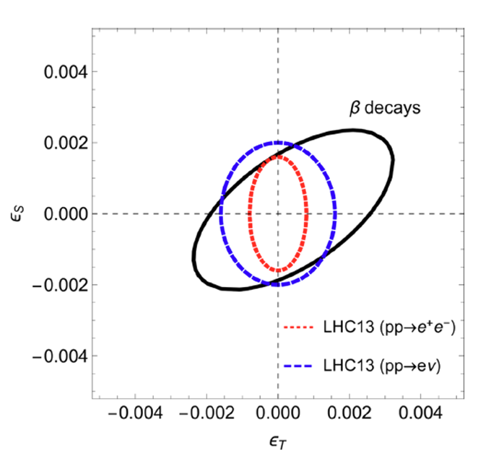
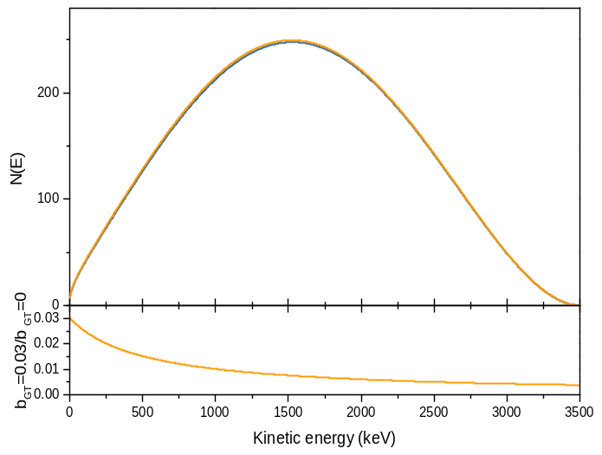

Search for BSM Physics at TeV scale in beta decay
b-STILED: b – Search for Tensor Interaction in nucLear bEta Decay
    Measure the Fierz interference term b_{GT} in the pure GT transition of ⁶He (b_{GT} α 𝜖_{T})
            Phase I (now): Δb_{GT} = 4.10⁻³ → present constraints from beta decay
            Phase II (future): Δb_{GT} = 1.10⁻³ → competitive with LHC
  For left-handed neutrinos
$$N\left(E\right)∝F\left(Z,E\right)\left(1+η\right)pE{\left(E−E_{0}\right)}^{2}\left(1+\frac{m_{e}}{E}b_{GT}\right)$$
90% CL
⁶He β spectrum
b_{GT} = 0
b_{GT} = 0.03
BSM
  Best constraints on 𝜖_{𝑆}
  Ft values in 0+→0+ transitions
  LHC (pp → e⁺e⁻ + MET )
  Best constraints on 𝜖_{T}
  Dominated by
  LHC (pp → e⁺e⁻ + MET )
Small but direct effect on β-spectrum shape
A. Falkowski, M. Gonzáles-Alonso,
O. Naviliat-Cuncic, JHEP04 (2021)

Slide 3


Project genesis and resources
Collaborative effort between three French institutions
Main actor: detector design & characterization, DAQ, data analysis and systematic effects…
X. Fléchard, L. Hayen, E. Liénard, O. Naviliat-Cuncic & technical staff
Production of ⁶He beams at low- and high-energy with sufficient intensity and purity
J-Ch. Thomas & technical staff
Production of calibration sources for the detectors calibration
X. Mougeot & S. Leblond & technical staff
Project approved by ANR and GANIL PAC in 2020
ANR funding: 290k€ for 4 years
PhD of Mohamad Kanafani (2020-2023) funded by Region Normandie
PhD of Romain Garreau (2023-2026) funded by IN2P3
Postdoc of Anjali Rani (2024-2026) funded by ANR
New PhD Ali Saleh (2026-2029) funded by CNRS (N&P-MITI)
ANR extension → 30/06/2027
Remaining ANR budget: → ~ 30 k€

Slide 4
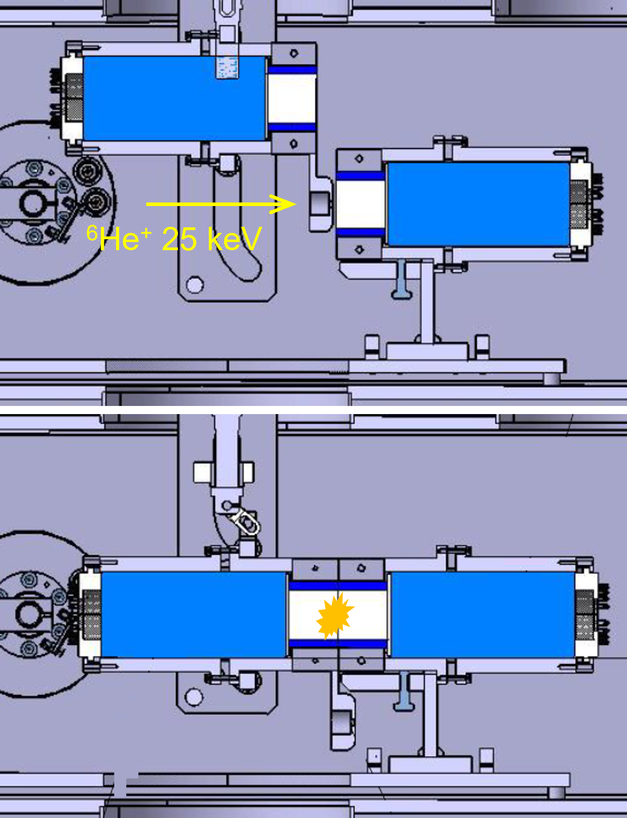
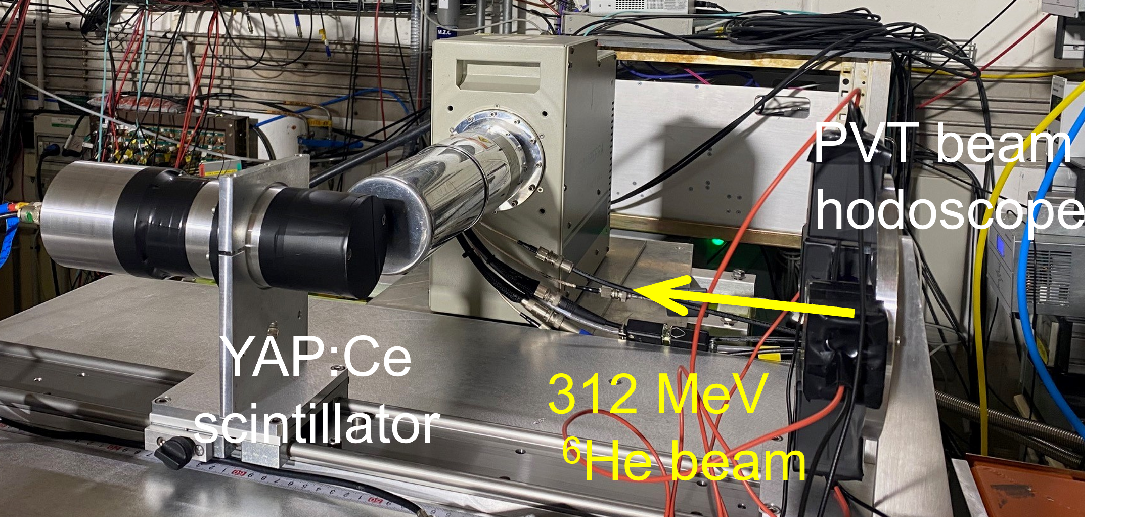
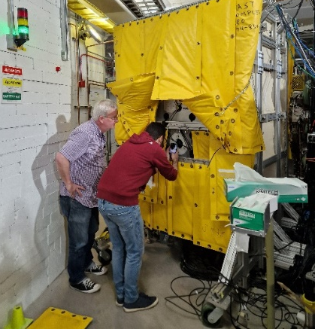
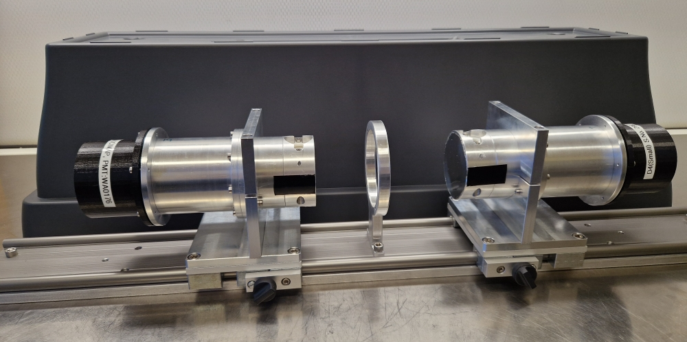
Experimental campaigns
⁶He
Bremsstrahlung
escape (Geant4)
2 on-line experiments @ GANIL with ⁶He:
YAP scintillators with 4π detection to suppress backscattering
β-range
hν
Low energy experiment (LIRAT, 2021) M. Kanafani
→ shallow implantation, no radioactive contaminants
High energy experiment (LISE, 2023) R. Garreau
→ In depth implantation, beam induced contaminants
Off-line measurements (for systematics):
Bremsstrahlung study (FRIB, 2024) R. Garreau
→ ⁹⁰Sr⁹⁰Y source, bremsstrahlung detection with MTAS
bSTILED detectors characterization (LNHB, 2026)
→ CE (²⁰⁷Bi,¹³⁷Cs, ¹⁰⁹Cd) and β (⁹⁰Sr⁹⁰Y, ¹¹⁴In, ³²P) sources from LNHB

Slide 5
Status & production
Low energy experiment (LIRAT, 2021)
→ High-precision measurement of the ⁶He half-life Kanafani et al., PRC 106 (2022) 045502
→ Backscattering study of electrons from 0.1 to 3.4 MeV Kanafani et al., PRC 113 (2026) 025501
→ Optical studies of scintillation detectors for β shape measurements… Vanlangendonck et al., arXiv 2511,0508
      Analysis on hold (no precise b_{GT} extraction from these data)
      (unexpected background from ⁶He implantation on collimator & light collection effects)
Bremsstrahlung study (FRIB, 2024)
→ Study of bremsstrahlung radiation losses for beta calorimetry measurements submitted to PRC in November
  Obtained precision (ΔP_{BE} ~ 0.2% ΔE_{loss} ~ 5 keV) to benchmark Geant4 translates into Δb_{GT} ≈ 0.7%
  Limited by YAP detector mechanical assembly & radiative corrections
  → can be improved by a factor ~5
High energy experiment (LISE, 2023)
  Sufficient stat. for phase 2, contaminants manageable (order 10⁻³)
  But discrepancies for data obtained with two different YAP detectors
    → Analysis still in progress…
        Carry on study of main sources of systematics
            - Detector response (non linearity)
            - Bremsstrahlung radiation escape

Slide 6
Short term (3 years) prospects
Analysis of LNHB measurements (PhD Ali Saleh)
    → Improve knowledge on YAP detector response function
    (CE & beta-energy end-points)
    Extract shape factors for ⁹⁰Y, ¹¹⁴In and ³²P
New experiment @ FRIB with MTAS in 2027 (PhD Ali Saleh)
  With improved setup (detector positioning & thinner source dead layers)
  With additional off-line β sources (allowed transitions¹¹⁴In and ³²P) for radiative corrections
    → Improve precision on bremsstrahlung escape study for bSTILED
    → Extract shape factors for ⁹⁰Y, ¹¹⁴In and ³²P (directly including brem. corrections)
    Potentially improve sensitivity to exotic tensor contributions in the decay of ³²P
Complete LISE experiment data analysis (PhD Ali Saleh)
    → Understand discrepancies between data from two detectors
    → Finalize the study of systematic uncertainties
PMTs linearity study
  With LEDs, requires per mill precision level
    → Understand discrepancies between data from two detectors

Slide 7
Longer term prospects
Prospects for phase 2
  Reaching the 10⁻³ precision level looks currently impossible with both approaches (low and high energy implantations).
  Uncertainties due to bremsstrahlung escape description will remain a limiting effect event after improvements obtained from measurement with MTAS.
  Control of scintillator detector linearities below the 10⁻⁴ level is very challenging. Other detectors (e.g. semiconductors) are not suitable to be used in an implantation configuration.
Request to CNRS N&P:
            No need for 2027 (30 k€ from ANR, application to IRL-NPA for 2027 experiment)
Need moderate support for the following years (conferences & meetings)

Slide 8


Collaboration
PhD & Postdoc technical support others
T.E. Haugen
O. Naviliat-Cuncic
X. Mougeot
S. Leblond
G. Craveiro
V. Dumenil
D. Etasse
X. Fléchard
R. Garreau
L. Hayen
M. Kanafani
F. Lebourgeois
E. Liénard
J. Lory
O. Naviliat-Cuncic
J. Perronnel
A. Rani
Ch. Vandamme
T. King
Th. Ruland
C. Rasco
K. Rykaczewski
J.C. Thomas
V. Morel
F. Marie-Saillenfest
O. Naviliat-Cuncic
S. Vanlangendonck

Slide 9
Scientific production
Publications
  High precision measurement of the ⁶He Half-life, M.Kanafani et al., PRC (2022)
  Precision measurements in the beta decay of ⁶He, M.Kanafani et al., EPJ Web of Conf (2023)
  Backscattering Study of Electrons from 0.1 to 3.4 MeV, M.Kanafani et al., PRC (2026)
  Optical studies of scintillation detectors for precision b energy measurements,
  S. Vanlangendonck et al., arXiv 2511,0508
  Study of Bremsstrahlung Radiation Escape for beta shape measurements,
  X. Fléchard et al., to be submitted to PRC
Conferences and workshops
  Posters: SSP 2022, PSI 2022, ARIS 2023, EJC 2025, EUNPC2025
  Talks: Colloque GANIL 2021, JRJC 2021, LISE Workshop 2022, ISOL-France 2022, INPC 2022, PhyNuBE 2023, Colloque GANIL 2023, Workshop LISE 2024, JRJC 2024, ISOL-France 2025, INPC 2025, ESNT Workshop 2025, EUNPC 2025, GDR INF 2025, Bormio 2026, ISOL-France 2026, Workshop ESNT 2026

