Slide 1
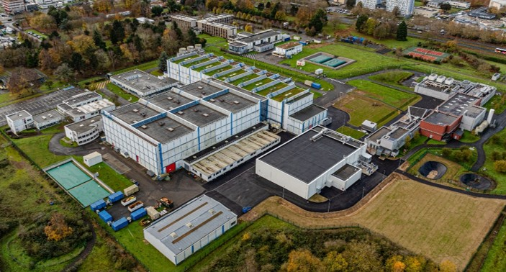

Status of the SPIRAL2-DESIR project
J.-C. Thomas, GANIL, on behalf of the DESIR project management and collaboration
  - Project manager: Ch. Peaucelle, LPSC (09/14/2026)
  - Scientific coordinator and spokesperson: B. Blank, LP2iB
  - Facility manager: F. Varenne, GANIL
EAP DESIR
October 20, 2026, LP2i Bordeaux
GANIL
SPIRAL2

Slide 2

OUTLINE
DESIR
Introduction
Scientific program
Buildings
Transport beam lines
Beam preparation and purification
Timeline
Conclusion

Slide 3
DESIR
Introduction

Slide 4
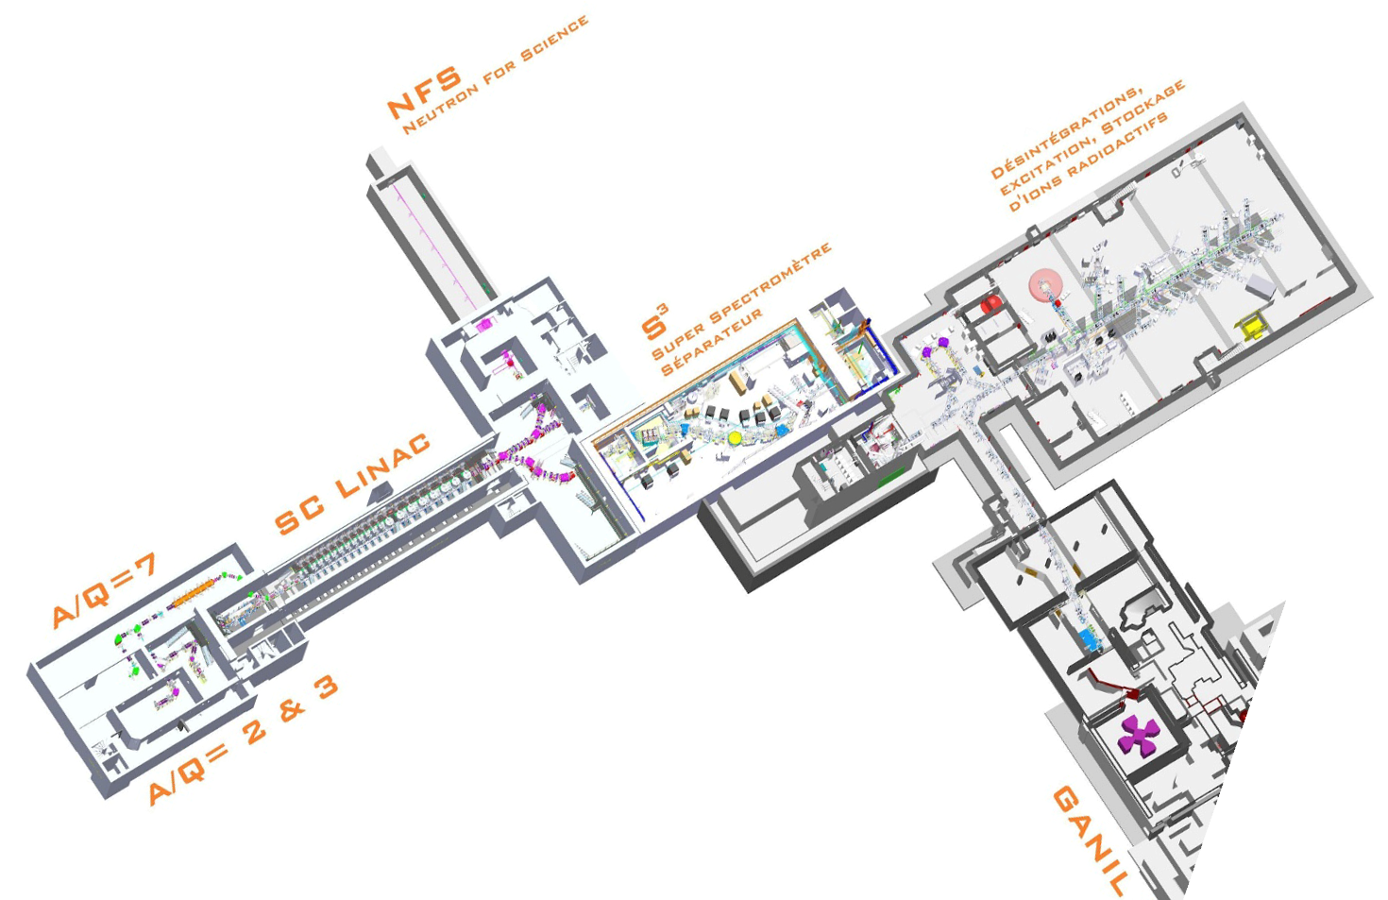




EAP: DESIR@GANIL-SPIRAL2
~30*50 m²
SPIRAL 2
SPIRAL 1
CYREN

Slide 5

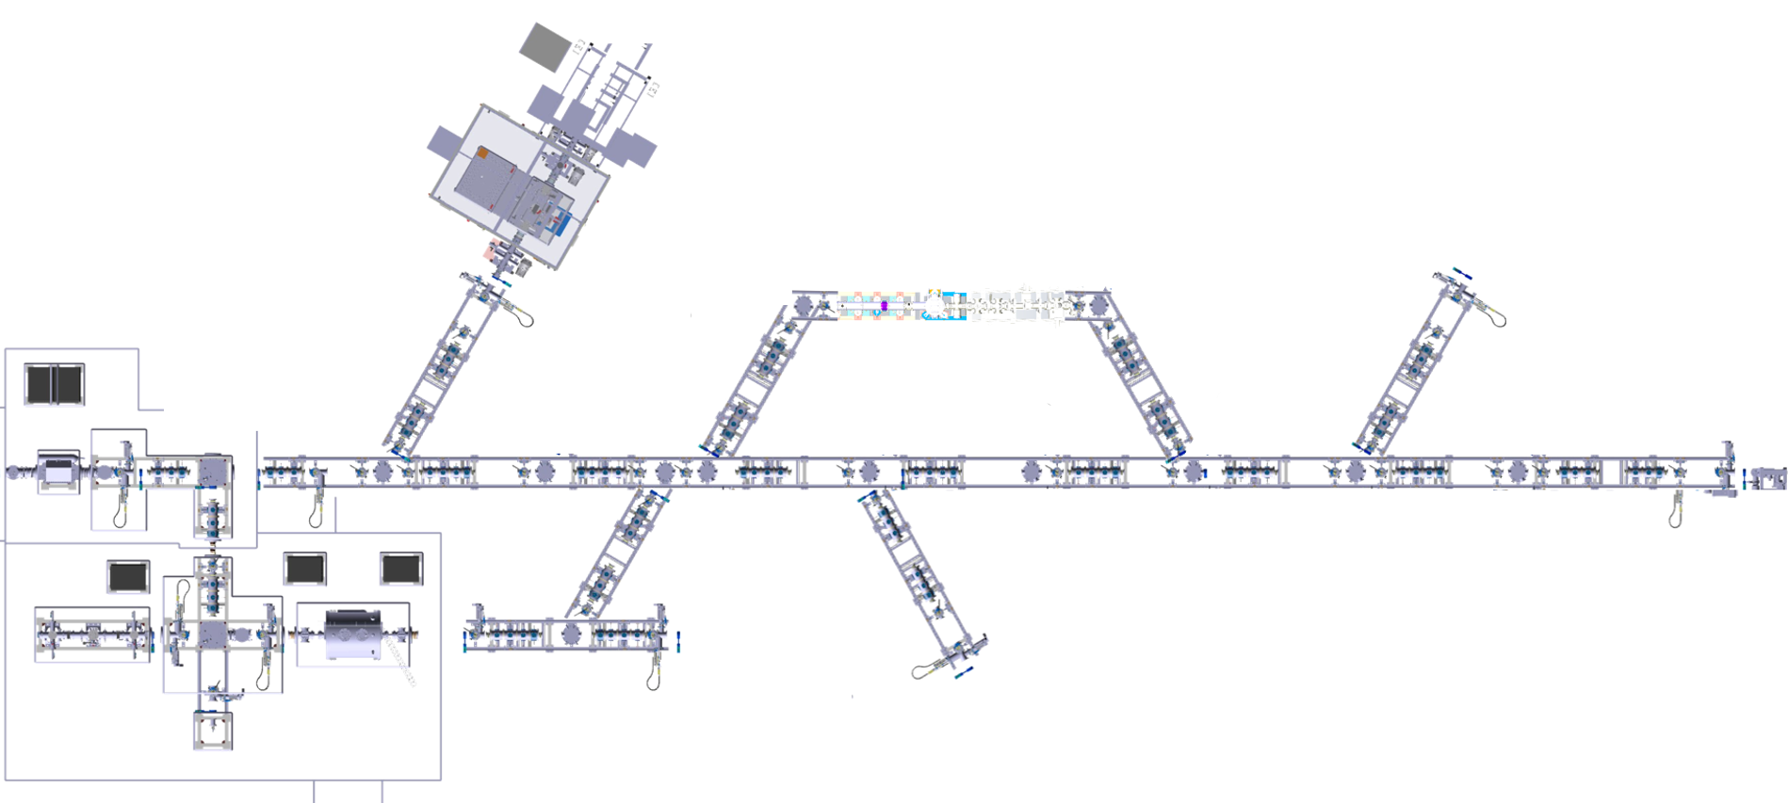



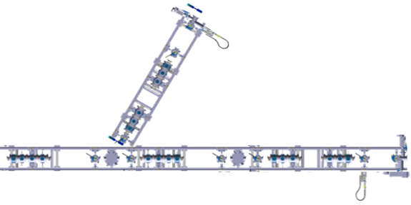


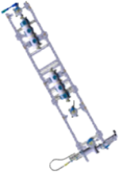
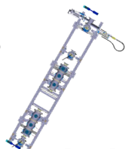

DESIR: Experimental equipment
Installation and operation --> >2030
G. Tocabens
BESTIOL
DETRAP
P. Delahaye
L. Lalanne
LUMIERE
bSTILED
WISArD
X. Fléchard
MORA
(2029)
M. Versteegen
S. Naimi
HINA
TORTILA
COeCO
LINO-LASAGN
(2027)
LRC
……
M. Gerbaux
Decay station
Id.
Station
(2028)
GPIB
(2028)
ARGOS
gSPEC
….
MR-TOF-MS
(2029)
PIPERADE
(2028)
(NA)2STARS
(2029)
……
L. Canete
……
P. Ascher
M. Fallot
DESIR Project perimeter
MLLTRAP
5
L. Hayen
E. Minaya Ramirez

Slide 6
DESIR
Scientific program

Slide 7
Scientific program
Preparation of DESIR physics case
Workshop DESIR: Spring 2024:100 participants, 22 institutes (15 from foreign countries)
Workshop LUMIERE: July 2024
Workshop BESTIOL: Dec. 2024
Workshop DETRAP: May 2025
Brainstorming (IN2P3): Impact of high-precision measurements on BSM physics at DESIR, July 2026
Letters of intent
DESIR LOI workshop: March 2026, > 50 LOIs
-> Working group to analyze the feasibility (RIBs), propose RIB developments and experiment priorities
=> Commissioning and Day-1 exp. strategy: GANIL SC - B. Blank, Nov. 2026
-> DESIR collaboration Committee: detailed LoI
Proposals ≥ 2027
Equipment commissioning: 2028-2029
Stable and radioactive beam without going through proposals and PAC
Routine operation ≥ 2030
7

Slide 8
Scientific program: DESIR LoIs - March 2026
Labs
Overview
50 LoIs, ~2000 UTs, ~300 isotopes from ⁶He to ²⁶³Sg, from 0.01 to 10⁷ pps
90% from French labs (46% IJClab)
Mainly n-deficient (production sites)
Using different techniques to probe the same region (e.g. around ¹⁰⁰Sn)
Combining different setups, e.g. PIPERADE + Decay spectroscopy
Combining S³-LEB and DESIR studies
Using beams expected from either S³-LEB (29 LoI) or SPIRAL1 (50 LoI) (overlap)
-> Feasibility to be checked: Day-1, Day-2, RIB devpt. priorities
Physics cases
Setups/Techniques
8

Slide 9
DESIR
Buildings and Infrastructure

Slide 10
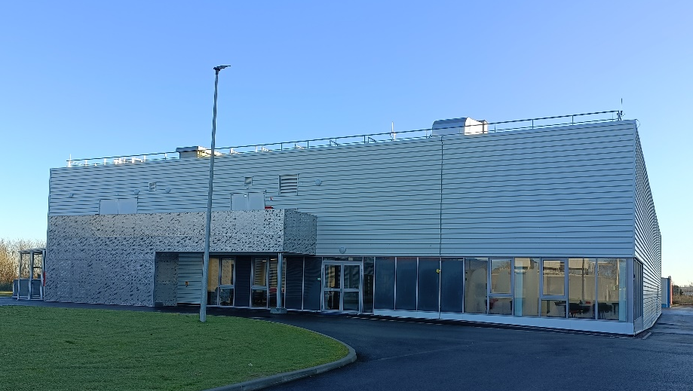
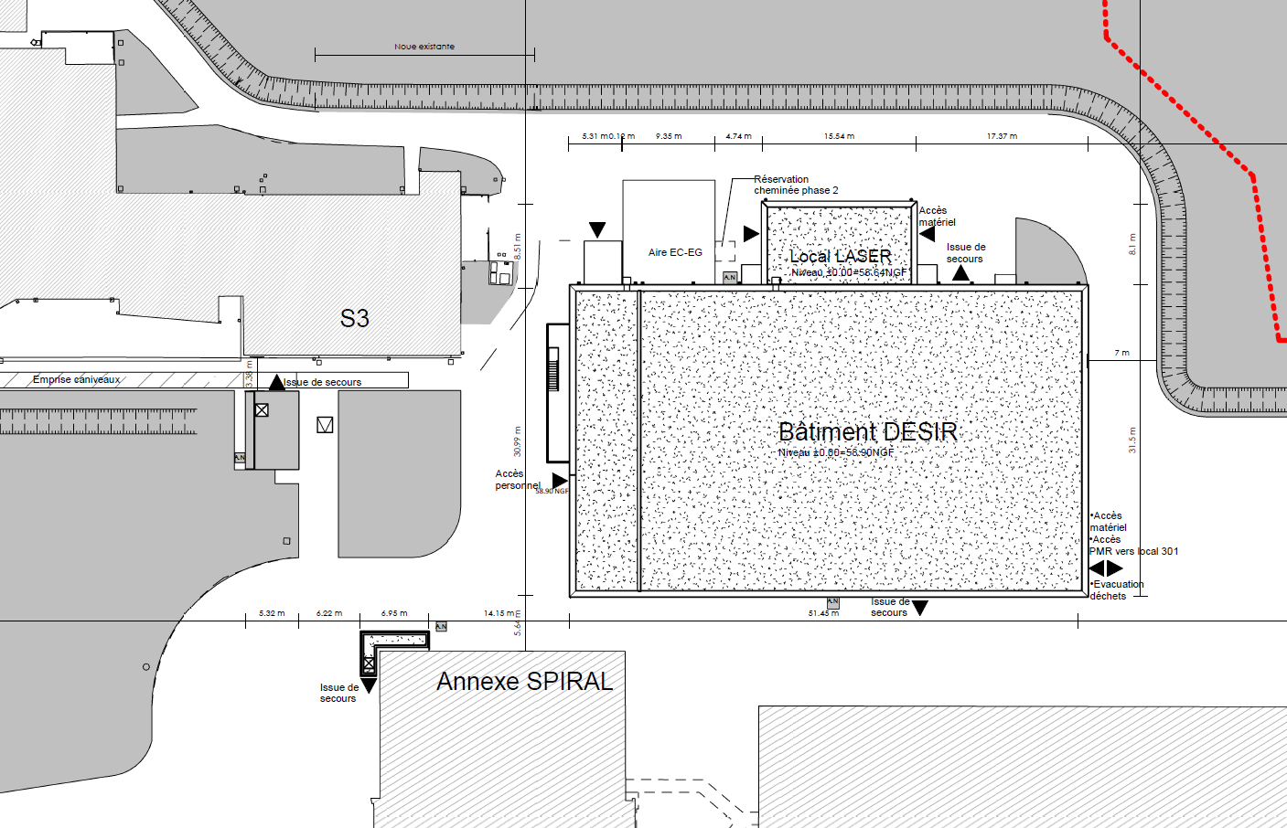
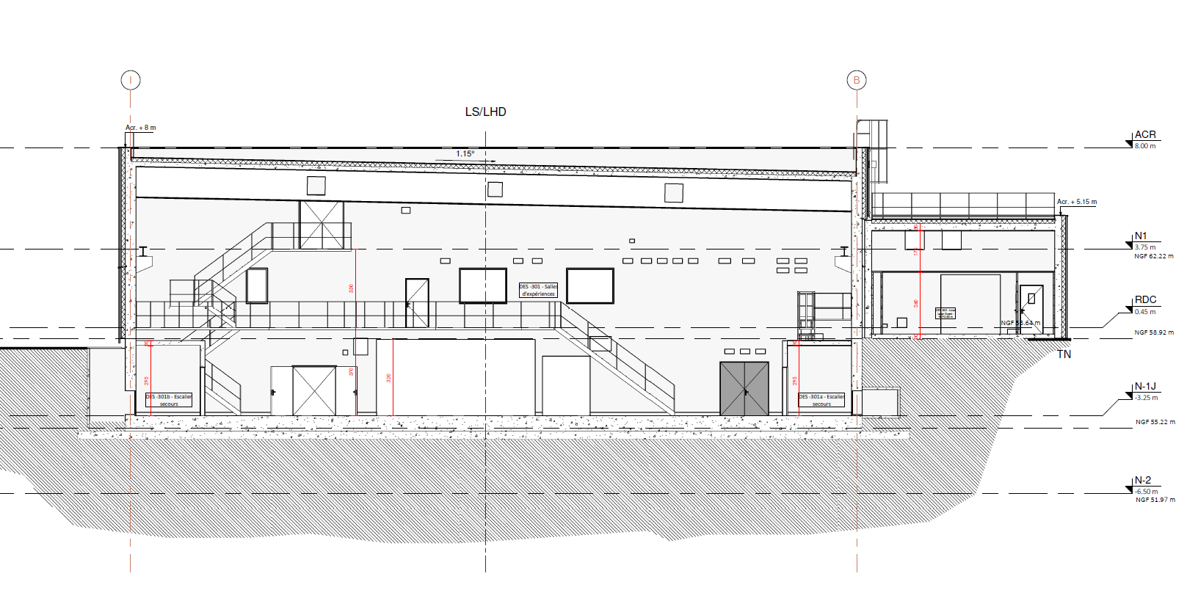
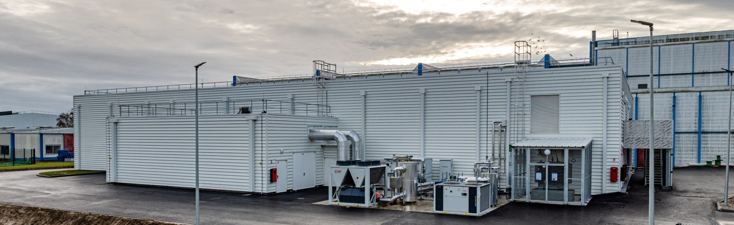
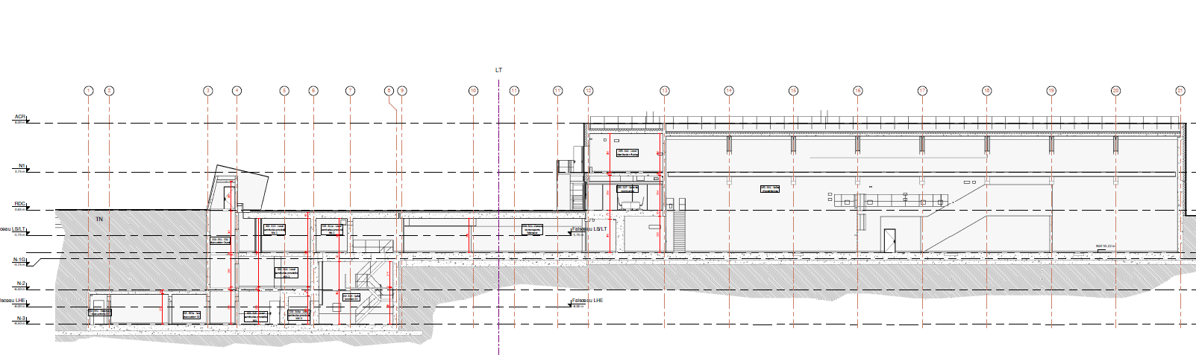
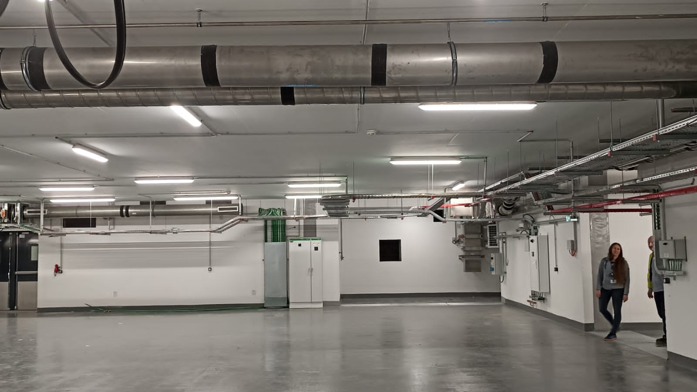
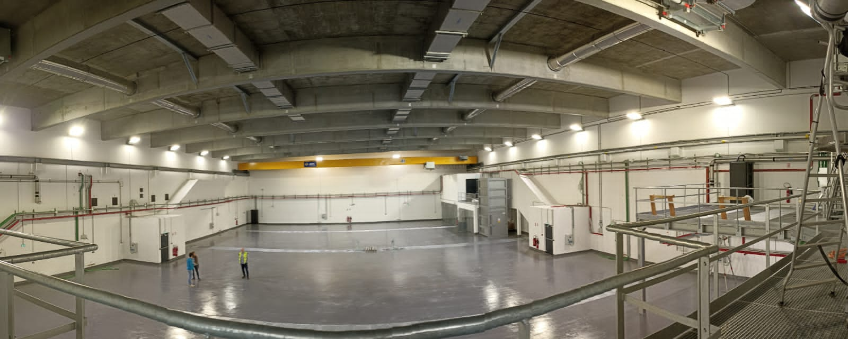
Buildings and infrastructure
Building delivery: 11/2025
Building operation (internal licence): 01/2027
Facility operation (safety licence request)
About to be submitted
Expected green light: 10/2028?
Salle 301 : Hall d’expérience
Laser room
31.35 m
51.50m
Laser room
11.25m
Laser rooms
8 m
9.50 m
Experimental hall
10
RFQ1P + HRS room

Slide 11
DESIR
Transport beam lines

Slide 12
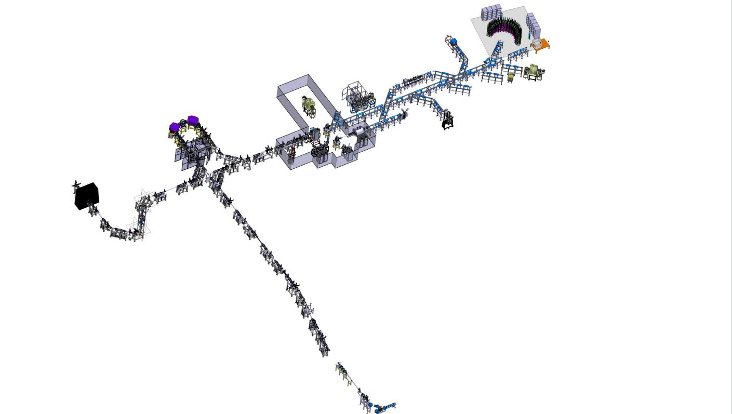
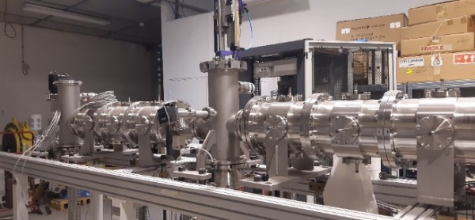


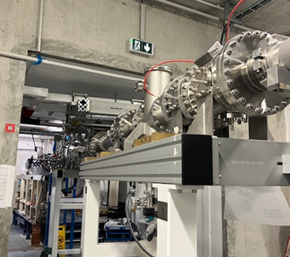


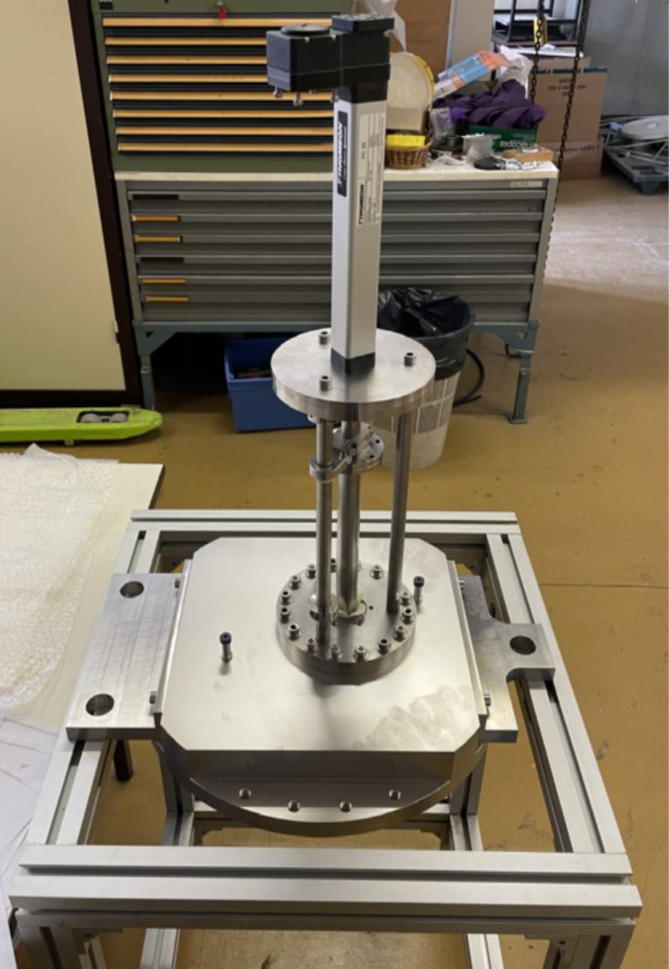
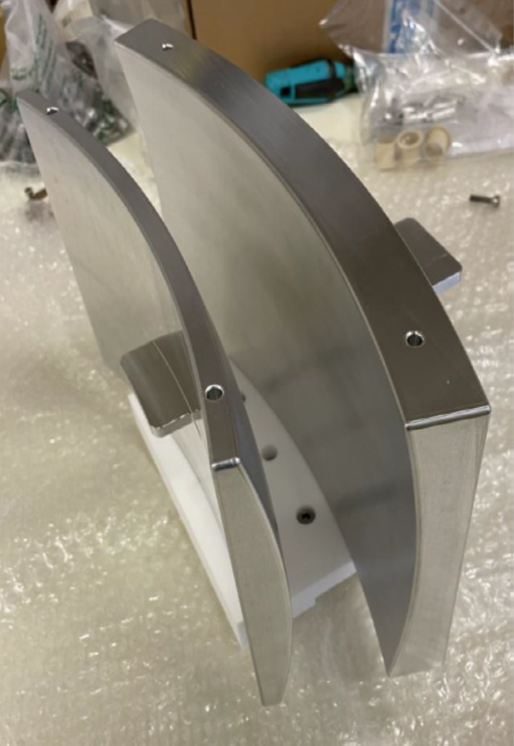
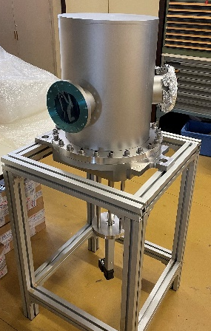
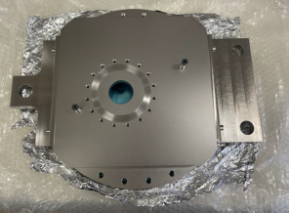
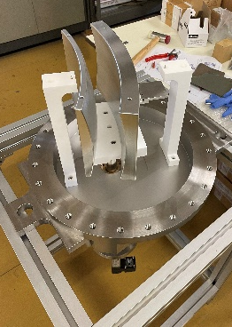
Overview: Transport beam lines
Test bench
Level -1
-3.25 m
DESIR Hall
Courtesy: Ph. Alfaurt, L. Daudin
Level -3
-9.5 m
3 keV
Junction beam lines from SPIRAL1 and S³-LEB to the DESIR Hall: ~100 m
1+ ions, < 60 keV, < 80 π.mm.mrad – fully electrostatic
SP1 -> DESIR beam line
Example: 45° deflector assembly
Upper part
Insertion
Pole assembly
Internal part
Base assembly
Courtesy: V. Watt-Morel
Level -1
-3.25 m
SPIRAL1
Courtesy: L. Perrot

Slide 13
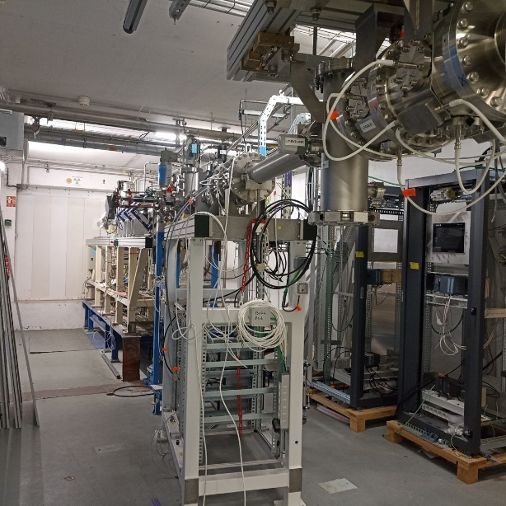
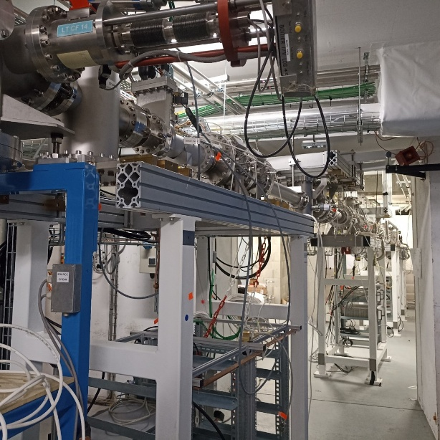
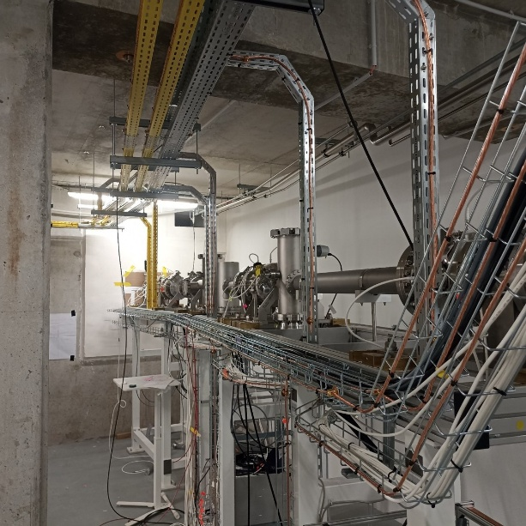
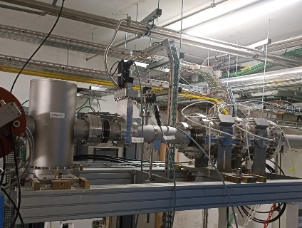
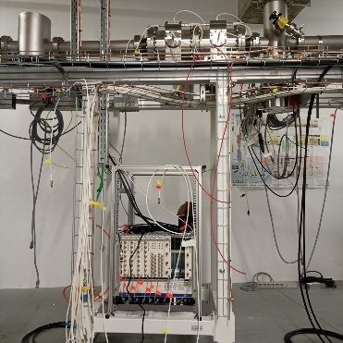
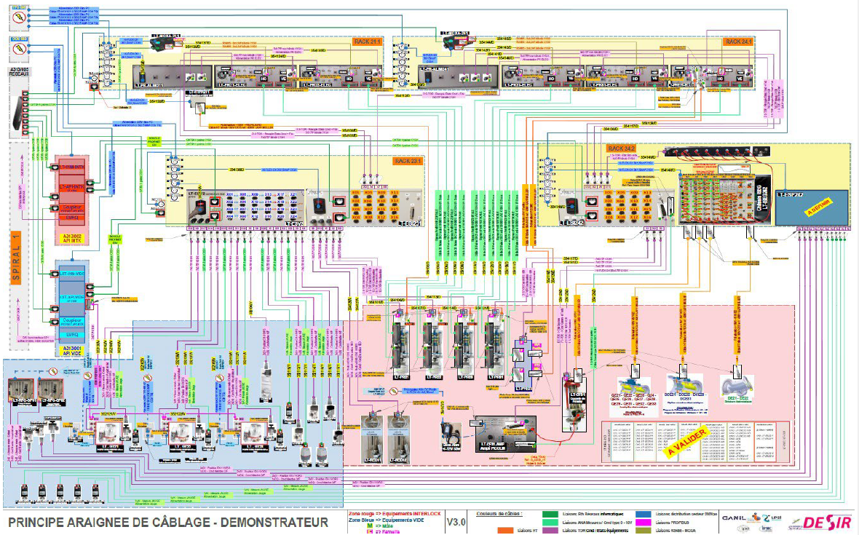
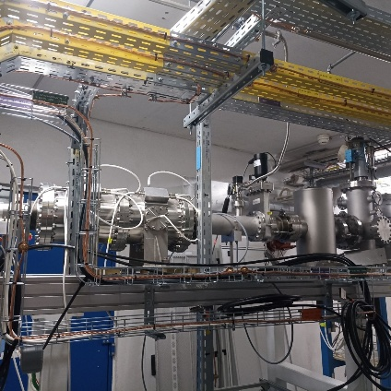
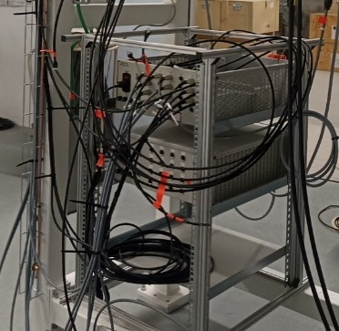
Transport beam lines: Prototype section
Validation of:
Assembly protocols √
Vacuum tests √
Cabling principles
Supplies integration √
Diagnostics insertion √
PLCs
Interlocks
Beam tuning software
SPIRAL1 -> --------------------------(~20 m)------------------------------→ DESIR
Still a lot to do: e.g., cabling
-> offline commissioning in 2027

Slide 14
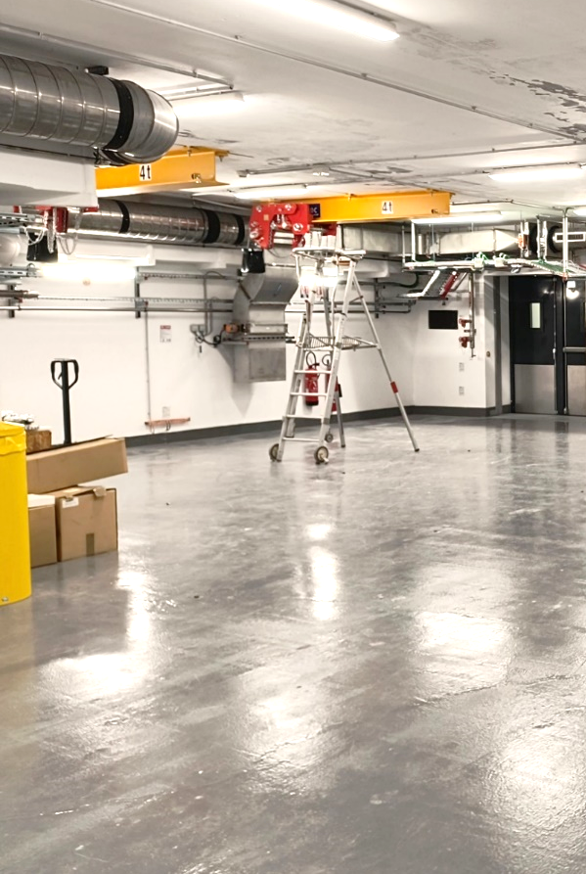
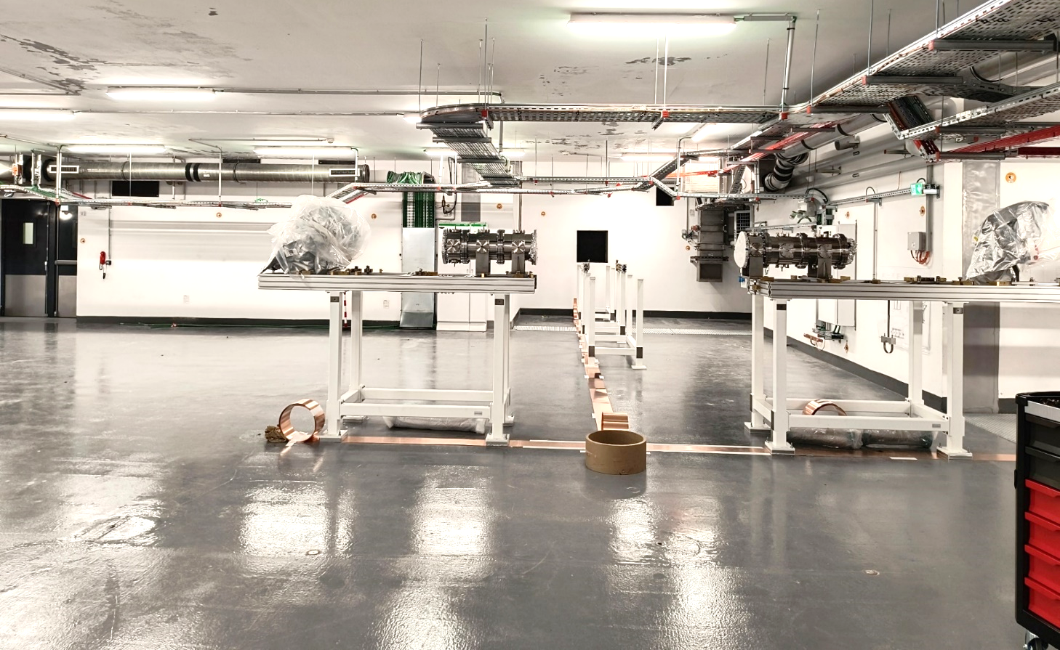

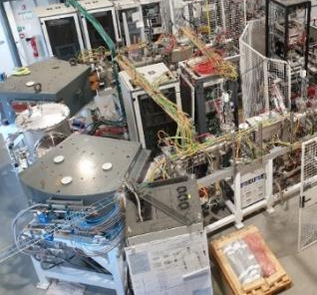
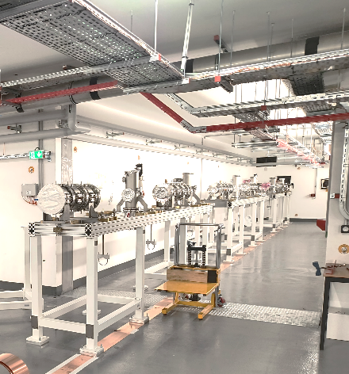
Transport beam lines: Junction tunnels
Installation of the beam line equipment (mechanics/optics): Early 2026 ---->
Call for tender for the cabling and piping: October 2026
RFQ-1P
HRS
SPIRAL2 LINAC
S³-LEB beam
Courtesy: C. Berteloite, GANIL
GANIL Cyclotrons
Spiral 1 beam
14

Slide 15
DESIR
Beam preparation and purification

Slide 16
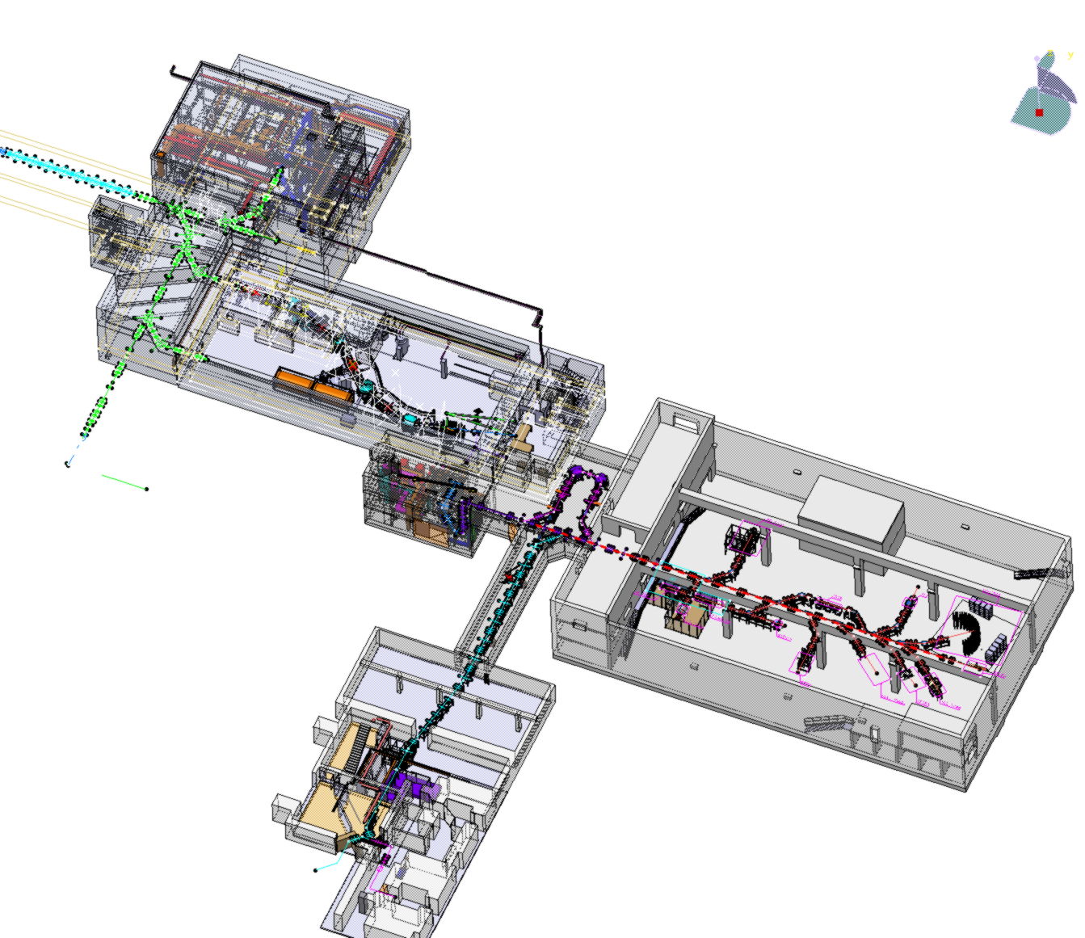



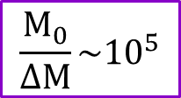


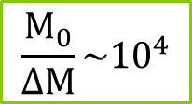

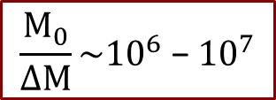
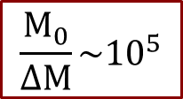
Beam preparation and purification
Beam preparation:
- Cooling and bunching
- Accumulation trap
Mass separation/beam purification:
GPIB
Time vs Resolving power
MR-ToF
$$\frac{M_{0}}{ΔM}\sim {10}^{4}$$
Clean most of isobars
$\sim {10}^{−5}$ s
HRS
PIPERADE
$\sim {10}^{−2}$ s
MR-ToF
$$\frac{M_{0}}{ΔM}\sim {10}^{5}$$
RFQ-Cooler Buncher
BRIoCHe
Clean almost all isobars
Double Penning Trap
PIPERADE
1st trap
$$\frac{M_{0}}{ΔM}\sim {10}^{5}$$
RFQ Cooler
High Resolution Separator HRS
$\sim {10}^{−1}$ s
Mass measurements:
PIPERADE
2nd trap
$$\frac{M_{0}}{ΔM}\sim {10}^{6} \text{−} {10}^{7}$$
$\sim {10}^{−1}$ s
MR-ToF-MS
TRAMWAY
Clean isomeric states separated by a few 10 keV
16
Courtesy: B. Blank, C. Berteloite
Mass precision: 10⁻⁸ – 10⁻⁹
Trap-assisted spectroscopy

Slide 17
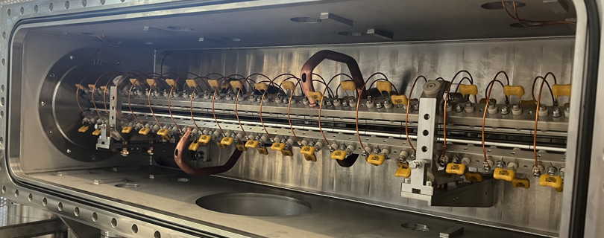

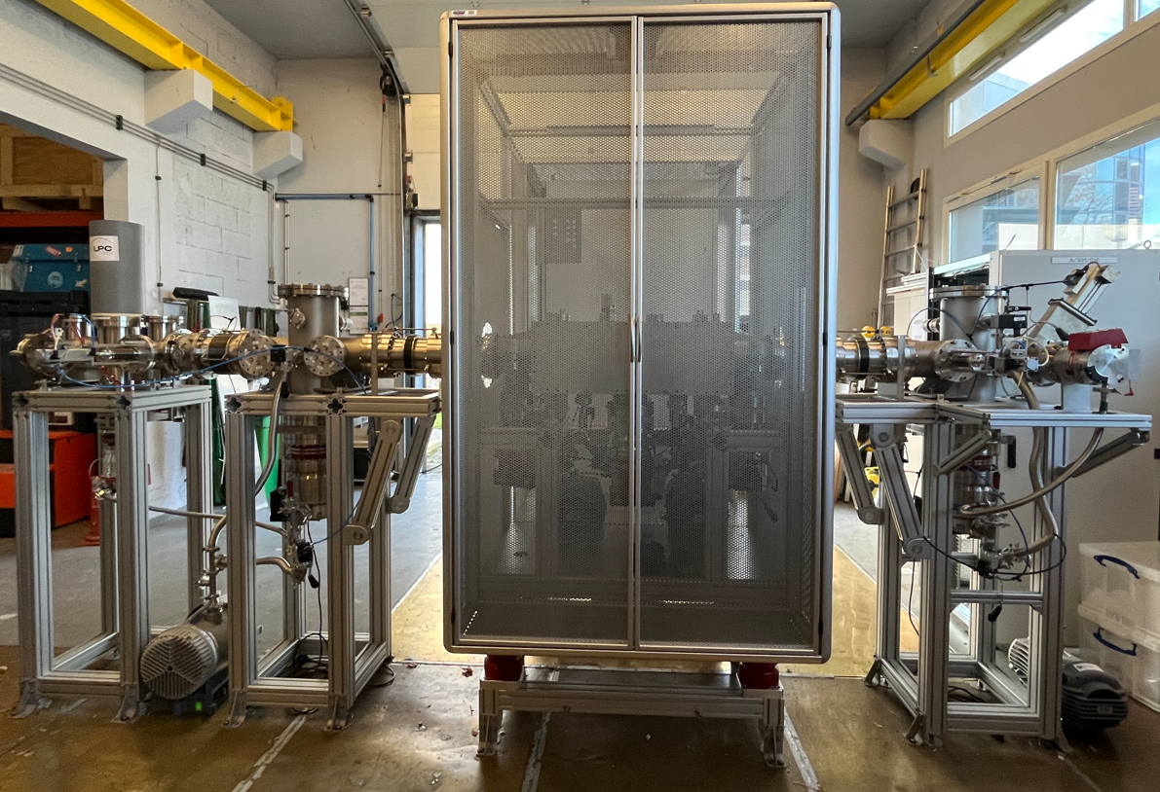
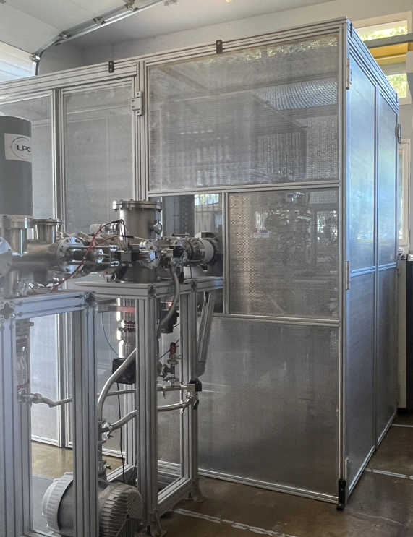
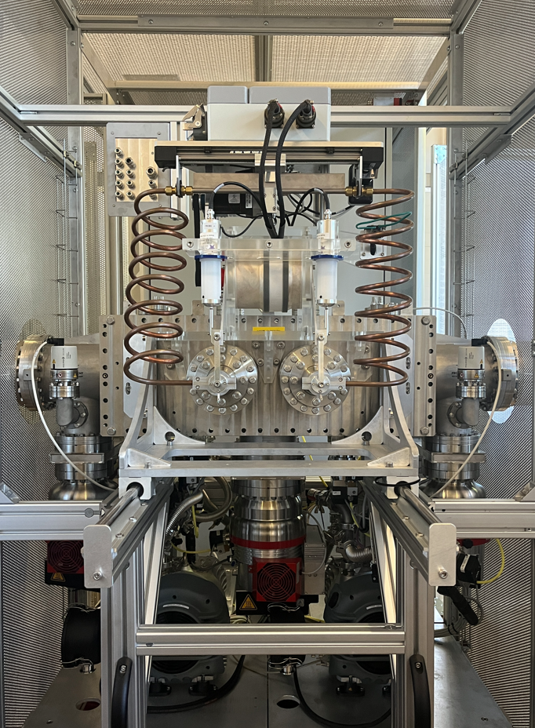
Beam preparation and purification: RFQ cooler
Based on the SHIRAC RFQ studied within SPIRAL2-Phase 2 and an upgraded version for SPES
R. Boussaid et al., JINST 9 (2014) P07009
Construction and tests at LPC Caen
- technical commissioning: end-2026
- offline commissioning: early 2027
-> transfer to GANIL: mid-2027
Material: J.-F. Cam, LPC Caen
Quadrupole triplet
Quadrupole
Ion source
Diagnostics
RFQ
RFQ1P test bench at LPC Caen (w/o the HV cage)
HV cage
RF circuit
17

Slide 18
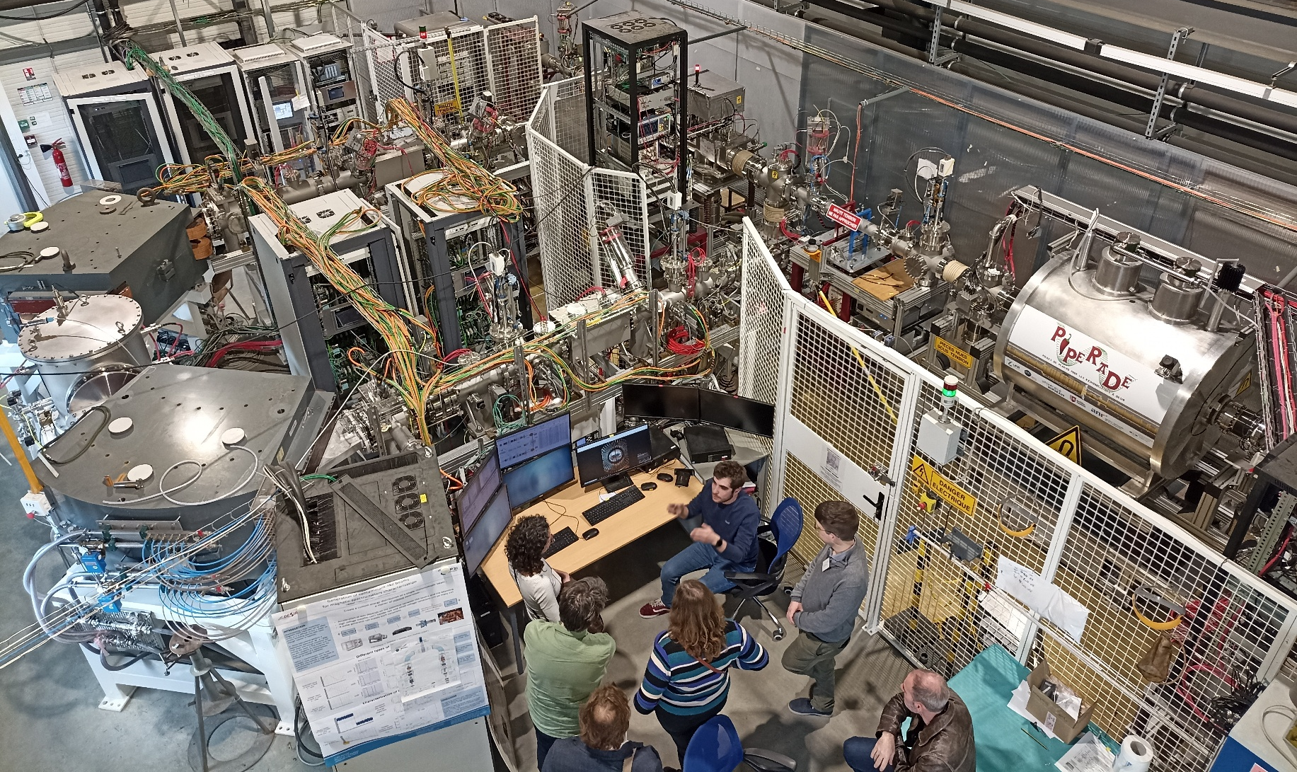

Beam preparation and purification: HRS
Fully commissioned at LP2iB - J. Michaud, A. Balana, B. Blank, L. Daudin
-> transfer to GANIL: end-2026
BRIoCHe
PIPERADE
HRS
J. Michaud et al., NIM B 541, 161 (2023)
T. Kurtukian Nieto et al., NIM B 317, 283 (2013)
18

Slide 19
DESIR
Timeline

Slide 20
Tentative timeline (preliminary)
RFQ-1P + HRS
Installation: Dec. 27
RIB in Exp. hall
Sept. 29?
BRIoCHe + PIPERADE
Installation: Sept 27 -> June 28
SIB before Exp. hall
Feb. 29?
Transport beam lines
Installation: Dec. 27
Demonstrator
Commissioning: March 27
20

Slide 21
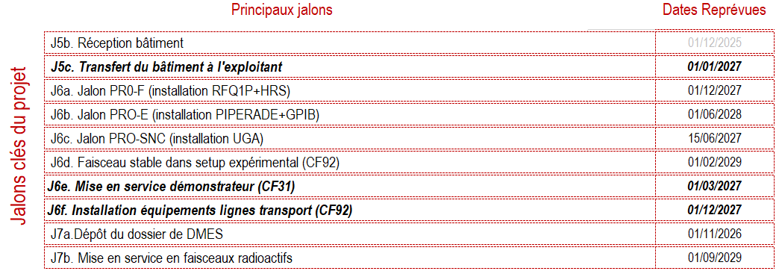
Tentative timeline (preliminary)
Tentative planning (DESIR COPIL and CAF – Oct.-Nov. 2026)
-> To be consolidated
21

Slide 22
DESIR
Conclusion

Slide 23
Conclusion
Critical points
Stable ion source for experimental equipment commissioning
1st laser room operation
Upgrade of the maximal B_{ρ} value of SPIRAL1 RIBs
Transfer of technical developments to the GANIL staff
23

Slide 24

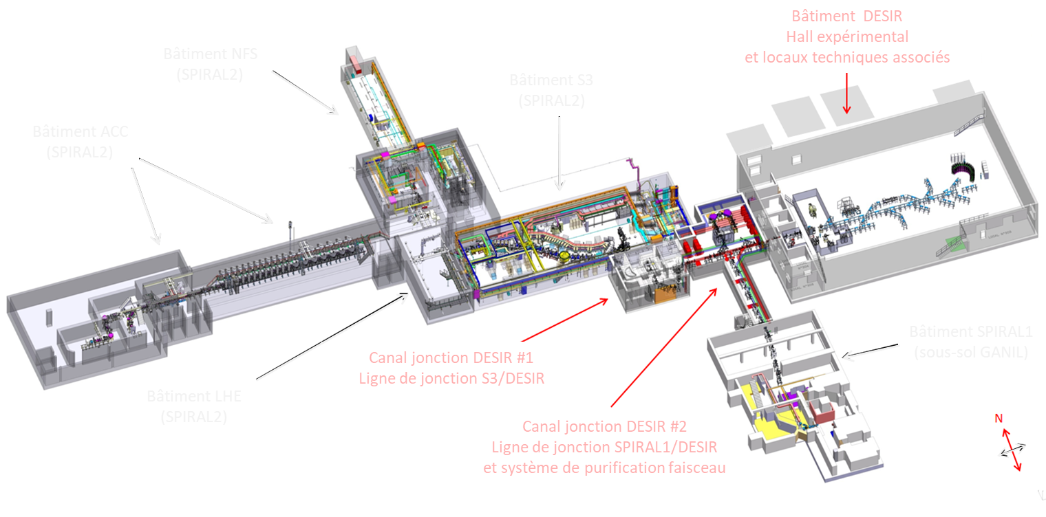
Thanks for your attention
NEWGAIN

