Slide 1
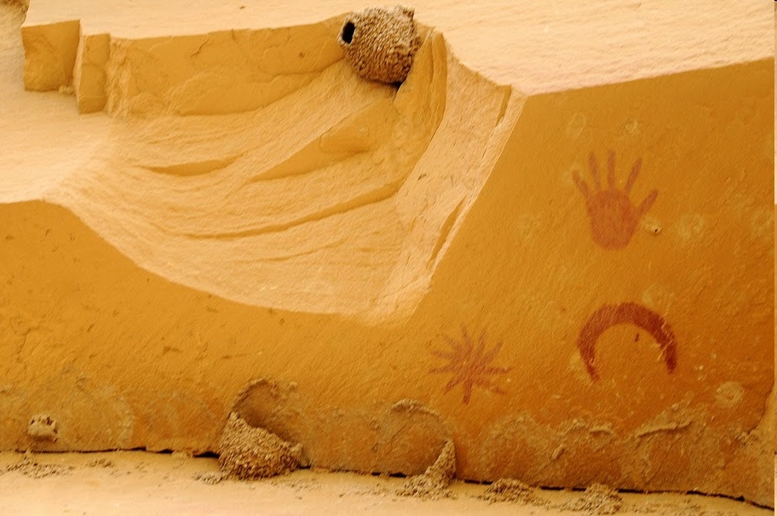

RADIO OBSERVATIONS OF SUPERNOVA REMNANTS AND THE SURROUNDING MOLECULAR GAS
CRISM-2011
Gloria Dubner

Slide 2
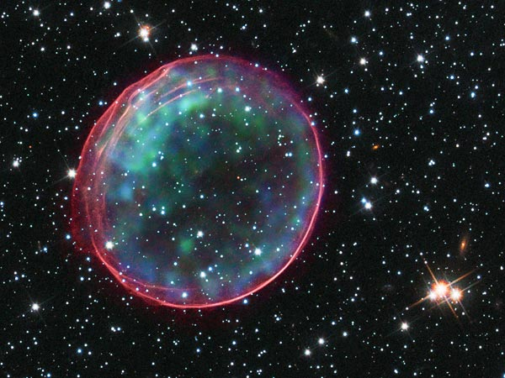
A Supernova Remnant (SNR) is the structure and the products created during and after the explosion and through the interaction with the surrounding matter.
CRISM-2011
Gloria Dubner

Slide 3
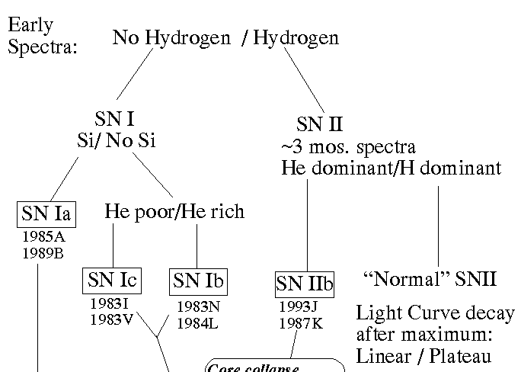
Based on the early spectra, we can classify the origin of the SN
thermonuclear
collapse
gravitational
collapse
Ia: Very old stars that have lost all their H
II:Massive progenitors with plenty of H
Massive stars where outer layers were stripped by winds (WR stars) or binary interaction: Ib: H removed, Ic: H and He removed.
IIb:Most (NOT all) H removed during evolution
CRISM-2011
Gloria Dubner

Slide 4
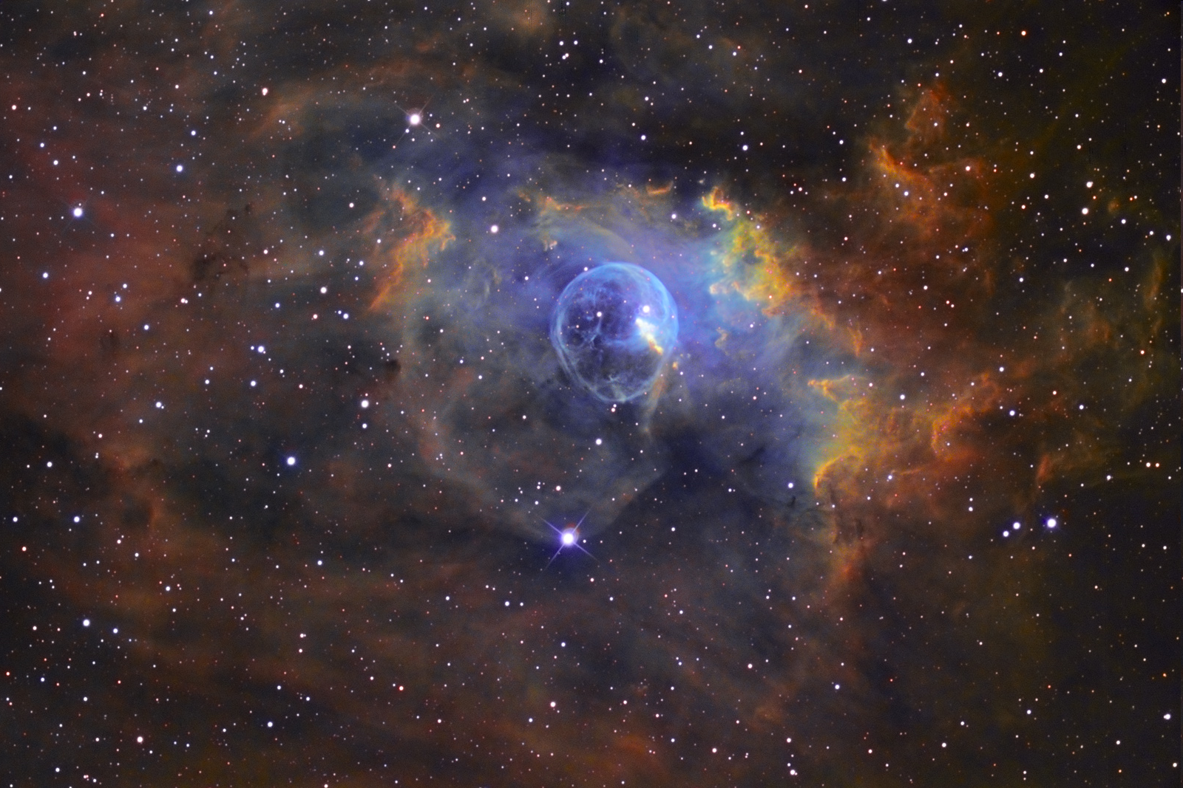
In about 80% of the cases or maybe more, the SNR evolves in an environment strongly modified by the precursor
The Bubble Nebula
CRISM-2011
Gloria Dubner

Slide 5
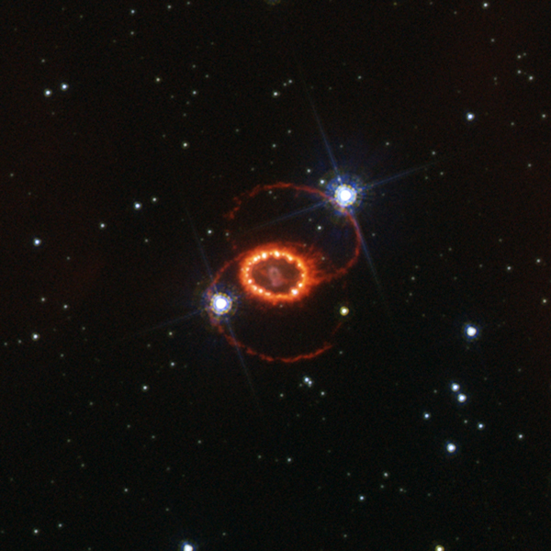
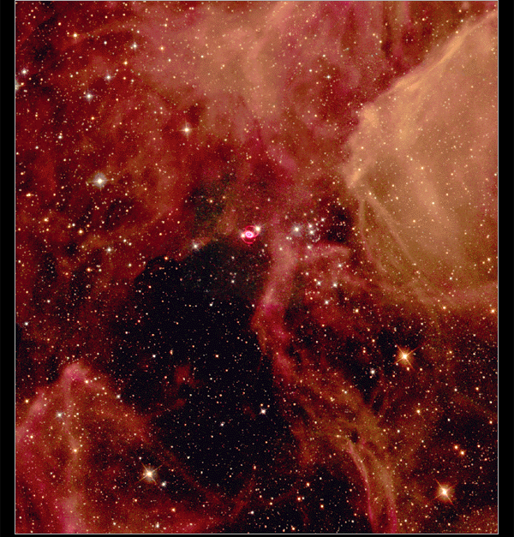
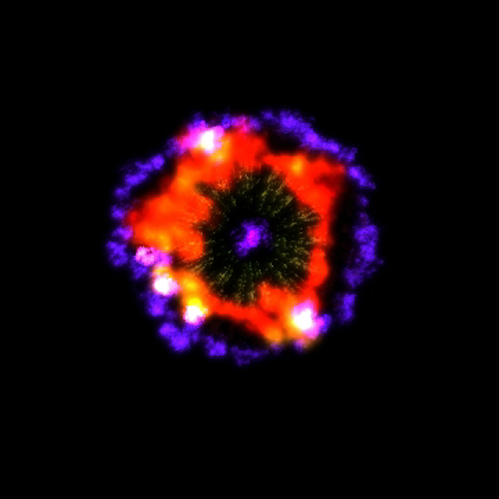
SN 87A
CRISM-2011
Gloria Dubner

Slide 6
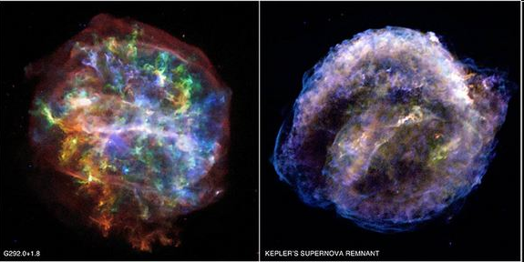
SNRs have memory of the explosion
and there are many controversial issues in the understanding of the explosion
Thermonuclear collapse:
the nature of the burning front : subsonic? supersonic? mixture? Detonation? Deflagration? A mixture?
the nature of the companion: red giant?, another white dwarf?
remnants of Type Ia SN tend to be more symmetric (Lopez et al. 2011)
Gravitational collapse:
what process can revert an implosion into an explosion?
what is the mass limit between collapse-and-explode or complete-collapse-to-black hole?
Explosion: Spherically symmetric? bi-lateral? other asymmetries?
remnants of Type II SN are distinctly more asymmetric.
CRISM-2011
Gloria Dubner

Slide 7
After the sudden injection of ~10⁵¹ ergs and several solar masses of processed stellar ejecta in an almost point-like region, shock waves with initial speeds of ~5000 to ~10000 km/s sweep up and move surrounding material (CSM and ISM) amplifying irregularities in pressure and density.
A SHELL SNR IS FORMED
+ NEUTRON STAR (?)
+ PULSAR WIND NEBULA (?)
.
CRISM-2011
Gloria Dubner

Slide 8
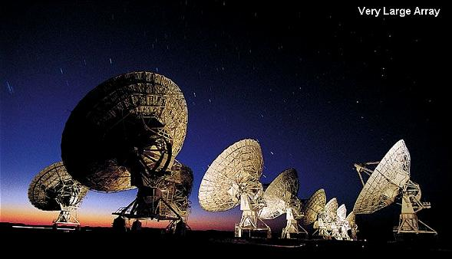
What can be learnt from radio studies
plus the combination with observations in
other spectral ranges?
CRISM-2011
Gloria Dubner

Slide 9
Supernova Remnants are, in general, good radio emitters of synchrotron radiation.
From radio studies at different frequencies we can basically study:
Brightness distribution → morphology
Polarization → electric field distribution (B field)
Spectrum → global and local variations of the energy spectrum of the accelerated particles and amplified B
CRISM-2011
Gloria Dubner

Slide 10
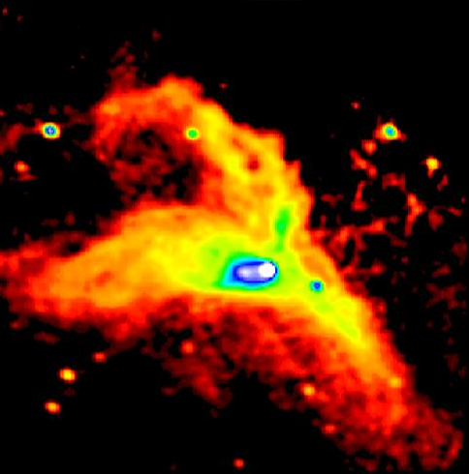
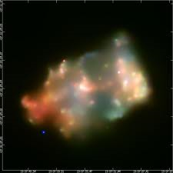
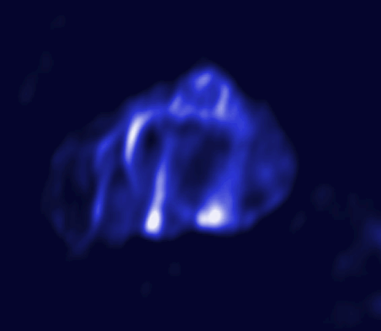
SNRs shape and are shaped by their surroundings
CTB 80
3C 397
G340.4+0.4
CRISM-2011
Gloria Dubner

Slide 11
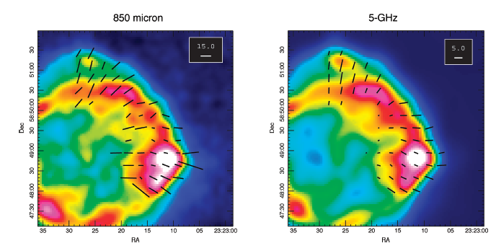
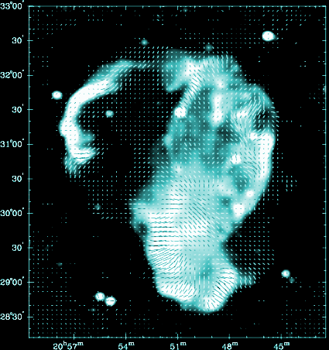
SNRs amplify and reorganize interstellar magnetic fields
Cassiopeia A
Cygnus Loop
CRISM-2011
Gloria Dubner

Slide 12
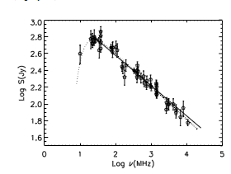
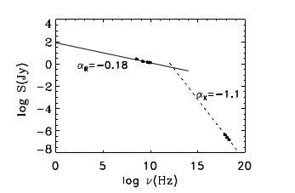
Spectral studies
Global spectrum
Spatial variations
Carrying information not only about
the SNR but also about the intervening ISM
Showing the thermal and non-thermal emission and illuminating the possible sites of particles acceleration
absorbing ionized gas
and then B field
turnover
frequency
CRISM-2011
Gloria Dubner

Slide 13
Spectral studies
-0.2
-0.4
Global spectrum
Spatial variations
Carrying information not only about
the SNR but also about the intervening ISM
Showing the thermal and non-thermal emission and illuminating the possible sites of particles acceleration
absorbing ionized gas
Global index =-0.52
-0.6
-0.8
Bright areas have radio spectral indices steeper than the assumed and dark areas
imply flatter spectral indices.
turnover
frequency
CRISM-2011
Gloria Dubner

Slide 14
Radio spectral index α (S ∝ν ^{α} )
Diffusive shock acceleration (DSA) predicts a radio spectral index
→ α ~ -0.5 for compression ratio of 4
→ Down to α ~ -0.25 can be obtained from higher compression ratio
Also flat indices can be obtained from:
multiple shocks
efficient 2nd. order Fermi acceleration in strongly amplified magnetic fields.
These are flat spectral indices of NON-THERMAL ORIGIN. For example if a SNR blast wave impacts a dense cloud→ strong post shock compression + higher Mach numbers and/or higher B field
Steeper indices are obtained for low Mach number shocks
CRISM-2011
Gloria Dubner

Slide 15
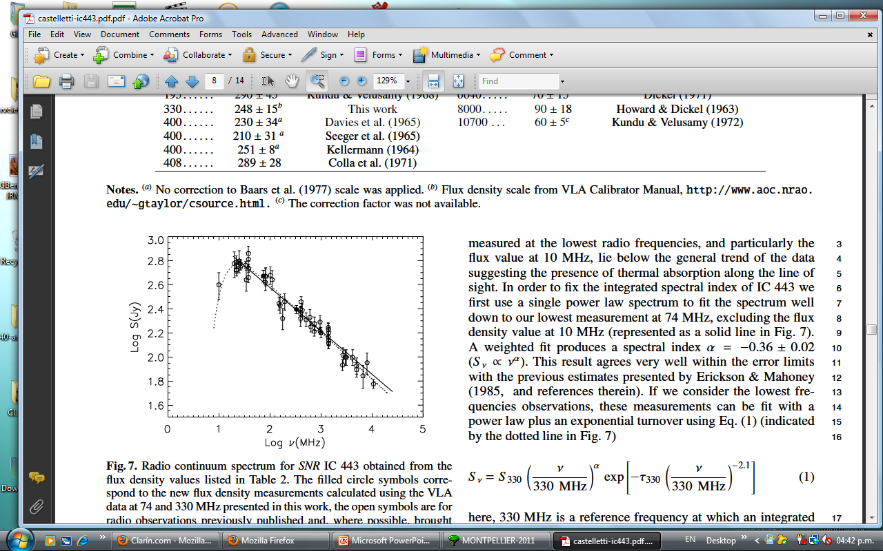
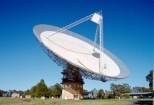
Ionized gas along line of sight
SNR
HII
SNR / molecular cloud
SNR
CRISM-2011
Gloria Dubner

Slide 16
Flat radio spectral index α (S ∝ν ^{α} )
Origin
Proof
Fermi acceleration at sites with stronger postshock compression- Higher Mach number shocks – higher compression of B fields
Intrinsic
NON-THERMAL
Radio continuum
the regions with low α coincide with bright synchrotron emission
MIR +FIR (Spitzer)
Catalogues of HII regions
Ionized gas along
the line of sight
Extrinsic
THERMAL
J-type dissociative shock impacting on a molecular cloud (collisional ionization)
NIR (2MASS)
Lines of multi-ionized species NeII NeIII SiII SIII
CRISM-2011
Gloria Dubner

Slide 17
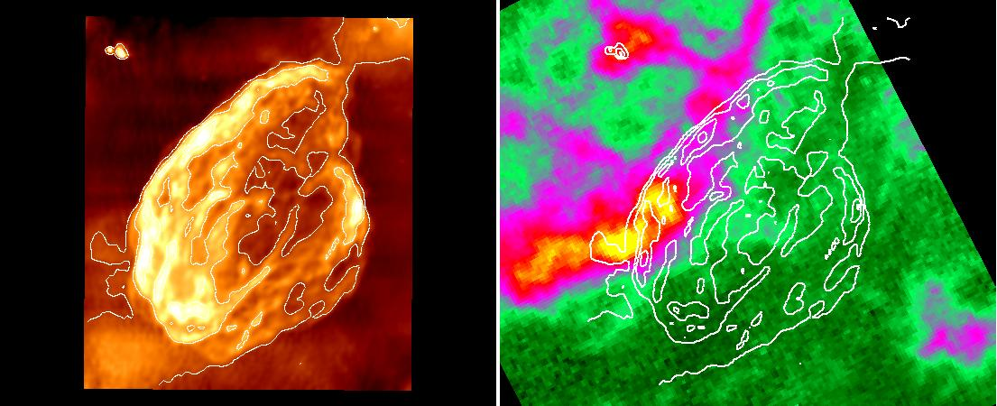
SNR W44 evolving in a molecular environment
¹³CO emission
CRISM-2011
Gloria Dubner

Slide 18
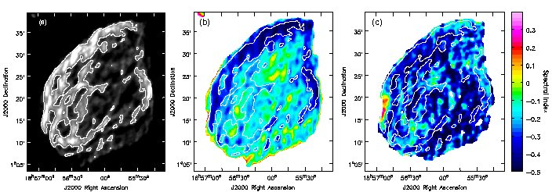
radio spectrum between 330 MHz and 1420 MHz

Slide 19
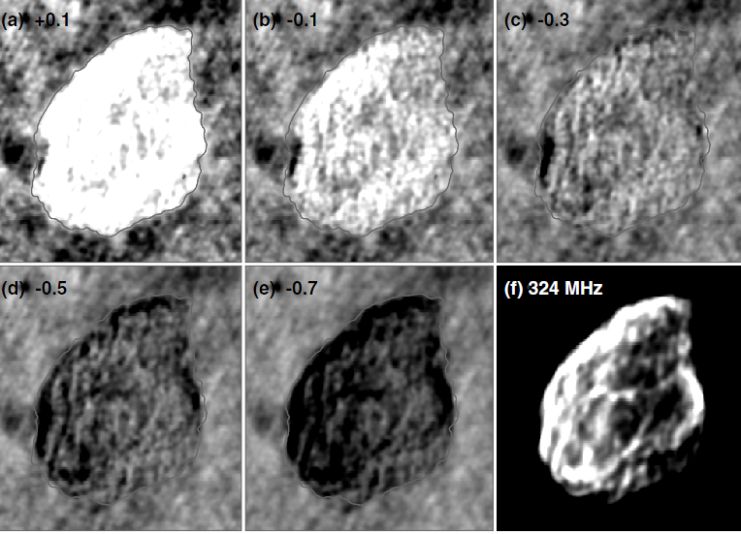
Tomographic spectral analysis of W44
CRISM-2011
Gloria Dubner

Slide 20
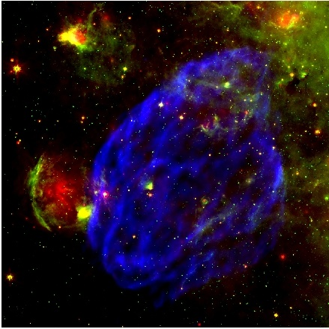
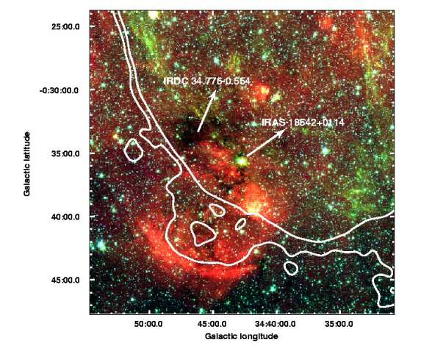
W 44
Radio + 8 and 24 microns
CRISM-2011
Gloria Dubner

Slide 21
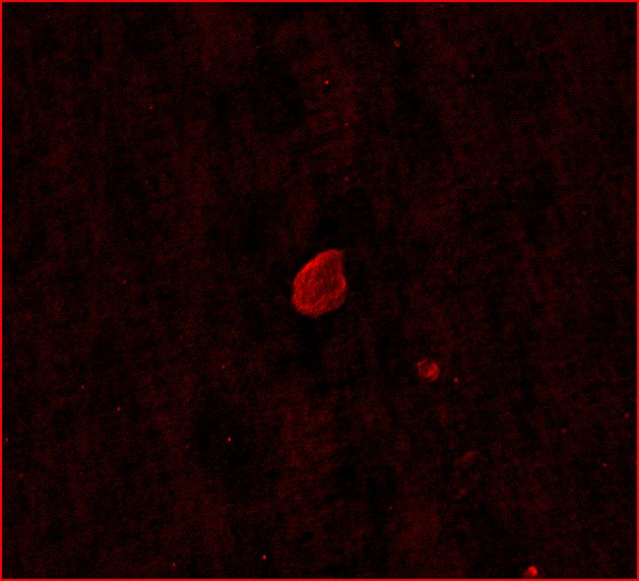
Observing at low radio frequencies
15º
CRISM-2011
Gloria Dubner

Slide 22
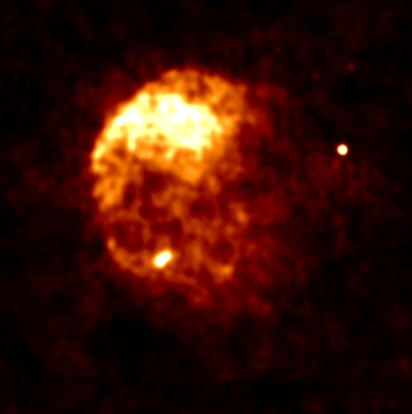
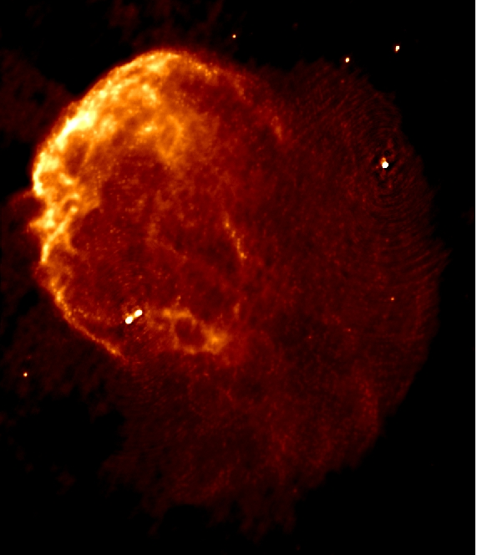
First images of IC443 at low radio frequencies
74 MHz
330 MHz
CRISM-2011
Gloria Dubner

Slide 23
Radio and optical
emissions
in IC443
Castelletti, Dubner, Clarke & Kassim 2011,
astro-ph 1104.0205
CRISM-2011
Gloria Dubner

Slide 24
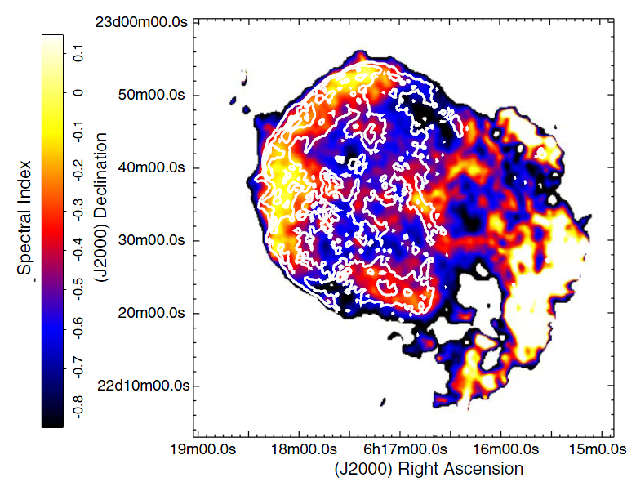
Spectral index map constructed using VLA observations at 74 and 330 MHz
Thermal origin
Non-Thermal origin
CRISM-2011
Gloria Dubner

Slide 25
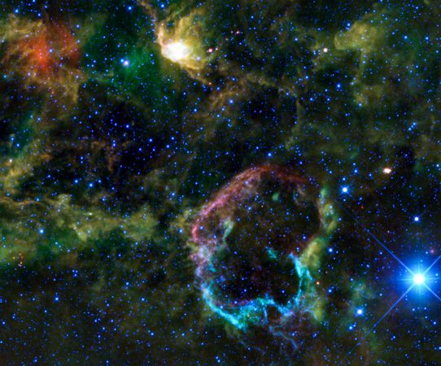
IC443 in infrared light

Slide 26
IC443 in near IR
The top half is emitting light from Fe, Ne Si and O highly ionized.
The bottom is primarily emitting light from H2.
CRISM-2011
Gloria Dubner

Slide 27
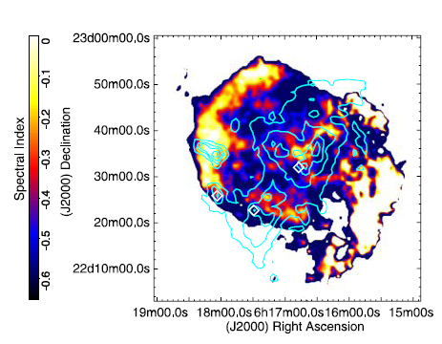
Radio spectral index and CO emission in IC443
Flat spectrum of thermal origin
OH masers
Flat spectrum of non- thermal origin
CRISM-2011
Gloria Dubner

Slide 28
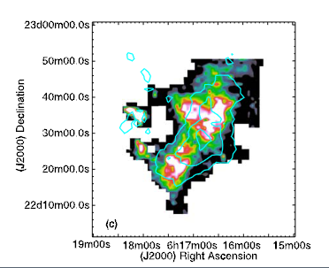
TeV VERITAS (Acciari et al. 2009) source VERJ0616.9+2230 (contours) superposed to 12C0 (J = 1−0) emission
CRISM-2011
Gloria Dubner

Slide 29
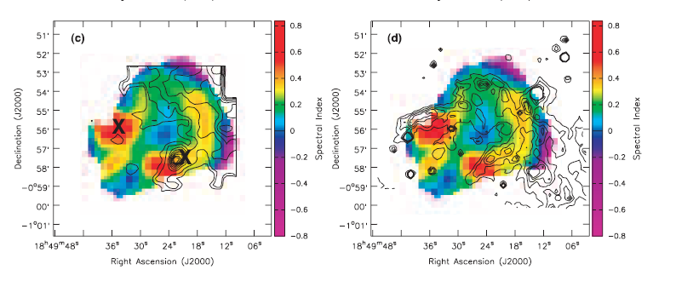
SNR 3C391
Interaction with molecular cloud proved through
radio spectral index and IR data
(Brogan et al. 2005)
CRISM-2011
Gloria Dubner

Slide 30
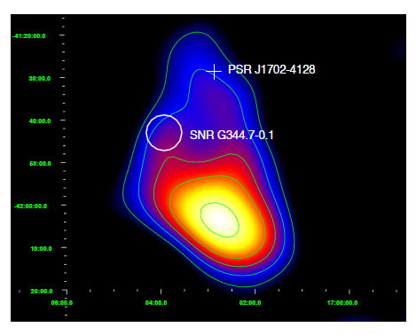
SNR G344.7-0.1 located in the vicinity of the
unidentified TeV source HESS J1702-420
CRISM-2011
Gloria Dubner

Slide 31
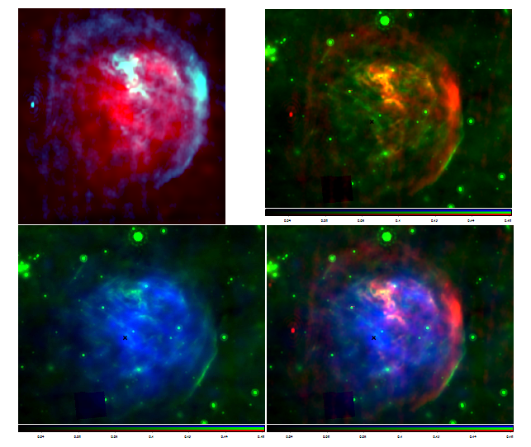
SNR G344.7-0.1: multiwavelength study
a PWN?
radio+Xray
radio+IR
Xray+IR
radio+Xray+IR
CXOU J170357.8-414302
Giacani, Smith, Dubner, Loiseau 2011, A&A
CRISM-2011
Gloria Dubner

Slide 32
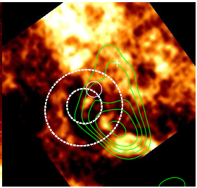
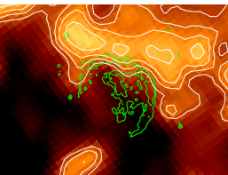

SNR G344.7-0.1: the environs
A wind-blown bubble
Immersed in a larger shell
the ¹²CO distribution
CRISM-2011
Gloria Dubner

Slide 33
SNR G338.3-0.0 HESS J1640-463
SNR G349.7 +0.2 Fermi detection
HESS J1943+213 (a PWN? BL Lac?)

Slide 34
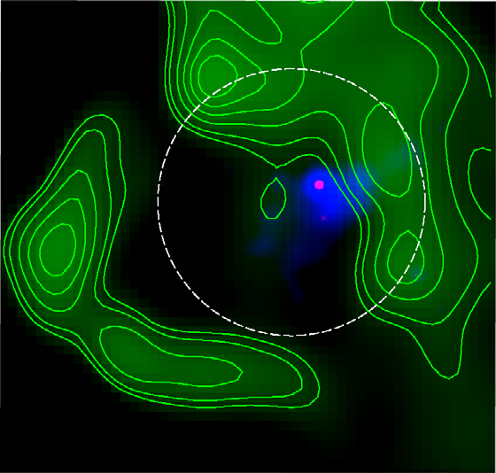
G338.3-0.0- HESS J1640-465
XMMU J164045.4−463131
X-ray PWN
CRISM-2011
Gloria Dubner

Slide 35
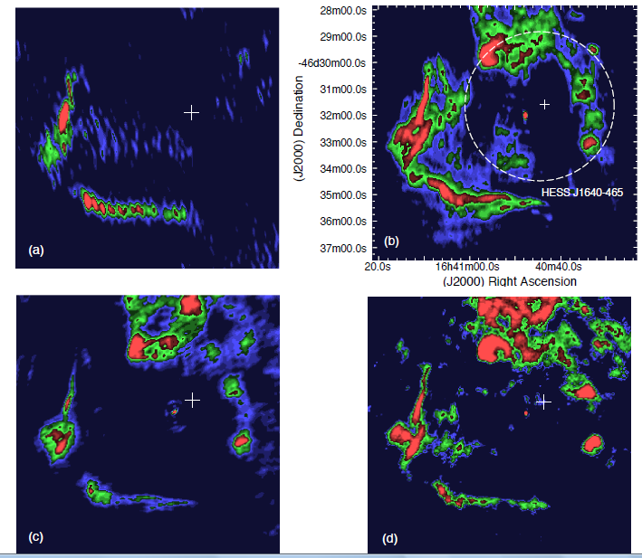
GMRT and ATCA observations at 235, 610, 1480 and 2300 MHz
Castelletti et al. A&A, 2011
CRISM-2011
Gloria Dubner

Slide 36
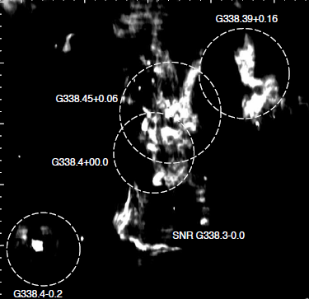
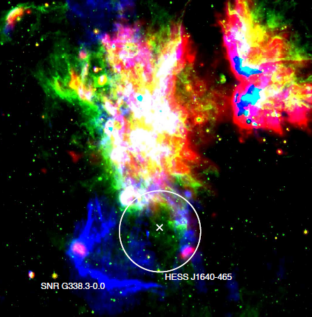
Blue: GMRT image at 613 MHz
Green: GLIMPSE at 8 μm
Red: MIPSGAL at 24 μm
CRISM-2011
Gloria Dubner

Slide 37
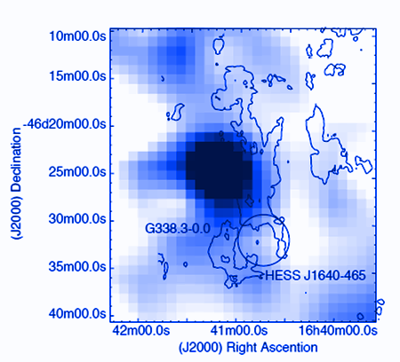
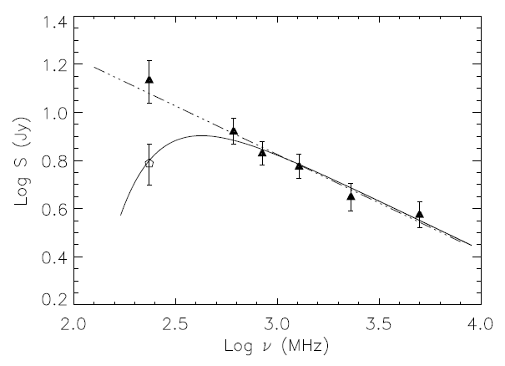
Radio spectrum
CO distribution
CRISM-2011
Gloria Dubner

Slide 38
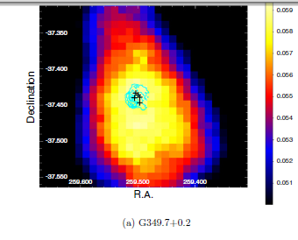
SNR G349.7 + 0.2
Fermi-LAT count maps of front converted events in the range 2–200 GeV
Castro & Slane, 2010, Apj 717,372
CRISM-2011
Gloria Dubner

Slide 39
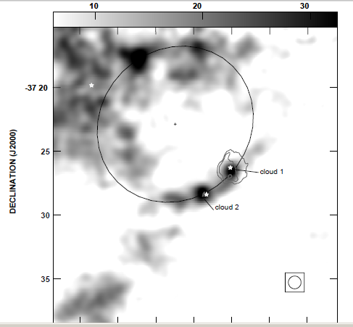
Reynoso & Mangum
2001
CRISM-2011
Gloria Dubner

Slide 40
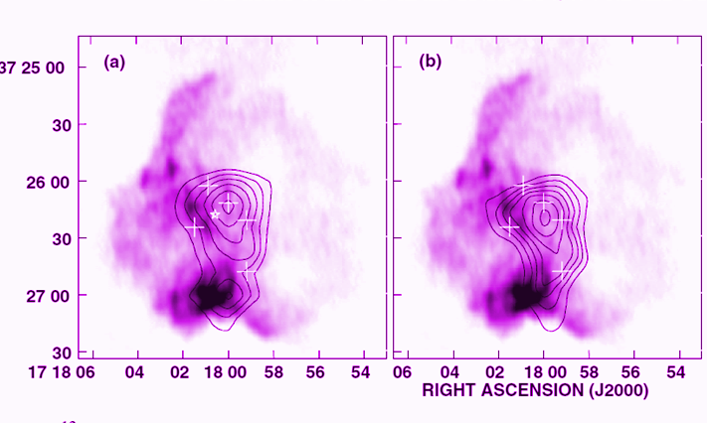
CRISM-2011
Gloria Dubner

Slide 41
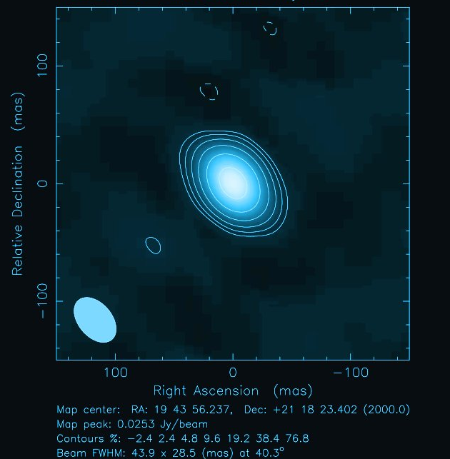
Search for a counterpart
to the newly discovered gamma-ray source
HESS J 1943+213
Using 7 antennae of the European VLBI network eEVN, with longest baseline 1300 km
HPBW 44 x 28 milli arcsec
^{0”.2}
Gabanyi, Frey, Paragi & Dubner, 2011 in prep
CRISM-2011
Gloria Dubner

Slide 42
In summary: Radio observations at various frequencies (specially in the lowest extreme of the electromagnetic spectrum) are useful tools :
To map large fields of view with arcsec angular resolutions (comparable to that of XMM-Newton, for example)
To map the synchrotron emission at the frequencies where the emission is maximum (2 to 3 times brighter than at λ20 cm, for example)
To independently identify regions where the SN shock is running into dense molecular clouds along the line of sight
To estimate the physical parameters of the warm, ionized gas between us and the SNR
To accurately estimate the radio spectrum anchoring it to the lowest frequencies and to separate thermal from non-thermal emission
To investigate the E field orientation and after correction by rotation measure, the B field orientation and, in some cases, its intensity.
CRISM-2011
Gloria Dubner

Slide 43
Some caveats:
Observations carried out with radio-interferometers produce beautiful images with high angular resolution, but they alone fail to recover the total flux density (necessary for an accurate spectral study)
Polarization measurements give an indication of orientation of E field. Two or more frequencies are needed to extract the B field orientation. And polarized signal is VERY WEAK (less than 10% of the total intensity flux). A polarization study requires 100-fold increase in observing time for the same source observed in total intensity
Regions with flat radio spectrum indicate e- accelerated at higher energies. However, contamination with thermal emission or interaction with molecular clouds produce the same effect
CRISM-2011
Gloria Dubner

Slide 44
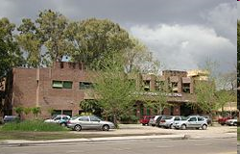
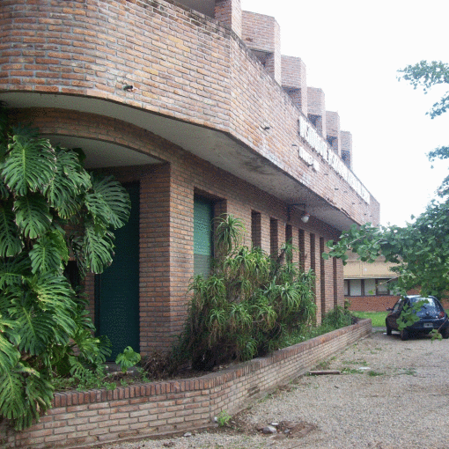

Thanks!
And welcome to the Institute of Astronomy and Space Physics in Buenos Aires
CRISM-2011
Gloria Dubner

