Slide 1
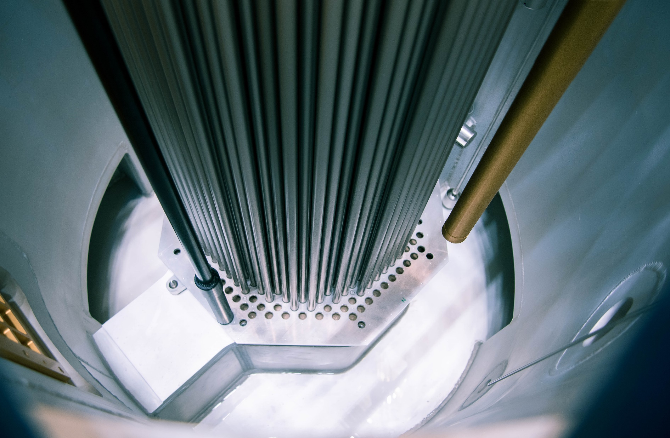
Analysis and Reproduction of Stainless‑steel Integral Experiments Towards Nuclear Data Assimilation
Thomas Ligonnet
LPC Seminar
October 5th 2026
Caen, France
Laboratory for Reactor Physics and Systems Behaviour
© Maxime Filliau

Slide 2
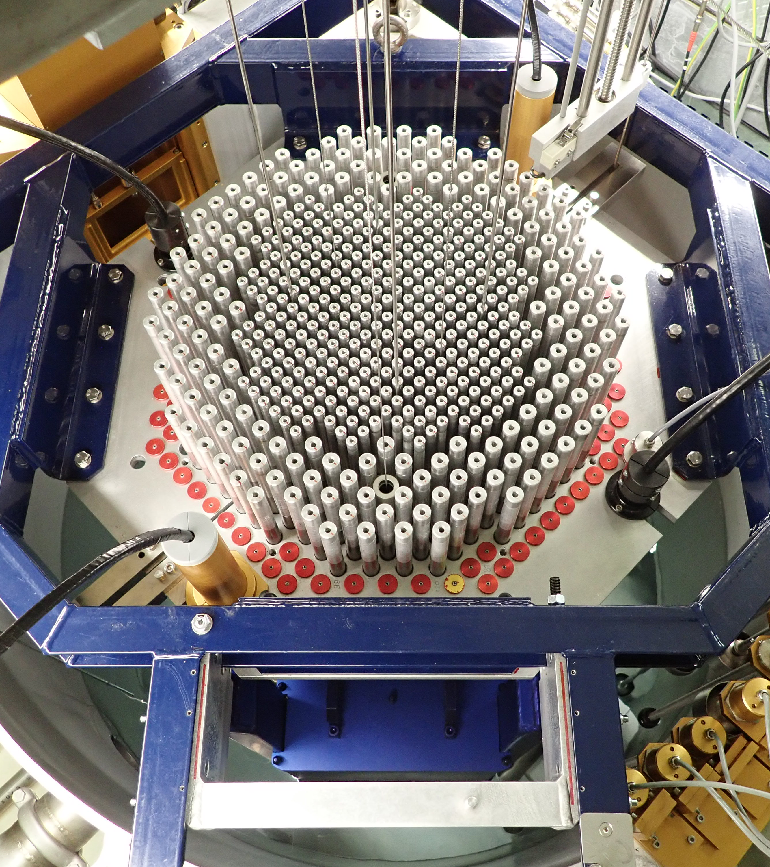
Plan
HARVEST-X
  Motivation
  PETALE
  BLOOM
Validation Results for Steel
  Nickel
  Chromium
  Iron
  304L
  BLOOM Additional Results
Conclusion and Outlook

Slide 3
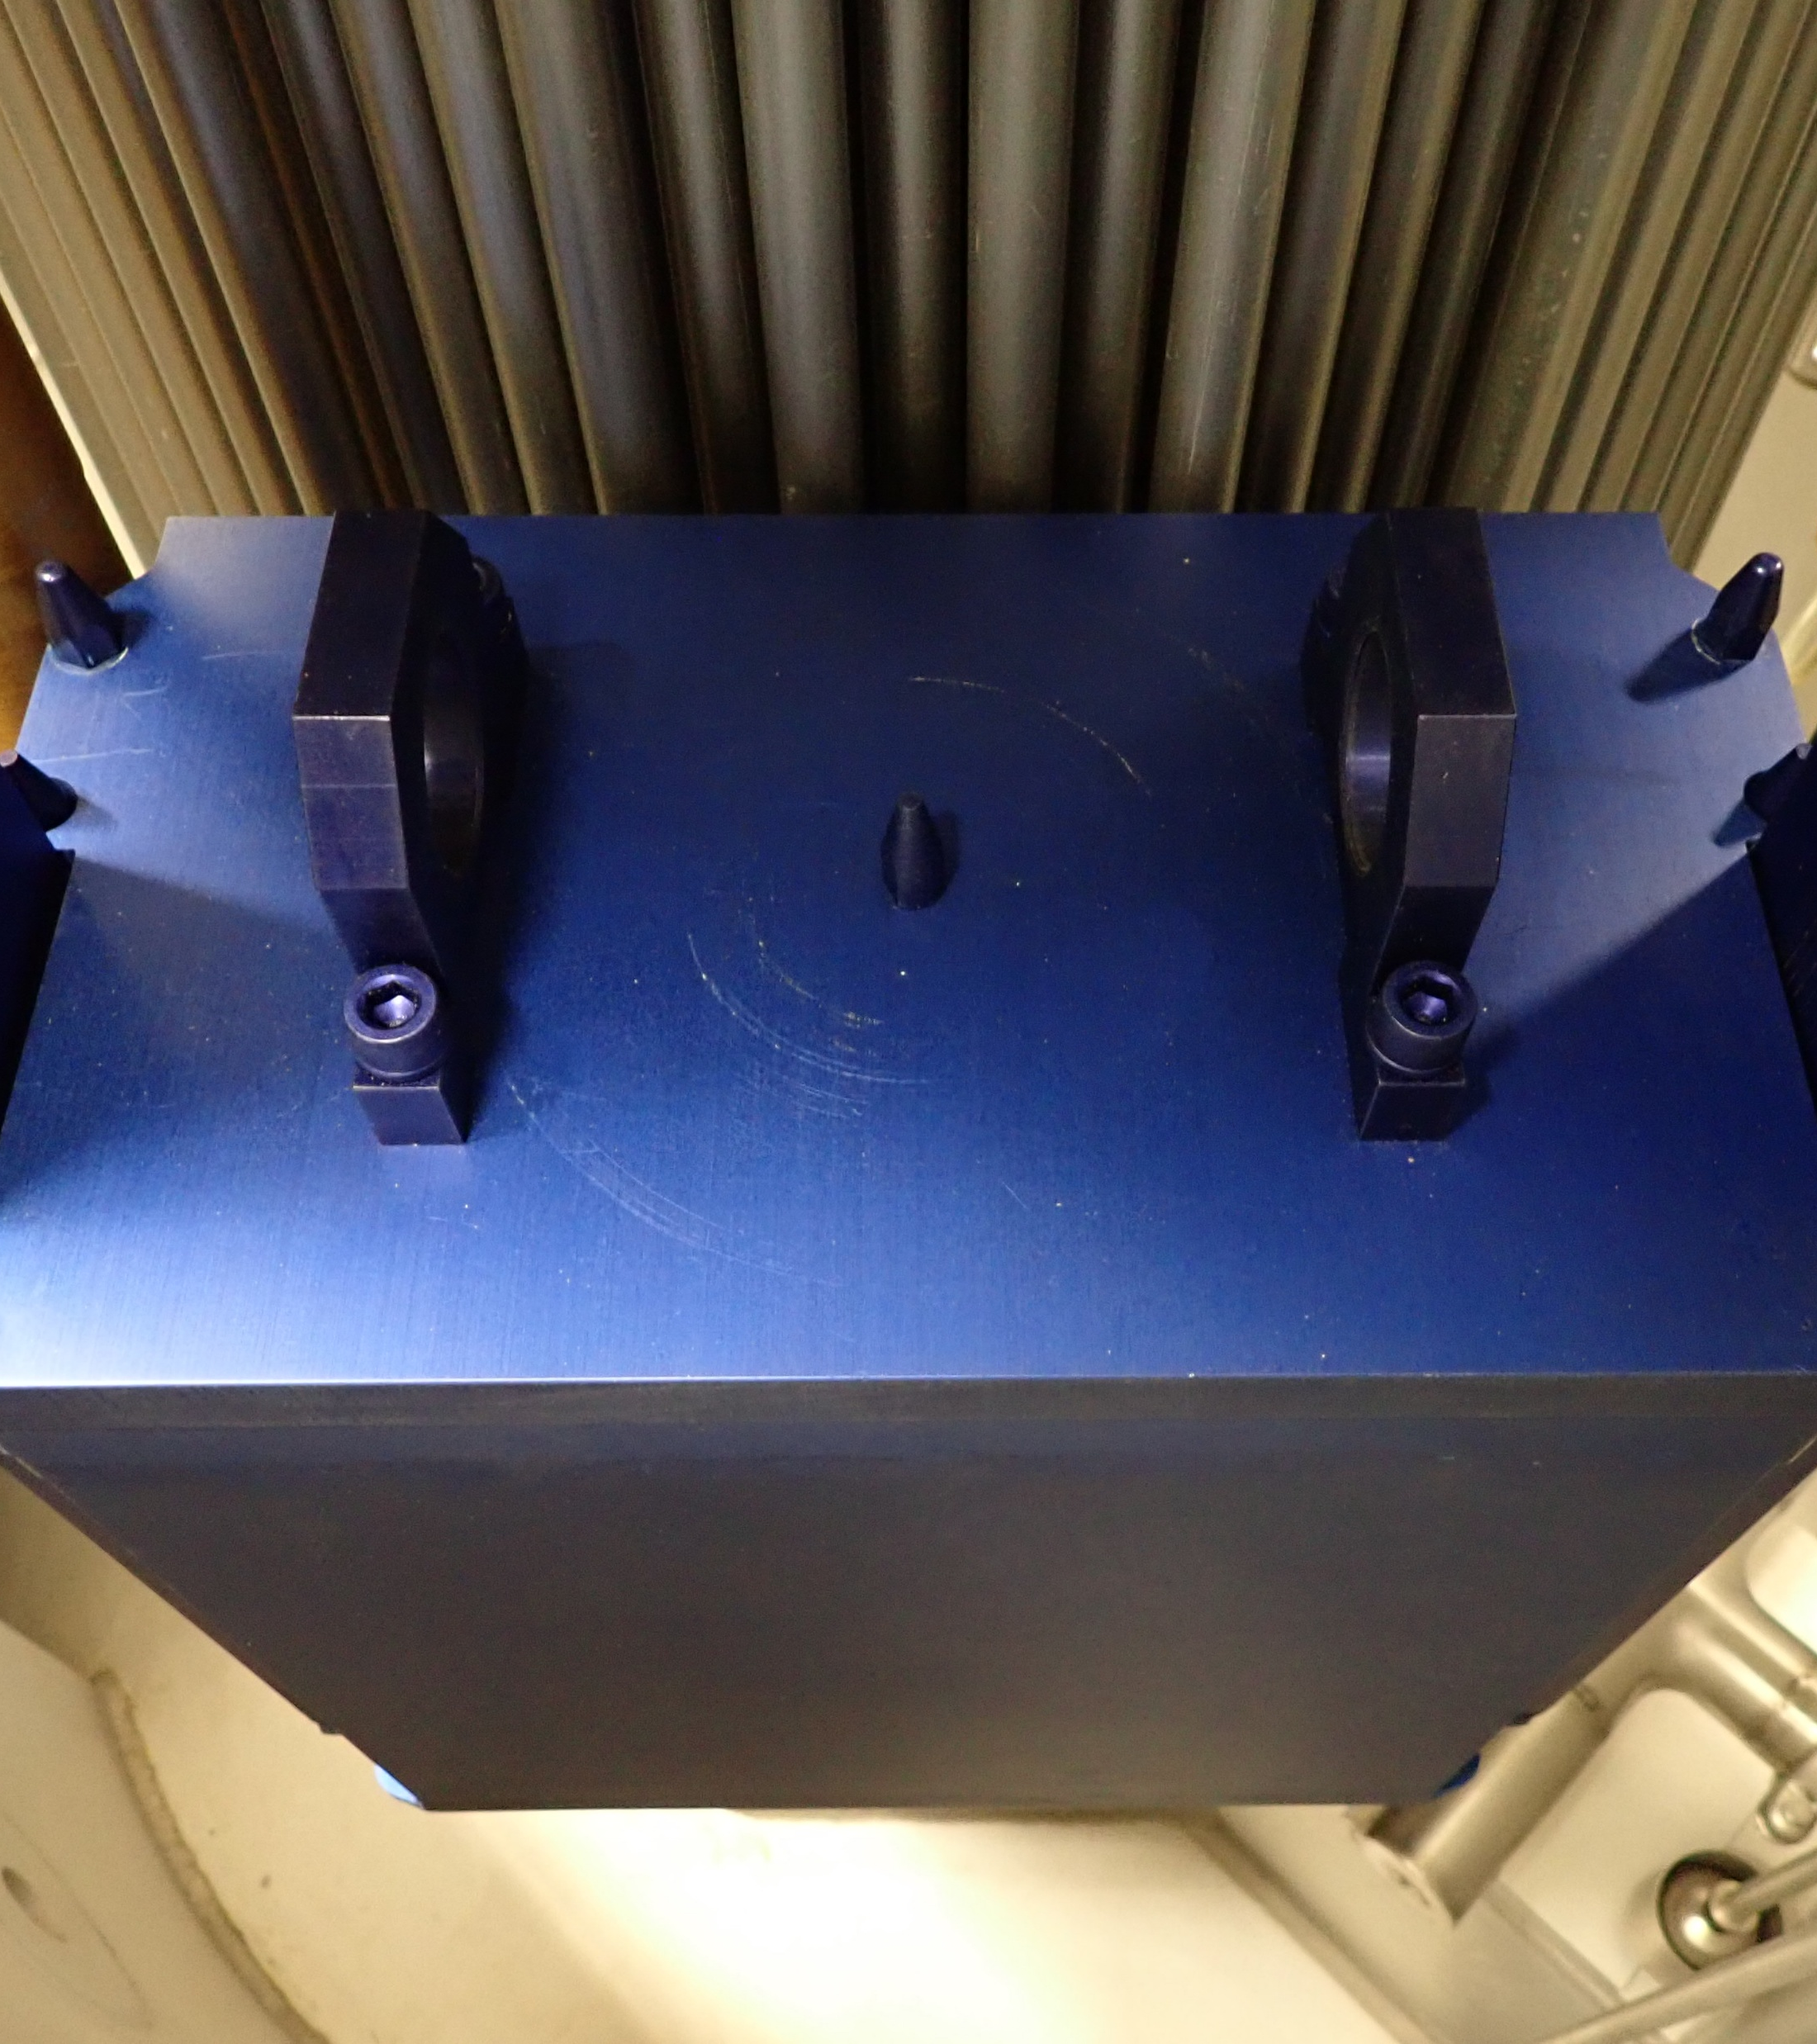
Plan
HARVEST-X
  Motivation
  PETALE
  BLOOM
Validation Results for Steel
  Nickel
  Chromium
  Iron
  304L
  BLOOM Additional Results
Conclusion and Outlook

Slide 4
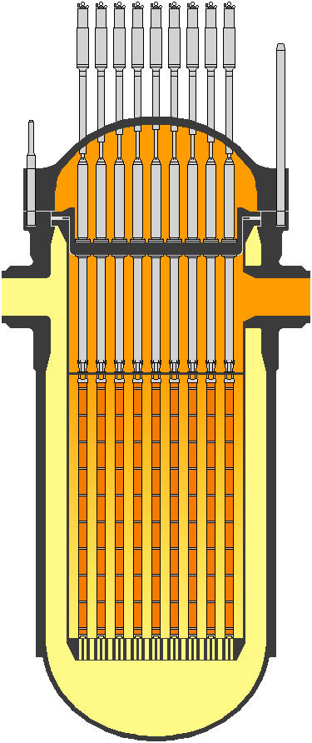
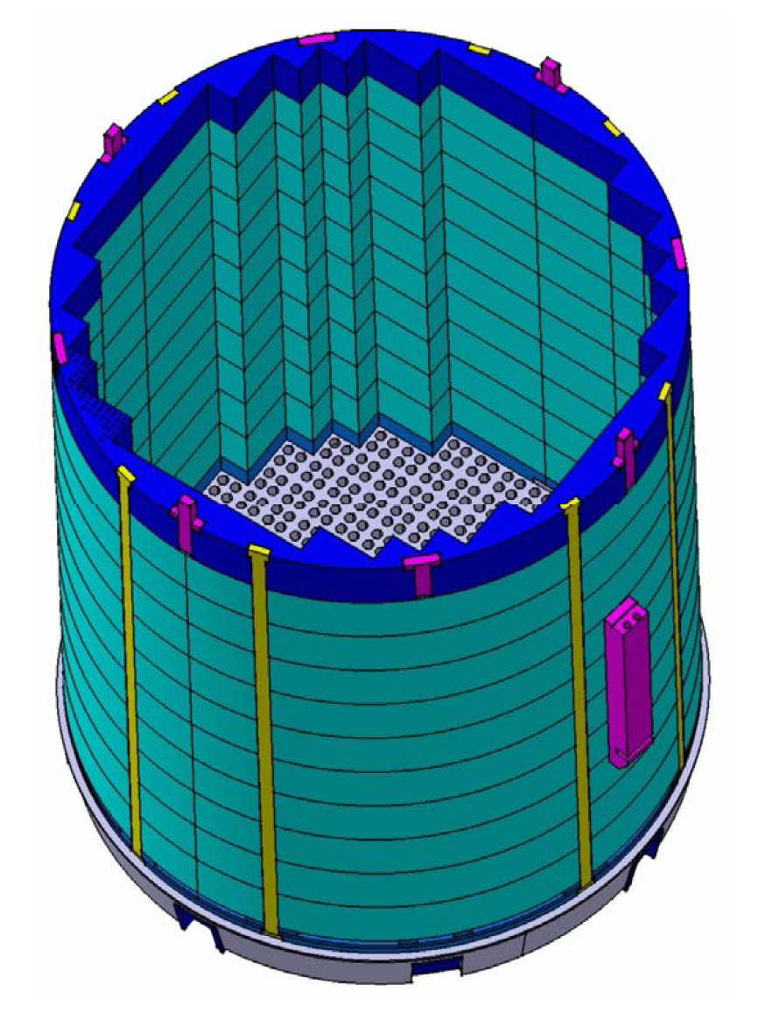
Stainless steel in nuclear reactors
Applications
Heavy reflectors (GEN-III PWR)
Réflecteurs Lourd
  EPR
Reactor Pressure Vessel fluence
Fluence cuve
  Life extension 50 70+ years
  Extension des opérations
Fuel transport casks
Conteneurs de transport
…
EPR heavy reflector
By ChNPP at English Wikipedia, CC BY 3.0, https://commons.wikimedia.org/w/index.php?curid=22017751

Slide 5
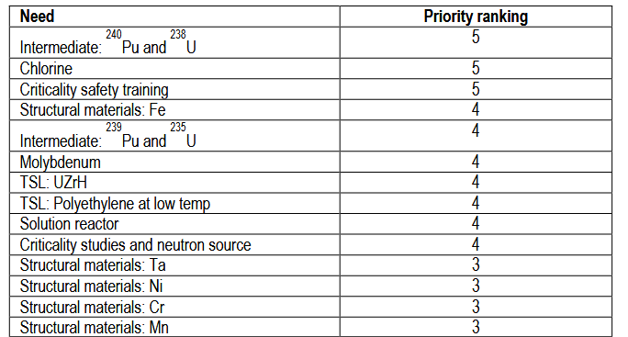
Identified needs in criticality safety
NEA Criticality Safety priority list
Iron ranking 4
Chromium ranking 3
Nickel ranking 3

Slide 6
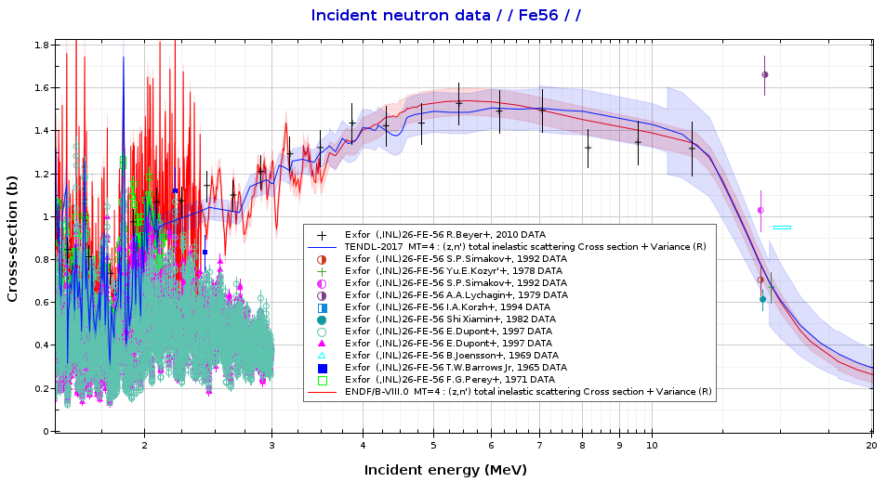
Identified needs in criticality safety
NEA Criticality Safety priority list
Iron ranking 4
Chromium ranking 3
Nickel ranking 3
NEA High Priority Request List
⁵⁶Fe >0.5 MeV
⁵⁰Cr, ⁵³Cr
Iron inelastic scattering cross section data (JANIS)

Slide 7
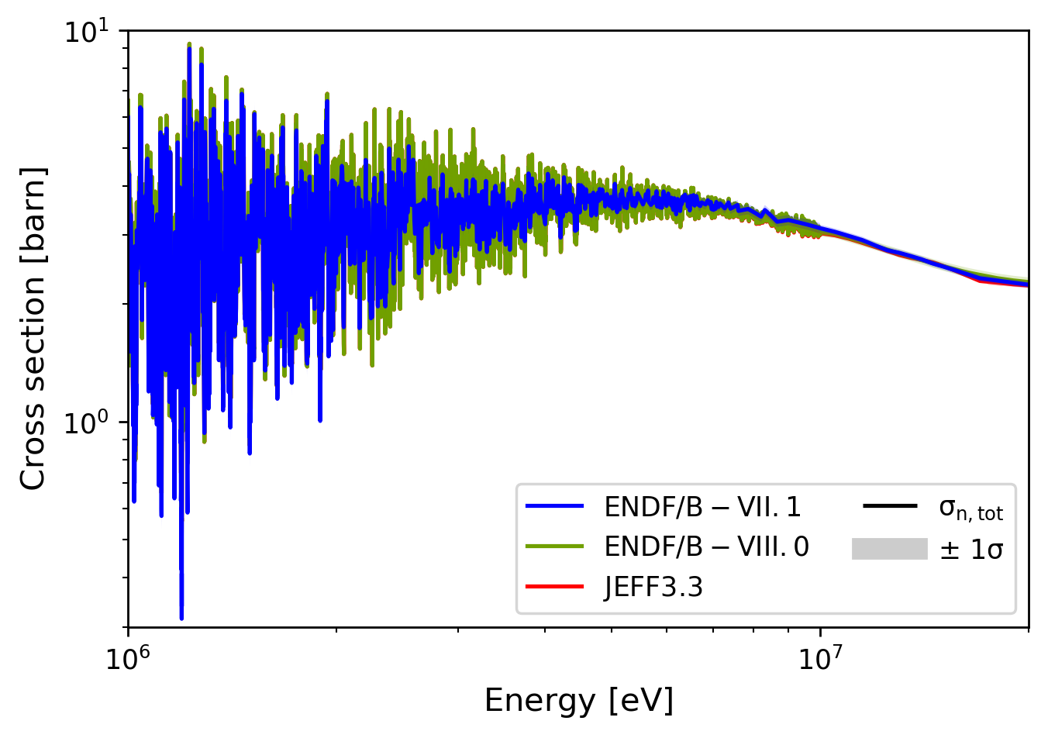
Identified needs in criticality safety
NEA Criticality Safety priority list
Iron ranking 4
Chromium ranking 3
Nickel ranking 3
New evaluations produced recently
Iron
  INDEN: 54, 56, 57
Chromium
  INDEN: All isotopes
Nickel
  Tendl-2024: All isotopes
NEA High Priority Request List
⁵⁶Fe >0.5 MeV
⁵⁰Cr, ⁵³Cr

Slide 8
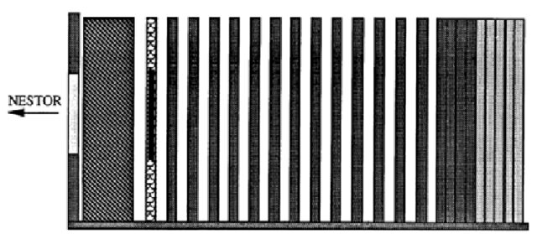
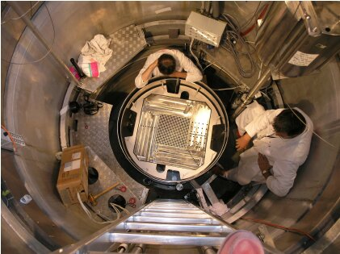
Benchmarking needs
Old or new evaluations are available…
… but are they adequately validated?
Available experiments
Iron and steel
Old
Suspicion of elemental compensation effects
Or unavailable (e.g., MAESTRO @MINERVE, FLUOLE2 @EOLE)
ASPIS-88
PERLE
Reactor
Fe slabs
Steel reflector

Slide 9
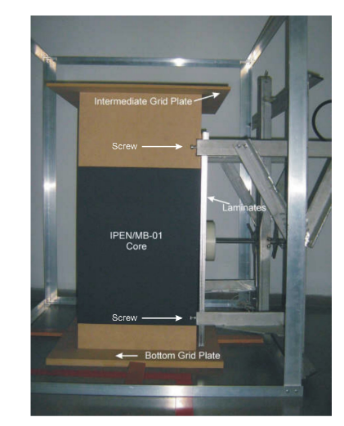
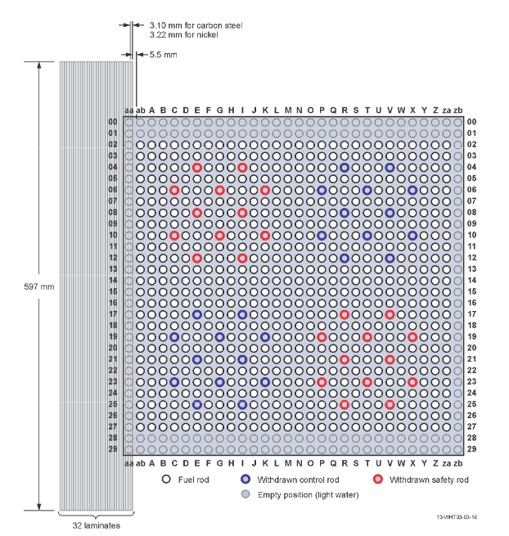
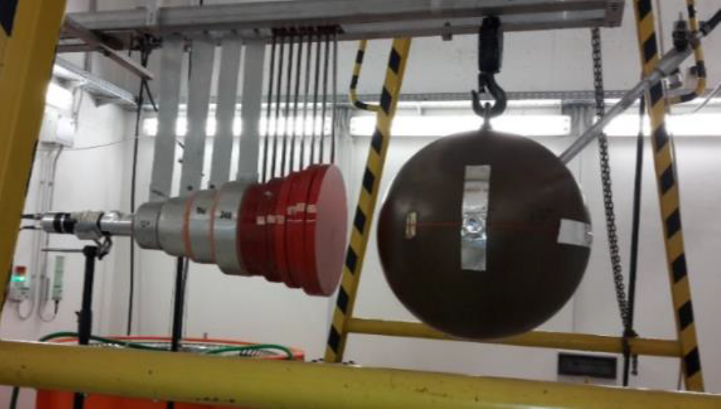
Benchmarking needs
Old or new evaluations are available…
… but are they adequately validated?
Available experiments
Iron and steel: limited
Nickel
IPEN-MB01 (BR)
Leakage experiments at RC Řež (CZ)
²⁵²Cf
Ni reflector
Ni sphere

Slide 10

Benchmarking needs
Old or new evaluations are available…
… but are they adequately validated?
Available experiments
Iron and steel: limited
Nickel: limited
Chromium: none!
But new differential measurements at n_TOF (Preprint available)

Slide 11
Benchmarking needs
Old or new evaluations are available…
… but are they adequately validated?
Available experiments
Iron and steel: limited
Nickel: limited
Chromium: none!
How can we contribute?
?

Slide 12
The HARVEST-X project
Heuristic Assimilation, Reproduction, and Validation of Experiments for stainless STeel Cross sections

Slide 13

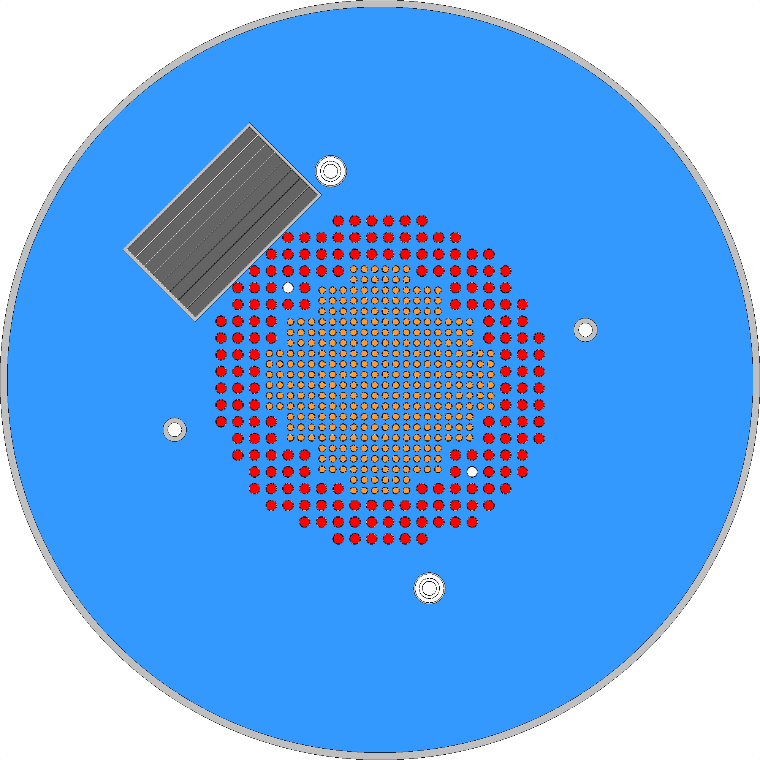
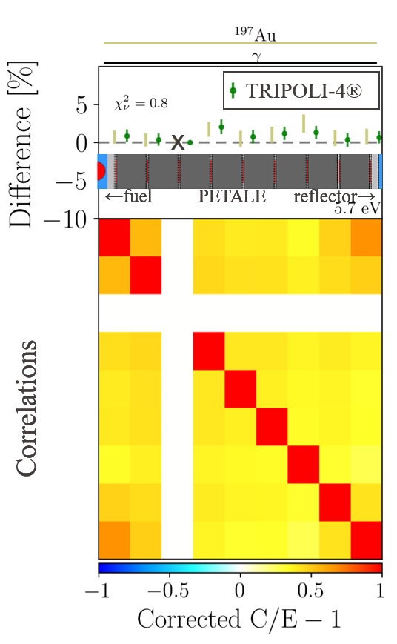
The HARVEST-X project
Foils
Heuristic Assimilation, Reproduction, and Validation of Experiments for stainless STeel Cross sections
Analysis and assimilation of existing experimental data
Results and benchmarking of the PETALE program
Sheet
Metal reflector
30 × 30 × 16
2020

Slide 14
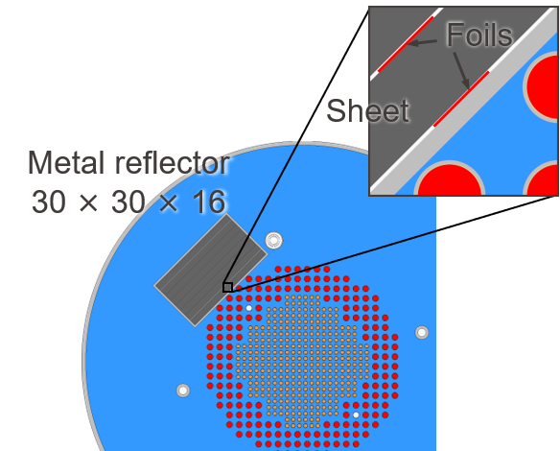
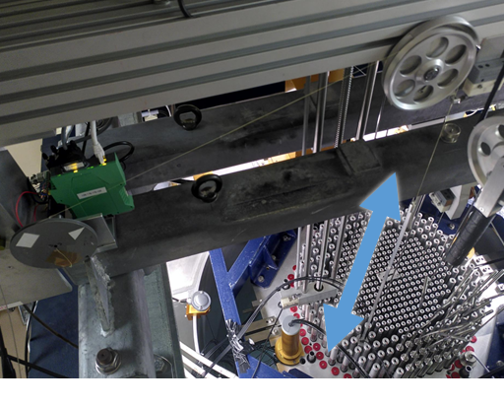
The HARVEST-X project
Heuristic Assimilation, Reproduction, and Validation of Experiments for stainless STeel Cross sections
Analysis and assimilation of existing experimental data
Results and benchmarking of the PETALE program
Production and analysis of new complementary experimental results, allowing to tackle biases
Reproduction with other systems
  Experiments in accelerator facility
  Experiments in reference fields
Reproduction with other methods
  Pile-oscillation experiments in CROCUS: BLOOM
2020
2024

Slide 15
The HARVEST-X project
Heuristic Assimilation, Reproduction, and Validation of Experiments for stainless STeel Cross sections
Analysis and assimilation of existing experimental data
Results and benchmarking of the PETALE program
Production and analysis of new complementary experimental results, allowing to tackle biases
Reproduction with other systems
  Experiments in accelerator facility
  Experiments in reference fields
Reproduction with other methods
  Pile-oscillation experiments in CROCUS: BLOOM
2020
2024

Slide 16
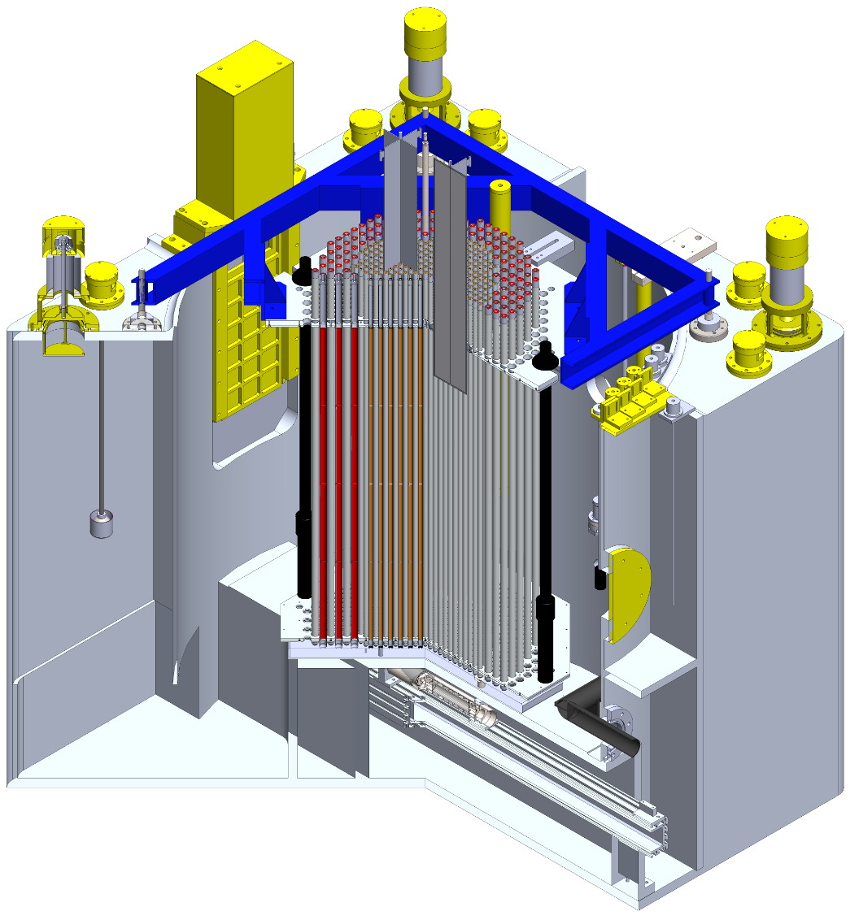
The CROCUS reactor
Reactor type
LWR with partially submerged core
Room T (controlled) and atmospheric P
Forced water flow (160 l.min⁻¹)
Operation
100 W (zero-power reactor)
i.e. maximum 2.5×10⁹ cm⁻².s⁻¹
Control: B₄C rods and spillway
Core
⌀60 cm/100 cm, 2-zone
Inner: 336 UO₂ 1.806 wt% 1.837 cm
Outer: 176 U_{met} 0.947 wt% 2.917 cm

Slide 17

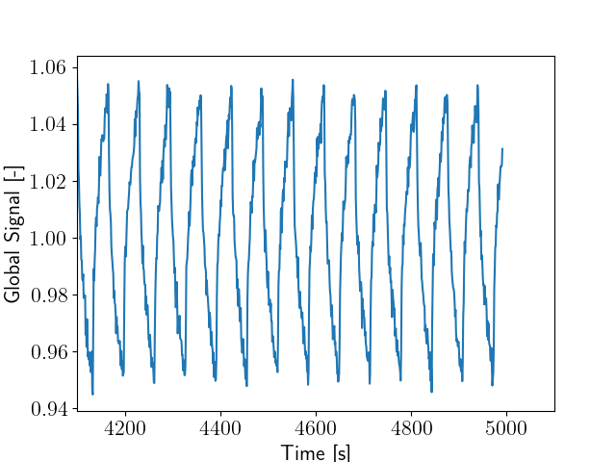
The BLOOM program in CROCUS
Reproduction of PETALE critical experiments
Same materials/system/QoI but different method: pile oscillation (open loop)
Quantities of interest:
  Reactivity worth
M
    Global

Slide 18
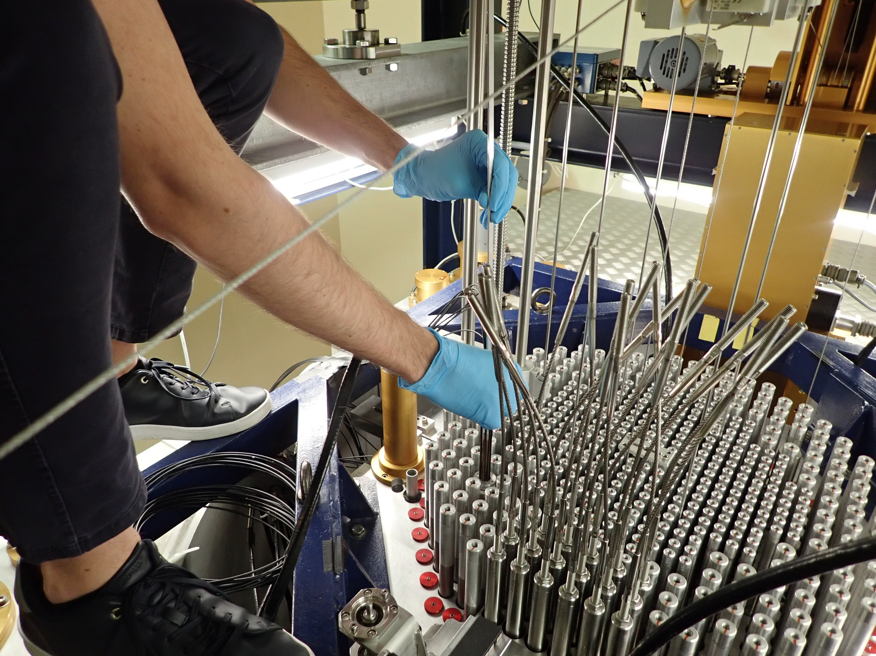
The BLOOM program in CROCUS
Reproduction of PETALE critical experiments
Same materials/system/QoI but different method: pile oscillation (open loop)
Quantities of interest:
  Reactivity worth
    Global → Reactivity

Slide 19
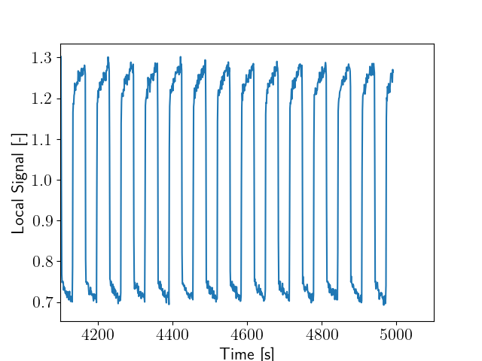
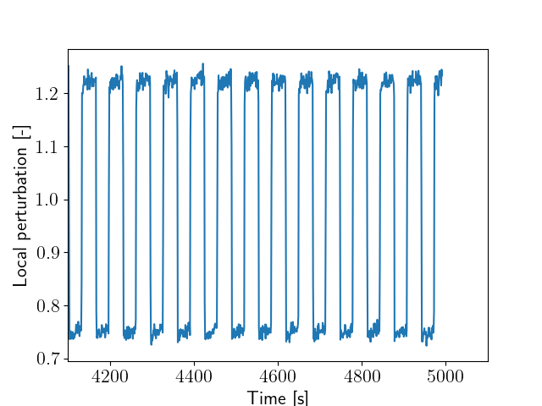
The BLOOM program in CROCUS
Reproduction of PETALE critical experiments
Same materials/system/QoI but different method: pile oscillation (open loop)
Quantities of interest:
  Reactivity worth
  Local flux perturbation
  Sample activation
    - Global
    Global → Reactivity
    Local signal
→
    Local perturbation

Slide 20
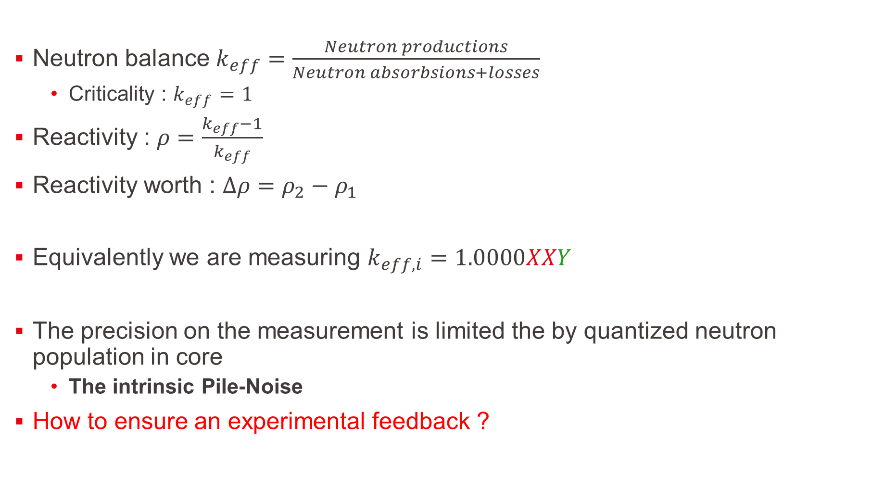
Reactivity 101
Neutron balance $k_{eff}=\frac{Neutron productions}{Neutron absorbsions+losses}$
  Criticality : $k_{eff}=1$
Reactivity : $ρ=\frac{k_{eff}−1}{k_{eff}}$
Reactivity worth : $∆ρ=ρ_{2}−ρ_{1}$
Equivalently we are measuring $k_{eff,i}=1.0000XXY$
The precision on the measurement is limited the by quantized neutron population in core
  The intrinsic Pile-Noise
How to ensure an experimental feedback ?
Aimed effect
Aimed precision

Slide 21


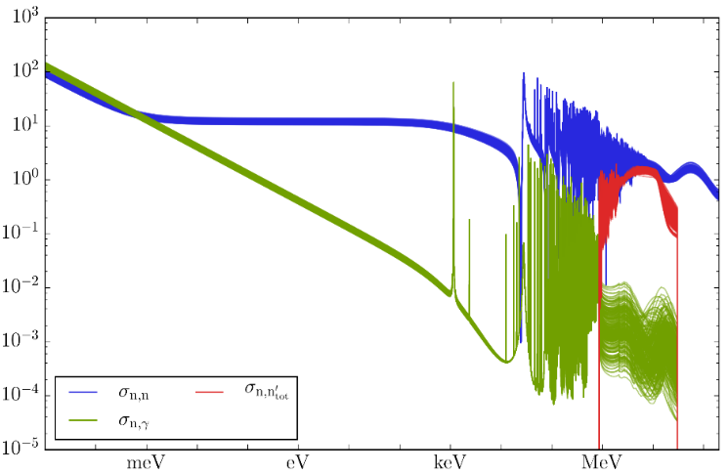

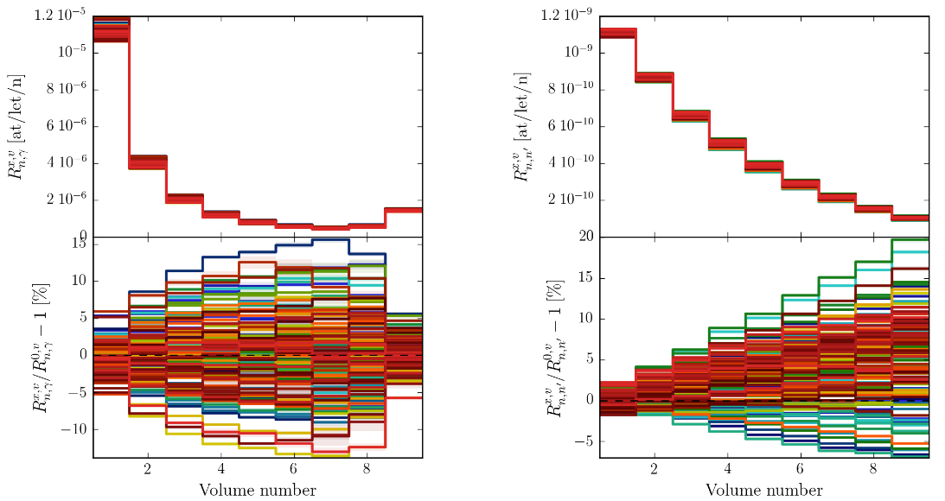
Design by uncertainty propagation
Relating XS uncertainty distribution with measured reaction rates/reactivity worths using Total Monte Carlo and Correlated Sampling^{1,2}
←fuel PETALE reflector→
1.2
1.0
0.8
0.6
0.4
0.2
Reaction rate
(a.u.)
Cross section (barn)
15
10
5
0
-5
-10
Entry
2
4
6
8
Exit
Dosimeter position in the reflector
Variation
(%)
Energy (MeV)
⁵⁶Fe cross sections dispersion in TENDL 2017

Slide 22
Design by uncertainty propagation
Relating XS uncertainty distribution with measured reaction rates using Total Monte Carlo and Correlated Sampling^{1,2}
←fuel PETALE reflector→
1.2
1.0
0.8
0.6
0.4
0.2
Reaction rate
(a.u.)
Cross section (barn)
15
10
5
0
-5
-10
Variation
(%)
2%
✔
Energy (MeV)
Entry
2
4
6
8
Exit
⁵⁶Fe cross sections dispersion in TENDL 2017
Dosimeter position in the reflector
Reaction rate distributions with In(n,γ)
in the iron metal reflector (128 ACE files)

Slide 23
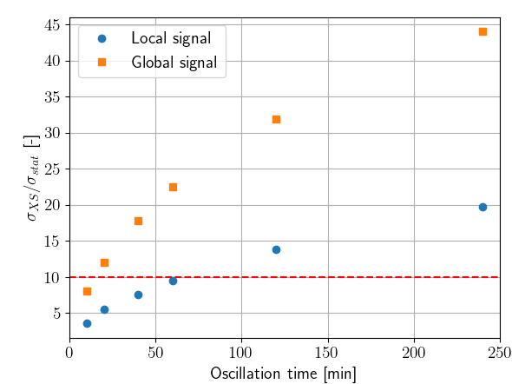
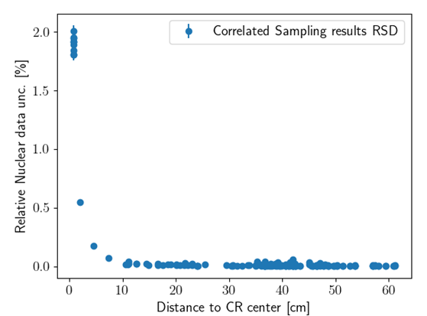
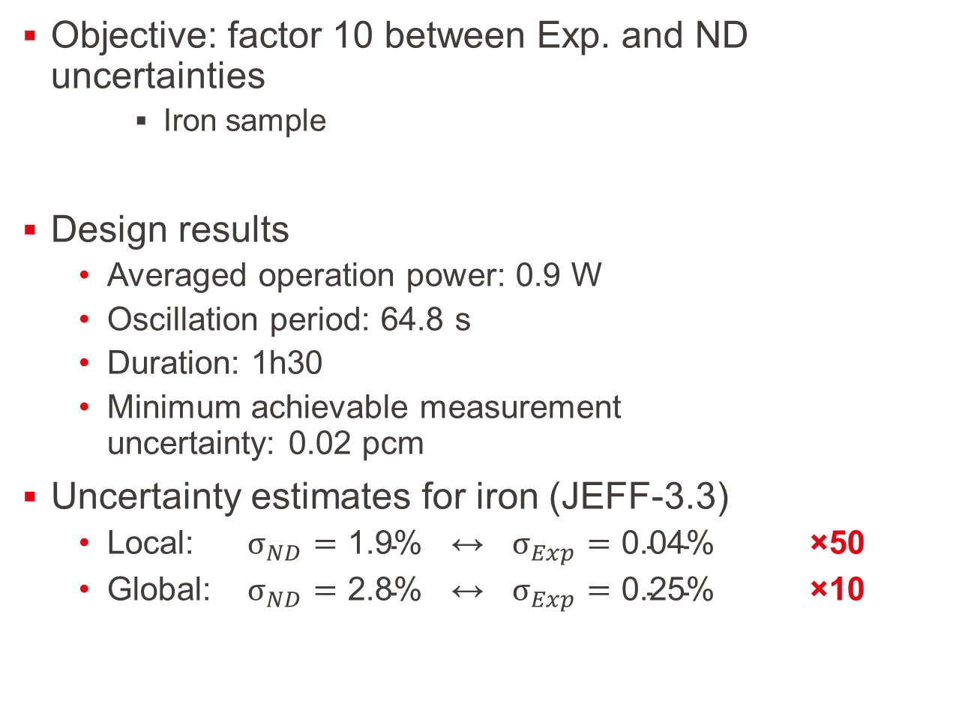
Design by uncertainty propagation
Objective: factor 10 between Exp. and ND uncertainties
    Iron sample
Design results
  Averaged operation power: 0.9 W
  Oscillation period: 64.8 s
  Duration: 1h30
  Minimum achievable measurement
  uncertainty: 0.02 pcm
Uncertainty estimates for iron (JEFF-3.3)
  Local: $σ_{ND}=\text{1.9\%}$ ↔ $σ_{Exp}=\text{0.04\%}$ ×50
  Global: $σ_{ND}=\text{2.8\%}$ ↔ $σ_{Exp}=\text{0.25\%}$ ×10
3 W / ⌀16 mm

Slide 24
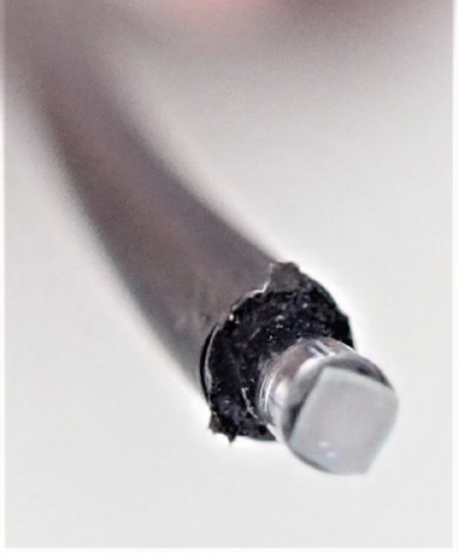
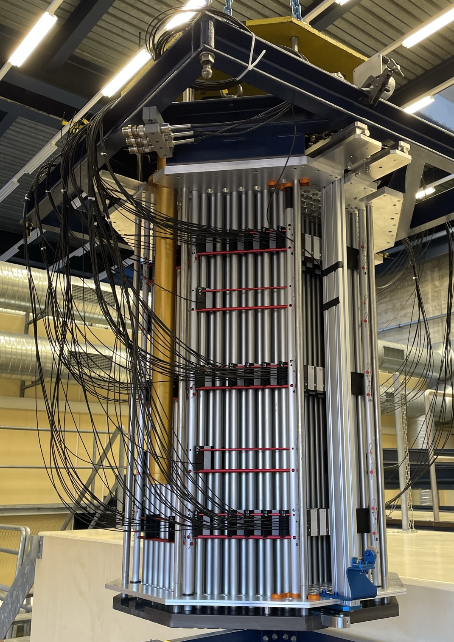
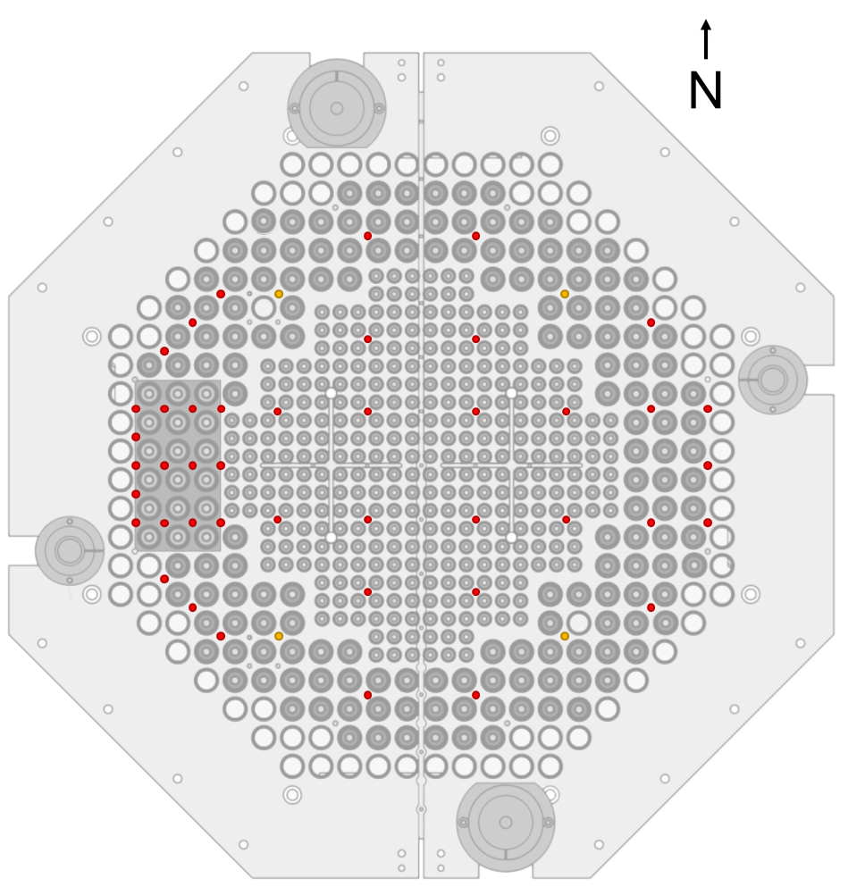
Global and distributed flux: SAFFRON array
3D array of MiMi detectors in CROCUS
Developed by Fanny Vitullo during her PhD
Array of 160 MiMi neutrons detectors
Mapping of the core: 3 main axial layers
~240 kcps/W over many detectors
  Perfect for global signal measurement
  Allows testing the validity of PK assumption
Axial
levels
Oscillation channel
~50 per level
Vitullo, Fanny. Miniature and Minimalistic Neutron Detectors for Online High-Resolution Experiments in the Zero-Power Reactor CROCUS. No. THESIS. EPFL, 2022.

Slide 25
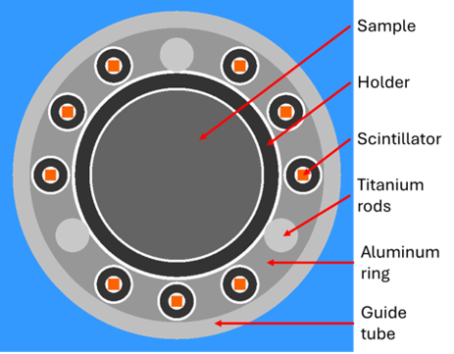
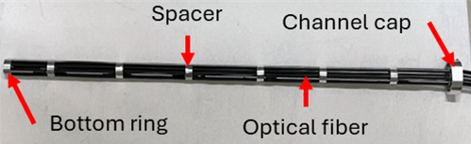
Local flux: instrumented channel
    SAFFRON
    Global & local measurements
Set in the control rod guide tube
  Air filled
Aluminum for rings and holder
  With titanium rods for mechanical stability
Instrumented with a ring of 9 MiMis
  ~25 kcps/W for the local signal
  At 2.1 mm from sample surface
  Placed at core mid-height
Sample diameter up to 10.25 mm
  Possibly up to 12 mm without a holder

Slide 26
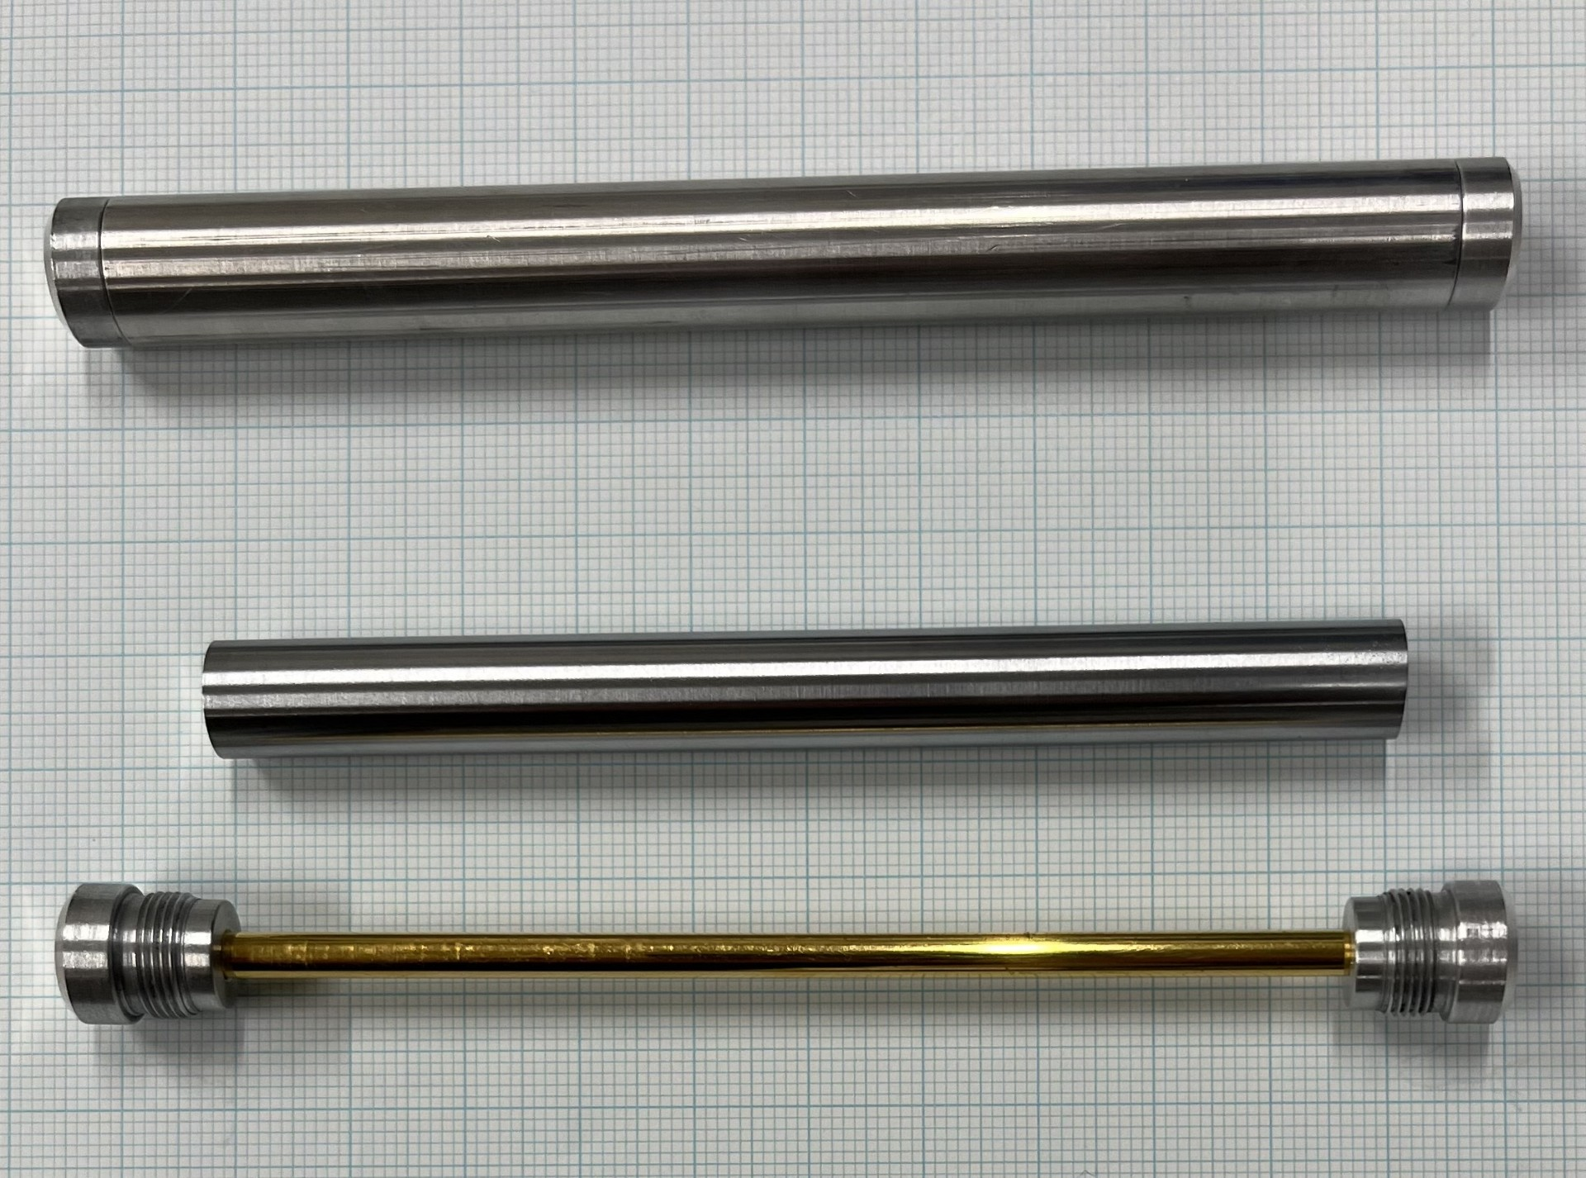
Studied materials: stainless steel & more
Focus on stainless-steel related samples
Reuse of PETALE spares for main components
  Fe, Ni, Cr, 304L
Additional minor alloying elements
  C, Mn, Mo, Nb, Si, V, Zn
Exotic alloying elements and other materials
of interest
  Al, Cu, Ta, Ti, W, Y
  304, 316, Incoloy-800, Incoloy-718
Reference materials
  Au, D₂O, H₂O, ⁶Li (solution), ¹⁰B (solution)
Totaling 25 materials and 40 samples
Holder
Au
Cr

Slide 27
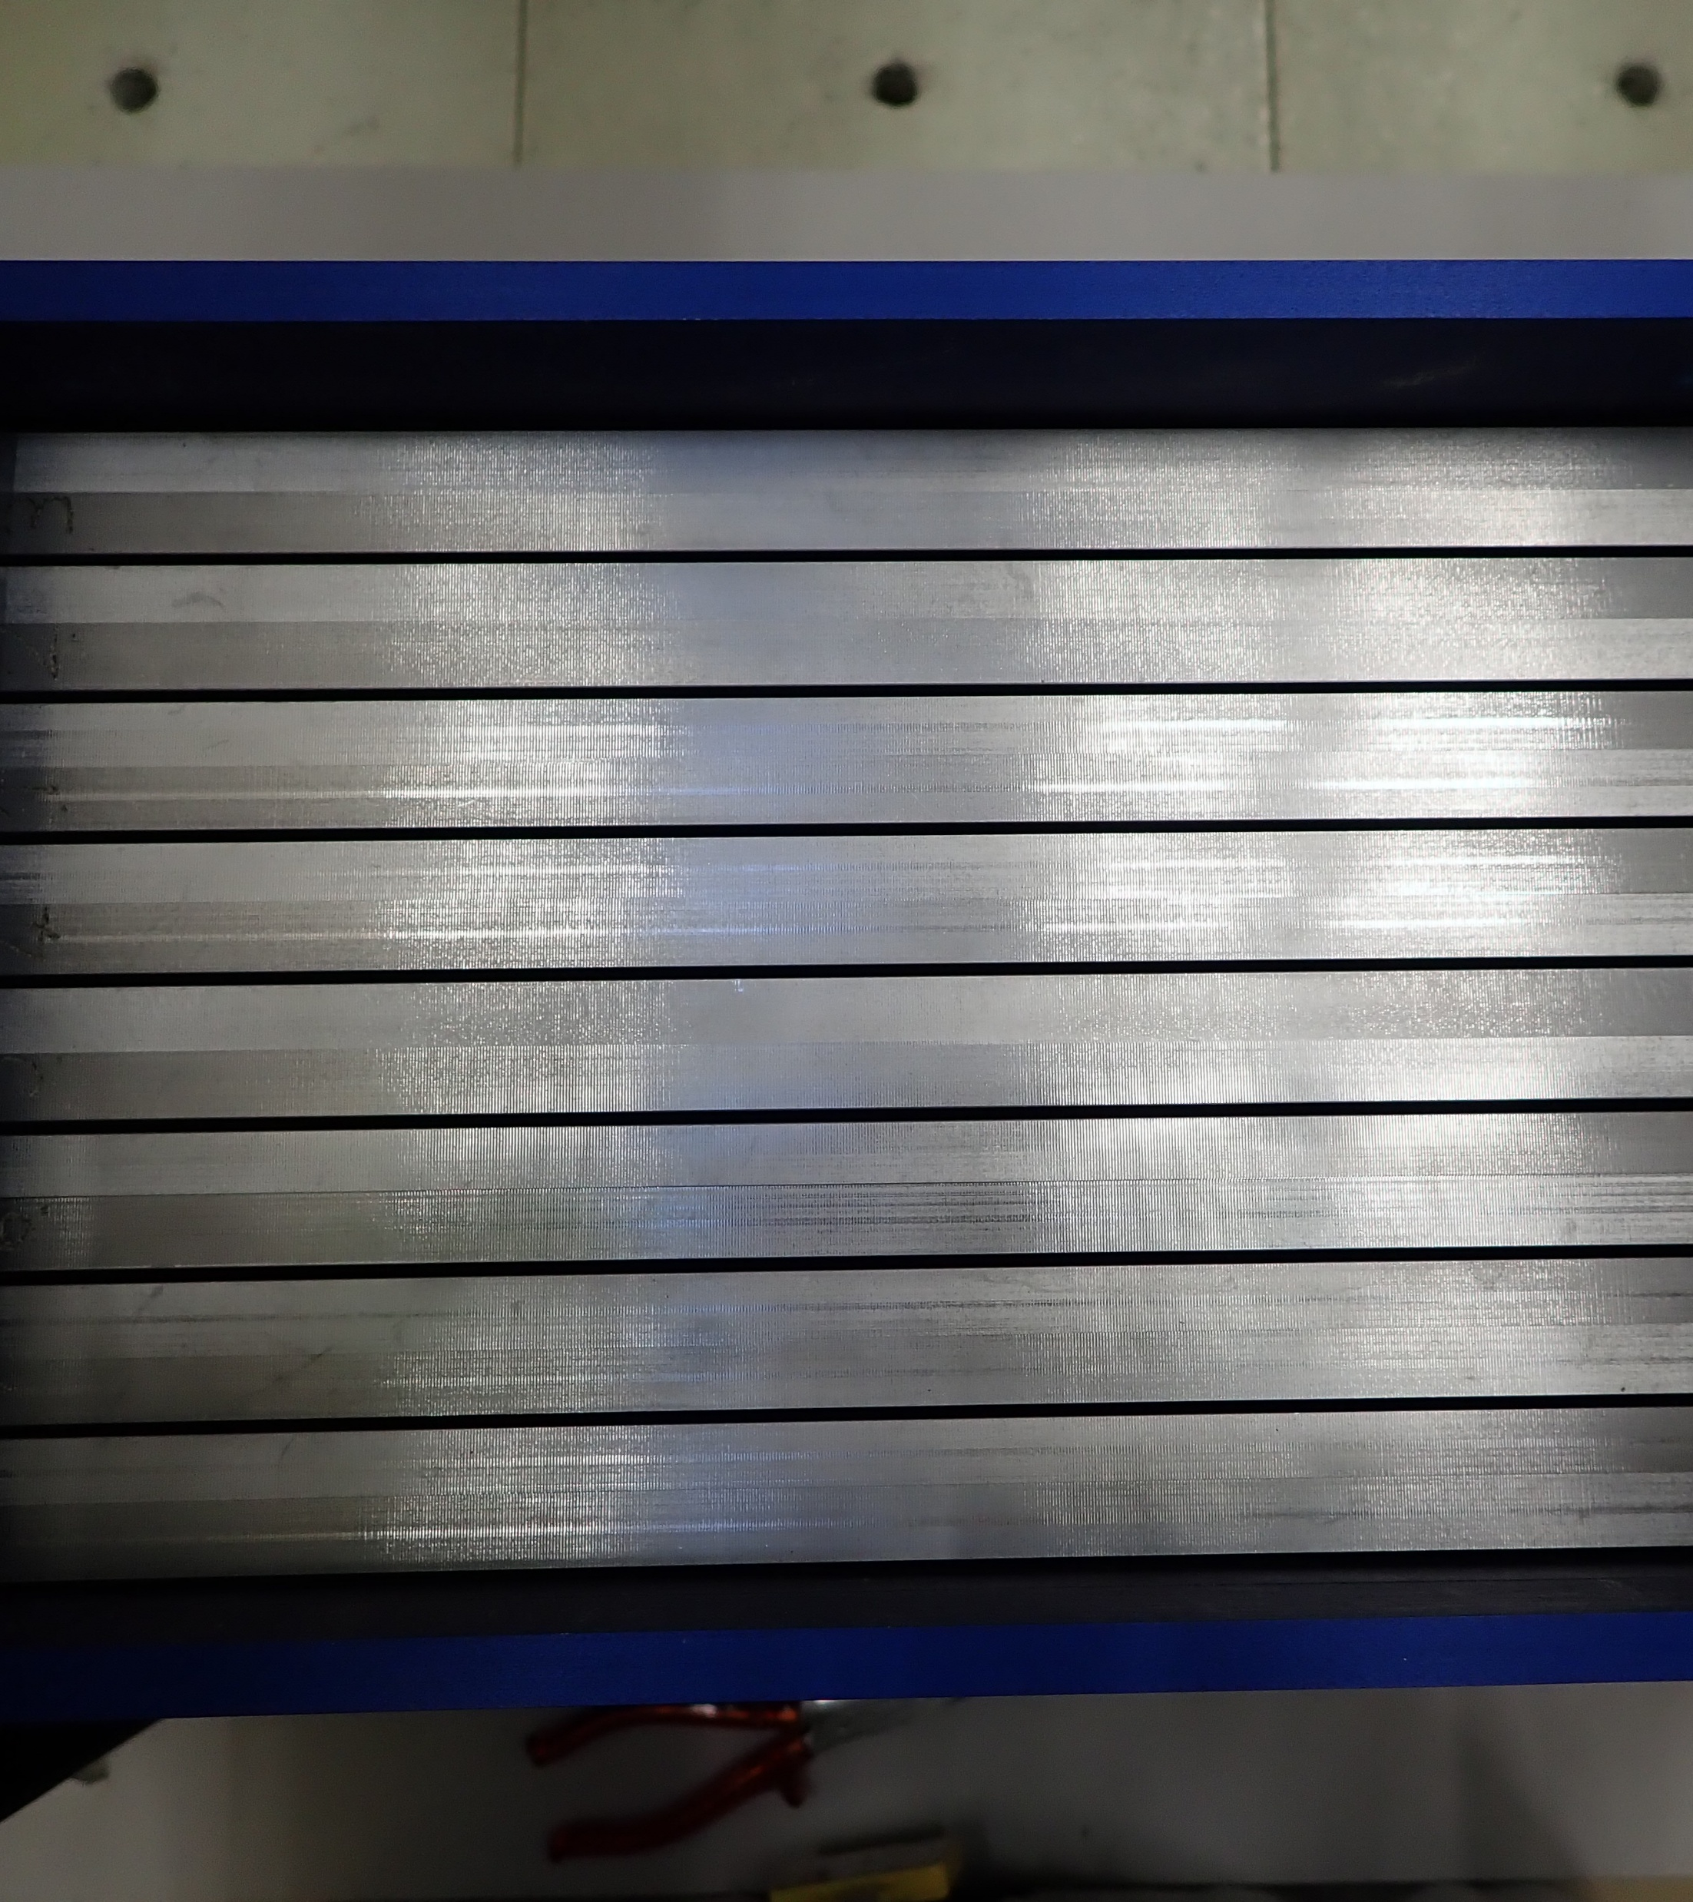
Plan
HARVEST-X
  Motivation
  PETALE
  BLOOM
Validation Results for Steel
  Nickel
  Chromium
  Iron
  304L
  BLOOM Additional Results
Conclusion and Outlook

Slide 28
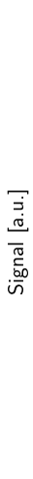
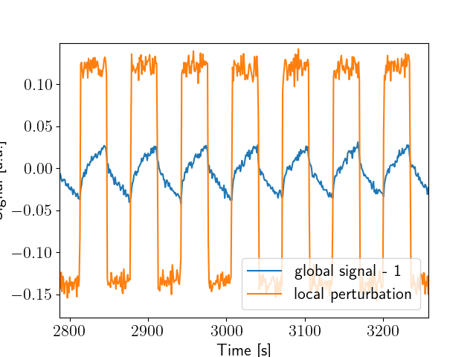
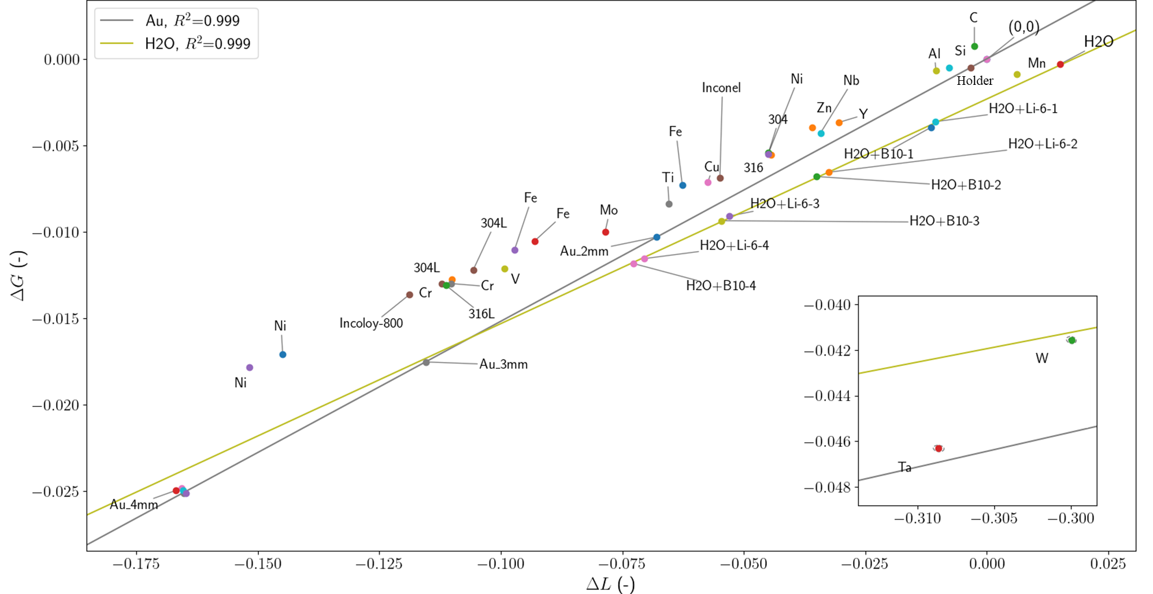
Global vs. Local
45 experiments
  1h30 of oscillation at ~0.9 W each
  Mostly absorbers
Global perturbation amplitude ΔG vs. local one ΔL
25 materials
40 samples

Slide 29
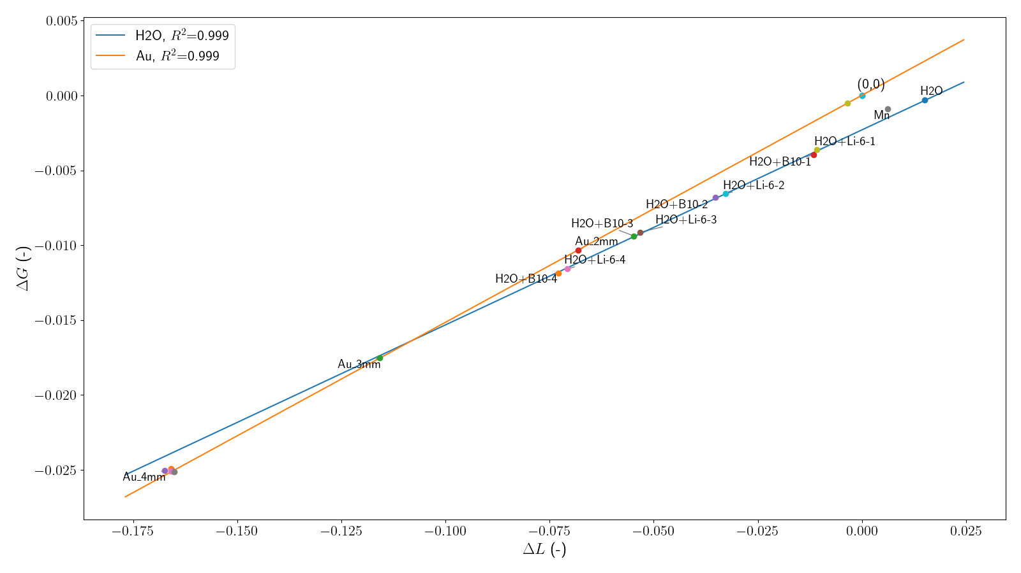
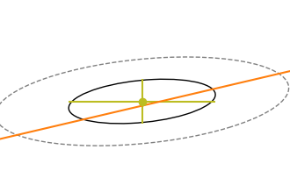
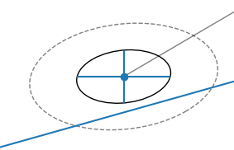
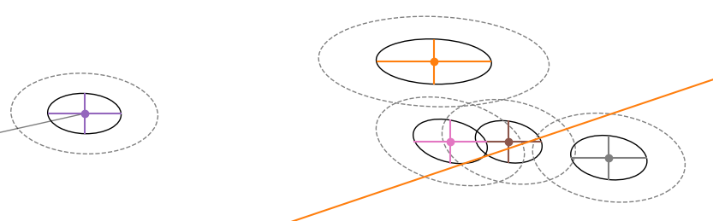
Proportionality for H₂0 and Au references
Reproduction of past reference experiments
A Linear relationship is observed between the perturbation
  8 samples with different concentrations of ¹⁰B or ⁶Li
  3 gold samples with different diameters
Method
Validated

Slide 30
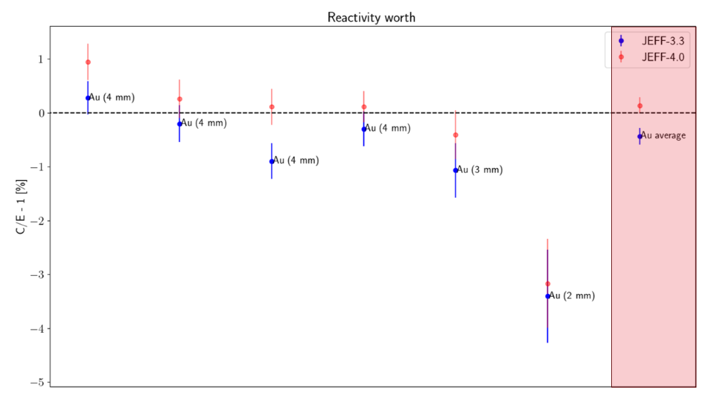
C/E for Au references
Reactivity worth
Already good
Improved with JEFF-4.0
Uncertainties
Simulation : 0.04 pcm
Experimental : 0.02 pcm

Slide 31
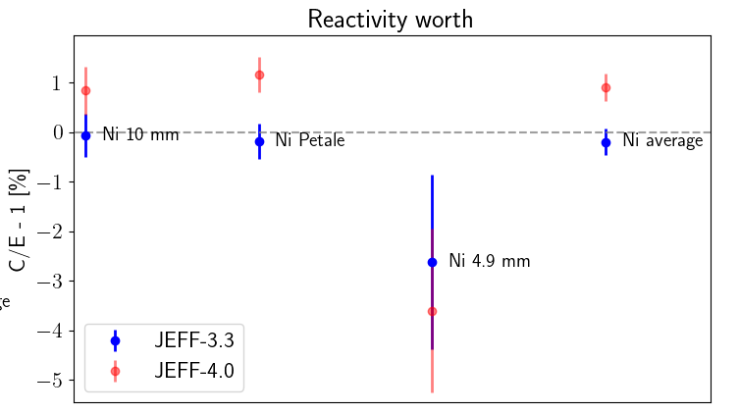
From JEFF-3.3 to JEFF-4.0: Ni
C/E for nickel pile-oscillation experiments
Nickel C/E degrades
  C/E Increase of +1 %
  From agreement to disagreements
    JEFF-4.0 ~3.5 sigma away
  Degradation of Ni was also observed with PETALE non-threshold
Ni

Slide 32
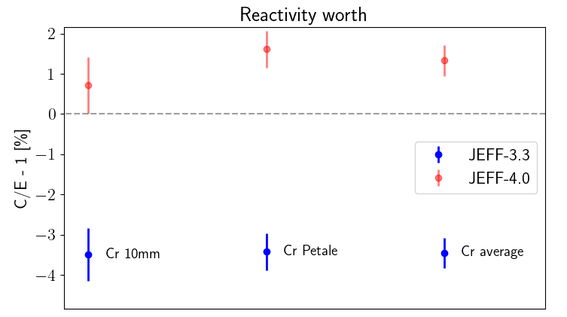
From JEFF-3.3 to JEFF-4.0: Cr
C/E for chromium pile-oscillation experiments
Clear improvement of the C/Es
  From -3.5 % to +1.3 %
  Still ~ 3.5 sigma distance from
  experiments with JEFF-4.0
    Better than the previous 9 sigma
  Unlike PETALE results
    Degradation of non-threshold
    dosimeters
Ni
Cr

Slide 33
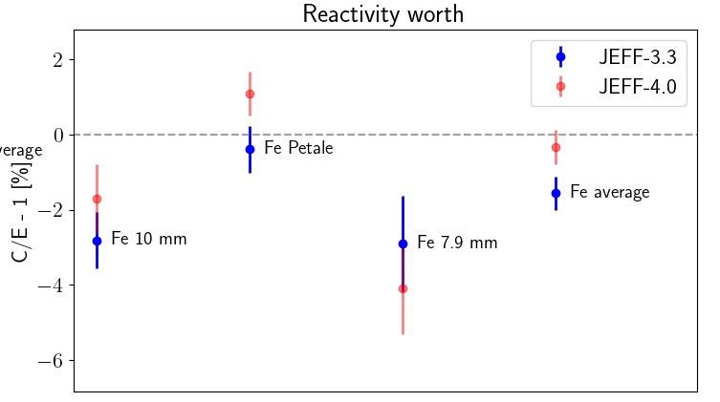
From JEFF-3.3 to JEFF-4.0: Fe
C/E for iron pile-oscillation experiments
Significant improvement
  JEFF-3.3 results at >3σ from 0
  Close to JEFF-3.1.1 in MAESTRO
    0.3 ± 1.2 %*
  Smaller uncertainties needed (sim.)
*Gilles NOGUERE, private communication
Ni
Cr
Fe

Slide 34
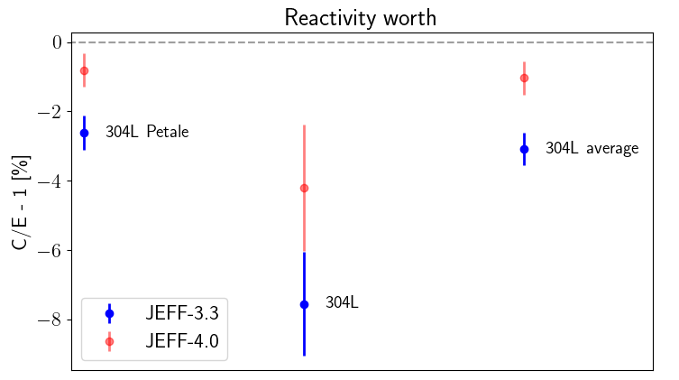
From JEFF-3.3 to JEFF-4.0: 304L
C/E for 304L pile-oscillation experiments
Clear improvement of C/Es
  Rightfully driven by Fe,…
  …by Cr (probably too much)…
  …and wrongfully by the Ni
  End results close to the iron results
Ni
Cr
Fe
304L

Slide 35
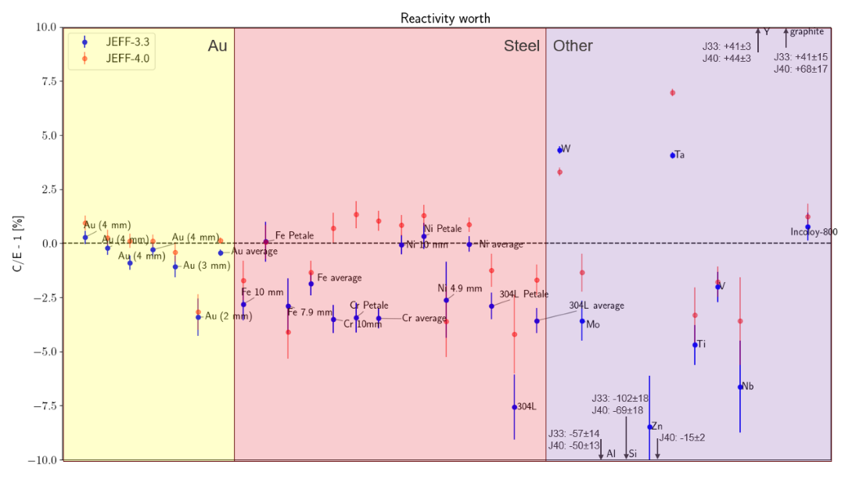

BLOOM Library Comparison Results
Δρ: 0.2 to 24 pcm
Constant uncertainties
  Regardless of the sample
Clear Improvements:
  W
  Mo
Small improvement:
  Si
Clear degradation:
  Ta
  Zn

Slide 36
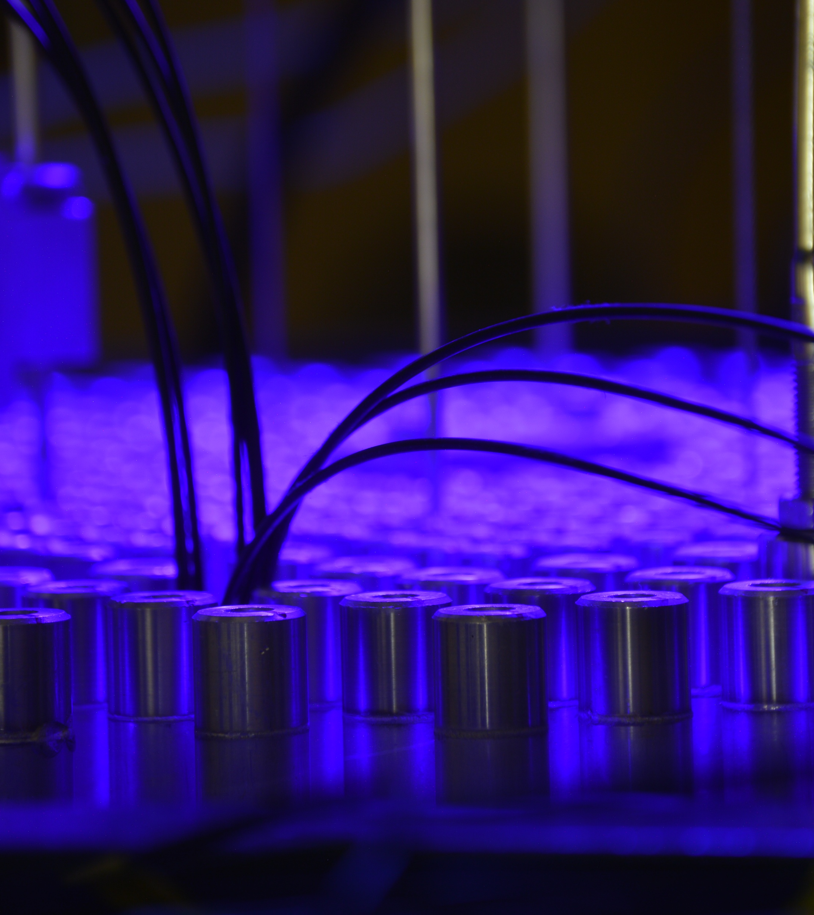
Plan
HARVEST-X
  Motivation
  PETALE
  BLOOM
Validation Results for Steel
  Nickel
  Chromium
  Iron
  304L
  BLOOM Additional Results
Conclusion and Outlook

Slide 37
Conclusion: Experimental Programs
Design and Conduction of 45 experiments
  25 materials
Modeling and simulation of 30 experiments performed
  With two libraries JEFF-3.3 and -4.0
  Using a Black Body Exact Perturbation method
First analysis performed, with first feedback on nuclear data
  Slight improvement for the iron samples
  Chromium C/Es are improving in BLOOM reactivity worth results
    From -3.5% to +1.3%
  Nickel are degrading
    +1% in reactivity worth
    Potential issue for Ni based alloys
Side note : both Cr and Ni showed degraded results in the PETALE program

Slide 38
Outlook: Experimental Programs
Finalization of analysis and Benchmarking
  Proposal approved and grant received
  Different parts to be included in ICSBEP and IRPhE
Developments for the use of local signals
  Higher sensitivity and feedback prospect
  Some simulation development to be performed
Expansion of the program to non-structural material, e.g., fissile samples
  Feedback on isotopes of the high-priority list
  Test data for highly needed materials, e.g., HALEU, using only small quantities!

Slide 39
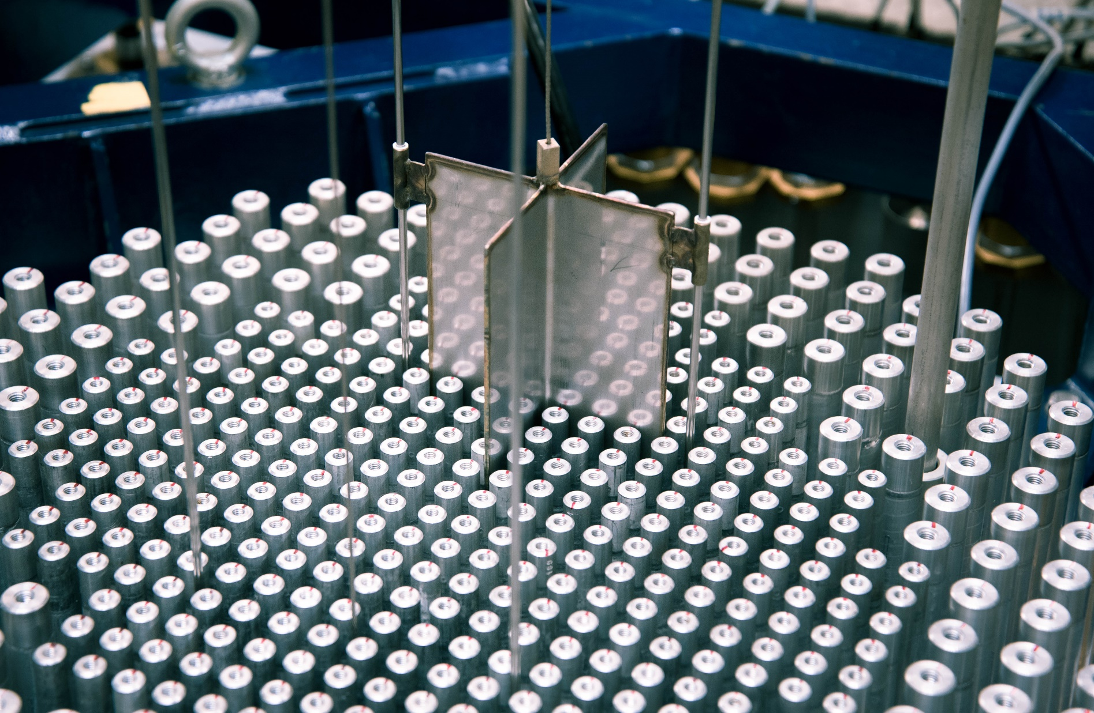
Merci!
Thomas Ligonnet
LPC Seminar
Caen, France
© Maxime Filliau

Slide 40
Representativity of HARVEST-X
Are these experiments representative?
Short answer: No!
But do we need a good representativity?
Long answer: it depends ☺
?
* V. Lamirand et al., “Design of separated element reflector experiments in CROCUS: PETALE,” React. Dosim. 16th Int. Symp. ASTM STP1608, p. 7, 2018.
V. Lamirand, T. Ligonnet, A. Laureau, A. Vasiliev, A. Pautz, “Harvest-X – Heuristic Assimilation…” SNSF proposal, 2022.
A. Vasiliev et al., “Assessment of representativity of the PETALE experiments for validation of…,” EPJ Web Conf., vol. 239, p. 22001, Sep. 2020.

Slide 41

Is this design representative of anything ?
Once again: No!
4 cm in reflector/RPV spectra

Slide 42
Is this design representative of anything ?
Once again: No!
Difficult to achieve in CROCUS
  Ambient temperature
  Low enrichment
  Strongly moderated (MTFR: 2.5)
Representativity of PETALE
  Study by A. Vasiliev
  Best case: 69% (¹¹⁵In(n,n’) dos.)
  Most of them: ≤ 60%
Again, do we need a good representativity for these experiments?
A. Vasiliev et al., “Assessment of representativity of the PETALE experiments for validation of Swiss LWRs ex-core dosimetry calculations,” EPJ Web Conf. 239, 22001, EDP Sciences (2020);

Slide 43
Do we need representativity?
Representativity ↔ application-oriented
PETALE is not representative…
… but it can contribute indirectly
How to ensure we are useful?
By designing through uncertainty propagation!

Slide 44

PETALE analysis method
Analysis with an in-house methodology
Simulation with a Serpent2 custom solver
  High-resolution model
  CEA worked in parallel with Tripoli-4®

Slide 45

Black body exact perturbation
Derived from the exact perturbation theory¹
Reactivity worth of a sample against a perfect absorber (black body)
Calculation with Serpent in 2 parts
Generation of sources with a black body
  Only done once
  Material set as “outside”
  Surface Tracking only!
  Outputs:
    Fission source
    All neutrons entering the black body (>1M)
    W The sum of their weight
    k_{BB} the simulation k-effective
    N the total number of histories
1
1. G. Truchet, P. Leconte. Small sample reactivity worths calculation exact perturbation theory and Monte Carlo transport. M&C2019, Aug 2019, Portland, United States.

Slide 46

Black body exact perturbation
Derived from the exact perturbation theory
Reactivity worth of a sample against a perfect absorber (black body)
Calculation with Serpent in 2 parts
Generation of sources with a black body
  Common to all samples
K-eigenvalue simulations with the sample
  One simulation A with the black body record as the initial source
  One simulation B with the black body fission source as the initial source
  Record the cycle-wise k_{eff} of all cycles
  30 cycles
  > 5M neutrons per cycle (5 times the source)
1
2.A
2.B

Slide 47


Black body exact perturbation
Derived from the exact perturbation theory
Reactivity worth of a sample against a perfect absorber (black body)
Sample reactivity worth:
  Difference with a sample of air
    Common to all cases
Uncertainties by repetition with different seeds
  64 instances
  ~0.05 pcm on the reactivity worth
$${∆ρ}_{S−BB}=\frac{W\prod_{i=1}^{30}{k_{eff,i}^{A}}}{Nk_{BB}\prod_{i=1}^{30}{k_{eff,i}^{B}}}$$
$${∆ρ}_{S−Air}={∆ρ}_{S−BB}−{∆ρ}_{Air−BB}$$

Slide 48
Verification against the standard method
$${∆ρ}_{S−BB}=\frac{W\prod_{i=1}^{30}{k_{eff,i}^{A}}}{Nk_{BB}\prod_{i=1}^{30}{k_{eff,i}^{B}}}$$
Reactivity worth iron sample JEFF-3.3
  k-eigenvalue: 5.6±0.5 ppm
    Week-long simulations
  BBEP: 5.45±0.05 ppm
    ~25 h each reactor configuration
$${∆ρ}_{S−Air}={∆ρ}_{S−BB}−{∆ρ}_{Air−BB}$$

Slide 49


Model profile BLOOM

Slide 50


Pile-noise
Other name for Reactor/Neutron noise
Type of shot-noise (Poisson noise)
  Finite amount of neutron/fission produced
    During a measurement
  Analogy to diodes
Main assumption
  The neutron population evolution is negligeable
  No external source
Intrinsic variance of reactivity measurement
$$〈{\left|S_{0}\right|}^{2}〉=2\sum_{i}{{q_{i}}^{2}R_{i}}$$
$$〈{\left|S_{0}\right|}^{2}〉=2\frac{n}{l}\overline{ν}D_{v}$$
$$S_{ρ}=\frac{n}{l}ρ$$
$$〈{\left|ρ\right|}^{2}〉=2\frac{l}{n}\overline{ν}D_{v}$$
$$σ_{ρ}^{ }=\sqrt{\frac{2D_{v}}{fT}}$$

Slide 51


Pile-noise
Other name for Reactor/Neutron noise
Type of shot-noise (Poisson noise)
  Finite amount of neutron/fission produced
    During a measurement
  Analogy to diodes
Main assumption
  The neutron population evolution is negligeable
  No external source
Intrinsic variance of reactivity measurement
$$\frac{dn}{dt}=\frac{ρ−β}{l}n+λC+S$$
$$\frac{dδn}{dt}=\frac{n_{0}}{l}δρ−\frac{β}{l}δn+λδC$$
$$S_{ρ}=\frac{n}{l}ρ$$
$$〈{\left|ρ\right|}^{2}〉=2\frac{l}{n}\overline{ν}D_{v}$$
$$σ_{ρ}^{ }=\sqrt{\frac{2D_{v}}{fT}}$$

Slide 52


Neutron balance equation
$$\frac{1}{v}\frac{∂}{∂t}Φ\left(r,t\right)−D∆Φ\left(r,t\right)+\left(Σ_{a}−\left(1−β\right){νΣ}_{f}\right)Φ\left(r,t\right)−λC(r,t)=0$$
$$\frac{∂}{∂t}C\left(r,t\right)=β{νΣ}_{f}Φ\left(r,t\right)−λC\left(r,t\right)$$

Slide 53



Local and global Litterature ver.
$$\frac{\tilde{δn}\left(r,ω\right)}{n_{0}}=\frac{\tilde{δn_{a}}\left(r,ω\right)}{n_{0}}+\frac{\tilde{δn_{f}}\left(r,ω\right)}{n_{0}}$$
Assume
$$\frac{\tilde{δn}\left(r,ω\right)}{n_{0}}={\tilde{δΣ}}_{a}\left(s\right)H_{a}\left(r,ω\right)+\overline{ν}{\tilde{δΣ}}_{f}\left(s\right)H_{f}\left(r,ω\right)$$
and
$$\left\{\begin{aligned}&H_{a}\left(r,ω\right)=AH\left(ω\right)+a\left(r\right) \\ &H_{f}\left(r,ω\right)=BH\left(ω\right)+b\left(r\right)\end{aligned}\right.$$
Assume
$$\frac{\tilde{δn}\left(r,ω\right)}{n_{0}}=\underset{GLOBAL}{\underbrace{\left.{\left(A\tilde{δΣ}\right.}_{a}\left(ω\right)+B\overline{ν}{\tilde{δΣ}}_{f}\left(ω\right)\right)H\left(ω\right)}}+\underset{LOCAL}{\underbrace{{a\left(r\right)\tilde{δΣ}}_{a}\left(ω\right)+b\left(r\right)\overline{ν}{\tilde{δΣ}}_{f}\left(ω\right)}}$$
Then

Slide 54

MiMi detectors
Miniature & Minimalistic neutron scintillators
Developed by Fanny Vitullo during her PhD thesis
ZnS(Ag):⁶LiF scintillator
Light collection with optical fibres and SiPMs
Miniature size: 0.66 mm sides/0.225 thickness
In-house FPGA firmware for neutron counting
3.37 kcps/W at mid-height of the CR guide tube
Vitullo, Fanny, et al. Developing and testing a miniature fiber-coupled scintillator for in-core neutron counting in CROCUS. EPJ Web of Conferences. Vol. 225. EDP Sciences, 2020.
Vitullo, Fanny. Miniature and Minimalistic Neutron Detectors for Online High-Resolution Experiments in the Zero-Power Reactor CROCUS. No. THESIS. EPFL, 2022.
Vitullo, Fanny, et al. Design of a 150-miniature detectors 3D core-mapping system for the CROCUS reactor. EPJ Web of Conferences. Vol. 253. EDP Sciences, 2021.

Slide 55



Point kinetics testing
Channel
fiber 96
Flux redistribution verification:
Would imply a correction factor for global
Computation of the spectral power ratio¹
  Using 1st harmonic of CPSD
  Comparison with core center fiber nº 96
$${SPR}_{i,77}≡\frac{\sqrt{P_{i,i}}}{\sqrt{P_{77,77}}}=\frac{1}{M}\sum_{j}^{M}{\frac{P_{i,j}}{P_{j,77}}}$$
Local amplitude effect clearly visible
  Dissipate at 15 cm
No significant flux redistribution
No correction required!
1, Ambrožič, Klemen, et al. "CORTEX experiments, Part II: Postprocessing of neutron noise time series to determine reliable mean and uncertainties." Annals of Nuclear Energy 208 (2024): 110704.

Slide 57

Angular distribution the ΔL
7
6
8
5
Angular distribution of the local detectors observed
SPRs significantly different
Measured with the gold sample
Highly correlated uncertainties
  ~ 95%
Flux gradient in the channel was already measured
Further investigation would be interesting while treating local signals in more details
9
4
1
3
2
2
4
7
8

Slide 58

Reference MAESTRO
B. Geslot, et al. "Innovative Hybrid Pile Oscillator Technique in the Minerve Reactor: Open Loop Versus Closed Loop," in IEEE Transactions on Nuclear Science, doi: 10.1109/TNS.2018.2874690.

Slide 59

Au
Steel
Other
J33: +41±3
J40: +44±3
J33: +41±15
J40: +68±17
J33: -102±18
J40: -69±18
J33: -57±14
J40: -50±13
J40: -15±2

Slide 60


