Slide 1
Understanding SPIDER ASIC
Anna-Lena Alfke
08.06.2026-20.07.2026
Supervised by Vincent Tisserand

Slide 2
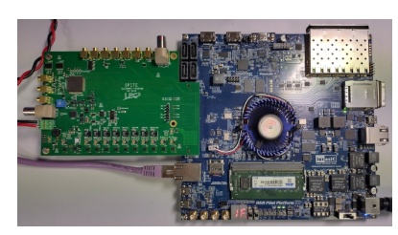
SPIDER ASIC
SPIDER = Swift Pipelined Digitizer
Waveform time-to-digital converter (WTDC) + digital constant fraction discriminator (CFD)
8 channels
  Each channel with 8 banks with 32 sample-cells
  Each channel has discriminator that self triggers acquisition
Event during trigger window → freezes content of current bank → available for conversion + switch to next bank
Capture, conversion & extraction occur in parallel in the 8 banks
  → process high rate of events (theoretically 50% occupancy)
SPIDER v0:
  2 self triggering channel
  Design similar to final specifications
  Simplified readout interface

Slide 3
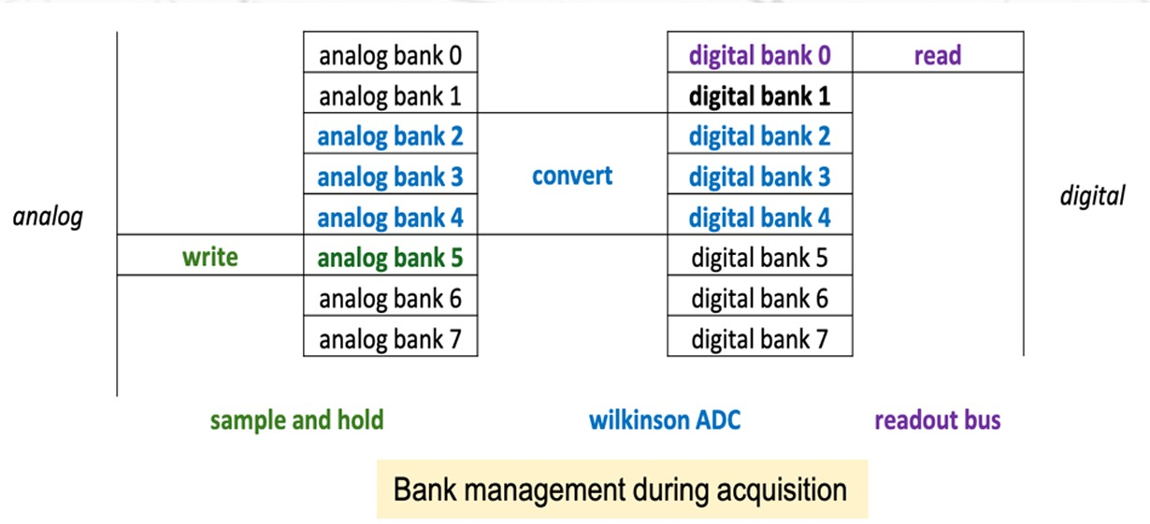

Slide 4
Understanding the Code

Slide 5
Data Flow
Raw SPIDER Data (*.txt)
↓
[spider_decoder.py]
↓
Decoded Ntuples (ntuples/*.root)
↓
[analyse.py]
↓
Analysis Results (analysis/*.root)
↓
[Plotting/Visualization]

Slide 6
analyse.py
ROOT file (run)
↓
TTree access
↓
loop over entries
↓
loop over channels
↓
apply cuts
↓
extract quantities:
├── amplitude
├── baseline
├── cfd_time
├── adc waveforms
↓
fill histograms / arrays
↓
fit distributions
↓
write ROOT outputs
Analyses already reconstructed root ntuples and creates
  Average waveform per channel
  amplitude and baseline distributions & slew rate
  time resolution via ΔCFD between the channels
  Fit results (gaussian fits)
  cut based studies (config & user cuts)
Run-by-run analysis of root ntuples
Saves results to ROOT files in the analysis directory

Slide 7
Closer look to output_run1.root ch0=mcp1 ch1=mcp2

Slide 8
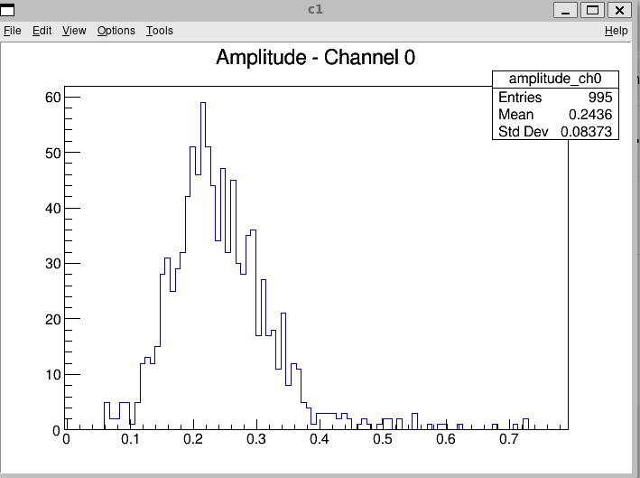
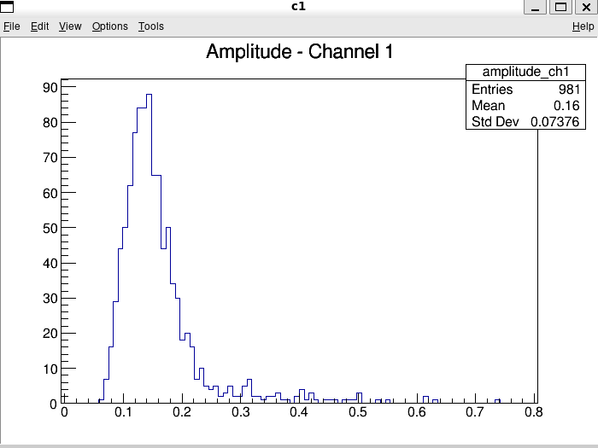
amplitude_ch0 & amplitude_ch1 (TH1F)
Histogram of the signal strength
counts
Measured amplitude

Slide 9
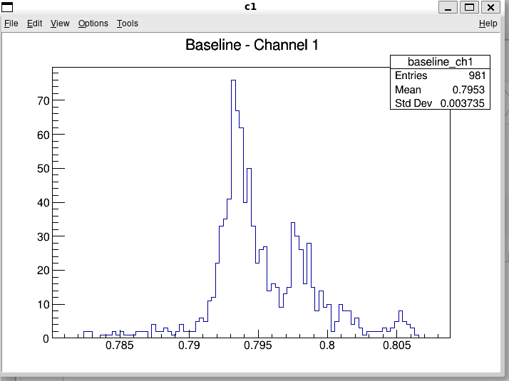
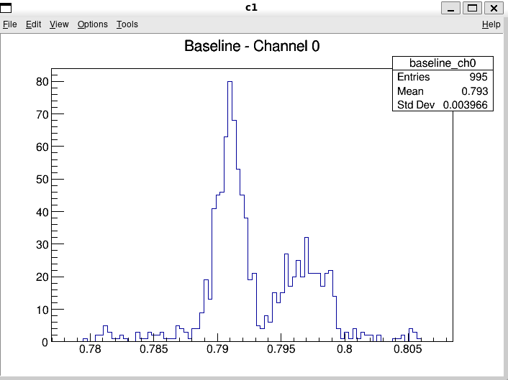
baseline_ch0 & baseline_ch1 (TH1F)
Background noise/offset
Good data = small baseline distribution
counts
Measured baseline

Slide 10
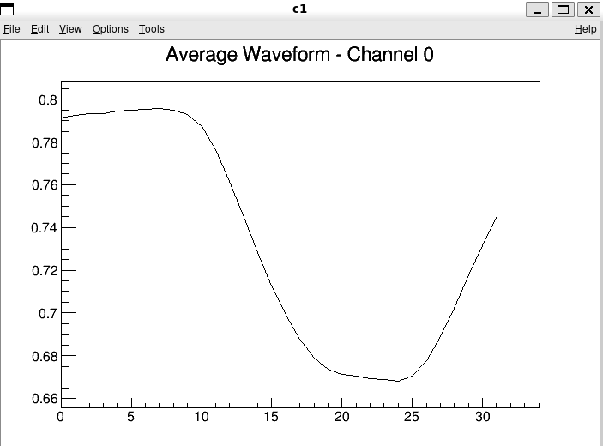
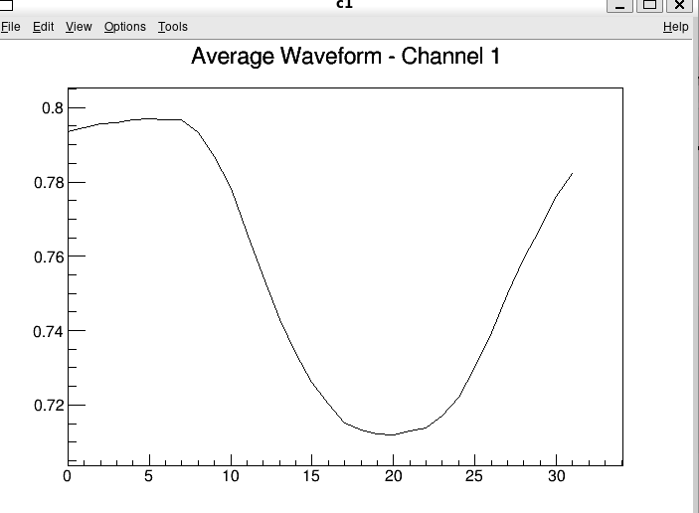
avg_waveform_ch0 & avg_waveform_ch1 (TGraph)
Average waveform per channel
Measured voltage/ADC values
time

Slide 11
avg_waveforms (TTree)
******************************************************************************
*Tree :avg_waveforms: Average waveforms per channel *
*Entries : 2 : Total = 2544 bytes File Size = 1226 *
* : : Tree compression factor = 1.00 *
******************************************************************************
*Br 0 :channel : channel/I *
*Entries : 2 : Total Size= 584 bytes File Size = 91 *
*Baskets : 1 : Basket Size= 32000 bytes Compression= 1.00 *
*............................................................................*
*Br 1 :n_samples : n_samples/I *
*Entries : 2 : Total Size= 594 bytes File Size = 93 *
*Baskets : 1 : Basket Size= 32000 bytes Compression= 1.00 *
*............................................................................*
*Br 2 :waveform : vector<float> *
*Entries : 2 : Total Size= 877 bytes File Size = 376 *
*Baskets : 1 : Basket Size= 32000 bytes Compression= 1.00 *
*............................................................................*

Slide 12
cfd_summary (TTree)
******************************************************************************
*Tree :cfd_summary: Summary of CFD time fits *
*Entries : 1 : Total = 4436 bytes File Size = 1439 *
* : : Tree compression factor = 1.00 *
******************************************************************************
*Br 0 :ch1 : ch1/I *
*Entries : 1 : Total Size= 558 bytes File Size = 81 *
*Baskets : 1 : Basket Size= 32000 bytes Compression= 1.00 *
*............................................................................*
*Br 1 :ch2 : ch2/I *
*Entries : 1 : Total Size= 558 bytes File Size = 81 *
*Baskets : 1 : Basket Size= 32000 bytes Compression= 1.00 *
*............................................................................*
*Br 2 :mean : mean/F *
*Entries : 1 : Total Size= 563 bytes File Size = 82 *
*Baskets : 1 : Basket Size= 32000 bytes Compression= 1.00 *
*............................................................................*
*Br 3 :sigma : sigma/F *
*Entries : 1 : Total Size= 568 bytes File Size = 83 *
*Baskets : 1 : Basket Size= 32000 bytes Compression= 1.00 *
*............................................................................*
*Br 4 :mean_err : mean_err/F *
*Entries : 1 : Total Size= 583 bytes File Size = 86 *
*Baskets : 1 : Basket Size= 32000 bytes Compression= 1.00 *
*............................................................................*
*Br 5 :sigma_err : sigma_err/F *
*Entries : 1 : Total Size= 588 bytes File Size = 87 *
*Baskets : 1 : Basket Size= 32000 bytes Compression= 1.00 *
*............................................................................*
*Br 6 :n_entries : n_entries/I *
*Entries : 1 : Total Size= 588 bytes File Size = 87 *
*Baskets : 1 : Basket Size= 32000 bytes Compression= 1.00 *
*............................................................................*

Slide 13
cfd_summary_amp_cut (TTree)
******************************************************************************
*Tree :cfd_summary_amp_cut: Summary of CFD time fits _amp_cut *
*Entries : 1 : Total = 4524 bytes File Size = 1521 *
* : : Tree compression factor = 1.00 *
******************************************************************************
*Br 0 :ch1 : ch1/I *
*Entries : 1 : Total Size= 566 bytes File Size = 89 *
*Baskets : 1 : Basket Size= 32000 bytes Compression= 1.00 *
*............................................................................*
*Br 1 :ch2 : ch2/I *
*Entries : 1 : Total Size= 566 bytes File Size = 89 *
*Baskets : 1 : Basket Size= 32000 bytes Compression= 1.00 *
*............................................................................*
*Br 2 :mean : mean/F *
*Entries : 1 : Total Size= 571 bytes File Size = 90 *
*Baskets : 1 : Basket Size= 32000 bytes Compression= 1.00 *
*............................................................................*
*Br 3 :sigma : sigma/F *
*Entries : 1 : Total Size= 576 bytes File Size = 91 *
*Baskets : 1 : Basket Size= 32000 bytes Compression= 1.00 *
*............................................................................*
*Br 4 :mean_err : mean_err/F *
*Entries : 1 : Total Size= 591 bytes File Size = 94 *
*Baskets : 1 : Basket Size= 32000 bytes Compression= 1.00 *
*............................................................................*
*Br 5 :sigma_err : sigma_err/F *
*Entries : 1 : Total Size= 596 bytes File Size = 95 *
*Baskets : 1 : Basket Size= 32000 bytes Compression= 1.00 *
*............................................................................*
*Br 6 :n_entries : n_entries/I *
*Entries : 1 : Total Size= 596 bytes File Size = 95 *
*Baskets : 1 : Basket Size= 32000 bytes Compression= 1.00 *
*............................................................................*

Slide 14
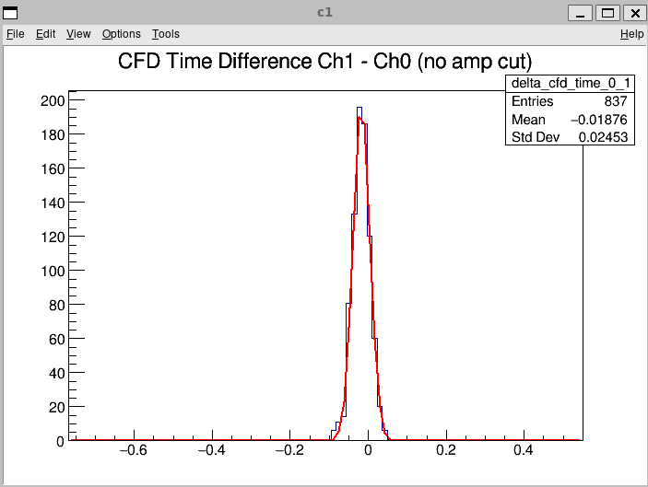
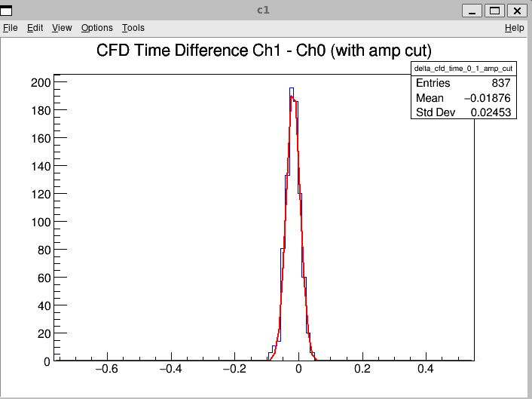
cfd_time (TDirectoryFile)
Subfolder of the analysis folder
delta_cfd_time_0_1
delta_cfd_time_0_1_amp_cut
Look same because
no amplitude cut is
applied
counts
Time difference

Slide 15
avg_waveforms_default_cut (TNamed)
OBJ: TNamed avg_waveforms_default_cut bcid[chid]>0
Let through just valid BCID
Drops empty/unphysical events
cdf_time_default_cut (TNamed)
OBJ: TNamed cfd_time_default_cut bcid[ch1]==bcid[ch2] && bcid[ch1]>0
Both channel need to be in the same event
user_cut (TNamed)
OBJ: TNamed user_cut No additional cut applied

Slide 16
Different channels

Slide 17
Why do the different output_run have different channels?
run3: channel 0 & channel 1
run4: channel 0 & channel 2
run5: channel 0 & channel 2
run6: channel 0 & channel 1
run7: channel 0 & channel 1
run8: channel 0 & channel 2
run9: channel 0
run10: channel 0 & channel 2
run11: channel 0 & channel 2
run12: channel 0 & channel 2
run13: channel 0 & channel 2
run14: channel 1
run15: channel 0 & channel 1 & channel 2
run16: channel 0 & channel 1 & channel 2 & channel 3
run17: channel 0 & channel 1 & channel 2 & channel 3
run18: channel 0 & channel 1 & channel 2 & channel 3
run19: channel 0 & channel 1 & channel 2 & channel 3
run20: channel 0 & channel 1 & channel 2 & channel 3
run21: channel 0 & channel 1 & channel 2 & channel 3
run22: channel 0 & channel 1 & channel 2 & channel 3
run23: channel 0 & channel 1 & channel 2 & channel 3
run24: channel 0 & channel 1 & channel 2 & channel 3
run25: channel 0 & channel 1 & channel 2 & channel 3
run26: channel 0 & channel 1 & channel 2 & channel 3
run27: channel 0 & channel 1 & channel 2 & channel 3
run28: channel 0 & channel 1 & channel 2 & channel 3
run29: channel 0 & channel 1 & channel 2 & channel 3
run30: channel 0 & channel 1 & channel 2 & channel 3
run31: channel 0 & channel 1 & channel 3
run32: channel 0 & channel 1 & channel 3
run33: channel 0 & channel 1 & channel 3
run34: channel 0 & channel 1 & channel 3
run35: channel 0 & channel 1 & channel 3
run36: channel 0 & channel 1 & channel 3
run37: channel 0 & channel 1 & channel 3
run38: channel 0 & channel 1 & channel 3
run39: channel 0 & channel 1 & channel 3
run40: channel 0 & channel 1 & channel 3
run41: channel 0 & channel 1 & channel 3
run42: channel 0 & channel 1 & channel 3
run43: channel 0 & channel 1 & channel 3
run44: channel 0 & channel 1 & channel 3
run45: channel 0 & channel 1 & channel 3
run46: channel 0 & channel 1 & channel 3
run47: channel 0 & channel 1 & channel 3
run48: channel 0 & channel 1 & channel 3
run49: channel 0 & channel 1 & channel 3
run50: channel 0 & channel 1 & channel 3
Analysis python script was run
checked given analysis folder & after produced test_analysis folder
Given folder run 1- run 50
Produced folder run 1- run 59
Got the logbook→ some runs are not mentioned here (9,10,11,13,14,16,17,18,19,20,21,28,31,32,42,43,49,55,56)

Slide 18
What the different channels are for
run1: channel 0 & channel 1 3GeV
  ch0=mpc1
  ch1=mpc2
run8: channel 0 & channel 2 3GeV
  ch0=mpc1
  ch2=mpc2
run15: channel 0 & channel 1 & channel 2 3GeV
  ch0=mpc1
  ch1=trigger
  ch2=mpc2
ch0, ch1, ch2, ch3 = inputs of the DAQ system
mcp1, mcp2
  mcp = microchannel plate
    Reference detectors
    Deliver precise arrival time
spacal 11 = one specific readout channel of the SpaCal
The mapping is configured for each run
Questions:
  Why are the channels used differently
  Why is there not always a trigger? For what is it useful?
run24: channel 0 & channel 1 & channel 2 & channel 3 3GeV
  ch0=mpc1
  ch1=trigger
  ch2=mpc2
  ch3=spacal 11
run35: channel 0 & channel 1 & channel 3 3GeV
  ch0=mpc1
  ch1=mpc2
  ch3=spacal 11

Slide 19
trigger - mcp1:
  checks how the trigger timing relates to the mcp1 signal
mcp2 - mcp1:
  time-of-flight between the two mcp or comparison of two reference timing detectors
  used to determine the mcp timing resolution
spacal 11 - mcp1:
  measures the timing of the calorimeter relative to the reference detector
  one of the key quantities for evaluating the calorimeter time resolution and characterize the SpaCal module
mcp2 - trigger:
  checks the timing of mcp2 relative to the trigger
spacal 11 - trigger:
  gives the calorimeter timing with respect to the acquisition trigger
spacal 11 - mcp2:
  calorimeter timing relative to the second mcp
  can be compared with spacal 11 -mcp1 to check consistency or detector alignment

Slide 20
Why current/backup cycle just in analysis folder?
Why are these two types of files not created when running analysis.py?
  Do I have to run it another time? → Did not work
analysis folder file output_run1.root
test_analysis folder file output_run1.root
KEY: TH1F amplitude_ch0;2 Amplitude - Channel 0 [current cycle]
KEY: TH1F amplitude_ch0;1 Amplitude - Channel 0 [backup cycle]
KEY: TH1F baseline_ch0;2 Baseline - Channel 0 [current cycle]
KEY: TH1F baseline_ch0;1 Baseline - Channel 0 [backup cycle]
KEY: TH1F amplitude_ch1;2 Amplitude - Channel 1 [current cycle]
KEY: TH1F amplitude_ch1;1 Amplitude - Channel 1 [backup cycle]
KEY: TH1F baseline_ch1;2 Baseline - Channel 1 [current cycle]
KEY: TH1F baseline_ch1;1 Baseline - Channel 1 [backup cycle]
KEY: TH1F amplitude_ch0;1 Amplitude - Channel 0
KEY: TH1F baseline_ch0;1 Baseline - Channel 0
KEY: TH1F amplitude_ch1;1 Amplitude - Channel 1
KEY: TH1F baseline_ch1;1 Baseline - Channel 1

Slide 21
Grouping/Sorting

Slide 22
Sorted by channel
 | mcp2-mcp1 / channel 0,1,3
 | SpaCal pac v1 100 Ohm (HV)
33 | Ch1-ch0 / ch0=mpc1 ch1=mcp2 ch3=spacal11 | 1 GeV | 0.03205 | 23
34 | Ch1-ch0 / ch0=mpc1 ch1=mcp2 ch3=spacal11 | 2 GeV | 0.02634 | 19
35 | Ch1-ch0 / ch0=mpc1 ch1=mcp2 ch3=spacal11 | 3 GeV | 0.0243 | 17
36 | Ch1-ch0 / ch0=mpc1 ch1=mcp2 ch3=spacal11 | 4 GeV | 0.02394 | 17
 | SpaCal pac v1 100 Ohm low HV
37 | Ch1-ch0 / ch0=mpc1 ch1=mcp2 ch3=spacal11 | 1 GeV | 0.03164 | 22
38 | Ch1-ch0 / ch0=mpc1 ch1=mcp2 ch3=spacal11 | 2 GeV | 0.02634 | 19
39 | Ch1-ch0 / ch0=mpc1 ch1=mcp2 ch3=spacal11 | 3 GeV | 0.02501 | 18
40 | Ch1-ch0 / ch0=mpc1 ch1=mcp2 ch3=spacal11 | 4 GeV | 0.02362 | 17
41 | Ch1-ch0 / ch0=mpc1 ch1=mcp2 ch3=spacal11 | 5 GeV | 0.02343 | 17
 | SpaCal pac v1 100 Ohm optimal HV
44 | Ch1-ch0 / ch0=mpc1 ch1=mcp2 ch3=spacal11 | 5 GeV | 0.02408 | 17
45 | Ch1-ch0 / ch0=mpc1 ch1=mcp2 ch3=spacal11 | 4 GeV | 0.02382 | 17
46 | Ch1-ch0 / ch0=mpc1 ch1=mcp2 ch3=spacal11 | 3 GeV | 0.02497 | 18
47 | Ch1-ch0 / ch0=mpc1 ch1=mcp2 ch3=spacal11 | 2 GeV | 0.02616 | 18
48 | Ch1-ch0 / ch0=mpc1 ch1=mcp2 ch3=spacal11 | 1 GeV | 0.03172 | 22
 | Shashlik SPIDER high voltage
50 | Ch1-ch0 / ch0=mpc1 ch1=mcp2 ch3=spacal11 | 5 GeV | 0.02418 | 17
51 | Ch1-ch0 / ch0=mpc1 ch1=mcp2 ch3=spacal11 | 4 GeV | 0.02418 | 17
52 | Ch1-ch0 / ch0=mpc1 ch1=mcp2 ch3=spacal11 | 3 GeV | 0.02458 | 17
53 | Ch1-ch0 / ch0=mpc1 ch1=mcp2 ch3=spacal11 | 2 GeV | 0.02666 | 19
54 | Ch1-ch0 / ch0=mpc1 ch1=mcp2 ch3=spacal11 | 1 GeV | 0.03118 | 22
 | Shashlik SPIDER low voltage
57 | Ch1-ch0 / ch0=mpc1 ch1=mcp2 ch3=spacal11 | 1 GeV | 0.03095 | 22
58 | Ch1-ch0 / ch0=mpc1 ch1=mcp2 ch3=spacal11 | 2 GeV | 0.02691 | 19
59 | Ch1-ch0 / ch0=mpc1 ch1=mcp2 ch3=spacal11 | 3 GeV | 0.02554 | 18
Then manually splitted into groups for easier comparison

Slide 23
Sorted by channel & energy
 | mcp2-mcp1 / channel 0,1,3
33 | Ch1-ch0 / ch0=mpc1 ch1=mcp2 ch3=spacal11 | 1 GeV | 0.03205 | 23
37 | Ch1-ch0 / ch0=mpc1 ch1=mcp2 ch3=spacal11 | 1 GeV | 0.03164 | 22
48 | Ch1-ch0 / ch0=mpc1 ch1=mcp2 ch3=spacal11 | 1 GeV | 0.03172 | 22
54 | Ch1-ch0 / ch0=mpc1 ch1=mcp2 ch3=spacal11 | 1 GeV | 0.03118 | 22
57 | Ch1-ch0 / ch0=mpc1 ch1=mcp2 ch3=spacal11 | 1 GeV | 0.03095 | 22
34 | Ch1-ch0 / ch0=mpc1 ch1=mcp2 ch3=spacal11 | 2 GeV | 0.02634 | 19
38 | Ch1-ch0 / ch0=mpc1 ch1=mcp2 ch3=spacal11 | 2 GeV | 0.02634 | 19
47 | Ch1-ch0 / ch0=mpc1 ch1=mcp2 ch3=spacal11 | 2 GeV | 0.02616 | 18
53 | Ch1-ch0 / ch0=mpc1 ch1=mcp2 ch3=spacal11 | 2 GeV | 0.02666 | 19
58 | Ch1-ch0 / ch0=mpc1 ch1=mcp2 ch3=spacal11 | 2 GeV | 0.02691 | 19
35 | Ch1-ch0 / ch0=mpc1 ch1=mcp2 ch3=spacal11 | 3 GeV | 0.0243 | 17
39 | Ch1-ch0 / ch0=mpc1 ch1=mcp2 ch3=spacal11 | 3 GeV | 0.02501 | 18
46 | Ch1-ch0 / ch0=mpc1 ch1=mcp2 ch3=spacal11 | 3 GeV | 0.02497 | 18
52 | Ch1-ch0 / ch0=mpc1 ch1=mcp2 ch3=spacal11 | 3 GeV | 0.02458 | 17
59 | Ch1-ch0 / ch0=mpc1 ch1=mcp2 ch3=spacal11 | 3 GeV | 0.02554 | 18
36 | Ch1-ch0 / ch0=mpc1 ch1=mcp2 ch3=spacal11 | 4 GeV | 0.02394 | 17
40 | Ch1-ch0 / ch0=mpc1 ch1=mcp2 ch3=spacal11 | 4 GeV | 0.02362 | 17
45 | Ch1-ch0 / ch0=mpc1 ch1=mcp2 ch3=spacal11 | 4 GeV | 0.02382 | 17
51 | Ch1-ch0 / ch0=mpc1 ch1=mcp2 ch3=spacal11 | 4 GeV | 0.02418 | 17
41 | Ch1-ch0 / ch0=mpc1 ch1=mcp2 ch3=spacal11 | 5 GeV | 0.02343 | 17
44 | Ch1-ch0 / ch0=mpc1 ch1=mcp2 ch3=spacal11 | 5 GeV | 0.02408 | 17
50 | Ch1-ch0 / ch0=mpc1 ch1=mcp2 ch3=spacal11 | 5 GeV | 0.02418 | 17

Slide 24
First look at energy resolution

Slide 25
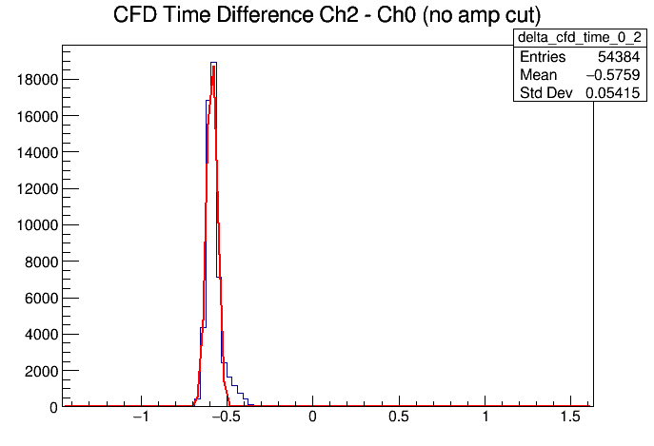
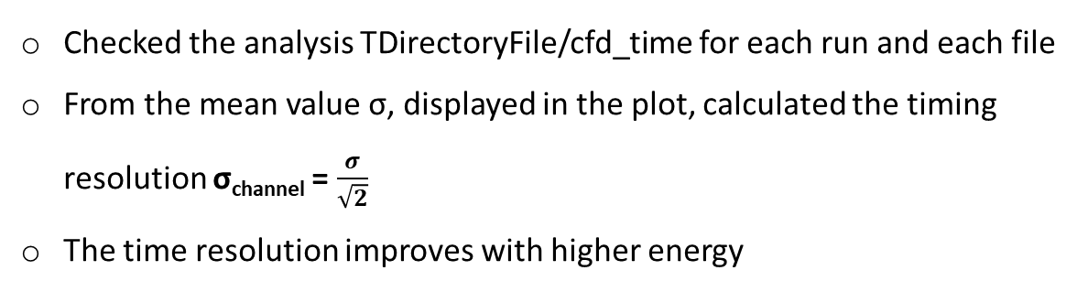
Time resolution at different energies
run number | ch(x)-ch(y) | Energy | σ_{channel}
22 | ch2-ch0 or mcp2-mcp1 | 5 GeV | 0.038 ns = 38 ps
23 | ch2-ch0 or mcp2-mcp1 | 4 GeV | 0.041 ns = 42 ps
24 | ch2-ch0 or mcp2-mcp1 | 3 GeV | 0.045 ns = 45 ps
25 | ch2-ch0 or mcp2-mcp1 | 2 GeV | 0.046 ns = 46 ps
26 | ch2-ch0 or mcp2-mcp1 | 1 GeV | 0.053 ns = 53 ps
22 | ch3-ch0 /spacal 11-mcp1 | 5 GeV | 0.041 ns = 41 ps
23 | ch3-ch0 /spacal 11-mcp1 | 4 GeV | 0.044 ns = 44 ps
24 | ch3-ch0 /spacal 11-mcp1 | 3 GeV | 0.049 ns = 49 ps
25 | ch3-ch0 /spacal 11-mcp1 | 2 GeV | 0.057 ns = 57 ps
26 | ch3-ch0 /spacal 11-mcp1 | 1 GeV | 0.083 ns = 83 ps
22 | ch3-ch2/spacal 11-mcp2 | 5 GeV | 0.055 ns = 55 ps
23 | ch3-ch2/spacal 11-mcp2 | 4 GeV | 0.079 ns = 79 ps
24 | ch3-ch2/spacal 11-mcp2 | 3 GeV | 0.113 ns = 113 ps
25 | ch3-ch2/spacal 11-mcp2 | 2 GeV | 0.124 ns = 124 ps
26 | ch3-ch2/spacal 11-mcp2 | 1 GeV | 0.141 ns = 141 ps
Checked the analysis TDirectoryFile/cfd_time for each run and each file
From the mean value σ, displayed in the plot, calculated the timing resolution σ_{channel} = $\frac{σ}{\sqrt{2}}$
The time resolution improves with higher energy
Run 22

Slide 26
Plotting development of time resolution

Slide 27
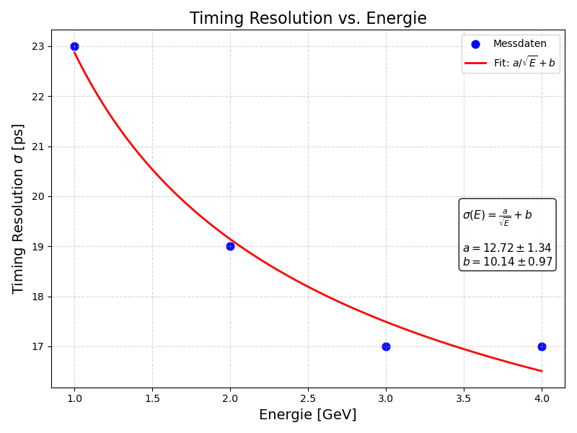
Plotted the time resolution development with increasing energy
Run number | ch(x)-ch(y) | Energy | σ/ns | σ_{channel} (σ/√2)/ps
 | mcp2-mcp1 / channel 0,1,3
 | SpaCal pac v1 100 Ohm (HV)
33 | Ch1-ch0 / ch0=mpc1 ch1=mcp2 ch3=spacal11 | 1 GeV | 0.03205 | 23
34 | Ch1-ch0 / ch0=mpc1 ch1=mcp2 ch3=spacal11 | 2 GeV | 0.02634 | 19
35 | Ch1-ch0 / ch0=mpc1 ch1=mcp2 ch3=spacal11 | 3 GeV | 0.0243 | 17
36 | Ch1-ch0 / ch0=mpc1 ch1=mcp2 ch3=spacal11 | 4 GeV | 0.02394 | 17

Slide 28
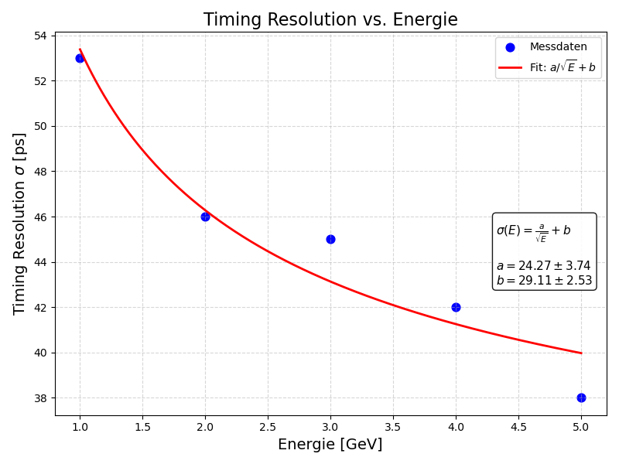
Plotted the time resolution development with increasing energy
 | mcp2-mcp1 /channel 0,1,2,3
 | SpaCal SPIDER high voltage
22 | Ch2-ch0 / ch0=mpc1 ch1=trigger ch2=mpc2 ch3=spacal11 | 5 GeV | 0.05759 | 38
23 | Ch2-ch0 / ch0=mpc1 ch1=trigger ch2=mpc2 ch3=spacal11 | 4 GeV | 0.05861 | 42
24 | Ch2-ch0 / ch0=mpc1 ch1=trigger ch2=mpc2 ch3=spacal11 | 3 GeV | 0.06403 | 45
25 | Ch2-ch0 / ch0=mpc1 ch1=trigger ch2=mpc2 ch3=spacal11 | 2 GeV | 0.06536 | 46
26 | Ch2-ch0 / ch0=mpc1 ch1=trigger ch2=mpc2 ch3=spacal11 | 1 GeV | 0.07529 | 53

Slide 29
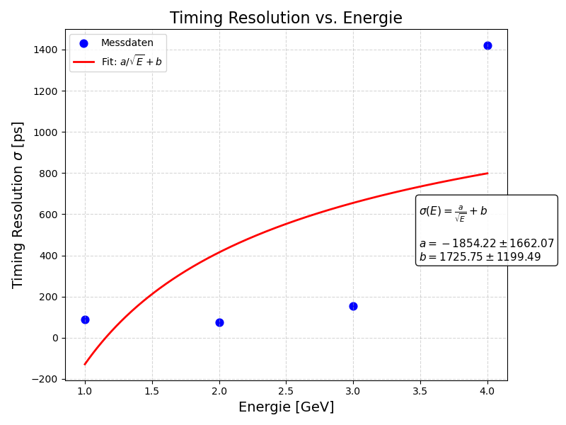
Plotted the time resolution development with increasing energy
 | spacal 11-mcp1 /channel 0,1,3
 | SpaCal pac v1 100 Ohm (HV?)
33 | Ch3-ch0 / ch0=mpc1 ch1=mcp2 ch3=spacal11 | 1 GeV | 0.1279 | 90
34 | Ch3-ch0 / ch0=mpc1 ch1=mcp2 ch3=spacal11 | 2 GeV | 0.1044 | 74
35 | Ch3-ch0 / ch0=mpc1 ch1=mcp2 ch3=spacal11 | 3 GeV | 0.2189 | 155
36 | Ch3-ch0 / ch0=mpc1 ch1=mcp2 ch3=spacal11 | 4 GeV | 2.009 | 1421

Slide 30
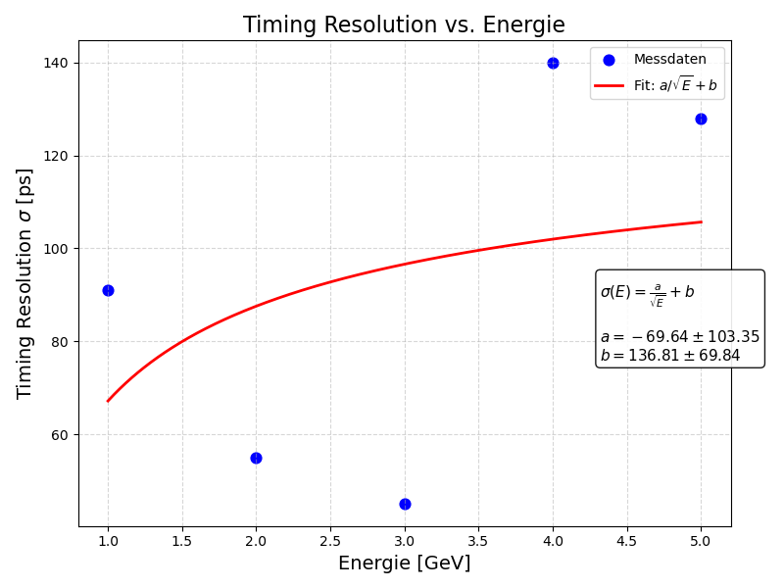
Plotted the time resolution development with increasing energy
 | SpaCal pac v1 100 Ohm optimal HV
44 | Ch3-ch0 / ch0=mpc1 ch1=mcp2 ch3=spacal11 | 5 GeV | 0.1807 | 128
45 | Ch3-ch0 / ch0=mpc1 ch1=mcp2 ch3=spacal11 | 4 GeV | 0.1983 | 140
46 | Ch3-ch0 / ch0=mpc1 ch1=mcp2 ch3=spacal11 | 3 GeV | 0.06425 | 45
47 | Ch3-ch0 / ch0=mpc1 ch1=mcp2 ch3=spacal11 | 2 GeV | 0.07784 | 55
48 | Ch3-ch0 / ch0=mpc1 ch1=mcp2 ch3=spacal11 | 1 GeV | 0.1288 | 91

Slide 31
Unusual values at timing resolution

Slide 32
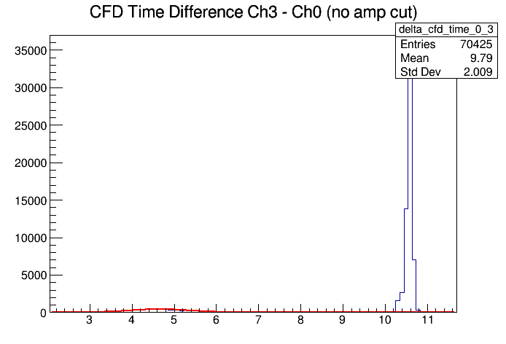
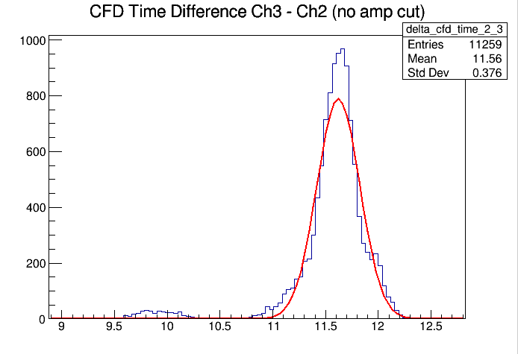
What causes the unusual values in time resolution?
The trend of improving timing resolution with higher energy is visible
Some runs have unusual high values & sometimes not working gauss fit
  run 33-36 (spacal11-mcp1 & spacal11-mcp2)
    ch3-ch0 and ch3-ch1
  Run 44-48 (spacal11-mcp1 & spacal11-mcp2) → theoretically optimal voltage
    ch3-ch0 and ch3-ch1
  Run 29 & 30 → because of low voltage runs ?
  Sometimes the gauss fit looks weird

Slide 33
Strange behaviour with the timing resolution
run number | ch(x)-ch(y) | Energy | σ
44 | ch1-ch0 / mpc2-mcp1 | 5 GeV | 0.017 ns = 17 ps
45 | ch1-ch0 / mpc2-mcp1 | 4 GeV | 0.017 ns = 17 ps
46 | ch1-ch0 / mpc2-mcp1 | 3 GeV | 0.018 ns = 18 ps
47 | ch1-ch0 / mpc2-mcp1 | 2 GeV | 0.018 ns = 18 ps
48 | ch1-ch0 / mpc2-mcp1 | 1 GeV | 0.022 ns = 22 ps
44 | ch3-ch0 /spacal 11-mcp1 | 5 GeV | 0.128 ns = 128 ps
45 | ch3-ch0 /spacal 11-mcp1 | 4 GeV | 0.140 ns = 140 ps
46 | ch3-ch0 /spacal 11-mcp1 | 3 GeV | 0.045 ns = 45 ps
47 | ch3-ch0 /spacal 11-mcp1 | 2 GeV | 0.055 ns = 55 ps
48 | ch3-ch0 /spacal 11-mcp1 | 1 GeV | 0.091 ns = 91 ps
44 | ch3-ch1/spacal 11-mcp2 | 5 GeV | 0.127 ns = 127 ps
45 | ch3-ch1/spacal 11-mcp2 | 4 GeV | 0.141 ns = 141 ps
46 | ch3-ch1/spacal 11-mcp2 | 3 GeV | 0.047 ns = 47 ps
47 | ch3-ch1/spacal 11-mcp2 | 2 GeV | 0.056 ns = 56 ps
48 | ch3-ch1/spacal 11-mcp2 | 1 GeV | 0.093 ns = 93 ps
 | SpaCal pac v1 100 Ohm (HV?, 1230 V)
33 | Ch3-ch0 / ch0=mpc1 ch1=mcp2 ch3=spacal11 | 1 GeV | 0.1279 | 90
34 | Ch3-ch0 / ch0=mpc1 ch1=mcp2 ch3=spacal11 | 2 GeV | 0.1044 | 74
35 | Ch3-ch0 / ch0=mpc1 ch1=mcp2 ch3=spacal11 | 3 GeV | 0.2189 | 155
36 | Ch3-ch0 / ch0=mpc1 ch1=mcp2 ch3=spacal11 | 4 GeV | 2.009 | 1421
 | SpaCal pac v1 100 Ohm (HV?, 1230 V)
33 | Ch3-ch1 / ch0=mpc1 ch1=mcp2 ch3=spacal11 | 1 GeV | 0.1327 | 94
34 | Ch3-ch1 / ch0=mpc1 ch1=mcp2 ch3=spacal11 | 2 GeV | 0.1072 | 76
35 | Ch3-ch1 / ch0=mpc1 ch1=mcp2 ch3=spacal11 | 3 GeV | 0.2125 | 150
36 | Ch3-ch1 / ch0=mpc1 ch1=mcp2 ch3=spacal11 | 4 GeV | 1.996 | 1411
 | SpaCal SPIDER low voltage (735 V)
29 | Ch3-ch0 / ch0=mpc1 ch1=trigger ch2=mpc2 ch3=spacal11 | 4 GeV | 0.264 | 187
30 | Ch3-ch0 / ch0=mpc1 ch1=trigger ch2=mpc2 ch3=spacal11 | 3 GeV | 0.4675 | 331
 | SpaCal SPIDER low voltage (735 V)
29 | Ch2-ch0 / ch0=mpc1 ch1=trigger ch2=mpc2 ch3=spacal11 | 4 GeV | 0.0588 | 42
30 | Ch2-ch0 / ch0=mpc1 ch1=trigger ch2=mpc2 ch3=spacal11 | 3 GeV | 0.5835 | 413
 | SpaCal SPIDER low voltage (900 V)
29 | Ch3-ch2 / ch0=mpc1 ch1=trigger ch2=mpc2 ch3=spacal11 | 4 GeV | 0.376 | 266
30 | Ch3-ch2 / ch0=mpc1 ch1=trigger ch2=mpc2 ch3=spacal11 | 3 GeV | 0.6205 | 439

Slide 34
Comparing SpaCal with Shashlik runs

Slide 35
Shashlik
SpaCal
 | mcp2-mcp1 / channel 0,1,3
1230 V
 | mcp2-mcp1 /channel 0,1,2,3
 | SpaCal SPIDER high voltage
22 | Ch2-ch0 / ch0=mpc1 ch1=trigger ch2=mpc2 ch3=spacal11 | 5 GeV | 0.05759 | 38
23 | Ch2-ch0 / ch0=mpc1 ch1=trigger ch2=mpc2 ch3=spacal11 | 4 GeV | 0.05861 | 42
24 | Ch2-ch0 / ch0=mpc1 ch1=trigger ch2=mpc2 ch3=spacal11 | 3 GeV | 0.06403 | 45
25 | Ch2-ch0 / ch0=mpc1 ch1=trigger ch2=mpc2 ch3=spacal11 | 2 GeV | 0.06536 | 46
26 | Ch2-ch0 / ch0=mpc1 ch1=trigger ch2=mpc2 ch3=spacal11 | 1 GeV | 0.07529 | 53
 | SpaCal SPIDER low voltage
29 | Ch2-ch0 / ch0=mpc1 ch1=trigger ch2=mpc2 ch3=spacal11 | 4 GeV | 0.0588 | 42
30 | Ch2-ch0 / ch0=mpc1 ch1=trigger ch2=mpc2 ch3=spacal11 | 3 GeV | 0.5835 | 413
 | Shashlik SPIDER high voltage
50 | Ch1-ch0 / ch0=mpc1 ch1=mcp2 ch3=spacal11 | 5 GeV | 0.02418 | 17
51 | Ch1-ch0 / ch0=mpc1 ch1=mcp2 ch3=spacal11 | 4 GeV | 0.02418 | 17
52 | Ch1-ch0 / ch0=mpc1 ch1=mcp2 ch3=spacal11 | 3 GeV | 0.02458 | 17
53 | Ch1-ch0 / ch0=mpc1 ch1=mcp2 ch3=spacal11 | 2 GeV | 0.02666 | 19
54 | Ch1-ch0 / ch0=mpc1 ch1=mcp2 ch3=spacal11 | 1 GeV | 0.03118 | 22
 | Shashlik SPIDER low voltage
57 | Ch1-ch0 / ch0=mpc1 ch1=mcp2 ch3=spacal11 | 1 GeV | 0.03095 | 22
58 | Ch1-ch0 / ch0=mpc1 ch1=mcp2 ch3=spacal11 | 2 GeV | 0.02691 | 19
59 | Ch1-ch0 / ch0=mpc1 ch1=mcp2 ch3=spacal11 | 3 GeV | 0.02554 | 18
1100 V
900 V
735 V
Shashlik with smaller resolution
Note: slightly different voltages!
 | spacal 11-mcp1 /channel 0,1,3
 | spacal 11 - mcp1 / channel 0,1,2,3
 | SpaCal SPIDER high voltage
22 | Ch3-ch0 / ch0=mpc1 ch1=trigger ch2=mpc2 ch3=spacal11 | 5 GeV | 0.0575 | 41
23 | Ch3-ch0 / ch0=mpc1 ch1=trigger ch2=mpc2 ch3=spacal11 | 4 GeV | 0.06236 | 44
24 | Ch3-ch0 / ch0=mpc1 ch1=trigger ch2=mpc2 ch3=spacal11 | 3 GeV | 0.06939 | 49
25 | Ch3-ch0 / ch0=mpc1 ch1=trigger ch2=mpc2 ch3=spacal11 | 2 GeV | 0.08112 | 57
26 | Ch3-ch0 / ch0=mpc1 ch1=trigger ch2=mpc2 ch3=spacal11 | 1 GeV | 0.1176 | 83
 | SpaCal SPIDER low voltage
29 | Ch3-ch0 / ch0=mpc1 ch1=trigger ch2=mpc2 ch3=spacal11 | 4 GeV | 0.264 | 187
30 | Ch3-ch0 / ch0=mpc1 ch1=trigger ch2=mpc2 ch3=spacal11 | 3 GeV | 0.4675 | 331
 | Shashlik SPIDER high voltage
50 | Ch3-ch0 / ch0=mpc1 ch1=mcp2 ch3=spacal11 | 5 GeV | 0.06406 | 45
51 | Ch3-ch0 / ch0=mpc1 ch1=mcp2 ch3=spacal11 | 4 GeV | 0.06793 | 48
52 | Ch3-ch0 / ch0=mpc1 ch1=mcp2 ch3=spacal11 | 3 GeV | 0.07435 | 53
53 | Ch3-ch0 / ch0=mpc1 ch1=mcp2 ch3=spacal11 | 2 GeV | 0.08951 | 63
54 | Ch3-ch0 / ch0=mpc1 ch1=mcp2 ch3=spacal11 | 1 GeV | 0.1396 | 99
 | Shashlik SPIDER low voltage
57 | Ch3-ch0 / ch0=mpc1 ch1=mcp2 ch3=spacal11 | 1 GeV | 0.2765 | 196
58 | Ch3-ch0 / ch0=mpc1 ch1=mcp2 ch3=spacal11 | 2 GeV | 0.1351 | 96
59 | Ch3-ch0 / ch0=mpc1 ch1=mcp2 ch3=spacal11 | 3 GeV | 0.09507 | 67
1100 V
1230 V
900 V
735 V
Shashlik with a little higher resolution than SpaCal
Note: slightly different voltages!

Slide 36
 | spacal 11-mcp2 /channel 0,1,3
 | spacal 11-mcp2 / channel 0,1,2,3
 | SpaCal SPIDER high voltage
22 | Ch3-ch2 / ch0=mpc1 ch1=trigger ch2=mpc2 ch3=spacal11 | 5 GeV | 0.07847 | 55
23 | Ch3-ch2 / ch0=mpc1 ch1=trigger ch2=mpc2 ch3=spacal11 | 4 GeV | 0.1111 | 79
24 | Ch3-ch2 / ch0=mpc1 ch1=trigger ch2=mpc2 ch3=spacal11 | 3 GeV | 0.1592 | 113
25 | Ch3-ch2 / ch0=mpc1 ch1=trigger ch2=mpc2 ch3=spacal11 | 2 GeV | 0.1756 | 124
26 | Ch3-ch2 / ch0=mpc1 ch1=trigger ch2=mpc2 ch3=spacal11 | 1 GeV | 0.2 | 141
 | SpaCal SPIDER low voltage
29 | Ch3-ch2 / ch0=mpc1 ch1=trigger ch2=mpc2 ch3=spacal11 | 4 GeV | 0.376 | 266
30 | Ch3-ch2 / ch0=mpc1 ch1=trigger ch2=mpc2 ch3=spacal11 | 3 GeV | 0.6205 | 439
1100 V
1230 V
 | Shashlik SPIDER high voltage
50 | Ch3-ch1 / ch0=mpc1 ch1=mcp2 ch3=spacal11 | 5 GeV | 0.06446 | 46
51 | Ch3-ch1 / ch0=mpc1 ch1=mcp2 ch3=spacal11 | 4 GeV | 0.06981 | 49
52 | Ch3-ch1 / ch0=mpc1 ch1=mcp2 ch3=spacal11 | 3 GeV | 0.07637 | 54
53 | Ch3-ch1 / ch0=mpc1 ch1=mcp2 ch3=spacal11 | 2 GeV | 0.09696 | 69
54 | Ch3-ch1 / ch0=mpc1 ch1=mcp2 ch3=spacal11 | 1 GeV | 0.1476 | 104
 | Shashlik SPIDER low voltage
57 | Ch3-ch1 / ch0=mpc1 ch1=mcp2 ch3=spacal11 | 1 GeV | 0.2867 | 203
58 | Ch3-ch1 / ch0=mpc1 ch1=mcp2 ch3=spacal11 | 2 GeV | 0.14 | 99
59 | Ch3-ch1 / ch0=mpc1 ch1=mcp2 ch3=spacal11 | 3 GeV | 0.09818 | 69
900 V
735 V
Shashlik with a little lower resolution
Note: slightly different voltages!

Slide 37
Checking abnormalities in amplitude, baseline & waveform

Slide 38
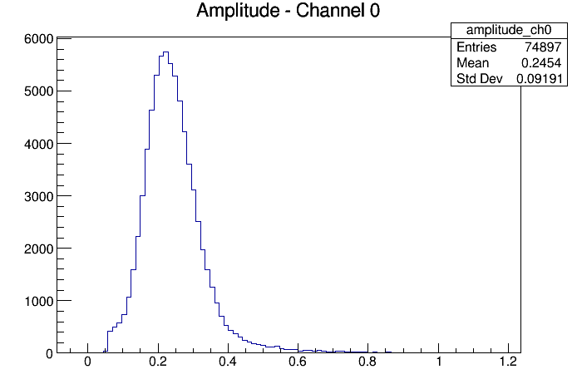
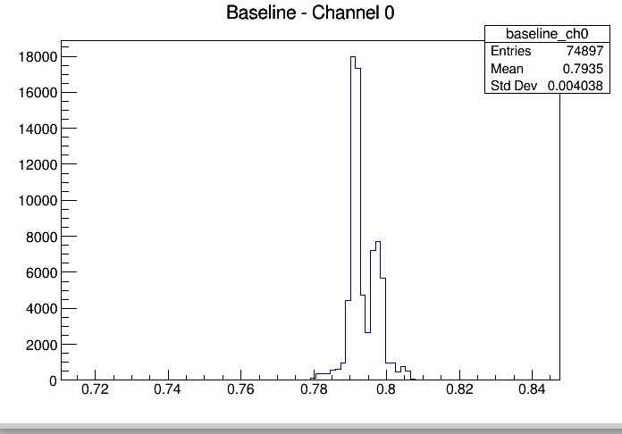
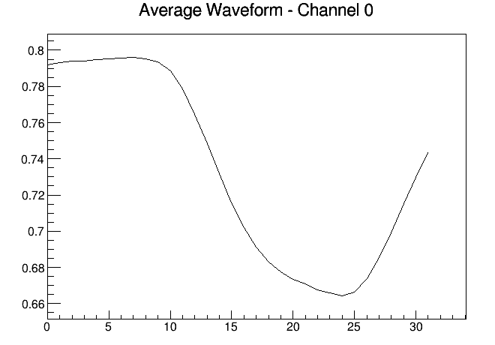
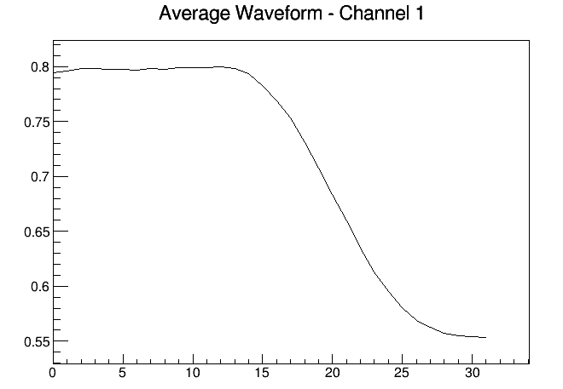
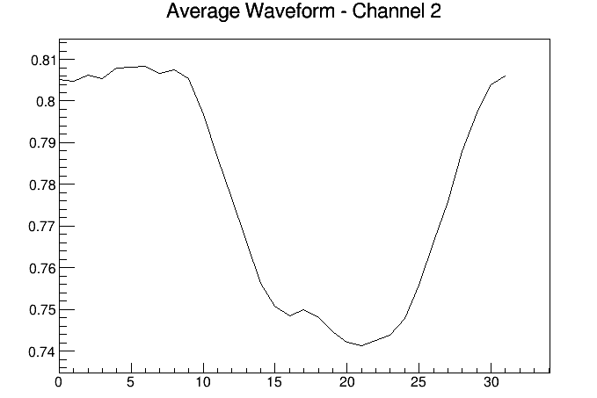
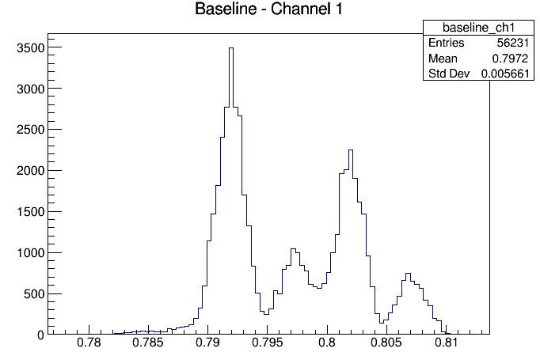
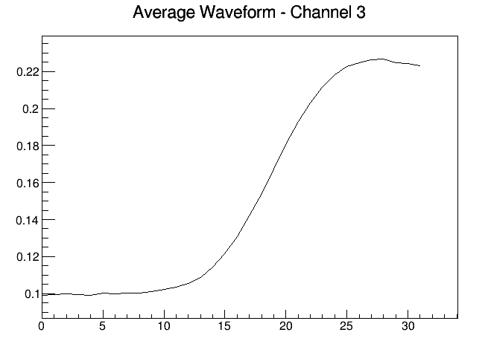
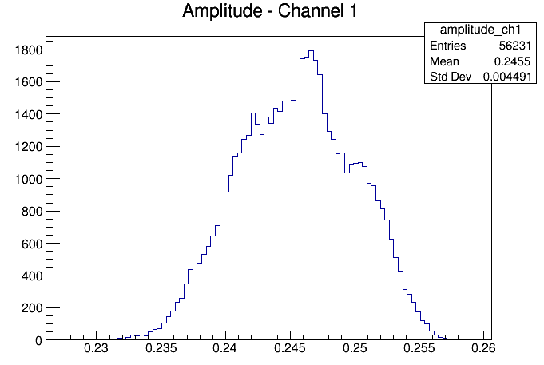
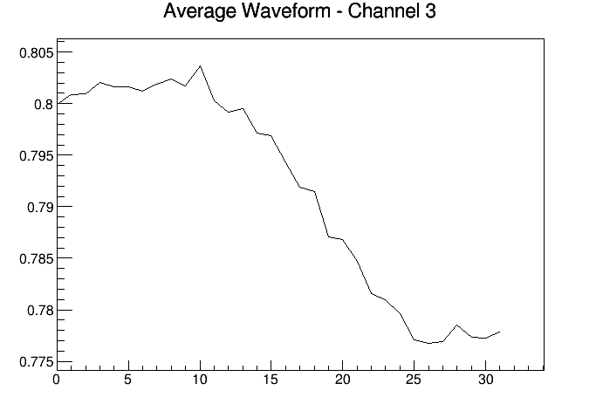
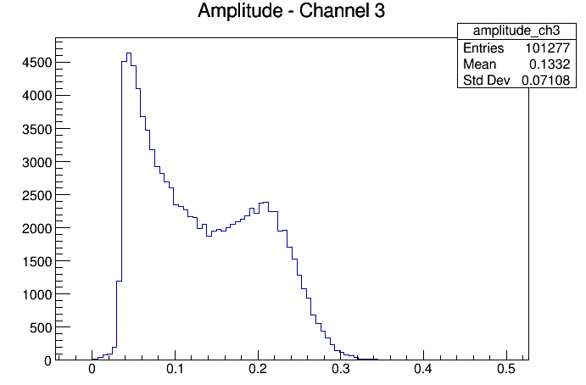
Checking for abnormalities in amplitude, baseline & waveform
→ Most of the runs look like this
Run 12
Run 29
Run 33
From run 51 on there is no waveform

Slide 39
Checking impact of different voltages

Slide 40
mcp2-mcp1/channel 0,1,3
SpaCal pac v1 100 Ohm
 | SpaCal pac v1 100 Ohm low HV (735 V)
37 | Ch1-ch0 / ch0=mpc1 ch1=mcp2 ch3=spacal11 | 1 GeV | 0.03164 | 22
38 | Ch1-ch0 / ch0=mpc1 ch1=mcp2 ch3=spacal11 | 2 GeV | 0.02634 | 19
39 | Ch1-ch0 / ch0=mpc1 ch1=mcp2 ch3=spacal11 | 3 GeV | 0.02501 | 18
40 | Ch1-ch0 / ch0=mpc1 ch1=mcp2 ch3=spacal11 | 4 GeV | 0.02362 | 17
41 | Ch1-ch0 / ch0=mpc1 ch1=mcp2 ch3=spacal11 | 5 GeV | 0.02343 | 17
 | SpaCal pac v1 100 Ohm optimal HV (1130 V)
44 | Ch1-ch0 / ch0=mpc1 ch1=mcp2 ch3=spacal11 | 5 GeV | 0.02408 | 17
45 | Ch1-ch0 / ch0=mpc1 ch1=mcp2 ch3=spacal11 | 4 GeV | 0.02382 | 17
46 | Ch1-ch0 / ch0=mpc1 ch1=mcp2 ch3=spacal11 | 3 GeV | 0.02497 | 18
47 | Ch1-ch0 / ch0=mpc1 ch1=mcp2 ch3=spacal11 | 2 GeV | 0.02616 | 18
48 | Ch1-ch0 / ch0=mpc1 ch1=mcp2 ch3=spacal11 | 1 GeV | 0.03172 | 22
 | SpaCal pac v1 100 Ohm (HV, 1230 V)
33 | Ch1-ch0 / ch0=mpc1 ch1=mcp2 ch3=spacal11 | 1 GeV | 0.03205 | 23
34 | Ch1-ch0 / ch0=mpc1 ch1=mcp2 ch3=spacal11 | 2 GeV | 0.02634 | 19
35 | Ch1-ch0 / ch0=mpc1 ch1=mcp2 ch3=spacal11 | 3 GeV | 0.0243 | 17
36 | Ch1-ch0 / ch0=mpc1 ch1=mcp2 ch3=spacal11 | 4 GeV | 0.02394 | 17
The voltage does not affect the timing resolution here

Slide 41
spacal 11-mcp1 / channel 0,1,3
SpaCal pac v1 100 Ohm
 | SpaCal pac v1 100 Ohm low HV (735 V)
37 | Ch3-ch0 / ch0=mpc1 ch1=mcp2 ch3=spacal11 | 1 GeV | 0.4694 | 332
38 | Ch3-ch0 / ch0=mpc1 ch1=mcp2 ch3=spacal11 | 2 GeV | 0.2018 | 143
39 | Ch3-ch0 / ch0=mpc1 ch1=mcp2 ch3=spacal11 | 3 GeV | 0.1334 | 94
40 | Ch3-ch0 / ch0=mpc1 ch1=mcp2 ch3=spacal11 | 4 GeV | 0.1029 | 73
41 | Ch3-ch0 / ch0=mpc1 ch1=mcp2 ch3=spacal11 | 5 GeV | 0.08679 | 61
 | SpaCal pac v1 100 Ohm optimal HV (1130 V)
44 | Ch3-ch0 / ch0=mpc1 ch1=mcp2 ch3=spacal11 | 5 GeV | 0.1807 | 128
45 | Ch3-ch0 / ch0=mpc1 ch1=mcp2 ch3=spacal11 | 4 GeV | 0.1983 | 140
46 | Ch3-ch0 / ch0=mpc1 ch1=mcp2 ch3=spacal11 | 3 GeV | 0.06425 | 45
47 | Ch3-ch0 / ch0=mpc1 ch1=mcp2 ch3=spacal11 | 2 GeV | 0.07784 | 55
48 | Ch3-ch0 / ch0=mpc1 ch1=mcp2 ch3=spacal11 | 1 GeV | 0.1288 | 91
 | SpaCal pac v1 100 Ohm (HV?, 1230 V)
33 | Ch3-ch0 / ch0=mpc1 ch1=mcp2 ch3=spacal11 | 1 GeV | 0.1279 | 90
34 | Ch3-ch0 / ch0=mpc1 ch1=mcp2 ch3=spacal11 | 2 GeV | 0.1044 | 74
35 | Ch3-ch0 / ch0=mpc1 ch1=mcp2 ch3=spacal11 | 3 GeV | 0.2189 | 155
36 | Ch3-ch0 / ch0=mpc1 ch1=mcp2 ch3=spacal11 | 4 GeV | 2.009 | 1421
Low voltage start at a higher time resolution & has higher values for 1-2 or 3 GeV
Unusual values at high & optimal voltage

Slide 42
Checking impact of digitalisation resolution

Slide 43
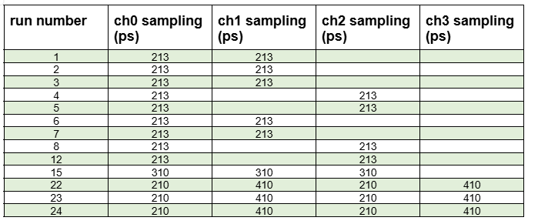
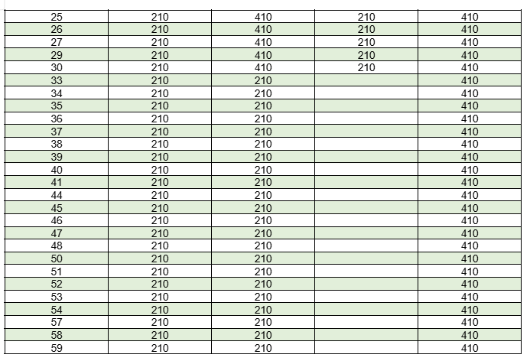
Used sampling resolutions: 210ps, 213ps, 310ps, 410ps
Still checking the impact

Slide 44
Checking abnormalities & similarities at the cfd time difference plots

Slide 45
run number | channel combination | max.Amplitude (y-value) | x-value
22 | ch2-ch0 | 19000 | -0.6
23 | ch2-ch0 | 21000 | -0.6
24 | ch2-ch0 | 20500 | -0.6
25 | ch2-ch0 | 19500 | -0.6
26 | ch2-ch0 | 22000 | -0.6
22 | ch3-ch0 | 9000 | 8.05
23 | ch3-ch0 | 9200 | 8.05
24 | ch3-ch0 | 7800 | 8.05
25 | ch3-ch0 | 9500 | 8.05
26 | ch3-ch0 | 3500 | 8.05
22 | ch3-ch2 | 1200 | 8.6
23 | ch3-ch2 | 12000 | 8.6
24 | ch3-ch2 | 11000 | 8.65
25 | ch3-ch2 | 7800 | 8.6
26 | ch3-ch2 | 3700 | 8.6
Not really an impact visible, but need a closer look

Slide 46
Starting to check impact of cuts

Slide 47
Trying this right now, first run ended eith an error:
python python/analyse.py -o test_analysis_cfd_cut -c "cfd_time[0]>0 && cfd_time[1]>0”
Did run into strange outcome:
-c "cfd_time[0]>0 && cfd_time[1]>0&& cfd_time[2]>0 && cfd_time[3]>0"
→ cfd histograms then just show one bar

Slide 48

Questions

Slide 49
Backup

Slide 50
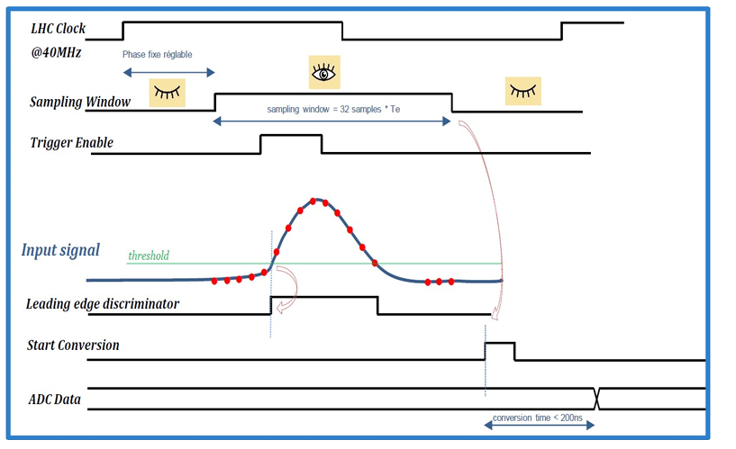
SPIDER ASIC
Chronogram of sampling, trigger and conversion in SPIDER.
LHC Clock
  global tact of 40 MHz
  T = 1/40MHz = 25ns → each rising edge occurs every 25 ns
  tact synchronises the whole electronics
Sampling Window
  determines when the waveform recording is active
  sampling window = 32 samples (will be saved) * Te (sampling period)
    eg. Te=1ns → 32*1ns = 32ns → in this window points are recorded
  position of the sampling window can be moved relative to the LHC tact
Trigger Enable
  just during this time an event can be accepted
  Trigger prevents from: noise, wrong pulses, unnecessary ADC conversions
Input Signal
  analogue signal of the detector
  red points = saved samples = actual recorded waveform
    reconstructed from this : Pulse height, area, rise time, pulse width
  threshold = when signal rises above (V_{signal} > V_{threshold}) the event is recognised

Slide 51
Leading edge discriminator
  is a comparator
  turns the analog signal into a digital signal
    if V_{signal} > V_{threshold} then out=1 else out=0
  “leading edge” because the time at which the threshold was exceeded is measured, meaning the rising edge →timestamp is generated
Start Conversion
  Sampling window is terminated
    samples are saved
    trigger got accepted
    ADC conversion starts (only after the recording, otherwise samples will be lost)
ADC Data
  the saved voltages are now getting digitised
  every red point turns to a numerical value
  conversion time < 200 ns = Digitalisation of all 32 samples takes less than 200ns → after that the data can be read out

Slide 52
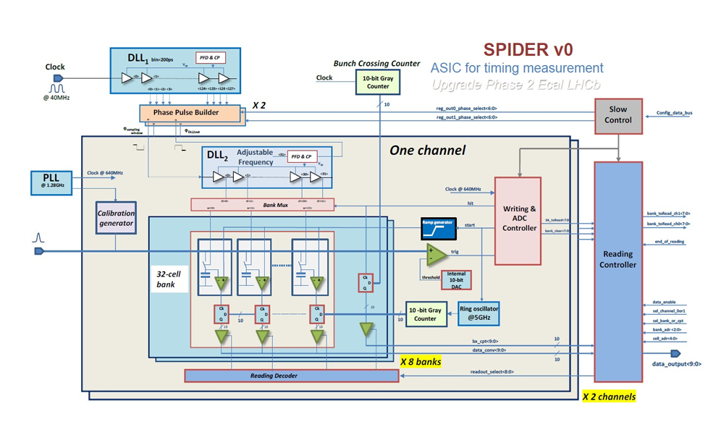
SPIDER version v0 architecture
DLL1
  controls the time windows
  locked on LHC clock
  houses 128 delay cells with step of 195ps
    generates many precise delays of the same clock signal → 25ns (LHC clock) are splitted in 128 parts
  measures always the 128 delays and adjusts when they fluctuate
PPB (phase pulse builder)
  after DLL1
  generates out of the 128 possible options : start of sampling-window, end of sampling window, sampling period and trigger enable window
  eg. user configured Start-tab =20 (3.9ns) , end-tab=60 (11.7ns)
    PPB turns this into
    for the sampling frequency measures the PPB the time between start and stop (=7.8 ns) → this time gets distributed to 32 samples 7.8 ns/32 = 244ps
    gives the start & stop signal and the sampling frequency to DLL2

Slide 53
SPIDER version v0 architecture
DLL2
  situated in every channel → every channel can have its own sampling frequency/period, time window and fine-tuning
  generates write commands for the 32 memory cells
A/D conversion uses massive parallel Wilkinson scheme based on ramp generator (200ns for 800mV)
  Wilkinson ADC
    uses only a ramp, a comparator and a counter
    problem: really slow
    SPIDER-solution: massive parallel Wilkinson scheme
      All samples are converted simultaneously
      Each memory cell has its own comparator
      As the ramp rises, all comparators monitor the ramp simultaneously
      When the ramp reaches its value at a memory cell, the comparator triggers
      the current Gray code is stored (5GHz 10bit-Gray-code counter)
peak detector → will be used for smart readout
saturation detector → will be used for the width of the saturation plateau
calibrations of ADC and timing required

