Slide 1
Higgs coupling to electrons and neutrinos
Precision on Higgs couplings from FCC Feasibility Study Report, no electron, no neutrino (and no u, no d)

Slide 3
e+e- →‾bb is 20 pb

Slide 7
Key result assuming 4.1 MeV beam energy spread. 2.0 sigma significance 10ab-1. (2yrs)
unfortunately…

Slide 10
Big progress on monochromatization …. BUT

Slide 11
Progress in obtaining reduction of energy spread, with decent luminosity, but rms Ecm ~30 MeV (not 4 MeV)
Fundamental limitation seems to be associated with energy spread generated by the collisions themselves.

Slide 12
Improving e-Yukawa coupling further. Beam polarization
The idea is to improve the signal to background ratio by using the beam polarization
A. Longitudinal polarization
⬅ x ➔ or ➔ x ⬅ = spin 0 state enhance H production wrt Z production
⬅ x ⬅ or ➔ x ➔ = spin 1 state enhance Z production wrt H production
B. transverse polarization generates azimuthal distribution different of Higgs and Z.
-- Both require polarization of both beams
-- Polarization is never 100% so enhancement is only partial
-- Electron polarization can be as high as 90% (done at the SLC at SLAC in 1990-1998)
-- Positron polarization more complicated, requires a dedicated ring →
or a dedicated conversion of polarized photons to polarized e+e- beams (ILC design not applicable here)
Theoretical studies include a possible improvement by a factor 5 of the signal/bkg
Design of polarizing ring OK for the low intensity e+ needed for the beam calibrations (200/10000 bunches 2%)
Requested design of positron polarizing ring (large increase of intensity and synchrotron radiation…. ONGOING

Slide 13
https://indico.cern.ch/event/1298458/contributions/5977748/attachments/2874448/5034676/petrielloFCC24.pdf

Slide 14
This is where we are -- ideas!
The main tasks are to
design a polarized ring with full intensity (hard)
design the tools for polarization manipulation (already done for LEP) in order to reverse either e- and e+ Polarization
to optimize the best running scenario

Slide 15
Massive NEUTRINOS (aka Heavy Neutral Leptons)
{
The fact that neutrinos have mass is THE observed BSM phenomenon
Immediate consequence:
-- Fermion number conservation (FNC) no longer there
-- accidental in SM, valid iff neutrinos are massless
‘SM-like’ minimal solutions call for right-handed neutrinos (RHv). Two versions
A. 2 or 3 RHv’s with same mass as left-handed ones
-- unobservable consequence, the new states are perfectly sterile
-- masses / Yukawas are < 10⁻⁷ (10⁻¹²) x m_{e} (m_{top}) (why??)
-- requires to re-impose FNC (new, BSM, symmetry?)
B. 2 or 3 RHv’s with different masses (see-saw I = baseline model)
-- HUGE consequences, with DM and BAU possibilities
-- RHv are sterile Majorana particles, mix with light active v’s |θ_{v}|² ~ m_{v}/m_{N}
-- masses m_{N} can be anywhere between e.g. m_{v} and 10¹⁰ GeV
(« chance » is 5% per order of magnitude x 3 neutrino families)
-- neutrino Yukawa coupling y_{v} =√ m_{N} . m_{v} /<H> can be similar to charged leptons
-- mass eigenstates are called HNL, long lived, rare, observable decay (FCC 2014 & 2022)
-- measurable consequences on lifetime, charge asymetries etc. at the Z pole
-- Majorana neutrino mass term ( N_{R} <->‾N_{R} transition/spin-flip) is not forbidden, but not « Higgs »
Intimately Higgs Physics questions, that FCCee has a chance (&duty) to address :
➔ what are the couplings of H(125) to neutrinos? Are there masses beyond the Higgs boson?
H
A
y_{v}=
B
y_{v} =√ m_{N} . M_{v} / <H>

Slide 16
Towards a significant HNL study -- items and target
On the theory side
-- Clarify semantics for the ‘is this BSM and how?’ question!
-- Clarify the model for 3x3 light x heavy families,
-- relationship between HNL decay modes and PMNS matrix
-- Meaning of the ‘see-saw’ line : exclusion or a guideline?
-- is ‘excluding down to the see-saw limit’ a good experimental target?
-- Interest of the various decays
-- in particular the Neutral Current decays
e.g. HNL → HNL’ + γ decay?
-- Relationship between production rate and lifetime etc…
ALL For 1) observation of a single HNL 2) case of 2 HNL in range for BAU
-- complementarity with FCC-hh physics potential
Exclusion
On the experimental side THIS MIGHT LEAD TO DETECTOR REQUIREMENTS
-- LLP mode: background estimate (time and space coincidence)
For LHC: dominated by fake displaced vertex (DV) from accidental overlap of track segments folded with poor track reconstruction from IR to DV. Needs study for FCC-ee.
-- Overlap involving cosmics ? Need simulation of cosmics in FCC-ee caverns!
Target: THIS MIGHT LEAD TO RUNNING TIME/PERFORMANCE REQUIREMENTS
Evaluate statistics required for ‘discover or rule out HNL’
e.g. down to the See-saw limit as function of HNL mass
Suggest not to worry about “beyond the baseline” scenarios
until the baseline is solidly established
Discovery

Slide 17
Heavy Neutral Leptons and Fermion number violation
courtesy
Panos Charitos

Slide 18
Fermion number conservation
Is *not* in itself a law or a symmetry of the Standard Model
For charged fermions (e/mu/tau and the quarks) it is not possible to transform
a fermion into an antifermion because of charge conservation
For neutrinos, which are neutral, the SM assumes they are massless.
neutrino is left-handed (identical if massless to negative helicity)
and the antineutrino has positive helicity
neutrino <-> antineutrino transition is forbidden by angular momentum conservation
This results in practice in apparent conservation of fermion number
The existence of massive neutrinos allows for spin flip and thus in principle a neutrino-antineutrino transition.
since a left handed field has a component of the opposite helicity (and vice versa)
ν_{L} ≈ ν₋ + ν₊ m/E (mass is what allows to flip the helicity)
for very small mass and light neutrinos this is very, very small: for m=50meV and P =30 MeV ➔ (m/E)² = 10⁻¹⁸
This can be observed in neutrino less double beta decay or by searching directly for the right-handed neutrinos!

Slide 19
fermion number violation is the first Sakharov condition for the
Baryon Asymmetry of the Universe
Baryogenesis or Leptogenesis + sphalerons
Also requires
-- CP violation and
-- out of equilibrium universe (Big Bang OK
Fermion number conservation
Is *not* in itself a law or a symmetry of the Standard Model
For charged fermions (e/mu/tau and the quarks) it is not possible to transform
a fermion into an antifermion because of charge conservation
For neutrinos, which are neutral, the SM assumes they are massless.
neutrino is left-handed (identical if massless to negative helicity)
and the antineutrino has positive helicity
neutrino <-> antineutrino transition is forbidden by angular momentum conservation
This results in practice in apparent conservation of fermion number
The existence of massive neutrinos allows for spin flip and thus in principle a neutrino-antineutrino transition.
since a left handed field has a component of the opposite helicity (and vice versa)
ν_{L} ≈ ν₋ + ν₊ m/E (mass is what allows to flip the helicity)
for very small mass and light neutrinos this is very, very small: for m=50meV and P =30 MeV ➔ (m/E)² = 10⁻¹⁸
This can be observed in neutrino less double beta decay or by searching directly for the right-handed neutrinos!

Slide 20
Motivation and Communication
A matter of name:
Sterile neutrinos ``ν₄ “ ( and *NO* it is *not* a fourth family of neutrino!)
Heavy Neutral Leptons
Right-Handed Neutrinos
Heavy Majorana neutrinos
are all the same!
Generically we are talking of the new degree of freedom that arises for each family of light neutrinos that is massive. Massive neutrino → two helicity states, which can be projected on
Electroweak Left-handed (ν_{L}= ν₋ +m/E ν₊ ) and Right-Handed (ν_{R}= ν₊ +m/E ν₋ ) states.
At least two are needed to account for observed three family neutrino oscillations, three more ‘natural’
Most models of neutrino mass generation, and certainly the simplest and most natural ones,
involve right-handed neutrinos
Of course it is possible to generate heavy neutral leptons in different, ad-hoc ways.

Slide 21
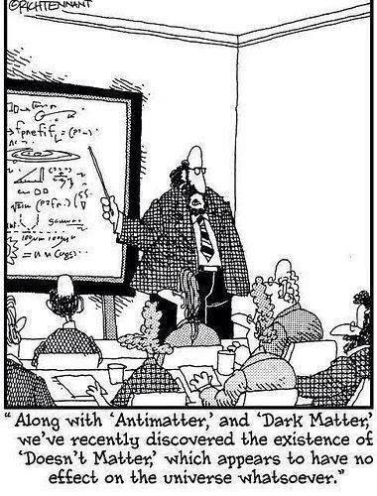









my SM training in 1976
Electroweak eigenstates
$$\left({e \atop v_{e}}\right)$$
$$\left({ \atop v_{μ}}\right)$$
$$\left({ \atop v_{τ}}\right)$$
$$\left(e\right)$$
$$\left(\right)$$
$$\left(\right)$$
Q= -1
R
R
R
L
L
L
$$\left(_{e}\right)$$
$$\left(_{μ}\right)$$
$$\left(_{τ}\right)$$
Q= 0
R
R
R
I = 1/2
I = 0
Right handed neutrinos
are singlets
no weak interaction
no EM interaction
no strong interaction
can’t produce them
can’t detect them
-- so why bother? –
Also called ‘sterile’
NB unlike for v_{L} , nothing distinguishes the particle and antiparticle of v_{R} which is a singlet (no ‘charge’)
→ naturally a Majorana particle

Slide 22

Neutrino masses occur via processes which are intimately related to the Higgs boson
➔ what are the couplings of the H(125) to neutrinos?
Adding neutrino masses to the Standard model 'simply' by adding a Dirac mass ➔ right-handed neutrino
m_{D} is the Higgs Yukawa coupling (like everybody else). Then the right-handed neutrinos are perfectly sterile, (except that they couple to both the Higgs boson and gravitation).
Things become more interesting: a Majorana mass term arises. So-called Weinberg Operator (only Dim5 operator in EFT) and involves the Higgs boson and the neutrino Yukawa coupling
H
Majorana mass term is extremely interesting as this is the
particle-to-antiparticle transition that we want
in order to explain
the Baryon asymmetry of the Universe
(+ CP violation in e.g. neutrinos)
M_{R}
Pilar Hernandez,
Granada 2019-05

Slide 24

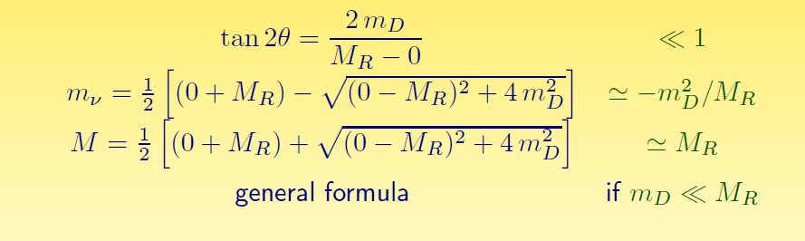
Mass eigenstates
See-saw type I :
M_{R} ≠ 0
m_{D} ≠ 0
Dirac + Majorana
mass terms
Yukawa coupling:
m_{D} = √m_{ν} . M
see-saw
M_{R} = 0
m_{D} ≠ 0
Dirac only, (like e- vs e+):
ν_{L} ν_{R} ‾ν_{L} ‾ν_{R}
½ 0 ½ 0
4 states of equal masses
M_{R} ≠ 0
m_{D} = 0
Majorana only
ν_{L} ‾ν_{R}
½ ½
2 states of equal masses
M_{R} > m_{D} ≠ 0
Dirac + Majorana
ν N ‾ν N
½ 0 ½ 0
4 states , 2 mass levels
m
m
m
I_{weak}=
dominantly:
I_{weak}=
I_{weak}=
Some have I=1/2 (active)
Some have I=0 (sterile)
All have I=1/2 (active)
m₁ have ~I=1/2 (~active)
m₂ have ~I=0 (~sterile)

Slide 25
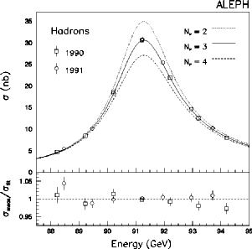


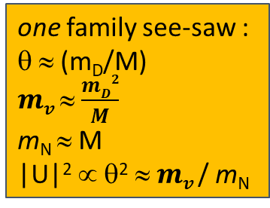
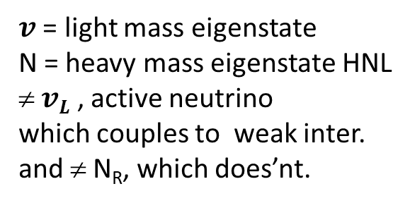

Manifestations of right handed neutrinos (HNL)
$v$ = light mass eigenstate
N = heavy mass eigenstate HNL
≠ $vL$ , active neutrino
which couples to weak inter.
and ≠ N_{R}, which does’nt.
one family see-saw :
θ ≈ (m_{D}/M)
$mv$ ≈ $\frac{mD2}{M}$
m_{N} ≈ M
|U|² ∝ θ² ≈ $mv$/ m_{N}
ν = ν_{L} cosθ - ${Nc}_{R }^{} sin$θ
$N=N_{R}^{} \text{cos}\text{θ}+ vL$ ^{c} sinθ
what is produced in W, Z decays is:
$vL= v$ cosθ + $N_{ }^{}sin$θ
-- mixing with active neutrinos leads to various observable consequences in High Energy experiments
If N is not too heavy it will decay in the detector ➔ POTENTIAL FOR DIRECT DISCOVERY
If it is too heavy to be produced
➔ PMNS matrix unitarity violation and deficit in Z «invisible» width
➔ violation of unitarity and lepton universality in Z, W or τ decays
➔ EW observables that contain neutrinos are modified, G_{F} in particular μ→ e ν_{e} ν_{μ}
➔ affect prediction of both {α G_{F} m_{Z}} → sin²θ_{W}^{eff}, m_{W} and all that follows
➔ tau life time
➔ N_{v} < 3
-- missing neutrino rate is proportional to sin²θ_{mix} regardless of HN mass
-- certainly effects in low energy experiments, due to ν-N mixing
Antusch, vdBeij...

Slide 26
POTENTIAL FOR DIRECT DISCOVERY of HEAVY NEUTRINOS

Slide 27
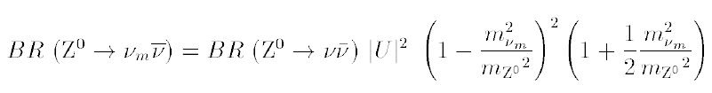
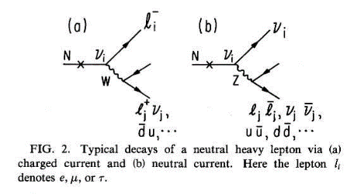

HNL
RH neutrino production in Z decays
Production:
multiply by 2 for antineutrino and add contributions of 3 neutrino species (➔ Σ_{λ=e,μ,τ} |U_{λ} |² )
Decay
Decay length:
cm
NB CC decay always leads to
≥ 2 charged tracks
Backgrounds : four fermion: e+e- → W*⁺ W*⁻ e+e- → Z*(vv) + (Z/γ)*
Long life time → detached vertex for ~<M_{Z}

Slide 28
Production of HNL in Z decays
We begin experimentally by assuming HNL production one at a time.
This is an approximation of the more favored situation where two or three almost degenerate HNLs are produced,
possibly generating a phenomenology akin to e.g. K_{L} and K_{S} or (K <->‾K) system with oscillations and other lifetime effects.
This is extraordinarily interesting ... see S. Antusch
In the simplified, one-N-at-a-time assumption the particle has one mass, one cross-section and one decay width/life time.
and four decay modes N→ eW*, μW*, τW* (CC decays) and N→ vZ* (NC decay)-- two or more charged tracks except N->vvv
0.6
0.5
0.4
0.3
0.2
0.1
0.0
Tanishq Sharma
N→ λ W*→ qq
N→ v Z* → qq
N→ λ⁺λ^{(‘)-} v
N→ λ W*→λ’v and
N→ v Z*→ λ λ)
N→ ν νν
BRANCHING
RATIO
10 20 30 40 50 60 70 80
HNL Mass (GeV/c²)

Slide 29
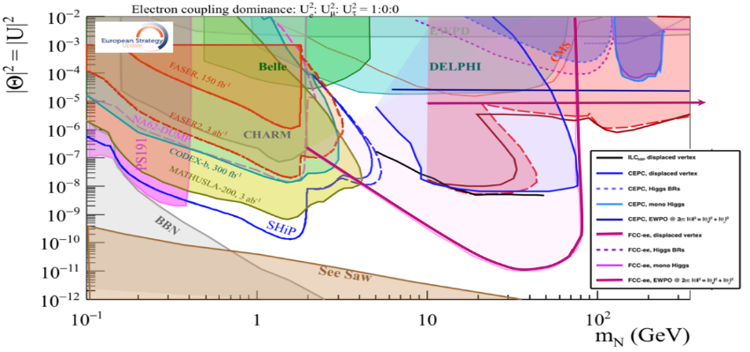
This picture from the ESPP BB is relevant to Neutrino, Dark sectors and High Energy Frontiers.
FCC-ee (Z) compared to the other machines for right-handed (sterile) neutrinos
How close can we get to the ‘see-saw limit’?
-- the purple line shows the 95% CL limit if no HNL is observed. (here for 10¹² Z),
-- the horizontal line represents the sensitivity to mixing of neutrinos to the dark sector,
using EWPOs (G_{F} vs sin²θ_{W}^{eff} and m_{Z}, m_{W}, tau decays) which extends sensitivity from 10⁻³ (now)
to 10⁻⁵ (FCC) mixing all the way to very high HNL masses (500-1000 TeV at least). arxiv:2011.04725

Slide 30
Dirac vs Majorana(I)
It has been emphasized by Matthew Mccullough that there exist ways to create models of Dirac HNL-like particles
and that the discovery of a RHv requires the observation of the Majorana nature of the particle.
In any case Fermion number violation is of the greatest interest.
At a hadron or ep collider the HNL can appear in W decay W(*)→ λ⁺N → λ’± W*⁺ . The charge of the final vs initial lepton is a test of fermion number violation which arises if HNL are Majorana particles.
At the Z the process Z→ Nv does not make it very easy.
Several methods (very interesting situation of entanglement!)
Forward-backward asymmetry relic of the Z parity violating couplings. Dirac keeps it, Majorana washes it out.
➔ uses N→ λqq decay and requires lepton charge reconstruction.
Polarization (also relic of Z parity violation) of HNL leads to harder lepton spectrum for Dirac than for Majorana
➔ uses N→ λqq and requires lepton momentum reconstruction (but not the charge)
NB analysis sensitive to detail W* mass distribution, esp. for small masse W* (in tau & D mass region and below)
W/Z diagram interference (Petcov) for N→ λλv Very elegant but less statistics and less easy
These methods work for the prompt analysis as well as for the LLP analysis within presumably a smaller radius.

Slide 32
Dirac vs Majorana(II)
in addition the lifetime is reduced by a factor 2 for a Majorana vs Dirac particle
C_{MD}= 1(Dirac), 2(Majorana)
At the Z the production cross-section and the decay rate depend on the same combination of mixing angles!
CAVEATs!!
Of course this can only be used if we can measure the lifetime,
and can be falsified if e.g two dirac neutrinos are produced with similar masses in the experiment.
The other methods (polarization and asymmetry) can be always used – 400 events are needed for 2σ separation

Slide 33
Drewes, ICHEP

