Slide 1



International Master on
Advanced Methods in Particle Physics
prof. Angelo Carbone
Department of Physics and Astronomy Augusto Righi - Bologna

Slide 2
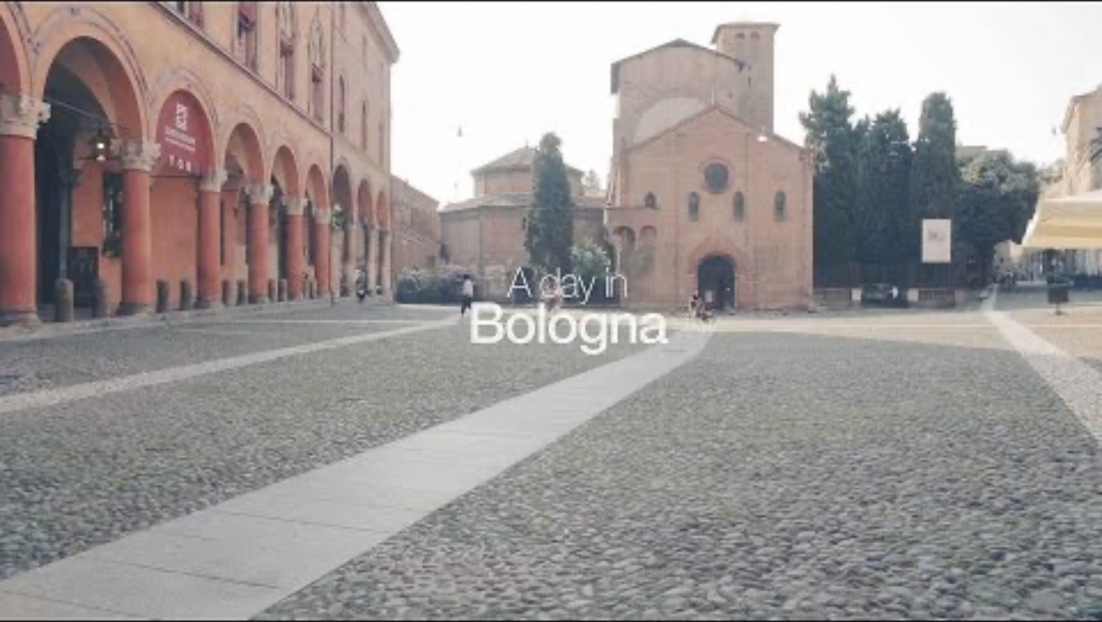
Felsina (Etruscans 6th century BC) → Bononia (Romans in 189 BC)
Bologna (today)

Slide 3
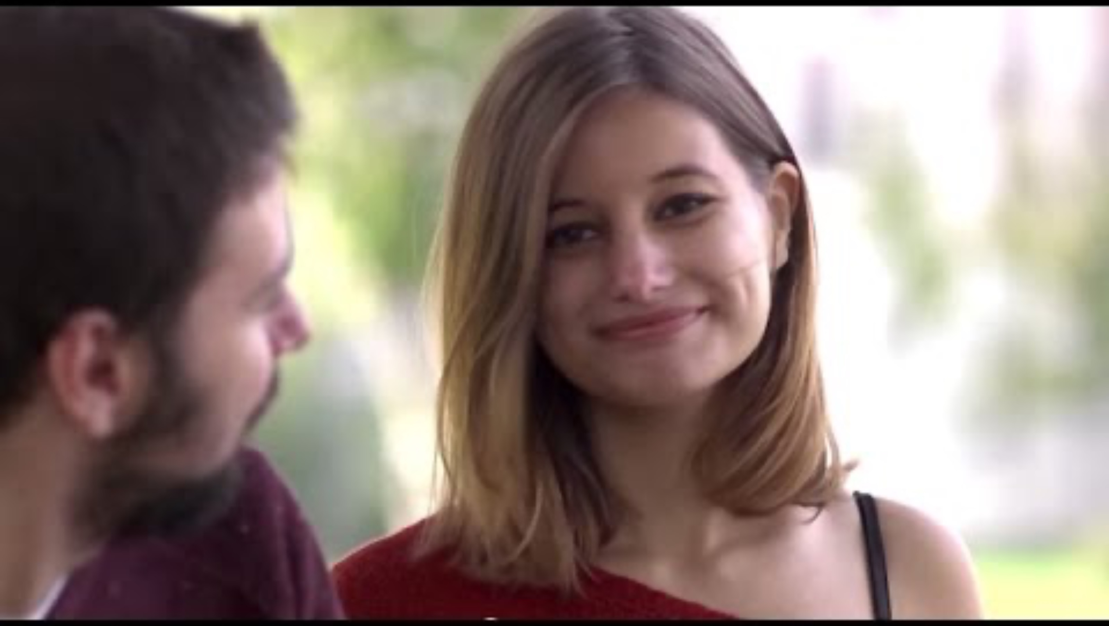
The University of Bologna

Slide 4

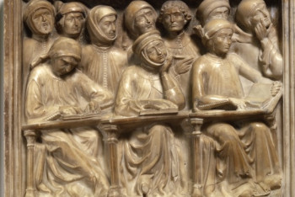
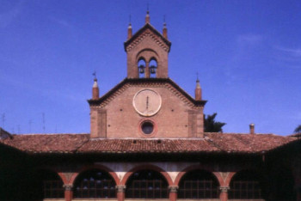
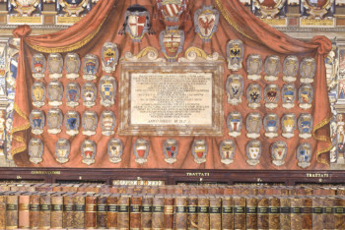
History – Alma Mater Studiorum - UNIBO
The University of Bologna is considered to be the oldest university in the Western world
Founded in 11th-12th centuries - The birth of the Studium and the Commune
It was the outcome of the spontaneous and informal initiative of a few students
A long history over Nine centuries
In the 21st century, UNIBO set up the first Multicampus scheme in Italy

Slide 5
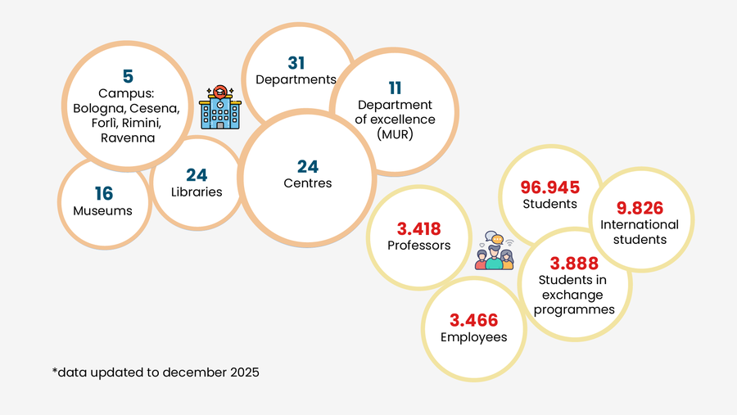
The University of Bologna in figures

Slide 6
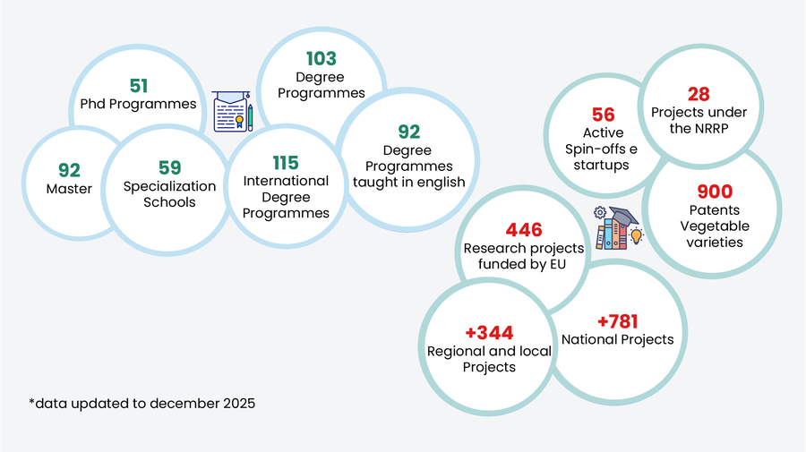
What we are working on

Slide 7
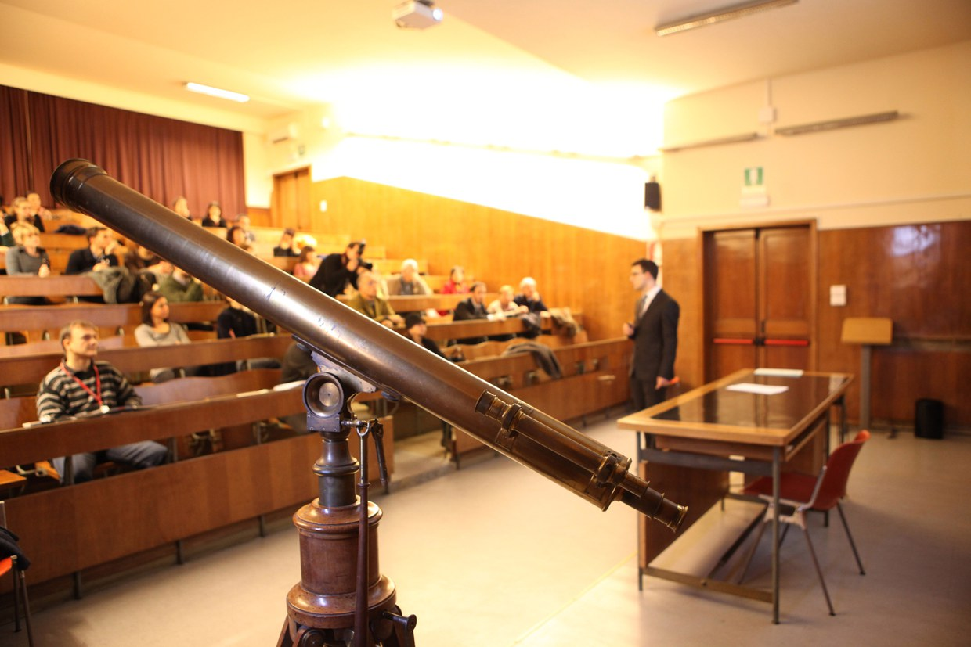
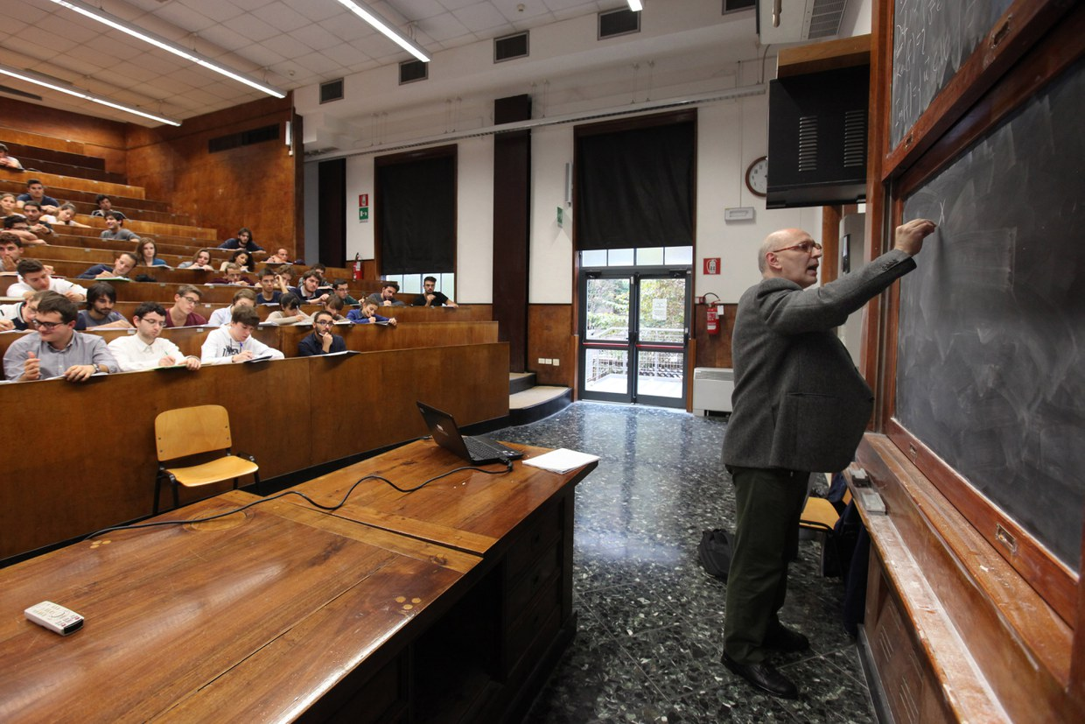
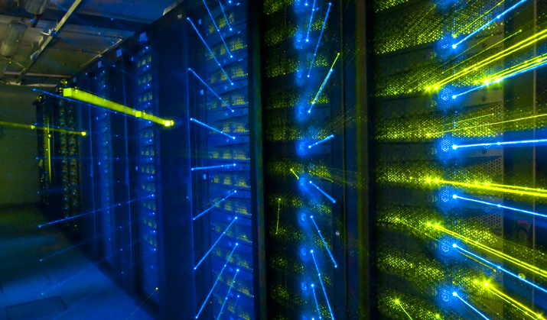
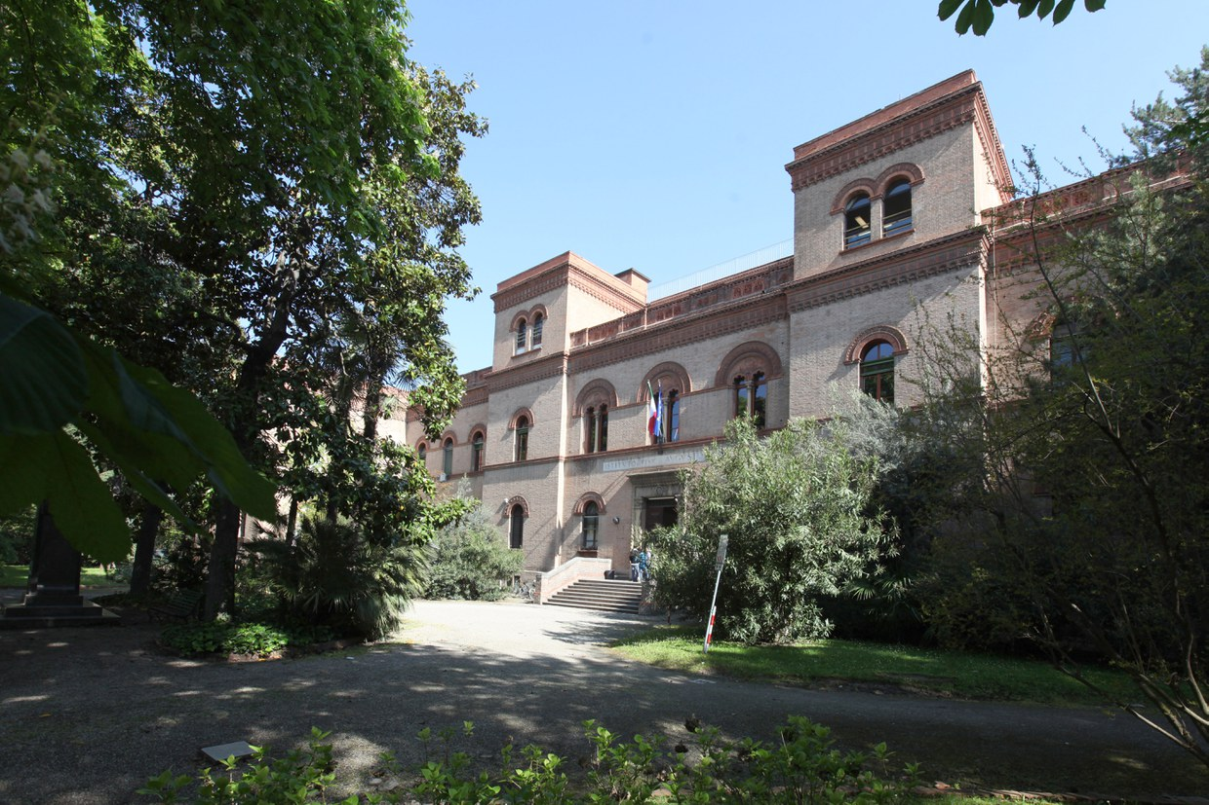
Department of Physics and Astronomy (DIFA)
DIFA is a significant structure integrated with almost 500 researchers achieving a level of excellence in Research and Teaching
DIFA area hosts researchers, laboratories and infrastructures of
Istituto Nazionale di Fisica Nucleare (Bologna's branch of INFN)
INFN's Centro nazionale tecnologie informatiche (CNAF)
CNAF- Particle physics computing centre
It is located in the city centre of Bologna

Slide 8
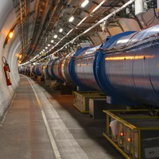
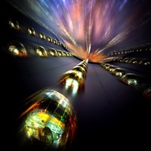
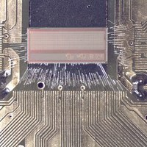
Research areas
High Energy Particle Physics with accelerators
ATLAS, ALICE, CMS, LHCb
Nuclear Physics
FOOT, FAMU, n_TOF, NUCL-EX
Neutrino Physics
CUORE, ENUBET, NU@FNAL
Astroparticle Physics and Cosmology
AMS, DarkSide, EUCLID, KM3, LVD, XENON
Detector R&D, Technology Transfer and Computing

Slide 9
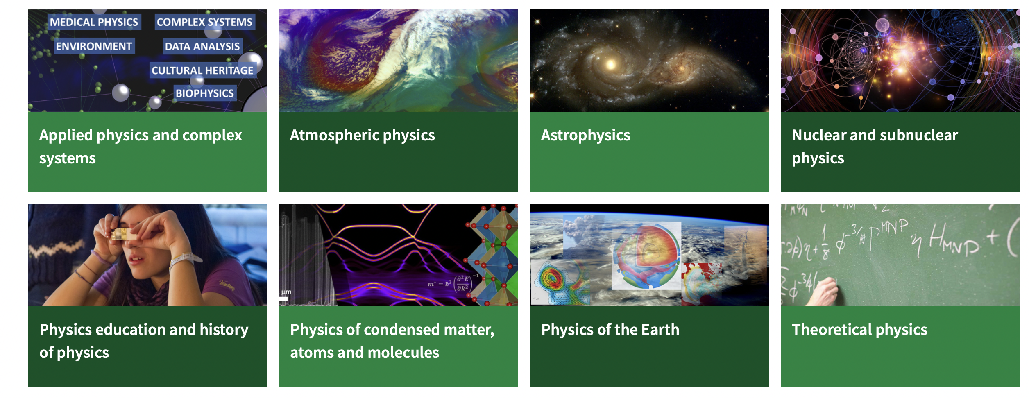
Research areas

Slide 10
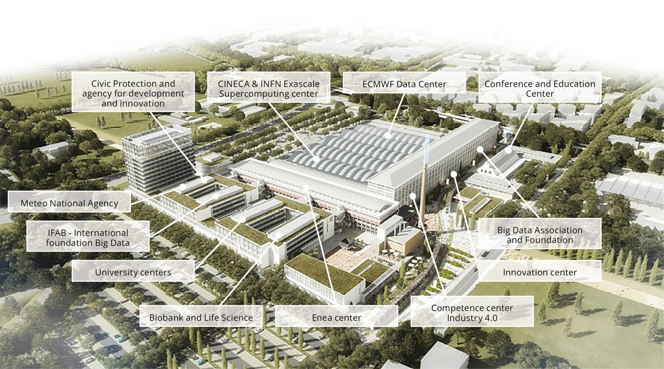
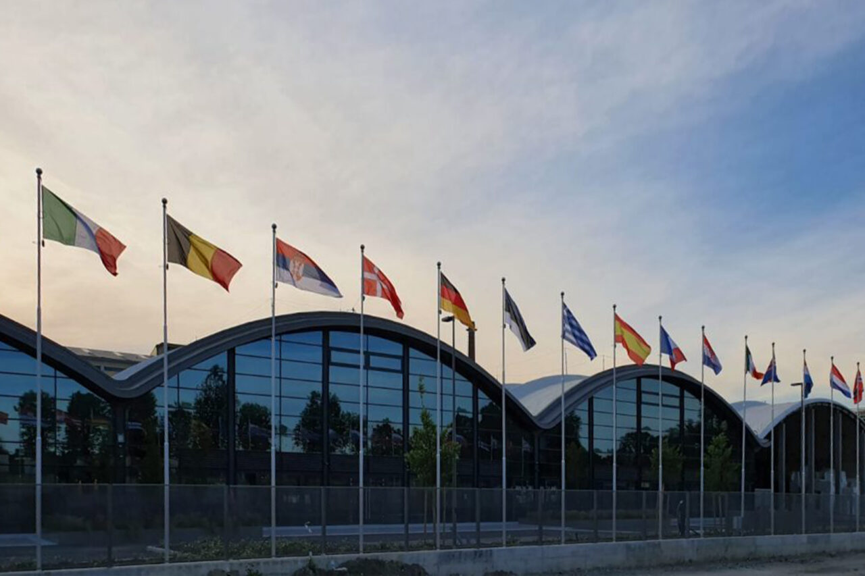
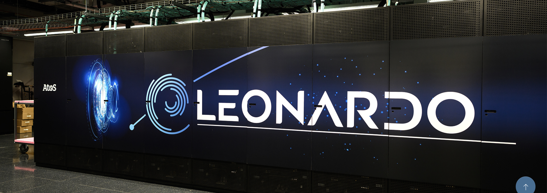
Bologna, in the heart of Data Valley
Bologna hosts 70% of Italian computing and storage capacity at the European research hub: the Big Data Technopole
Leonardo is one of the fastest and most powerful supercomputers in the world, ranking among the top positions in the TOP500 list

Slide 11
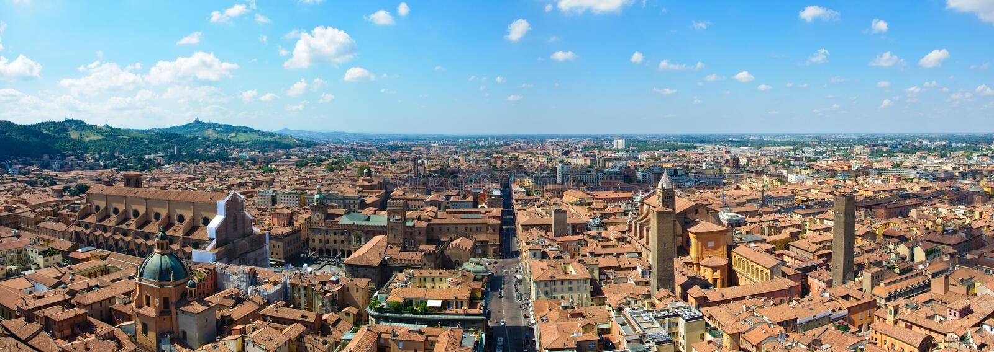
The semester in Bologna
First semester – second year
Introduction day in Bologna: mid-September 2027
Courses start in Bologna: mid-September 2027
Courses end in Bologna: ~22 December 2027
Exam period: January-February 2028
Focus:
Particle Physics and Computer Science

Slide 12
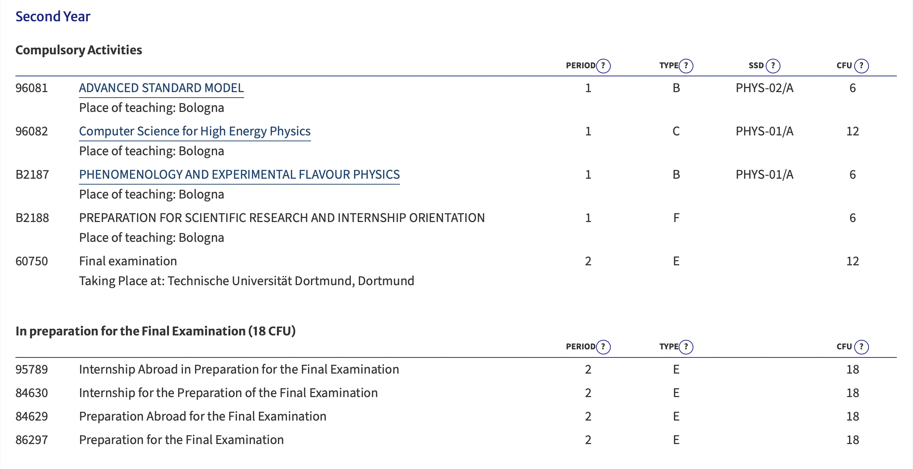
Second year

Slide 13
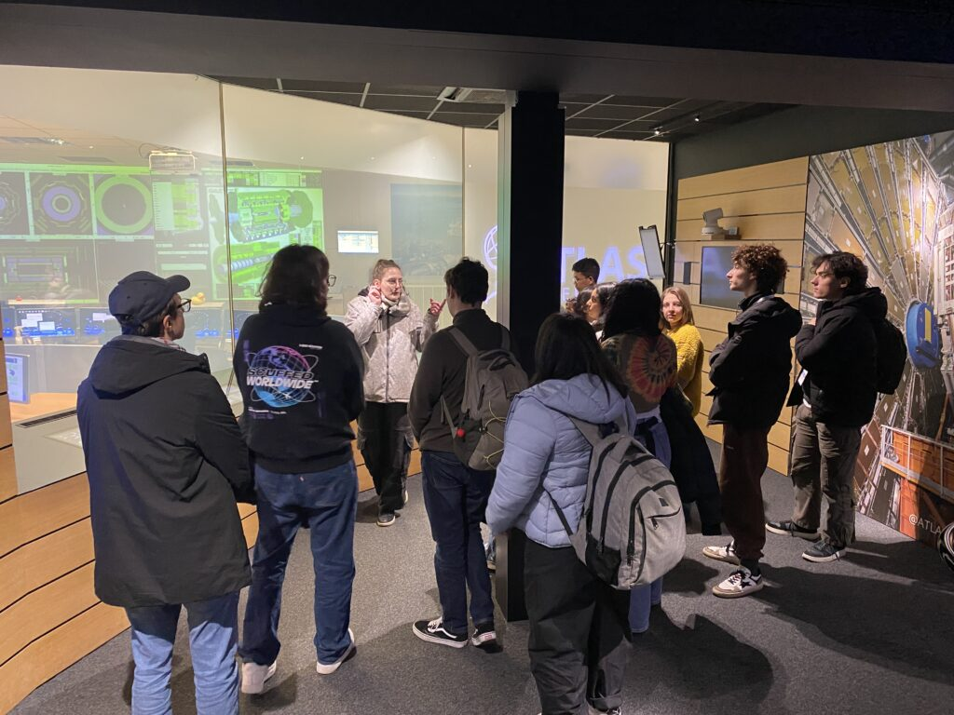
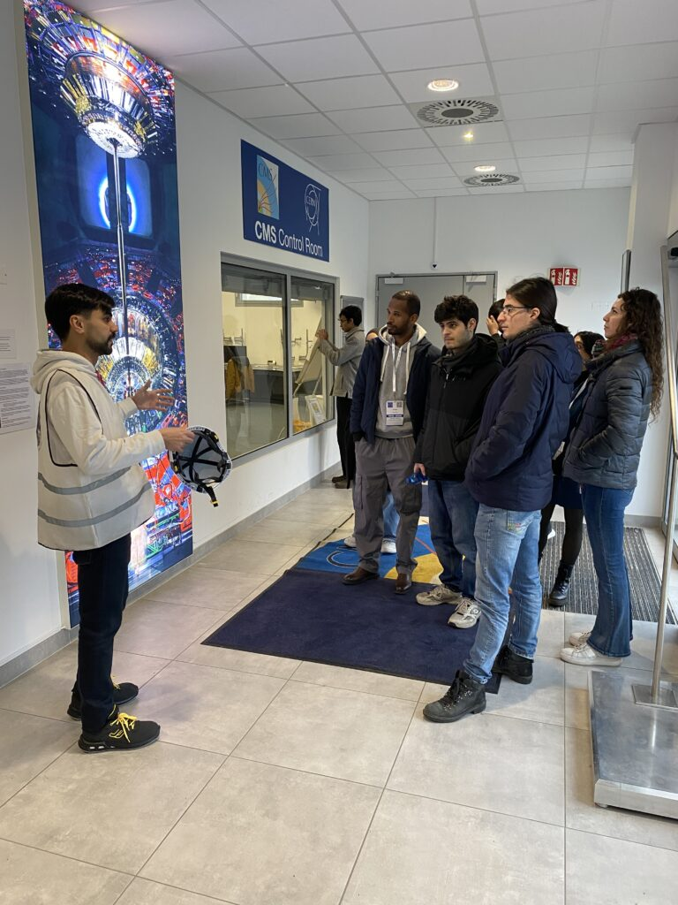
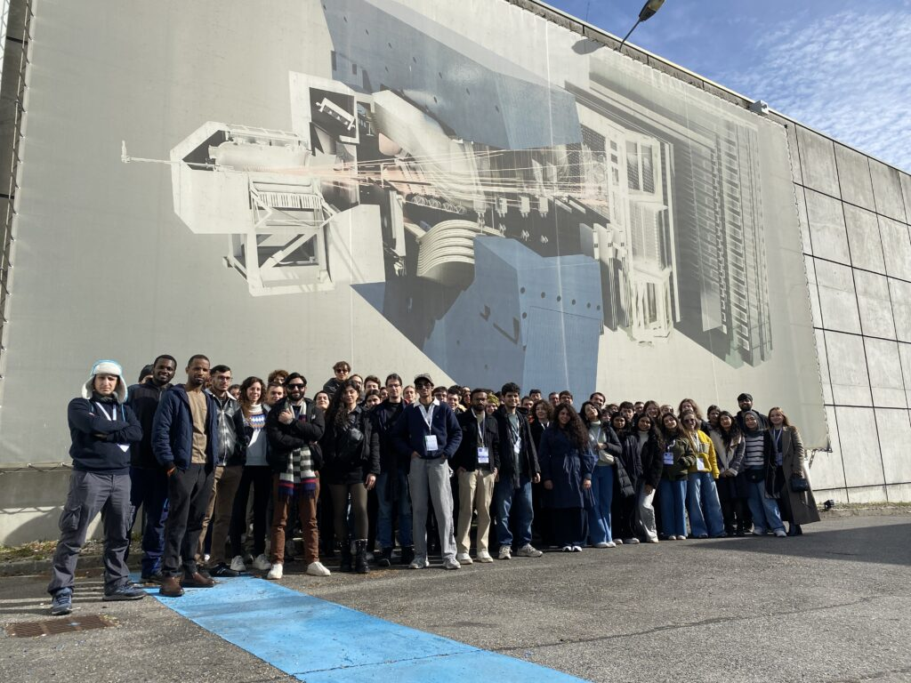
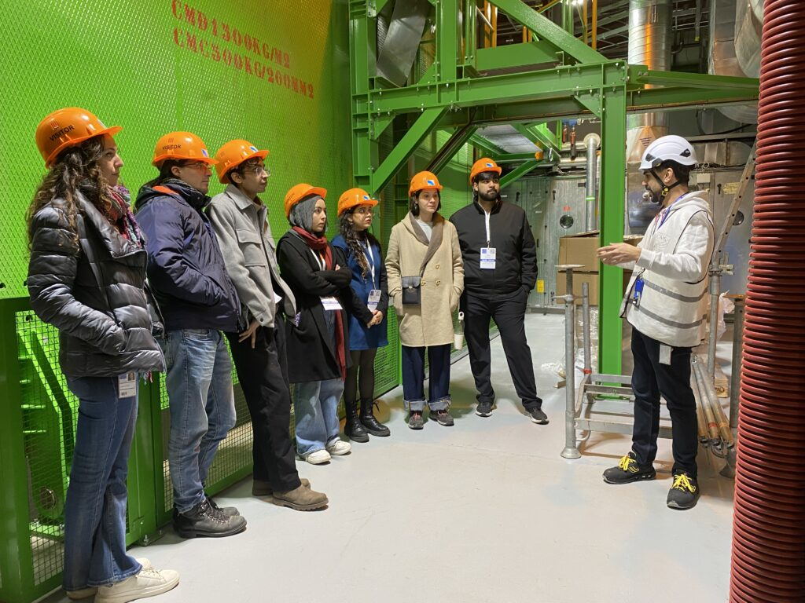
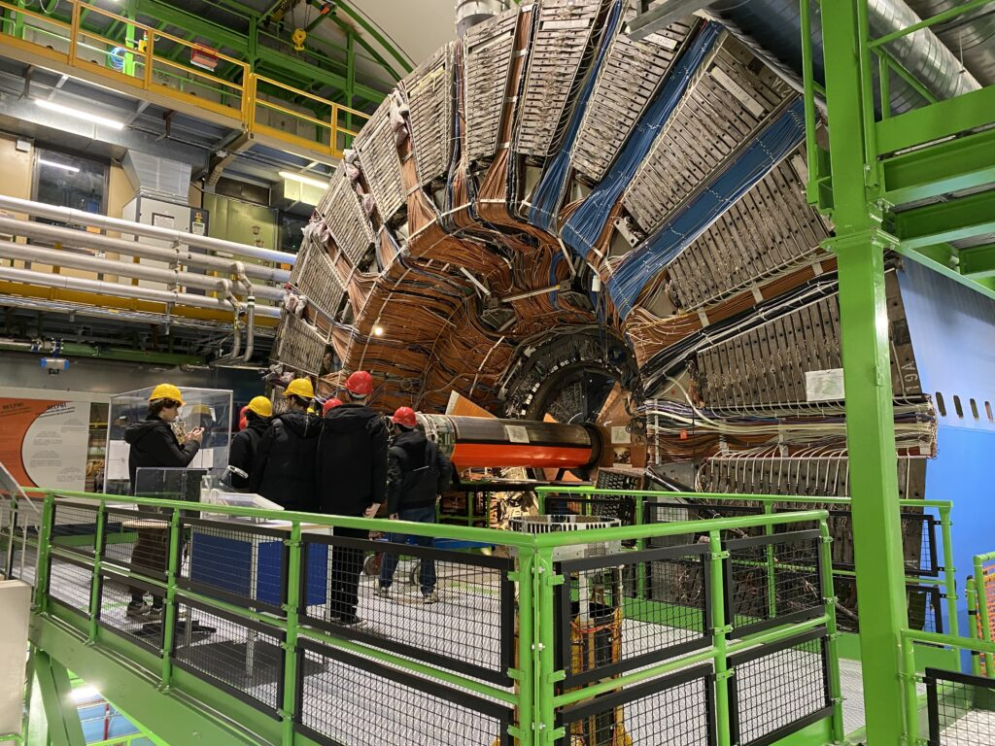
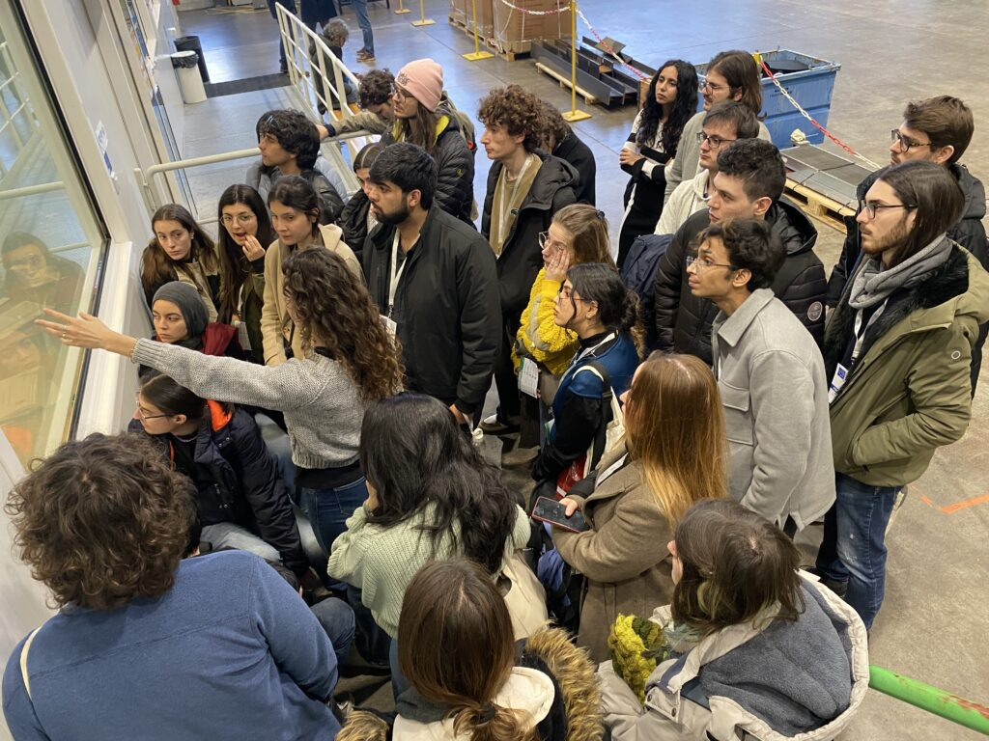
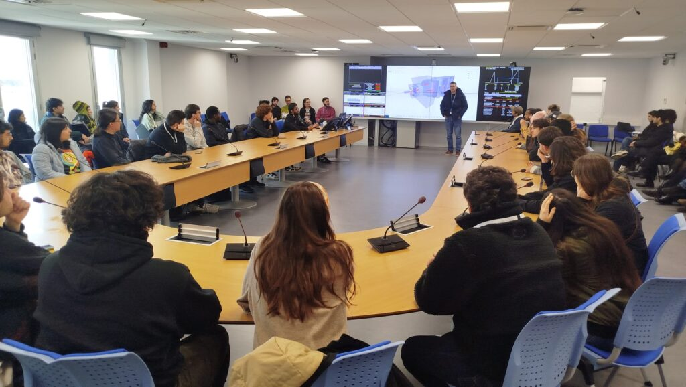
Class trip → CERN

Slide 14
Registration’s to Bologna University
To access UNIBO services, you need to register on the UNIBO portal
It is not urgent, you will receive an email at the beginning of 2027 when the registration process for IMAPP is completed
Please do it to get access to UNIBO facilities!

Slide 15
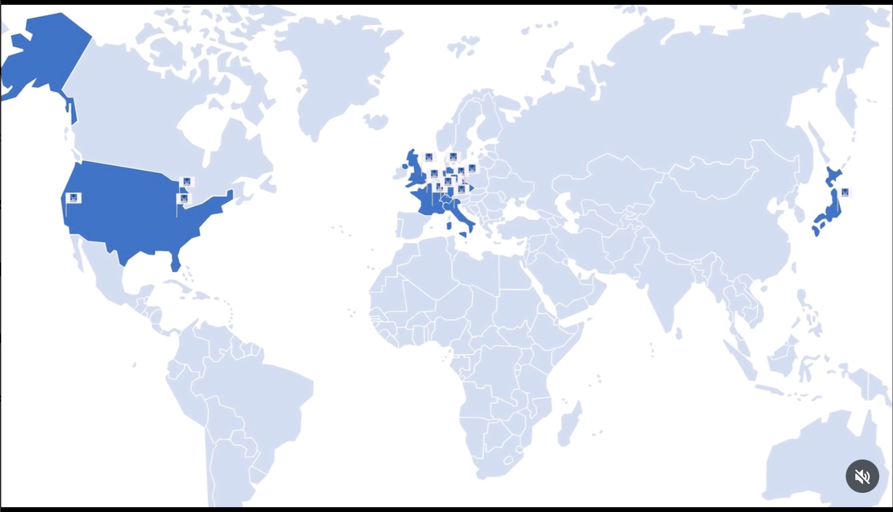
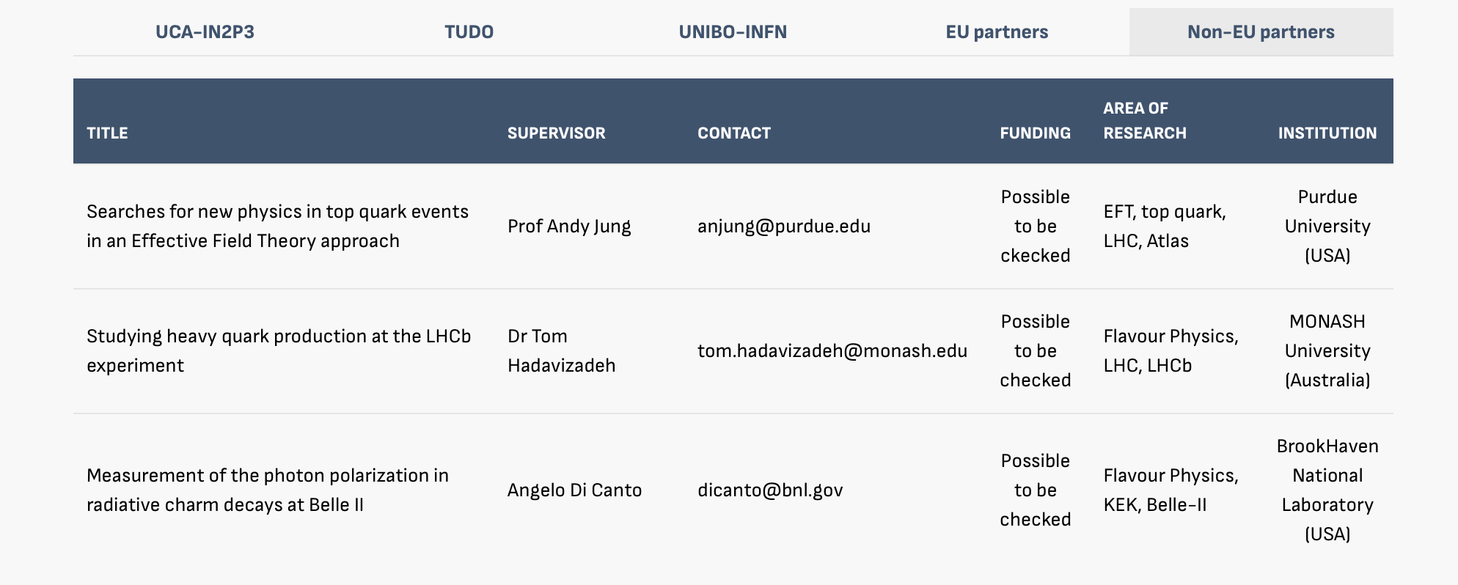
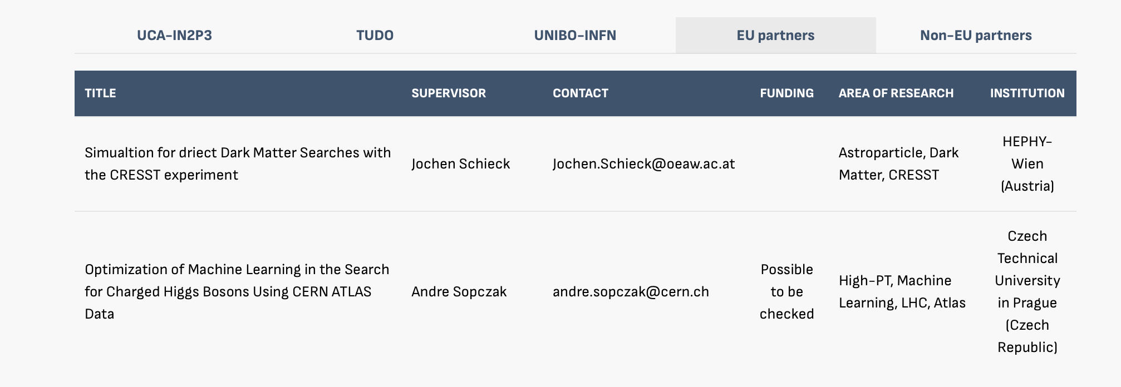
Internship
Internship will last six months (maximum). It will conclude with a written Master’s thesis, which has to be submitted within the duration of the Master’s project. → 15th of September deadline for delivering the thesis
You are required to have earned at least 86 ECTS credits before beginning the internship.

Slide 16
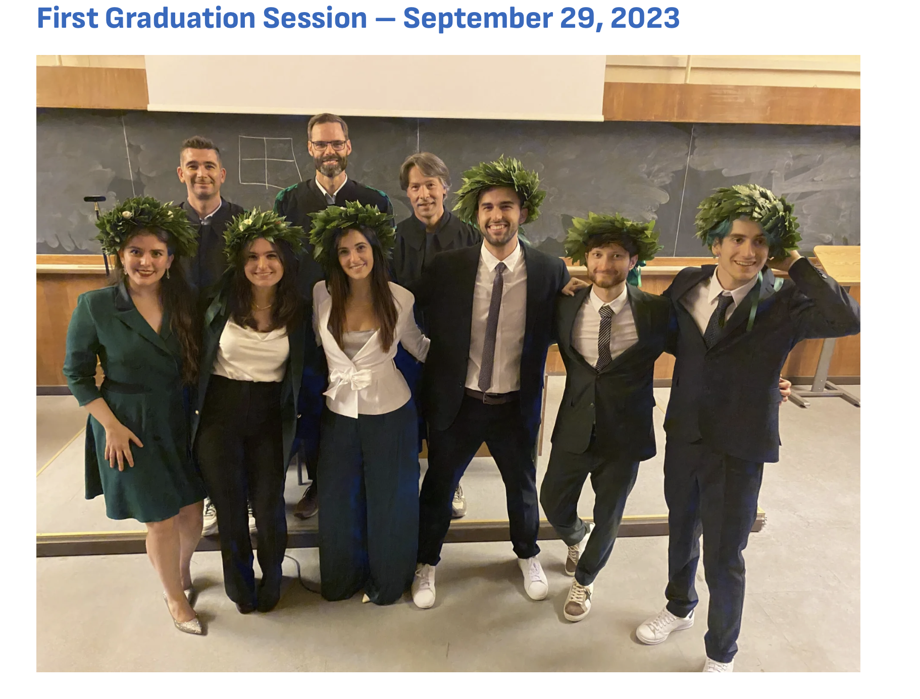
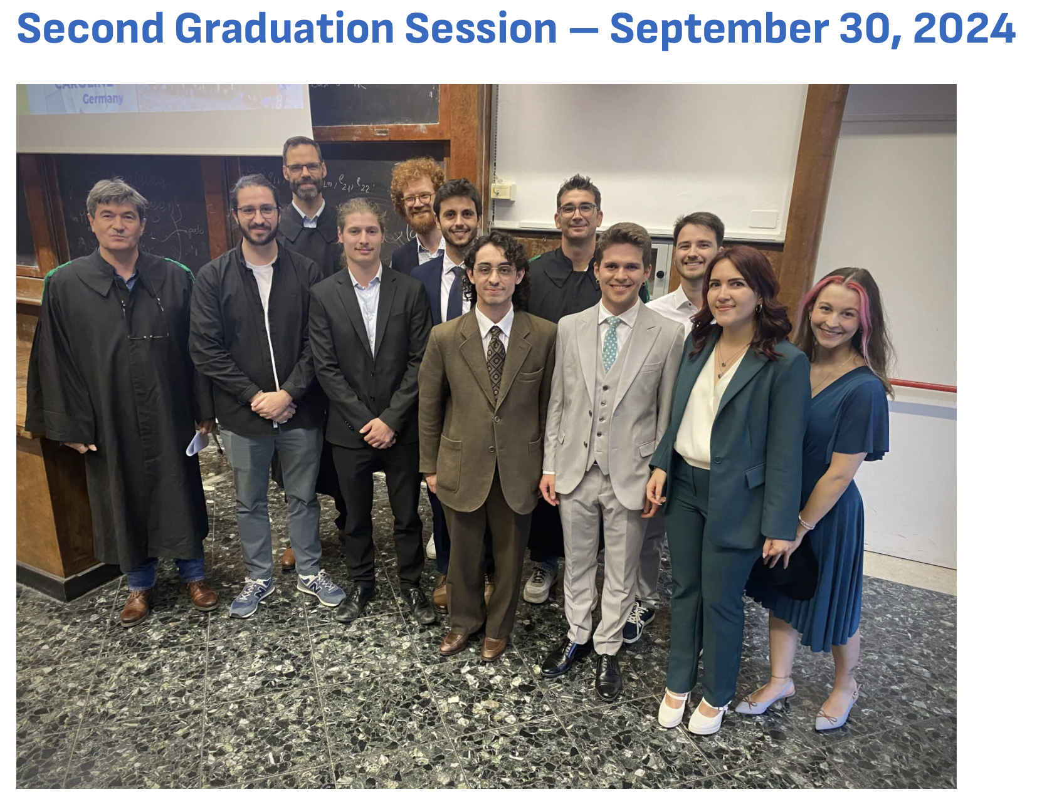
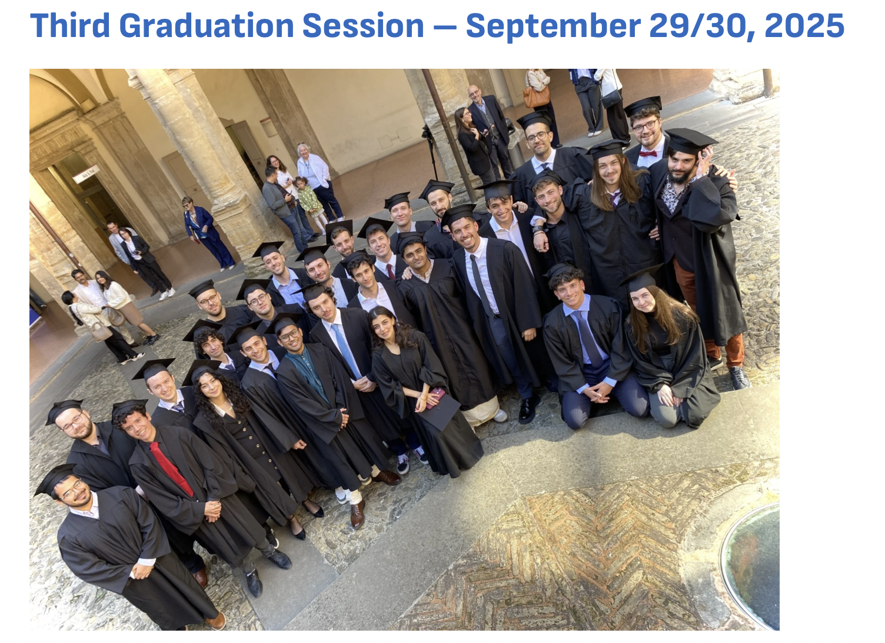
Final examination
The final examination is held annually at the end of September
So far, the University of Bologna has hosted the discussion of the thesis and the diploma Ceremony
The fourth graduation session will be on the 28th and 29th of September in Bologna About 25 students will discuss the thesis and receive the final diploma

Slide 17
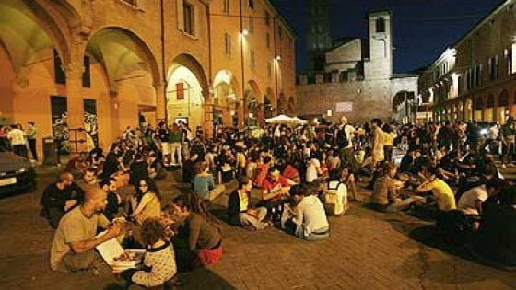
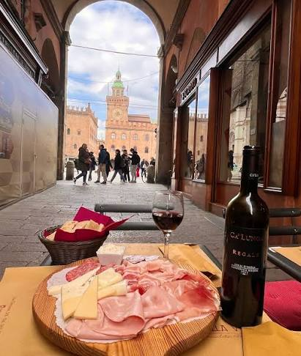
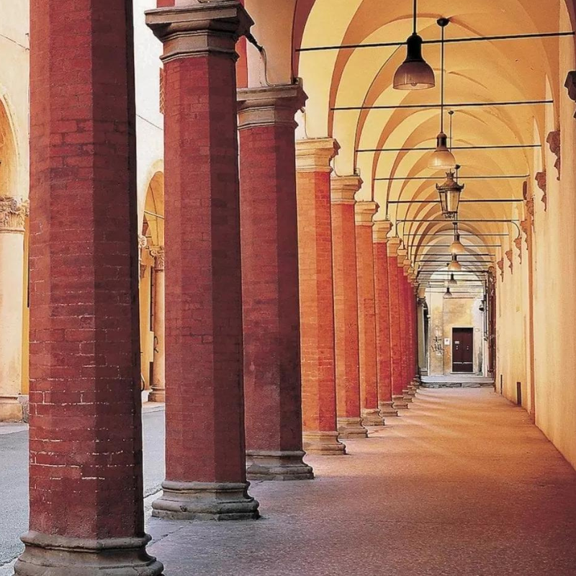
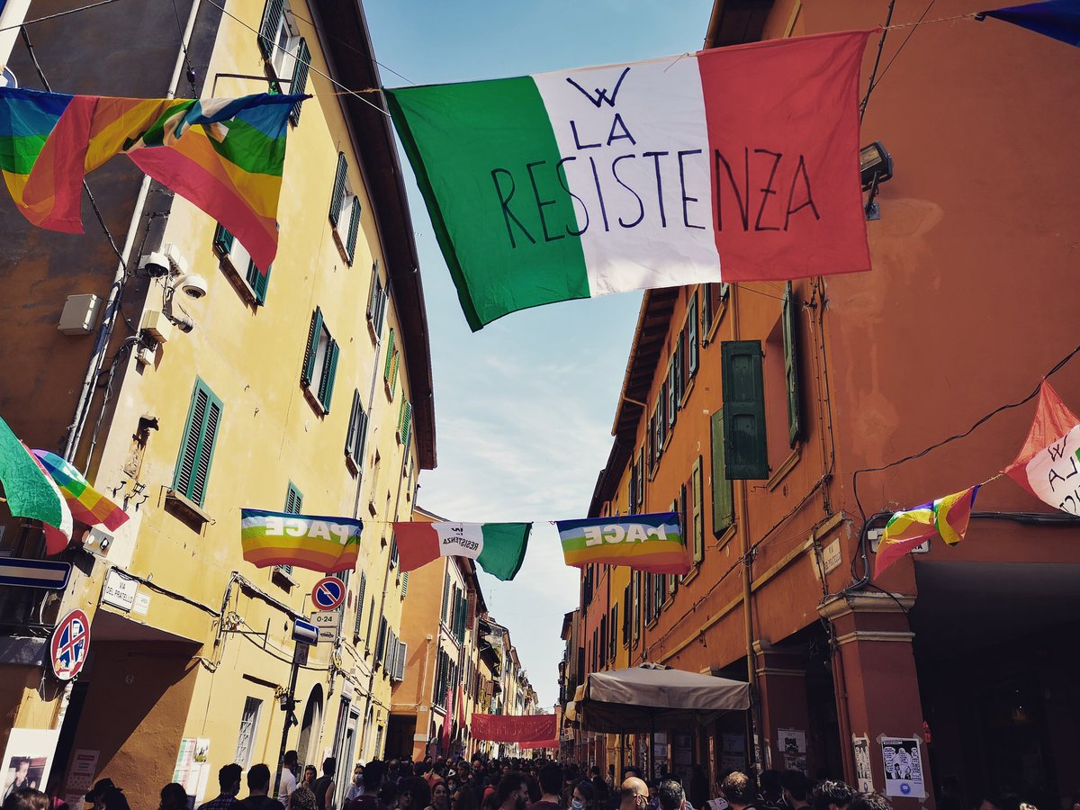
Bologna’s life
Bologna is an important agricultural, industrial, financial, and transport hub, where many large mechanical, electronic and food companies have their headquarters as well as one of the largest permanent trade fairs in Europe
Famous for nicknames
“la dotta” (the erudite), it's home to the oldest university in Europe
“la grassa” (the fat), referring to its rich cuisine
“la rossa” (the red) for the colour of its buildings (alternatively, for its past communist leanings)
Bologna is a lovely place to live for numerous reasons.

Slide 18
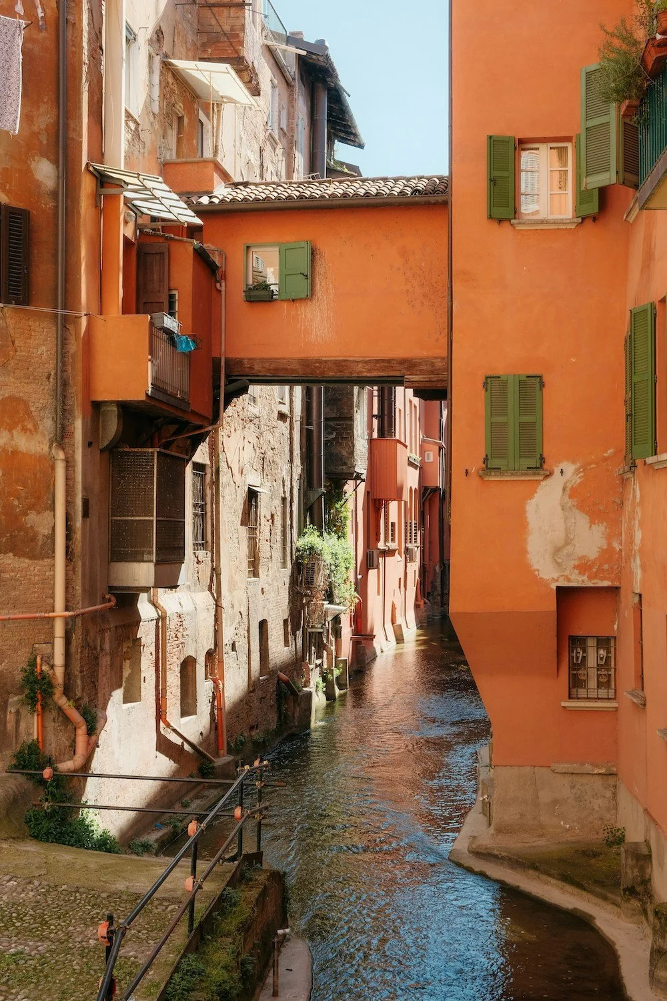
Accomodation
There is not a pre-bookgin procedure for getting accommodation, however, the University of Bologna offer several supports
Accommodation Showcase (Vetrina Alloggi) virtual bulletin board
SAIS (Student Accommodation and Information Service) supports international exchange students and enrolled students in finding accommodation
Agreement with Camplus (private companies), which offers in May/June possible solutions for the semesters
Typical price
Single room: 500-600 euros
Double room: 300-400 euros

Slide 19
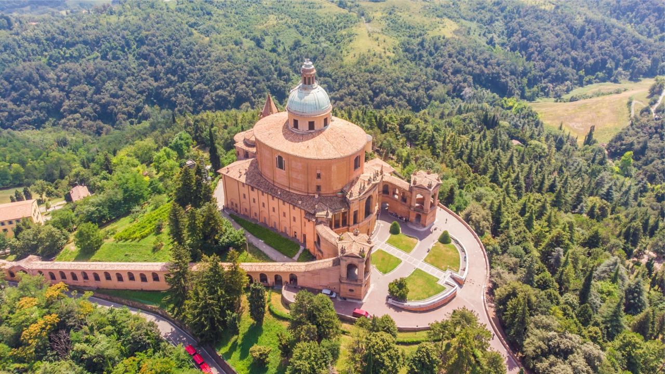
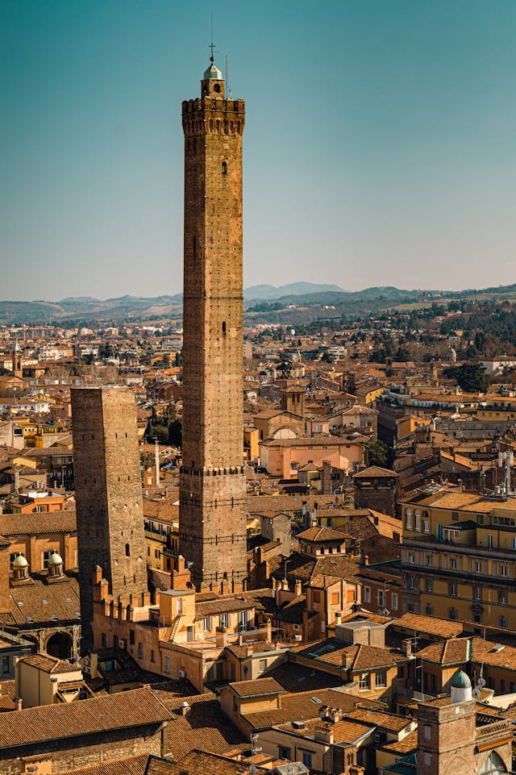
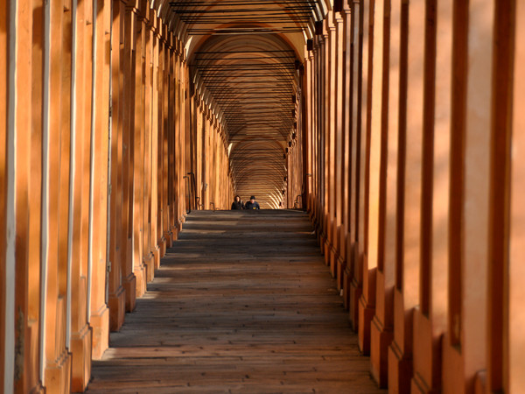
Don’t forget…
Never climb to the top of the tower or San Luca if you want to graduate

