Slide 1



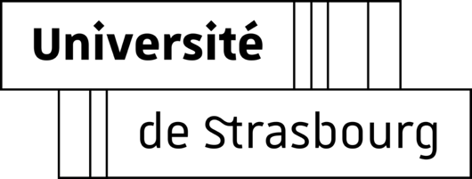
cocotb to model a DCO inside an ADPLL
Thomas Lauber
Université de Strasbourg – IPHC
thomas.lauber@etu.unistra.fr

Slide 2
Overview
01
Context
Me and my internship
02
ADPLL
How does it work
Behavioral modeling
with cocotb
Testbench, LUT, noise generation and validation
03
ADPLL testbench
Example of testbench and results
04
Conclusion
05

Slide 3

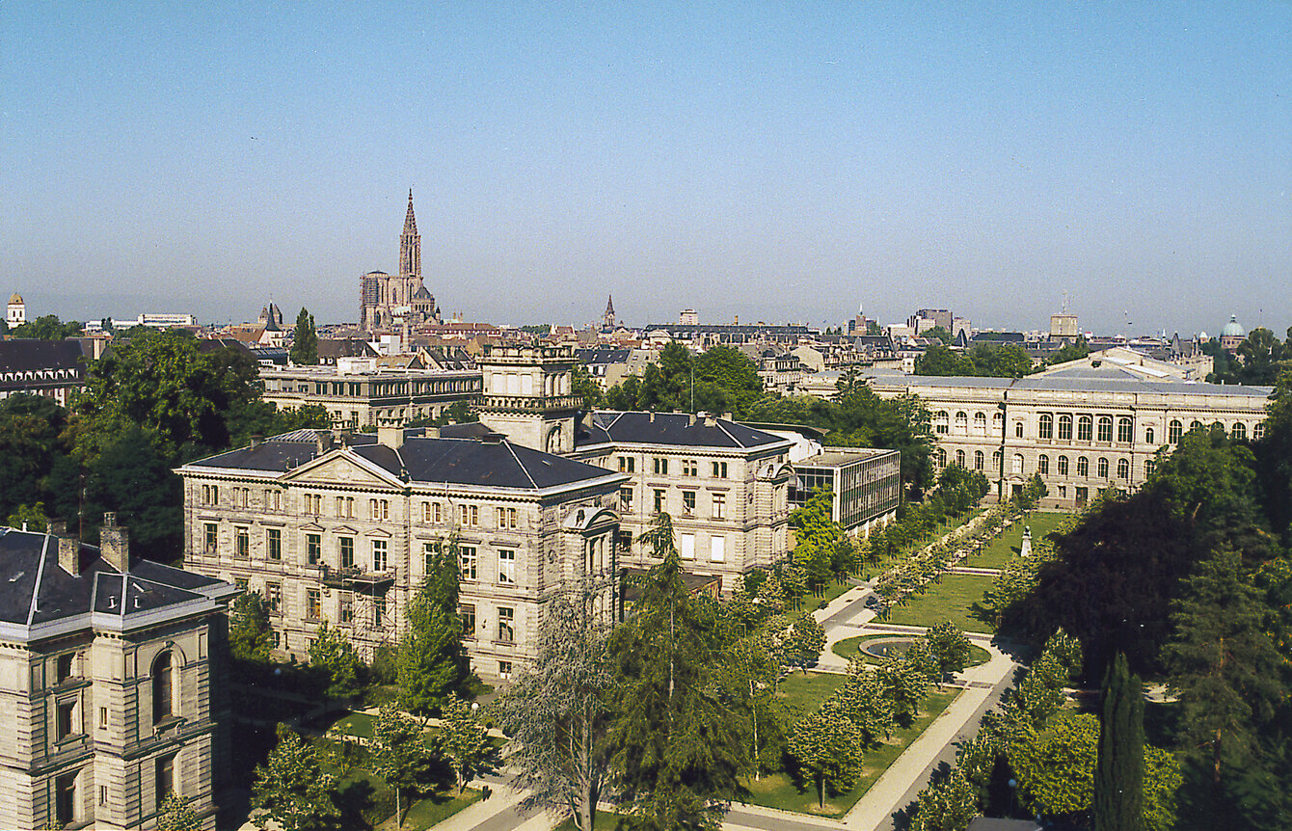
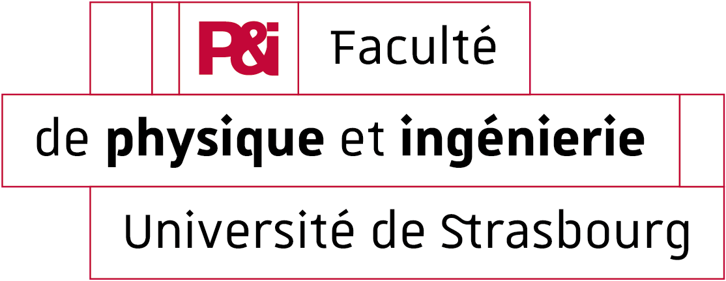
Context – My profile & my work
MSc Electronic & MicroElectronic Systems (SEME)
Intern at C4PI from March to August (6 months)
Designing an All-Digital PLL in 65nm node
Clock Synthesis
40MHz
1.28GHz
PLL
PAD

Slide 4

ADPLL – Bang-bang All Digital PLL
40MHz
Digitally Controlled Oscillator
(ring oscillator)
PLL
$$F=K.W+F_{0}$$
1.28GHz
PAD

Slide 5

Behavioral DCO – Why ?
Transistor level simulator (analog) or event driven simulator (digital) ?
Digital blocks
Analog block
DCO is the only analog block
PLL transients with Spectre can take up to weeks of simulation time
RTL simulator is used

Slide 6
Behavioral DCO – Phase noise and jitter concepts
Jitter is a time domain measure of the timing accuracy of the oscillator period
Phase noise is a frequency-domain view of the noise spectrum around the carrier
Time domain
Frequency domain
$$P_{c}$$
jitter
$$1Hz$$
f
$$f_{c}$$
offset

Slide 7
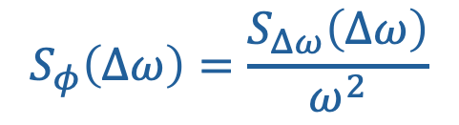
Behavioral DCO – How ?
DCO phase noise
$$S_{φ}\left(Δω\right)=\frac{S_{Δω}\left(Δω\right)}{ω^{2}}$$
Need of a behavioral model that reproduces these three regions
Use Spectre results as the reference and try to match it

Slide 8
Behavioral DCO – How ?
$$ΔT_{inject}\left[n\right]=ΔT_{inject,f}\left[n\right]+ΔT_{inject,w}\left[n\right]+ΔT_{inject,j}\left[n\right]$$
Injection of timing deviations from the nominal period
One amplitude for each phase noise region

Slide 9


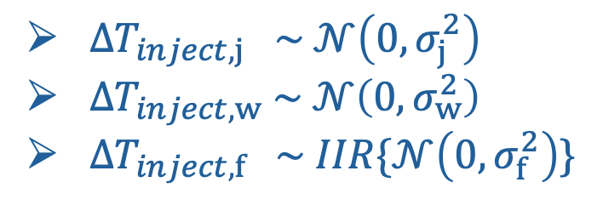
Behavioral DCO – How ?
Noise_injection.py
noise
$$ΔT_{inject}\left[n\right]=ΔT_{inject,f}\left[n\right]+ΔT_{inject,w}\left[n\right]+ΔT_{inject,j}\left[n\right]$$
$ΔT_{inject,j} \sim 𝒩\left(0,σ_{j}^{2}\right)$
$ΔT_{inject,w} \sim 𝒩\left(0,σ_{w}^{2}\right)$
$ΔT_{inject,f} \sim IIR\{𝒩\left(0,σ_{f}^{2}\right)$}
Inspired on [Waheed, K. and Staszewski, R.B.] paper

Slide 10

Behavioral DCO – How ?
$$ΔT_{inject}\left[n\right]=ΔT_{inject,f}\left[n\right]+ΔT_{inject,w}\left[n\right]+ΔT_{inject,j}\left[n\right]$$
Spectre
$$F=K.W+F_{0}$$

Slide 11

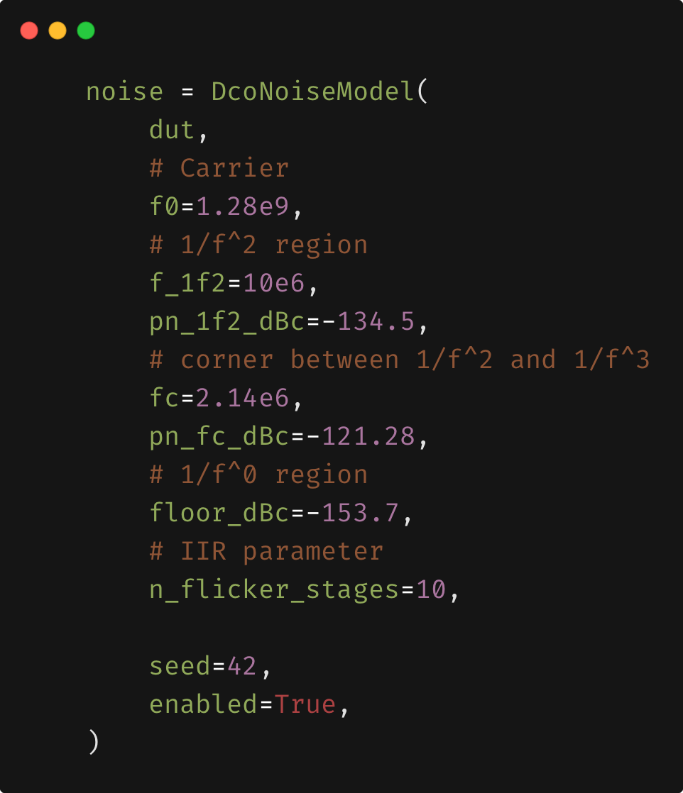



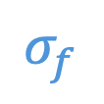
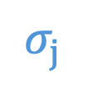
Behavioral DCO – How ?
Xcelium
Python wrapper
Post-layout simulation
Spectre results (PSS + PN)
$$σ_{f}$$
DUT.sv
Noise_injection.py
$$σ_{w}$$
noise
$$σ_{j}$$
pn_fc
Post_process.py
fout
FFT
pn_1f2
floor
csv
fc
f_1f2
Match ?

Slide 12

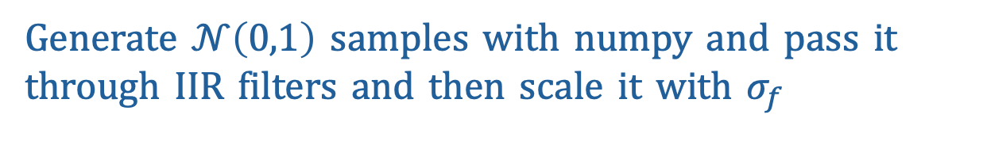
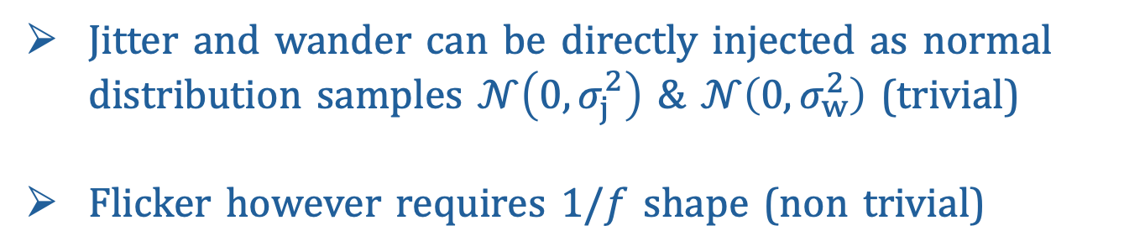
Behavioral DCO – Advantage of cocotb
Jitter and wander can be directly injected as normal distribution samples $𝒩\left(0,σ_{j}^{2}\right)$ & $𝒩\left(0,σ_{w}^{2}\right)$ (trivial)
Flicker however requires $1/f$ shape (non trivial)
random.standard_normal()
Generate $𝒩\left(0,1\right)$ samples with numpy and pass it
through IIR filters and then scale it with $σ_{f}$
Filtering is easy in python (numpy)

Slide 13
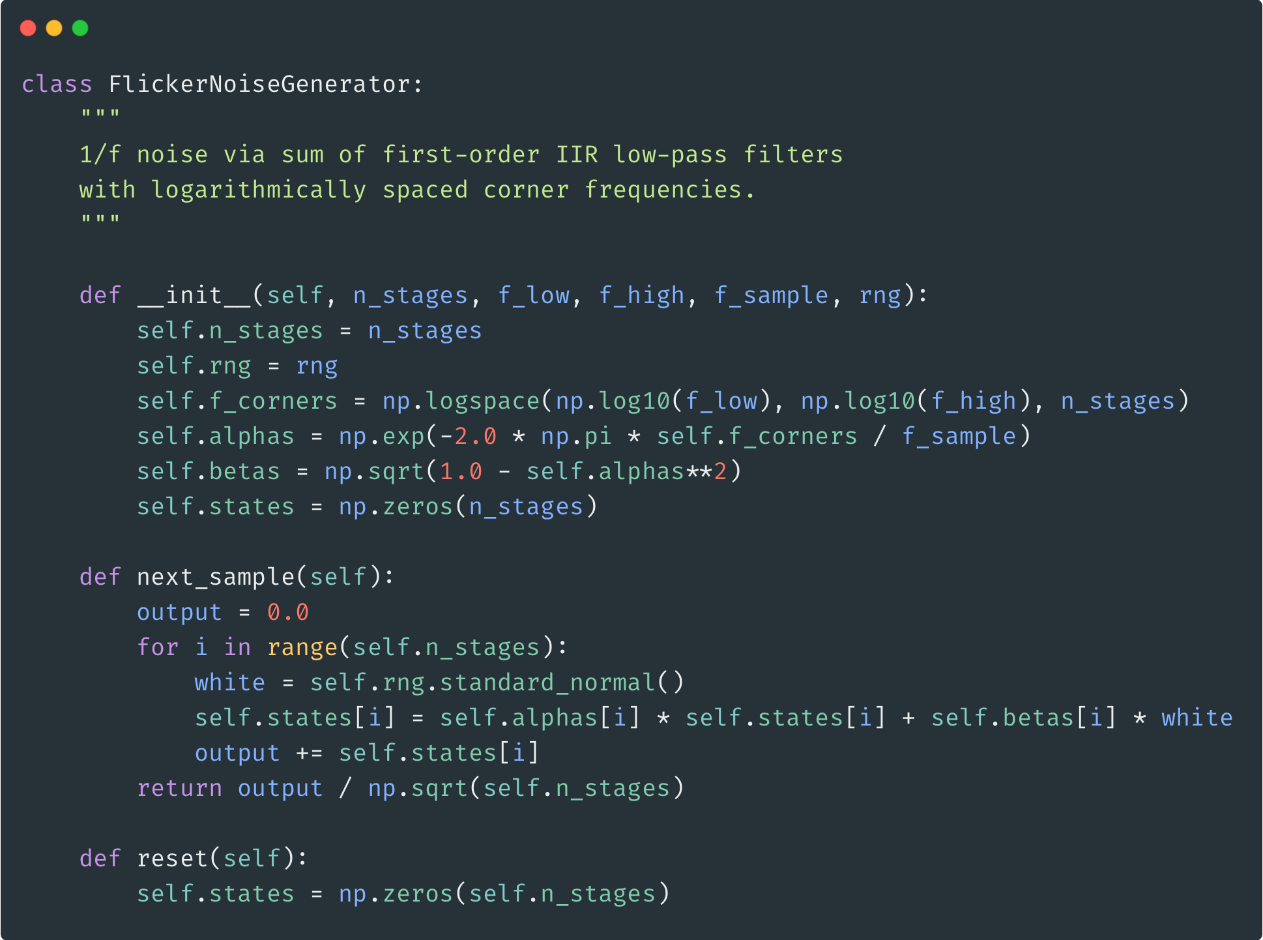
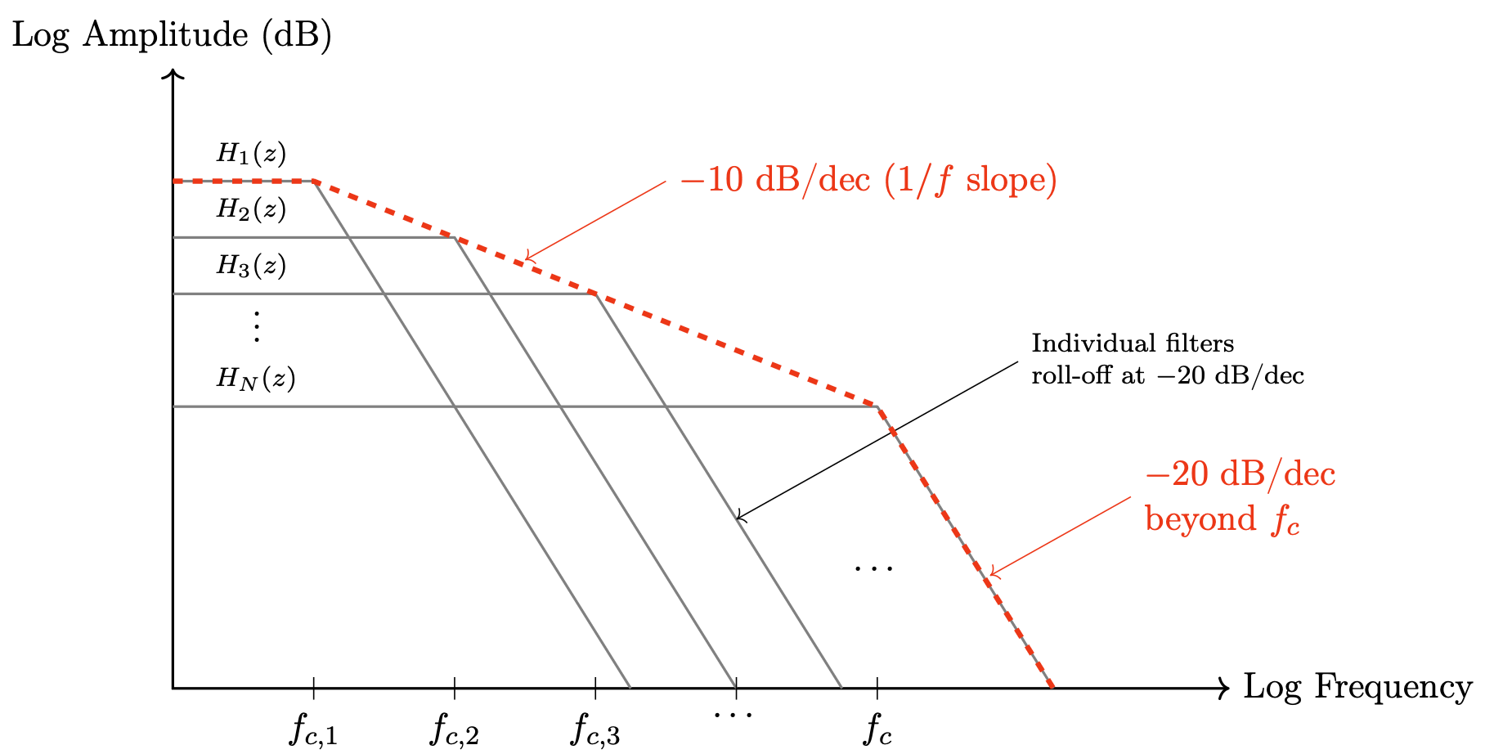

Behavioral DCO – Advantage of cocotb
Generation of $1/f$ shape

Slide 14
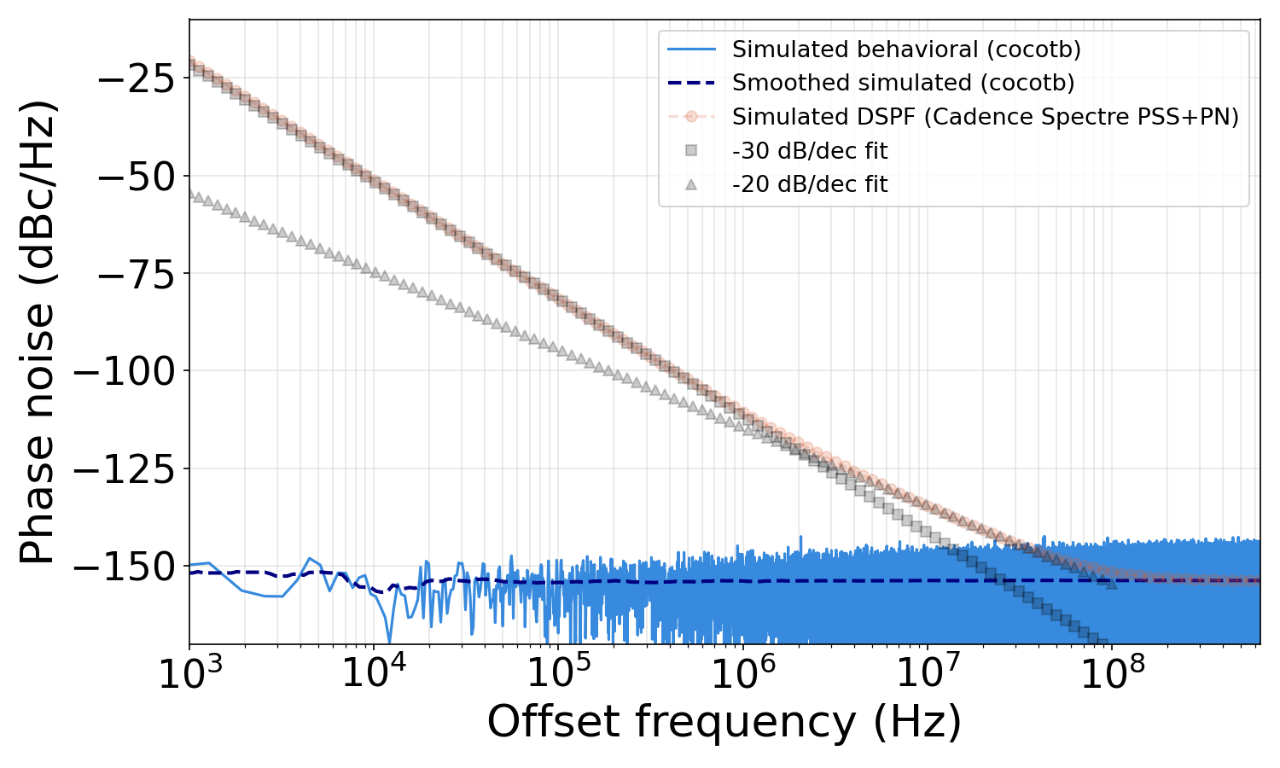

Behavioral DCO – model validation
Jitter injection –$1/f^{0}$
vs
$$ΔT_{inject}\left[n\right]=ΔT_{inject,j}\left[n\right]$$

Slide 15
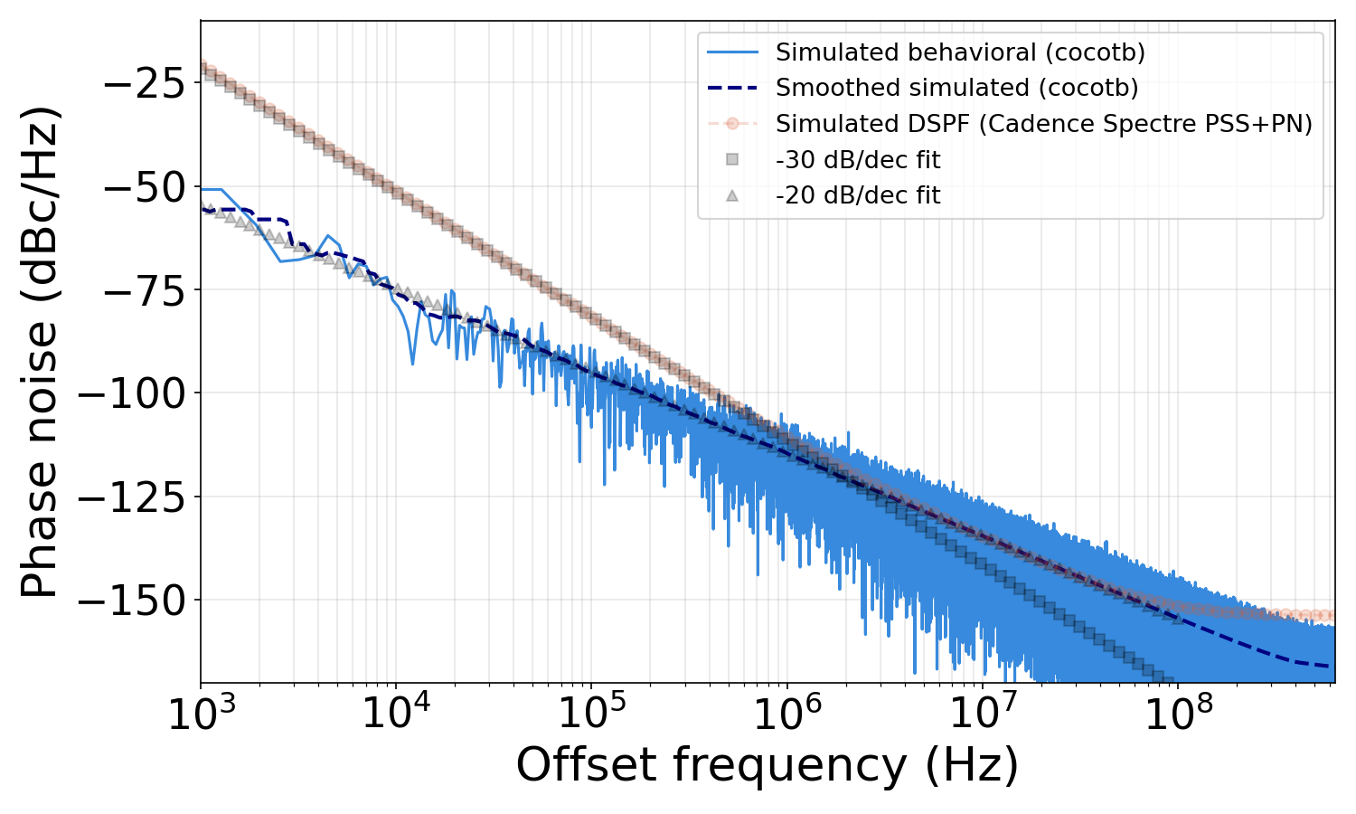

Behavioral DCO – model validation
Wander injection –$1/f^{2}$
vs
$$ΔT_{inject}\left[n\right]=ΔT_{inject,w}\left[n\right]$$

Slide 16
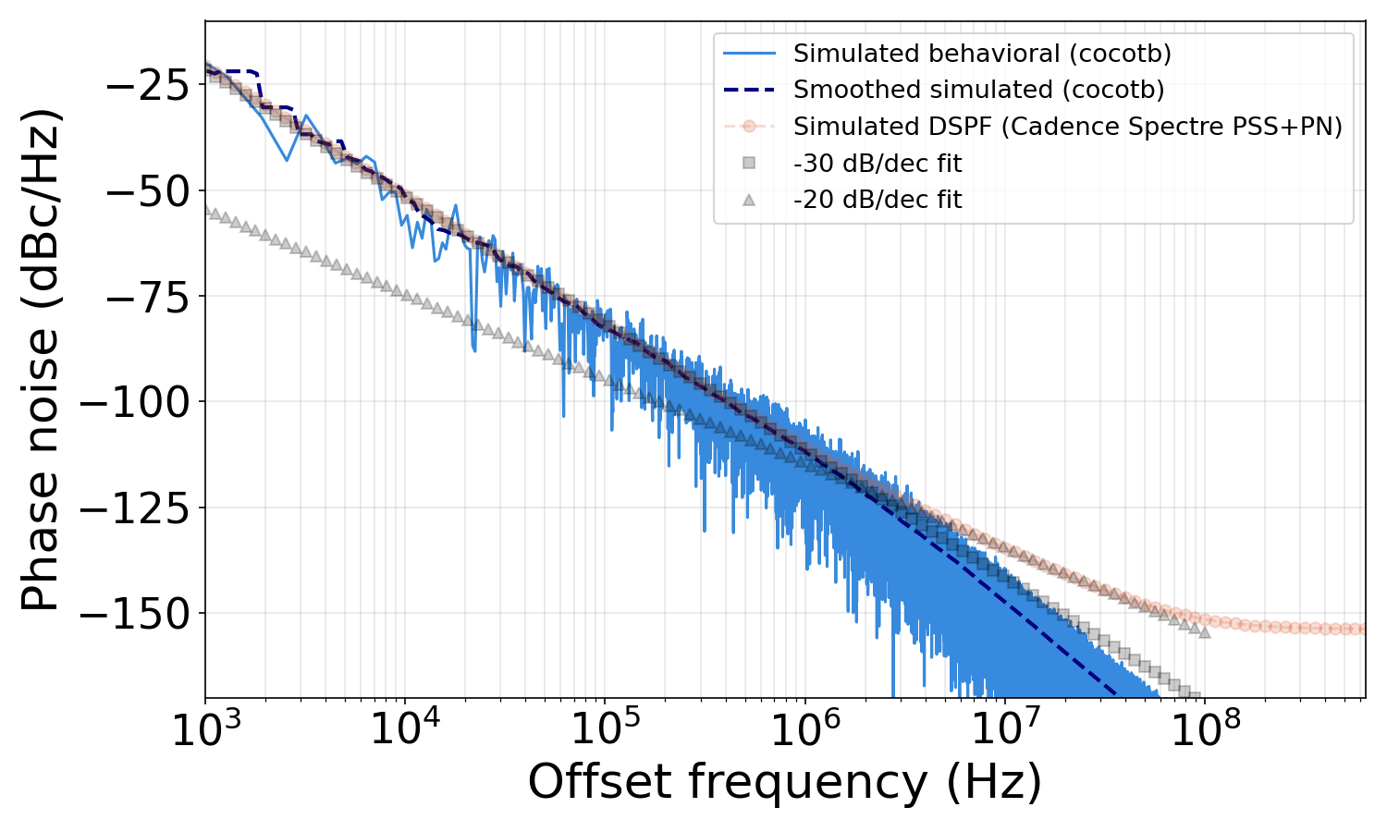

Behavioral DCO – model validation
Flicker injection –$1/f^{3}$
vs
$$ΔT_{inject}\left[n\right]=ΔT_{inject,f}\left[n\right]$$

Slide 17
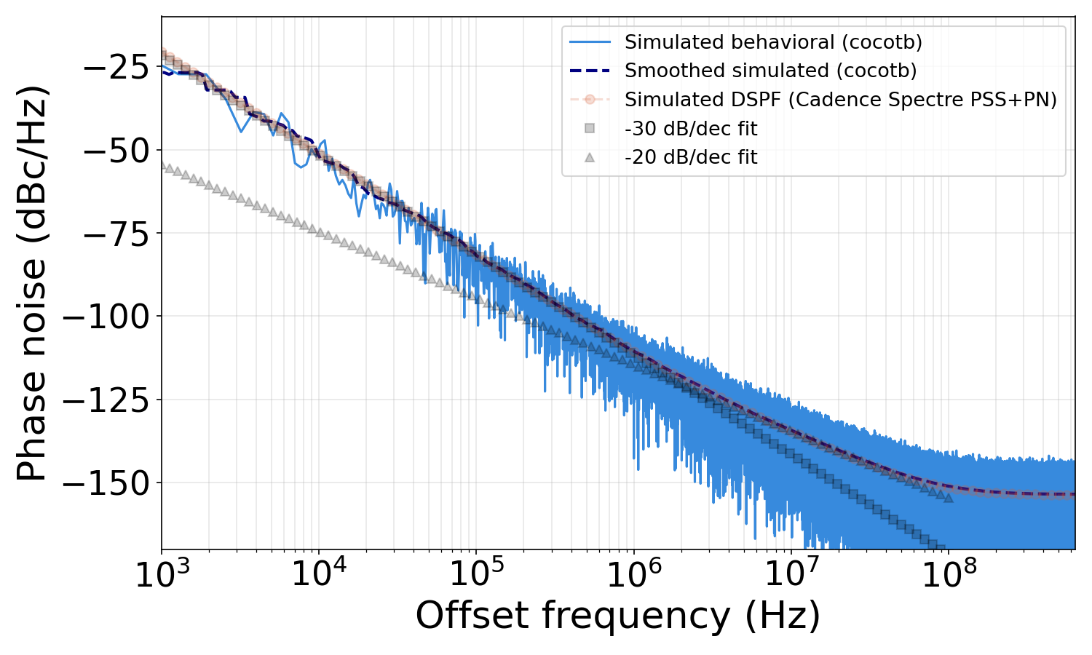
Behavioral DCO – model validation
All
vs
$$ΔT_{inject}\left[n\right]=ΔT_{inject,f}\left[n\right]+ΔT_{inject,w}\left[n\right]+ΔT_{inject,j}\left[n\right]$$

Slide 18
ADPLL simulation – testbench

Slide 19

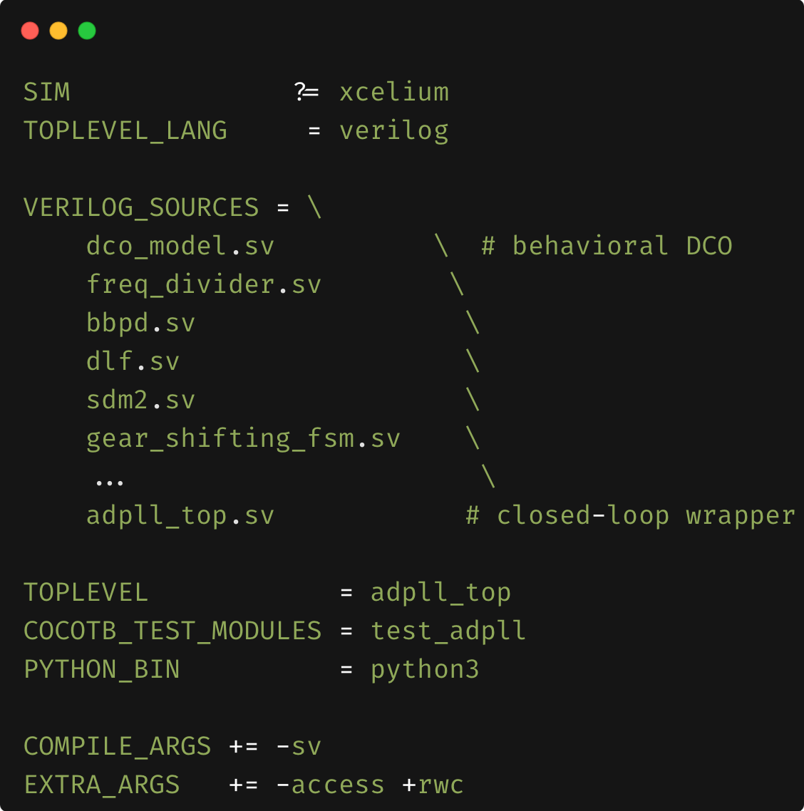
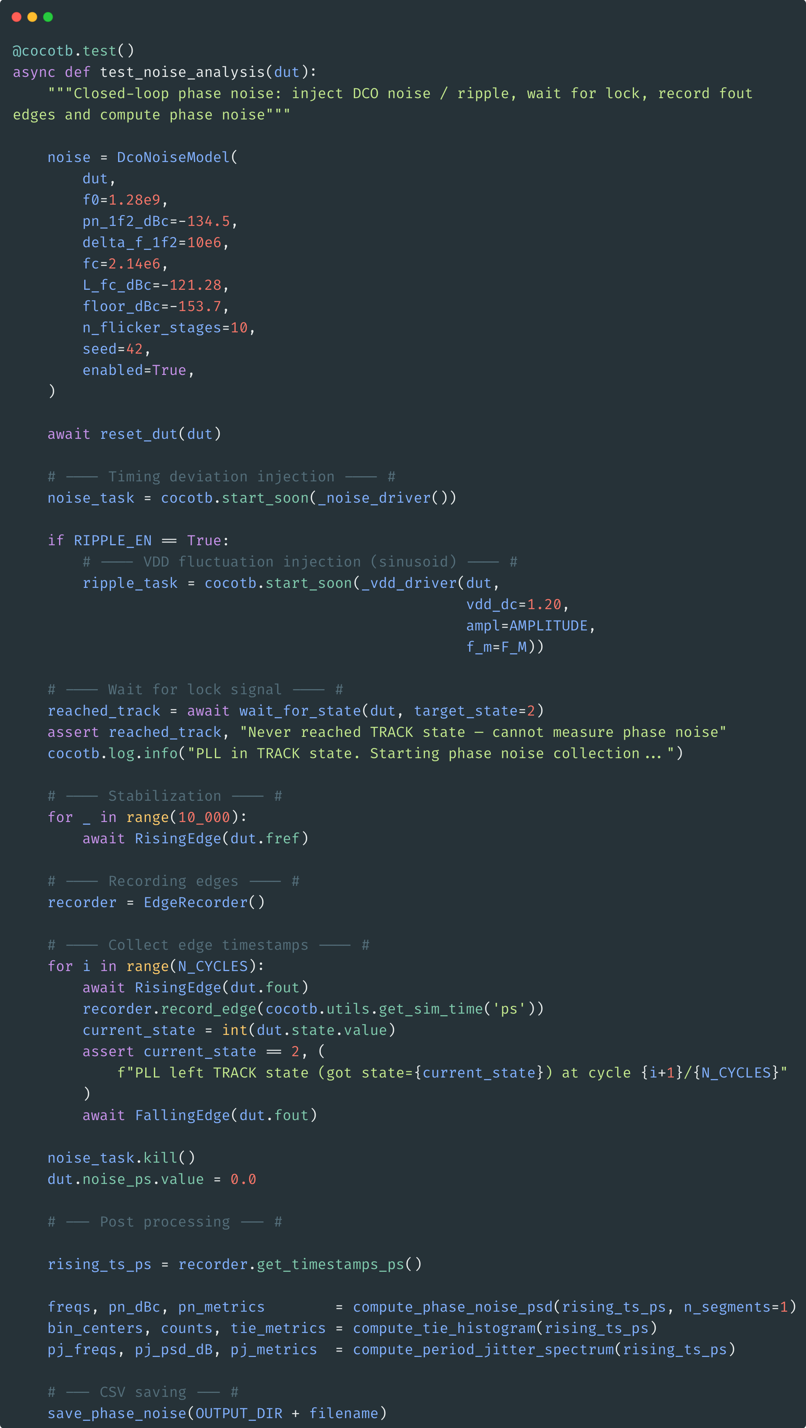
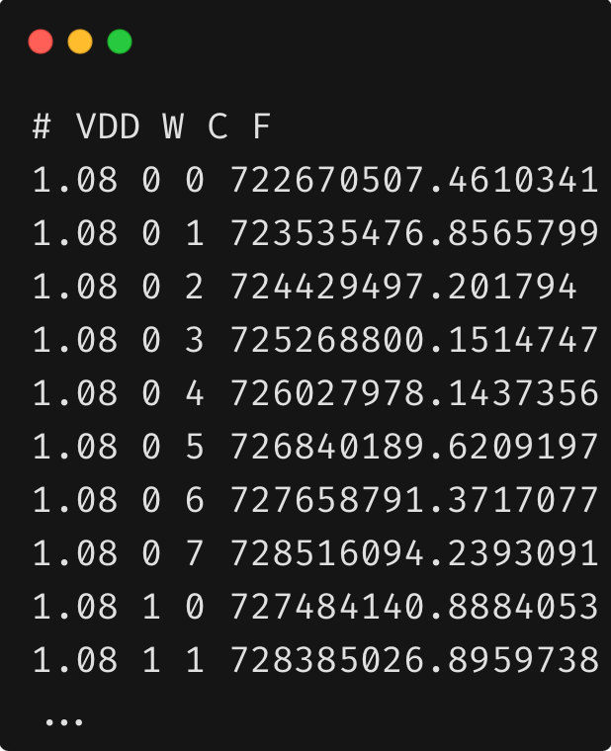
ADPLL simulation – setup

Slide 20
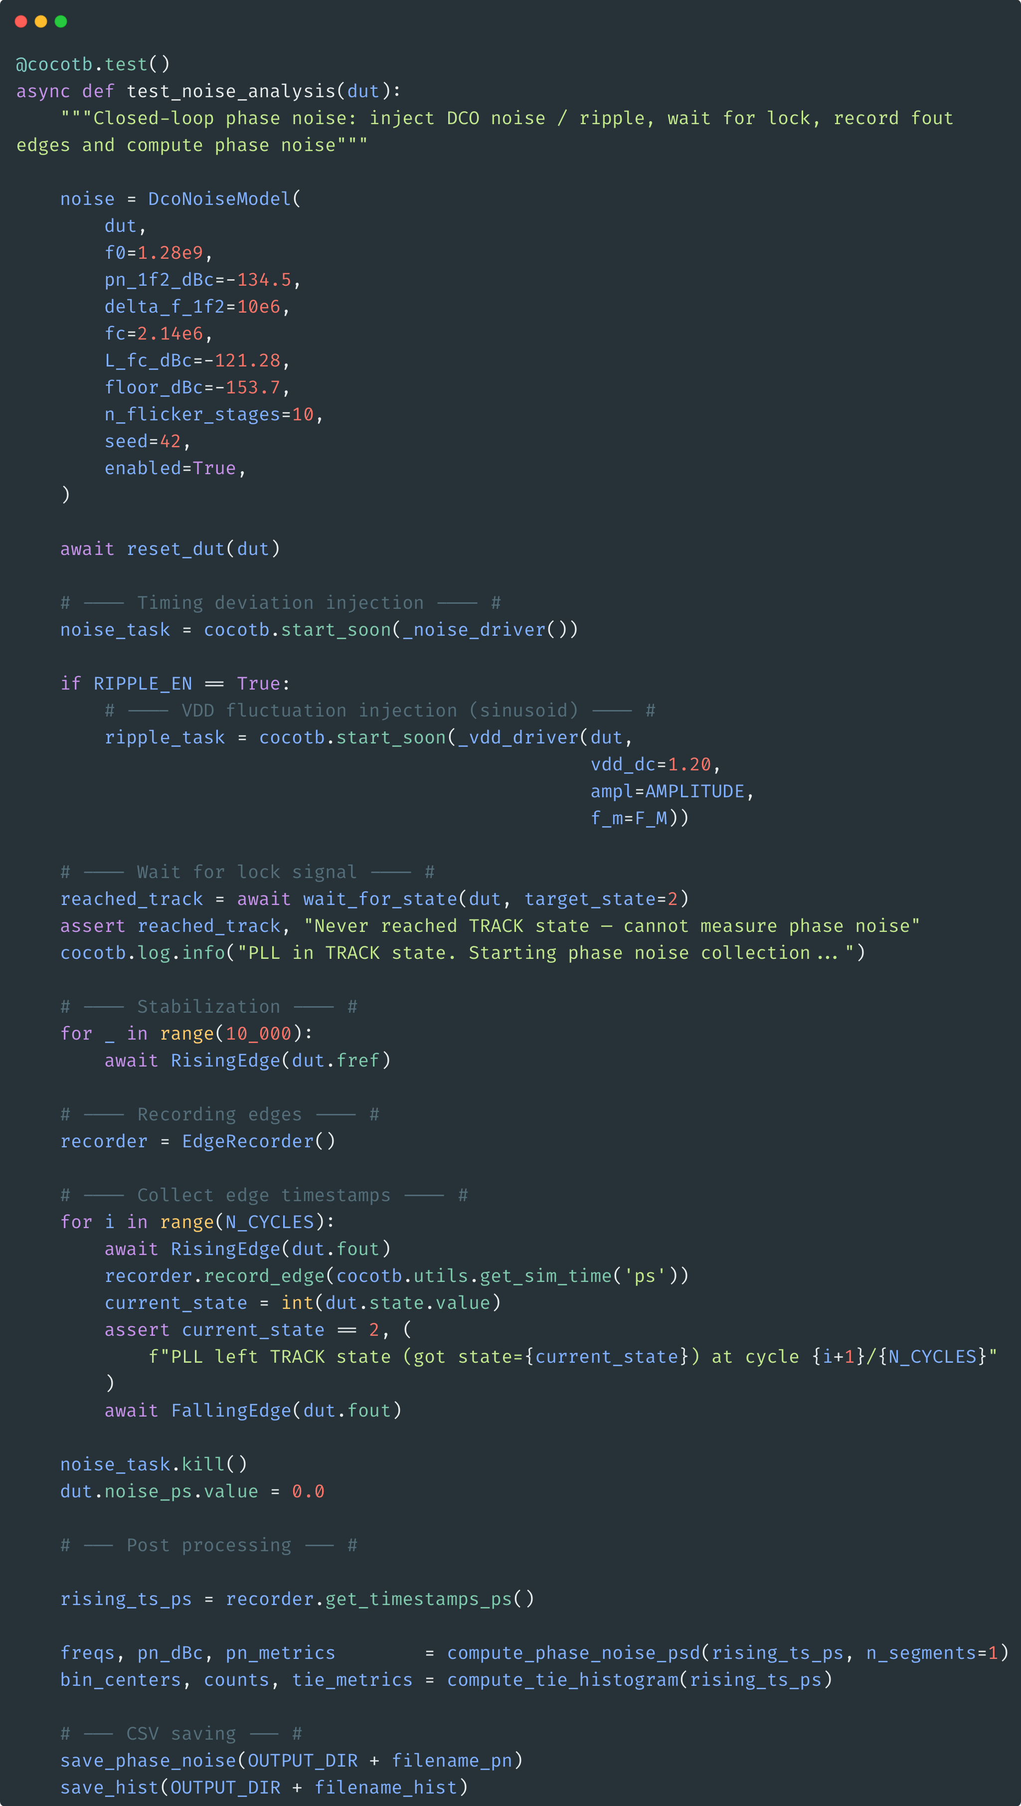
ADPLL simulation – testbench example
Closed loop phase noise testbench
Injection timing noise and ripple on supply
Accumulate N cycles
Compute phase noise

Slide 21
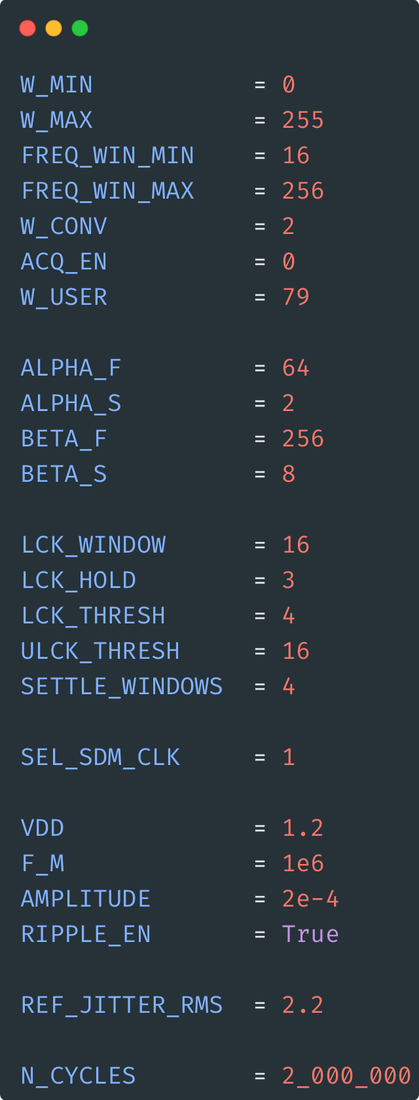
ADPLL simulation – testbench example
Initialization of pll parameters (filter coefficients, lock detection, …)
Set reference jitter
Set ripple config : 0.2mV @1MHz
Set the number of simulation cycles :
2M -> ~1.56ms

Slide 22
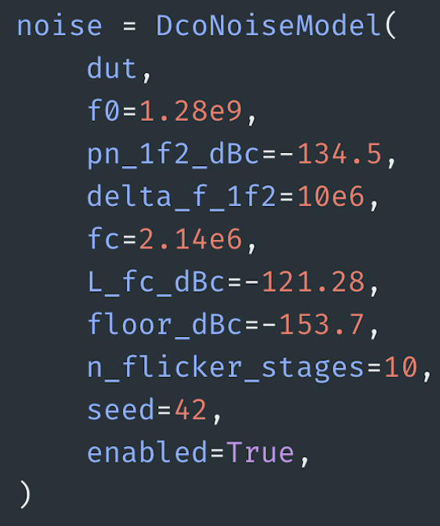
ADPLL simulation – testbench example
User set the Spectre measurements by calling the class

Slide 23
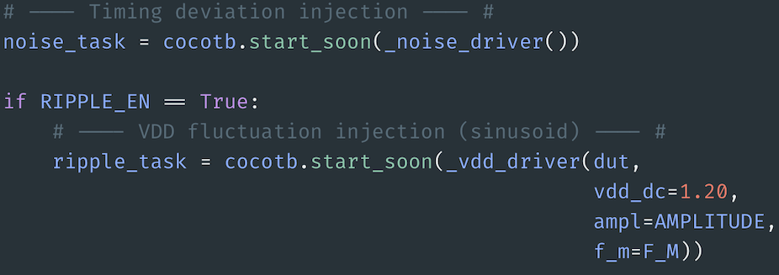
ADPLL simulation – testbench example
Start both noise and ripple injection co-routines

Slide 24
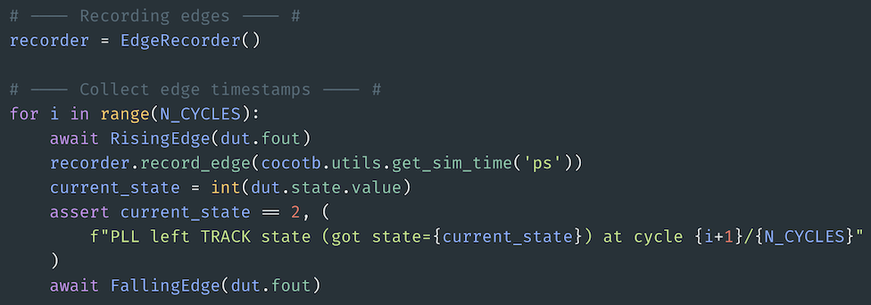
ADPLL simulation – testbench example
Record edges of PLL output
Make sure PLL stays locked during the entire simulation

Slide 25
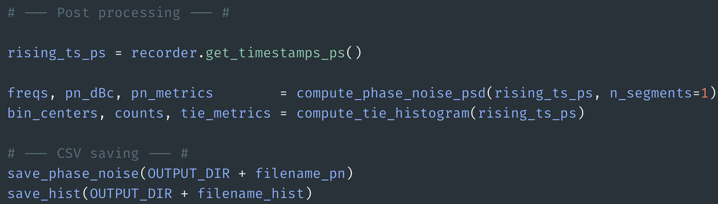
ADPLL simulation – testbench example
Collect timestamps
Compute phase noise
Save the data

Slide 26
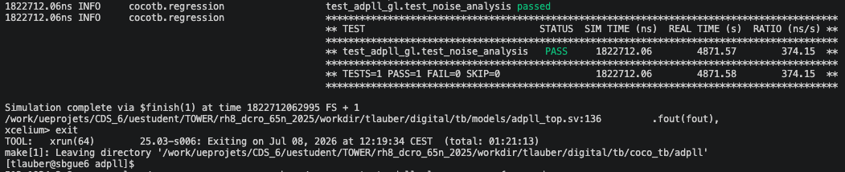
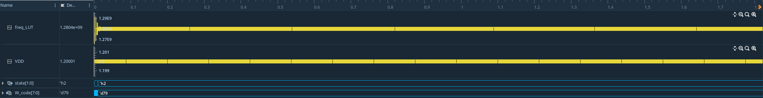
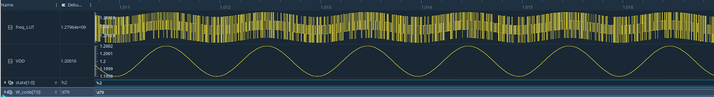
ADPLL simulation – results 2M cycles
~1hr for 1.56ms
Verisium

Slide 27
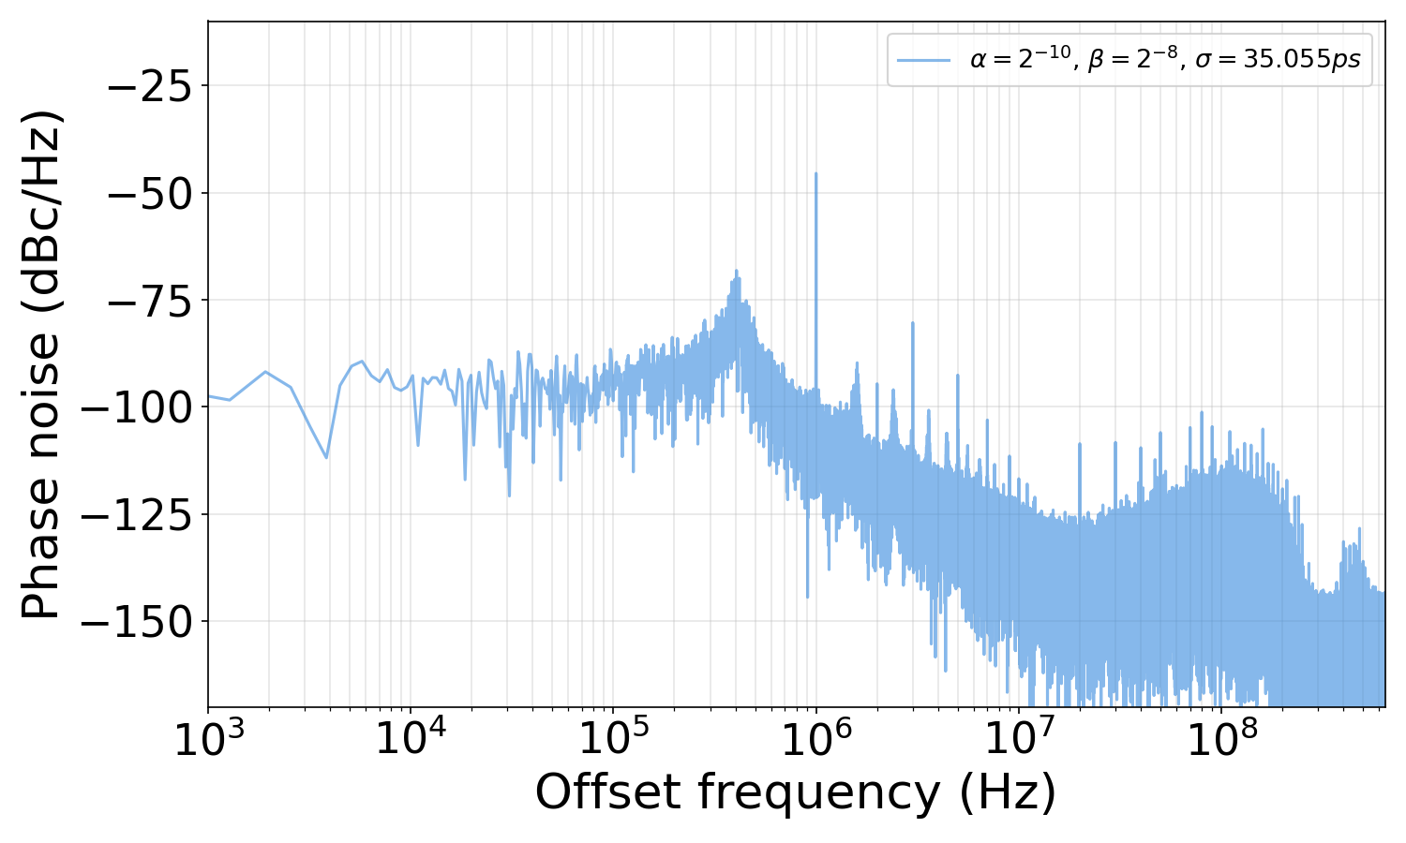
ADPLL simulation – results 2M cycles
ripple

Slide 28
Conclusion
Bridging Python's scientific stack and Xcelium for mixed digital/behavioral simulation
Makefile
Xcelium

Slide 29
Thank you

