Slide 1

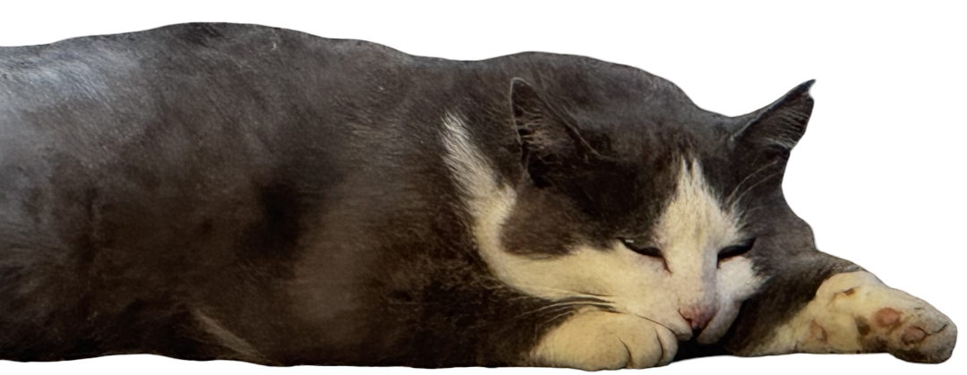

Matter and Universe Summer Institute
– internship in the cosmology group
Student: Valeriya Pak
Supervisors: Julian Bautista, Juan Mena-Fernández

Slide 2
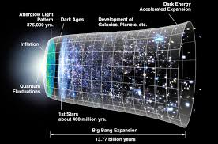
Internship Overview
Prior knowledge of cosmology:
Universe is expanding! 😁
It is complicated… 😫
? What is cosmology about ?
Goal: to study how the Universe evolves within different cosmological models by coding, plotting, and interpreting key cosmological quantities such as redshift, the scale factor, and the Hubble parameter.

Slide 3
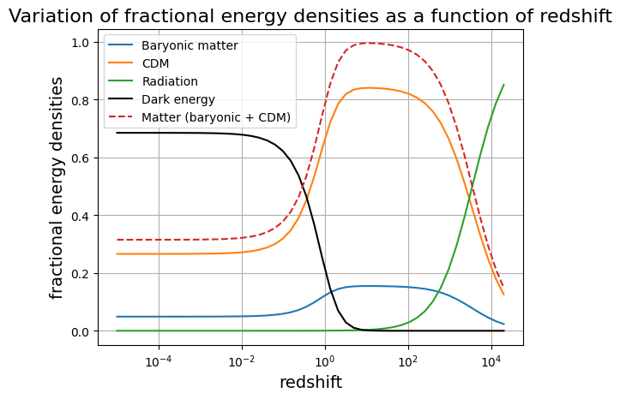
✔ Learned the basics of cosmology
✔ Improved Python coding skills
Present-day Universe
Dark-energy domination
Matter domination
Radiation domination

Slide 4
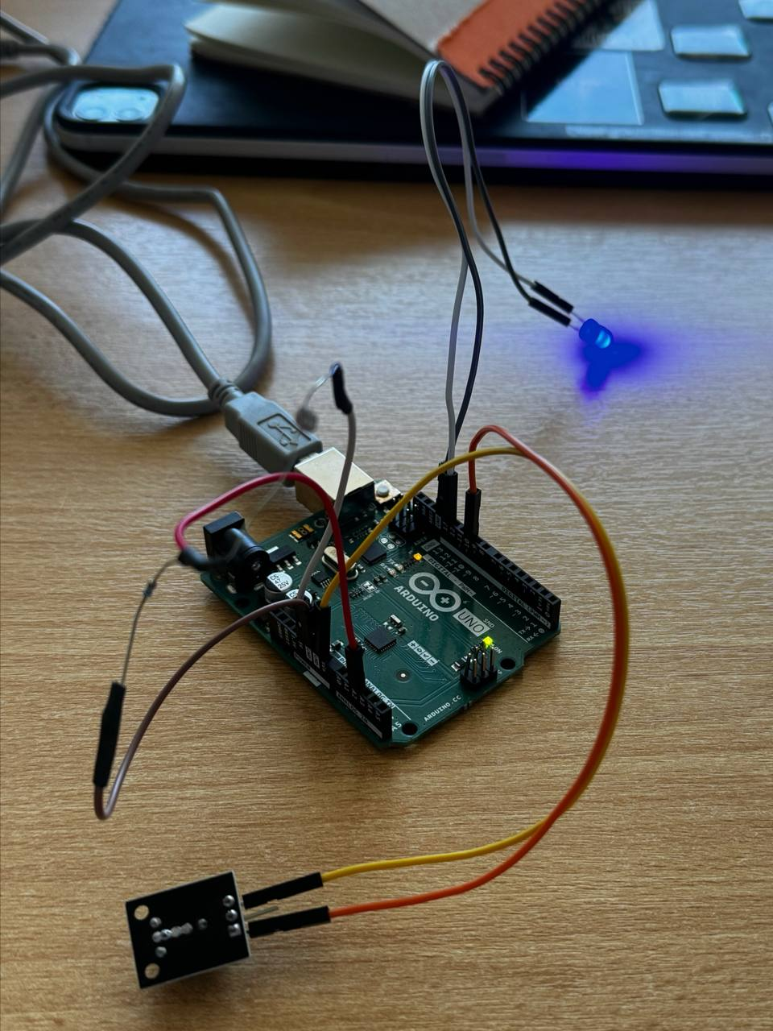
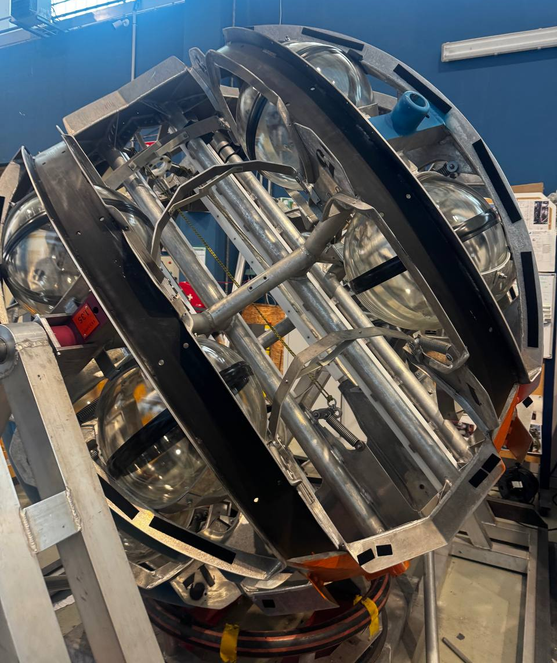
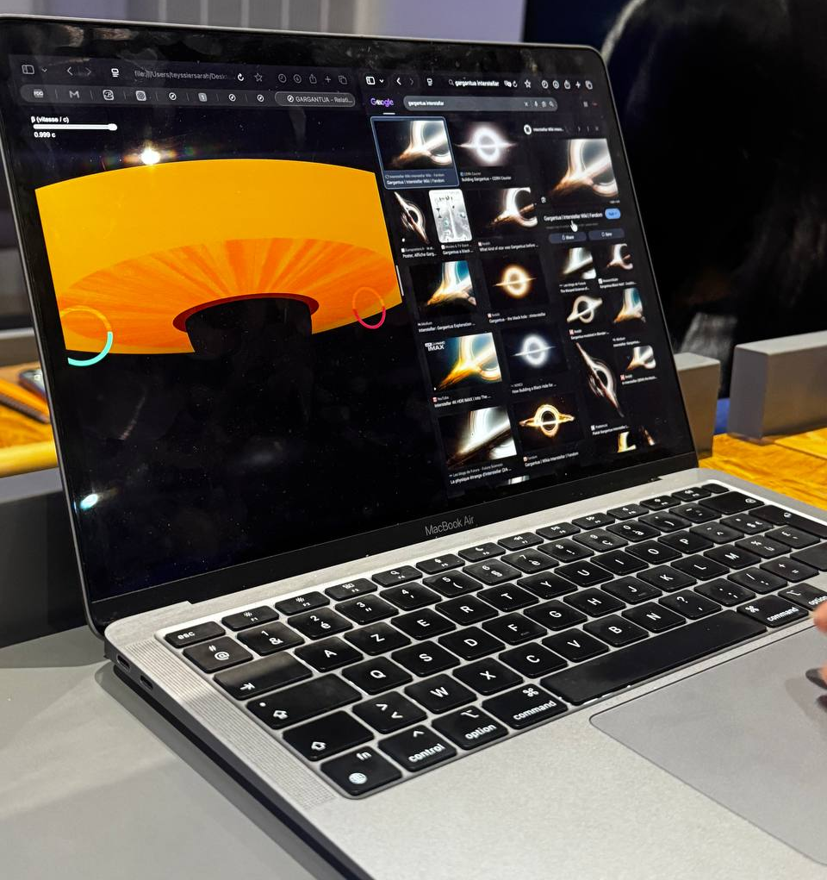
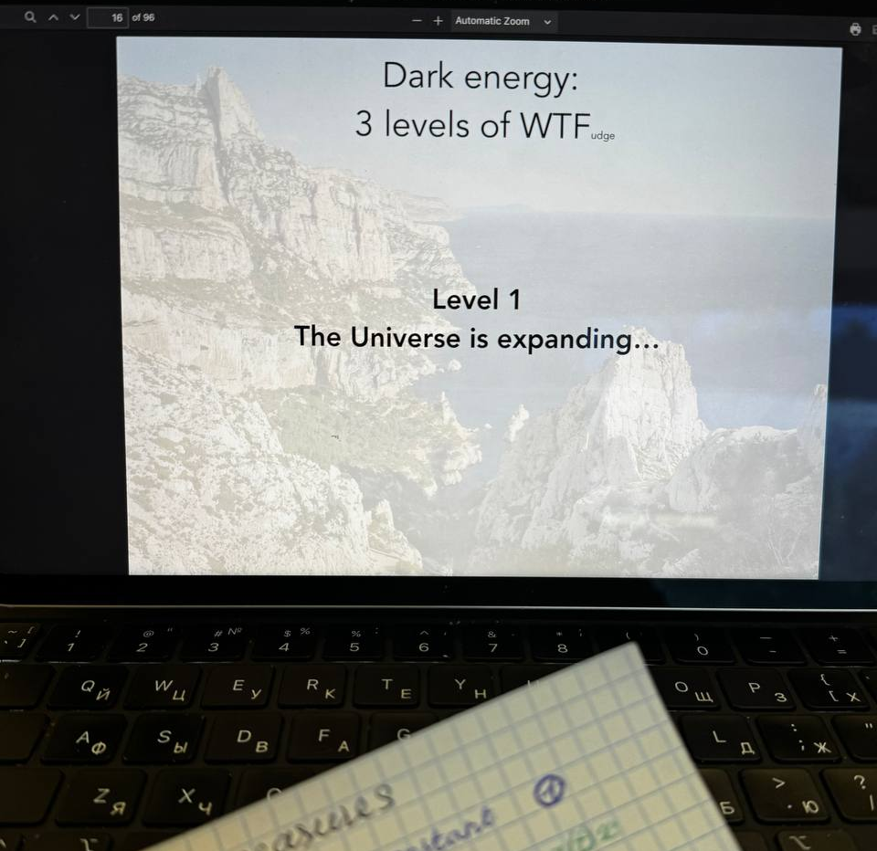
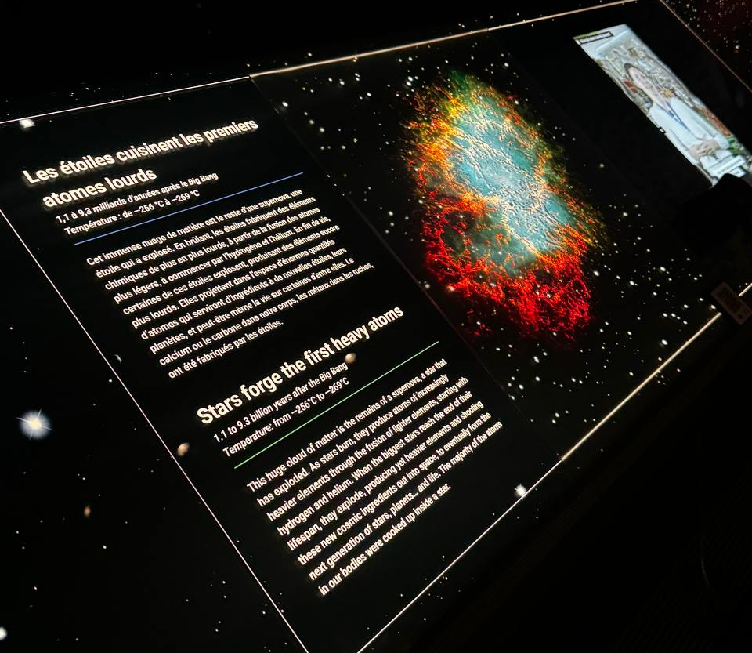
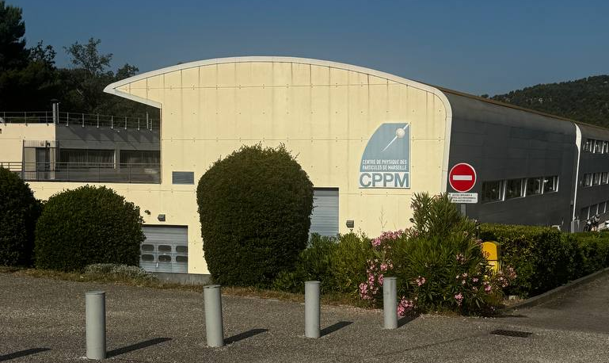
MUSI Program
✔ Laboratory visits
✔ Learned about particle physics, cosmology, and other areas of research
✔ Spent 57.3 hours on public transport… was totally worth it!

Slide 5
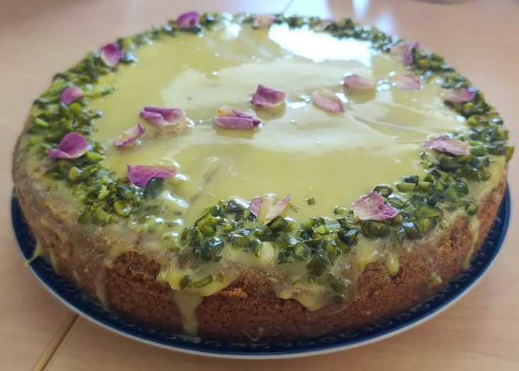
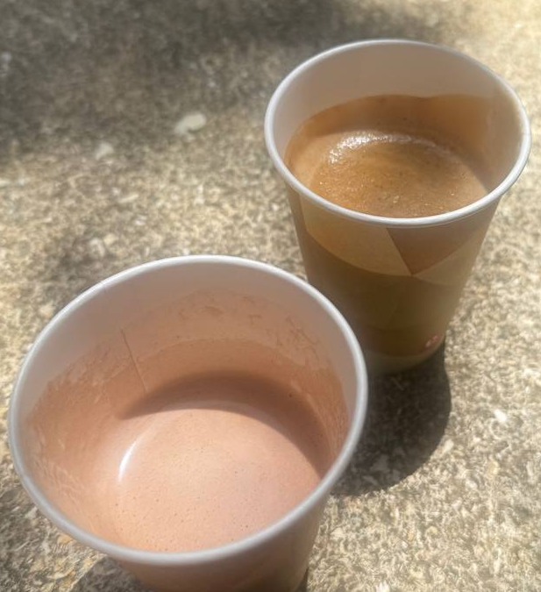
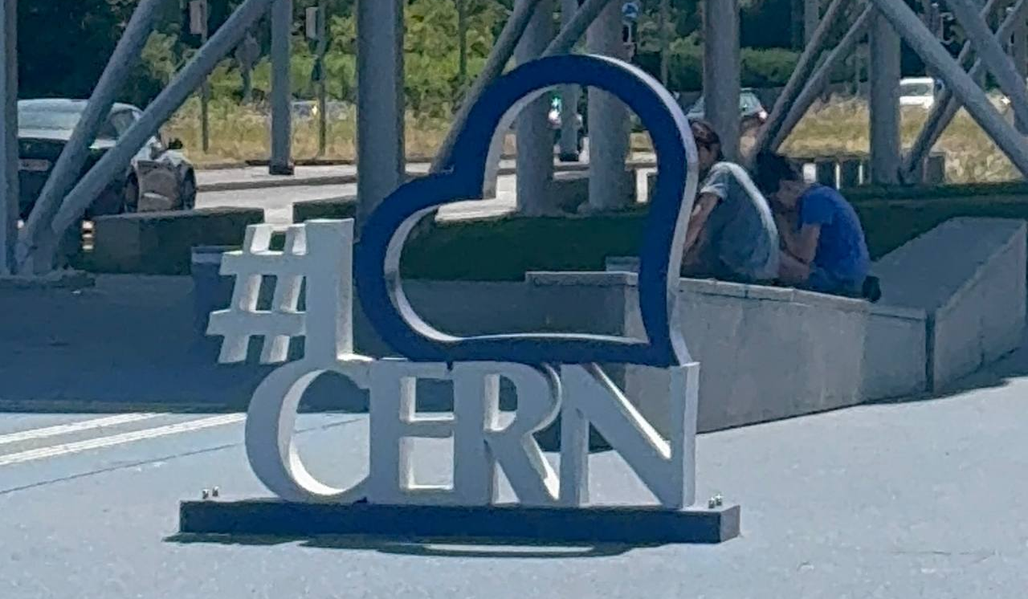
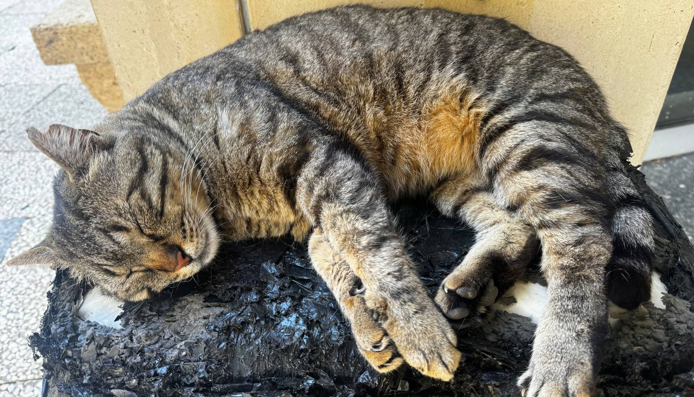
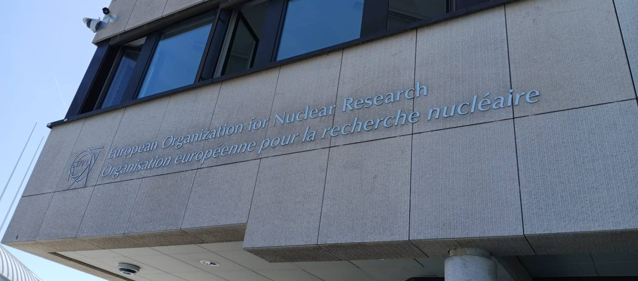

Other MUSI Experiences
Thank you very much!

