Slide 1
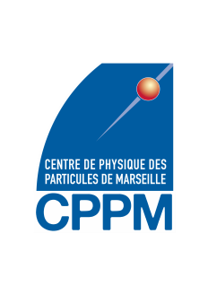


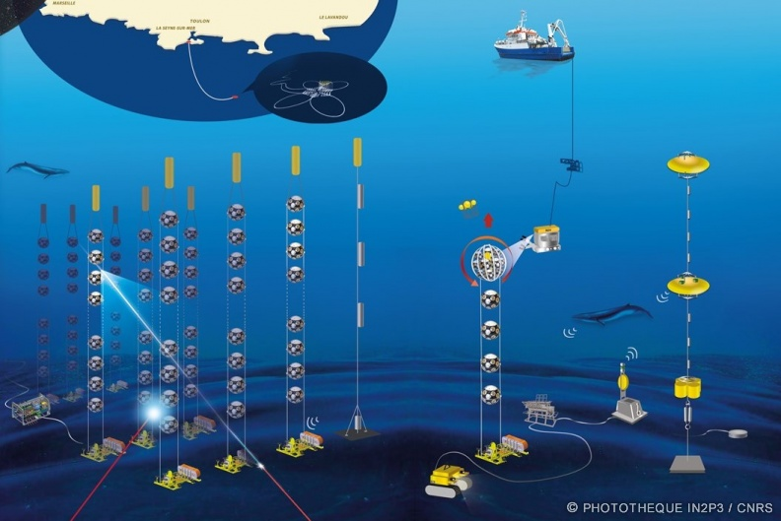
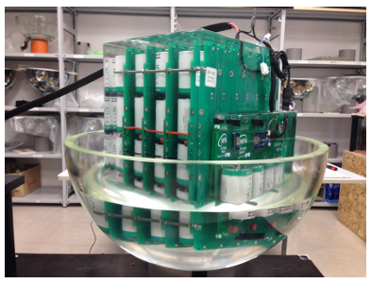
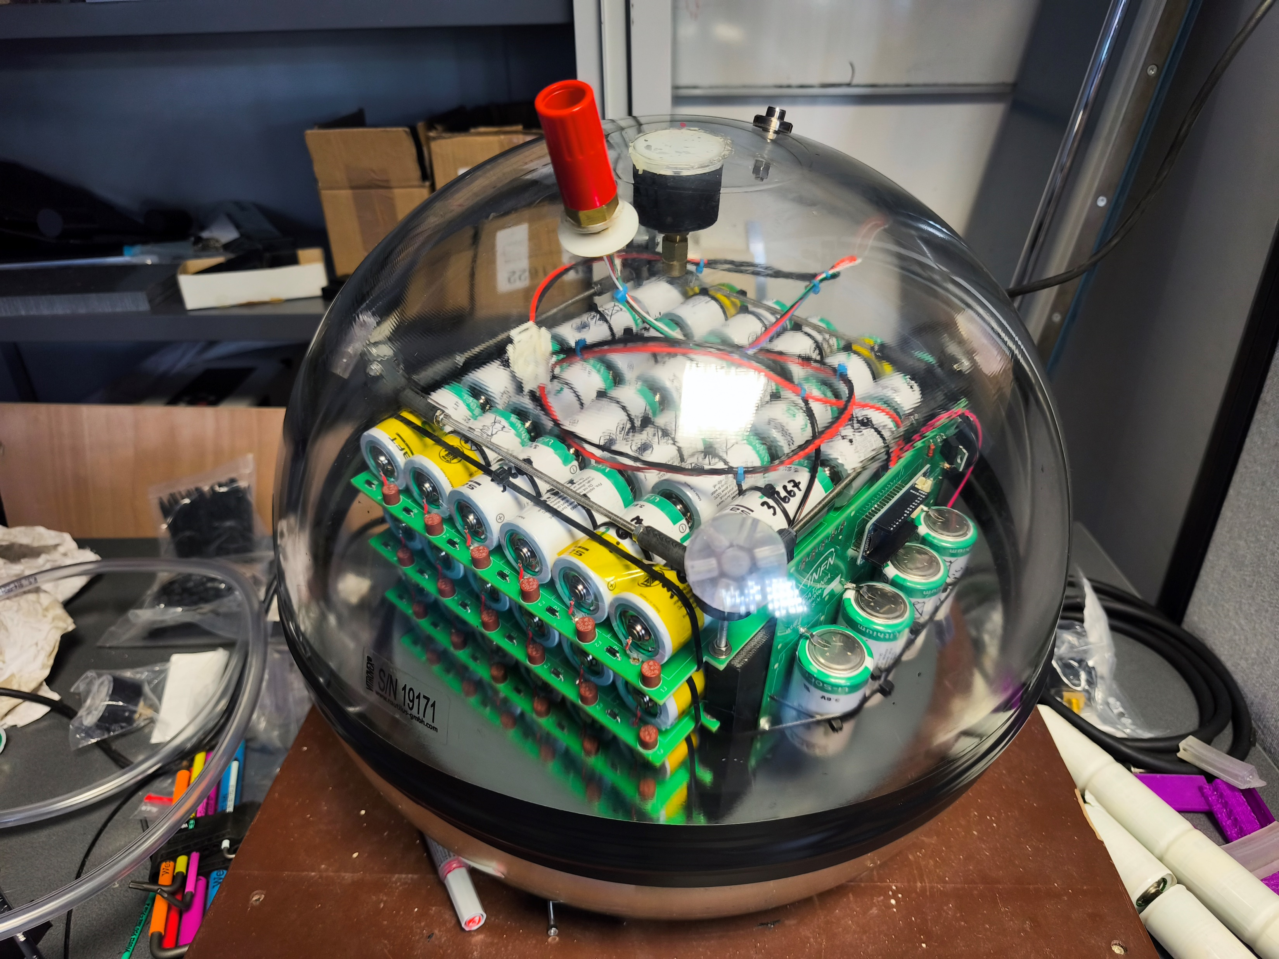
MUSI@CPPM
A Comparative Study of the Environmental Impacts of INFN and CPPM Battery Cells Using Life Cycle Assessment (LCA)
Student : Léna Gevaud
Supervisor : Alain Cosquer
KM3NET Project
INFN Sphere battery
CPPM Sphere battery

Slide 2
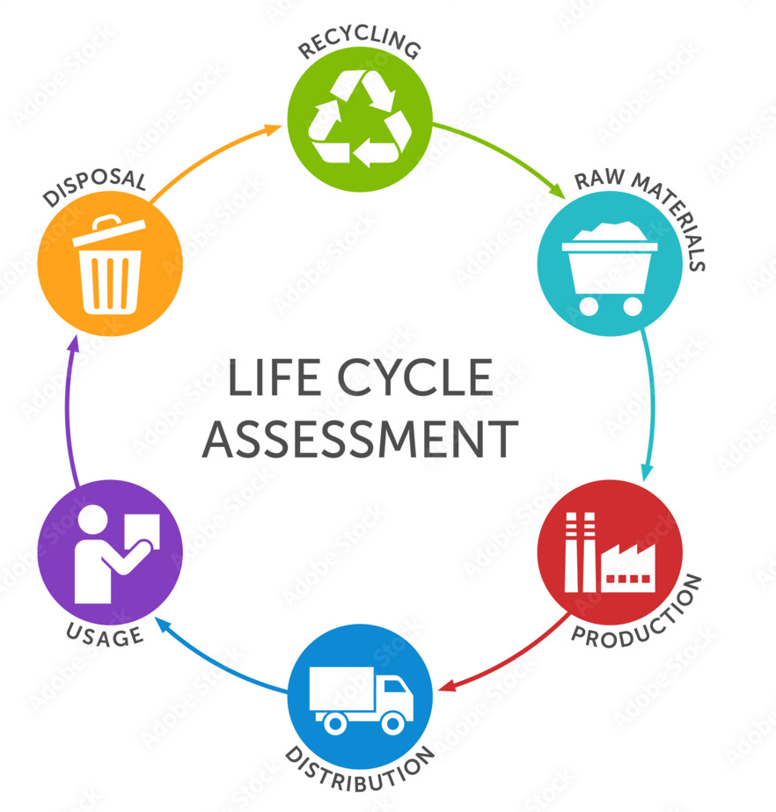
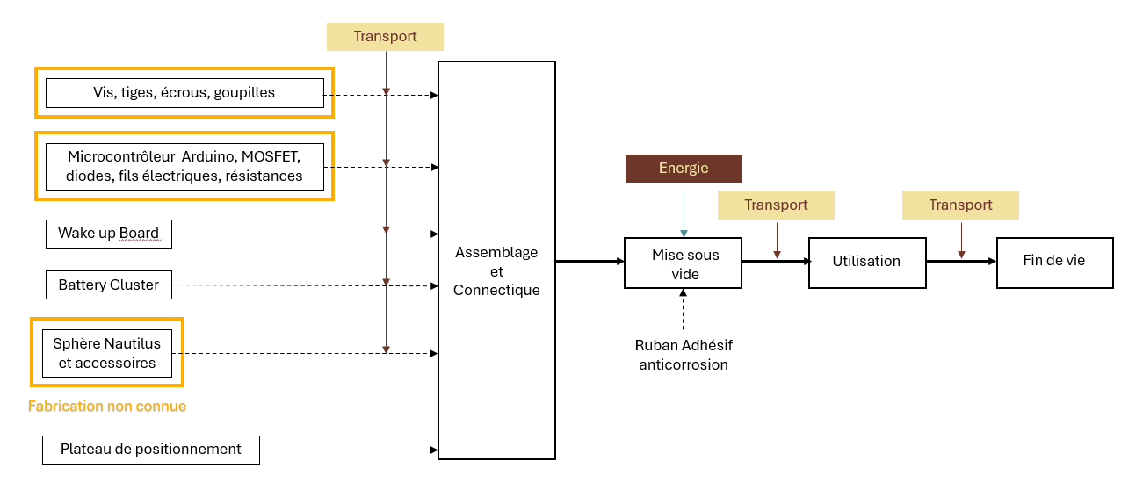
Environmental Impact Assessment Using Life Cycle Analysis
Life Cycle Analysis
Introduction to and hands-on experience with the main LCA software programs
European regulations and standards (calculation methods)
Comparative Study of Two Batteries
Definition of the Scenarios Studied
List of Components
Flow Charts
Comparison of Results Using OpenLCA/BAFU:2025/Ecoinvent3.1

Slide 3
Environmental Impact Assessment Using Life Cycle Analysis
Scores PEF
CPPM Sphere Battery : 0,38
INFN Sphere Battery : 0,52
The CPPM sphere battery reduces the environmental impact by 27% over 10 years compared to the INFN sphere battery.
3

Slide 4
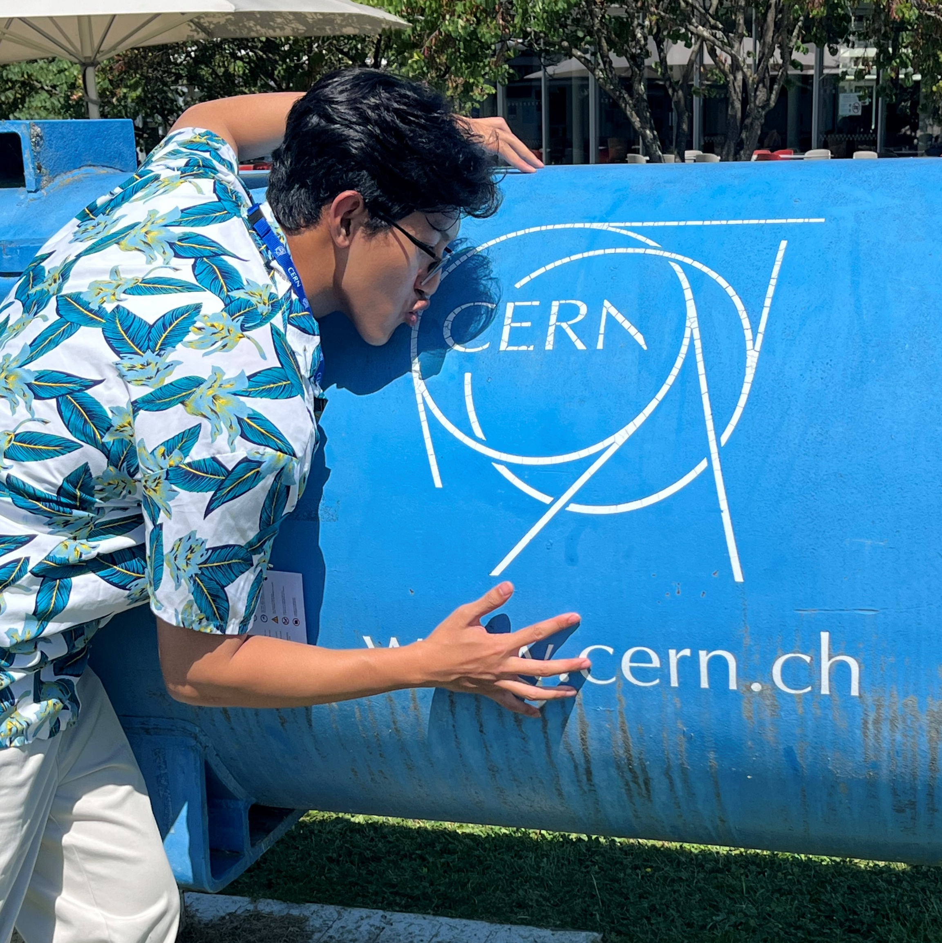
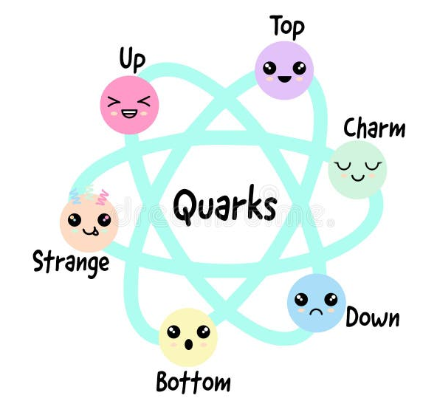
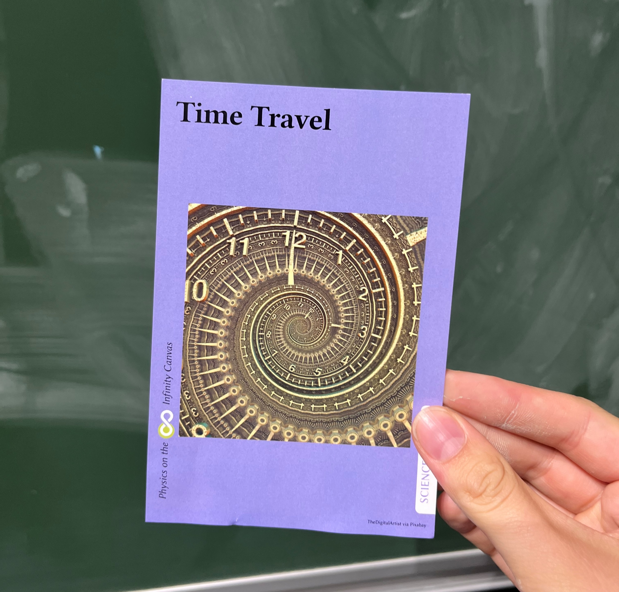
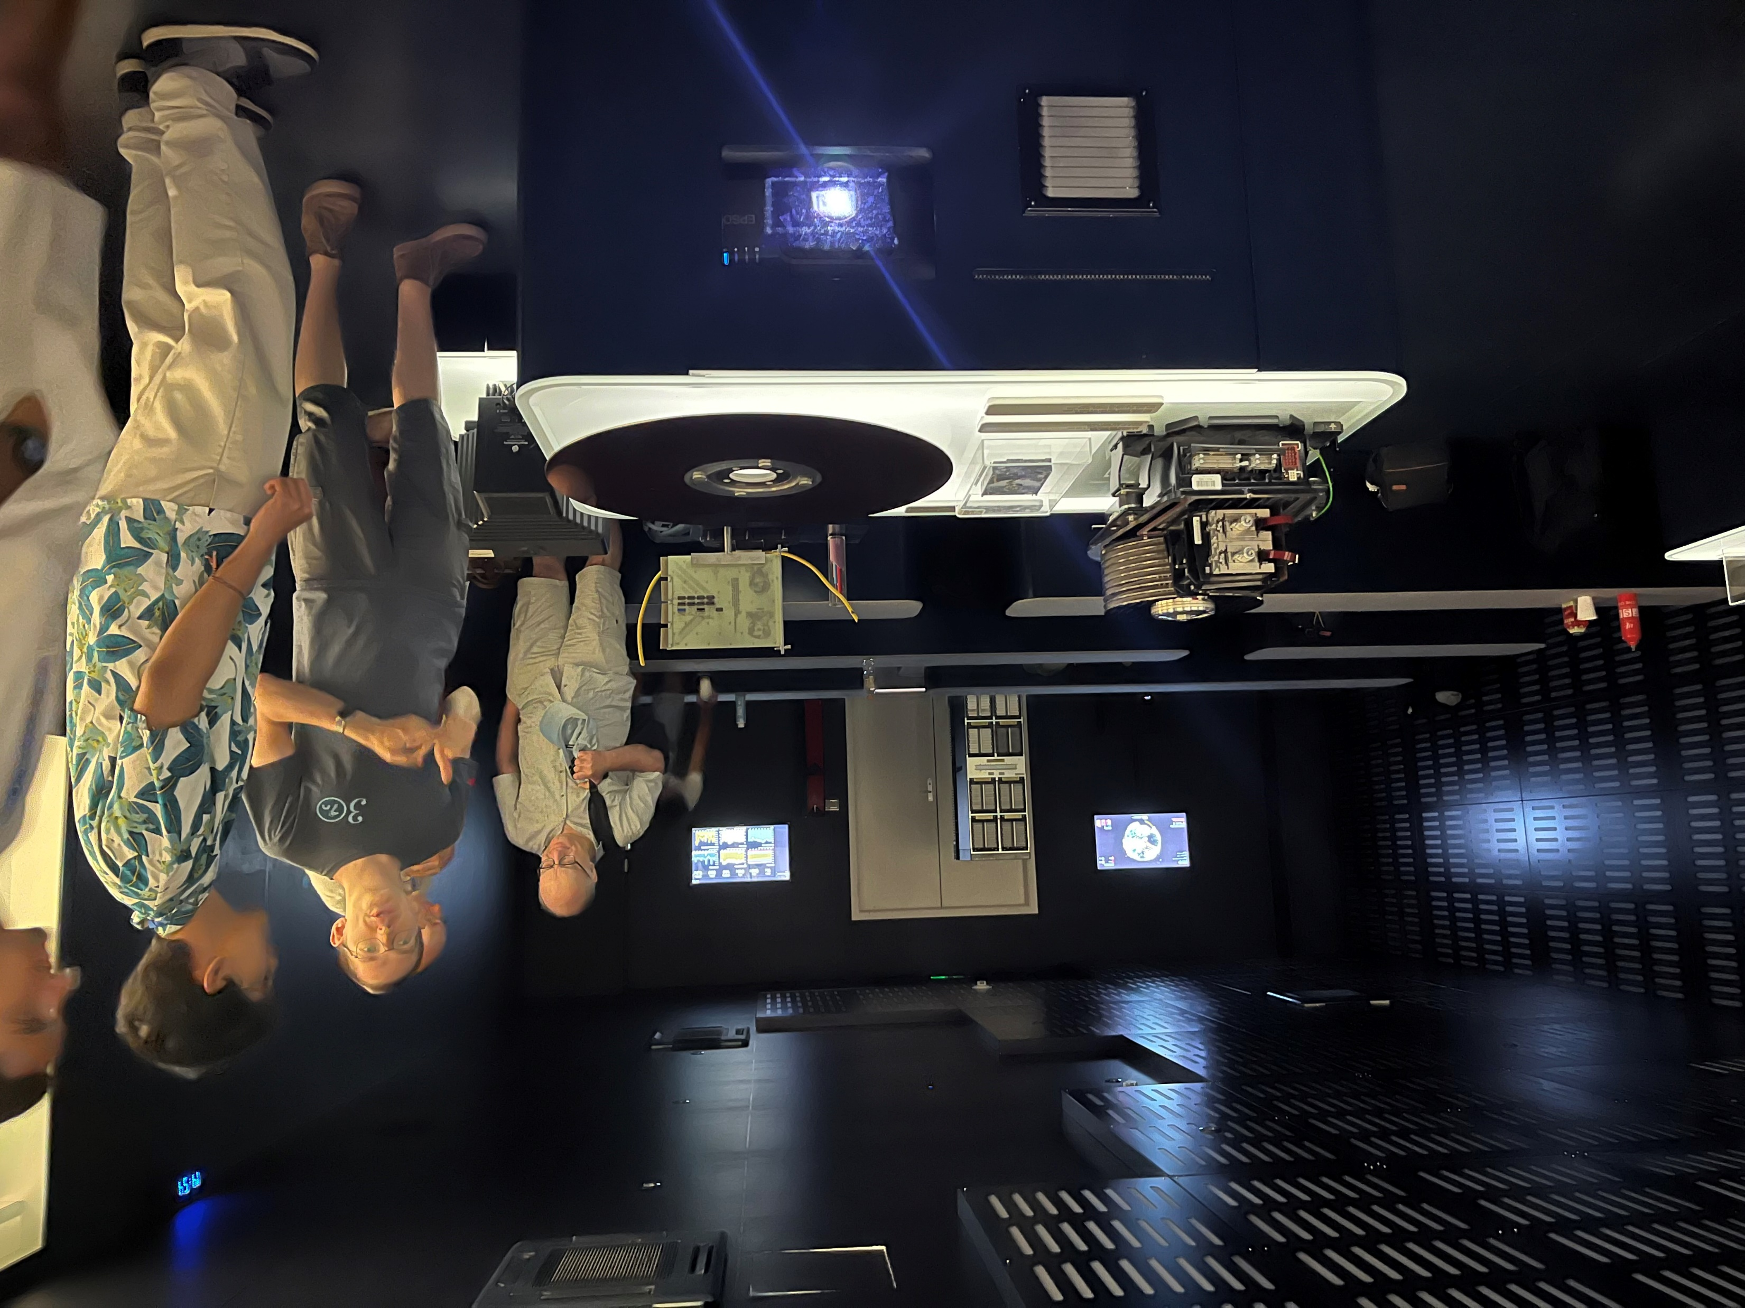
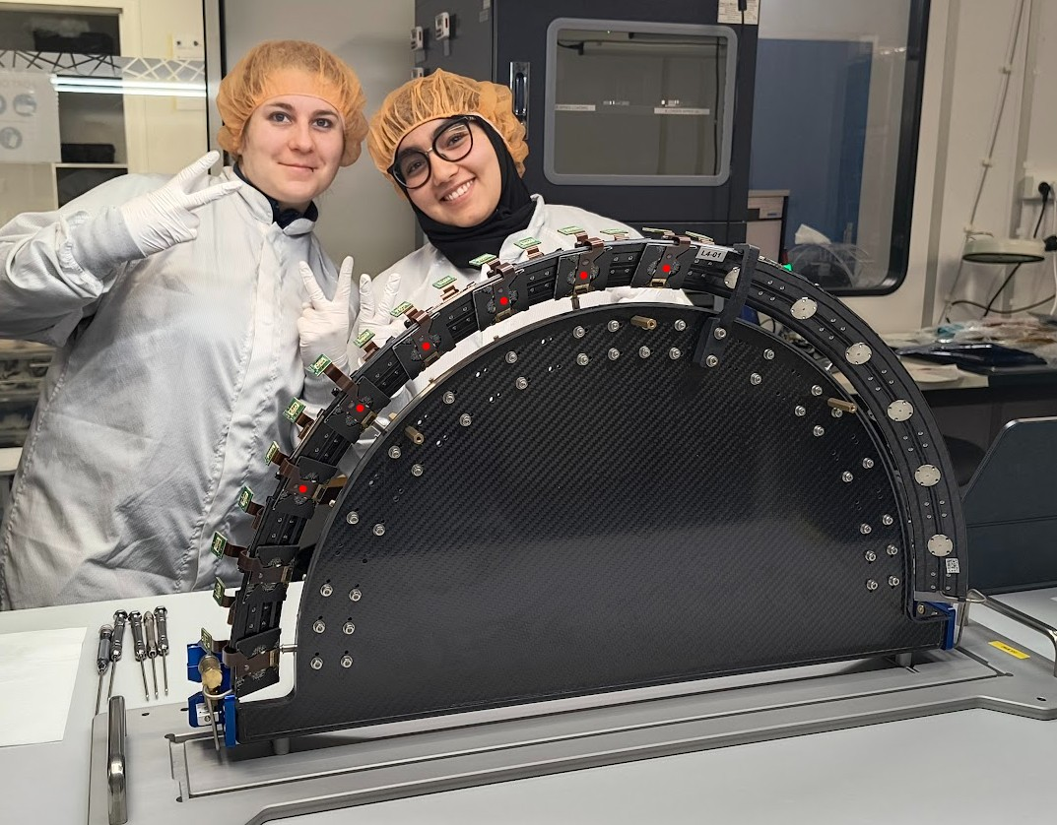
Matter and Universe Summer Institute
Conferences and Visits
Not much prior knowledge about basic physics
Cosmology and particle physics
Detector design and fabrication
Science’s societal and environmental impact
AI in research
Research careers
CERN visit and FCC debate

Slide 5

Acknowledgments
Bérénice Fatela and Cristinel Diaconu : for this opportunity and for organizing the MUSI Program.
Alain Cosquer : for your guidance and support.
Everyone involved in the MUSI Program : for the inspiring visits, conferences, and discussions.
And finally, Marius (the cat 🐈) : for being the best office companion

