Slide 1
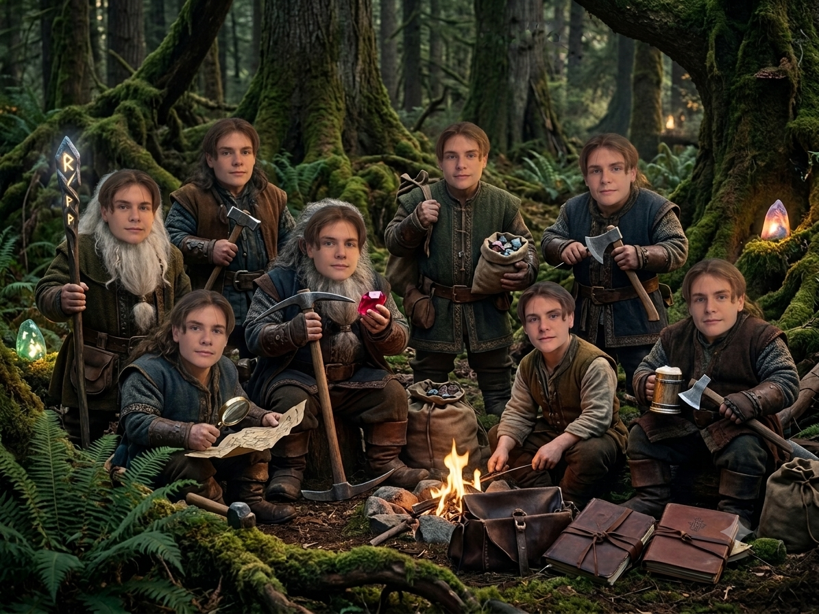
MUSI 2026 - PathFinders
Mark - The Seven Dwarfs (At Once)
Mark BRENNER

Slide 2
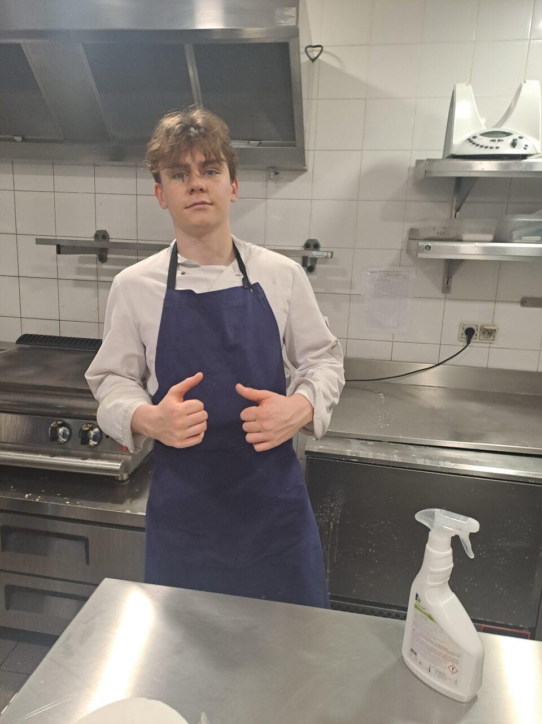
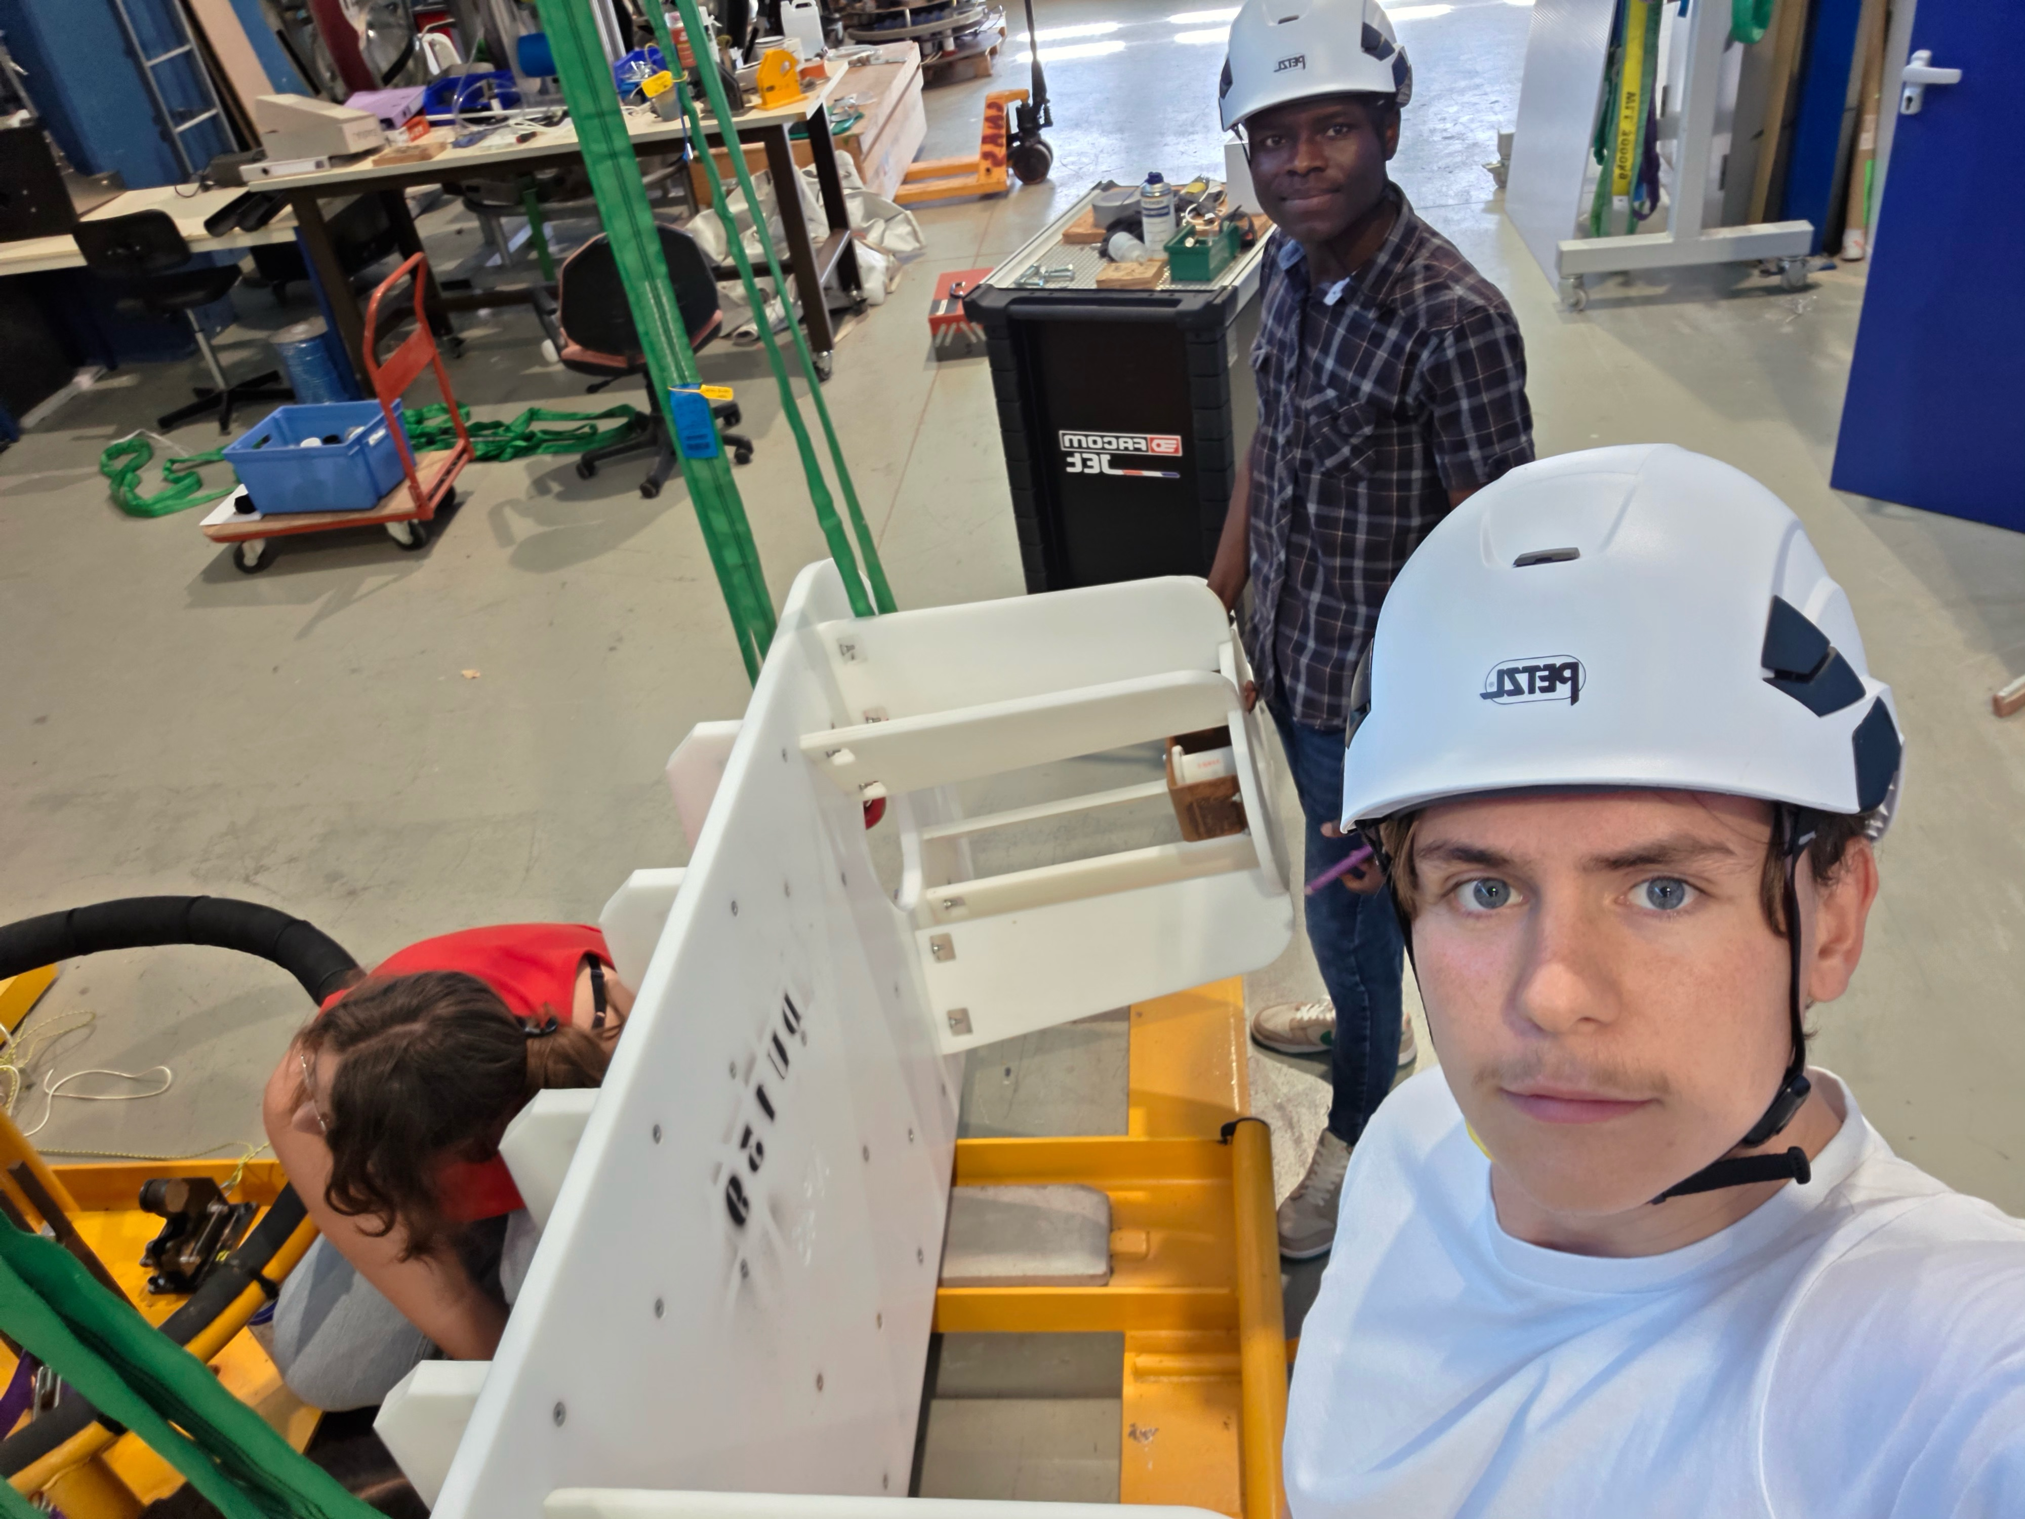
Who am I ?
A cook ? A future Physicist ? Both ?

Slide 3
What Did I Do ?
TALKED.

Slide 4
What Did I Do ?
TALKED.
A LOT.

Slide 5
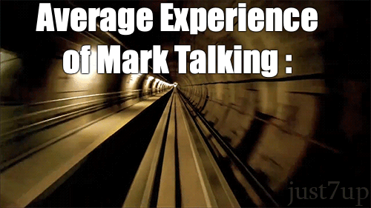

Slide 6
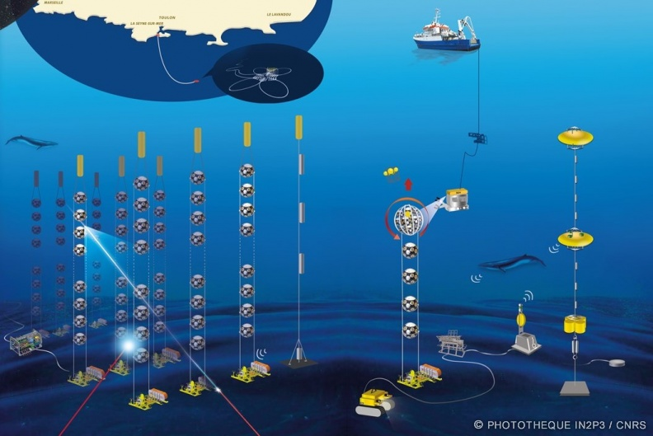
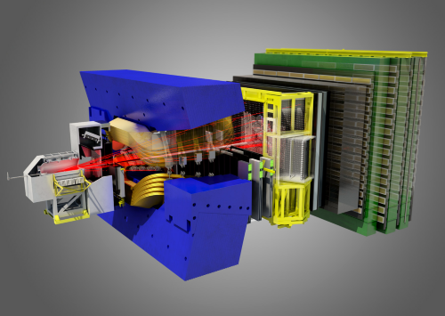
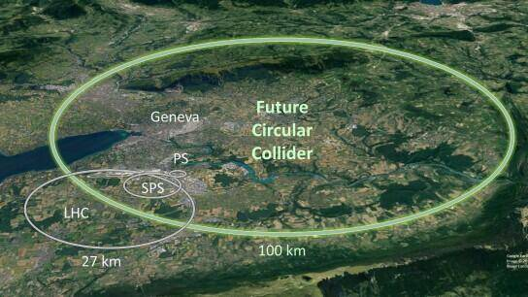
What Did I Do ?
Few Projects
KM3NeT
LHCb
FCC-ee

Slide 7
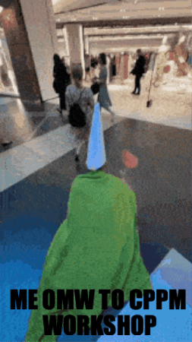
What Did I Do ?
A lot of side quests…

Slide 8
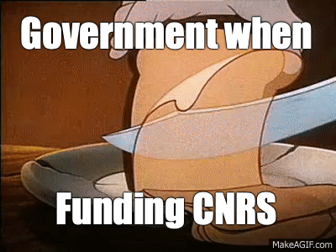
What was my impression ?
A lot of brilliant men and women that work hard… with tight budgets
A lot of Bad Jokes (jk I love them)
Among those laughs, bunch of hardworking people, working for the same goals all around the world

Slide 9
What did I learned in MUSI ?
TO DARE

Slide 10
What did I learned in MUSI ?
<<<

Slide 11
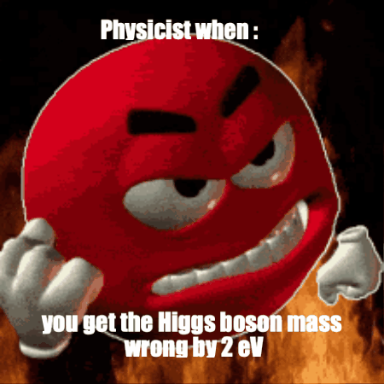
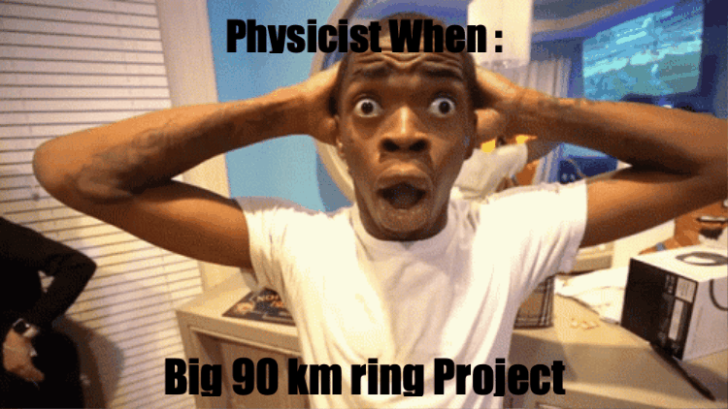
The End ? Or is It ?

Slide 12
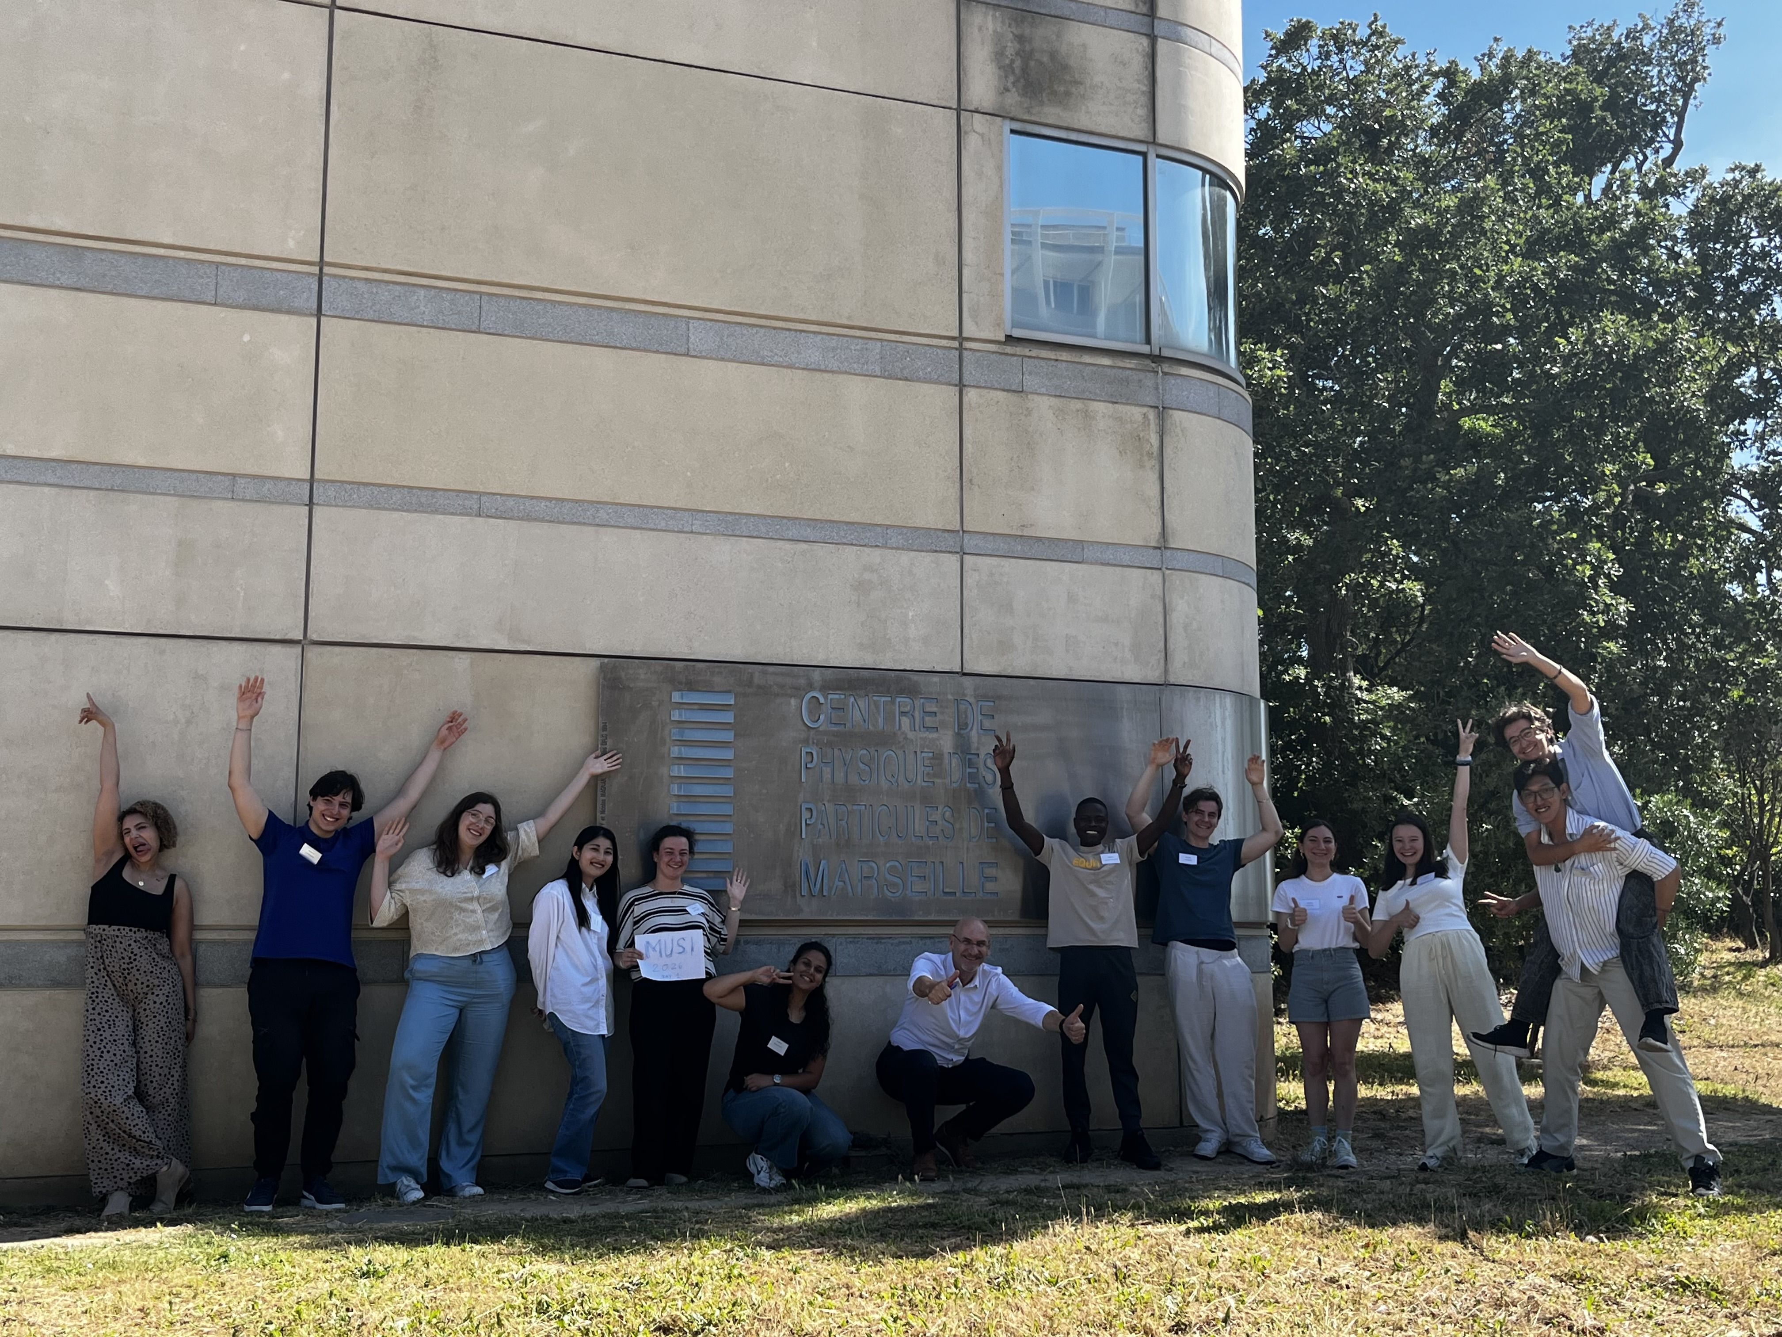
Thank You

