Slide 1

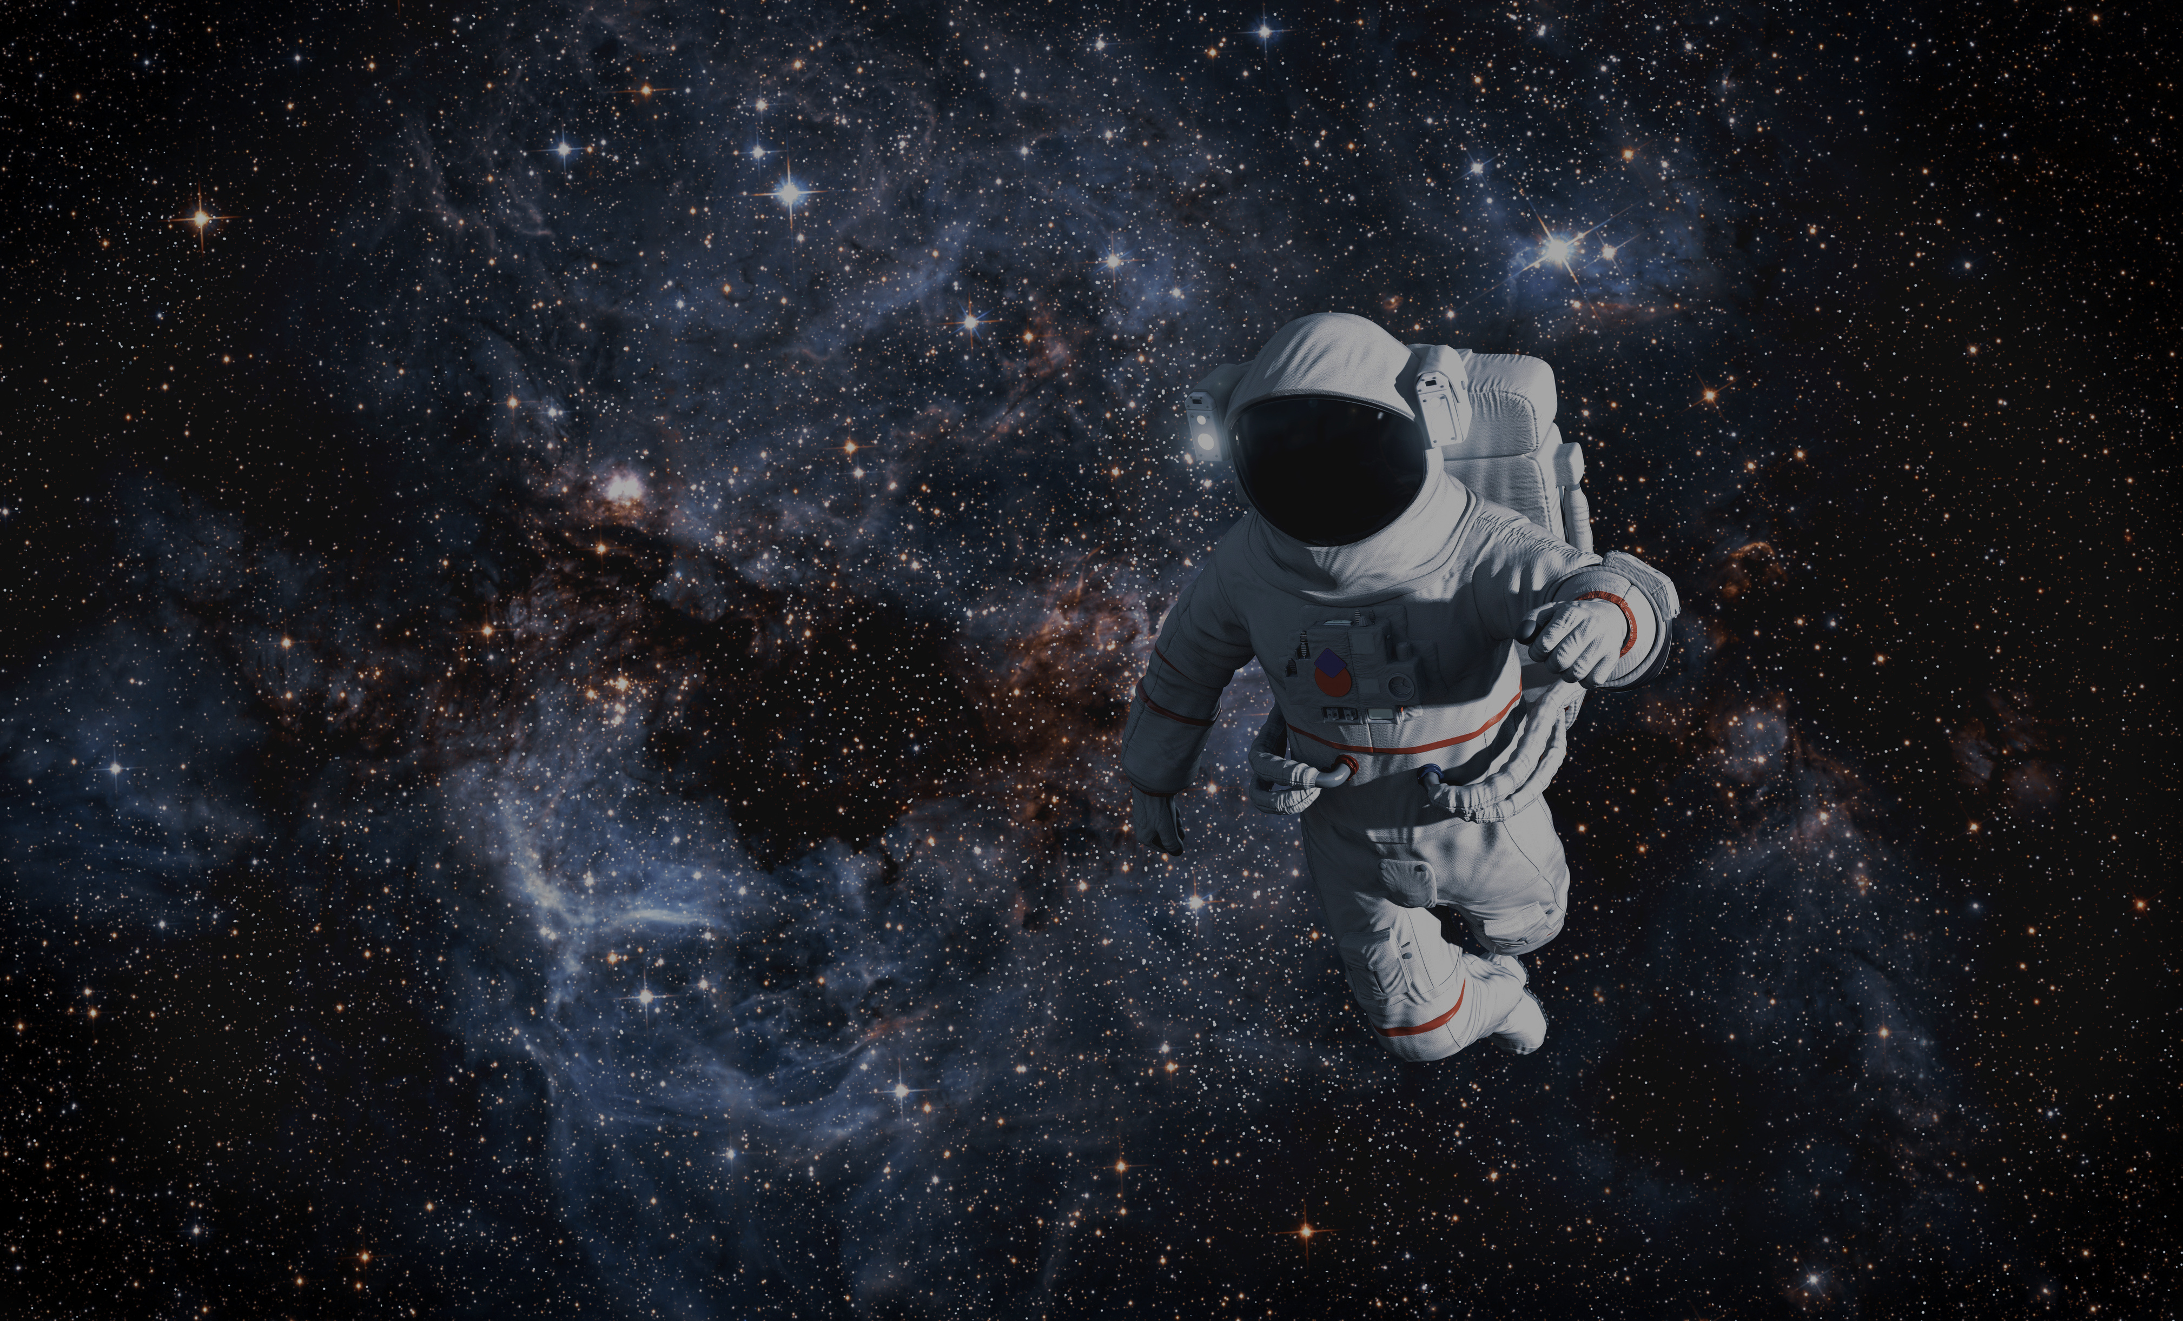


HOME
ABOUT
CONTENT
OTHERS
30/06/2026
Presentation By:
Meriem ALAHOM
My personal
experience
Let’s Go

Slide 2
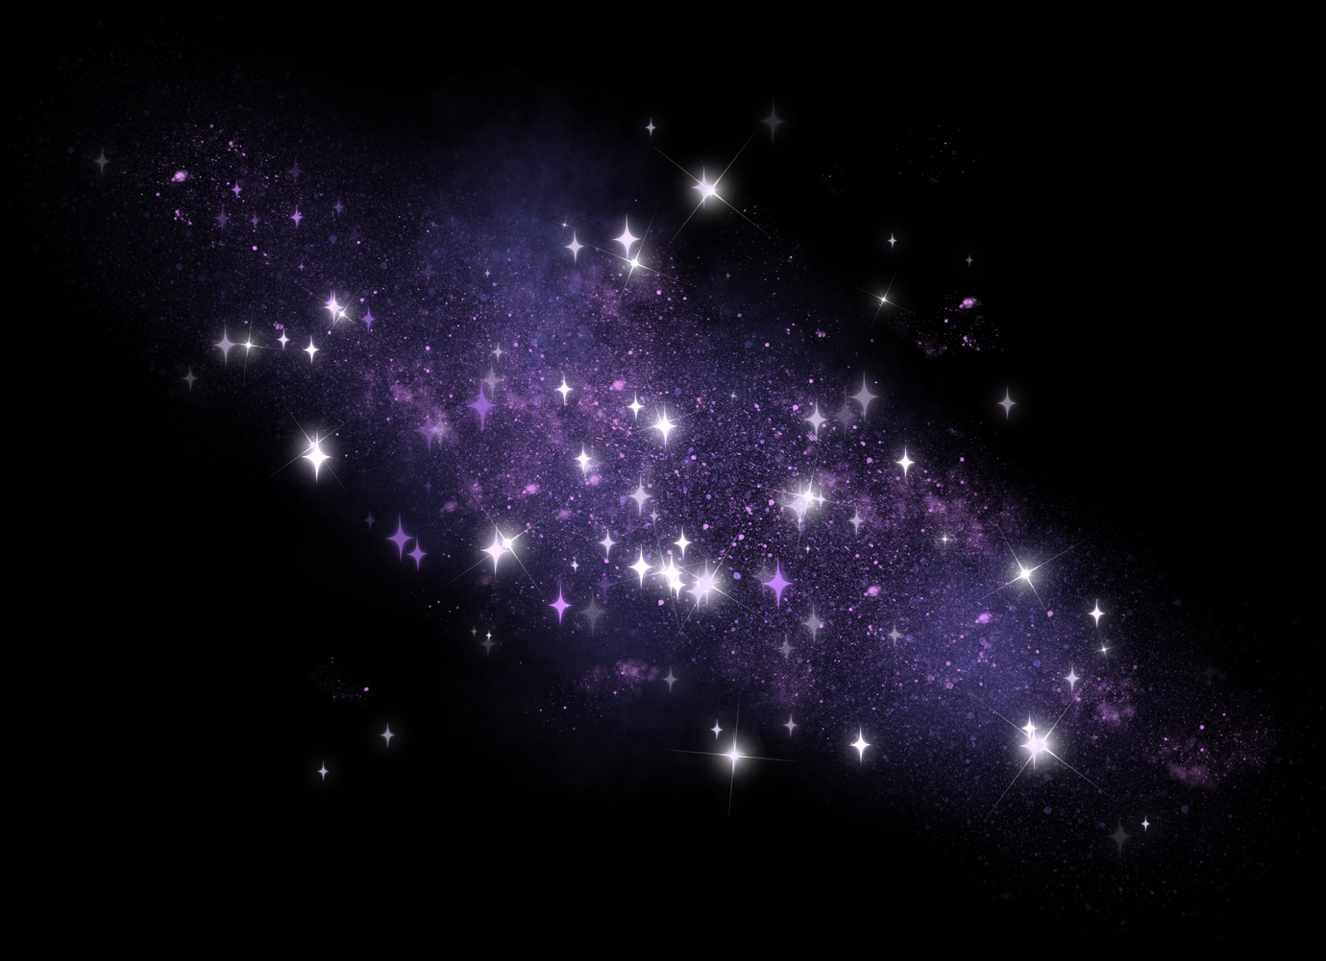
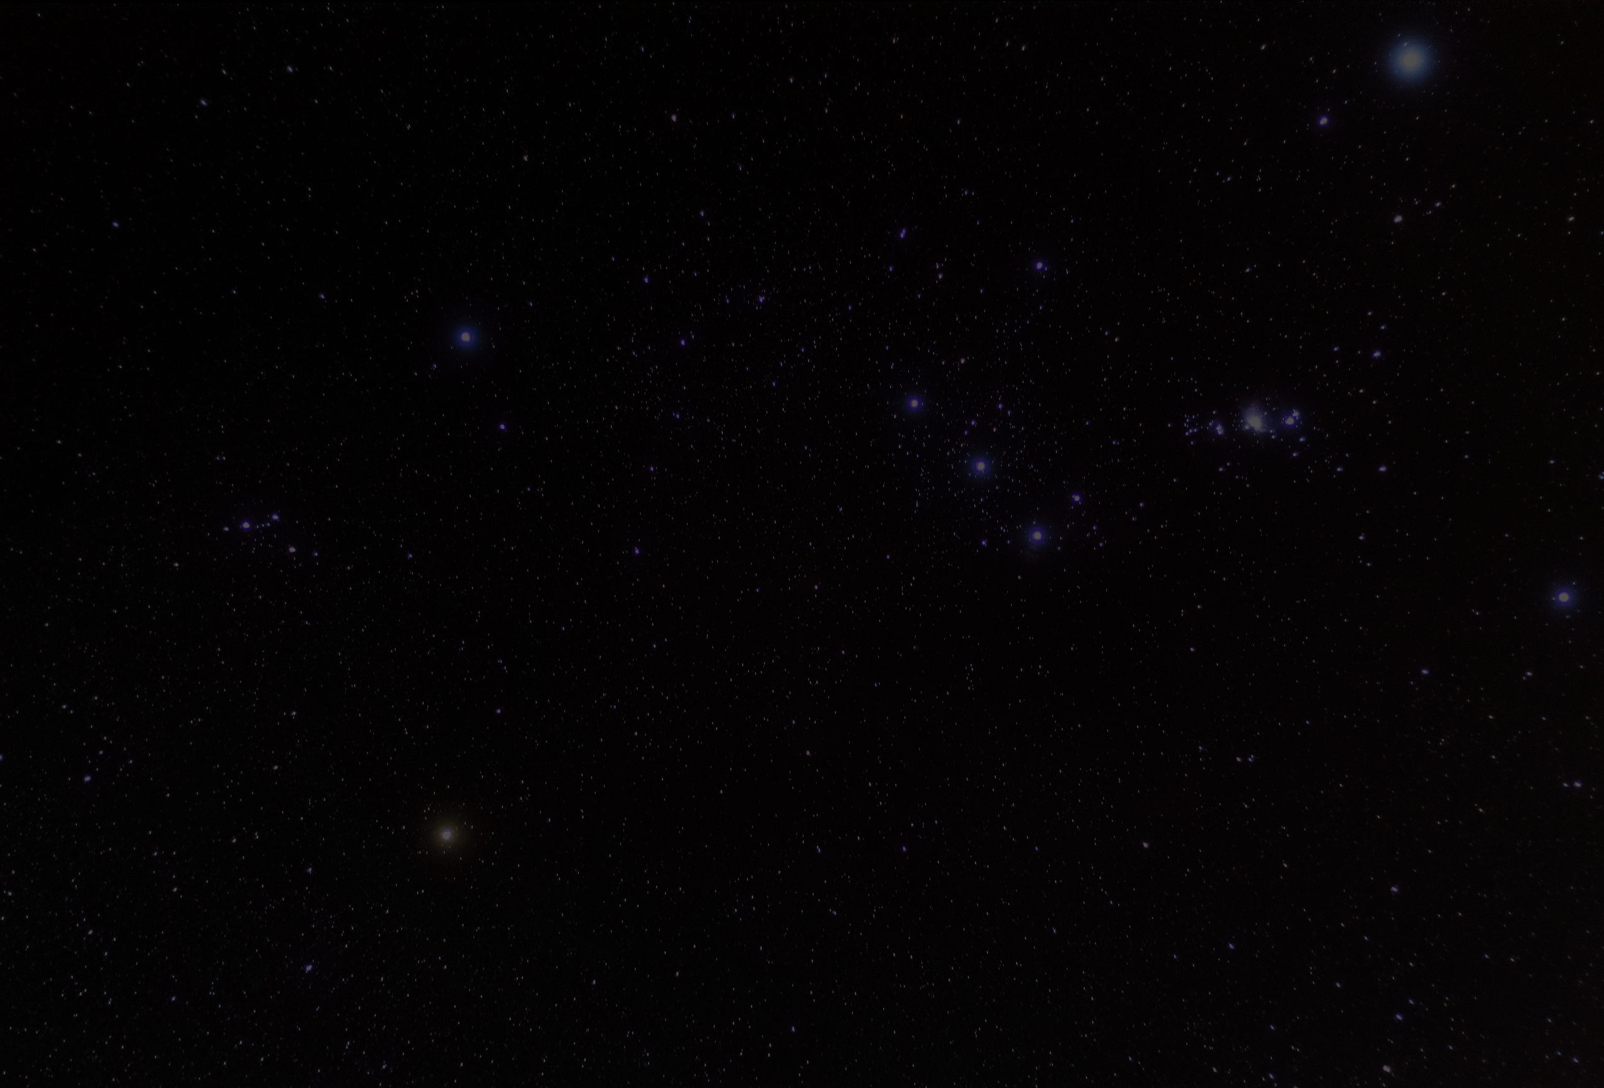
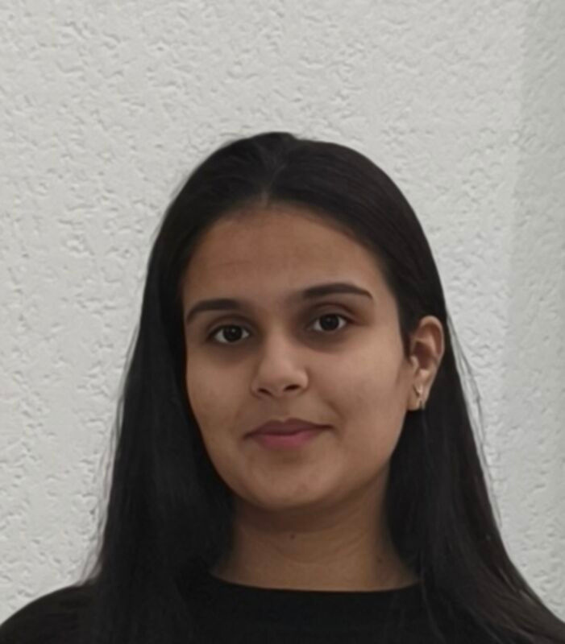
HOME
ABOUT
CONTENT
OTHERS
HI
Who am I ?
  Meriem ALAHOM, 20 years old
  Passionate about maths, algorithms, and solving complex problems
  Trilingual: French, English, Arabic
  Next: Polytech Sorbonne – Applied Mathematics & Computer Science
  Curious by nature – I love learning about psychology, sociology, and human behaviour
  I enjoy staying active: ping pong, dancing, music

Slide 3
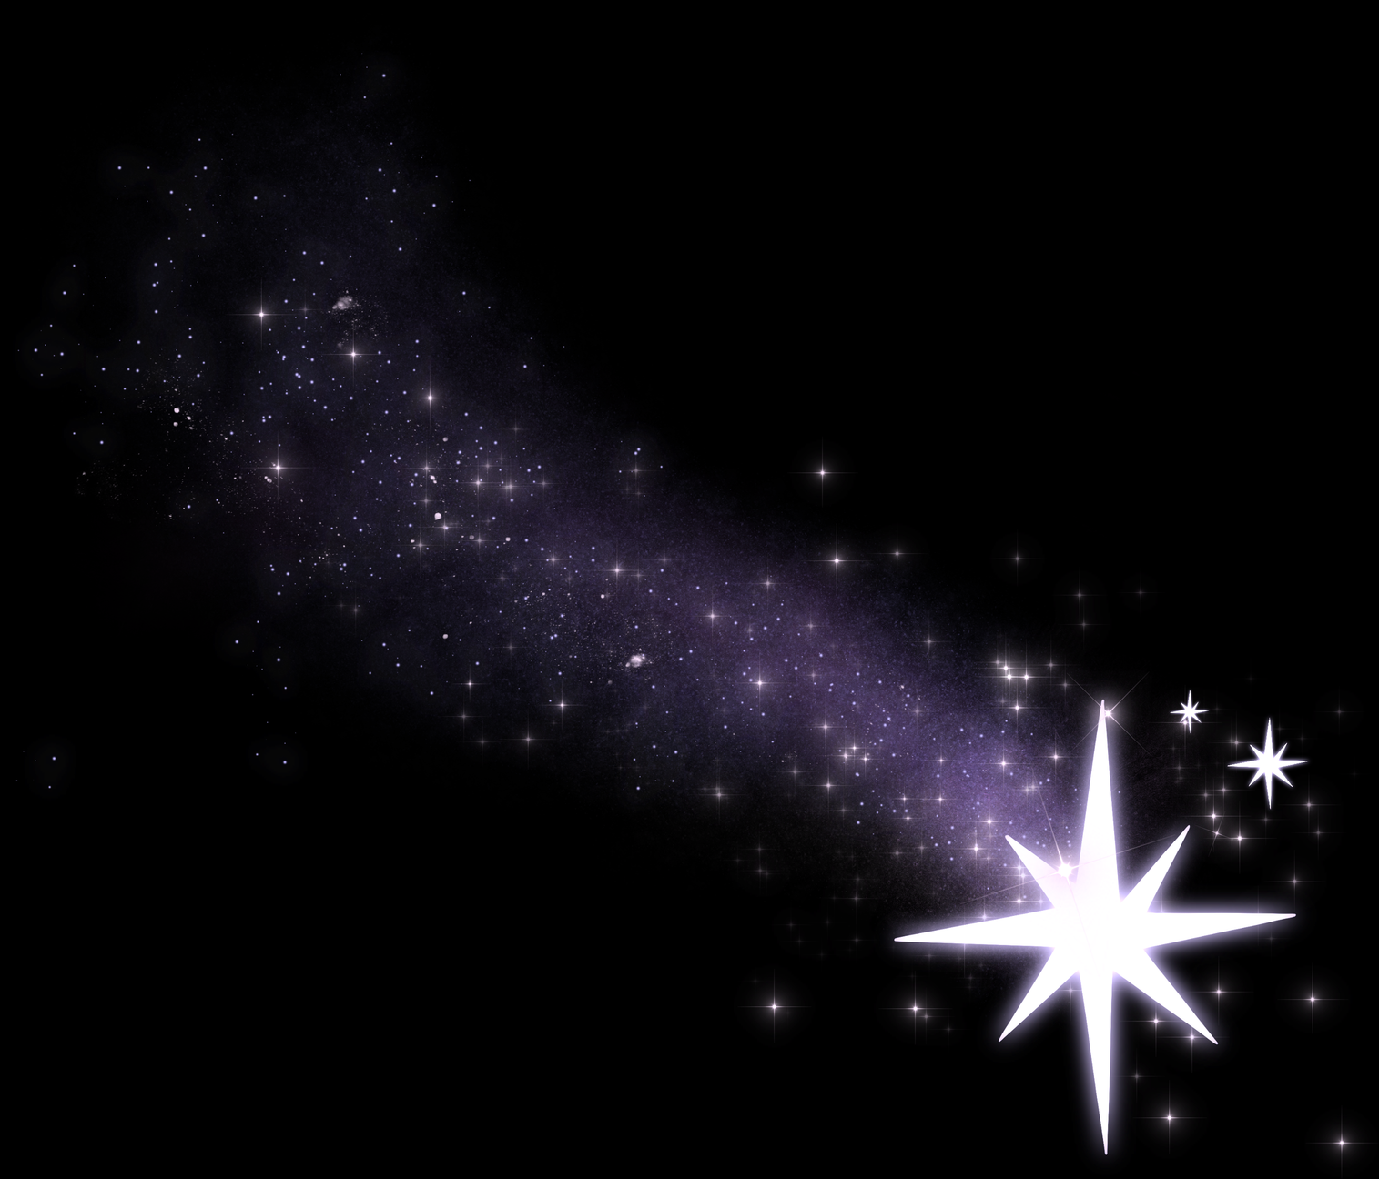
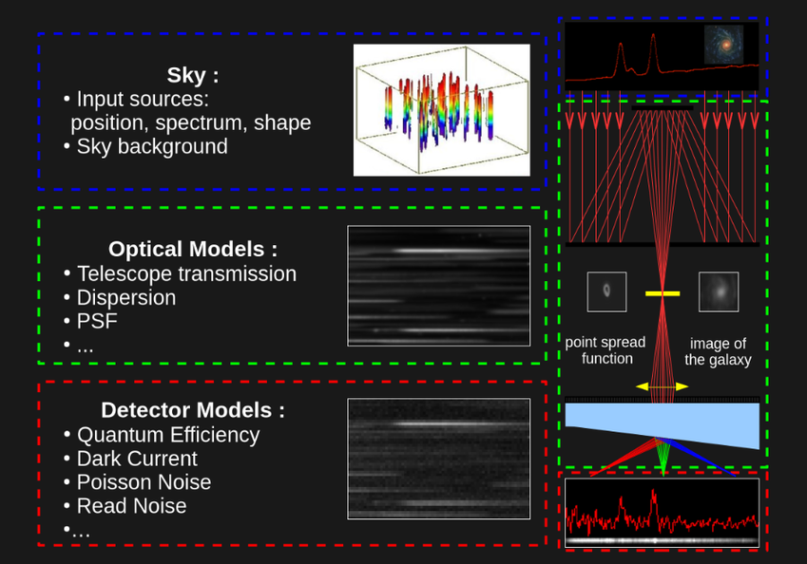
HOME
ABOUT
CONTENT
OTHERS
What I have learned
Hybrid Modelling for Euclid/NISP
  Context: Euclid mission aims to understand dark energy by measuring baryon acoustic oscillations (BAO)
  Challenge: Improve the accuracy of the spectral dispersion model for the NISP instrument
  The approach:
    Implemented a paraxial optical model (lenses, collimator, grism, camera) in Python
    Predicted photon position on the detector from sky position and wavelength
    Designed a supervised regression correction to absorb non‑linear residuals due to real grism misalignment
  Key result: The hybrid (physics + ML) approach outperformed classical polynomial fitting while remaining interpretable

Slide 4
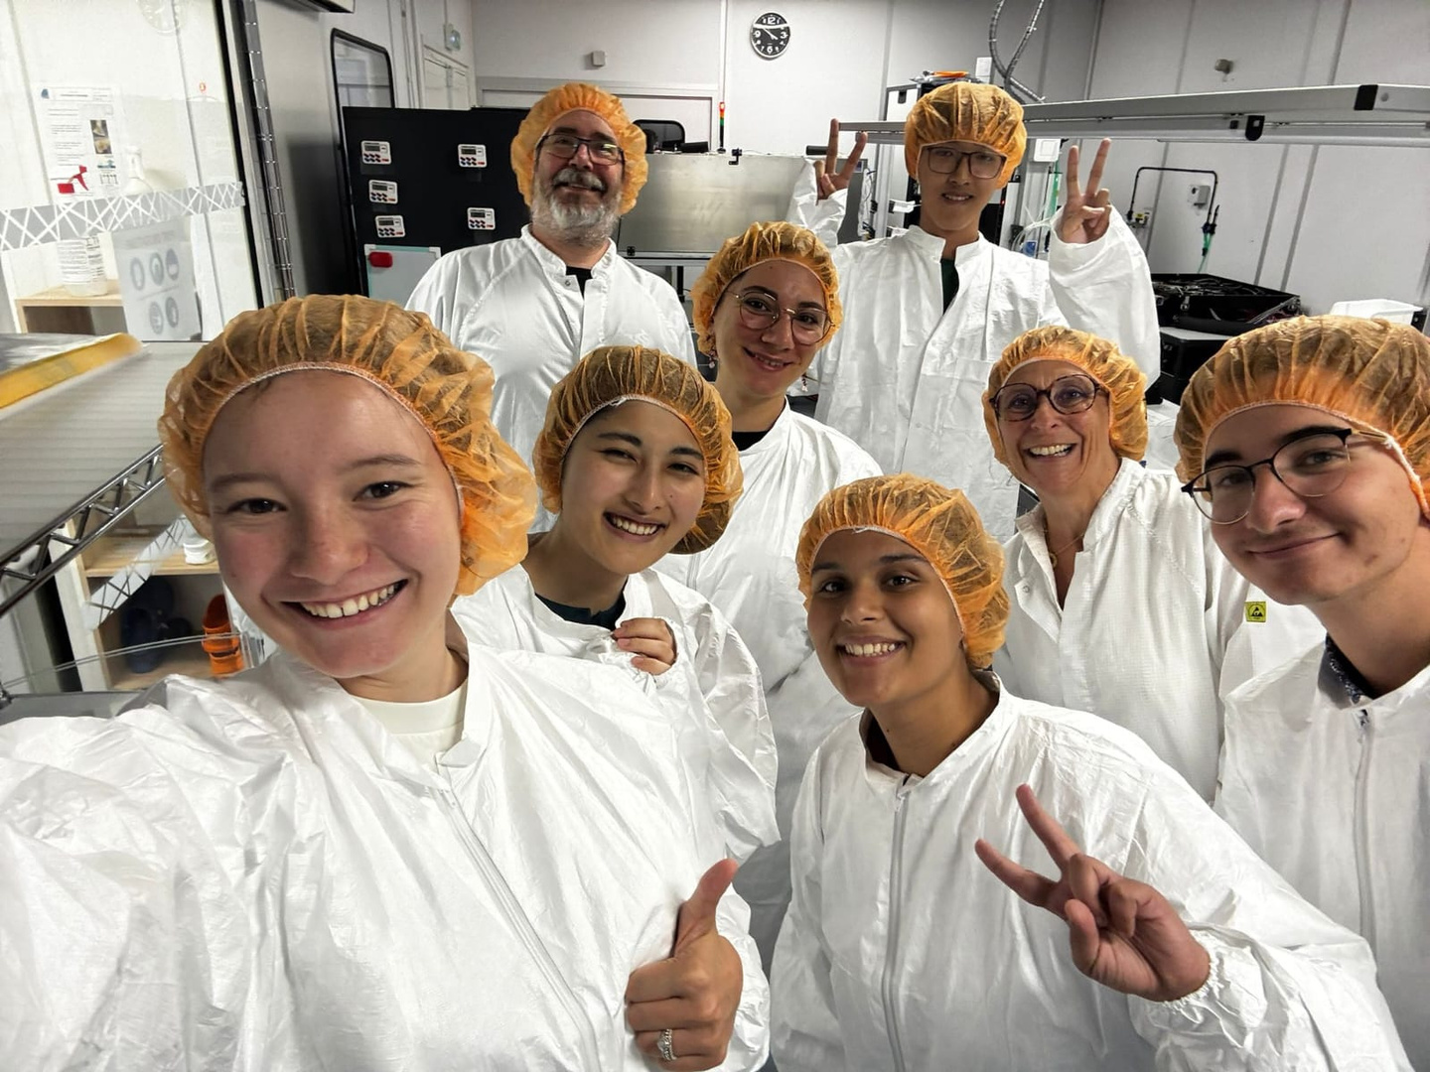

HOME
ABOUT
CONTENT
OTHERS
What I Found Interesting
About Musi
A taste of everything
Visits and conferences
The FCC debate

Slide 5
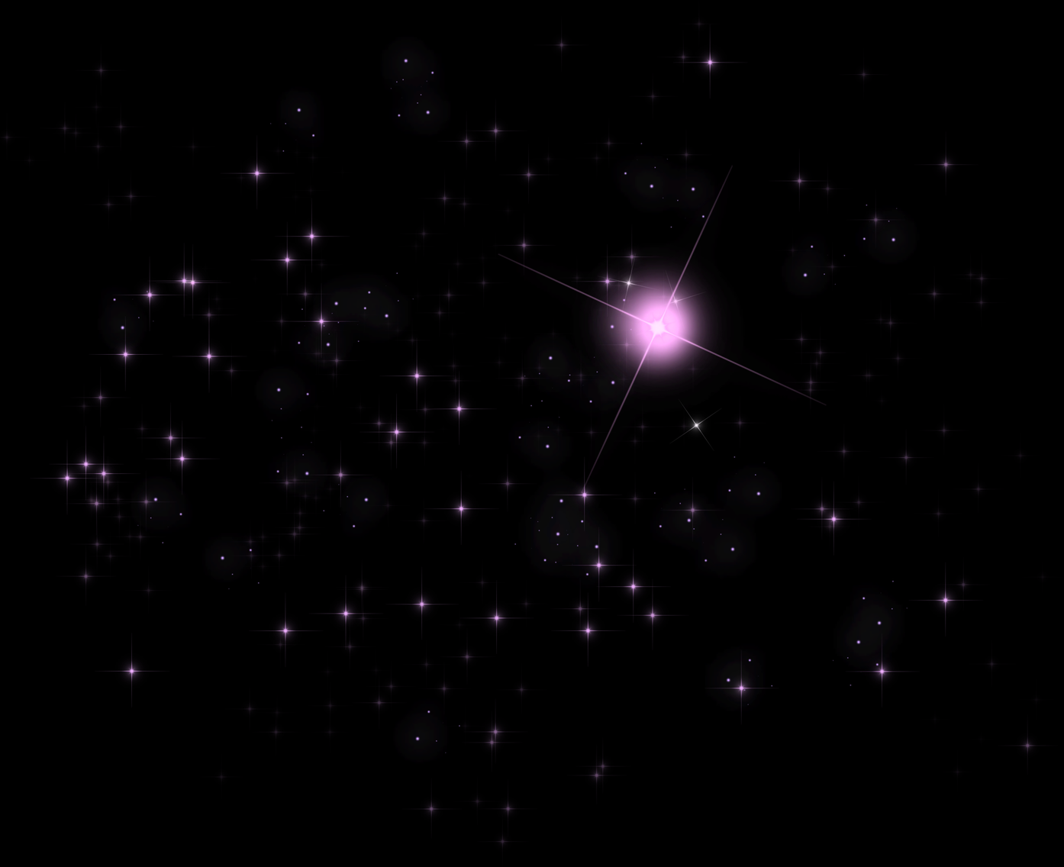
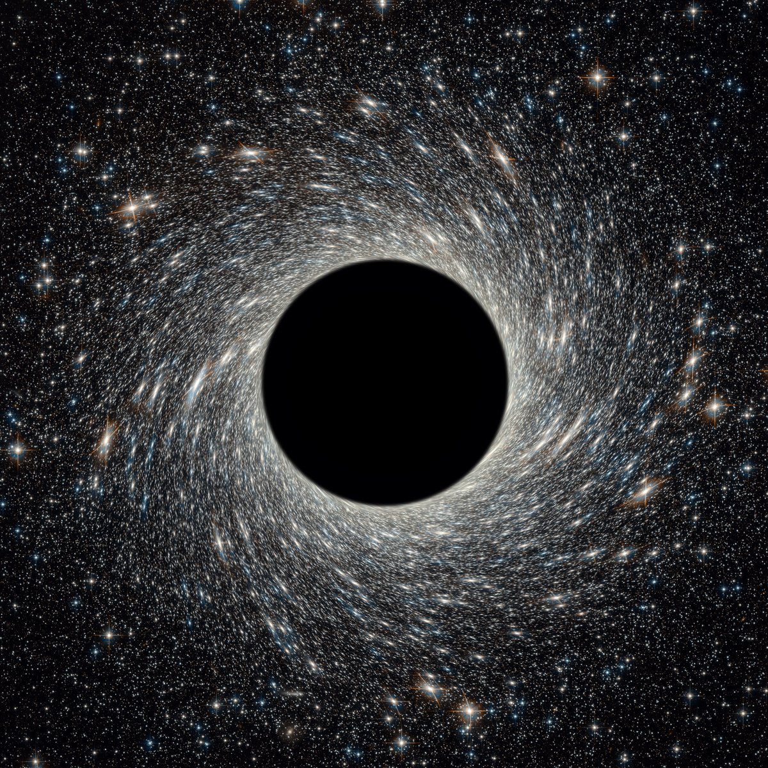
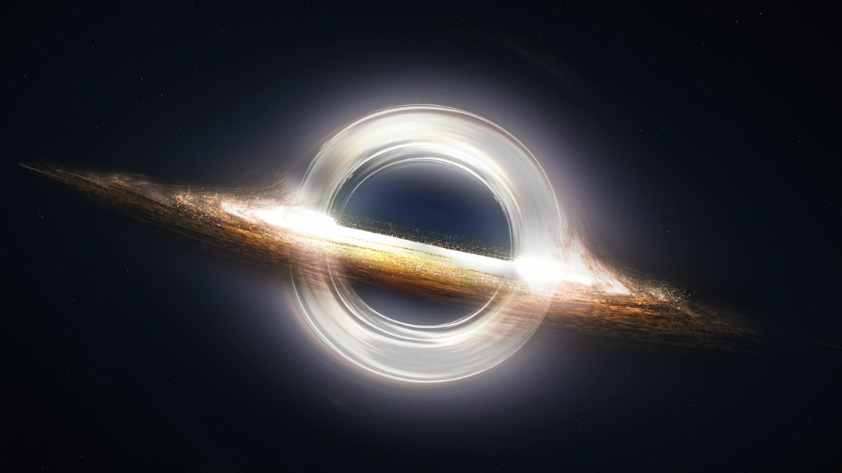
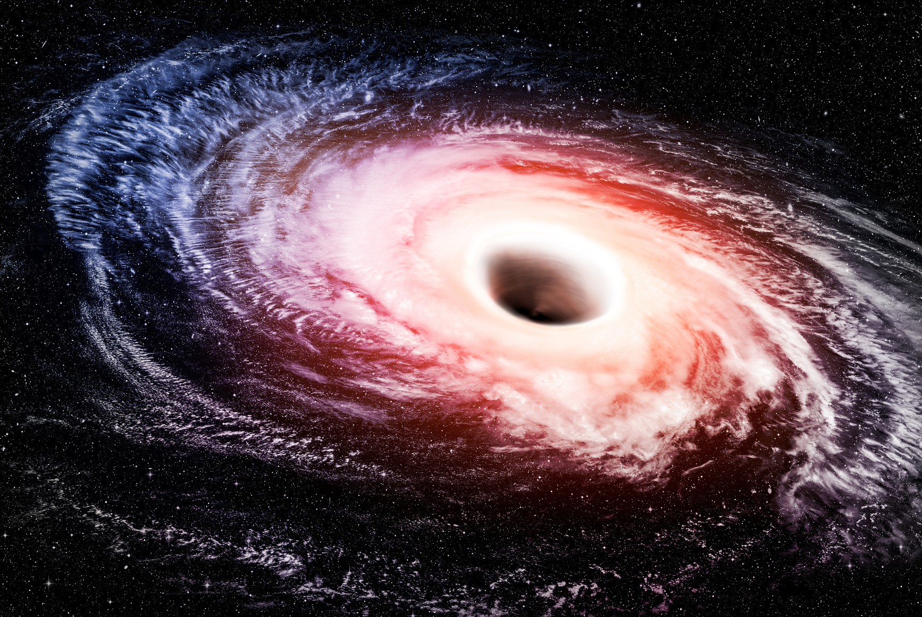
HOME
ABOUT
CONTENT
OTHERS
My message for future MUSI applicants
  Yes, I would encourage everyone to apply
  It was a lovely and tiring experience – but absolutely worth it
  I learned so much, met amazing people, and got a taste of what research really looks like
  If you're curious, hard‑working, and ready to step out of your comfort zone – go for it

Slide 6
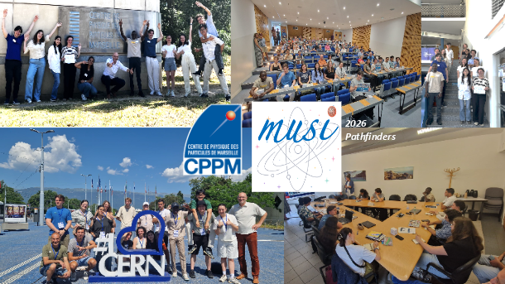
HOME
ABOUT
CONTENT
OTHERS
A message for CPPM
Thank You
  A huge thank you to my supervisor Julien Zoubian for his passion, availability, and guidance throughout this internship
  Thank you to the entire CPPM team for their warm welcome and for sharing their expertise
  Thank you to the teachers and organisers of MUSI – this programme is exceptional
  And a special thank you to the CPPM community – I leave with unforgettable memories

Slide 7
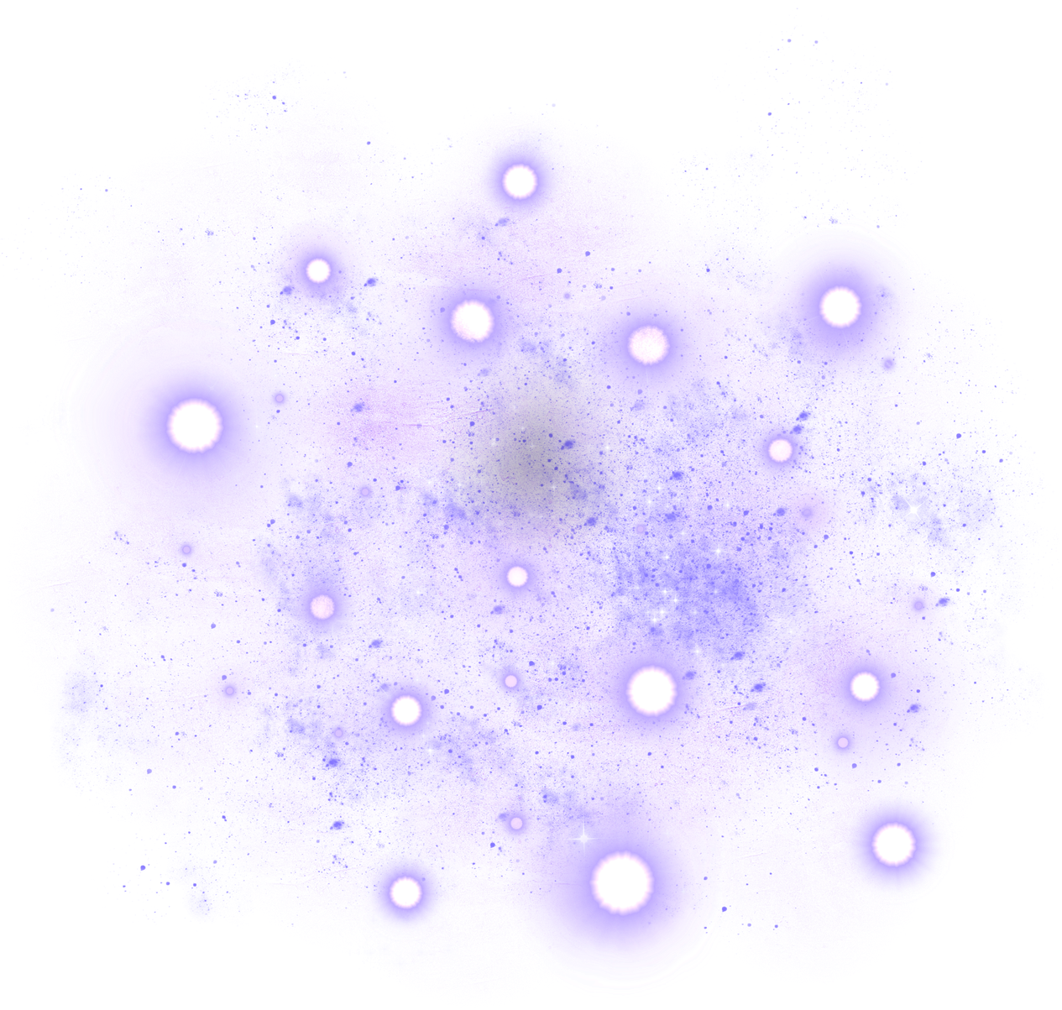
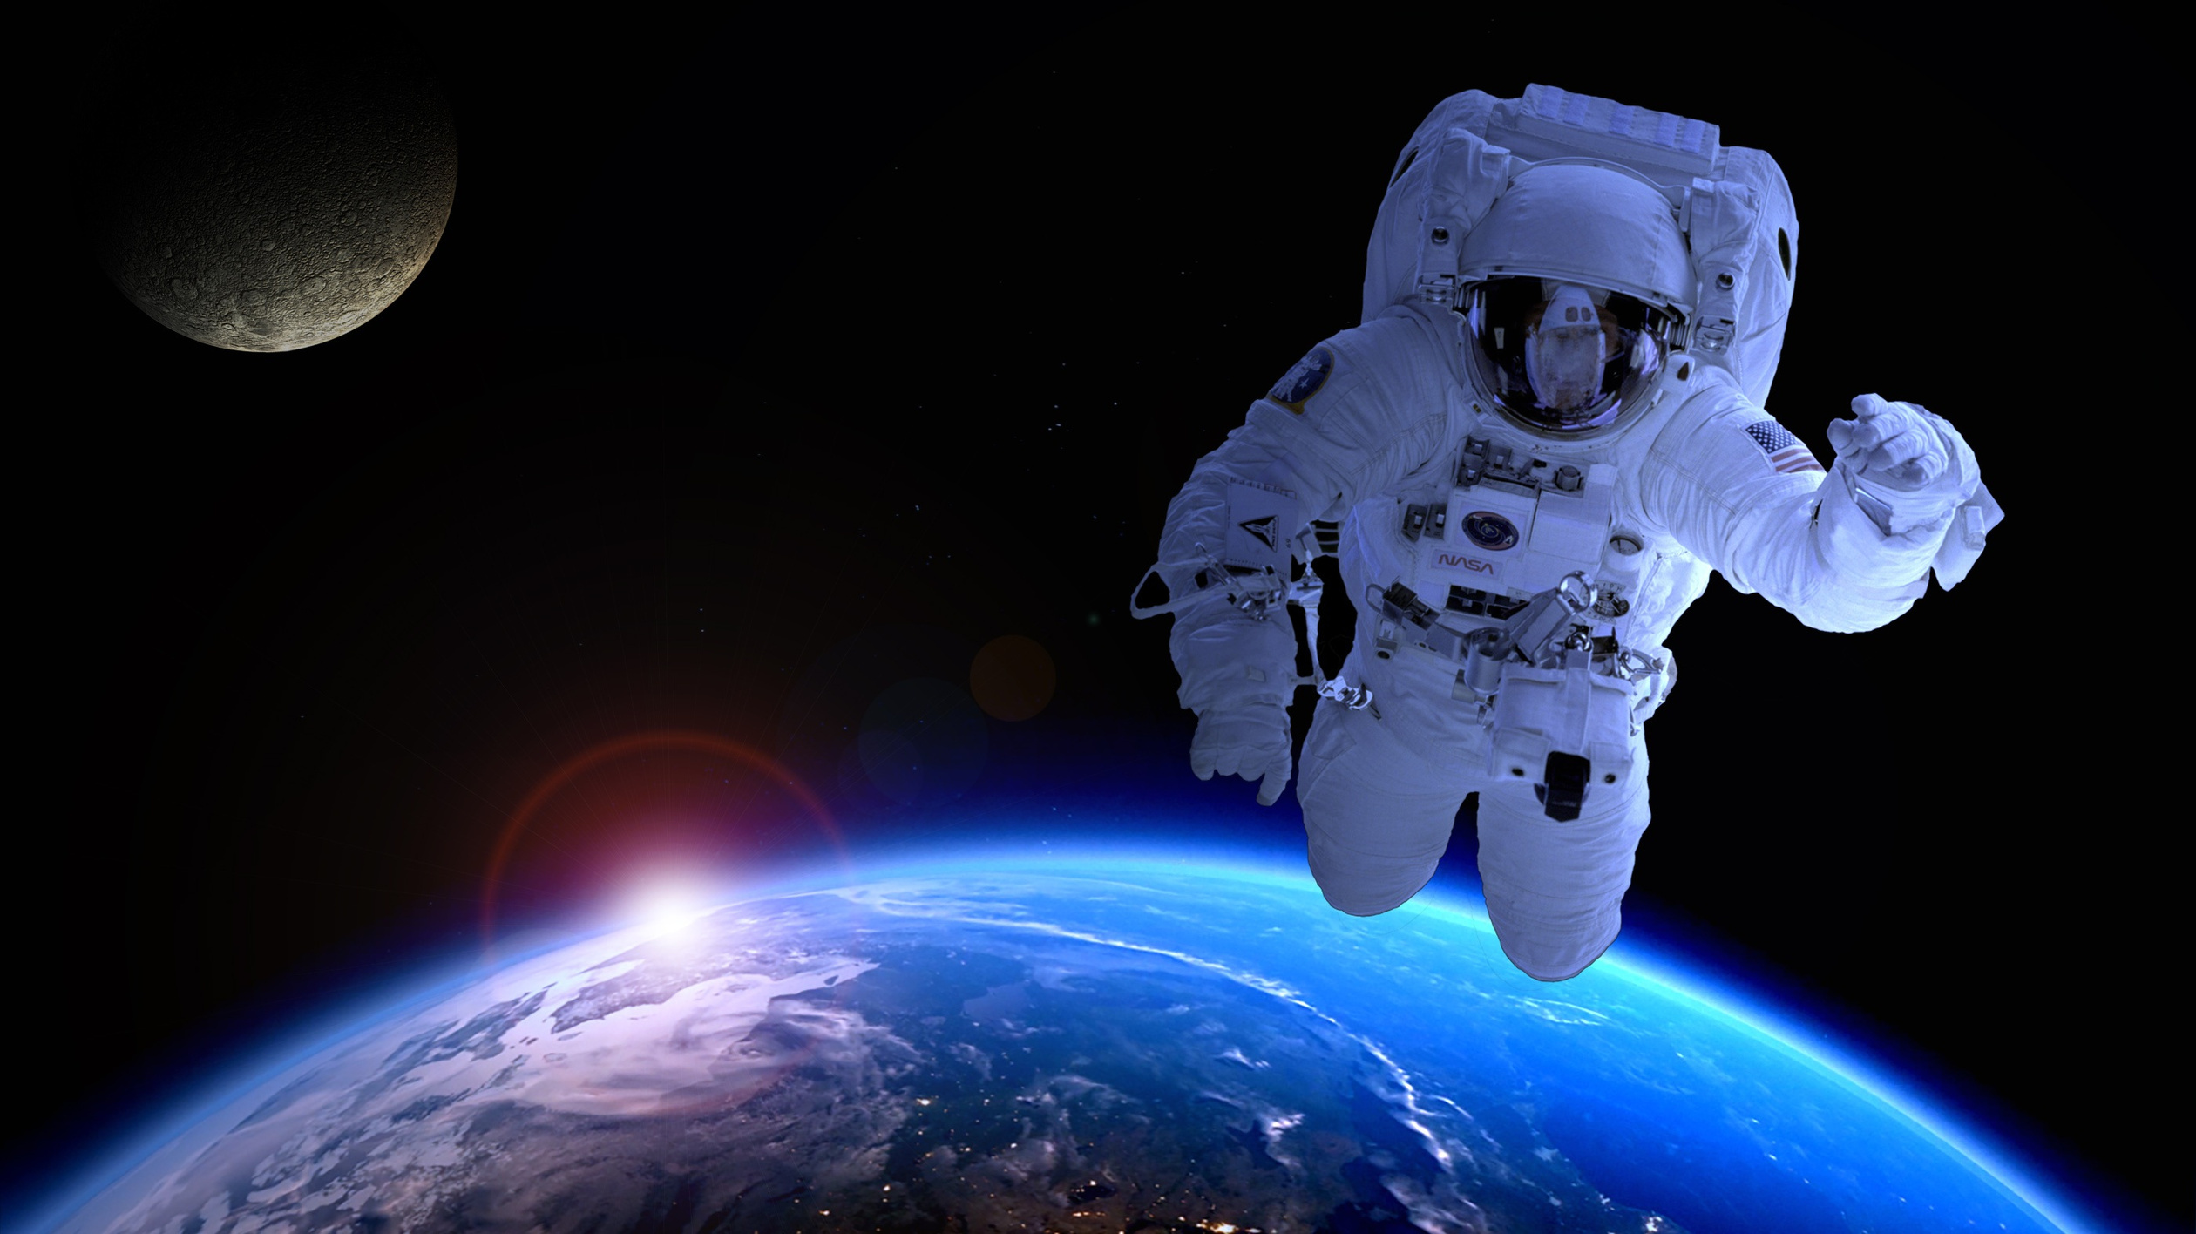
HOME
ABOUT
CONTENT
OTHERS
Thank You
Contact :
meriemalahom999@gmail.com

