Slide 1
SCICOPRO
Dosimétrie par scintillateur plastique en protonthérapie
(G. Daviau^{1,2},) A-M. Frelin¹, Cathy Fontbonne³, Jean-Marc Fontbonne³, Dorothée Lebhertz⁴, Cyril Moignier⁴ and Anthony Vela⁴
¹ GANIL, CEA/DRF-CNRS/IN2P3
² Normandie University, UNICAEN³ Université de Caen Normandie, ENSICAEN, CNRS/IN2P3, LPC Caen
⁴ Medical Physics Department, CLCC François Baclesse, 14000 Caen, France

Slide 2
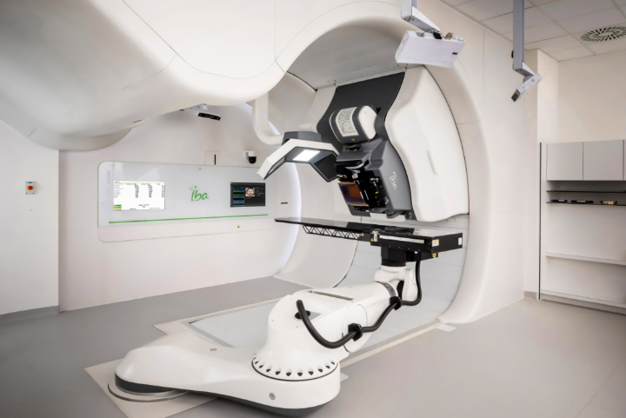
Objectifs et défis scientifiques
Dosimetry vs. Pencil Beam Scanning constraints
Cyclhad proton therapy center
IBA Proteus®ONE
Spots ∼ cm
Beam frequency = 1 kHz
Pulse = 7 µs
Maximum energy = 230 MeV
Blind Golfer Algorithm Strategy
→ Delivery of spots in several non consecutive pulses
Challenging treatment verification
  1D or 2D detectors arrays
  Time consuming measurements
Objective: development of a 3D dosimeter
  Verification of all spots characteristics
  3D dose reconstruction
  in a single irradiation
Notes:
This study was performed on a proteus one at the cyclhad center at Caen in France, which delivers treatments through pencil beam scanning.
The specificities of PBS treatments are pencil beams with dimensions of the order of the cm and a high delivery frequency (up to 1 kHz).
This makes the verification of treatments challenging.
Most quality control measurements are made with 1D or 2D detectors such as ionization chamber matrix or stack, which makes extensive controls time consuming.
The objective of this work was thus to develop a detector allowing 3D verifications and dose reconstruction.

Slide 3
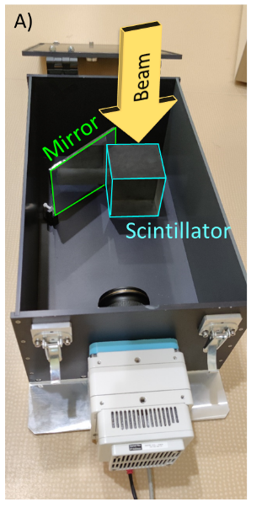


SCICOPRO Experimental setup
Direct view
Mirror view
E
X
Y
10 × 10 × 10 cm³ BC412 plastic scintillator
Ultra fast camera: up to 5200 fps @ 1200 × 800 px
Synchronized to the “pulses delivery” (delivered at 1 kHz)
  ← logical signal provided by the Proteus®ONE
Record of each pulse
Measurement of beams characteristics:
Position (X,Y), Energy, Intensity (MU) for each pulse
3D dose distribution reconstruction
Notes:
The detector we developed is a scintillator system, shown in this picture. It consists of a plastic scintillator cube of 10x10x10cm, with 4 faces on 6, painted black to limit parasitic light and optical reflections.
The system is designed to be irradiated by vertical beams.
The scintillation is recorded by an ultra-fast camera synchronised with the beam delivery.
The camera records two views of the scintillator: a direct view and a view reflected by a mirror. Here is an example of the recording of an irradiation where we can see each pulse delivered by the Proteus®ONE. The horizontal position of the pulse on the direct view is mainly representative of the Y position. The horizontal position of the pulse on the view reflected by the mirror is representative of the X position of the pulse. The depth of the Bragg peak, whatever the view, is representative of the energy. And the signal intensity at the Bragg peak position is correlated to the delivered pulse intensity in MU.

Slide 4
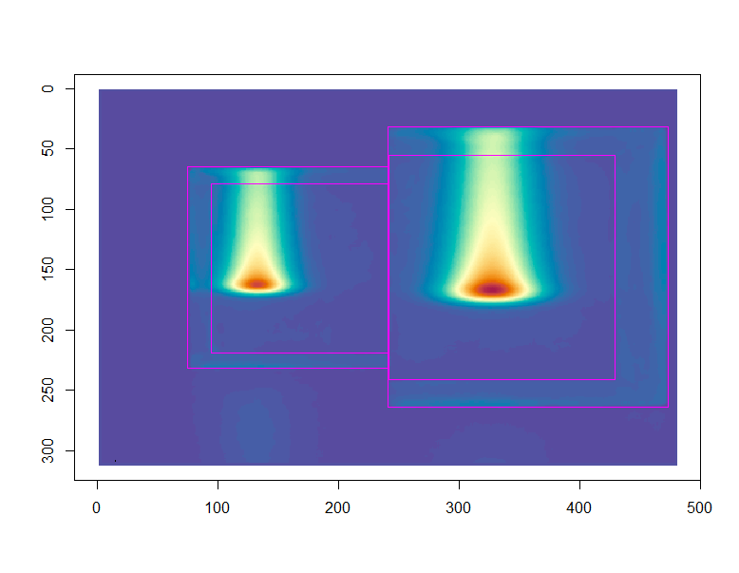
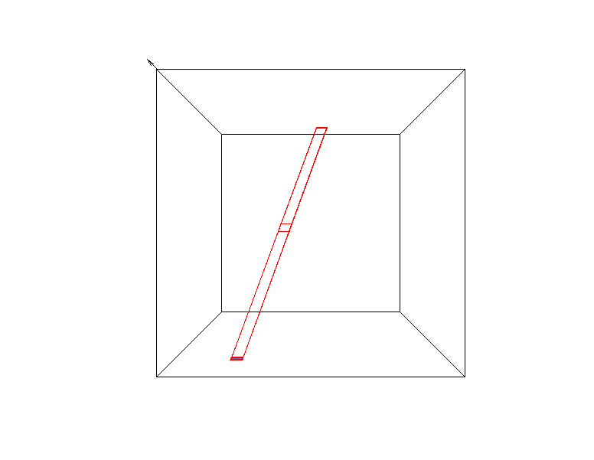

Scintillation distribution reconstruction
3D reconstruction algorithm
G. Daviau PhD Thesis
BEAM
  Loop on all the pixels of the direct view
  For each pixel of the direct view ( )
  Calculation of the corresponding projected volume (in red)
  Projection of this volume on the mirror view ( )
  Retro-projection of each pixel ( ) of the yellow area
  Elementary volumes of scintillation intensity S:
  S( ) = PV( ) × PV( ) / PV( )
  3D Scintillation distribution but not regular grid
  Registration on a regular grid of cubic voxels
Mirror view
Direct view
Vue miroir
BEAM
Vue directe
Notes:
The two images are used to reconstruct the 3D dose distribution of the PBs delivered by the treatment. The reconstruction is based on a loop on all the pixels of the direct view.
For each pixel, the corresponding volume, contributing to the scintillation signal measured by the pixel is calculated by retroprojection
This volume is then projected on the mirror view, to get the corresponding pixels.
An those pixels are themselves retro-projected to define elementary volumes in the scintillator volume.
The scintillation produced in this volume is finally calculated from the pixel values recorded in the direct and the mirror views.
This algorithm allows to reconstruct the scintillation distribution but in a not regular grid.

Slide 5
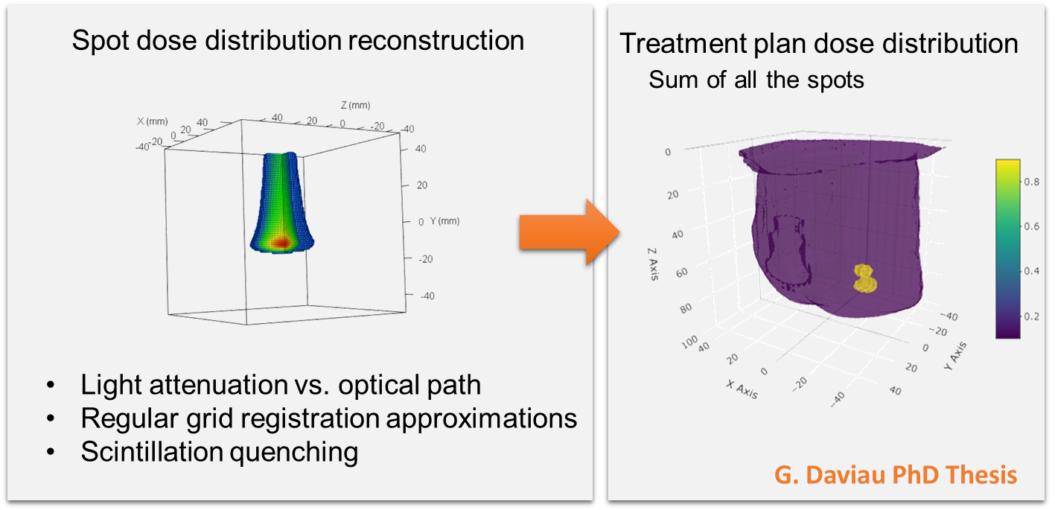
Faits marquants 2025/26
Reconstruction de distributions de dose 3D
Development of a three-dimensional scintillation detector for pencil beam verification in proton therapy patient-specific quality assurance, Med Phys. 2024 Sep 10. https://doi.org/10.1002/mp.17388.
Communication orale PTCOG 2026
Papier soumis pour la reconstruction 3D
1 papier en preparation sur le contrôle des traitements patients
Notes:
The process I presented you allows to reconstruct the 3D scintillation distribution from two projections. Of course, the process also needs corrections at different stages.
In particular, the images must be corrected from optical artifacts such as lens vignetting, hot pixels, internal reflections et caetera.
The reconstructed distribution then must be corrected from light attenuation which depends on the different optical paths, and from the approximations performed during the registration and from scintillation quenching.
Finally the dose distribution of all the PBs delivered during the treatment are summed to get the whole treatment dose distribution.

Slide 6
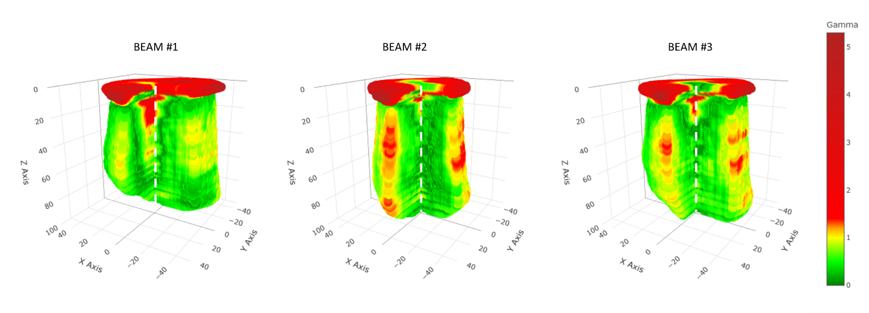
Vision 2030
Projet européen TwinRISE sur l’IA
Stage de M2 + Thèse en 2027
  Correction des biais optiques
  Setups expérimentaux alternatifs
  Stratégies IA pour la reconstruction 3D
  Ouverture à d’autres modalités
Dosimétrie en Carbone thérapie
i (pixel)
Mirror view
Direct view
j (pixel)
Gamma Index SCICOPRO vs TPS

Slide 7
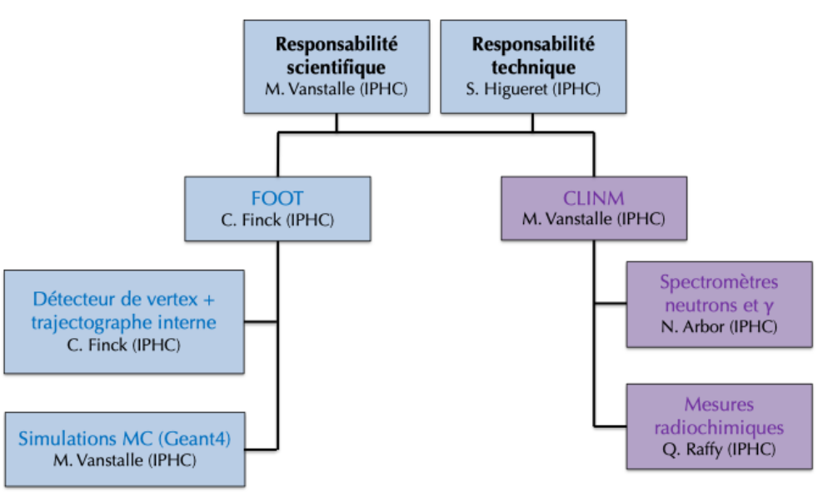
Structure du projet
Personnes et laboratoires impliqués (IN2P3 et associés) et leur rôle
GANIL (A-M, Frelin + stagiaires et doctorants) et LPC Caen (J-M. Fontbonne, C. Fontbonne)
Collaborations nationales et internationales
CLCC François Balesse
Plateformes
Centre Cyclhad (Caen)
Partenaires industriels
Tentatives non concluantes avec IBA Dosimetry
Un peu difficile de passer à l’étape supérieure pour se diriger vers un transfert clinique
…

Slide 8
Nouvelles collaborations
Au sein du MP hadronthérapie
ou externes

Slide 9
AaP en cours et visés (2-5 ans)
Projet européen TwinRISE (en cours – début 01/2027)
  Thèse CEA: 138 k€ + 16 k€ de missions et temps de faisceau

Slide 10
Besoins 2027
budget
CDD
…

