Slide 1
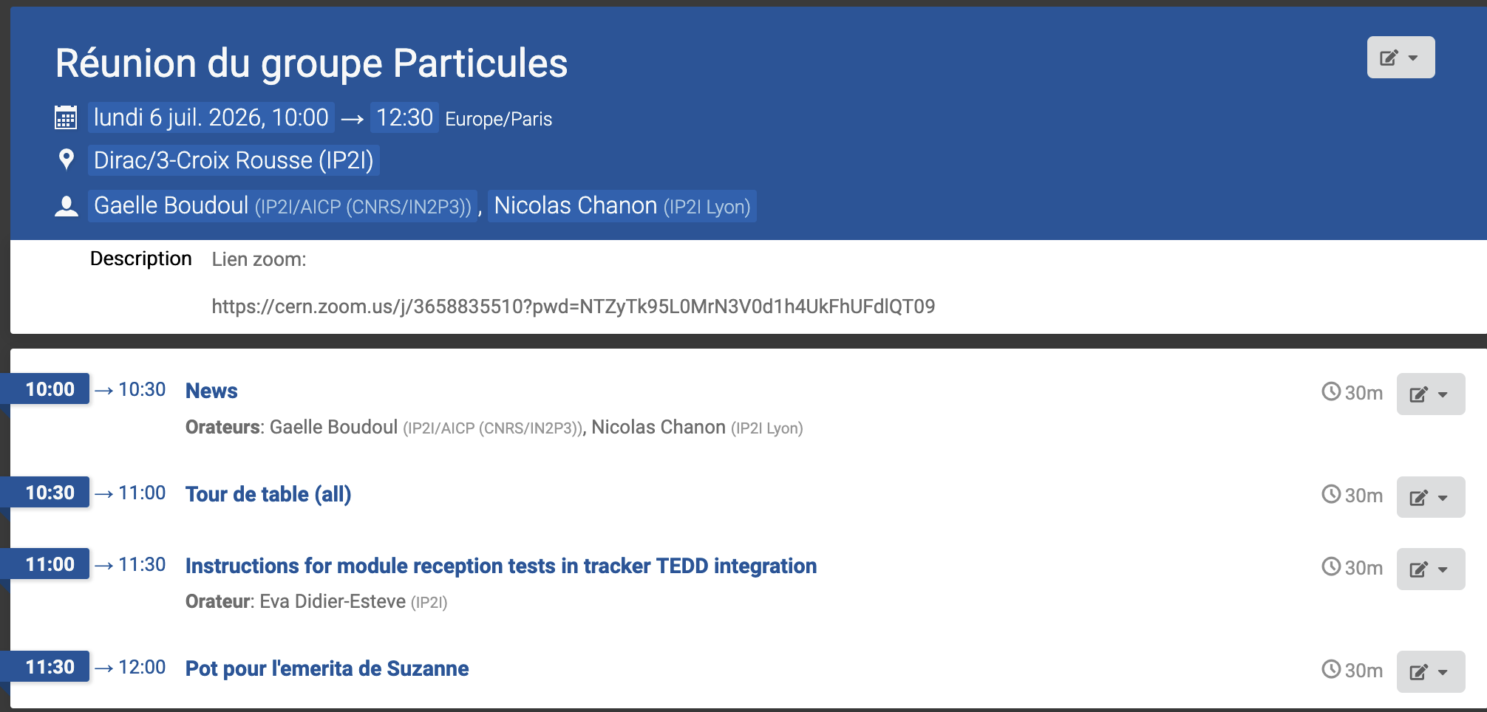
Agenda, Particle group meeting

Slide 2
News
IN2P3/UCBL/lab news:
IN2P3: Recruitment of short-term contract at the CNRS: stopped until the end of the year (not only September). Short-contracts IR* HL-LHC secured.
‘Institut Thematique One Universe’: Anne detached to the University to remain co-PI. Kick-off meeting last Monday. Funding unclear, the ANR recently changed rules. No news from a labex call for project by the Ministry.
Following the success of 3 locals MCF to the Prof concours, 3 Maitre de Conferences positions will be opened
Doctoral school PHAST concours results: 3 theory, 1 cosmo
NSIP (declarations of time spent on each project): thanks for filling out, was sent to the lab direction by the end of June
DIALOG (funding and RH requests): prepared by permanent staff, was sent to the lab direction on Friday
Mid-2026: Please fill the ‘conference table’ to foresee our budget: https://docs.google.com/spreadsheets/d/17vS1I54gX5d-UqzV33r8gOD00mkwZSNUOEuykF15nYE/edit?usp=sharing
R&D for future collider news:
Public debate on FCC (https://www.debatpublic.fr/projet-accelerateur-particules): there was a session in Lyon on 17 June. Each lab should be asked to write a ‘cahier d’acteur’ to prepare answers to typical questions
CMS news:
Data taking 2026 is over

Slide 3
News on our activities (tour de table)

Slide 4
Back-up slides

