Slide 1
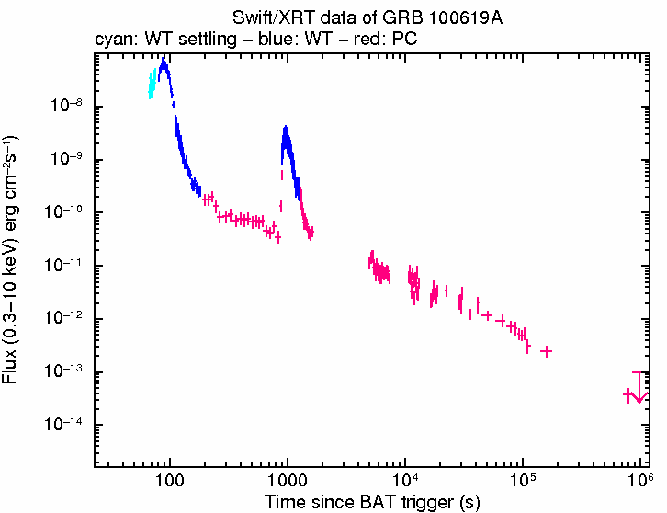
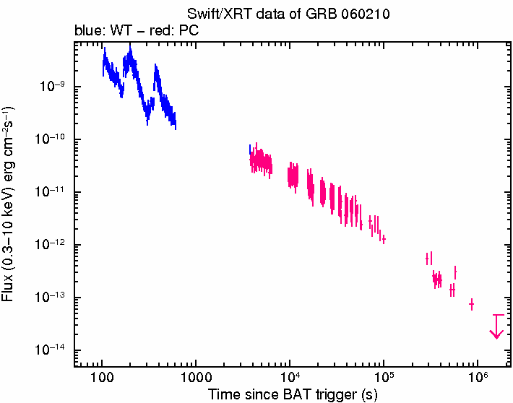
Do flares in the early X-ray afterglow really imply a late activity of the central source ?
R. Mochkovitch, F. Daigne, R. Hascoët (IAP)
Basic properties of flares:
from a few 10 s to a few 10⁵ s, superimposed to underlying AG light curve
shape and spectral evolution comparable to that of prompt pulses
but Δt/t ~ 0.1 – 0.3
Seems to exclude a forward shock origin: refreshed shocks, clumps in CSM
→ late activity of the central source ?
May be, but implies a very specific temporal behavior different from prompt emission

Slide 2
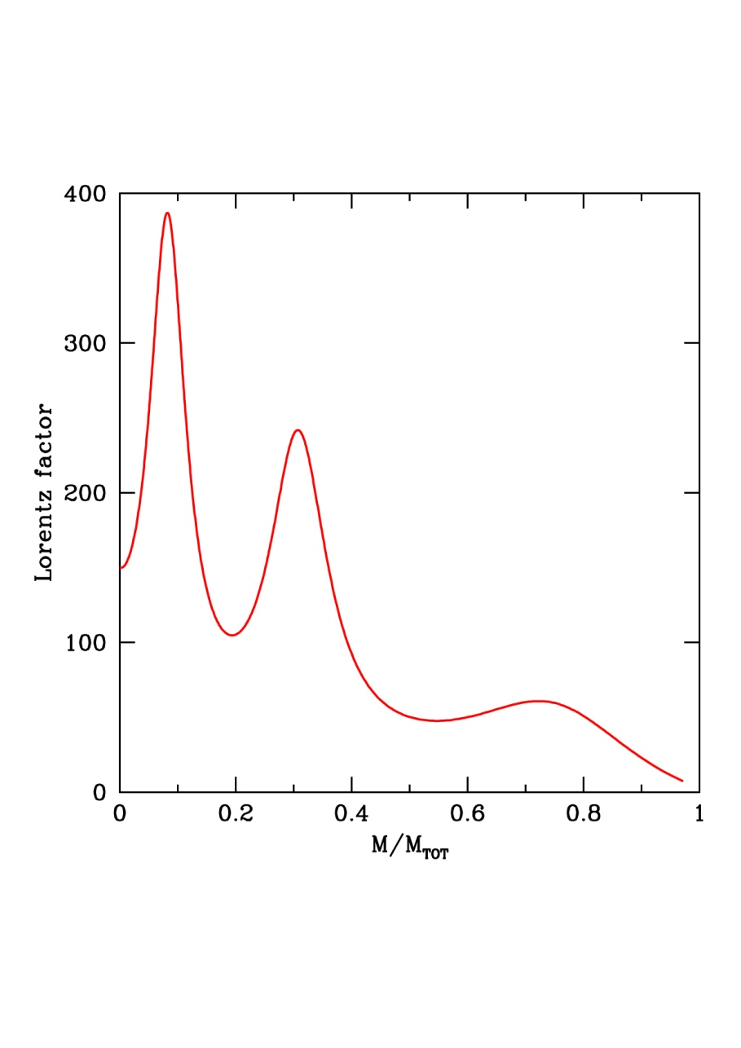
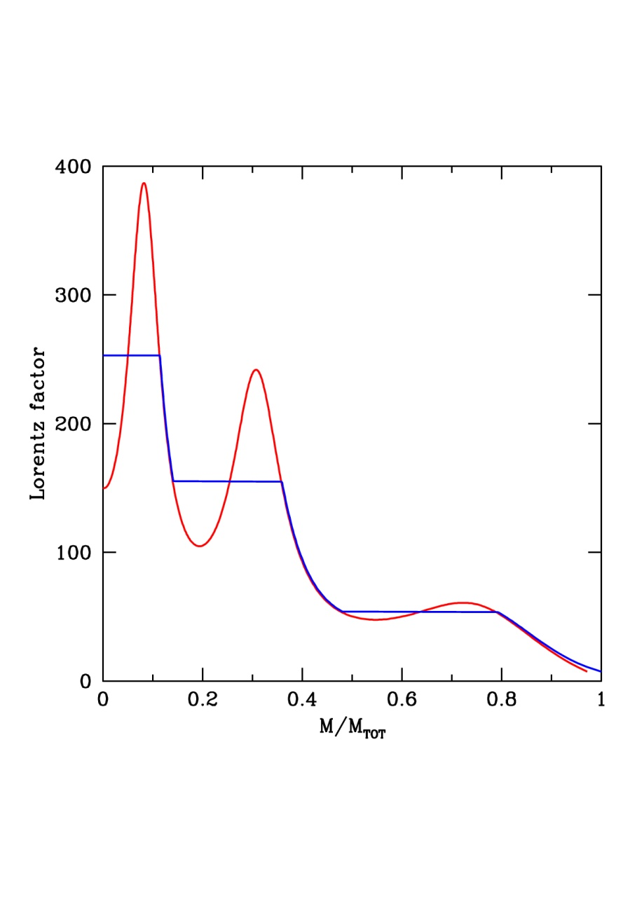
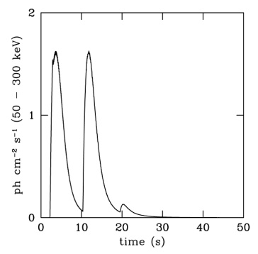
An alternative to late activity:
X-ray flares as a necessary consequence of internal shocks
What happens during the internal shock phase ?
Γ is redistributed into the ejecta with slower material decelerating faster one until
only a few dense shells remain with ordered Γ values (decreasing from front to tail)
Shell 1: Γ = 260 ; 30% of E_{TOT}
Shell 2: Γ = 140 ; 30% of E_{TOT}
Shell 3: Γ = 50 ; 20% of E_{TOT}
~ 20% unshocked

Slide 3
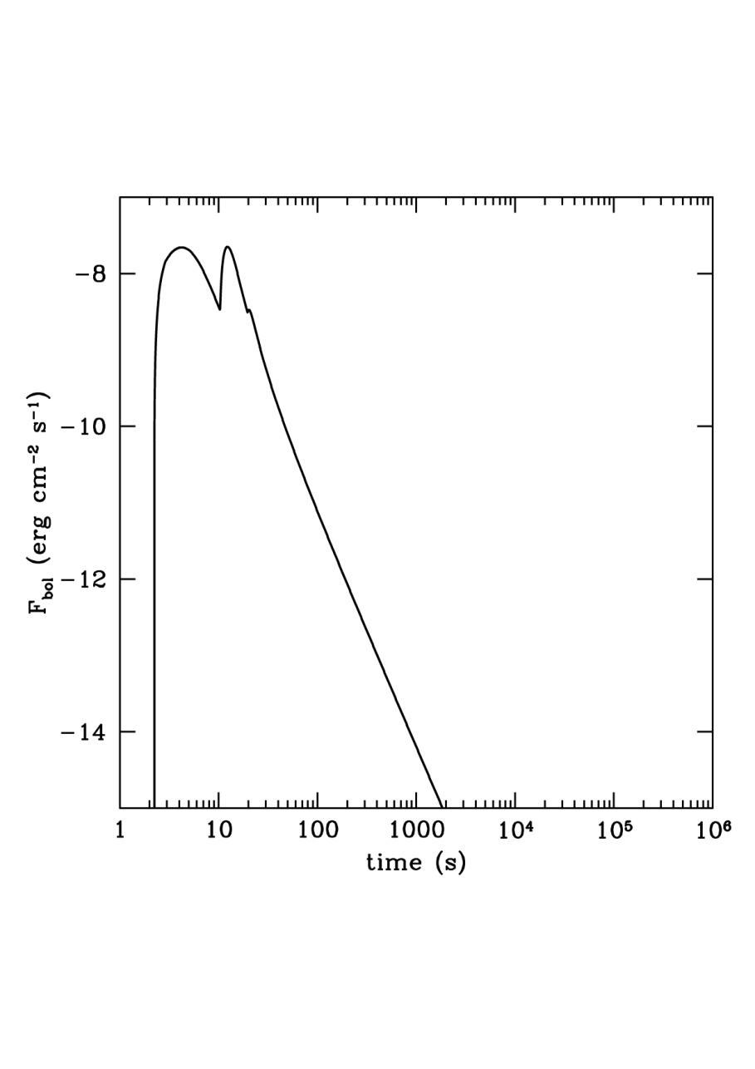
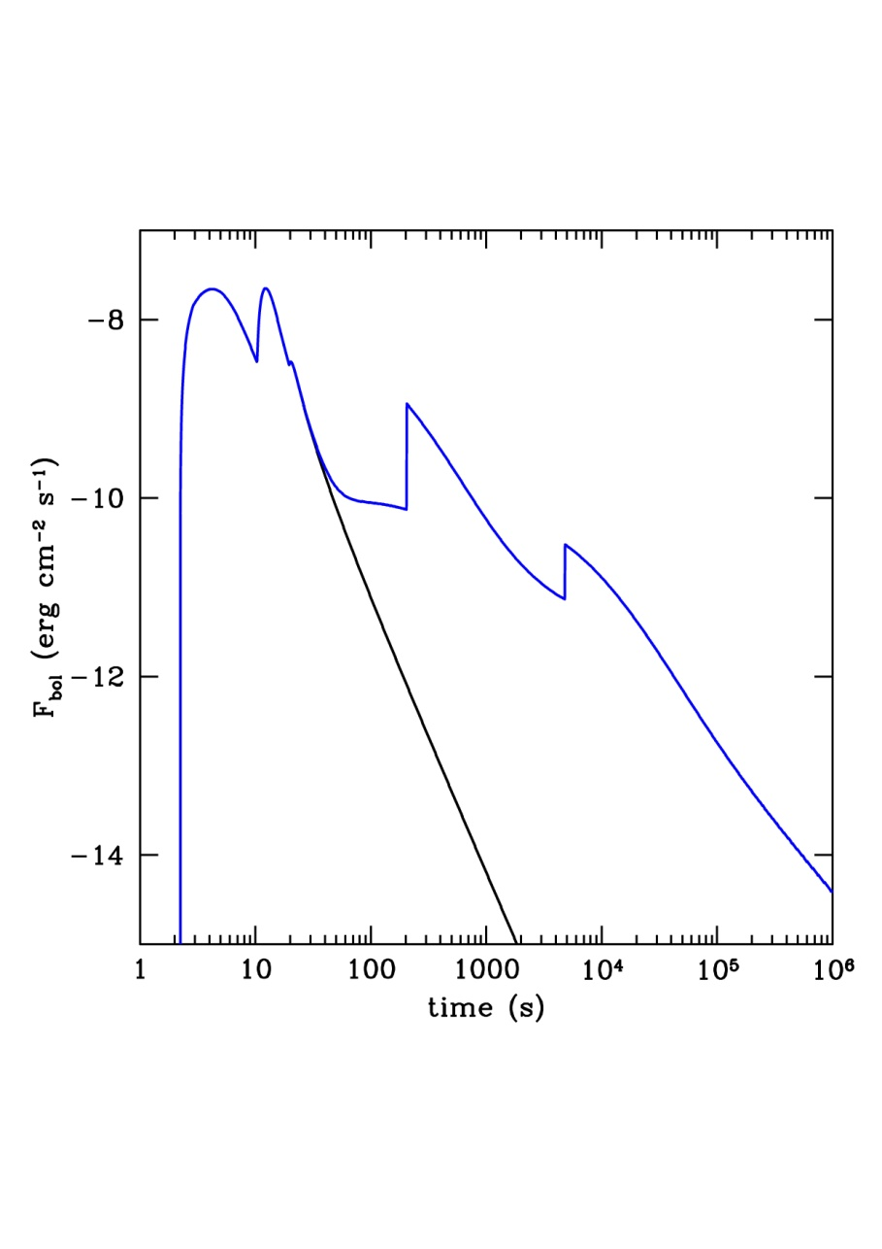
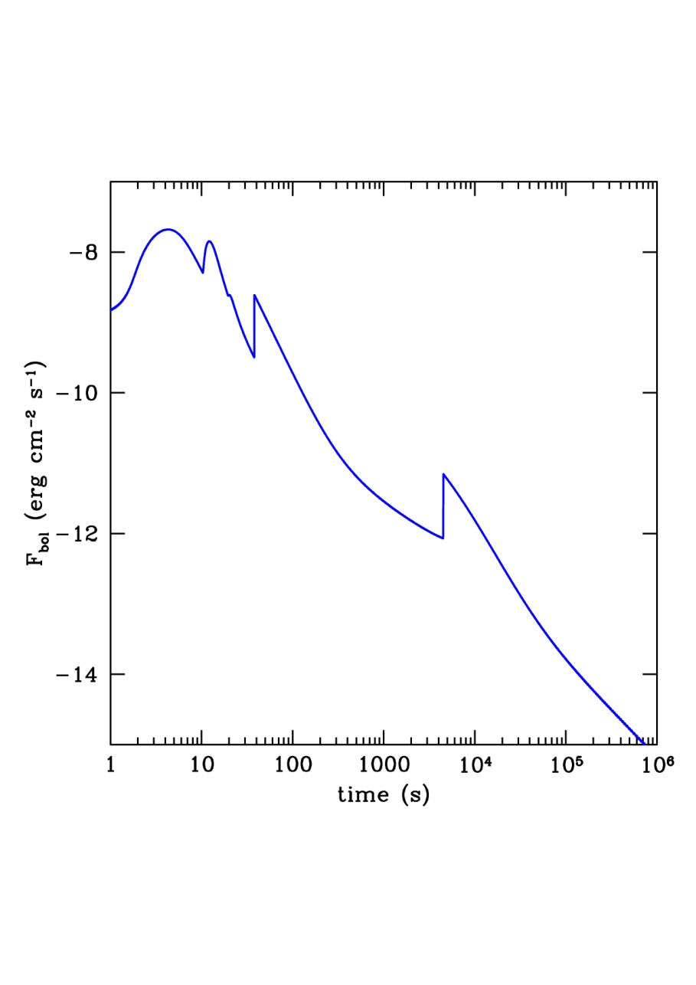
Then, this structured ejecta is decelerated by the surrounding medium
→ two additional shocks at later times when Γ has decreased to respectively
140 and 50
n = 1 cm⁻³ A* = 0.1
t⁻³

Slide 4
The accidents in the light curve have:
Δt/t ~ const (good)
but with const ~ 1 (bad)
A logical sequence …
if this defect can be corrected
→ the « accidents » become attractive candidates to make the flares
if not
→ internal shocks may not be responsible for the prompt emission ...
Then, is it possible to reduce Δt/t from 1 to 0.1 – 0.3 ?
May be … if the radiation is anisotropic in the frame of the emitting shell
(Beloborodov, Daigne, Mochkovitch & Uhm, 2010)
Shell rest frame | Observer frame | Decay (bolometric)
isotropic | 1/Γ | t⁻ ³
anisotropic | 1/kΓ (k>1) | t^{-α} (α > 3)
Rise time looks OK but may be artificially steep (requires true hydro)

Slide 5
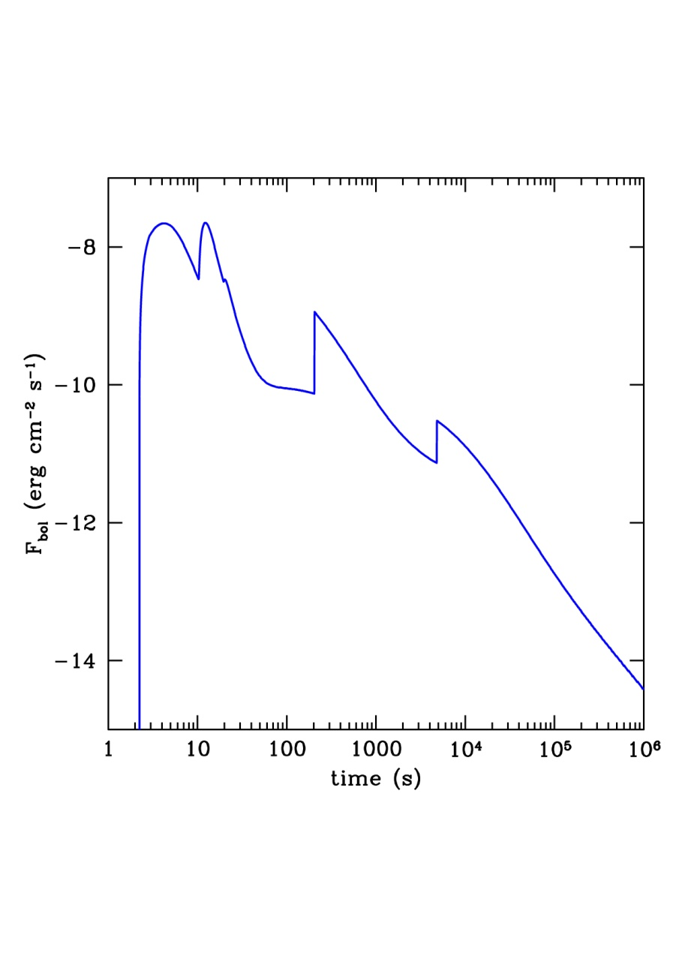
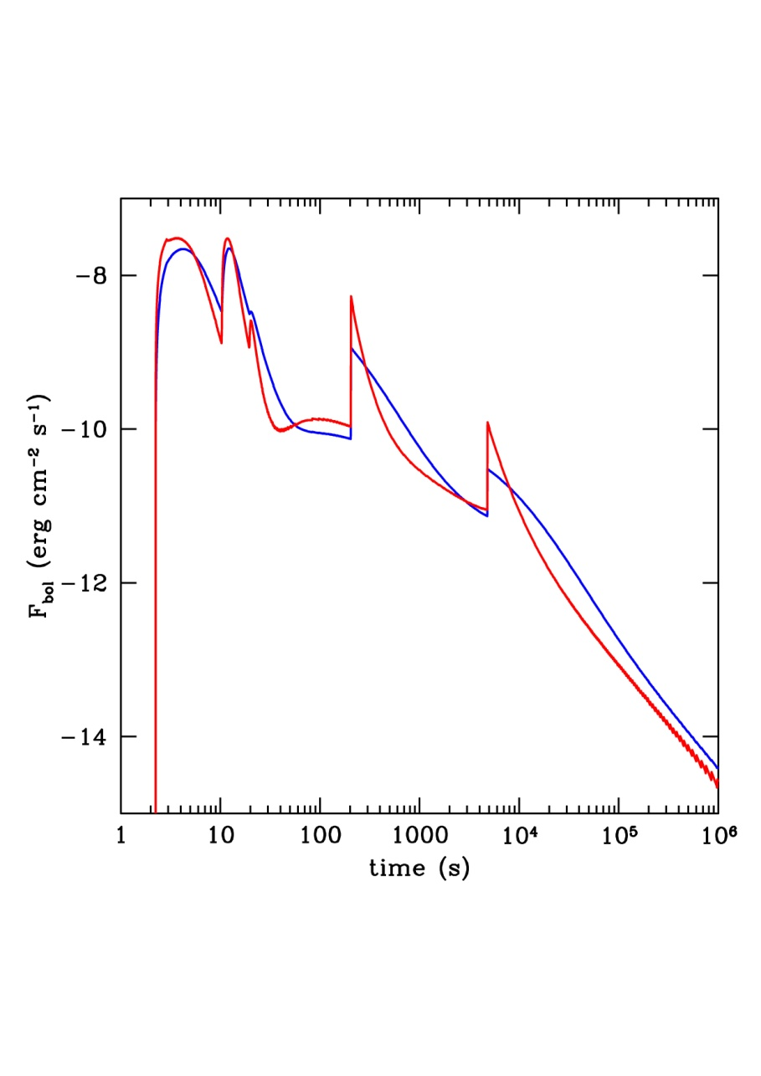
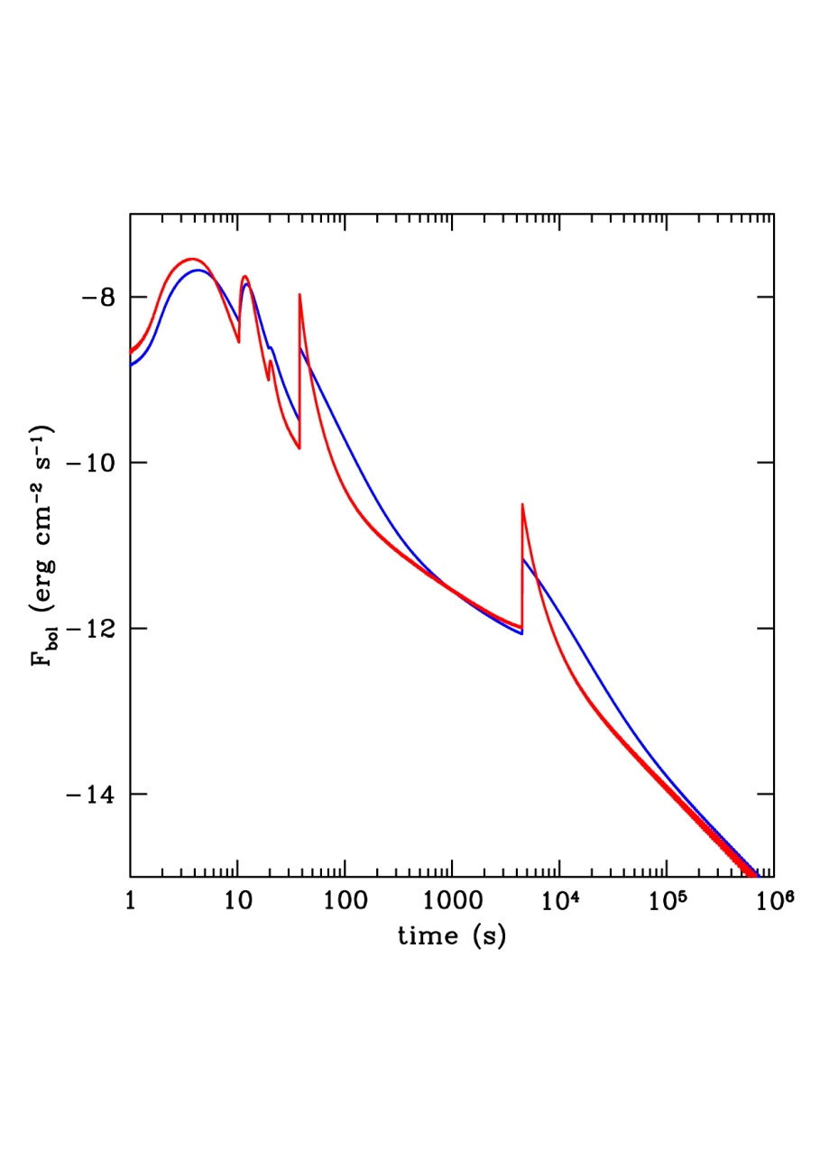
Anisotropy sharpens the flares
n = 1 cm⁻³ A* = 0.1

Slide 6
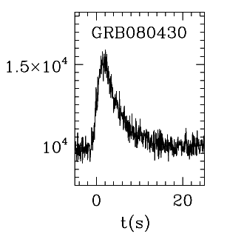
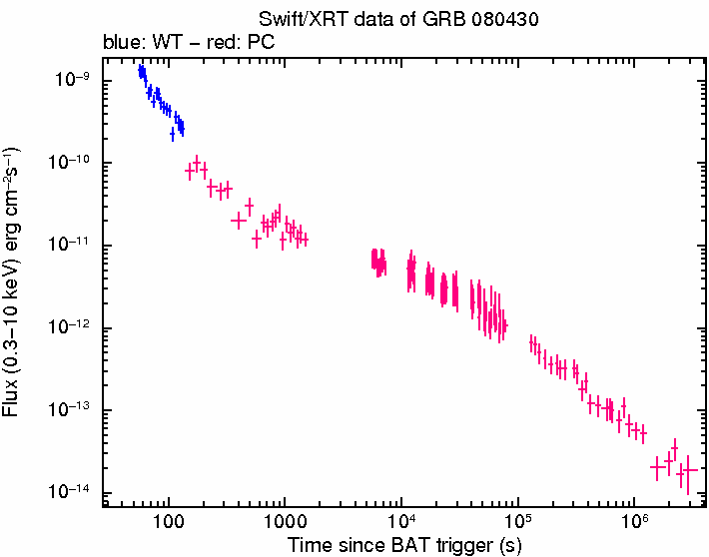
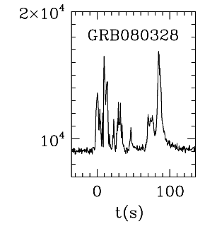
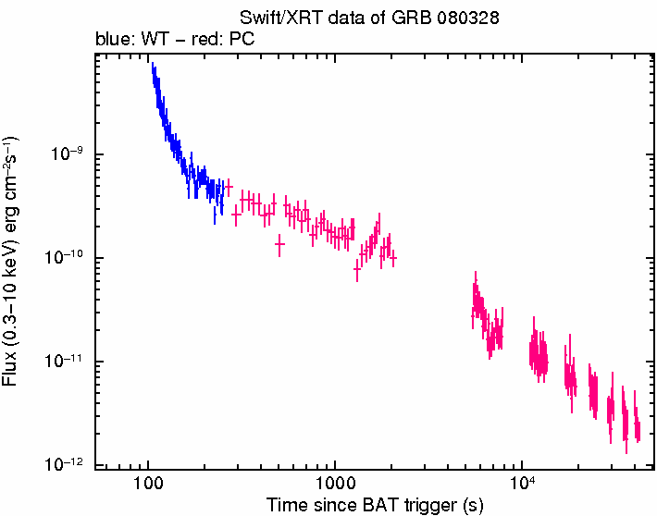
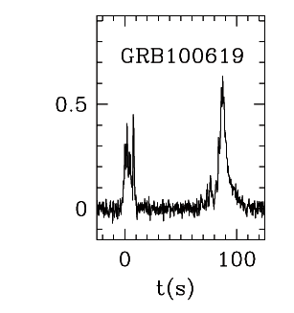
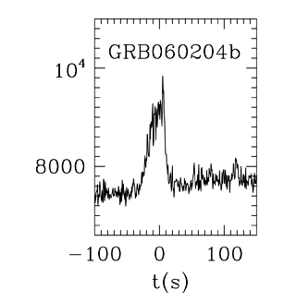
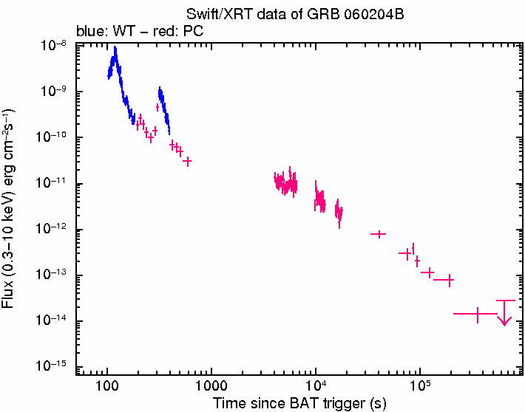
Should one expect a correlation between the prompt light curve and the flaring behavior ?
Some good cases
Some less good cases
→ early flares mixed with prompt emission ?
slow cooling ?
Complex bursts / afterglow with no flare
Simple burst / afterglow with flares (less frequent)
→ overlapping pulses ?

Slide 7
Conclusions
Accidents in the early afterglow light curve are expected if the prompt emission comes from internal shocks
But basic model predicts Δt/t ~ 1
→ exploring some ways to decrease this to 0.1 – 0.3
anisotropy (decay)
full hydro (rise)
microphysics (value of B ?)
detailed check of the BAT/XRT light curves and test of the different situations
Work in progress!

