Slide 1
GW signal associated with GRBs & prospects for coincident detection
Tania Regimbau
Toulouse, 24/09/10
Notes:
Well thank you to the the jury members for coming. I know some of you woke up very early to arrive on time for this presentation.
The stochastic background.
This talk will be devided into two parts. In a first part I’ll speak about the detection with ground based interferometers such as LIGO or Virgo and in a second part, I’ll discuss some astrophysical models.

Slide 2
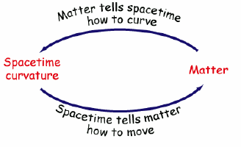
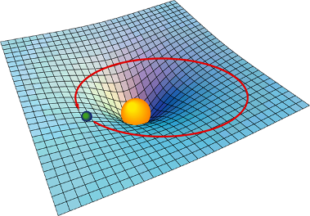
Einstein General Relativity (1916)
“Mass tells space-time how to curve,
and space-time tells mass how to move.“
John Archibald Wheeler

Slide 3
Gravitational Waves
GWs are space-time perturbations created by asymmetric acceleration of masses or non stationary field, propagating at the speed of light.
Weak field approximation of the metric (background metric nearly flat):
Linearized Einstein’s equation (jauge TT*)
Outside sources ( = 0 ) , wave equation:
* Defined by geodesics of falling test masses

Slide 4
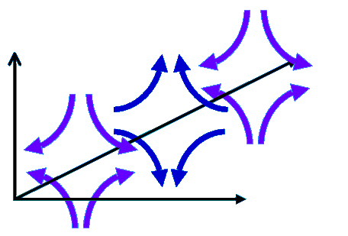
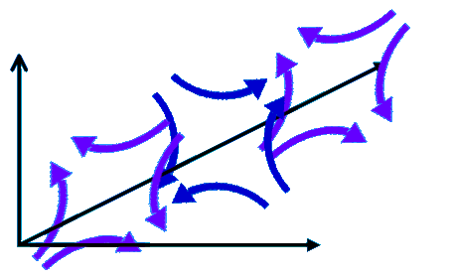
GW Polarization (jauge TT)

Slide 5
Generation of GWs
quadrupolar approximation ( Thorne 1980):
mass quadrupole moment:
GW energy emitted:

Slide 6
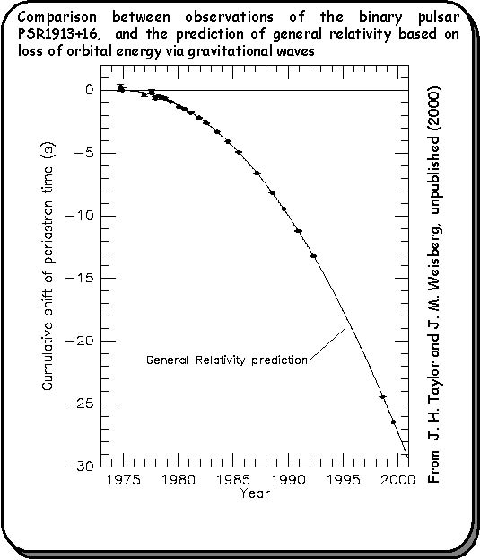
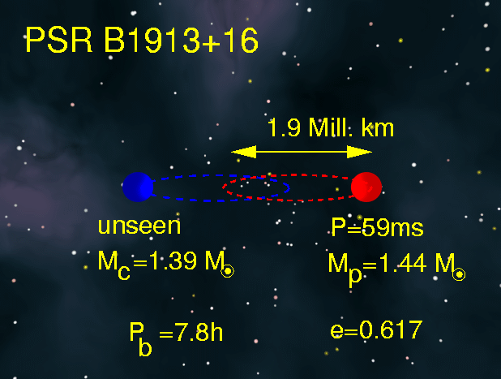
Indirect Evidence: PSR B1913+16
discovered by Hulse & Taylor in 1974 at Arecibo (Nobel Prize in 1993)
orbital decay, due to the emission of GW, in precise agreement with GR ~0.2%
will take another 300 million years to merge

Slide 7
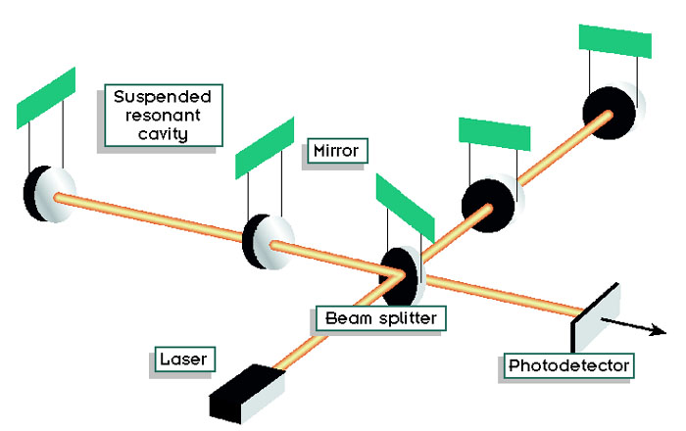
GW Interferometry
GW interferometers measure the phase difference caused by passing GWs, which stretch one arm as they compress the other.
L
L- ΔL/2
laser
L
L+ΔL/2
Δφ = 0
Δφ ∝ ΔL
h=ΔL/L=10⁻²¹

Slide 8
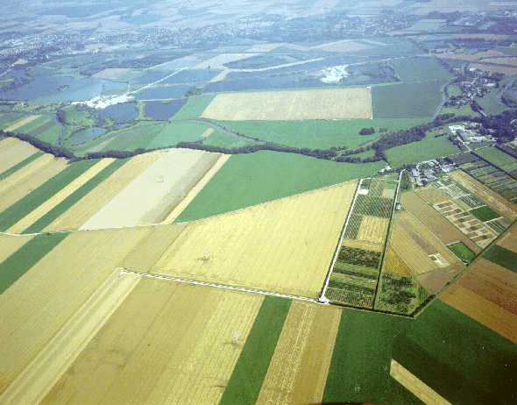
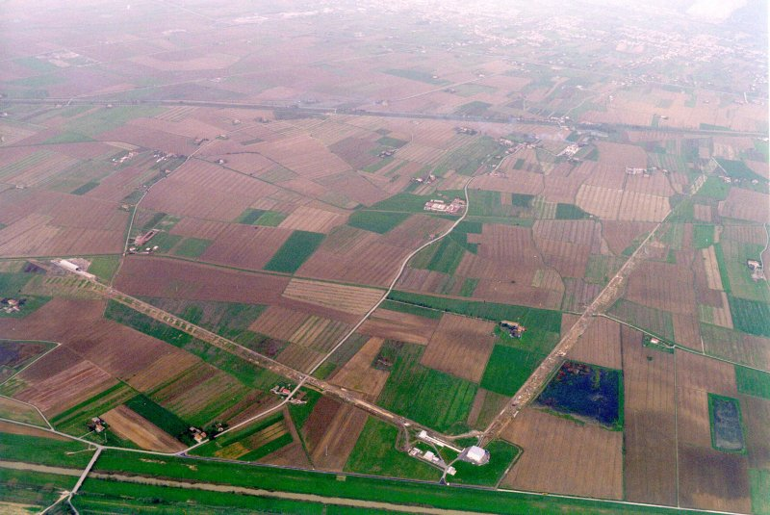
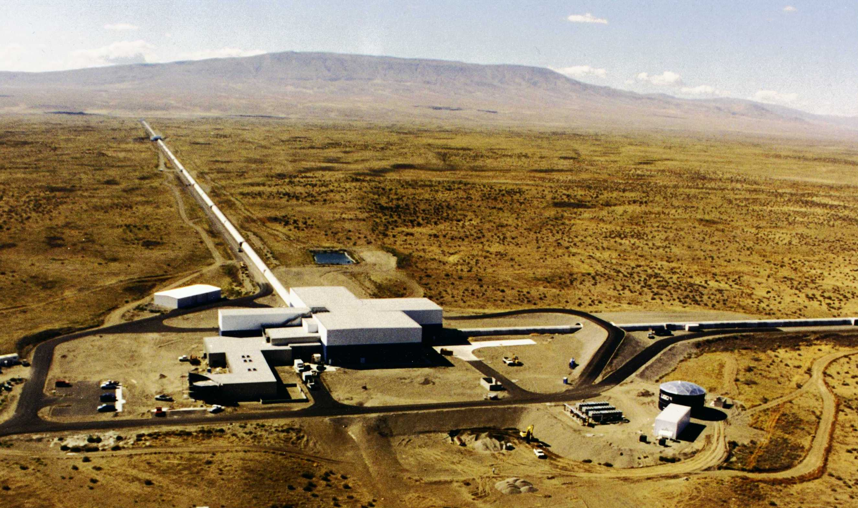
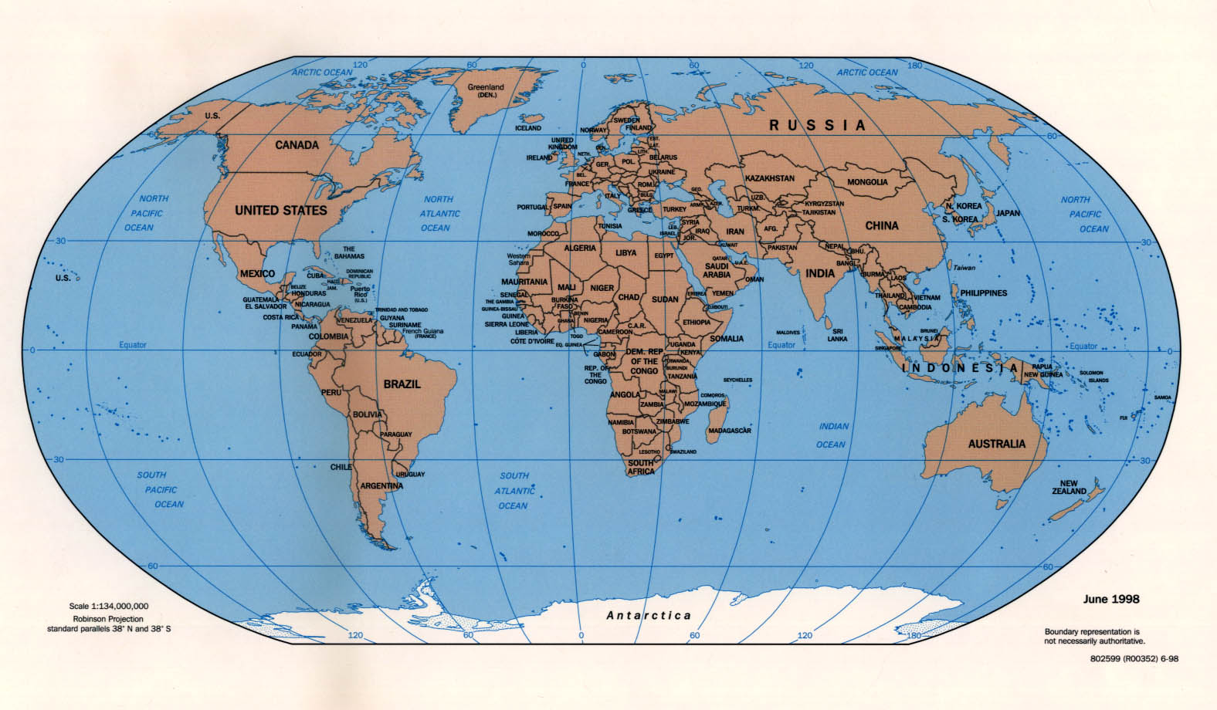
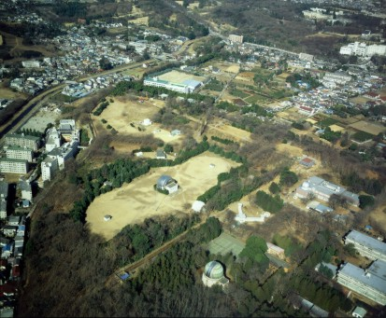
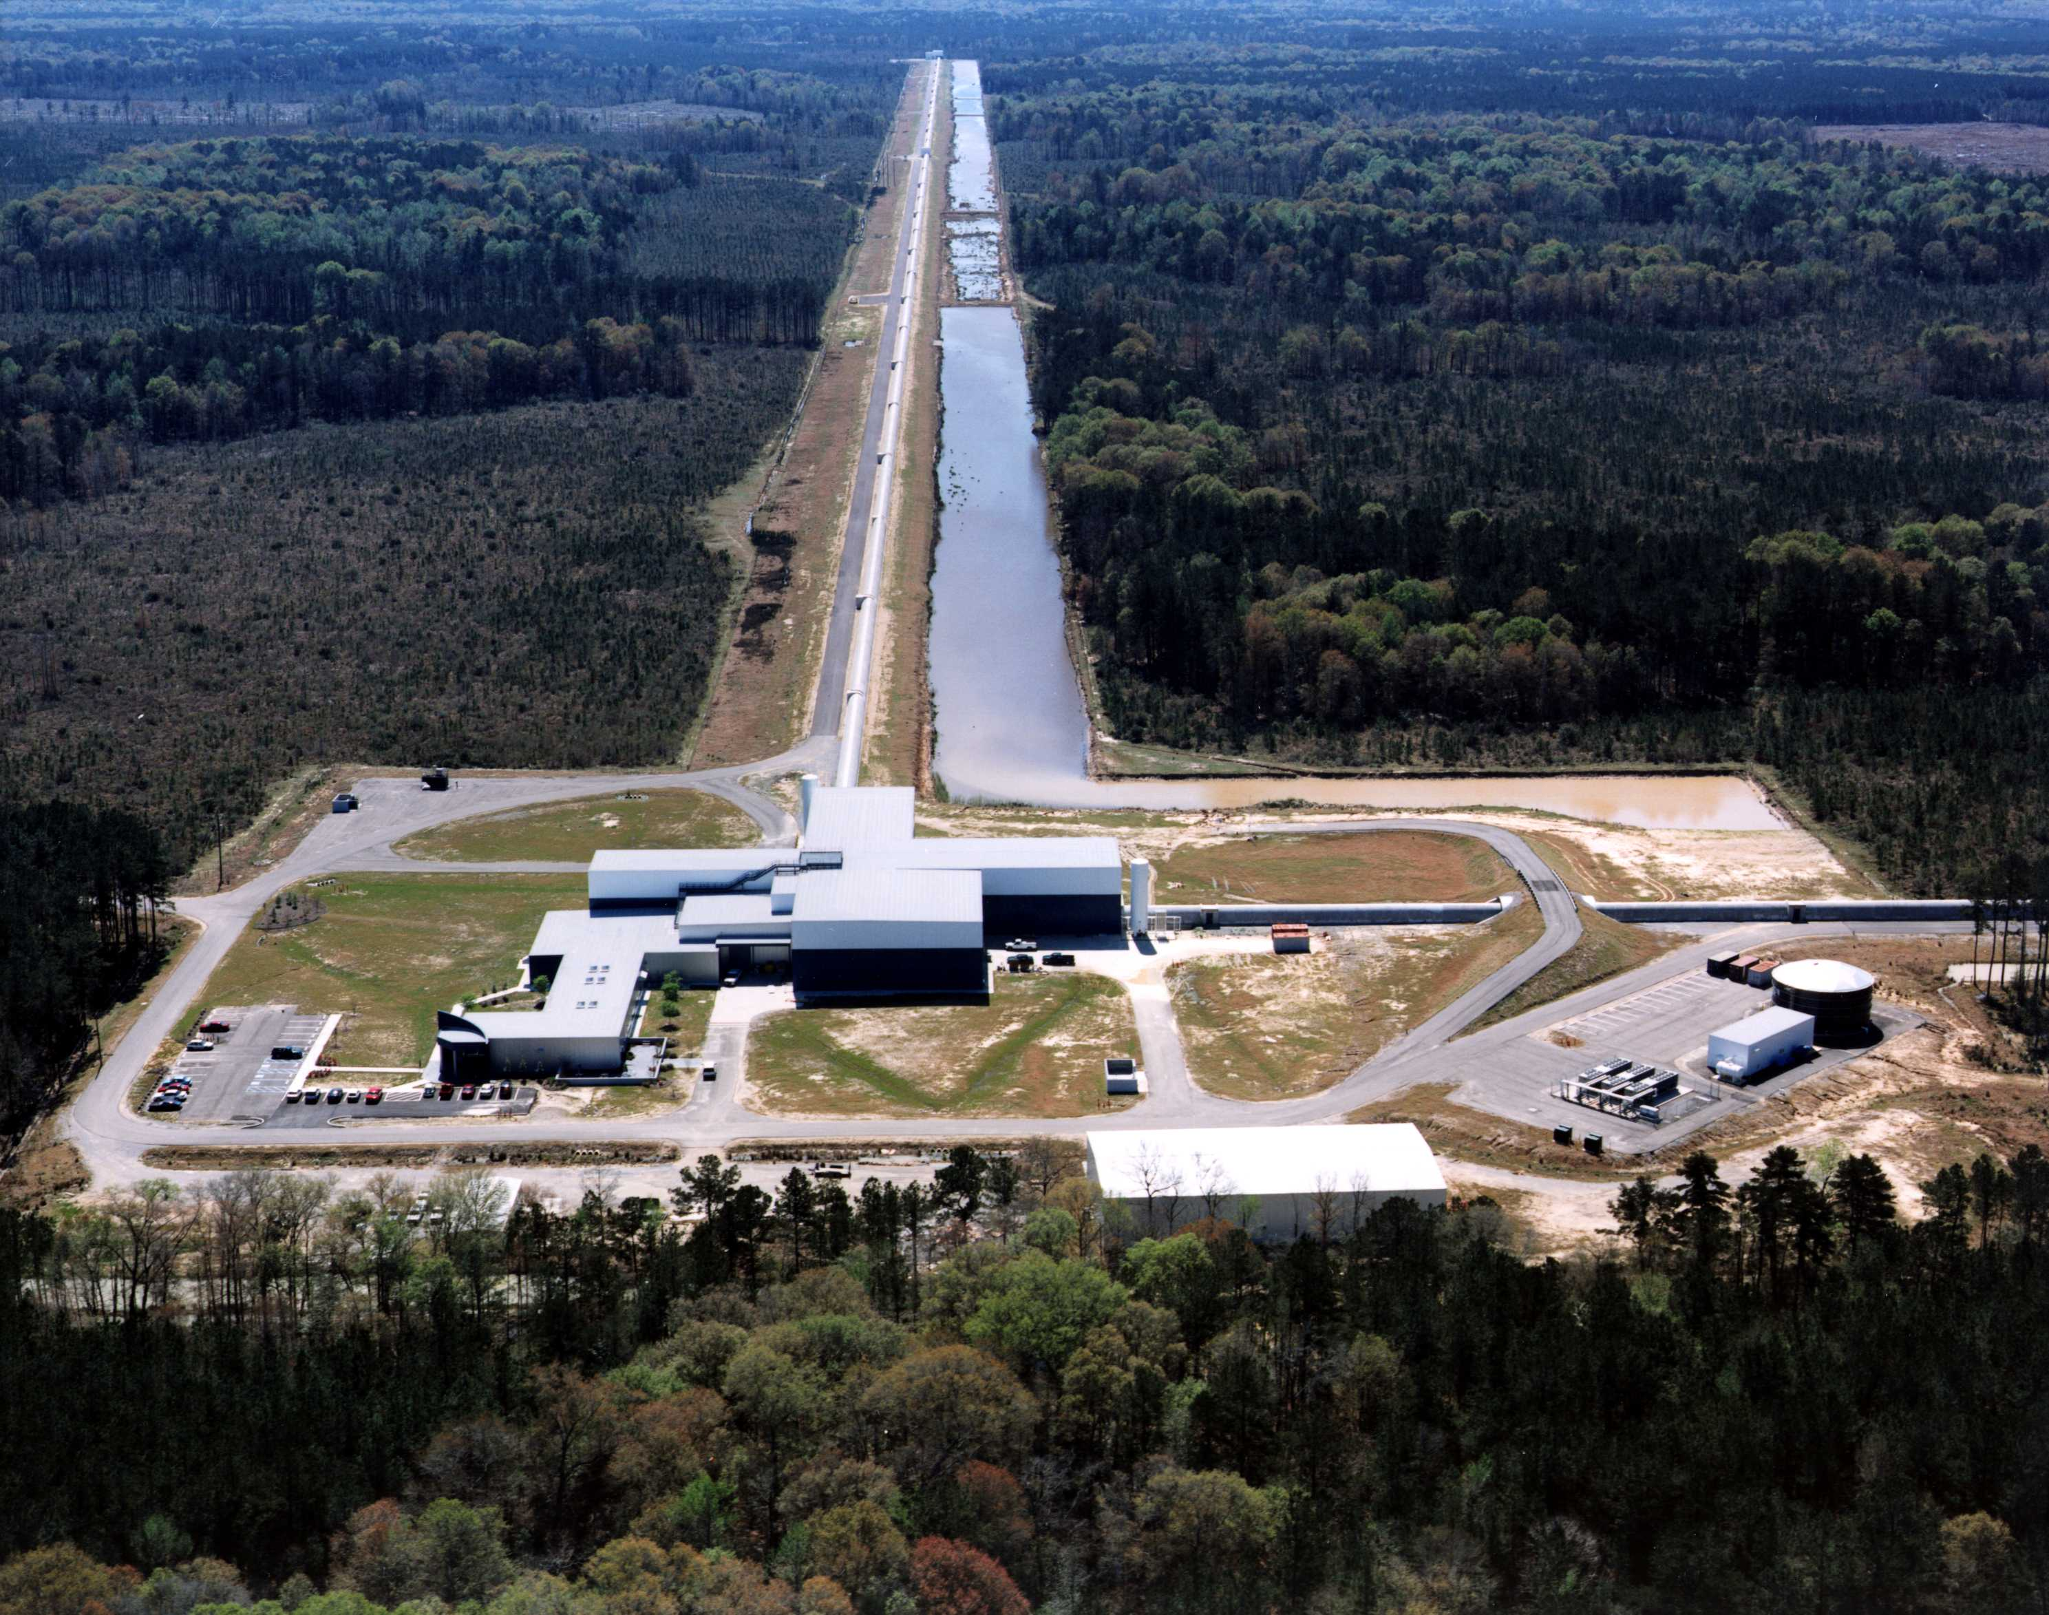
Global Network of Interferometers
GEO600
VIRGO 3 km
LIGO 4 & 2 km
TAMA300
LIGO 4 km
+ resonant bars and spheres, LISA

Slide 9
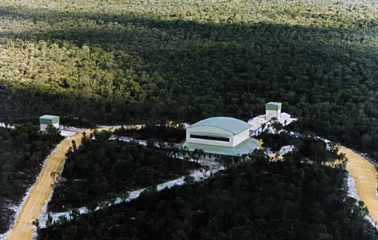
Global Network of Interferometers
GEO600 HF
Ad VIRGO 3 km
Ad LIGO 4 & 2 km
LCGT
Ad LIGO 4 km
South LIGO
2nd GENERATION ~2015

Slide 10
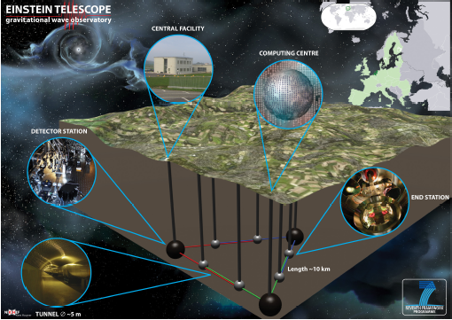
Global Network of Interferometers
GEO600 HF
Ad VIRGO 3 km
Ad LIGO 4 & 2 km
LCGT
Ad LIGO 4 km
South LIGO
3rd GENERATION ~2025

Slide 11
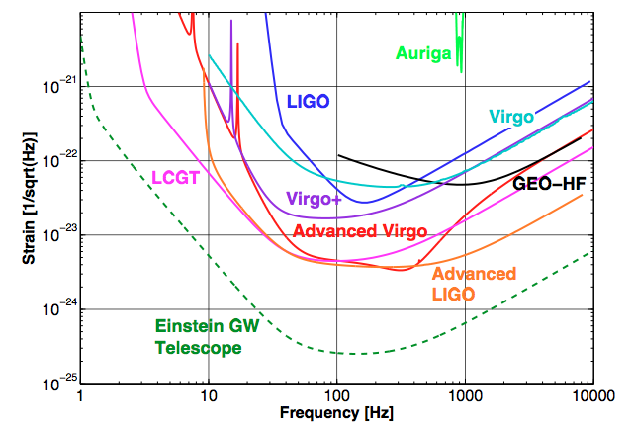
Detector Noise
Seismic Wall
X 10

Slide 12
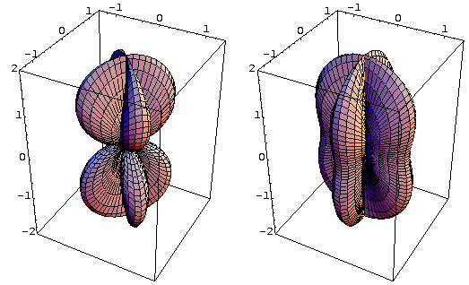
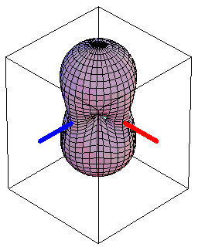
Detector Directionality
“×” polarization
“+” polarization
RMS sensitivity

Slide 13
GW Sources
Periodic
Pulsars, LMXB
Compact binary coalescence
Inspiral,merger, ringdown
Neutron stars, Black holes
Bursts
Core collapse to NS or BH, Cosmic strings
Stochastic Background

Slide 14
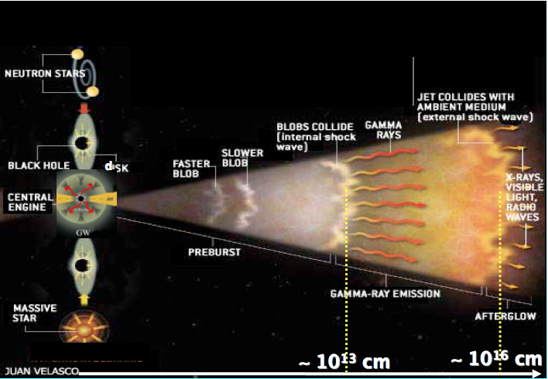
GRB progenitor models
Fireball Model : « For both long and short bursts, GRB powered by the formation of a central fast rotating BH plus an accretion disk »
short GRB =
Binary coalescence
Compact binary
NS- NS or NS-BH
(+~15% of SGR)
long GRB =
Core-collapse to BH
(or ms magnetar)

Slide 15
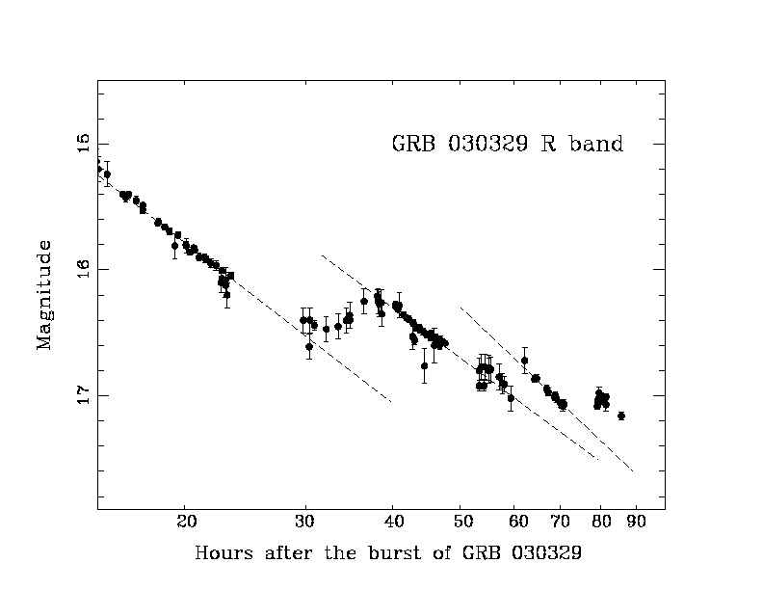
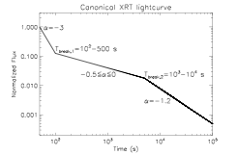
Model of Core–collapse (LGRB)
Observational support
star forming regions
Type I collapsar : type Ib/c supernova (W-R) signature in afterglows for z < 1 (bump)
Core-collapse to magnetar : long lived plateau in the X-ray afterglow of SL-GRB (slowly rotational energy decreased into a relativistic outflow via magnetic dipole emission)
Corsi et Meszaros, 2009

Slide 16
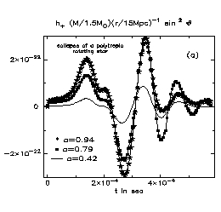
GW Emission from Core Collapse
Core-collapse to BH:
distorted BH QNM exited by fallback, fragmentation
torus fragmentation, instabilities (oscillations, bar modes)
Core-collapse to magnetar (QNM, bar modes, r modes…)
Stark & Piran, 1985

Slide 17
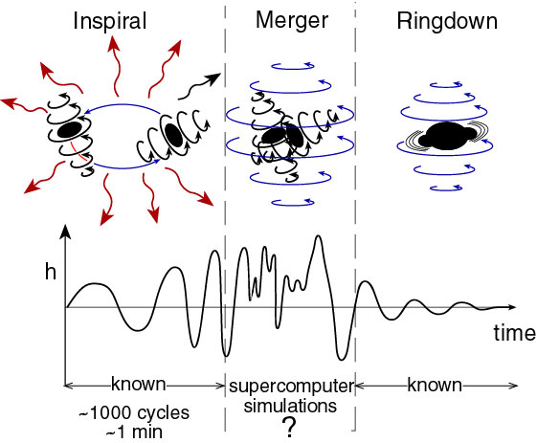
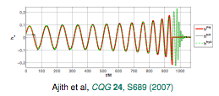
GW emission from binary coalescence
3 phases:
- inspiral : very well modeled up to LSO
- plunge : unmodelled
- ringdown : very well modeled
Inspiral phase:
as for core-collapse

Slide 18
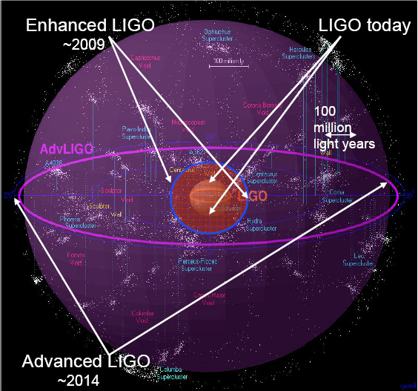
Horizon/Rate
 | NS/NS | NS/BH
LIGO I/Virgo | 15 Mpc | 30 Mpc
Ad LIGO/ Ad Virgo | 200 Mpc | 420 Mpc
l
 | NS/NS | NS/BH
LIGO I/Virgo | 0.02 yr⁻¹ (2e-4 – 0.2) | 0.004 yr⁻¹ (7e-5 – 0.1)
Ad LIGO/ Ad Virgo | 40 yr⁻¹ (0.4 – 400) | 10 yr⁻¹ (0.2 – 300)

Slide 19
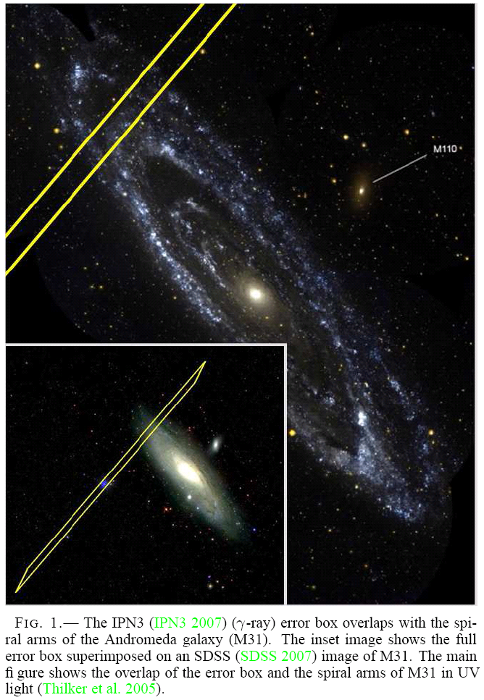
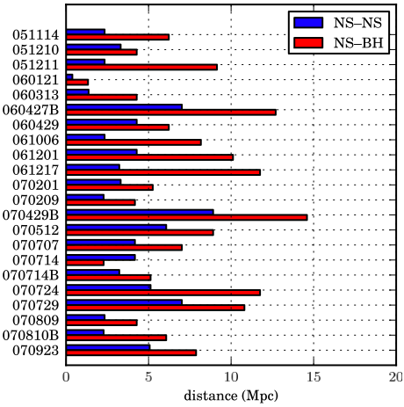
LIGO/Virgo results
GRB 070201
No plausible GW signal found; very unlikely to be from a binary merger in M31
Abbott et al. (LSC & Virgo), ApJ 715, 1454 (2010)
22 short GRB (SWIFT)
Median 90% CL distance limits :
NS-NS: (1.4/1.4) M⊙: 3.3 Mpc
BH-NS: (1.4/10) M⊙: 6.7 Mpc
Abbott et al. (LSC & Virgo), ApJ 681, 1419 (2008)

Slide 20
Compact binaries as standard candles
ET expects to see ~1 million of NS-NS a year up to z~2
The inspiral signal will be observed for several days (can extract intrinsic parameters with high accuracy)
can measure both apparent (amplitude) and absolute luminosity (phase), and deduce distance = self calibrated standard candles (no cosmic distance ladder required)
need other observations to determine redshift (short-hard GRB, mass measurement, host galaxy)

Slide 21
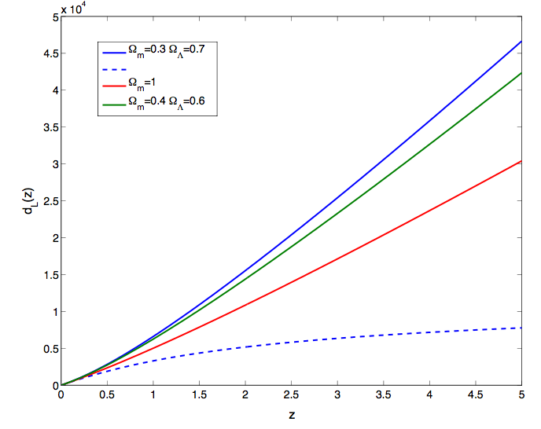

Slide 22
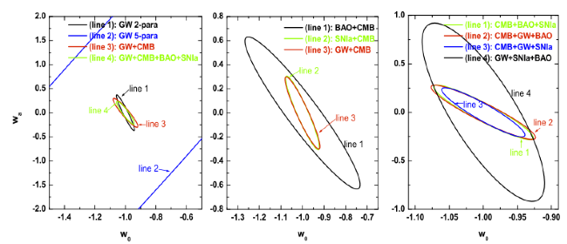
Cosmology with NS-NS
Advanced LIGO-Virgo : constrains Hubble constant to a few percent (Nissanke et al., arXiv:0904.1017)
Einstein Telescope: (Sathyaprakash et al., arXiv:0906.4151)
- Hubble constant
- density of matter (~15%) and dark energy (3-4%)
- DE EOS parameters w₀ and w_{a}
(GW+CMB+SNIa+BAO improves by 6% CMB+SNIa+BAO)
Zhao, Baskaran, Li, CVDB, in preparation

Slide 23
Summary
expect GW/GRB association
Coincident detection would increase our confidence in a detection and improve parameter estimates
GW emission provide direct information on the GRB precursor
most promizing sources for next generations of GW detectors = SHGRB
with ET, GW/GRB detection provide a tool to study cosmology
the ideal for the future, a GRB mission optimized for SHGRB during ET

