Slide 1
Linkedin : Le point de vue du CERN
Témoignages et retours d'experience
Kate Kahle
Responsable de la communication numérique et des réseaux sociaux au CERN
14 septembre 2026
Séminaire des correspondantes et correspondants communication CNRS Nucléaire & Particules

Slide 2
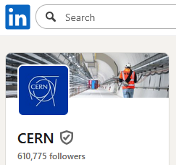
Contents
CERN social media overview
Linkedin: CERN’s main account
Linkedin: the CERN ecosystem
Linkedin & internal comms
Targeted posts
Leadership communications
Conclusions

Slide 3
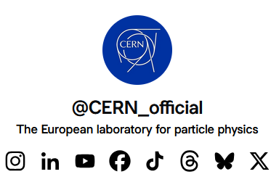
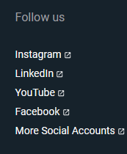
1. CERN social media overview
9 accounts across 8 platforms…
  Human resources: 1 staff, 1 graduate, 1 student
  Focusing efforts on developing Insta, Linkedin and YouTube
Differentiating content and tone of voice
  Linkedin, Facebook, YouTube, BlueSky, X: Serious institutional voice, inspiring trust and reliability
  Instagram, TikTok, Threads: Peer to peer dialogue about science, playful, lighter, still trustworthy

Slide 4
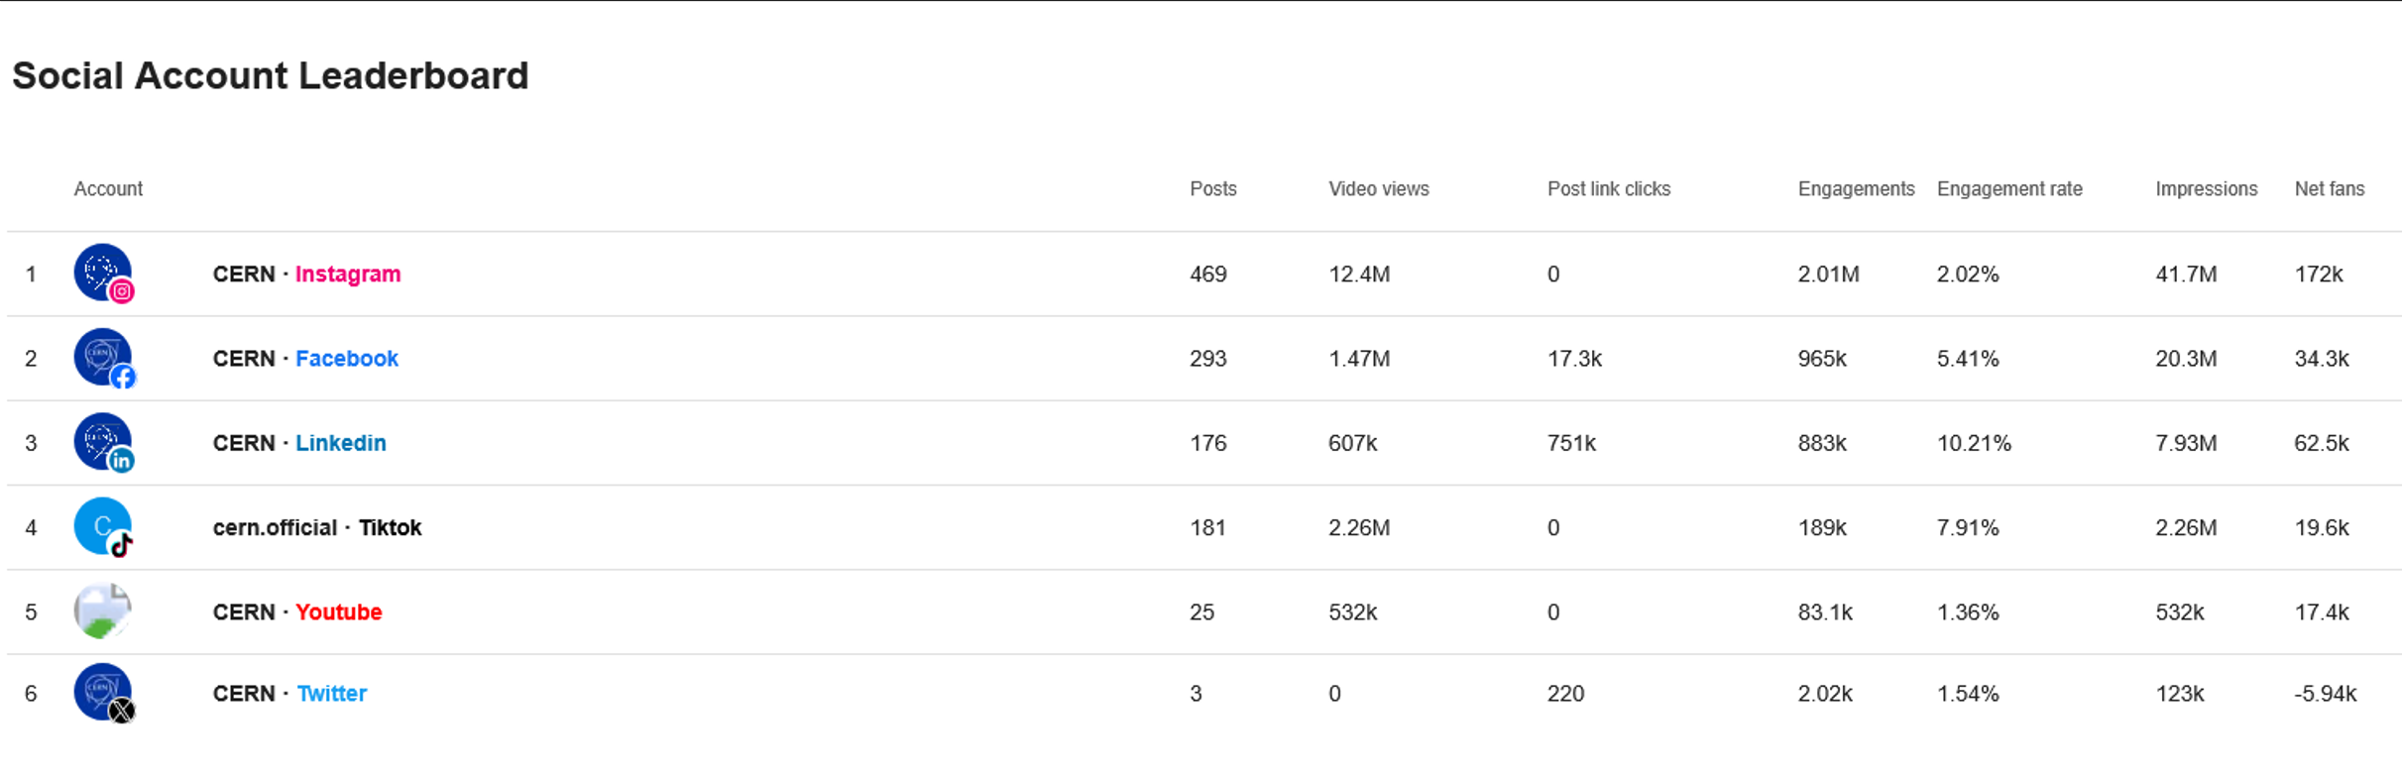
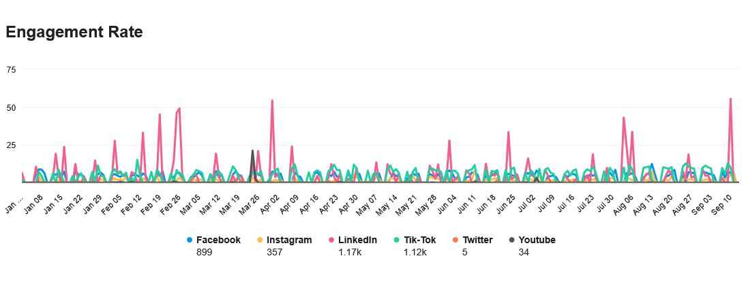
1. CERN social media overview
Most engaging topics:
Big news stories
Recruitment
Innovation and society
* Data from 1 Jan to 13 Sep 2026
Notes:
Engagement rate: The average engagement rate for the posts published to your accounts on Facebook, Instagram, LinkedIn, TikTok, YouTube, and X. It is the number of times users engaged with your content as a percentage of impressions.
Big news stories: Antimatter transport, final days of LHC

Slide 5
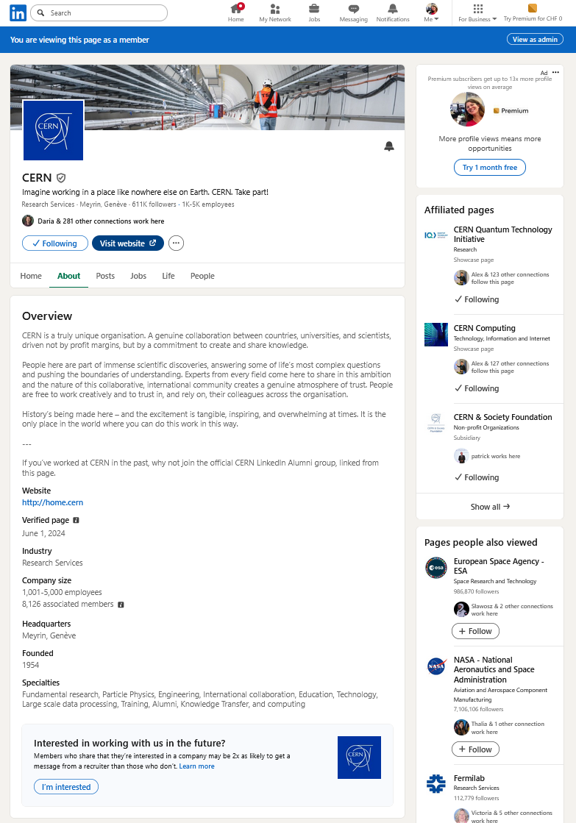
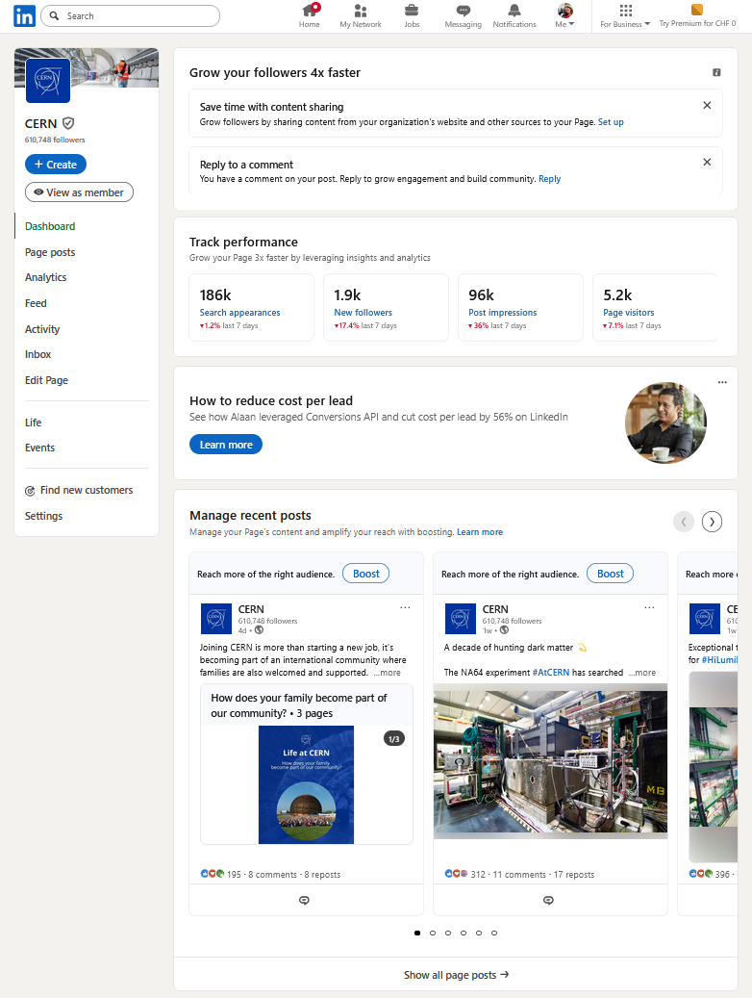
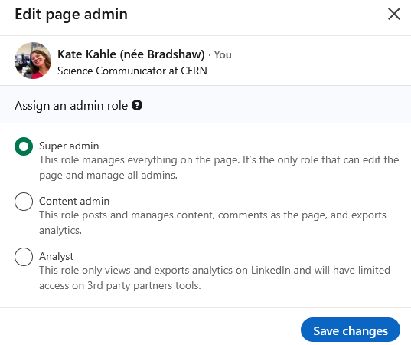
2. CERN’s main Linkedin account

Slide 6
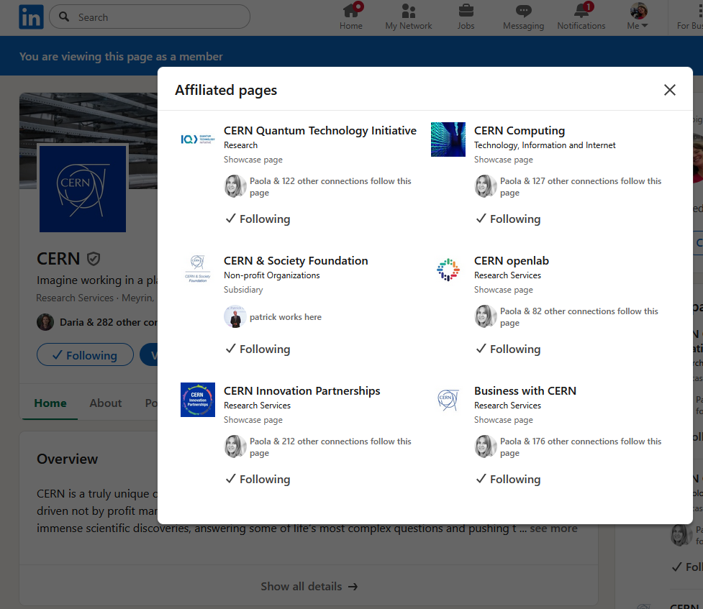
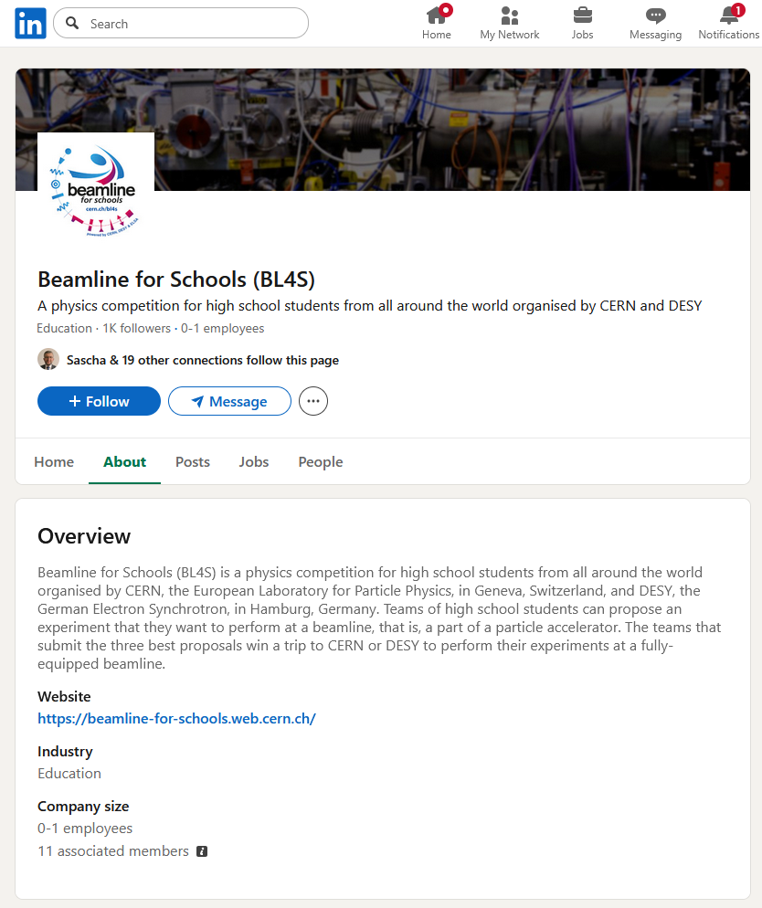
3. The CERN ecosystem on Linkedin
Ongoing audit of ecosystem, looking at audience, followers, frequency of posts etc

Slide 7
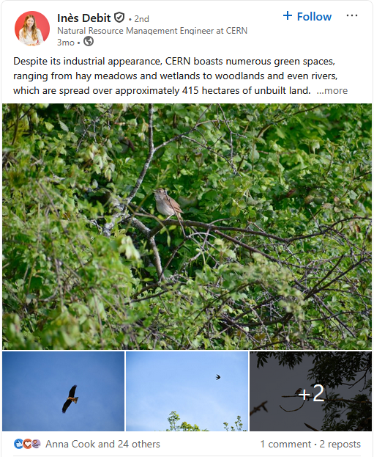
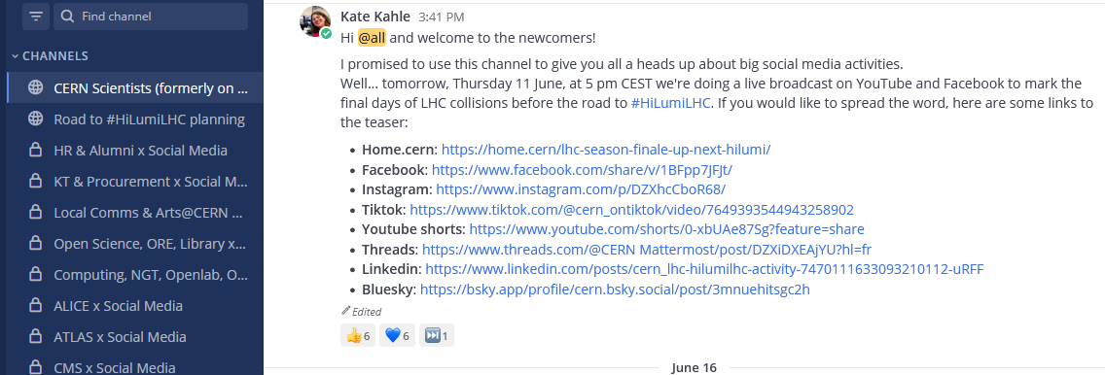
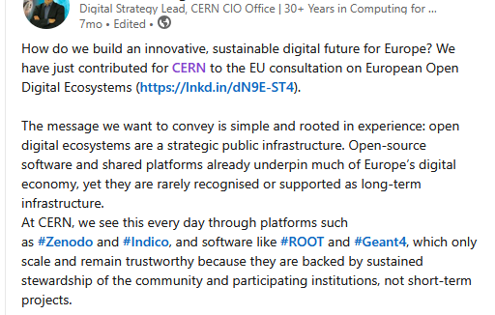
4. Linkedin and internal comms

Slide 8

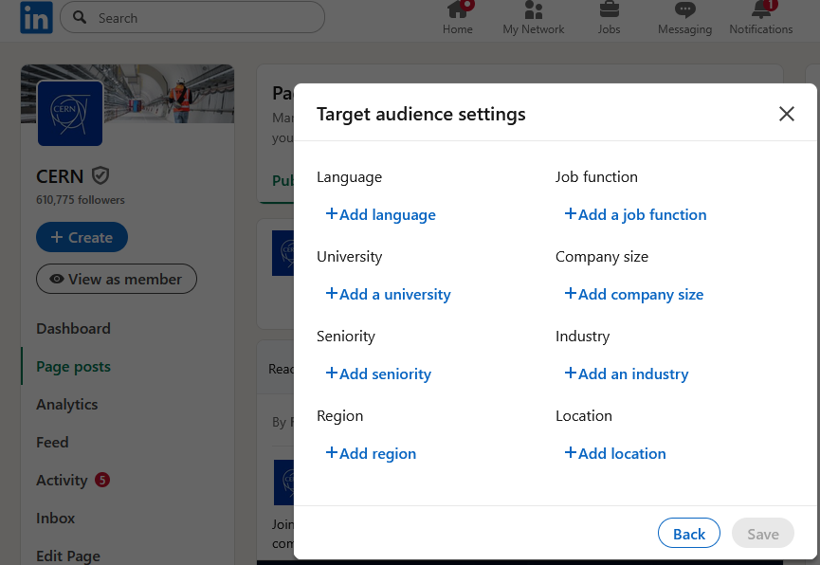
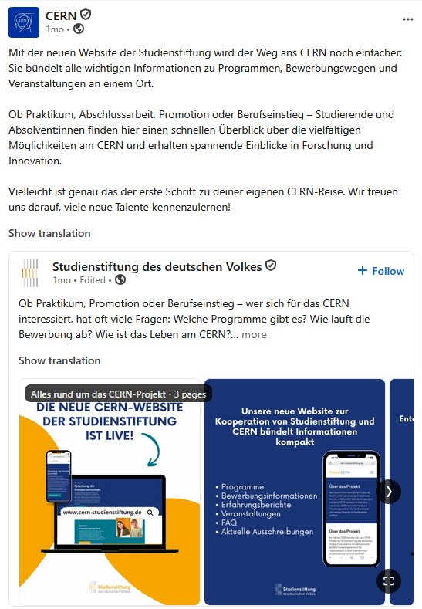
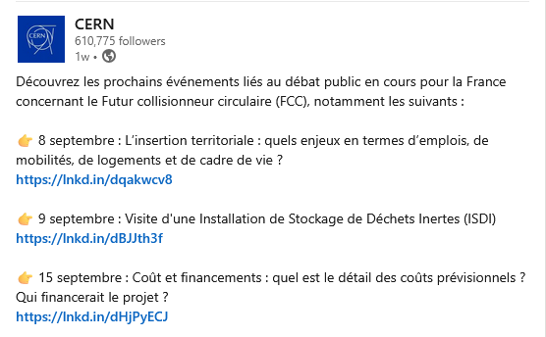
5. Targeted posts

Slide 9
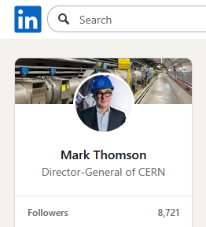
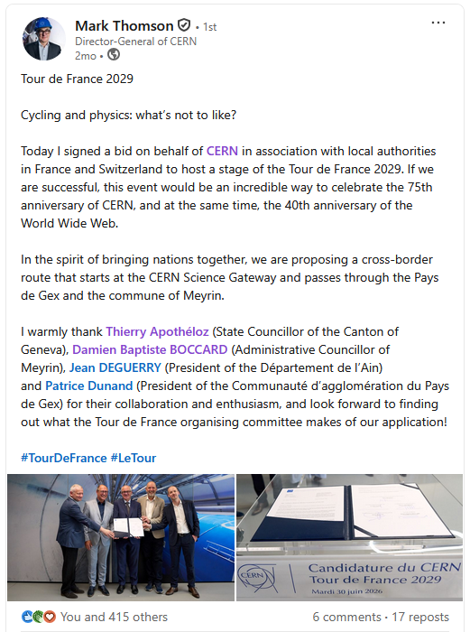
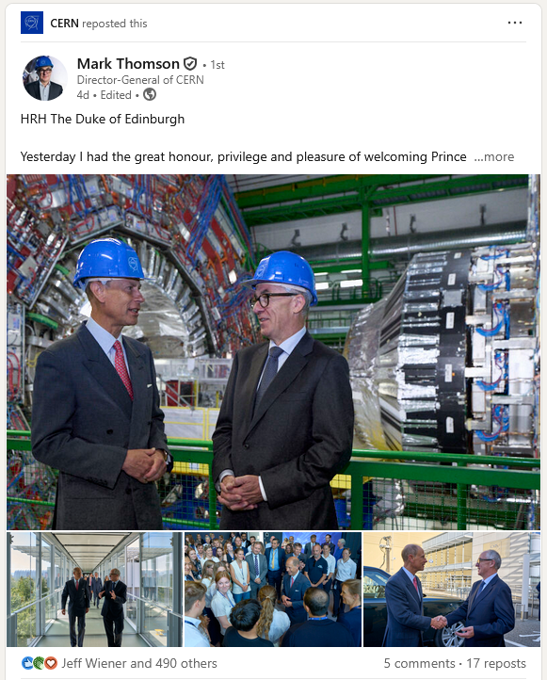
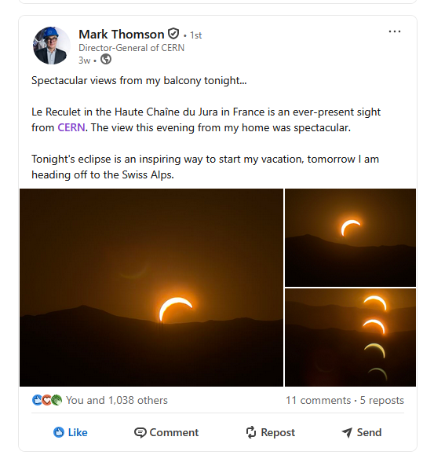
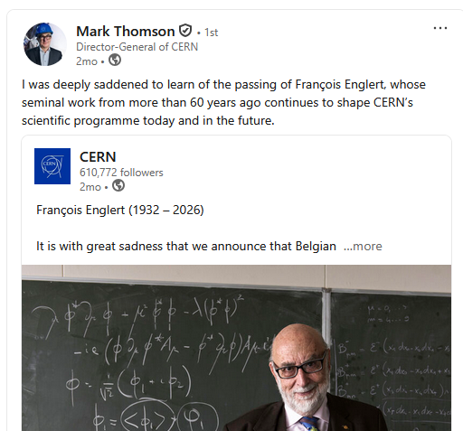
6. Leadership communications

Slide 10
7. Conclusions
Decide tone of voice
Work closely with HR
Consider showcase pages
Explore verification
Target posts as needed
Find your internal and external amplifiers
Promote account tagging and specific hashtags

