Slide 1
Cosmic pit profile

Slide 2
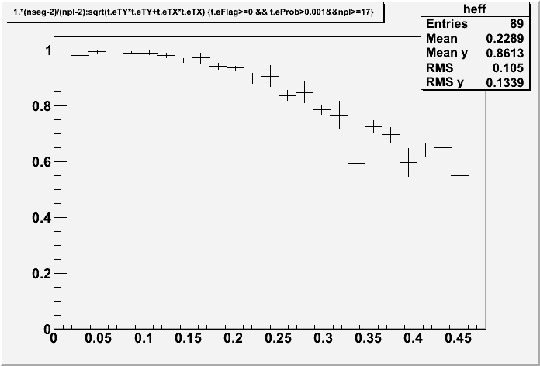
fedra

Slide 3
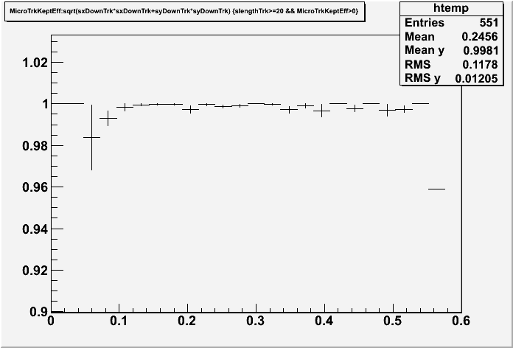
Sysal

