Slide 1





Diffusing the assumptions
realistic LISA stochastic component separation
with physics-aware simulation-based inference
Iuliu Cuceu
Observatoire de la Côte d'Azur, Nice
GDR Ondes Gravitationnelles · méthodes d'analyse des données
7 October 2026
Notes:
theme: transformers = flexible inference engine · ~16 min

Slide 2
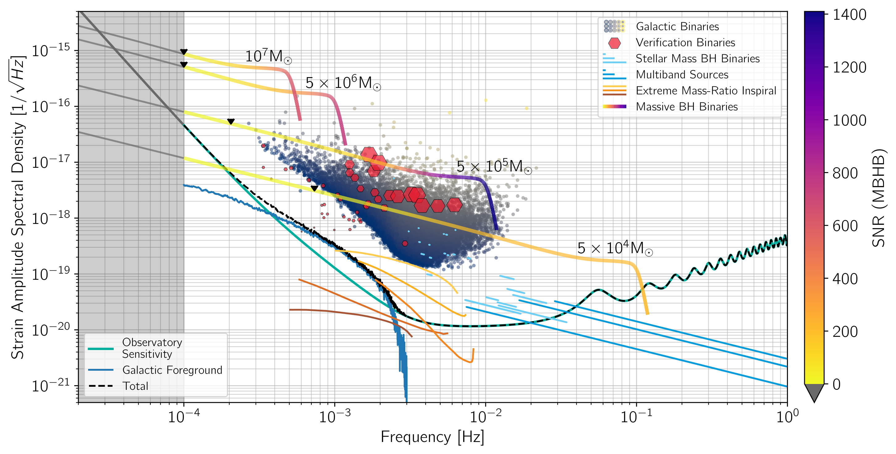
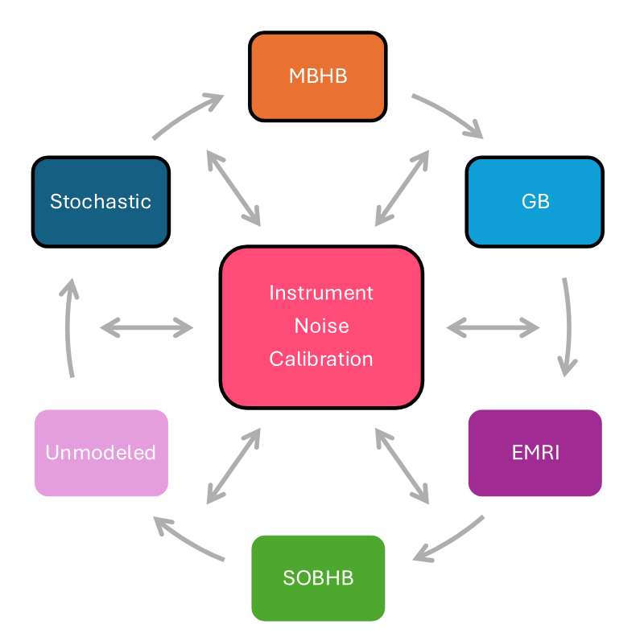
The big picture
• A giant Blocked Gibbs RJMCMC scheme: The global fit
• Initializing this “well” is critical: Pre-global fit search
2/18
Notes:
global fit = blocked Gibbs over everything · noise + stochastics touch every block · pre-GF search: PSD split, transients marginalised

Slide 3
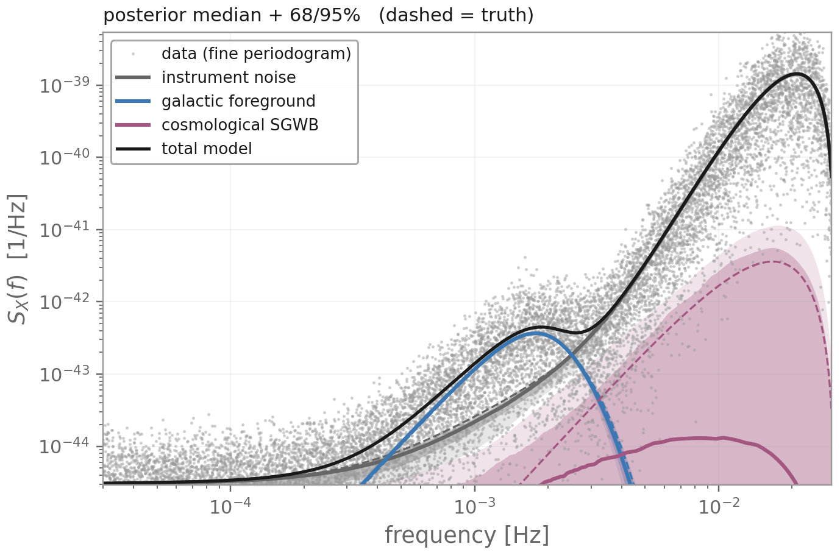
The stochastic components
Instrument noise 2 → 32 parameters
No off-source data: inferred jointly with the signals
usual model
spline shape
links
blocks
Galactic foreground 3 parameters
Millions of unresolved binaries: loud (SNR ≈ 250)
and always wanted, like a good noise estimate
Stochastic background 2 parameters
Faint (SNR ≈ 5): low-information benchmark
3/18
Notes:
data = noise + galaxy + SGWB · noise: no off-source, 2 → 32 params (shape, per link, per block) · galaxy loud (SNR 250 in 11.6 d), always wanted · SGWB faint, always there, hard

Slide 4
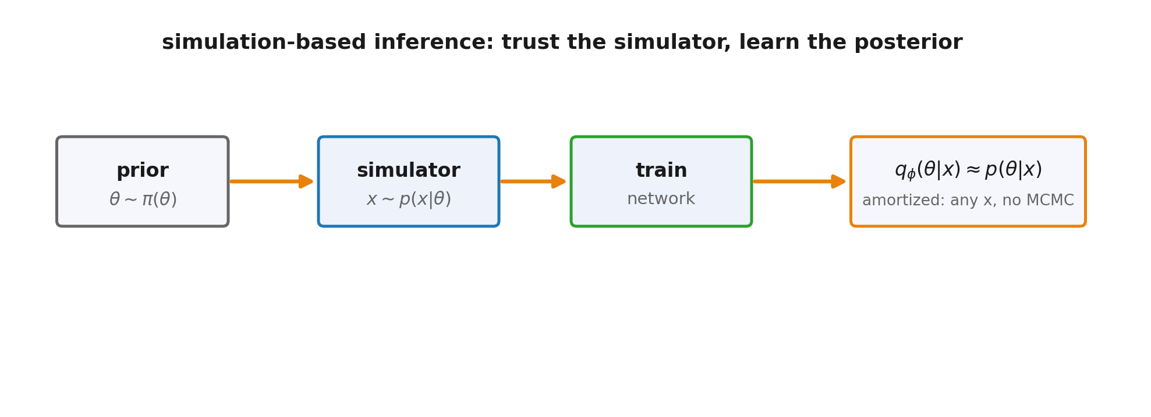
Method: amortised, score-based SBI
· Simulate from the prior, learn the posterior
directly
· Score-based diffusion and flow matching
· Transformer over parameter and data tokens
· Train once, then infer ‘amortized’
· Nuisances marginalised by construction
4/18
Notes:
15 s · simulate → train → amortised · nuisances integrated out

Slide 5
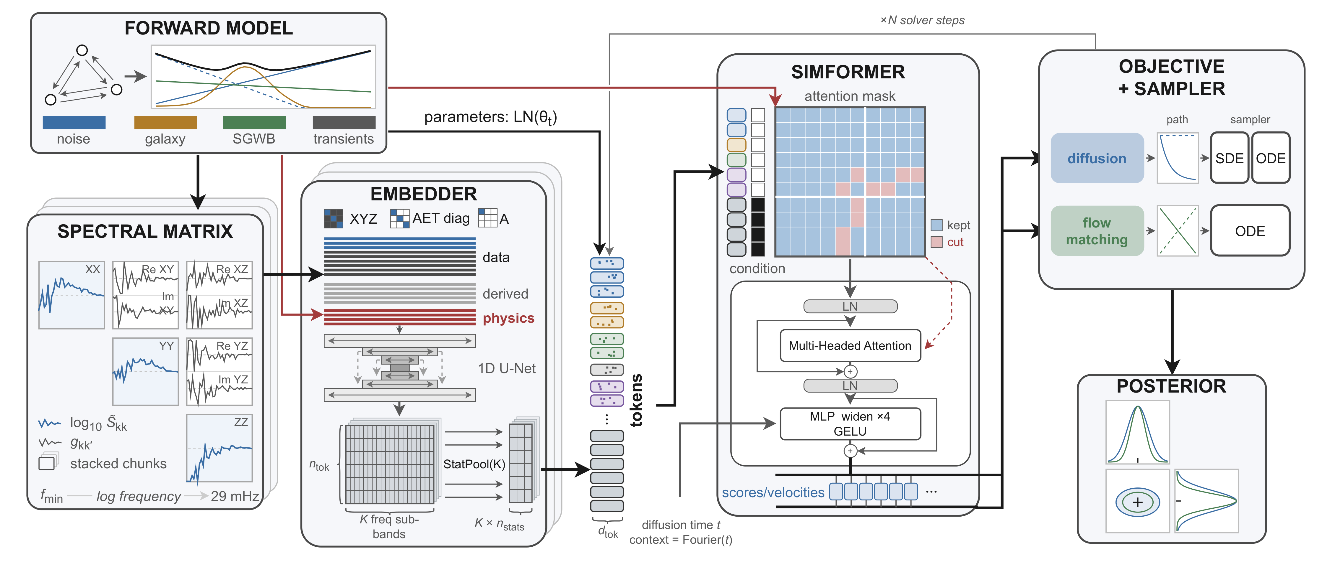
Everything is a token
one token per parameter · physics-aware data tokens · attention mask from the simulator · DSM or FM, same network
(tokens are just data vectors)
5/18
Notes:
one token per parameter · data tokens: U-Net + sub-band pooling · mask = simulator graph · score or velocity head, same net

Slide 6
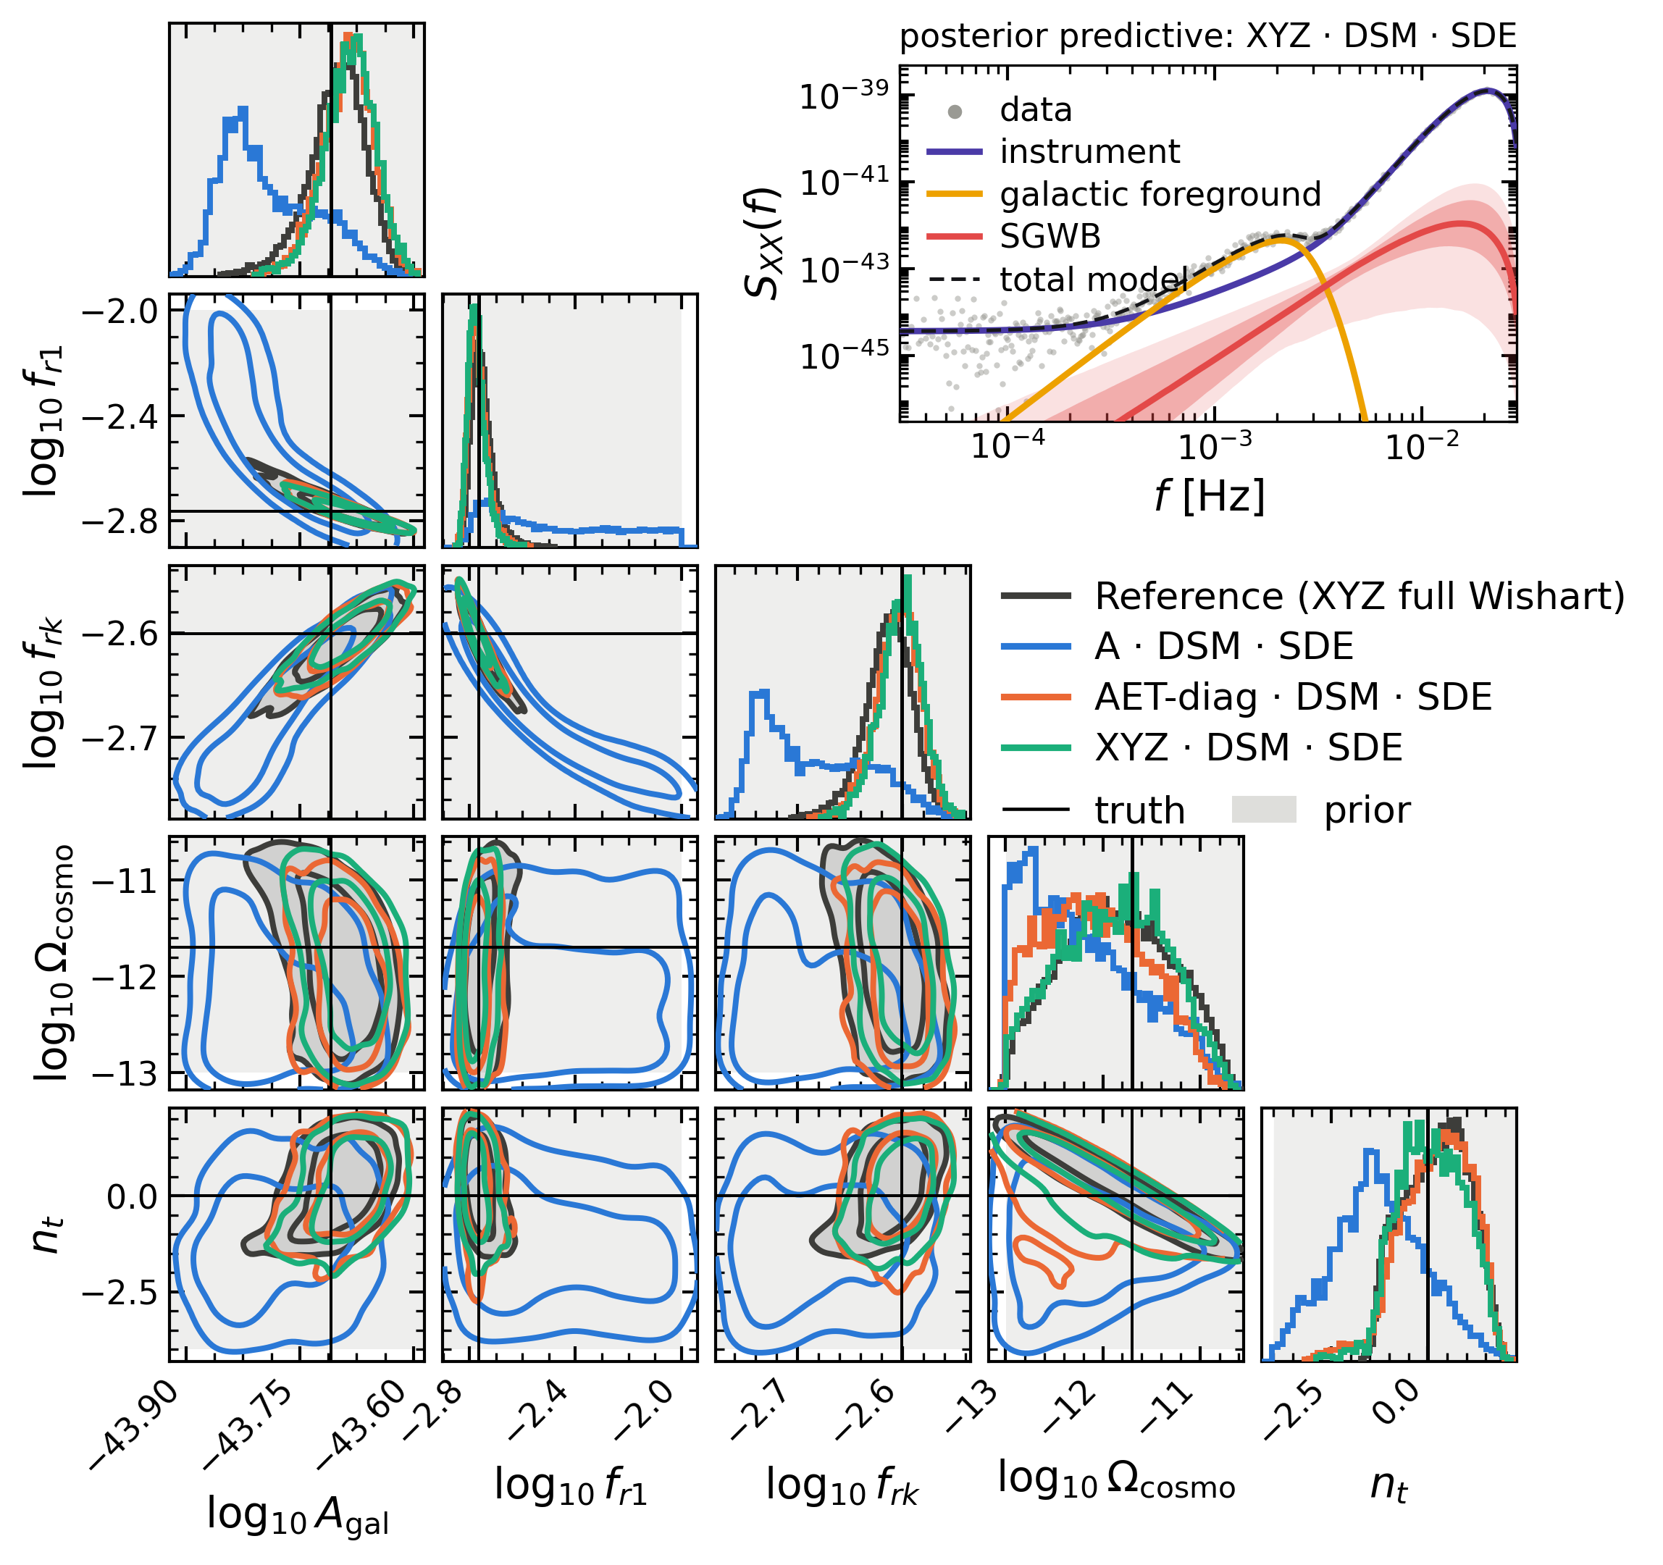
Stochastic only: incomplete data
· 11.6 day observation, noise+galaxy+SGWB
· One observation, three views of its 3×3 spectral
matrix: 1, 3 or 9 channels, giving 1, 3 or 6 data
tokens
· Grey: the exact Wishart likelihood on the full data
· Less data, wider posteriors; each network still
matches its own exact likelihood
6/18
Notes:
A / AET-diag / XYZ = 1 / 3 / 9 channels · galaxy SNR 249, SGWB 5 · width vs own exact likelihood 0.97-1.03

Slide 7
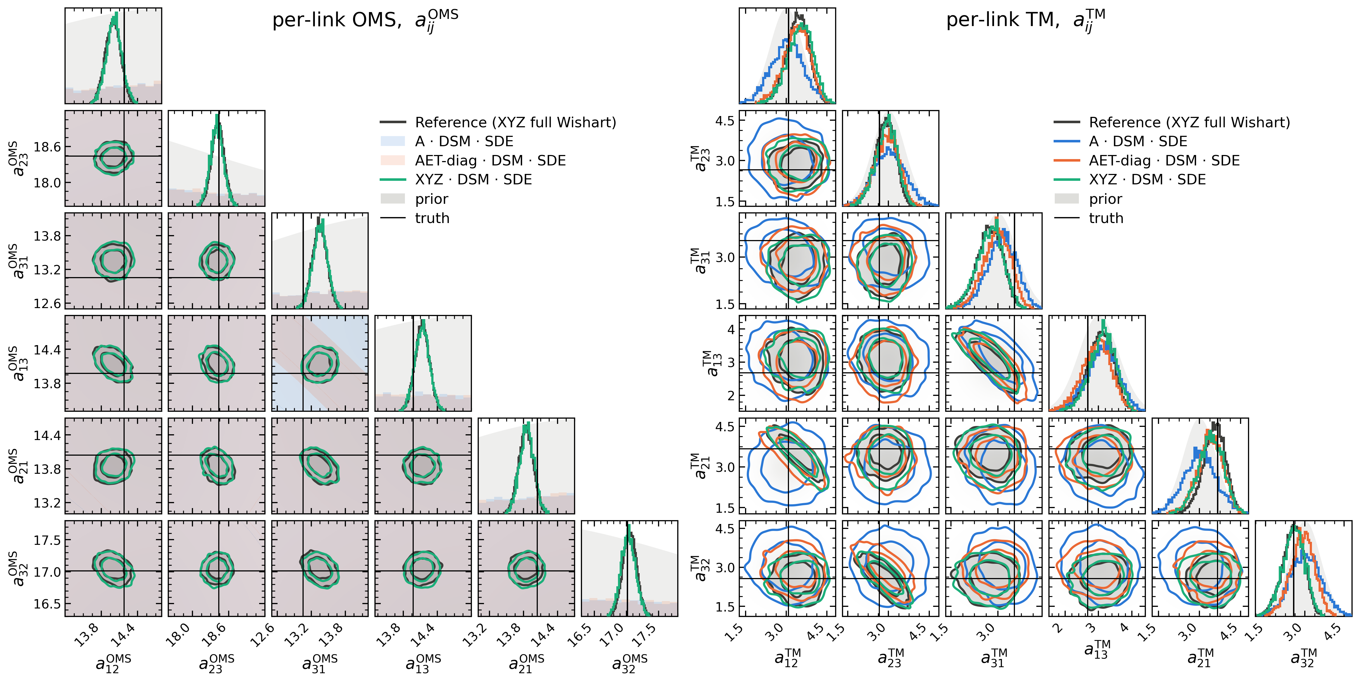
Stochastic only: the noise
7/18
Notes:
12 per-link amplitudes · OMS: XYZ ≈ exact, A / AET at the prior · TM: arm sums only

Slide 8
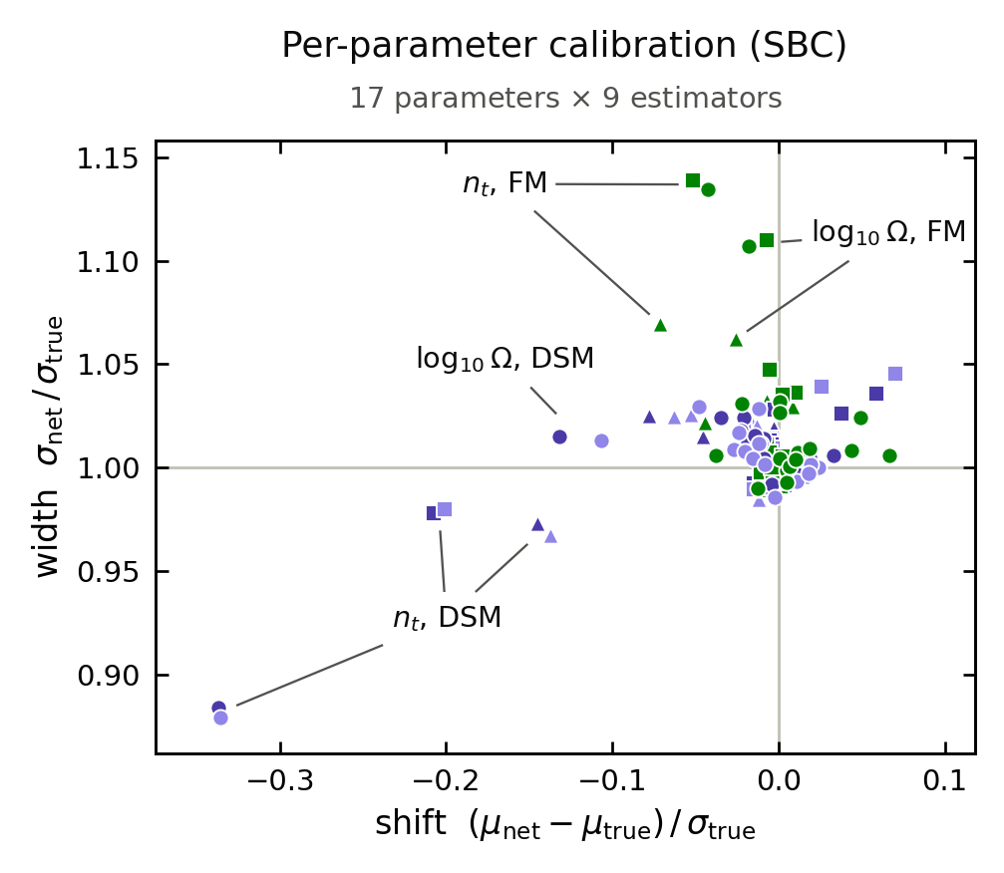
Calibration when everything is ideal
· 16384 prior draws, 256 posterior samples each
· All 17 parameters, 12 of them noise, for 9
estimators
· Shift and width of every marginal, from the SBC
ranks
· All within a few %, except the faint SGWB
8/18
Notes:
null (2σ): shift ±0.016, width ±0.013 · n_t DSM −0.34σ, 12% narrow · FM SGWB 6-14% wide · rest: shift < 0.1σ, width ±3%

Slide 9
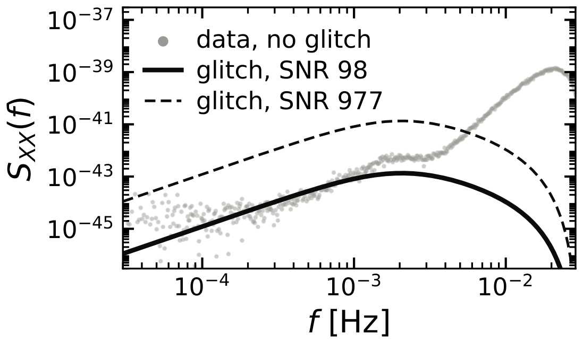
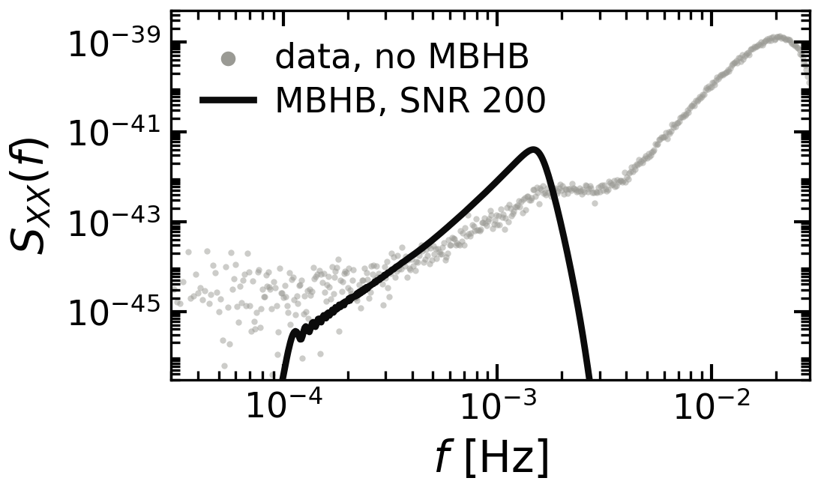
Adding transients
Instrument glitch
3 parameters, one link, broad in frequency
Massive black hole binary
11 parameters, a posterior far sharper than we need
9/18
Notes:
same stochastic data + coherent transient · difference: number of parameters + posterior resolution · previous talks: MBHB PE

Slide 10
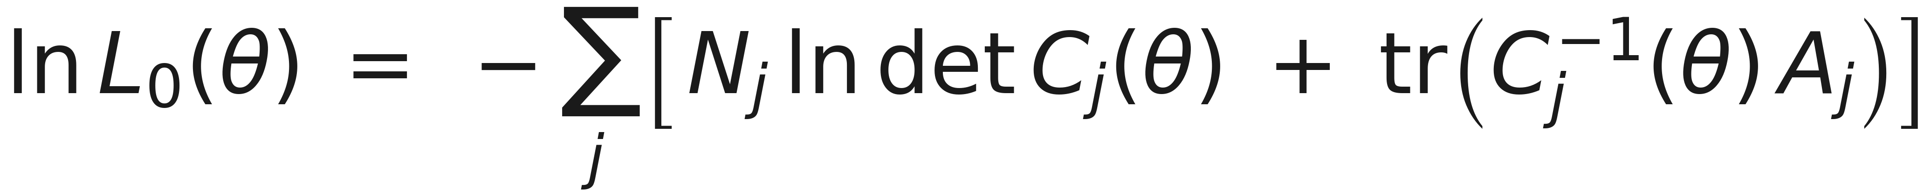
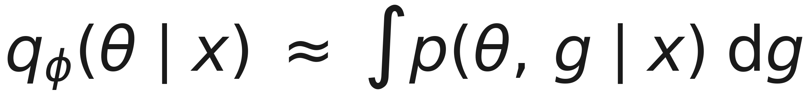
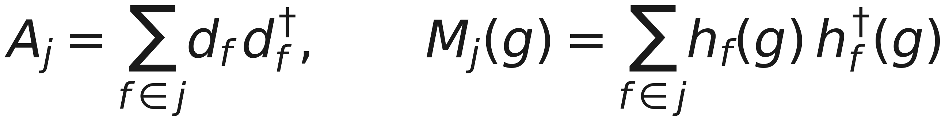
Marginalisation: analytic or learned
L0
no glitch,
or glitch ignored
L1
glitch explicit
L2
glitch marginalised
network
never told about it
10/18
Notes:
L0 central Wishart · L1 non-central, glitch amplitude + decay in θ · L2 Laplace over the glitch · network trained on the joint, never told

Slide 11
Marginalisation: analytic or learned
Transient term
L0
no glitch,
or glitch ignored
Stochastic-transient coupling
L1
glitch explicit
L2
glitch marginalised
network
never told about it
Occam factor
Maximum-likelihood glitch term
10/18
Notes:
L0 central Wishart · L1 non-central, glitch amplitude + decay in θ · L2 Laplace over the glitch · network trained on the joint, never told

Slide 12
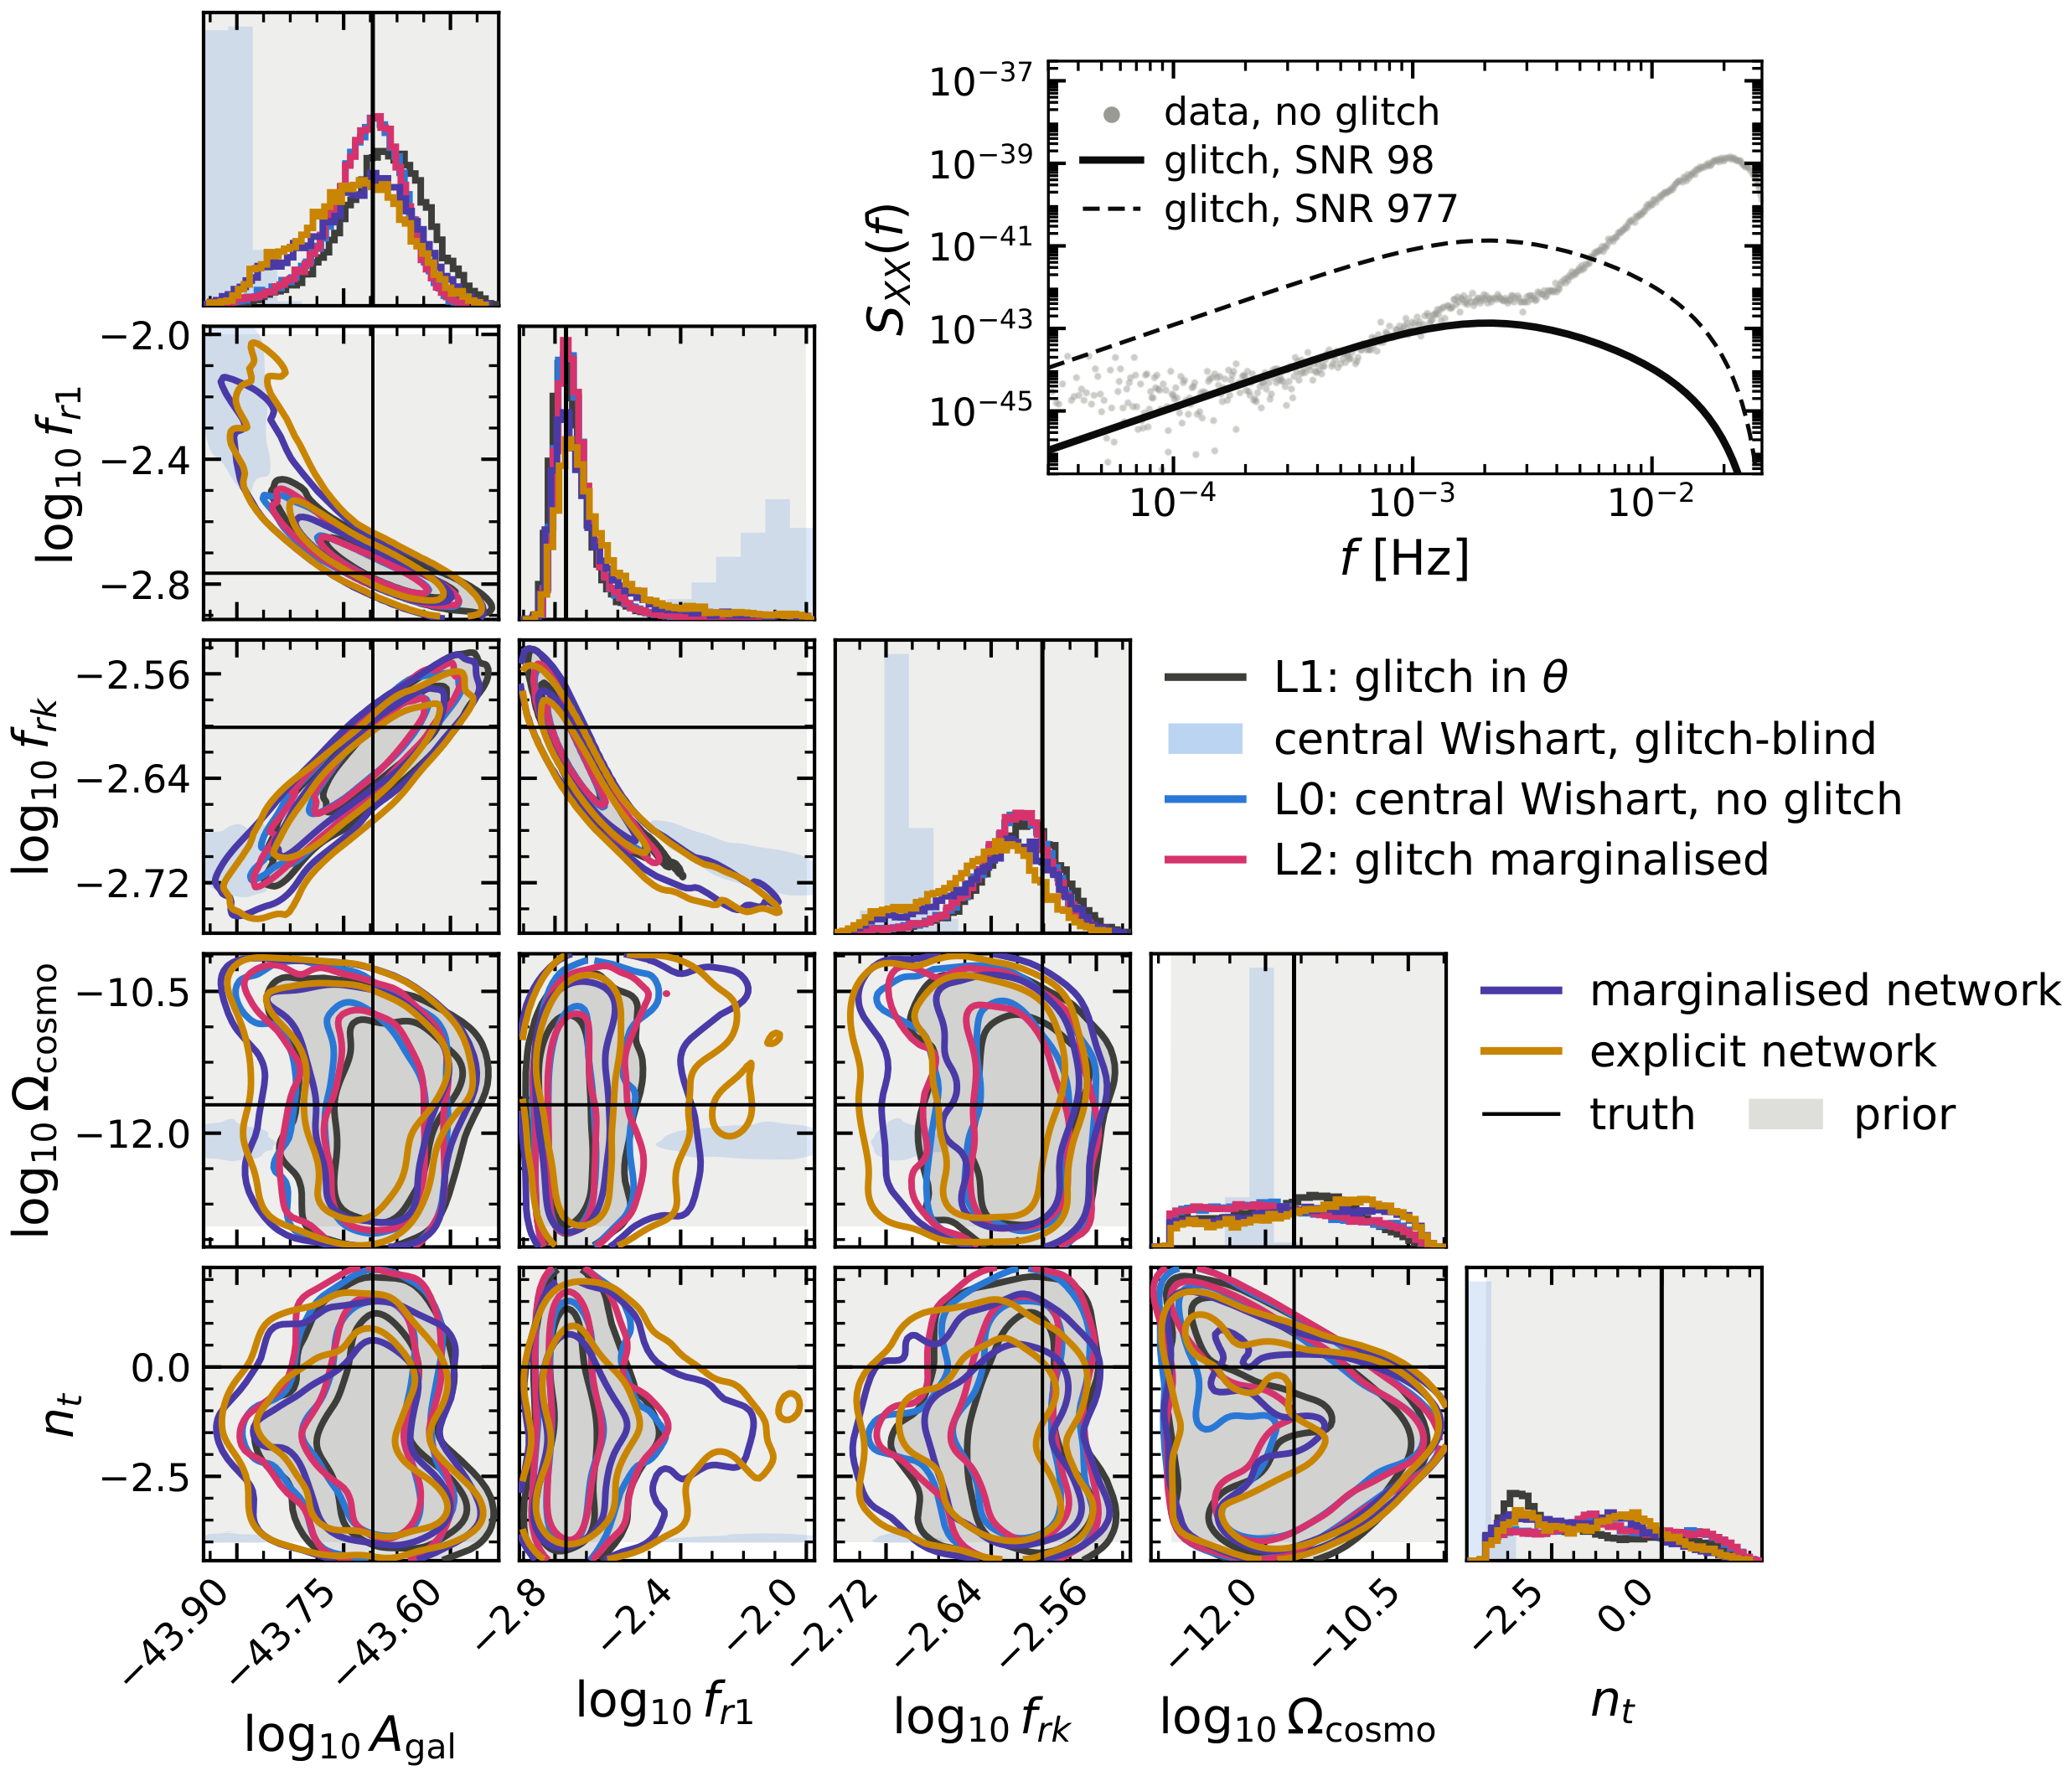
Learned vs analytic marginalisation
· One noise realisation, glitch SNR 98 on one link
· Marginalised and explicit networks sit with L1
and L2
· Glitch ignored (blue wash): a biased foreground
· 11.6 days, stochastic + 1 transient (glitch)
11/18
Notes:
explicit net infers amplitude + decay · marginalised net never sees them · L0 blue = the no-glitch answer

Slide 13
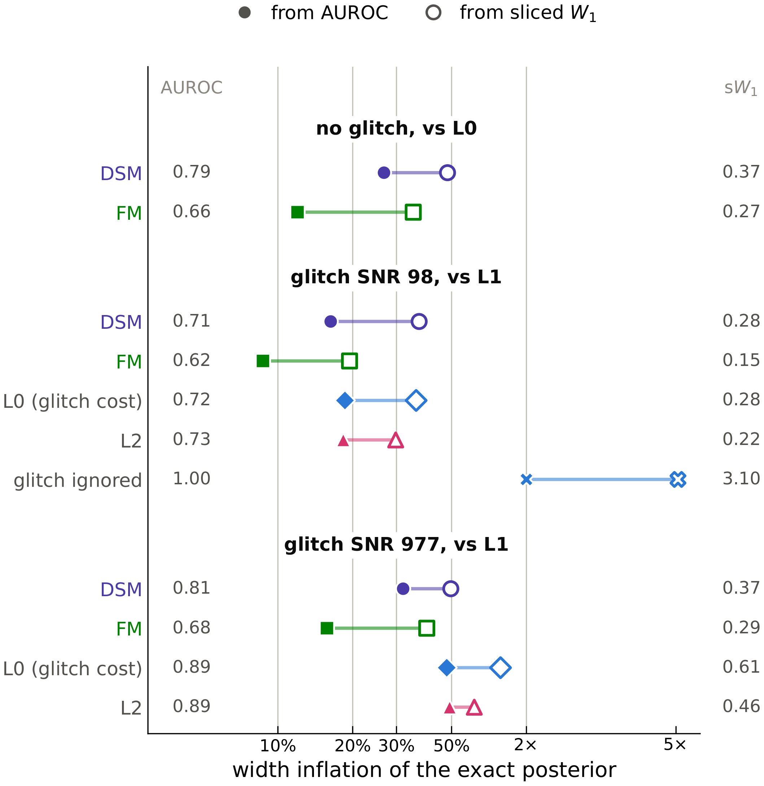
How close is close?
· Distances read as the width error that would score the
same against the exact posterior
· Network vs L1 ≈ L2 vs L1 ≈ the glitch's own cost
· Ignoring the glitch: 2× to 5×
12/18
Notes:
ruler measured, not the Gaussian formula · no glitch: DSM 0.79, FM 0.66 · SNR 977: nets ≈ L2 ≈ glitch cost

Slide 14
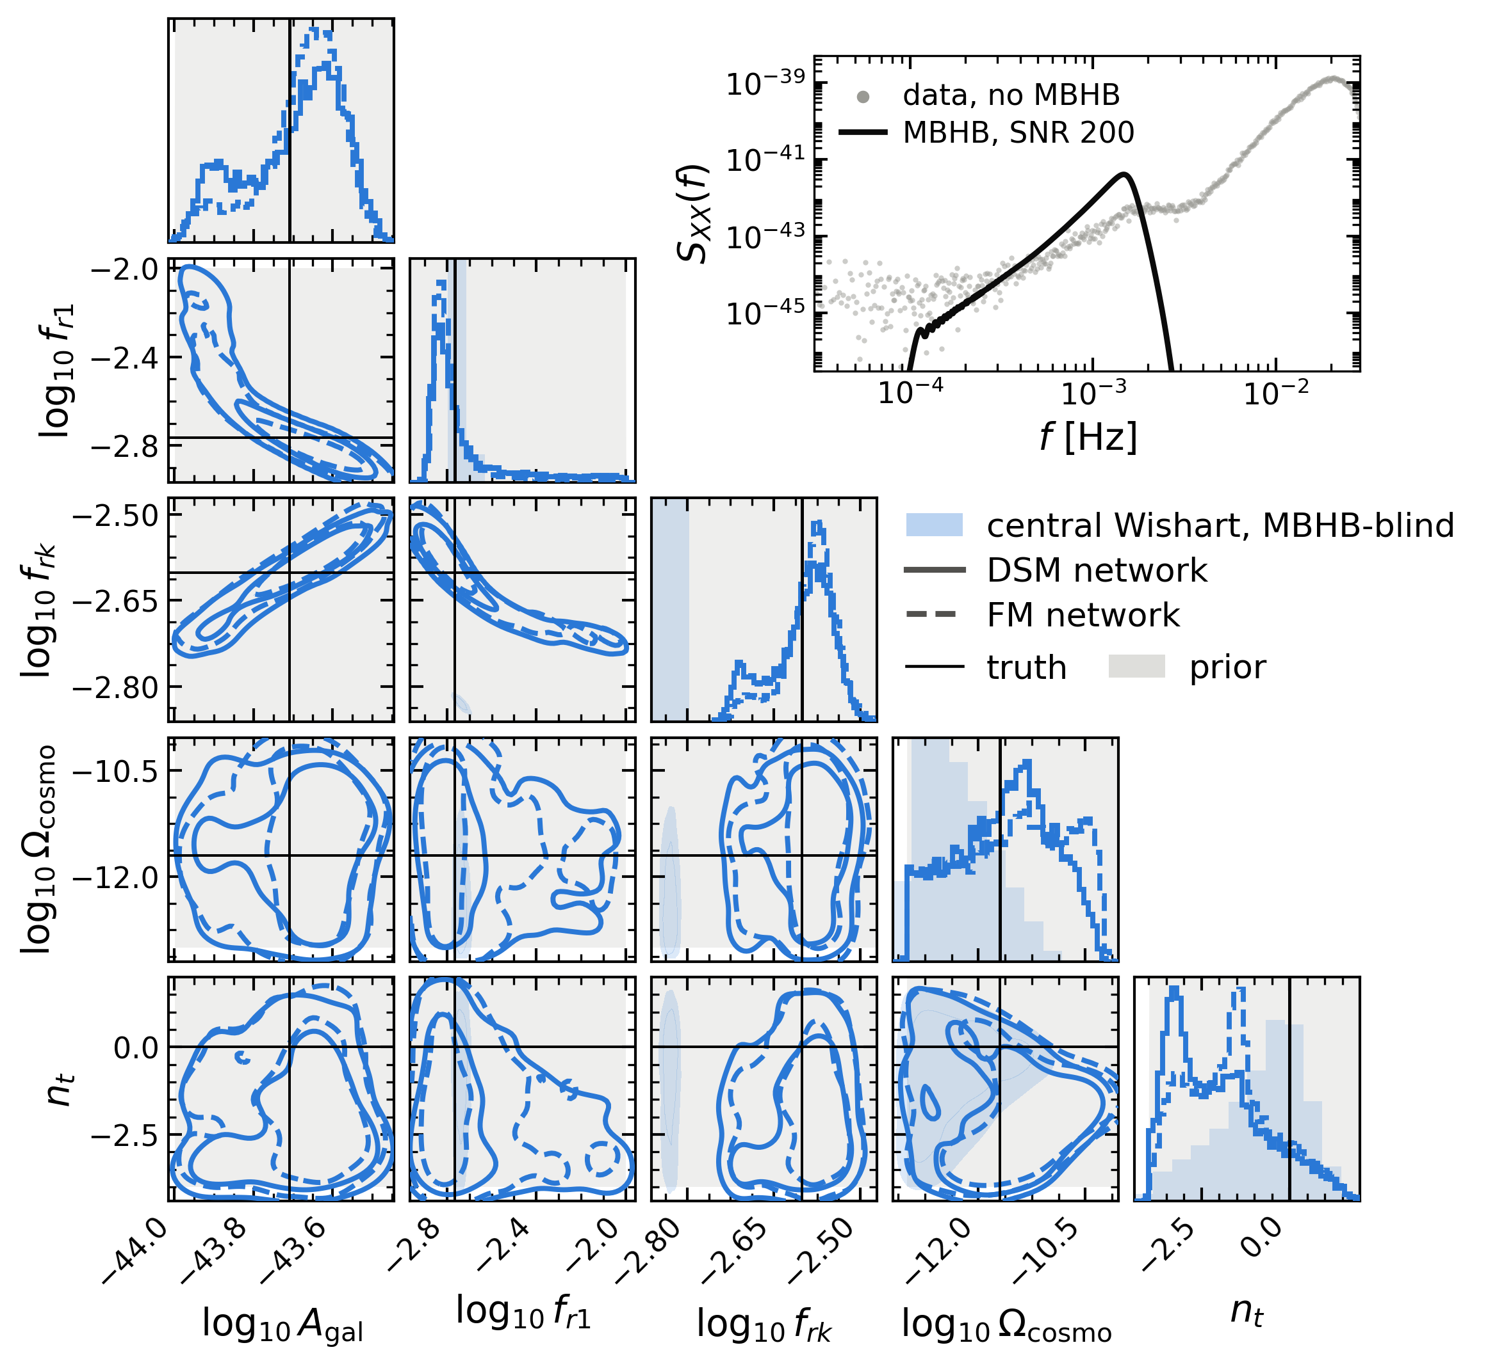
MBHBs: 15 parameters we never infer
· SNR 200 merger in the same noise realization
· DSM and FM networks, never told about the MBHB
· MBHB-blind likelihood (blue wash): a biased
foreground
· 11.6 days, stochastic + 1 transient (MBHB)
13/18
Notes:
previous talks fit it, we integrate it out · SNR 200 · blind A_gal off the panel

Slide 15
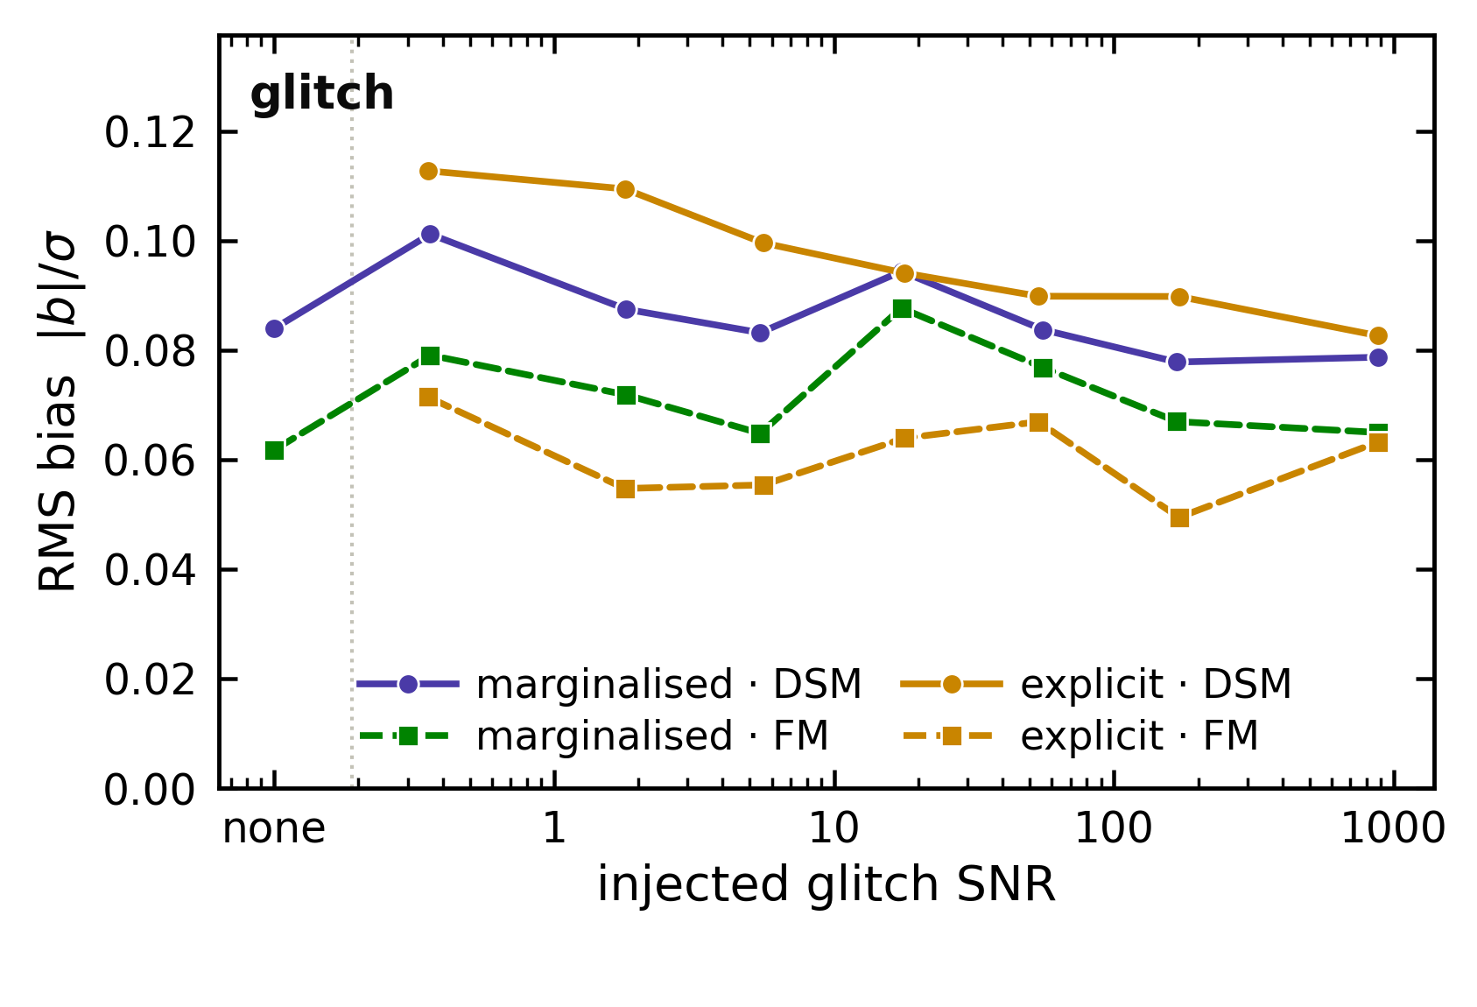
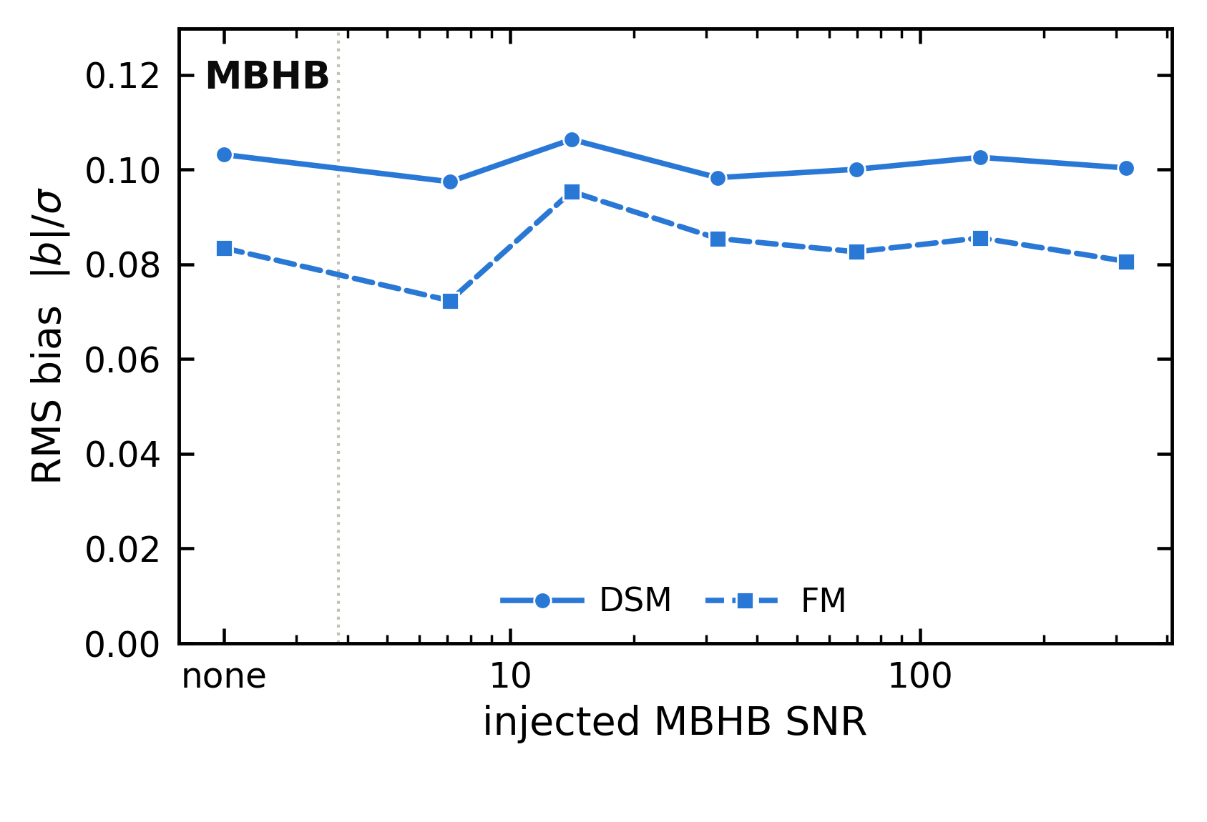
Three decades of transient SNR
16384 prior draws per network, binned by injected SNR · RMS bias over the 24 shared parameters
14/18
Notes:
population, not one observation · flat from no transient to SNR ~1000 · ~0.1σ

Slide 16
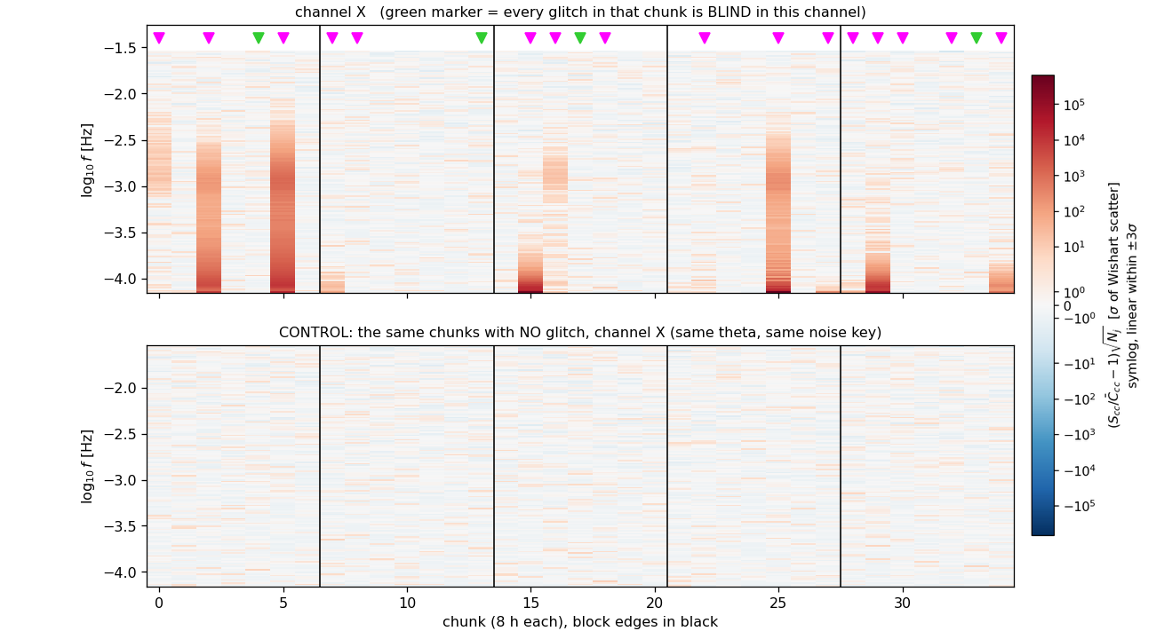
Tokens in time
· 35 chunks of 8 h → 35 data tokens,
one shared embedder (11.6 day total)
· Attention across chunks builds the
time-frequency map
· Per-block noise levels see only their
own block
· Realistic glitch rate; a gap is a
missing token
· 37 parameters, 72 tokens
15/18
Notes:
no STFT imposed: per-chunk spectra → tokens · d_b ↔ block b only (derived mask) · data shown: run50 obs

Slide 17
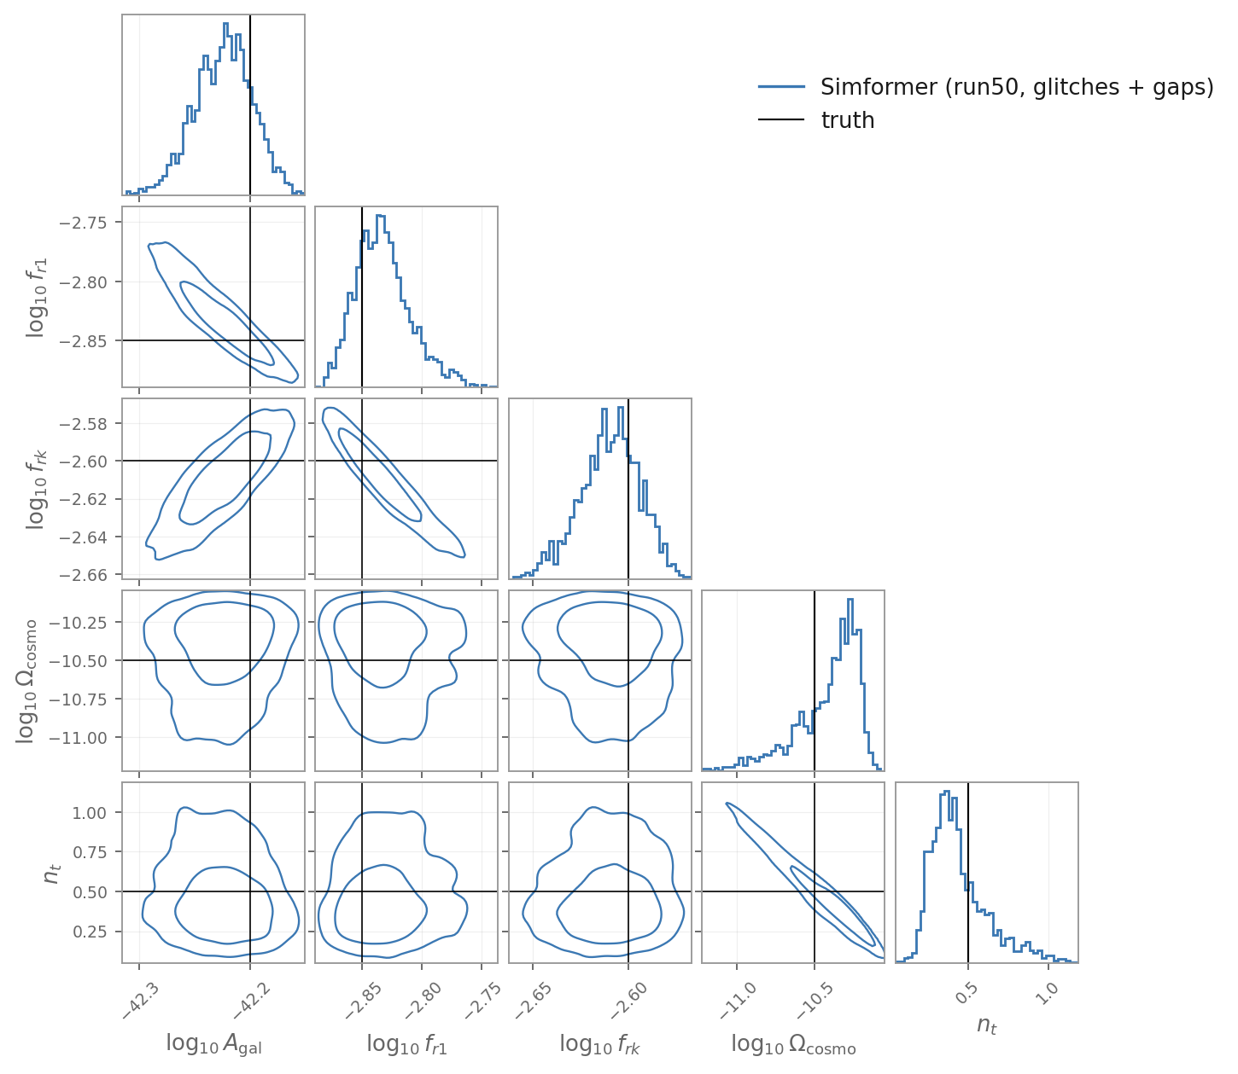
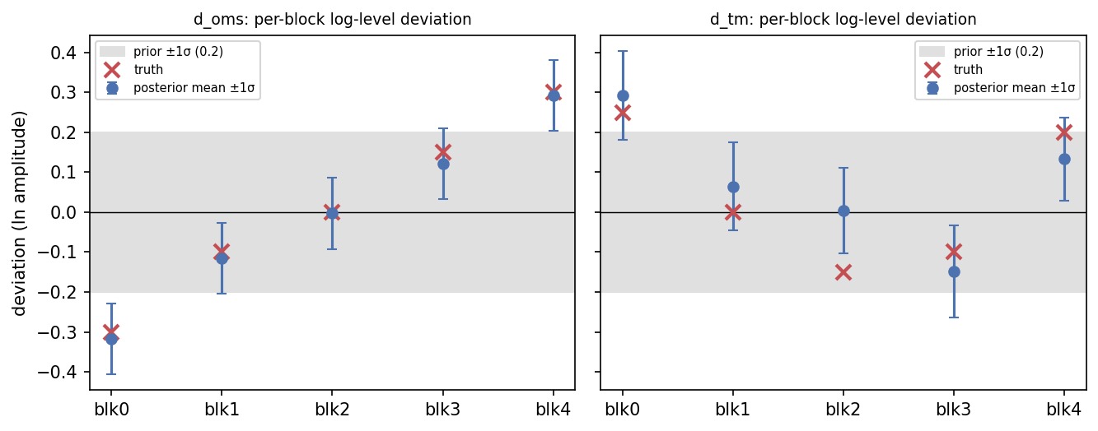
It measures the non-stationarity
16/18
Notes:
left: 5 blocks × 2 levels, tracked · right: science corner, same obs · galaxy off along its degeneracy (run50)

Slide 18
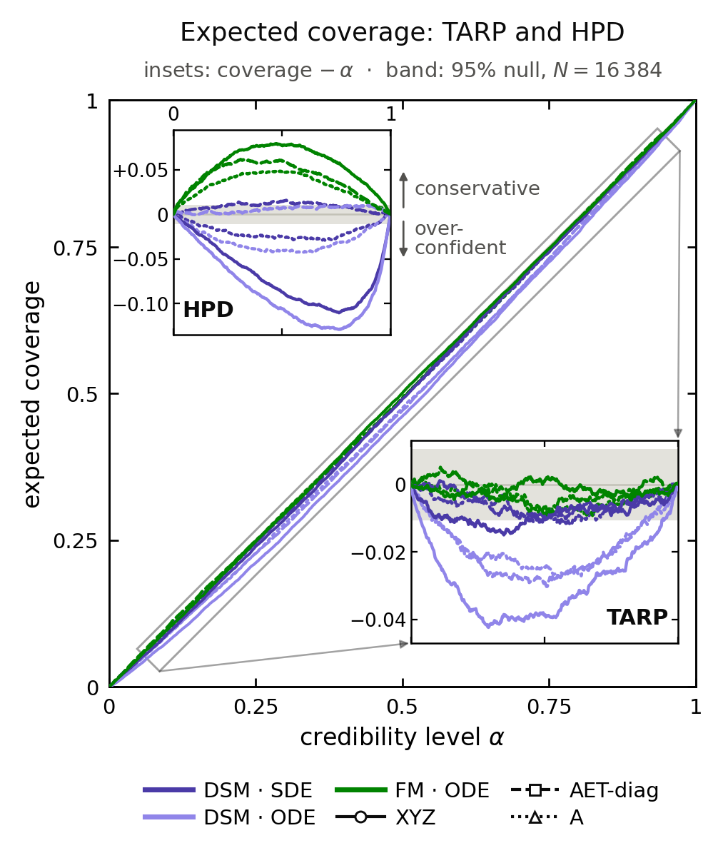
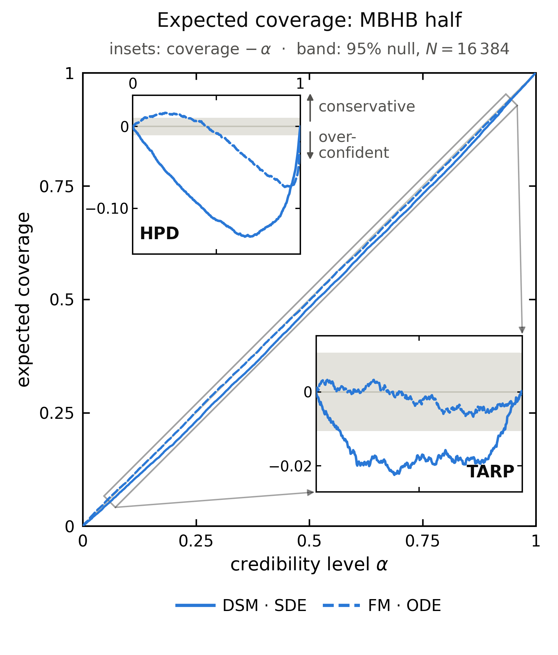
Checking the networks: Diffusion vs Flow Matching
stochastic only
with an MBHB
· TARP: both close to the
diagonal
· HPD separates them:
DSM is the more
over-confident
· 16384 trials: every null
rejects, so read the
effect size
17/18
Notes:
TARP both ≈ diagonal · Sec III HPD: FM +6%, DSM −10% · MBHB HPD: DSM −13%, FM −7% · 16384 trials: every null rejects

Slide 19
Take-home
• Parameters and data are tokens: 7 → 37 parameters, 1 → 35 data tokens
• Learned marginalisation of transients, as good as the analytic one
• Non-stationarity as tokens in time: a learned time-frequency map
• Calibrated at the percent level; diffusion and flow matching
• Transformer flexibility as an inference engine is unmatched
18/18
Notes:
paper soon · next: LISA Simulation Tools

Slide 20
Thank you

Slide 21
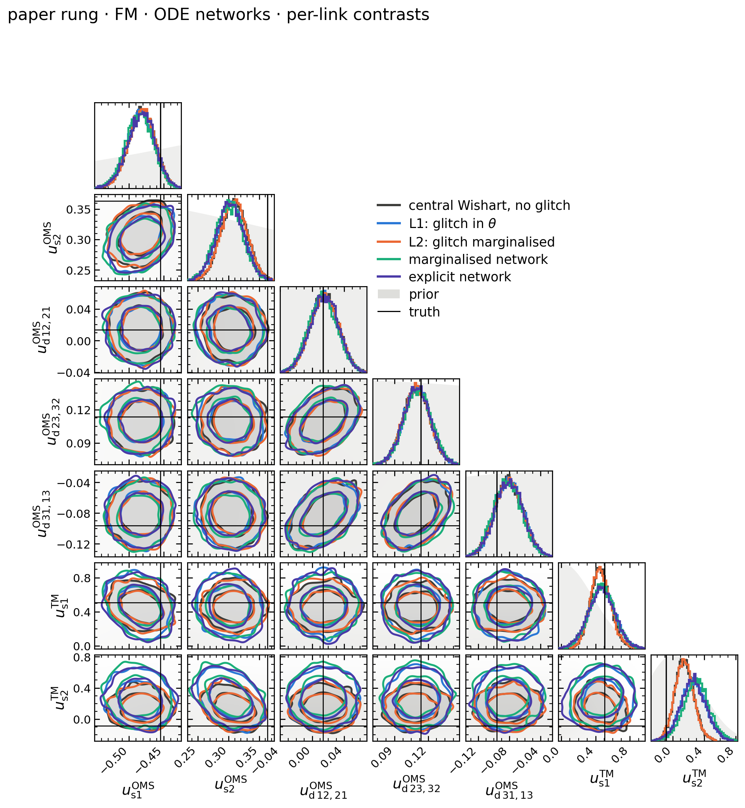
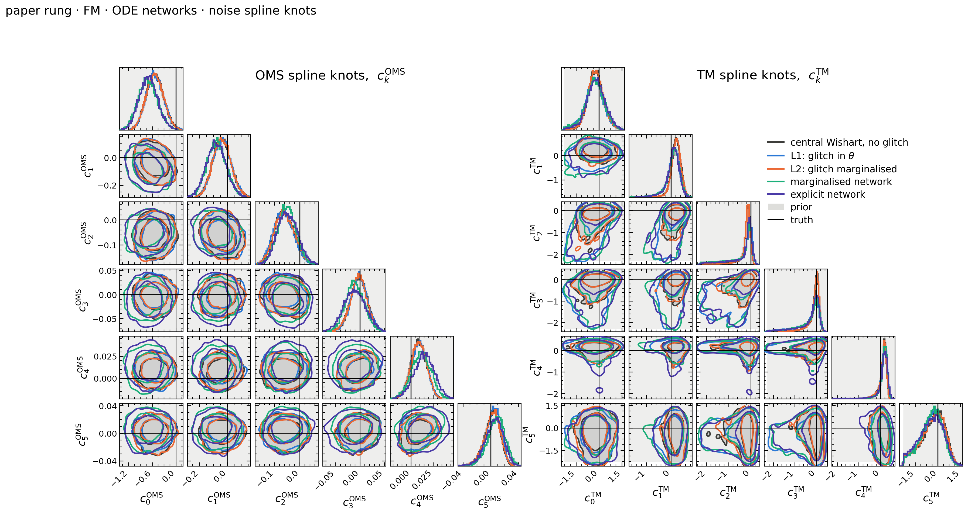
Instrument noise 2 → 32 parameters
Noise galore
No off-source data: inferred jointly with the signals
usual model
spline shape
links
blocks
18/18
Notes:
paper soon · next: LISA Simulation Tools

