Slide 1
Studies of W(→eν) boson production in pp interactions in ATLAS Journées Jeunes Chercheurs 2010
Dimitra Tsionou
Supervisors: Lucia Di Ciaccio (LAPP) & Stathes Paganis (Sheffield)

Slide 2
Outline
Standard Model and W physics
LHC
ATLAS detector & LAr Calorimeters
Online calculation of energy, time and quality factor
W→eν analysis
Shower shapes
Background estimation

Slide 3
W&Z bosons
W and Z bosons - the carriers of the electroweak interactions - were discovered in 1983 at the SppS (CERN)
 | Mass (GeV/c²) | Charge | Spin
W | 80.398±0.023 | ±1 | 1
Z | 91.1876±0.0021 | 0 | 1
They will be abundantly produced in LHC (√s=7TeV: σ_{W→eν}=10.46 ± 0.42 nb ⇨ ~3000 W→eν/pb⁻¹ detected )
Allowing us to understand the detector performance since it is a known process
Need to be better measured since they are a background to new physics
Perform precision measurements (eg m_{W})

Slide 4
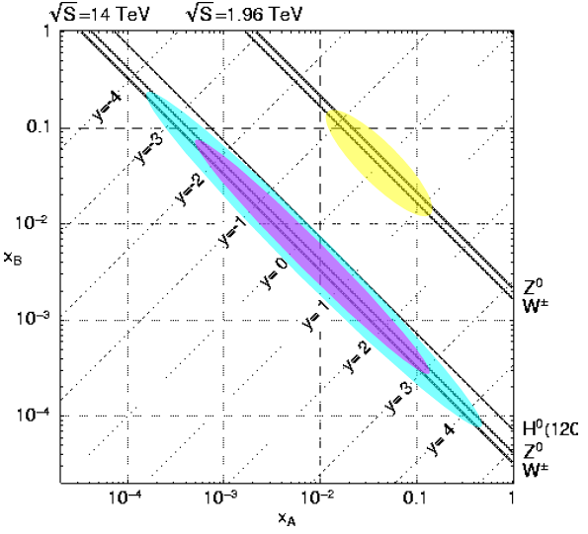
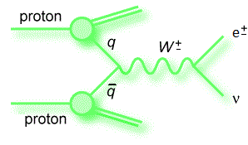
Physics with W
The W differential cross-section measurements and W asymmetry can be used to constrain the Parton Density Functions
x_{A}p
x_{B}p
x range for Tevatron
Q²=M²=x_{A}x_{B}s
x range for LHC

Slide 5
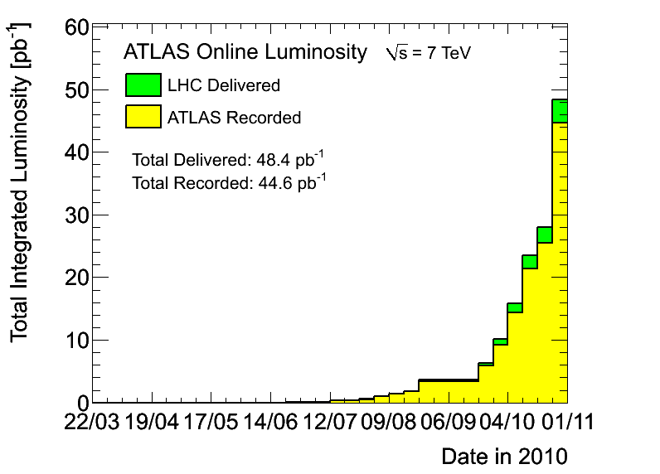
Large Hadron Collider
LHC characteristics
 | Energy | Luminosity | Number of bunches | Interactions/crossing
Nominal | 14 TeV | 10³⁴ cm⁻²s⁻¹ | ~2800 | ~23
Actual | 7 TeV | 2∙10³² cm⁻²s⁻¹ | ~400 | ~3
45 pb⁻¹ recorded in ATLAS during the proton-proton collisions

Slide 6
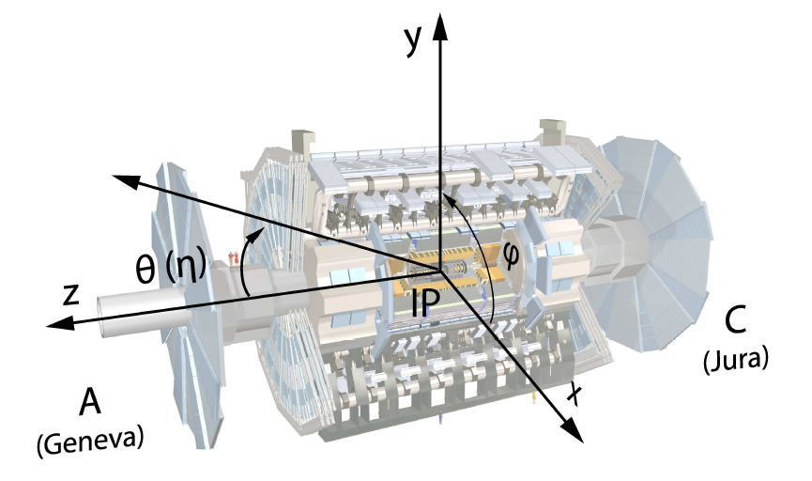
A Toroidal LHC ApparatuS
The ATLAS experiment
Inner Detector (Tracking in Solenoid), Calorimeters, Muon Detectors (Toroid)
pseudorapidity

Slide 7
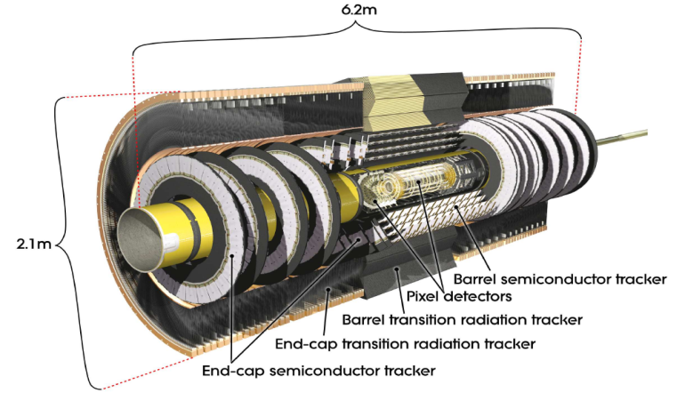
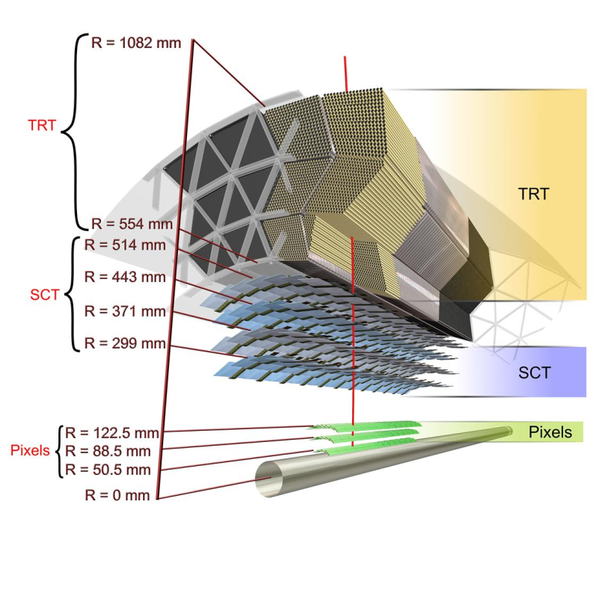
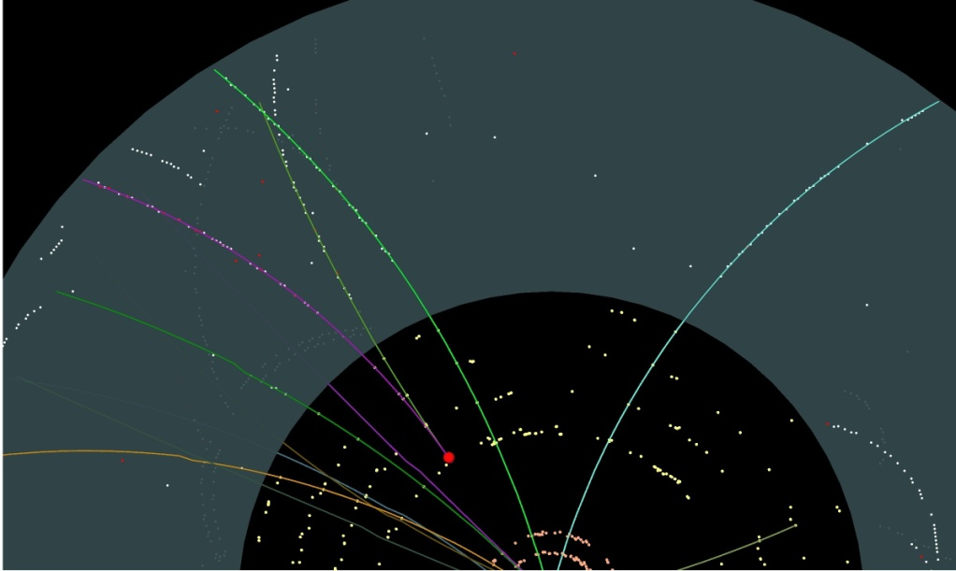
Inner Detector
Pixel – SCT - TRT
Pixel support shift ~ 1cm
Photon conversion
Track Reconstruction
Momentum
Direction (η, φ, ...)
Vertex Reconstruction (primary, secondary, conversions)
Particle Identification (TRT)
Material description: agreement at 10%

Slide 8
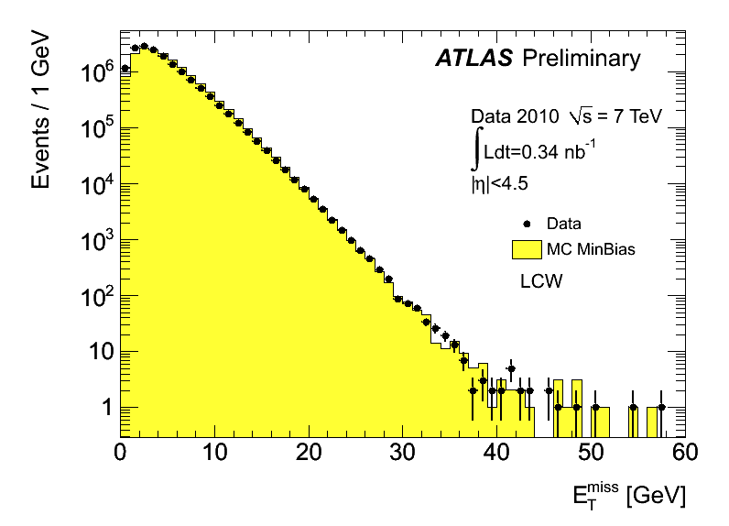
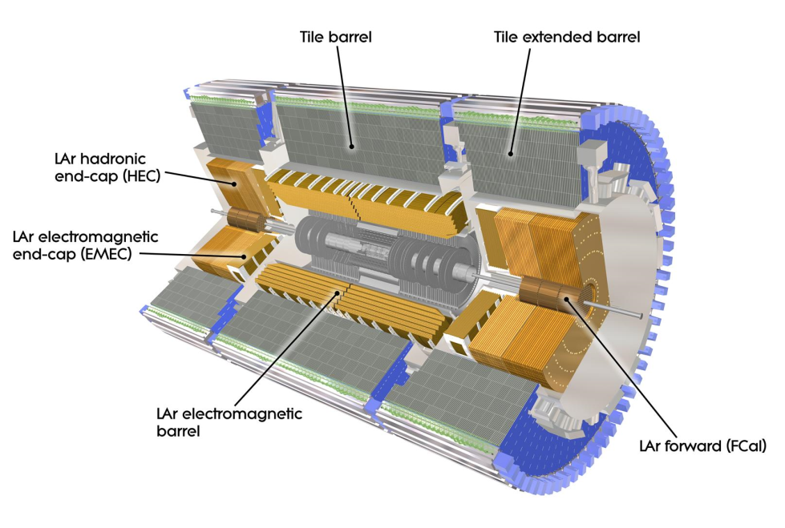
Calorimeters
EM Calorimeter
Hadronic Calorimeter
Good performance of the Missing Transverse Energy reconstruction
Reconstruction of the EM and hadronic energy deposit
Energy, Missing Transverse Energy
Position, direction
Particle Identification (electrons, photons)

Slide 9
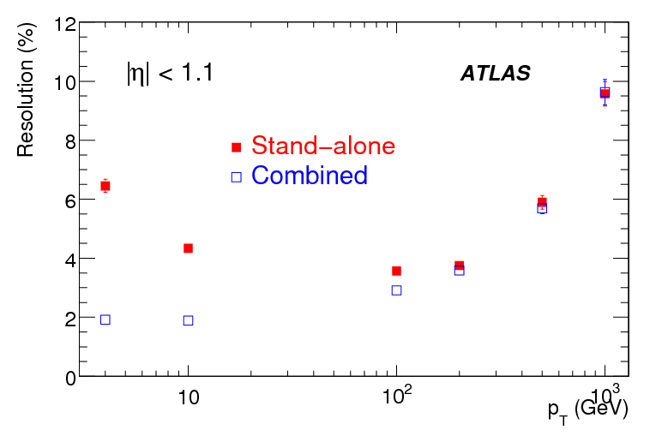
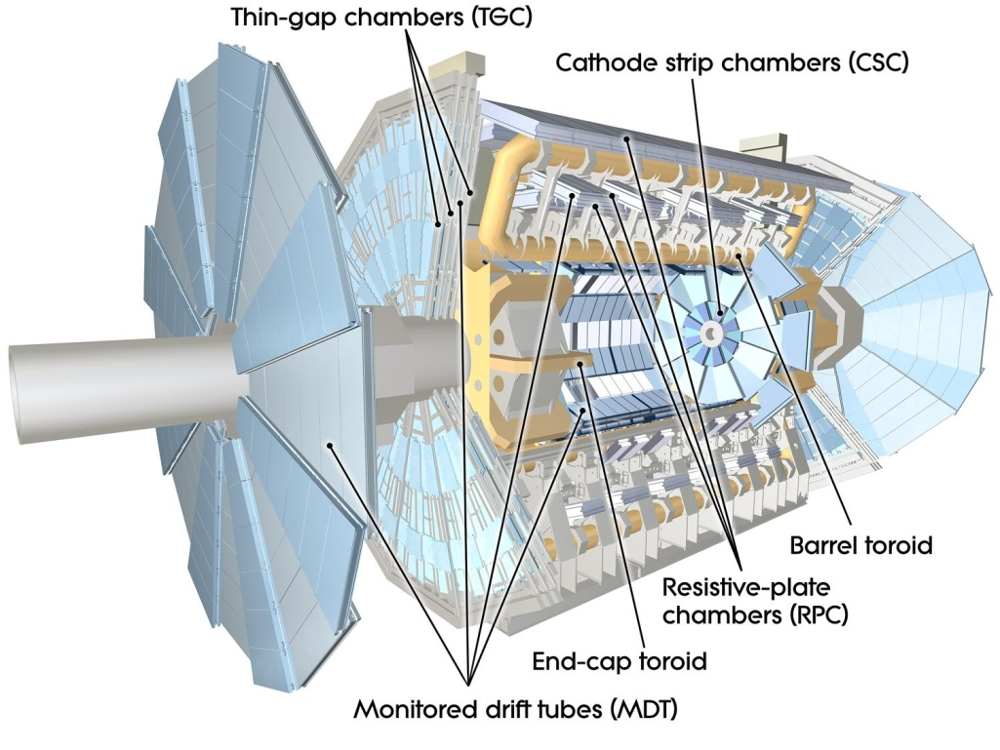
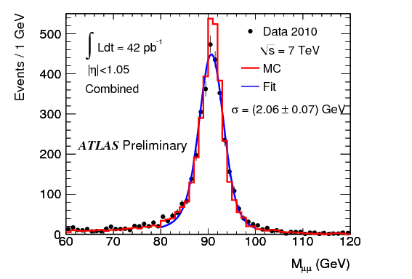
Muon Spectrometer
Muons’ transverse Momentum resolution
Track reconstruction and identification (muons)
Momentum
Direction (η, φ, ...)
Combined

Slide 10
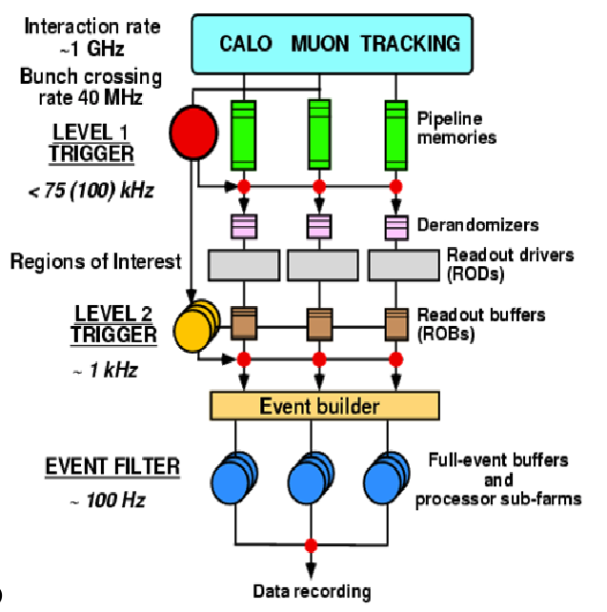
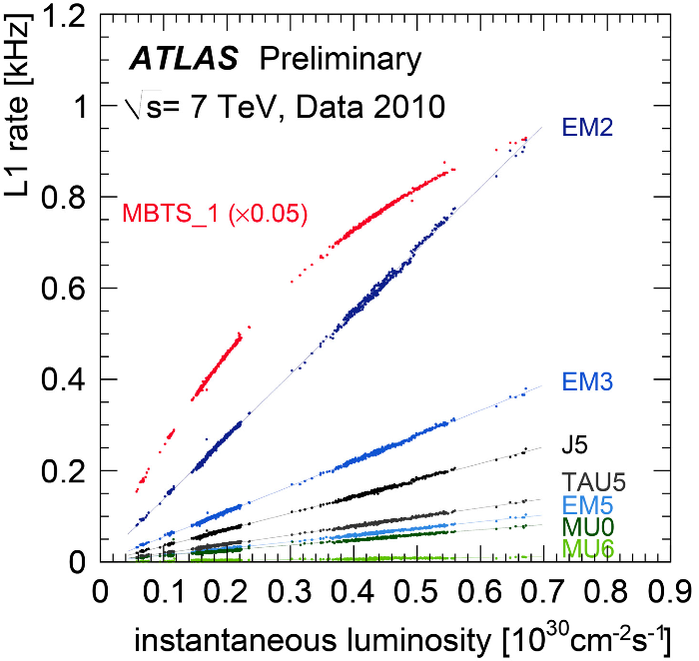
Trigger System
3 levels: LVL1, LVL2, Event Filter (EF)
300 Hz
Trigger output at 300 Hz
Trigger menu updated to comply with the increasing luminosity

Slide 11
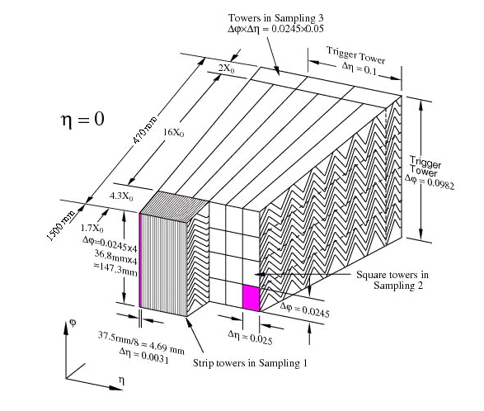
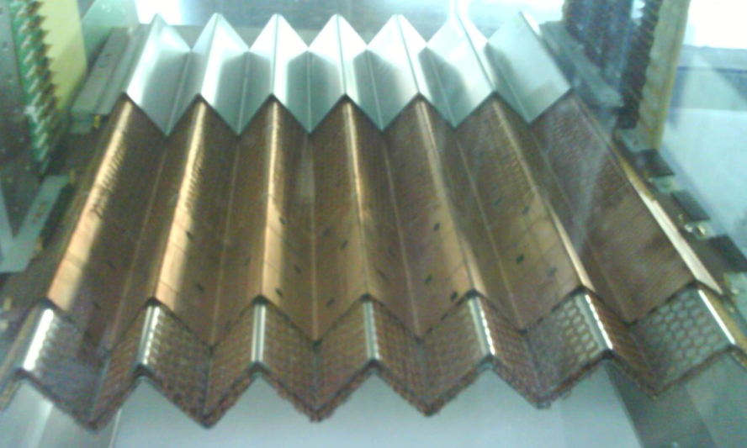
LAr Calorimeters
EM Calorimeter
4 sub-detectors: Electromagnetic Barrel and End-cap, Hadronic End-cap, Forward Calorimeter (~200000 cells)
~20 X₀
Active medium: Liquid Argon (LAr)
Accordion geometry (complete coverage in φ)
e
Longitudinal segmentation allowing to look at the shower development
The signal is amplified, shaped and digitized by the Front-End electronics. The Back-End electronics reconstruct the energy and the time of each cell

Slide 12
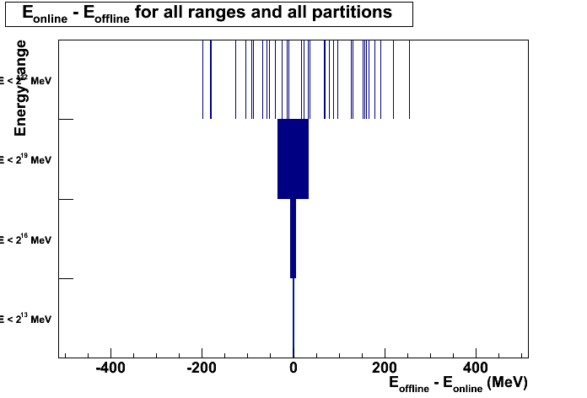
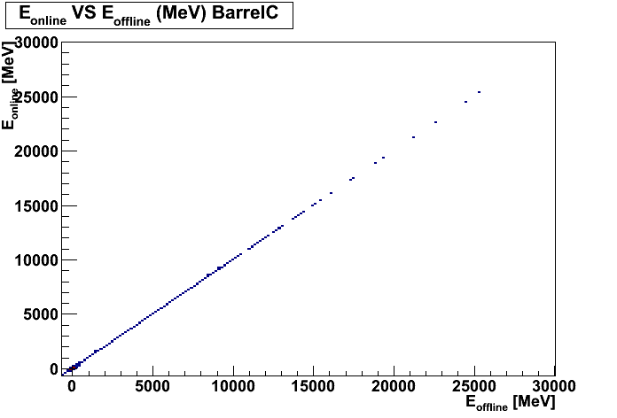
Online (Digital) Signal Processor
The DSP is part of the LAr Back-End electronics . It computes the energy, signal timing and a quality factor for each cell.
Store directly high level information rather than all the digital samples composing the electric signal recorded when a particle crosses the detector
Online Monitoring of the DSP and investigation of any errors that occur during data-taking is vital since they can affect the data quality
ATLAS work in progress
ATLAS work in progress
Eoffline [MeV]
Difference between the energy calculated on the DSP (online) and the energy calculated offline.
4 energy ranges defined, each one with a different precision
Eonline [MeV]

Slide 13
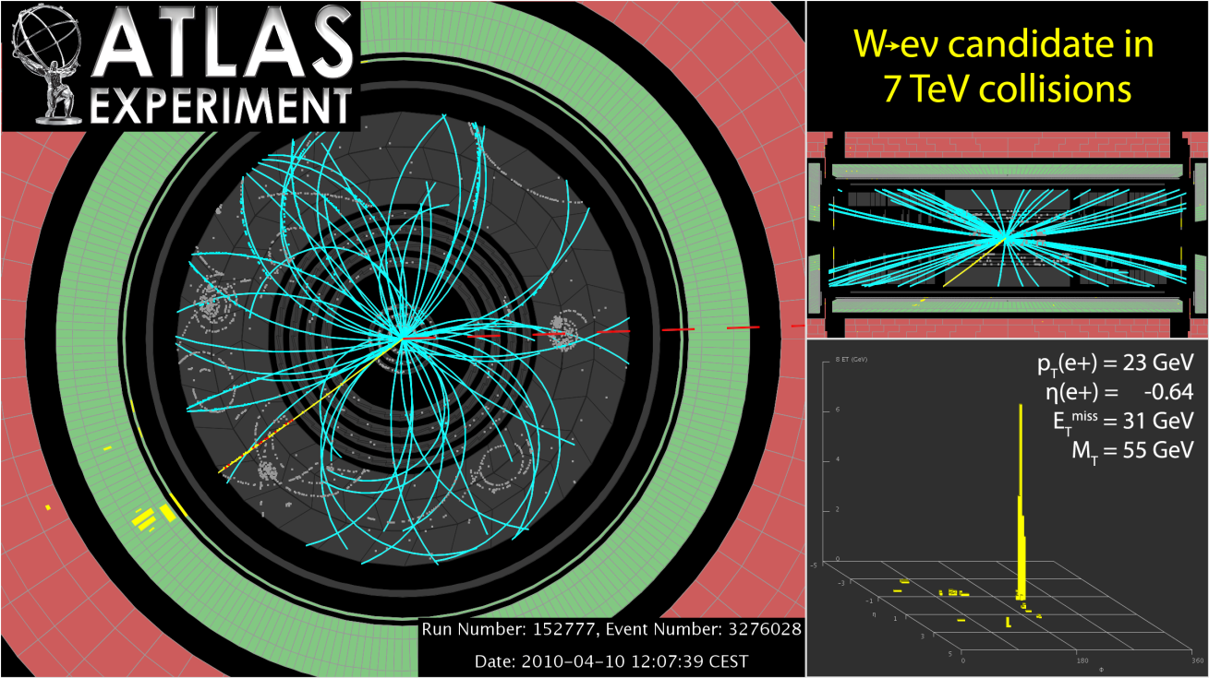
W→eν Analysis – Event Selection
Selection cuts:
Event cleaning cuts
Electron cuts (pt, η, e identification)
Etmiss cut (escaping ν)
W transverse mass cut
Soft tracks bend in the inner detector
Analysed data: 36.41 pb⁻¹

Slide 14
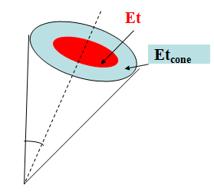
Electron Identification & Isolation
A number of variables is used to distinguish between electrons and fakes (3 levels of identification: loose, medium, tight)
Loose: calorimetric criteria (lateral shower shapes)
Medium: lateral and longitudinal shower shapes criteria, track variables
Tight: cluster-track matching, track variables
Signal (isolated electrons)
Criteria defined in a p_{t} and η grid
background
Isolation
An additional cut to select W events is the calorimetric isolation (eg Etcone30/Et)
Smaller values → more isolated object, less activity around it
Energy in a cone around the shower

Slide 15
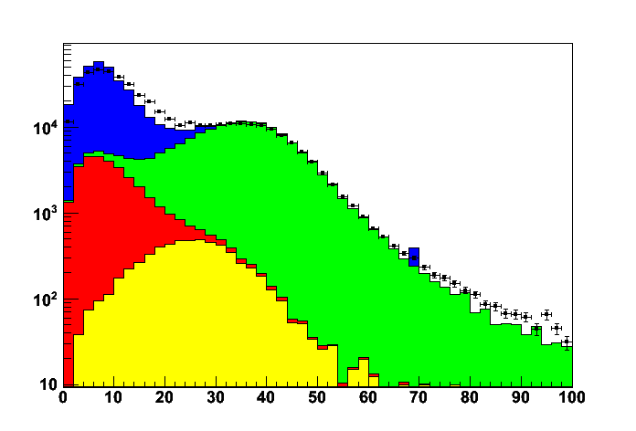
Cutflow
ATLAS work in progress
Cutflow for the W analysis
Preselection includes event cleaning cuts as well as a number of electron cuts such as p_{t} and η
Data
W→eν
W→τν
Z→ee
QCD
Etmiss distribution for the W selection
Etmiss [GeV]
 | All ( 36. 41 pb⁻¹) | Expected signal (MC)
Preselection | 506103 | 157358
e Identification tight | 197446 | 136010
Etmiss>25 GeV | 135221 | 110582
m_{tW}>40 GeV | 118521 | 109465

Slide 16
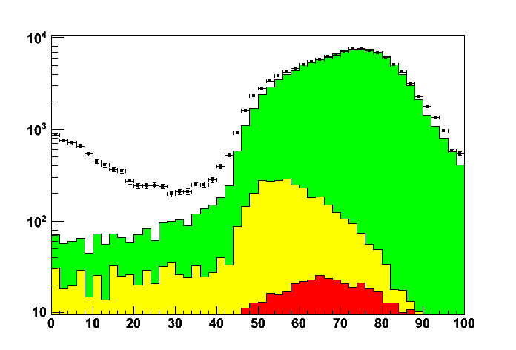
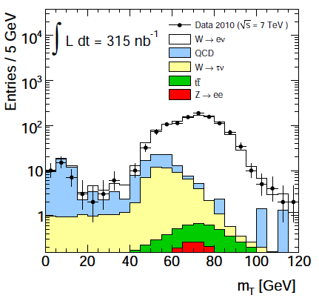
W Transverse Mass
ATLAS work in progress
ATLAS Preliminary
Data
W→eν
W→τν
Z→ee
m_{tW} [GeV]
m_{tW} [GeV]
After all cuts the S/B is ~15
Expected W→eν X-section: σ_{W→eν}=10.46 ± 0.42 nb (MSTW2008)
Measured W→eν X-section: σ_{W→eν}= 10.02 ± 0.23(stat) ± 0.37(syst) ± 1.11(lumi) nb

Slide 17
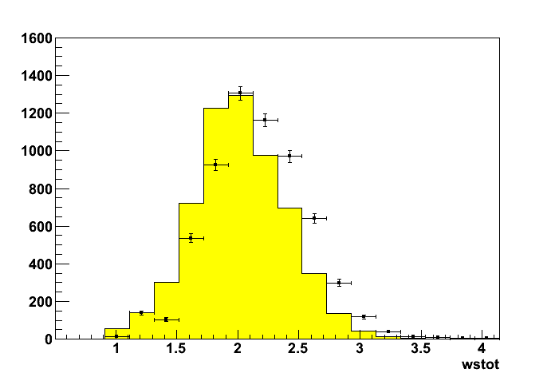
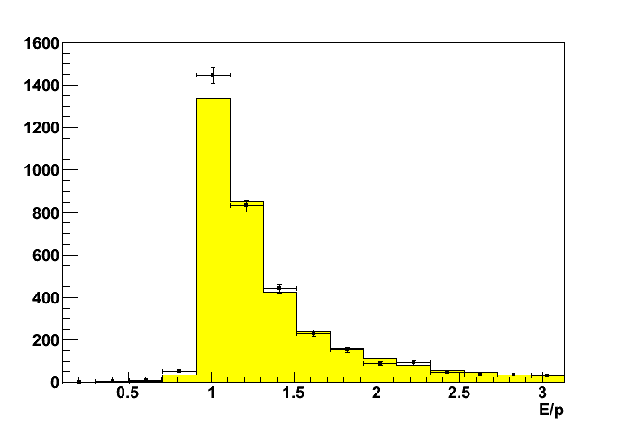
Electron Shower Shapes from W
W→eν is a clean signal. It can be used to compare electrons in data and Monte Carlo
Official analysis uses cuts on calorimetric electron shower shapes
Setting up an alternative selection based mostly on Inner Detector variables allowed to study these shower shapes. Alternative cuts:
event cleaning cuts
electron cuts (pt, η, number Inner Detector hits, loose identification, isolation)
Etmiss cut
ATLAS work in progress
ATLAS work in progress
Shower width broader in data
Calibration effect

Slide 18
Background Estimation
Two sources of background in W analysis:
The electroweak background (well-known) is estimated using Monte Carlo. The W→τν and Z→ee processes are studied
Data (3.13pb⁻¹) | W→eν (signal) | W→τν | Z→ee
9901 | 9400±32 | 242±5 | 40±1
The W→τν is the main electroweak background and amounts to ~2.5% of the signal
QCD background: The QCD cross-section is not well-known so data-driven methods are used in order to estimate this background

Slide 19
QCD Background Estimation
Method
After the analysis
Applying an additional cut
Variables to be measured in order to calculate N_{QCD}
N_{wcand}, N_{wcand,cut} from the cutflow of the analysis
ε_{sig} determined from data using Z→ee events
ε_{QCD}: Select a signal-free QCD sample similar to the one that passes the selection criteria of the W analysis
Completely data-driven method

Slide 20
Selecting QCD background sample
In order to select our QCD sample we use the same cuts as for the W analysis but use medium electron instead of tight electron and reverse the Etmiss cut
 | QCD sample (Data 3.13pb⁻¹) | W→eν (MC) | W→τν (MC) | Z→ee (MC)
Before isolation | 161595 | 1358 | 174 | 1198
After isolation | 79280 | 1335 | 170 | 1170
~3% contamination of the QCD sample from the electroweak processes W→eν, W→τν, Z→ee

Slide 21
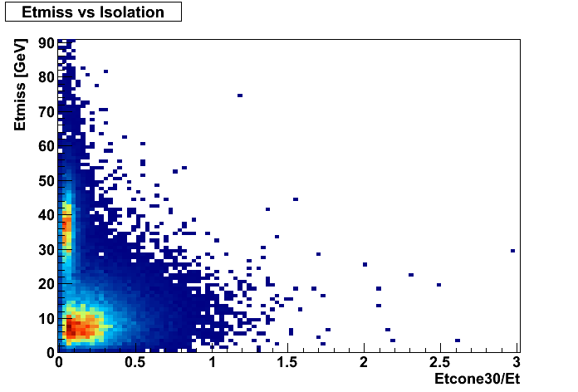
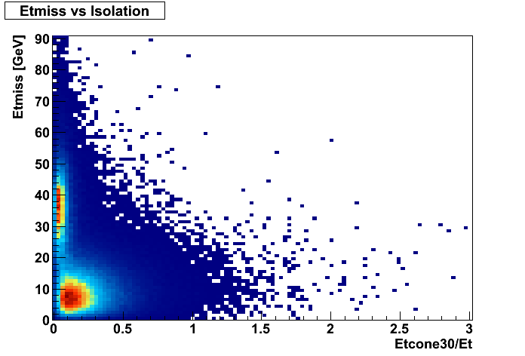
Etmiss-Isolation correlation Study
ATLAS work in progress
Data passing the event cleaning and the electron cuts for the W analysis
Data
Data passing the event cleaning and the electron cuts for the QCD sample. W→eν MC that passes the W analysis cuts (event cleaning and electron cuts) has been added
ATLAS work in progress
MC Wenu + QCD sample
Conclusion: similar correlation in both samples (W data and MC W→eν+QCD)  We can use this cut

Slide 22
QCD background calculation
Using the formulae shown previously we can calculate the N_{QCD} as well as the uncertainty on it
 | Data (3.13 pb⁻¹)
W candidates | 9901
N_{QCD} | 447±120 (4.5%)

Slide 23
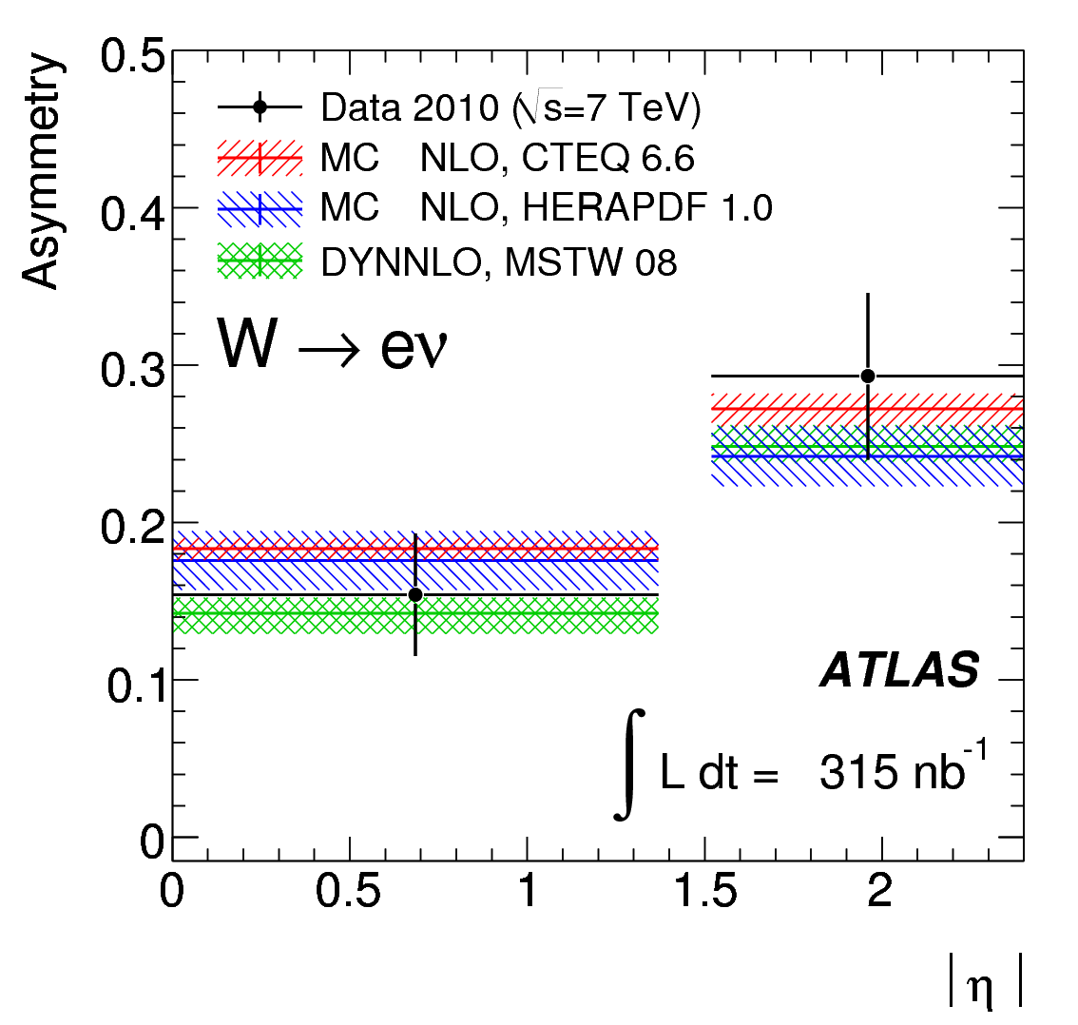
Future Plans
Since LHC is a pp collider there is an asymmetry in the W⁺ (uđ) and W⁻ (ūd) production
Charge mis-identification (wrong identification of electron charge can affect the measurement of W⁺/W⁻ production (e⁺/e⁻ >1)
W→eν differential cross-section measurement
W asymmetry provides information on the u and d quark content
In agreement but large uncertainties. With more data we might be able to rule out some models

Slide 24
Conclusion
The QCD background estimation can be used as a complementary method to control the systematics of the method currently used in the ATLAS collaboration
Charge mis-identification study for differential cross-section and W asymmetry
Ongoing DSP studies on timing calculation, improvement of the online code
Investigation of electron shower shapes

Slide 25
Backup

Slide 26
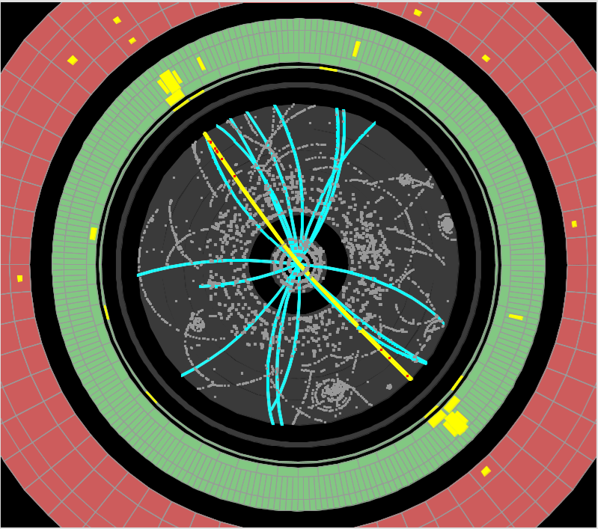
Tag & Probe
Data-driven technique for performance analysis
Derive efficiencies using the Z→ee decay
The method is based on the definition of a probe-like object, used to make the performance measurement, within a properly “tagged” sample of events
tag electron
Search for a second electron with desired properties (probe)

Slide 27
Contribution to the Benchmark Code
Development of the official analysis code within the ATLAS framework (ATHENA) for W→eν
It produces results against which all other analyses can be compared (bench-marking)
User-friendly and flexible: the user can plug in their own analysis
Used for W→eν selection and producing an easy-to-use output
Relaxing the selection criteria, this program is now used by the ATLAS Standard Model group to produce reduced datasets for analysis

Slide 28
DSP energy calculation
The energy is calculated for every LAr cell during data taking. There is an energy threshold for time and quality factor calculation
Taking into account the required precision on the energy measurement and the performance of the DSP: four energy ranges are defined each one with a different precision
Since we want to store the Energy and not the digits we need to be sure that the energy computation is correct
4th energy range: E<2²² MeV, ΔE≤512
3rd energy range: E<2¹⁹ MeV, ΔE≤64
2nd energy range: E<2¹⁶ MeV, ΔE≤8
1st energy range: E<2¹³ MeV, ΔE≤1
Eoff-Eon [MeV]

Slide 29
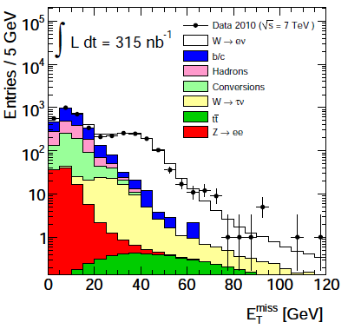
Official Method for Estimating the QCD Background in W→eν
Partially data-driven method
Etmiss as a discriminating variable. The signal and QCD background fractions are extracted using a binned maximum likelihood fit
Templates for signal shape from MC while templates for QCD shape from data (sample selected by inverting trackmatching,.. cuts)
Data
W→eν
W→τν
Z→ee
QCD
Etmiss [GeV]
Etmiss distribution for the W selection

