Slide 1


Indirect Search For Dark Matter With Antares
Ziad Charif
Supervisor: Paschal Coyle
Co-supervisor: Vincent Bertin
Co-supervisor: Pascal Gay

Slide 2
Outline
What’s dark matter? And how we know it exist
Neutrino astronomy
Searching for dark matter with neutrinos
Antares Telescope
The analysis
Conclusions and final remarks

Slide 3
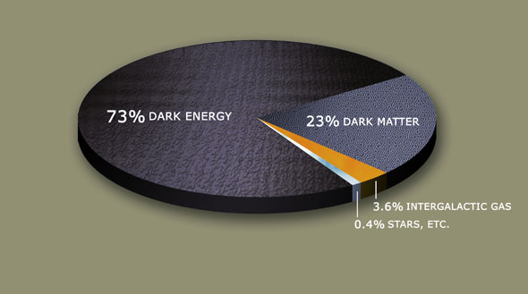
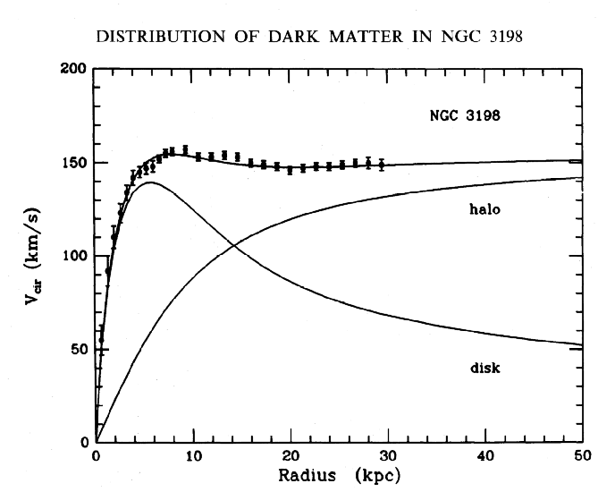
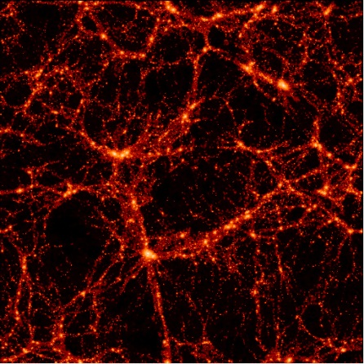
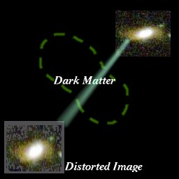
Dark Matter and the Evidence
Rotation curves of spiral galaxies
Galaxy groups emitting X-rays
Mass to luminosity ratios
Velocity dispersion of galaxies
Gravitational lensing
Other: CMB, BAO, etc.

Slide 4

Possible explanations of DM
Particle Origin:
Super-Symmetry LSP
Universal Extra Dimensions LKP
Axions
Sterile neutrinos
Etc…
Fields Origin:
MOND(MOdified Newtonian Dynamics)
Dark fluid
From corrections to the conventional gravitational interaction as a result of the reconciliation of gravity with quantum mechanics
Etc…

Slide 5
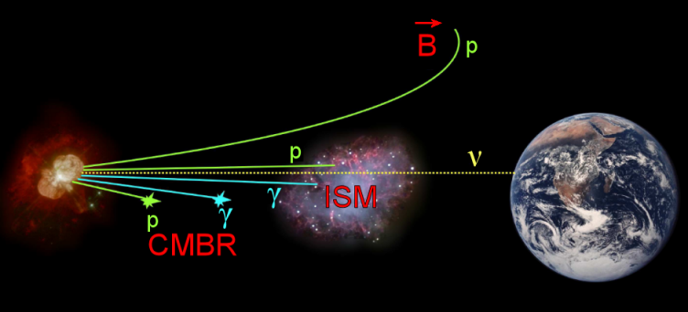
Neutrino Astronomy
Low cross-section messenger
No charge, so no deviation by magnetic fields
Ability to observe the inner workings of the astrophysical objects

Slide 6
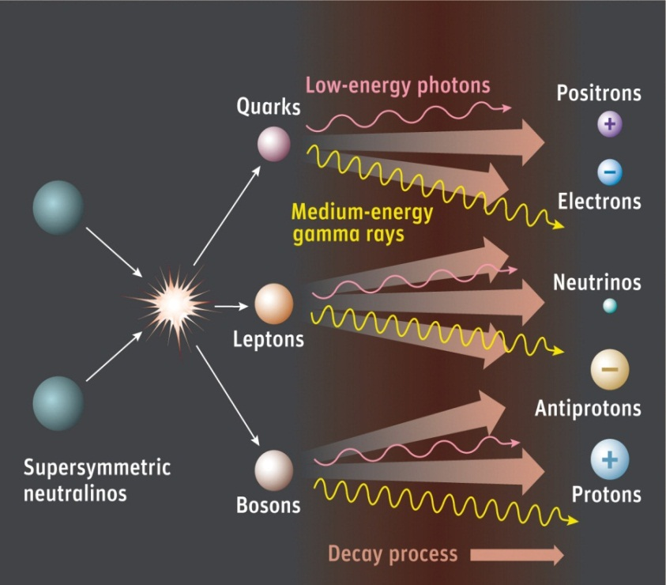
Dark matter search via neutrino astronomy
If DM is from a particle origin (LSP or LKP)
Auto-annihilation is possible
Unless the products are stable(photons or electrons), there is always a neutrino
The sun is a very close
possible accumulation
of DM that can be detected

Slide 7
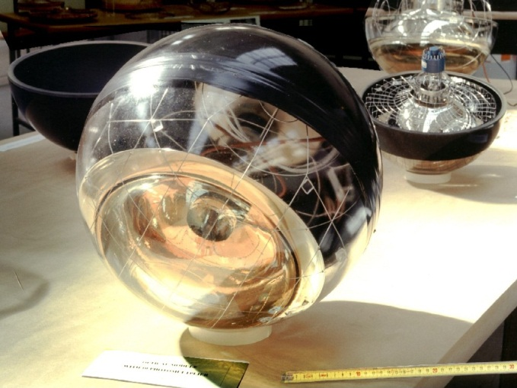
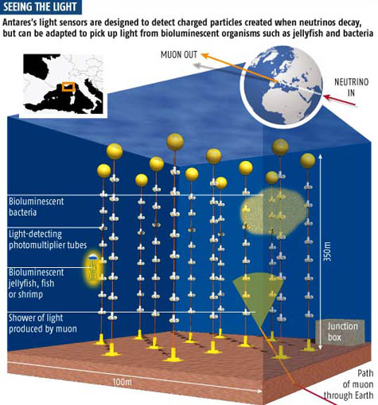
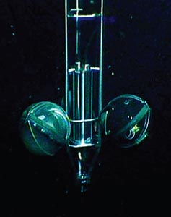
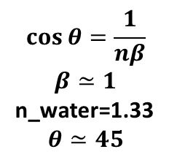
ANTARES
$$\cos{θ}=\frac{1}{nβ}$$
$$β≃1$$
n_water=1.33
$$θ≃45$$
One of the only few Cherenkov neutrino telescopes in the world (Antares, Baikal, IceCube)
40Km offshore, ~2500m deep, 12 lines, 25 floors per line, with 3 OMs per floor. Totaling a sum of 900 OMs

Slide 8

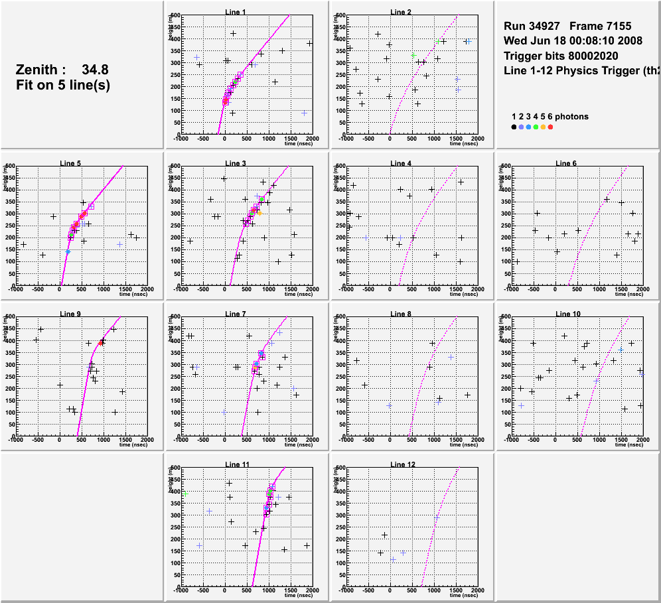
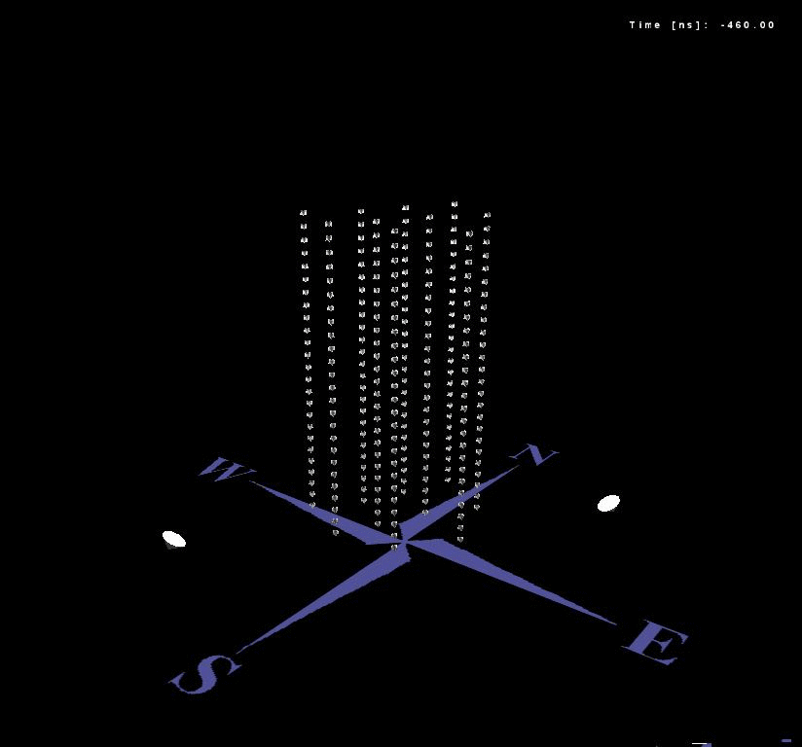
Event Display: Neutrino-induced muon
reconstruction of muon trajectory from time, charge and position of PMT hits
assuming relativistic muon emitting Cherenkov light
height
Example of a reconstructed up-going muon (i.e. a neutrino candidate) detected in 6/12 detector lines:
time
Notes:
M. Spurio- ANTARES
8

Slide 9
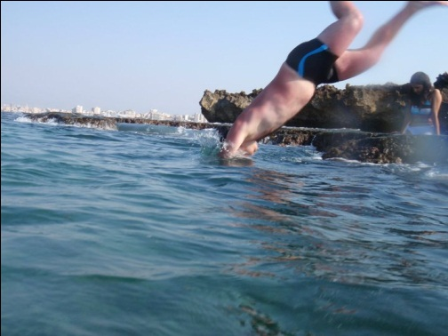
And once per year
You have to go on detector Shift
And search for neutrinos yourself
Man Overboard!

Slide 10
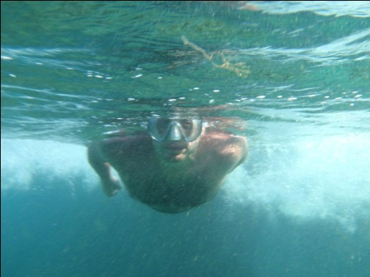
And Then
The hunt begins
Neutrinos!

Slide 11
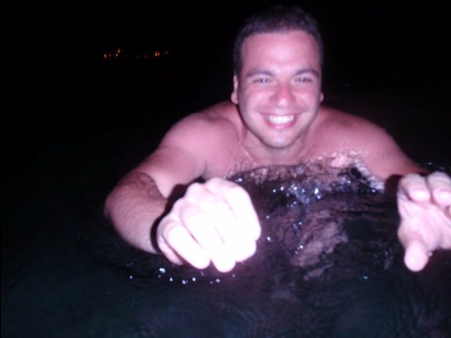
And we keep on searching
Even during the night
It ran away!

Slide 12
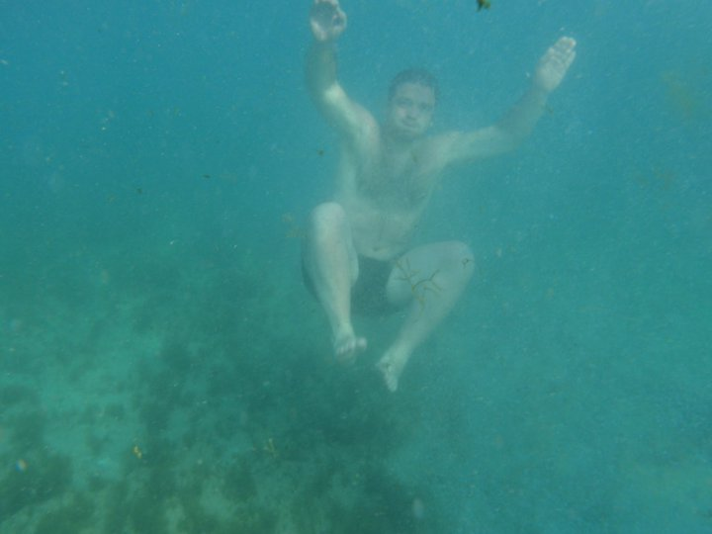
Finally
A 5 minutes break with the fish and shrimp
Got neutrinos?

Slide 13
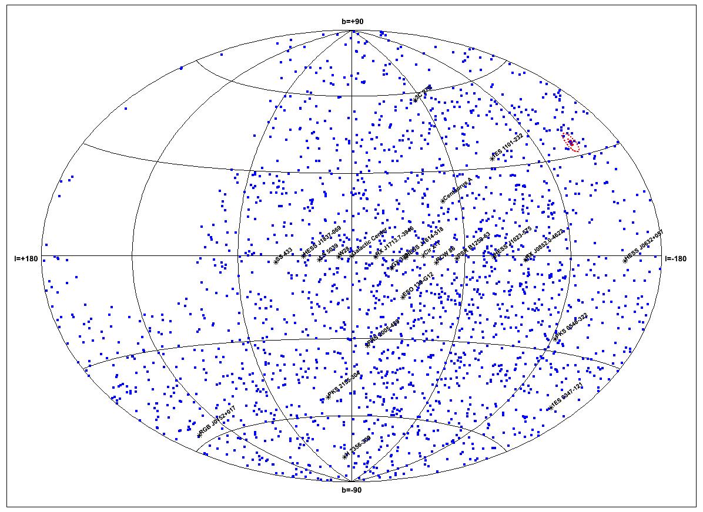
Physics with Antares
Neutrino astronomy
Neutrino oscillation
Diffuse fluxes
GRBs
Cosmic rays
Magnetic monopoles
Dark matter
Nuclearites
K-40 radioactivity
Water proprieties

Slide 14
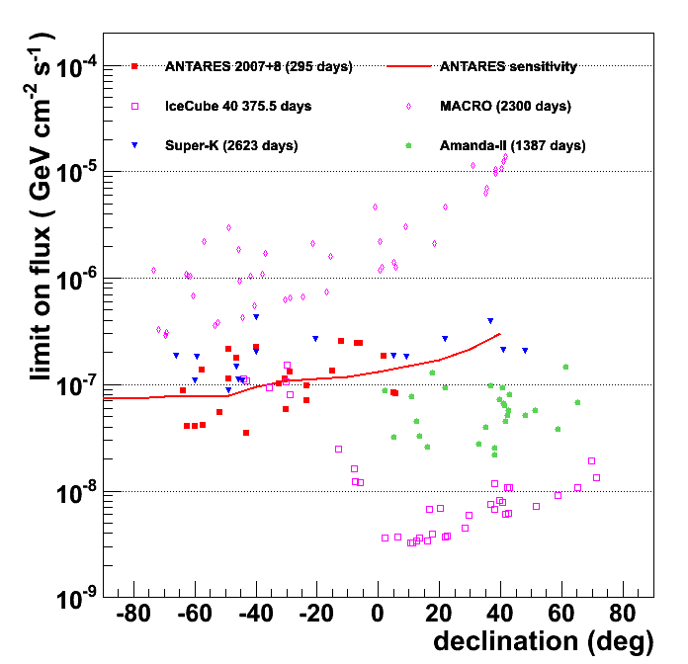
Physics with Antares
Neutrino astronomy
Neutrino oscillation
Diffuse fluxes
GRBs
Cosmic rays
Magnetic monopoles
Dark matter
Nuclearites
K-40 radioactivity
Water proprieties

Slide 15
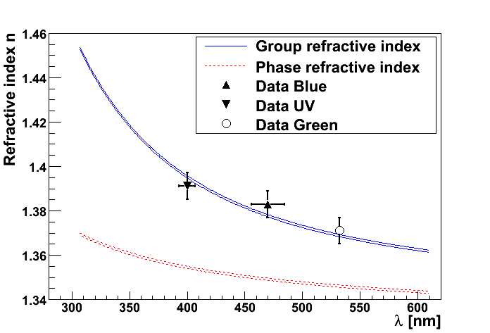
Physics with Antares
Neutrino astronomy
Neutrino oscillation
Diffuse fluxes
GRBs
Cosmic rays
Magnetic monopoles
Dark matter
Nuclearites
K-40 radioactivity
Water proprieties

Slide 16
DM Search With Antares
Point source analysis of the Sun and the Galactic center
Anisotropic analysis of the Galactic halo
Dwarf galaxies(high DM/Baryonic mass ratio)
Earth Center

Slide 17
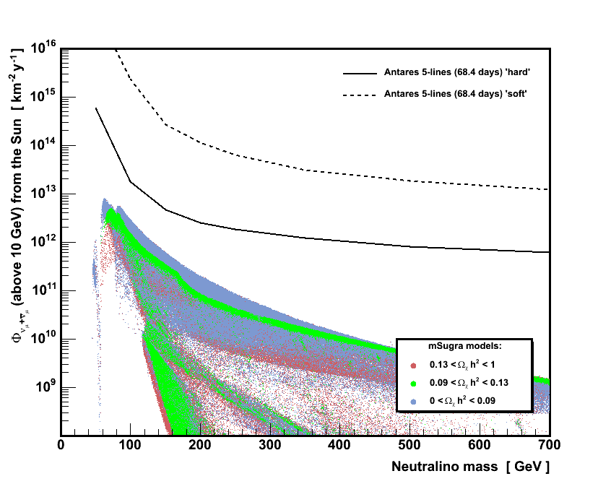
Previous DM results:
Search in the Sun
Differences between old and new analysis will be highlighted in the next slides

Slide 18
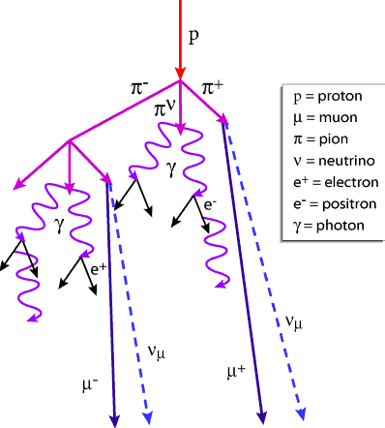
Searching for DM in the sun analysis
Data sample: 2008 data, which is equivalent to 73.5 of total data life time
Background noise consists of cosmic rays, hitting the earth atmosphere creating muons for down-going events and neutrinos for up-going events
The analysis will mostly focus on eliminating muons that are badly reconstructed as up-going and keeping the neutrinos at the end
A simple track reconstruction algorithm that does not take into account the detector’s dynamic geometry

Slide 19
Event Characteristics
Number of floors hit(trigger and reconstruction)
Number of detector lines hit
A Cherenkov cone like fit estimator
A bright point like fit estimator
Reconstructed Zenith of the muon
Reconstructed Azimuth of the muon
Sadly no information on the energy of the neutrino
Etc…

Slide 20
Cuts
Apply basic cuts:
Events that touch 5 floors or more
Events that touch 2 lines or more
Cut on Zenith, keep up-going events and remove down-going
Then with more complex cuts:
Tchi2: or quality of reconstruction as a muon generating a Cherenkov cone
Bchi2: Or quality of reconstructions as a bright point , a characteristic of an electron emitting light
Half Cone angle around the sun, which follows it during our data taking period

Slide 21
Dark Matter and Monte Carlo
Background noise:
With a Monte Carlo event generator we simulate our main background noise contributors (and secondary sources), atmospheric neutrinos and muons. And then run them through a simulation of our detector and the same reconstruction algorithm
Dark Matter:
With Wimpsim we can generate auto- annihilation of DM particles via model independent process for any DM mass we want, to obtain the differential flux of neutrinos at earth surface

Slide 22
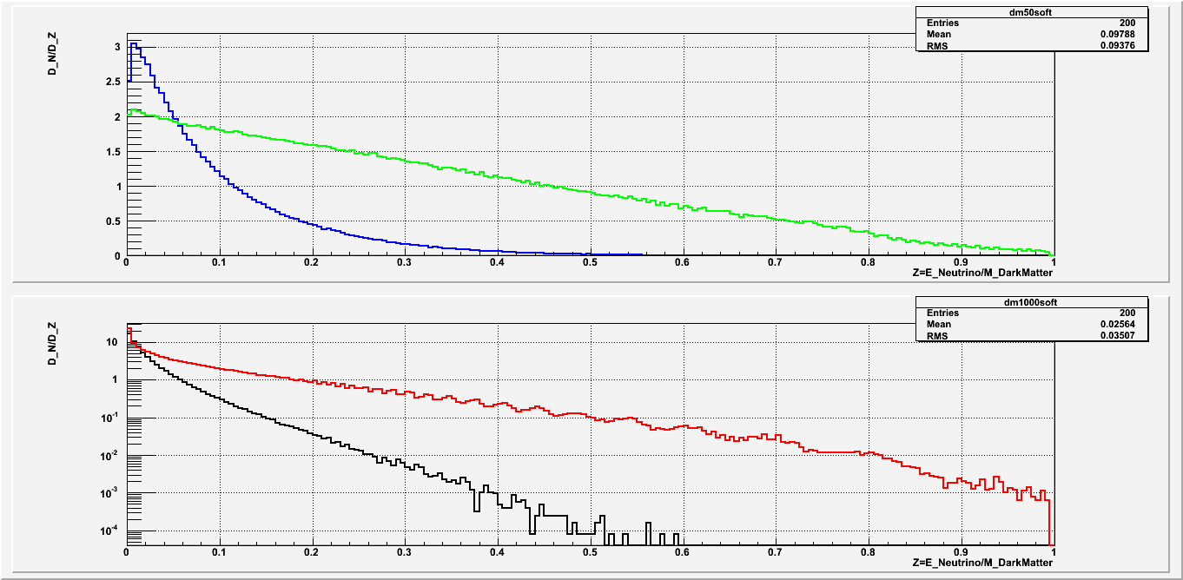
DM Flux and Decay channels
The following masses(GeV) of DM were chosen for the analysis: 50, 80.3, 100, 150, 200, 350, 500, 750, 1000
Two main decay channels: Hard (τ+τ-), and Soft (b+b-)
Linear scale:
50 GeV Hard
50 GeV Soft
Log scale:
1000 GeV Hard
1000 GeV Soft

Slide 23
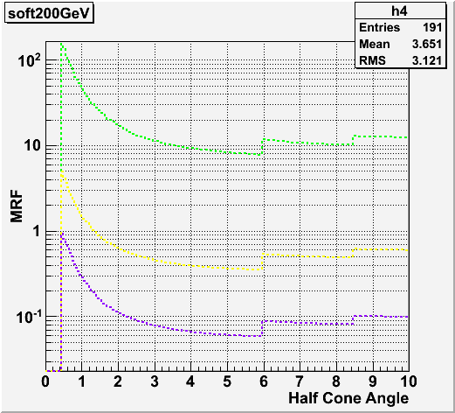
Cut optimization
We use a Model Rejection Factor method based on the Feldman-cousins method of rare events to optimize for best detector sensitivity
This MRF uses a function of three variables, which are the Track fit quality (TChi2), Bright point fit quality (Bchi2), and the Half-cone angle. In order to find the exact cut values for the best sensitivity and then apply them on the data set

Slide 24
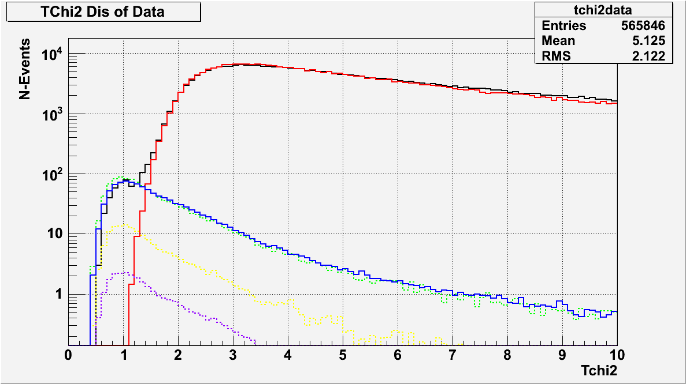
TCHI2
DATA
Muons
Atm Neutrinos
DM_1TeV Hard
DM_1TeV Soft
DM_200GeV Hard
TChi2<1.4

Slide 25
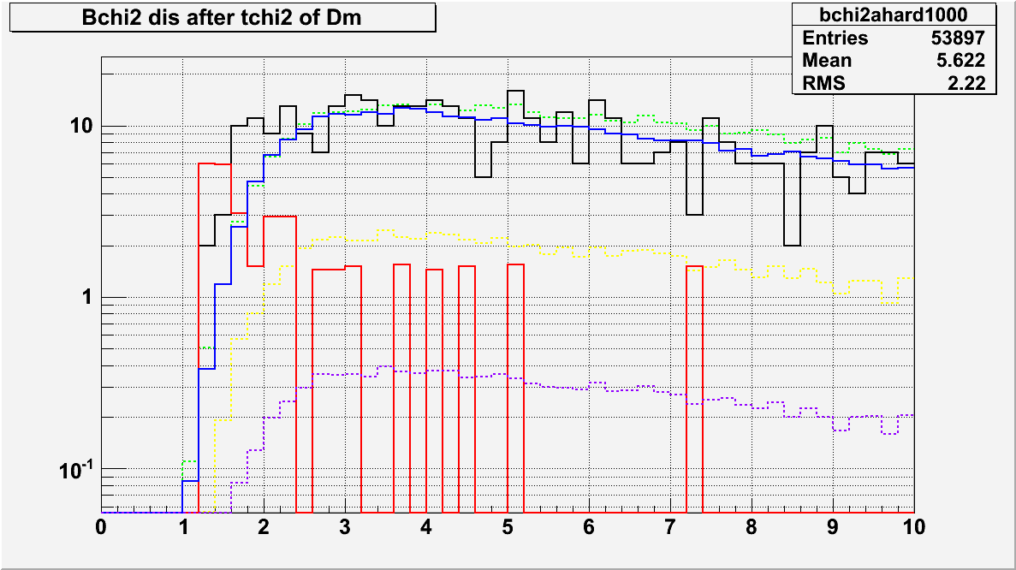
BCHI2
DATA
Muons
Atm Neutrinos
DM_1TeV Hard
DM_1TeV Soft
DM_200GeV Hard
BChi2>1.8

Slide 26
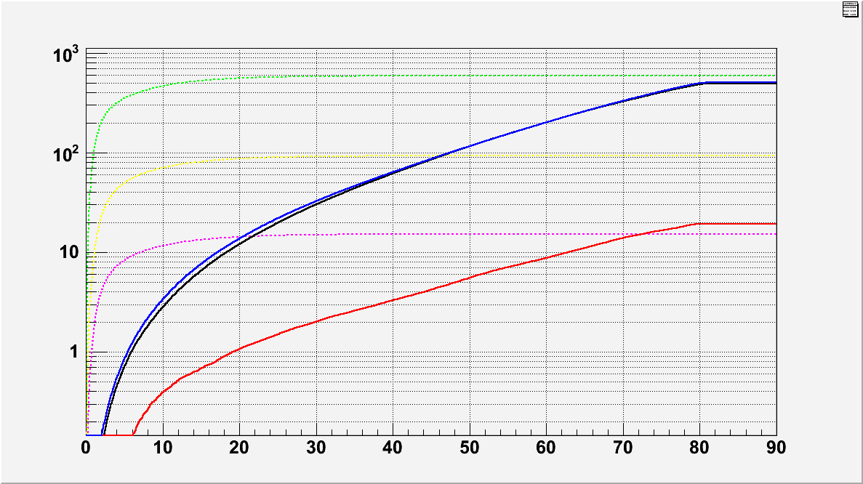
Half-Cone
Scrambled DATA
Muons
Atm Neutrinos
DM_1TeV Hard
DM_1TeV Soft
DM_200GeV Hard
Theta < 6.1 Degrees

Slide 27
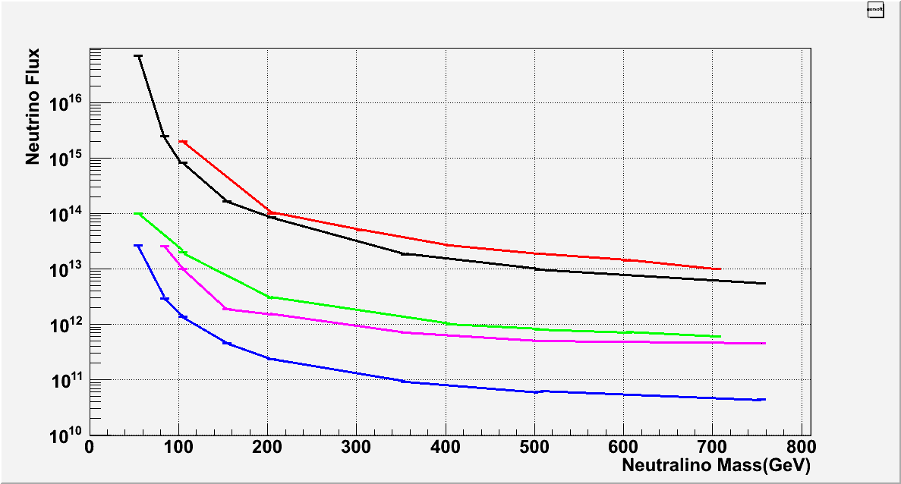
Results
Preliminary
2007 Data-Soft
2008 Data-Soft
2007 Data-Hard(W+W- decay channel)
2008 Data-hard(W+W- decay channel
2008 Data-hard(tau+tau- decay channel)

Slide 28
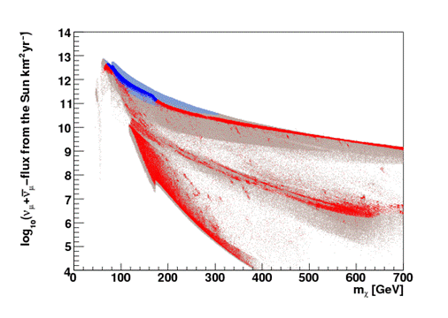
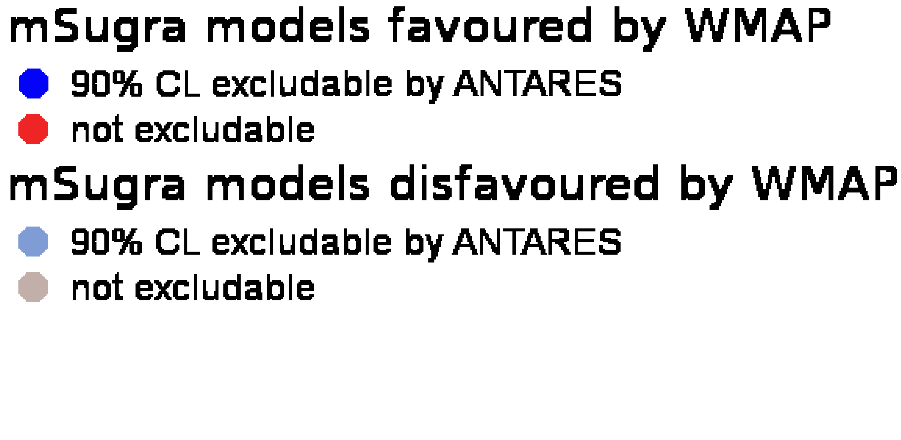
Projection
Life time of 3 years

Slide 29
Conclusions And Final Remarks
Same analysis is being finalized with more data, roughly three times the current life time, which should result in around 1.7 better sensitivity
And can be extended to include the Galactic Center, and Dwarf Galaxies
A parallel analysis using neural networks is in progress, and already showing promising results
Next step will include the switch to PDF’s and estimators instead of the simple binned method, and the use of a dedicated low energy reconstruction to optimize the analysis
Models with higher branching ration in the hard decay channel has more chance of detection

