Slide 1
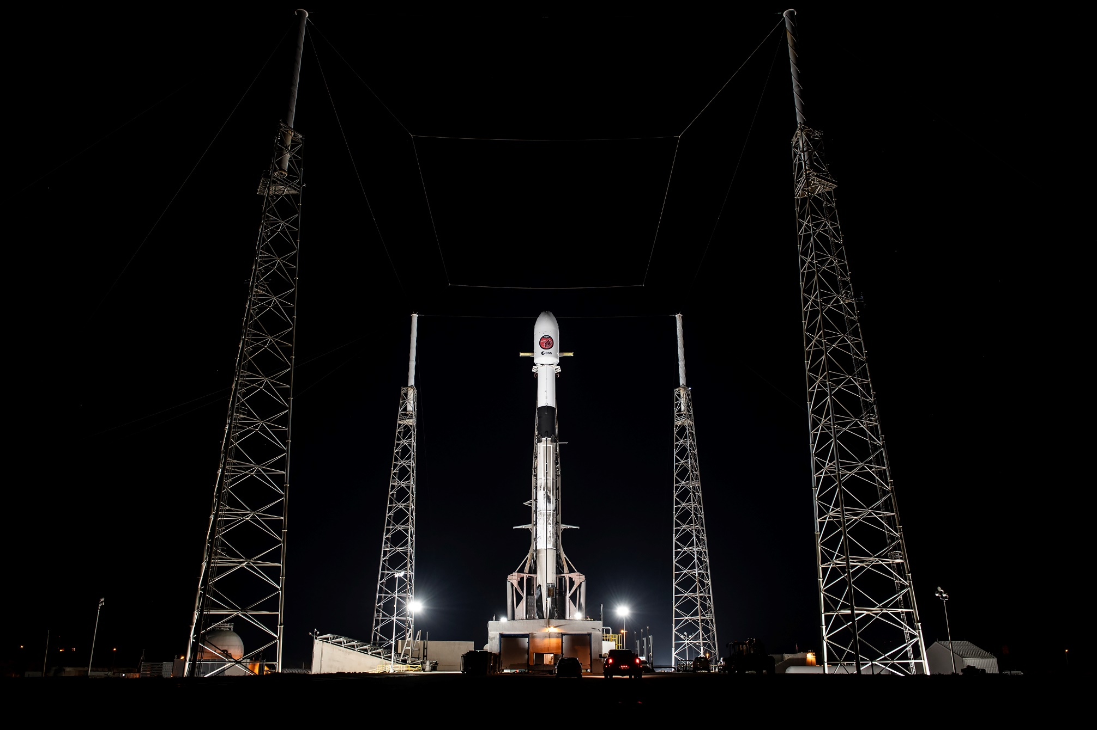

Reconstructing non-minimally coupled gravity
from cosmological data
and with the Euclid Collaboration
Martin Kunz
University of Geneva
with Anton Chudaykin,
Gen Ye and
Camille Bonvin

Slide 2
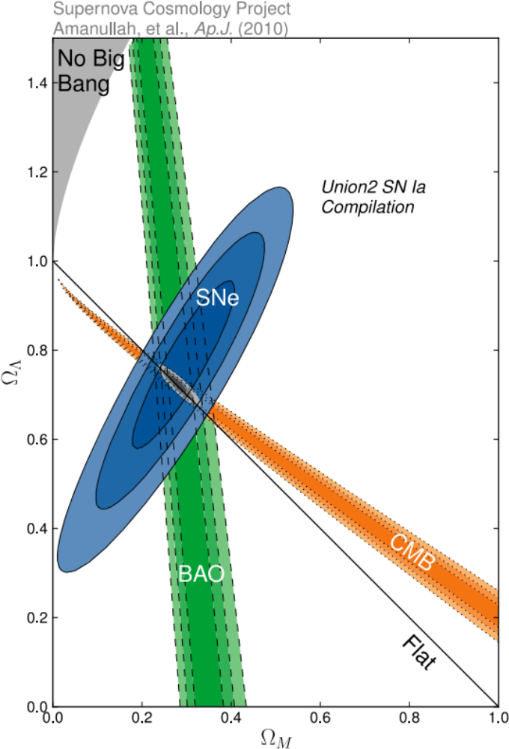
(Action) Dark Energy
Physics Nobel prize 2011:
"for the discovery of the accelerating expansion of the Universe through observations of distant supernovae”
GR: accelerating expansion if p < -ρ/3
Λ is unique natural extension (Lovelock) – should be there
we know that for Λ: p = -ρ
the data is (fairly) consistent with Λ
why look elsewhere?!
Because we can (test LCDM)
Because of issues and tensions
Amount of Λ: (p = -ρ → w = -1)
Amount of matter (p = 0 → w = 0)

Slide 3

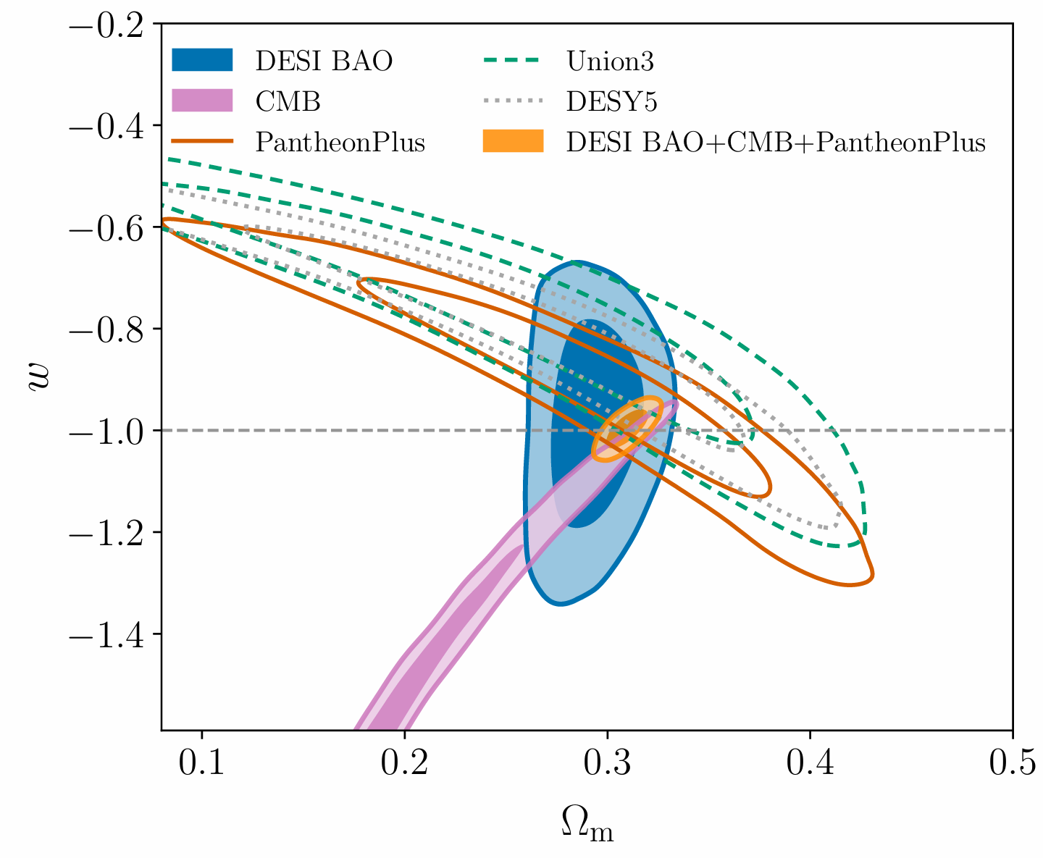
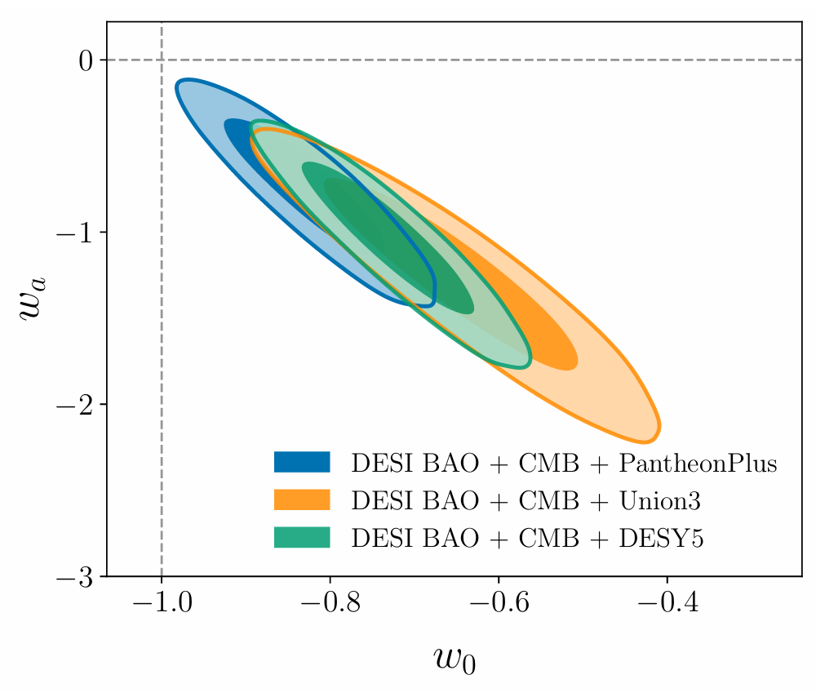
Constraints on a dark energy fluid
DESI collaboration, arXiv:2404.03002
But dark energy could evolve …
p = w ρ and w(a) = w₀ + (1-a) w_{a}
Λ : w₀ = -1 and w_{a} = 0
p = w ρ
(Ω_{DE} = 1-Ω_{m})
Notes:
Verification pipeline has FoM 500

Slide 4
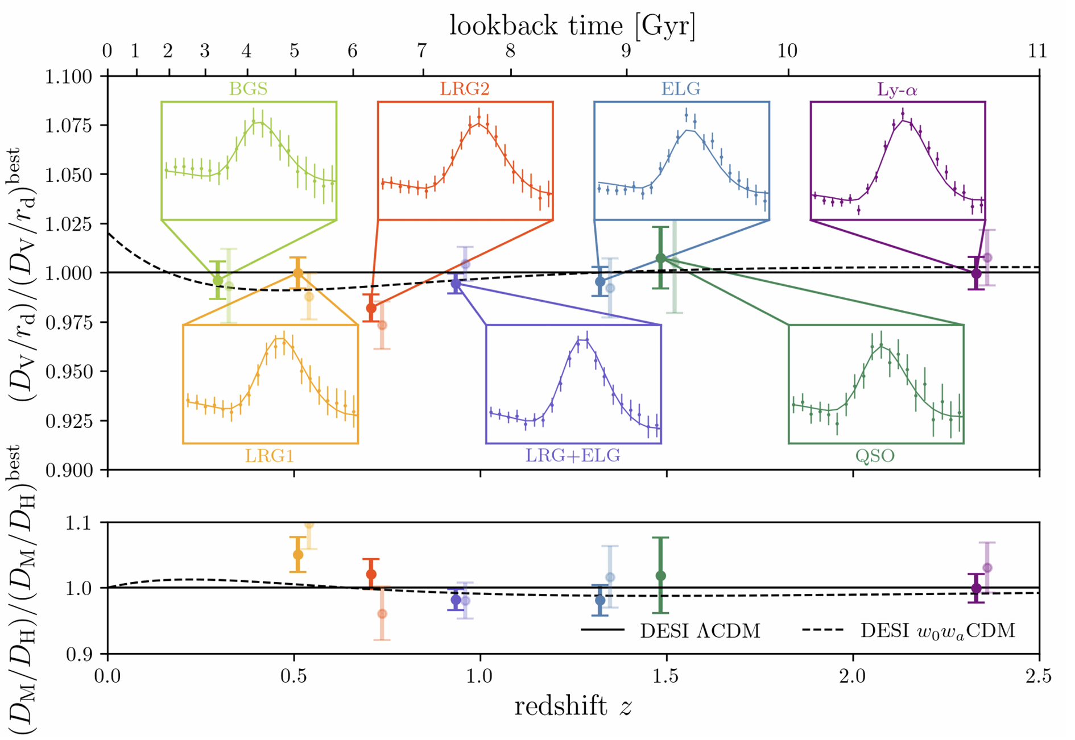
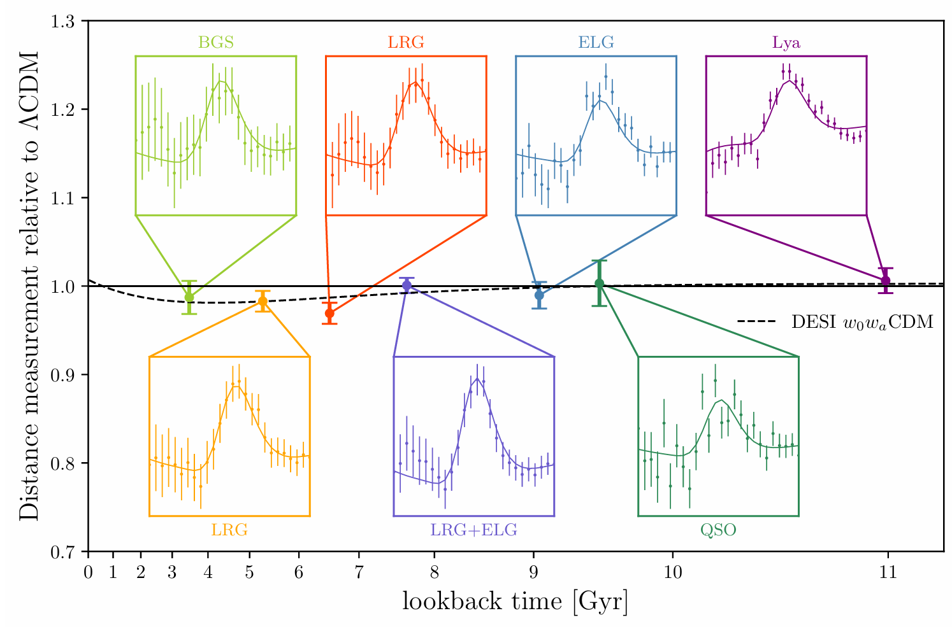
How does the DESI data look like?
Preference for w₀w_{a} model rests on few BAO points (specifically the two LRG data points).
Replacing those with older data at equal constraining power reduces deviation to 1.8σ (Chudaykin & MK, 2407.02558)
But evidence is contained not only in BAO but also in CMB and SN-Ia, corresponding to a shift in Ω_{m} if ΛCDM is assumed.
It also did not go away with more DESI data.
Conclusion: need more data! ☺
And should use consistent model.
(Arnaud de Mattia /
DESI collaboration)

Slide 5
How to model Dark Energy?
fundamental (action-based) models
constrain
physics
effective field theories (action-based)
not independent
more physical
more general
equivalent fluid description
phenomenological metric parameters
test for
deviations
cosmological observations

Slide 6
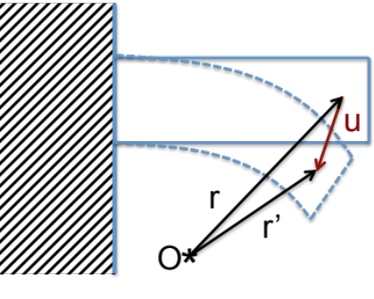
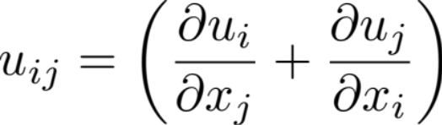
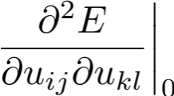
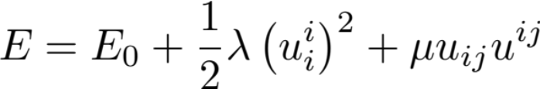
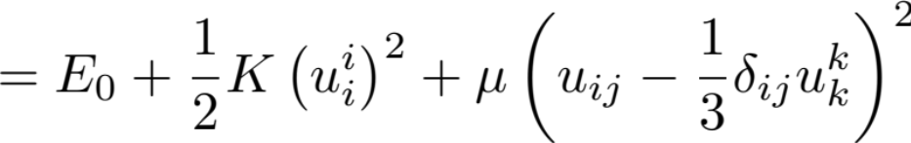
effective theory of elasticity
either build detailed model at molecular level
or effective model of deformations
effective d.o.f →
deformation tensor:
vanishes because of definition of ‘no deformation’
expand energy in
terms of deformation:
apply symmetry constraints: isotropy + homogeneity → λ₂ scalar const.
lessons:
valid only in a certain regime (eg. no big deformations, not crystals)
can be written in different ways, some better for physical interpretation

Slide 7
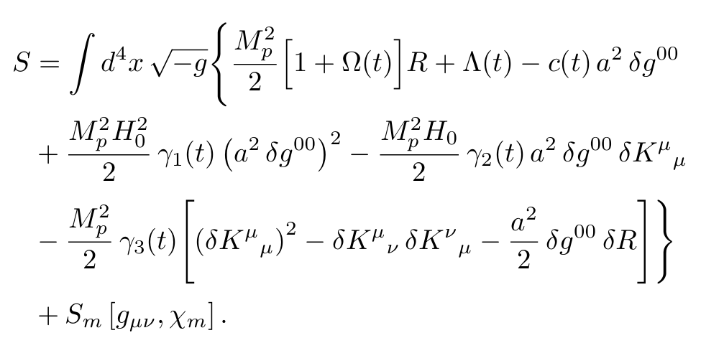
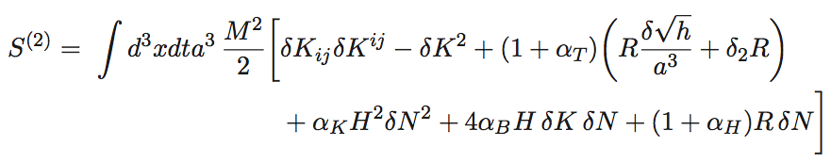
effective theory of dark energy
(Cheung et al, 2008; Gubitosi et al, 2013, Bloomfield et al 2013, …)
Some comments:
The two notations are effectively equivalent.
In the ‘top’ form, c(t) can be determined, Ω and Λ determine non-minimal coupling or the evolution of the Planck mass (α_{M}) and the background, w_{eff}
γ₁ is mostly related to the ‘kineticity’ α_{K} ~ 1/c_{s}²
γ₂ is mostly related to the ‘kinetic gravity braiding’ α_{B}
Models with non-zero α_{M} or α_{B} can cross w = -1
γ₃ and α_{T} are proportional and determine the speed of gravitational waves, but GW170817 places strong constraints; we set them to zero.
Extensions are possible but strongly constrained by stability.
An alternative notation is (Bellini & Sawicki 2014, Gleyzes et al 2015)
Notes:
h is determinant of space-space part of metric (ADM split)
eft of inflation: as no matter can remove part by going to Einstein frame, but here this doesn’t work as things just get moved to matter side

Slide 8
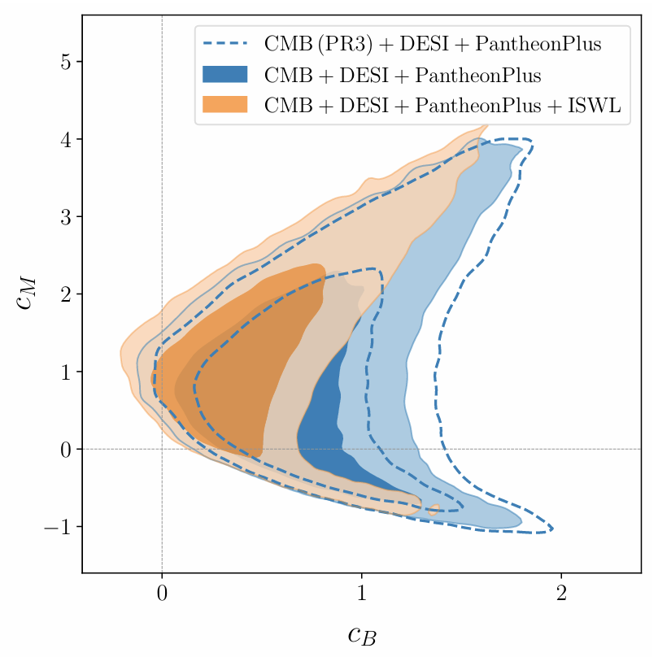
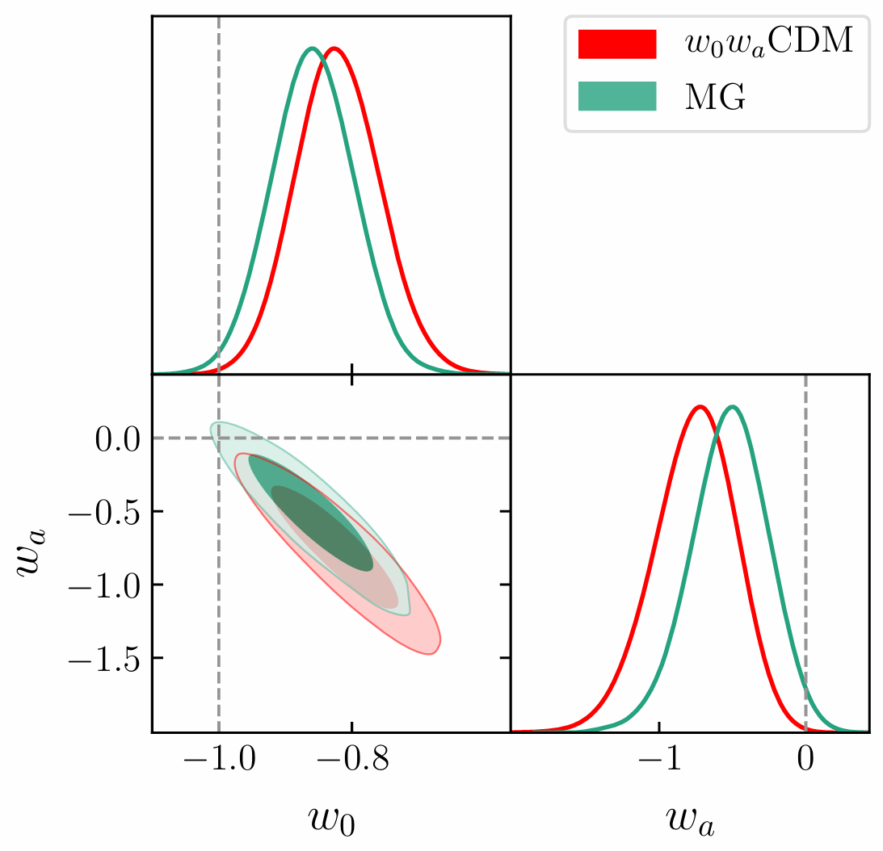
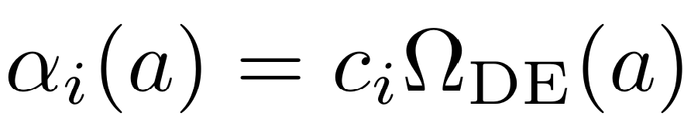
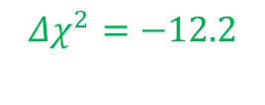
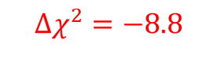
Using a consistent model
Chudaykin+, arXiv:2503.09893
$$Δχ^{2}=−8.8$$
$$Δχ^{2}=−12.2$$
arXiv:2404.03002
(Chudaykin, MK, arXiv:2407.02558)
Notes:
ISWL (temperature-lensing ‘bispectrum’) is good to constrain braiding

Slide 9
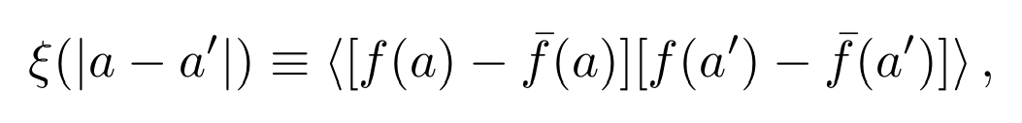
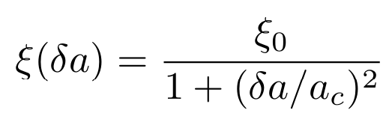
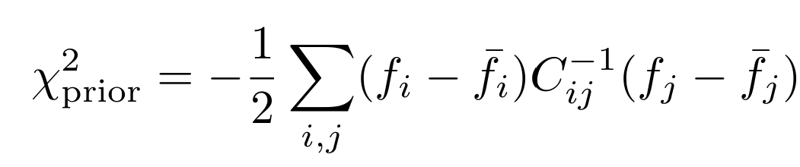
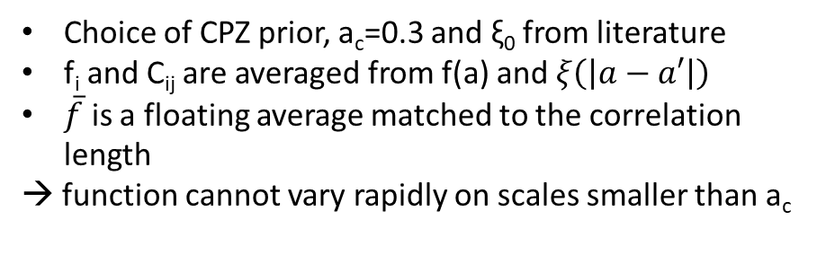
What is the right evolution for the α_{i} ?
We don’t know, but it might be important (constant w vs w₀/w_{a})
→ Use a flexible and smooth scheme like a spline interpolation with many knots
Constraints are not very strong, and bins can be strongly (anti-)correlated.
We want to avoid spurious oscillations that blow up the uncertainty band.
Introduce a correlation function that limits the expected function space
‘CPZ prior’
Choice of CPZ prior, a_{c}=0.3 and ξ₀ from literature
f_{i} and C_{ij} are averaged from f(a) and $ξ\left(\left|a−a′\right|\right)$
$\overline{f}$ is a floating average matched to the correlation length
→ function cannot vary rapidly on scales smaller than a_{c}
Notes:
Smooth since we need up to second derivatives

Slide 10
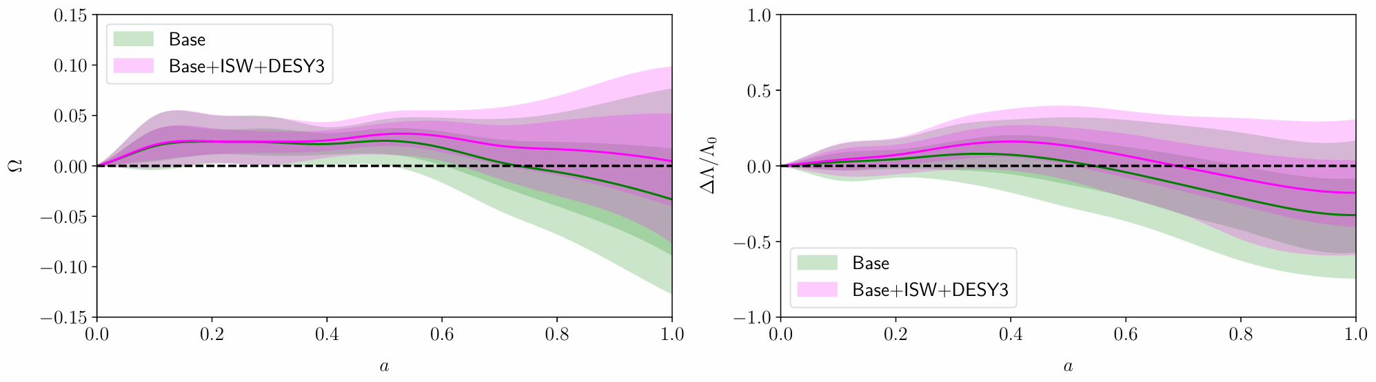
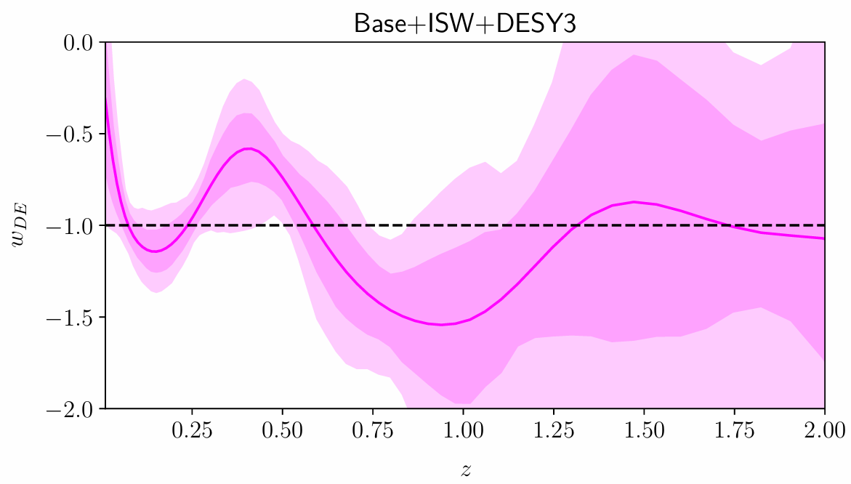
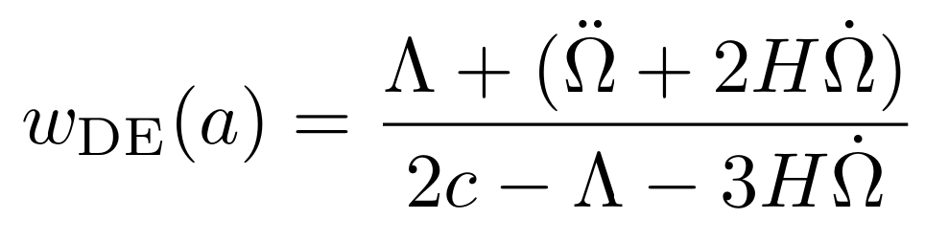
Constraining non-minimal coupling
Base: CMB + BAO + SNIa ; DESY3 is 3x2pt w/ linear scale cuts
Ye, Chudaykin, Bonvin, MK, arXiv:2605.12415
“background” function
a = 1/(1+z)
Functions are fixed to zero at a=0.
fixed in early universe
fixed in early universe
non-minimal coupling function
Non-minimal coupling is positive (2.8σ), probably to allow for phantom-crossing.
The background evolution depends non-trivially on these functions, but we can compute w.
Need c > 0 for stability
→ Cannot cross if Ω is constant
Also, clustering and lensing are weaker than in GR for Ω > 0
Notes:
Mostly DESY3 adds the constraints here (maybe since only one additional dof), we use linear scale cuts

Slide 11
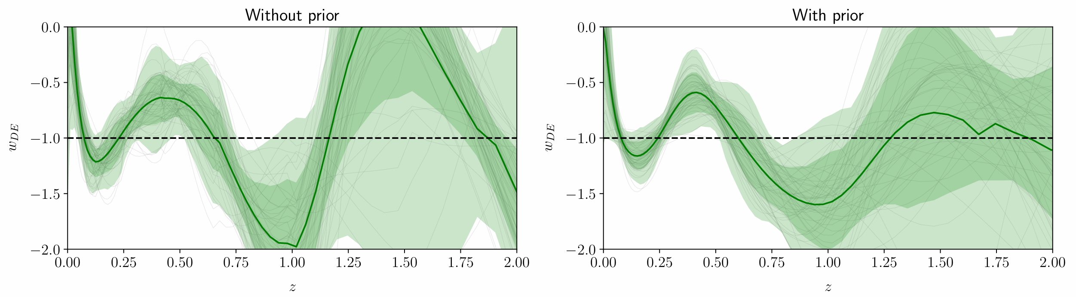
Impact of smoothness prior
Does the smoothness prior actually make the results smoother?
Could it be even smoother?
Could we set the parameters by including them as free parameters?
Other methods to reduce spurious oscillations?

Slide 12
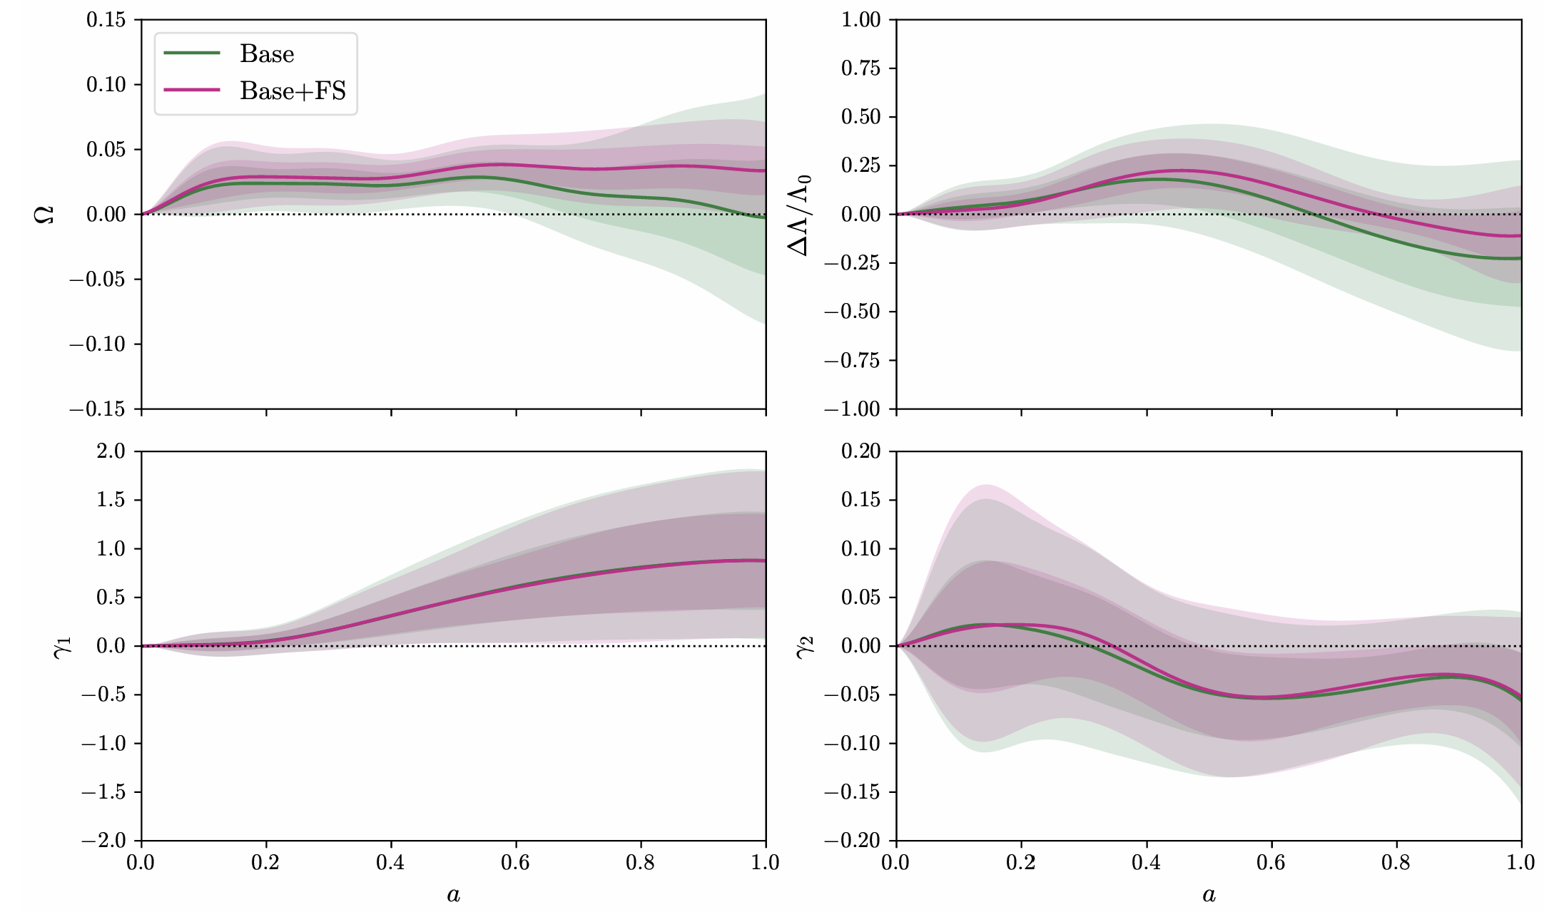
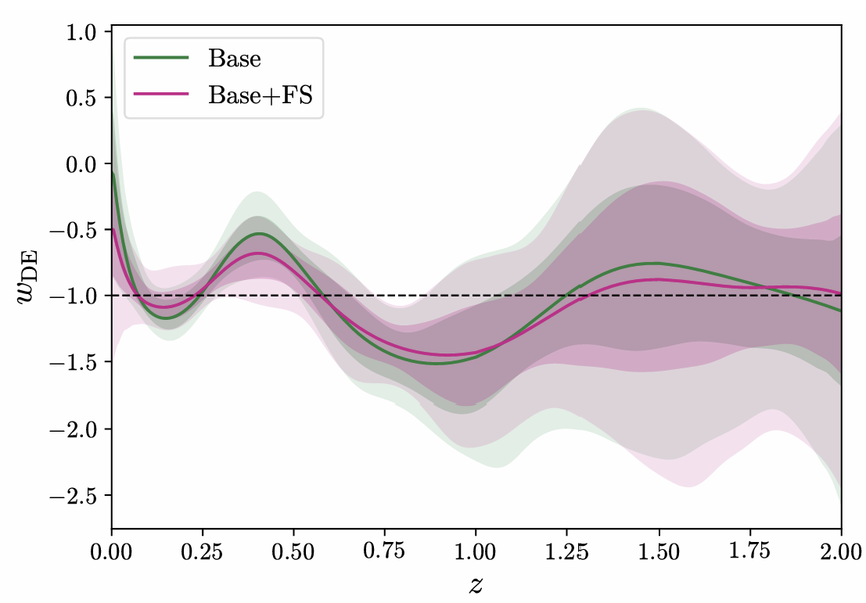
Varying more EFT functions
Ongoing / preliminary
Horndeski with luminal GW; Ye, Chudaykin, Bonvin, me + Silvestri group
(Maria Luisa Gallavotti, Stan Verhoeve, Dani de Boe)
‘Base’ is now the previously extended data set (purple).
No significant change in Ω and Λ visible w/o FS data.
Kineticity is badly constrained.
The DESI DR1 full matter P_{l}(k) shape for l=0,2,4 (FS) reduces error bars on Ω and Λ.
“background”
non-minimal coupling
kineticity – difficult to constrain
braiding
derived function
Notes:
See notes in obsidian

Slide 13
And so?
The incredibly simple ΛCDM model provides a good description of what we observe in the Universe.
But theorists think that the cosmological constant Λ has to be ‘too simple’.
We have been looking for more than two decades for a signal of new physics.
And maybe now we start to see such a signal – but more data is needed to be sure.
Luckily, the next decade will literally flood us with data.

Slide 14
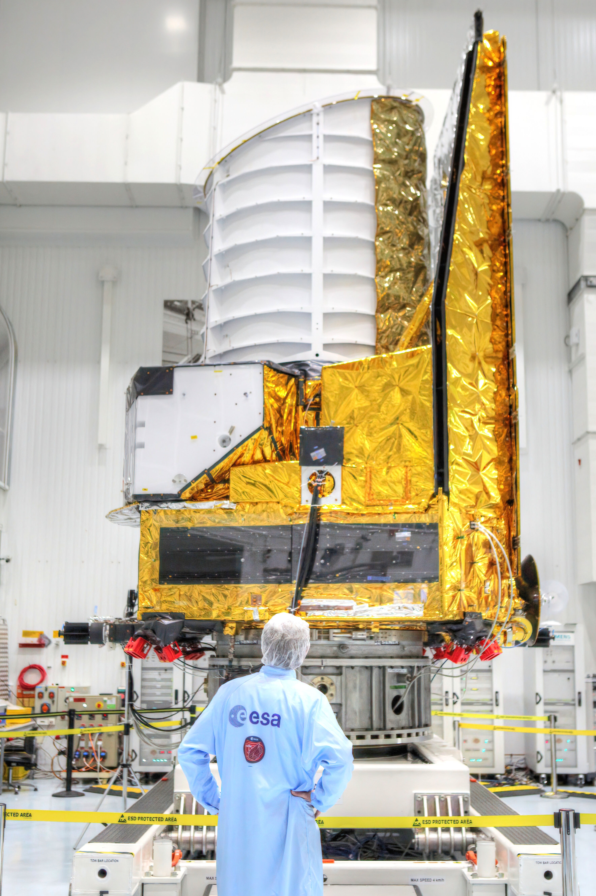
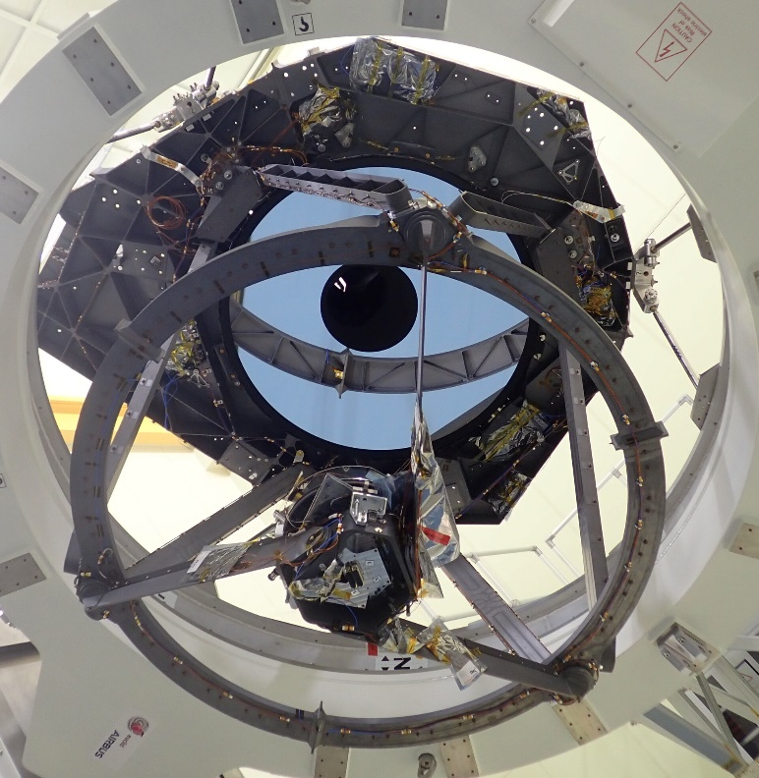
Euclid, an ESA M-class mission
Ca 4.7m tall, 3.7m wide
1988kg launch mass
1.2m primary mirror
Near-infrared & optical instruments
Launch: July 1st, 2023 on SpaceX Falcon 9
Daily data rate of ca 100GB compressed data
Nominal mission duration of 6 years, extension possible.
© ESA / Euclid Consortium / NASA / TAS-I
‘eye of Euclid’ ©Airbus

Slide 15
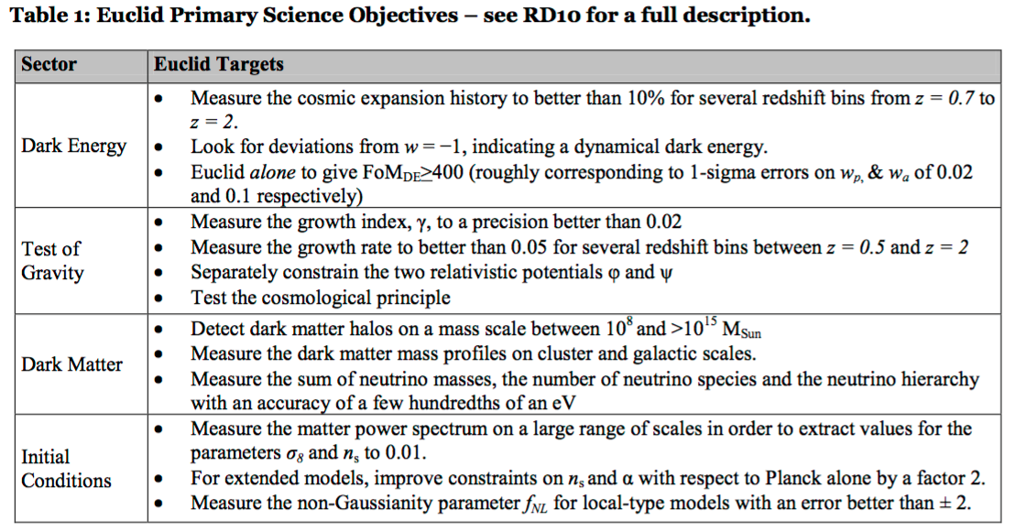
Euclid main science objectives
DE/MG

Slide 16
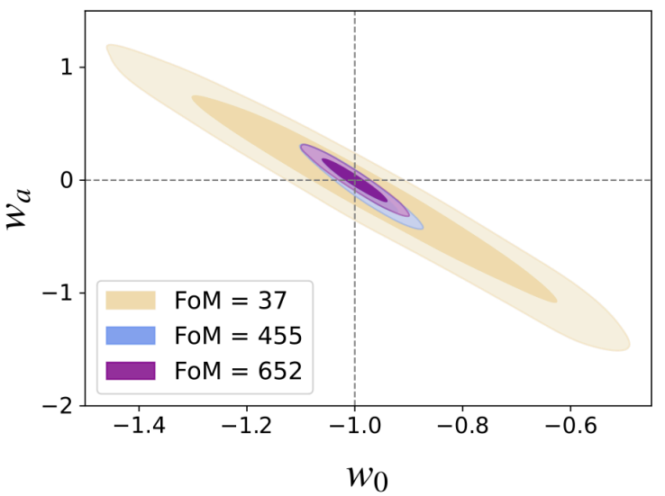
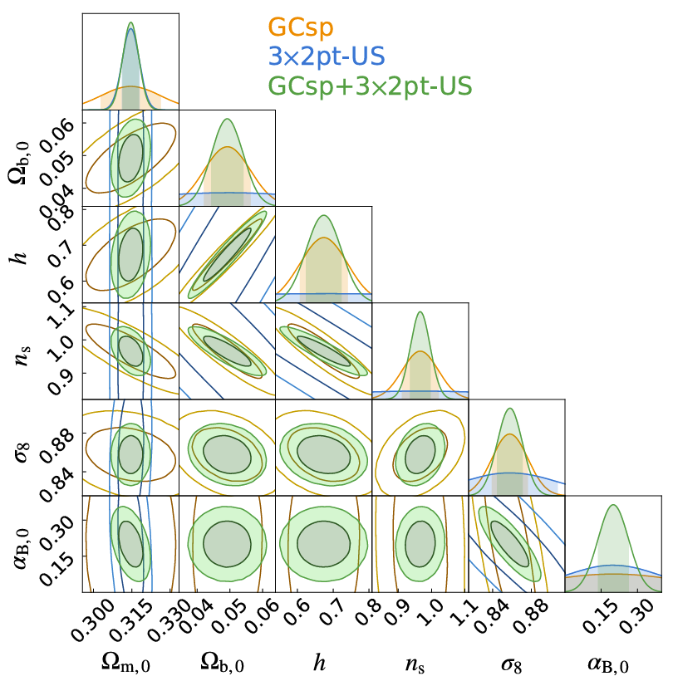
Euclid forecasts
Euclid. I. Overview of the Euclid mission, arXiv:2405.13491
Euclid Collaboration, arXiv:2506.03008
arXiv:2404.03002
α_{B} = 0.2 +/- 0.06 ; α_{M} = 0 (fixed)
Currently α_{B} = 0.45 +0.17/-0.41 (but α_{M} varying)
Notes:
Verification pipeline has FoM 500

Slide 17

Conclusions
Do we see first hints of a dynamical dark energy? We need more data to be sure, but also good methodological approaches.
Euclid is producing copious amounts of data, with DR1 releases in 11/2026 (Foundation) and 06/2027 (Cosmology).
Decades of development, but still many things to think about :
  Fast inference methods (including emulators), flexible ‘parametrisations’ and generally AI/ML methods are important
  Is this the ‘best’ way to constrain DE/MG?
  Simply finding stuff in the data deluge is hard – there is just too much data ☺
Much is still to be discovered, and much new data is coming!
DR1 Foundation: November 12
→ In a week!

Slide 18

Thank you!

