Slide 1
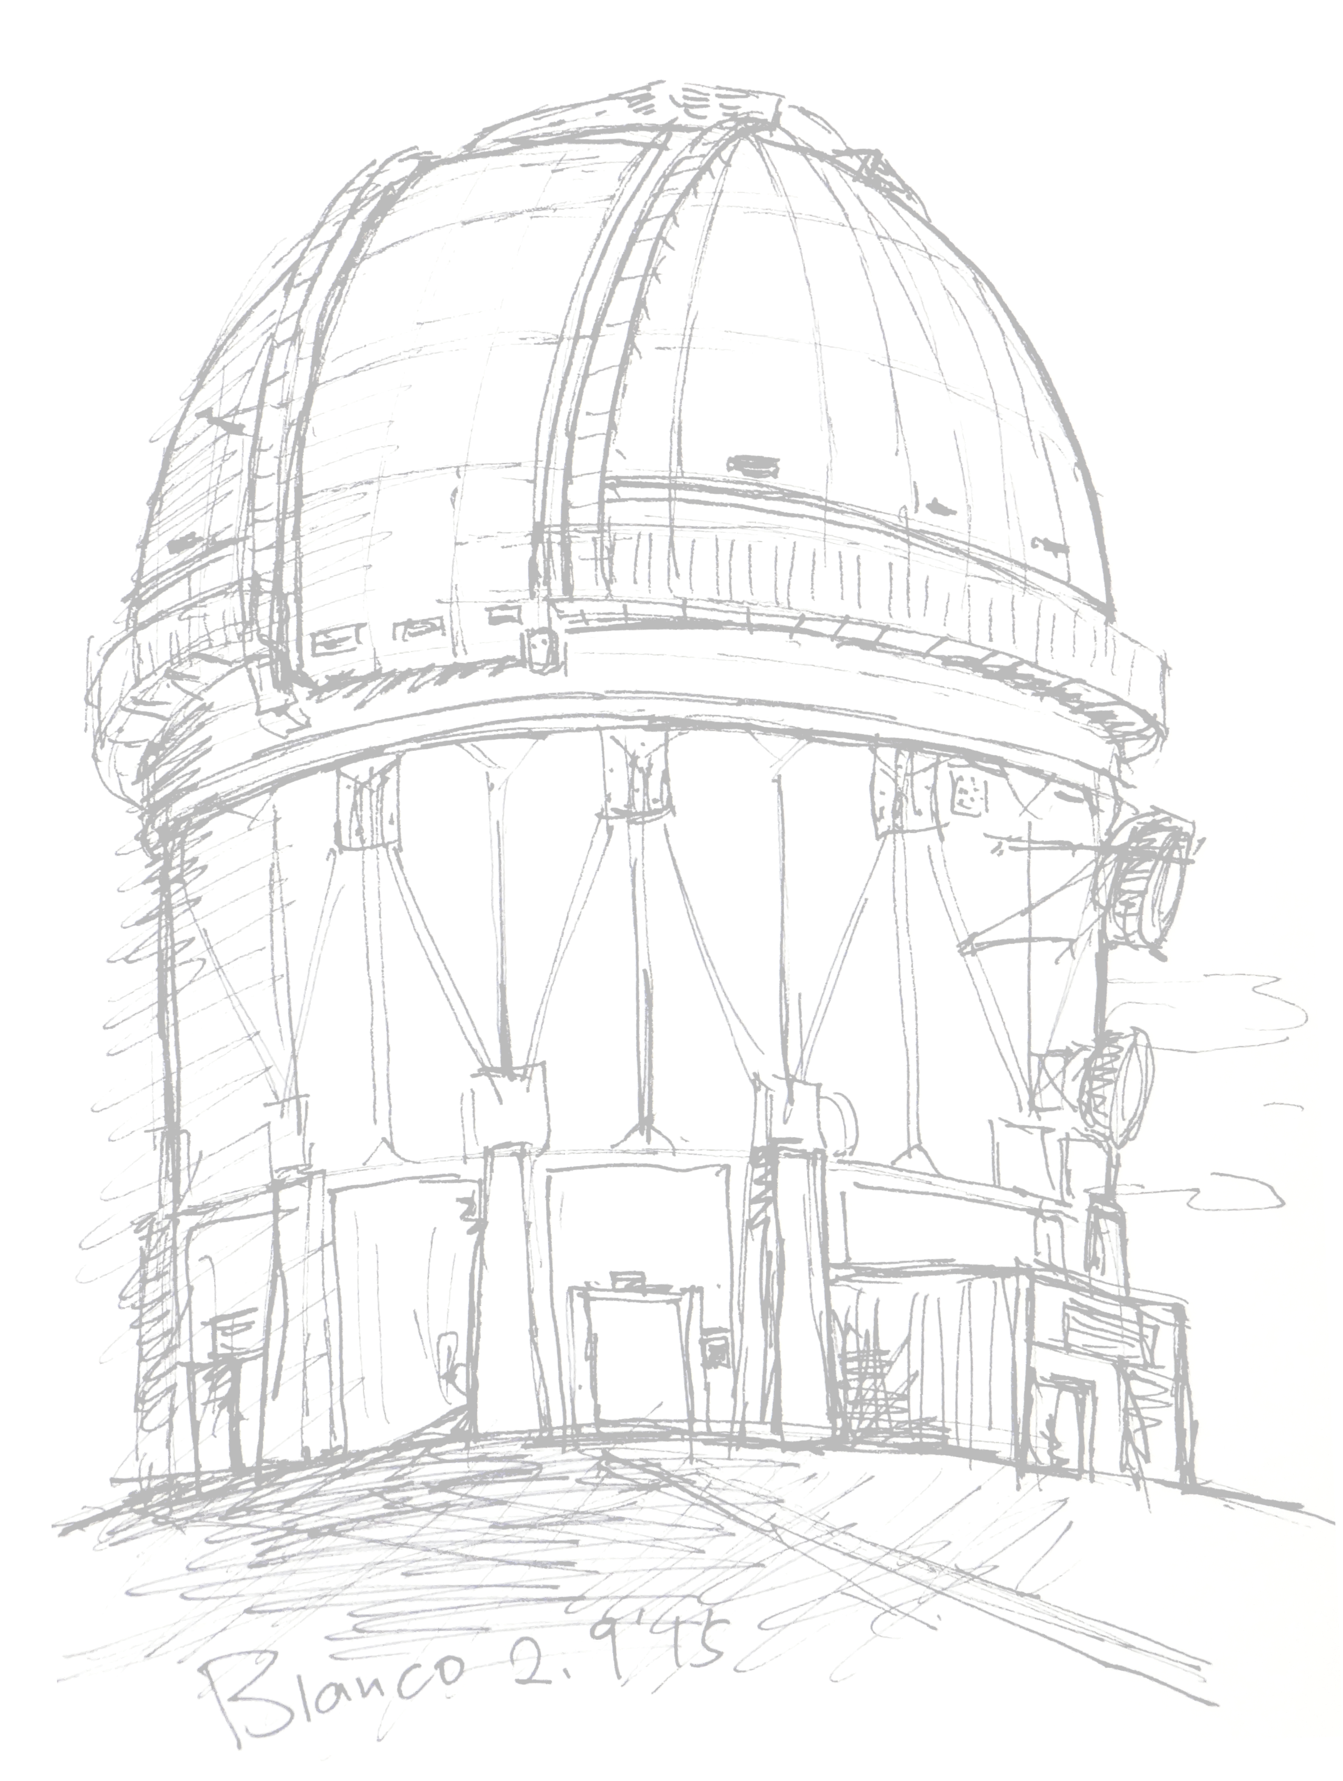


The Dark Energy Survey- Ten years of WL: what did we learn?
William d’Assignies ,
postdoc Royal Observatory Edinburgh,
on behalf of the Dark Energy Survey Collaboration
Presentation using material from M. Crocce, G. Bernstein, C. Chang, E. Legnani
@ C. Chang

Slide 2
The Dark Energy Survey- Ten years of WL: what did we learn?
DES 3x2pt:
  survey- data- probe
Modelling of 3x2pt
  Cosmology, astrophysics, observational effects
Position samples:
  Different samples from y1 to y6, and their problems…
Source samples:
  how to estimate shear from shapes
So what did we learn?
1

Slide 3
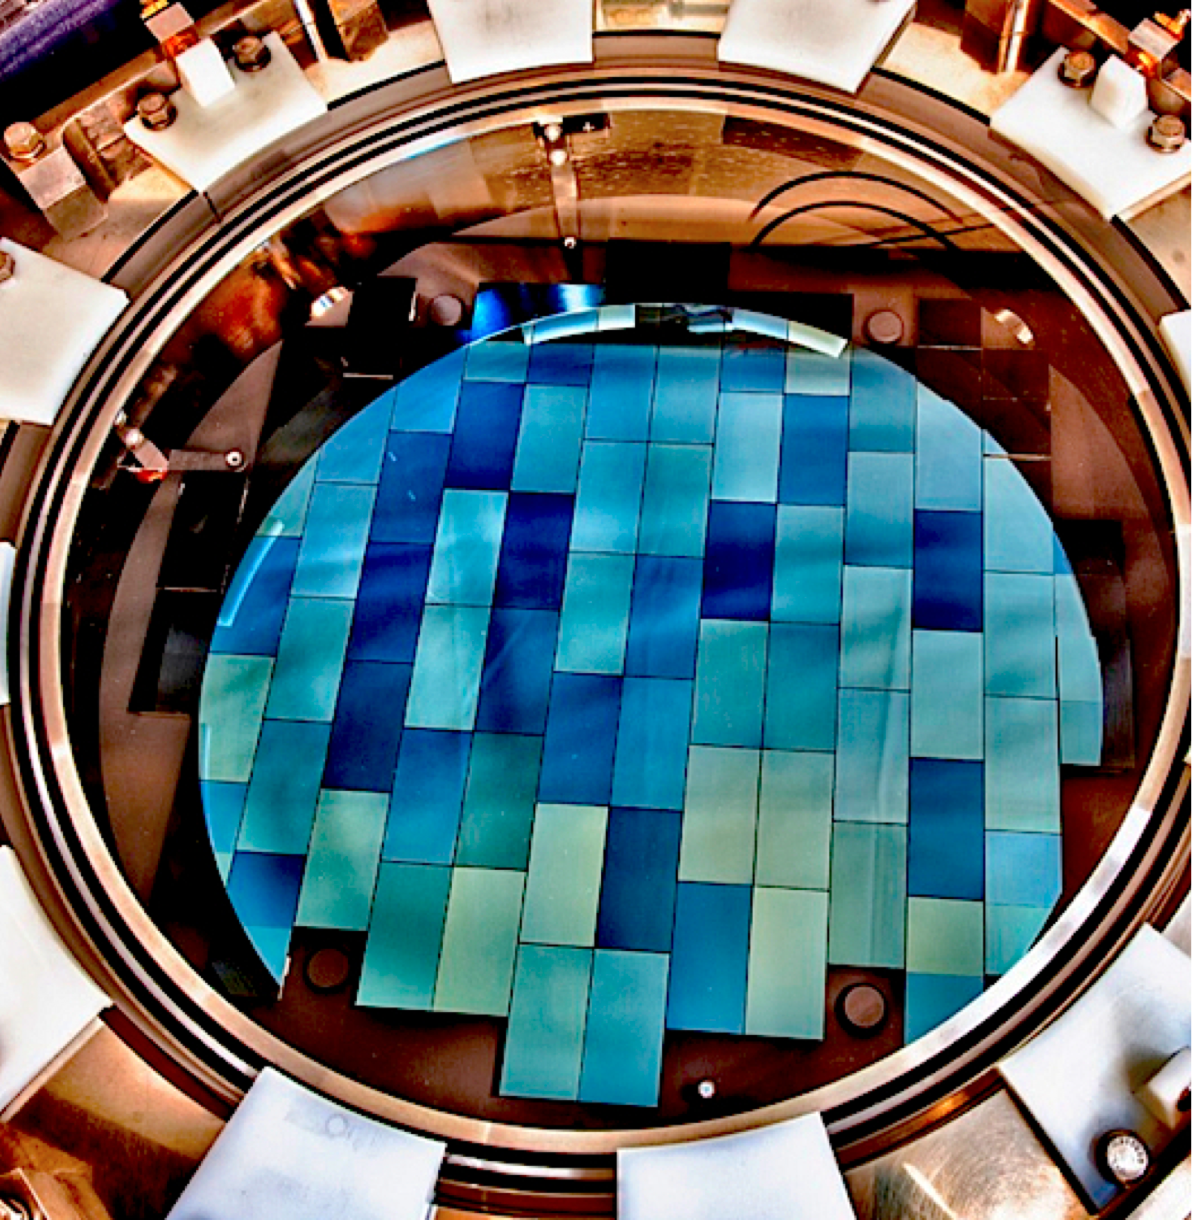
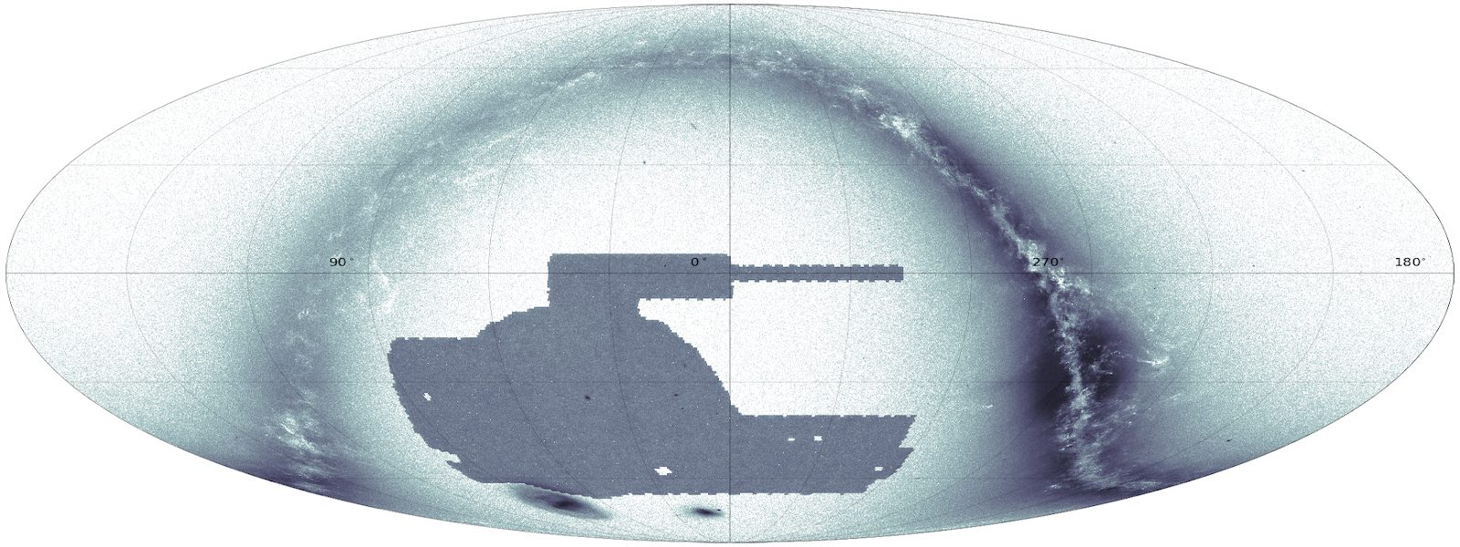
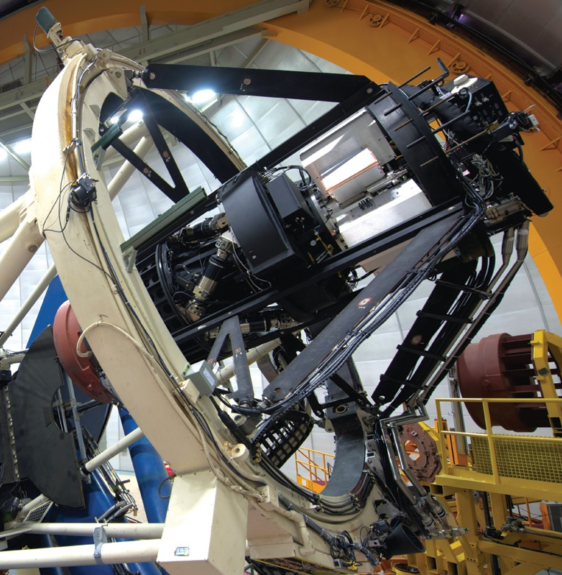
The Dark Energy Survey (DES)
William d’Assignies
570 Megapixel camera for the Blanco 4m telescope in Chile.
Observed in 5 imaging bands (grizY) : photometric redshifts
Full survey 758 nights (2013-19)
Wide field: 5000 sq. deg. with limiting depth i <~ 24
Deep field: 30 sq. deg. with near-IR YJHK bands, 10x wide field depth
Image Credit: CosmoHub, Port d'Informació Científica (PIC)
1
Notes:
DES Deep Fields aimed for approximately 25–30 visits per filter per season per field in the Deep Fields.
Over 5 seasons, that amounts to roughly:
~100–150 total passes per filter per field.
The actual number varied by field and weather conditions.
DR1 (Y3) reached 23.3 at 10 S/N at 2’’ aperture in i-band while DR2 (Y6) reaches 23.8 (but a bit deeper effective depth), in all close to 40,000 exposures have been coadded in the wide fields. By the end of the survey the footprint was scanned roughly ten times in each band and images are co-added. I was large-scale structure coordinator from 2017 until last year and now I’m cosmology coordinator. DESY3 publications were mostly submitted by summer 2021 and next summer we expect to finalise DESY6. NOTICE there is a 4 yrs lag between data being taken and publications submission!

Slide 4
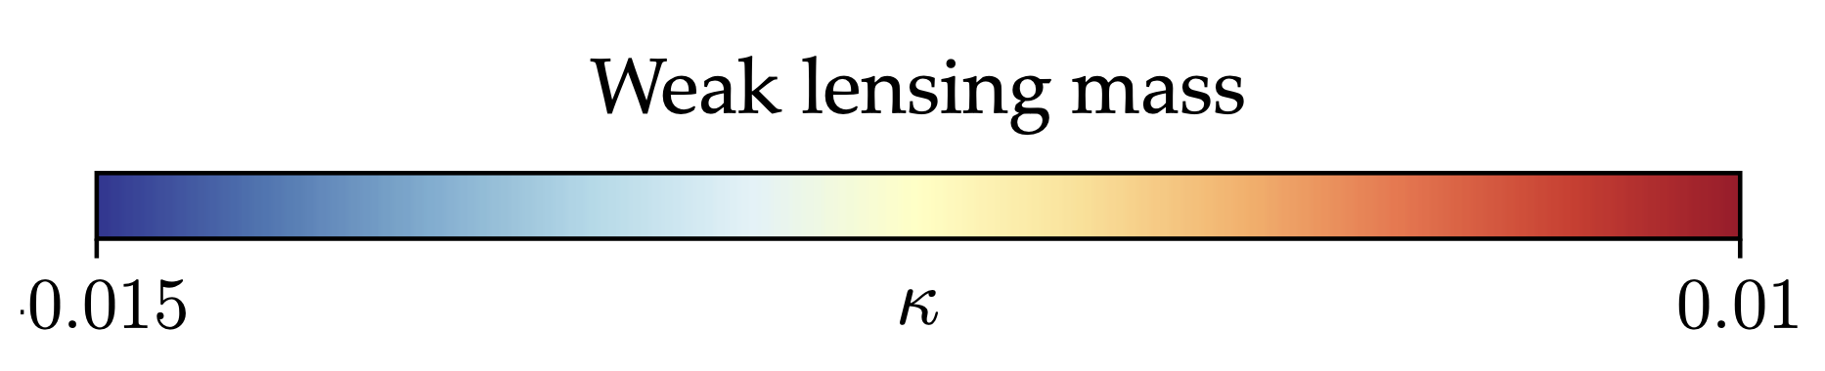
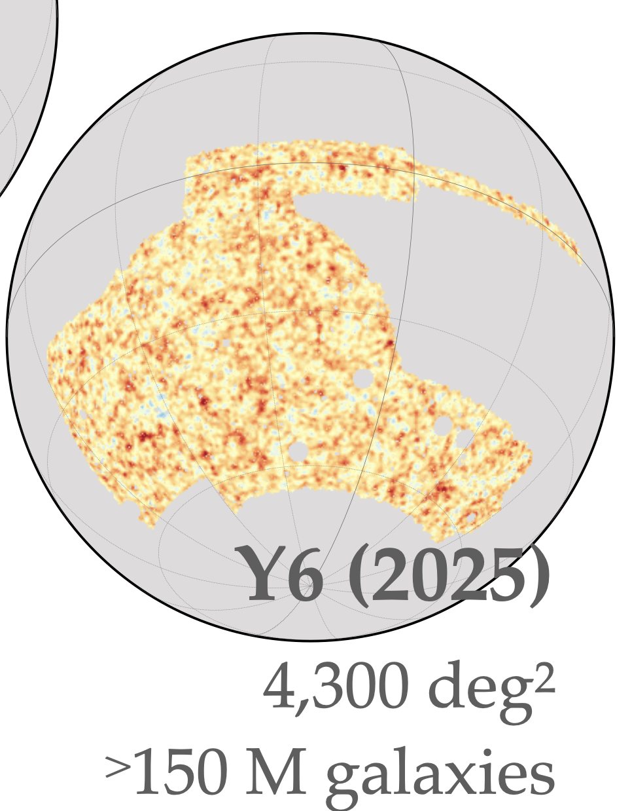
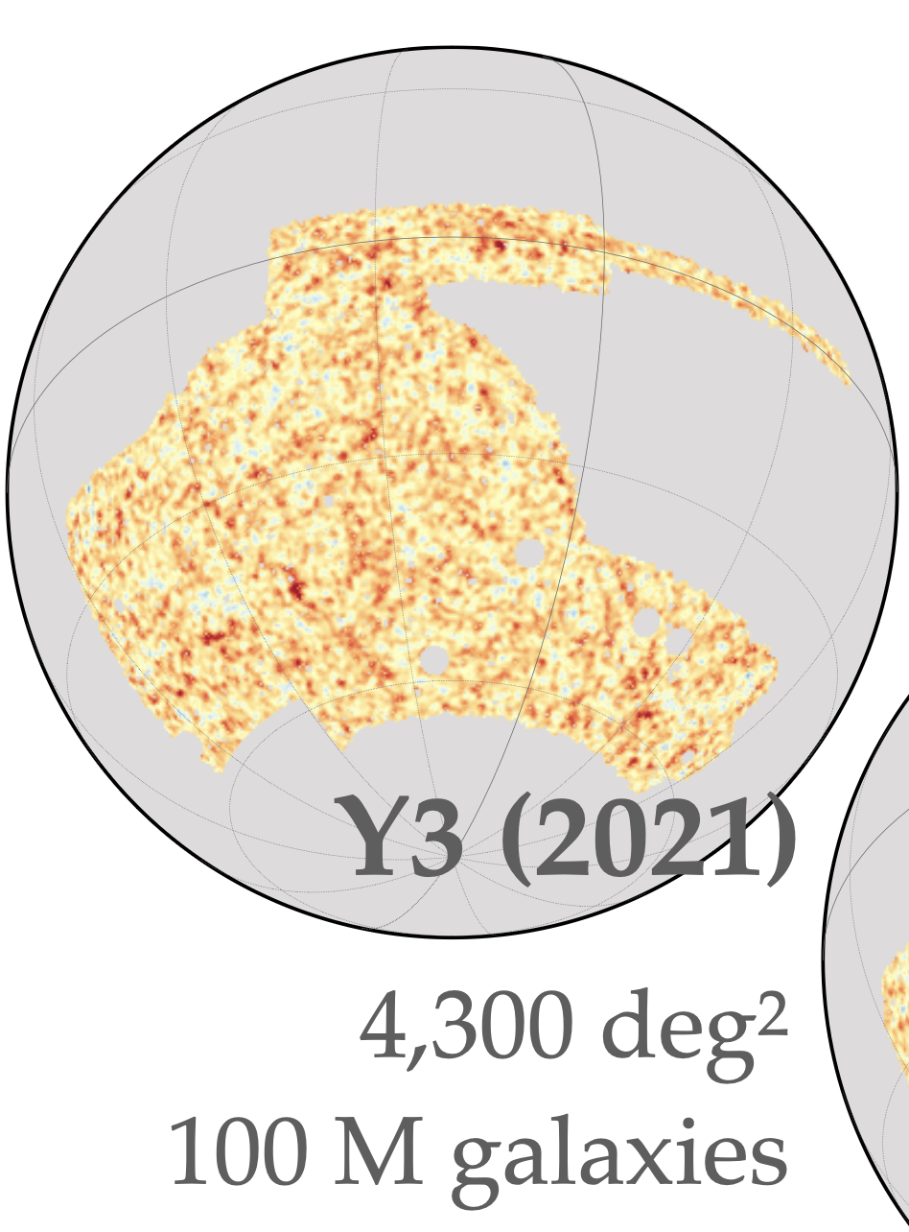
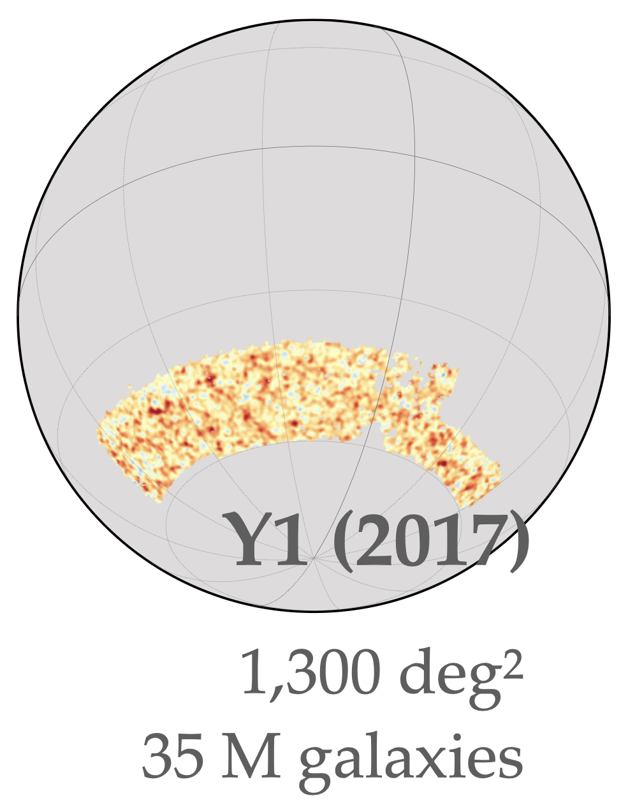
From DES Year-1 to DES Year-6
William d’Assignies
DESY1 (1300 deg2/2017) to DESY3 (4300 deg2/2020) to DESY6 (4300 deg2/2025)
DR2 final dataset, DES Collaboration 2021 (arxiv 2101.05765)
DR2 Gold Catalogue for DES Y6 has ~ 543 M galaxies + 145 M stars
2
Notes:
Note how the timeline is more or less fixed at 4 years … independently of the dataset .. DES is quite complex as a collaboration, pushing in developing state of the art in different probes.

Slide 5
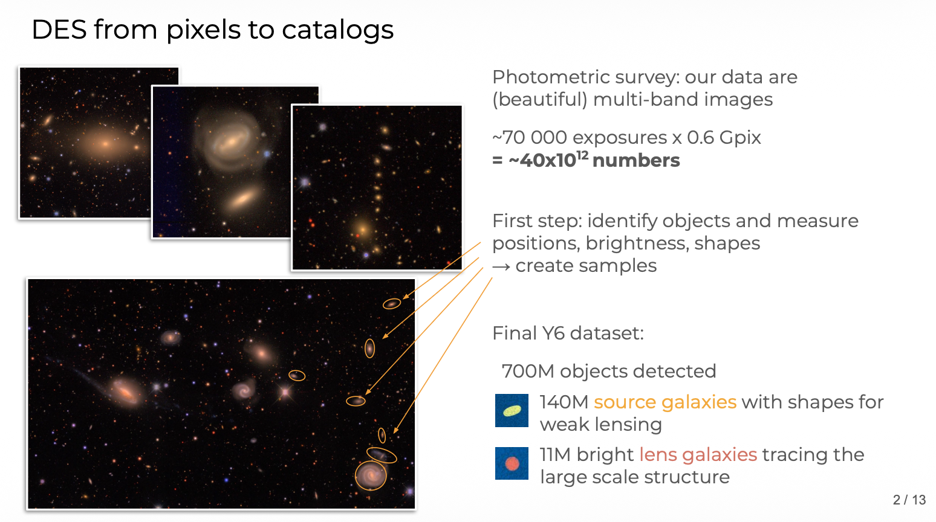
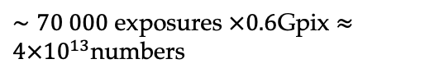
DES data: from images to catalogs
William d’Assignies
Photometric survey: our data are (beautiful) multi-band images
$∼70 000$ exposures $×0.6$Gpix $≈4×{10}^{13}$numbers
Sextractor we identify 700 millions of object (550 millions of galaxies)
3
Notes:
Note how the timeline is more or less fixed at 4 years … independently of the dataset .. DES is quite complex as a collaboration, pushing in developing state of the art in different probes.

Slide 6

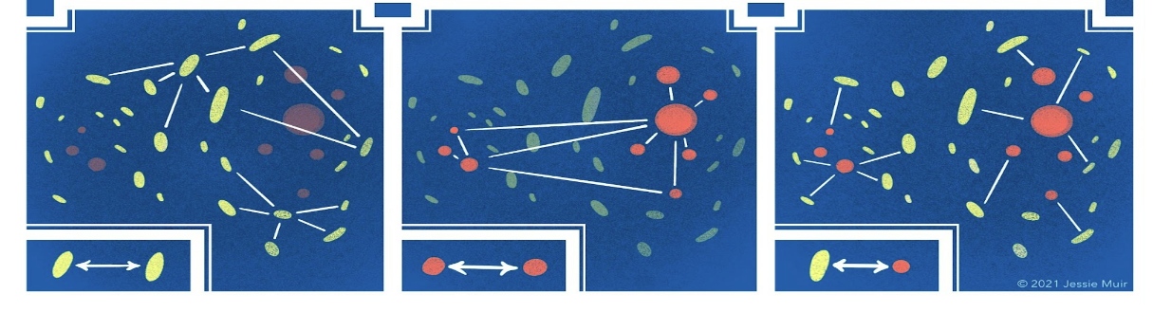
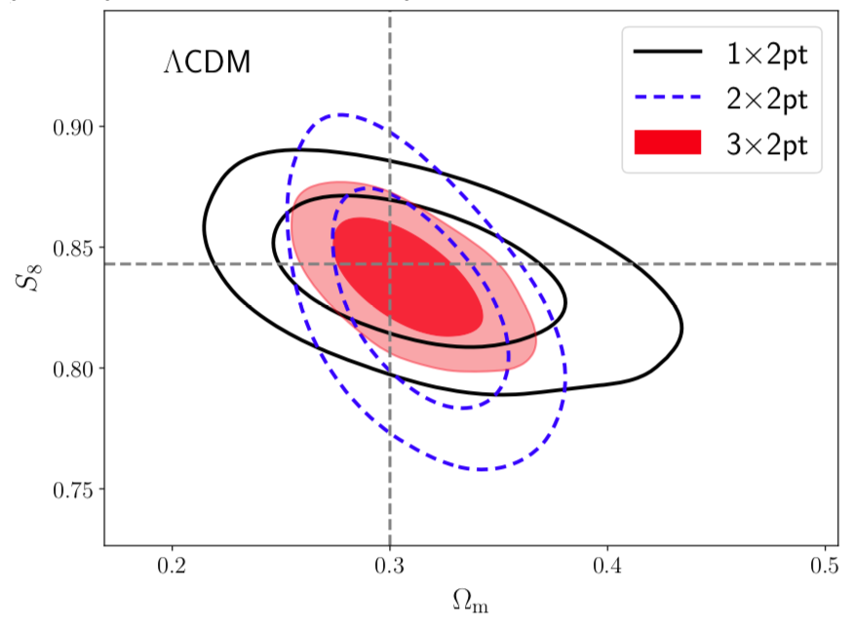
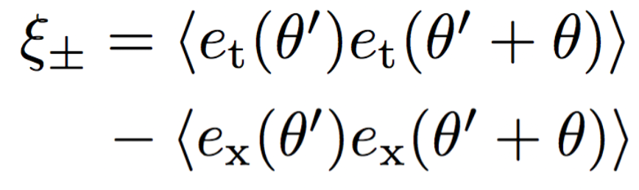


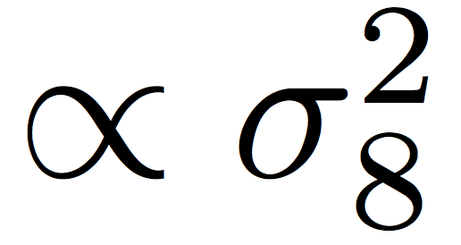
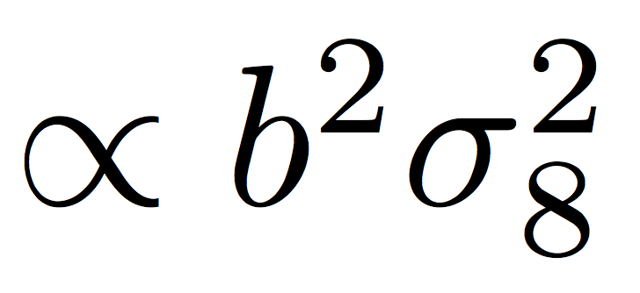
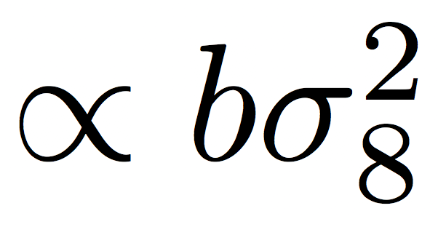
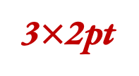
William d’Assignies
  DES and the 3x2pt probe
cosmic shear
galaxy clustering
galaxy-galaxy lensing
correlation in the shapes of (source) galaxies
correlation in the positions of (lens) galaxies
correlation between positions of the lenses and shapes of the sources
3$×$2pt
4
Notes:
This is now the scope of lensing surveys, in our case we measure clustering and galaxy-galaxy lensing, and combining those two we can solve for bias and constrain cosmology. We can also constrain cosmology just with cosmic shear. And of course we can go one step further and combine all.

Slide 7
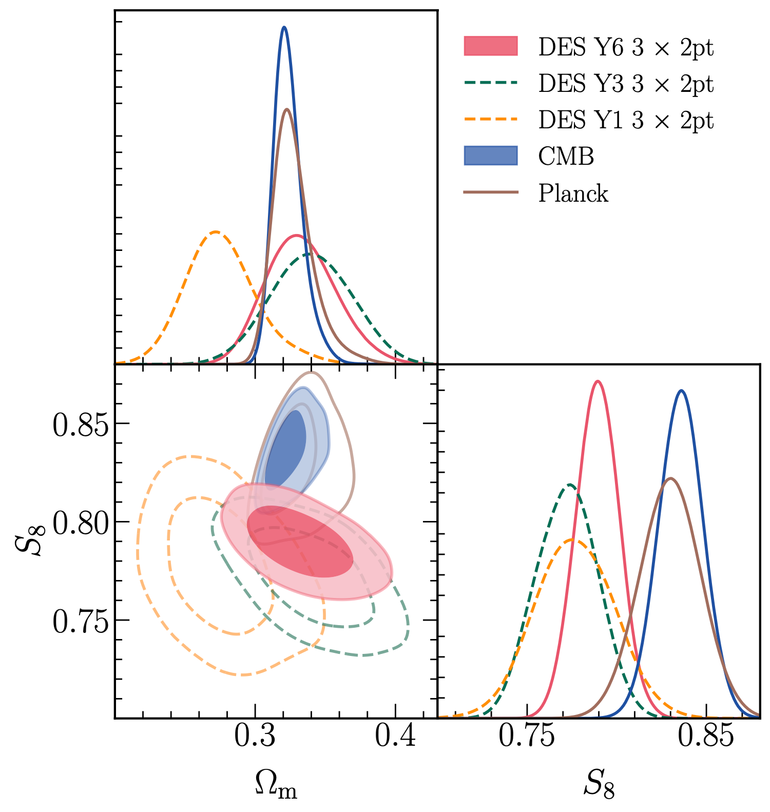
DES 3x2pt vs CMB across releases
William d’Assignies
Between Y1, Y3, and Y6, increase area, depth, but also methodology improvements.
Yet S₈ constraints are consistent across releases, Y3 vs Y6.
With respect to Planck, the difference has decreased Y6 vs Y3.
5

Slide 8
DES 3x2pt:
  survey- data- probe
Modelling of 3x2pt
  Cosmology, astrophysics, observational effects
Position samples:
  Different samples from y1 to y6, and their problems…
Source samples:
  how to estimate shear from shapes
So what did we learn?

Slide 9
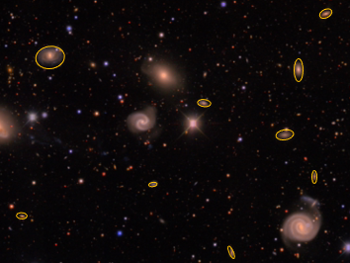
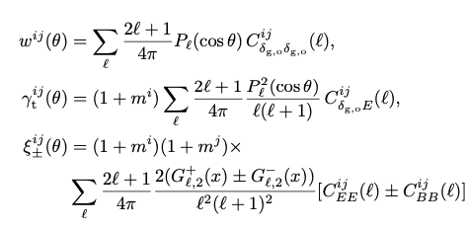
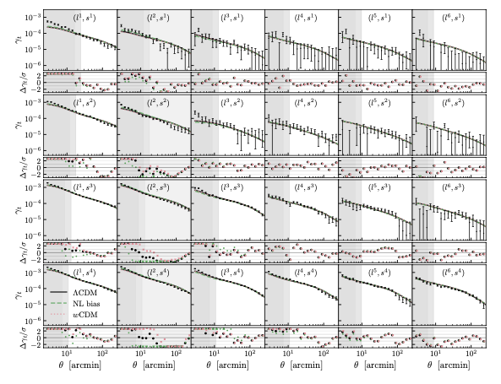
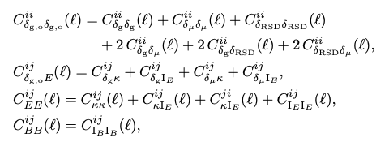
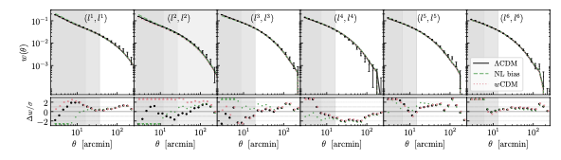




William d’Assignies
  3x2pt inference chain
Cosmology
Images to catalogs
Data-vectors
MCMC
Data-Model
Model ($Λ$CDM, $w_{0}w_{a}$CDM), priors.
$$ℒ(DV|DM)$$
Astrophysical sys
correlations
IA, magnification, redshift pdf, baryons, ….
Pixels to galaxy positions + shapes
Marginalise over sys
Instrumental & obs sys
Bayes thm
…
Mask, angular systematics, blending, redshift pdf
$$P\left(cosmo\right|DV)$$
6

Slide 10
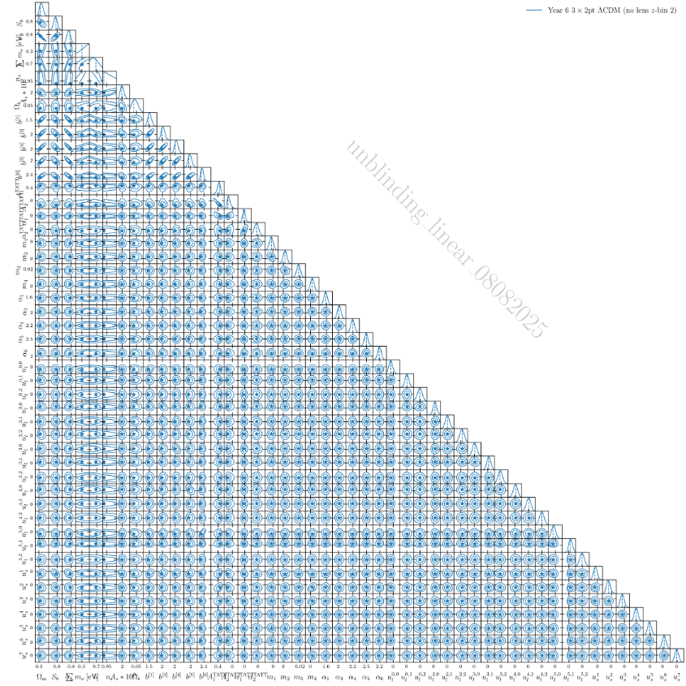

3x2pt: what are we constraining ?
William d’Assignies
$$S_{8}−Ω_{m}$$
Nuisance parameters
References:
Dark Energy Survey Year 6 Results: Cosmological Constraints from Galaxy Clustering and Weak Lensing, 2601.14559 .
7

Slide 11
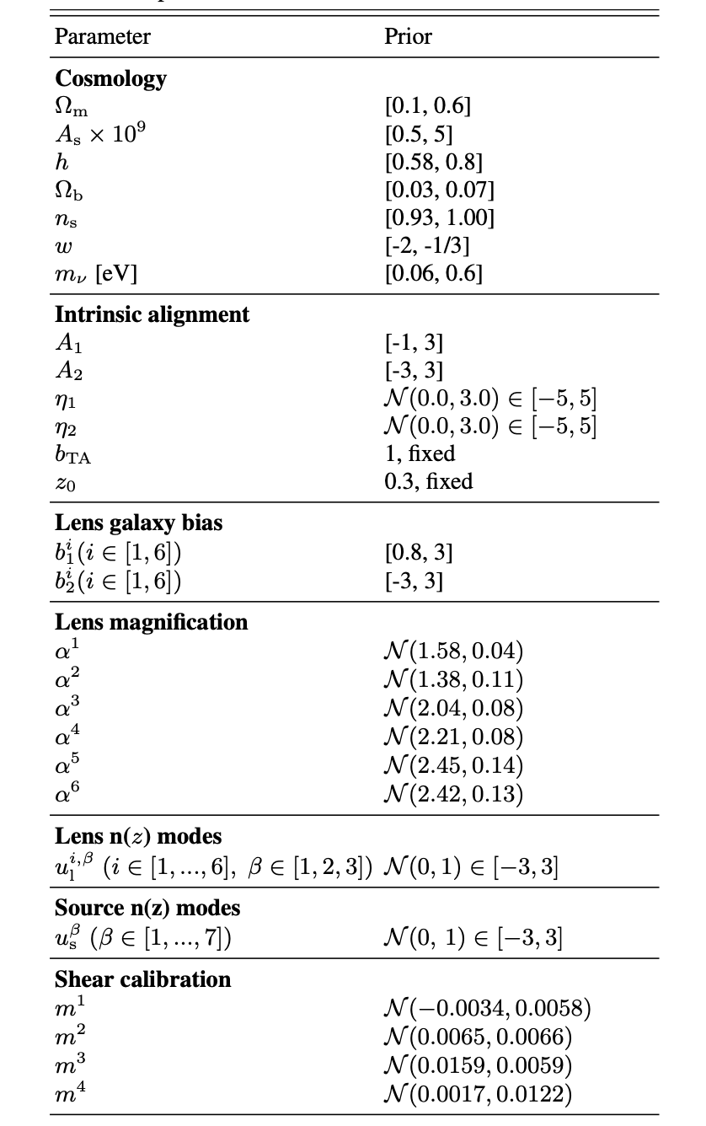
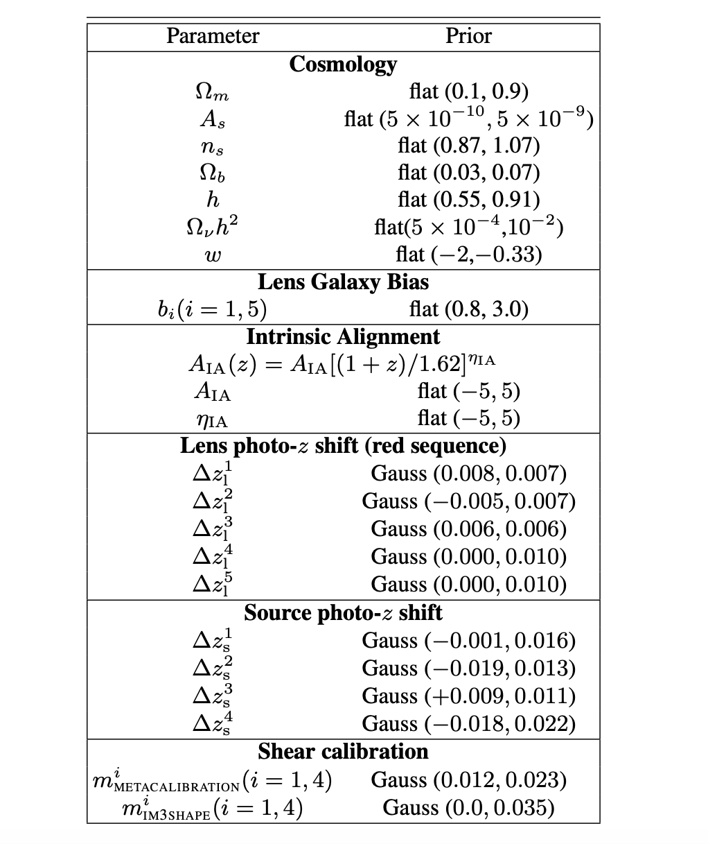
Modelling across releases:
William d’Assignies
25 parameters to 50ish.
DESY6
DESY1
Same cosmology.
Between Y1, Y3, and Y6, increase area, depth, but also methodology improvements.
Yet S₈ constraints are consistent across releases, Y3 vs Y6.
With respect to Planck, the difference has decreased Y6 vs Y3.
This is a huge success of DES.
From NLA to TATT
Linear (same) and NL bias
New parameters, new effect
Shifts to modes, 9 → 25
Same number, but not the same modelling.
8

Slide 12
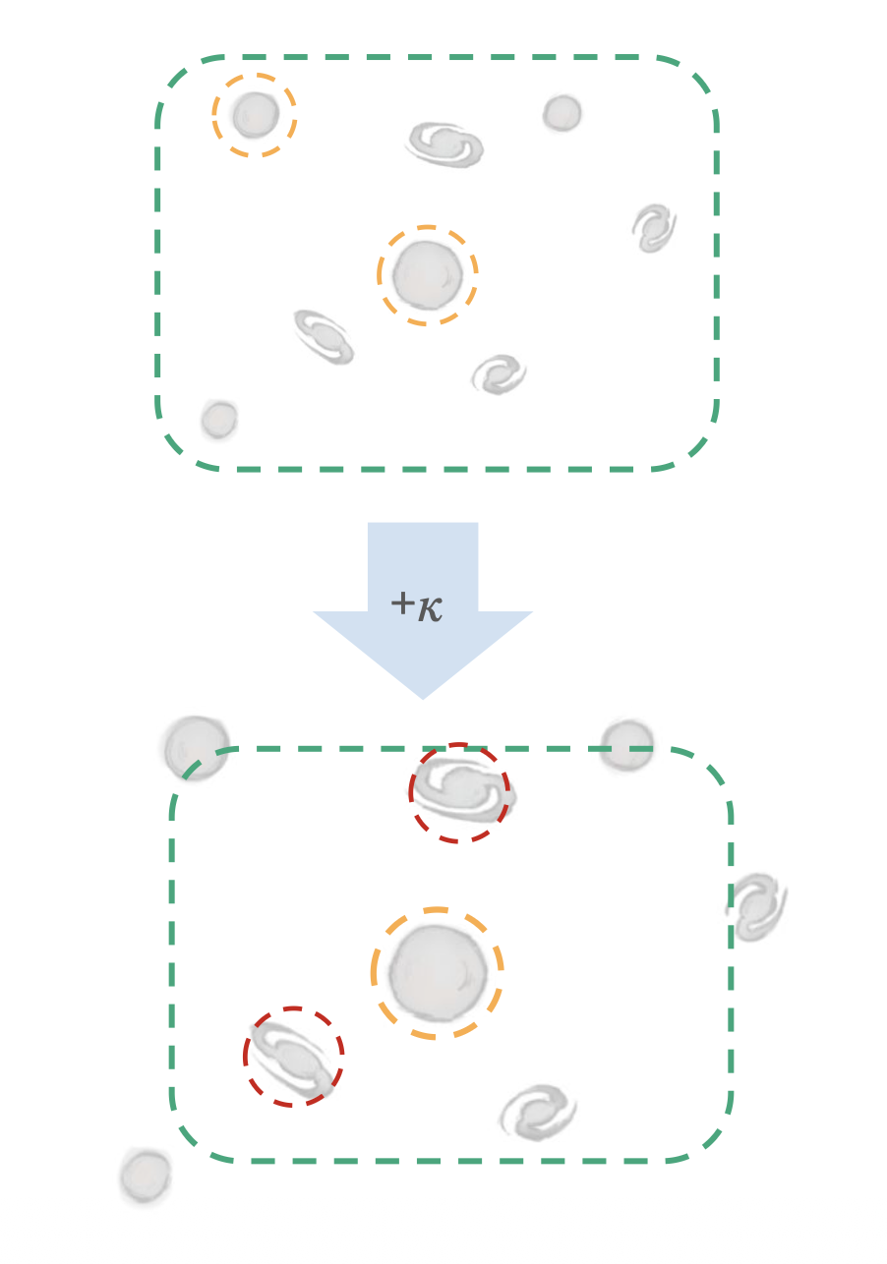
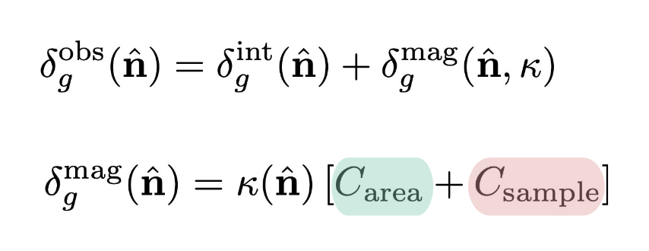
Modelling: magnification
William d’Assignies
C: E.Legnani
Change in the galaxy position field!
Between Y1, Y3, and Y6, increase area, depth, but also methodology improvements.
Yet S₈ constraints are consistent across releases, Y3 vs Y6.
With respect to Planck, the difference has decreased Y6 vs Y3.
This is a huge success of DES.
Higher order lensing effect
Effect of change of apparent area
Effect of change of fluxes, which has an impact on the selection.
9

Slide 13
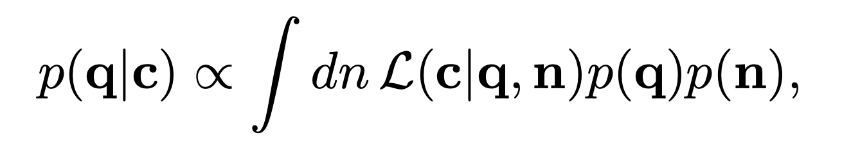
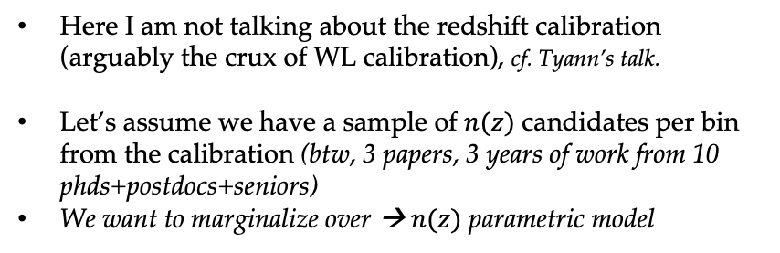
Modelling: redshift uncertainties
William d’Assignies
Here I am not talking about the redshift calibration (arguably the crux of WL calibration), cf. Tyann’s talk.
Let’s assume we have a sample of $n(z)$ candidates per bin from the calibration (btw, 3 papers, 3 years of work from 10 phds+postdocs+seniors)
We want to marginalize over → $n(z)$ parametric model
Between Y1, Y3, and Y6, increase area, depth, but also methodology improvements.
Yet S₈ constraints are consistent across releases, Y3 vs Y6.
With respect to Planck, the difference has decreased Y6 vs Y3.
This is a huge success of DES.
Y1
Y3
Y6
10

Slide 14
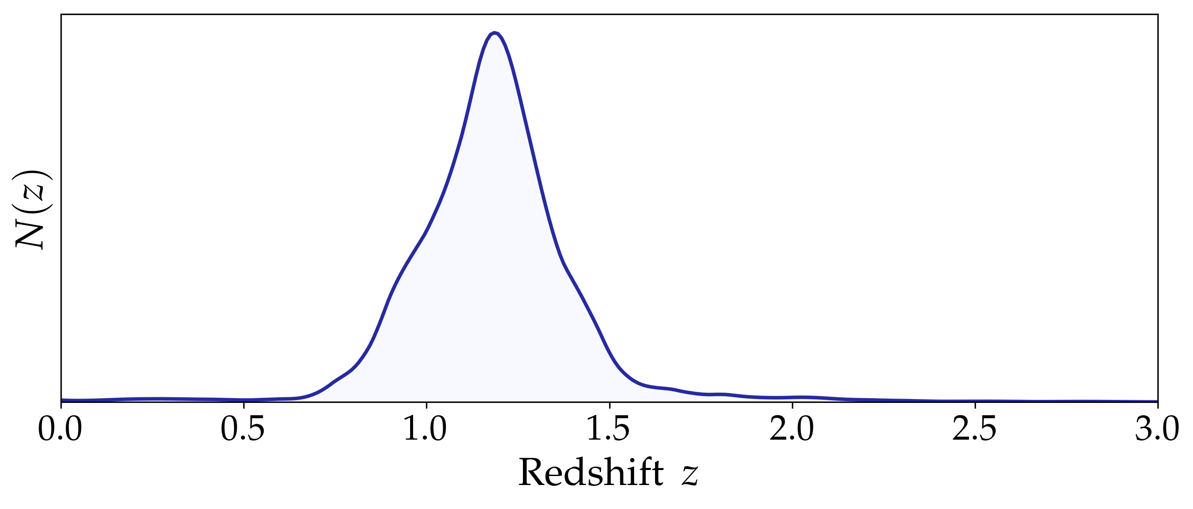

Modelling: redshift uncertainties
William d’Assignies
Here I am not talking about the redshift calibration (arguably the crux of WL calibration), cf. Tyann’s talk.
Let’s assume we have a sample of $n(z)$ candidates per bin from the calibration (btw, 3 papers, 3 years of work from 10 phds+postdocs+seniors)
We want to marginalize over → $n(z)$ parametric model
Between Y1, Y3, and Y6, increase area, depth, but also methodology improvements.
Yet S₈ constraints are consistent across releases, Y3 vs Y6.
With respect to Planck, the difference has decreased Y6 vs Y3.
This is a huge success of DES.
Y1
Y3
Y6
mean-$z$ shift per source bin
mean-$z$ shift per lens bin
$$\hat{n}\left(z,δz,\right)=n_{0}\left(z−δz\right)$$
10

Slide 15
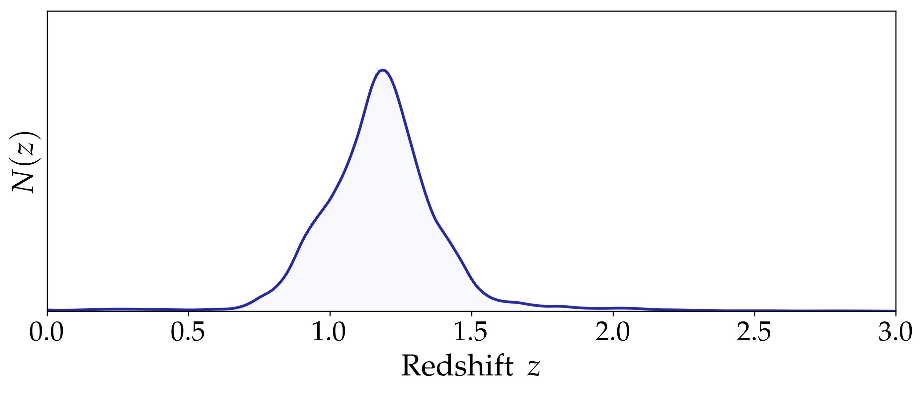


Modelling: redshift uncertainties
William d’Assignies
Here I am not talking about the redshift calibration (arguably the crux of WL calibration), cf. Tyann’s talk.
Let’s assume we have a sample of $n(z)$ candidates per bin from the calibration (btw, 3 papers, 3 years of work from 10 phds+postdocs+seniors)
We want to marginalize over → $n(z)$ parametric model
Between Y1, Y3, and Y6, increase area, depth, but also methodology improvements.
Yet S₈ constraints are consistent across releases, Y3 vs Y6.
With respect to Planck, the difference has decreased Y6 vs Y3.
This is a huge success of DES.
Y1
Y3
Y6
mean-$z$ shift per source bin
mean-$z$ shift per source bin
mean-$z$ shift per lens bin
mean-$z$ shift and width stretch per lens bin
$$\hat{n}\left(z,δz,\right)=n_{0}\left(z−δz\right)$$
$$\hat{n}\left(z,δz,s\right)={\frac{1}{s}n}_{0}\left(\frac{z−δz}{s}\right)$$
10

Slide 16
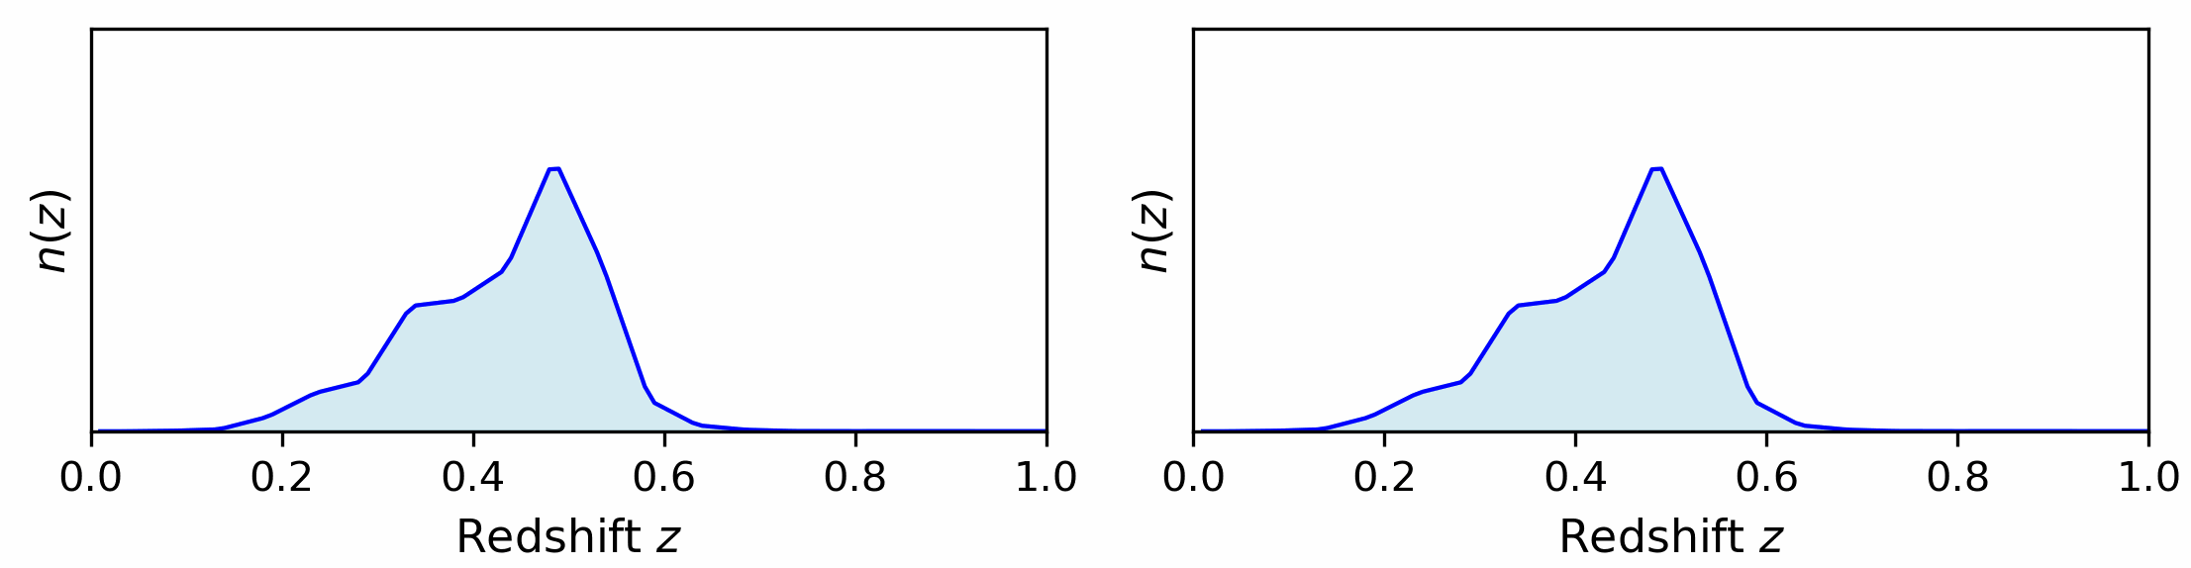
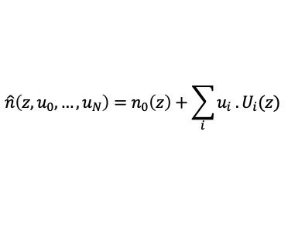
Modelling: redshift uncertainties
William d’Assignies
Here I am not talking about the redshift calibration (arguably the crux of WL calibration), cf. Tyann’s talk.
Let’s assume we have a sample of $n(z)$ candidates per bin from the calibration (btw, 3 papers, 3 years of work from 10 phds+postdocs+seniors)
We want to marginalize over → $n(z)$ parametric model
Between Y1, Y3, and Y6, increase area, depth, but also methodology improvements.
Yet S₈ constraints are consistent across releases, Y3 vs Y6.
With respect to Planck, the difference has decreased Y6 vs Y3.
This is a huge success of DES.
Y1
Y3
Y6
mean-$z$ shift per source bin
mean-$z$ shift per source bin
Linear expansion around fiducial n(z) with redshift modes (2 per source, 3 per lens)
mean-$z$ shift per lens bin
mean-$z$ shift and width stretch per lens bin
$$\hat{n}\left(z,δz,\right)=n_{0}\left(z−δz\right)$$
$$\hat{n}\left(z, u_{0},…,u_{N}\right)=n_{0}\left(z\right)+\sum_{i}{u_{i} . U_{i}(z)}$$
$$\hat{n}\left(z,δz,s\right)={\frac{1}{s}n}_{0}\left(\frac{z−δz}{s}\right)$$
10

Slide 17
DES 3x2pt:
  survey- data- probe
Modelling of 3x2pt
  Cosmology, astrophysics, observational effects
Position samples:
  Different samples from y1 to y6, and their problems…
Source samples:
  how to estimate shear from shapes
So what did we learn?

Slide 18
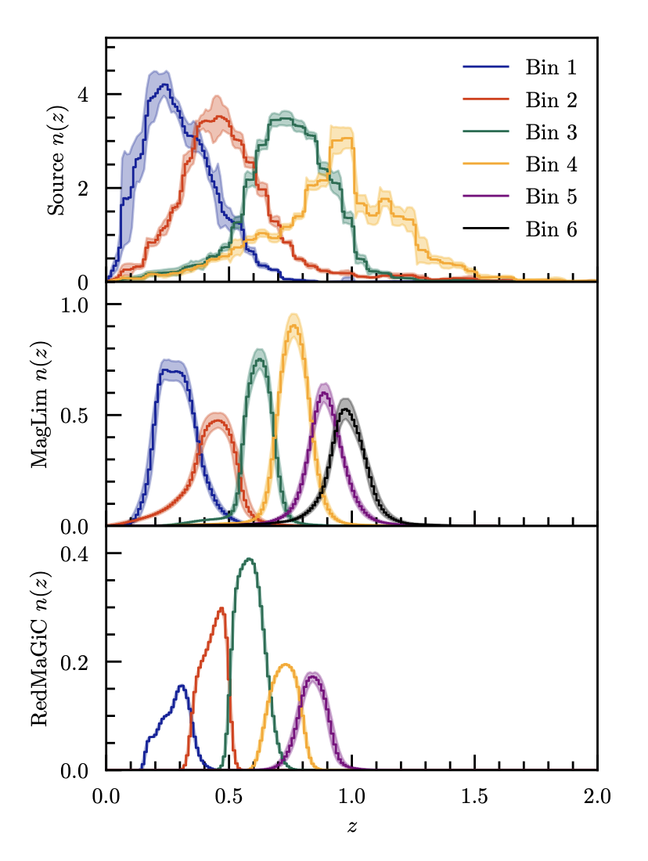
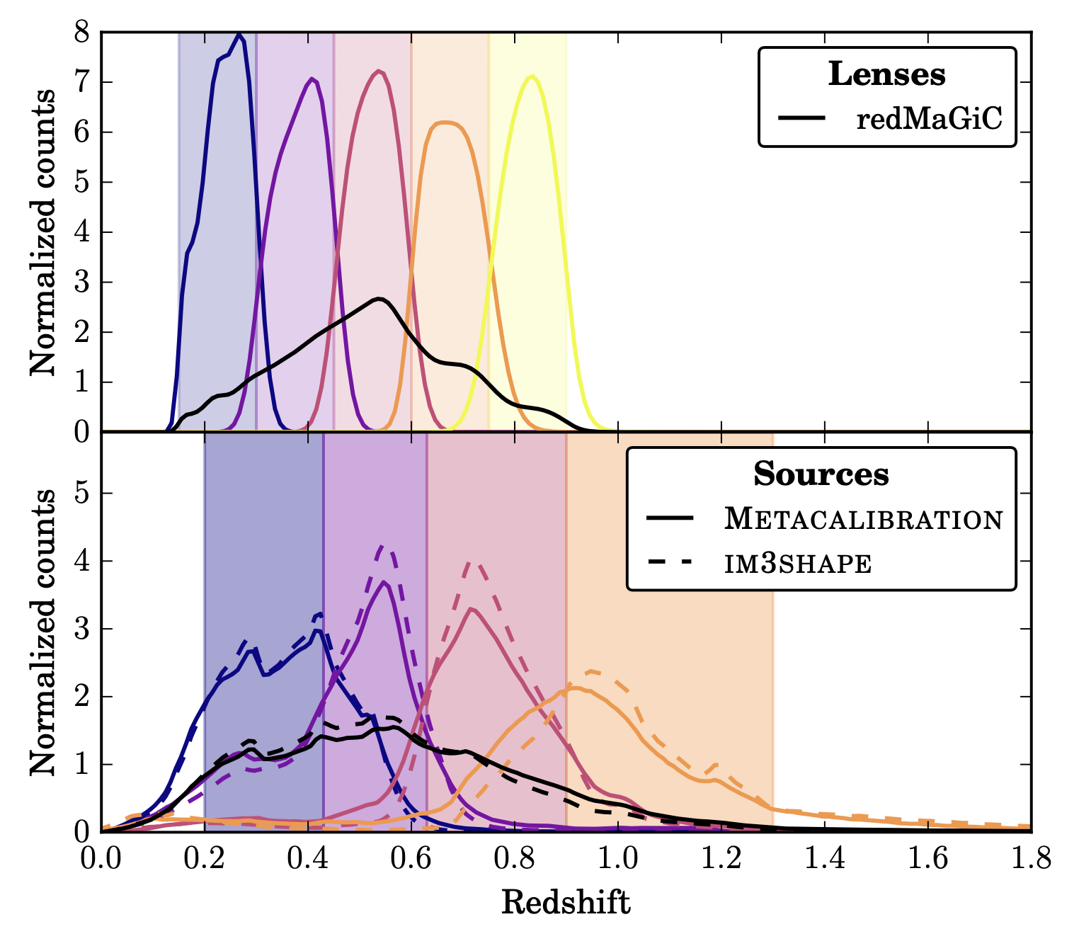
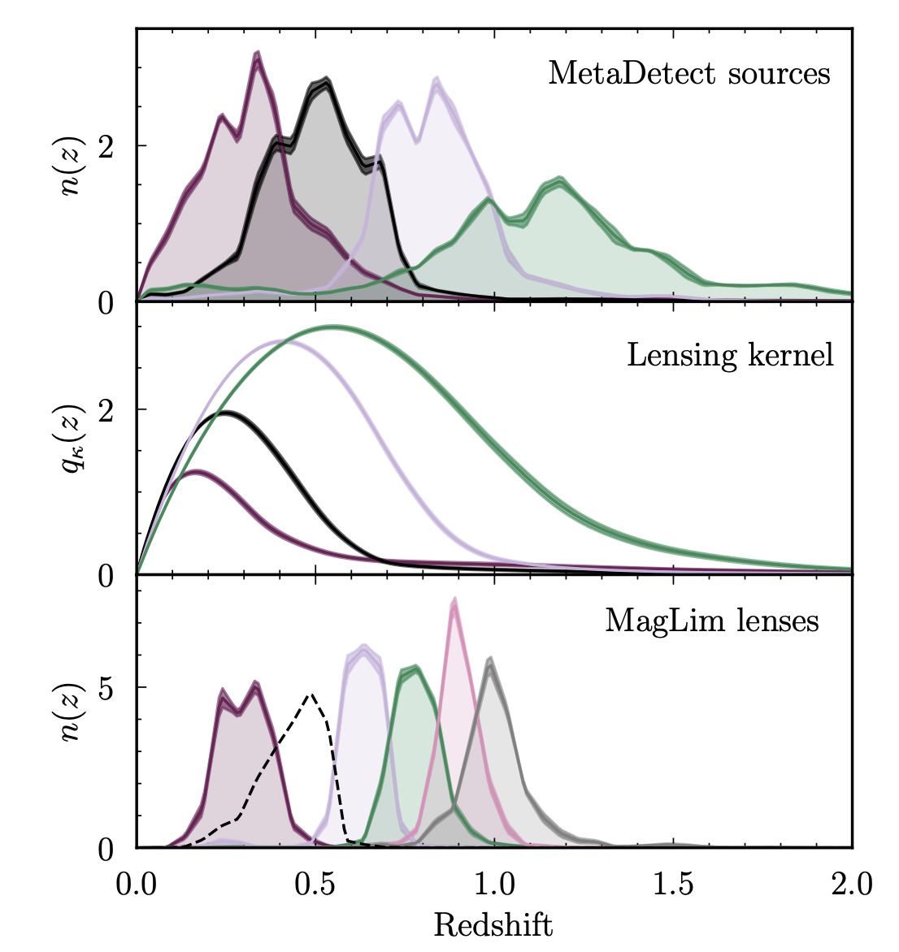
DES 3x2pt samples across releases
William d’Assignies
Position (lens) samples : you want a subsample clean from systematics (Y6 10 millions).
Source samples : being able to measure shapes (Y6 150 millions).
DESY3 samples
DESY1 samples
DESY6 samples
11

Slide 19
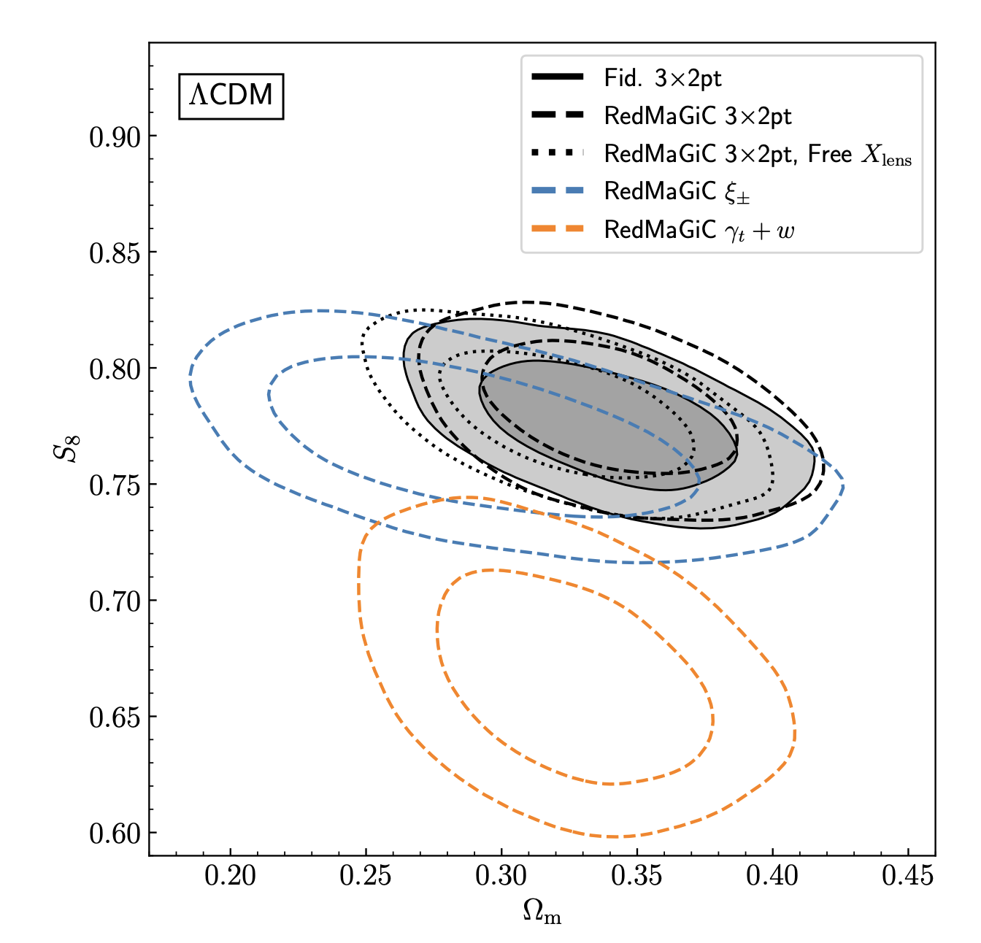
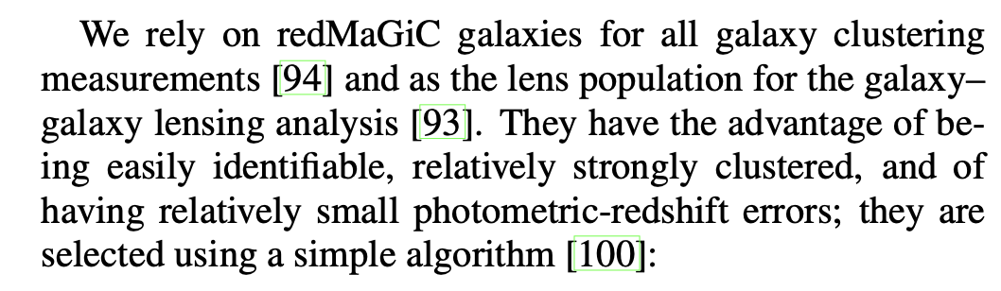
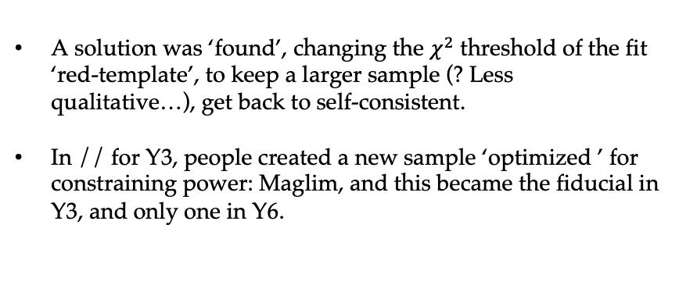
Position samples: Redmagic
William d’Assignies
DESY3 Results
Different part of the data vector using Redmagic, gives incompatible results….
DESY1
A solution was ‘found’, changing the $χ^{2}$ threshold of the fit ‘red-template’, to keep a larger sample (? Less qualitative…), get back to self-consistent.
In // for Y3, people created a new sample ‘optimized ’ for constraining power: Maglim, and this became the fiducial in Y3, and only one in Y6.
12

Slide 20
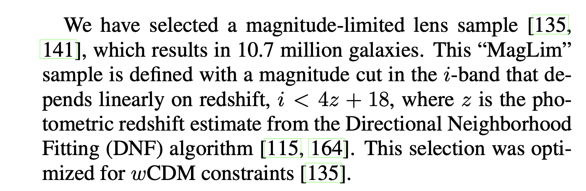
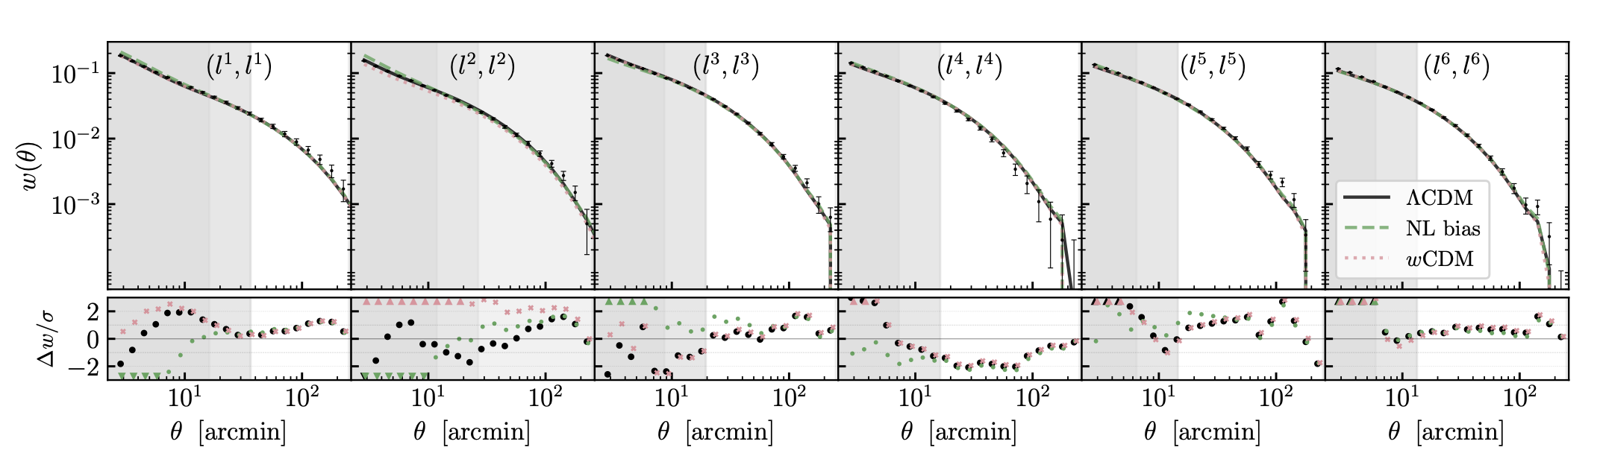
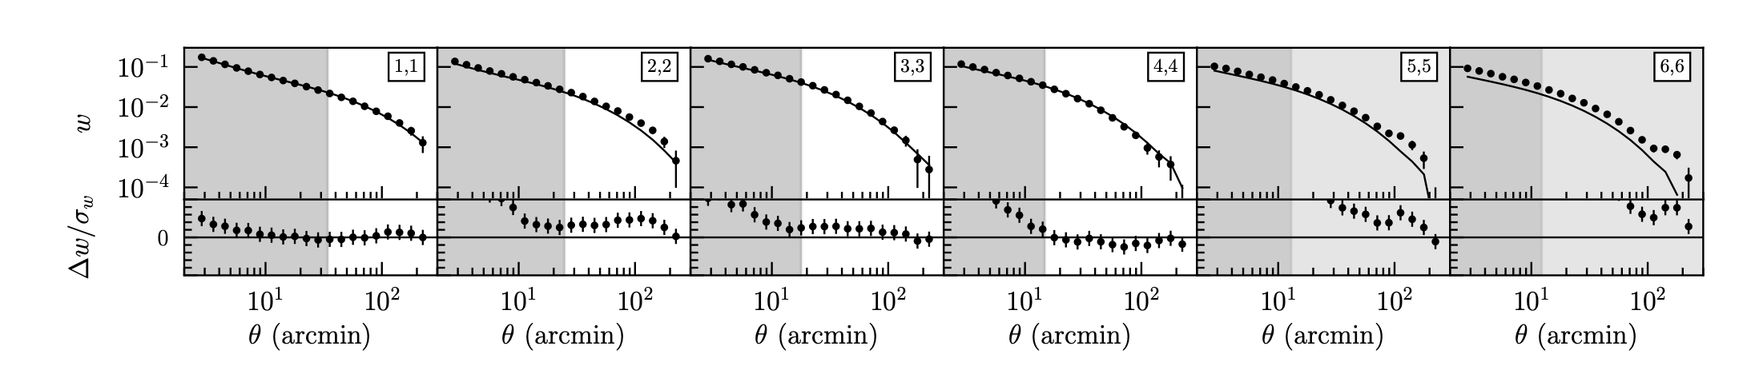

Position samples: Maglim
William d’Assignies
DESY6
DESY3
Removing larger area with systematics map based arguments,
Cleaning the sample with a systematic trained SOM
Better weights, more templates.
Constructing a position sample robust to systematics is very challenging…
→ Selection sample as simple as possible
We believe the systematics are entering into the selection through the photo-z
13

Slide 21
DES 3x2pt:
  survey- data- probe
Modelling of 3x2pt
  Cosmology, astrophysics, observational effects
Position samples:
  Different samples from y1 to y6, and their problems…
Source samples:
  how to estimate shear from shapes
So what did we learn?

Slide 22
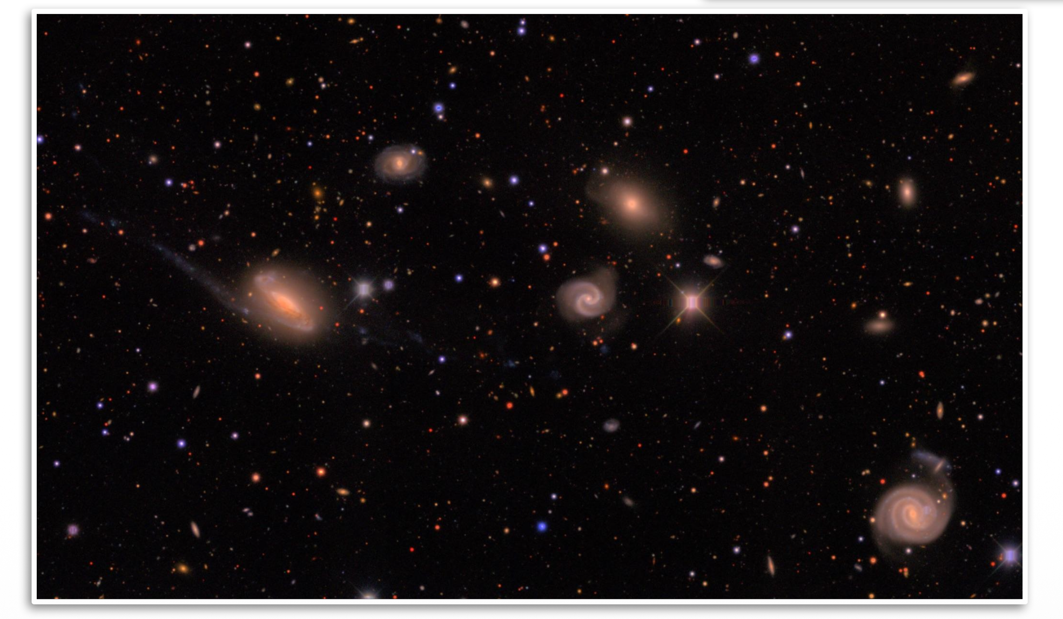
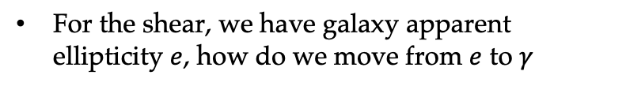
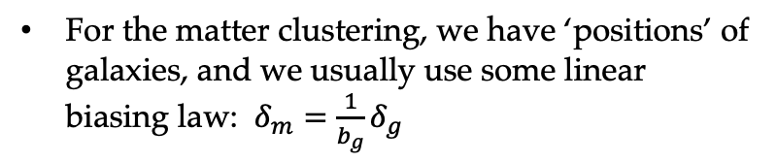
William d’Assignies
Source samples across releases
For the matter clustering, we have ‘positions’ of galaxies, and we usually use some linear biasing law: $δ_{m}={\frac{1}{b_{g}}δ}_{g}$
For the shear, we have galaxy apparent ellipticity $e$, how do we move from $e$ to $γ$
14
Notes:
More extensive/aggressive masking (total area 3914 deg2)
Remove outlier regions of footprint (depth, dust, skybright, etc.)
Stricter quality cuts on lens sample
Color cuts to remove bad photo-zs
Better star-galaxy separation methods
Better mocks (data-calibrated lognormals)
SP maps pre-vetted for LSS to avoid inducing Xlens
We follow the approach of [2], which demonstrated that using NIR data from unWISE could provide a means of identifying stars that is complementary to the morphological EXTMASH star-galaxy classifier used in the DESY3 and DESY6 GOLD catalalogs. Star-galaxy separation cut its bin optimised. Removes 2% objects overall. Also it makes stellar contamination just obscuration, and hence a multiplicative systematics, not an additive one. Which is consistent with our overall treatment of systematics (otherwise additive+multiplicative compete).

Slide 23
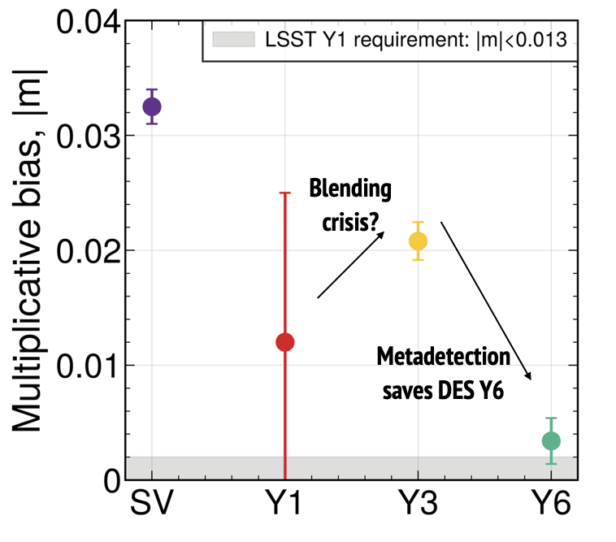
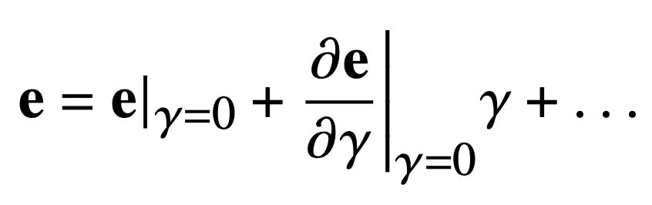
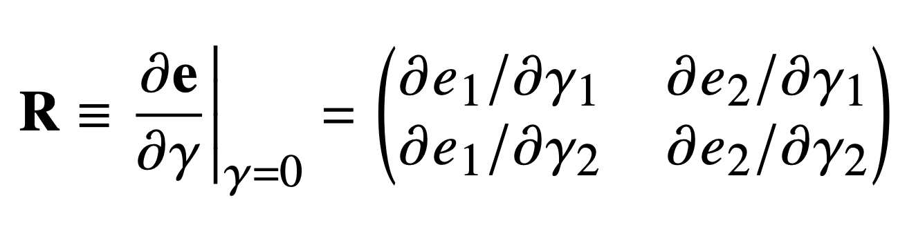
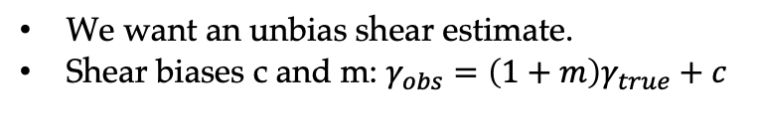

William d’Assignies
Source samples across releases
For the matter clustering, we have ‘positions’ of galaxies, and we usually use some linear biasing law: $δ_{m}={\frac{1}{b_{g}}δ}_{g}$
For the shear, we have galaxy apparent ellipticity $e$, how do we move from $e$ to $γ$
Shear response
$$γ=R^{−1}(e−e_{i})$$
We want an unbias shear estimate.
Shear biases c and m: $γ_{obs}=\left(1+m\right)γ_{true}+c$
14
Notes:
More extensive/aggressive masking (total area 3914 deg2)
Remove outlier regions of footprint (depth, dust, skybright, etc.)
Stricter quality cuts on lens sample
Color cuts to remove bad photo-zs
Better star-galaxy separation methods
Better mocks (data-calibrated lognormals)
SP maps pre-vetted for LSS to avoid inducing Xlens
We follow the approach of [2], which demonstrated that using NIR data from unWISE could provide a means of identifying stars that is complementary to the morphological EXTMASH star-galaxy classifier used in the DESY3 and DESY6 GOLD catalalogs. Star-galaxy separation cut its bin optimised. Removes 2% objects overall. Also it makes stellar contamination just obscuration, and hence a multiplicative systematics, not an additive one. Which is consistent with our overall treatment of systematics (otherwise additive+multiplicative compete).

Slide 24



William d’Assignies
Source samples across releases
Metacal (Y1,Y3) → Metadetect (Y6): A technic to self-calibrate raw galaxy shape measurements with noise bias, model bias, and selection bias, by artificially process the image and calculating the shear response R
Selection (‘detect’)
(Yamamoto, Becker et al. )
Improvements :
Addition of chromatic PSF allows us to use g-band flux for photo-z, and reduce shear bias. (T. Schutt et al.)
Multiplicative bias from im-sim + accounting for the impact on $n(z)$s (S. Mau et al., in prep.)
We account for the redshift dependence of the shear response R(z)
15
Notes:
More extensive/aggressive masking (total area 3914 deg2)
Remove outlier regions of footprint (depth, dust, skybright, etc.)
Stricter quality cuts on lens sample
Color cuts to remove bad photo-zs
Better star-galaxy separation methods
Better mocks (data-calibrated lognormals)
SP maps pre-vetted for LSS to avoid inducing Xlens
We follow the approach of [2], which demonstrated that using NIR data from unWISE could provide a means of identifying stars that is complementary to the morphological EXTMASH star-galaxy classifier used in the DESY3 and DESY6 GOLD catalalogs. Star-galaxy separation cut its bin optimised. Removes 2% objects overall. Also it makes stellar contamination just obscuration, and hence a multiplicative systematics, not an additive one. Which is consistent with our overall treatment of systematics (otherwise additive+multiplicative compete).

Slide 25
DES 3x2pt:
  survey- data- probe
Modelling of 3x2pt
  Cosmology, astrophysics, observational effects
Position samples:
  Different samples from y1 to y6, and their problems…
Source samples:
  how to estimate shear from shapes
So what did we learn?

Slide 26




Y3 to Y6: Changes
William d’Assignies
We revisited all the steps from images to cosmological constraints!
References:
Dark Energy Survey Year 6 Results: Cosmological Constraints from Galaxy Clustering and Weak Lensing, 2601.14559 .
16

Slide 27
DES 3x2pt across releases
William d’Assignies
Yes, we are broadly consistent across realises, but not totally
Over releases and analyses, we did find new systematics, new effects, we improved the calibrations, we changed the samples.
Regarding cosmology, DES-WL no ‘discovery’… We have been consistently consistent with CMB.
The differences we see across years is the reason why we work, whenever you measure new probes with data, you will find systematics and undesired effects.
From the theory (cosmology) prediction to a constraints on some parameters, there is a long and difficult road. Performing a robust weak lensing analysis is hard.
17

Slide 28

DES 3x2pt across releases
William d’Assignies
DESY6 (LCDM) 3x2pt: 18 papers.
Yes, we are broadly consistent across realises, but not totally
Over releases and analyses, we did find new systematics, new effects, we improved the calibrations, we changed the samples.
Regarding cosmology, DES-WL no ‘discovery’… We have been consistently consistent with CMB.
The differences we see across years is the reason why we work, whenever you measure new probes with data, you will find systematics and undesired effects.
From the theory (cosmology) prediction to a constraints on some parameters, there is a long and difficult road. Performing a robust weak lensing analysis is hard.
Euclid DR1: 15ish papers coming
17

Slide 29





  The bin 2 problem: few insights
Photo-z is still the usual suspect.
Remember Maglim is selected with photo-z cuts:
Because of the gap between g and r bands, photo-z is degraded at $z∼0.4$
Legnani et al. also showed that the photo-z was very sensitive to flux variations for that bin specifically.
Thus if we had to suspect one bin, that would be bin 2
But there is no clear explanation
We can only recommand in the future to favour sample selection for robutstness to systematics rather than optimising the FOM of a parameter with Fisher forecasts.
52

Slide 30


  Photometric surveys and the 3x2pt probe
William d’Assignies
Selection steps have to be included. Systematics, astrophysics, data properties !!
We need a model for the data $\overline{D}$ and cov($\overline{D}$ )
12

Slide 31





Samples
William d’Assignies
source sample = Metadetection (Yamamoto, Becker et al. )
~ 150 million galaxies
neff = 8 gals / arcmin2 and $σ_{e}$= 0.272
Reduced shear bias (e.g. in blended objects).
50% more sources than Y3.
lens sample = MagLim ++ (Weaverdyck, Rodriguez et al. )
10 million galaxies with mag cut : i < 4 $z_{photo}$ + 18
Selected by optimizing the wCDM constraints by balancing density and photo-z.
z
→ Both selections are being used in Stage IV
lens sample 2 = broad redmagic
Twice more galaxies, a bit worse photo-z than Y3
source sample 2 = BFD [bayesian fourier domain
200 million shapes a bit worse shape noise than metadetect
[BFD → Bernstein and Armstrong 2014]
z
15
Notes:
Low calibration errors from blending or detection

Slide 32








Maglim++
(Weaverdyck, Rodriguez et al.)
William d’Assignies
Maglim++
(i) mag-lim sample, 10 M galaxies into 6 (photo-$z$) bins:
Improve purity and reduce systematics wrt Y3 Maglim
Photo-$z$ quality cuts
Use SOM to group galaxies, identify and remove colors with bad photo-zs
Improved star-galaxy separation
galaxies
(Bin ) optimized cuts in the ($r−z, z−W_{1}$) color space to isolate and remove stars
Uses $W_{1}$, a NIR magnitude (unWISE catalog)
stars
17
Improved EXTMASH morphological star cut
Match w/ NIR photometry from unWISE
unWISE cuts to remove stellar contamination
  up to 15% at low latitudes!
Notes:
More extensive/aggressive masking (total area 3914 deg2)
Remove outlier regions of footprint (depth, dust, skybright, etc.)
Stricter quality cuts on lens sample
Color cuts to remove bad photo-zs
Better star-galaxy separation methods
Better mocks (data-calibrated lognormals)
SP maps pre-vetted for LSS to avoid inducing Xlens
We follow the approach of [2], which demonstrated that using NIR data from unWISE could provide a means of identifying stars that is complementary to the morphological EXTMASH star-galaxy classifier used in the DESY3 and DESY6 GOLD catalalogs. Star-galaxy separation cut its bin optimised. Removes 2% objects overall. Also it makes stellar contamination just obscuration, and hence a multiplicative systematics, not an additive one. Which is consistent with our overall treatment of systematics (otherwise additive+multiplicative compete).

Slide 33

  DES redshift calibration pipeline:
William d’Assignies
Self-Organised-Maps, photometry
Adding WZ: clustering
Credit: G. Giannini
Include effect of blending on redshift
Parametrisation of uncertainties for the inference
20

Slide 34






William d’Assignies
  Redshift uncertainty : modes
  (Bernstein, d’Assignies, Troxel et al. )
Idea: Use Principal Component Analysis to extract a set of redshift modes $U_{i}(z)$
MCMC: sample mode coefficients $u_{i}$:
‘PCA’
$$\hat{n}\left(z\right)=n_{0}\left(z\right)+\sum_{i}{u_{i} . U_{i}(z)}$$
We don’t capture all the variations of the $n(z)$, only the variations which have an impact on cosmology observables $\hat{c}$ (1x2 or 3x2 or whatever).
0.6
1.0
1.4
Redshift
Observables covariance
Quantity to minimize
Mode model of the realisation
Sum over realisations
Calibration realisation
Observables (1x2, 3x2pt)
25

Slide 35



Y3 Redmagic curse
Inconsistent with Maglim: same physics, same volume…
Inconsistent 3x2pt and 2x2pt, visible on galaxy bias:
$X_{lens}=b_{3×2}/b_{2×2}$ , not consistent with 1…
Had to change sample after unblinding, still ?, reason why PPDs in Y6

Slide 36


  3x2pt ‘pre-unblinding’ papers
Modelling (in prep.),
D. Sanchez, A. Ferté et al.
Balrog (2501.05683)
D. Anbajagane et al.
Cardinal (2303.12104)
C. To et al.
Mask (2509.07943).
M. Rodríguez, N. Weaverdyck et al.
Simulated data
Gold paper (2501.05739)
K. Bechtol et al.
Magnification (in prep.),
E. Legnani et al.
PSF(2501.05781)
T. Schutt et al.
Image Sim (in prep.)
S. Mau. M. Becker, et al.
GGL (in prep.)
G. Giannini et al.
Metadetect (2501.05665)
M. Yamamoto, M. Becker et al.
GC and obs sys (in prep.)
N. Weaverdyck,
Rodríguez, N. et al.
PPDs (in prep.)
C. Doux, J. Muir, et al.
SOM (2509.07964 & 2510.23566):
B. Yin et al, G. Giannini et al
WZ (2510.23565): W. d’Assignies et al.
$z$-priors (2506.00758): G. Bernstein et al.
13

Slide 37
  3x2pt ‘pre-unblinding’ papers
Modelling (in prep.),
D. Sanchez, A. Ferté et al.
Balrog (2501.05683)
D. Anbajagane et al.
Cardinal (2303.12104)
C. To et al.
Mask (2509.07943).
M. Rodríguez, N. Weaverdyck et al.
Simulated data
Gold paper (2501.05739)
K. Bechtol et al.
Magnification (in prep.),
E. Legnani et al.
PSF(2501.05781)
T. Schutt et al.
Image Sim (in prep.)
S. Mau. M. Becker, et al.
GGL (in prep.)
G. Giannini et al.
Metadetect (2501.05665)
M. Yamamoto, M. Becker et al.
GC and obs sys (in prep.)
N. Weaverdyck,
Rodríguez, N. et al.
PPDs (in prep.)
C. Doux, J. Muir, et al.
SOM (2509.07964 & 2510.23566):
B. Yin et al, G. Giannini et al
WZ (2510.23565): W. d’Assignies et al.
$z$-priors (2506.00758): G. Bernstein et al.
13

