Slide 1
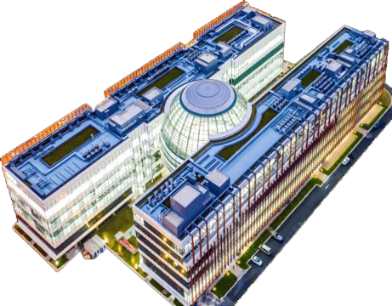

TSUNG-DAO LEE INSTITUTE · SHANGHAI JIAO TONG UNIVERSITY
Particle and
Nuclear Physics
Division
Research at the frontiers of fundamental physics
Jianglai Liu
EUROPEAN ACADEMIC TOUR
Distinguished fellow · on behalf of the Division
May 2026

Slide 2
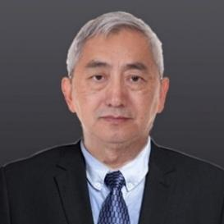

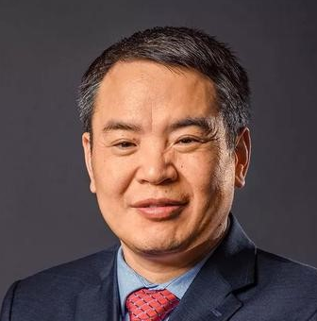
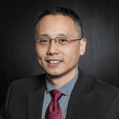
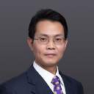
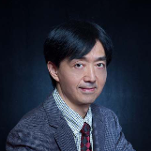
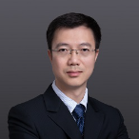
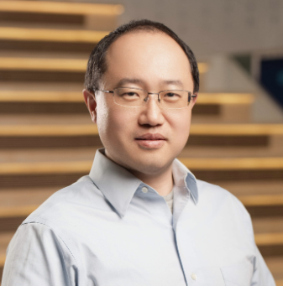
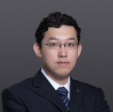


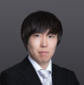
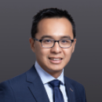
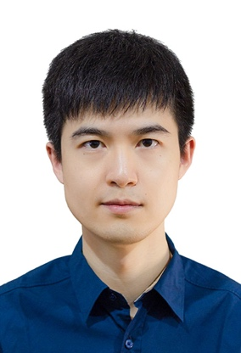
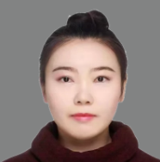
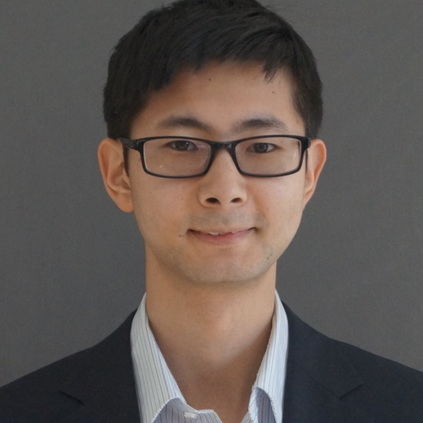
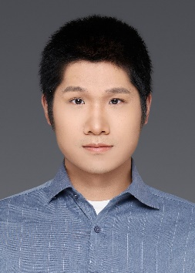
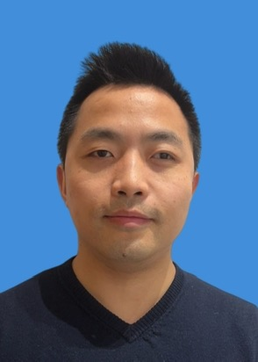
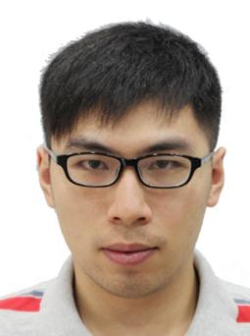
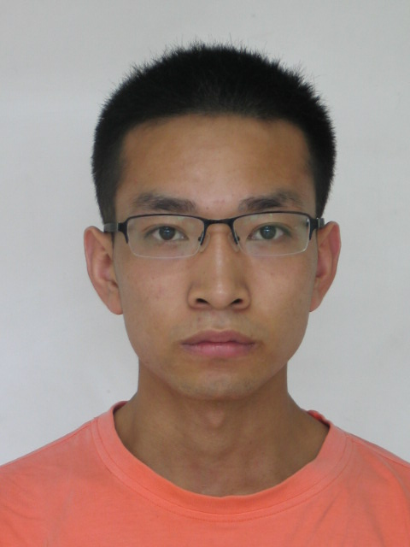
Our People
3
Head: Xiao-Gang He
T. D. Lee
Chair Professors
Deputy head: Ning Zhou
Xiaogang He
Michael Ramsey-Musolf
Xiangdong Ji
5
Working closely with faculty in Institute of Nuclear & Particle Physics (INPAC) at SJTU
Similar number of faculties in INPAC.
Distinguished
Fellows
Jianglai Liu
Haijun Yang
Hong-Jian He
Dao Xiang
Ning Zhou
6
Tenured
Fellows
Shu Li
Donglian Xu
Shao-Feng Ge
Yuichiro Nakai
Kim Siang Khaw
Huilin Qu
6
Tenure-track
Fellows
Sophia Han
Xin Xiang
Hualin Mei
Wenyuan Ai
Yifan Chen
Keping Xie
02 / 13
Notes:
About 20, similar number at INPAC-SPA in another campus of the university.

Slide 3
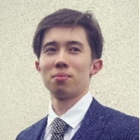


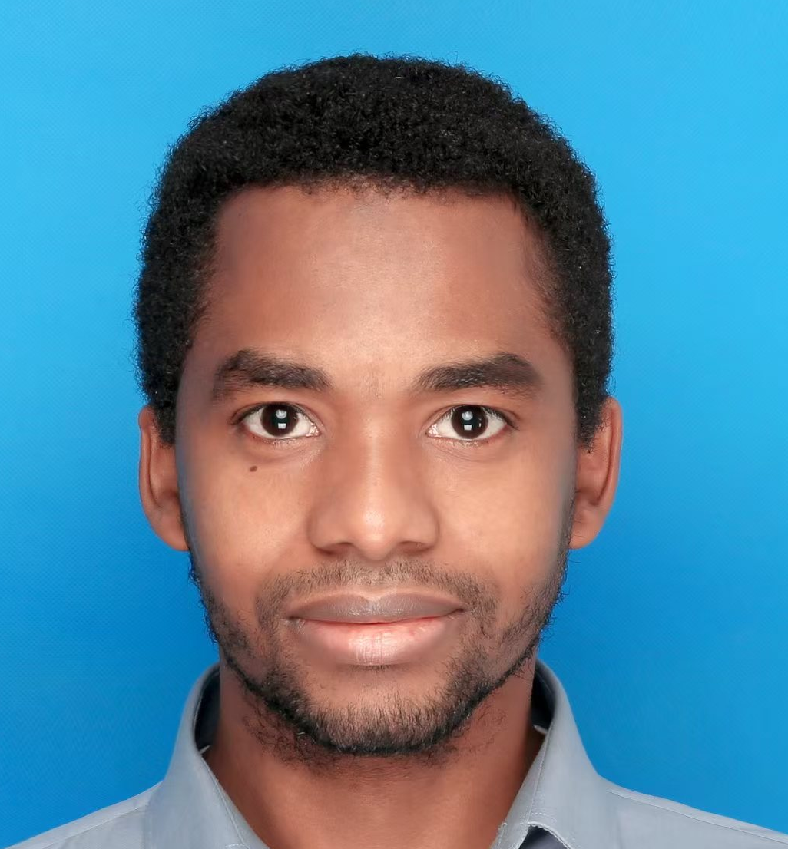
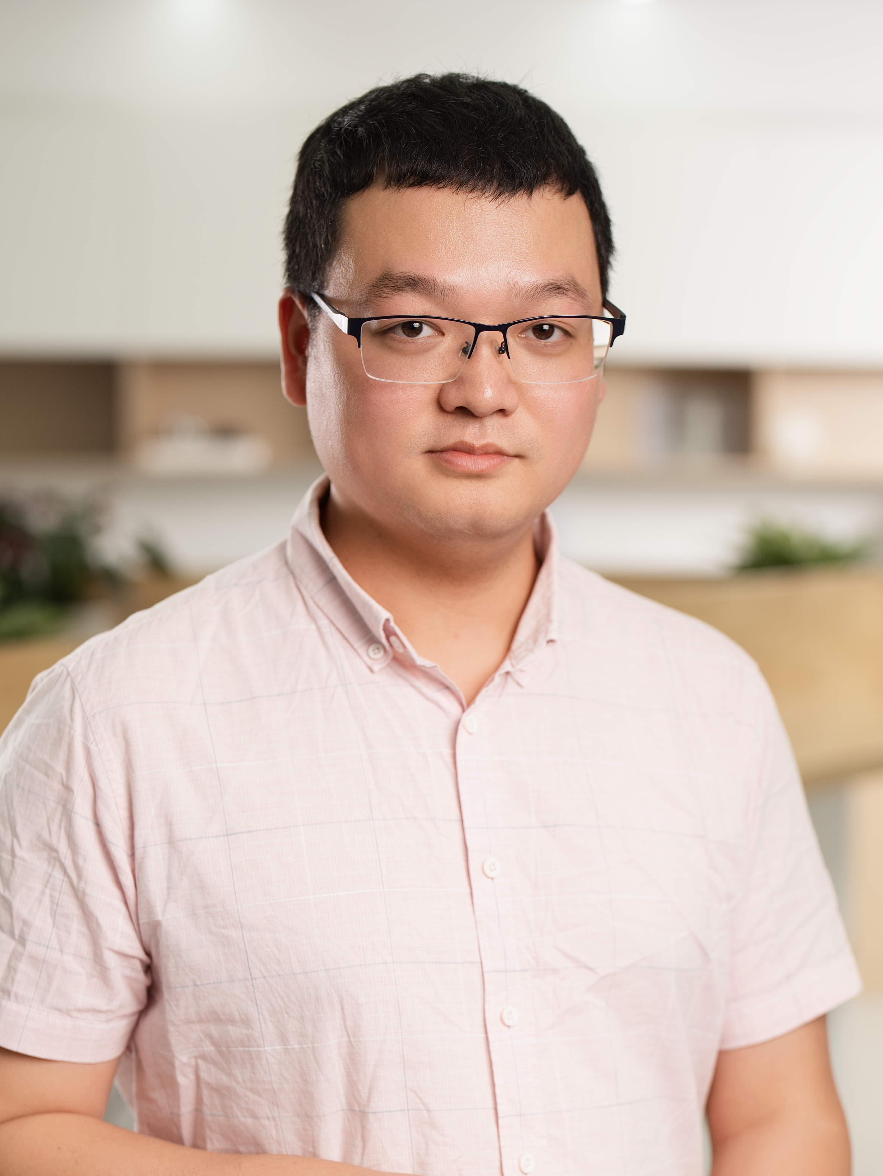

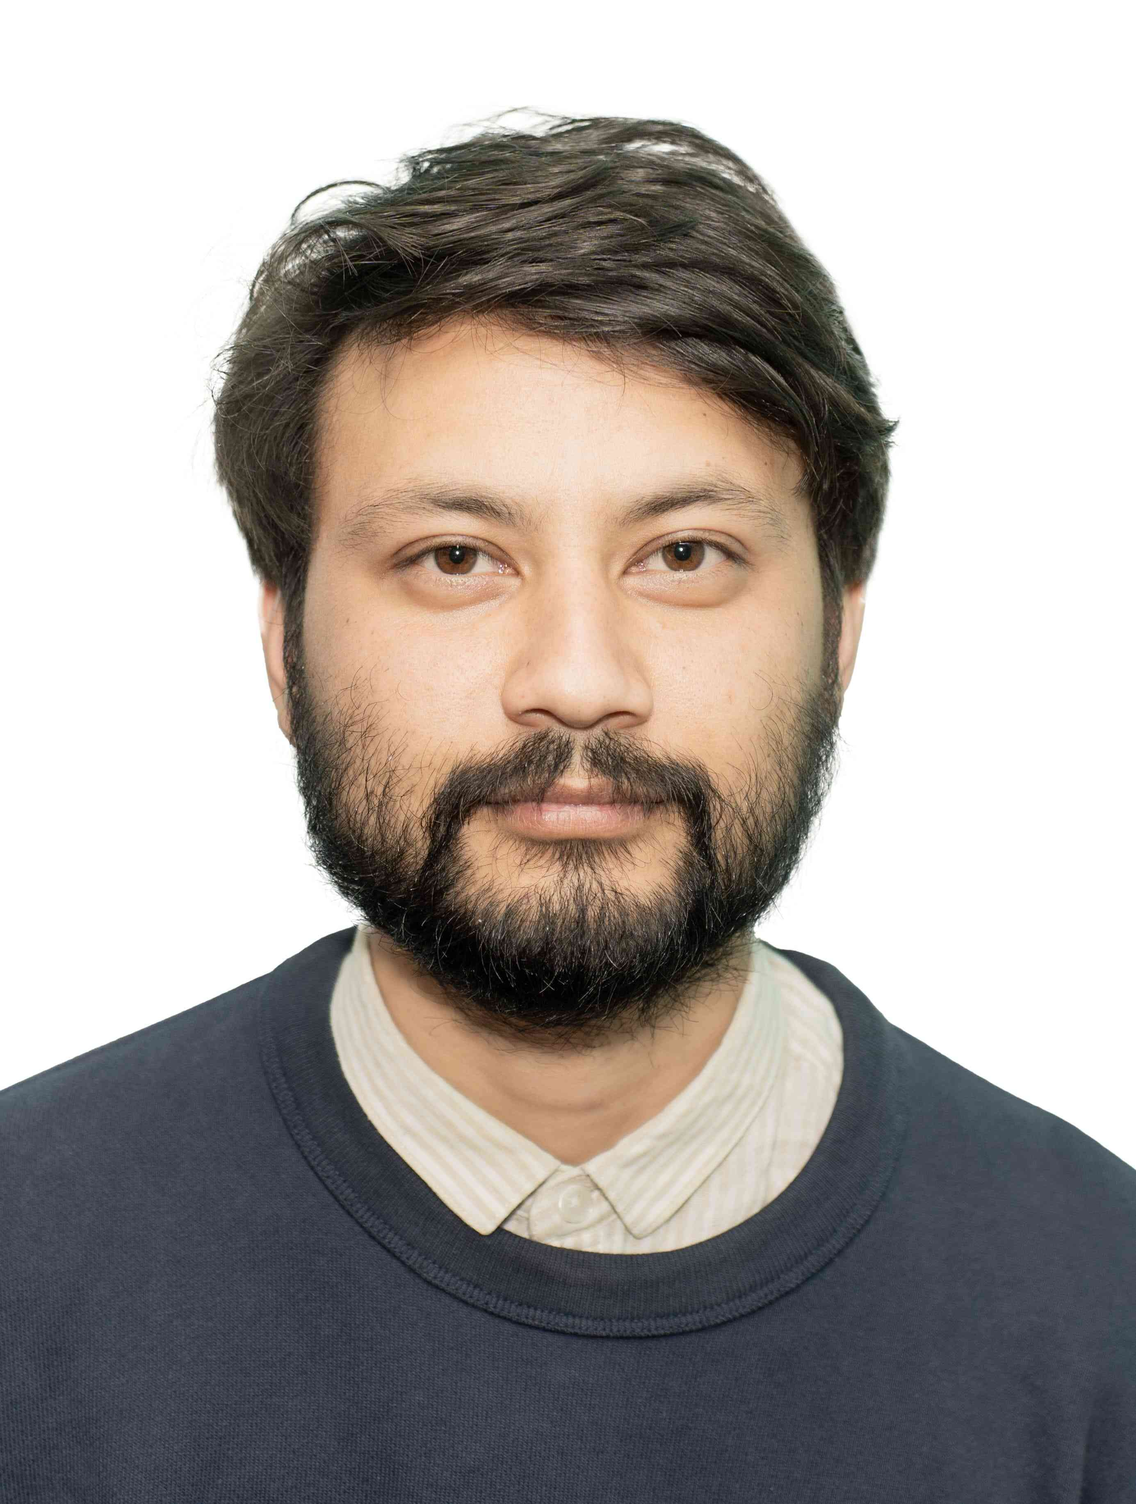




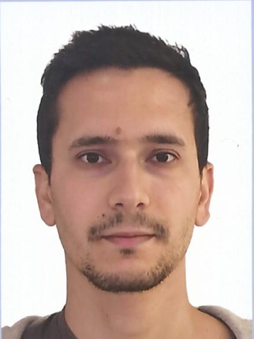

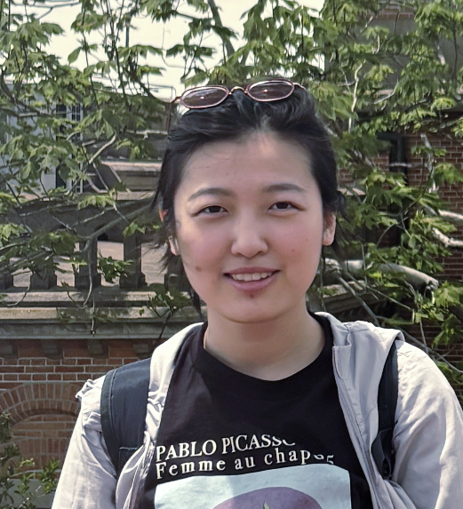

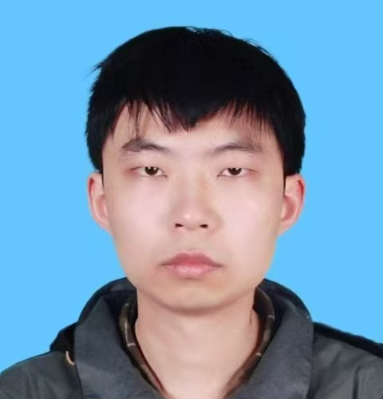

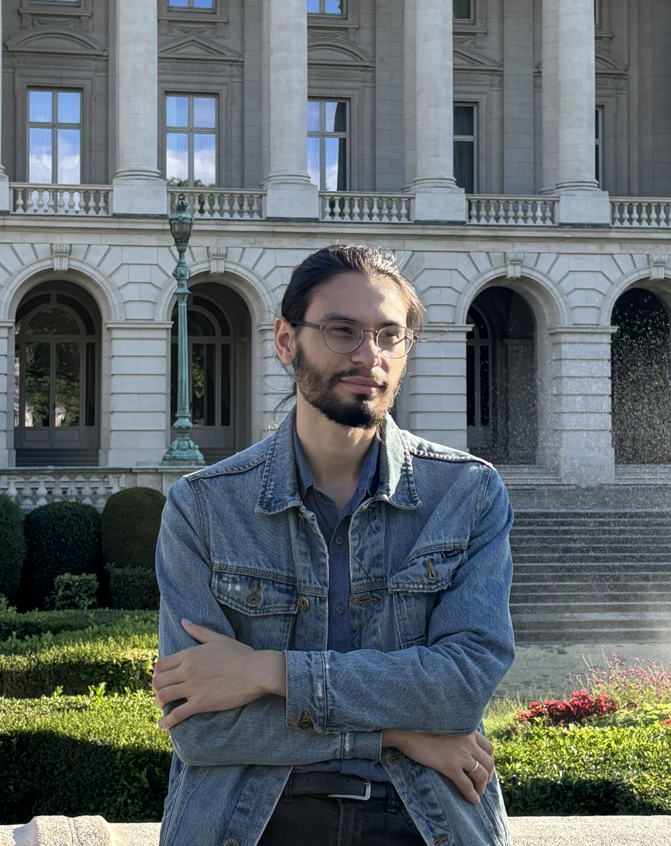
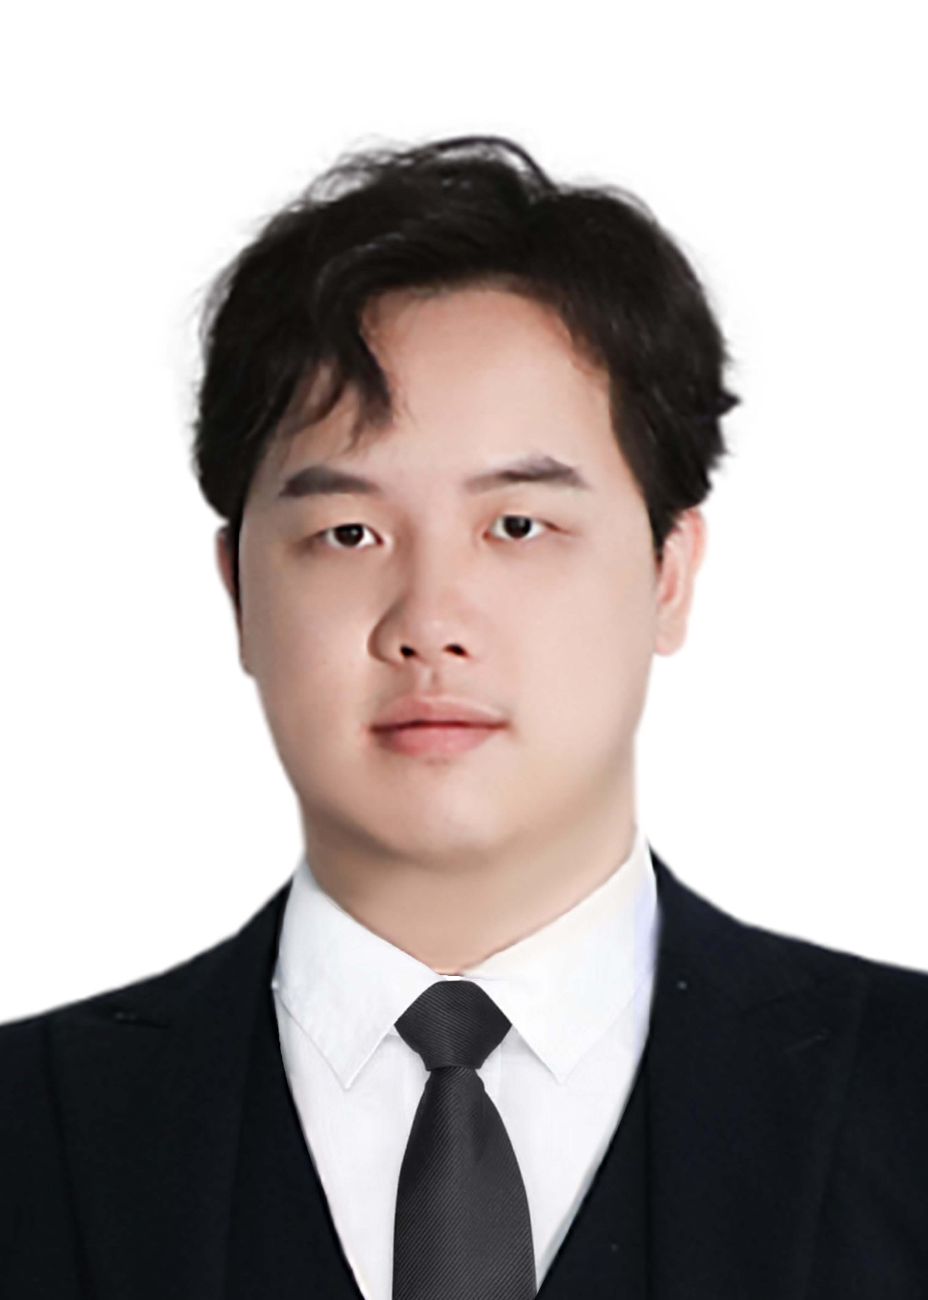

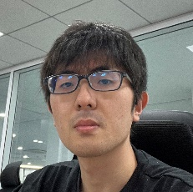



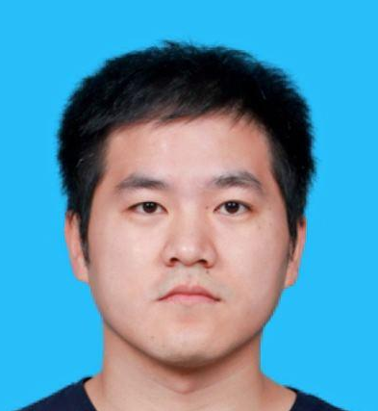
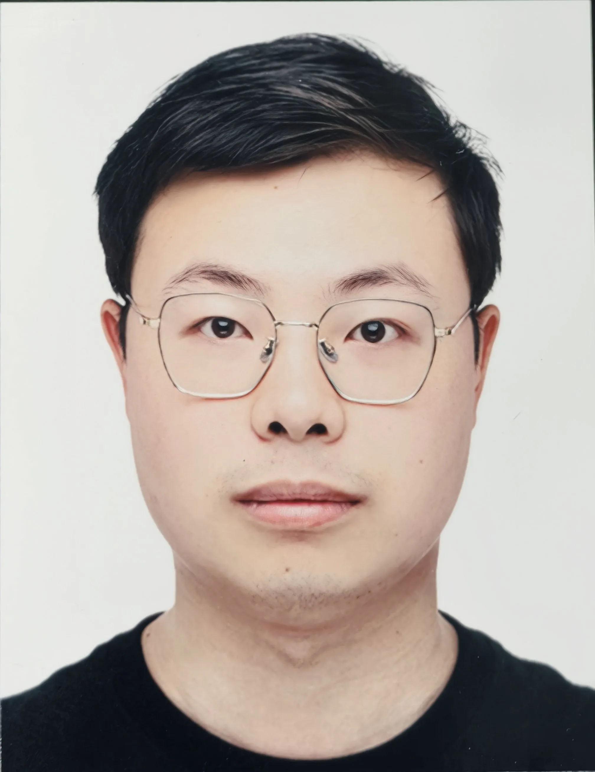
Our People
Iwan Morton-Blake
Andrew Cheek
Cristian Felipe
Sierra Fonseca
Haidar Masud Alfanda
Jiaqi Hui
Oleg Titov
26
Postdoctoral
Fellows
Samip Basnet
Shihwen Hor
Matthias Jean Tartarin
Yusuke Takeuchi
Xiangyan An
Mohamed Younes Sassi
Yuqi Xiao
72
Graduate
Students
Tailin Zhu
Yufeng Wang
Sudhakantha
Girmohanta
Yifan Zhu
Hailin Xu
Arsenii Gavrikov
Minzhen Zhang
Shota Nakagawa
Jiang Zhu
Joao Paulo
Roni Dey
Chao Chen
Ximeng Li
03 / 13
Notes:
growing number of students and postdocs

Slide 4




Three Research Pillars
Astroparticle Experiments
Accelerator-based Experiments
Theory
Dark matter direct detection and Neutrinoless double-beta decay (PandaX)
High energy cosmic neutrino telescope (TRIDENT)
Reactor neutrino experiment (JUNO)
Collider physics (ATLAS, CEPC, STCF)
Beam dump (DarkSHINE)
Muon g–2 and EDM
Dark matter and neutrinos
Beyond Standard Model and Phenomenology
Early universe cosmology
Quantum chromodynamics
TWO COORDINATED "BIG" EFFORTS:
PandaX — dark matter & fundamental neutrino properties · TRIDENT — deep-sea neutrino telescope
Using AI as discovery tool (“Autonomous Laboratory for Physical Sciences” funded by a private donor)
04 / 13

Slide 5
The Theory Frontier
Phenomenology, early-universe physics, and QCD
Theory–experiment interplay
Early-universe particle physics
Quantum chromodynamics
Fully engage TDLI theorists with our experimental programmes — turning measurements into breakthroughs.
Build an international, coherent group connecting particle physics with cosmology.
Develop a world-leading lattice QCD and hadron-structure programme to advance precision strong-interaction physics.
Higgs, neutrino & flavour phenomenology
BSM theory and phenomenology
Collaborating with PandaX, TRIDENT, ATLAS, DarkSHINE, Wakefield Axion LSW
Quantum field theory in the early universe
Electroweak phase transition & gravitational waves
Inflation, dark energy and unified theories
Hadron structure and dynamics
Parton distribution functions for precision physics
Strong partnerships with experimental collaborations
THEORY connecting the biggest with the smallest — strong synergy with experiments
10/ 13
Notes:
joint work or working? axion

Slide 6
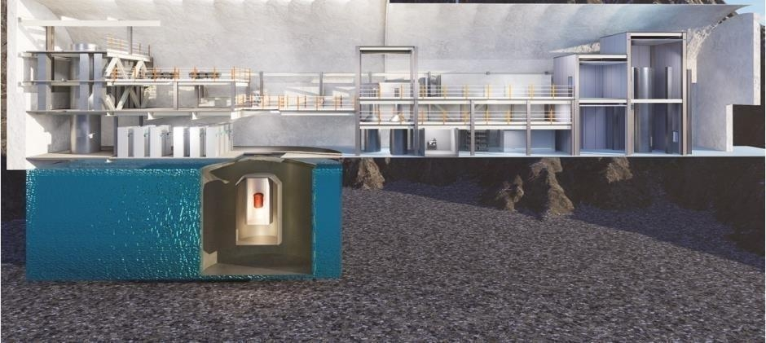
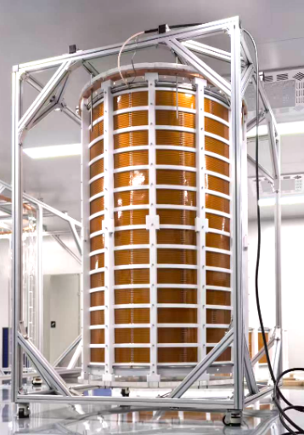
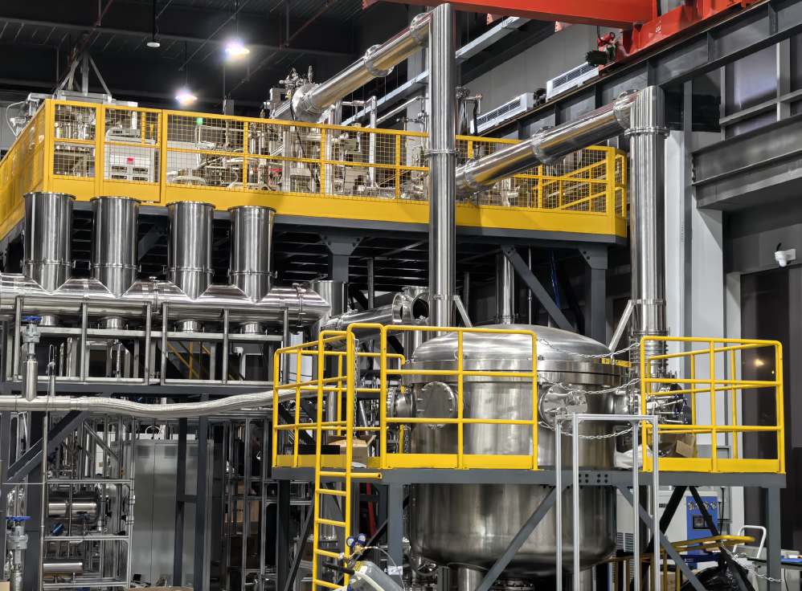
Dark Matter & Neutrinoless Double Beta Decay
PandaX as a discovery tool
EXPERIMENTAL PROGRAM
Step-wise scaling toward an “ultimate” 40-ton liquid xenon detector at 2,400 m deep underground
2020-2026 PandaX-4T completed
2026-2030 PandaX-20T 2027 in operation
2031 - PandaX-40T next future
Very rich physics opportunities
Search for dark matter all the way to “neutrino floor”
Precise low-E astrophysical neutrino observatory
Search for Majorana neutrino to 15 meV mass sensitivity
Looking for international collaboration (visiting IN2P3 tomorrow)!
A multi-purpose ultralow background LXe Observatory
05 / 13

Slide 7
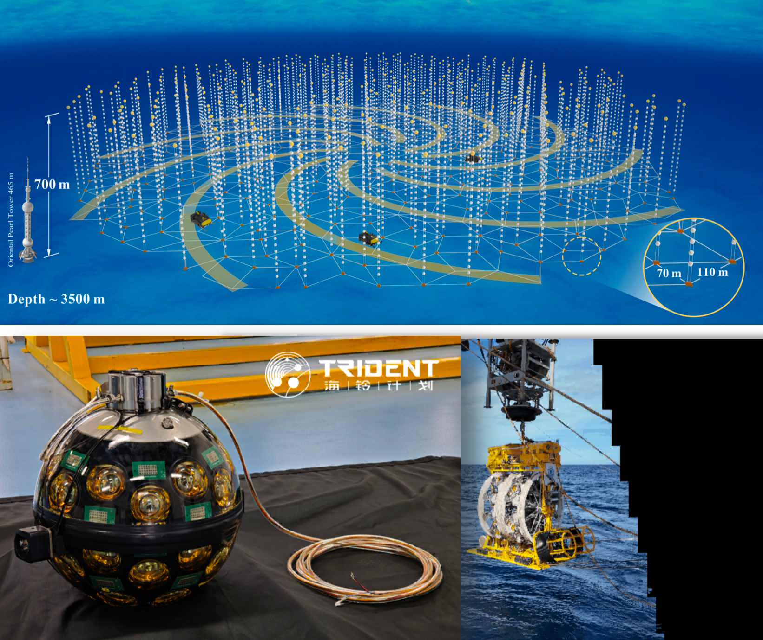
High Energy Neutrino & Multi-messenger Astrophysics
TRIDENT — opening the high-energy neutrino window from the West Pacific
EXPERIMENTAL PROGRAM
TRIDENT-I 0.1 km³-scale Cherenkov array
10 strings with hybrid digital optical modules ~3,500 m depth, 800 m vertical instrumentation height
Key technological demonstrator
Future TRIDENT full array, 10 km³-scale Cherenkov array (scaling up in steps)
Understand the origin of ultra-high energy cosmic rays
Messengers for extreme cosmic conditions
Fundamental neutrino properties
THE SOUTHERN-HEMISPHERE COMPLEMENT TO ICECUBE — IN West Pacific.
06 / 13

Slide 8
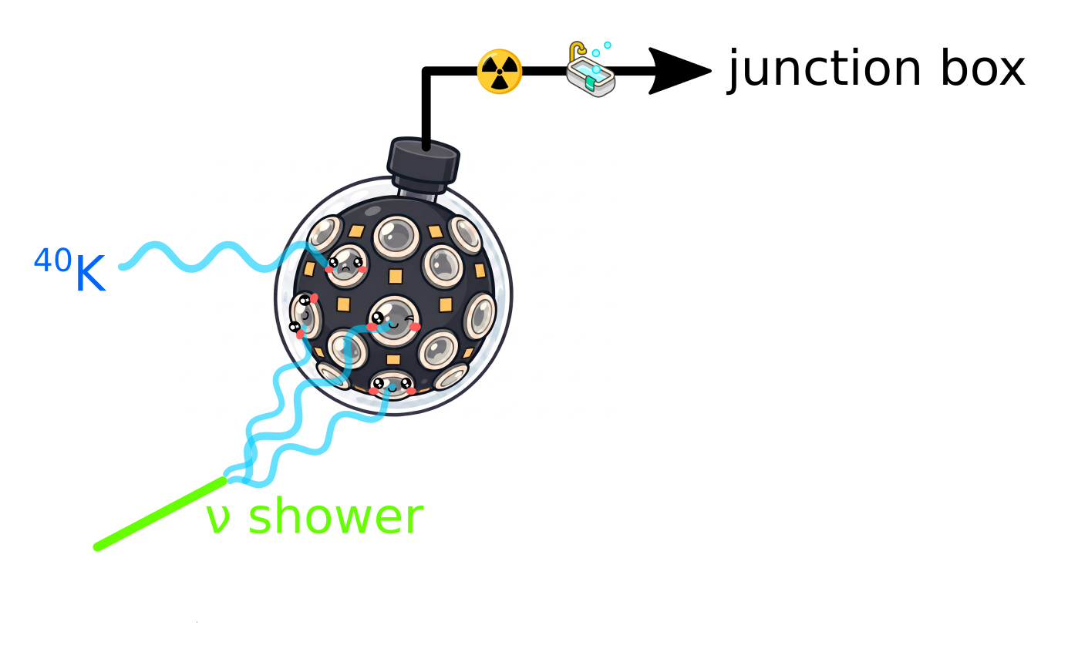
Strong synergy with APC’s KM3NeT program
Commit to establish long-term student and postdoc exhanges between two groups
Joint analyses between KM3NeT and TRIDENT Phase-I data to boost physics potential
Form a task force to understand the hDOM / mDOM (radioactivity) backgrounds, aiming to boost DOM-level neutrino detection efficiecy, eg MeV SNe neutrinos.
T. Cartraud (2026)
Building stronger ties with APC partners (visiting IN2P3 tomorrow)!

Slide 9
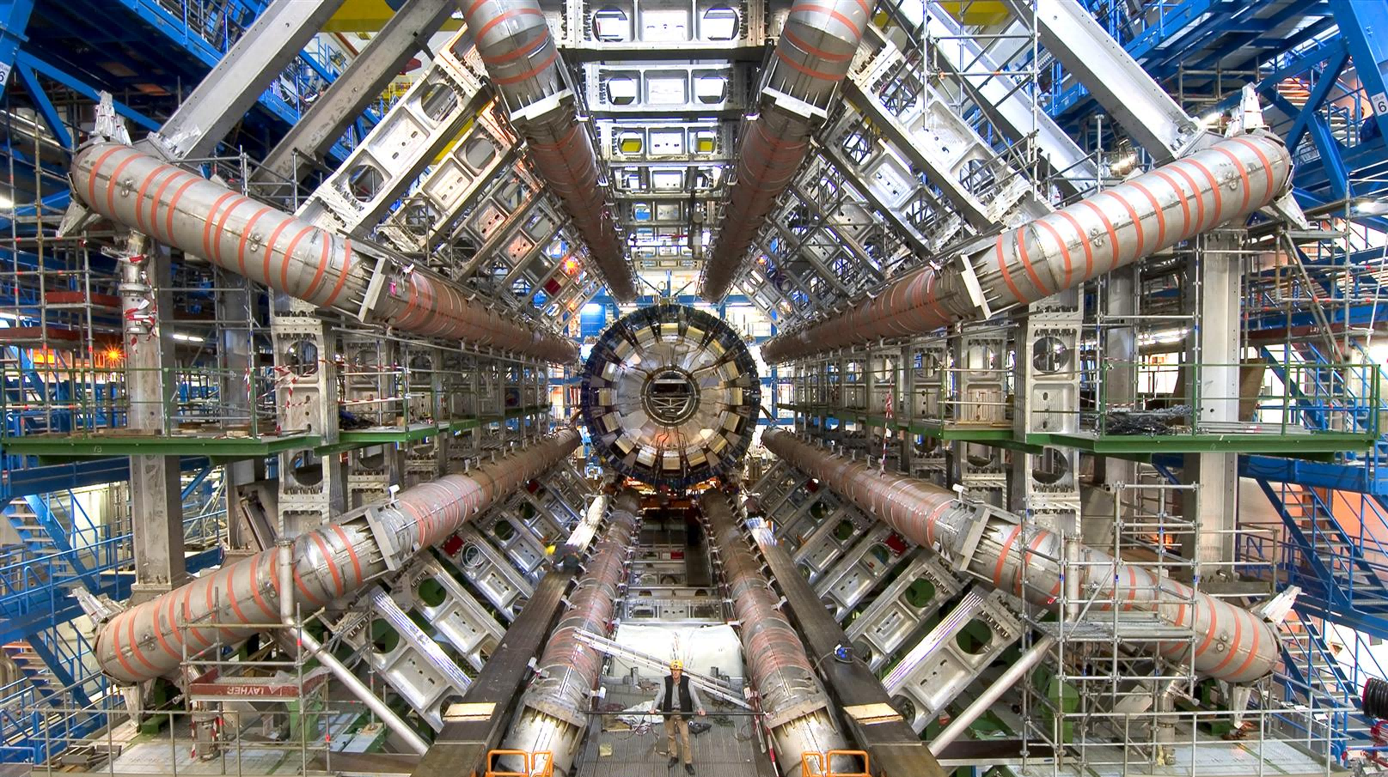
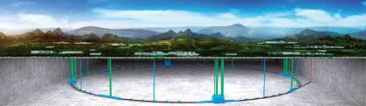
Higgs as a Portal to New Physics
From LHC Run 3 today to a Higgs/flavour factory tomorrow
EXPERIMENTAL PROGRAM
ATLAS at LHC · Run 3 → HL-LHC
Higgs property measurements, electroweak physics, BSM searches
Advanced detector R&D
Continuing engagement on CEPC calorimeter R&D
Technology also applicable to Super tau-charm factory
ENERGY FRONTIER (LHC) + INTENSITY FRONTIER (CEPC/STCF).
07 / 13

Slide 10
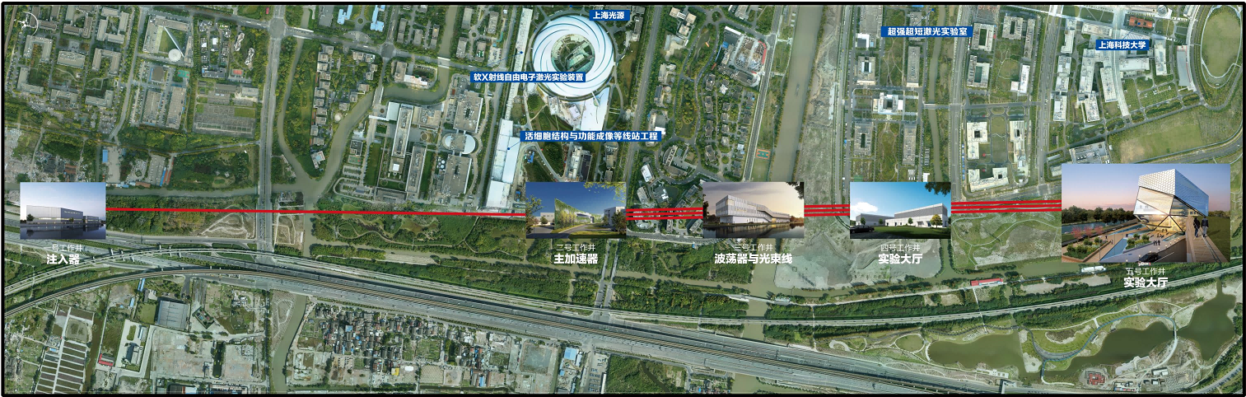
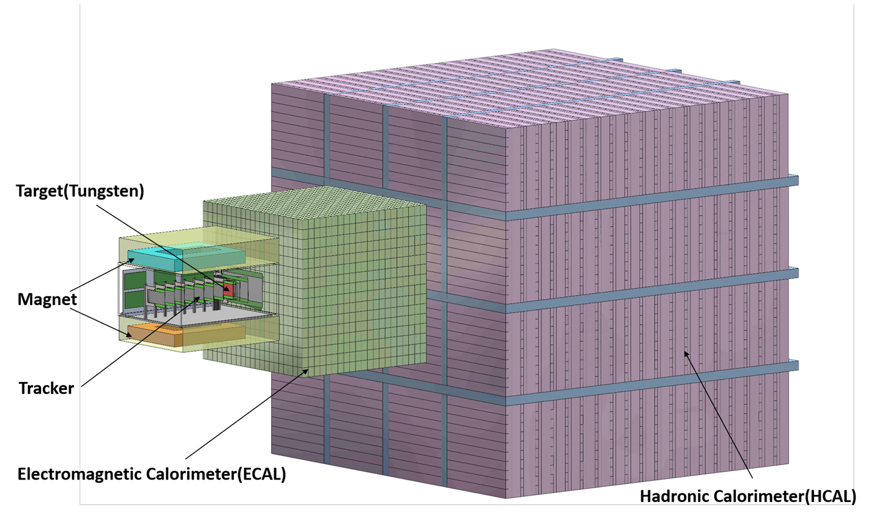
Beam dump @ SHINE
DarkSHINE — exploiting Shanghai SHINE's 8 GeV electron beam
EXPERIMENTAL PROGRAM
GeV electron beam at Shanghai SHINE
Facility under construction;
DarkSHINE schedule tracks SHINE commissioning (2028)
Tungsten-target missing-energy spectrometer
Tracker (Silicon Strip) - ECAL (Crystal) - HCAL (Sampling)
Beam-tested ECAL & electronics prototypes
Characterized at CERN and at DESY in 2024–2025
A NATIVE SHANGHAI EXPERIMENT — DETECTOR AND ACCELERATOR ON THE SAME CAMPUS.
08 / 13
Notes:
T9 H2?

Slide 11
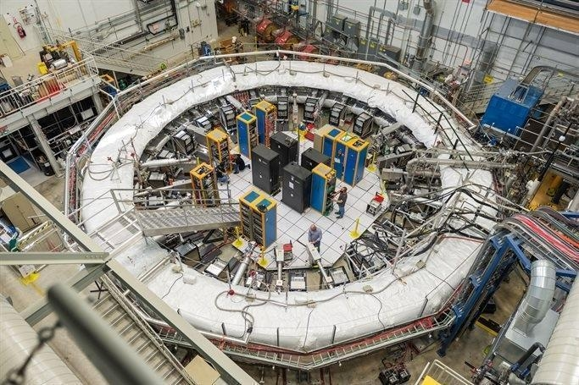
The Muon Precision Frontier
From Fermilab to PSI to Shanghai — a fundamental muon program
EXPERIMENTAL PROGRAM
Muon g–2 at Fermilab · final analysis
Breakthrough Prize 2025
TDLI is a long-term collaboration partner
Muon EDM at PSI (Switzerland)
Novel frozen-spin technique; muon trigger detector
SHINE muon facility — Shanghai
Production target R&D under way; Phase-0 prototype
MUONS AS A HIGH-LEVERAGE PROBE OF NEW PHYSICS — ACROSS THREE CONTINENTS.
09 / 13

Slide 12
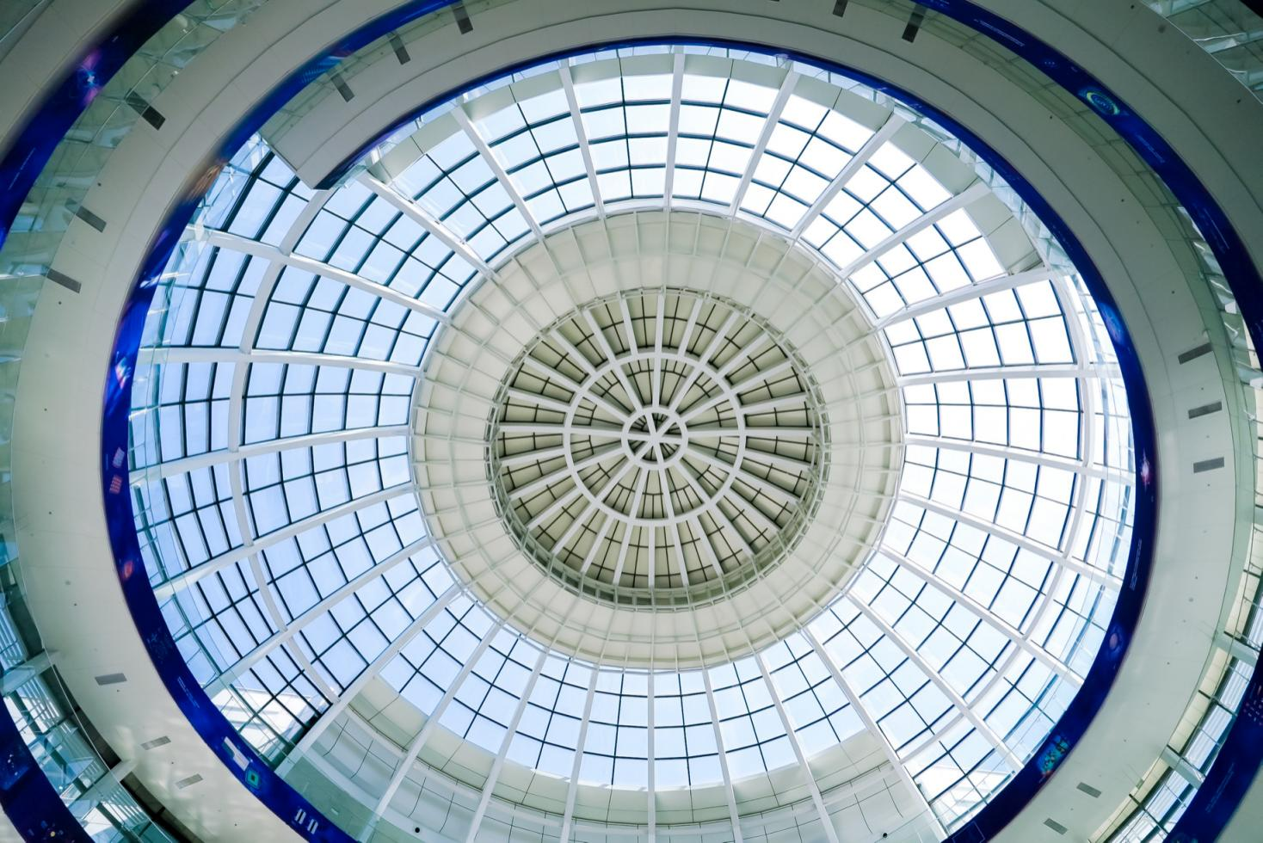




By the Numbers (2025)
Sustained funding and a steady pipeline of high-impact publications
87
¥ 222M
~150
13
Active grants
Total funding (RMB)
SCI papers
PRL
11 / 13
Notes:
remove?

Slide 13

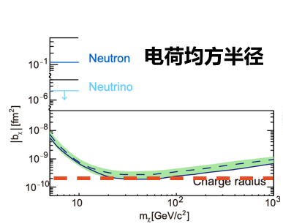
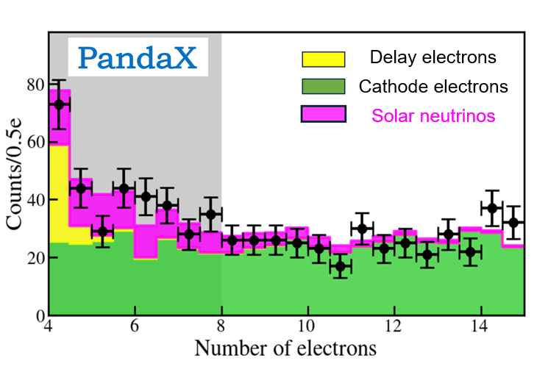
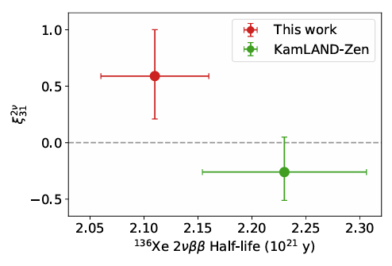
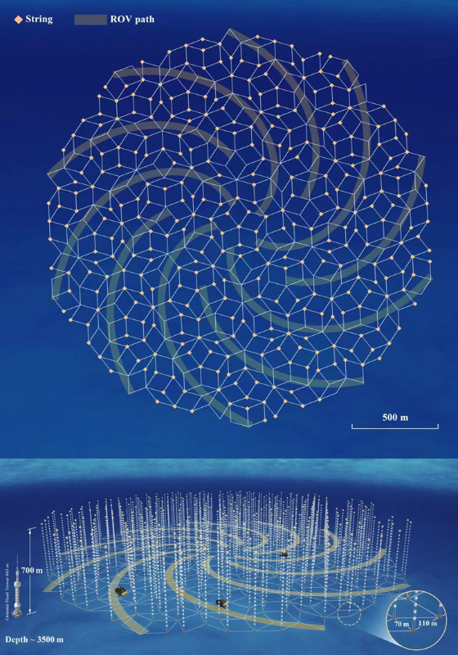
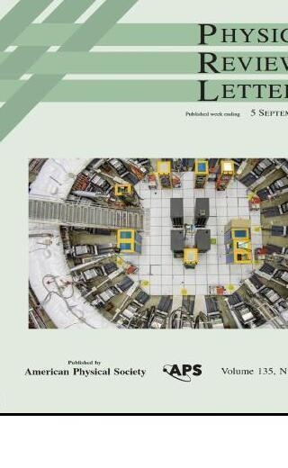
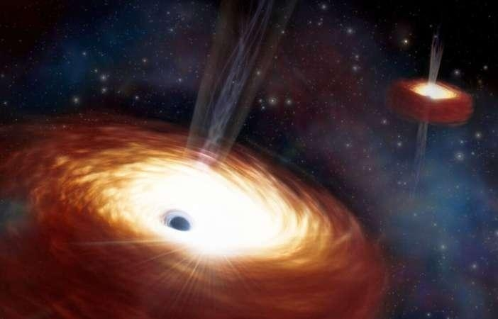
Selected Research Highlights
PandaX
PandaX
PandaX
Strongest constraints on the “luminance” of dark matter
First solar ⁸B neutrino CEνNS indication
Most precise measurement to two-neutrino double beta decay of ¹³⁶Xe
Nature 618, 7963 (2023)
PRL 133, 191001 (2024)
PRL 136, 162501 (2026)
TRIDENT
Muon g-2
Phenomenology
Site and conceptual design for TRIDENT, a neutrino telescope in West Pacific
Most precise muon g–2 measurement
Gravitational wave background probing galactic center density
Nature Astron. 7 (2023) no.12
PRL 135, 101802 (2025)
Nature Astron. 10 (2026) no.4
12 / 13

Slide 14
THANK YOU
We welcome partnership
with European institutions.
Visiting scholars · joint postdocs · students exchange · joint grants
DIVISION HEAD
DEPUTY HEAD
WEB
Xiao-Gang He
Ning Zhou
tdli.sjtu.edu.cn
hexg@sjtu.edu.cn
nzhou@sjtu.edu.cn
Shanghai · China
TSUNG-DAO LEE INSTITUTE · SHANGHAI JIAO TONG UNIVERSITY

