Slide 1
AGATA Project
12 link Bay STARE and EMC issues monitoring
N. Karkour et al.

Slide 2
Outline
  When did the idea germinate
  Why do we need this Bay
  12 Link Bay functionalities
  From 12 link to 150 Gbps Bay qualification
  EMC report and recommendations

Slide 3
When did the idea germinate
Slow Control for PACE
Slow Control for STARE
STARE Firmware and IPbus
Slow Control for Digiopts
PACE Firmware and Ipbus
DECOD SQM RUDP etc.
Topology Manager for STARE PACE
IJCLab Orsay
INFN & U. Milano
SCOPE Monitoring
STARE
Topology Manager for STARE standalone
Topology Manager for STARE Emulateur
IFIC Valence

Slide 4
When did the idea germinate
Total number of cristals is 120
Topology Manager configuration is not easy
  Needs test benches for several types of HW and SW developpement
  Stare alone for the STARE firmware development
  Stare with PACE for HW and FW tests and qualification of the V2 electronics
  Stare emulation software to check for DAQ improvements and new programs validation.
  Online monitoring link to see
  Each board type has its own scripts to setup reset load save recall etc…
Must validate all software packages before installation in Legnaro
Must test in standalone
We need to validate the RUDP along with UDP and compare using multiple STAREs

Slide 5
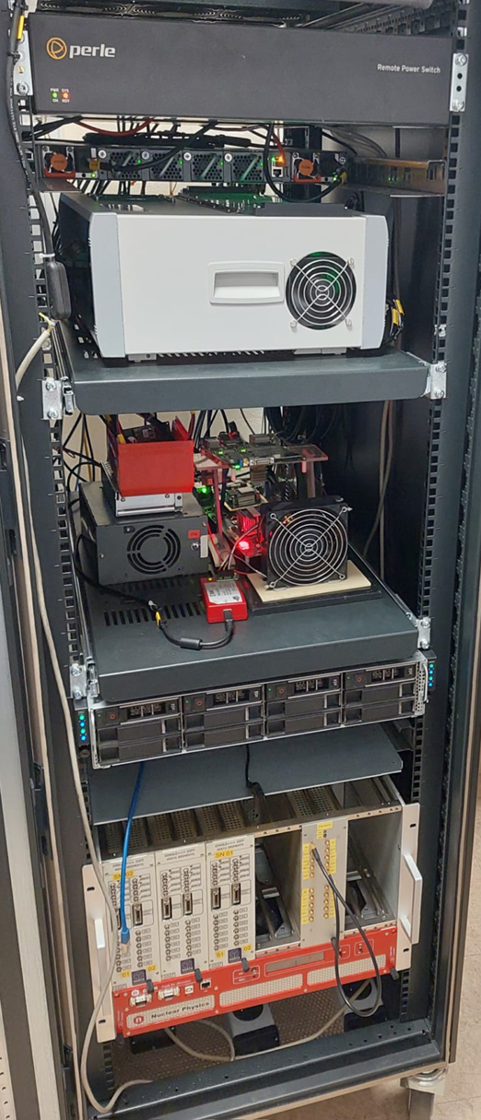
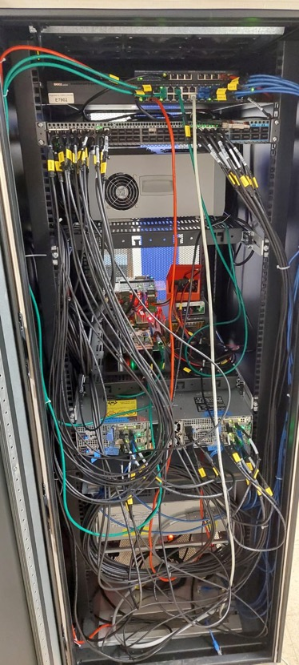
12 Link Bay characteristics
STARE Data Readout
Power Switch for remote control
Completely controlled from remote
New V2 electronics Hardware
Full cooling system , Fans, PS mechanics to fix the backplane.
12 x 10 Gbps links Stare bench
100 Gbps switch to transfer to Bat206
Power switch for network control
Up to 8 DAQ servers (4 are already installed there already)
External control via mini-PC
Cristal emulator (HighResolution Pulser + faninfanout + single_diff + MDRs etc.)
100 Gbps Optical Switche
STARE 12 links
PACE Test Bench (in a crate *)
Up to 2 Pizza boxes
(8 DAQ servers)
Cristal emulator *
Front
BACK
* Missing HRP and other modules

Slide 6
12 Link Bay functionalities
We propose to simulate 38 High resolution low noise pulses to the PACE board and analyse the data contents
Validate the Slow Control using multiple cristal configuration
Validate the AGATA monitoring system in order to see continuous triggered signals.
We need to validate the DAQ software and make it more reliable.
All this development is done is parallel
All this cannot be done with a simple test bench

Slide 7
12 Link Bay functionalities
Recently we started to make integration tests in Legnaro and we did lot of progress because of the Bay architecture which includes a simple PACE STARE test bench.
We can make parallel development (We can test firmware development on one stare and test Topology manager on other STAREs, or Slow control on one or 2 STARE and firmware on PACE in parallel
Topology Manager configuration can be qualified using STARE, STARE with PACE and STARE emulator
We can validate SC TM and DECOD before installation in Legnaro (Completely Crucial for the ongoing physics experiments to start quickly)
Remember Legnaro 2009 and GSI 2012 plus beginning of GANIL phase in 2014
We can mix RUDP readout from STARE emulator with UDP readout from true STARE and compare if RUDP is needed

Slide 8
12 Link Bay functionalities
What is Still needed?
we have a preliminary very primitive PACE STARE couple to test the STARE readout. It needs to be a complete V2 electronics crate with water cooling system to be as close as possible to the Legnaro V2 electronics installed now.
We need a High resolution low noise pulser to simulate detector preamplifier signals to the DIGIopt12 boards board and analyse the data contents of the PACE board and compare to Legnaro tests.
We can have a scope of 48 channels for the AGATA monitoring system in order to see continuous triggered signals.
The DAQ box will be connected to a 100 Gbps link to qualify reliability .
All this development is done is parallel

Slide 9
First Full qualification
This test was done in Orsay with the STARE Dream Team (IP2I IPHC and IJCLAB).
Several tests were made on March 2026 to stamp the use or not of the RUDP inside the STARE for data quality insurance.
Several configurations were programmed by the Topology Manager to transfer data at different rates and different use (soft emulator, AGATA events, and monitoring).
Start with 18 links and go up to 24 (plus 6 soft emulators from the C6400)
18 links come from 12 link crate, 1 stare Tb and 1 PACE STARE module.
The DAQ box @ Bat. 206 connected to a 100 Gbps link to qualify reliability .

Slide 10
First Full qualification
Test 1
18 Stare links @5kHz (AGATA plus PSA)
SQM->SQM2ADF->PreProcessing->PSA->BasicAFC
Launch OK (11:10 AM) on all 18 links.
After a few minutes, link 06C loses packets (received on snode053). Backpressure from the PSA is suspected.
Swapping 06C (snode053) and 06B (snode043): the problem reappears on 06C on snode043 --> confirms the PSA is too slow depending on the frame selected for crystal 06C.
Apart from this problem related to the test data, the acquisition works correctly for 45 minutes

Slide 11
First Full qualification
TEST2
18 Stare links + 6 soft emulator links @5kHz
The STARE generator is configured to send a single known ADF frame.
SQM->SQM2ADF->PreProcessing->PSA->BasicAFC . Topology: 18 links, 6 emulators, Stare, PSA
Launch OK (12:00 PM) on all 18 + 6 links.
The topology ran for 2 hours and 15 minutes. Losses occurred on two crystals, 06C and 12C. 06C is known to cause problems (replaced with 05C), and 12C exceeded the PSA output buffer size (the buffer was increased from 8 to 32 MB).
Souhir's monitoring test: it didn't work for the software emulators because the python3-redis module wasn't installed on the machines.
After installing python3-redis, the 18+6 topology was restarted at 20 kHz with monitoring enabled (Back Pressure management Nicolas Talk).

Slide 12
First Full qualification
Test 3 - 4:44 PM
18 Stare links + 6 soft emulator links @20kHz and above SQM->SQM2ADF->BlackHole
Preprocessing and PSA are removed to increase throughput.
The Stare links are then increased to 50kHz: no packet loss for 10 minutes.
We increased the Stare speed to 4800 Mbps (approximately 73 kHz): packet loss occurred after a few minutes (we were at 95 Gbps on the 100 Gbps link). This problem will need to be diagnosed once we have network monitoring.
6:05 PM: For the night, we used a Stare random number generator at 50 kHz (x18) + 6 software emulators at 20 kHz. SQM->SQM2ADF->BlackHole
After 15 hours of operation, there were no packet losses on the Stare links, but some losses on the software links. This could be due to a different network packet transmission profile between the software emulators and the Stare. The software emulator stores several hundred frames in a buffer and sends them all at 10 Gbps, then adjusts the pause duration to achieve the desired count rate. The Stare sends packets on the UDP link frame by frame with a variable interval between each frame to achieve the desired count rate.

Slide 13
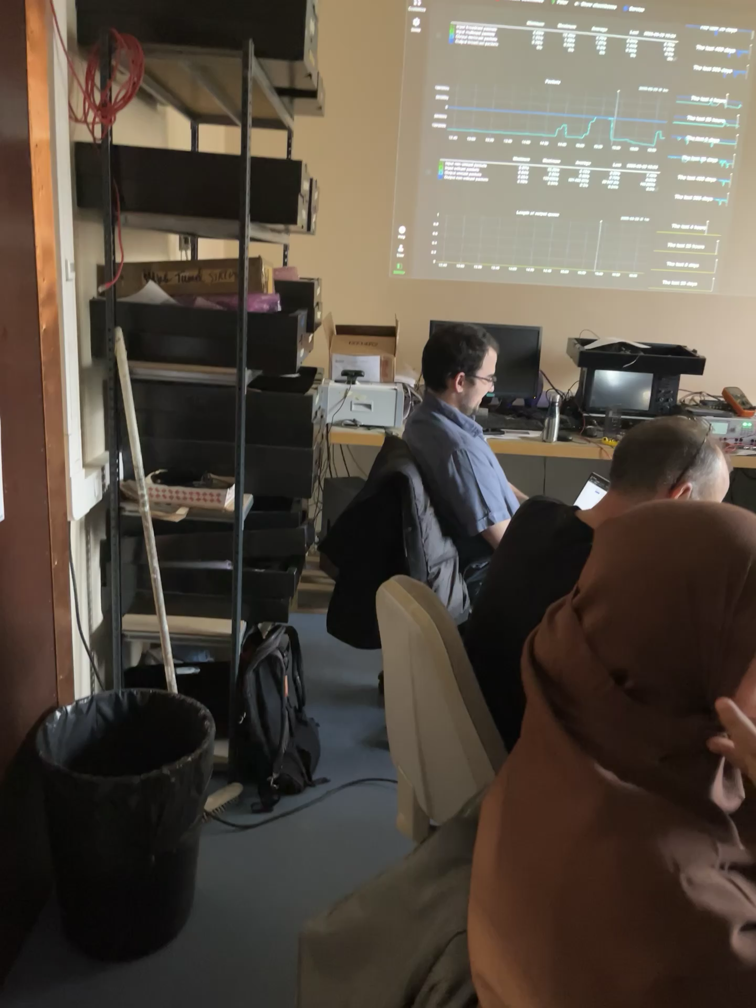
First Full qualification
Thanks to Xavier, Nico, Souhir, Patrick, Mathias, Guillaume, Olivier et Christian le DreamTeam Stare

Slide 14
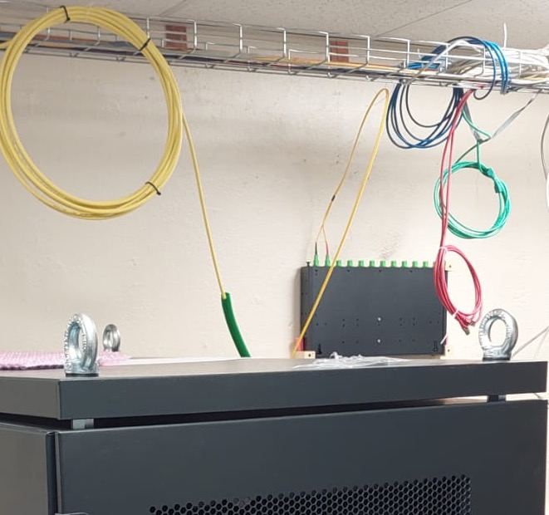
First Full qualification
Conclusion :
STARE Readout was qualified up to 73 kHz using 18 links in parallel @ 100 Gbps link going from 104 to 206.
This confirms that RUDP is not needed because if RUDP is activated the readout speed goes down to 6 Gbps (at max). While normal UDP can go up to 7 Gbps without any losses.
Server and Switch configurations are mandatory to insure no packet loss.
Slow Control was tested but when used a readout link is taken off. Hence a second 100 Gbps link is needed for monitoring.
Next is to build a second crate of 12 links for monitoring in order not to change the Topology manager every time we need to test a readout link.

Slide 15
First Full qualification
An IEEE paper is written for the 2026 NSS Nuclear Physics Symposium

Slide 16
EMC @ LNL April 2026
EMC Report on actual and future visits to Legnaro

Slide 17
EMC Development Plan
Long traces and Scope signal monitoring is crucial, as well as other parameters like LVPS or HVPS or other parameters to measure.
We must have an eye on each part of AGATA without touching the instrument.
Monitoring MUST be made physically on the signals and without generating noise
We need detailed and synchronised monitoring of :
Low Voltage Power supplies for Preamps.
High Voltage Power supplies for detector biaising (Discussion started with CAEN).
ADC Long Traces and Preamplifier outputs.
Other parameters are needed (why peak shift for Co).
Many answers could be hidden within experts long time qualification and experiences

Slide 18
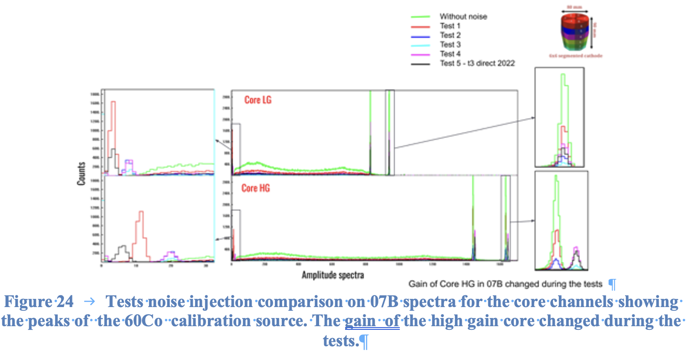
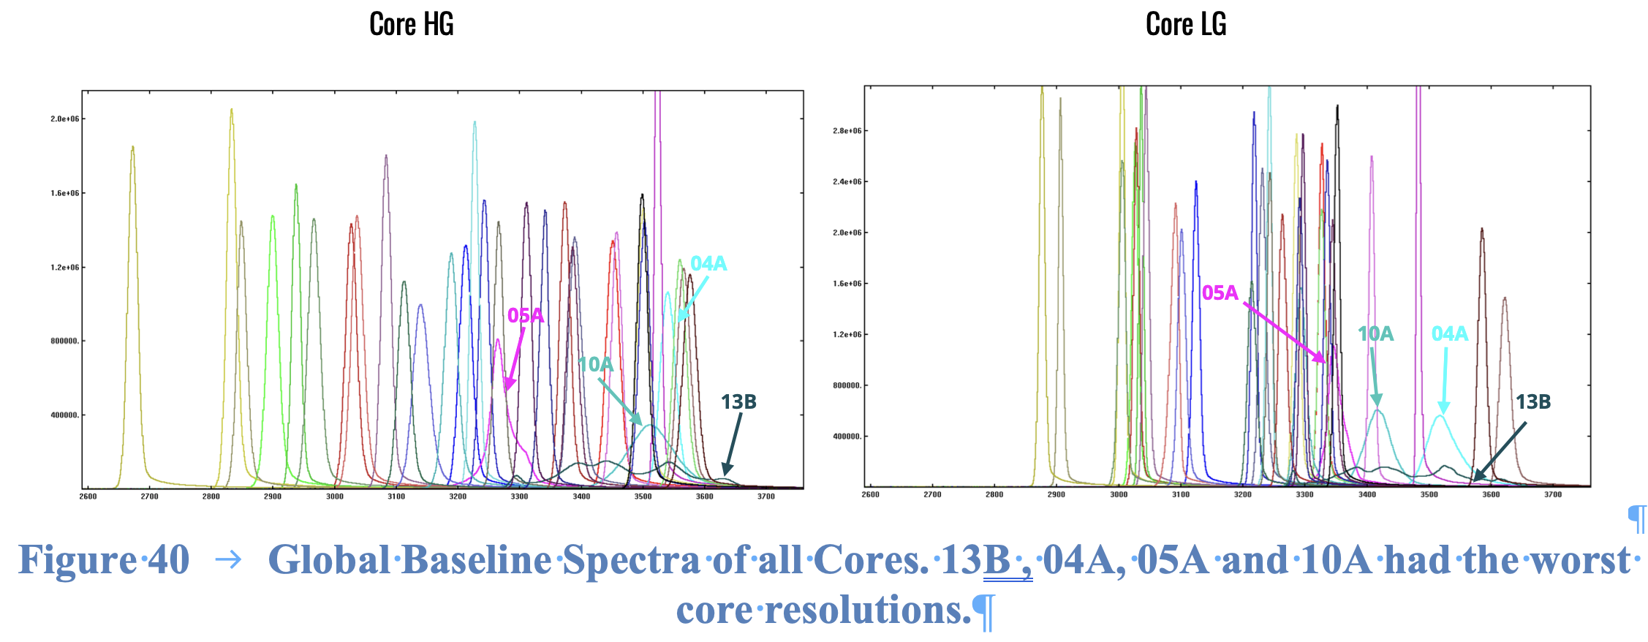
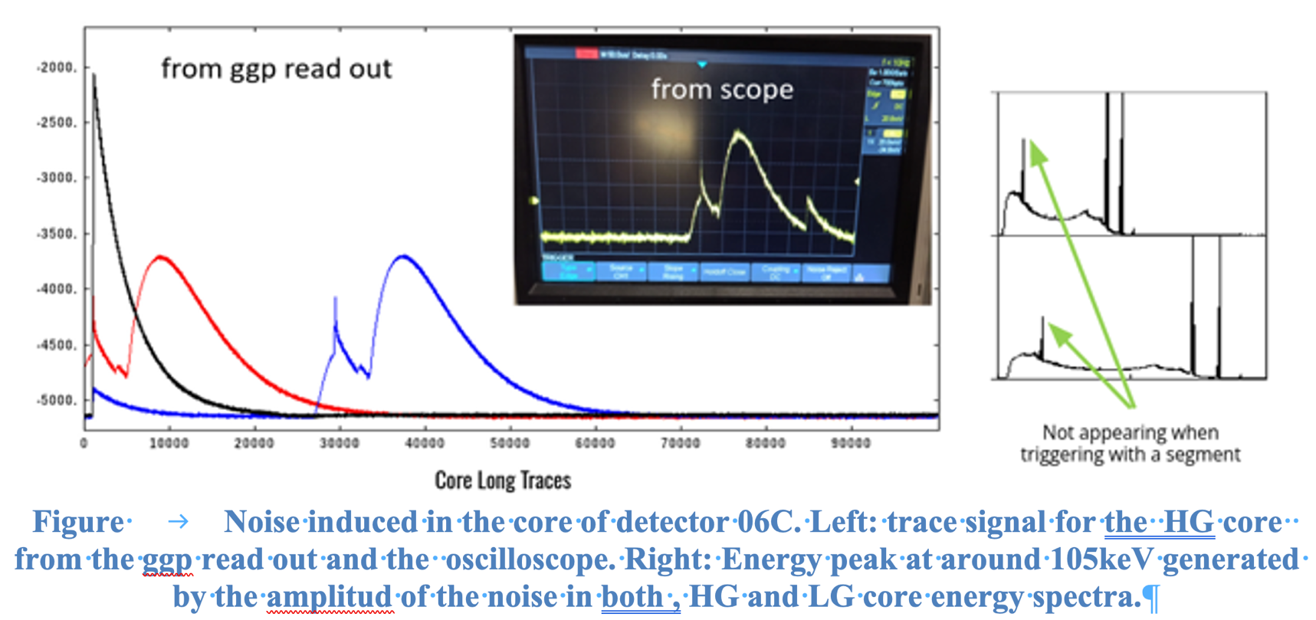
EMC Development Plan

Slide 19
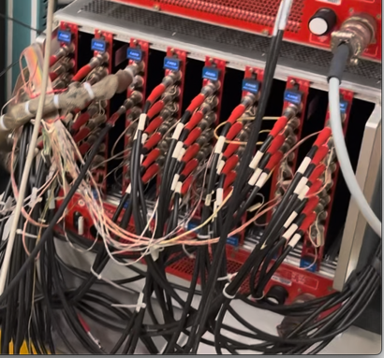
EMC @ LNL April 2026
HV Qualification
The procedure to qualify the AGATA HV output baseline is based on several steps:
An HV decoupler is lent gently by the CAEN company to check for ripple voltage signals.
The needed HV output to the detector is replaced by another output with the same HV on that detector and this output is connected to the Decoupler .
The HV baseline signal is analysed on the scope using Vp-p and FFT frequency analysis.
The HV is then plugged back into the detector and the core output preamplifier baseline spectra using long trace is recorded and plotted.
Figure 1 AGATA High Voltage crate

Slide 20
EMC @ LNL April 2026
HV Scheme tests

Slide 21
EMC @ LNL April 2026
The HV decoupler has its limitations in frequency cutoff @ 6 and 8 MHz.
Hig frequency signals level is reduced.
Test of the noise @ 0V and the results are the same.
The following tests were made @0V without the HV decoupler.
The 50 ohm load is taken out because in reality the HV is a high impedance .

Slide 22
EMC @ LNL April 2026
NON Shielded 20 cm Decoupler Cable
Instrinsic HV Noise and external EMC Noise

Slide 23
EMC @ LNL April 2026
Shielded 20 cm Decoupler Cable
Instrinsic HV Noise

Slide 24
EMC @ LNL April 2026
0 kV 1 Mohm load direct connection to scope
The HV decoupler has its limitations in frequency cutoff @ 6 and 8 MHz.
High frequency signals level is reduced.
Noise test @ 0V and the results are the same.
The following tests were made @0V without the HV decoupler.
The 50 ohm load is taken out because in reality the HV is a high impedance .

Slide 25
EMC @ LNL April 2026

Slide 26
EMC @ LNL April 2026

Slide 27
EMC @ LNL April 2026
Most significant noise frequency selected .
104 kHz.
3,125 MHz.
52 kHz.
Huge bump from 3 to 5 kHz

Slide 28
EMC @ LNL April 2026

Slide 29
EMC @ LNL April 2026

Slide 30
EMC @ LNL April 2026

Slide 31
EMC @ LNL April 2026
CONCLUSION
In this report there are lot of information which was discovered about the HV modules. It is clear that the outputs are noisy for the AGATA requirements and a simple solution is required. Discussions will be engaged with CAEN to decide what is the most possible solution.
First recommendation is to develop an automatic Baseline spectrum and define which tolerance is acceptable in measuring the FWHM of the core baseline. Some issues can come from the LVPS and this is the goal of the next trip to Legnaro. Moreover, The Autofill EMC connections should be verified and qualified to check for good grounding in the Autofill. Also, there is a way to check for the autofill status and stop the acquisition if the Autofill generates noise.
It is better to detect problems early by making this automatic scanning on the CORE Baselines. There are several issues to the core bad resolution or noise issues :

Slide 32
EMC @ LNL April 2026
Future visits to Legnaro
For the Agata Installation at zero degrees The EMC must be taken into consideration..
Few meetings to discuss with the mechanical engineers and infrastructure group.
2 or more EMC campaigns to be realized prior to the AGATA installation.
New recommendations to the AGATA experiments should be taken in considerations.

Slide 33
MERCI

