Slide 1
Agata Steering Committee meeting
(University of York, April 23-24 2026)
Chair: Magda Gorska (vice chair: Magda Zielinska)
New members: D. Mengoni replaces G. De Angelis
S. Leoni replaced A. Bracco already at the Salamanca meeting (nov 2025)
A. lopez-Martens

Slide 2
Agenda
Funding situation update in each country
Slovakia joining collaboration: presentation and discussion/recommendation
ASC policy for participating institutions: minimum budget/year
Duration term of ASC and ACC members discussion
Core author policy voting
New ASC chair elect voting (candidate: A. Boston, UK)
CERN Recognized Experiment status for AGATA discussion
ACC report
AMB report
ARRB report
Budget report
Nustar report

Slide 3
New contribution from Slovakia
Slovakia is considering investing in AGATA as a way to attract more young people into nuclear science
Plan to invest 1 M€ for a full ATC (3 capsules, cryostat, electronics, daq, infrastructure & mechanics)
ASC voted to accept Slovakia into the ASC with oberver status until the funds arrive
(hopefully sometime late 2026, 2027)

Slide 4
New Core author list policy
For researchers and engineers in permanent positions, inclusion in the core list requires a sustained contribution to technical or managerial tasks related to the campaign, averaging at least 10% of their time over the year
Researchers & engineers on non-permanent contracts or stipends whose primary responsibilities were related to the campaign preparation or technical developments should be included in the core list, provided their AGATA-related activities (excluding experiment analysis) spanned a minimum of two years.
Individuals in technical positions are not included in the core list.
=> Acknowledgement list at the end of every article together with funding agencies & contract codes

Slide 5
➔ New IJCLab core list
S. Elloumi
N. Dosme
N. Karkour
A. Korichi
V. Lafage
X. Lafay
P. Le Jeannic
D. Linget
A. Lopez-Martens
L. Gibelin a été inscrit sur la liste technicien

Slide 6
Recognised CERN experiment
https://committees.web.cern.ch/rec-exp-status
History (late 90s): Recognized experiment status responds to a desire to intensify links with non-CERN experiments (triggered by the request for services at CERN by AMS (Alpha Magnetic Spectrometer))
➔ Recognized Experiment Status
CERN is prepared to recognize experiments in fields allied to particle physics, such as astroparticle or nuclear physics, provided they meet the requirements listed here.
Granting the status of Recognized Experiment does not imply that CERN has in any sense approved the experiment.
Recognized Experiments will be able to:
- register members of the experiment as CERN users (at no more than 30% of their working time), without implying that office space is assigned;
- use CERN's premises to organise meetings;
- use basic services such as standard personal computing accounts;
- open third-party accounts for visiting research teams if justified,
all provided that the cost for CERN is truly marginal, and that approved CERN activities always take priority
Other services the experiment may wish are beyond the scope of a Recognized Experiment, and require dedicated Collaboration Agreements.
Notes:
AMS mounted on the ISS to measure antimatter in cosmic rays

Slide 7
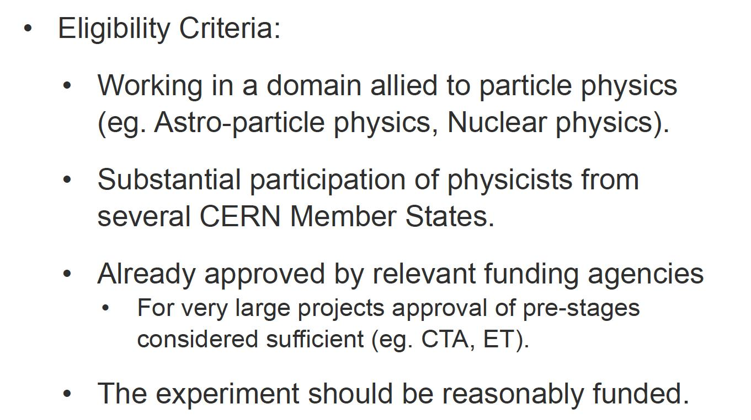
Conditions
AGATA meets ALL criteria !

Slide 8
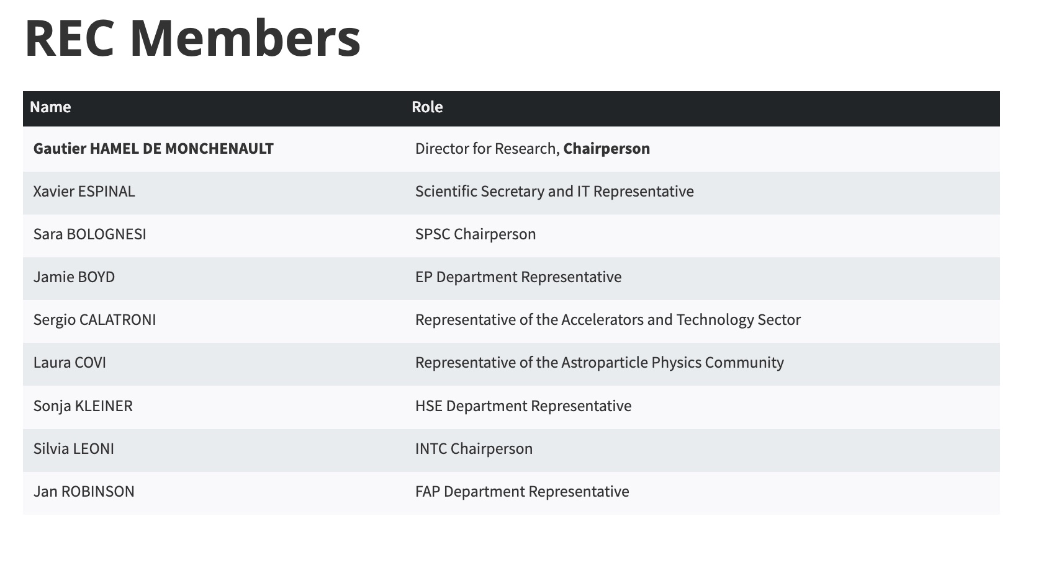
Procedure
Requets are handled by the Recognized Experiments Committee, chaired by CERN director of research and computing
Replaced M. Pfuftzner april 2026

Slide 9
List of Recognized Experiments

Slide 10
Advantages
acquire a very special label of top class/élite experiment also recognized by High-Energy People
(main, real motivation for all experiments asking for it ...)
more visibility towards funding agencies, advantages in making applications, etc...
more visibility towards CERN
(also in view of a possible future campaign with AGATA at CERN, ...)
small advantages in terms of
CERN access, meetings, direct use of indico pages, ...
Magda Zielinska & S. Leoni to start discussions with chair
(CRE would be a + on top of IR status)

Slide 11
ACC news
Core list modifications on-going and should apply to new LNL papers
Receiving funding codes and technician names to be included in future AGATA papers
Data policy questionnaire sent out, processing answers
New web pages (Johan Nyberg can no longer update/host agata.org, Istvan Kuti (Hungary) is now the webmaster but system is obsolete): discussions on first draft by a Spanish company: https://agata.globalcomunica.com/ (temporary)
The historical gsi mailing list (agata_all) which cannot be managed properly anymore has been replaced by CNRS list (138 registered March 2026)
Need to discuss AGATA@GANIL campaign organisation at the next ACC meeting (elect scientific corrdinator and prepare call for pre-pac)

Slide 12
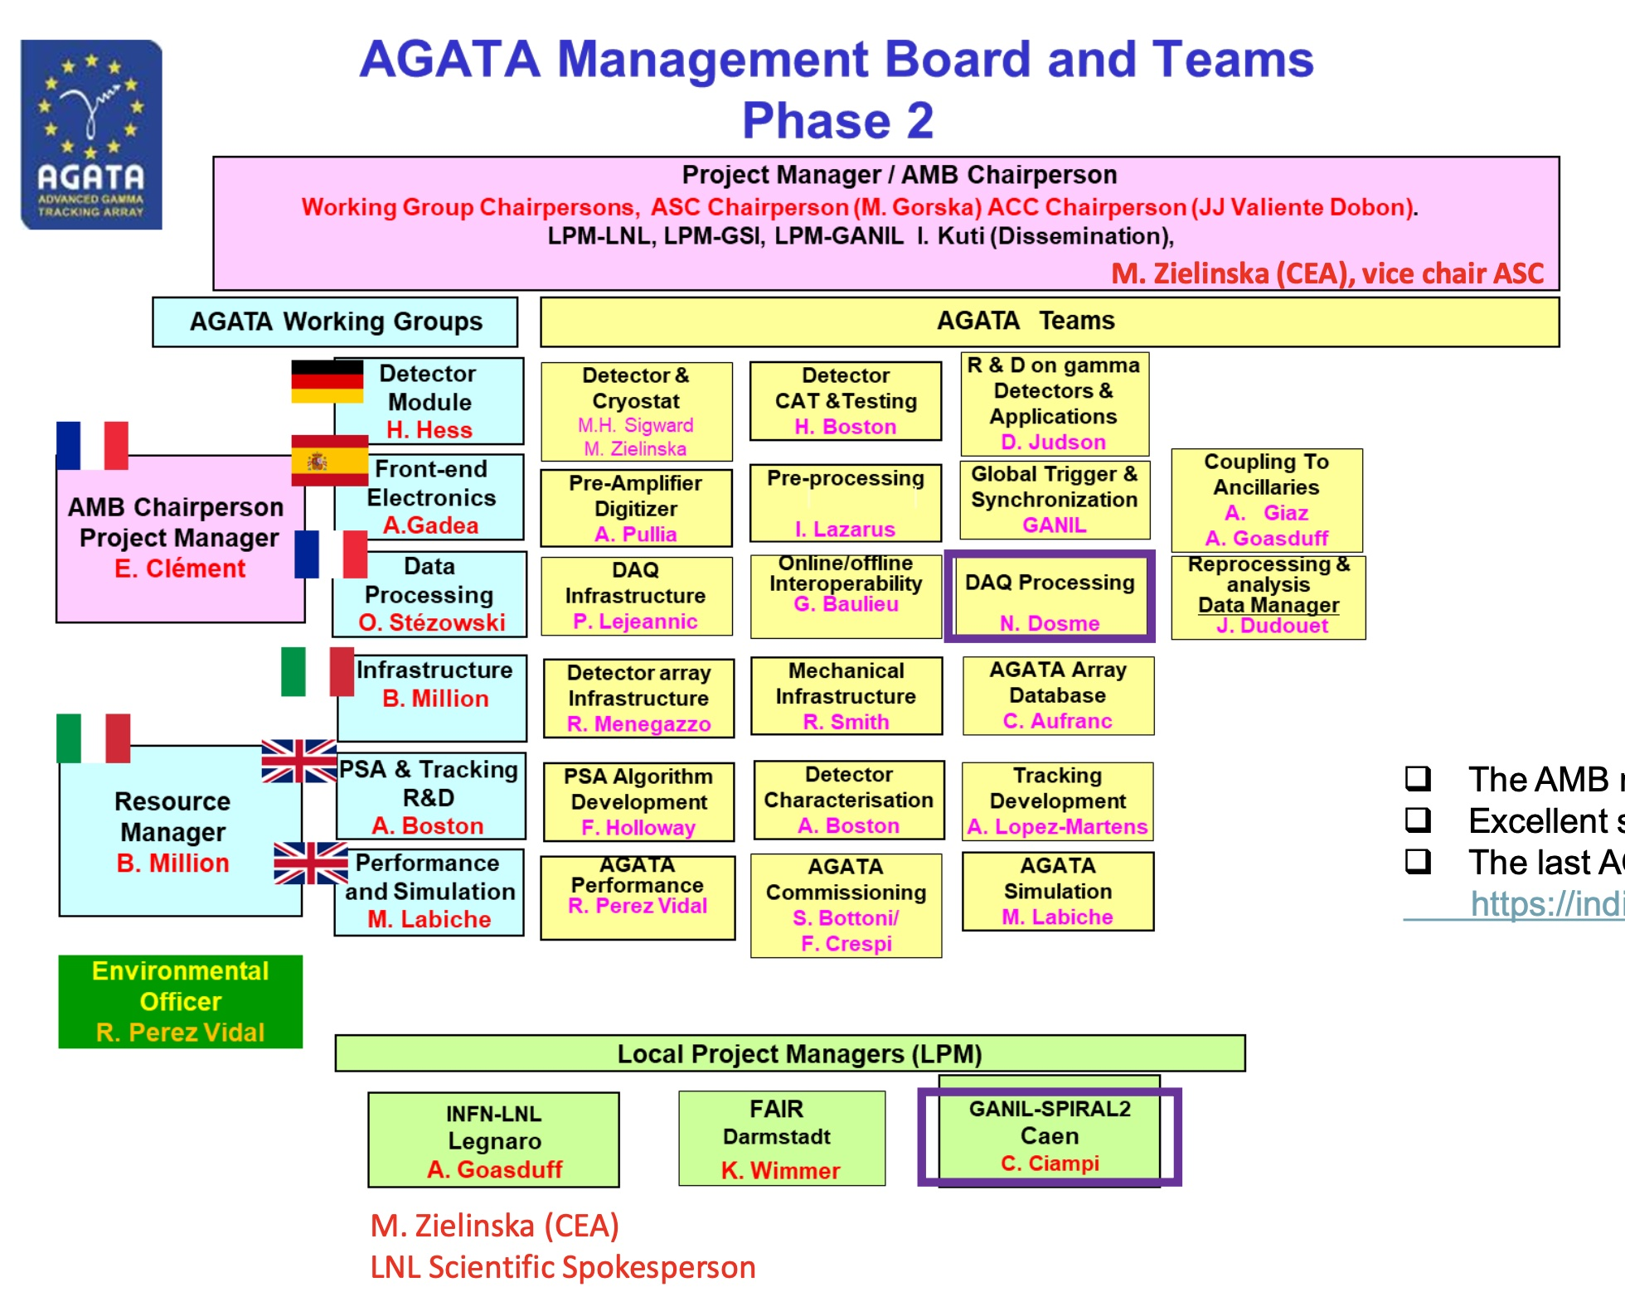
AMB news

Slide 13
AMB news
90 capsules funded (as of 2026)
Major progress on the CTT to Mirion transfer. The 2025 – 2026 orders are still CTT but the next will be to MIRION (cost of an ATC is to be reevaluated after summer 2026..estimate is +50%)
2π infrastructure and mechanics already installed in LNL
The highest priority of the AMB remains the delivery of the V2 system from DIGIOPT12 -> DCOD with Analysis pipe
All v2 2π items are funded
Bottle necks: firmware delivery with high delays & unexpected production issues for the PACE boards and long delivery times for some cables and connectors
The full integration is a milestone of 2026
The second priority is to support the LNL/PD local team in the switch from the « PRISMA » to the 0° campaign
AGATA week in Warsaw in September https://indico.in2p3.fr/event/37746/overview

Slide 14
IMAGe (proposing institue: FAIR/GSI)
WorkPackage 2: “New technologies for Position Sensitive HPGe detectors”, Coordination: A.Gadea, E.Clement
Task 2.1: Development of germanium detector technologies: improving reliability, sustainability, position sensitivity and timing
Subtask 2.1.1 Technological developments of PLM contact HPGe for position sensitive segmented detector production: improving reliability, sustainability, position sensitivity and timing.
Possible Participants: UNIPD, INFN, CNRS, GANIL, MIRION Technologies
Contact person: Davide De Salvador
Subtask 2.1.2 Technological developments on cryostats with electro-cooling technology: Possible Participants: UOC Subcontractor: CTT
Contact persons: Peter Reiter , Herbert Hess
Subtask 2.1.3 Simulations and tests of advanced segmentation patterns and characterization of the p- type prototypes: improving position sensitivity
Possible Participants : CNRS, GSI, ILL, GANIL, MIRION Technologies
Contact person: Gilbert Duchene
Task 2.2: Digital Pre-Amplifier Development
Subtask 2.2.1 Cryogenic and Refrigerated High-bandwidth ASIC pre-amplifier developments for position sensitivity and timing.
Possible Participants: UNIMI, CNRS, CEA, GANIL. Subcontractor: EUROPRACTICE
Contact persons: Stefano Capra, Alberto Pullia, Philippe Vallerand
Subtask 2.2.2 Interconnection of Cryogenic and Refrigerated pre-amplifier to warm digitizer. Possible Participants: CNRS, UOC Subcontractor: CTT
Contact person: Nabil Karkour
Subtask 2.2.3 Low-Power, Low-Noise ADC System and pre-processing electronics for Cryogenic and Refrigerated ASIC Pre-Amplifier Readout.
Possible Participants: UVEG, UNIMI, CSIC
Contact person: Vicente González Millán

Slide 15
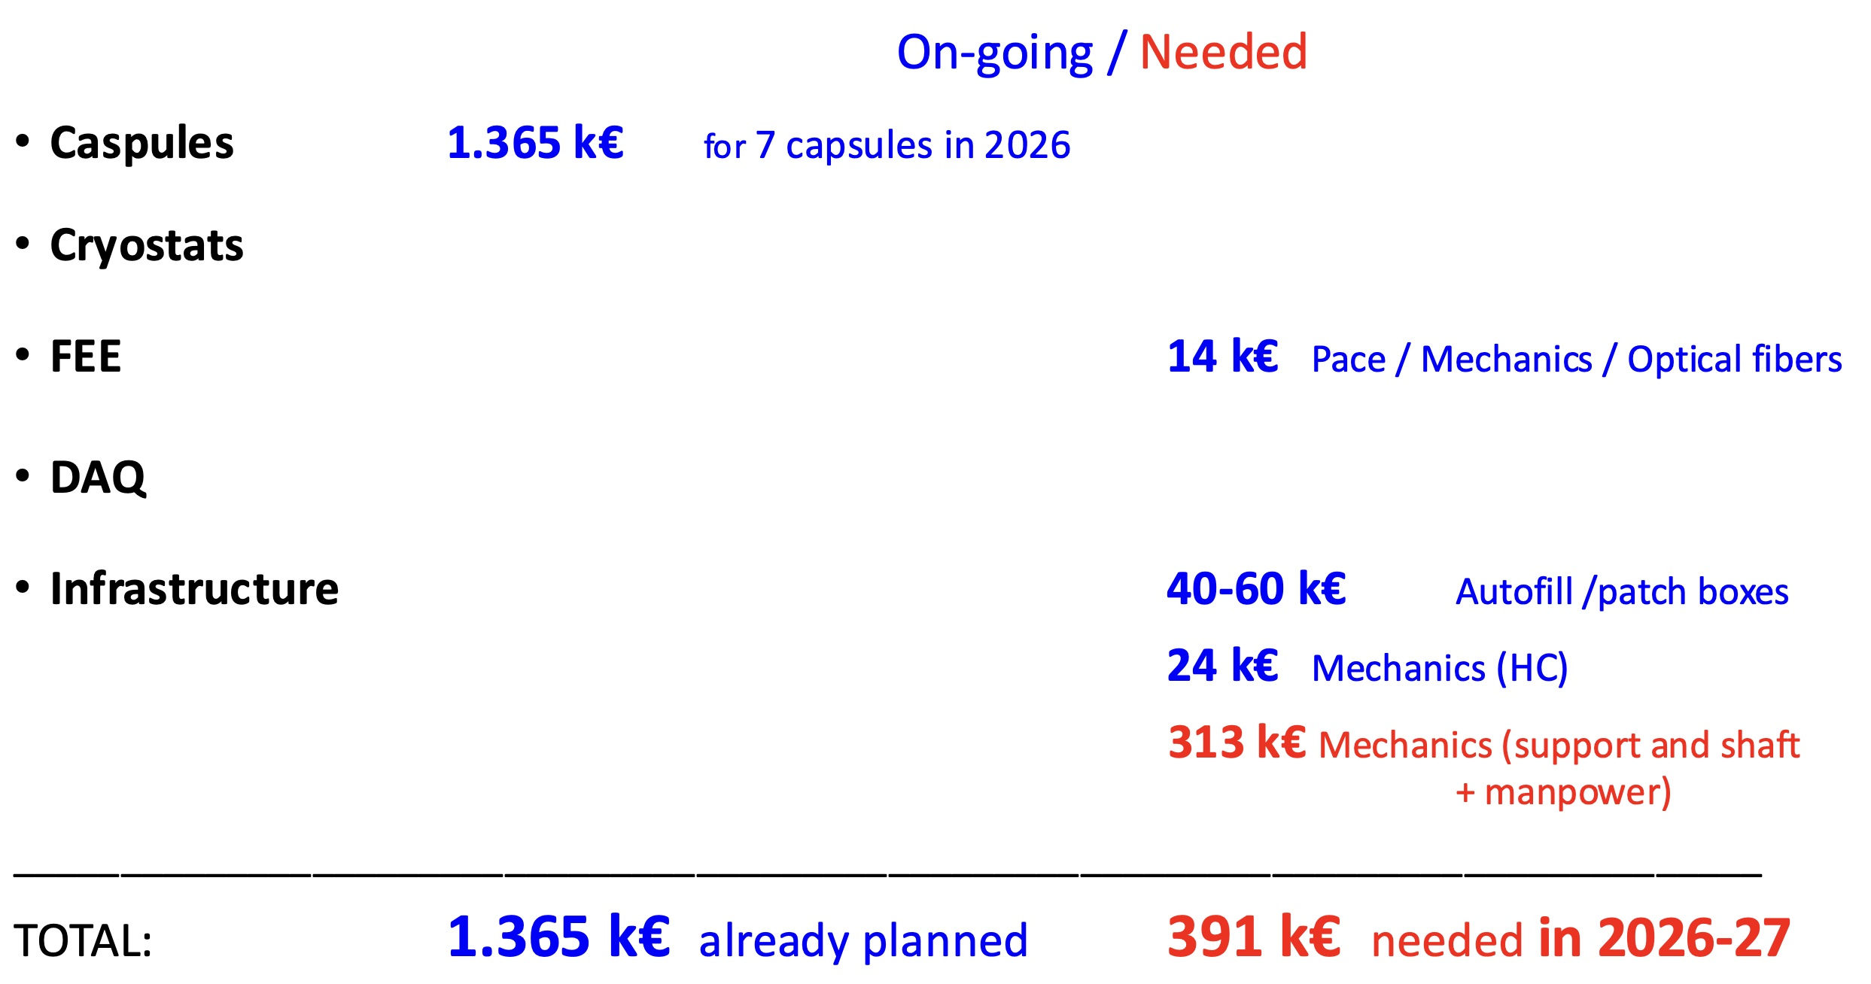
Budget update
Plan for Core purchase in 2026 towards 135 capsules (3π) setup within 2030
2x GANIL, 1x IN2P3, 1x CEA (?), 2x INFN, 1x Spain
Anticipate critical items for 3π
Prepare GANIL campaign (installation mid 2028)
186 k available after capsule purchase; looking for new possibilities for gathering core funds……

Slide 16
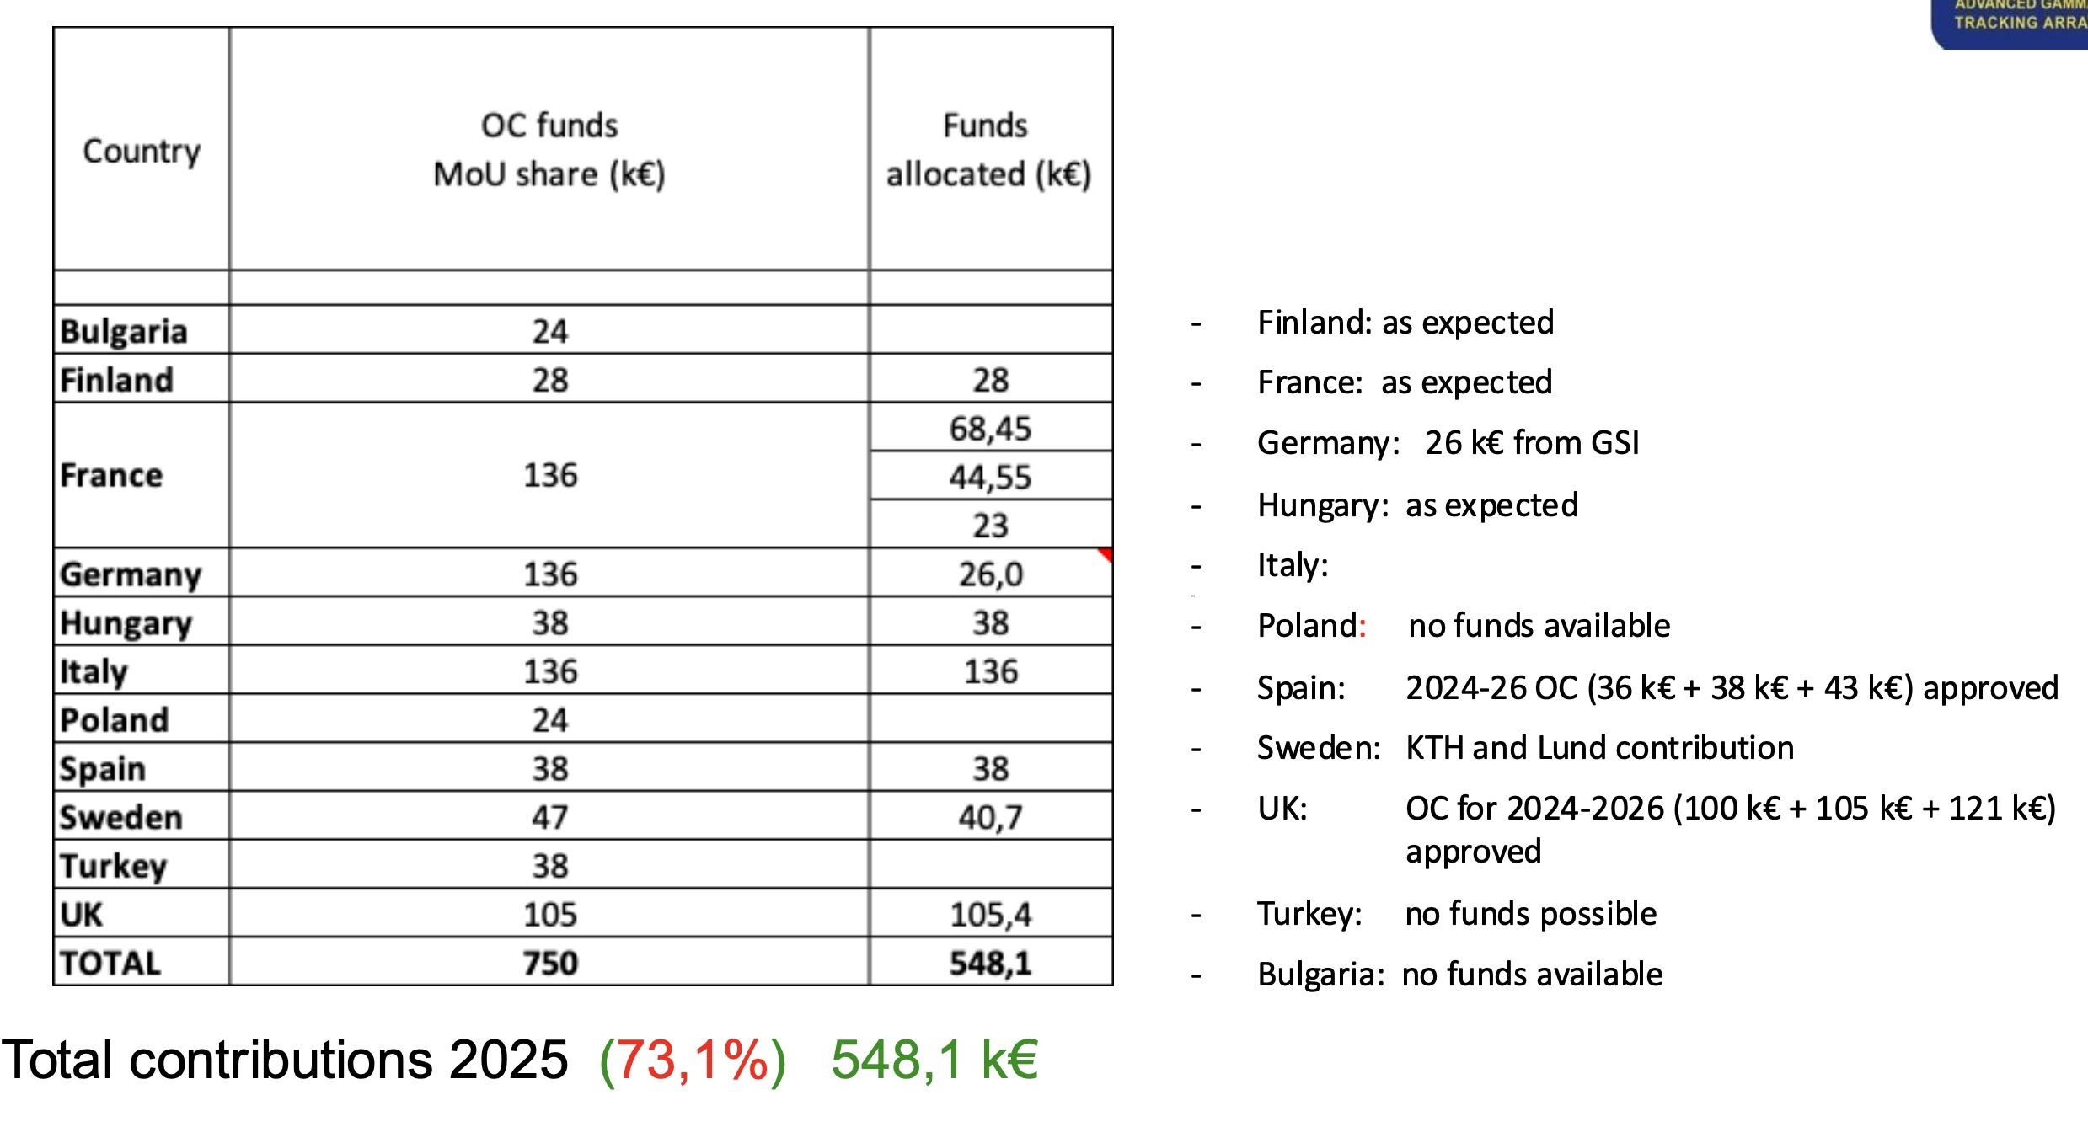
Budget update
Operational Costs funds 2025
as expected
Main expenses: detector annealing & repairs

Slide 17
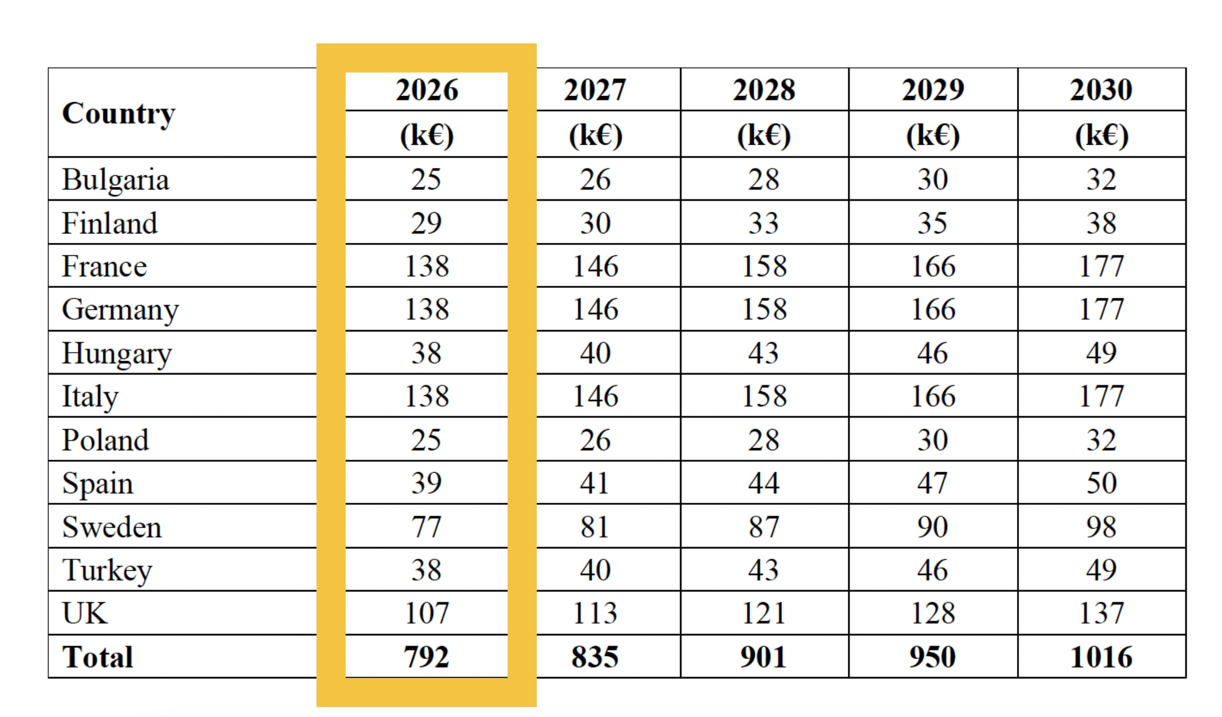
Budget update
12 annealings & repair of C003
DAC->ATC
D-AGATA cryostat refurbishment
Zeptonova firmware contract
+ fixed expenses (Ge labs, LN2)

