Slide 1
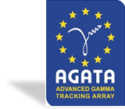
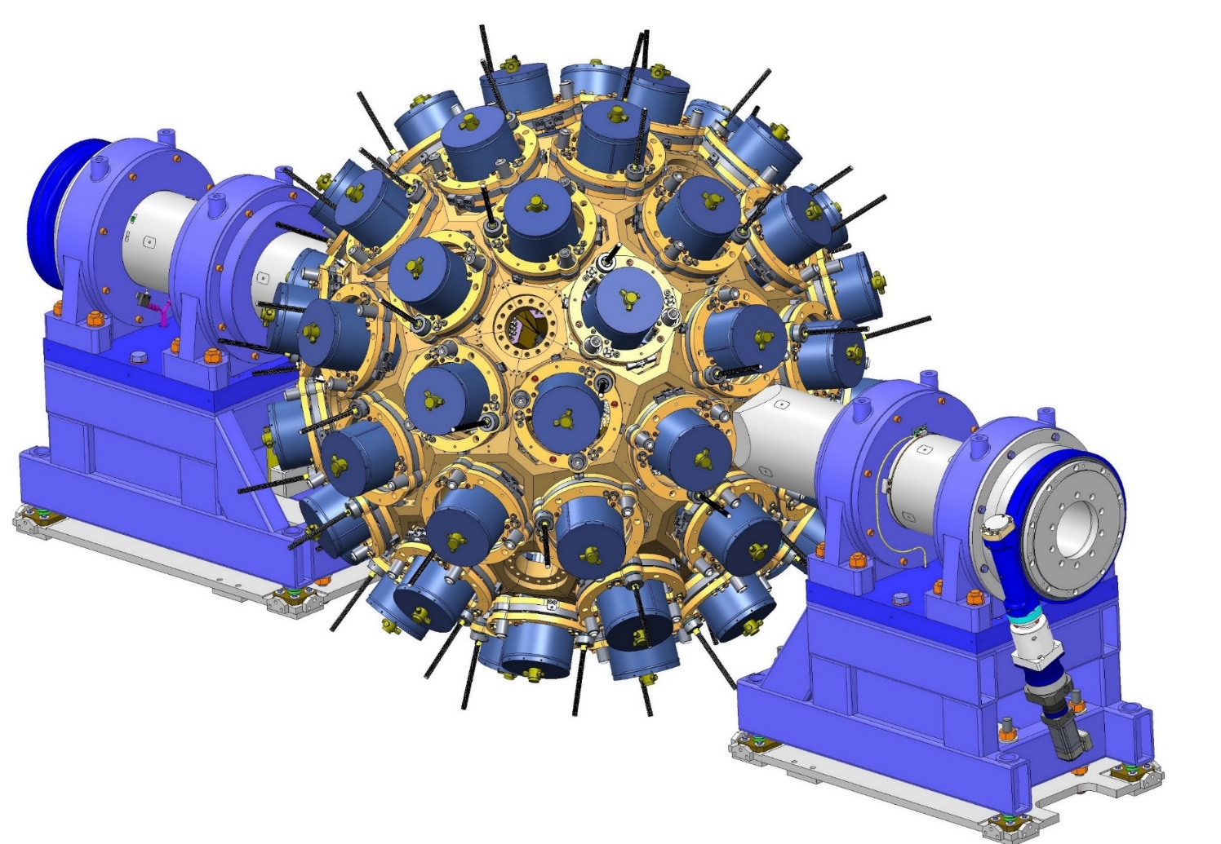

AI generated code in AGATA - how to mange it?
E. CLEMENT (GANIL)

Slide 2
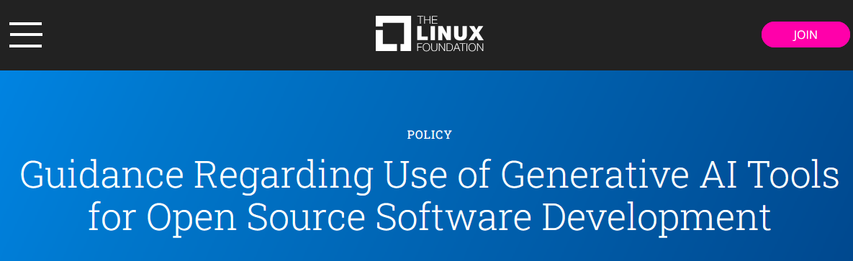
A question I want to rise is how AGATA Software team will manage the influx of AI-generated “toolkits”, “software analyses”, “alternative PSAs”, “AI-assisted codes” produced by our PhD, postdoc researchers and the WG Data Flow ?
Can we realistically develop advanced software for AGATA without agents, LLM, Codex, Claude, Copilote etc ….. ?
We probably need a guideline as the “linux fundation” has defined

Slide 3
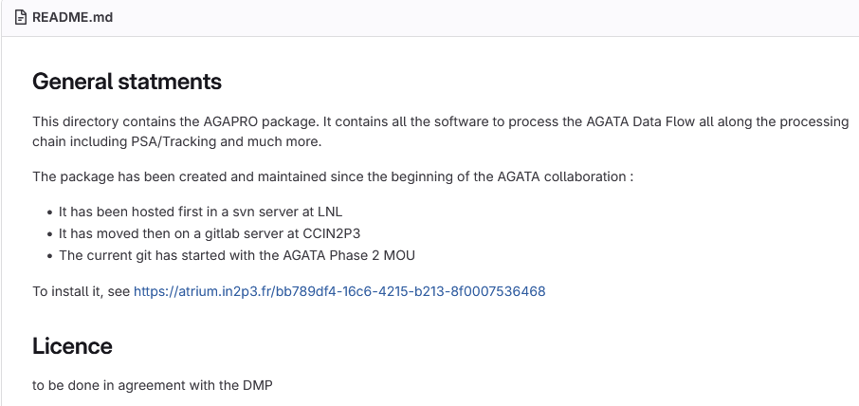
Summary: Linux Kernel AI Coding Assistants Guidance translated to AGATA ?
Scope
The document provides rules and best practices for developers and AI tools contributing to the Linux kernel, ensuring transparency, legal compliance, and accountability.
. Compliance with Kernel Processes
AI-assisted contributions must follow the standard Linux kernel development process, including coding style and patch submission guidelines.
2. Licensing and Legal
All code (including AI-generated) must be compatible with GPL-2.0-only.
Use appropriate SPDX license identifiers.
Full compliance with the Linux kernel licensing rules is mandatory.
AGAPRO - git

Slide 4
3. Attribution and Transparency
AI tools must never add a Signed-off-by tag—only humans can certify the Developer Certificate of Origin (DCO).
The human submitter is fully responsible for reviewing AI-generated code, ensuring license compliance, and adding their own Signed-off-by tag.
Attribution: Use an Assisted-by tag to document AI involvement,
→e.g.: Assisted-by: AGENT_NAME:MODEL_VERSION [TOOL1] [TOOL2]
AGENT_NAME: Name of the AI tool/framework (e.g., Claude, GitHub Copilot, Codex).
MODEL_VERSION: Specific model version used.
[TOOL1] [TOOL2]: Optional specialized tools (e.g., coccinelle, sparse).
Basic tools (git, gcc, editors) should not be listed.
4. Accountability
The human submitter bears full responsibility for the quality, legality, and security of AI-assisted code. Blaming the AI for errors is not permitted.
AI-assisted codes must be reviewed as from a junior DevOps
Should we prepare a similar guidance for AGATA ?
Opportunity to clear our mind on licences, softwares catalog ?
Adapt the DMP ?

Slide 5

Second subject :
Can we realistically develop advanced softwares for AGATA without agents, LLM, Codex, Claude, Copilote etc ….. ?
Can it be a limitation if we don’t, to attract younger collaborators ?
→CNRS has a (limited) licence with Mistral.
Consequence : it is forbidden to use alternative editors for our work
Investigating a « by-pass » will take some time and efforts→ Worst it ?

