Slide 1
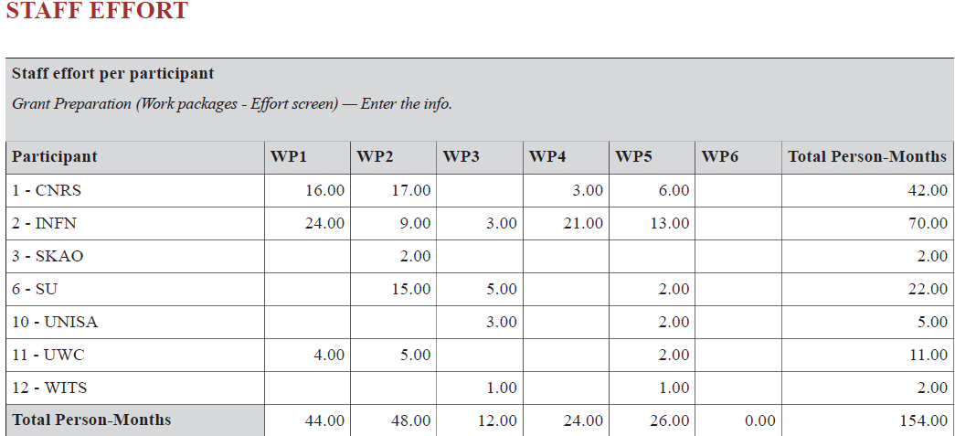
Staff Exchanges

Slide 2
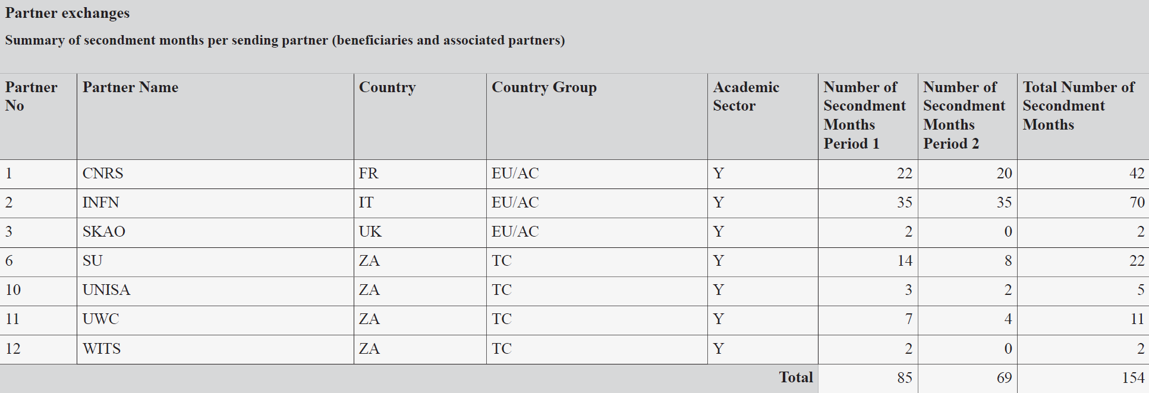
Staff Exchanges

Slide 3
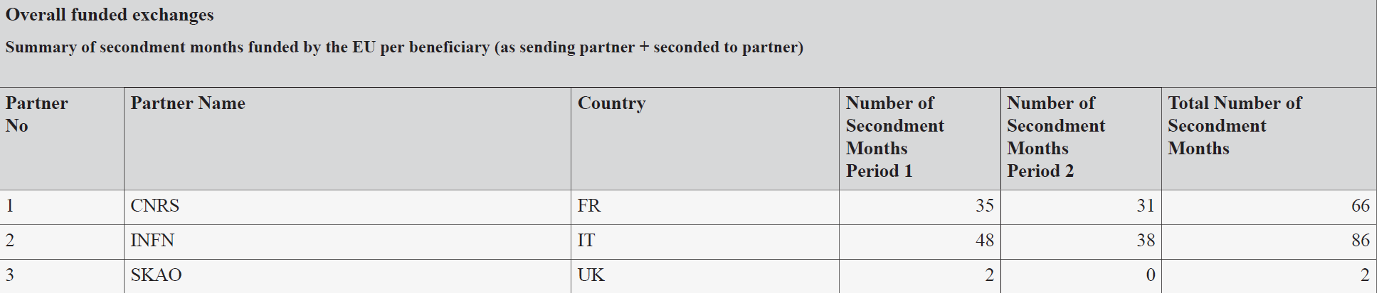
Funded exchanges

Slide 4
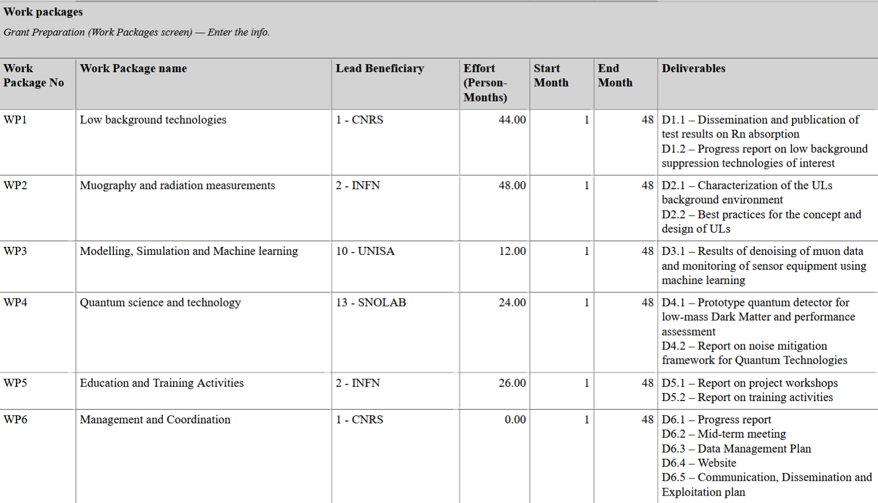

Slide 5
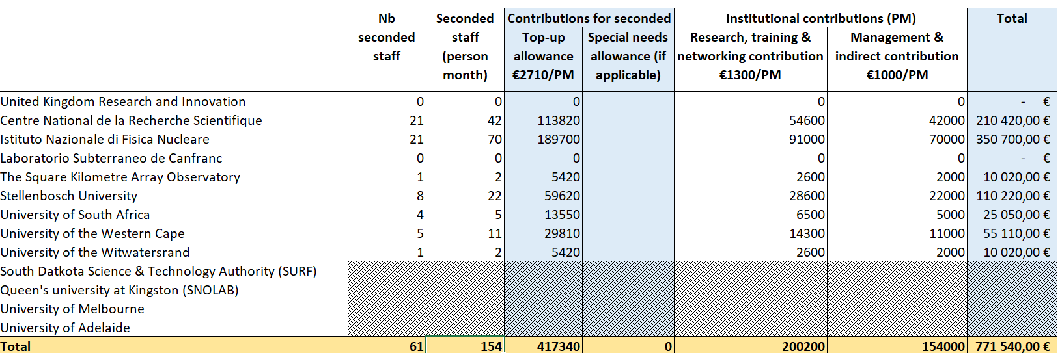
Budget sharing– Partners+ Associated Partners

Slide 6

Payments – Associated Partners
Beneficiaries may transfer funds to Associated Partners
Beneficiaries are accountable
Distribution of funds agreed in the Consortium Agreement
Budget – Unit costs

Slide 7
Reallocation of the budget 19/03/2026 (CA Art. 7, Attachment 1B)
 | Partner | Person-month | Budget before compensation | Planned top-up allowance | Planned institutional contributions | Deducted amount (28,7%) | Compensation for organisational & logistics costs |  |  |  |  |  | Budget after compensation | Total available for research, networking, training and management
 |  |  |  |  |  |  | Project manager |  | Project WK | Summer schools | Long-distance secondments (NETC) | Contribution for travels costs (NETC)
Beneficiaries | CNRS | 42 | 210420 | 113820 | 96600 | 27722,73 | 48450 |  |  |  |  |  | 231147,27 | 68877,27
 | INFN | 70 | 350700 | 189700 | 161000 | 46204,55 |  |  | 5000 |  |  |  | 309495,45 | 114795,45
 | SKAO | 2 | 10020 | 5420 | 4600 | 1320,13 |  |  |  |  |  |  | 8699,87 | 3279,87
Associated Partners | LSC | 0 | 0 | 0 | 0 | 0 |  |  |  |  |  | 1600 | 1600,00 | 0
 | SNOLAB | 3 | 0 | 0 | 0 | 0 |  |  |  |  | 1500 | 3000 | 4500,00 | 0
 | SURF | 0 | 0 | 0 | 0 | 0 |  |  |  | 10000 |  | 3000 | 13000,00 | 10000
 | SU | 22 | 110220 | 59620 | 50600 | 14521,43 |  |  |  | 10000 |  |  | 95698,57 | 36078,57
 | UoA | 9 | 0 | 0 | 0 | 0 |  |  |  |  | 4500 | 3000 | 7500,00 | 0
 | UKRI | 0 | 0 | 0 | 0 | 0 |  |  |  |  |  | 1600 | 1600,00 | 0
 | UoM | 4 | 0 | 0 | 0 | 0 |  |  |  |  | 2000 | 3000 | 5000,00 | 0
 | UNISA | 5 | 25050 | 13550 | 11500 | 3300,32 |  |  |  |  |  |  | 21749,68 | 8199,68
 | UWC | 11 | 55110 | 29810 | 25300 | 7260,71 |  |  | 5000 |  |  |  | 47849,29 | 18039,29
 | WITS | 2 | 10020 | 5420 | 4600 | 1320,13 |  |  |  |  |  |  | 8699,87 | 3279,87
Total |  |  | 771540 | 417340 | 354200 | 101650 | 48450 |  | 10000 | 20000 | 8000 | 15200 | 771540 | 252550

Slide 8
Budget CNRS
BUDGET CNRS CONSOLIDE
 | Seconded staff (person month) | Contributions for seconded staff members per PM |  | Institutional contributions (PM) |  | Total | Prélèvement pot commun | Total après prélèvement
 |  | Top-up allowance €2710/PM | Special needs allowance (if applicable) | Research, training & networking contribution €1300/PM | Management & indirect contribution €1000/PM
DR11 - LPSC | 36 | 97560 |  | 46800 | 36000 | 180360 | 23762,34 | 156597,66
DR17 - SUBATECH | 8 | 21680 |  | 10400 | 8000 | 40080 | 5280,52 | 34799,48
DR15 - LP2I (Bordeaux) | 1 | 2710 |  | 1300 | 1000 | 5010 | 660,06 | 4349,94
DR04 - IJCLab | 4 | 10840 |  | 5200 | 4000 | 20040 | 2640,26 | 17399,74
DR02 - LPNHE | 5 | 13550 |  | 6500 | 5000 | 25050 | 3300,32 | 21749,68
DR07 - IP2I (Lyon) | 12 | 32520 |  | 15600 | 12000 | 60120 | 7920,78 | 52199,22
Total CNRS | 66 | 178860 | 0 | 85800 | 66000 | 330660 | 43564,29 | 287095,71
 |  |  |  |  |  |  | 28,70%

Slide 9
Mobilité CNRS
 | Mobilités CNRS
 |  | Seconded staff (person month) | Contributions for seconded staff members per PM |  | Institutional contributions (PM) |  | Total | Prélèvement pot commun | Total après prélèvement
 |  |  | Top-up allowance €2710/PM | Special needs allowance (if applicable) | Research, training & networking contribution €1300/PM | Management & indirect contribution €1000/PM
 | DR11 - LPSC | 20 | 54200 |  | 26000 | 20000 | 100200 | 13201,30 | 86998,70
 | DR17 - SUBATECH | 8 | 21680 |  | 10400 | 8000 | 40080 | 5280,52 | 34799,48
 | DR15 - LP2I (Bordeaux) | 1 | 2710 |  | 1300 | 1000 | 5010 | 660,06 | 4349,94
 | DR04 - IJCLab | 2 | 5420 |  | 2600 | 2000 | 10020 | 1320,13 | 8699,87
 | DR02 - LPNHE | 5 | 13550 |  | 6500 | 5000 | 25050 | 3300,32 | 21749,68
 | DR07 - IP2I (Lyon) | 6 | 16260 |  | 7800 | 6000 | 30060 | 3960,39 | 26099,61
 | Total CNRS | 42 | 113820 | 0 | 54600 | 42000 | 210420 | 27722,73 | 182697,27

Slide 10
Accueil Mobilité CNRS
Accueil mobilités pays non-associés éligibles au financement
 | Seconded staff (person month) | Contributions for seconded staff members per PM |  | Institutional contributions (PM) |  | Total | Prélèvement pot commun | Total après prélèvement
 |  | Top-up allowance €2710/PM | Special needs allowance (if applicable) | Research, training & networking contribution €1300/PM | Management & indirect contribution €1000/PM
DR11 - LPSC | 16 | 43360 |  | 20800 | 16000 | 80160 | 10561,04 | 69598,96
SU | 13 | 35230 |  | 16900 | 13000 | 65130 | 8580,84 | 56549,16
UWC | 2 | 5420 |  | 2600 | 2000 | 10020 | 1320,13 | 8699,87
UNISA | 1 | 2710 |  | 1300 | 1000 | 5010 | 660,06 | 4349,94
DR07 - IP2I (Lyon) | 6 | 16260 |  | 7800 | 6000 | 30060 | 3960,39 | 26099,61
SU | 3 | 8130 |  | 3900 | 3000 | 15030 | 1980,19 | 13049,81
UWC | 3 | 8130 |  | 3900 | 3000 | 15030 | 1980,19 | 13049,81
DR04 - IJClab | 2 | 5420 |  | 2600 | 2000 | 10020 | 1320,13 | 8699,87
WITS | 1 | 2710 |  | 1300 | 1000 | 5010 | 660,06 | 4349,94
UNISA | 1 | 2710 |  | 1300 | 1000 | 5010 | 660,06 | 4349,94
Total accueil mobilité | 24 | 65040 |  | 31200 | 24000 | 120240 | 15841,56 | 104398,44

Slide 11
Flux financiers DR11
Flux financiers en DR11
Budget total | 771540
Préfinancement (65% du montant total) | 501501
Mutual insurance mechanism (MIM - 5%) | 38577
 | Montant total | Part préfinancement | Part pot commun | Préfinancement à reverser
CNRS | 330660 | 214929 | 43564,29 | 330 660,00 € | Pour le CNRS, l'intégralité des crédits sont ouverts. Ajustement sur le pot commun à prévoir après le reporting (M24 ou M48)
DR11 - LPSC | 180360 |  | 23762,34 | 180 360,00 €
DR17 - SUBATECH | 40080 |  | 5280,52 | 40 080,00 €
DR15 - LP2I (Bordeaux) | 5010 |  | 660,06 | 5 010,00 €
DR04 - IJCLab | 20040 |  | 2640,26 | 20 040,00 €
DR02 - LPNHE | 25050 |  | 3300,32 | 25 050,00 €
DR07 - IP2I (Lyon) | 60120 |  | 7920,78 | 60 120,00 €
INFN | 430860 | 280059 | 56765,58 | 223 293,42 €
SKAO | 10020 | 6513 | 1320,13 | 5 192,87 €
Répartition budget au LPSC | Total
Missions CNRS | 86 998,70 €
Missions Afrique du Sud | 69 598,96 €
Pot commun | 101 650,00 € | dont 19801,95€ à récupérer auprès des autres DR au moment du reporting (M24 ou M48)

Slide 12
Autres Budgets - Bénéficiaires
BUDGET INFN
 | Seconded staff (person month) | Contributions for seconded staff members per PM |  | Institutional contributions (PM) |  | Total | Allocation for common pot | Total for INFN
 |  | Top-up allowance €2710/PM | Special needs allowance (if applicable) | Research, training & networking contribution €1300/PM | Management & indirect contribution €1000/PM
INFN LNGS | 40 | 108400 |  | 52000 | 40000 | 200400 | 26402,60 | 173997,40
INFN LNF | 46 | 124660 |  | 59800 | 46000 | 230460 | 30362,99 | 200097,01
Total INFN | 86 | 233060 | 0 | 111800 | 86000 | 430860 | 56765,58 | 374094,42
 |  |  |  |  |  |  | 28,70%
5000 € from the common pot will be allocated to INFN for the organisation of a project workshop. Funds will be transferred upon justification of the organisation and budget.

