Slide 1

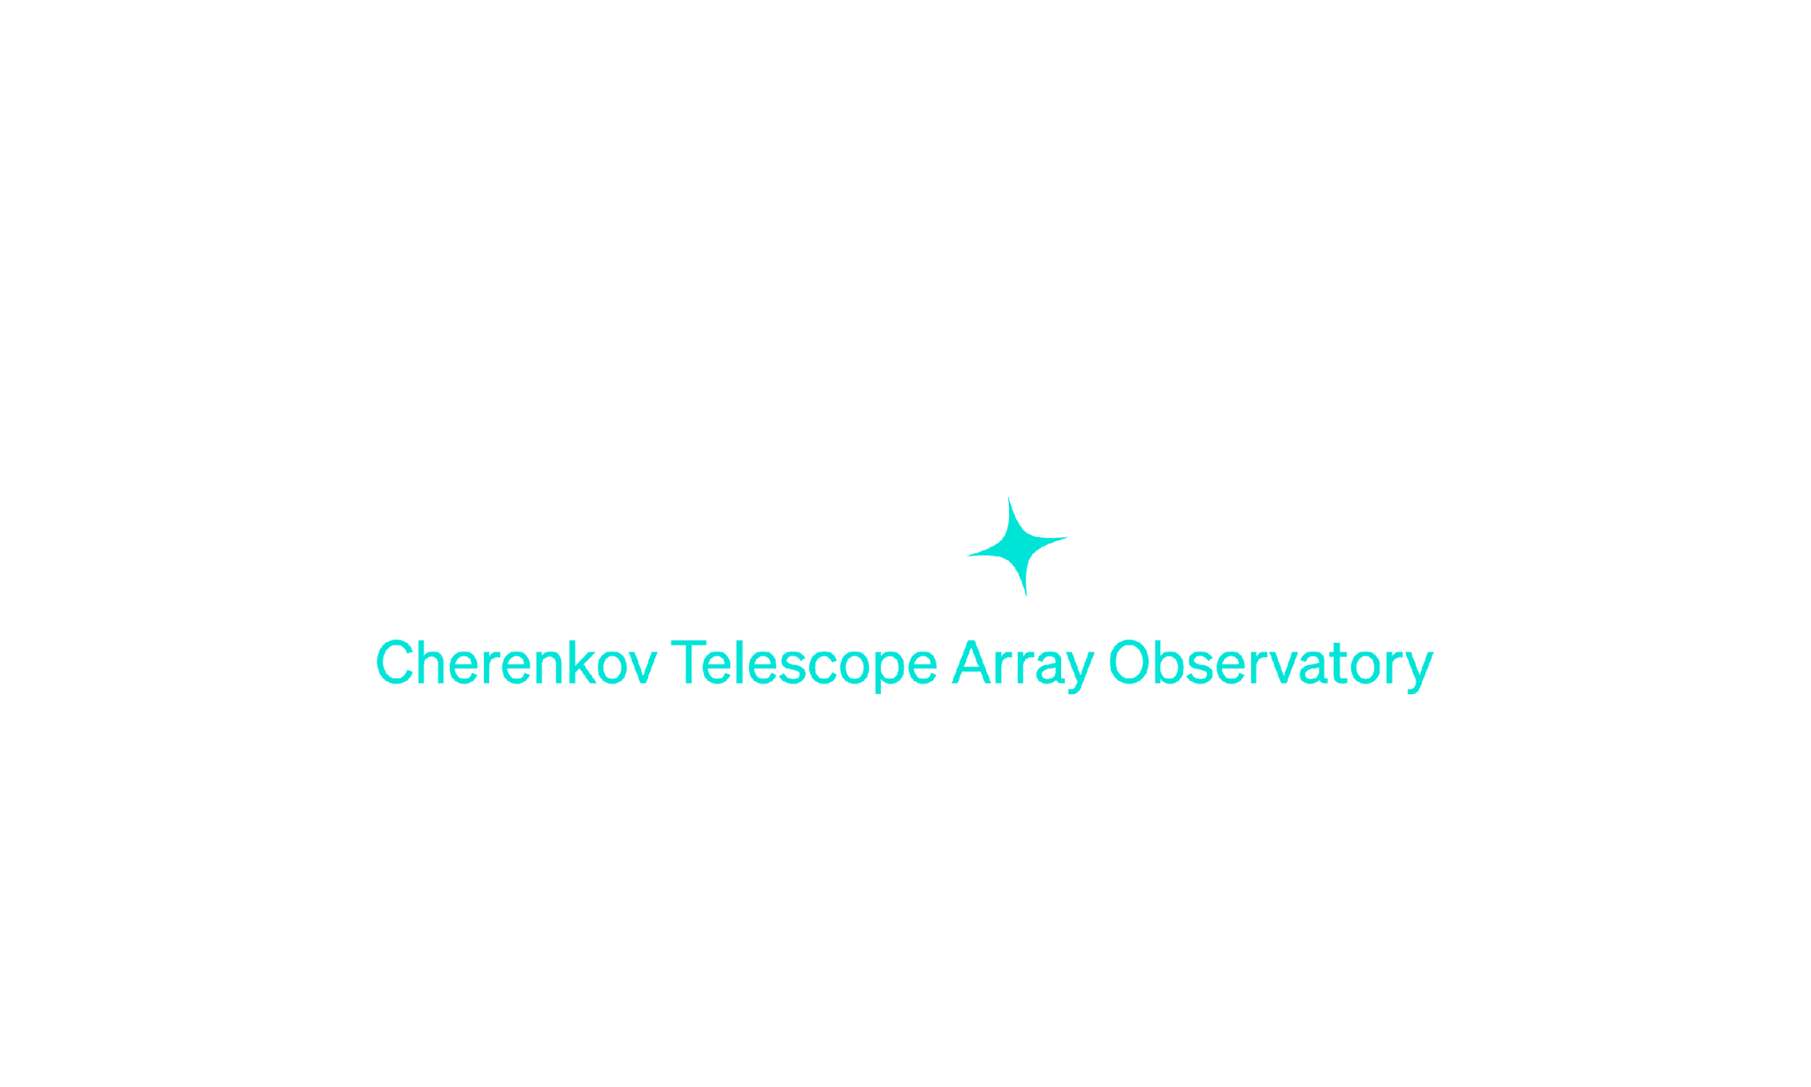

Gamma-Ray Pulsars as probes for Lorentz Invariance Violation with CTAO
Lina Breton-Zaourat
Sami Caroff
Vincent Poireau

Slide 2

Gamma-Ray Pulsars as probes for Lorentz Invariance Violation with CTAO
Lorentz Invariance Violation through time lag effect

Slide 3


LIV effect : Case without LIV
c
c

Slide 4
LIV effect : Case without LIV
c
c

Slide 5
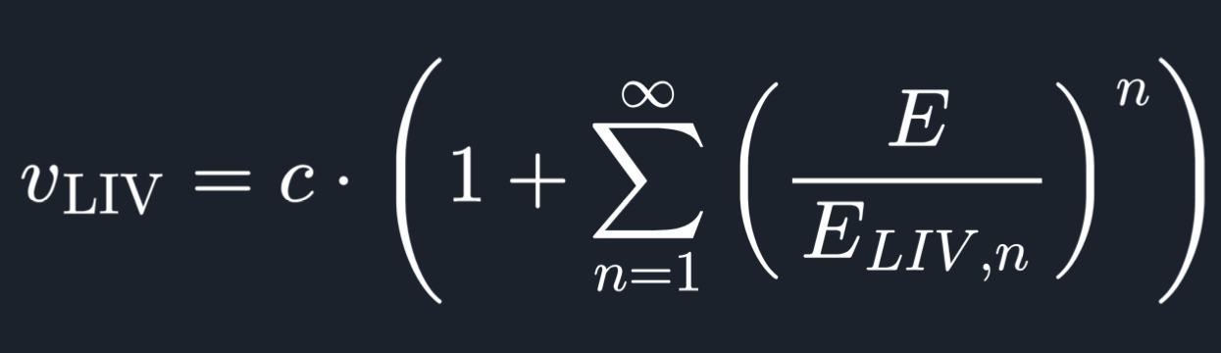
LIV effect : Case with LIV
Eᵧ2 > Eᵧ1
c
vᵧ(Eᵧ,E_{LIV})
vᵧ₁(Eᵧ₁)
vᵧ₂(Eᵧ₂)

Slide 6
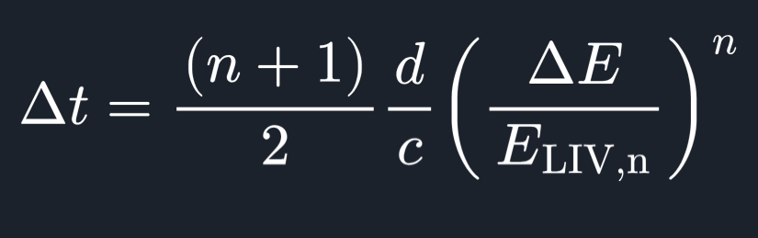
LIV effect : Case with LIV
Eᵧ2 > Eᵧ1
c
vᵧ(Eᵧ,E_{LIV})
vᵧ₁(Eᵧ₁)
Δt
vᵧ₂(Eᵧ₂)

Slide 7

Gamma-Ray Pulsars as probes for Lorentz Invariance Violation with CTAO
Lorentz Invariance Violation through time lag effect
Pulsars and millisecond pulsars

Slide 8
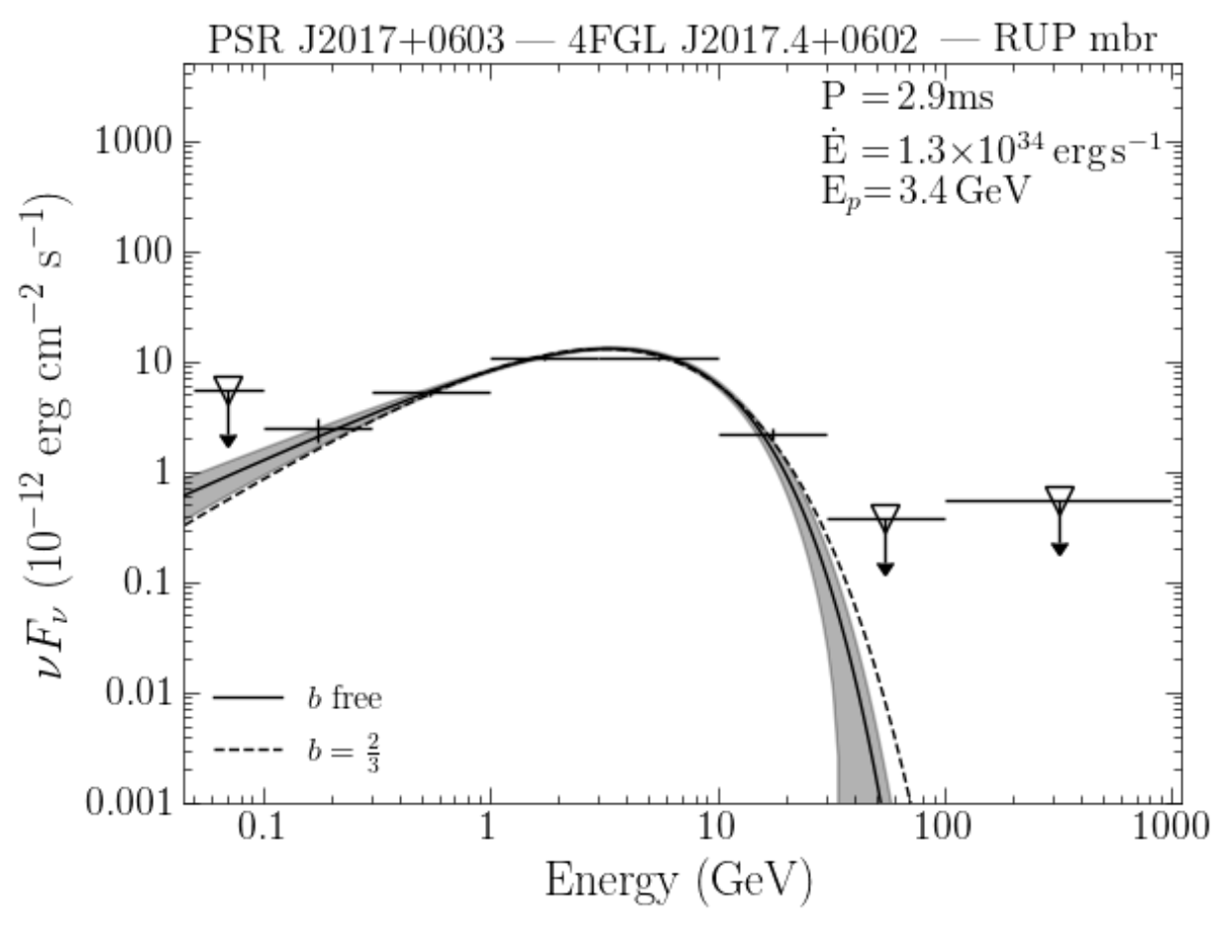
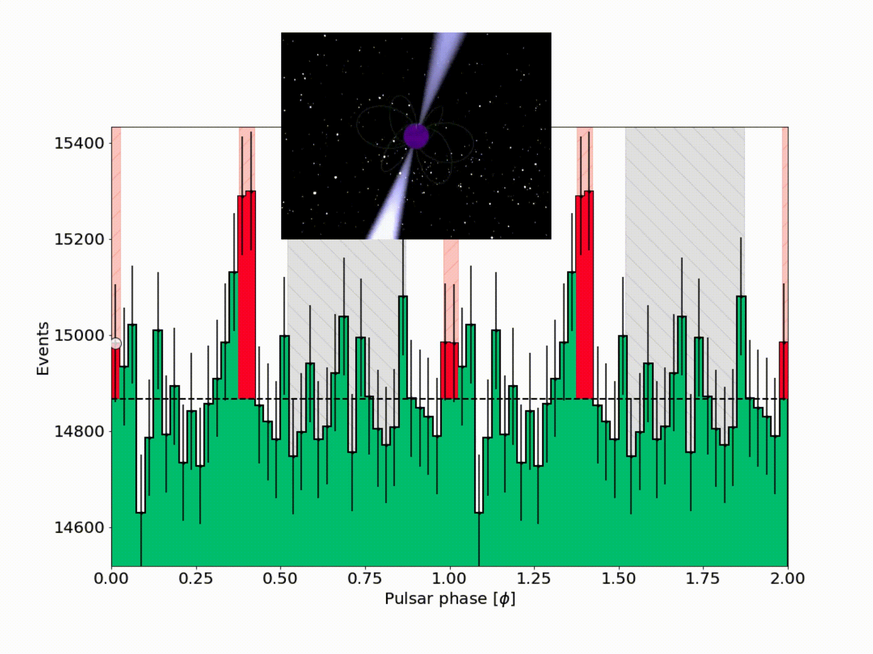
Pulsars
Rapidly rotating neutron stars
Extremely dense ! (≈ a solar mass contained within a sphere with a diameter of 20 km)
Phasogram
Spectral energy distribution (SED)
https://fermi.gsfc.nasa.gov/
Generally the same pattern: P1, P2 and Bridge
The emission of the pulsar VS energy fitted by a specific model

Slide 9
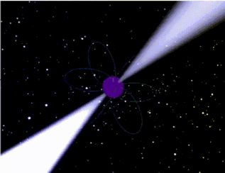
Pulsars : good candidates for LIV
Periodic nature of pulsar :
Deterministic and almost stable variability
Data accumulation for a long time
Galactic origin:
Avoids cosmological effect on the time lag propagation (better model independence)
Combined pulsars analysis necessary to disentangle LIV (propagation effect) from intrinsic effect

Slide 10
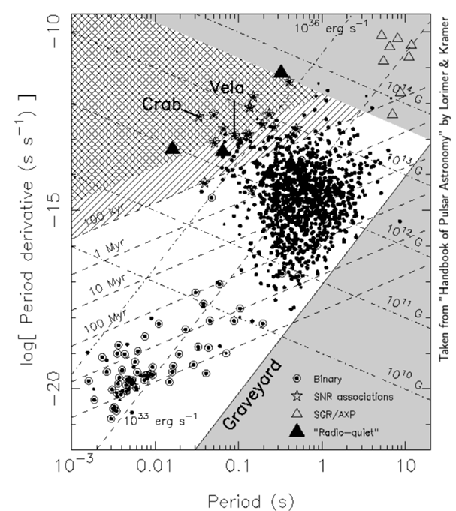
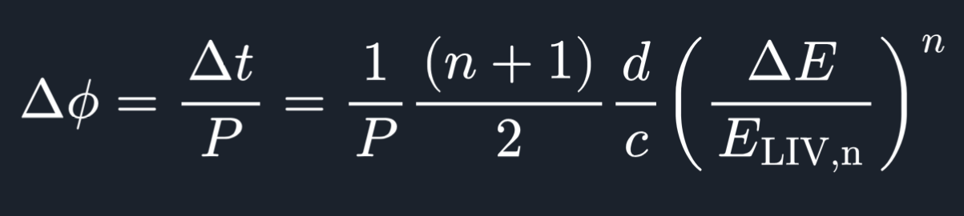
best pulsar candidates for LIV
Young Pulsars
The higher the energy difference, the higher ΔΦ
High energy emission component (Inverse Compton)
The higher the distance, the higher ΔΦ
Very far pulsars
The shorter the rotation period, the higher ΔΦ
Very fast rotating pulsars
Millisecond Pulsars

Slide 11

Gamma-Ray Pulsars as probes for Lorentz Invariance Violation with CTAO
Lorentz Invariance Violation through time lag effect
The CTA observatory
Pulsars and millisecond pulsars

Slide 12
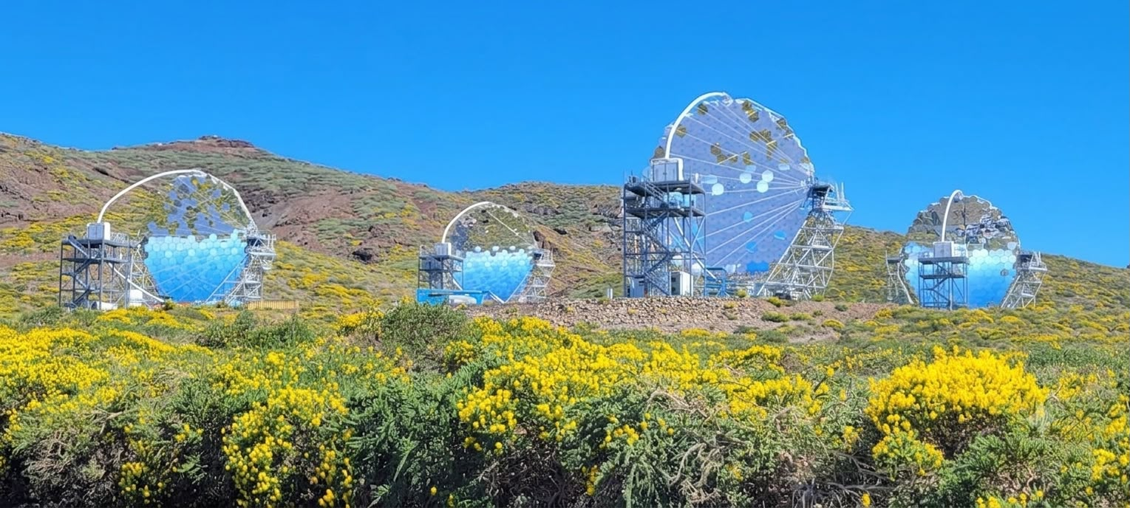
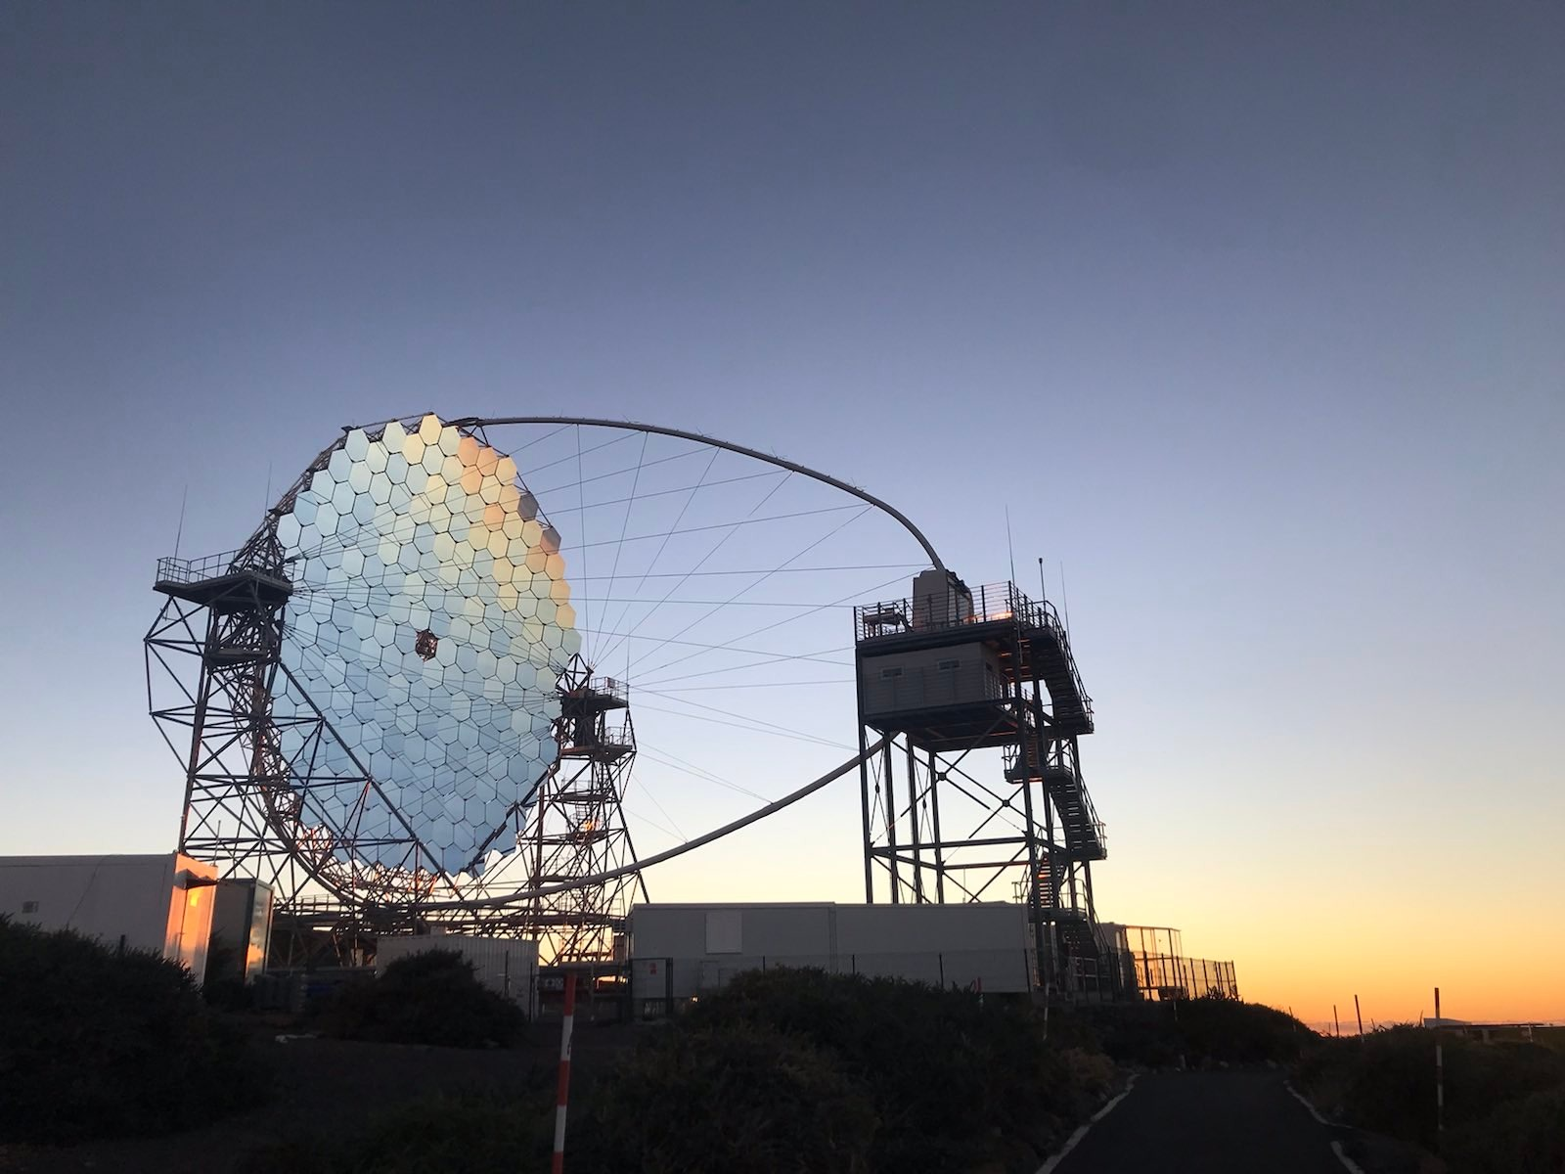
The CTA observatory
The Large Sized Telescope (LST)
Cherenkov Telescope Array
2 sites : La Palma & Chile
3 different types of telescopes: LST, MST, SST
Cherenkov Light detection emitted by the electromagnetic showers
3 future LST telescopes in 2027
C. Plard

Slide 13
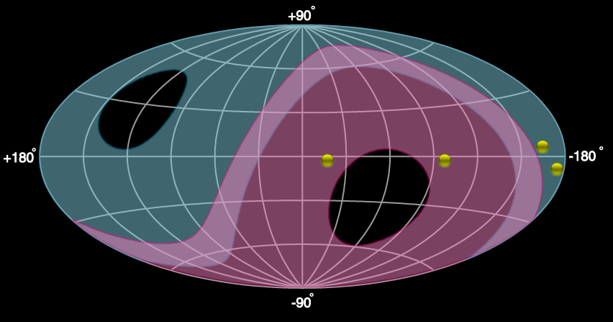
Current state of the art
Northern hemisphere
4 pulsars detected by the IACTs (HESS, LST, VERITAS, MAGIC)
No millisecond pulsars have been detected yet by the IACTs
LIV application only for the Crab and Vela among pulsars
(https://iopscience.iop.org/article/10.3847/1538-4357/ac5048/pdf )
Geminga
Vela
Crab
J1709-4429
Southern hemisphere
Next steps :
What are the best pulsar candidates to detect with CTAO ?
What are the best pulsar candidates to probe LIV ?

Slide 14
Research Work

Slide 15



First focus of my research:
Evaluate Fermi pulsar detectability with CTAO/LST
Analysis steps
SED fit and extrapolation
Pulsar candidates
Fermi pulsar catalog https://fermi.gsfc.nasa.gov/
CTAO/LST detectability evaluation

Slide 16

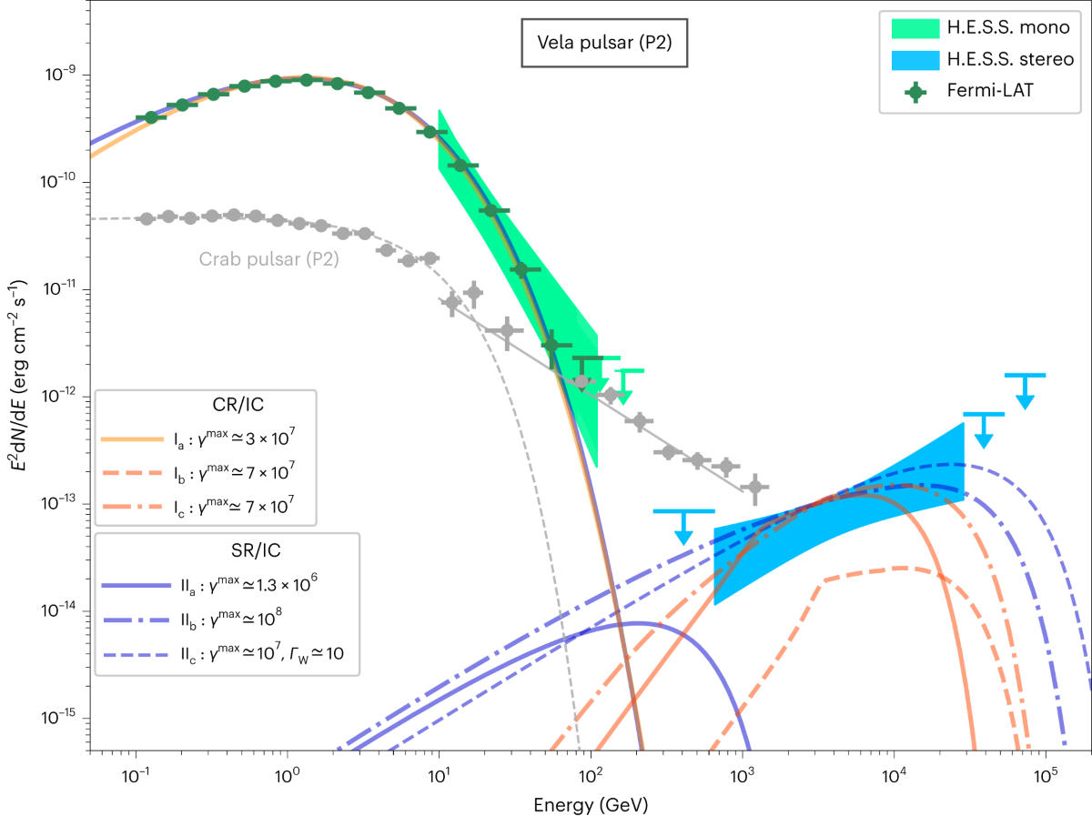
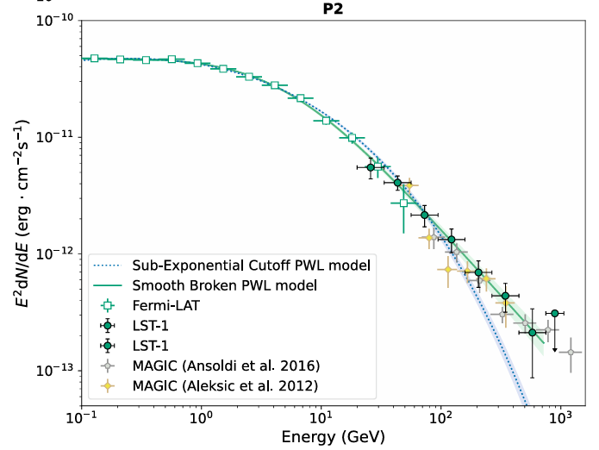
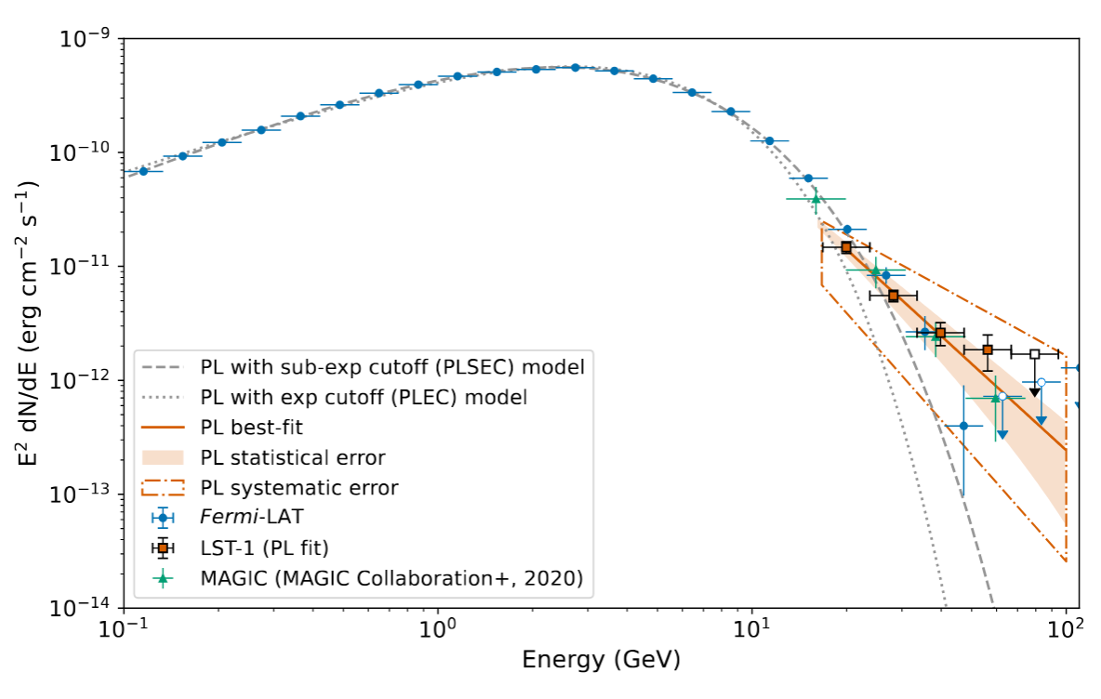
SED fit and extrapolation
Models
Power Law Exponential Cut-Off (ExpCutOff)
Smooth Broken Power Law (SBPL)
Geminga-like
https://doi.org/10.1038/s41550-023-02052-3
https://doi.org/10.1051/0004-6361/202450059
https://arxiv.org/abs/2505.21632

Slide 17

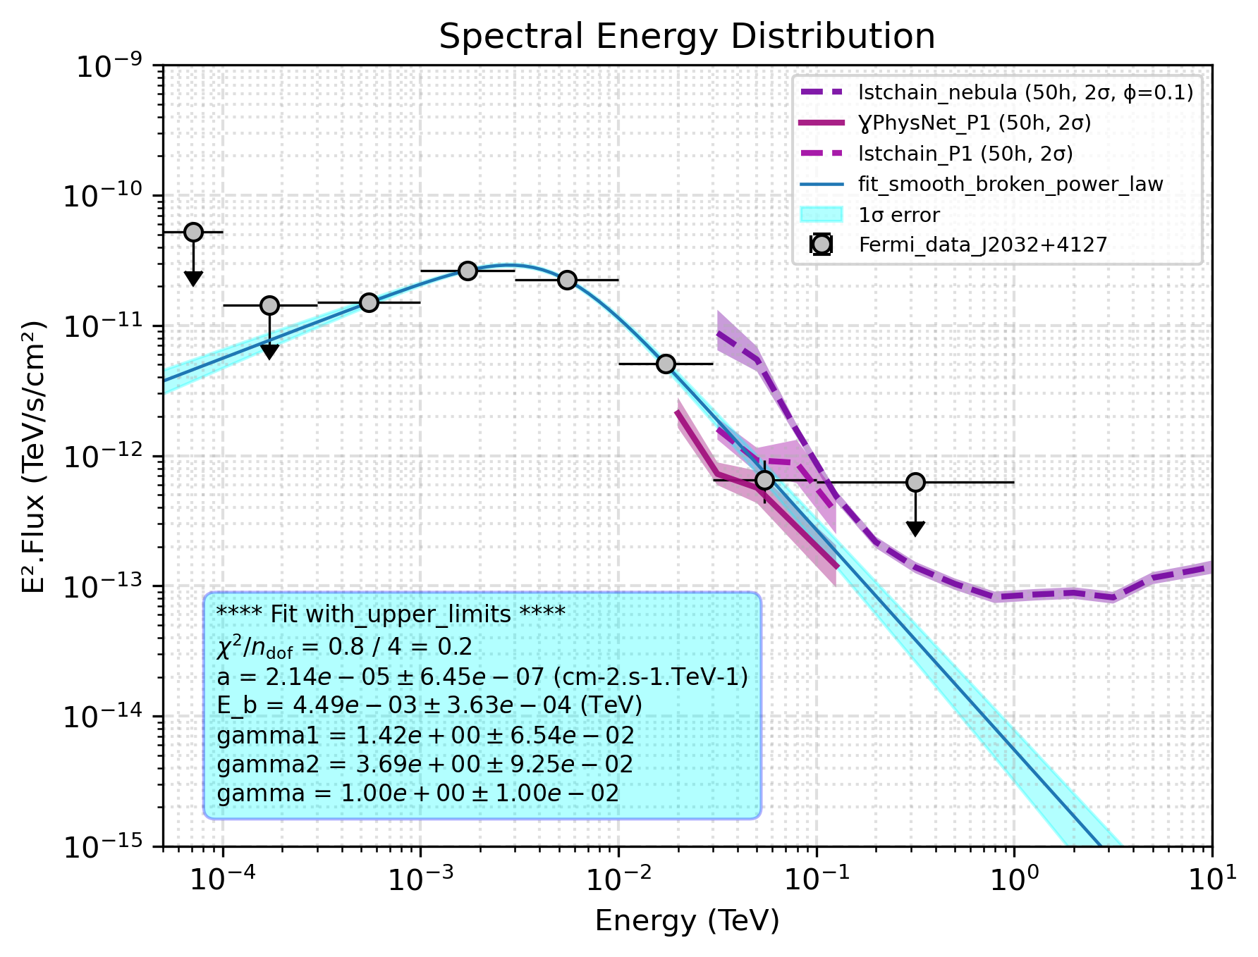

Fitted SED & sensitivities
SED of the Fermi pulsar J2032+4127 (gray points) fitted with SBPL shown in blue. The sensitivity curves of the LST telescope (for different configurations) are also shown in pink and purple
lstchain
New method of reconstruction !
gammalearn
A significant improvement in LST sensitivity at low energy ( ≈ tens of GeV) !

Slide 18

CTAO/LST detectability evaluation: ratio method
Sensitivity rescale
Sigma evaluation by energy bin
Total significance sum

Slide 19

Results for pulsars
Parameter
Observation time : 50h
In the very short term, 1 LST North (current CTAO configuration) :
Northern hemisphere
4 new pulsars that had not previously been detected by the lstchain analysis (or that had not yet been analysed) are now potentially detectable thanks to a gammalearn analysis!
J 1913+1011
DragonFly
Geminga
J2032+4127
Vela
Crab
Boomerang
J1709-4429
Name
RA
(°)
DEC
(°)
Rot Period
(ms)
Distance
(kpc)
Southern hemisphere
Crab
83.6
22.0
34
1.9
Detected by LST
Geminga
98.5
17.8
237
0.25
Next step :
DragonFly
305
36.8
104
1.8
LST Data available
Boomerang
337
61.2
52
3.00
Perform a gammalearn analysis of the data already available
J2032+4127
308
41.5
36
4.61
J1913+1011
288
10.2
143
1.80

Slide 20
Results for millisecond pulsars
Parameter
Observation time : 50h
The best candidates are mostly observable by the Southern hemisphere
In the long term with one LST South (~2030) : two millisecond pulsars (J1536-4948, J0614-3329) detectable according to the estimations
Name
RA
(°)
DEC
(°)
Rot Period
(ms)
Distance
(kpc)
The best candidate for the North is J2017+0603
J0614-3329
93.5
-33.5
3
0.63
In the very short term with 1 LST North (current CTAO configuration): not detectable except in a very optimistic scenario :(
J1536-4948
234
-49.8
3
0.98
J1231-1411
188
-14.2
4
0.42
J1514-4946
229
-49.7
4
0.91
Results of this analysis motivated a observation proposal for LST on Feb 2026 : declined
J2017+0603
304
6.05
3
1.40
Southern hemisphere
Northern hemisphere
In the medium term with 4 LSTs North (~2027) : potentially detectable (at least a strong hint at 3σ)

Slide 21
Current state of the art
Northern hemisphere
4 pulsars detected by the IACTs (HESS, LST, VERITAS, MAGIC)
J 1913+1011
No millisecond pulsars have been detected yet by the IACTs
DragonFly
Geminga
J2032+4127
Vela
Crab
LIV application only for the Crab and Vela among pulsars
(https://iopscience.iop.org/article/10.3847/1538-4357/ac5048/pdf )
Boomerang
J1709-4429
Southern hemisphere
Next steps :
What are the best pulsar candidates to detect with CTAO ?
What are the best pulsar candidates to probe LIV ?

Slide 22
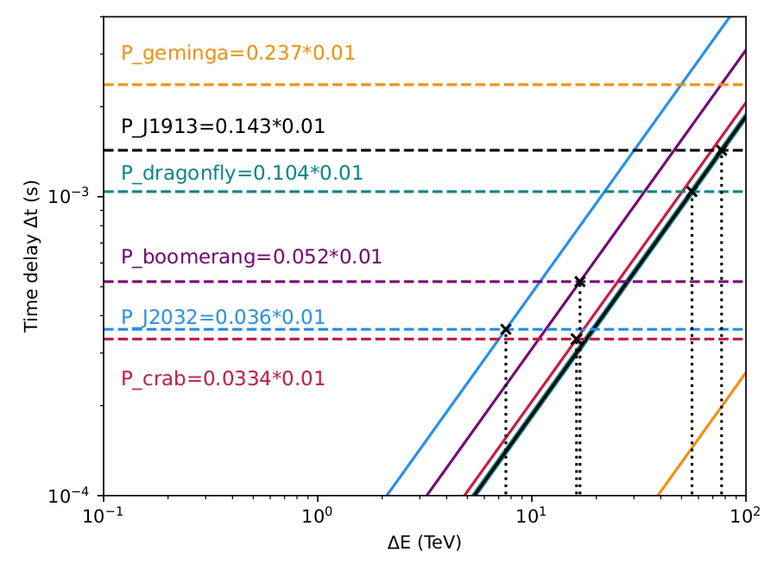
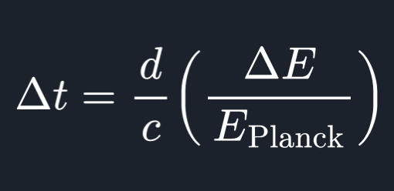
Best pulsar candidates to probe LIV
Interpretation :
The intersection point is the key information : allows us to determine approximately the minimal energy where we could find a time lag effect
The idea is to minimize this energy because the higher the energy of the
emitted photons, the more difficult - or even impossible -it will be for LST to detect them
Better
Conclusion :
best pulsar candidates for LIV : Crab and J2032+4127 and in second time Boomerang and DragonFly

Slide 23
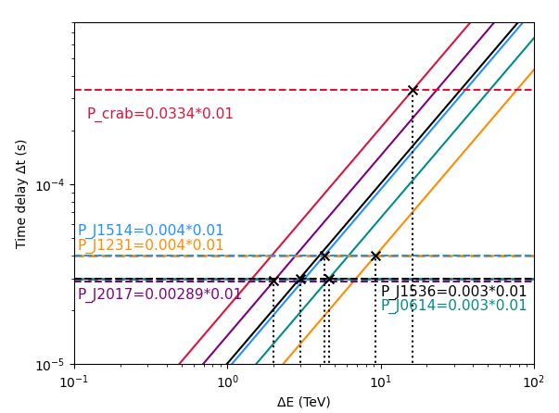
Even better candidates : millisecond pulsars to probe LIV
Interpretation :
around 17 TeV gamma to detect for LIV (with the Crab: the best pulsar for the normal population)
at the order of the TeV gamma to detect for millisecond pulsars !
Conclusion :
best millisecond pulsar candidates for LIV in order of priority :
J2017+0603
J1536-4948
J1514-4946
J0614-3329
J1231-1411
Better
Southern hemisphere
Northern hemisphere

Slide 24


Conclusion & Perspectives
Pulsar and millisecond pulsar detectability estimation for:
LST North
LST 1-4 North
LST South
Presented at the general LST meeting, Padova, June 2026
Rank the pulsars from best to worst for the LIV
Conduct an analysis with gammalearn in order of priority:
Crab, Geminga
DragonFly , J2032+4127 ( first detection ?)
Boomerang (difficult due to high zenith )
J1913+1011 (observation proposal ? )
In long term, use of this analysis to motivate the future proposals ( for the northern millisecond pulsars J2017+0603) and as tool for the Southern pulsars detectability estimation

Slide 25
Second research focus :
Crab analysis to probe LIV through time lag effects
Analysis steps
Phasogram fitting models
Crab lstchain analysis
LIV effect constraints evaluation

Slide 26
Crab LST data analysis
Data selection
Data selection :
First data cleaning to remove data affected by light pollution and atmospheric variations
Add the phases
Second data selection related to gamma-hadron discrimination
Add the phases
ephemeris: a radio telescope specifically dedicated to observing the Crab Pulsar (https://ww.jb.man.ac.uk/~pulsar/crab.html)
Add the pulsar phase with PulsarTimingAnalysis code
High level analysis

Slide 27
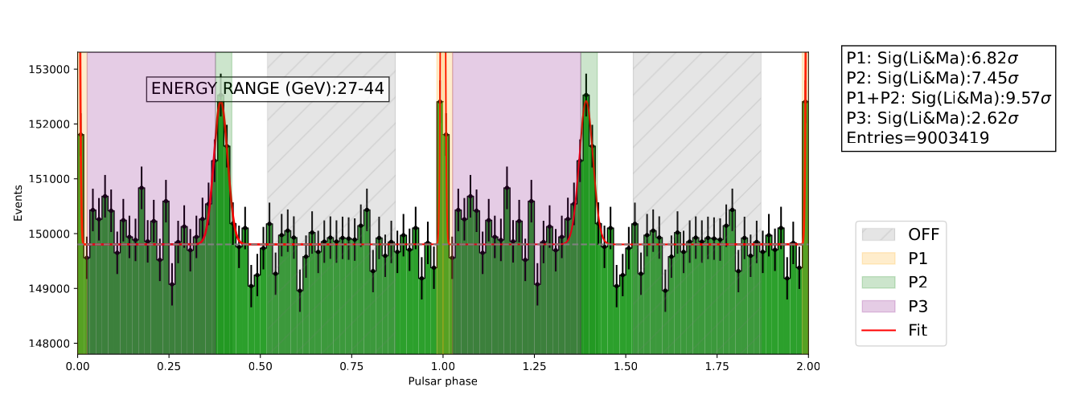
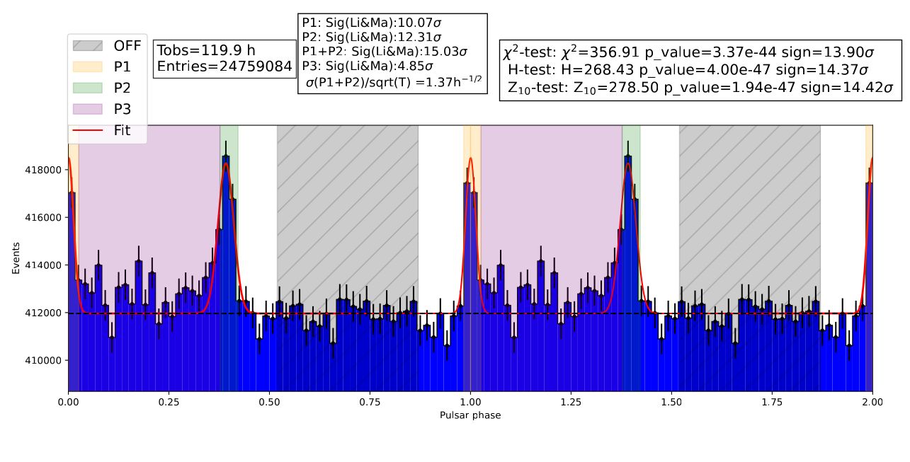
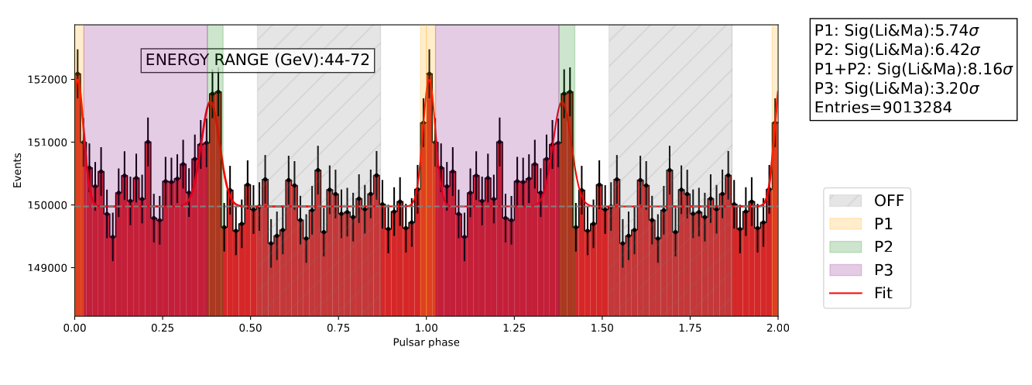
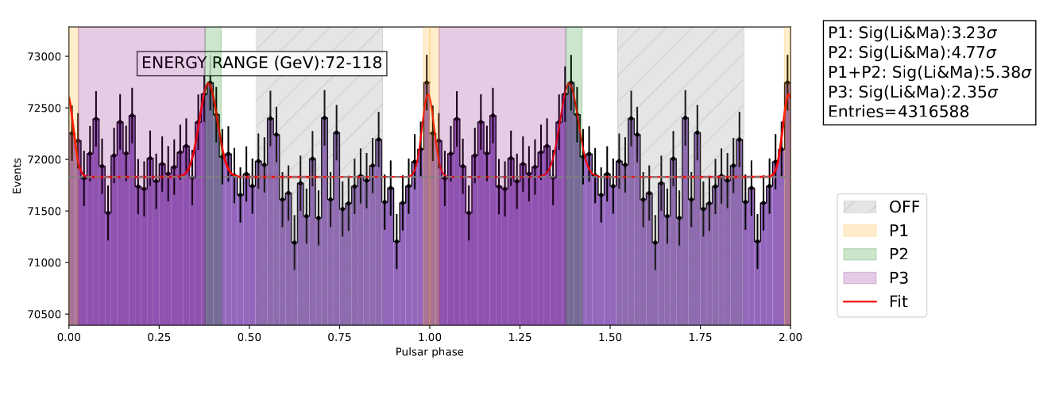
Crab Phasogram analysis
Energy binning from 10 GeV to 10 TeV
Double gaussian phasogram fitting
[55,75]
[0,35]
[35,55]
Energy integrated crab phasogram

Slide 28
[35,55]
LIV effect constraints evaluation
MeanPhase VS Energy : ∆Φ=f(∆E)
Determine the Mean phase from the fitted P1 and P2 for each energy bin
Linear fit of the plot to estimate approximately constraints on E_{LIV}
Fixed parameters
LIV parameter to constrain

Slide 29
Conclusion & Perspectives
Crab analysis for LIV : work in progress
Data selection done : 192 hours of Crab data to analyse
Pipeline that allows us to perform high level analysis (SED and Phasogram construction)
Presented at the general LST meeting, Padova, June 2026
multi-zenith study to research a potential emission at high energy : no such component was detected
simple double gaussian fit performed for the phasogram
estimation of the LIV constraints (in progress)
Gammalearn re-analysis (an estimate of +10 σ compared to the standard analysis for the Crab ! )
Other pulsars LIV analysis thanks to the Crab analyse code (DragonFly, 2032+4127 and boomerang)
Use of LIVelihood code for a more rigorous LIV constraints

Slide 30
Future work for the next year
Conduct an analysis with gammalearn in order of priority:
Crab, Geminga (an estimate of +10 σ compared to the standard analysis for the Crab ! )
DragonFly , J2032+4127 ( first detection ?)
Boomerang (difficult due to high zenith )
J1913+1011 (observation proposal ? )
Use of the the detectability estimation analysis to motivate the future proposals ( northern millisecond pulsars J2017+0603) and as tool for the Southern pulsars detectability estimation
Other pulsars LIV analysis (lstchain and gammalearn) thanks to the Crab analyse code (DragonFly, 2032+4127 and boomerang)
Use of LIVelihood code for a more rigorous LIV constraints
Technical task : provide the softwares (detectability estimation, LIV analysis) documented to the CTA collaboration
LST Shift in La Palma ?

Slide 31
Activities
Presentations
LST General meeting, Padova, June 2026
Bridging high and low energies in search of quantum gravity - 2026 Cost Action CA23130 Second Annual Conference, Varna, July 2026
Schools
2nd Cherenkov Astronomy Data School – November 2025
School : Sustainable Scientific Software School 2026 – January 2026
2nd UNDARK School : The multi-messenger non-thermal universe – March 2026
Teaching
Enseignement de TP d’informatique, 1ère année Licence Physique – 15 heures
Enseignement de TP de mathématiques, 1ère année IUT spécialité GEII – 14 heures

Slide 32
Doctoral school (~ 120 h)
Catégorie professionnelle (~90h)
Catégorie professionnelle (50h)
MOOC Doctorat et poursuite de carrière/ PhD and career development (24h)
Encadrer efficacement des TD + TP (16h)
Career Development Day for PhD Students (10h)
Catégorie transversale (48h)
S'initier à la vulgarisation ; Raconter, expliquer, et partager sa recherche (20h)
Journée de Rentrée des Doctorantes et doctorants 2025 (3h)
Éthique de la recherche (15h)
Outreach : Fête de la Science 2025, FIRST, Mercredi du LAPP, présentations Eutopia (10h)

Slide 33
Thank you for your attention !

Slide 34
BACK UP

Slide 35
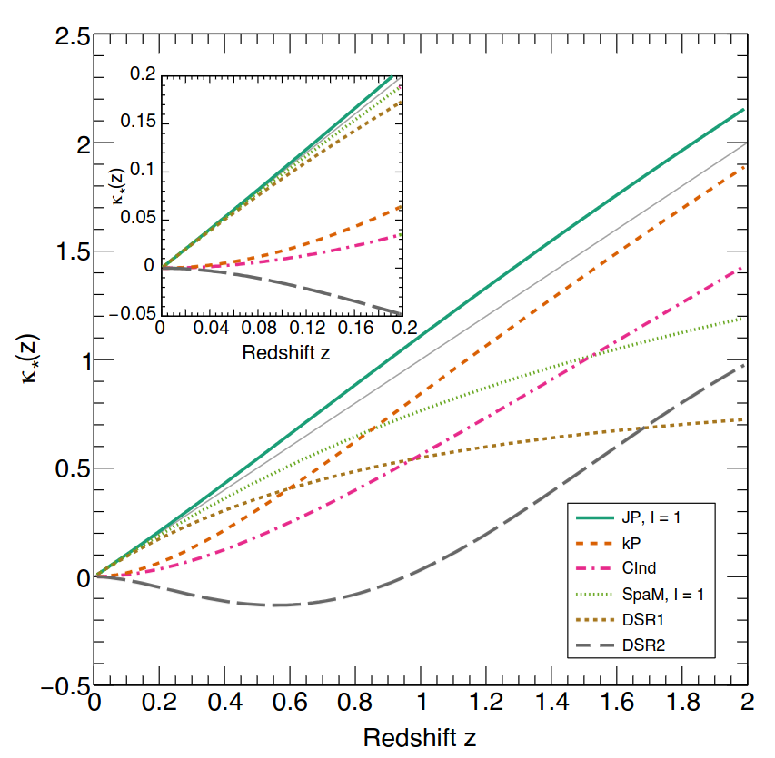
Pulsars : good candidates for LIV
Periodic nature of pulsar :
Deterministic and almost stable variability
Data accumulation for a long time
Galactic origin:
Avoids cosmological effect on the time lag propagation (better model independence)
Pulsar counterbalance small distance with high variability
Combined pulsars analysis necessary to disentangle LIV (propagation effect) from intrinsic effect

Slide 36
Best pulsar candidates to probe LIV
Assumptions :
one of the energy photons is zero : ∆E= E-E₀ with E₀ =0
First order hypothesis : n=1
E_{LIV,1} ≈ E_{Planck} ≈ 10¹⁹ GeV
Rotation period multiplied by 0.01 : represents in first approximation the position error at high energy of Crab peak P1
Limitation :
This plot doesn’t take into account the statistics for each pulsars

Slide 37
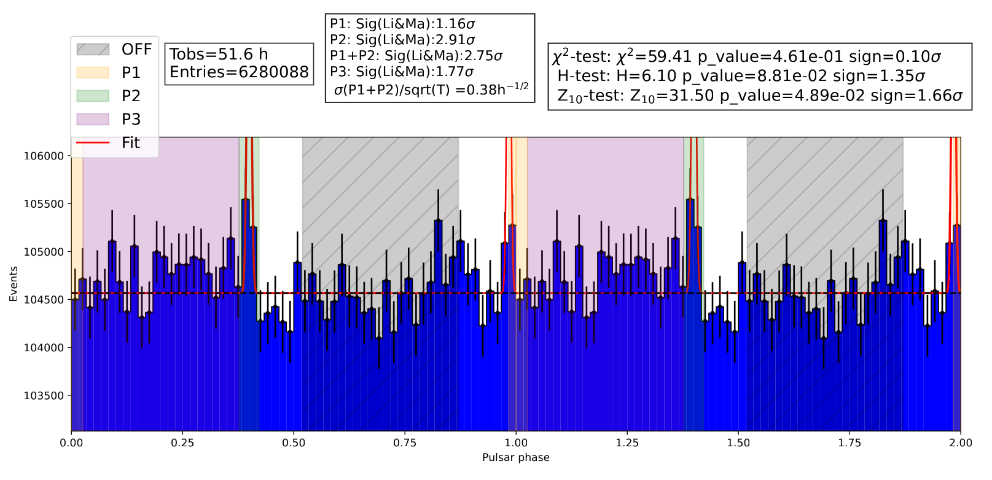
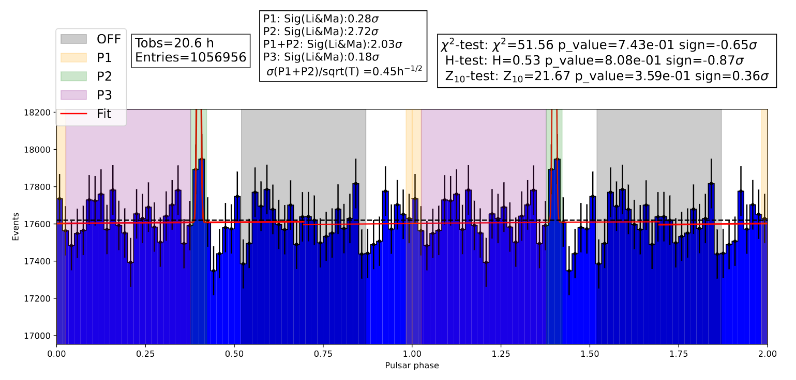
[35,55]
[55,75]

Slide 38
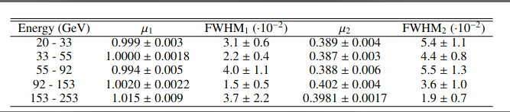

Slide 39
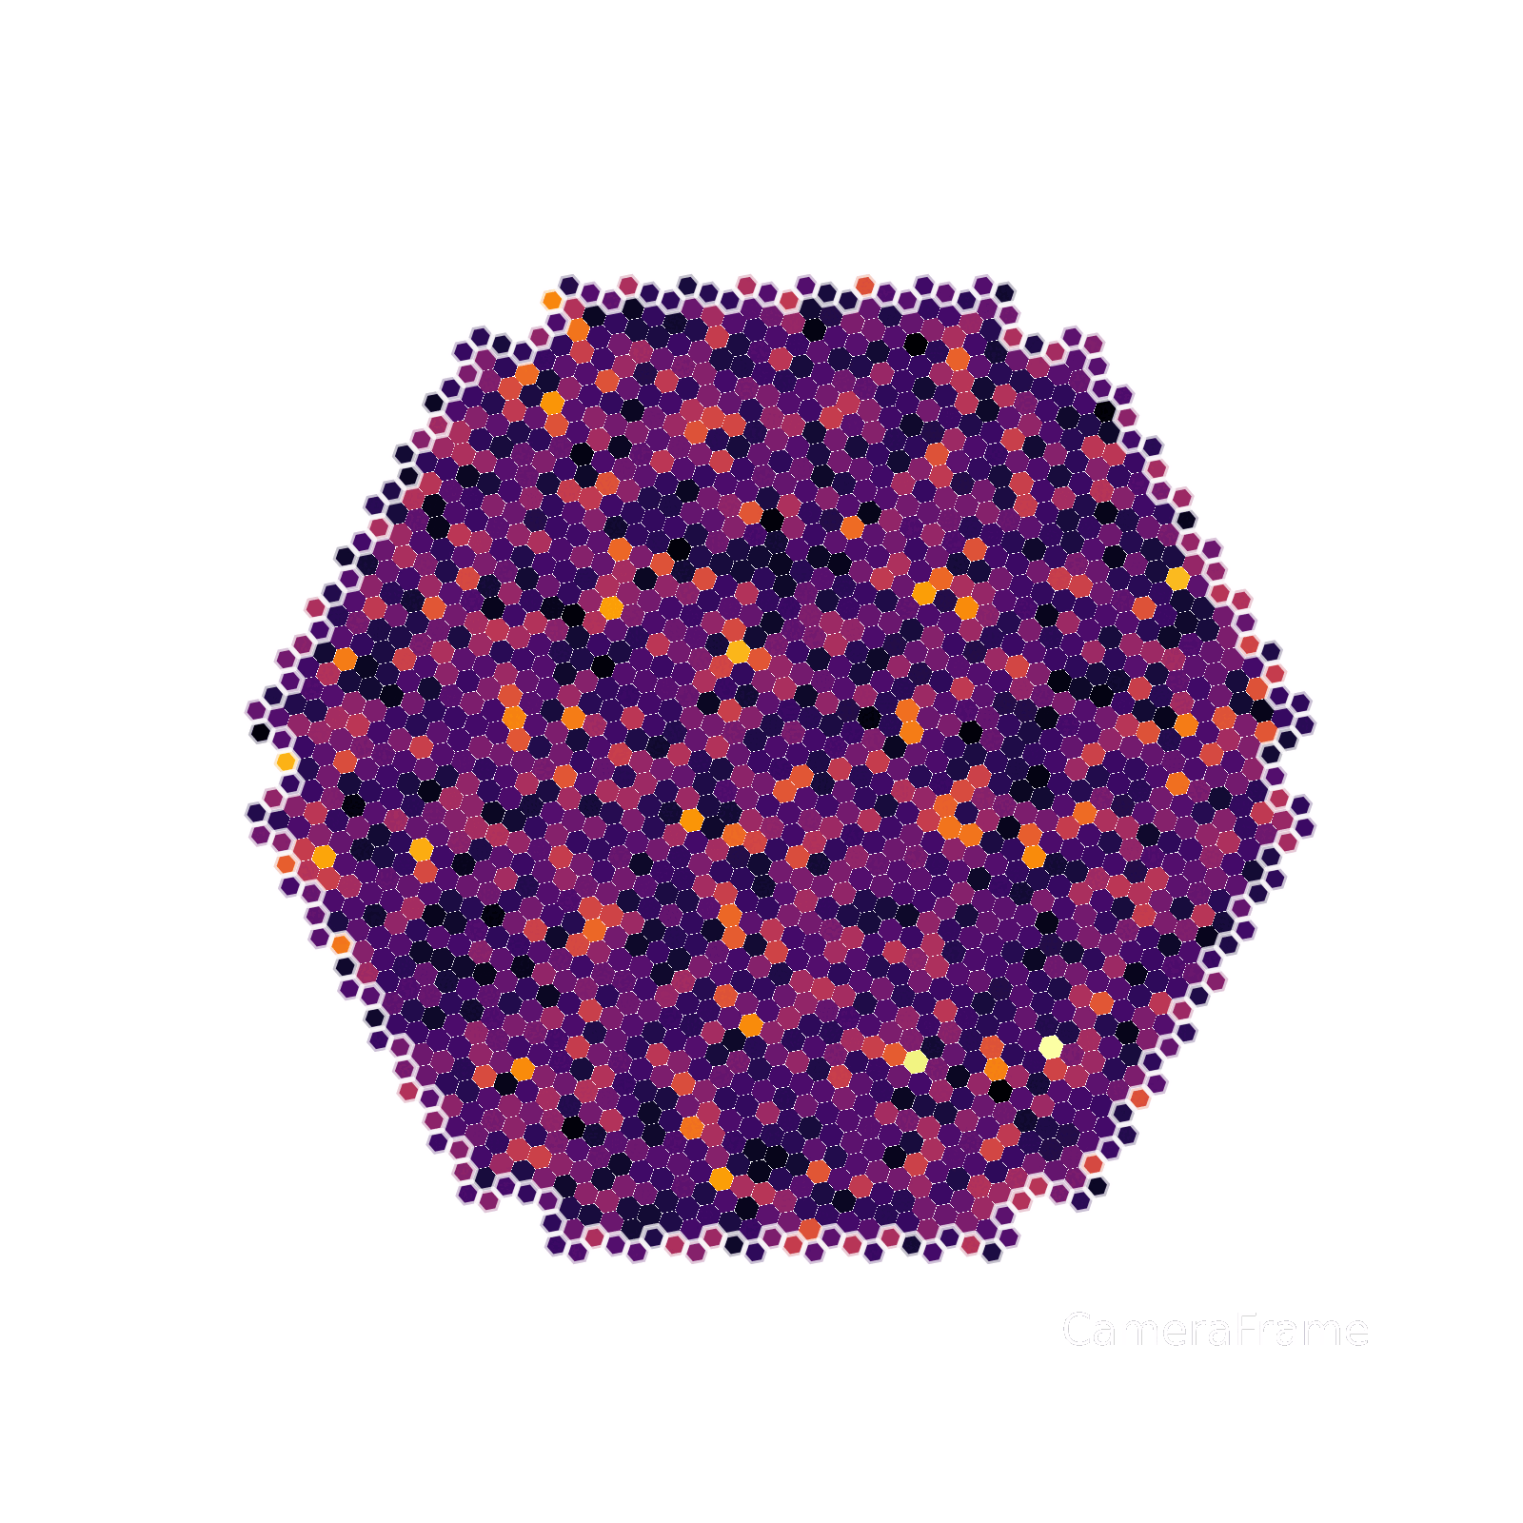
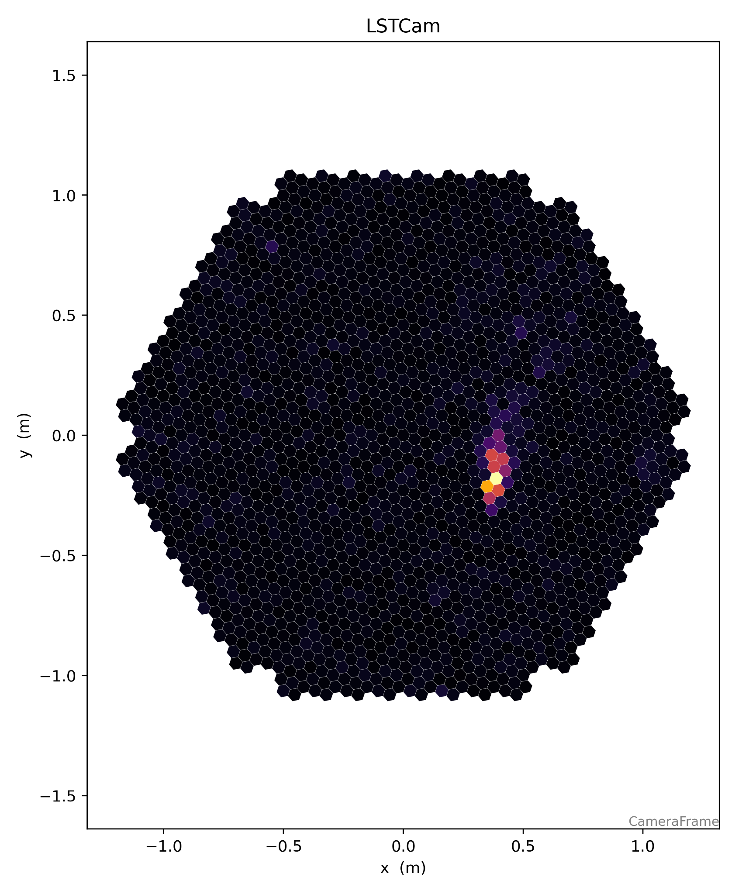
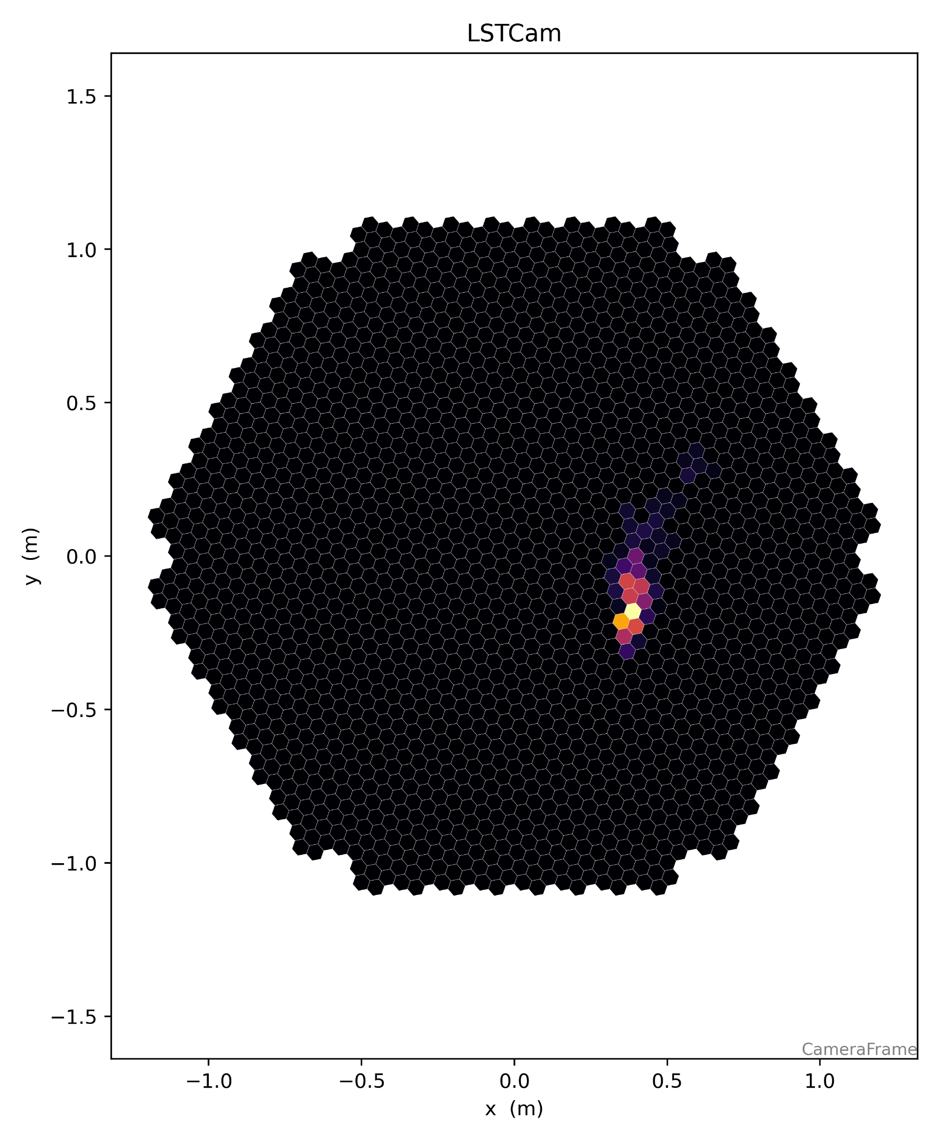

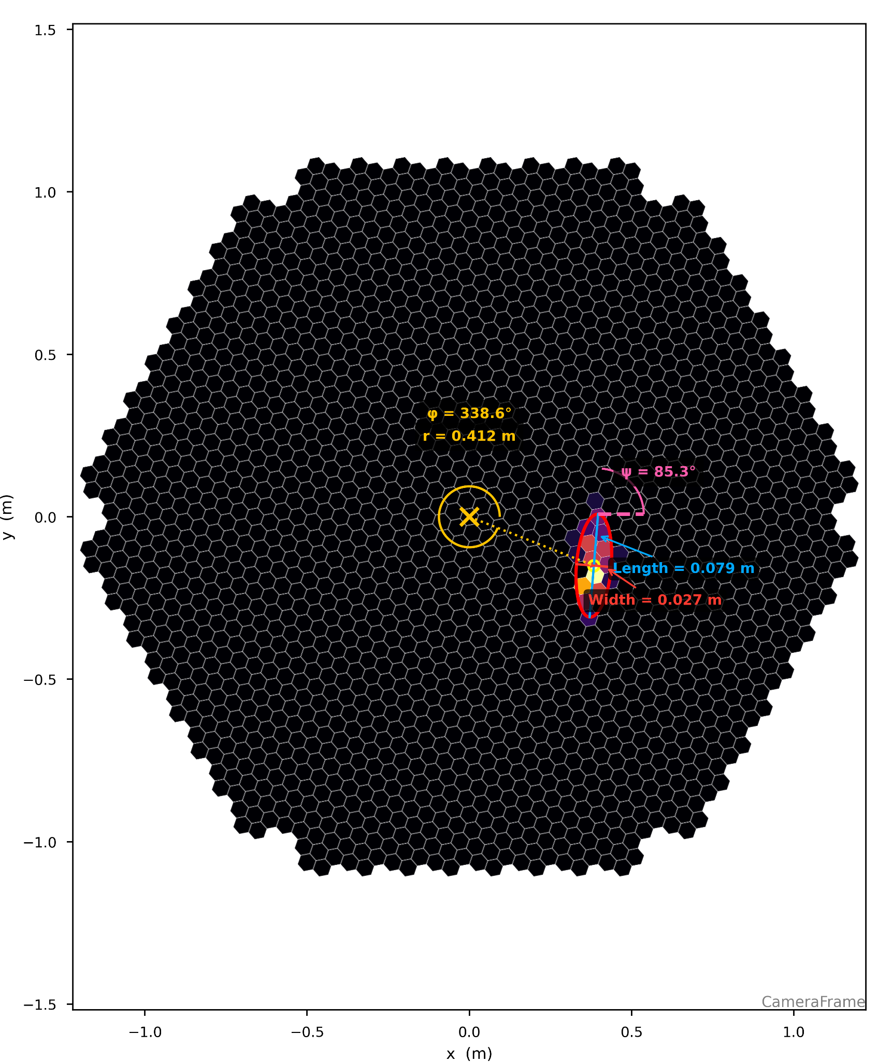
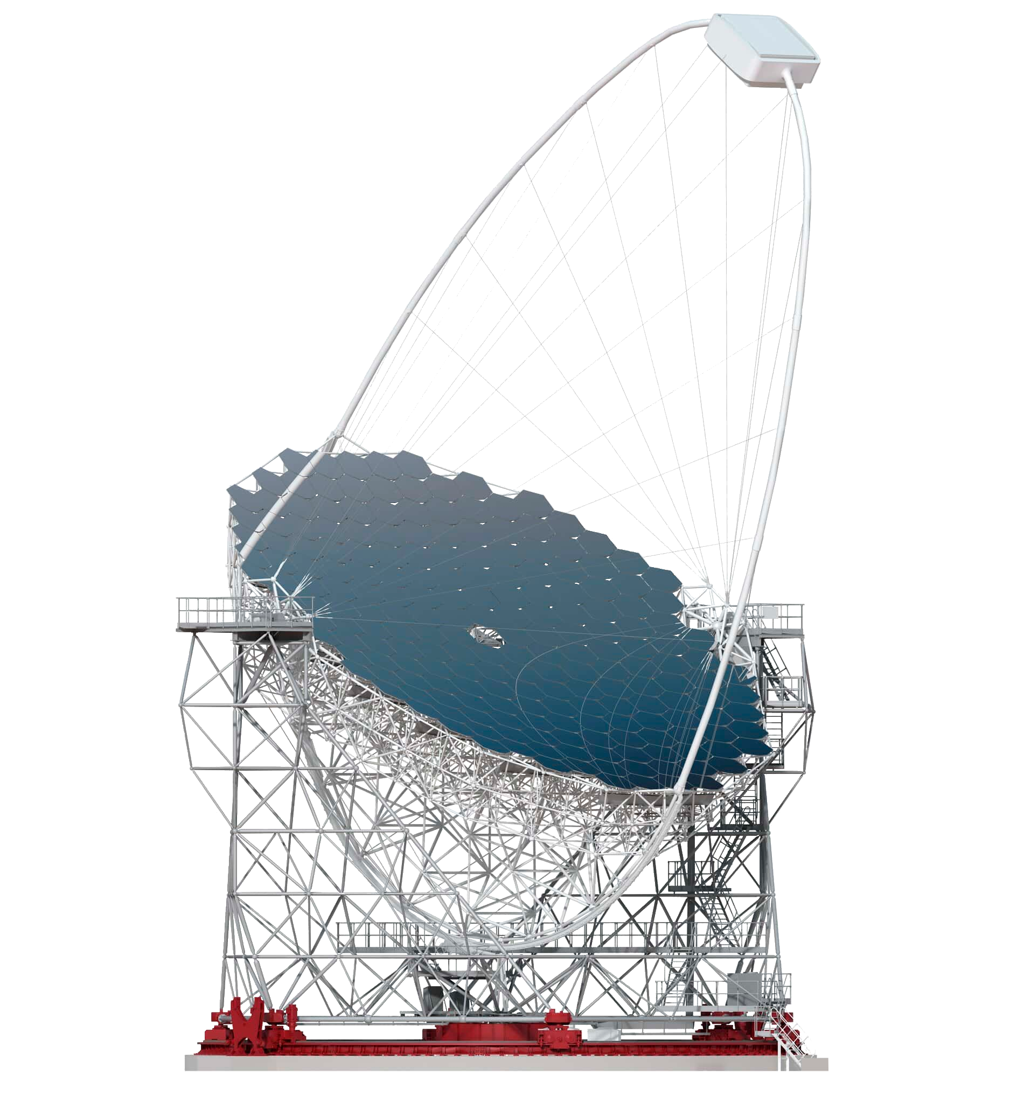
Event reconstruction
Calibration + Integration
Cleaning
40 snapshots
Incoming particle
Event detection
Camera
Cherenkov light
Mirror
HIllas parameters
virtual impact point
Machine learning algorithm
Energy
Class

Slide 40
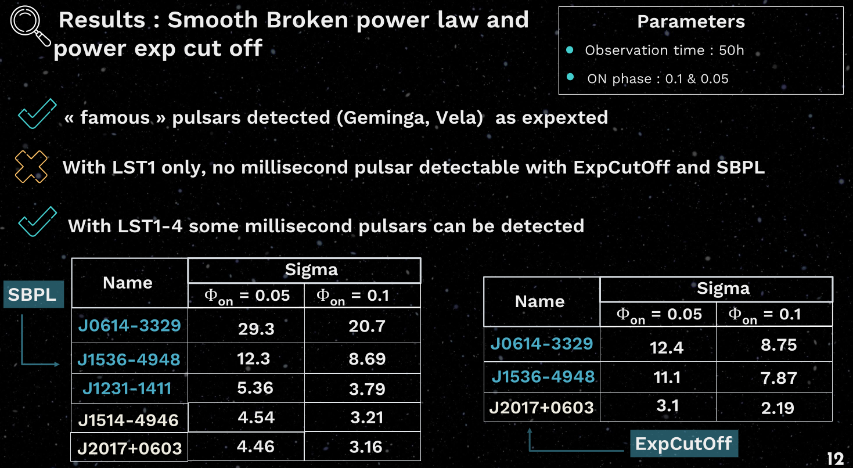

Slide 41
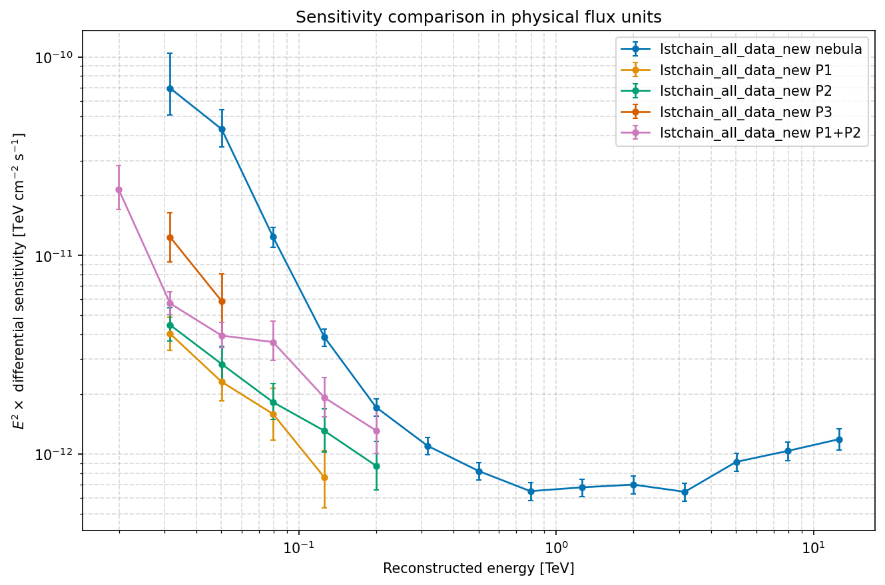
Sensitivities used
New LST pulsar phase-selected sensitivities based on the Crab data (P1,P2 and P1P2) and deep learning approach gammalearn (cf : Sami’s and Guillaume’s presentation tomorrow)
P1, P2, and P1P2 selected via a Ф_{on} region in the phasogram
P1, P2 present nearly the same sensitivity curves ( Ф_{on,P1}≈ Ф_{on,P2}≈ 0.05)
Signal concentrated in a single peak
P1+P2 region is more broader ( Ф_{on,P1+P2}≈ 0.1)
Signal is spread across two peaks
Also presented at the LST analysis meeting of May :
https://indico.cta-observatory.org/event/7280/contributions/57188/attachments/30439/45325/slide_sensitivity_pulsar_analysis_meeting.pdf

Slide 42
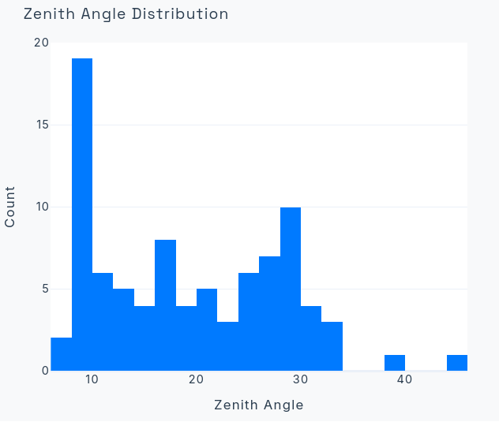
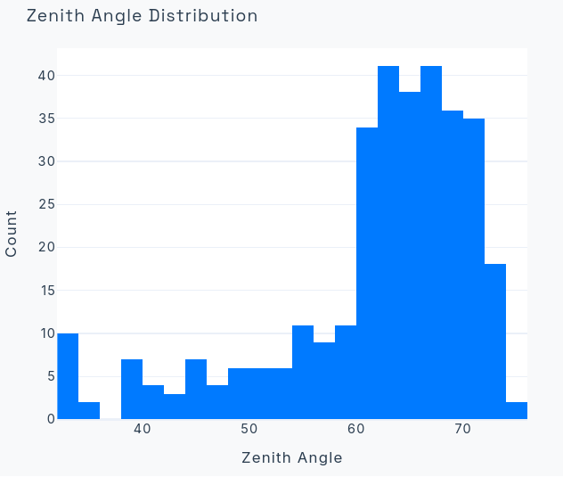
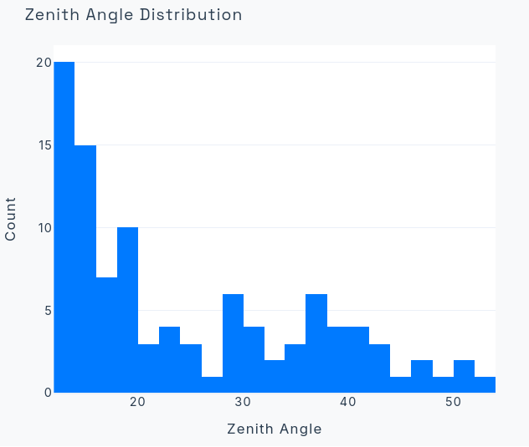
Zenith angle distributions
DragonFly
Boomerang
J2032+4127

Slide 43
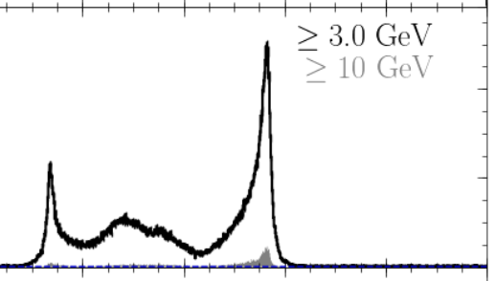
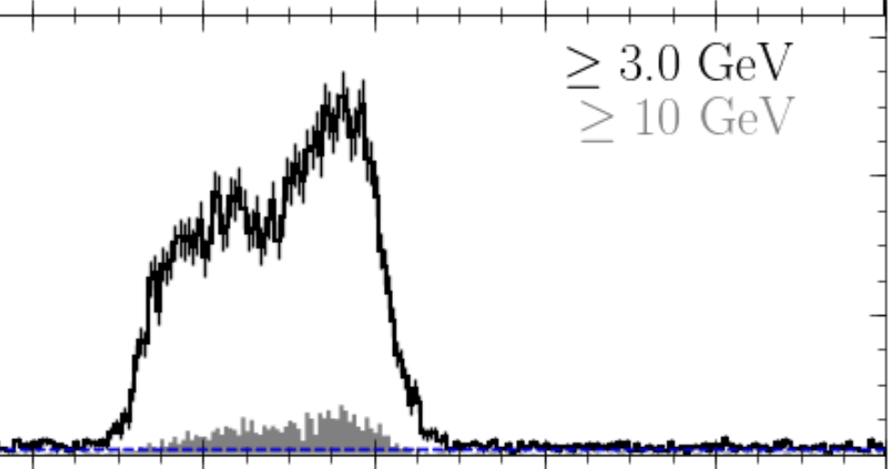
A more spread_out Peak
Single Peak concentrated

Slide 44
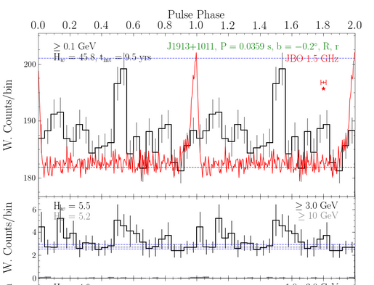
J1913+1011 fermi phasogram

Slide 45

LST simulations: lst-chain
A precise method to simulate a specific pulsar
Allows us to simply implement a personalized SED model
Only a simulator for LST 1 (based on the technical parameters of the telescope)
Heavy (Contain a lot of parameters to set), not adapted to a first global analysis

Slide 46
Crab Pulsar P1+P2
Parameters
Observation time : 103h
Comparison between the method and the real data (LST Paper )
P1+P2 sensitivity curve
simulation with the power-law of Г = 3.2 from the LST paper for P1+P2
Significance 𝜎
paper
lstchain pulsar
gammalearn pulsar
P1P2
12.5
13.9
24.9

Slide 47
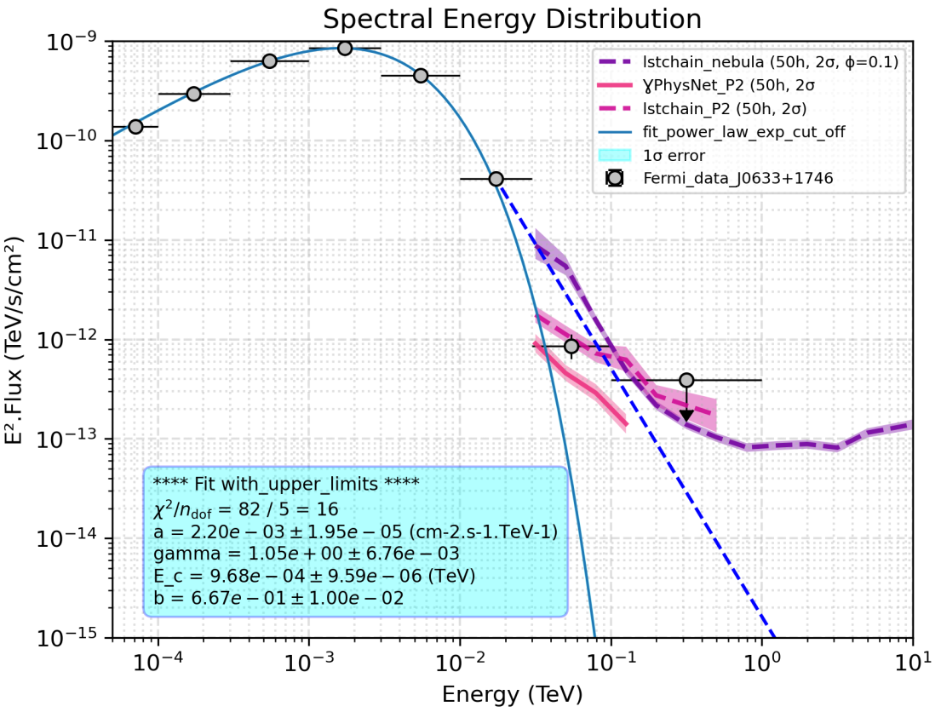
Geminga pulsar
Parameters
Observation time : 60h
Comparison between the method and the real data (LST Paper)
P2 sensitivity curve
geminga-like model used to simulate the power-law of Г = 4.5 from the LST paper
Significance 𝜎
paper
lstchain pulsar
gammalearn pulsar
P2
12.2
12.9
27.3
Major expected significance improvement with gammalearn

Slide 48
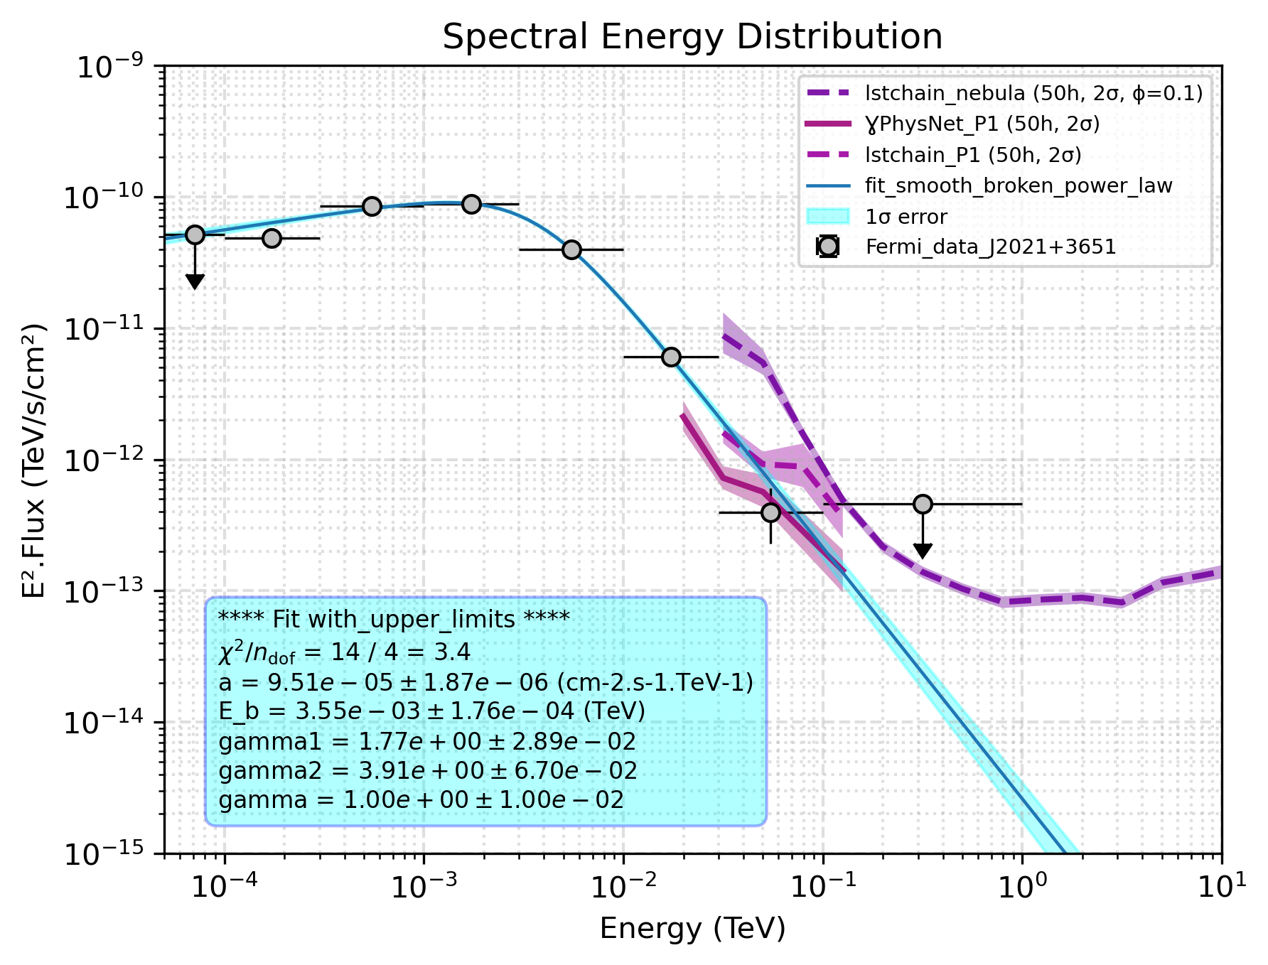
DragonFly pulsar
Potentially a first detection ?
data available with LST (88 runs) to analyse
Smooth Broken Power Law model used
Observation time : 50h
Significance 𝜎
Sensitivity
lstchain pulsar
gammalearn pulsar
P1
3.14
7.63
P2
2.81
6.24
P1P2
2.32
4.04
Expected detection if signal is concentrated in one peak, strong hint if two peaks

Slide 49
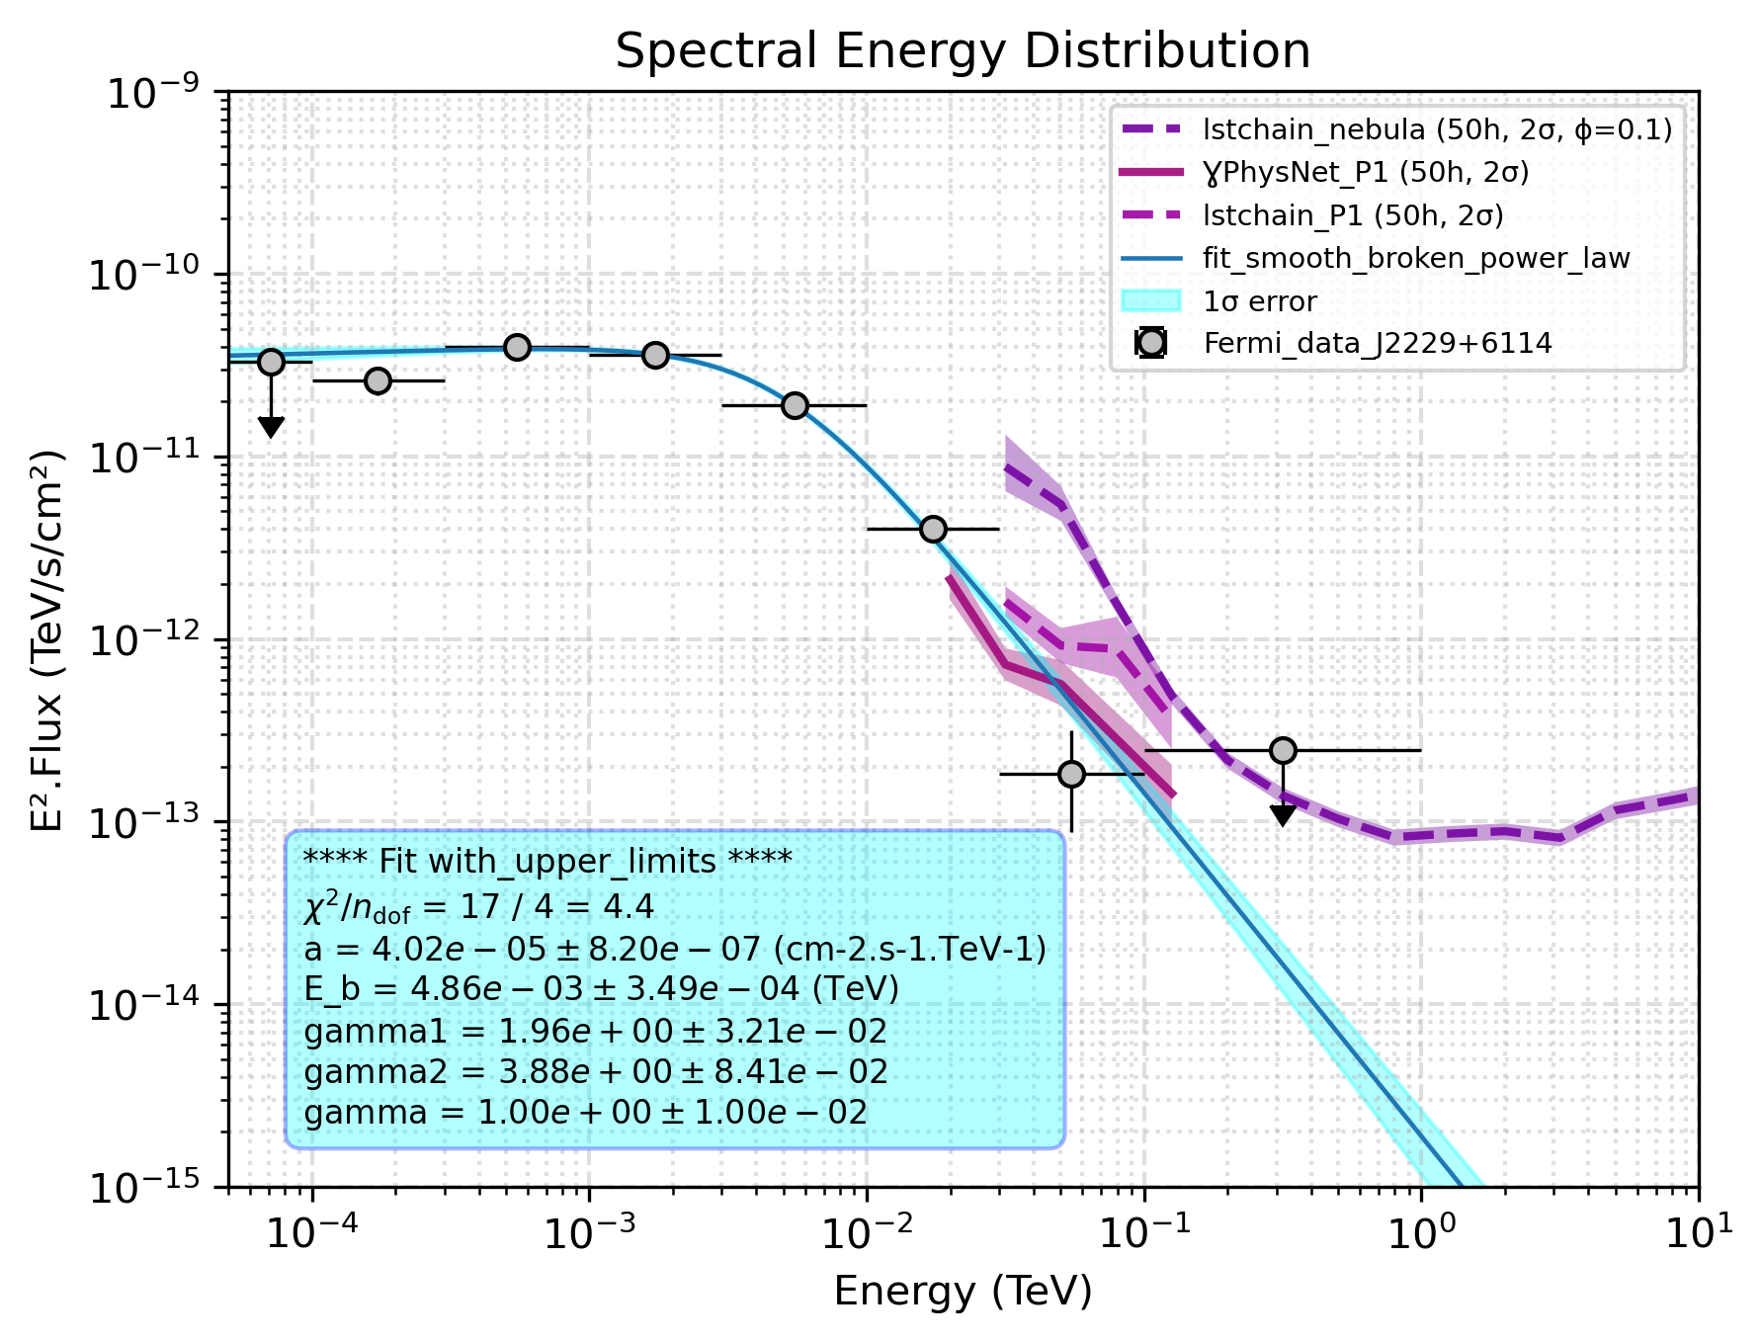
Boomerang pulsar
Potentially a first detection ?
data available with LST (331 runs) but mostly at high zenith (not adapted yet to current sensitivity curves used)
Smooth Broken Power Law model used
Observation time : 50h
Significance 𝜎
Sensitivity
lstchain pulsar
gammalearn pulsar
P1
2.04
4.87
P2
1.82
4.07
P1P2
1.49
2.58

Slide 50
J2032+4127 pulsar
Potentially a first detection ?
data available with LST (102 runs) to analyse
Smooth Broken Power Law model used
Significance 𝜎
Sensitivity
lstchain pulsar
gammalearn pulsar
P1
3.29
7.54
P2
2.96
6.74
P1P2
2.35
4.11
The last fermi data point is detectable directly by gammalearn without any model assumption

Slide 51
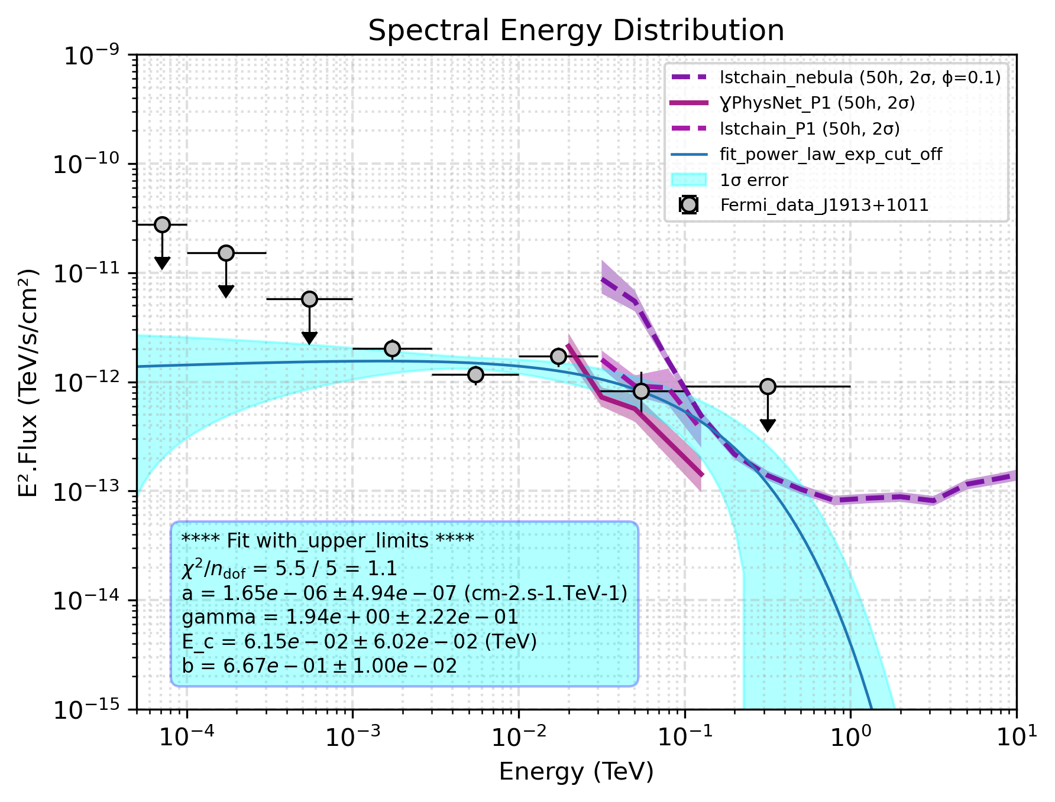
J1913+1011 pulsar
Potentially a first detection ?
No LST data available
Power Law ExpCutOff used
Significance 𝜎
Sensitivity
lstchain pulsar
gammalearn pulsar
P1
2.79
7.45
P2
2.38
5.40
P1P2
1.79
2.7
The last fermi data point is detectable directly by gammalearn without any model assumption

Slide 53
Results
Smooth Broken Power Law
LST 1

Slide 54
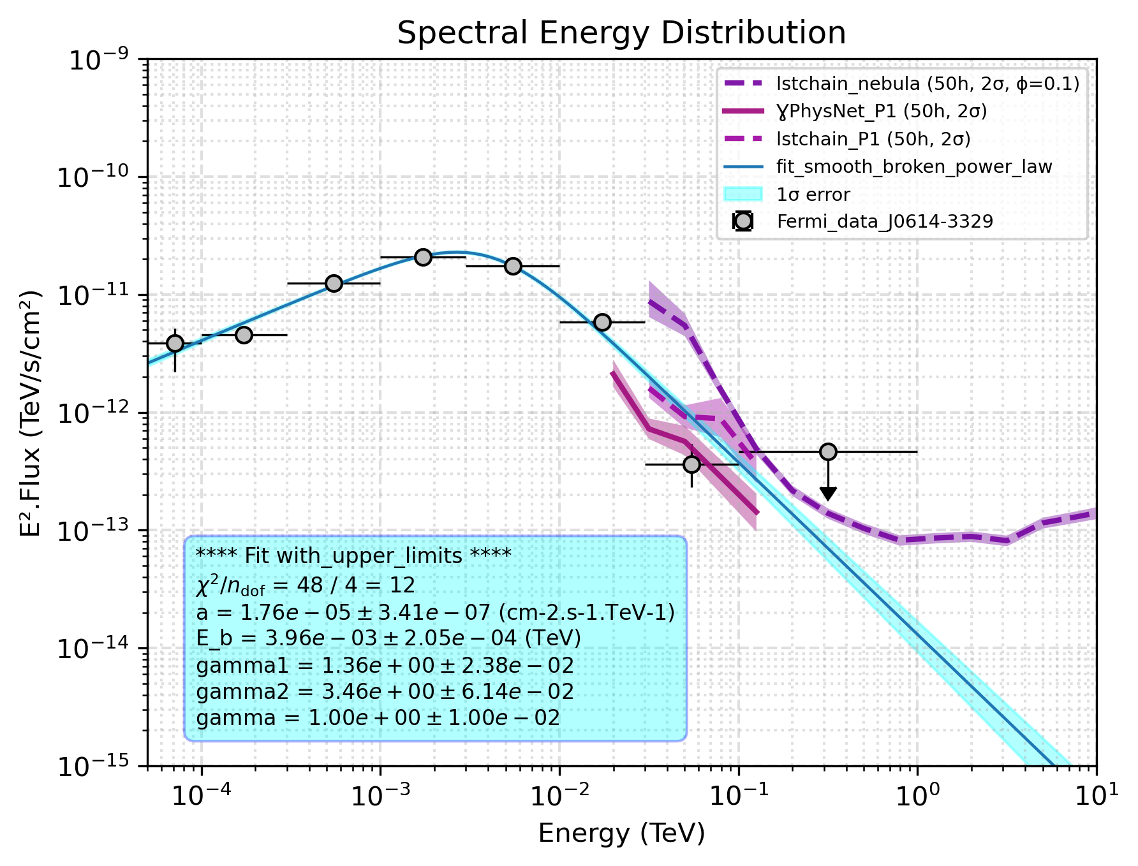
P1 sensitivity
Parameter
Observation time : 50h
SBPL
Sigma
Name
lstchain
gammalearn
J0614-3329
3.85
8.44
J1536-4948
1.55
3.70
J1231-1411
0.64
1.65
J1514-4946
0.56
1.39
J2017+0603
0.55
1.37
Southern hemisphere
Northern hemisphere

Slide 55
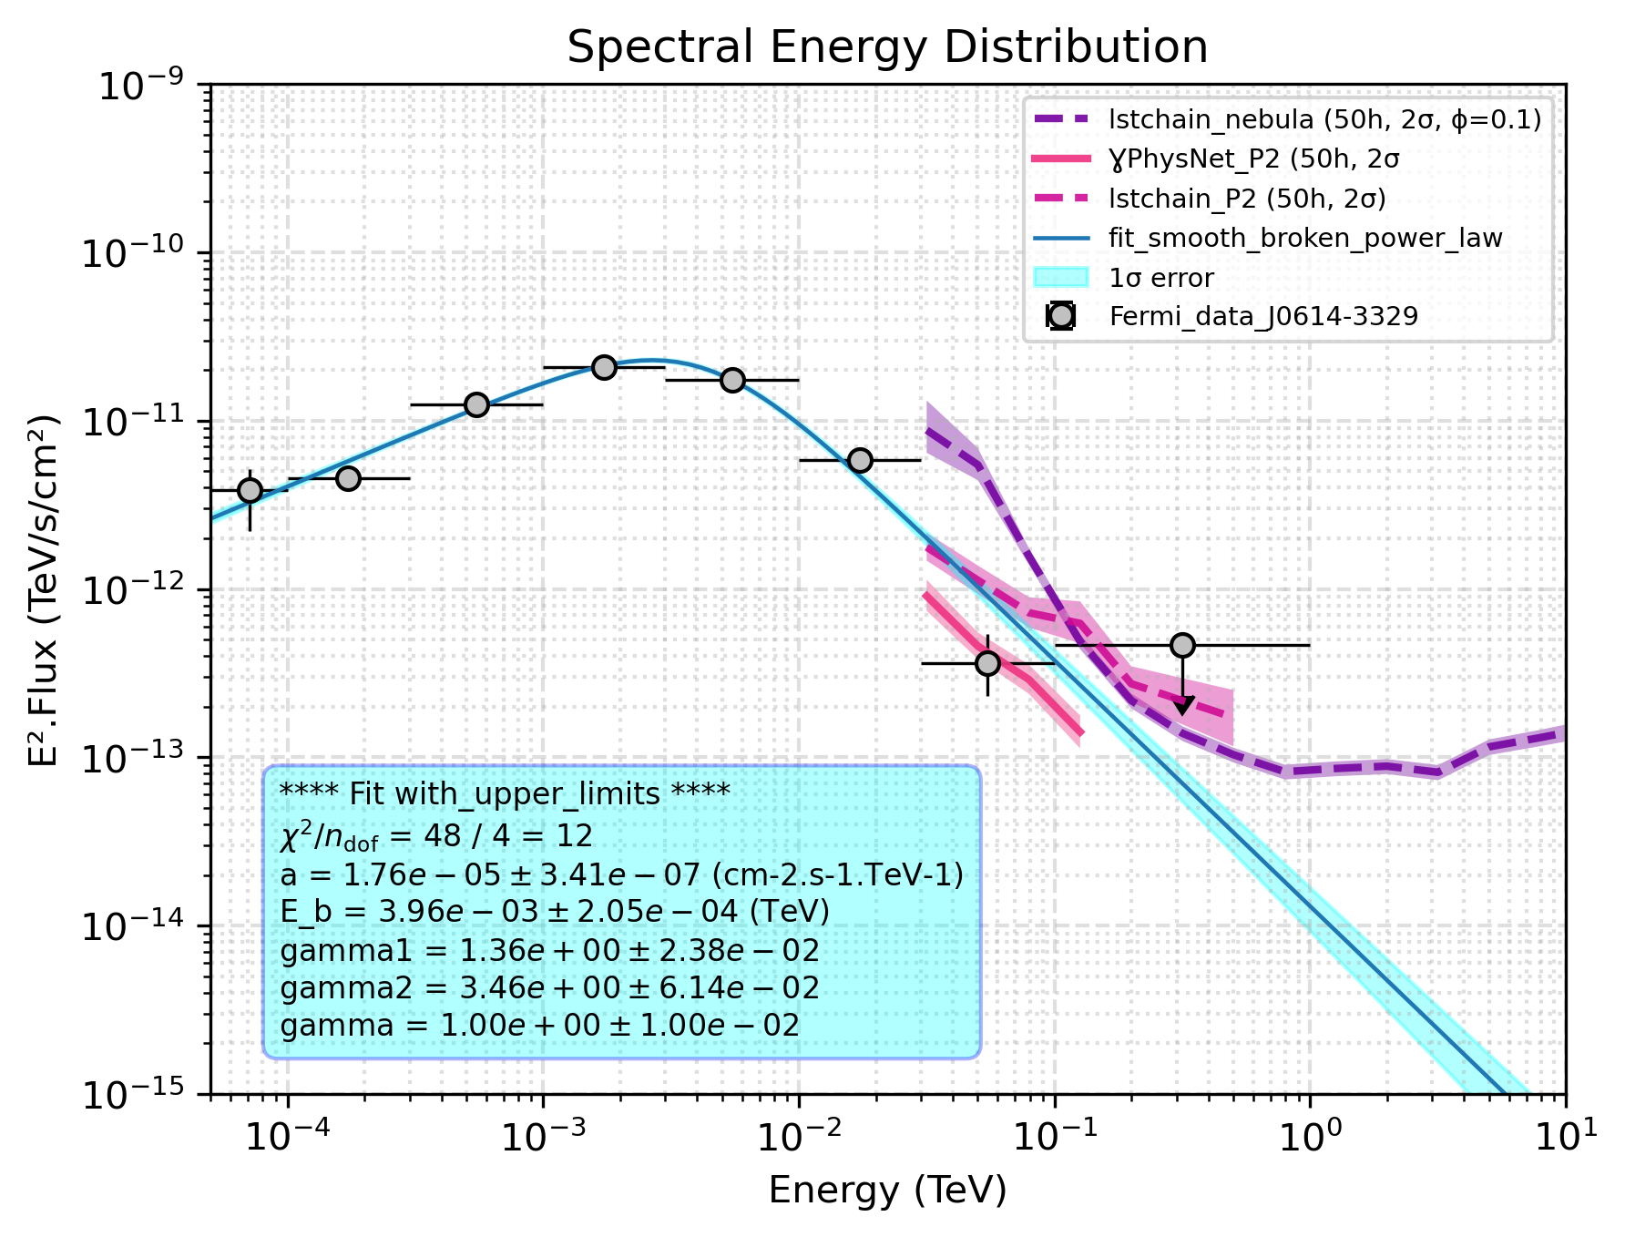
P2 sensitivity
Parameter
Observation time : 50h
SBPL
Sigma
Name
lstchain
gammalearn
J0614-3329
3.53
8.20
J1536-4948
1.39
3.09
J1231-1411
0.57
1.25
J1514-4946
0.50
1.09
J2017+0603
0.49
1.07
Southern hemisphere
Northern hemisphere

Slide 56
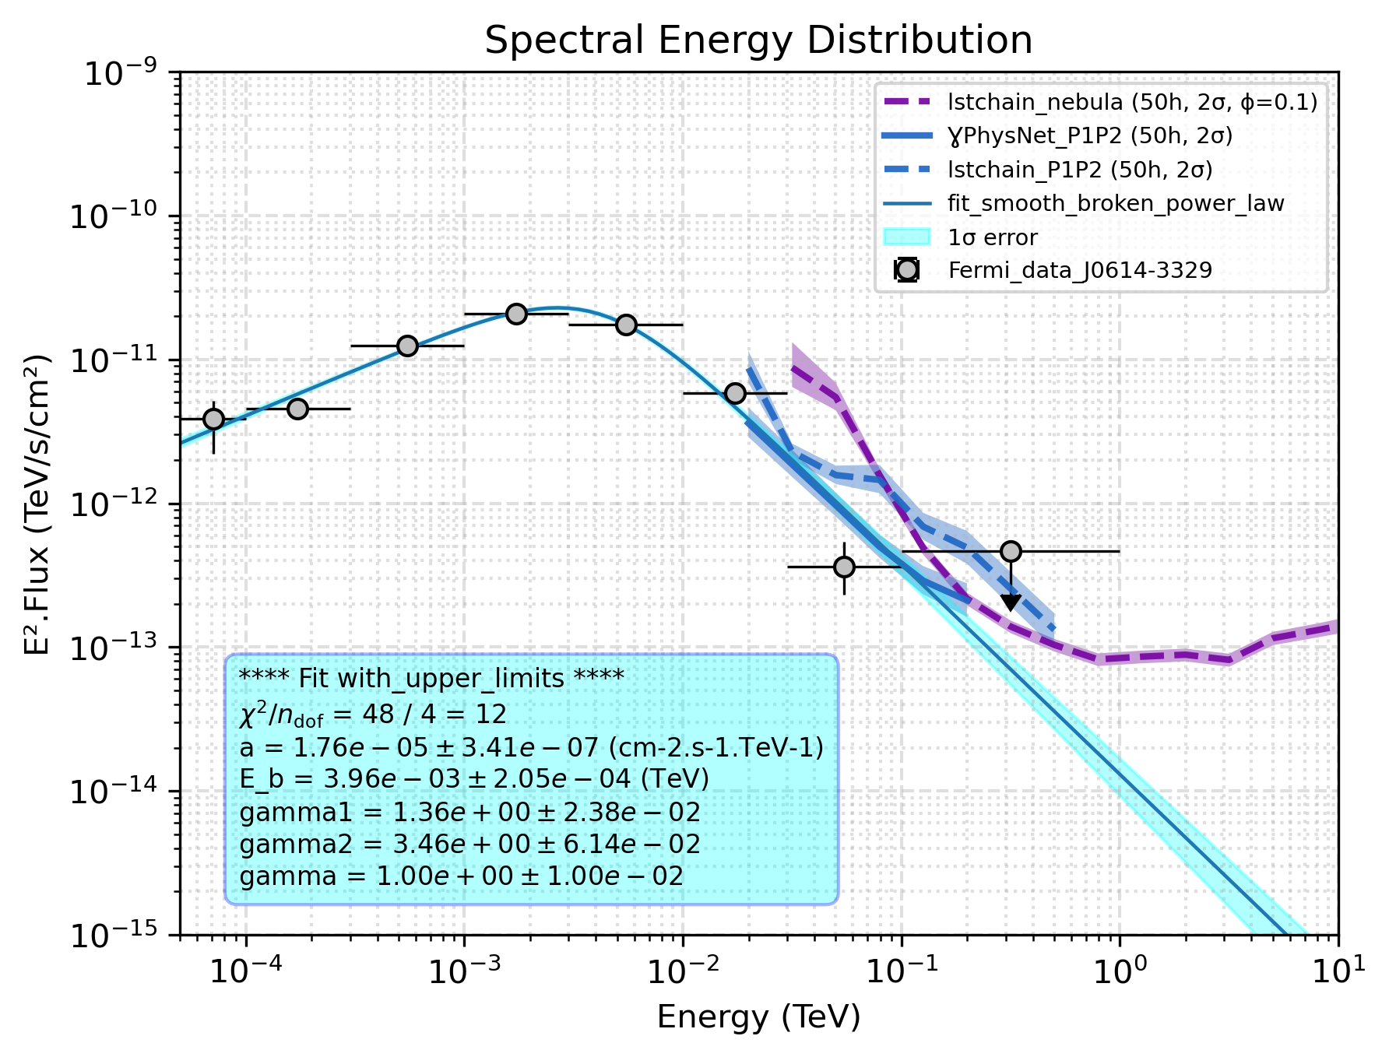
P1P2 sensitivity
Parameter
Observation time : 50h
SBPL
Sigma
Name
lstchain
gammalearn
J0614-3329
2.71
4.83
J1536-4948
1.13
1.96
J1231-1411
0.49
0.86
J1514-4946
0.42
0.73
J2017+0603
0.41
0.72
Southern hemisphere
Northern hemisphere

Slide 57
Results
Power Law Exp Cut Off
LST 1

Slide 58
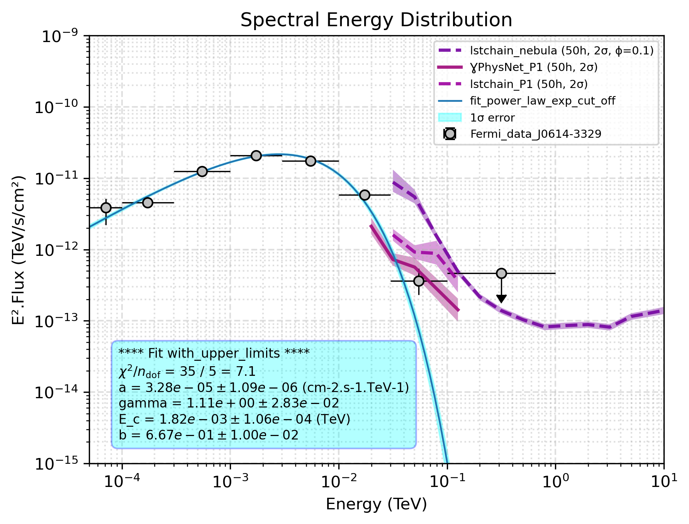
P1 sensitivity
Parameter
Observation time : 50h
PLExpCutOff
Sigma
Name
lstchain
gammalearn
J0614-3329
1.11
4.03
J1536-4948
1.16
3.50
J2017+0603
0.24
1.05
J1514-4946
0.21
0.92
J2339-0533
0.16
0.66
Southern hemisphere
Northern hemisphere

Slide 59
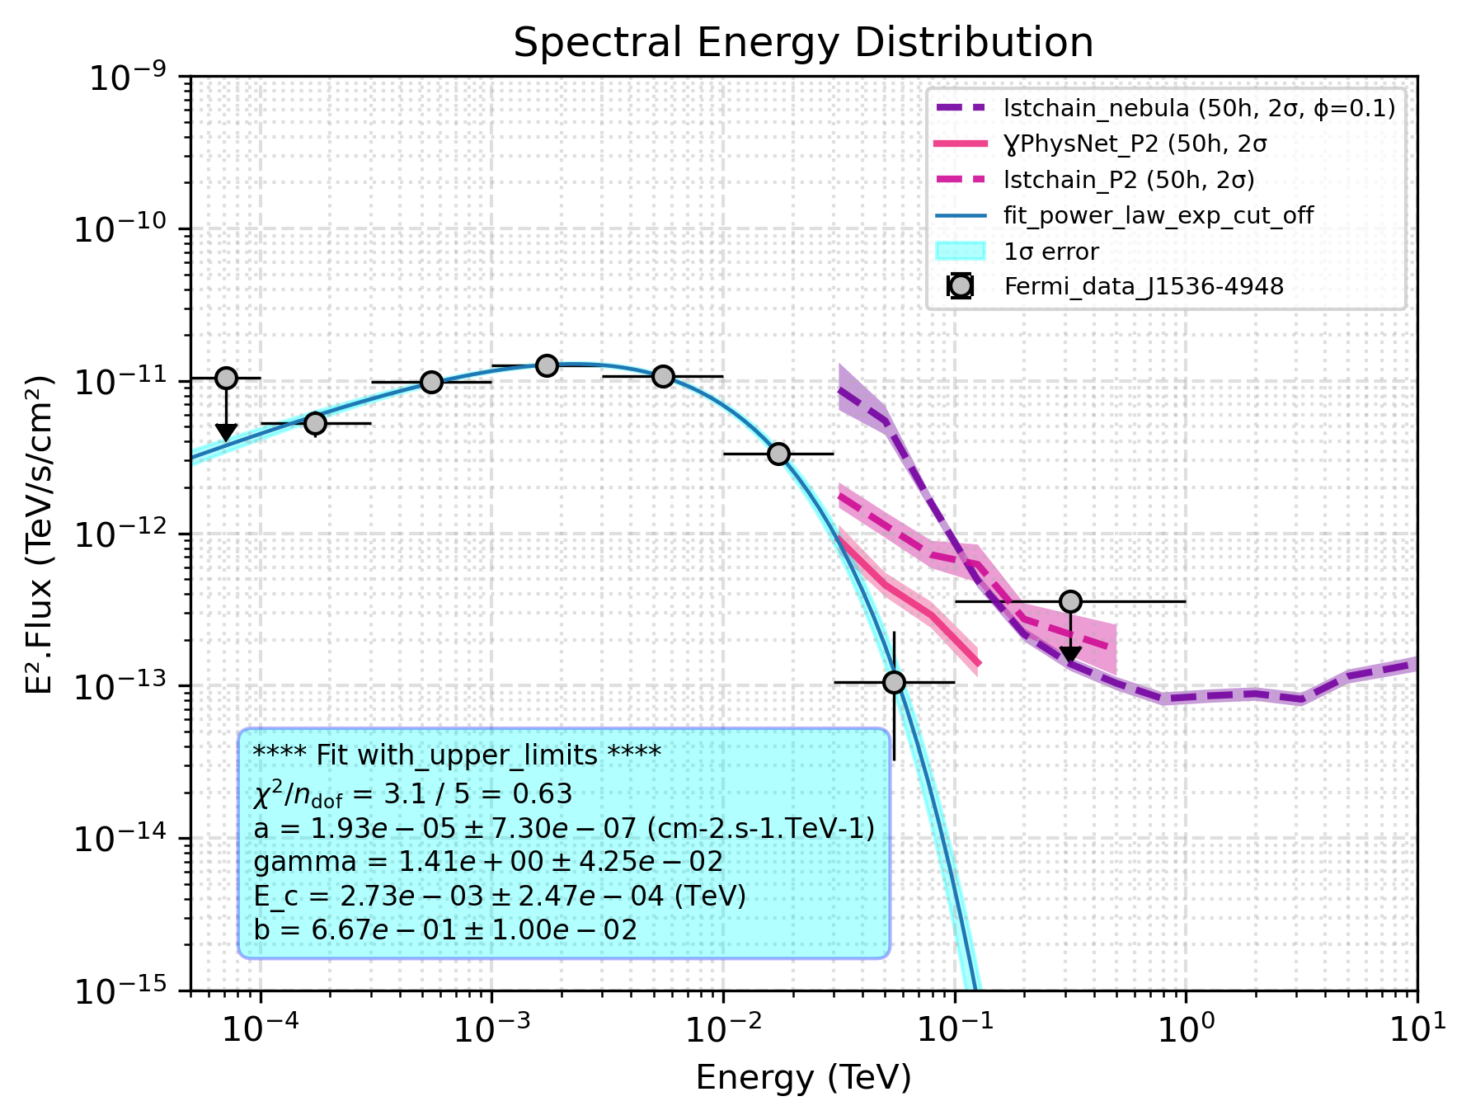
P2 sensitivity
Parameter
Observation time : 50h
PLExpCutOff
Sigma
Name
lstchain
gammalearn
J1536-4948
1.04
2.09
J0614-3329
1.00
1.98
J2017+0603
0.22
0.43
J1514-4946
0.19
0.38
J2339-0533
0.14
0.28
Southern hemisphere
Northern hemisphere

Slide 60
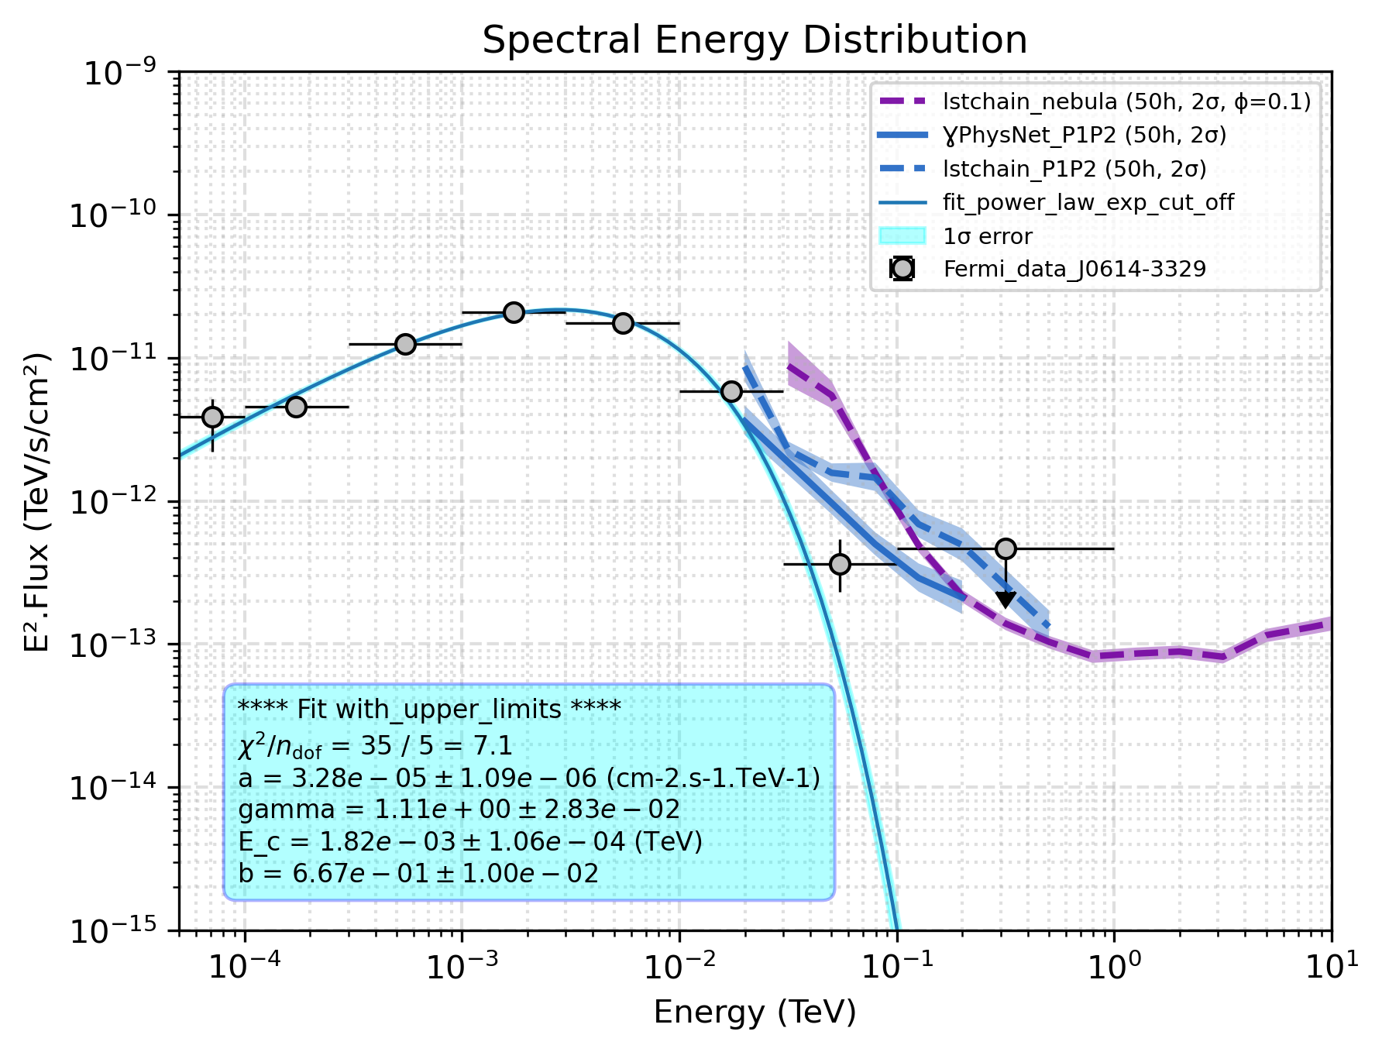
P1P2 sensitivity
Parameter
Observation time : 50h
PLExpCutOff
Sigma
Name
lstchain
gammalearn
J0614-3329
1.10
2.12
J1536-4948
1.00
1.76
J2017+0603
0.28
0.57
J1514-4946
0.24
0.50
J2339-0533
0.17
0.35
Southern hemisphere
Northern hemisphere

Slide 61
Results
Geminga-like
LST 1

Slide 62

Parameters
P1 sensitivity
Observation time : 50h
Geminga-like
Sigma condition: 5𝜎
Energy pivot : 0.017 TeV
Spectral index
Name
lstchain
gammalearn
J0614-3329
3.34
4.69
J1536-4948
2.82
3.55
J2017+0603
2.31
2.76
J1231-1411
2.31
2.72
J1514-4946
2.21
2.62
Southern hemisphere
Northern hemisphere

Slide 63
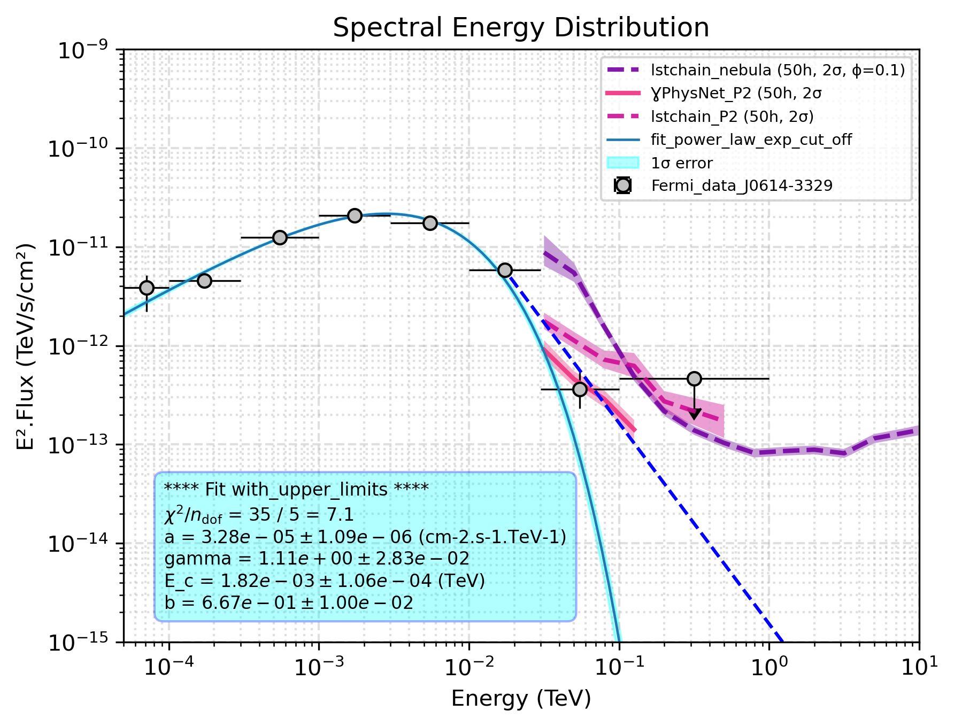
Parameters
P2 sensitivity
Observation time : 50h
Geminga-like
Sigma condition: 5𝜎
Energy pivot : 0.017 TeV
Spectral index
Name
lstchain
gammalearn
J0614-3329
3.24
4.03
J1536-4948
2.83
3.55
J1231-1411
2.41
2.83
J2017+0603
2.41
2.83
J1514-4946
2.41
2.72
Southern hemisphere
Northern hemisphere

Slide 64

Parameters
P1P2 sensitivity
Observation time : 50h
Geminga-like
Sigma condition: 5𝜎
Energy pivot : 0.017 TeV
Spectral index
Name
lstchain
gammalearn
J0614-3329
3.03
3.55
J1536-4948
2.72
3.14
J1231-1411
2.41
2.52
J2017+0603
2.41
2.52
J1514-4946
2.41
2.41
Southern hemisphere
Northern hemisphere

Slide 65
CTAO/LST detectability evaluation : ratio method
Sensitivity rescale
Total significance sum
Sigma evaluation by energy bin

Slide 66
Results for millisecond pulsars
Parameter
Observation time : 50h
In the very short term : 1 LST North (current CTAO configuration)
The best candidate is J2017+0603 but it will not be detectable by only one LST
In the medium term : 4 LSTs North (≈ 2027) :
The stereoscopic configuration LST1-4 will improve the sensitivity and will probably make J2017+0603 detectable ( at least a strong hint ≈ 3σ)
In the long term : CTAO South (≈ 2030) :
At least two millisecond pulsars (J1536-4948, J0614-3329) potentially detectable by one LST South

Slide 67
Conclusion & Perspectives
Crab analysis for LIV : work in progress
Data selection done : 192 hours of Crab data to analyse
Pipeline that allows us to perform high level analysis (SED and Phasogram construction)
multi-zenith study to research a potential emission at high energy : no such component was detected
simple double gaussian fit performed for the phasogram
estimation of the LIV constraints (in progress)
Analysis for the source dependent and optimized cuts data
Taking into account the Bridge in the phasogram fit (global fit P1,P2 and Bridge)
Use of LIVelihood code for a more rigorous LIV constraints
Other pulsars LIV analysis thanks to the Crab analyse code (DragonFly, 2032+4127 and boomerang)

Slide 68
Sensitivities used
New method of reconstruction !
lstchain
gammalearn
Based on a random forest
Based on deep learning
A significant improvement in LST sensitivity at low energy ( ≈ tens of GeV) !

Slide 69
Current state of the art
Northern hemisphere
4 pulsars detected by the IACTs (HESS, LST, VERITAS, MAGIC)
No millisecond pulsars have been detected yet by the IACTs
LIV application only for the Crab and Vela among pulsars
(https://iopscience.iop.org/article/10.3847/1538-4357/ac5048/pdf )
Geminga
Vela
Crab
J1709-4429
Southern hemisphere
Next steps :
What are the best pulsar candidates to detect with CTAO ?
What are the best pulsar candidates to probe LIV ?

