Slide 1


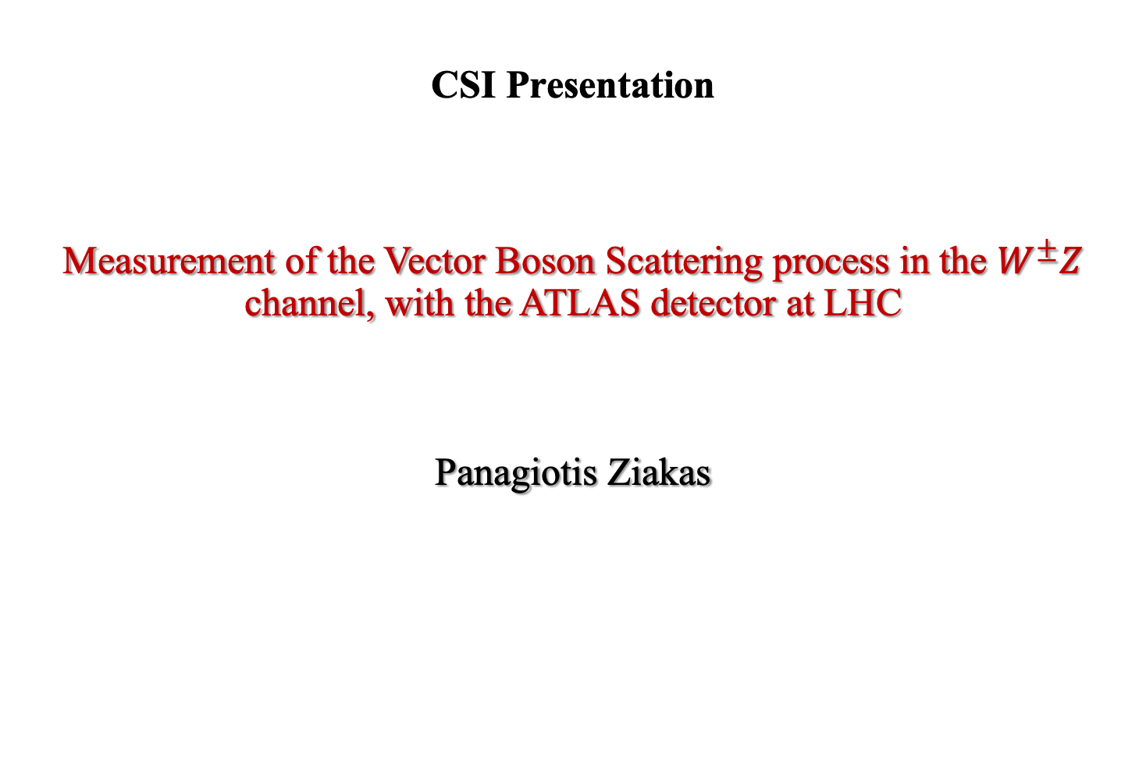
CSI Presentation
Measurement of the Vector Boson Scattering process in the $W^{±}Z$ channel, with the ATLAS detector at LHC
Panagiotis Ziakas

Slide 2
Contents
Introduction
  The VBS process
  Why is VBS important?
  VBS topology
Profile Likelihood Unfolding
  Definition
  Mathematical formulation
  Methodology
Differential Cross Section Measurements
  Run2 Inclusive Unfolding
  Run2 Simultaneous Unfolding
Conclusions and next steps
Doctoral School Training

Slide 3
Introduction

Slide 4
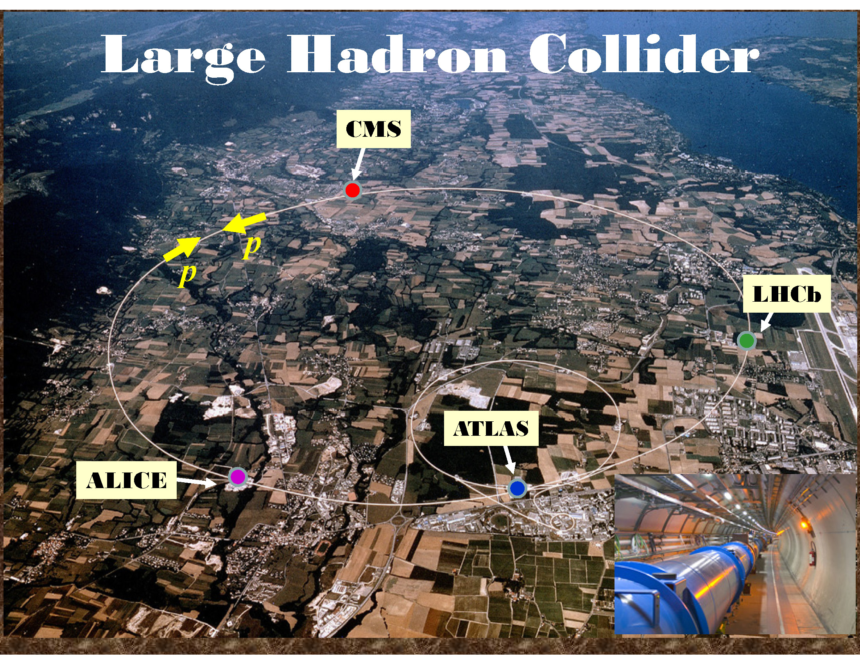
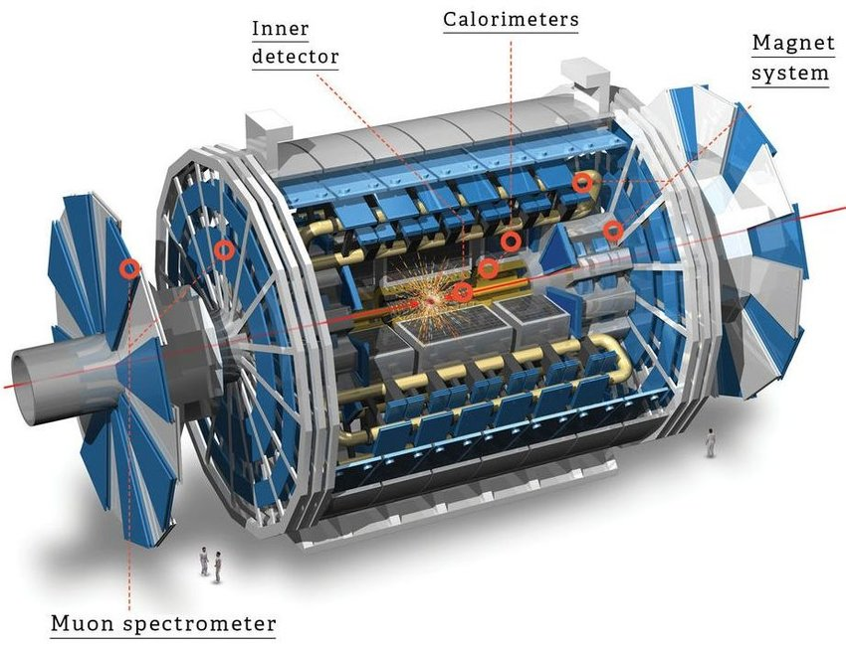
Large Hadron Collider & ATLAS experiment
Deeper understanding of the existing processes & exploration of New Physics
Higgs boson Discovery
Observation and precise measurements of rare processes

Slide 5
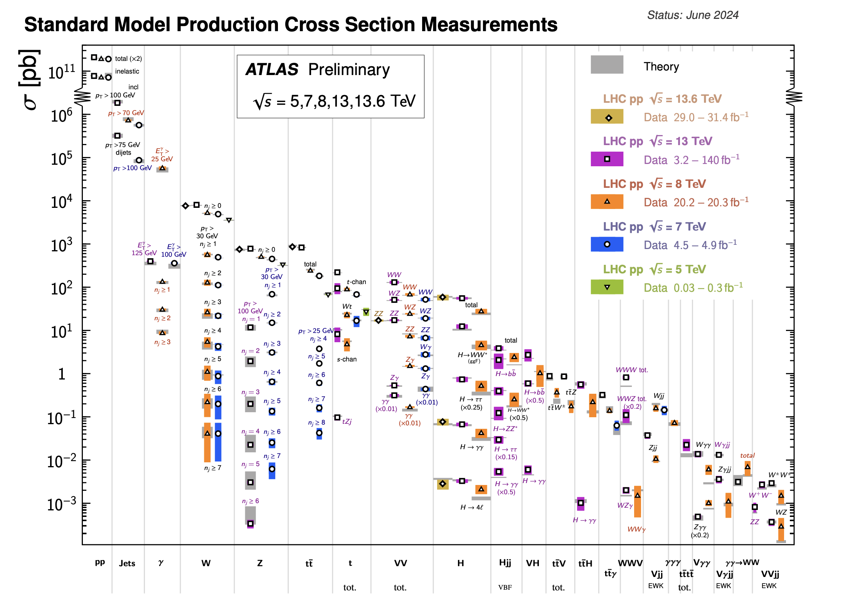
VBS as a rare process
Vector Boson Scattering (VBS)
ATL-PHYS-PUB-2024-011
Rare but very important process!
Higgs production
VBS production
EW symmetry breaking
Vector boson self -couplings

Slide 6
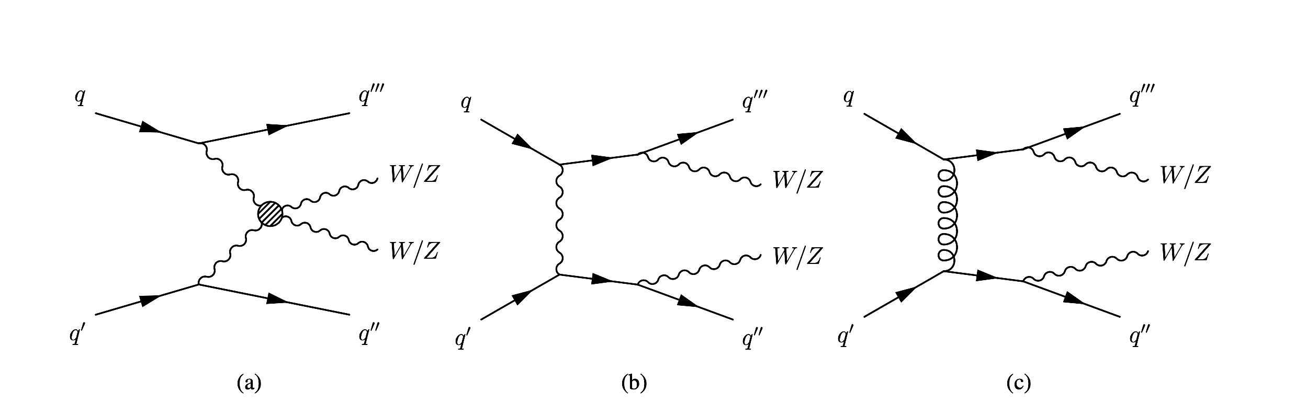
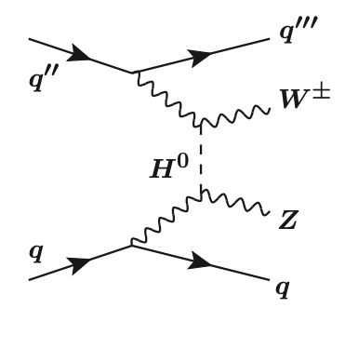
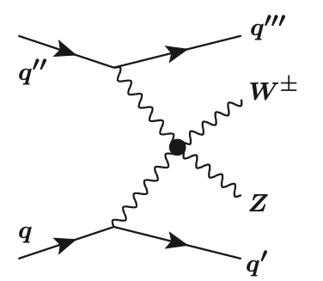
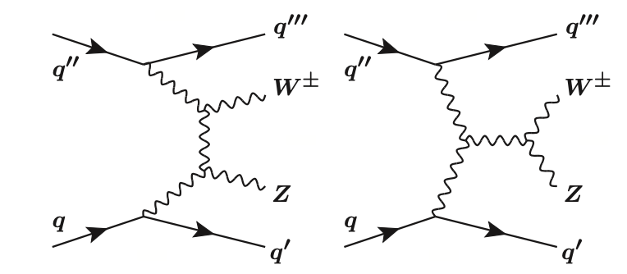


The Vector Boson Scattering process
$\sim a_{EW}$
$\sim a_{EW}$
EW VVjj via VBS

Slide 7
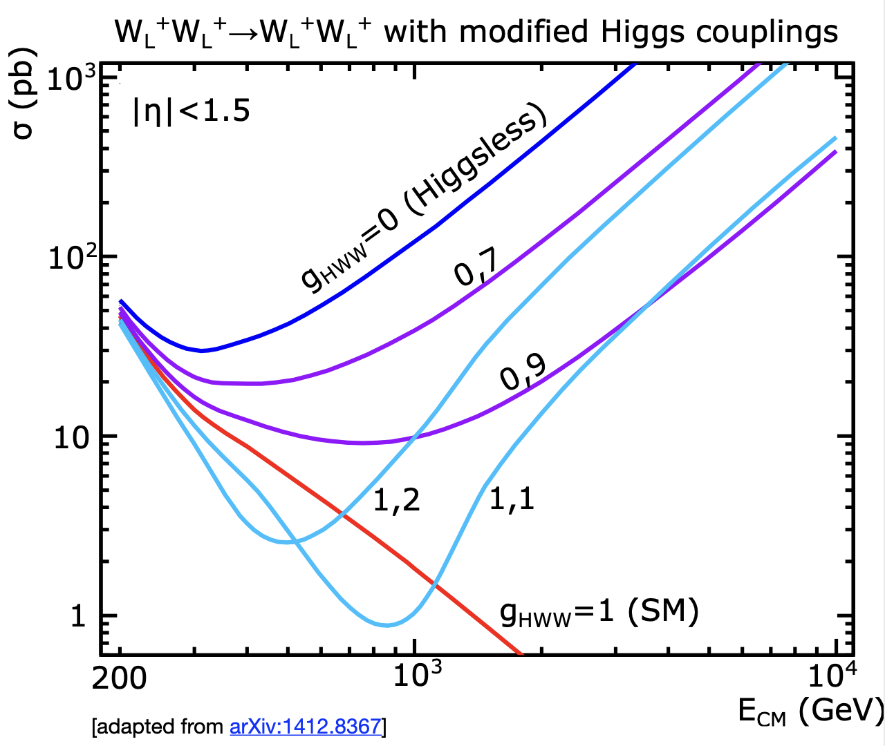
Polarized WZ production
Longitudinaly polarized boson prodcuction offers an excellent test of the electroweak symmetry breaking!
Unitarity violation if Higgs coupling deviates from SM!
arXiv:1412.8367

Slide 8
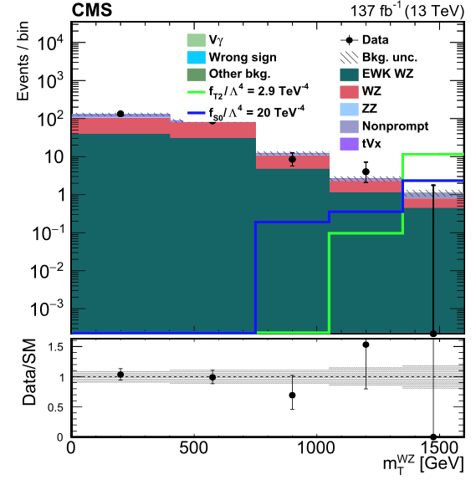
Quartic Gauge Coupling measurement
Quartic Gauge Coupling (QGCs)
Beyond SM theories predict enhanced couplings!
Deviations might signal the existence of new physics!
Deviations manifest themselves as excess of events!
Important to measure cross section differentially!

Slide 9
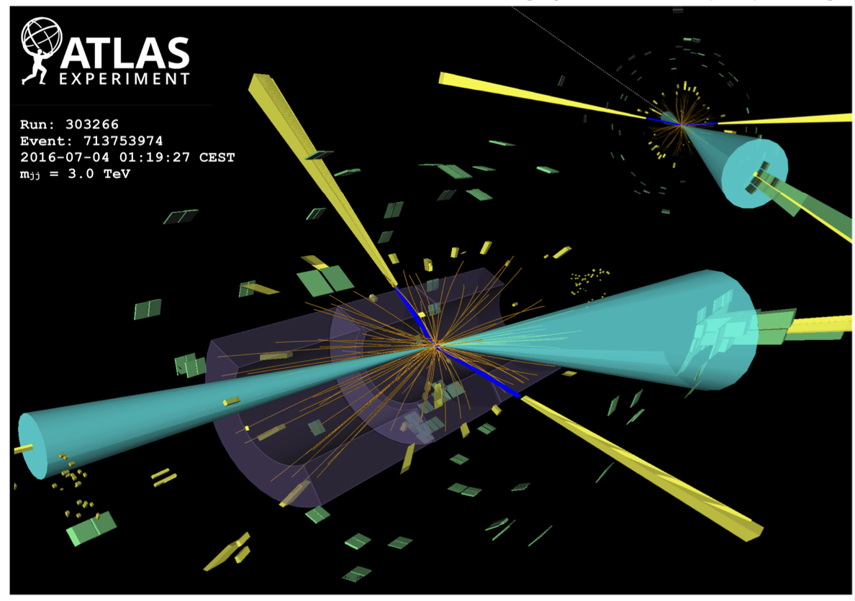



VBS event topology
Two oppositely charged leptons from Z (yellow)
One lepton and one neutrino from W ( yellow)
Two high energy forward jets (blue)
Additional jets due to higher order effects
WZ VBS Signal Region
$\sim a_{s}$
Major background source!
Fortunately, different topology!
$\sim a_{s}$
$WW→lvlv$ event
QCD VVjj

Slide 10
Profile Likelihood Unfolding

Slide 11
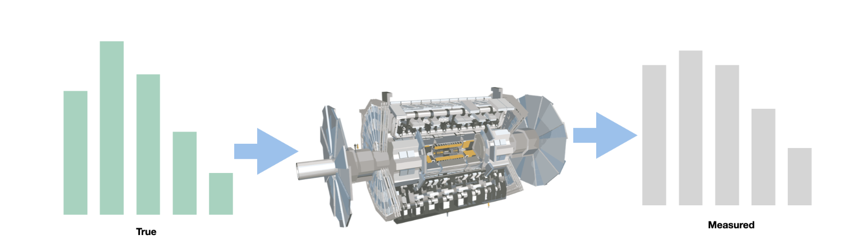
Unfolding definition
The distributions of kinematic variables at Particle level are subject to distortions due to detector effects!
Particle level (Truth)
Detector effects
Detector level (Reco)
Unfolding: The proccess of correcting the detector level distributions to get a good guess of the particle level distributions

Slide 12
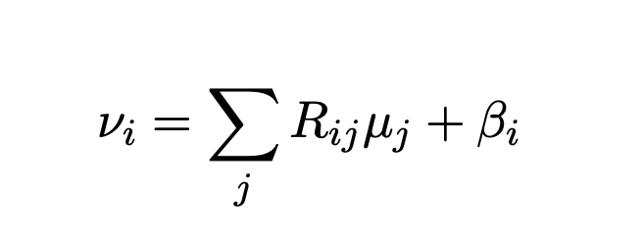
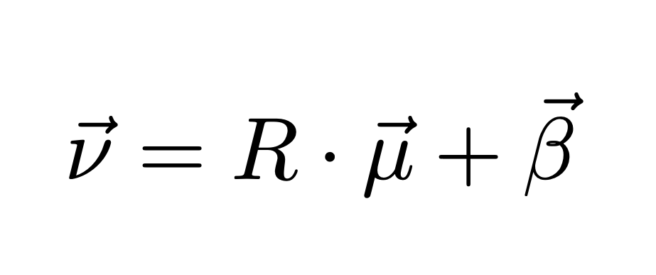
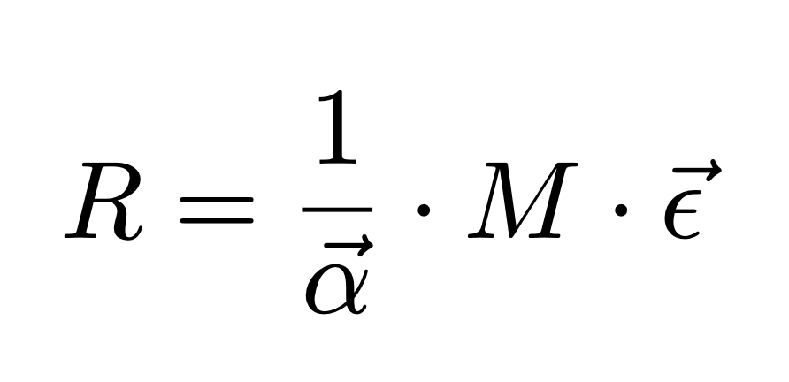

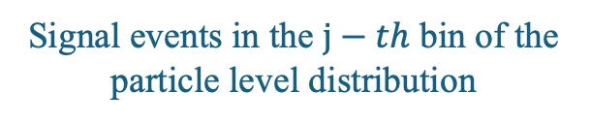
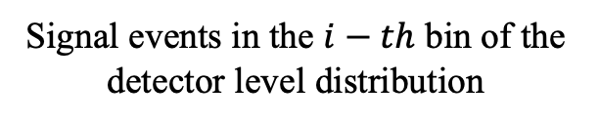
Mathematical Formulation
Background events in the $i−th$ bin of the detector level distribution
Signal events in the $i−th$ bin of the detector level distribution
Response matrix
Signal events in the $j−th$ bin of the particle level distribution
where

Slide 13
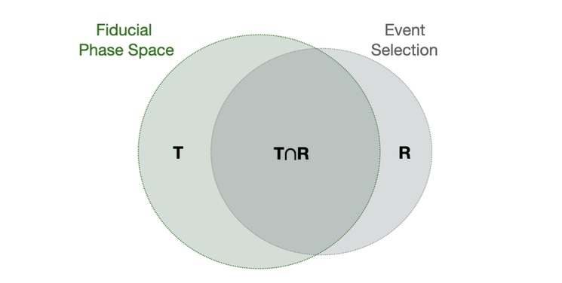
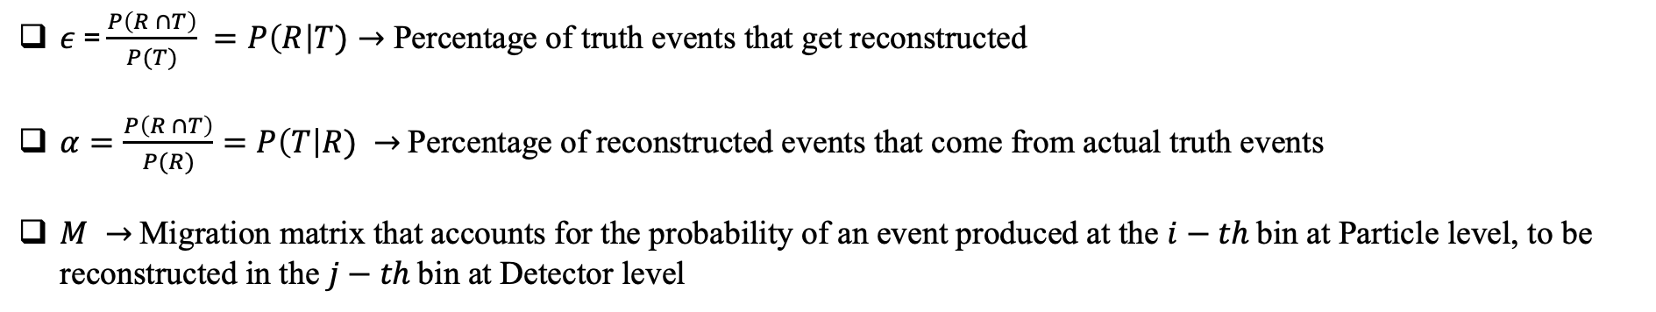
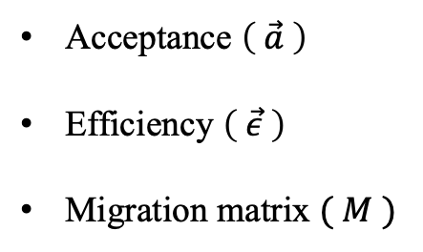
Mathematical Formulation
Acceptance $\left( \vec{a} \right)$
Efficiency $\left( \vec{ε} \right)$
Migration matrix $( M )$
$ε$ = $\frac{P\left(R ∩T\right)}{P(T)} =P\left(R\right|T)→$ Percentage of truth events that get reconstructed
$α=\frac{P\left(R ∩T\right)}{P(R)}=P\left(T\right|R) →$ Percentage of reconstructed events that come from actual truth events
$M →$ Migration matrix that accounts for the probability of an event produced at the $i−th$ bin at Particle level, to be reconstructed in the $j−th$ bin at Detector level

Slide 14
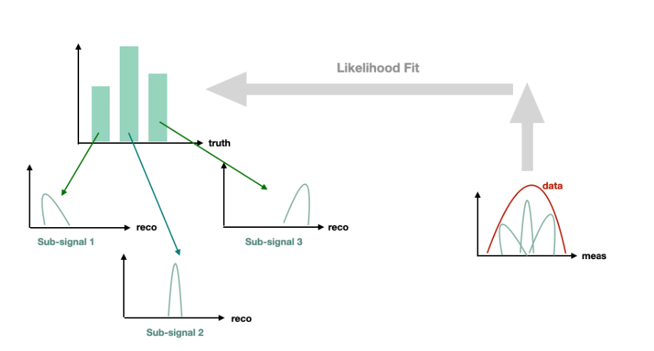
Profile Likelihood Unfolding methodology
$$μ_{truth_{bin1}},μ_{truth_{bin2} },μ_{truth_{bin3} }…+μ_{background}$$
Advantages of PLU
Fully implemented within TRexFitter
Systematics are treated normally as part of the Likelihood Function
Straightforward inclusion of many regions
Coherence and consistency due to the same formalism applied for all the ATLAS community
Simultaneous unfolding constitutes an innovation since it is used for the first time!

Slide 15
Differential Cross Section Measurements

Slide 16








Inclusive Fit
Measuring the inclusive differential cross sections means measuring the total cross sections of all the below processes:
${( a}_{EW}^{6} )$
${( a_{S}^{2}a}_{EW}^{4} )$
${({ a}_{S}a}_{EW}^{5} )$
$\sim a_{EW}$
$\sim a_{s}$
$$WZjj$$
=
+
+
Inteference term
$\sim a_{EW}$
$\sim a_{s}$
Inclusive WZjj
EW WZjj VBS
QCD WZjj
INT WZjj
The inclusive process includes ALL the above diagrams

Slide 17
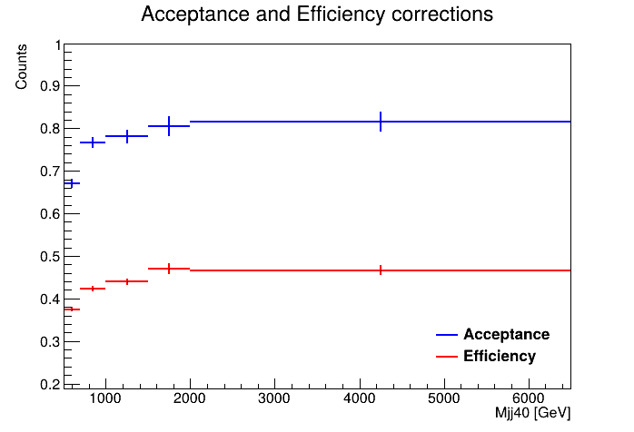
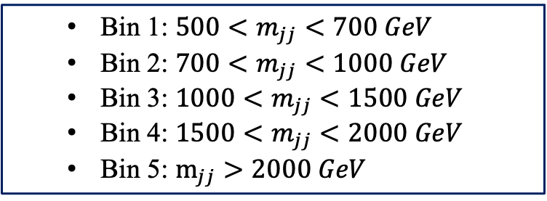


Run2 Inclusive Unfolding
  Bin 1: $500<m_{jj}<700 GeV$
  Bin 2: $700<m_{jj}<1000 GeV$
  Bin 3: $1000<m_{jj}<1500 GeV$
  Bin 4: $1500<m_{jj}<2000 GeV$
  Bin 5: $m_{jj}>2000 GeV$
Acceptance $\left( \vec{a} \right)$& Efficiency $\left( \vec{ε} \right)$
Migration matrix $( M )$

Slide 18
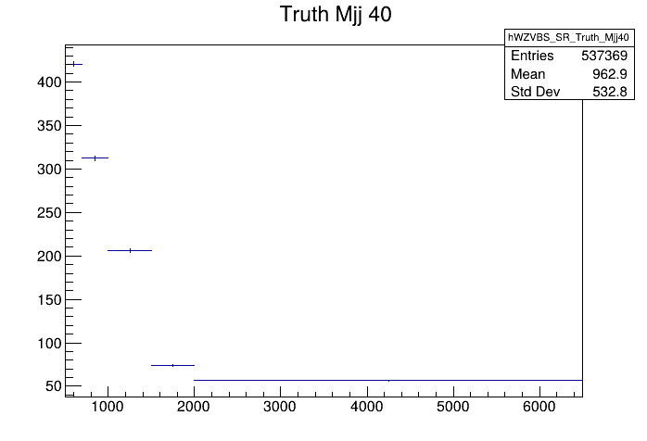


Run2 Inclusive Unfolding
Response Matrix $\left( R \right)$
Truth Distribution (QCD + EW + INT)
$$×$$

Slide 19
Data Fit Results – WZ INC

Slide 20
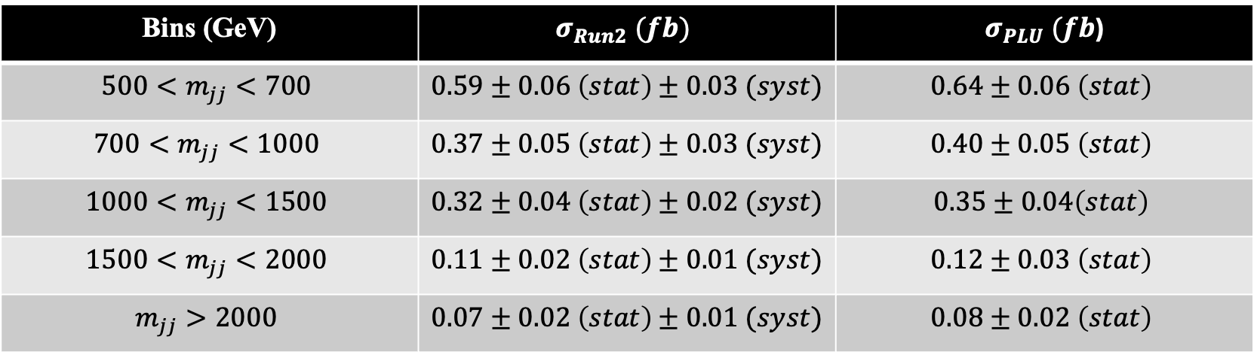
INC Differential cross section measurements
JHEP06(2024)192
Previous measurement using Bayesian iterative method
Current measurement using Profile Likelihood Unfolding Method
Bins (GeV) | $$σ_{Run2} (fb)$$ | $σ_{PLU} (fb$)
$$500<m_{jj}<700$$ | $0.59±0.06 \left(stat\right)$ $± 0.03 (syst)$ | $$0.64±0.06 \left(stat\right)$$
$$700<m_{jj}<1000$$ | $0.37±0.05 \left(stat\right)$ $± 0.03 (syst)$ | $$0.40±0.05 \left(stat\right)$$
$$1000<m_{jj}<1500$$ | $0.32±0.04 \left(stat\right)$ $± 0.02 (syst)$ | $$0.35±0.04\left(stat\right)$$
$$1500<m_{jj}<2000$$ | $0.11±0.02 \left(stat\right)$ $± 0.01 (syst)$ | $$0.12±0.03 \left(stat\right)$$
$$m_{jj}>2000$$ | $0.07±0.02 \left(stat\right)$ $± 0.01 (syst)$ | $$0.08±0.02 \left(stat\right)$$
Systematic uncertainties are not yet included for our results but their implementation is ongoing!

Slide 21







Simultaneous Fit
Measuring differential cross sections simultaneously means measuring the cross sections the below processes independently, but in the same fit!
${( a}_{EW}^{6} )$
${( a_{S}^{2}a}_{EW}^{4} )$
${({ a}_{S}a}_{EW}^{5} )$
$\sim a_{EW}$
$\sim a_{s}$
+
Inteference term
$\sim a_{EW}$
$\sim a_{s}$
EW WZjj VBS
QCD WZjj
INT WZjj
The goal is to measure simultaneously the differential cross section of the EW and the QCD+INT processes!

Slide 22
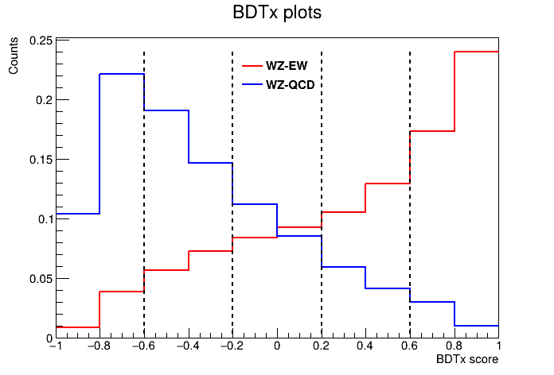
Simultaneous Fit
The challenge of this type of fit is the separation of the processes. For this reason we are using machine learning techniques.
Separation based on Boosted Decision Trees
To achieve maximum separation we devide the Singal Region in further regions based on a BDT score cut!

Slide 23
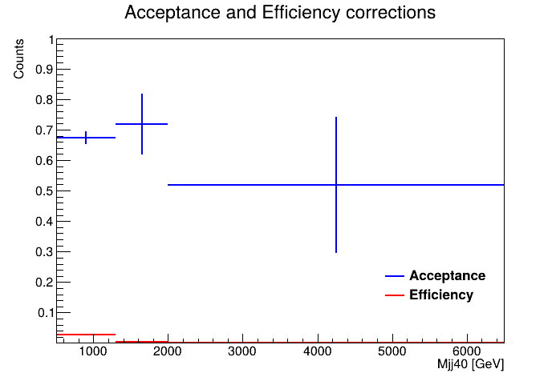
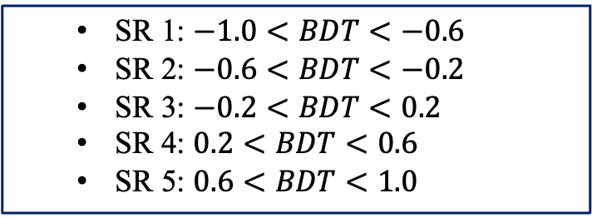
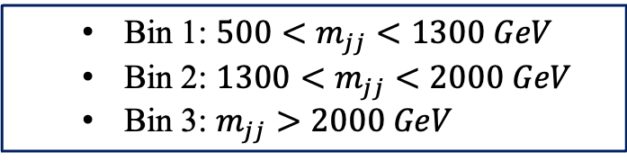
Run2 Simultaneous Unfolding – WZ EW
  SR 1: $−1.0<BDT<−0.6$
  SR 2: $−0.6<BDT<−0.2$
  SR 3: $−0.2<BDT<0.2$
  SR 4: $0.2<BDT<0.6$
  SR 5: $0.6<BDT<1.0$
  Bin 1: $500<m_{jj}<1300 GeV$
  Bin 2: $1300<m_{jj}<2000 GeV$
  Bin 3: $m_{jj}>2000 GeV$
Acceptance $\left( \vec{a} \right)$& Efficiency $\left( \vec{ε} \right)$
Migration matrix $( M )$

Slide 24
Unfolding the EW sample
Response Matrix $\left( R \right)$
Truth Distribution (EW)
$$×$$

Slide 25
Data Fit Results – WZ EW

Slide 26
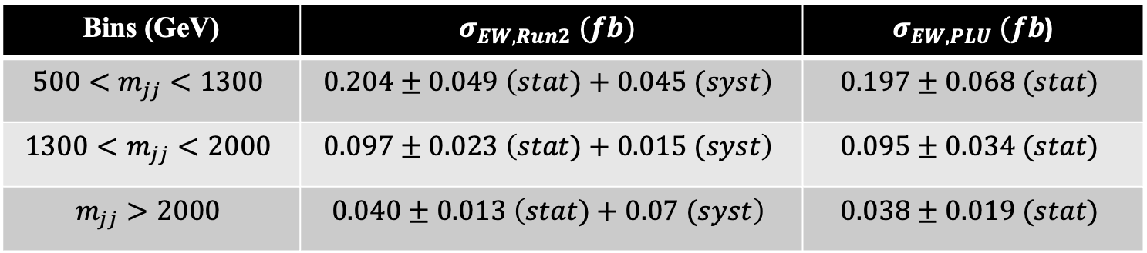
EW Differential cross section measurements
JHEP06(2024)192
Previous measurement using standard bin by bin unfolding
Current measurement using Profile Likelihood Unfolding Method
Bins (GeV) | $$σ_{EW,Run2} (fb)$$ | $σ_{EW,PLU} (fb$)
$$500<m_{jj}<1300$$ | $$0.204±0.049 \left(stat)+0.045 (syst\right)$$ | $$0.197±0.068 (stat)$$
$$1300<m_{jj}<2000$$ | $$0.097±0.023 \left(stat)+0.015 (syst\right)$$ | $$0.095±0.034 (stat)$$
$$m_{jj}>2000$$ | $$0.040±0.013 \left(stat)+0.07 (syst\right)$$ | $$0.038±0.019 (stat)$$
Systematic uncertainties are not yet included for our results but their implementation is ongoing!

Slide 27
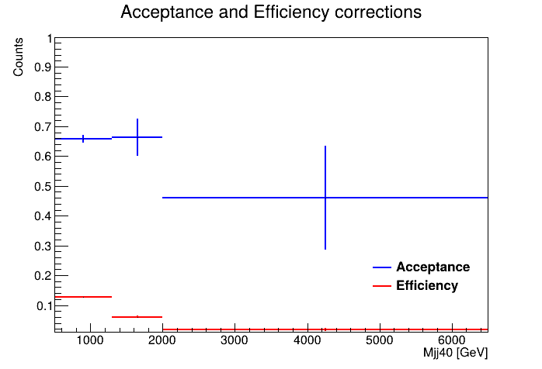
Run2 Simultaneous Unfolding – WZ QCD+INT
  SR 1: $−1.0<BDT<−0.6$
  SR 2: $−0.6<BDT<−0.2$
  SR 3: $−0.2<BDT<0.2$
  SR 4: $0.2<BDT<0.6$
  SR 5: $0.6<BDT<1.0$
  Bin 1: $500<m_{jj}<1300 GeV$
  Bin 2: $1300<m_{jj}<2000 GeV$
  Bin 3: $m_{jj}>2000 GeV$
Acceptance $\left( \vec{a} \right)$& Efficiency $\left( \vec{ε} \right)$
Migration matrix $( M )$

Slide 28
Unfolding the QCD + INT sample
Response Matrix $\left( R \right)$
Truth Distribution (QCD+INT)
$$×$$

Slide 29
Data Fit Results – WZ QCD+INT

Slide 30
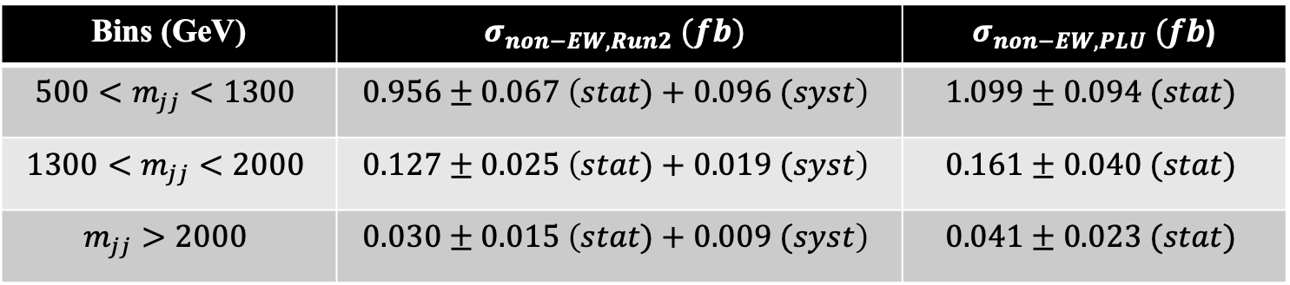
QCD+INT Differential cross section measurements
JHEP06(2024)192
Previous measurement using standard bin by bin unfolding
Current measurement using Profile Likelihood Unfolding Method
Bins (GeV) | $$σ_{non−EW,Run2} (fb)$$ | $σ_{non−EW,PLU} (fb$)
$$500<m_{jj}<1300$$ | $$0.956±0.067 \left(stat)+0.096 (syst\right)$$ | $$1.099±0.094 (stat)$$
$$1300<m_{jj}<2000$$ | $$0.127±0.025 \left(stat)+0.019 (syst\right)$$ | $$0.161±0.040 (stat)$$
$$m_{jj}>2000$$ | $$0.030±0.015 \left(stat)+0.009 (syst\right)$$ | $$0.041±0.023 (stat)$$
Systematic uncertainties are not yet included for our results but their implementation is ongoing!

Slide 31
Conclusions - Next steps
Conclusions:
  Attempted to reproduce differential cross section measurements of Run2 with the PLU method
  The measurements were performed for both the inclusive and simultaneous fit cases
  The PLU method is producing reliable results with respect to already perfomed measurements for both cases
  Results were validated across different variables
  The machinery for Run3 is almost ready, first Asimov fit studies have already been performed
Next steps:
  Systematic uncertainties need to be inserted in the fit
  With the addition of the 2025 dataset, the luminosity is expected to increase by a factor of ~2, so binning optimisation studies need to be performed (Preliminary studies have already been presented)
  Perform studies to check potential Run2 and Run3 combined measurements

Slide 32
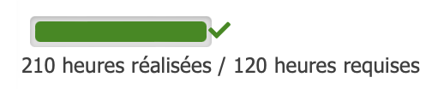
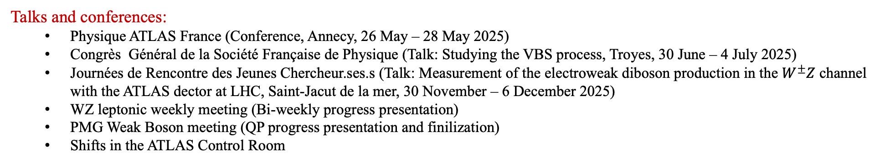
Doctoral School Training
Successfully registered training hours:
  Physics in the XXIst Centrury (13 March – 22 May 2025, 20 hours)
  Français Langue Etrangère (20 January – 18 April 2025, 45 hours)
  Constuire son Projet Professionnel (26 March – 27 March 2025, 12h)
  Journée de rentrée des doctorants (14 November 2024, 4h)
  Job Hunting Strategies (20 October – 22 October 2025, 21 h)
  MOOC PhD and Carreer Development (13 January – 24 February 2026, 12h)
  MOOC Ethique de la recherche – Univ. Lyon (20 October 2025 – 21 June 2026, 15h, Mandatory) ✅
  MOOC Research integrity in scientific professions - Univ. Bordeaux (01 September 2025 – 31 August 2026, 15h, Mandatory) ✅
  Gender based and sexual violence, discrimination and harassment (Mandatory) ❌ (Not validated yet)
Summer Schools:
  Gray Scott Computing School (L.A.P.P., Annecy, 23 June – 4 July 2025)
  IN2P3 School of Statistics (Centre Paul-Langevin, Aussois, 31 May – 5 June 2026)
Talks and conferences:
  Physique ATLAS France (Conference, Annecy, 26 May – 28 May 2025)
  Congrès Général de la Société Française de Physique (Talk: Studying the VBS process, Troyes, 30 June – 4 July 2025)
  Journées de Rencontre des Jeunes Chercheur.ses.s (Talk: Measurement of the electroweak diboson production in the $W^{±}Z$ channel with the ATLAS dector at LHC, Saint-Jacut de la mer, 30 November – 6 December 2025)
  WZ leptonic weekly meeting (Bi-weekly progress presentation)
  PMG Weak Boson meeting (QP progress presentation and finilization)
  Shifts in the ATLAS Control Room

Slide 33
THANKS FOR YOUR ATTENTION!

Slide 34
Backup Slides

Slide 35
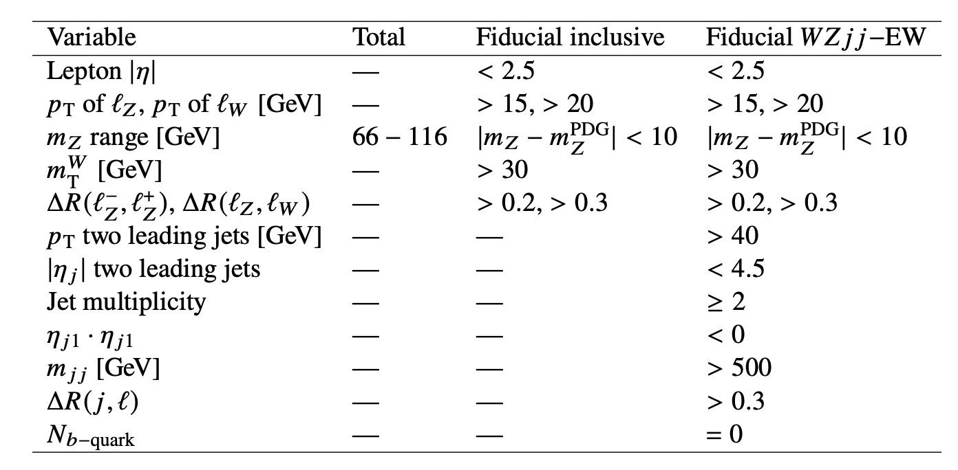
Phase Spaces
Fiducial Inclusive
Fiducial WZjj – EW Signal Region

Slide 36
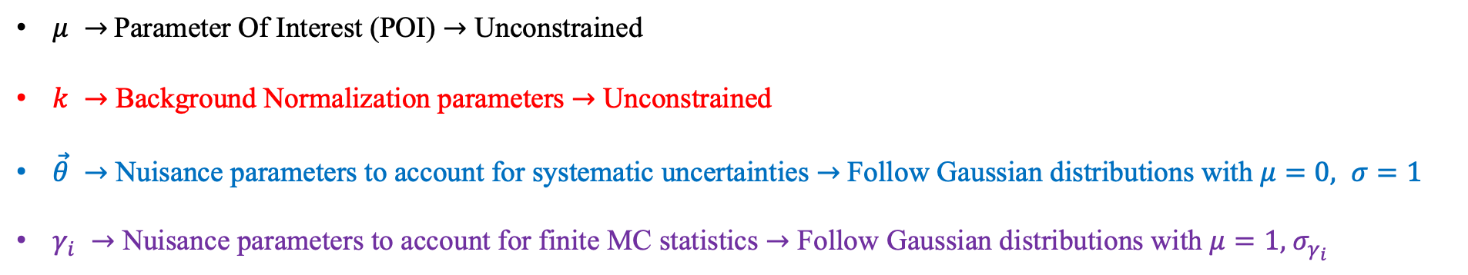
Profile Likelihood Unfolding
Unfolding is treated by Profile Likelihood Unfolding as a scaling factor estimation problem!
$μ →$ Parameter Of Interest (POI) $→$ Unconstrained
$k →$ Background Normalization parameters $→$ Unconstrained
$\vec{θ} →$ Nuisance parameters to account for systematic uncertainties $→$ Follow Gaussian distributions with $μ=0, σ=1$
$γ_{i} →$ Nuisance parameters to account for finite MC statistics $→$ Follow Gaussian distributions with $μ=1, { σ}_{γ_{i}}$

Slide 37
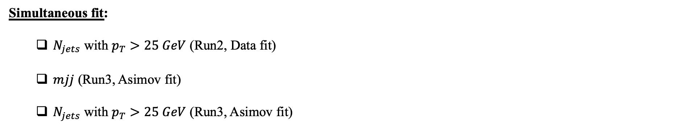
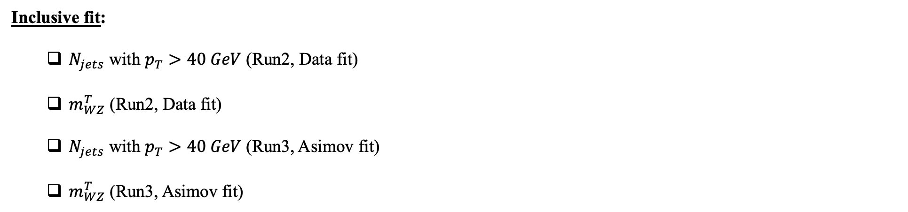
Honorable mentions
Inclusive fit:
  $N_{jets}$ with $p_{T}>40 GeV$ (Run2, Data fit)
  $m_{WZ}^{T}$ (Run2, Data fit)
  $N_{jets}$ with $p_{T}>40 GeV$ (Run3, Asimov fit)
  $m_{WZ}^{T}$ (Run3, Asimov fit)
✅
✅
✅
✅
Studied variables but not shown today due to lack of time!
Simultaneous fit:
  $N_{jets}$ with $p_{T}>25 GeV$ (Run2, Data fit)
  $mjj$ (Run3, Asimov fit)
  $N_{jets}$ with $p_{T}>25 GeV$ (Run3, Asimov fit)
✅
✅
✅

Slide 38
Run2 studies

Slide 39
  Inclusive Fit

Slide 40
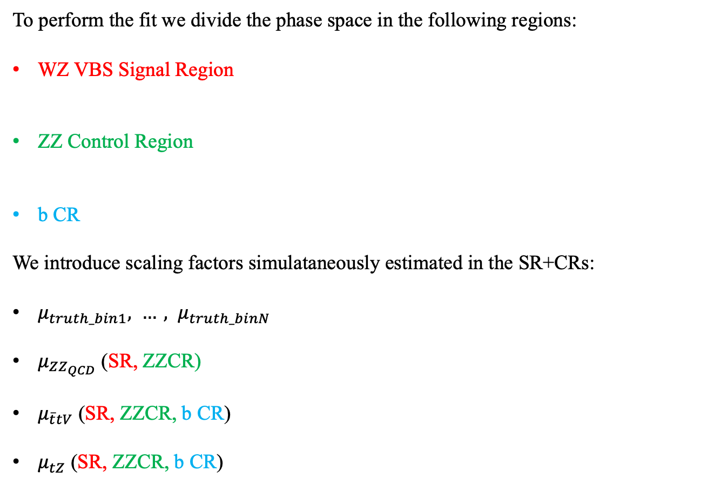
Inclusive Fit setup
To perform the fit we divide the phase space in the following regions:
WZ VBS Signal Region
ZZ Control Region
b CR
We introduce scaling factors simulataneously estimated in the SR+CRs:
$μ_{truth_bin1}, …, μ_{truth_binN}$
$μ_{ZZ_{QCD}}$ (SR, ZZCR)
$μ_{\overline{t}tV}$ (SR, ZZCR, b CR)
$μ_{tZ}$ (SR, ZZCR, b CR)
Region where we expect to have the most signal
Measurements are performed in this region
Region rich in the ZZ background events
Used to constrain the ZZ background
Region with at least on b-quark jet
Used to constrain the background $\overline{t}tV$ and $tZ$ background processes
Run2 Data Fit
(2015 - 2018)

Slide 41
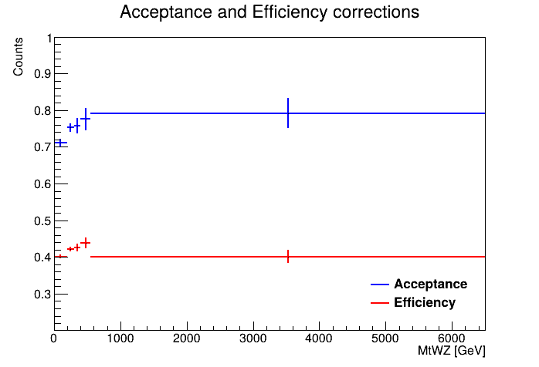
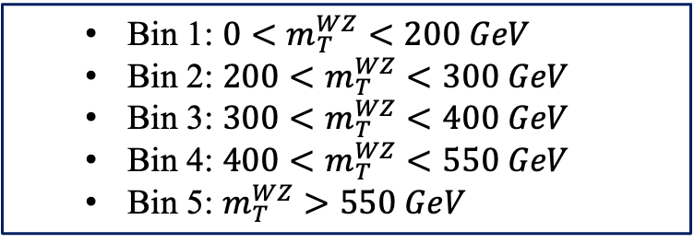
Run2 Inclusive Unfolding
  Bin 1: $0<m_{T}^{WZ}<200 GeV$
  Bin 2: $200<m_{T}^{WZ}<300 GeV$
  Bin 3: $300<m_{T}^{WZ}<400 GeV$
  Bin 4: $400<m_{T}^{WZ}<550 GeV$
  Bin 5: $m_{T}^{WZ}>550 GeV$
Acceptance $\left( \vec{a} \right)$& Efficiency $\left( \vec{ε} \right)$
Migration matrix $( M )$

Slide 42
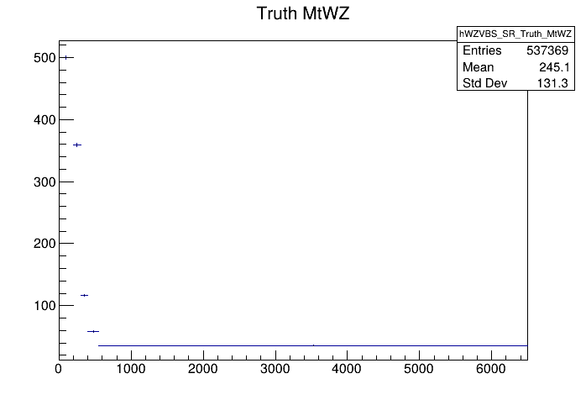
Run2 Inclusive Unfolding
Response Matrix $\left( R \right)$
Truth Distribution (QCD + EW + INT)
$$×$$

Slide 43
Data Fit Results – WZ INC

Slide 44
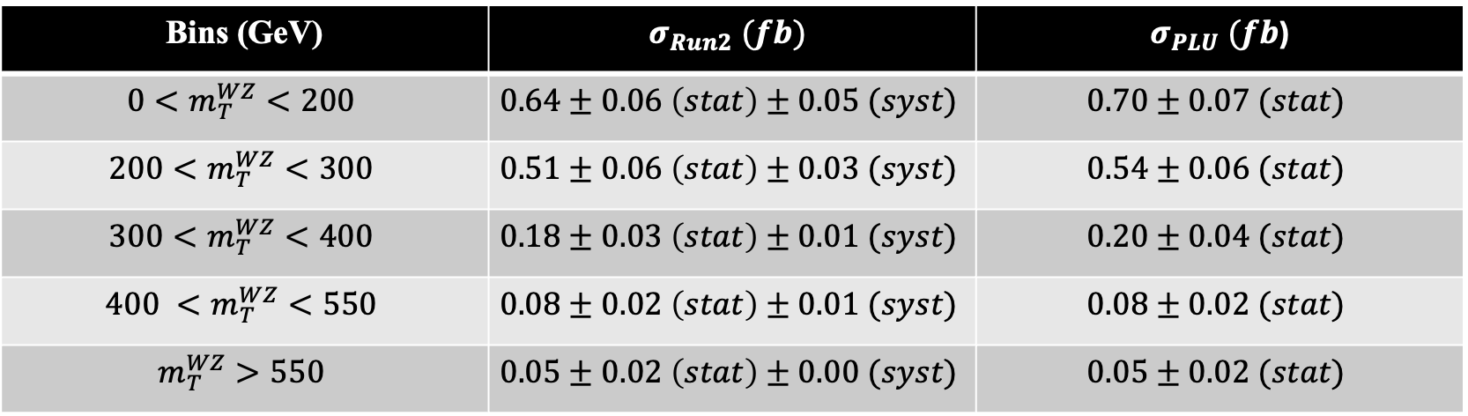
INC Differential cross section measurements
JHEP06(2024)192
Previous measurement using Bayesian iterative method
Current measurement using Profile Likelihood Unfolding Method
Bins (GeV) | $$σ_{Run2} (fb)$$ | $σ_{PLU} (fb$)
$$0<m_{T}^{WZ}<200$$ | $$0.64±0.06 \left(stat\right)±0.05 (syst)$$ | $$0.70±0.07 (stat)$$
$$200<m_{T}^{WZ}<300$$ | $$0.51±0.06 \left(stat\right)±0.03 (syst)$$ | $$0.54±0.06 (stat)$$
$$300<m_{T}^{WZ}<400$$ | $$0.18±0.03 \left(stat\right)±0.01 (syst)$$ | $$0.20±0.04 (stat)$$
$$400 <m_{T}^{WZ}<550$$ | $$0.08±0.02 \left(stat\right)±0.01 (syst)$$ | $$0.08±0.02 (stat)$$
$$m_{T}^{WZ}>550$$ | $$0.05±0.02 \left(stat\right)±0.00 (syst)$$ | $$0.05±0.02 (stat)$$
Systematic uncertainties are not yet included for our results but their implementation is ongoing!

Slide 45
  Simultaneous Fit

Slide 46
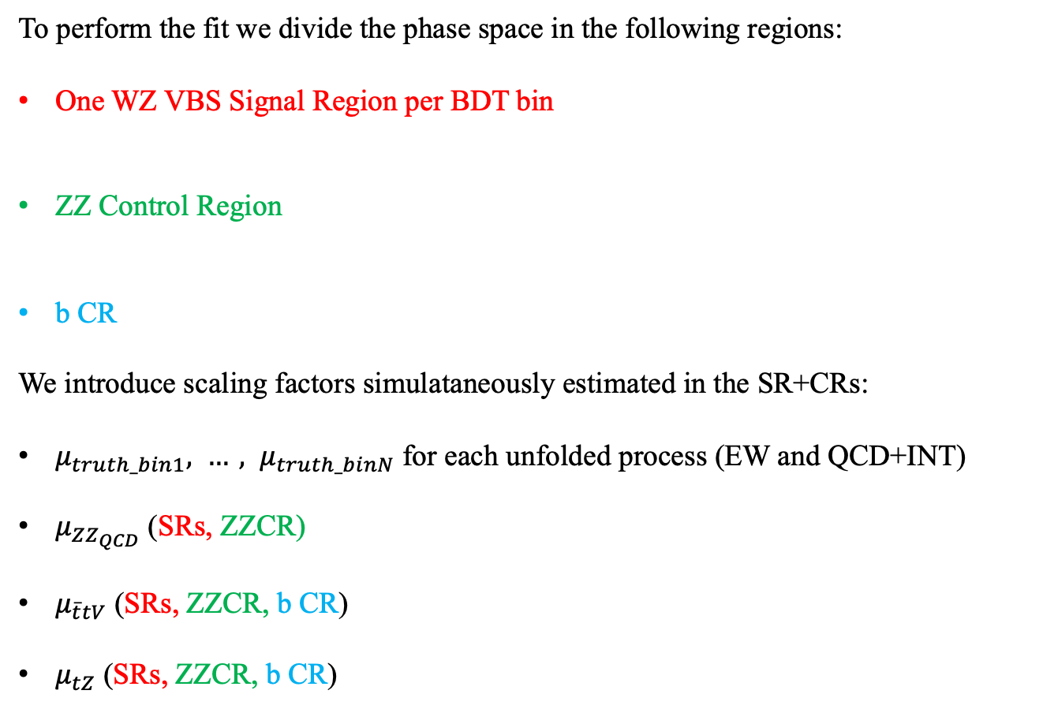
Simultaneous Fit setup
To perform the fit we divide the phase space in the following regions:
One WZ VBS Signal Region per BDT bin
ZZ Control Region
b CR
We introduce scaling factors simulataneously estimated in the SR+CRs:
$μ_{truth_bin1}, …, μ_{truth_binN}$ for each unfolded process (EW and QCD+INT)
$μ_{ZZ_{QCD}}$ (SRs, ZZCR)
$μ_{\overline{t}tV}$ (SRs, ZZCR, b CR)
$μ_{tZ}$ (SRs, ZZCR, b CR)
Region where we expect to have the most signal
Achieves maximum separation between processes
Region rich in the ZZ background events
Used to constrain the ZZ background
Region with at least on b-quark jet
Used to constrain the background $\overline{t}tV$ and $tZ$ background processes
Run2 Data Fit
(2015 - 2018)

Slide 47
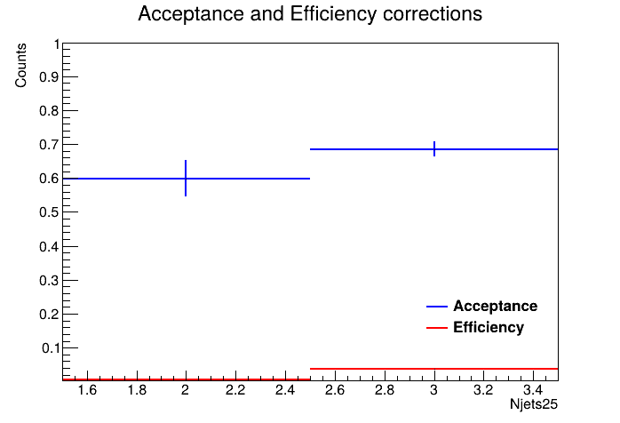
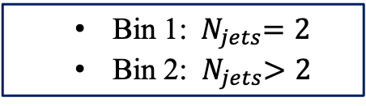
Run2 Simultaneous Unfolding – WZ EW
  SR 1: $−1.0<BDT<−0.6$
  SR 2: $−0.6<BDT<−0.2$
  SR 3: $−0.2<BDT<0.2$
  SR 4: $0.2<BDT<0.6$
  SR 5: $0.6<BDT<1.0$
  Bin 1:${ N}_{jets}=2$
  Bin 2: ${ N}_{jets}>2$
Acceptance $\left( \vec{a} \right)$& Efficiency $\left( \vec{ε} \right)$
Migration matrix $( M )$

Slide 48
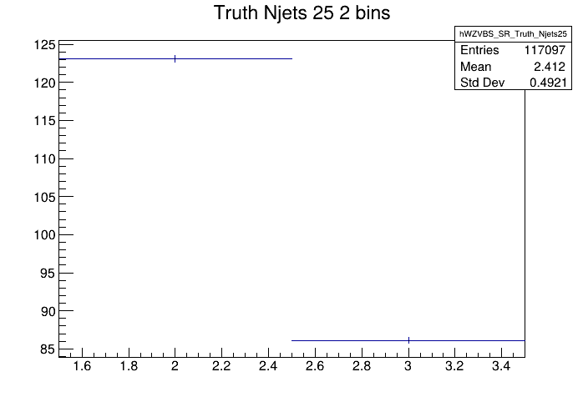
Run2 Simultaneous Unfolding
Response Matrix $\left( R \right)$
Truth Distribution (EW)
$$×$$

Slide 49
Data Fit Results – WZ EW

Slide 50
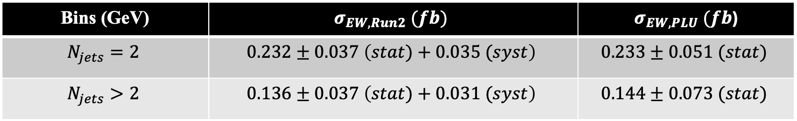
EW Differential cross section measurements
JHEP06(2024)192
Previous measurement using standard bin by bin method
Current measurement using Profile Likelihood Unfolding Method
Bins (GeV) | $$σ_{EW,Run2} (fb)$$ | $σ_{EW,PLU} (fb$)
$$N_{jets}=2$$ | $$0.232±0.037 \left(stat)+0.035 (syst\right)$$ | $$0.233±0.051 (stat)$$
$$N_{jets}>2$$ | $$0.136±0.037 \left(stat)+0.031 (syst\right)$$ | $$0.144±0.073 (stat)$$
Systematic uncertainties are not yet included for our results but their implementation is ongoing!

Slide 51
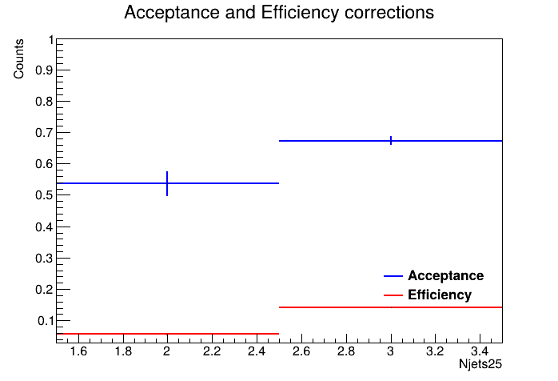
Run2 Inclusive Unfolding – WZ QCD+INT
  SR 1: $−1.0<BDT<−0.6$
  SR 2: $−0.6<BDT<−0.2$
  SR 3: $−0.2<BDT<0.2$
  SR 4: $0.2<BDT<0.6$
  SR 5: $0.6<BDT<1.0$
  Bin 1:${ N}_{jets}=2$
  Bin 2: ${ N}_{jets}>2$
Acceptance $\left( \vec{a} \right)$& Efficiency $\left( \vec{ε} \right)$
Migration matrix $( M )$

Slide 52
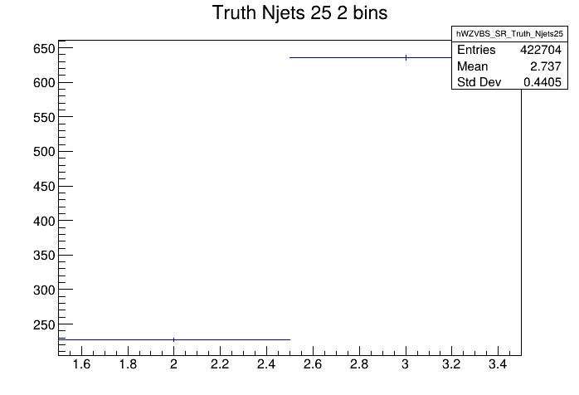
Run2 Simultaneous Unfolding
Response Matrix $\left( R \right)$
Truth Distribution (QCD+INT)
$$×$$

Slide 53
Data Fit Results – WZ QCD+INT

Slide 54

QCD+INT Differential cross section measurements
JHEP06(2024)192
Previous measurement using standard bin by bin method
Current measurement using Profile Likelihood Unfolding Method
Bins (GeV) | $$σ_{non−EW,Run2} (fb)$$ | $σ_{non−EW,PLU} (fb$)
$$N_{jets}=2$$ | $$0.189±0.038 \left(stat)+0.036 (syst\right)$$ | $$0.229±0.057 (stat)$$
$$N_{jets}>2$$ | $$0.905±0.063 \left(stat)+0.012 (syst\right)$$ | $$1.028±0.095 (stat)$$
Systematic uncertainties are not yet included for our results but their implementation is ongoing!

Slide 55
Run3 studies

Slide 56
  Inclusive Fit

Slide 57





Run3 Inclusive Unfolding
  Bin 1: $500<m_{jj}<700 GeV$
  Bin 2: $700<m_{jj}<1000 GeV$
  Bin 3: $1000<m_{jj}<1500 GeV$
  Bin 4: $1500<m_{jj}<2000 GeV$
  Bin 5: $m_{jj}>2000 GeV$
$$m_{jj}$$
$WZjj$ Inclusive
  Bin 1:${ N}_{jets} =2$
  Bin 2: ${ N}_{jets} =3$
  Bin 3: ${ N}_{jets} =4$
  Bin 4: ${ N}_{jets} ≥5$
$$N_{jets}$$

Slide 58
Run3 Inclusive Fit setup
To perform the fit we divide the phase space in the following regions:
WZ VBS Signal Region
ZZ Control Region
b CR
We introduce scaling factors simulataneously estimated in the SR+CRs:
$μ_{truth_bin1}, …, μ_{truth_binN}$
$μ_{ZZ_{QCD}}$ (SR, ZZCR)
$μ_{\overline{t}tV}$ (SR, ZZCR, b CR)
$μ_{tZ}$ (SR, ZZCR, b CR)
Region where we expect to have the most signal
Measurements are performed in this region
Region rich in the ZZ background events
Used to constrain the ZZ background
Region with at least on b-quark jet
Used to constrain the background $\overline{t}tV$ and $tZ$ background processes
Asimov Dataset Fit

Slide 59
Asimov Fit results – WZ INC

Slide 60

INC Differential cross section measurements
Profile Likelihood Unfolding Method Asimov measurement for Run2
Profile Likelihood Unfolding Method Asimov measurement for Run3
Bins (GeV) | $$σ_{Run2,PLU} (fb)$$ | $σ_{Run3,PLU} (fb$)
$$500<m_{jj}<700$$ | $$0.75±0.06 (stat)$$ | $$0.77±0.06 (stat)$$
$$700<m_{jj}<1000$$ | $$0.56±0.06 (stat)$$ | $$0.60±0.06 (stat)$$
$$1000<m_{jj}<1500$$ | $$0.37±0.05 (stat)$$ | $$0.41±0.04 (stat)$$
$$1500<m_{jj}<2000$$ | $$0.13±0.03 (stat)$$ | $$0.15±0.03 (stat)$$
$$m_{jj}>2000$$ | $$0.10±0.02 (stat)$$ | $$0.12±0.02 (stat)$$

Slide 61
Asimov Fit results – WZ INC

Slide 62

INC Differential cross section measurements
Profile Likelihood Unfolding Method Asimov measurement for Run2
Profile Likelihood Unfolding Method Asimov measurement for Run3
Bins (GeV) | $$σ_{Run2} (fb)$$ | $σ_{Run3} (fb$)
$$N_{jets}=2$$ | $$0.96±0.07 (stat)$$ | $$1.06±0.06 (stat)$$
$$N_{jets}=3$$ | $$0.65±0.07 (stat)$$ | $$0.62±0.06 (stat)$$
$$N_{jets}=4$$ | $$0.22±0.05 (stat)$$ | $$0.26±0.05 (stat)$$
$$N_{jets}≥5$$ | $$0.08±0.03 (stat)$$ | $$0.12±0.03 (stat)$$

Slide 63
  Simultaneous Fit

Slide 64







Run3 Simultaneous Unfolding
  Bin 1: $500<m_{jj}<1300 GeV$
  Bin 2: $1300<m_{jj}<2000 GeV$
  Bin 3: $m_{jj}>2000 GeV$
$$m_{jj}$$
$$N_{jets}$$
  Bin 1:${ N}_{jets}=2$
  Bin 2: ${ N}_{jets}>2$
$WZjj−EW$ + $WZjj−QCD$
  SR 1: $−1.0<BDT score<−0.6$
  SR 2: $−0.6<BDT score<−0.2$
  SR 3: $−0.2<BDT score<0.2$
  SR 4: $0.2<BDT score<0.6$
  SR 5: $0.6<BDT score<1.0$
$$BDT$$

Slide 65
Simultaneous Fit setup
To perform the fit we divide the phase space in the following regions:
One WZ VBS Signal Region per BDT bin
ZZ Control Region
b CR
We introduce scaling factors simulataneously estimated in the SR+CRs:
$μ_{truth_bin1}, …, μ_{truth_binN}$ for each unfolded process (EW and QCD+INT)
$μ_{ZZ_{QCD}}$ (SRs, ZZCR)
$μ_{\overline{t}tV}$ (SRs, ZZCR, b CR)
$μ_{tZ}$ (SRs, ZZCR, b CR)
Region where we expect to have the most signal
Achieves maximum separation between processes
Region rich in the ZZ background events
Used to constrain the ZZ background
Region with at least on b-quark jet
Used to constrain the background $\overline{t}tV$ and $tZ$ background processes
Asimov Dataset Fit

Slide 66
Asimov EW Fit results

Slide 67

EW Differential cross section measurements
Profile Likelihood Unfolding Method Asimov measurement for Run2
Profile Likelihood Unfolding Method Asimov measurement for Run3
Bins (GeV) | $$σ_{EW,Run2} (fb)$$ | $σ_{EW,Run3} (fb$)
$$500<m_{jj}<1300$$ | $$0.223±0.073 (stat)$$ | $$0.218±0.072 (stat)$$
$$1300<m_{jj}<2000$$ | $$0.089±0.033 (stat)$$ | $$0.082±0.033 (stat)$$
$$m_{jj}>2000$$ | $$0.062±0.021 (stat)$$ | $$0.057±0.021 (stat)$$

Slide 68
Asimov QCD Fit results

Slide 69

QCD Differential cross section measurements
Profile Likelihood Unfolding Method Asimov measurement for Run2
Profile Likelihood Unfolding Method Asimov measurement for Run3
Bins (GeV) | $$σ_{non−EW,Run2} (fb)$$ | $σ_{non−EW,Run3} (fb$)
$$500<m_{jj}<1300$$ | $$1.357±0.101 (stat)$$ | $$1.449±0.096 (stat)$$
$$1300<m_{jj}<2000$$ | $$0.145±0.038 (stat)$$ | $$0.186±0.040 (stat)$$
$$m_{jj}>2000$$ | $$0.040±0.023 (stat)$$ | $$0.062±0.023 (stat)$$

Slide 70
Asimov EW Fit results

Slide 71

EW Differential cross section measurements
Profile Likelihood Unfolding Method Asimov measurement for Run2
Profile Likelihood Unfolding Method Asimov measurement for Run3
Bins (GeV) | $$σ_{EW,Run2} (fb)$$ | $σ_{EW,Run3} (fb$)
$$N_{jets}=2$$ | $$0.220±0.051 (stat)$$ | $$0.223±0.051 (stat)$$
$$N_{jets}>2$$ | $$0.154±0.075 (stat)$$ | $$0.135±0.096 (stat)$$

Slide 72
Asimov QCD Fit results

Slide 73

QCD Differential cross section measurements
Profile Likelihood Unfolding Method Asimov measurement for Run2
Profile Likelihood Unfolding Method Asimov measurement for Run3
Bins (GeV) | $$σ_{non−EW,Run2} (fb)$$ | $σ_{non−EW,Run3} (fb$)
$$N_{jets}=2$$ | $$0.406±0.064 (stat)$$ | $$0.458±0.067 (stat)$$
$$N_{jets}>2$$ | $$1.135±0.099 (stat)$$ | $$1.239±0.108(stat)$$

