Slide 1
Introduction to CLARA Optimisation Challenge for ARTIFACT Hackathon
Amelia Pollard

Slide 2
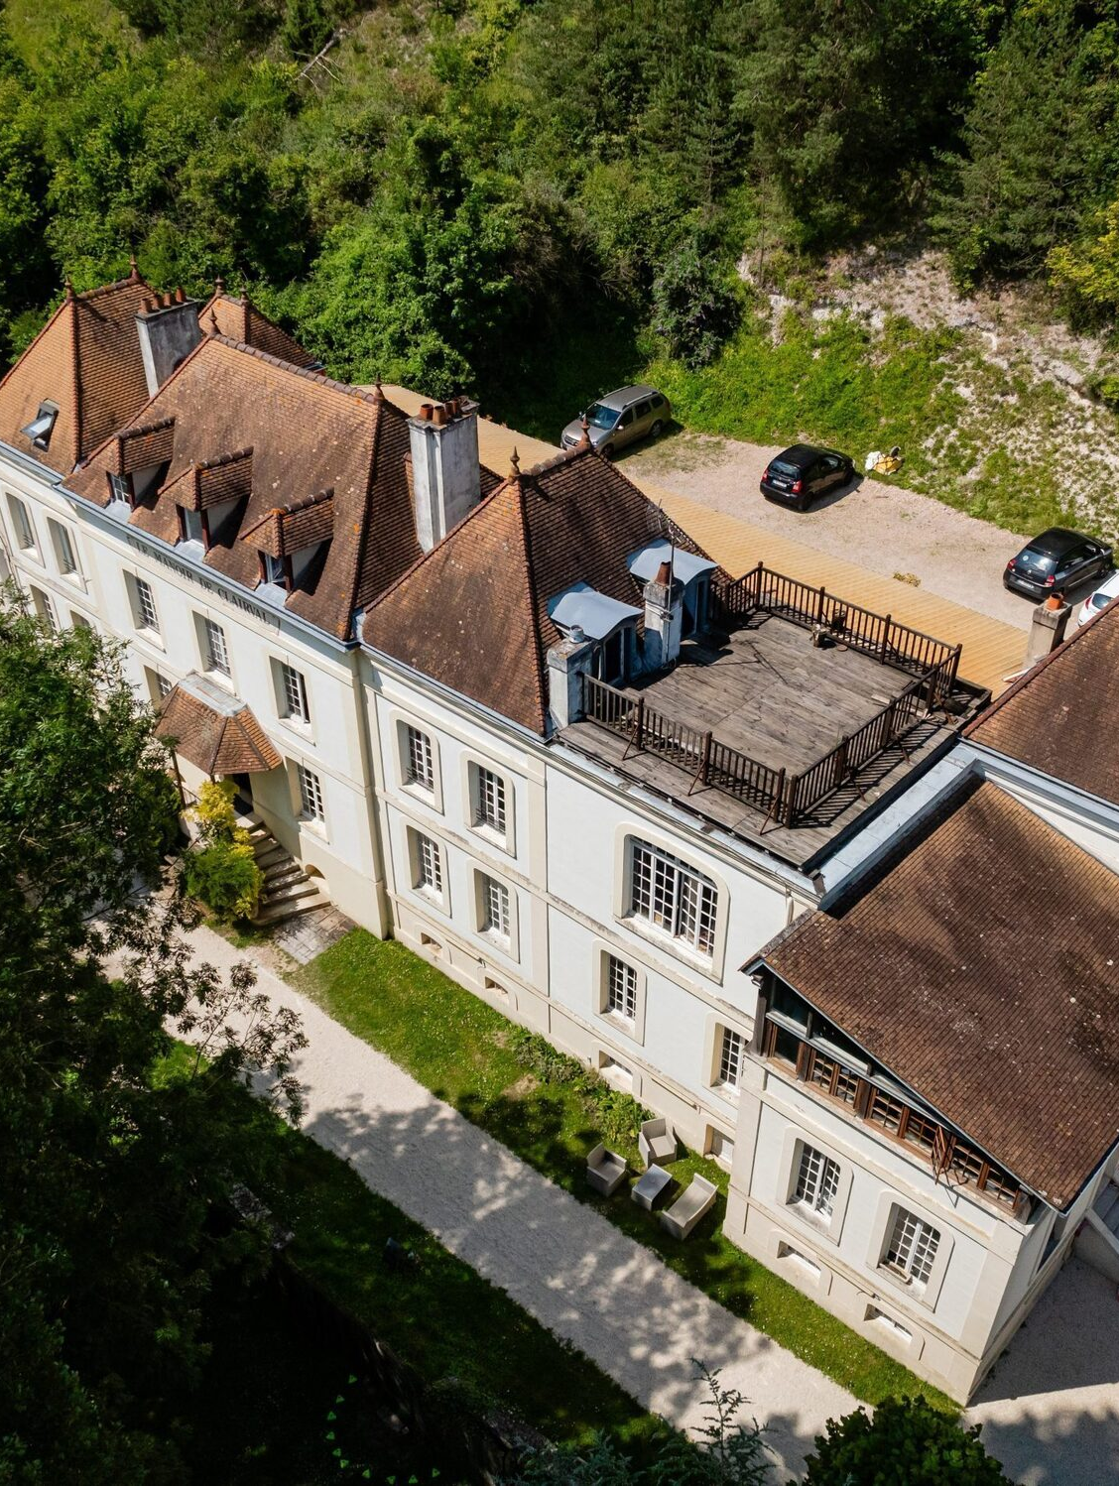
Outline
1. Introduction to CLARA
Accelerator overview, layout, and beam parameters
2. First User Experiments
Science themes, and an overview of the experiments
TOM PACEY
DEEPA ANGAL-KALININ
JAMES JONES
3. Challenge
Problem introduction, examples, and data web UI

Slide 3
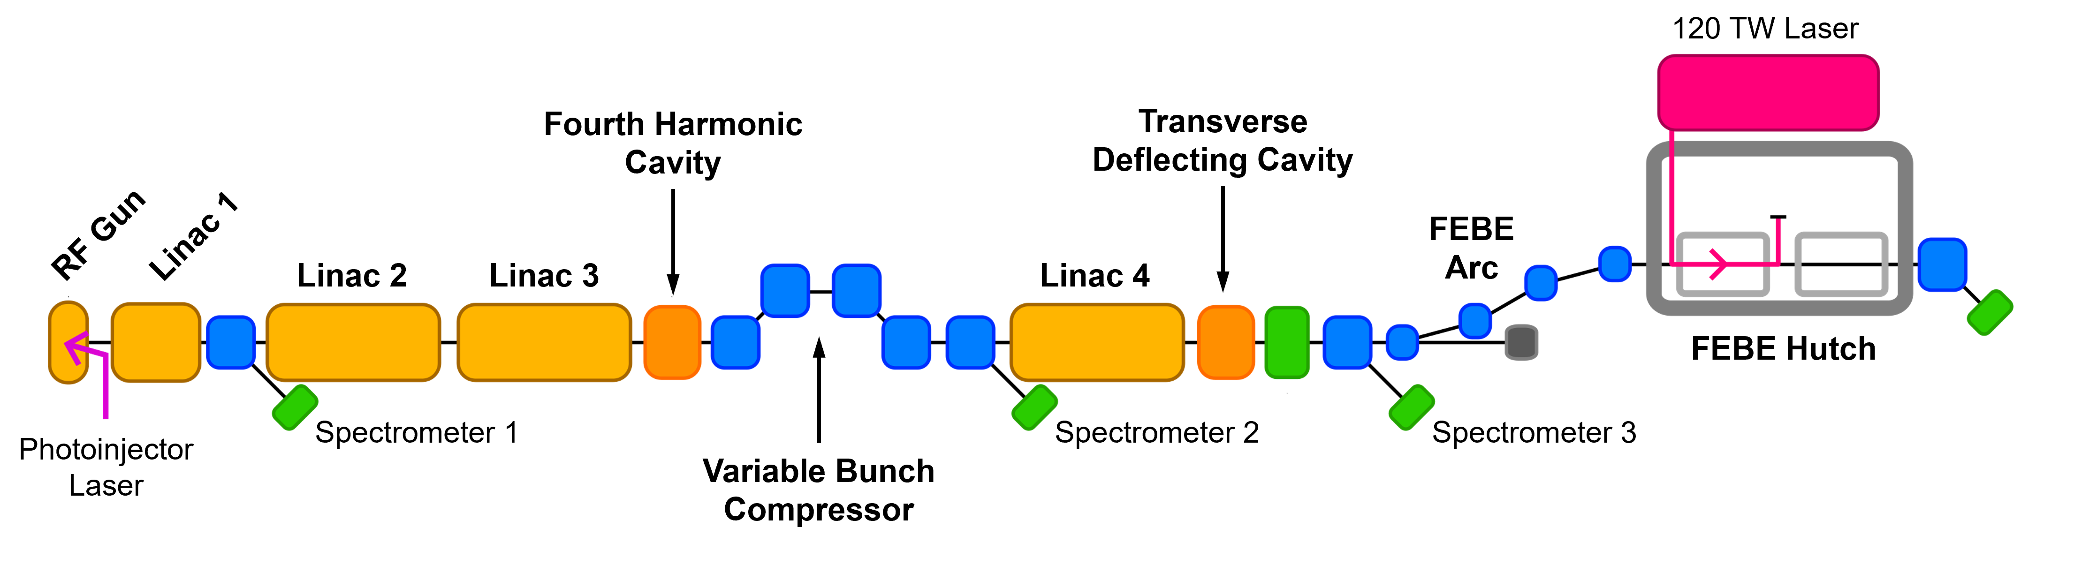
Introduction
J.A. Clarke et al., JINST 9 T05001 (2014)
D. Angal-Kalinin et al., PRAB 23, 044801 (2020)
E.W. Snedden et al., PRAB 27, 041602 (2024)
CLARA is a 250 MeV high-brightness electron
beam facility at STFC Daresbury Laboratory (UK)
CLARA will deliver high-quality, ultra-short electron
bunches to a wide variety of user experiments
The CLARA front end (~35 MeV) was previously
operated as a successful user facility until 2022
The accelerator has recently undergone commissioning
after installation of a major upgrade (2022 – 2025)
Parameter | Low Charge | High Charge
Repetition Rate [Hz] | 1 - 100
Bunch charge [pC] | 5 | 250
Bunch length [fs] | 50 | 100
Energy spread [%] | < 1 | < 5
Spot Size at IP [μm] | 20 | 100
Norm. Emittance [μm] | 2.0 | 5.0
Above: Design CLARA beam parameters for user experiments
Below: Simplified schematic showing the layout of the CLARA accelerator

Slide 4
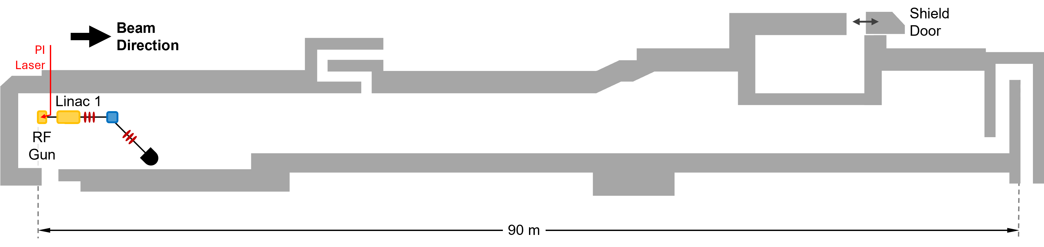
CLARA Front End Layout
D. Angal-Kalinin et al., PRAB 23, 044801 (2020)
Example Technical System | CLARA Front End (35 MeV)
RF Structures | 2
Magnets | 22
Diagnostic Systems | 13
Vacuum Gauges and Pumps | 57
The CLARA front end was
successfully operated as a separate user facility
(2018 – 2022)

Slide 5
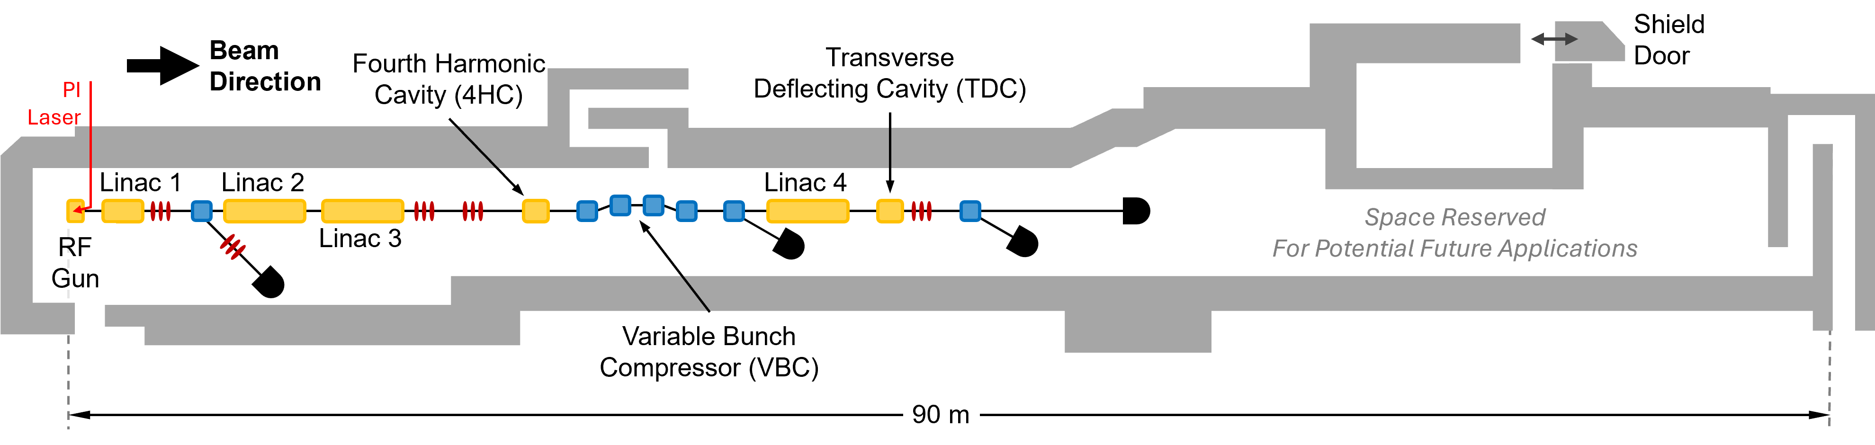
CLARA Layout
Example Technical System | CLARA Front End (35 MeV) | CLARA (250 MeV)
RF Structures | 2 | 7
Magnets | 22 | 77
Diagnostic Systems | 13 | 65
Vacuum Gauges and Pumps | 57 | 109

Slide 6
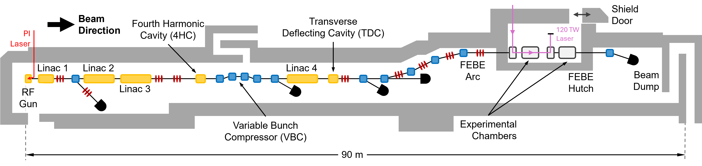
CLARA FEBE Layout
Example Technical System | CLARA Front End (35 MeV) | CLARA (250 MeV) | CLARA FEBE (250 MeV)
RF Structures | 2 | 7 | 7
Magnets | 22 | 77 | 126
Diagnostic Systems | 13 | 65 | 94
Vacuum Gauges and Pumps | 57 | 109 | 155
First experiments in the
Full Energy Beam Exploitation (FEBE) user area took place
in early 2026

Slide 7
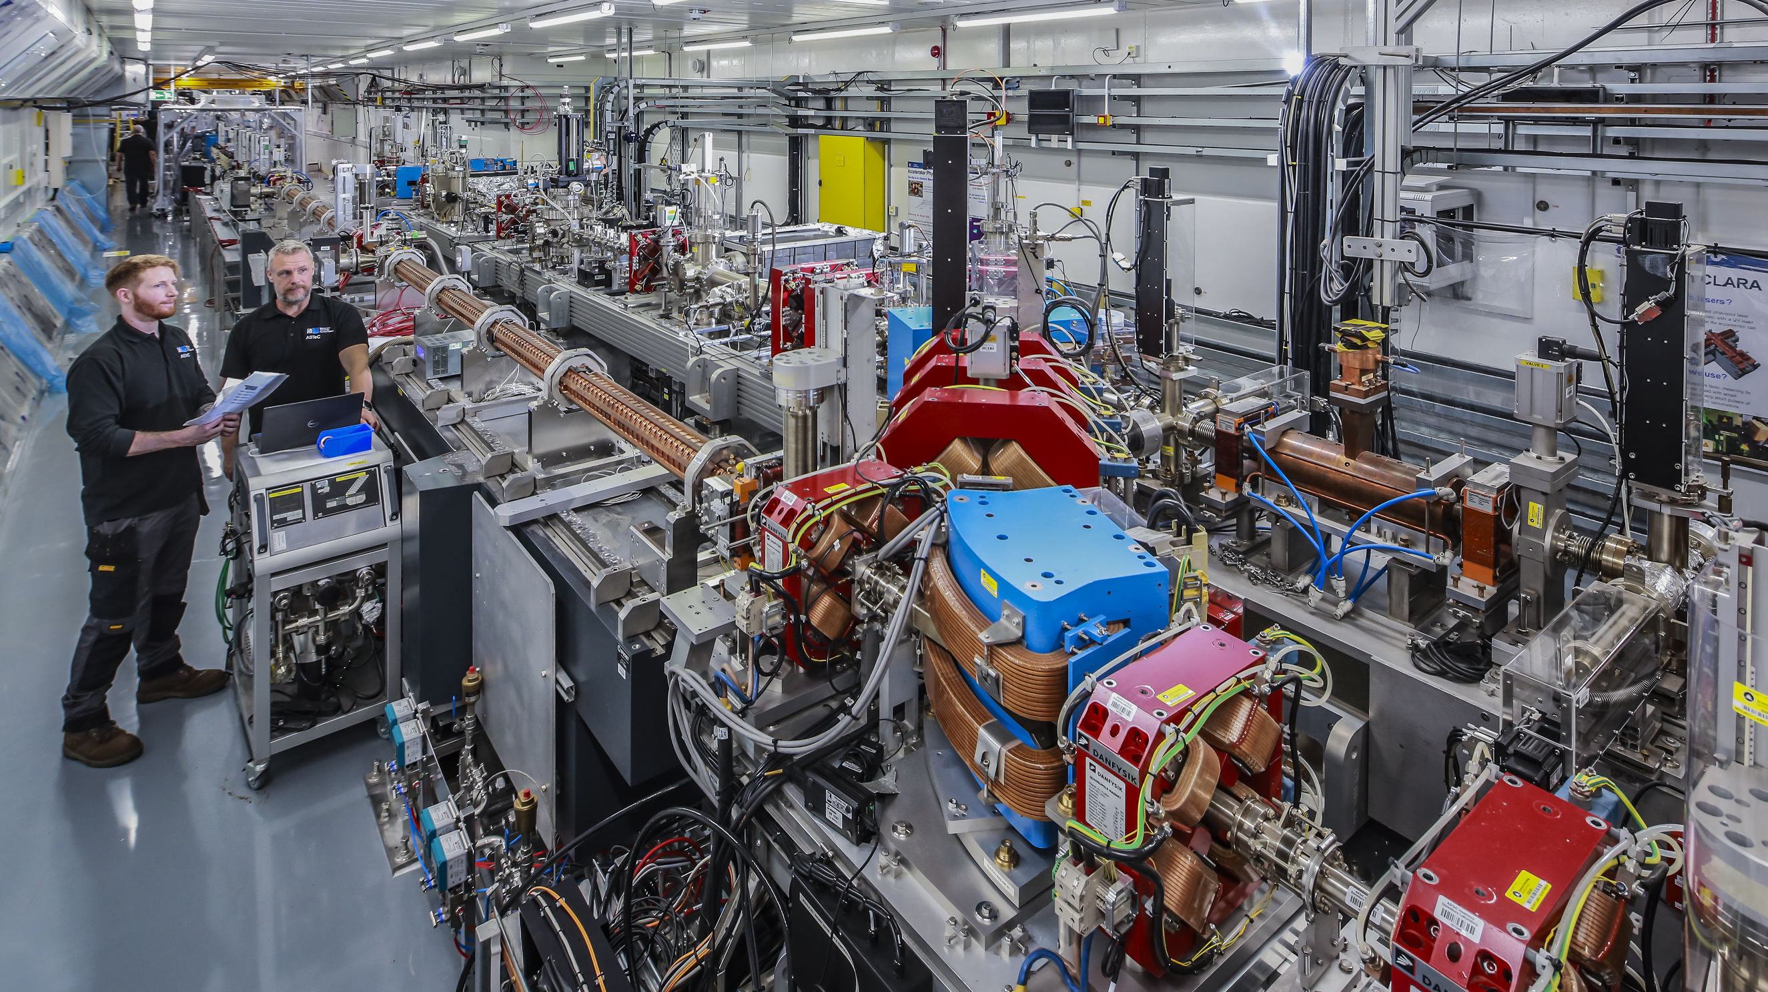

CLARA Installation
View of the CLARA bunker in 2024, looking
out from the accelerator’s front end
towards Linac 2 and Linac 3

Slide 8
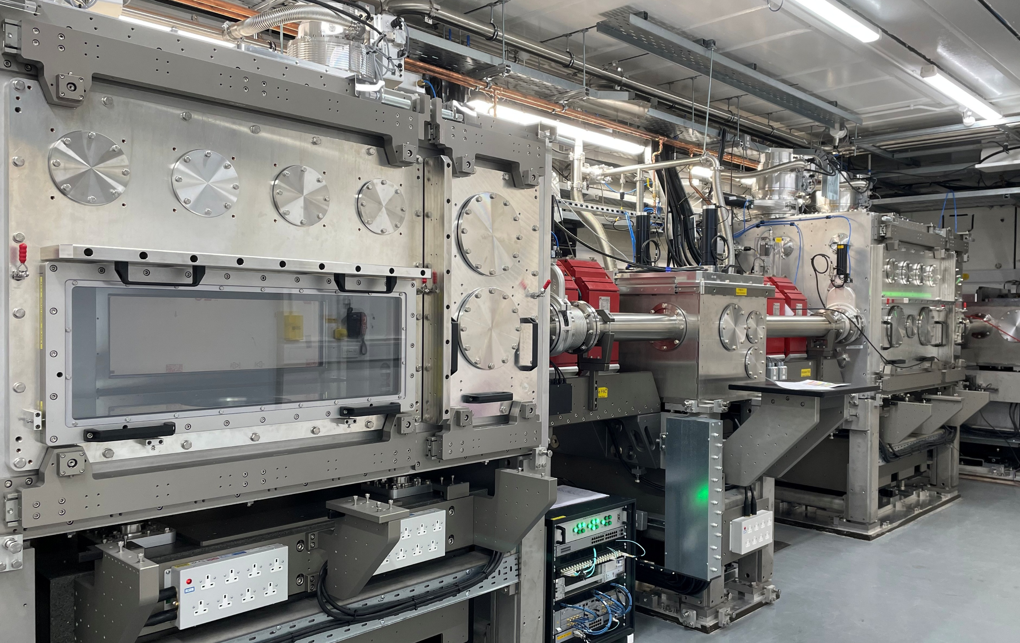
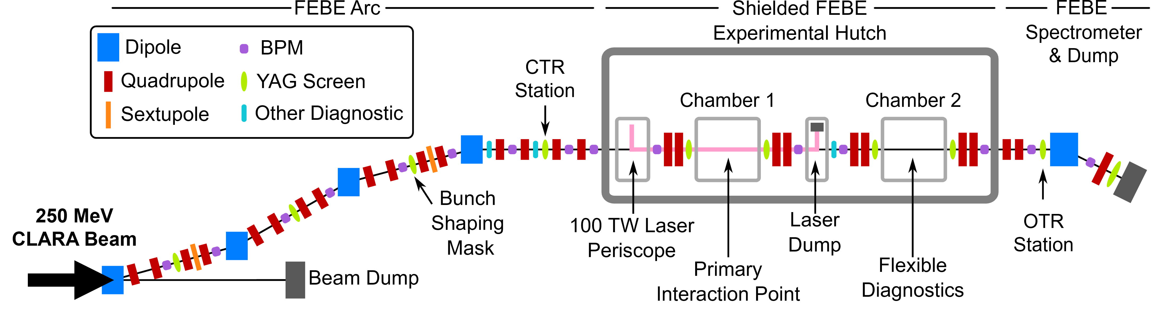
FEBE User Area on CLARA
E.W. Snedden et al., PRAB 27, 041602 (2024)
The Full Energy Beam Exploitation (FEBE) beamline includes a dedicated user area in a separately-shielded enclosure
Two large (~2 m³) experimental chambers can be configured for a wide range of experiments (both in air and under vacuum):
  Novel acceleration,
  Advanced diagnostics,
  New radiotherapy modalities,
A 120 TW laser will be available in late 2026,
for applications requiring synchronized
photon and electron beams
Beam
Direction

Slide 9
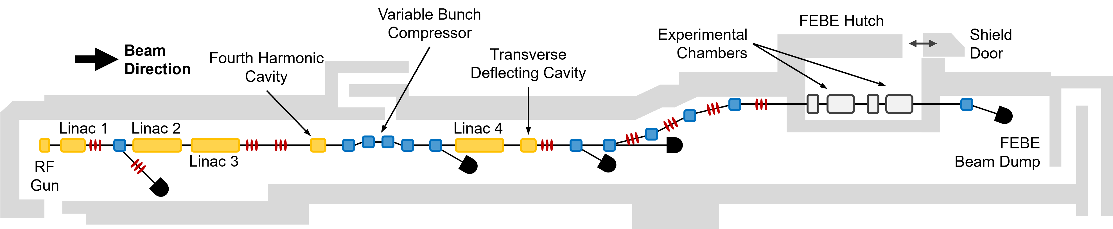
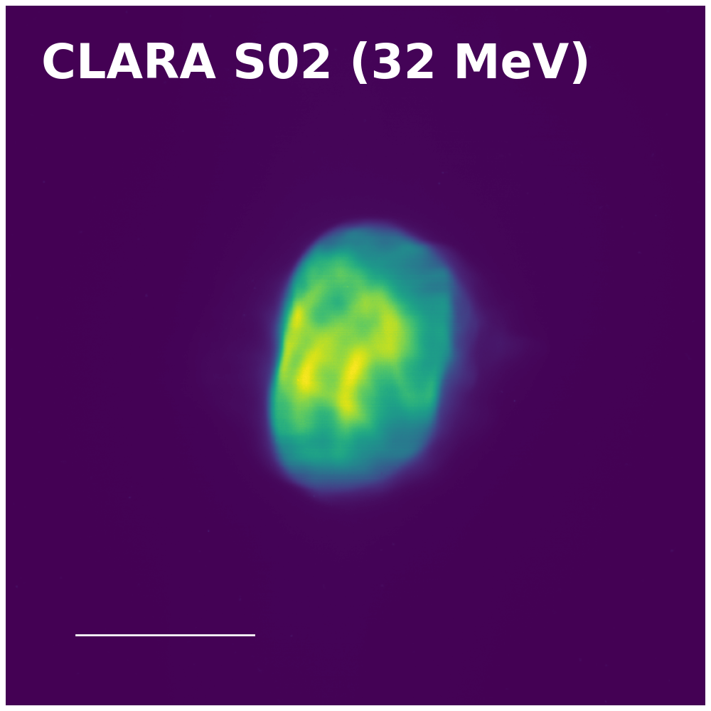
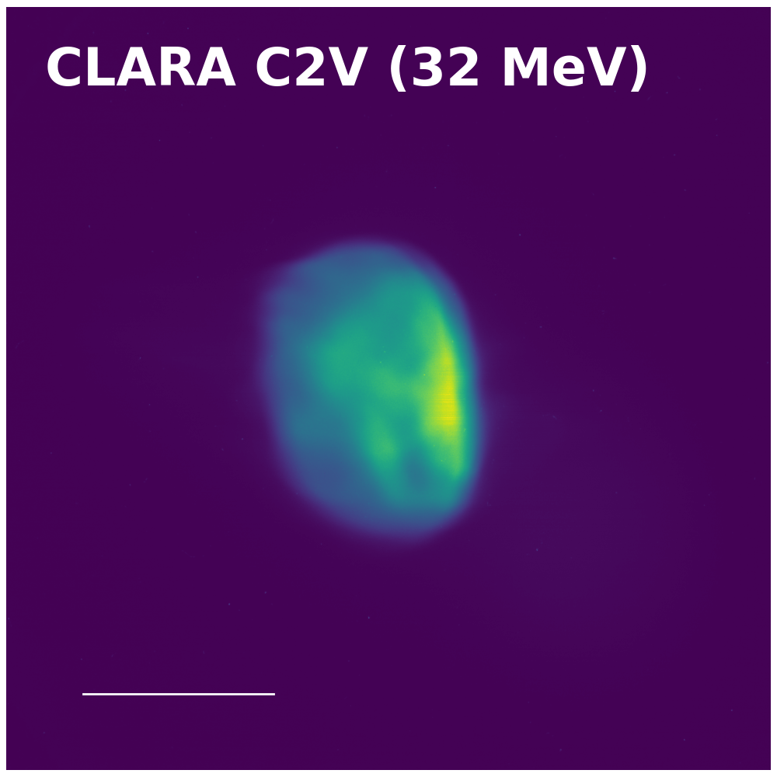
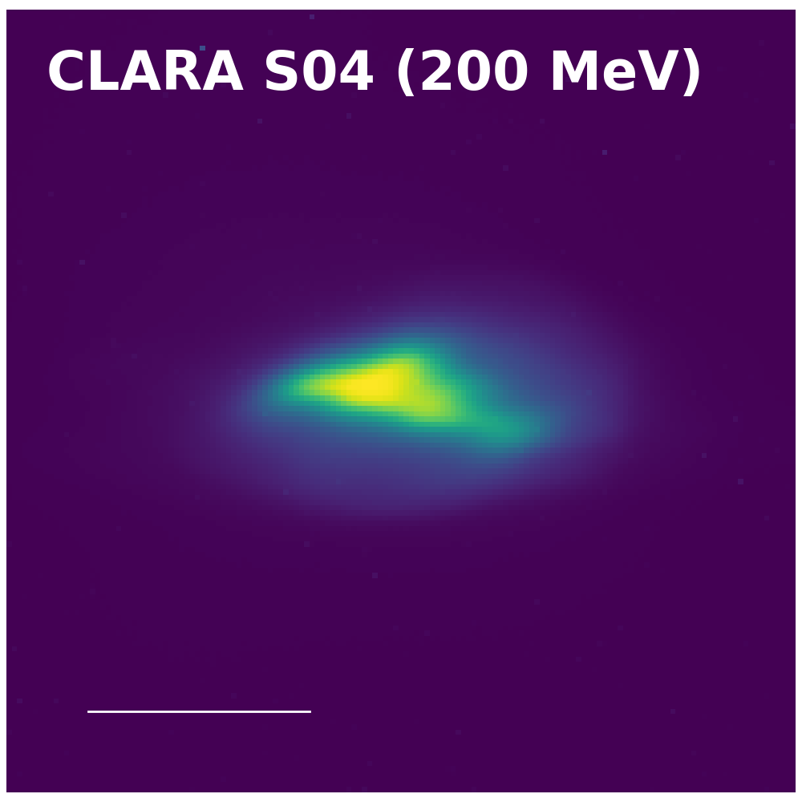
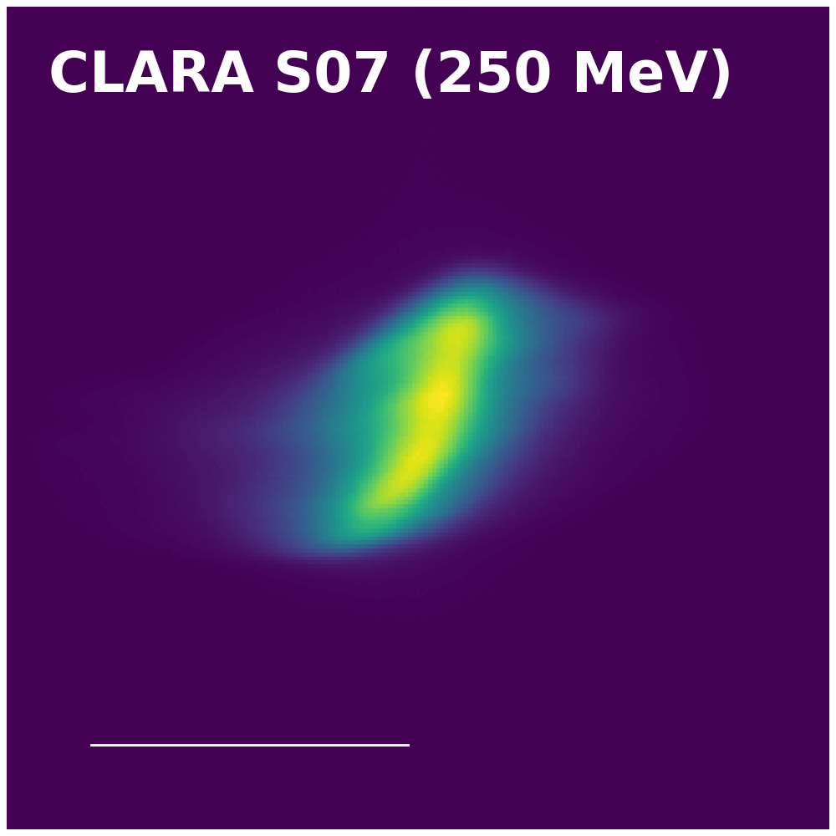
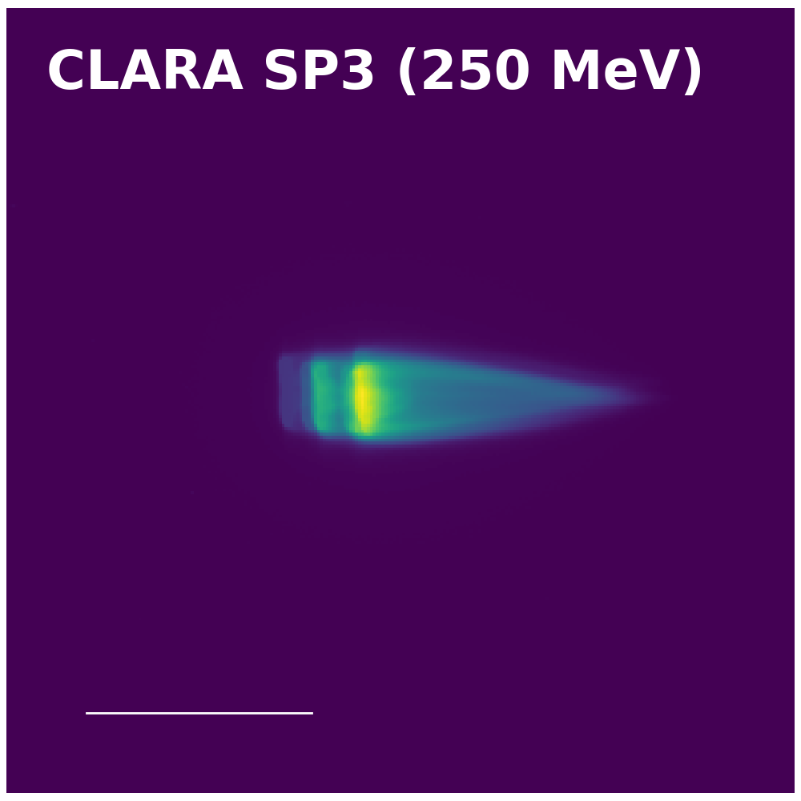
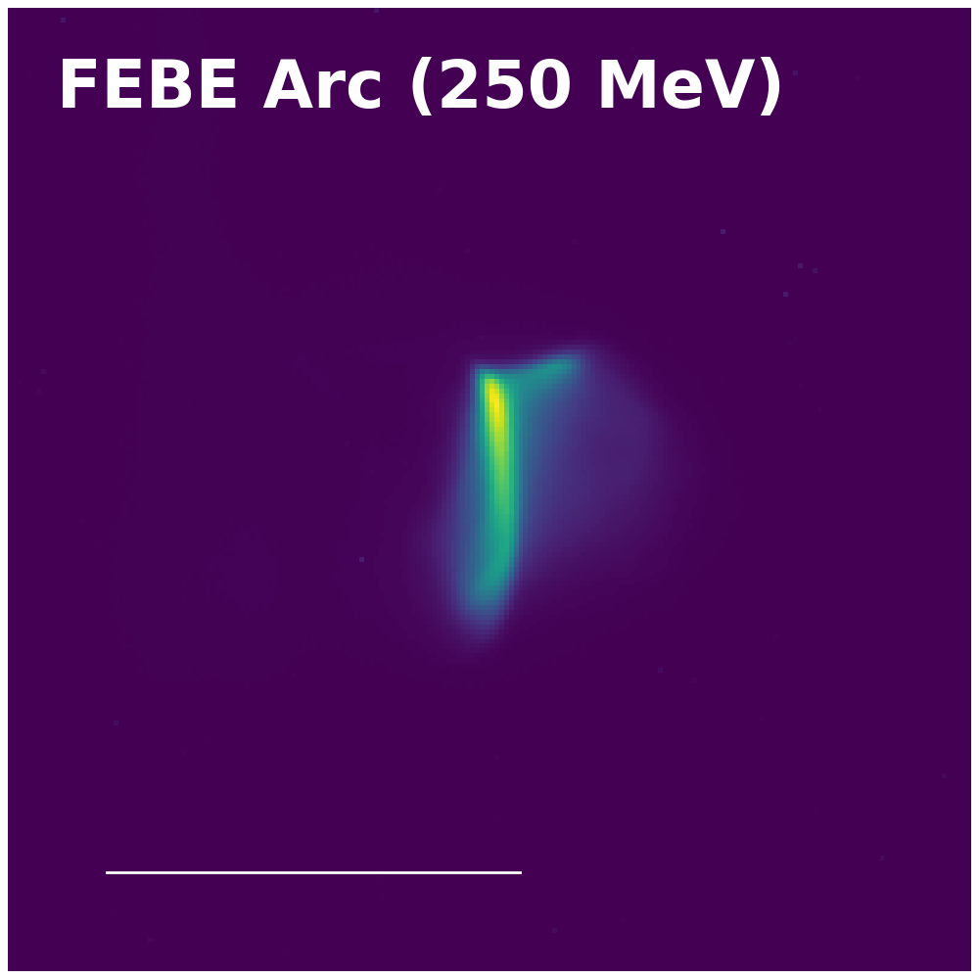
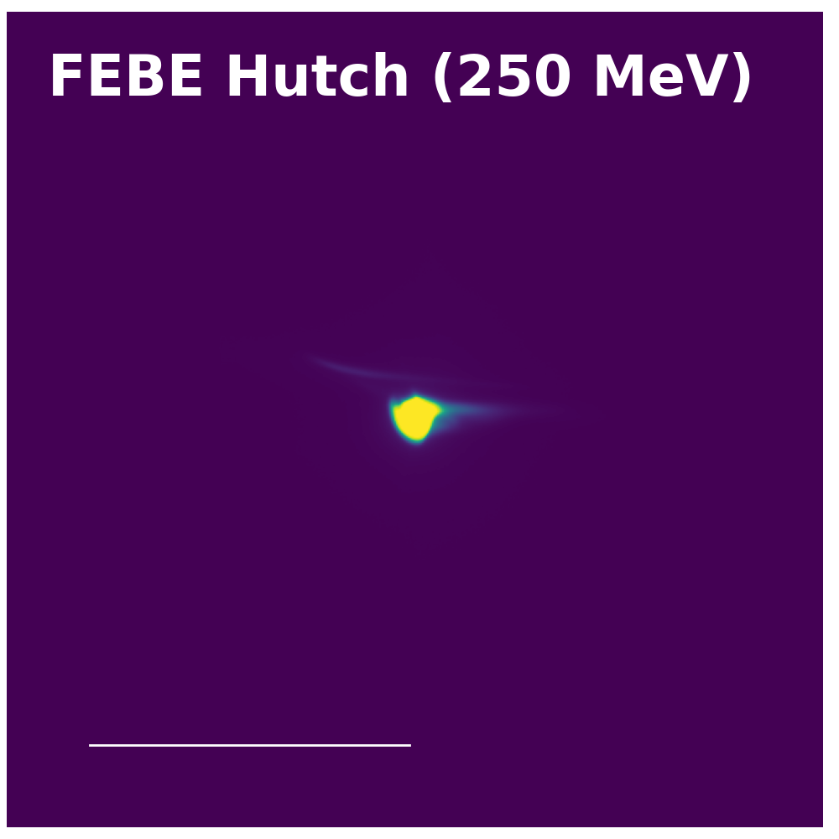
Beam Images (250 pC)
3 mm
5 mm
1 mm
1 mm
2 mm
2 mm
2 mm

Slide 10

User Science Themes
Advanced
Diagnostics
Medical
Applications
Compact
Accelerators
AI for
Accelerators
Laser Based
Accelerators
Examples:
Optical Transition Radiation (OTR),
Coherent Transition
Radiation (CTR)
Examples:
FLASH dosimetry,
VHEE beam delivery,
Radiobiology studies
Examples:
Beam driven
plasma acceleration,
Active plasma lenses
Examples:
Virtual diagnostics,
Reinforcement learning optimisation
Examples:
Laser-plasma acceleration,
Inverse Compton scattering
First Friendly User Run
(Q1 2026)
Planned
Friendly User Run
(Q2 2026)
After FEBE Laser
Commissioning
(Q3 2026)

Slide 11
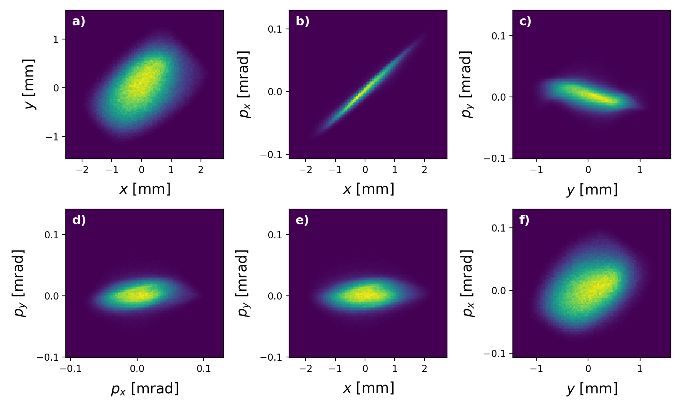
Emittance Measurements
Emittance measurements are based on quadrupole
scans throughout the CLARA beamline
We use generative Machine Learning (ML) for high-resolution measurements of the transverse phase space
The ML technique accurately reconstructs the beam’s
charge distribution, including any substructure
Beam Setup (250 pC) | Horizontal Normalised Emittance [μm]
Post-injector (35 MeV) | < 1.0
Uncompressed (250 MeV) | 2.3
Compressed (250 MeV) | ~5.0
Above: 4D transverse phase space, reconstructed for an uncompressed
30 pC beam immediately after the final linac
Left: Emittance measurements for a 250 pC compressed beam.
High-energy measurements were made immediately after the final linac
R. Roussel et al., PRL 130, 145011 (2023)
R. Roussel et al., PRAB 27, 094601 (2024)

Slide 12
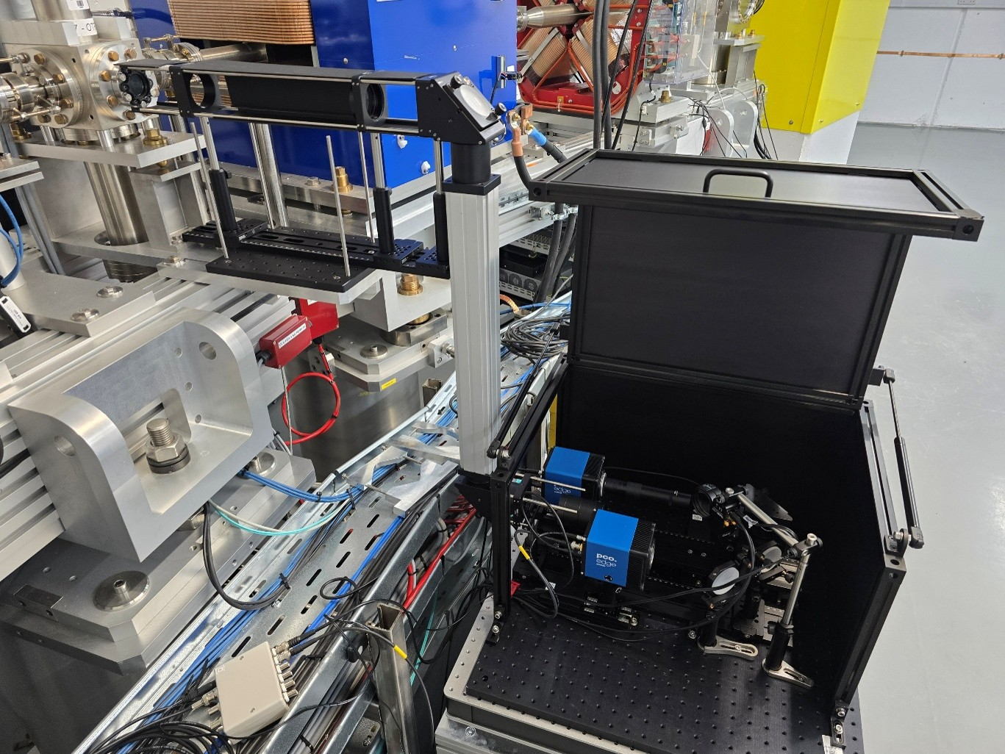
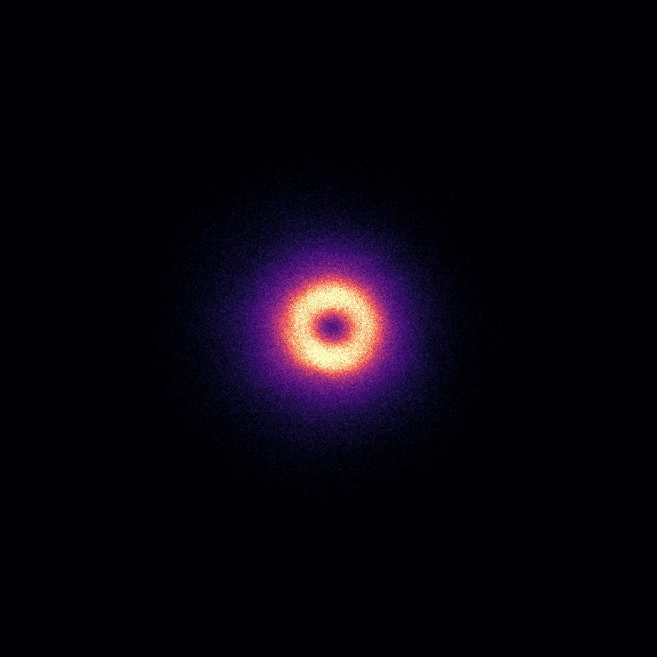
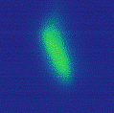
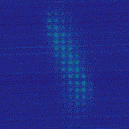
Optical Transition Radiation (OTR)
Lead Investigator: J. Wolfenden (Liverpool University)
Experiment involved measurements of the transverse beam
optics, using an OTR target located after the FEBE hutch
Aimed to characterize the resolution of single-shot emittance
measurements, made via an optical pepper pot technique
The FEBE beamline was used to:
  Benchmark OTR measurements
  against quadrupole scans,
  Deliver specific Twiss parameters
  to the OTR target
OTR
target
Periscope
Light box with optical paths for:
Direct imaging of OTR light
OTR imaging via a multi-lens array (MLA)
Spatially Coherent OTR
Beam Size < 50 μm at 250 pC
Direct
MLA

Slide 13
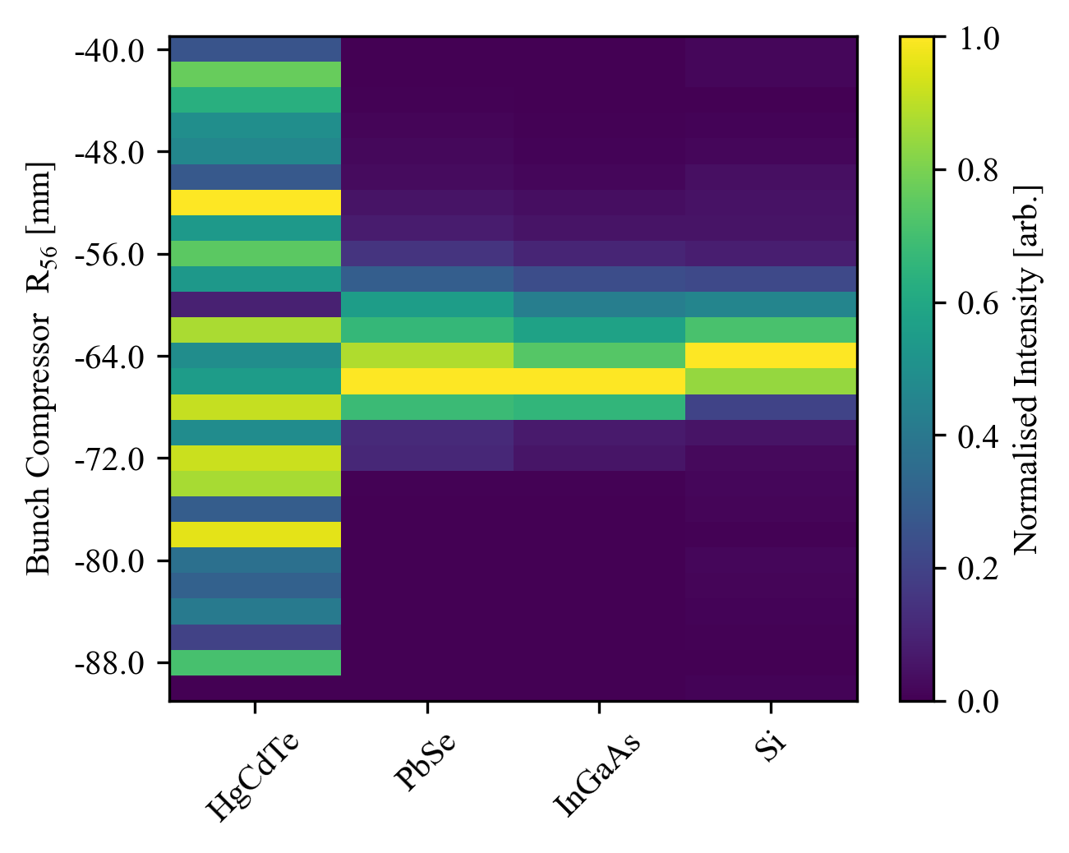
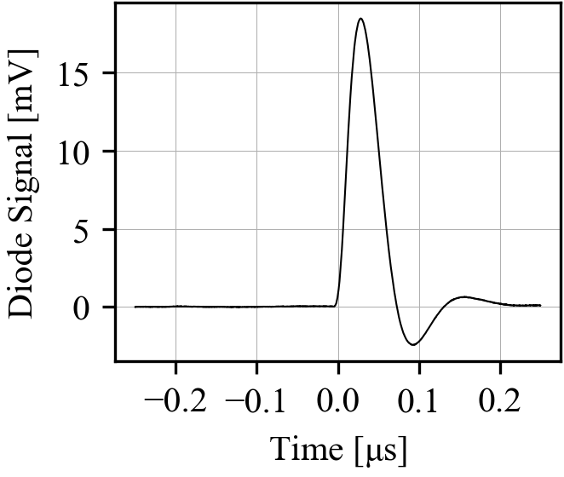
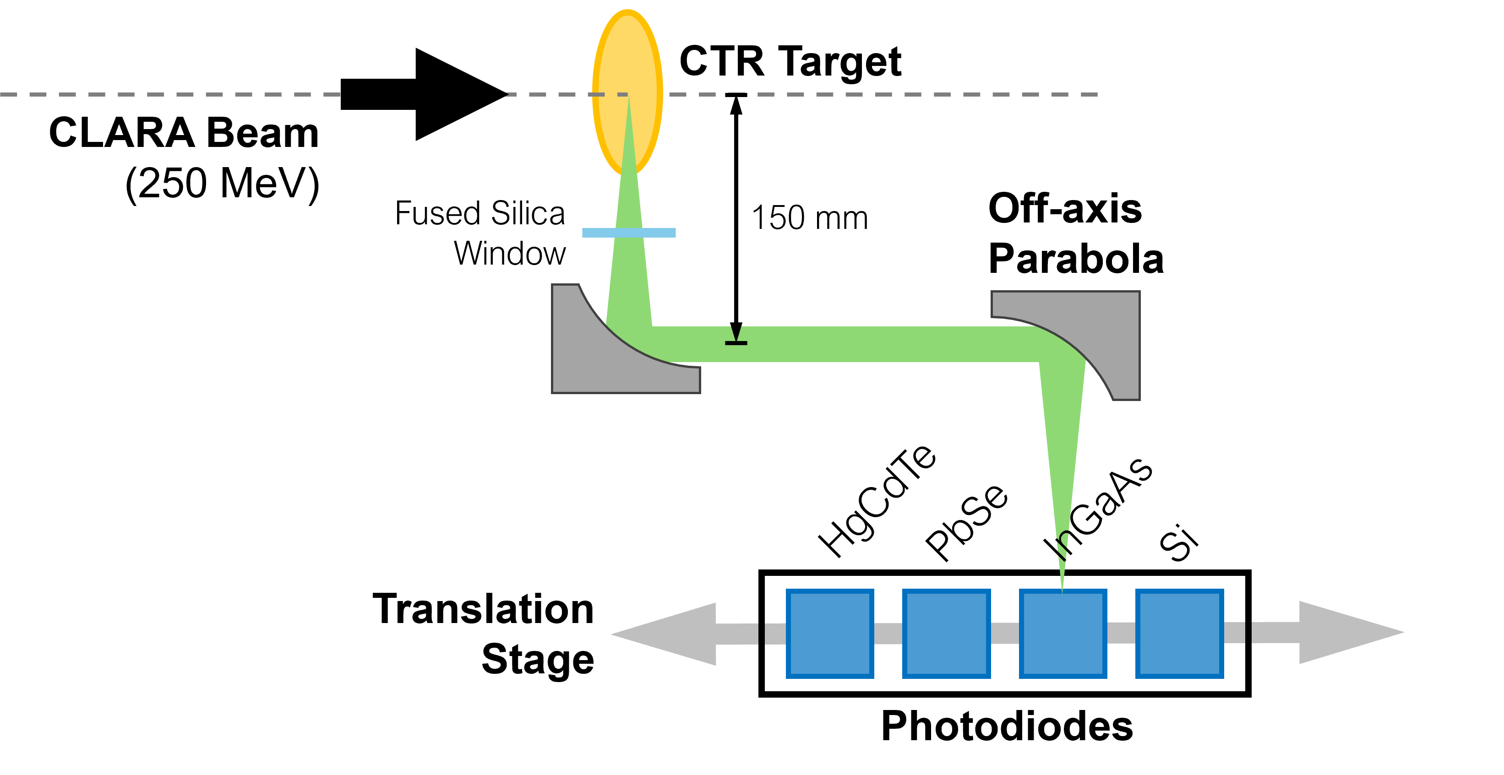

Coherent Transition Radiation (CTR)
Lead Investigator: W. Kuropka (DESY ARES)
Experiment aimed to demonstrate a CTR-based compression diagnostic for ultra-short (< 10 fs), low charge (< 5 pC) beams
Signals were measured with several photodiodes, mounted
next to a CTR target just before the FEBE hutch
Minimized the bunch length by adjusting the VBC R₅₆
to maximize the CTR signal at short wavelengths
Delivered ultra-short electron bunches:
≲ 5 fs duration at ~3.5 pC

Slide 14
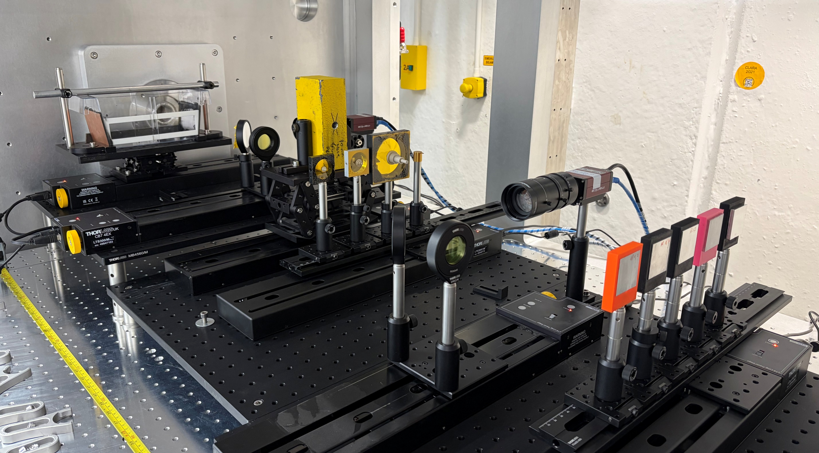
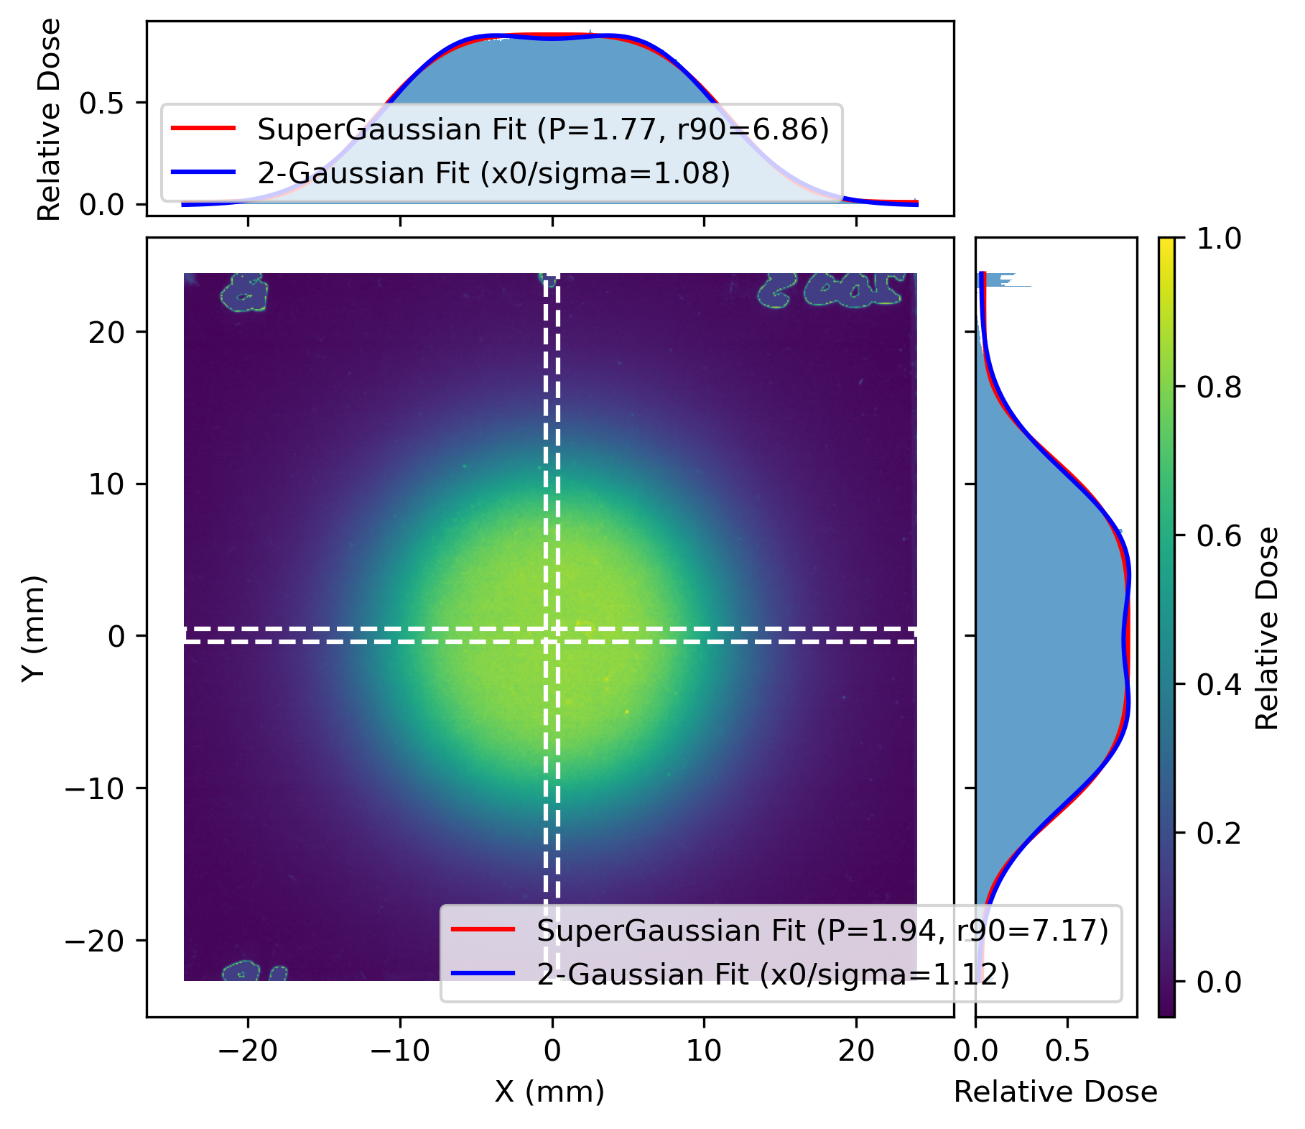
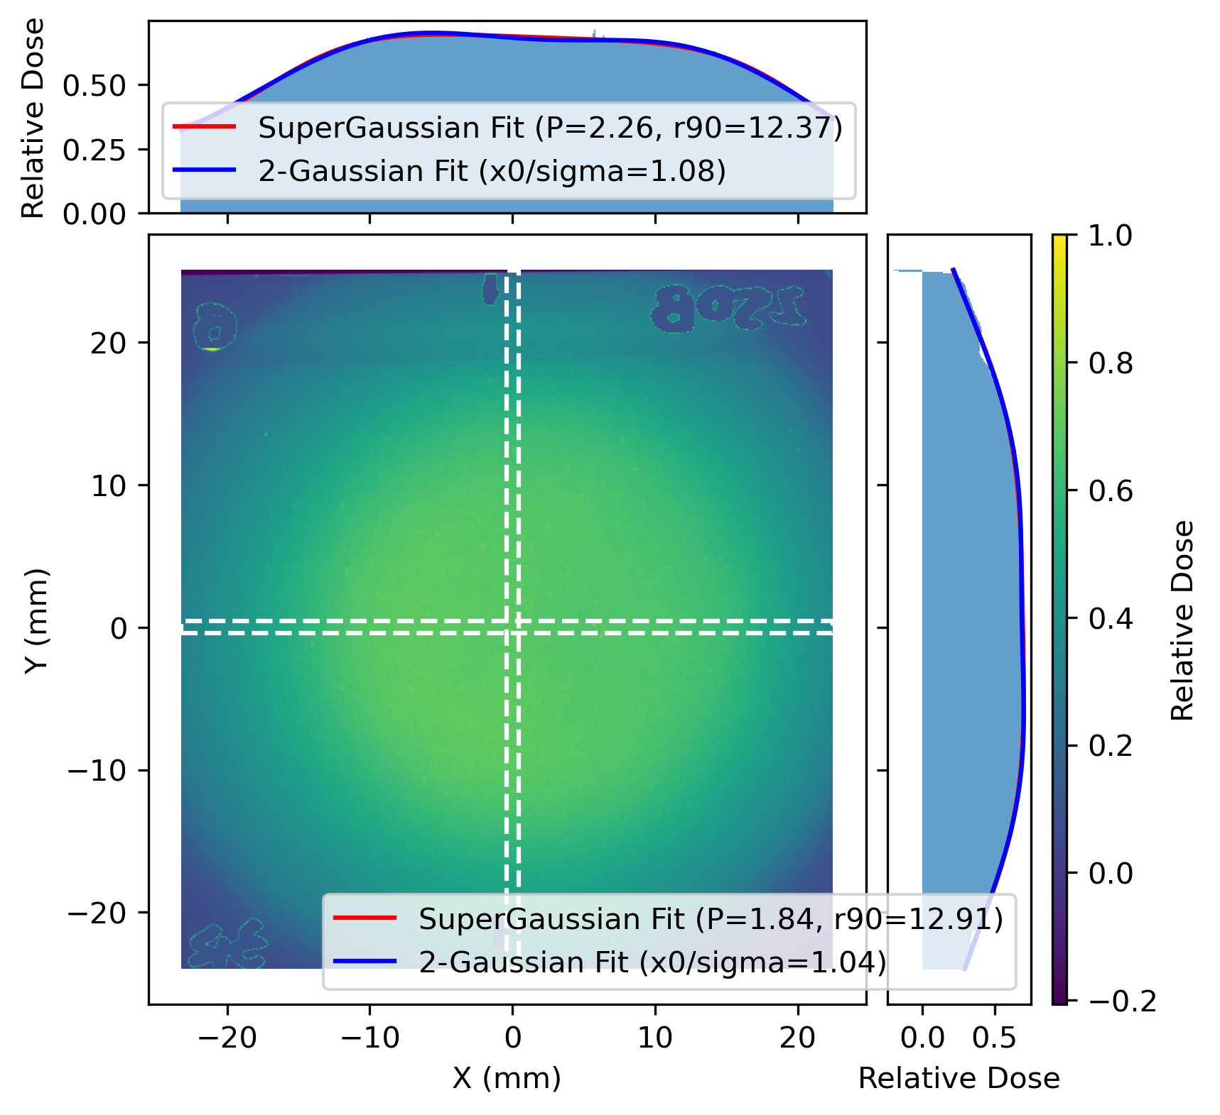


VHEE Scatterers
C. Robertson et al.
NIM A 1082, 170943 (2026)
Lead Investigator: M. Dosanjh (Oxford University and CERN)
The first in-air experiment carried out in either
of the FEBE experimental chambers
Aimed to generate large (~1 cm), uniform beam profiles
suitable for Very High Energy Electron (VHEE) radiotherapy
Successfully produced uniform beams at energies up
to 250 MeV, using various scatterer configurations
Builds on previous work with 200 MeV beam
at CLEAR (CERN)
Beam
Direction
Water
Phantom
Collimator
Conical
Scatterers
Top Right: Photo of the experimental setup inside the second FEBE chamber
Bottom Right: Analysis of RCF films
showing uniform electron beam profiles

Slide 15
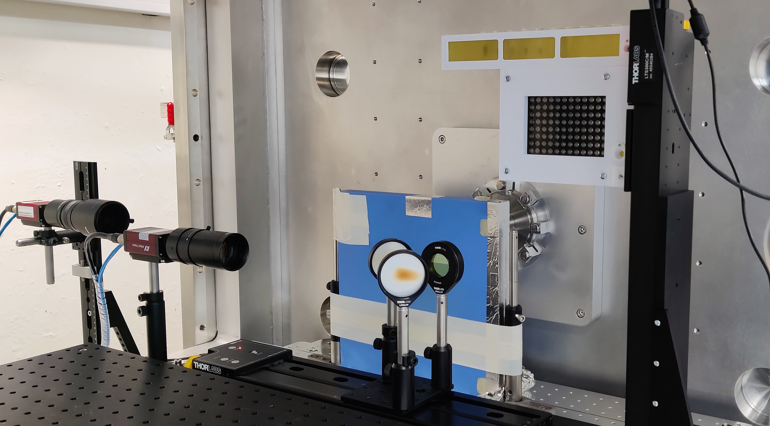
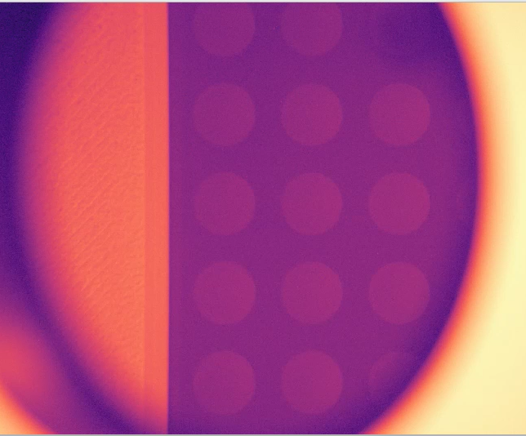

VHEE Cell Irradiation
K.L. Small et al., Sci. Rep 11, 3341 (2021)
D. Angal-Kalinin et al., Front. Phys. 12 1496850 (2024)
K. Small et al., NIM B 565, 165752 (2025)
Lead Investigator: R.M. Jones (Manchester University)
Dosimetry studies to establish the electron beam parameters
required to achieve FLASH dose rates (> 100 Gy/s) at CLARA
Experiment will study cell survival and DNA damage after VHEE irradiation at conventional and FLASH dose rates
Builds on previous studies at CLARA,
ARES (DESY) and CLEAR (CERN)
European first: VHEE FLASH irradiation of human cancer cells
(A549 lung adenocarcinoma) with the 250 MeV electron beam
96-Well
Cell Plate
Above: Photo of the experimental setup inside the FEBE chamber
Left: Video showing delivery of the
CLARA electron beam to samples
held in a 96-well cell plate
Beam
Axis
10 mm

Slide 16

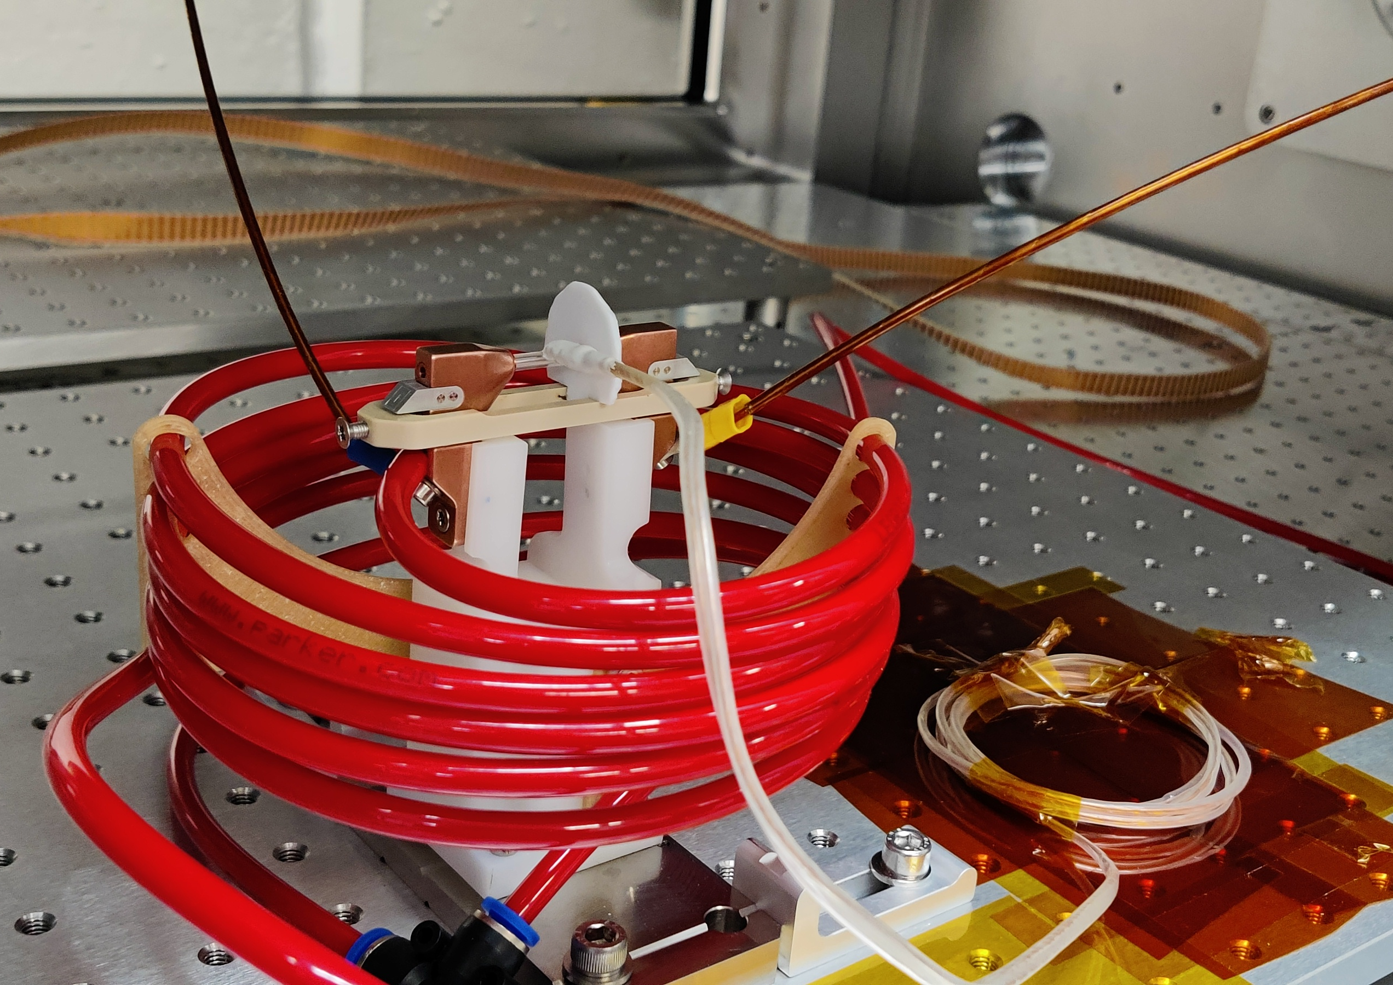
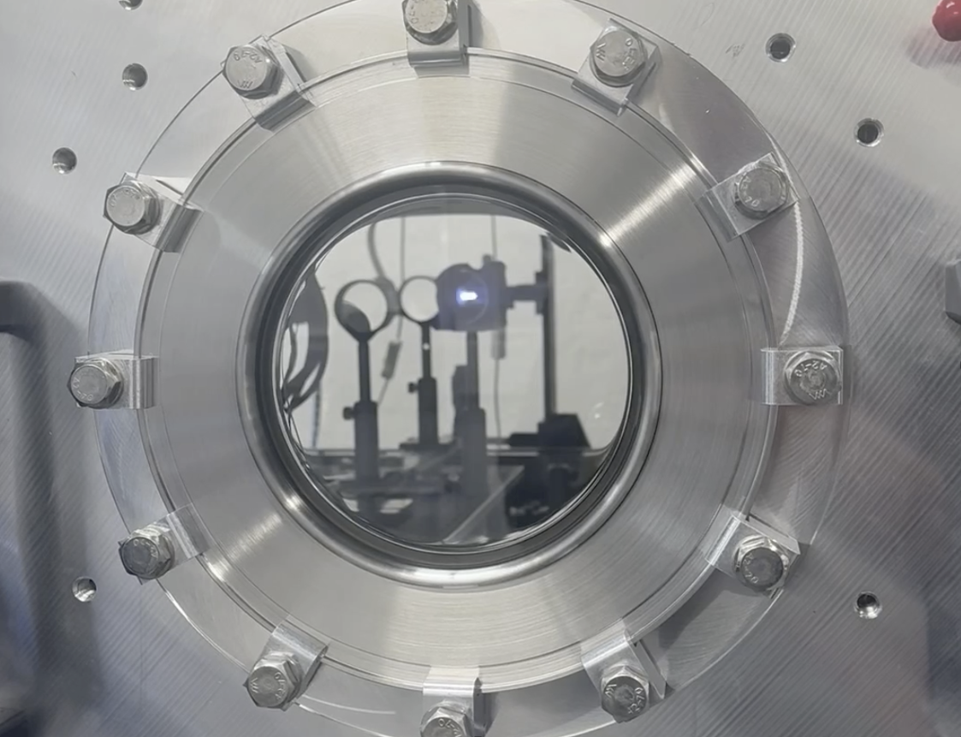
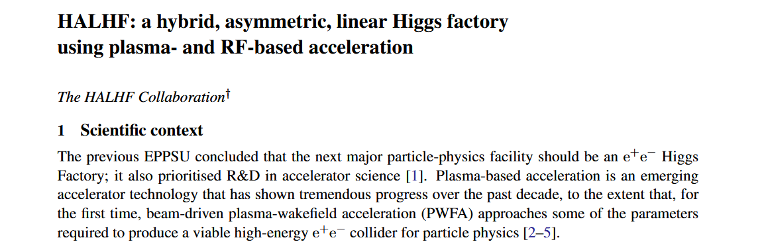

Plasma Acceleration - Goals
Lead Investigator: R. D’Arcy (Oxford University)
The HALHF Collaboration plan to explore concepts for novel accelerator
staging (for high energy) and repetition rates (for high luminosity) at CLARA
  Plan benefits from unique, flexible, modular infrastructure
  To be carried out in a multi-year phased approach
Experimental goals (this beam time):
  Prove plasma-accelerator infrastructure at CLARA,
  and generate plasma with a discharge capillary
  Drive a plasma wake with the CLARA beam
  Goal: Generate GV/m (decelerating) fields
  Focus CLARA beams with an active plasma lens
  Goal: Generate >100 T/m (focussing) fields
Above: Plasma cell in the
FEBE experimental chamber
Left: First (argon) plasma generation
arXiv:2503.19880

Slide 17
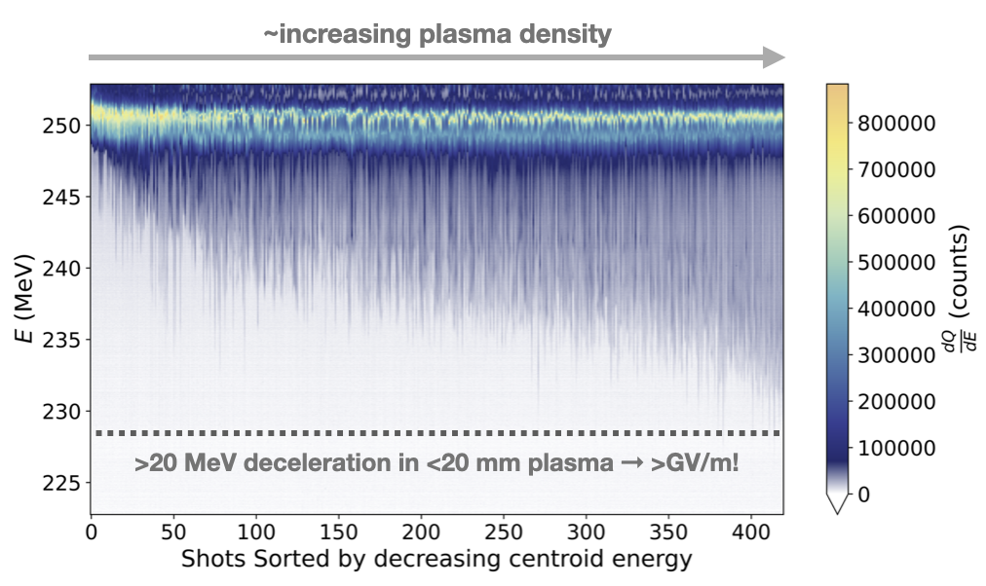
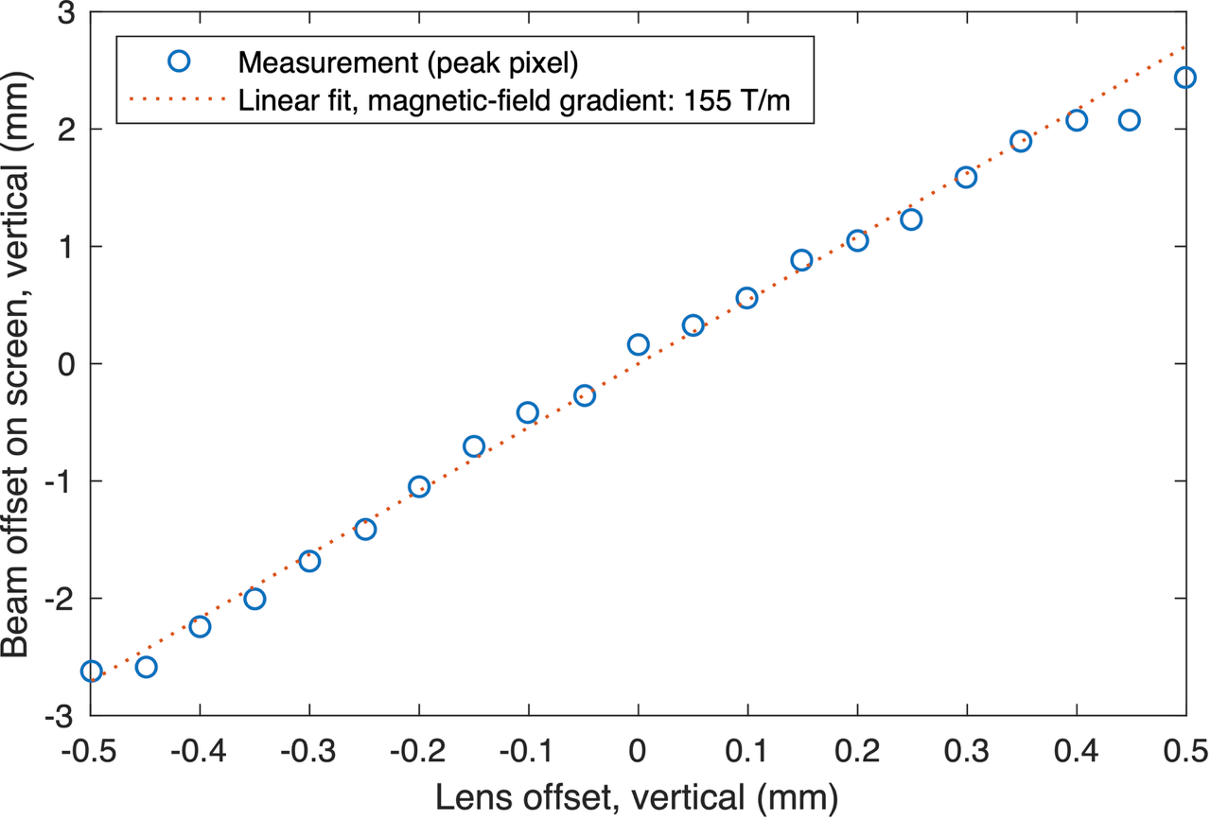
Plasma Acceleration - Results
Lead Investigator: R. D’Arcy (Oxford University)
All goals achieved!
  ~GV/m electric fields
  ~150 T/m magnetic fields
Next steps (in subsequent beam times)
  Novel interstage optics scheme
  (for staging of plasma-accelerated beams)
  Plasma acceleration of bunch trains with
  HALHF properties (~10 ns separation, 100 Hz)
  Energy-mapping studies and high average
  power plasma sources
Milestone: First beam-driven plasma “accelerator” in
the UK, and the first active plasma lensing at CLARA
Courtesy of C.A. Lindstrøm

Slide 18
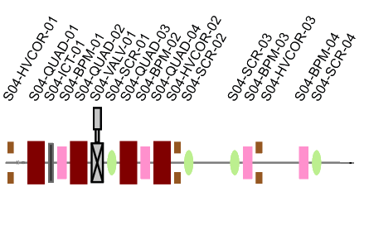
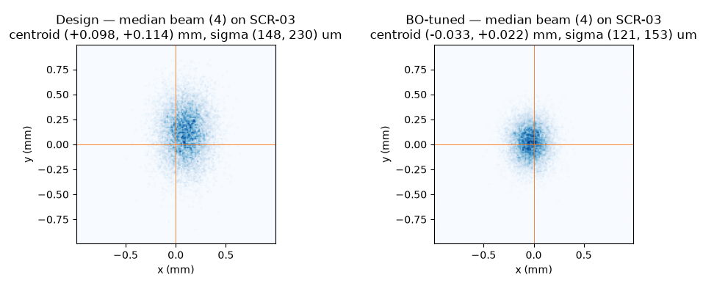
Optimisation Challenge: Example
The kickoff notebook you've been given has a demonstration of a simple optimisation over a small section of CLARA
You can control 4 quadrupoles and 4 correctors (2 H/V combined correctors).
The goal is to achieve a 0.1x0.1mm beam at the centre of S04-SCR-03 which Bayesian Optimisation can do handily, if you don't mind doing 40 to 80 observations!
Observations are expensive! Setting magnets, waiting for them to settle, and then taking a screen reading takes about 30 seconds

Slide 19
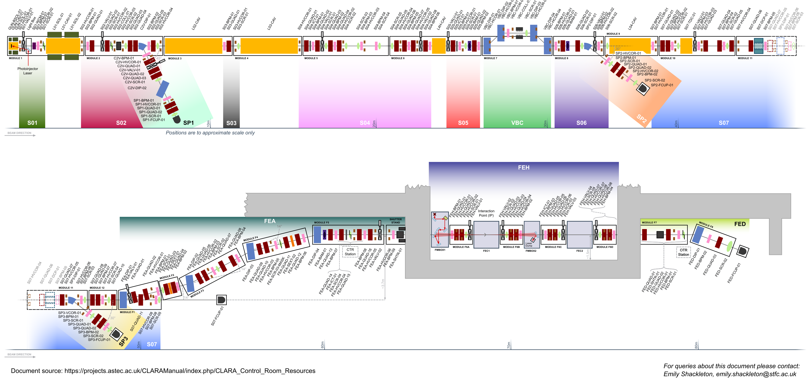
Optimisation Challenge: Beam in FEBE
The goal of the challenge is to take a randomised machine setup and to set magnet strengths along the whole accelerator to get beam to FEBE​ for the user's specification.
E.W. Snedden et al., PRAB 27, 041602 (2024)

Slide 20
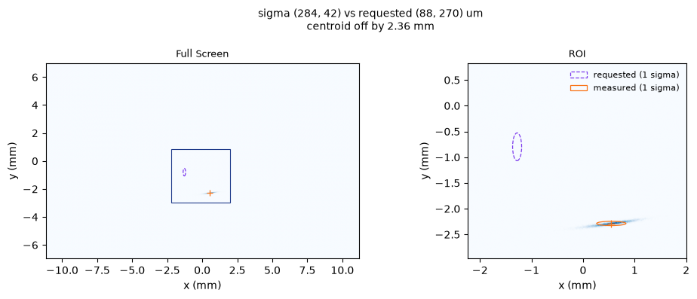
Optimisation Challenge: Beam in FEBE
For such a small section of the machine, BO works even if it is expensive. That will not work for the whole accelerator.
133 controllable magnets, 28 screens, 45 BPMs – can you take a random machine configuration and steer and focus a beam to the target in FEBE?

Slide 21
Optimisation Challenge: Beam in FEBE
Tips:
You can load a reference configuration with zeroed correctors as a starting point, though this won't help with misalignments.
There's a tunable severity parameter in the scoring function which controls how strong the misalignments and starting beam variations are. Start low, and work your way up.
Each screen blocks the beam, you can only read from one screen per run.
You have access to a searchable database of real data - use it to find the properties that matter most

Slide 22
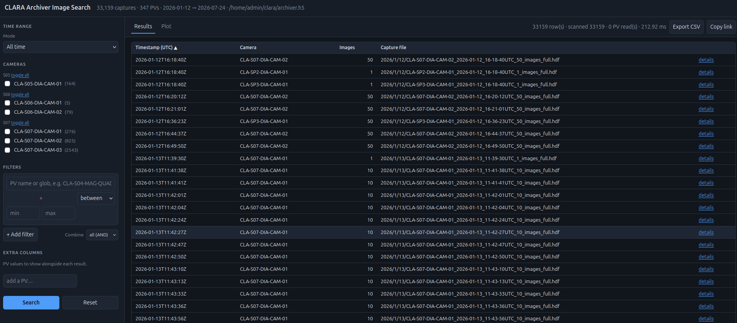
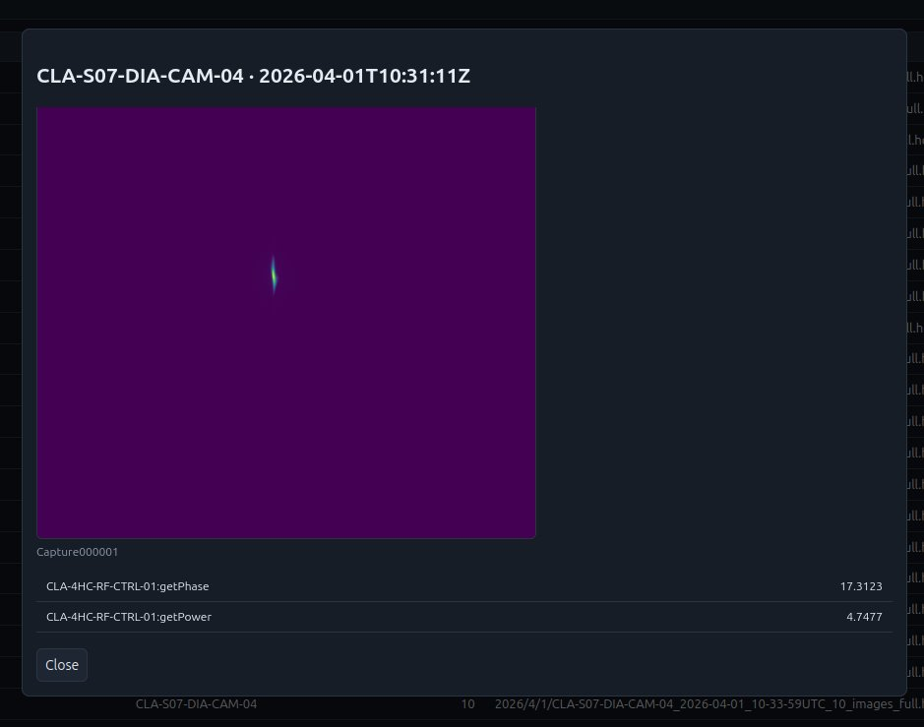
Real CLARA data

Slide 23
CLARA Electron Beam Parameters
E.W. Snedden et al., PRAB 27, 041602 (2024)
Parameter | Commissioning |  | Machine Development
 | High Charge | Low Charge | High Charge | Low Charge
Beam Energy E [MeV] | 250 | 250 | 250 | 250
Bunch Charge Q [pC] | 250 | 5 | 250 | 5
Bunch Length σ_{t} [fs] | 100 | 50 | ≤ 50 | ≪ 50
Energy Spread σ_{E} [%] | < 5 | < 1 | 1 | 0.1
Beam Size [μm]
σ_{x} | 100 | 20 | 50 | ~1
σ_{y} | 100 | 20 | 50 | ~1
Normalised Emittance [μm rad]
ε_{n,x} | 5 | 2 | < 5 | < 1
ε_{n,y} | 5 | 2 | < 1 | < 1
Above: Full table of expected beam parameters at the FEBE Interaction Point (IP). Parameters for included for initial beam commissioning, and following future Machine Development (MD) periods.

