Slide 1
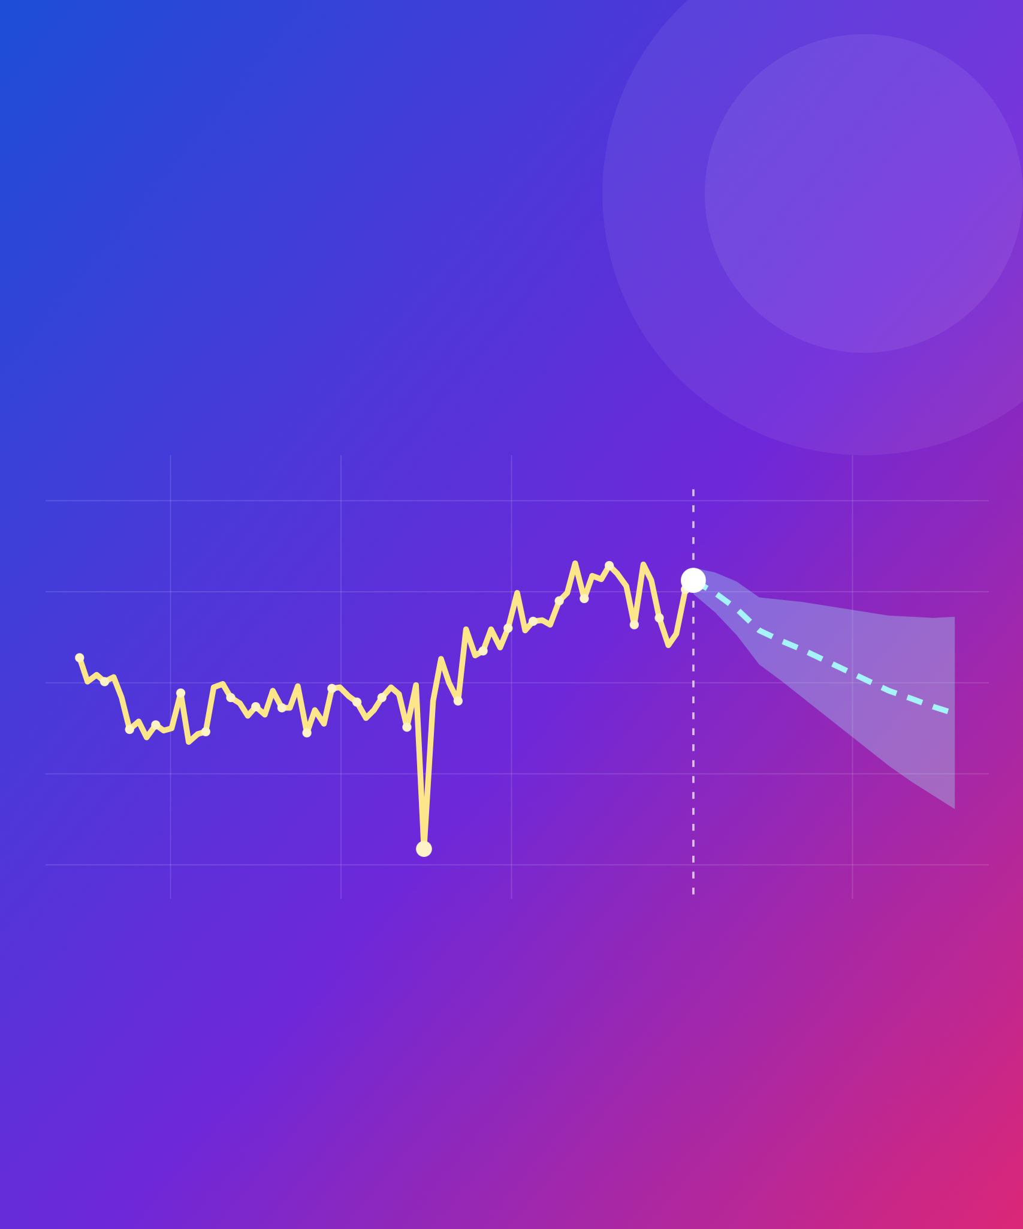
Forecasting the CLEAR beam charge
AISSAI ACCELERATOR HACKATHON 2026
OPTIMISATION CHALLENGE
now
forecast
How will the beam behave next, and can we see it coming?
dropout
past shots
Antonio Gilardi
CERN · CLEAR · antonio.gilardi@cern.ch
Notes:
Welcome. This is the forecasting part of the optimisation challenge, on real data from CLEAR at CERN. The picture is the whole story: the beam charge jitters and drifts shot by shot, sometimes drops out, and the question is whether we can see where it goes next.

Slide 2
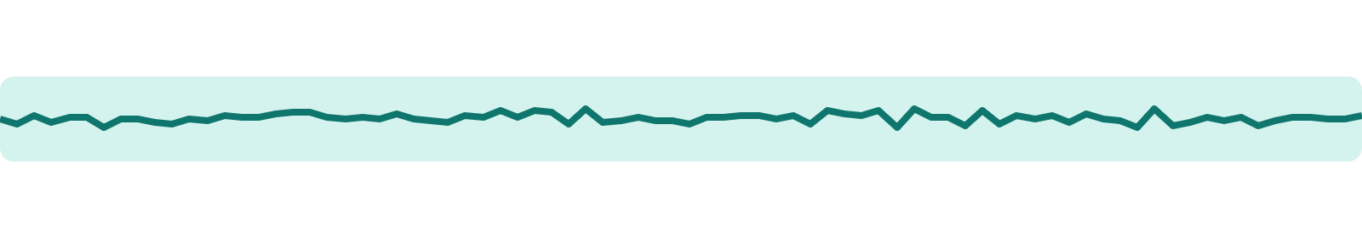
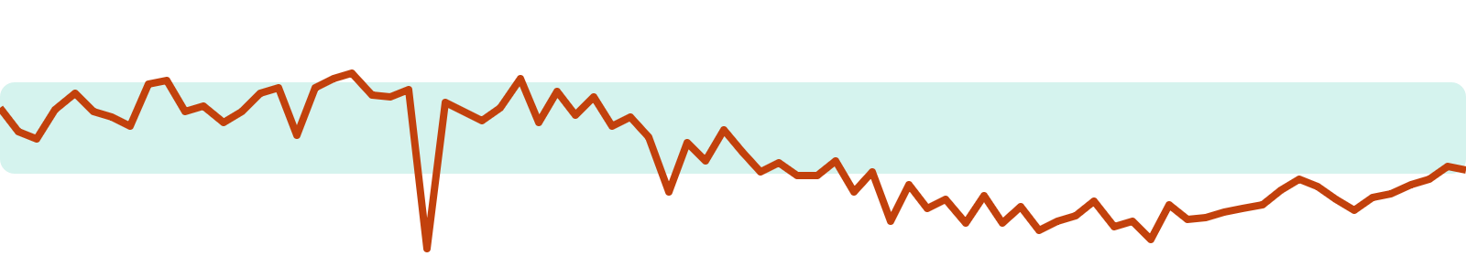
Users need a stable charge
WHY
The dose and the detector signal scale with the beam charge.
THE CAUSES ARE EVERYWHERE
WHAT USERS NEED: A STEADY CHARGE
Laser · power and cathode spot
RF · amplitudes and phases
WHAT THE MACHINE GIVES: DRIFT, JITTER, DROPOUTS
Ambient · temperature, humidity
No single knob fixes it.
Forecasting the CLEAR beam charge
02
Notes:
Many CLEAR users need the charge to stay stable, because what they measure scales with it. Medical irradiation alone is 43 % of CLEAR's experiments. Top: what users would like, a charge that stays inside its tolerance. Bottom: what the machine actually gives, drift over time, shot-to-shot jitter and sudden dropouts. The causes are spread across the machine, the laser, the RF, even the hall temperature, and there is no single knob to turn.

Slide 3
BACKGROUND
Time series and forecasting
y
Time series
the forecast
A sequence of points in time order. Here: one point per shot.
the past
Forecasting
Using the past to predict what comes next, with an uncertainty that grows with the horizon.
In an accelerator
x1 … xn, the machine variables, are left drifting. y can be any beam parameter: here, the charge.
t*
t
Forecasting the CLEAR beam charge
03
Notes:
A few words on the idea. A time series is a sequence of points in time order; for us, one point per shot. Forecasting means using the past to predict what comes next, and the uncertainty grows the further ahead we look. In the accelerator, the machine variables x1 to xn are left drifting, and y can be any beam parameter. In this challenge, y is the charge at the gun.

Slide 4
BACKGROUND
Virtual diagnostic or forecast?
A · VIRTUAL DIAGNOSTIC · MEDIUM TIER
B · FORECASTING · HARD TIER
Predict y at t* knowing x1…n up to t*
Predict y at t* knowing x1…n up to t* − 1
x1…n
x1…n
y
y
t
t
t*
t*
given to the model
to predict
given to the model
to predict
Forecasting the CLEAR beam charge
04
Notes:
Two related questions. A, the virtual diagnostic: predict y at time t-star knowing all the machine variables up to and including t-star, the same shot. B, forecasting: predict y at t-star knowing the variables only up to t-star minus one, so before the shot happens. A is the Medium tier, B the Hard tier.

Slide 5
BACKGROUND
From prediction to control
1
One step
2
Many steps
3
Closing the loop
g(x)
f(X, y) reads a window of past shots and predicts the next one. The window slides along the run.
Each prediction is fed back as an input to look further ahead. Errors grow with the horizon.
A controller g(x) moves a controllable subset x ⊂ X, like laser power or RF phase, to keep the forecast on target.
IN THIS CHALLENGE
Steps 1 and 2. Step 3 is the long-term goal, and the link back to optimisation.
Forecasting the CLEAR beam charge
05
Notes:
The full pipeline in three steps. One: a model f of X and y reads a window of past shots and predicts the next one; the window slides along the run. Two: the predictions are fed back to look several shots ahead, and the errors grow with the horizon. Three: close the loop, with a controller g acting on a controllable subset of the inputs, like laser power or RF phase, to keep the forecast charge on target. This challenge covers steps one and two; step three is the long-term goal.

Slide 6
THE FACILITY
CLEAR, a user facility since 2017
EXPERIMENTS PER YEAR
WHAT THE EXPERIMENTS ARE
Medical
43 %
38
38
39
Machine development
17 %
36
37
34
35
32
Instrumentation
16 %
Machine learning
6 %
Plasma
6 %
19
Impedance
4 %
Training
4 %
Detectors
2 %
Radiation to electronics
2 %
2017
2018
2019
2020
2021
2022
2023
2024
2025
Most experiments go beyond receiving a beam: users and the team test ideas together.
Forecasting the CLEAR beam charge
06
Notes:
CLEAR has run as a user facility since 2017, with 32 to 39 experiments a year since 2018. Medical applications are the largest share, 43 percent, followed by machine development and instrumentation. In most cases CLEAR goes beyond simply delivering a beam to the user specification: experiments are prepared and run together with the team, and ideas go quickly from paper to beam.

Slide 7
THE FACILITY
A flexible beam
THE TIME STRUCTURE
BEAM PARAMETERS
pulse length 0.1 ps–100 ns
1–150 bunches
Energy
20–220 MeV
pulse charge 10 pC–87 nC
every 0.1–1.2 s
0.833–10 Hz
Bunch charge
0.01–1.5 nC
Normalised emittance
3–20 µm
Bunch length
100–1200 µm
Energy spread
< 0.2 % rms
Repetition rate
0.833–10 Hz
Bunch spacing 333 or 666 ps
Bunch length 0.1–10 ps
Bunch charge 10 pC–1.5 nC
Bunches per train
1–150
Bunch spacing
1.5 or 3.0 GHz
Forecasting the CLEAR beam charge
07
Notes:
The beam is very flexible. Energy from 20 to 220 MeV, bunch charge from 10 pC to 1.5 nC, and trains of 1 to 150 bunches spaced at 1.5 or 3 GHz, repeated at 0.833 to 10 Hz. The normalised emittance goes from about 3 micrometres at 0.05 nC per bunch to 20 at 0.4 nC. This flexibility is exactly why the runs in this challenge look so different from each other: single bunch, multi-bunch, laser scans.

Slide 8

CLEAR at a glance
THE MACHINE
Laser
RF gun
Accelerating structures
Experimental areas
Hits the photocathode. The camera BTV0125 sees its spot.
Accelerates the electrons. BCM_GUN reads the charge.
Medical, plasma lens, in-air, VESPER.
Fed by 2 klystrons: MKS11, MKS15.
Coloured boxes: where this challenge looks. The charge is made here.
20–220
0.01–1.5
0.833–10
1–150
beam energy, MeV
bunch charge, nC
repetition rate, Hz
bunches per train
Forecasting the CLEAR beam charge
08
Notes:
CLEAR is a roughly 40 m electron linac at CERN, run as a user facility since 2017. A laser hits the photocathode in the RF gun, which produces and accelerates the electrons. The accelerating structures, fed by two klystrons, MKS11 and MKS15, then take the beam to the experimental areas. This challenge looks at the start of the machine, where the charge is made.

Slide 9
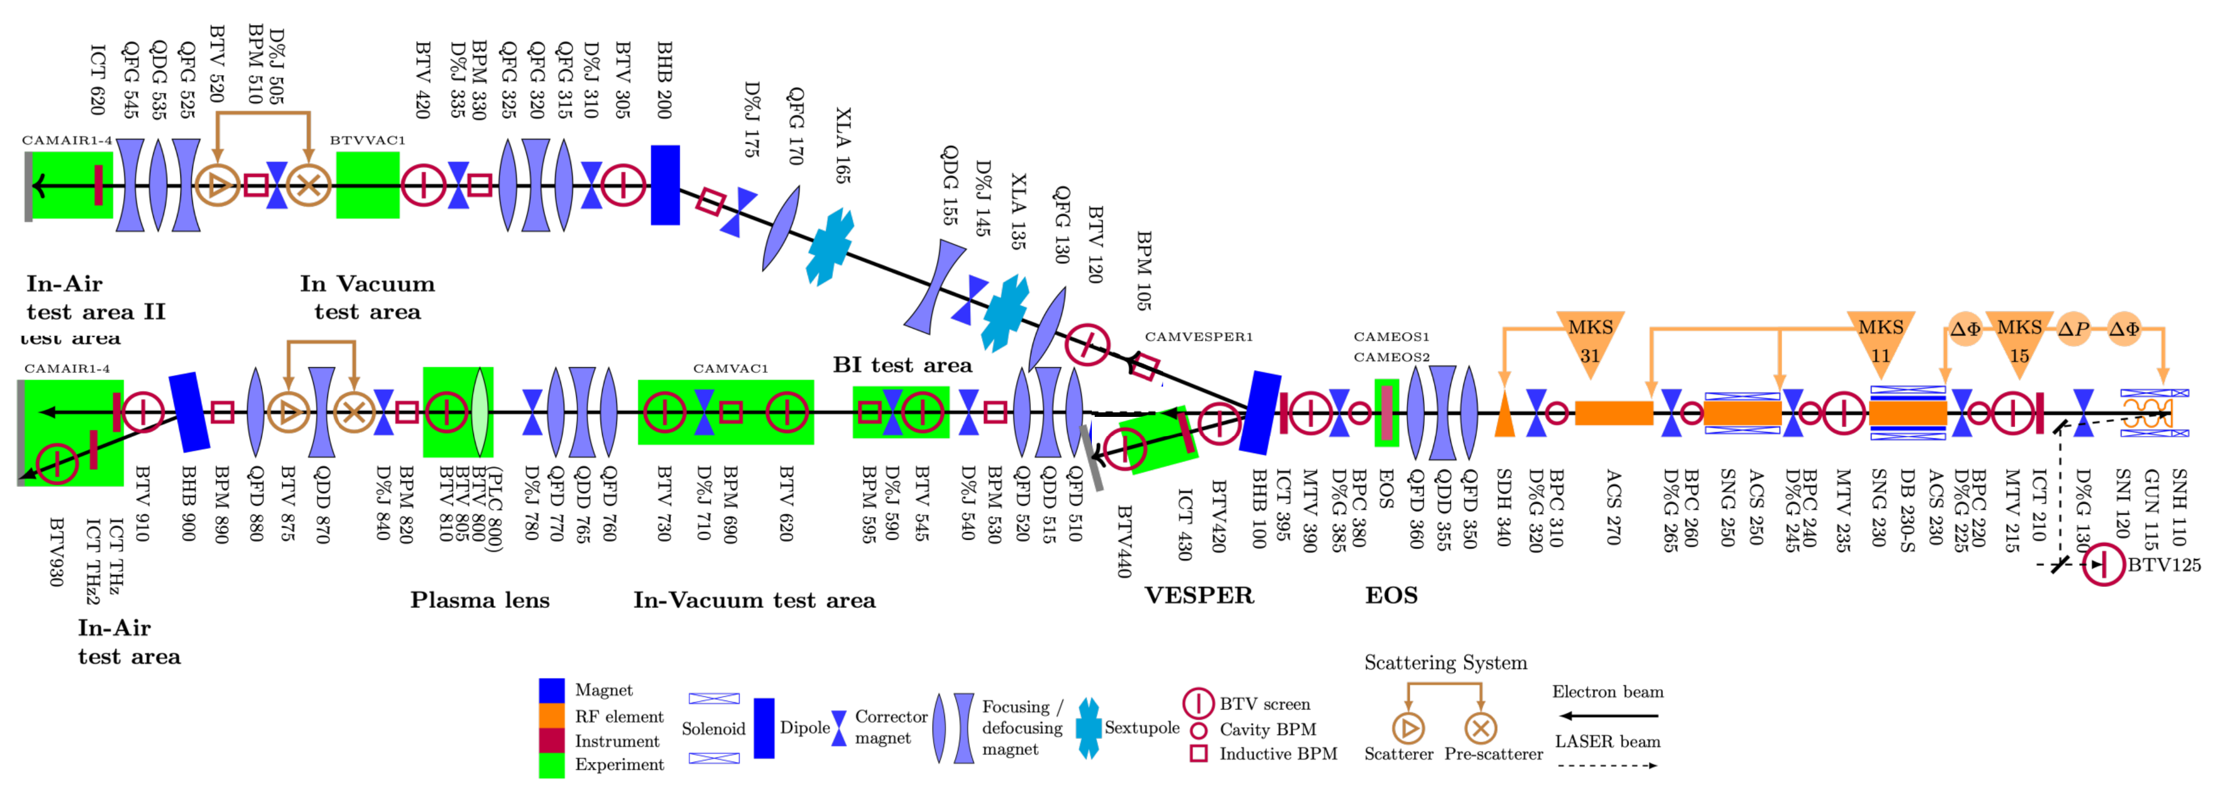
THE FACILITY
The CLEAR beamline
this challenge
About 40 m in all: the injector and linac on the right, the experimental areas on the left. The beam travels from right to left.
Forecasting the CLEAR beam charge
09
Notes:
The whole machine, about 40 metres. On the right, the photoinjector where the charge is made, with the laser, the gun and the charge monitor; then the accelerating structures fed by the klystrons. On the left, the experimental areas: VESPER, EOS, the plasma lens, the in-vacuum test areas and the in-air test areas. The beam travels from right to left. This challenge looks only at the injector, circled.

Slide 10
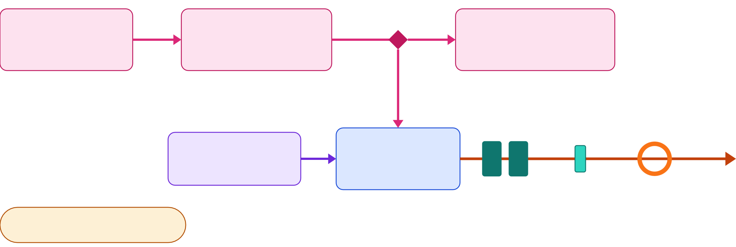
Where the charge is made
THE INJECTOR
Laser lab
Transport line
Virtual cathode
lab_laser_power
clex_laser_power
laser_scope
BTV0125 camera
to the linac
Gun RF
RF gun
PGIA PGRA PGLA PGIP
with the photocathode
Solenoids
Corrector
Charge
SNH_110 SNI_120
DHG0130
BCM_GUN
Hall: TEMP1–4, HUMID1–4
Forecasting the CLEAR beam charge
10
Notes:
A closer look at where the charge is made, and where each recorded signal sits. The laser energy is measured twice, in the laser lab and in the accelerator, and a fast photodiode sees each pulse. A mirror sends part of the laser to the virtual-cathode camera, BTV0125, which shows the spot as the cathode sees it. The rest hits the photocathode inside the RF gun, powered by the gun RF. The electrons then pass two solenoids and a corrector, and BCM_GUN measures their charge. The hall temperature and humidity are recorded too. The drawing is schematic, not to scale.

Slide 11
Three steps, one question
THE CHALLENGE
STEP 1 · EASY
STEP 2 · MEDIUM
STEP 3 · HARD
Understand
Virtual diagnostic
Forecast
raw run → clean table
Q[t] = f(X[t])
Q[t+1…t+H] = f(X[≤t], Q[≤t])
Clean, synchronise, rank every signal.
This shot's charge from this shot's signals.
The next shots' charge, from the past.
Close the loop with a controller g(x) on laser power or RF phase. Extremely promising results can earn real beam time on CLEAR.
THEN, OPTIONAL
Forecasting the CLEAR beam charge
11
Notes:
The parent challenge asks how to find the best settings. This one adds time: how will the beam behave next? Three steps, which are also the three tiers. First understand the data. Then a virtual diagnostic: the charge of a shot from the other signals of the same shot. Then forecasting: the charge of the next shot, or several shots ahead, from the past only. The long-term goal is to put the forecast inside a controller, which brings us back to optimisation. And if a team gets extremely promising results, we can ask for real beam time to test it on CLEAR.

Slide 12
Studied, but still under development
A first study showed the approach works. It is not finished: forecasting is still being developed.
Task | Best MAE, pC | Note
Virtual diagnostic | 3.37 – 6.56 | R² 0.56 – 0.84
One-step forecast | 4.12 – 7.47 | best: TFT, XGBoost, DeepAR
Rolling mean, no model | 4.28 – 7.73 | the naive baseline
Forecasts lean on the charge's own past. Laser and RF help, but much less.
For this challenge, custom datasets were acquired, and they are shared with you.
Forecasting the CLEAR beam charge
12
Notes:
This topic is not new for us: we presented a first study at MaLAPA in April 2026. The virtual diagnostic worked well. Forecasting was much harder: the best models, TFT, XGBoost and DeepAR, only just beat a plain rolling mean, and the forecasts leaned mostly on the charge's own past. So this is still under development, and that is exactly where you come in. For this challenge we acquired new, custom datasets, and they are shared with you.

Slide 13
LESSONS LEARNED · 2025 STUDY
A forecast is harder than a diagnostic
BEST MAE ON THE 2025 DATASETS, PC
virtual diagnostic
forecast (one step)
A virtual diagnostic tracks
It follows the charge shot by shot, from the same shot's laser and RF signals.
2025-04-01
3.86
7.16
3.37
A forecast drifts
2025-04-02
4.12
Soon after t* it drifts away. It leans on the charge's own past; the machine variables add less.
2025-08-02
6.56
7.47
The rolling mean is hard to beat
5.09
The best models (TFT, XGBoost, DeepAR) beat it by only 0.1 to 0.3 pC.
2025-08-03
6.36
Forecasting the CLEAR beam charge
13
Notes:
The first lesson from the 2025 study, on the downstream charge. On all four datasets the best virtual diagnostic is clearly better than the best one-step forecast. A virtual diagnostic follows the charge shot by shot; a forecast drifts away soon after the forecast origin. In the forecast, the most important features are the charge's own lags, and the machine variables add less. And a plain rolling mean is a very strong baseline. These are 2025 numbers, on other data: they are context, not a target.

Slide 14
LESSONS LEARNED
Choose the metric
MAE
RMSE
mean( |y − ŷ| )
√ mean( (y − ŷ)² )
The average error, in nC. Simple, and not dominated by a few large misses.
Punishes large errors more, such as missed jumps and dropouts.
MAPE
sMAPE
mean( |y − ŷ| / |y| )
mean( |y − ŷ| / ((|y| + |ŷ|) / 2) )
Relative error, in %. Blows up when the charge is close to zero.
A symmetric, bounded relative error. Compares runs with different charge.
Pick the metric that matches what operators care about, and explain it physically.
Forecasting the CLEAR beam charge
14
Notes:
Second lesson: the metric matters. MAE is the average error in nanocoulombs, simple and robust. RMSE punishes large errors more, such as missed jumps and dropouts. MAPE is a relative error but blows up when the charge is close to zero. sMAPE is a symmetric, bounded version that lets you compare runs with very different charge. We use MAE as the common reference, but pick the metric that matches what operators care about, and explain it physically.

Slide 15
LESSONS LEARNED
Beware of hidden leakage
Time series
The trap
FFT
The FFT does not leak data by itself, but it spreads information from the whole run across all frequencies. So each band's time series implicitly uses future shots.
Signal in frequency
split in bands
Band 1
Band 2
Band 3
inverse FFT
Do instead
Time series y1, y2, y3
Causal filters, rolling windows: anything computed from past shots only. Check every transformation for leakage.
model each band
f(X, yn)
Forecasting the CLEAR beam charge
15
Notes:
Third lesson, the hard way. An idea was to split the charge into frequency bands with an FFT, forecast each band, and recombine. It looked great, but it was leaking: the FFT does not leak data by itself, but it spreads information from the whole run across all frequencies, so each band time series implicitly uses future shots. Use causal filters and rolling windows instead, anything computed from past shots only, and check every transformation for leakage.

Slide 16
Beat the rolling mean.
A GOOD FIRST EXERCISE
Predict each shot as the mean of the last 9 good shots. It is surprisingly hard to beat.
Forecasting the CLEAR beam charge
16
Notes:
A good first exercise for the Hard tier: beat the rolling mean. Predicting each shot as the average of the last nine good shots is a very strong baseline for this signal. On the earlier data the best models only just beat it. But this is new data, taken under different conditions, so don't draw conclusions from those numbers: find out for yourselves.

Slide 17




Many runs, many machine conditions
THE DATA · OCTOBER 2026
The runs were taken on purpose under different conditions. None is labelled: recognising each one is part of the challenge.
Stable operation
Saturation
A steady machine: the cleanest case.
Wrong conditions: little or no correlation to find.
Single and multi-bunch
Laser scans
One bunch per shot, or a whole train.
Laser position and/or intensity varied during the run.
Not every run will be useful for training. Every run will test your processing.
Forecasting the CLEAR beam charge
17
Notes:
The data was acquired on CLEAR in October 2026, specifically for this challenge. The runs are deliberately diverse and represent real operating conditions: stable operation, runs in wrong conditions such as saturation where you should not expect much correlation, single and multi-bunch beams, and runs where the laser position or intensity was varied. Nothing is labelled. Some runs may not be useful for training a model at all, but every one of them is a good test of your processing.

Slide 18
23 parameters in six families
WHAT IS RECORDED
Charge · target
Laser
Gun RF
BCM_GUN
lab_laser_power clex_laser_power laser_scope BTV0125
PGIA PGRA PGLA PGIP
beam charge at the gun, nC
incident and reflected power, gun loop, phase; 960-sample waveforms
energy in the lab and in the linac (J), a fast photodiode, the virtual-cathode camera
Klystron 15
Magnets
Ambient
PKI15A PKR15A PKI15P
SNH_110 SNI_120 DHG0130
TEMP1–4 HUMID1–4
incident and reflected power, phase; 960-sample waveforms
solenoid and corrector currents, A; slow
hall temperature and humidity; slow
Not every signal carries information. Finding out which ones do is part of the challenge.
Forecasting the CLEAR beam charge
18
Notes:
Every shot records 23 parameters: the target charge BCM_GUN, the laser seen four ways, the gun RF, klystron 15, three magnets and the hall conditions. The RF signals are in arbitrary units, so compare them within a run, not across runs. And an important point: we do not promise that every signal is useful. Some may be redundant, some may be noise. Saying "this signal tells us nothing", with evidence, is a valid result.

Slide 19




Real machine data
WHY IT IS HARD
Every reading has its own clock
Slow devices
A device that has not updated yet hands over the previous shot. Put each reading back on its shot.
Temperature, humidity and magnet currents update less than once per shot.
Bad shots
Features to build
Charge dropouts, bad camera exposures, a saturated scope. Flag them, don't delete them.
Waveforms and camera images must become numbers: peaks, integrals, windows, spot position.
Forecasting the CLEAR beam charge
19
Notes:
This is not a clean benchmark. Each value comes with its own acquisition stamp, and a device may still be showing the previous shot, so synchronisation is real work. Some devices update far less often than once per shot. There are charge dropouts and bad camera frames: flag them, because forecasting needs them later. And the RF waveforms and camera images have to be turned into features first: which part of a waveform, which property of the laser spot, actually matters?

Slide 20
Understand and clean the data
TIER 1 · EASY
Clean the raw run, and grasp understand of all of them in which conditions were acquired and what they mean
THE GOAL
Synchronize the data checking different at lags for different variables
A reason for every variable kept or dropped
A ranking that holds across runs, or is explained where it changes
Prepare dataset for the future test
Work out each run's regime from the data
Flag dropouts and bad shots; don't delete them
Put every reading back on its own shot
Go beyond a waveform's peak and integral
Rank every signal four ways: Pearson, Spearman, distance correlation, mutual information
Forecasting the CLEAR beam charge
20
Notes:
Easy is about understanding. Clean a run, put every reading back on the shot it belongs to, and find out which variables really carry information about the charge. A good check for synchronisation: after alignment, a laser signal's dark shots should line up with the charge dropouts at lag zero. The kickoff notebook, sections 2 and 3, does a first pass, including a noise floor that tells real correlations from chance.

Slide 21
Virtual diagnostic
TIER 2 · MEDIUM
Examinate the performance of various model and try with and without BCM_GUN in the loop
THE GOAL
Obtain good performance in the virtual diagnostic fashion.
Identify the right metric and try some basic model (ElasticNet, Random Forest, XGBoost and MLP).
Compare a linear model, a tree ensemble and a neural network
Show what drives each model
Cross-run: train on one run, test on another
Report how much the metrics change with different past history
Forecasting the CLEAR beam charge
21
Notes:
Medium is the virtual diagnostic: infer the charge of a shot from the other signals of that same shot, without using any charge. Compare at least a linear model, a tree ensemble and a neural network, and show what drives each one: does it agree with your correlation study? Then the interesting part: train on one run and test on another, across days or across regimes. How much does it degrade, and which features stop transferring?

Slide 22
Forecasting
TIER 3 · HARD
Repeat what done for virtual diagnostic in a more complex scenario
THE GOAL
Identify the right metric and try some basic model
Beat the rolling mean
Deploy in the machine the model
One step ahead, then up to 50 shots
At least one sequence model: TFT, DeepAR, LSTM/GRU or a time-series foundation model
Tune the context window and show its effect
Forecasting the CLEAR beam charge
22
Notes:
Hard is forecasting: predict the charge of future shots from everything known up to now. First beat the rolling mean, which is not trivial. Then beat the notebook's XGBoost on lag features. Go multi-step and find the horizon where your model stops beating the rolling mean. Use at least one model built for sequences. And tell us where the forecast comes from: the charge's own history, or the machine.

Slide 23






Same rules for every team
SCORING
Chronological split
Metric in nC
Dropouts not scored
Test on the last 10 % of each run. No shuffling; fit everything on the first 90 %.
Try different and understand their physical meaning.
Charge below 30 % of the local median.
Decomposition
Forecasts
Ranking
Careful in the approach to be sure to be leakless
Complex problem try feature engineering
Try different model and rank them by performance
Forecasting the CLEAR beam charge
23
Notes:
The rules are fixed in score.py, so every team is scored the same way. The split is chronological: the last 10 % of each run is the test region, and nothing is shuffled. The score is MAE in nanocoulombs. Charge dropouts are not scored, but shots with a device flag are, because their charge is real. Report every scored run, not your best one. For forecasting, also report the gain over the rolling mean. Ranking is the highest tier with a bar beaten, ties broken by that tier's MAE.

Slide 24
Build your own pipeline
GETTING STARTED
The kickoff notebook shows one way through the three tiers. Take it as an example, not a recipe: you are free, and encouraged, to develop your own analysis.
Shown in the kickoff notebook
Up to you
Reducing a run to one row per shot
Quality checks, dropouts, synchronisation
A first correlation study
Baseline models for some tier
Your own cleaning and synchronisation
Your own features from waveforms and images
Any model you can justify
Extras: frequency bands, uncertainty, closing the loop
Forecasting the CLEAR beam charge
24
Notes:
The kickoff notebook will show you one way through: reducing the raw data to one row per shot, the quality checks and synchronisation, a first correlation study, and baseline models for each tier. Use it as an example, not as a recipe. We strongly encourage you to build your own analysis pipeline: your own cleaning, your own features, any model you can justify. The only thing fixed for everyone is the scoring, so results stay comparable. Everything is in the forecasting folder of the optimisation challenge.

Slide 25
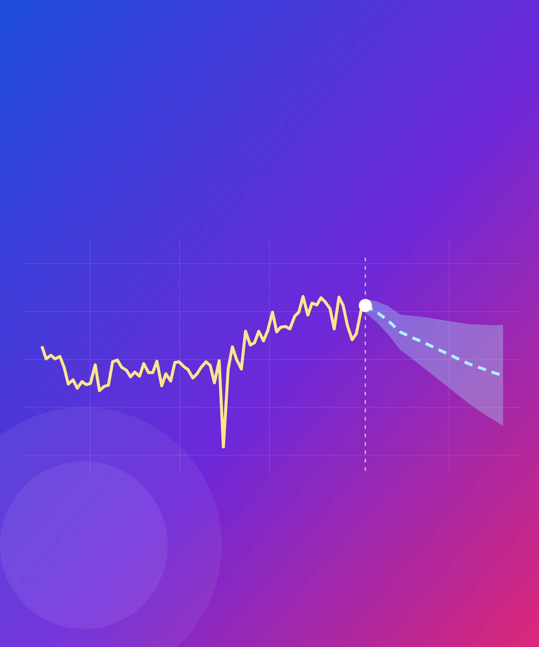
Let's predict the next shot
THANK YOU
Questions now, or any time this week.
Antonio Gilardi
antonio.gilardi@cern.ch
Notes:
That is the challenge: understand the data, infer the charge, then try to predict the next shot. Questions now, or any time during the week: find me at the Tuesday hands-on session or the Wednesday check-in.

