Slide 1
Challenge: Anomaly Detection on
ESS Time-series
AISSAI hackathon, 11-16 october, France
Ishkhan Gorgisyan et Al., ESS

Slide 2
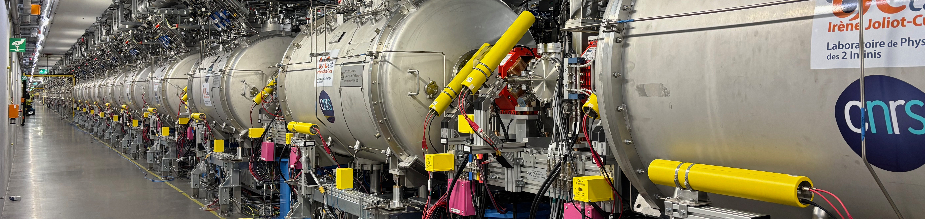
Agenda
Overview
Scientific case
Challenge objectives
Data structure
Summary

Slide 3
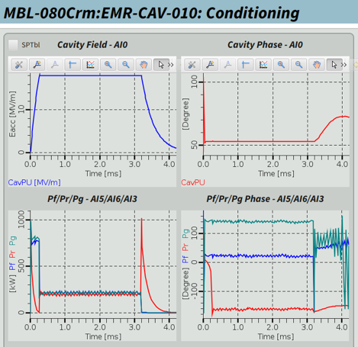
Challenge Overview
Anomaly detection on ESS data
  Raw waveforms from ESS superconducting RF
  Supplemented by scalars from entire machine
  Data from stability runs during 2025 and 2026 commissioning periods
  Nominal operation and trips
Challenge
  Binary classification: nominal vs anomaly
  Fault characterization and classification
  Precursor identification and fault prediction

Slide 4
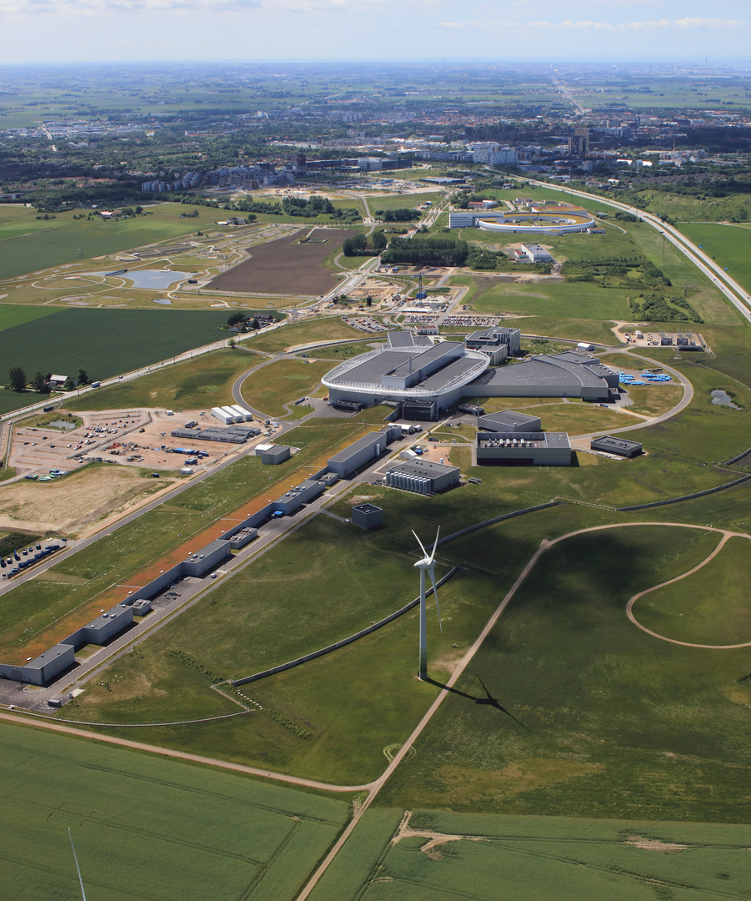
2
Scientific case

Slide 5
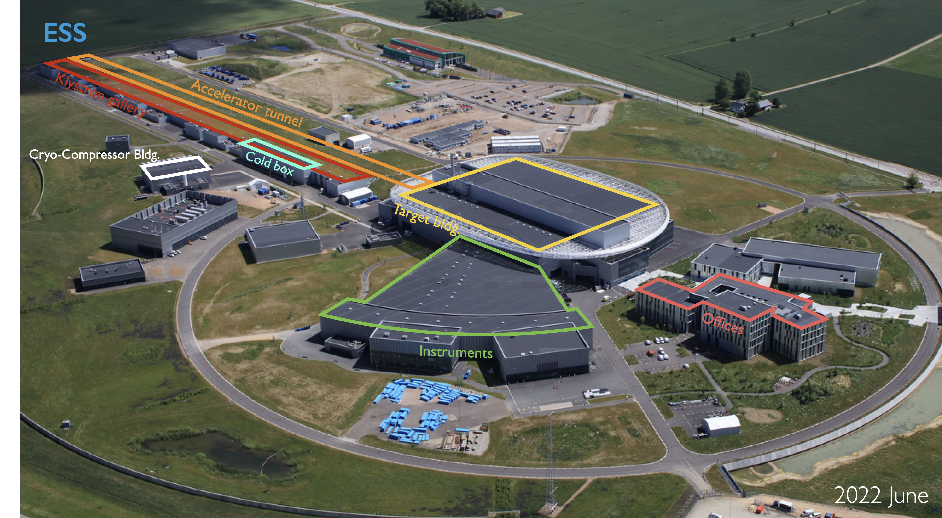
Scientific case
Background: European Spallation Source
Parameter | Value
Beam power (nominal) Beam power (initial) | 5 MW 2 MW
Beam energy (nominal) Beam energy (initial) | 2 GeV 0.8 GeV
Peak beam current | 62.5 mA
Beam pulse length | 2.86 ms
Pulse repetition rate | 14 Hz
Duty cycle | 4%
RF frequency | 352.21 MHz 704.42 MHz
In-kind collaboration of 13 members states

Slide 6
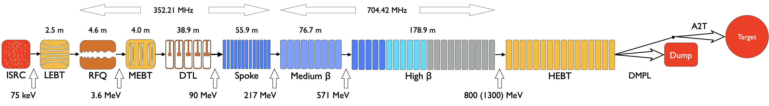
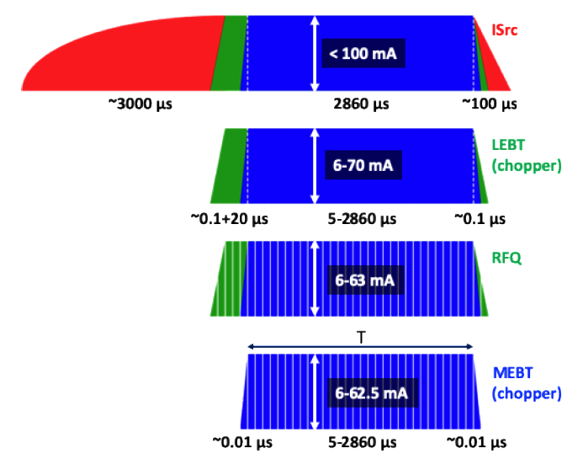
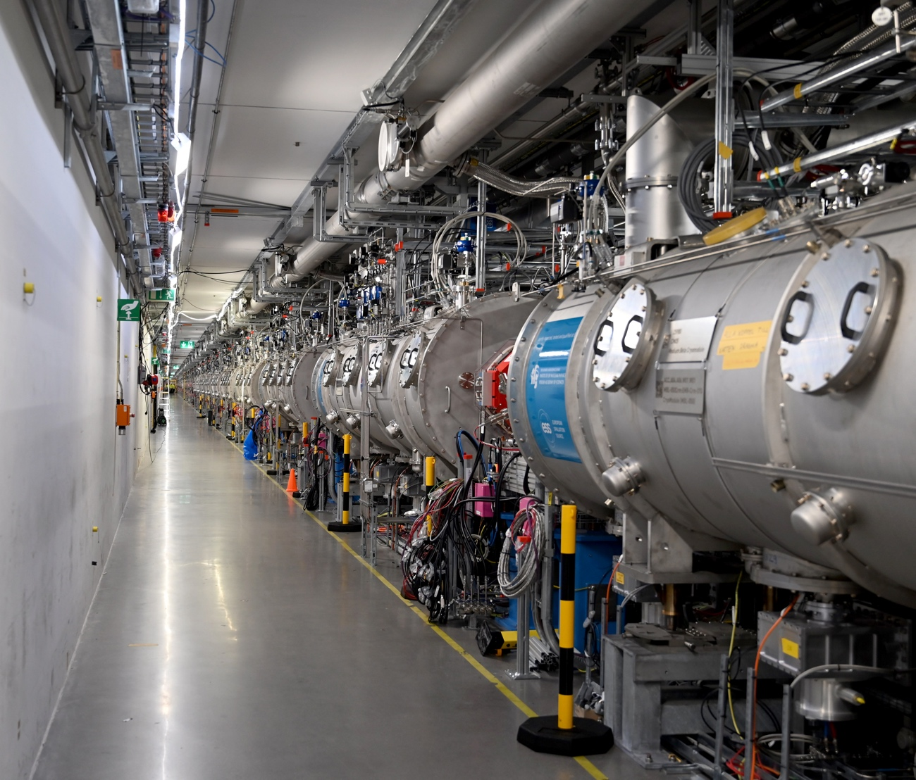


Scientific case
Background: European Spallation Source
26 Double Spokes
56 Ellipticals

Slide 7
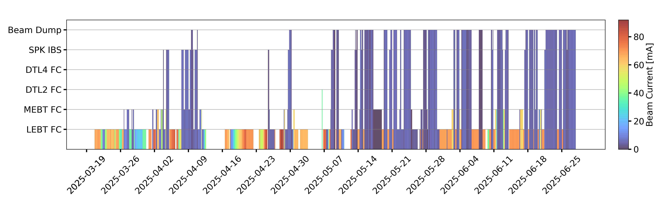
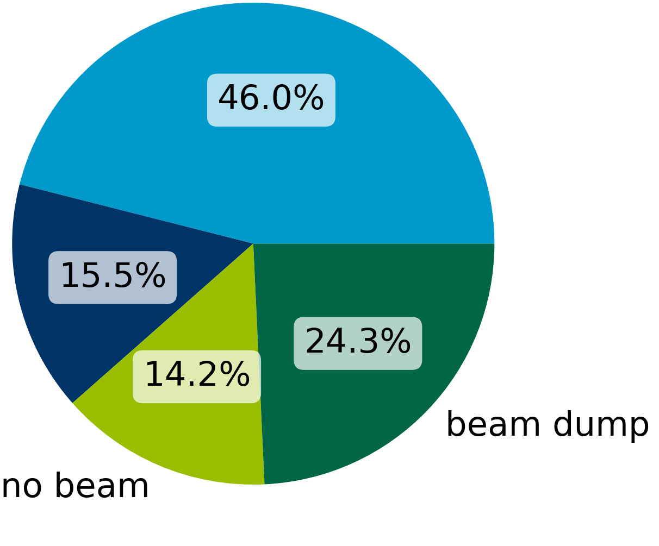
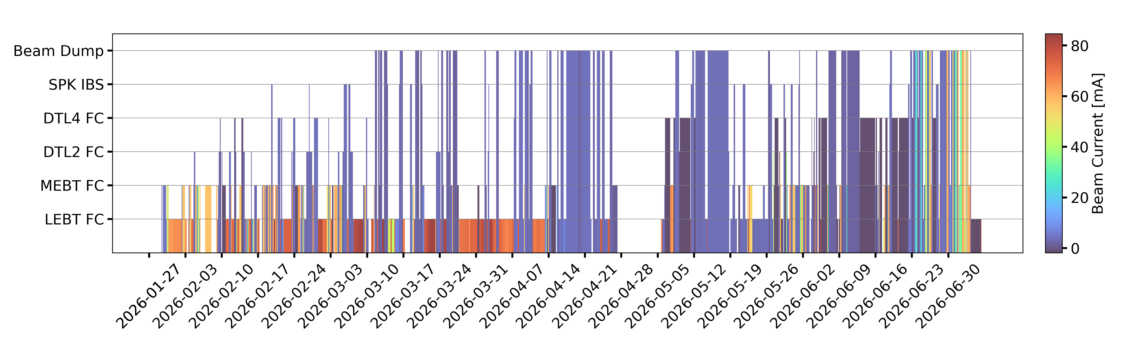
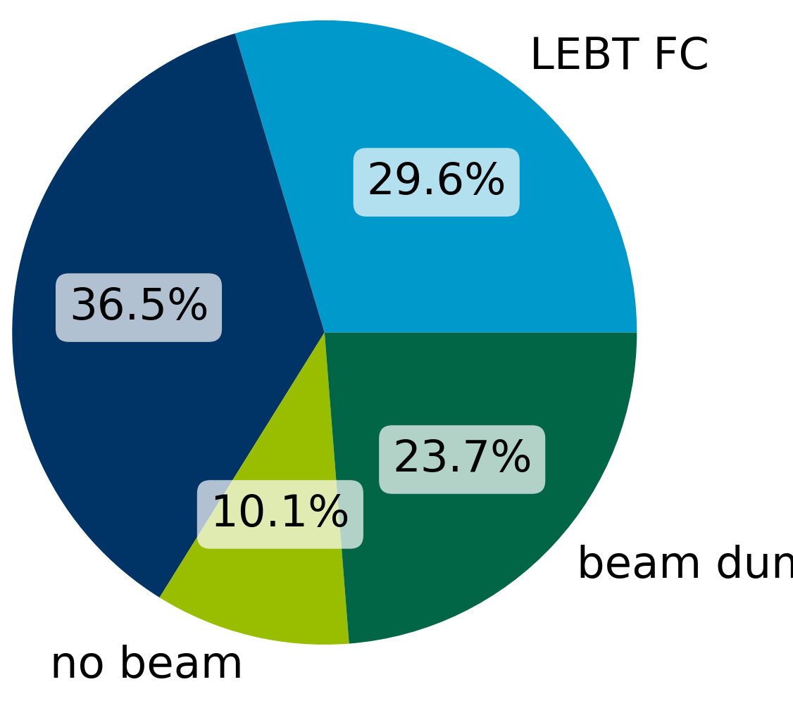
Scientific case
Background: European Spallation Source
LEBT FC
2025 (March to June)
Transport beam to dump
Accelerate to 800 MeV
Probe beam 6 mA, 5 μs
RF at 1 ms
Beam stops
Beam dump
No beam
2026 (Jan to July)
Commission sub-systems
Increase beam power
Current (> 5μs, >6 mA)
RF at > 1 ms
LEBT FC
Beam stop
Beam dump
No beam
By S. Johannesson

Slide 8
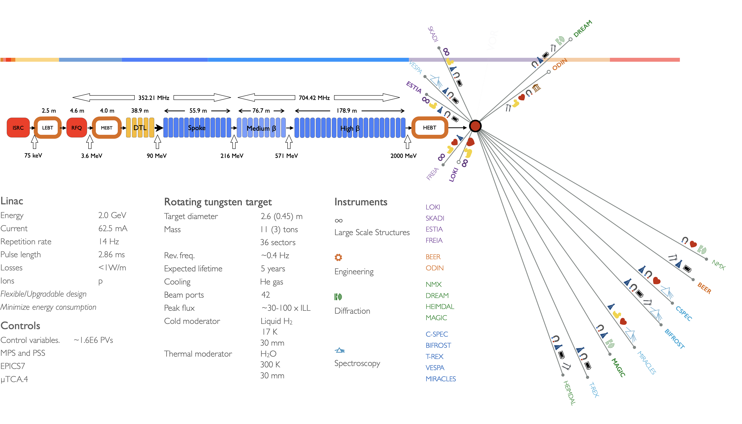
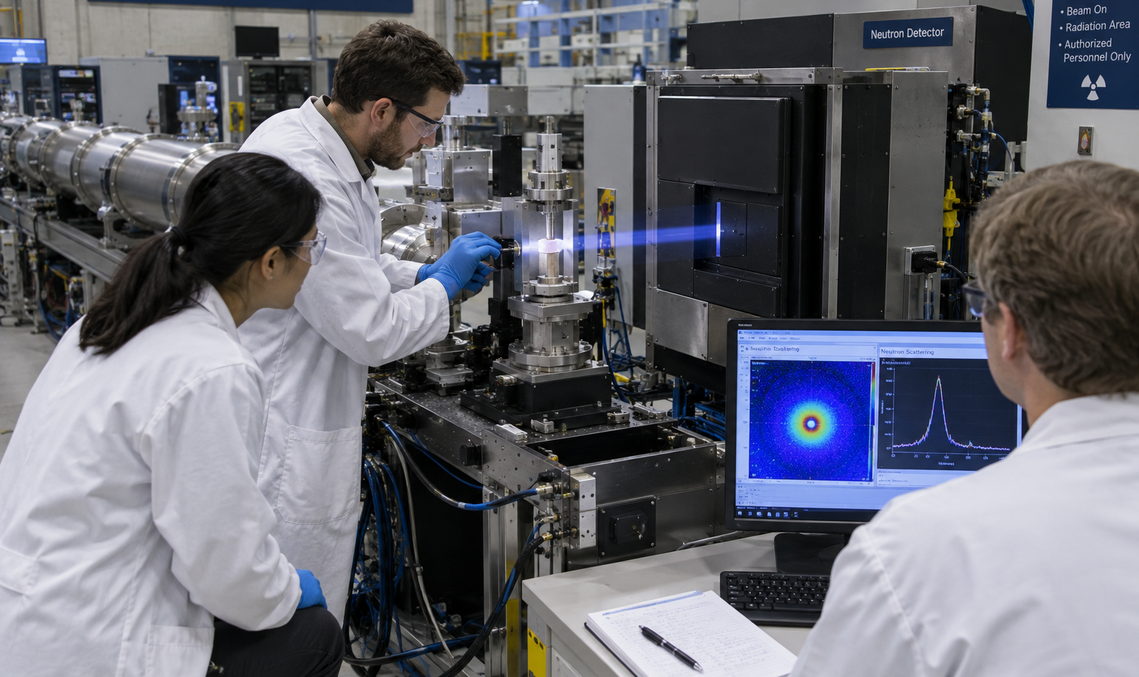

Scientific case
Motivation: ESS high level goals
ESS is a user facility: uninterrupted beam to users
Linac performance demand: 95% uptime
Multi-megawatt proton machine
Strict requirements on beam loss
Anomaly detection in the accelerator
Help to maximize the accelerator availability
Help to minimize activation of components

Slide 9
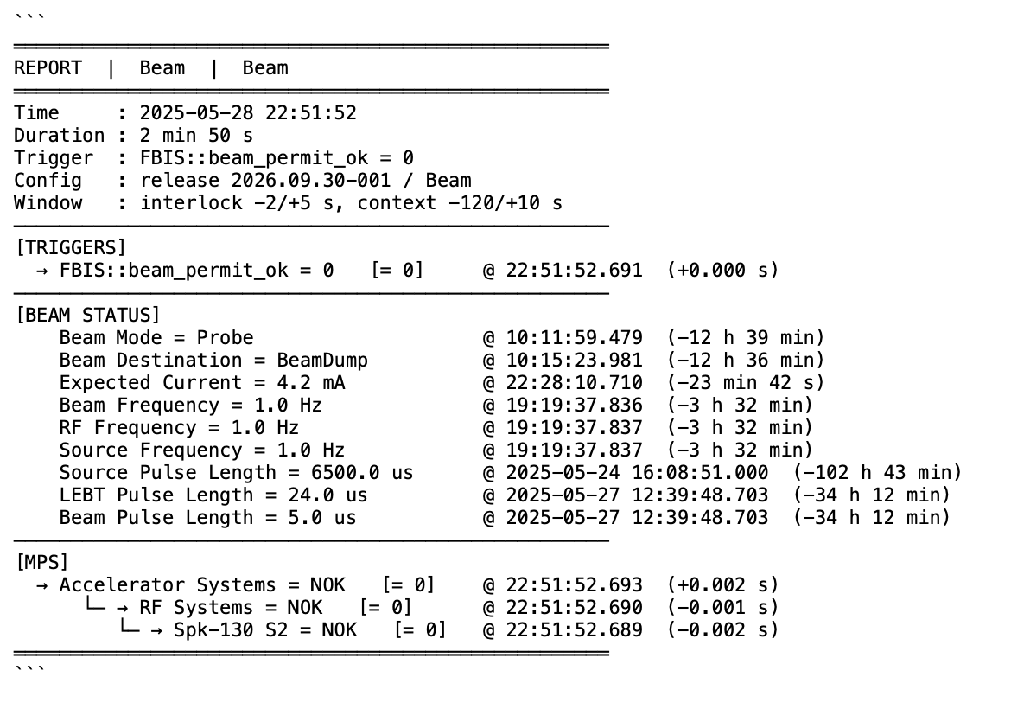
Scientific case
Current state/prior work
  No model developed for accelerator anomaly detection
    Model for anomaly detection in klystrons
  Synchronous Data Service (SDS) is implemented since 2025
  Post-mortem tool is implemented
  Fault reporting tool from operations
  Efforts to standardize/automate operational data retrieval
Yang, Zhe, et al. "Anomaly detection of particle accelerators using spatial-temporal contrastive fusion of multi-sensor time series." Reliability Engineering & System Safety (2025). https://doi.org/10.1016/j.ress.2025.111940
Boukela, Lynda, et al. "Exploring NAS for anomaly detection in superconducting cavities of particle accelerators." Frontiers in Physics 13 (2025). https://doi.org/10.3389/fphy.2025.1553993
Rajput, Kishansingh, et al. "Robust errant beam prognostics with conditional modeling for particle accelerators." Machine Learning: Science and Technology 5.1 (2024). https://doi.org/10.1088/2632-2153/ad2e18

Slide 10

3
Challenge objectives

Slide 11

Challenge objectives
Before starting
  Step 0: Data understanding and curation
  Noisy heterogeneous raw data
  Data cleaning and treatment
  Event identification, time alignment
  Pre-processing
  Feature extraction
  Step 1: Anomaly/fault detection
  Distinction between the nominal and abnormal behaviours
  Learning nominal envelope for different machine states
  Attention to false positive rate

Slide 12
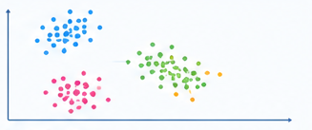
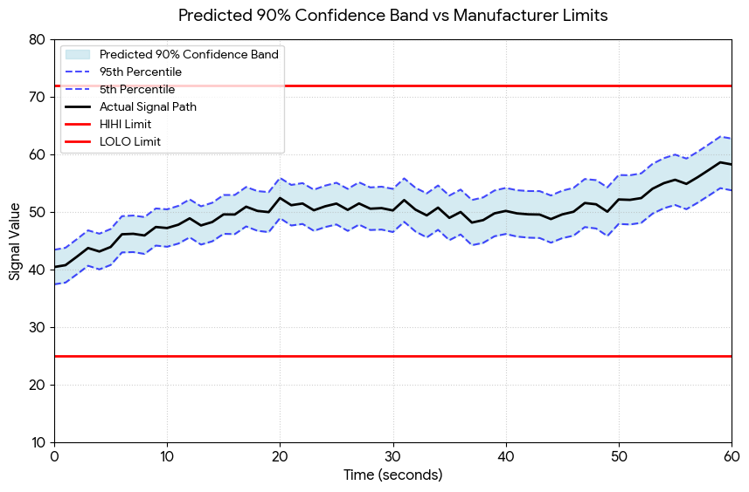
Challenge objectives
  Step 2: Fault characterisation and classification
  Clustering/grouping faults exhibiting similar behaviours
  Fault classification based on known trips
  Step 3: Fault precursor identification and prediction
  Detection of anomaly development
  Probability of fault within a time window dT
  Time-to-fault estimation
  Reliability/false-alarm rate vs warning time

Slide 13
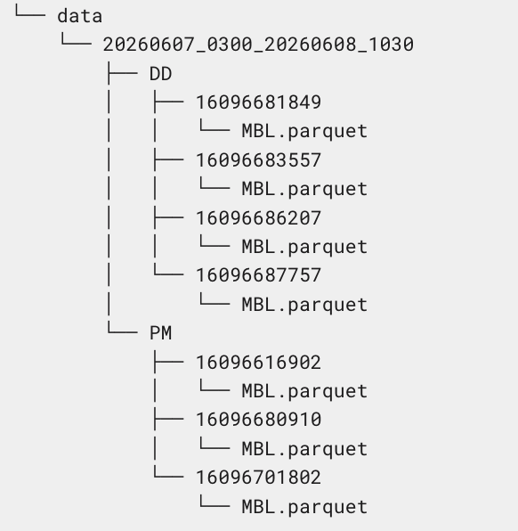
4
Data structure

Slide 14
Data structure
Stability run periods and stats
Periods | Durations | WF snapshots | WF file sizes (parquet, GB) | Scalar file sizes (parquet, GB)
2026-06-29: 22:26 - 2026-06-30: 06:26 CEST | 8h 00m | 18 | 5.6 | 0.54
2026-06-29: 14:25 - 2026-06-29: 22:25 CEST | 8h 00m | 28 | 8.5 | 0.52
2026-06-28: 21:00 - 2026-06-29: 06:26 CEST | 9h 26m | 16 | 5.3 | 0.61
2026-06-09: 22:30 - 2026-06-10: 09:30 CEST | 11h 00m | 7 | 0.15 | 0.66
2026-06-07: 03:00 - 2026-06-08: 10:30 CEST | 31h 30m | 28 | 0.01 | 1.70
2025-05-28: 20:45 - 2025-05-30: 04:16 UTC | 31h 31m | 181 | 32 | 2.50
Total | 99h 27m | 278 | 52 | 6.52
  Total 845 waveform PV names
  Total ~ 3500 scalar PV names
  About 1B lines of scalar data

Slide 15
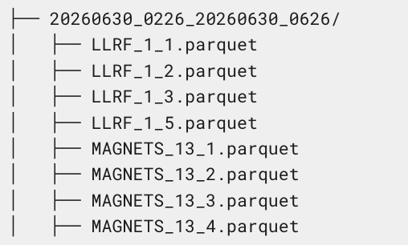
Data structure
Data hierarchy and event types
SDS data: waveforms
  Data is split in stability run periods
  PM (post-mortem) vs DD (data on demand)
  RF data: SPOKES/MBL/HBL
  Diagnostics data: BCM/BPM
Archiver data: scalars
  Split in different time periods
  Files from different parts of the machine
  Different archiving periods

Slide 16
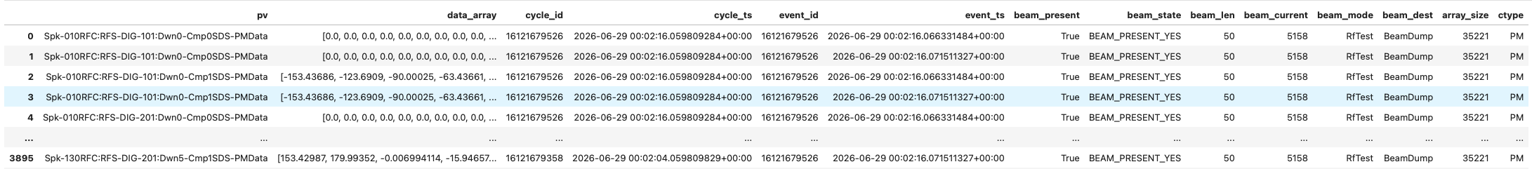
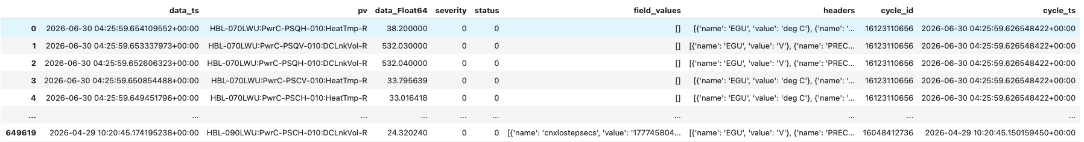
Data structure
File content
SDS data: waveforms
  Data saved in parquet files
  Relevant columns: pv, data_array, cycle_id, cycle_ts, event_id, event_ts, beam_present, beam_state
  RF waveforms for SPOKES, MBL, HBL: field amplitude and phase, forward and reflected power amplitude and phase
  BCMs waveforms, BPM X, Y positions, amplitude and phase waveforms
Archiver data: scalars
  Data saved in parquet files
  Entries were matched to cycle_ids based on time stamps

Slide 17
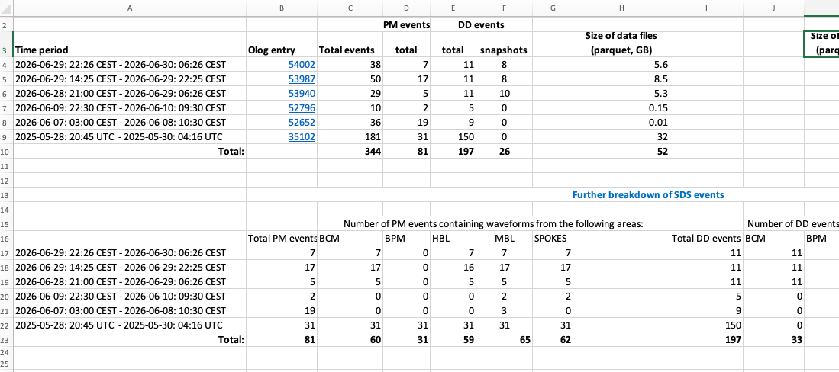
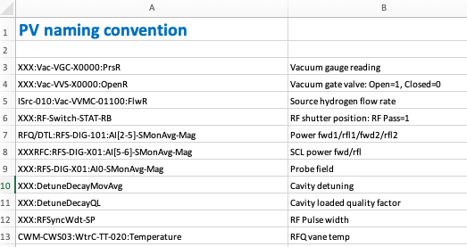
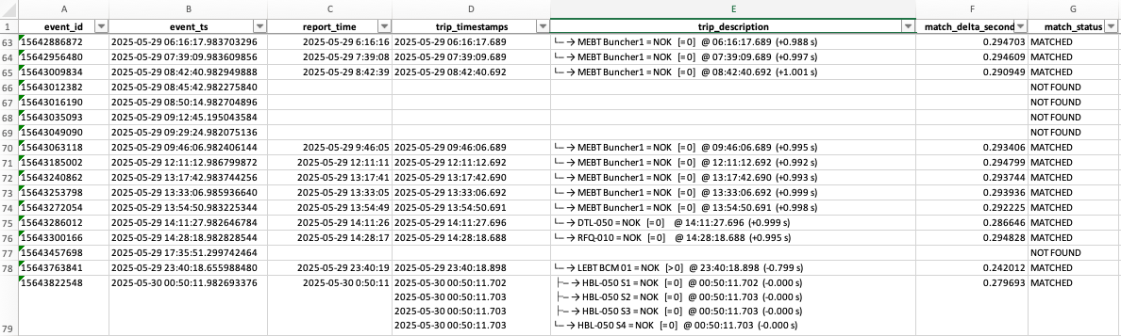
Data structure
Additional material
Datainformation.xlsx
PV_naming.xlsx
Event_reports.xlsx

Slide 18


5
Anomaly detection on ESS linac data
Data understanding and curation
Normal vs abnormal machine behaviour
Fault characterization and classification
Precursor finding and prediction
Summary
  Special thanks to:
  J. Brudvik, T. Shea, G. Kowalski, S. Brewer, Y. Serhiienko
  J. Paolo Martins, S. Pavonato, J. Korpijärvi and more
Best of luck

Slide 19
Thank you
Questions?

