Slide 1
Modeling thermal contribution produced by Cosmic Rays impact on a sub-K bolometric array at L2
G. Pascual-Cisneros, S. Della Torre, A. Besnard, F. J. Casas, M. Gervasi, T. Ghigna, B. Maffei, T. Matsumura, V. Sauvage, G. Patanchon, F. Piacentini, S. Stever, G. Signorelli, A. Tartari and M. Zannoni for the LiteBIRD collaboration.

Slide 2
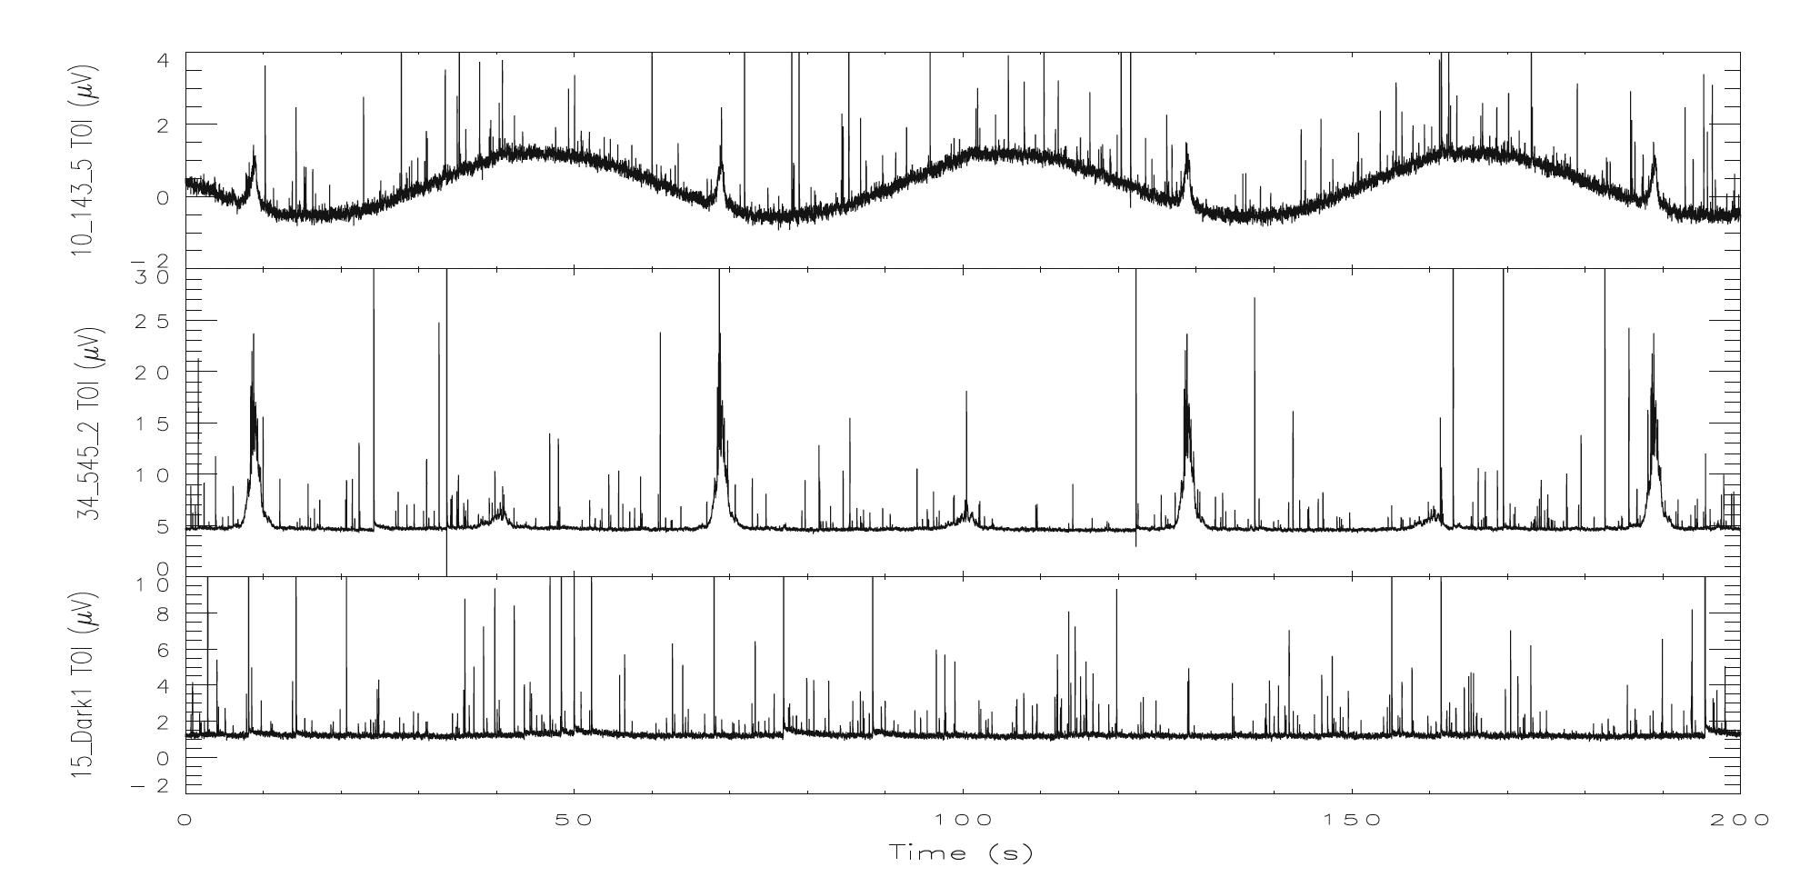
Introduction
Cosmic Rays (CR) impact on cryogenic detectors produce transient signals (“glitches”) that will downgrade detector performance.
In the case of Planck HFI, more than 30% of the acquired data was affected by CR events, requiring expensive post-processing efforts to mitigate their impact.
Modelling of this systematics will allow us to test different instrumental configurations that can mitigate them.
Catalano, A., et al. "Characterization and physical explanation of energetic particles on Planck HFI instrument." Journal of Low Temperature Physics 176.5 (2014): 773-786.

Slide 3
CR simulation pipeline
CR flux
CR flux on L2 is estimated
Deposited Energy on wafer
CR interaction with matter is simulated
TOD generation
Using a random poissonian generator we construct a TOD
Thermal Response
Detector Response
Obtain thermal fluctuations by solving the heat equation
Bolometer model is solved under the modeled thermal fluctuations

Slide 4
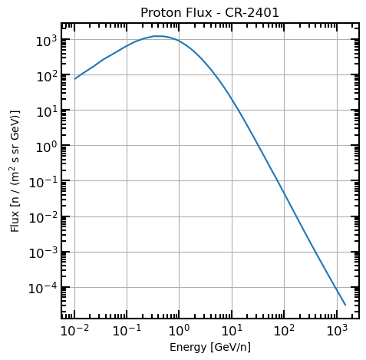
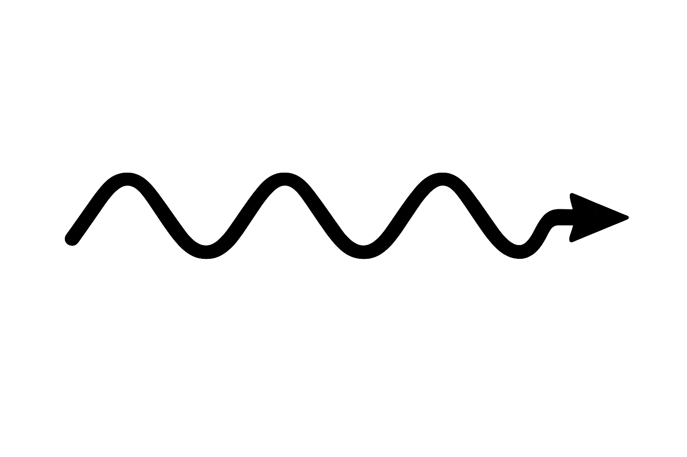
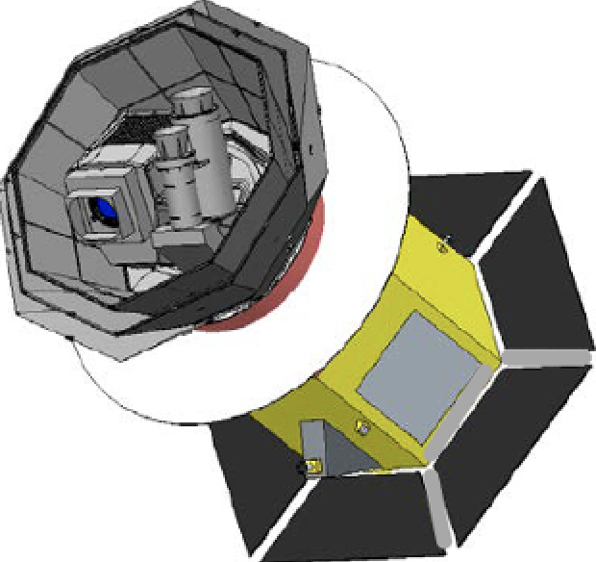

CR flux
For a satellite placed on L2, the main particles contributing to CR are protons, alpha particles, and iron nuclei.
𝛂
p
Sun
The number of CR hitting the satellite will also depend on the solar activity.
Flux for each particle at a specific epoch can be modelled using specific software: HelMod.
Fe

Slide 5
CR simulation pipeline
CR flux
CR flux on L2 is estimated
Deposited Energy on wafer
CR interaction with matter is simulated
TOD generation
Using a random poissonian generator we construct a TOD
Thermal Response
Detector Response
Obtain thermal fluctuations by solving the heat equation
Bolometer model is solved under the modeled thermal fluctuations

Slide 6
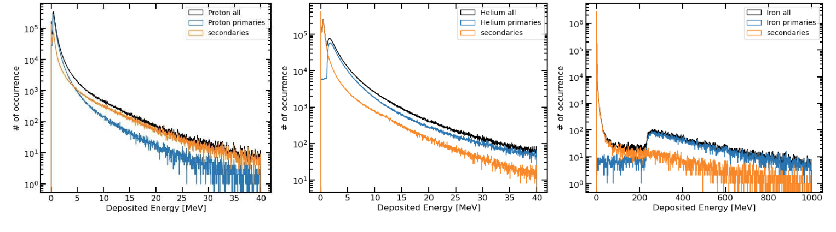
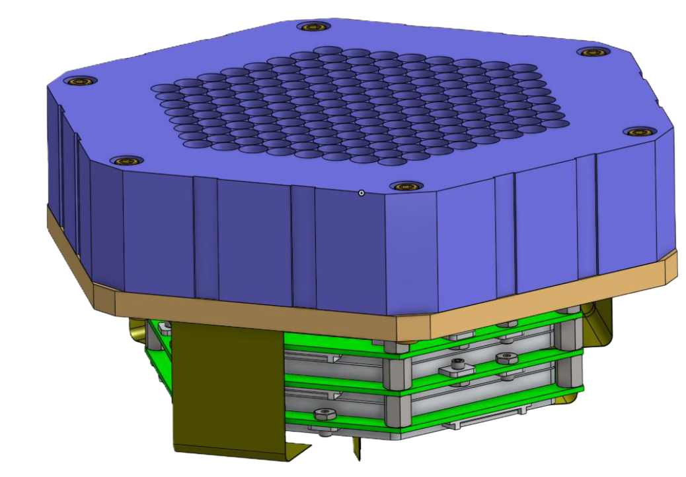
Deposited Energy
We use the HFT full focal-plane configuration to model how particles interact with all the different components using GEANT4.
We obtain the deposited energies produced by direct hits and secondary hits on the wafer, obtaining the distribution of energy deposited events.

Slide 7
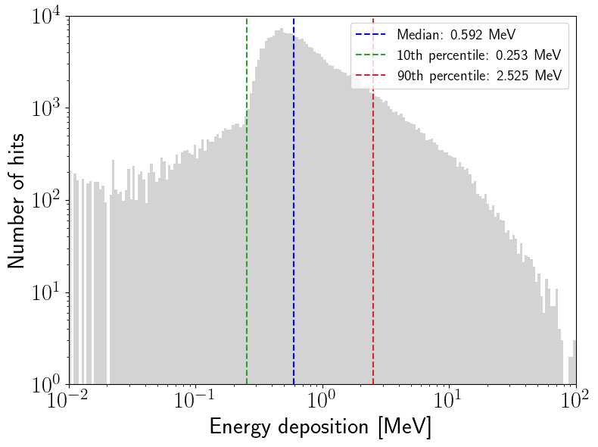
Deposited Energy
We use the HFT full focal-plane configuration to model how particles interact with all the different components using GEANT4.
We obtain the deposited energies produced by direct hits and secondary hits on the wafer, obtaining the distribution of energy deposited events.

Slide 8
CR simulation pipeline
CR flux
CR flux on L2 is estimated
Deposited Energy on wafer
CR interaction with matter is simulated
TOD generation
Using a random poissonian generator we construct a TOD
Thermal Response
Detector Response
Obtain thermal fluctuations by solving the heat equation
Bolometer model is solved under the modeled thermal fluctuations

Slide 9
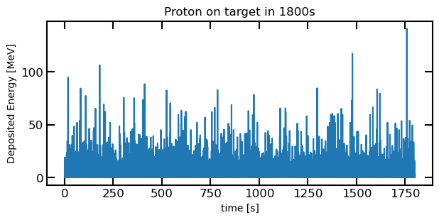
TOD
As CR impact can be described by poissonian statistic, we can generate an energy deposition TOD using random numbers.

Slide 10
CR simulation pipeline
CR flux
CR flux on L2 is estimated
Deposited Energy on wafer
CR interaction with matter is simulated
TOD generation
Using a random poissonian generator we construct a TOD
Thermal Response
Detector Response
Obtain thermal fluctuations by solving the heat equation
Bolometer model is solved under the modeled thermal fluctuations

Slide 11
Thermal Simulations
Two different methodologies to solve the heat equation has been adopted:
  Comsol-based simulator solving the detailed full focal plane design.
  Numerical solver of the heat equation for the “thin plate” approximation.
In the upcoming slides we will add some detail on the numerical solver and compare the results obtained with both methods.

Slide 12
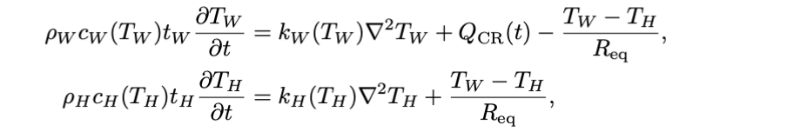
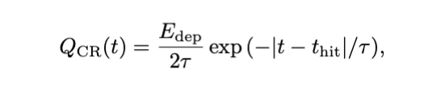

Thin Plate approximation
This approximation is ruled by the next equations, which describe a system formed by two thermally linked thin layers, one for the detector wafer and the other for the horns array.
Applying also Robin boundary condition to model the heat dissipated by the cryostat

Slide 13
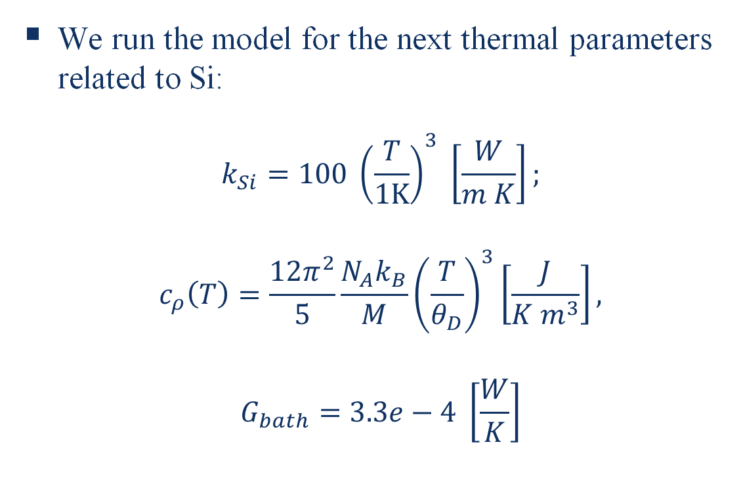
Thin plate: Results
We run the model for the next thermal parameters related to Si:
$$k_{Si}=100 {\left(\frac{T}{1K}\right)}^{3} \left[\frac{W}{m K}\right];$$
$$c_{ρ}\left(T\right)=\frac{12π^{2}}{5}\frac{N_{A}k_{B}}{M}{\left(\frac{T}{θ_{D}}\right)}^{3}\left[\frac{J}{K m^{3}}\right],$$
$$G_{bath}=3.3e−4 \left[\frac{W}{K}\right]$$

Slide 14
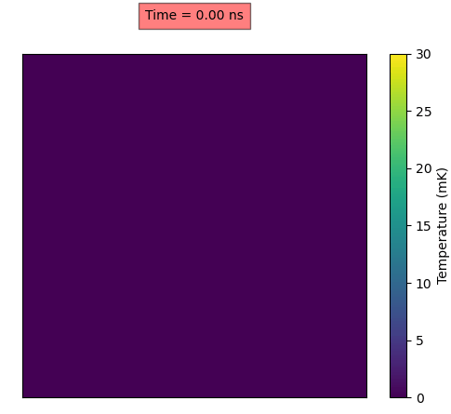
Thin plate: Results
We run the model for the next thermal parameters related to Si:
$$k_{Si}=100 {\left(\frac{T}{1K}\right)}^{3} \left[\frac{W}{m K}\right];$$
$$c_{ρ}\left(T\right)=\frac{12π^{2}}{5}\frac{N_{A}k_{B}}{M}{\left(\frac{T}{θ_{D}}\right)}^{3}\left[\frac{J}{K m^{3}}\right],$$
$$G_{bath}=3.3e−4 \left[\frac{W}{K}\right]$$

Slide 15
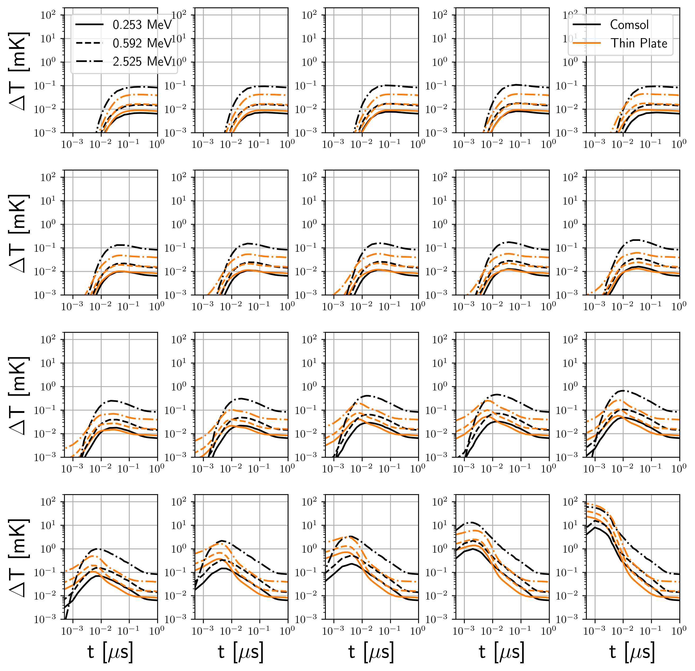
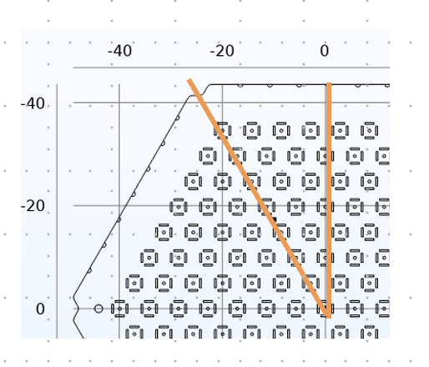
VS Comsol
Farther
We recover the thermal fluctuations at different positions related to different detectors to compare both models.
Closer
Farther
Closer

Slide 16
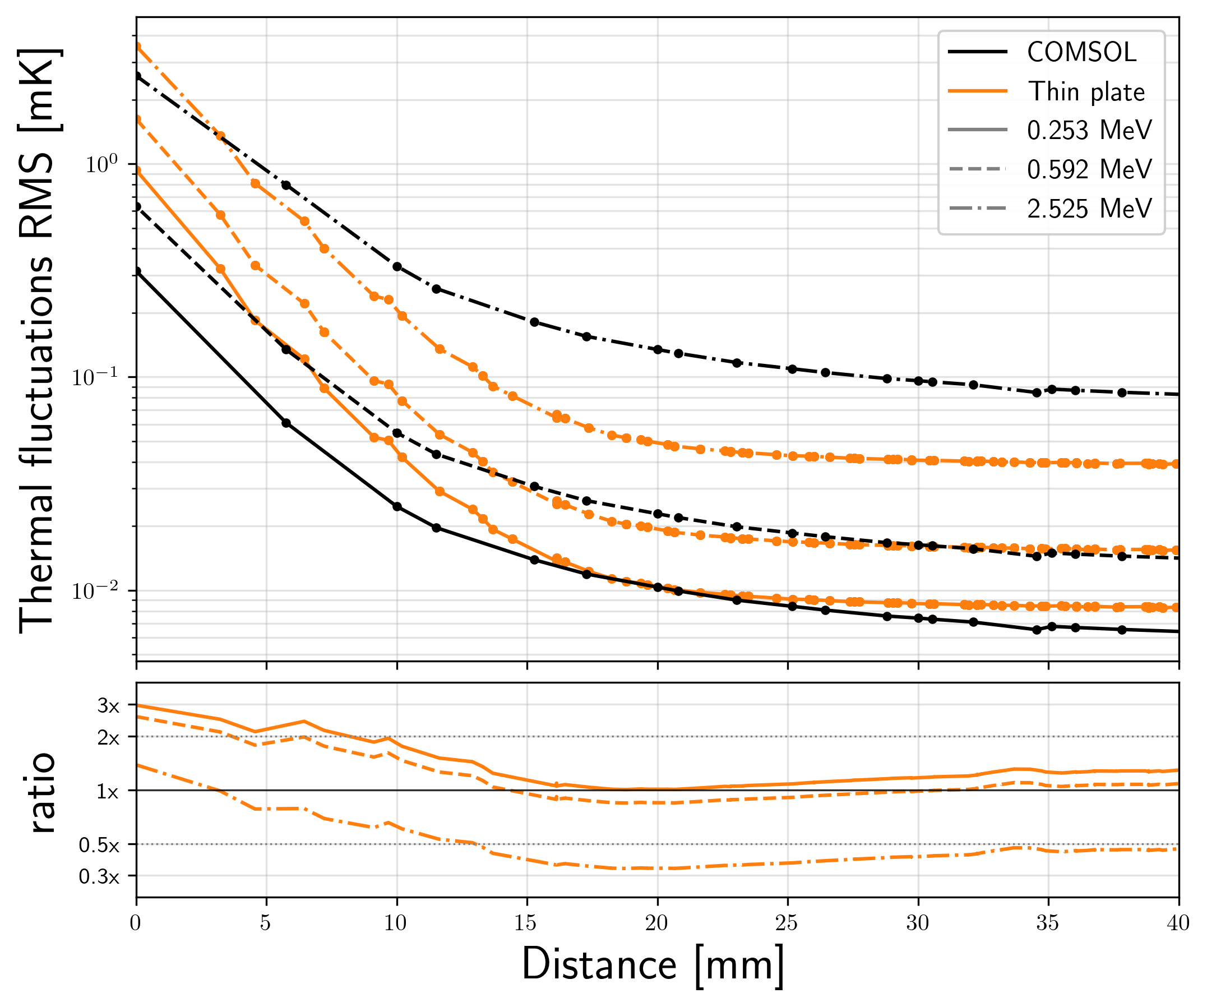
RMS values
As detectors work as a low pass filter, a better statistic to compare both models is the RMS of the fluctuations
We spot different energy scaling issues and inconsistencies at the smaller scales.
Inconsistencies at smaller scales may be produced by 3D diffusion effects.
Energy scaling issue is being studied and may be related to COMSOL accuracy.

Slide 17
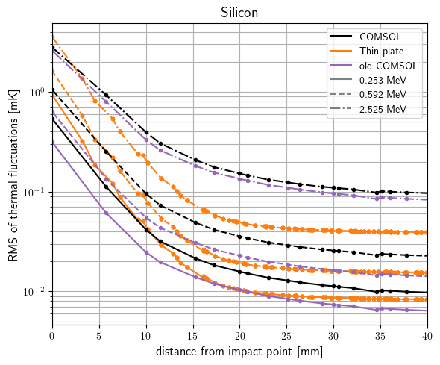
Comsol Update
Comsol interpolate some data to obtain the final solution.
Model tolerance can be modified to get more precise results at a cost of a higher computation time.
Preliminary results, notice that the relative behavior between models is more consistent for different deposition energies.

Slide 18
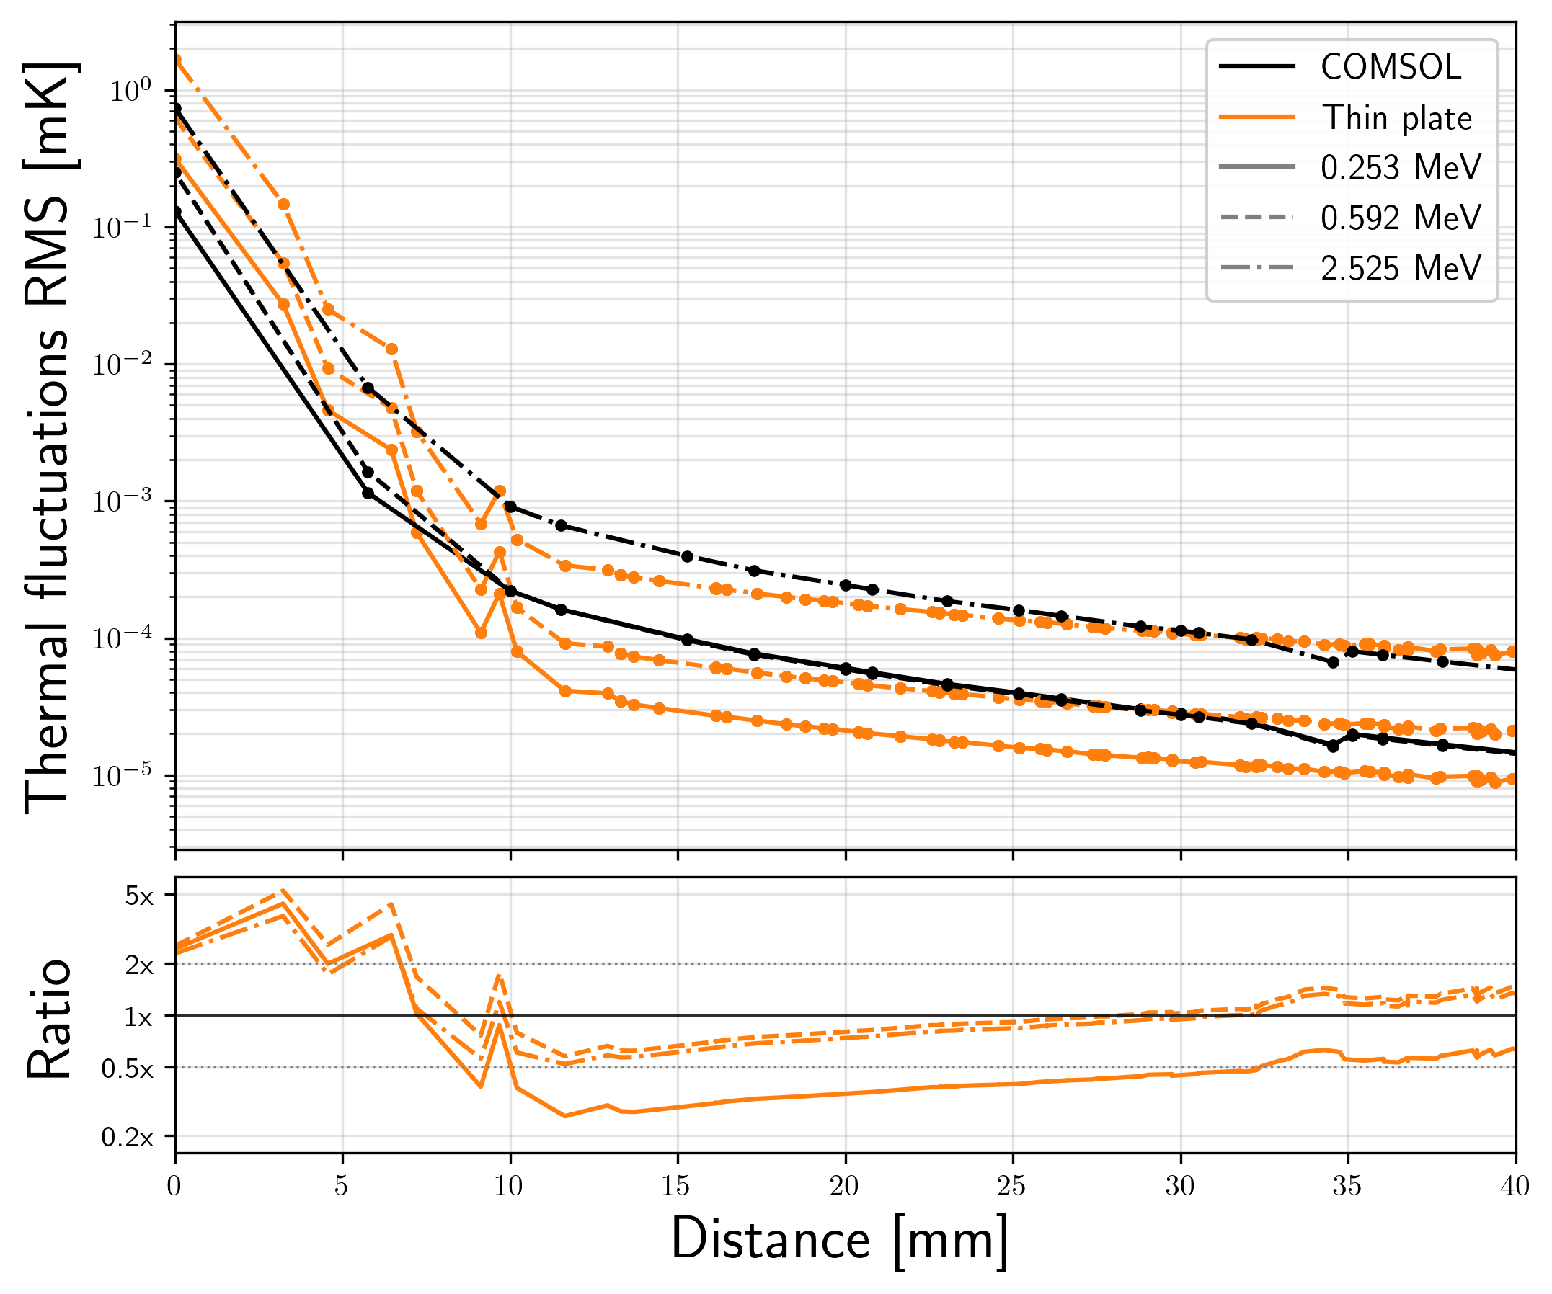
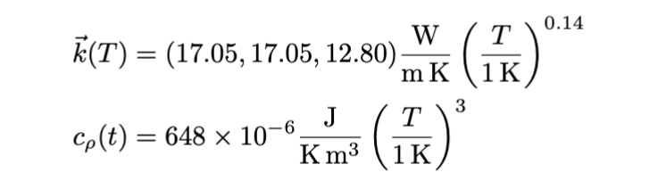
Aluminium Horns
We made the same comparison for another case of study in which horns are made of aluminum.

Slide 19
CR simulation pipeline
CR flux
CR flux on L2 is estimated
Deposited Energy on wafer
CR interaction with matter is simulated
TOD generation
Using a random poissonian generator we construct a TOD
Thermal Response
Detector Response
Obtain thermal fluctuations by solving the heat equation
Bolometer model is solved under the modeled thermal fluctuations

Slide 20
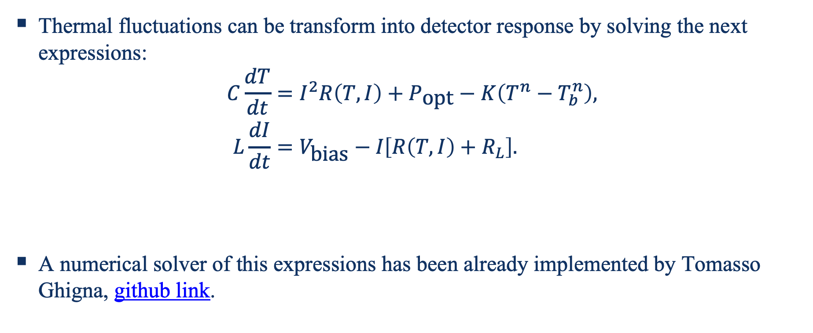
Detector Response
Thermal fluctuations can be transform into detector response by solving the next expressions:
$$\begin{aligned}C\frac{dT}{dt}&=I^{2}R\left(T,I\right)+P_{\text{opt}}−K\left(T^{n}−T_{b}^{n}\right), \\ L\frac{dI}{dt}&=V_{\text{bias}}−I​\left[R\left(T,I\right)+R_{L}\right].\end{aligned}$$
A numerical solver of this expressions has been already implemented by Tomasso Ghigna, github link.

Slide 21
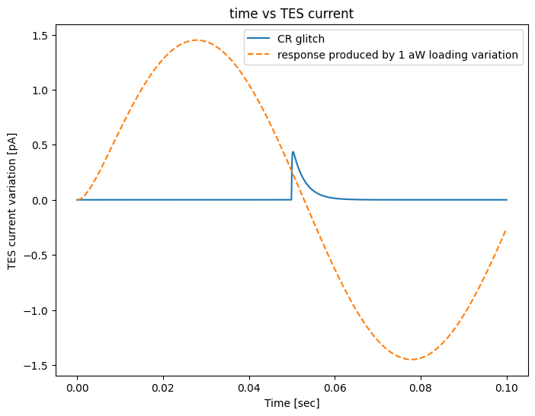
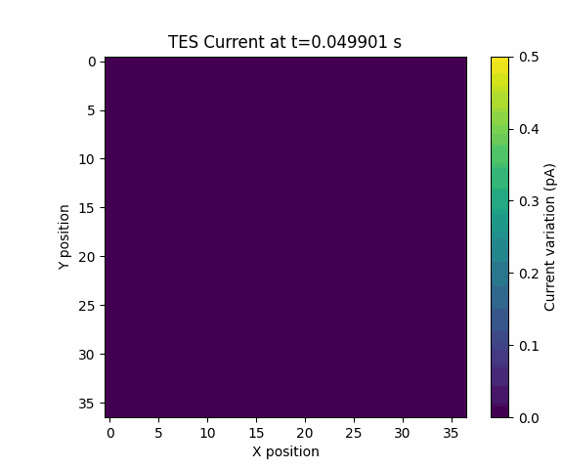
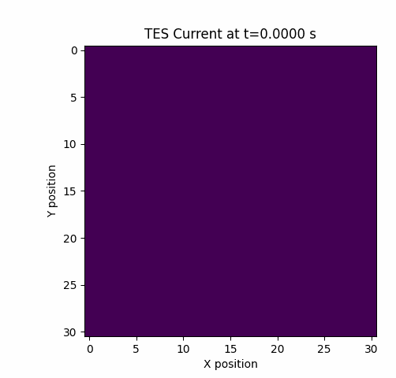
Detector Response
Adding now the thermal fluctuations as bath temperature, we can obtain TES signal

Slide 22
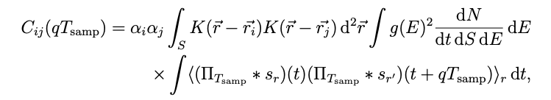
Noise level contribution
We now proceed to derive the expected CR contribution on detector noise and its correlation.
We have analytically derived the next covariance matrix, to describe both the equivalent white noise level contribution and the correlation between pixels.

Slide 23
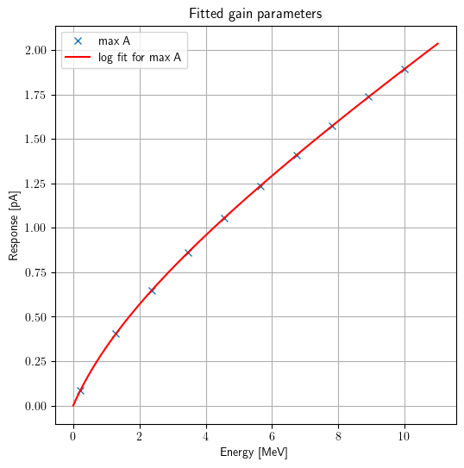
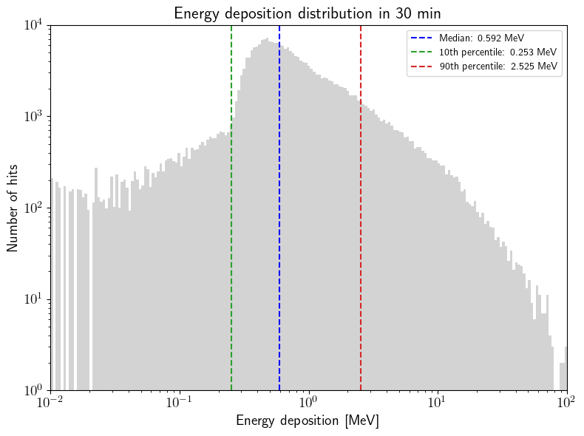
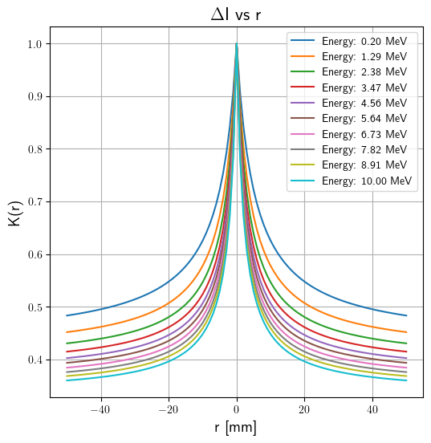
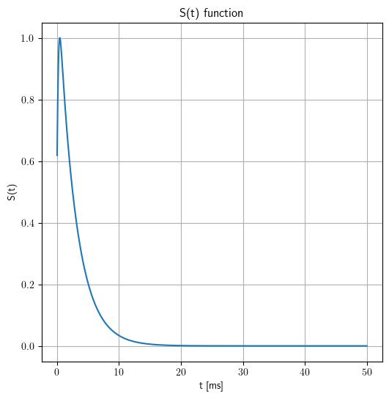
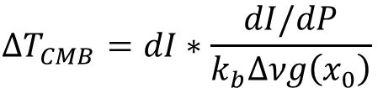
Noise level contribution: terms
$$ΔT_{CMB}=dI∗\frac{dI/dP}{k_{b}Δνg\left(x_{0}\right)}$$

Slide 24
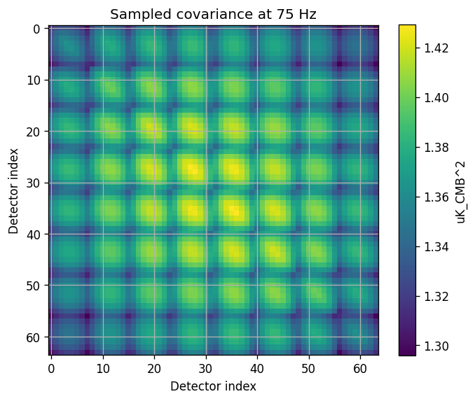
Covariance Matrix result
For an 8x8 grid of detectors

Slide 25
Map level projection
Using LiteBIRD-sims toolbox, We have simulated the map level contribution of CRs after 1 year using 2 different methods:
  From the previously derived covariance matrix.
  Creating a full simulation with random deposition events generated considering all the simulated information.

Slide 26
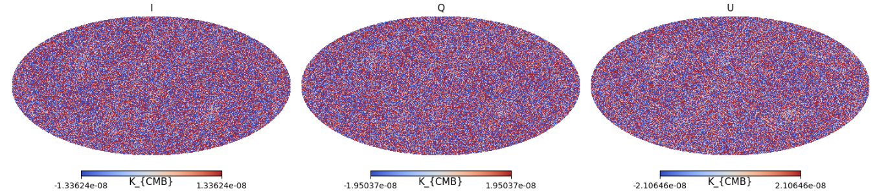
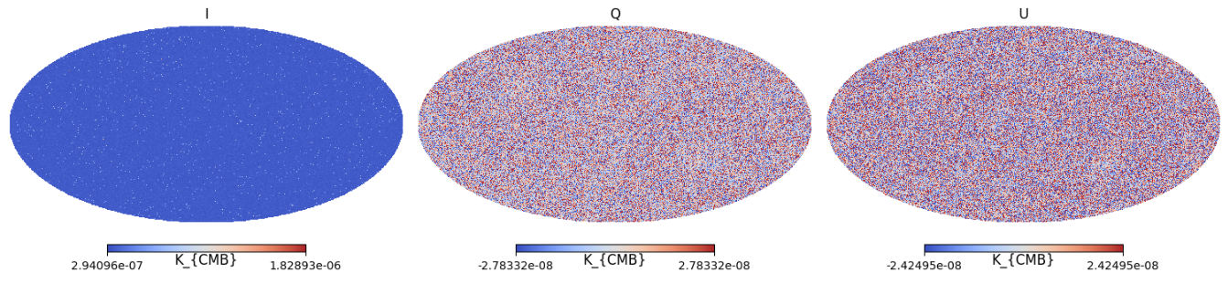
Map level projection
Covariance
Numerical

Slide 27
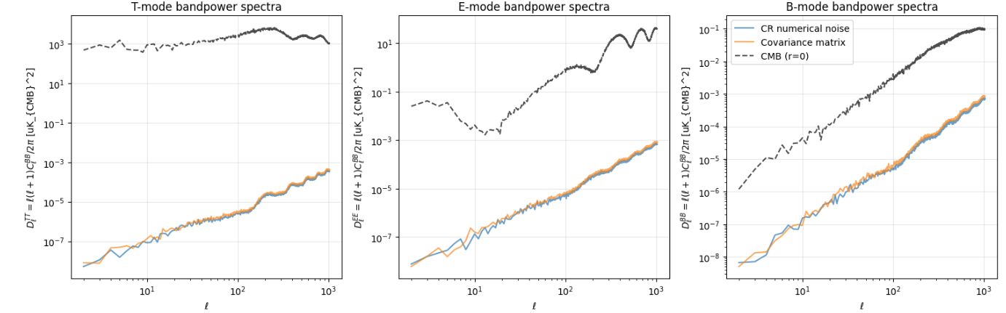
Power spectra

Slide 28
Conclusions & Future Work
We present a full pipeline to simulate CR influence, that allow us to derive detector response and to estimate map level noise contribution
We have derived a thermal model that reduces computation time from several hours to less than a minute while recovering similar thermal fluctuations.
Explore thermal parameters to understand if the agreement between models can be improved.
Study different configurations of the focal plane to reduce CR influence.
Apply simulations to the study of possible mitigation techniques

