Slide 1






CNRS Helmholtz Dark Matter Lab (DMLab)
Thomas Schörner (DESY) and Dirk Zerwas (DMLab)
5th Annual Meeting of DMLab
October 21-22, 2026

Slide 2
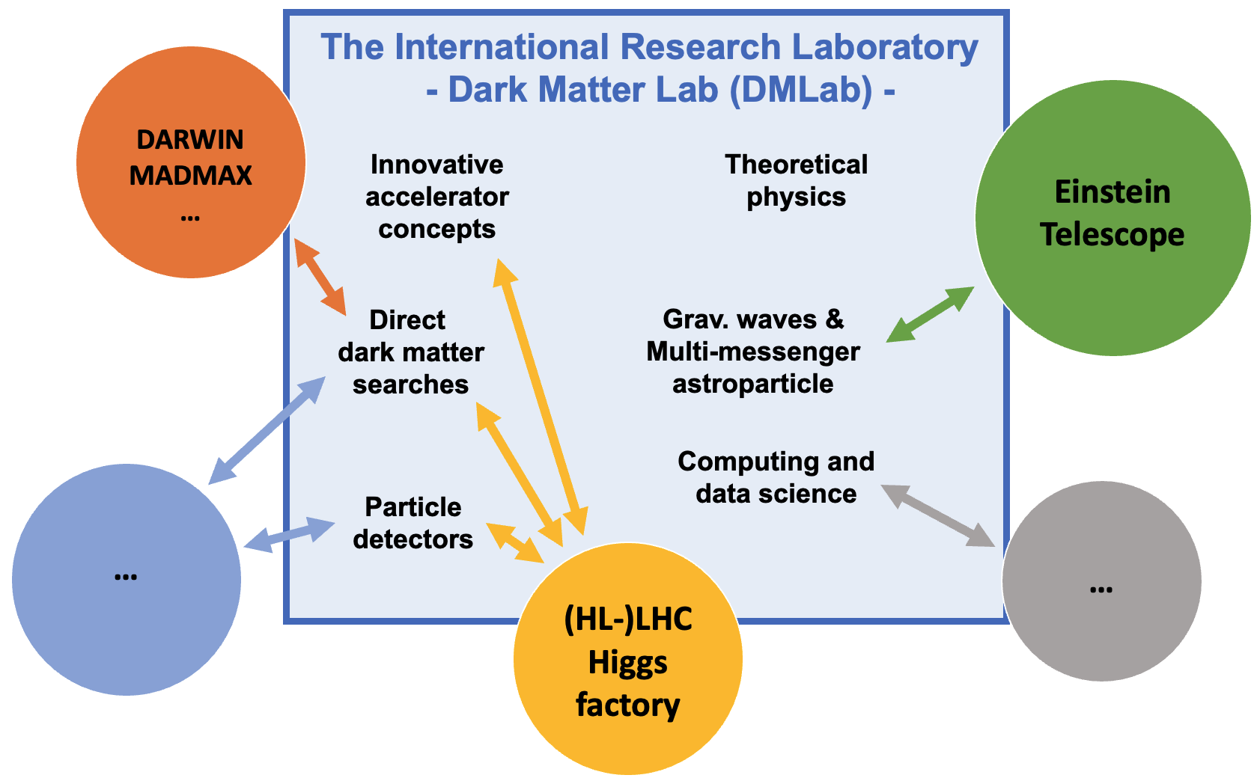
Scientific Topics of DMLab
DMLab is not a closed shop,new initiatives are always welcome!
Organized around the central theme of dark matter
IRL goal:
develop new ideas
across topic boundaries
glued by dark matter
Charge to the lab:
Personnel at DESY, KIT and GSI
  F: affectation
  D: sabbatical
Working visits (typically 1-2 weeks) to DESY, KIT, GSI
Workshops broad and narrow
Funding acquisition
Develop French-German collaboration

Slide 3
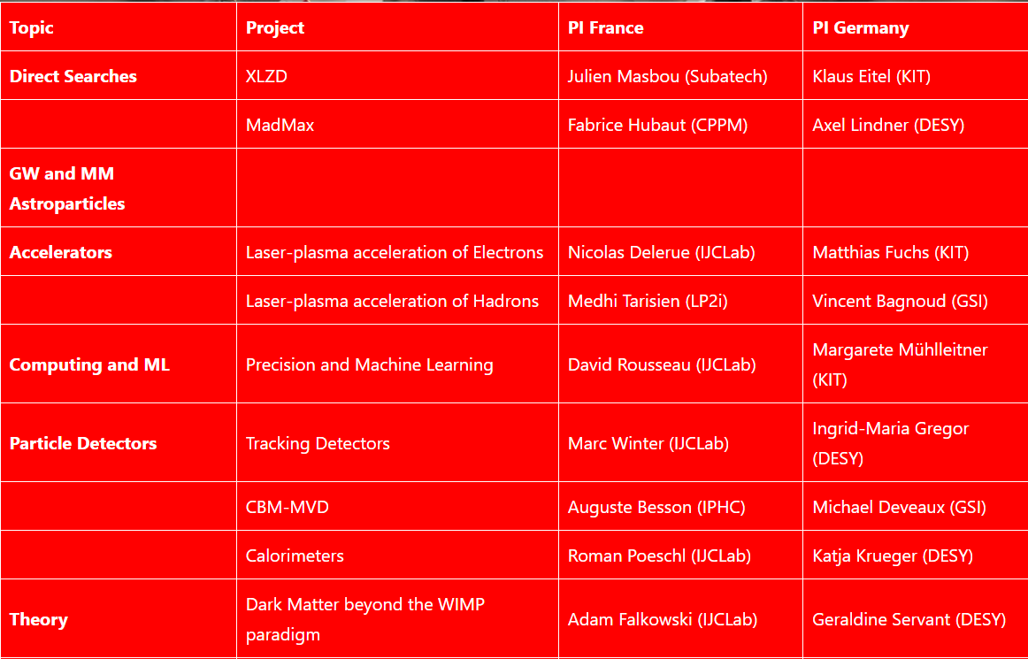

Scientific Projects of DMLab
Organized by topic

Slide 4
Publications
Cumulative
Contribution to “Data Preservation in High Energy Physics: Global Report 2026”, 2607.06775 [hep-ex]
Configuration and Benchmarking of e+e− Processes with K4GeneratorsConfig,e-Print: 2509.20116 [hep-ph]
ECFA Higgs, electroweak, and top Factory Study, e-Print: 2506.15390 [hep-ex], CERN Yellow Report 2025-005.
The ILD Detector: A Versatile Detector for an Electron-Positron Collider at Energies up to 1 TeV, e-Print: 2506.06030 [hep-ex]
Enhancing European Cooperation in the Search for Dark Matter, e-Print: 2504.01688 [hep-ex]
The Critical Importance of Software for HEP, e-Print: 2504.01050 [hep-ex]
The Linear Collider Facility (LCF) at CERN, e-Print: 2503.24049 [hep-ex]
A Linear Collider Vision for the Future of Particle Physics, e-Print: 2503.19983 [hep-ex]
A proposal for the Lohengrin experiment to search for dark sector particles at the ELSA Accelerator, e-Print: 2410.10956 [hep-ex] Eur.Phys.J.C 85 (2025) 5, 600
Focus topics for the ECFA study on Higgs / Top / EW factories, e-Print: 2308.00515 [hep-ex]
Technical Design Report for the LUXE Experiment, e-Print: 2308.00515 [hep-ex], Eur.Phys.J.ST (2024)
SuSpect3: A C++ code for the supersymmetric and Higgs particle spectrum of the MSSM, e-Print: 2211.16956 [hep-ph], Comput.Phys.Commun. 291 (2023) 108805
The Higgs boson mass as fundamental parameter of the minimal supersymmetric standard model, e-Print: 2202.06919 [hep-ph], Eur.Phys.J.C 82 (2022) 7, 657

Slide 5
Acknowledgements
Cumulative
A.W. Romero Jorge, E. Bratkovskaya, T. Song, L. Sagunski, Constraints on Kinetic Mixing of Dark Photons from Dilepton Spectra, arXiv:2507.11163
Adrian William Romero Jorge, Elena Bratkovskaya, Laura Sagunski Search for dark photons in heavy-ion collisions arXiv:2409.20141

Slide 6
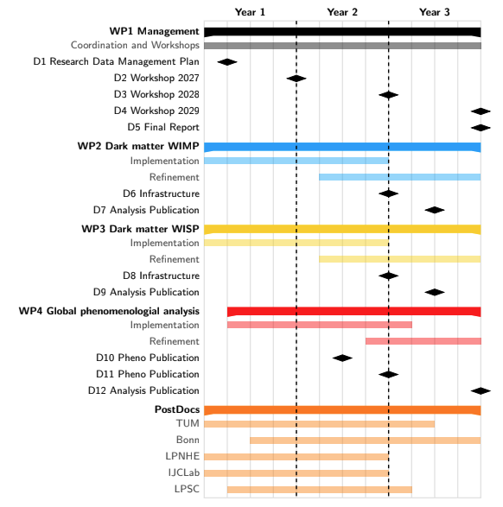
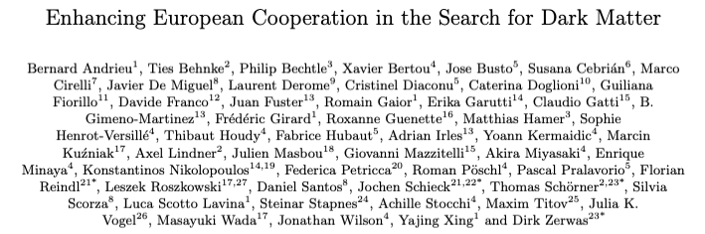
Other Activities
2023 ANR-DFG: CALO5D (detector development):
ANR:
  500K
  2PostDocs, 1PhD
  IJCLab and LLR
Germany:
  500K
  2 positions, upgraded to PostDoc by own funds
  DESY, KIT, University of Mainz
2024 ANR-DFG: HALOX (Direct Searches):
ANR:
  300K
  1 PostDoc
  CPPM
Germany:
  475K
  2 PhD
  UHH and DESY
Third-party funding etc.
DMInfraNet: Input on DM collaboration to the ESPPU 2026
arXiv:2504.01688
Huge variety of DM candidates, experimental approaches and technologies
Idea: Creation of a supportive network for the exchange of technology-related expertise and to facilitate access to the infrastructure for dark matter research, building on existing activities and supplement those that were previously missing
help community to speak with one voice & prepare grounds for joint (funding) activities
Guinea pig activity: providing a common data management framework
DIME - Data Management and Analysis for Invisible Matter Experiments (2025)
Proposal to DFG-ANR 2025; currently being updated: LPNHE, PSC, IJCLab, DMLab, Bonn, Siegen, Munich, DESY

Slide 7
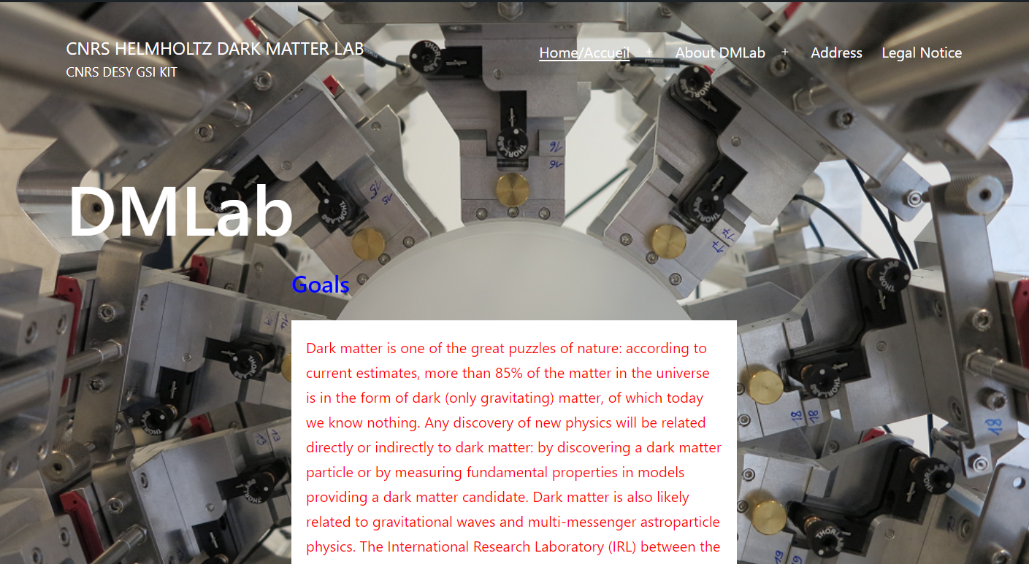
DMLab: Information
We wish us a fruitful meeting!
Infrastructure
Open mailing list: dmlab-general@desy.de (send Thomas or Dirk an email to register)
Web page:
  http://dmlab.in2p3.fr
Thank you to the UFA-DFH for their support
We are grateful to the LPNHE, its director Marco Zito and our main organizer Luca Scotto-Lavina and Christine Marquet (GDR DUPhy) as well as Hotel Lodge In for hosting us!

