Slide 1
Working on the INFRADEV proposal Strategy Board (extended)
Giovanni Lamanna
ESCAPE Director
1/4/2026

Slide 2
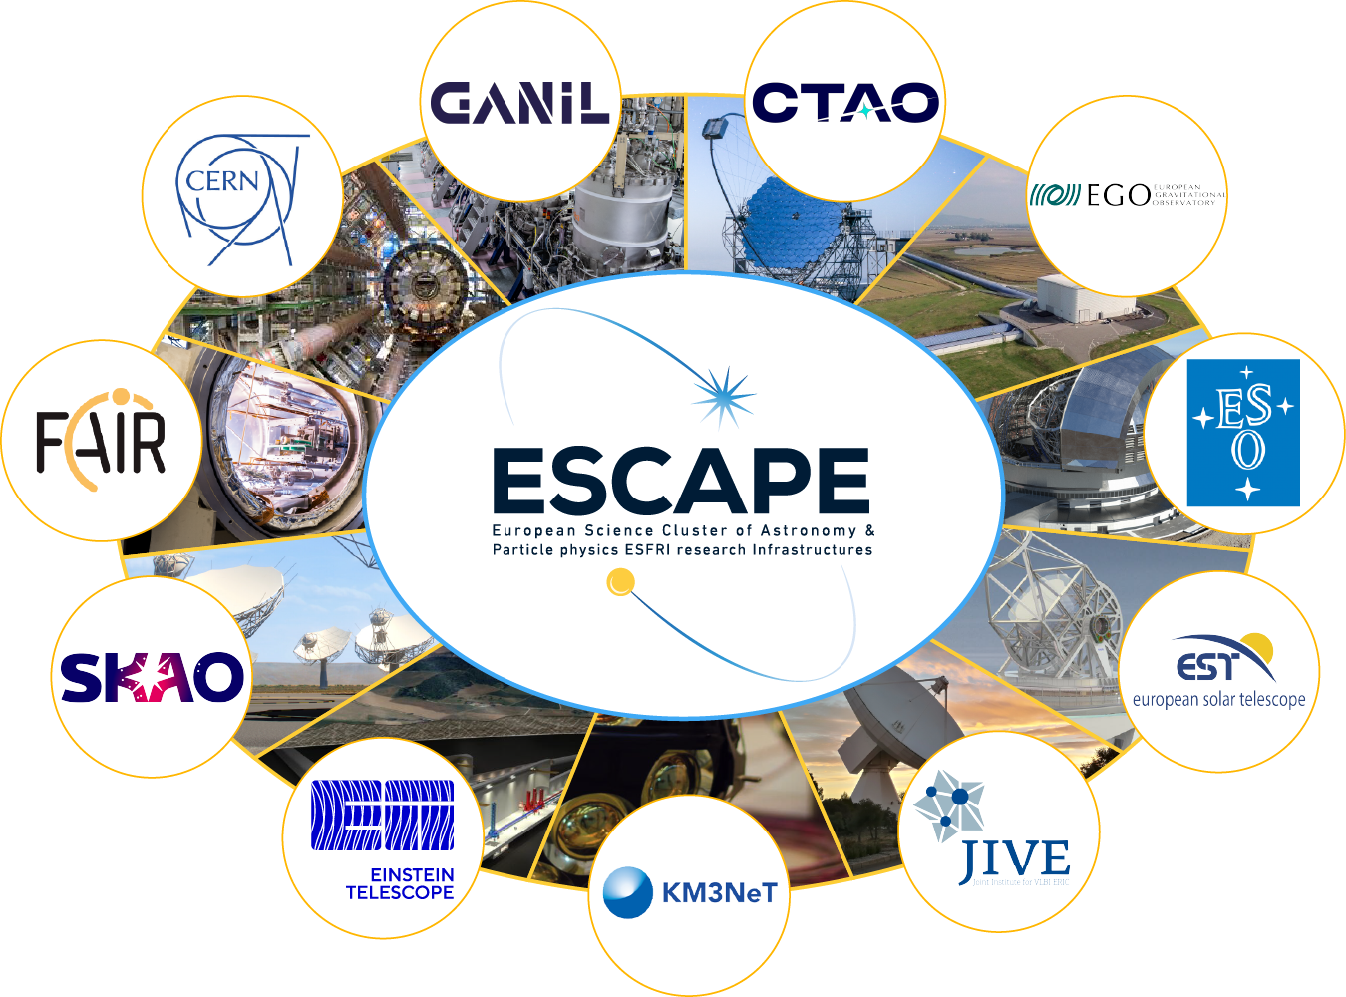
ESCAPE Open Collaboration
Giovanni Lamanna

Slide 3
Preparing the Horizon-Europe 2026 calls
2) HORIZON-INFRA-2026-DEV-01-02: Consolidation of the research infrastructure landscape – pilots for strategic coordination, synergies and simplified access pathways, by large thematic clusters of pan-European research infrastructures (8 MEur).
Proposals should involve, not necessarily as beneficiaries, ESFRI Landmarks and Projects and/or ERICs in the domain, other research infrastructures that are international European research organisations and, where relevant, well-established networks of key European research infrastructures open to external users. Proposals should elaborate on which key EU priorities and initiatives (such as Horizon Europe partnerships, missions) they will consider the nature and objectives of the envisaged coordination mechanisms or joint activities.
Giovanni Lamanna

Slide 4
HORIZON-INFRA-2026-DEV-01-02
Scope:
This topic aims at equipping large thematic clusters of research infrastructures of European interest with a policy arm combined with a technical arm, to increase awareness, findability and accessibility, better matching user needs. This thematic clustering is aligned with ESFRI approach: proposals should explicitly state which ESFRI domain they address*. Proposals should foresee close collaboration across projects under this topic to ensure, where applicable, policy coordination, technical interoperability and other synergies.
Building on the clusters under Horizon 2020 and Horizon Europe, on the development of catalogues of services, and on new access pathways and improved services such as under Horizon Europe INFRASERV projects.
*ESFRI domains: 1. Data, Computing and Digital Research Infrastructures; 2. Energy; 3. Environment; 4. Health & Food; 5. Physical Sciences and Engineering; 6. Social Sciences & Humanities. See ESFRI Landscape Analysis 2024 https://landscape2024.esfri.eu/
Giovanni Lamanna

Slide 5
“ESCAPE enhance”
EXPECTED OUTCOME | WP1 | WP2 | WP3 | WP4
1. Policy | X
2. Improved Coordination | X
3 Portfolio of R&I services |  | X
4 Ris’ awareness and access |  |  | X
Project management and communication |  |  |  | X
Giovanni Lamanna

Slide 6
WP1
POLICY AND COORDINATION (Outcomes 1 & 2; Aspects 1, 2 and 5)
Reminder about expected Outcomes 1) & 2):
1) Policy contribution, impact and visibility of research infrastructures of European interest, by large thematic domain, to relevant EU policy and priority initiatives, including beyond research, at national, regional, European and global level.
2) Improved coordination, complementarities, and where applicable, interoperability, harmonisation, integration and synergies among research infrastructures within large thematic domains and, where relevant, across domains.
Reminder about the aspects 1), 5) and partially 2) to be addressed in the proposal :
1) Strengthening the representation of the research infrastructures cluster, as a single or coordinated voice, in key EU policy developments and strategic initiatives and contribute to policies in their domain with a research infrastructure component. Coordination with cross-domains fora, such as the ERIC Forum and EIROforum should also be ensured.
2) Strengthening coordination among research infrastructures to foster complementarities, interoperability, harmonisation, integration and synergies within the domain, and where relevant with other domains to address increasingly complex and multidisciplinary science and technology challenges.
5) Elaborating and promoting indicators flagging the strategic relevance of specific research infrastructures services to key EU R&I priorities and initiatives, including through common or coordinated impact assessments, and possible validation mechanisms with these initiatives.
Giovanni Lamanna

Slide 7
WP1
POLICY AND COORDINATION (Outcomes 1 & 2; Aspects 1, 2 and 5)
TASK 1 – Coordinating and establishing the political arms of the clusters.
Establishing a PSE coordination structure with two major clusters : (1) ESCAPE cluster and (2) “Analytical Physics ESFRI” associations/networks.
- For each one (at least for ESCAPE…):
Supporting/strengthening its ‘strategy board’, ’executive board’, ‘management and secretariat’
Establishing road-maps, agenda and planned actions on key EU policy and strategies (where applicable searching for a PSE concertation between the two clusters).
Participate in the ‘coordination board’ with the other Science Clusters (ENVRI, LS RI, SSHOC), pre-define an enhanced cross-domain programme of potential synergies, support a common agenda in other fora such as ERIC Forum and EIROForum.
Drive the enhancement of the ESCAPE Community-based Competence Centre (CCC) fields towards some more technologies, societal and political questions.
- For both domains together:
Editing common PSE Position Statements.
Elaborating and provide access to indicators and impact assessment services on key EU R&I priorities and initiatives.
Subcontracting topical or general PSE ESFRIs impacts studies at pan-EU and global levels.
Harmonisation on access, policy and community/users survey mechanisms.
Giovanni Lamanna

Slide 8
WP1
POLICY AND COORDINATION (Outcomes 1 & 2; Aspects 1, 2 and 5)
TASK 2 – Strengthening/improving coordination and enhancing representativeness of thematic ESFRIs.
1) ASTROPHYSICS ESFRIs
ASTRONET, RADIONET, EUROPLANET, ORP etc. towards a concerted new and larger ‘Cosmo-EU-Assembly’ and then:
committing in bridging with others for a PSE-INFRASERV project;
engaging in supporting the ESCAPE’s executive programme and helping the cluster in reaching out further RIs;
strengthening synergies on access programmes and data services;
striving to convene the scientific community in joining any pertinent cross-fertilisation WG (within ‘ESCAPE-enhance’ /JENA++ like framework and further when applicable).
… to be completed ..
2) ACCELERATOR-BASED HEP and NUCLEAR PHYS. ESFRIs (?)
NUPPEC, CERN, ECFA:
committing in bridging with others for a PSE-INFRASERV project;
promoting the pan-European ESCAPE cluster towards their communities;
strengthening synergies with Astrop. ESFRIs in the fields of Research and Innovation services;
deploying and coordinating a federated PSE “access-programme” series of services, pathways, projects and tools (to facilities and technological platforms).
… to be completed …
Giovanni Lamanna

Slide 9
WP1
POLICY AND COORDINATION (Outcomes 1 & 2; Aspects 1, 2 and 5)
3) ASTROPARTICLE ESFRIs (if needed and not merged with (1))
APPEC and individual ESFRIs
- committing in bridging with others for a PSE-INFRASERV project;
driving and striving cross-fertilisation WG (within ‘ESCAPE-enhance’/ JENA++ like framework and further when applicable).
engaging in supporting the ESCAPE’s executive programme and helping the cluster in reaching out further RIs;
strengthening synergies on access programmes and data services (e.g. Virtual Observatory services);
… to be completed ..
4) ANALYTICAL PHYISCS ESFRIs (?)
(list of entities that have contacted GL:) CERIC-ERIC, LENS (ESS, ILL), EMF + others LEAPS (?) :
committing in bridging with others for a PSE-INFRASERV project;
NOT asked to join ESCAPE but invited to acknowledge and connect with ESCAPE as the “2-infinities cluster” in the EU ecosystem.
… to be completed …
Giovanni Lamanna

Slide 10
WP2
R&I SERVICES’ CATALOGUE (Outcome 3; Aspects 2, 3 and 4)
Reminder about expected Outcome 3):
A European portfolio of R&I services of European interest, supported by a common front page and few single-entry point access portals, integrated or interoperable catalogues of R&I services and converging access conditions and selection procedures, strengthening the European landscape of ESFRI-prioritised infrastructures and other world-class research infrastructures by large thematic domains.
Reminder about the aspects 2), 3) and 4) to be addressed in the proposal :
2) Strengthening coordination among research infrastructures to foster complementarities, interoperability, harmonisation, integration and synergies within the domain, and where relevant with other domains to address increasingly complex and multidisciplinary science and technology challenges.
3) Developing, optimising and connecting catalogues of research infrastructures services of European interest. Attention is required to new users, notably researchers and innovators from widening countries and candidate countries, industry (including SMEs, startups and scaleups), early-stage career researchers, and non-expert users. Flexibility to address future needs should be considered.
4) Developing and implementing intermediary services, user support, tools and notably AI assisted research infrastructure services navigation. When relevant, resulting data and digital services should be made accessible through EOSC.
Giovanni Lamanna

Slide 11
WP2
R&I SERVICES’ CATALOGUE (Outcome 3; Aspects 2, 3 and 4)
TASK 1 – Front page and catalogue architectural conception, design, deployment and operation
(including AI assisted services navigation)
TASK 2 – By subdomain:
Perform survey, critical analysis and selection of more impactful multi-RI services.
Establish access/selection procedures (as a function of users’ type).
Maximize where applicable harmonization, integration and interoperability of RIs.
for
TASK 2.1 – ESFRI and other RIs’ CORE services for scientific exploitation /data research
TASK 2.2 – ESFRI and other RIs’ CORE curiosity-driven access and TNA services (based on previous successful practices and
Access2Access framework).
TASK 2.3 – ESFRI and other RIs’ technological innovation services based on subdomain Roadmaps (APPEC, NuPPEC, ect.)
TASK 2.4 – ESFRI and other RIs’ innovation services based on PSE DIGIT roadmap.
TASK 3 – Leverage a sample of services that would contribute in deploying “pilot” federated activities aligned with EU
priorities and strategy (to be managed by WP3)
Giovanni Lamanna

Slide 12
WP3
VIRTUAL COOPERATIVE SPACE (Outcome 4; Aspect 4)
Reminder about expected Outcome 4):
Increased awareness, findability and accessibility of research infrastructures for European researchers and innovators; simplified and adapted access pathways for new needs or new communities of users (e.g. where relevant, multidisciplinary R&I, EU collaborative research projects, EU operational or deployment programmes, public authorities, and industry, including SMEs, startups and scaleups).
Reminder about the aspect 4) to be addressed in the proposal :
4) Developing and implementing intermediary services, user support, tools and notably AI assisted research infrastructure services navigation. When relevant, resulting data and digital services should be made accessible through EOSC.
Giovanni Lamanna

Slide 13
WP3
VIRTUAL COOPERATIVE SPACE (Outcome 4; Aspect 4)
TASK 1 – Deploy executive working groups enhancing the Community based Competence Centre of ESCAPE and APF
(opening at large to diverse user profile access requirements and inter Science Clusters’ “knowledge hubs”)
TASK 2 – Supporting ESCAPE for JENA++ working groups and “pilot” federated activities (or EoI from the community)
aligned with EU priorities and strategy. Ex.:
Digital twin (Monte Carlo generator and hybrid computational optimisation) (to be linked to related EC actions) (as from the internal survey)
REANA, RUCIO, AAI and VO services for data access and pipelines. (as from the internal survey)
Scientific software catalogue and quality standards. (as from the internal survey)
And a few more … (as from the internal survey)
5) Further Quantum technology for time synchronisation, computation and cybersecurity
6) New electronics for observatory, sensors and detectors ?? (It may be advantageous to prioritise semiconductors)
7) Vacuum and cryogenics ??
According to a matrix approach where all of the above pilot activities follow a few strategic pathways:
Delivering services/technologies for reducing the environmental and climate footprint
Enhancing HPC in Europe
Supporting science for AI/Quantum
Mentoring the Digital transition
New adoptions and therefore potential new competitive markets (for semiconductor, photonics, vacuum, new materials…)
Linking to EOSC (from open science to data sovereignty)
TASK 3 - Deploy relevant thematic “technical fora” and “training schemes” (for cross-fertilisation purpose and strengthening
cluster’s identity and offer)
Giovanni Lamanna

Slide 14
WP4
MANAGEMENT AND COMMUNICATION
TASK 1 – Project coordination
TASK 2 – Retrieve indicators, produce impact assessment, and deploy validation mechanism
TASK 3 – Communication
Giovanni Lamanna

