Slide 1

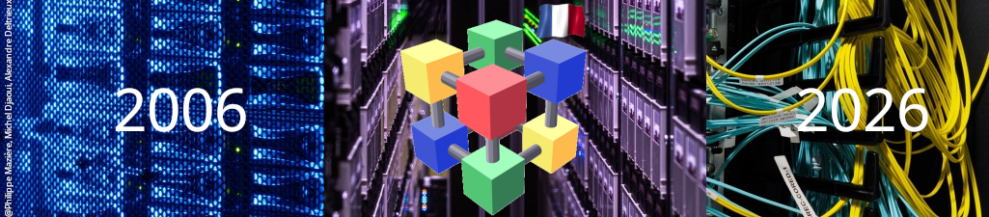
WLCG evolution towards
the High-Luminosity LHC
from an Ops Coordination perspective
M. Litmaath, CERN
June 23, 2026
20 ans LCG France

Slide 2
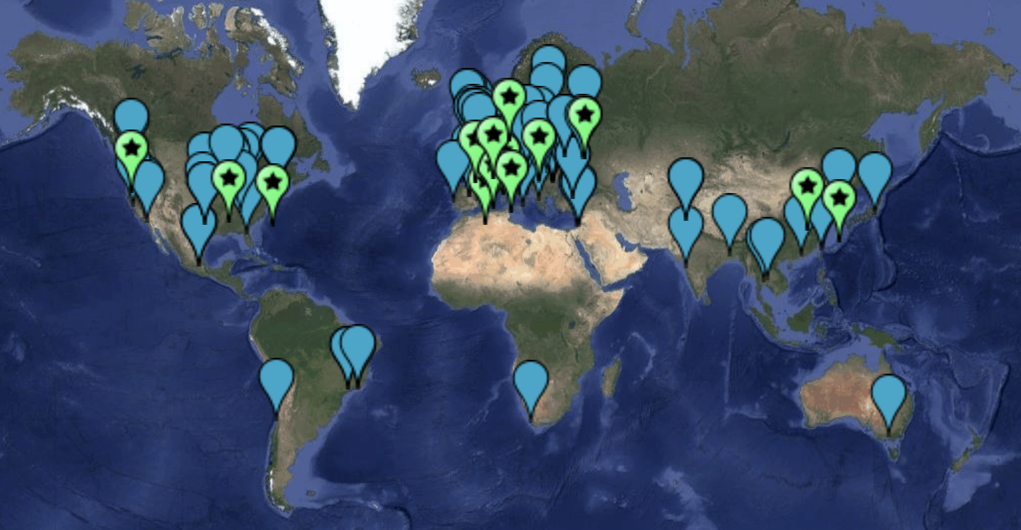
What is the Worldwide LHC Computing Grid?
140+ sites
40+ countries
The WLCG Collaboration provides the distributed computing
infrastructure for the CERN Large Hadron Collider experiments.

Slide 3
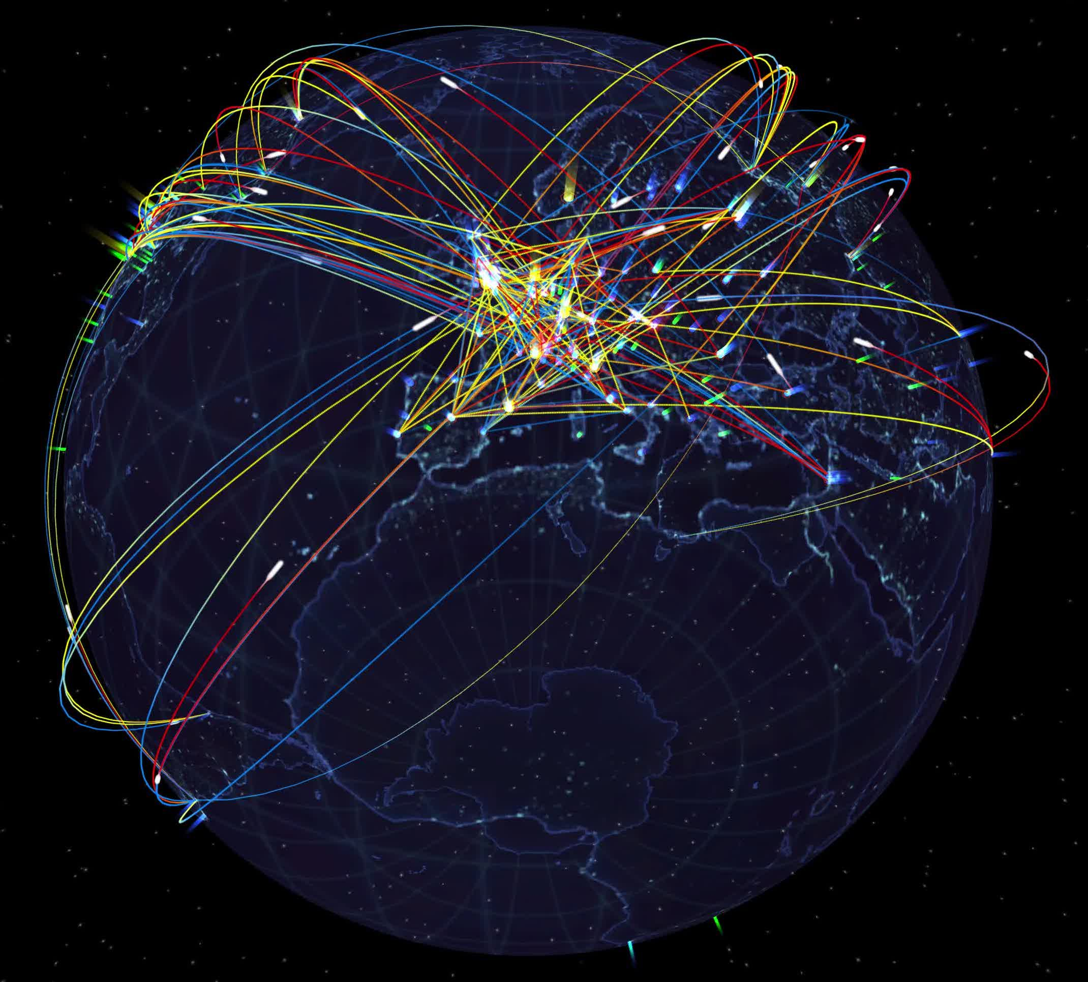
Worldwide data storage and processing 24/7

Slide 4
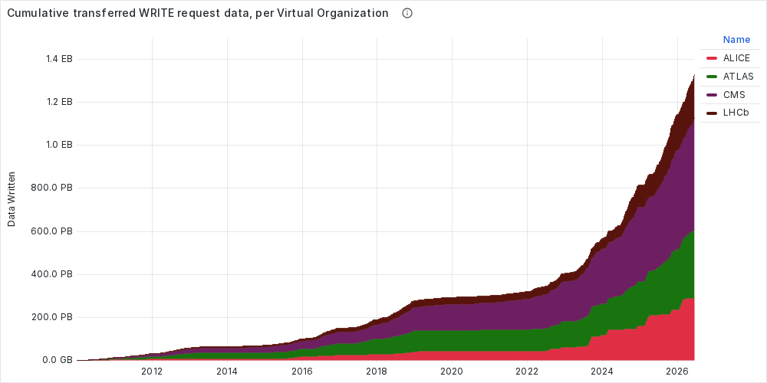
LHC experiment data on tape at CERN

Slide 5
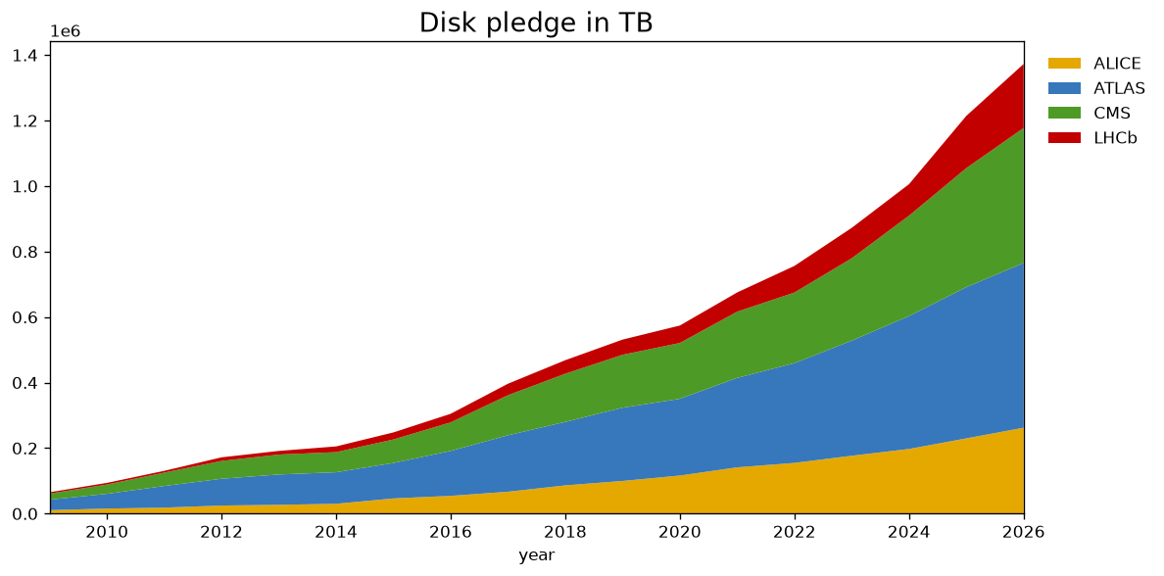
Disk pledge history

Slide 6
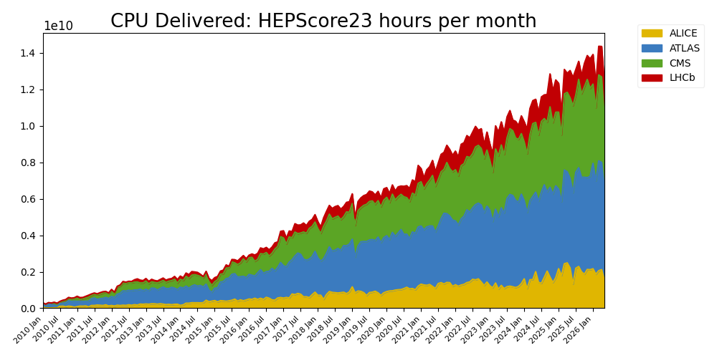
Corresponding increases in computing

Slide 7
Ever increasing luminosity and pileup …
Focusing on ATLAS and CMS
L~900 fb-1
L~350 fb-1
L=156 fb-1
L=29 fb-1
LHC Run-1
LS1
LHC Run-2
LS2
LHC Run-3
LS3
HL-LHC Run-4
LS4
HL-LHC Run-5

Slide 8
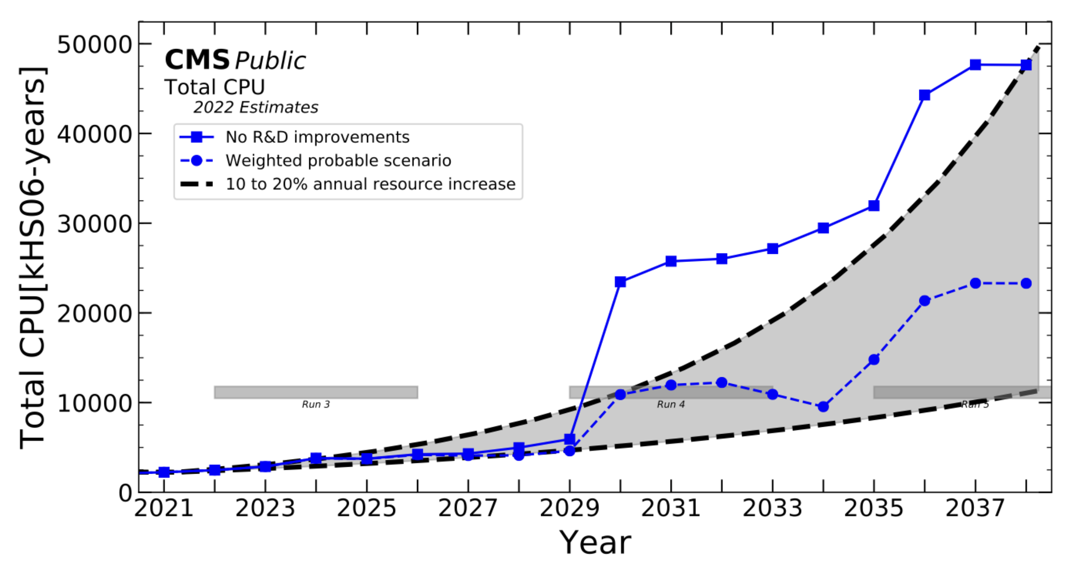
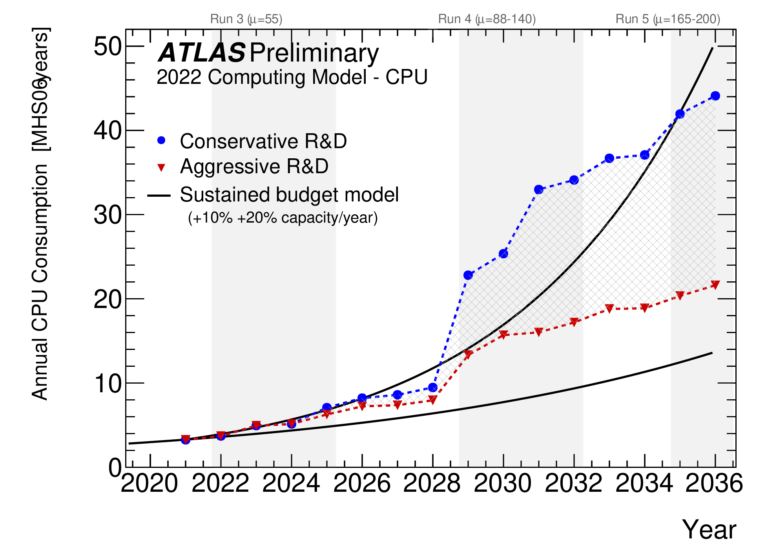
… leading to ever increasing processing needs
Estimates from before the AI boom!
… that require improvements in SW & services

Slide 9
Technical Evolution Roadmap
A community-driven roadmap for technical evolution of WLCG is being prepared
The document itself will also evolve in the next years,
to take account of progress as well as external changes
in the big-science computing landscape and beyond
The first version will be published this autumn
The audience includes everyone involved in WLCG in some way
  In particular our LHCC referees and our funding agencies
Please see this CHEP 2026 talk for further details

Slide 10
Computing model & SW evolution
Improved data formats for less space and faster processing
  RNTuple
Alternative architectures for cheaper and/or faster processing
  ARM
  GPU
  After very extensive physics validation!
SW development groups, foundations and projects foster R&D
  SFT
  HSF
  IRIS-HEP
  SWIFT-HEP
  EVERSE
  …
Quantum computing?
→ Expected to complement
classical systems, some day!

Slide 11
WLCG facility perspectives
HW cost trends – badly hit by AI factories!
Energy costs may also rise, depending on the country
  Power and cooling
Alternative architectures may be better in one or more ways
  Work per second per monetary / energy / sustainability budget
Energy may also be saved at peak periods
  CPU frequency reduction
  Active capacity reduction
Future: climate-neutral data centers…
Now: UPB in Bucharest is a new T1 center for ALICE !
Dec 2025 Workshop on
Heterogeneous
Architectures summary
Sustainability Forum

Slide 12
Analysis Facilities
HL-LHC computing models foresee Analysis Facilities as a new type of resources
Some WLCG facilities may want to offer such resources instead of traditional set-ups, or even in addition
  Proper recognition needed in pledges and accounting
Input data must not too quickly become the bottleneck
  Fast local storage and network are needed (cf. HPC burst buffers)
  Possibly in the form of caches, i.e. local data losses can be tolerated
Profiting again from alternative architectures
  ARM
  GPU
Users may access such services through notebooks
  Auto-scaling from the laptop to the grid…

Slide 13
Benchmarking
HEPScore is a flexible, modern benchmarking suite
  Based on containers and a configurable variety of reference workloads
HEPScore23 is a specific benchmark constructed from 7 modern HEP workloads
  Released for x86_64 and ARM
  Adopted by WLCG and EGI
Under construction: GPU support, sustainability metrics, …
CHEP 2026 talk

Slide 14
Accounting
To support new architectures, sustainability metrics, and different types of resources (grid, HPC, cloud), the APEL legacy framework will be replaced with PEAR (Portal for Enhanced Accounting Records) at RAL and AUDITOR at EGI sites
  Supported by the ENSURE EU project (September 2026 – 2029)
  The legacy Accounting Portal will already be replaced in July!
CHEP 2026 talk

Slide 15
High Performance Computing centers
HPC centers are used by the experiments since many years
  Mostly opportunistically so far
  Also part of NDGF-T1 pledges
Some countries may intend to pledge HPC rather than HTC resources
Various barriers have been reduced over the years, some still exist
  Operator access controls
  Network access limitations
  Lack of CVMFS
  …
Some can be worked around
  ARC CE data handling
  …
EU and US projects help make HPC look more like our HTC sites

Slide 16
Cloud computing
Experiments have been using commercial cloud resources through special projects since many years
  Sponsored by big providers and EU projects
So far, resources on our own premises have been less expensive
  That may well change in the coming years, though
For computing, cloud procurements can make a lot of sense
  Potential accounting issue: no standard HS23 ratings for the underlying HW…
For storage, we must be able to abandon our data!
  All custodial storage must remain with our T0 and T1 sites
  Data replicas in the cloud help speed up processing and analyses
Integrating such resources has security implications today
  Their CAs are not in IGTF
  Perhaps we won’t be needing our own set of CAs anymore in the future

Slide 17
Containers
Pilot jobs of the LHC experiments run user tasks in Apptainer containers distributed via CVMFS
  Provide legacy payloads with their expected environments
  Isolate payloads to limit interference and potential fallout
    With additional help from cgroups v2 where available
Containers are also used increasingly for service deployments
  Can come largely pre-configured
  Pods with micro-services can be restarted or scaled up as needed
    If the service design allows for that
  May (!) help simplify the lives of site admins
Victoria T2 – all services already on Kubernetes except storage
  R&D project: EOS deployment via K8s on CephFS

Slide 18
Storage
Erasure coding has matured and may allow sites to use a lot less disk space to provide good resilience against HW failures
As an alternative to expensive tape infrastructure, T1 sites could consider looking into custodial disk storage
  KISTI have pioneered such a service for ALICE, UPB is using it as well
Industry has been looking into new custodial storage technologies (e.g. optical) for many years, but progress has been slow
  Meanwhile tape is still looking OK – see this spring 2026 HEPiX talk
Object stores and access protocols are becoming more popular
  Ceph
  S3
  Experiment data model adjustments desired or required to take full advantage
    RNTuple

Slide 19
Networks
Dual-stack deployment of storage is at ~100% while computing is at 75%
IPv4 will need to remain supported at least a few more years for legacy workflows that cannot handle IPv6
IPv6 networks allow new features to be taken advantage of
  Dynamic provisioning through Software Defined Networks
    Allowing better use of available capacity instead of relying on overprovisioning
  Packet marking and flow labeling
    Allowing activities to be monitored separately, both between and within VOs
New L3 VPNs like LHCONE are expected to be set up for partner projects
  Our MW and network monitoring tools will also be shared where feasible
Such networks also need to be interfaced with HPC centers and cloud providers
  To avoid overloading general-purpose networks connecting sites to the internet

Slide 20
Monitoring
Though many systems are used by experiments and sites,
complete overviews at the WLCG level are tricky and incomplete
For example, data traffic monitoring improvements, in particular for the Xrootd protocol (CHEP 2026 talk), concern many stakeholders
  Experiments
  SE and FTS developers
  CERN MONIT
  WLCG, OSG and EGI Operations
MONIT is foreseen to be used even more for consolidation
  With CRIC used as WLCG information system
New systems keep emerging and gaining popularity for monitoring data center activities in general
  OpenTelemetry
  …

Slide 21
Authentication & Authorization (1)
WLCG is progressing in transitioning from X509 user certificates and VOMS proxies towards using WLCG tokens instead
Steered via the Authorization WG, Bulk Data Transfers WG and Token Trust and Traceability WG
Pilot submission – HTCondor CE done, ARC CE in progress
Data – in production for large fractions of FTS traffic
  To be done: tape transfers, grid job payloads, user workflows
End game (2028): users no longer need X509 certificates!
  And do not need to know about tokens either!

Slide 22
Authentication & Authorization (2)
As more experience was acquired, the WLCG Token Profiles have been updated accordingly: v1.1 (Sep), v1.2 (Dec), v1.3 (June)
Accompanied by related publications
  WLCG standard system JWKS cache
  WLCG Token Usage Risk Assessment
IAM v1.14.0 is the first version that allows access tokens not to be stored in the service DB
  Should soon allow ATLAS to increase token usage for disk-to-disk transfers from 50 to 100%
IAM v2 (ETA autumn) is based on a modern stack that will allow further requirements and enhancements to be implemented

Slide 23
Data Challenge 2027
DC27 (Feb 22 – March 5) will allow us to test the infrastructure at the next level toward HL-LHC conditions
  The aim was 50% → may not quite be feasible with the available HW
To test improvements implemented after lessons learned from DC24 – some were tested in mini challenges at smaller scale
  FTS4 will replace FTS3
  Tokens will be used on the largest scale so far
    Also planned for tape
Next stop DC29
  Aiming for 70 – 100% ?

Slide 24
Where can WLCG use AI / GPUs?
Computing
  Fast and full simulation workflows
  Offline reconstruction: GPU-compatible fraction will increase
  End-user high-level analysis → Analysis Factories?
Operations – experiments, sites, central services
  Anomaly / problem detection and, to some extent, automatic recovery by agents
    Data / workflow management systems and services, …
  Chatbots, expert systems
    Ditto, GGUS, CRIC, EOS, …
  Agents for routine use cases → what might we see in the next years?
    Inspiration can be taken from this Belle II CHEP 2026 talk
Coding assistants for SW development, testing, defect analysis

Slide 25
Operations Coordination
Coordinating the evolution of the WLCG infrastructure is part of the mandate of the Operations Coordination team, in close collaboration with stakeholders
  Experiments
  Infrastructure provider projects
  Sites
  Middleware projects
Various activities serve in different capacities
  Weekly operations meetings
  Monthly Operations Coordination meetings
  Task forces
  Working groups
  Open Technical Forum and Management Board meetings
  Workshops

Slide 26
Partners & Projects
WLCG users and admins will rely more on federated identities to have access to vital auxiliary services through EGI Check-in
For example: GGUS
Current and new infrastructure and SW partnerships and projects will continue playing important roles
  EGI, NT1, OSG, ASGC, IGTF, HEPiX, GÉANT, ESnet, ATCF, perfSONAR, …
  EOSC Beyond, PATh, EuroHPC JU, PRACE, …
  And all the middleware and experiment software projects!
Infrastructure and middleware will continue being shared with other communities, in particular through MoUs with various collaborations
  Belle II, DUNE, JUNO, Virgo, SKAO, …

Slide 27
Not so fast…
Security incidents may affect part of our infrastructure at times
  Security experts from our infrastructure provider projects and sites collaborate to minimize the fallout
    For example through proactive mitigation against SW vulnerabilities
  WLCG sites can collaborate on incident response and prevention through the Security Operations Center WG
  Sites can contribute through passive DNS SOC services
  Training opportunities are provided in EGI Conferences (2026 session) and the CERN School of Computing (2025 timetable)
We may be affected by upstream licensing or support changes
  Case in point: the RHEL source code policy for the last 3 years
  Which had consequences for AlmaLinux and Rocky Linux

Slide 28
Conclusions & Outlook
Already for 20+ years, the Worldwide LHC Computing Grid has successfully provided the distributed computing infrastructure
for the CERN LHC experiments.
During that time, the WLCG has seen evolution in technologies
as well as growth, to deal with ever increasing data rates.
Those trends need to be made to continue, to allow the WLCG to take on High-Luminosity LHC data volumes as of 2030.
Improvements across a wide range of services and software have been described, some of which already bring benefits as of today.
Thanks to many partners and projects, not only do the LHC experiments profit, but many other communities as well !
Merci de votre aimable attention!

