Slide 1



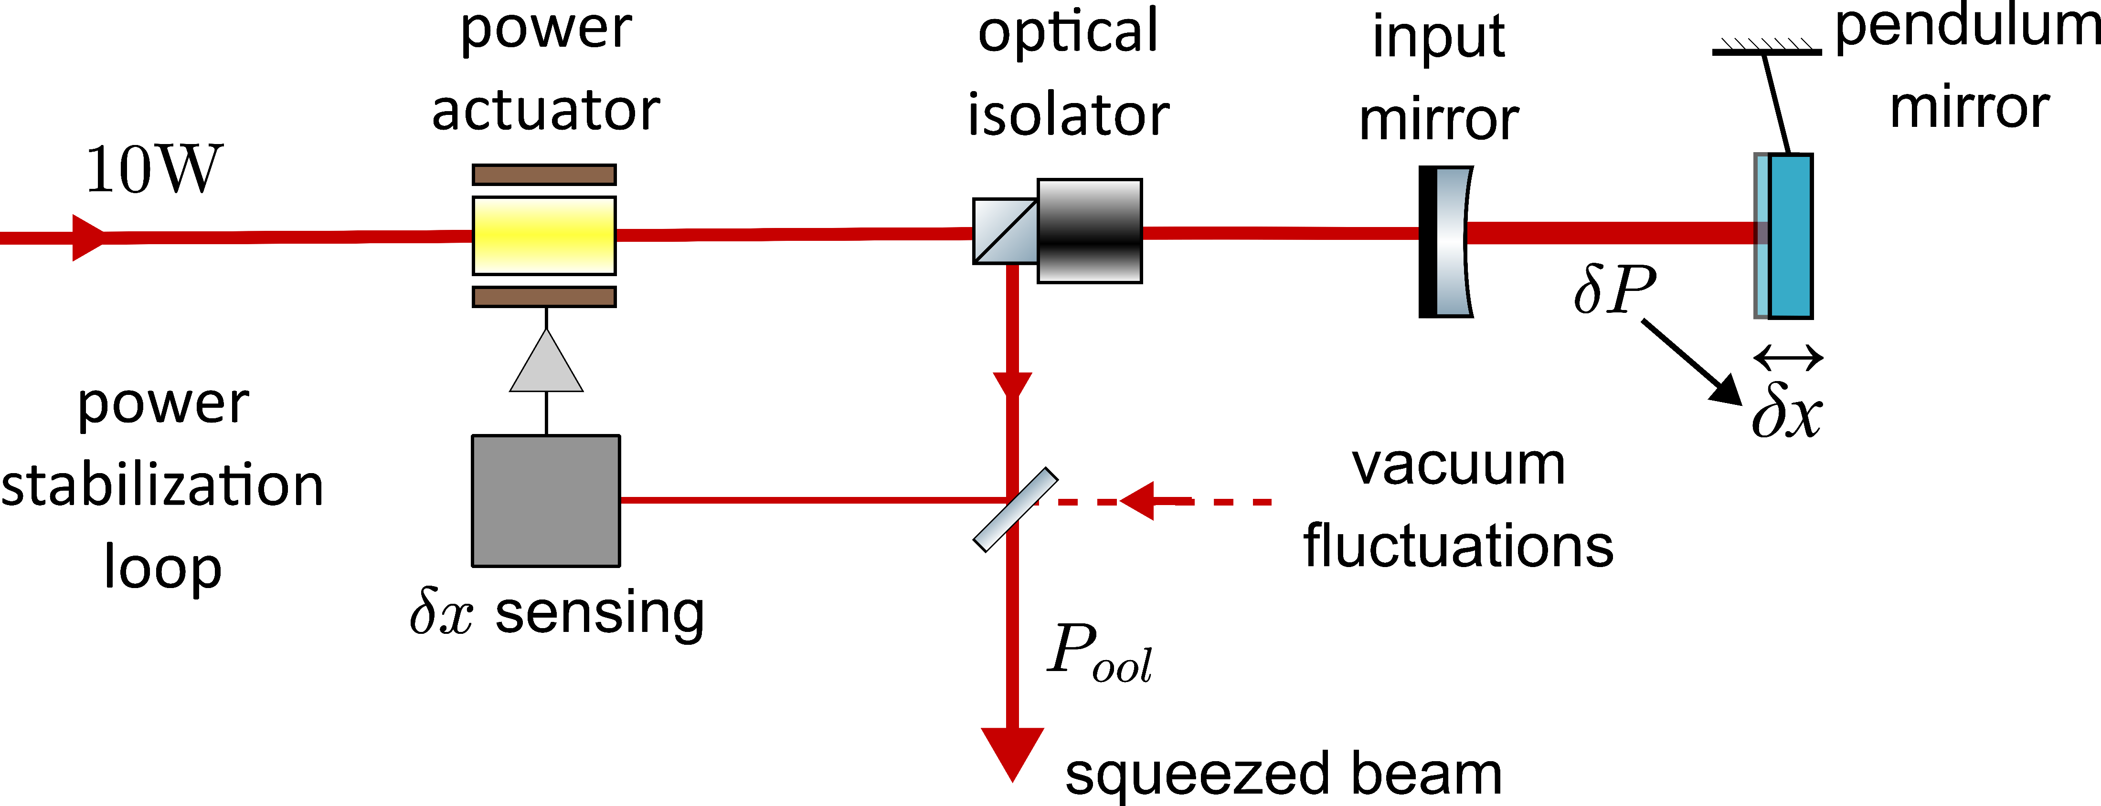
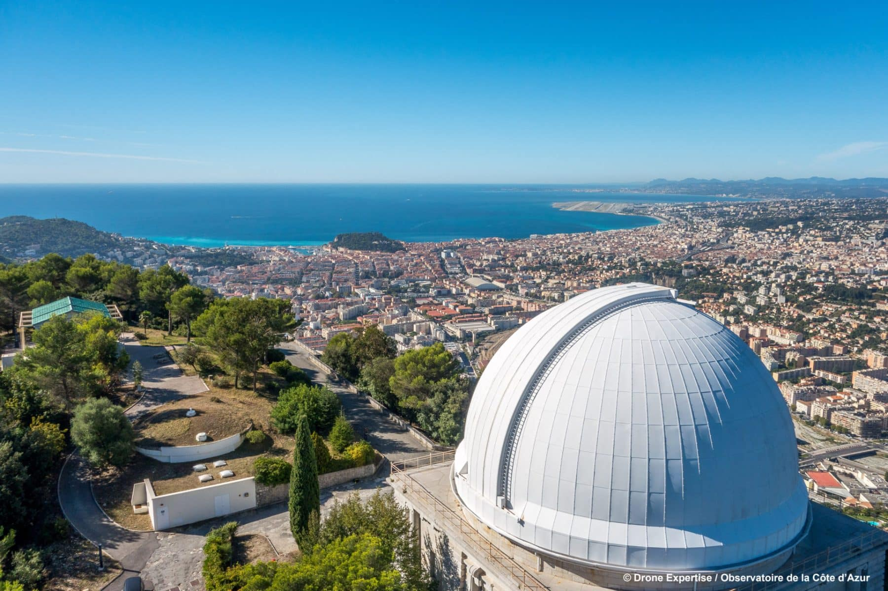
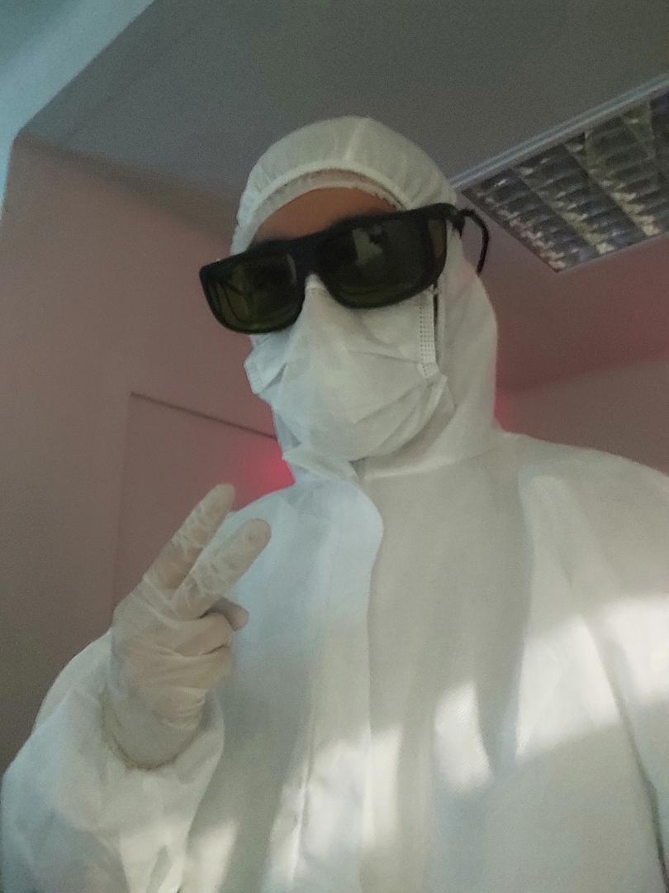
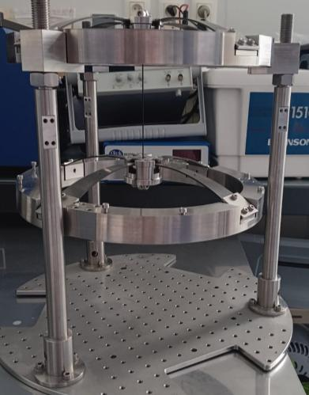
Laser power stabilization and bright squeezing generation via radiation pressure
Alejandro Muñoz
Marina Trad-Nery
Oualid Chaibi
Notes:
Phd student – lab – present scheme for sq/stab via rad pressure on a suspended mirror

Slide 2
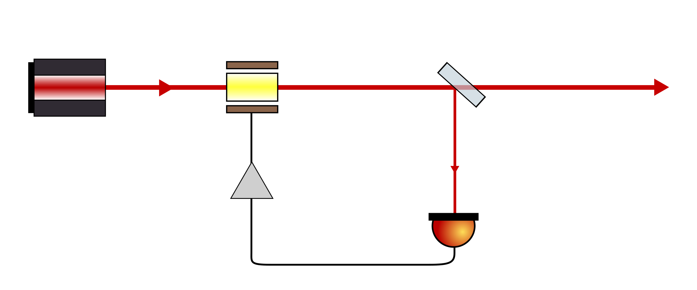
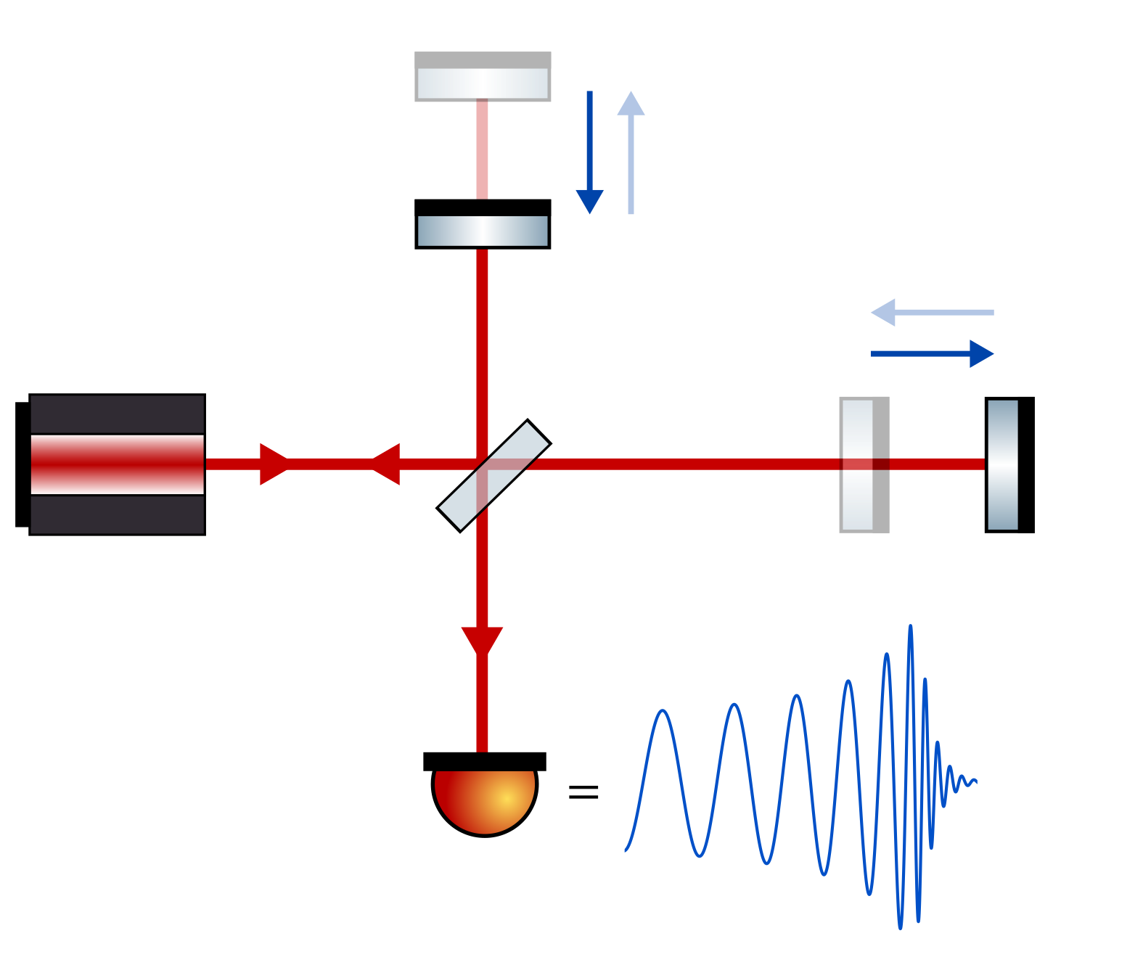
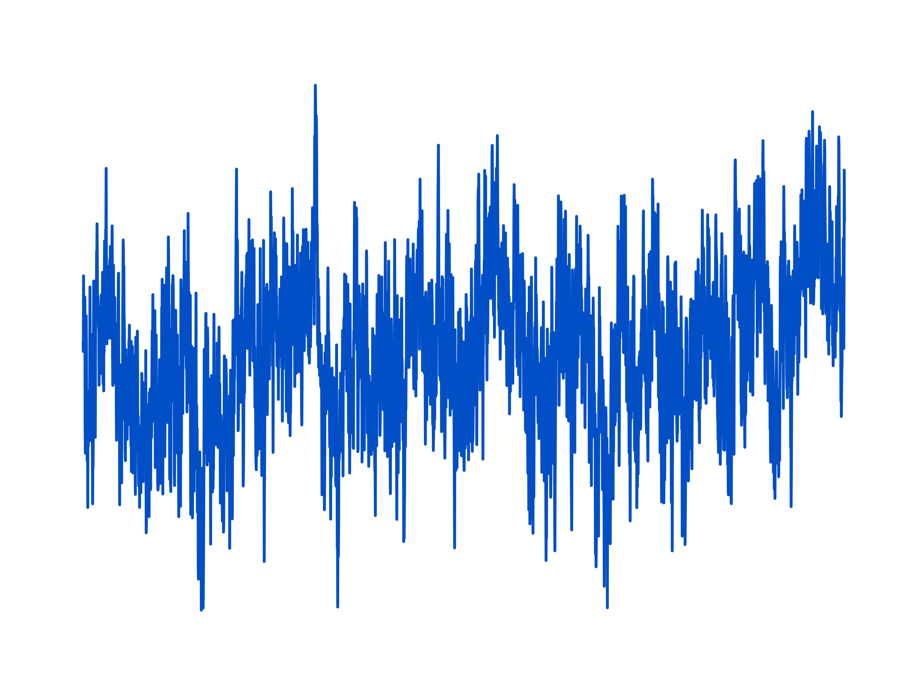
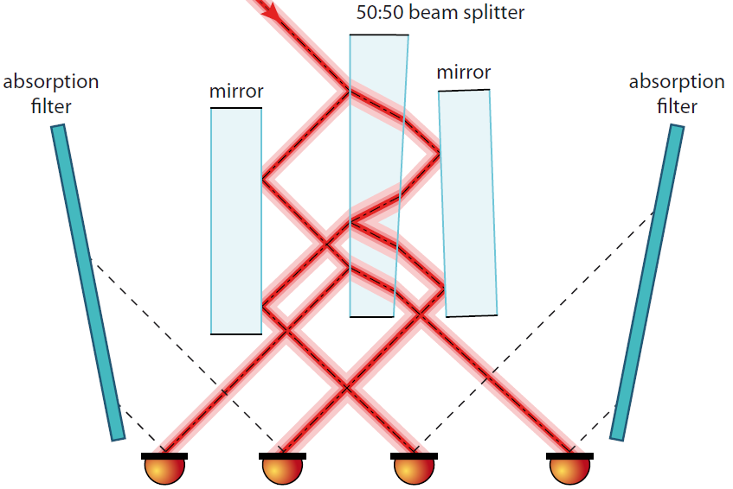
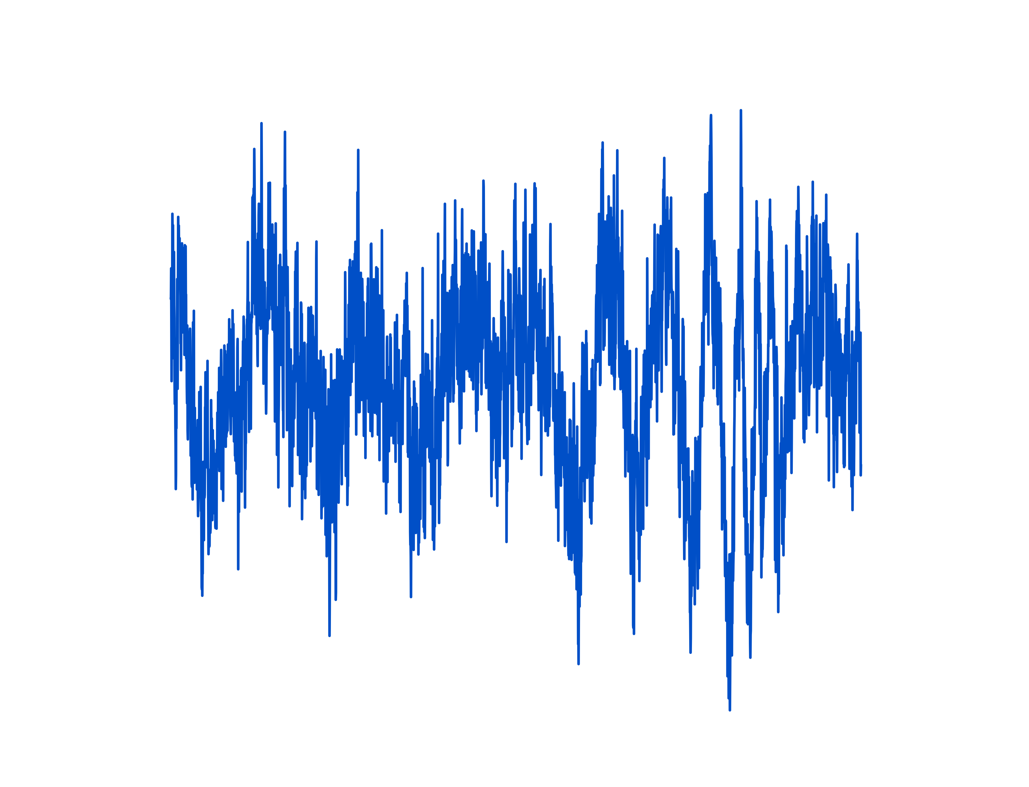


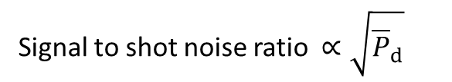
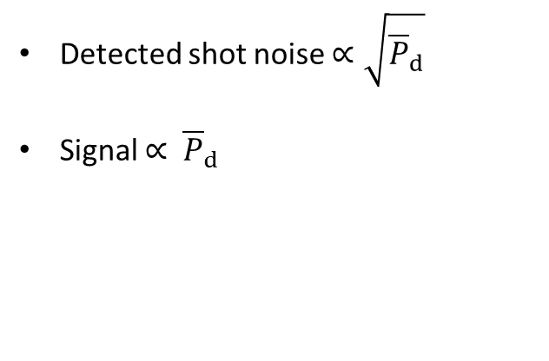

Motivation and current technique
power actuator
beam splitter
laser
$$P_{fr}$$
$$P_{ool}$$
Stability in the output beam?
Power noise
out-of-loop beam
feedback controller
$$P_{d}$$
Detected shot noise $∝\sqrt{{\overline{P}}_{d}}$
Signal $∝$ ${\overline{P}}_{d}$
solution adopted by aLIGO
Signal to shot noise ratio $∝\sqrt{{\overline{P}}_{d}}$
ET requirement:
More than 700 PDs!!!
Each sensing 50mW
Ref.: Patrick Kwee, Laser characterization and stabilization for precision interferometry (2010)
Notes:
Gwd are very sensitive, the power noise couples to the output via different paths. It can mask the weak GW effect, so we need power stabilization.
Currently GWD achieve stabilization with the traditional scheme. Remove interferometer and talk about the detected shot noise (from pickoff) limiting the stabilization. It goes with the square root of the detected power. Currently to satisfy the requirement we need to measure a certain amount of power (how much?). Put picture of ET requirements (below 10e-10, how many PDs?)
This schemeis fundamentally limited by the detected shot noise and the signal to noise ratio is proportional to the sqrt of the detected power. For ligo to fullfill that requirement (10^-9). This exceeds the working limit of the PDs.

Slide 3
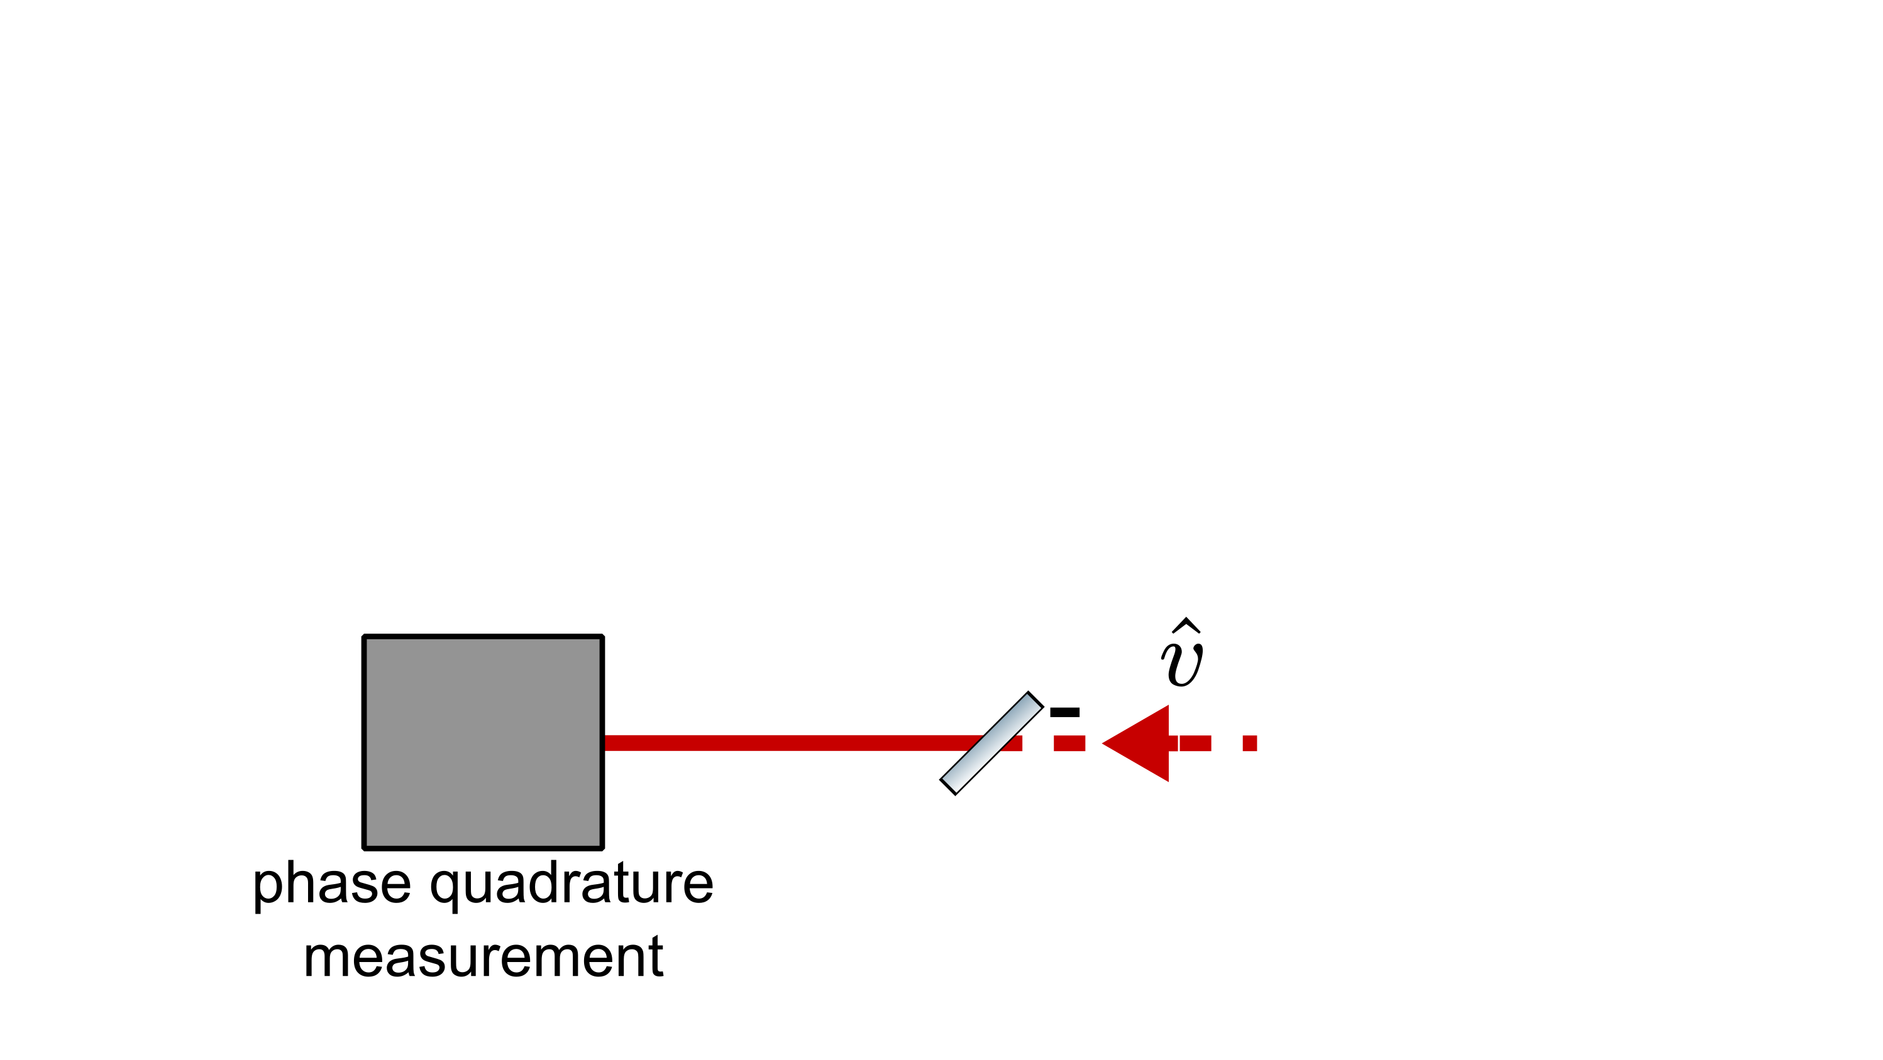
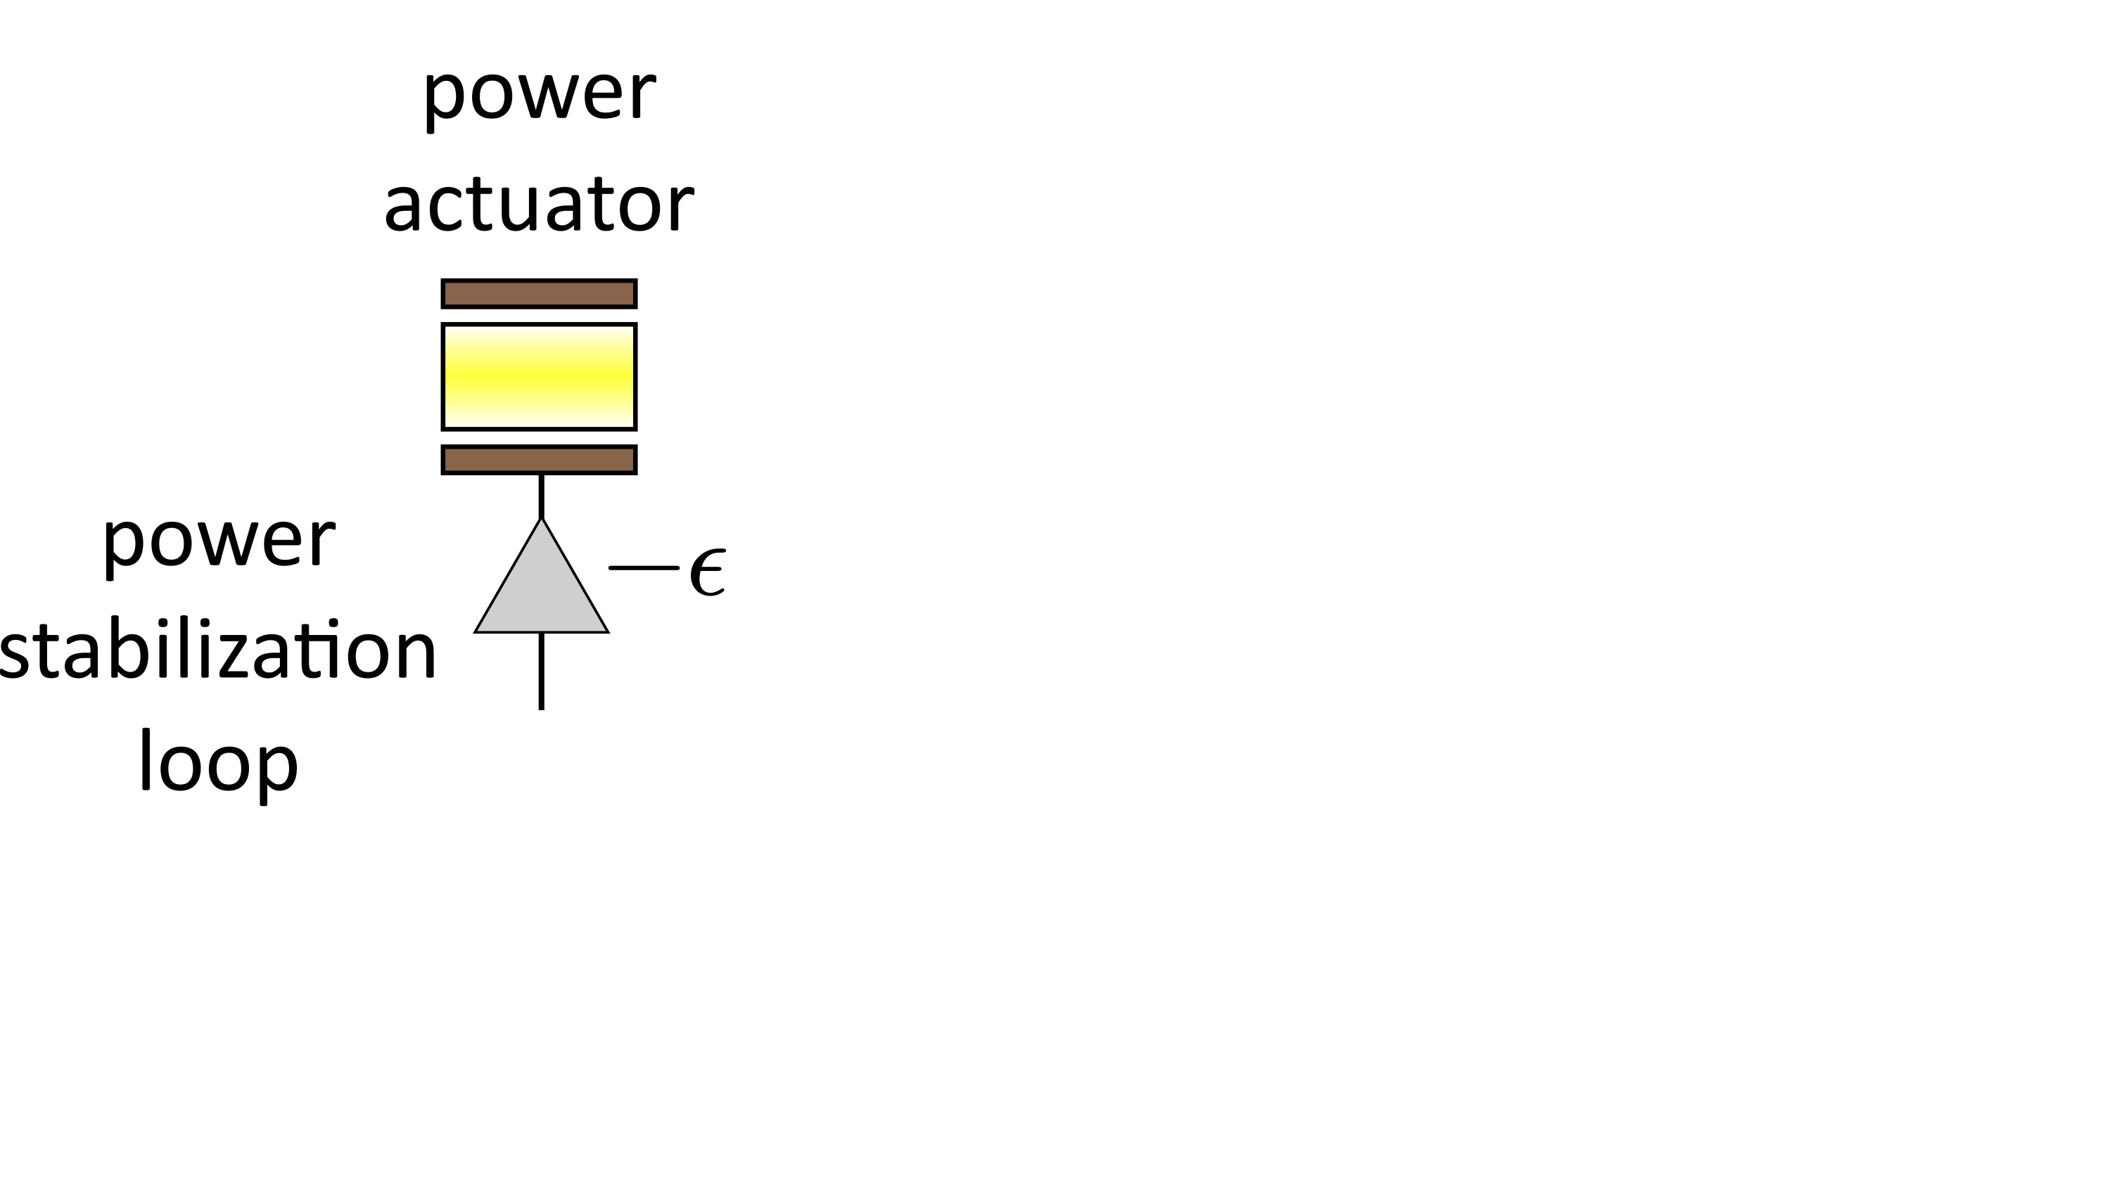
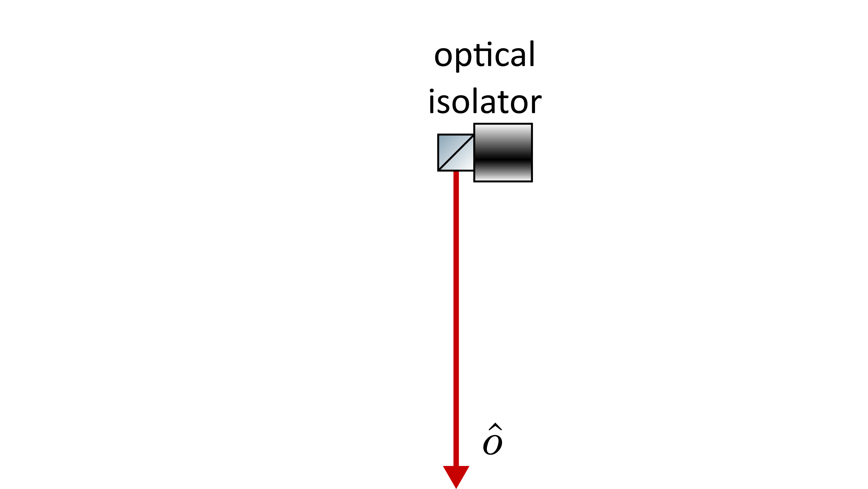
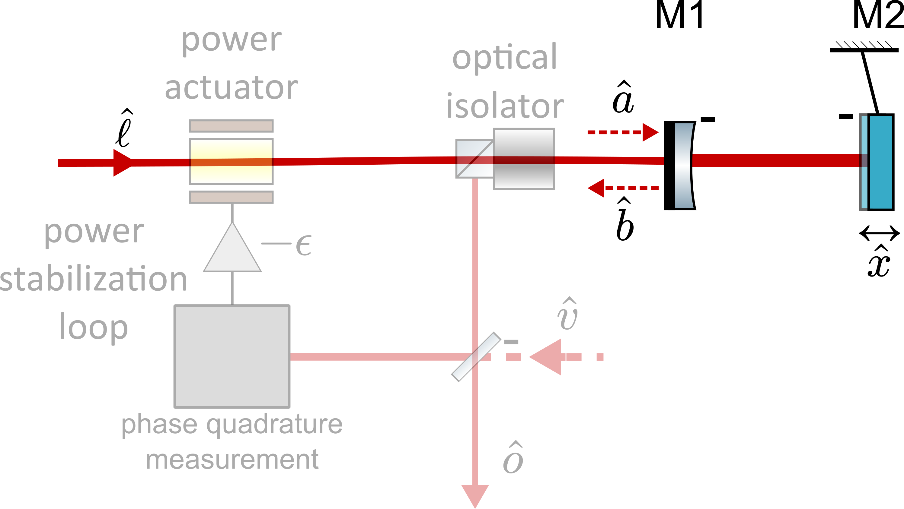
Non-demolition scheme via radiation pressure
Goals of the project:
Generate bright squeezing at low frequencies.
Achieve record of technical power stabilization.
Notes:
Explain concept of the scheme
State goals
Goal: -> sense technical and quantum power noise using radiation pressure in a suspended mirror, sense mirror position PDH, feedback this to power actuator, stabilize technical and quantum noise.
Goals are bright squeezing at low freq and record technical power stabilization
Say non-demolition – highlight signal to noise ratio by detecting full power. Quantum-noise-wise, we can achieve 10e-10 with this scheme (link to next slide)
Goal: calculate the RPN in the output. For this we have some simulations that i will show for the quantum and thermal noise.

Slide 4
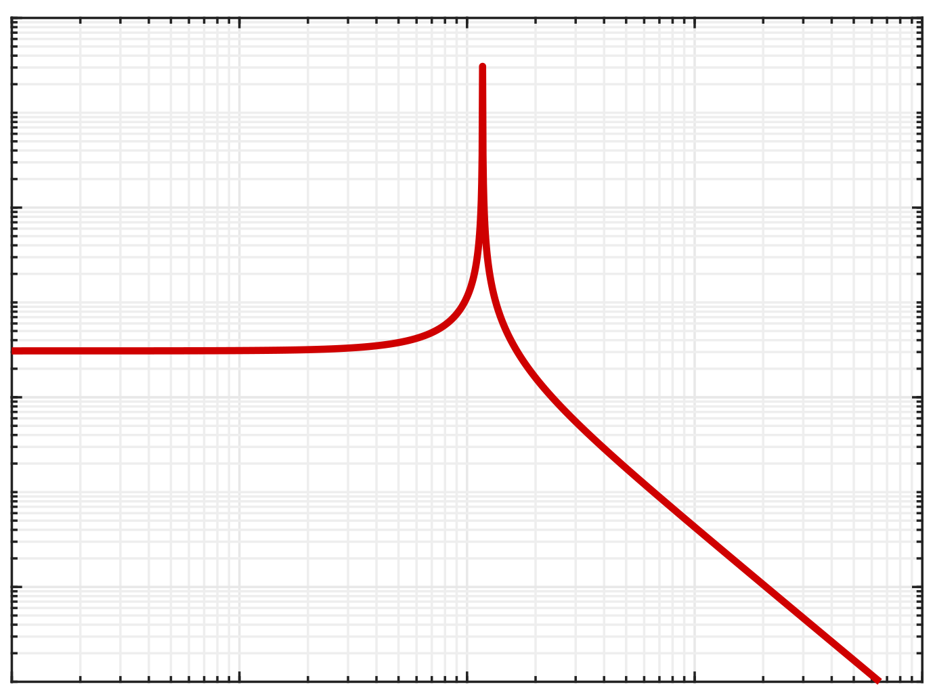
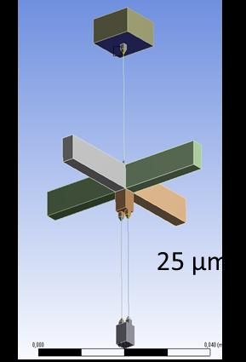



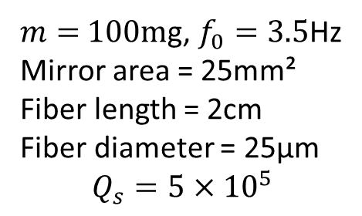


Quantum noise limit
amplitude
Two-photon formalism:
phase
Input phase fluctuations
Input amplitude fluctuations
Mechanical susceptibility
$$\hat{h}$$
$$f_{0}$$
$χ_{m}$ (m$∙$N⁻¹)
$$f^{−2}$$
Reflected phase fluctuations
$$∝1/(m∙f_{0}^{2})$$
Frequency
$m=$ 100mg, $f_{0}=$ 3.5Hz
Mirror area = 25mm²
Fiber length = 2cm
Fiber diameter = 25µm
$$Q_{s}=5×{10}^{5}$$
Notes:
Explain the process in the loop, cavity enhances, and PHD lets read the sine quadrature.
Cavity fully reflective so we dont have an extra uncorrelated vacuum field from the right
Signal in control loop increases with mechanical susceptibility, lighter and smaller resonance frequency
Cavity enchances drastically power hitting the mirror.

Slide 5
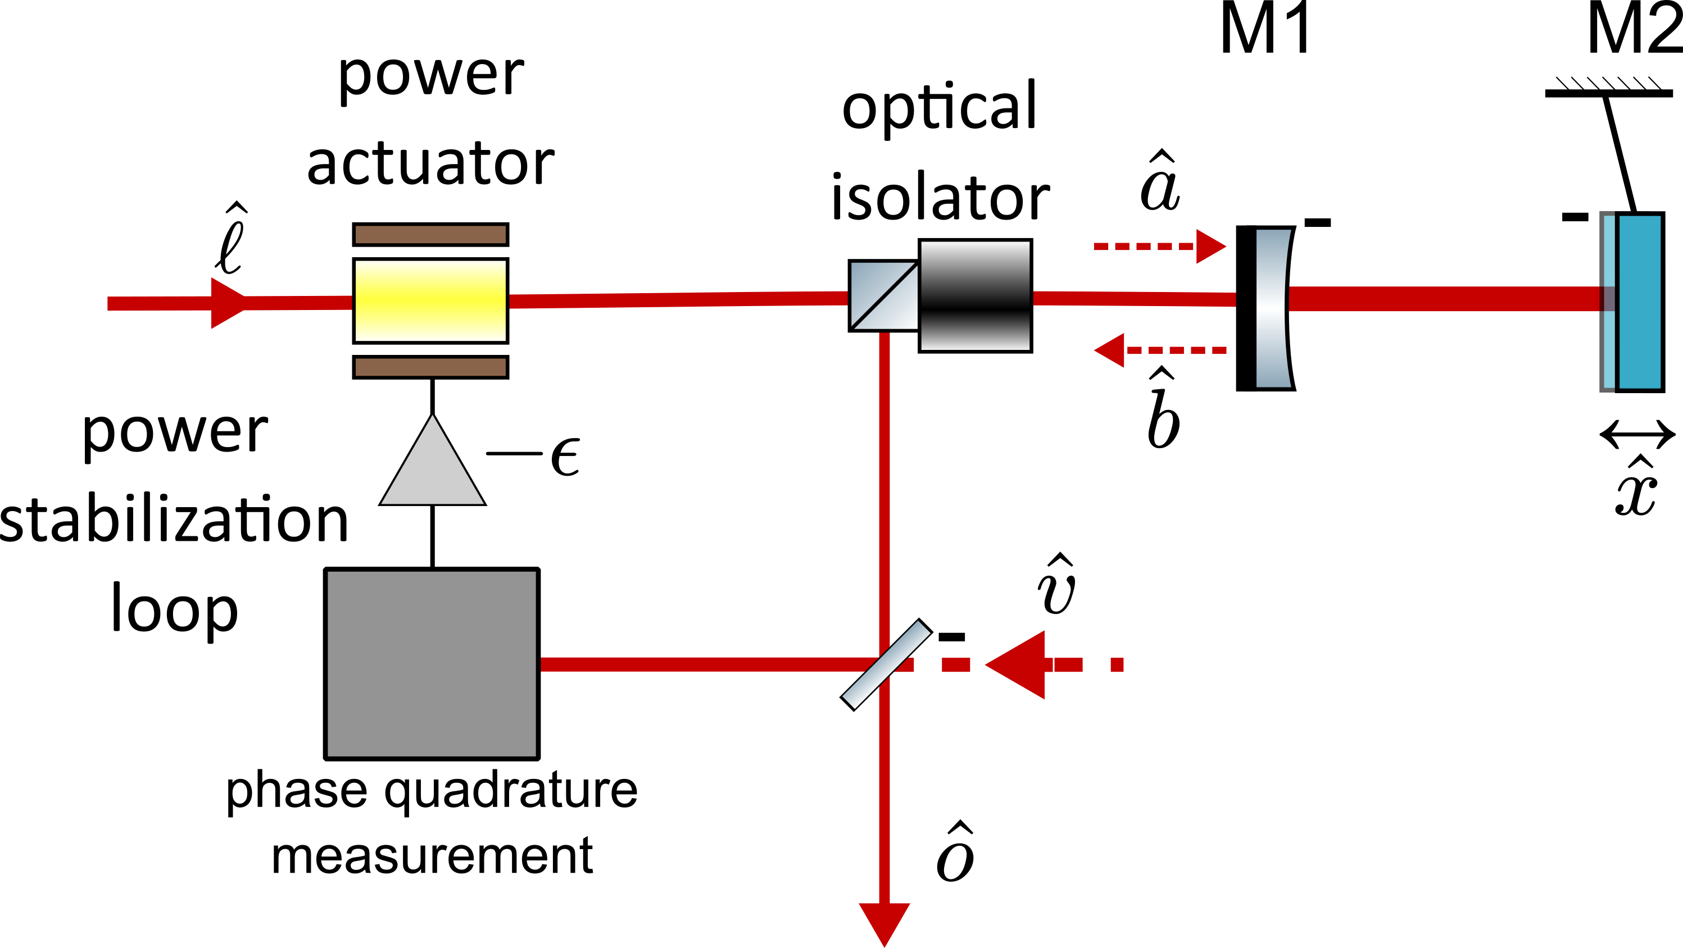
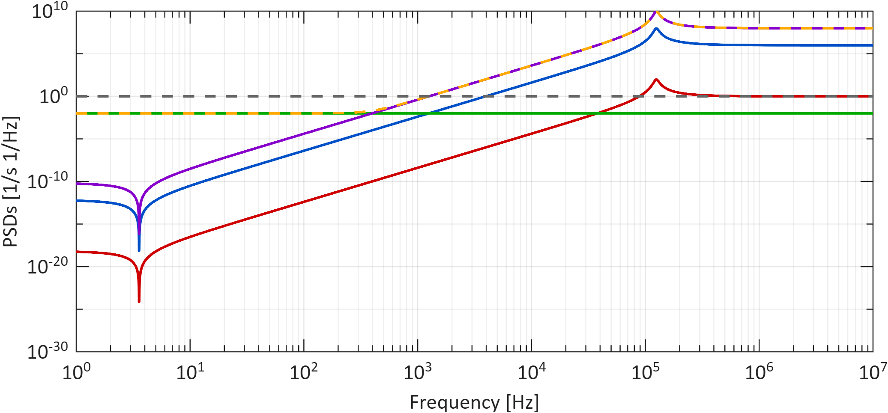





Quantum noise limit
Coherent beam
Noise in the output cosine quadrature
Mechanical susceptibility
Squeezing!
$$\hat{h}$$
$$f_{0}$$
Laser amplitude
Laser phase
Vacuum amplitude
Vacuum phase
Total
Coherent beam
$χ_{m}$ (m$∙$N⁻¹)
$$f^{−2}$$
$$∝1/(m∙f_{0}^{2})$$
Frequency
Notes:
the shape is because of the cavity TF, and its proportionality to the mechanical susceptibility. The laser power fluctuations are further suppressed by the controller gain. The phase fluctuations have a similar role, because they are both indistinguishable from laser power fluctuations, so the loop also tries to compensate for them (hence their dependence on K). But the limitant factor are the vacuum power fluctuations that are directly imprinted to the ool and never enter the loop.
Since it cannot distinfuish, it imprints then in the output. If the susceptibility is large it imprints less noise because the signal to noise ratio is better

Slide 6
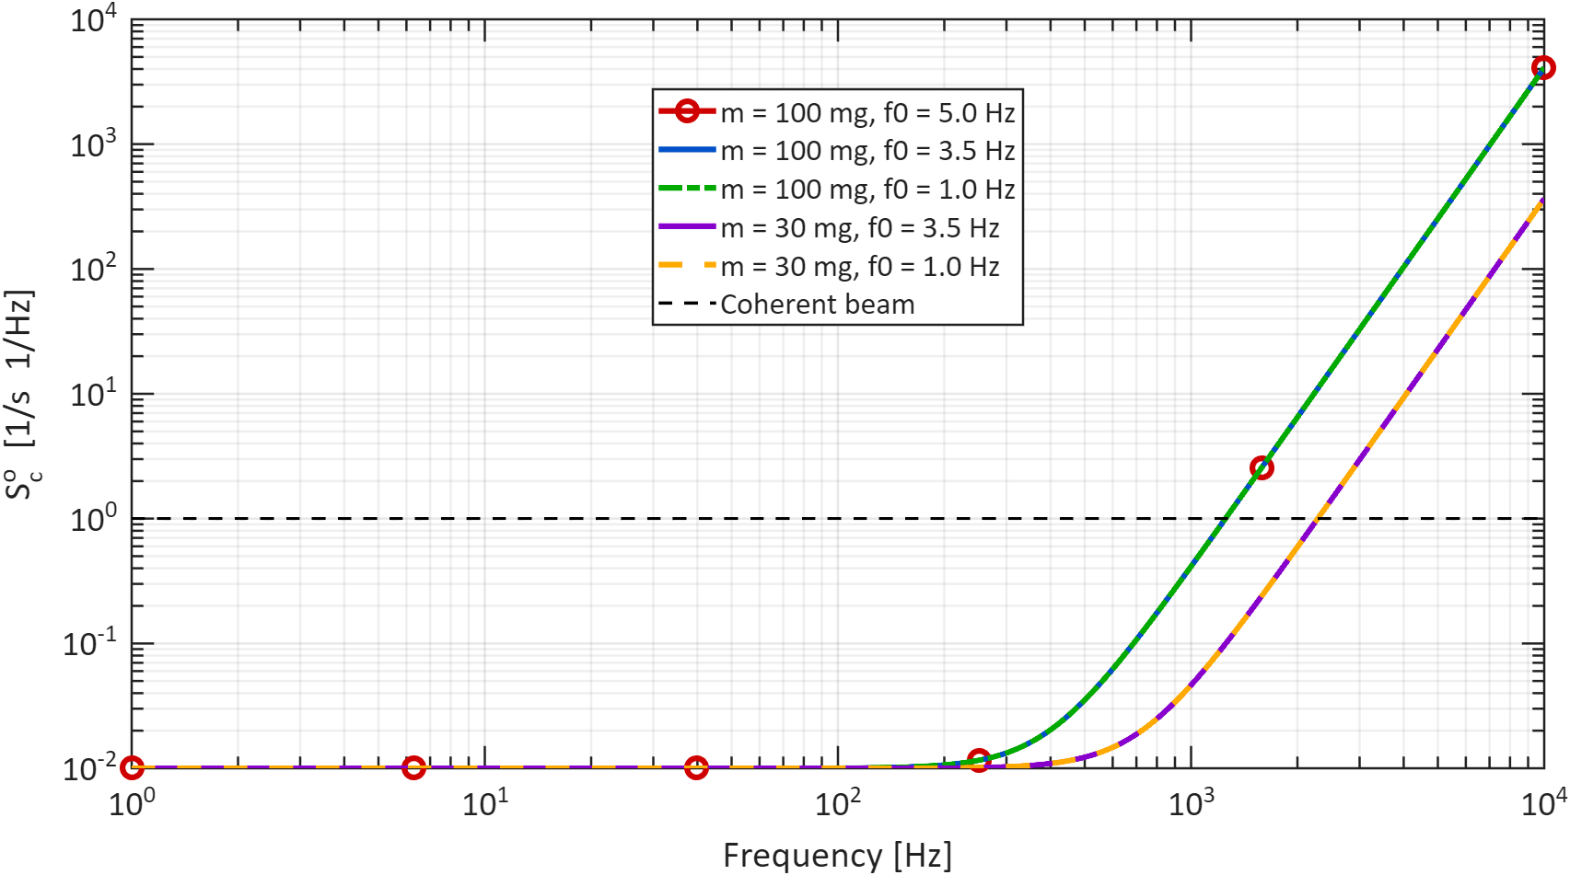
Quantum noise limit
Coherent beam
Noise in output cosine quadrature for different mirrors
Laser amplitude
Laser phase
Vacuum amplitude
Vacuum phase
Total
Coherent beam
100mg
30mg

Slide 7
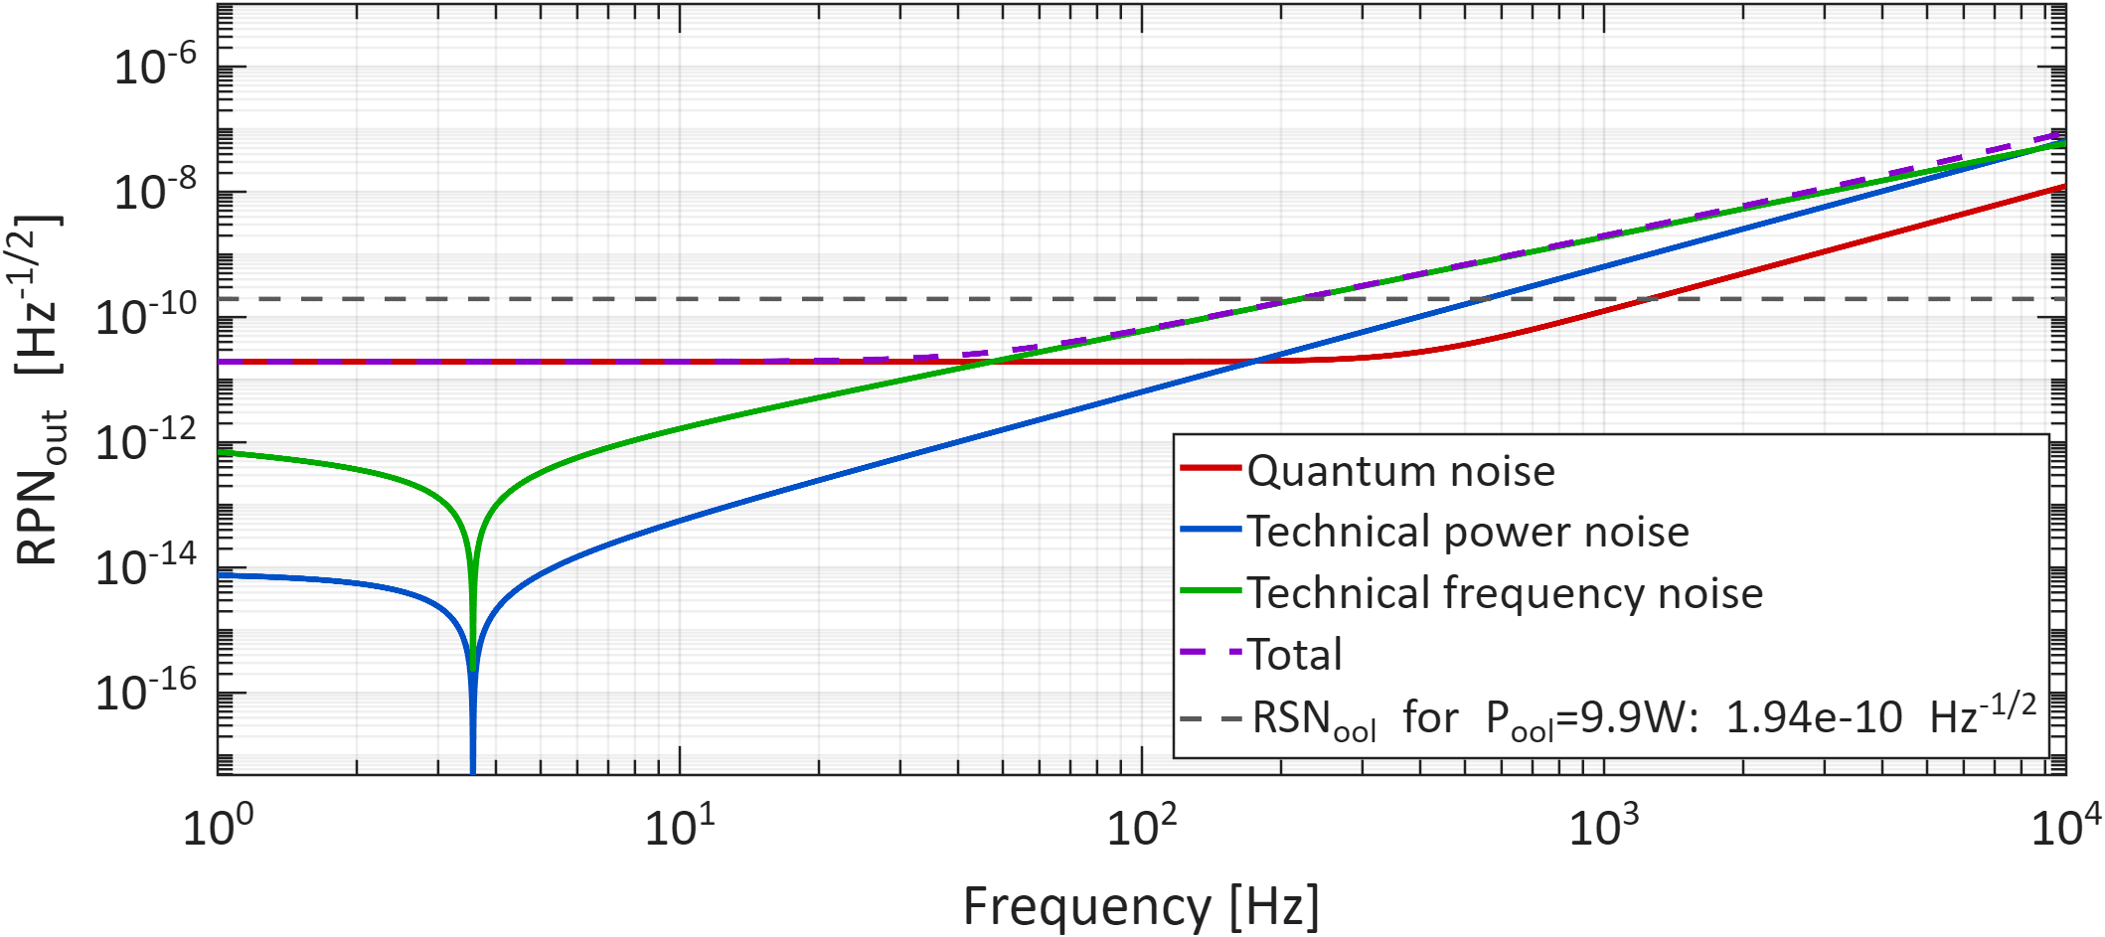
Laser technical noise
Laser power noise:
Laser frequency noise to position noise:
Power noise in the output accounting for technical laser noise
Notes:
Move eqs to backup
I used the frequency noise of a laser stabilized to a very stable reference cavity

Slide 8
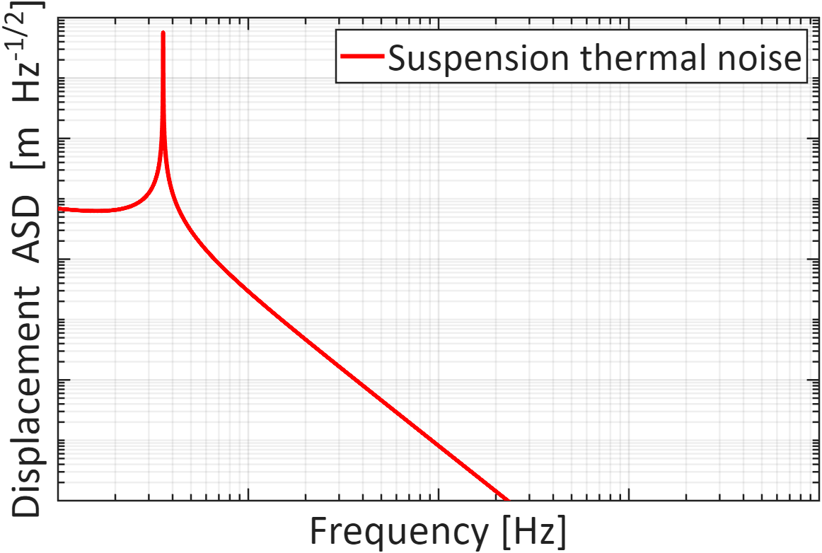
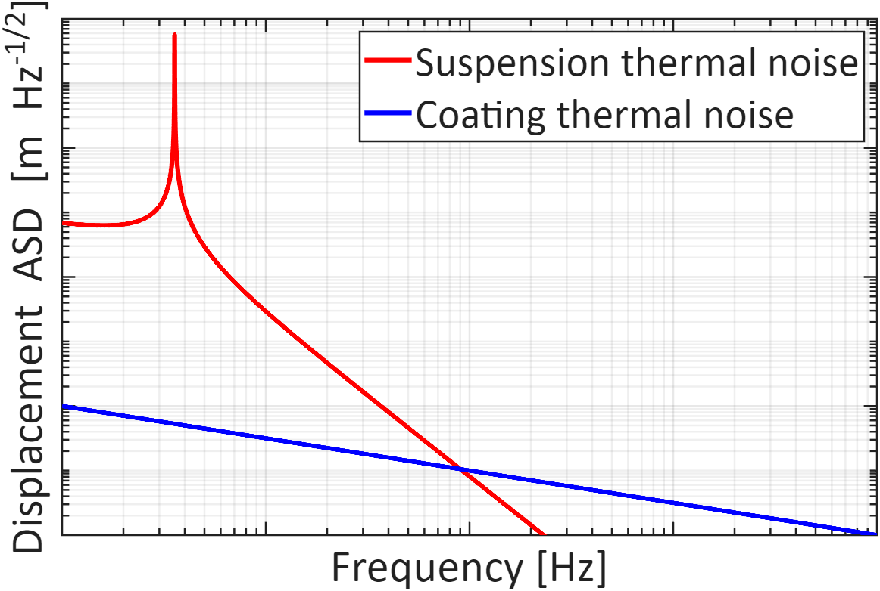

Thermal noise limit
Minimum RPN limited by
suspension thermal noise
Suspension
$$x_{rp}≥x_{th}$$
Coating
Minimum RPN limited by
coating thermal noise
Notes:
Thermal noise limit is obtained by imposing xrp>=xtn. Put plot of suspension and coating thermal noise. Gets better with suspension quality factor, power hitting the mirror, and by the dilution factor.

Slide 9
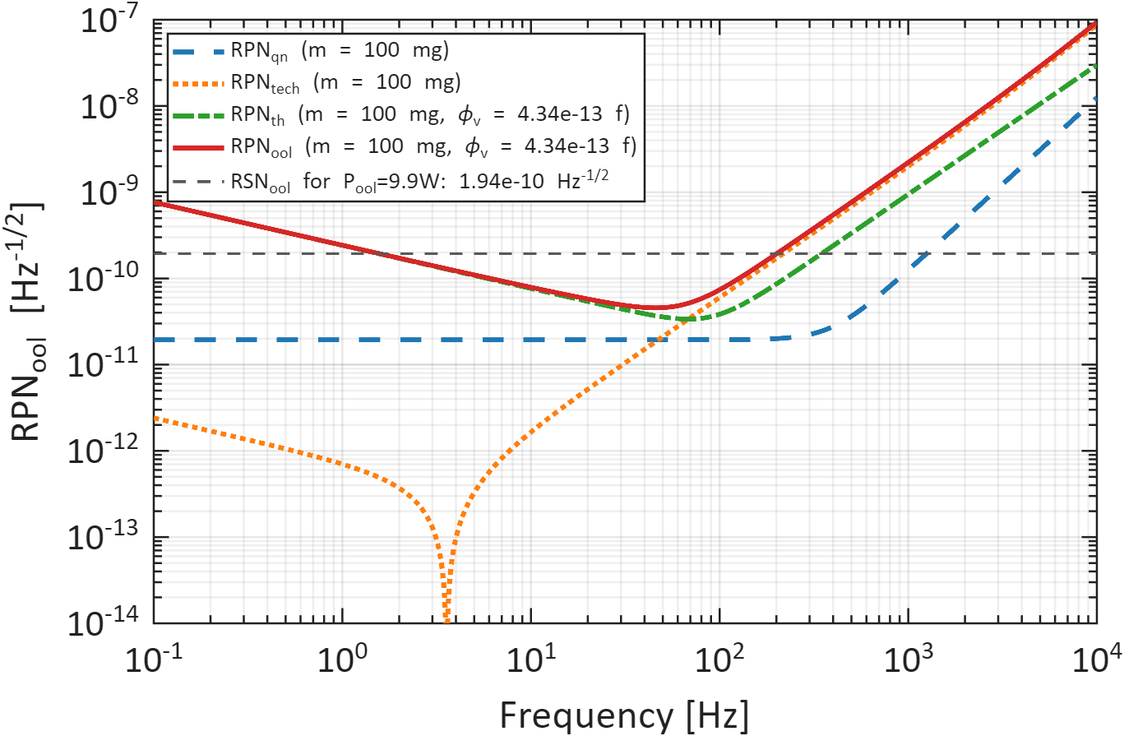
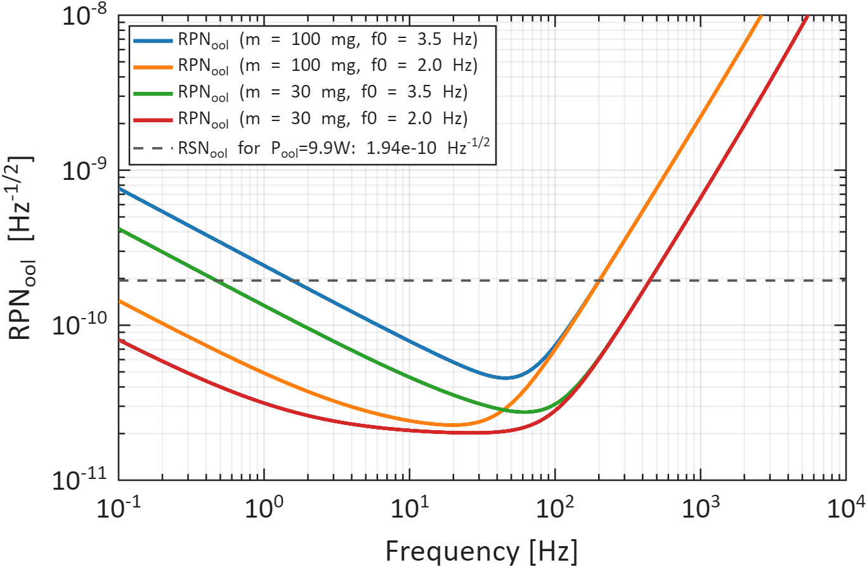
Total fundamental limit
RPN limited by quantum, technical, and thermal noise
Total power noise in the output for different mirrors
12.6dB
17.0dB
19.6dB
How to improve:
Increase power hitting suspended mirror
Increase susceptibility
Notes:
Put picture of mirror, the parameters mass and length. We choose these parameters because the work for the mirror is already ongoing in artemis for another project. If the fiber can be shorter would be nice.

Slide 10
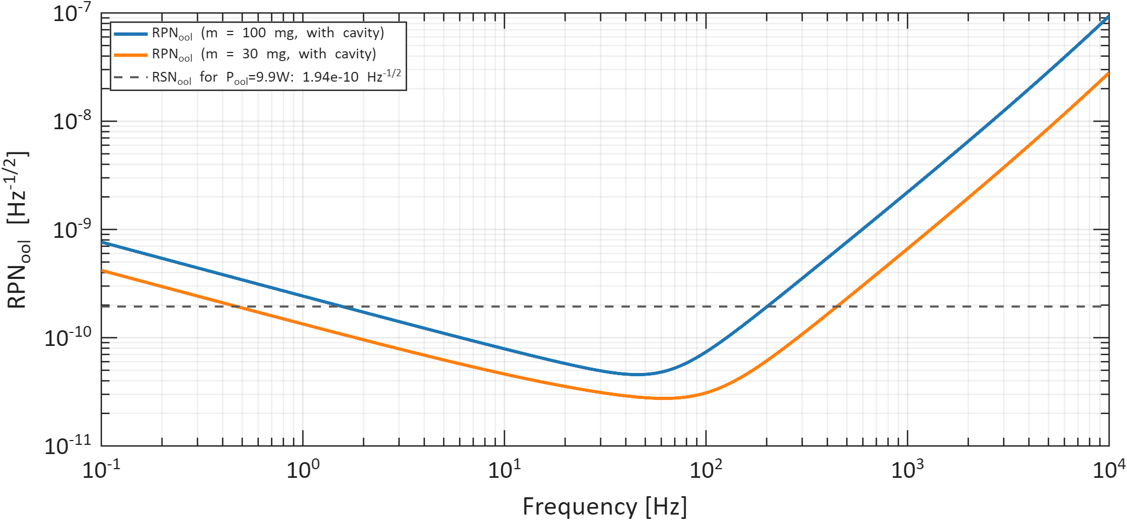
Other bright squeezing schemes
RPN in output beam for different schemes
Cavity scheme
Cav. scheme 100mg
Cavity scheme w/o input mirror
RSN 9.9W
Cav. scheme 30mg
Notes:
Goals: compare different schemes
In gravitational wave detections the traditional scheme consists in sensing power fluctuations from a pickoff beam to then actuate on the power to compensate. The best case scenario, the resulting squeezing is limited by the vacuum fluctuations coming from the top port. Because of that, injecting squeezed vacuum improves the squeezing achieved.

Slide 11
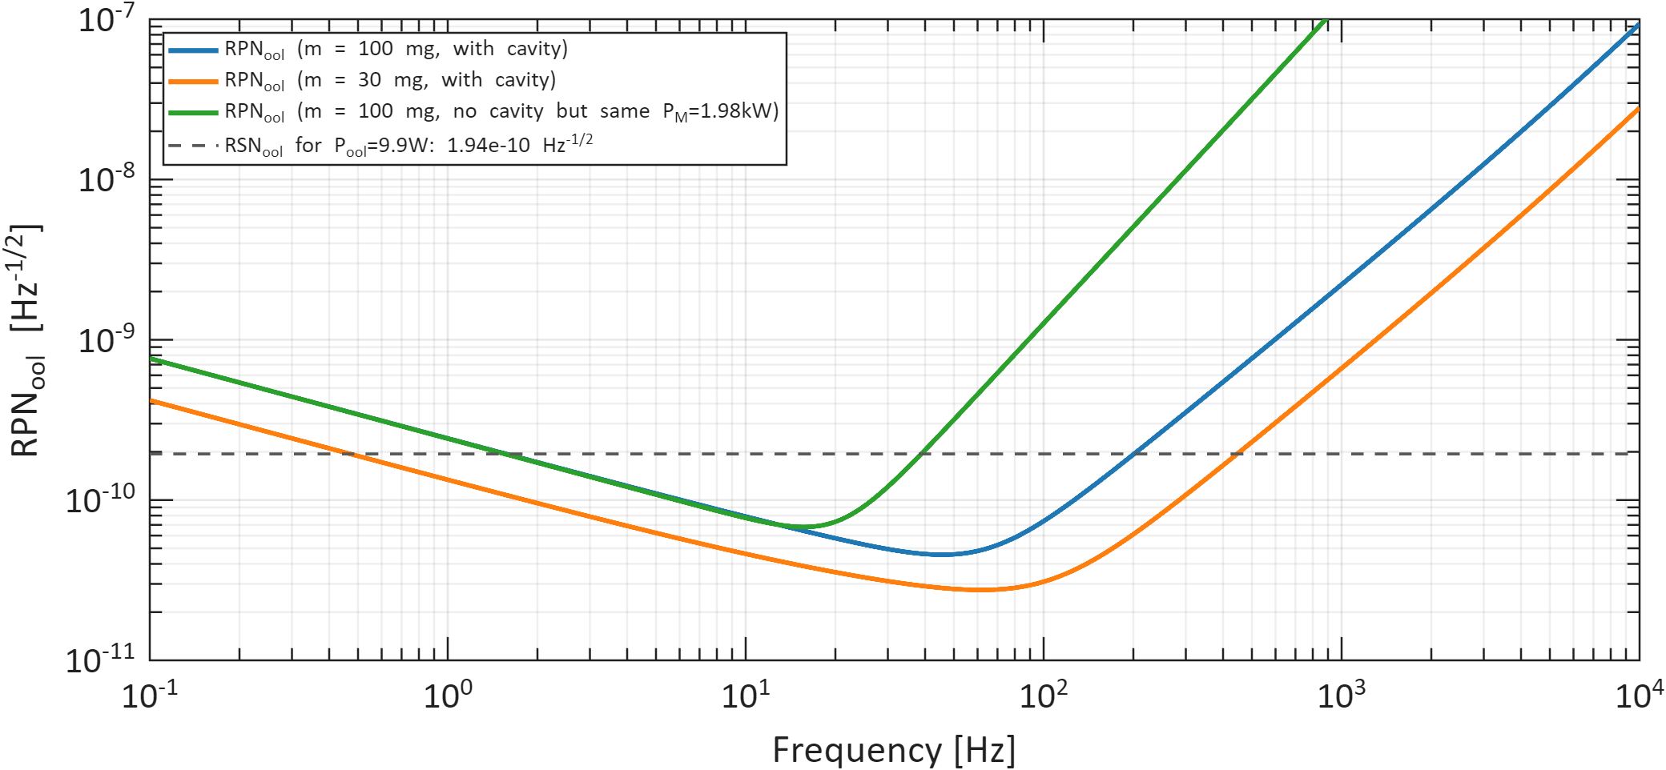
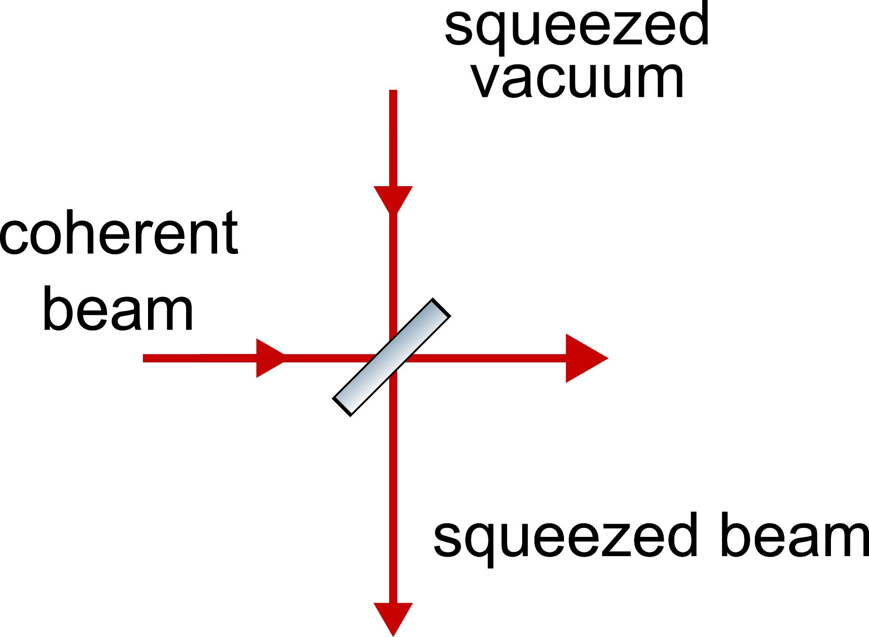
Other bright squeezing schemes
RPN in output beam for different schemes
Cav. scheme 100mg no cavity
Cav. scheme 100mg
BS interference
10W
RSN 9.9W
Cav. scheme 30mg
Notes:
Goals: compare different schemes
In gravitational wave detections the traditional scheme consists in sensing power fluctuations from a pickoff beam to then actuate on the power to compensate. The best case scenario, the resulting squeezing is limited by the vacuum fluctuations coming from the top port. Because of that, injecting squeezed vacuum improves the squeezing achieved.

Slide 12
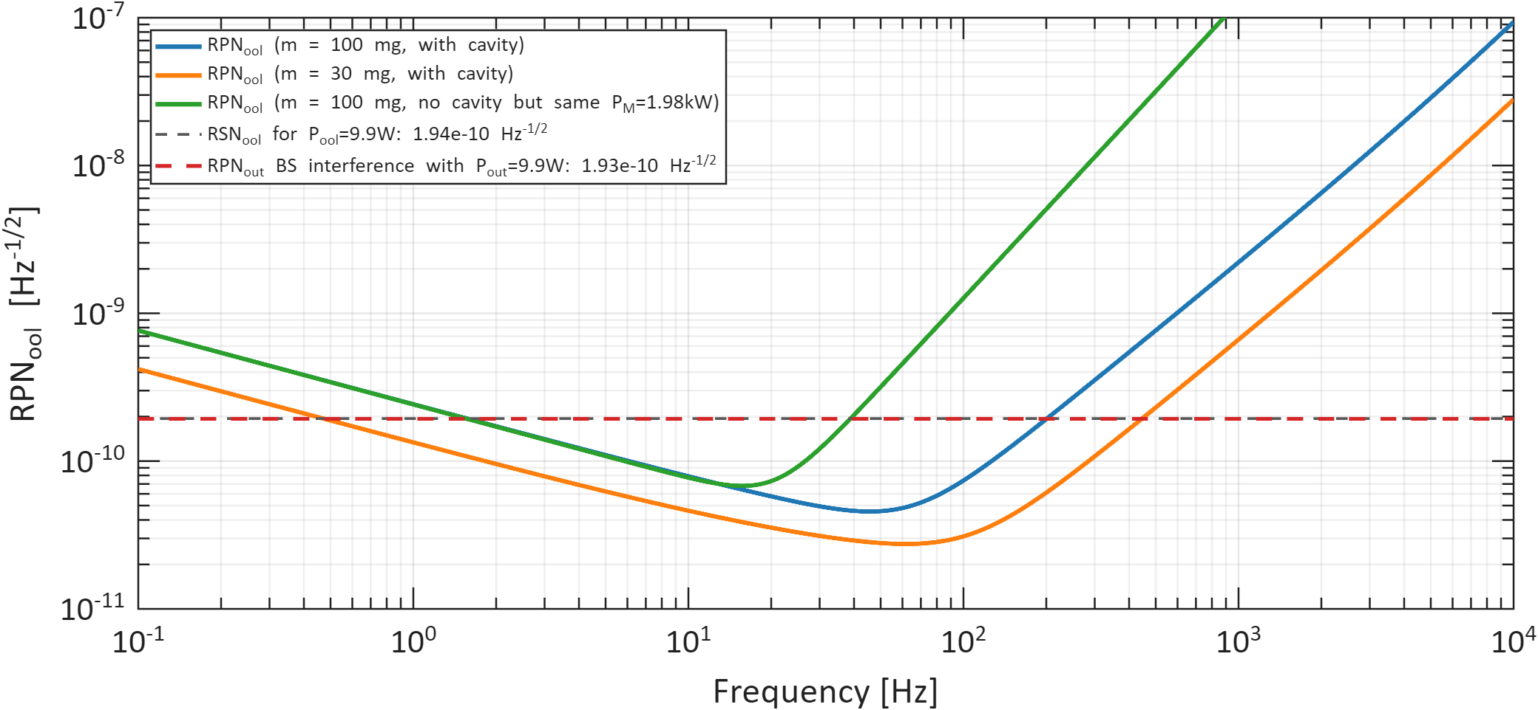
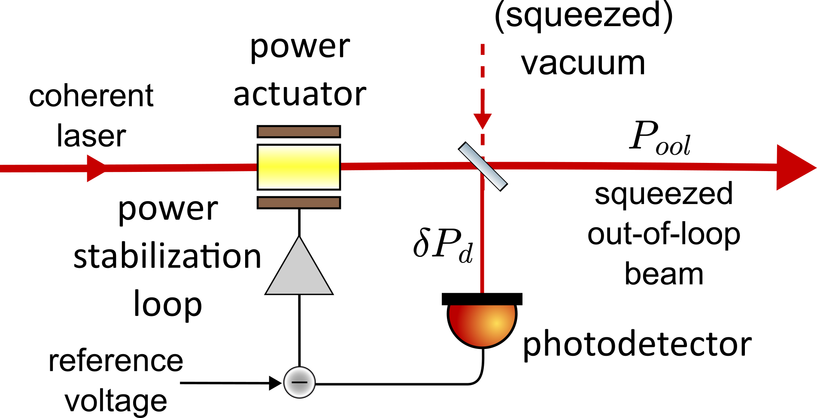
Other bright squeezing schemes
RPN in output beam for different schemes
Cav. scheme 100mg no cavity
Cav. scheme 100mg
Traditional scheme
RSN 9.9W
BS interference
Cav. scheme 30mg
Notes:
Goals: compare different schemes
In gravitational wave detections the traditional scheme consists in sensing power fluctuations from a pickoff beam to then actuate on the power to compensate. The best case scenario, the resulting squeezing is limited by the vacuum fluctuations coming from the top port. Because of that, injecting squeezed vacuum improves the squeezing achieved.

Slide 13
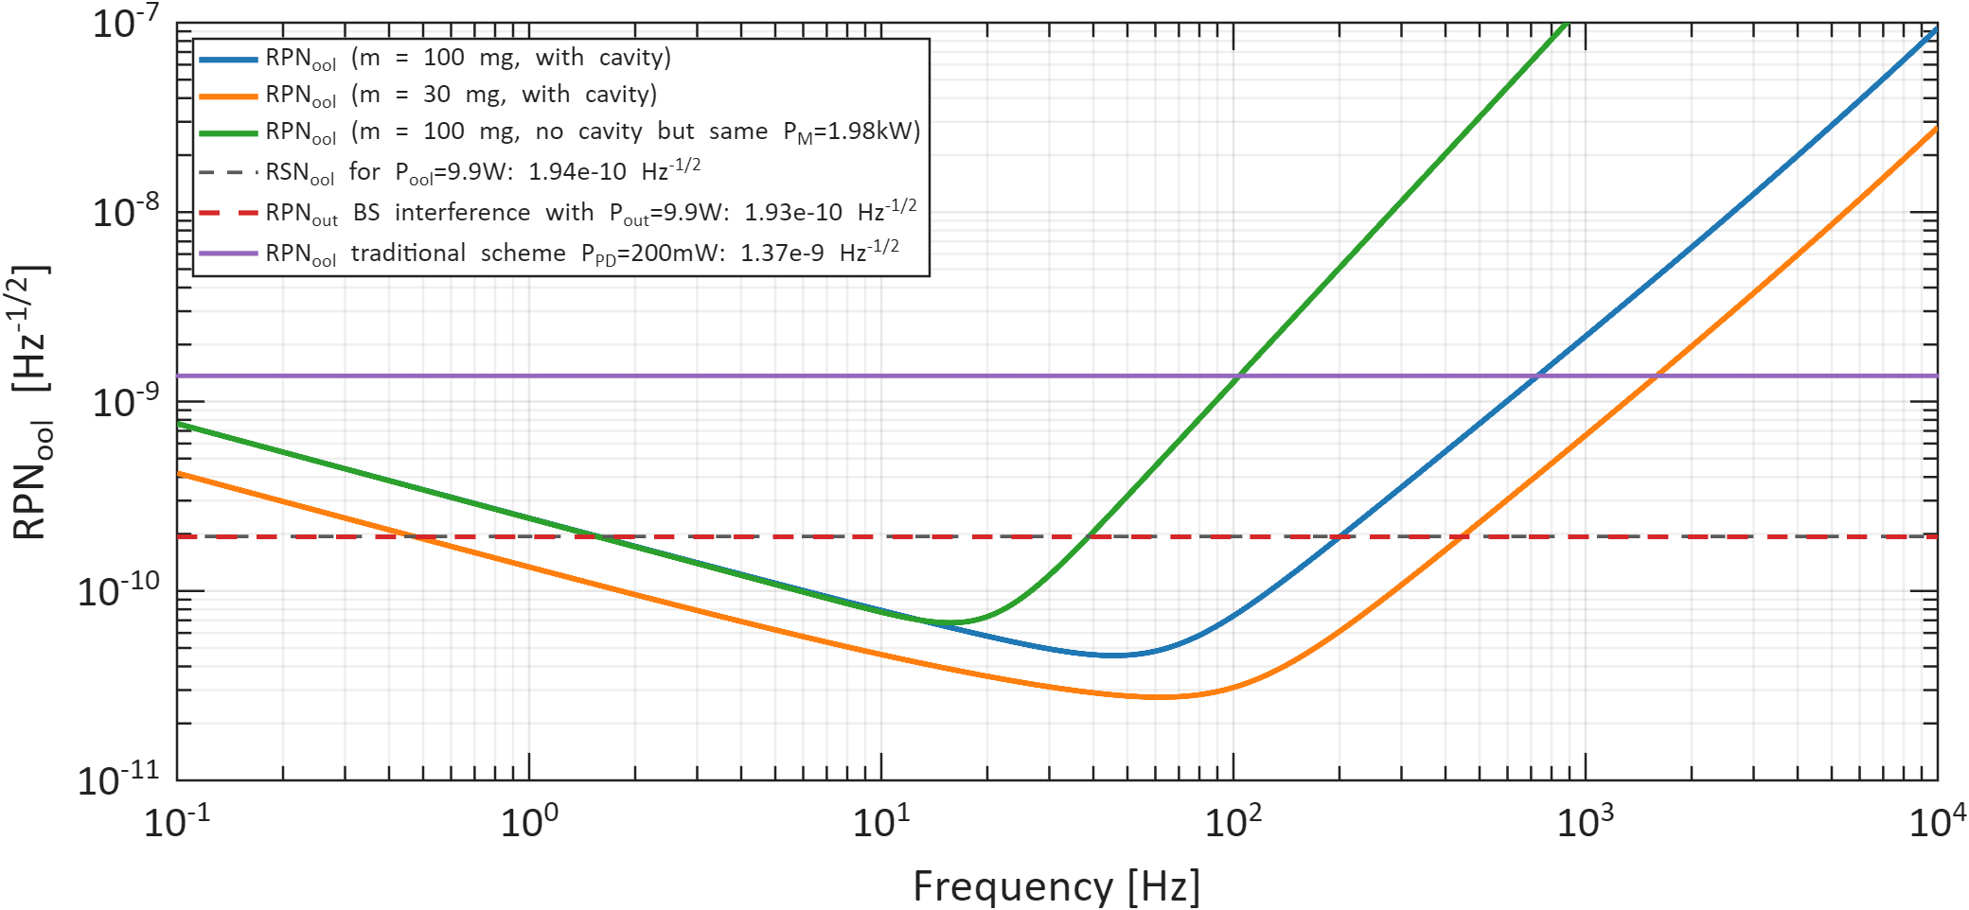
Other bright squeezing schemes
RPN in output beam for different schemes
Cav. scheme 100mg no cavity
Cav. scheme 100mg
Traditional scheme + 10dB squeezing
Traditional scheme
RSN 9.9W
BS interference
Cav. scheme 30mg
Notes:
Goals: compare different schemes
In gravitational wave detections the traditional scheme consists in sensing power fluctuations from a pickoff beam to then actuate on the power to compensate. The best case scenario, the resulting squeezing is limited by the vacuum fluctuations coming from the top port. Because of that, injecting squeezed vacuum improves the squeezing achieved.
Traditional scheme has photodiode array

Slide 14
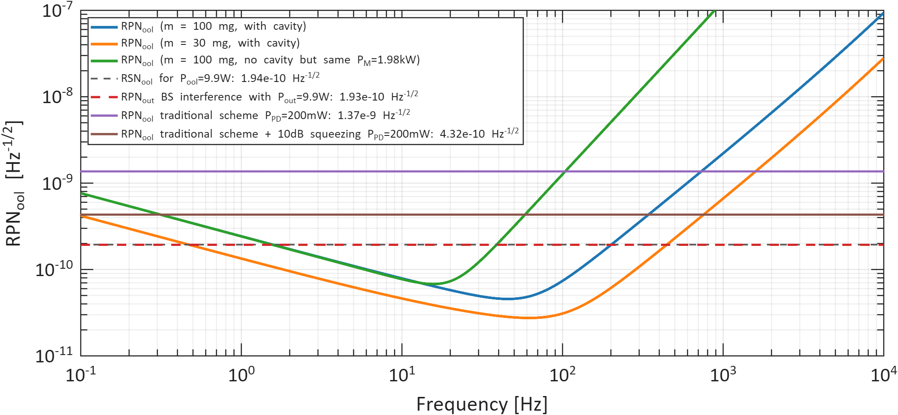
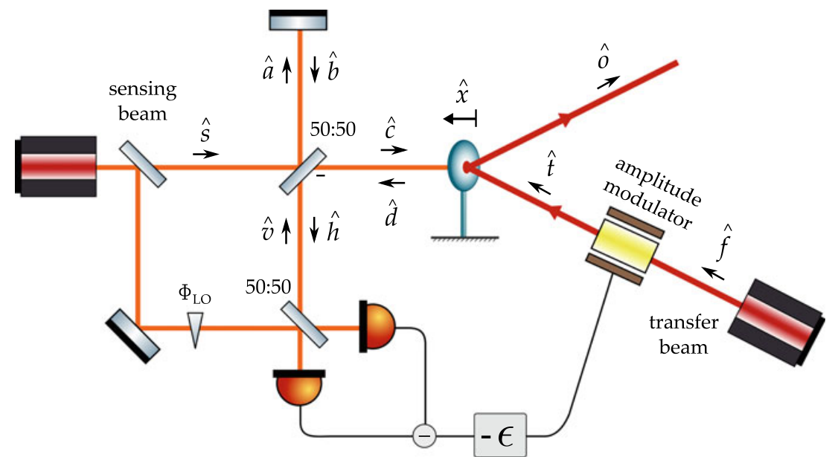
Other bright squeezing schemes
RPN in output beam for different schemes
Cav. scheme 100mg no cavity
Cav. scheme 100mg
2 beam scheme (Marina’s thesis)
Traditional scheme
200mW
Traditional + squeezing
RSN 9.9W
BS interference
9.9W
Cav. scheme 30mg
Notes:
Goals: compare different schemes
In gravitational wave detections the traditional scheme consists in sensing power fluctuations from a pickoff beam to then actuate on the power to compensate. The best case scenario, the resulting squeezing is limited by the vacuum fluctuations coming from the top port. Because of that, injecting squeezed vacuum improves the squeezing achieved.

Slide 15
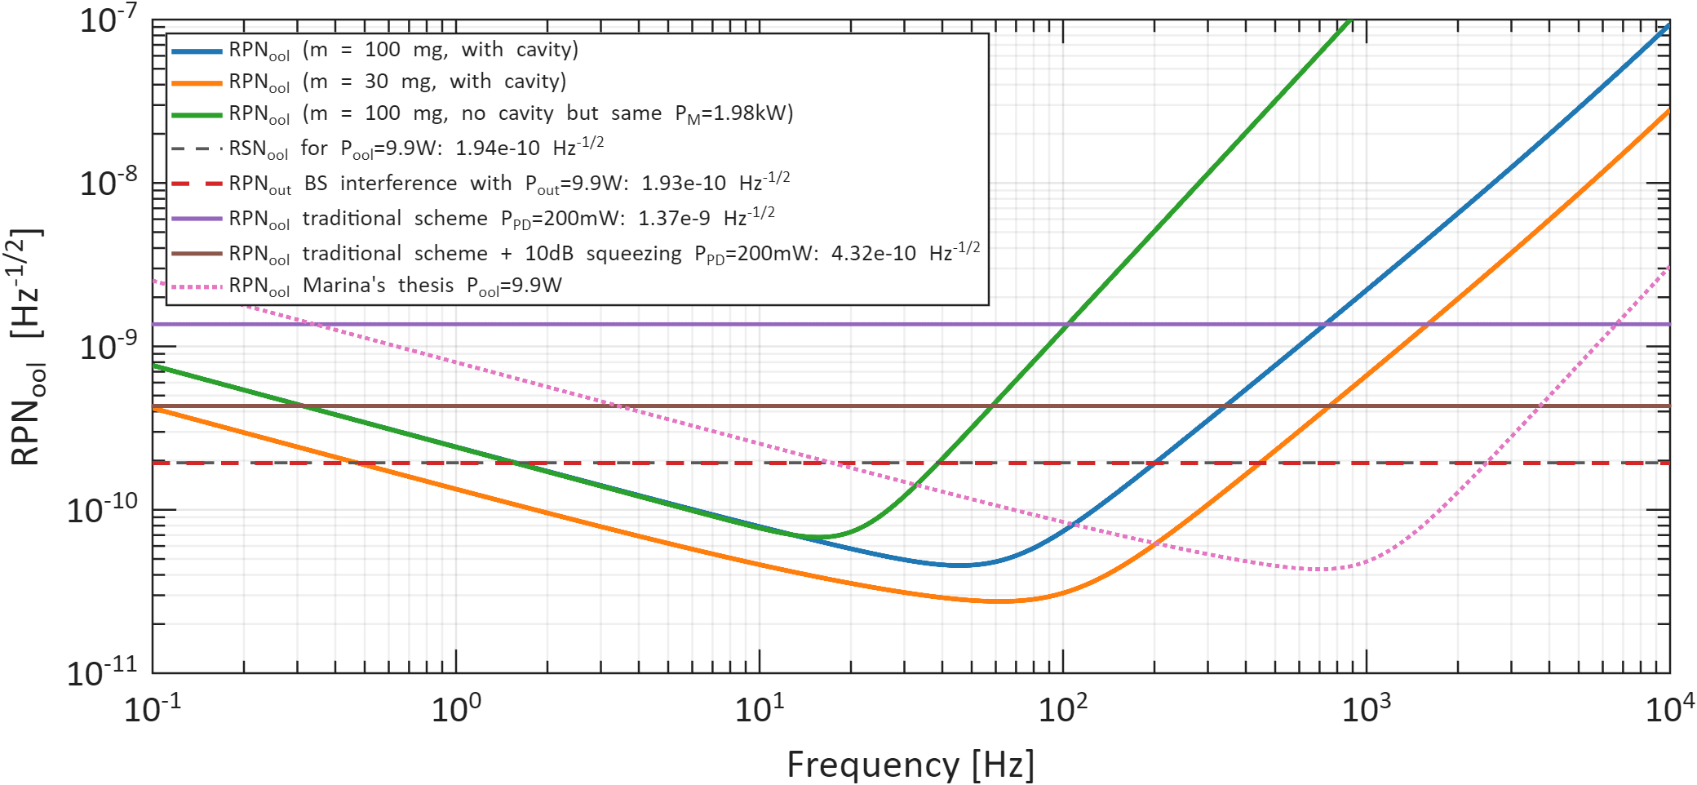
Other bright squeezing schemes
RPN in output beam for different schemes
Cav. scheme 100mg no cavity
Cav. scheme 100mg
Traditional scheme
Traditional + squeezing
RSN 9.9W
BS interference
2 beam scheme (Marina’s)
Cav. scheme 30mg
Notes:
Goals: compare different schemes
In gravitational wave detections the traditional scheme consists in sensing power fluctuations from a pickoff beam to then actuate on the power to compensate. The best case scenario, the resulting squeezing is limited by the vacuum fluctuations coming from the top port. Because of that, injecting squeezed vacuum improves the squeezing achieved.
Marinas: other possibility would be to use microoscillator mirrors that are already tested in Germany, but this requires a very soft texture that can stand a very high power and cryogenic conditions, and even with that this simpler scheme is better, and it could even fullfill GWD requirements

Slide 16
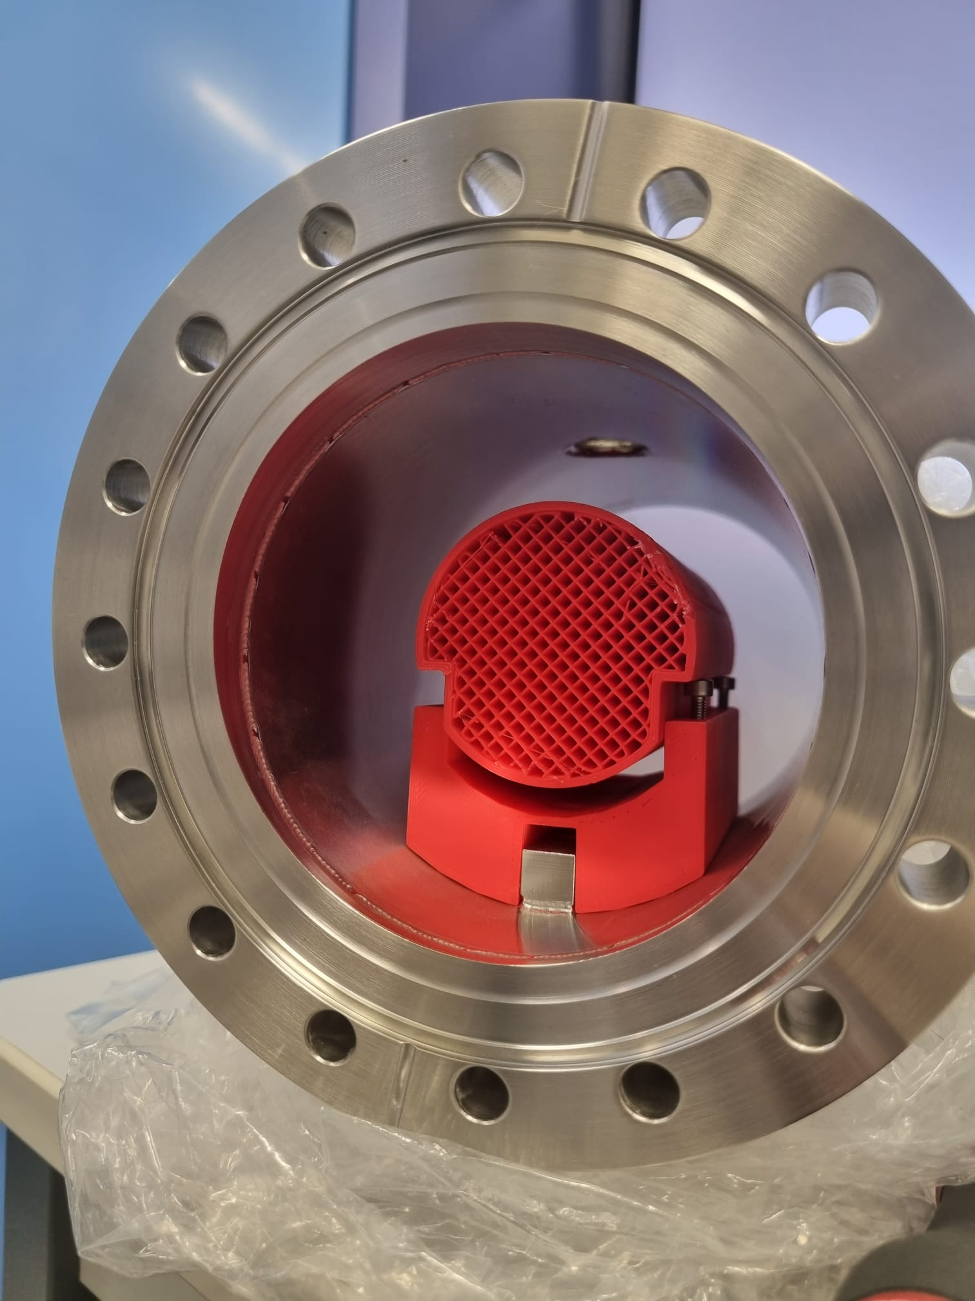
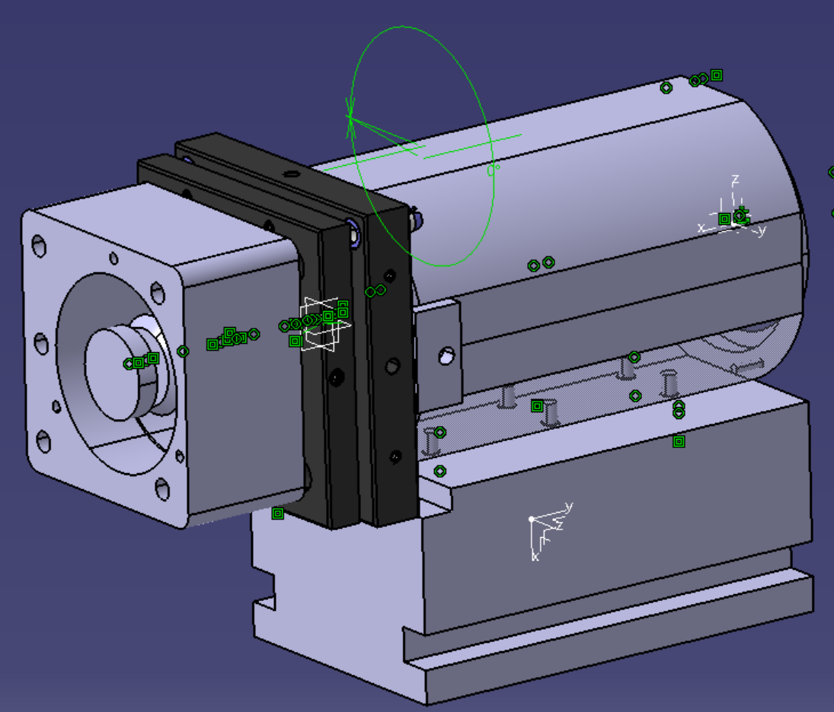
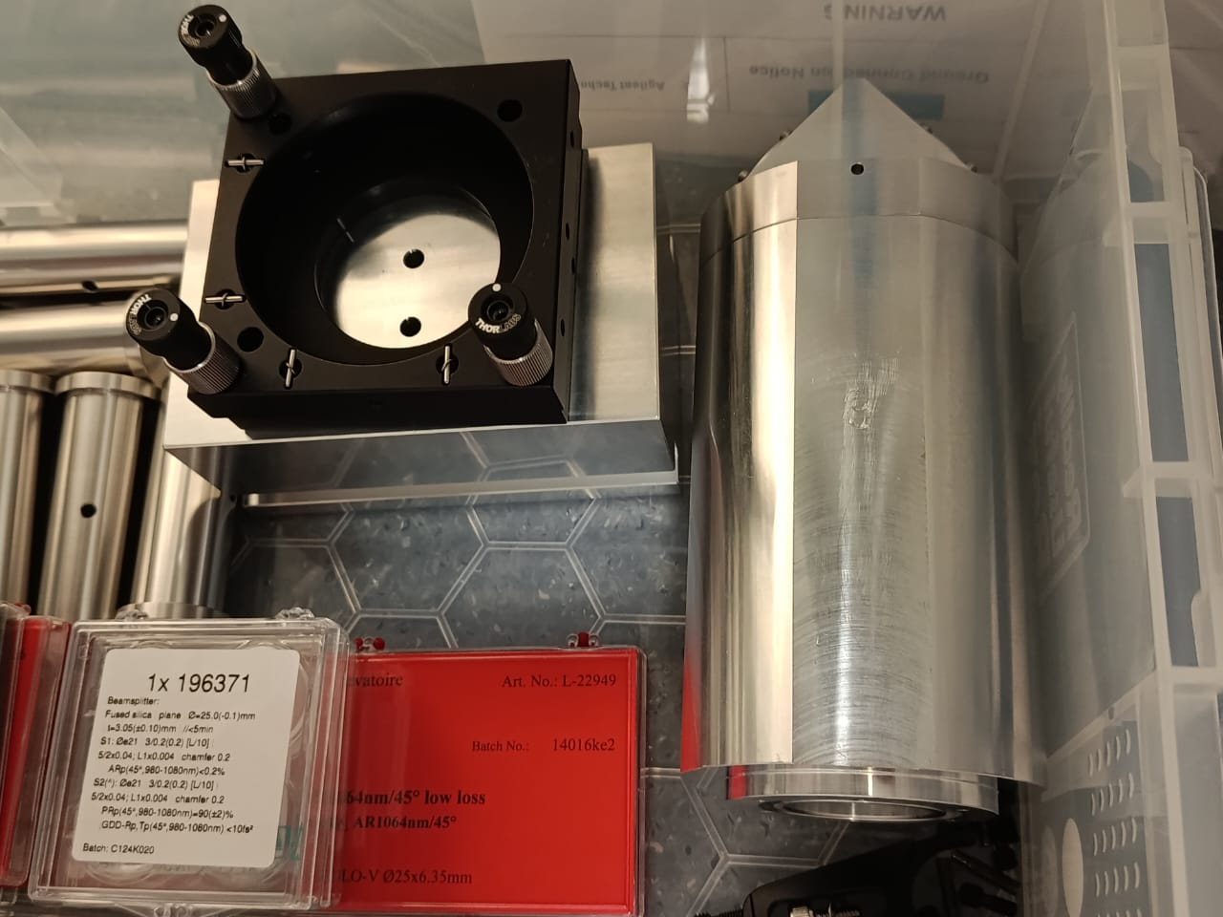
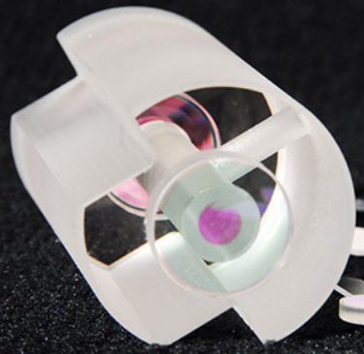
Experiment in Artemis
Notes:
So far we have this full setup: our laser coupled to fiber, a power amplification stage, a PMC cavity to get rid of high order modes, and then 2 paths, one for frequency locking with a reference cavity (because frequency and power noise are indistinguishable), and the other one for power stabilization with the suspended cavity.
Here we can see the suspension system at Artemis. The fiber diameter is 25um, and the mirror area is 25mm^2. We can see the marionette to activery adjust the position and on top of that the super-attenuator. Eventually this will go into a vacuum chamber as well.
We are currently mounting and aligning the components/cavities
High order modes reflected from the suspended cavity, and this is power noise in the detection

Slide 17
Summary
power actuator
beam splitter
laser
$$P_{fr}$$
Power noise
$$P_{ool}$$
GWD requirements
Traditional scheme
Non-demolition scheme via radiation pressure
Experiment in Artemis
out-of-loop beam
feedback controller
$$P_{d}$$
700 PDs required for ET

Slide 18
Thank you!

Slide 19
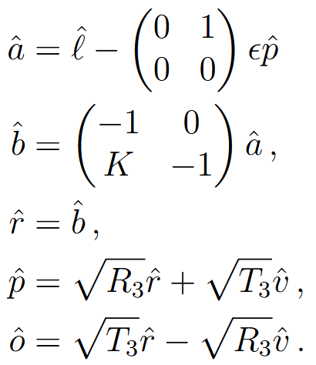
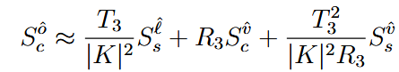
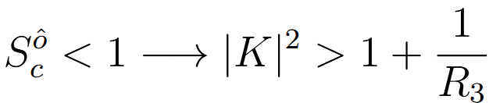
Highlight source PSD and TF
High gain limit:
Squeezing condition:

Slide 20
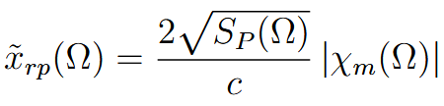
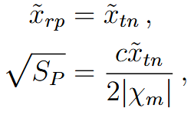

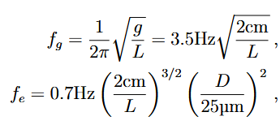







ASD of mirror displacement due to radiation pressure:
RPN in the output beam limited by thermal noise:

Slide 21
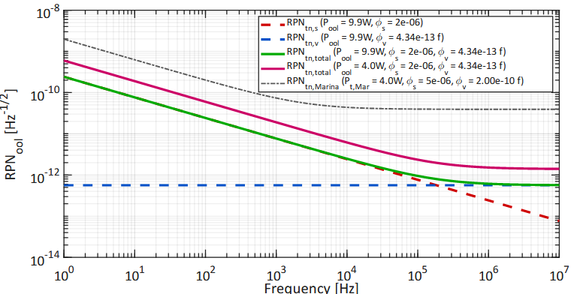
Suspension:
Viscosity:

