Slide 1
Réseau Semi-conducteur 11/06/26

Slide 2



The integration of the DIAMMONI detector into ARRONAX and its application
Robin Molle
Robin Molle – robin.molle@diamfab.com – Réseau Semi-conducteur 2026

Slide 3
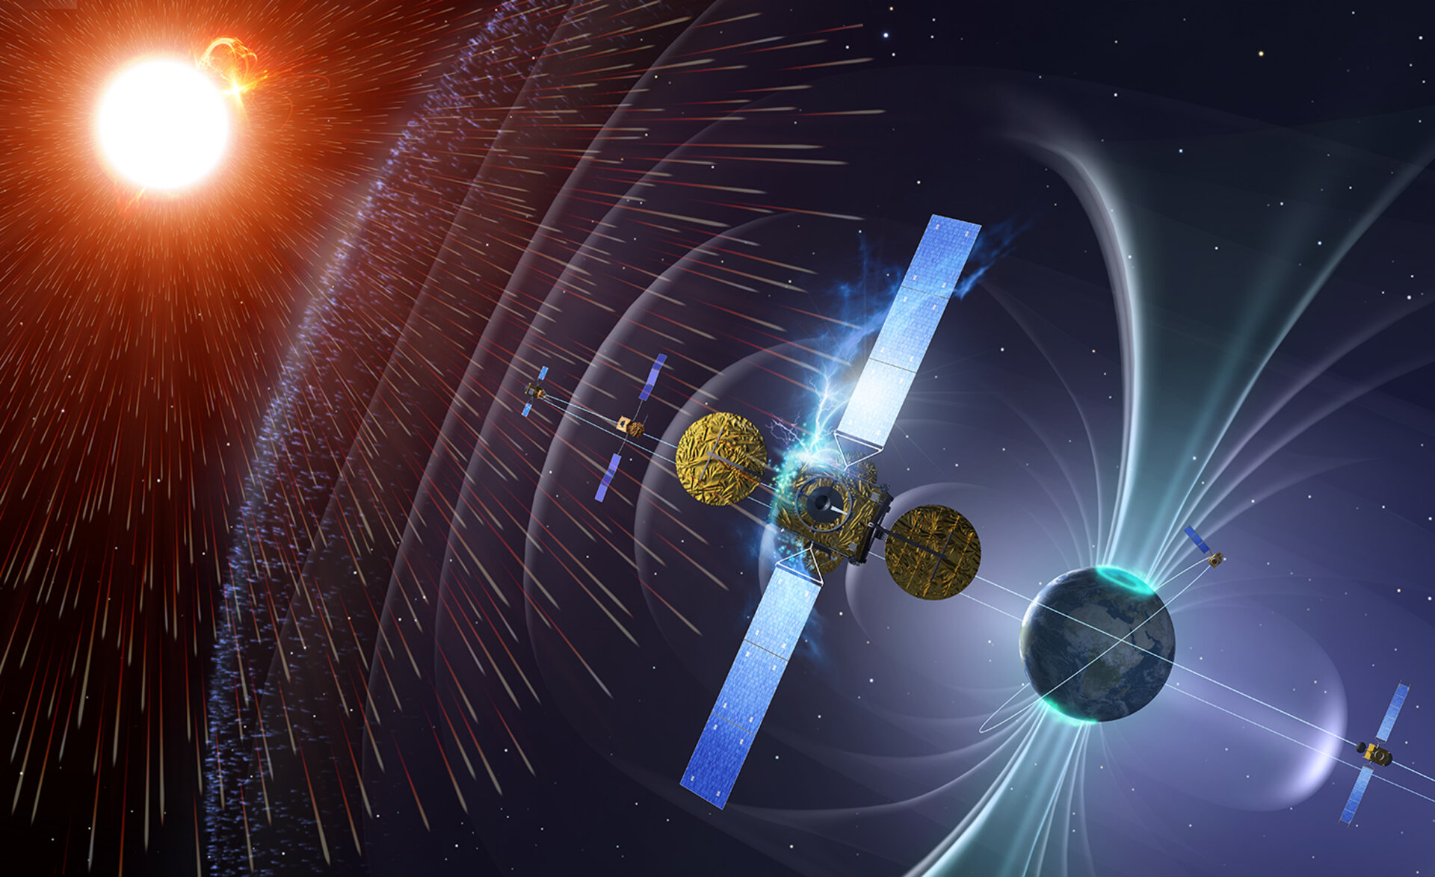
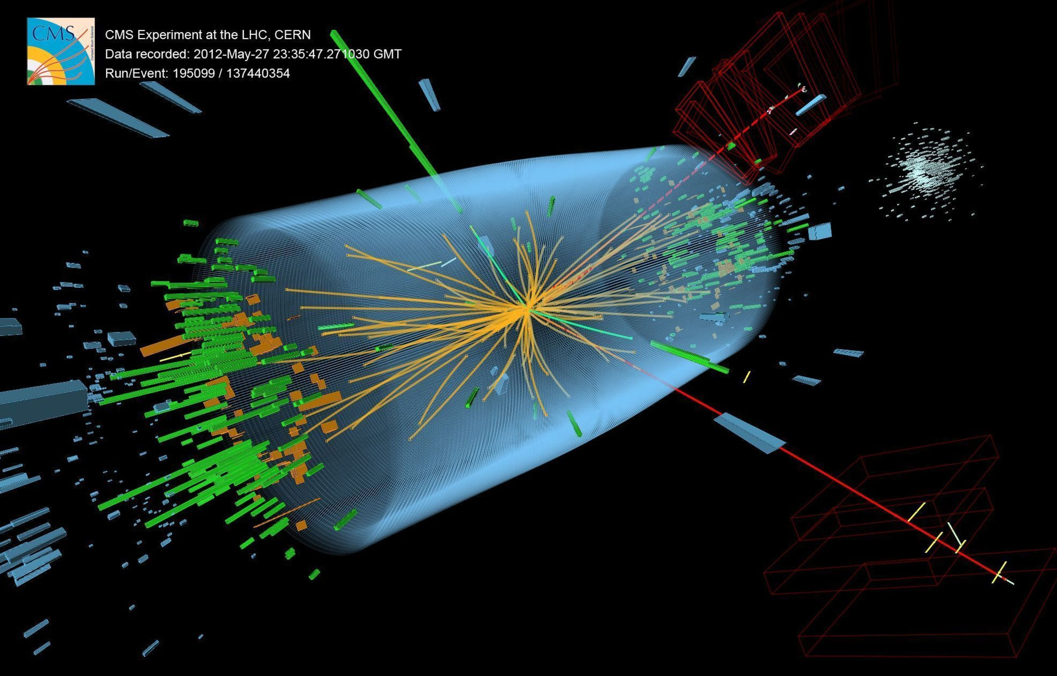
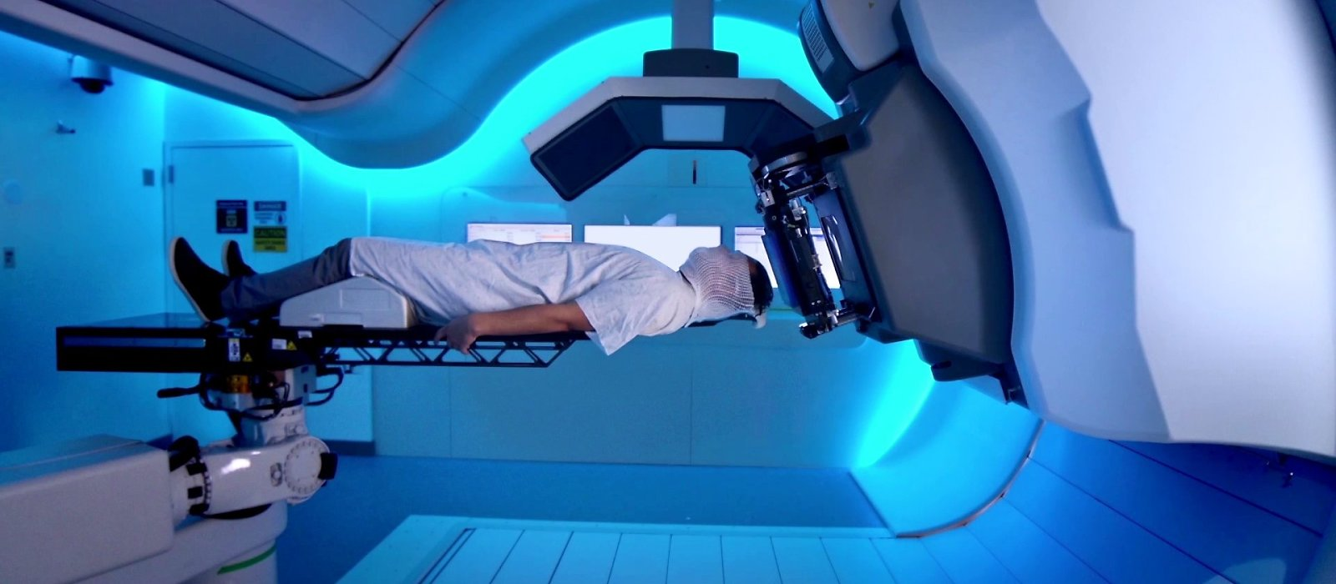
Why radiation tolerance ?
Study of detector behavior in extreme conditions
Spatial
High Energy Physics
Medical applications
Robin Molle – robin.molle@diamfab.com – Réseau Semi-conducteur 2026

Slide 4
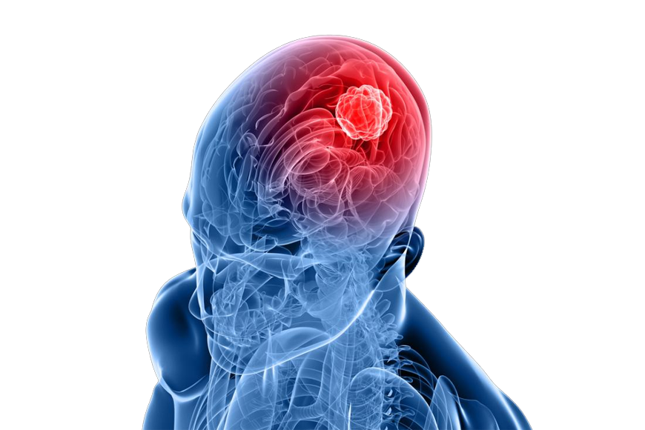
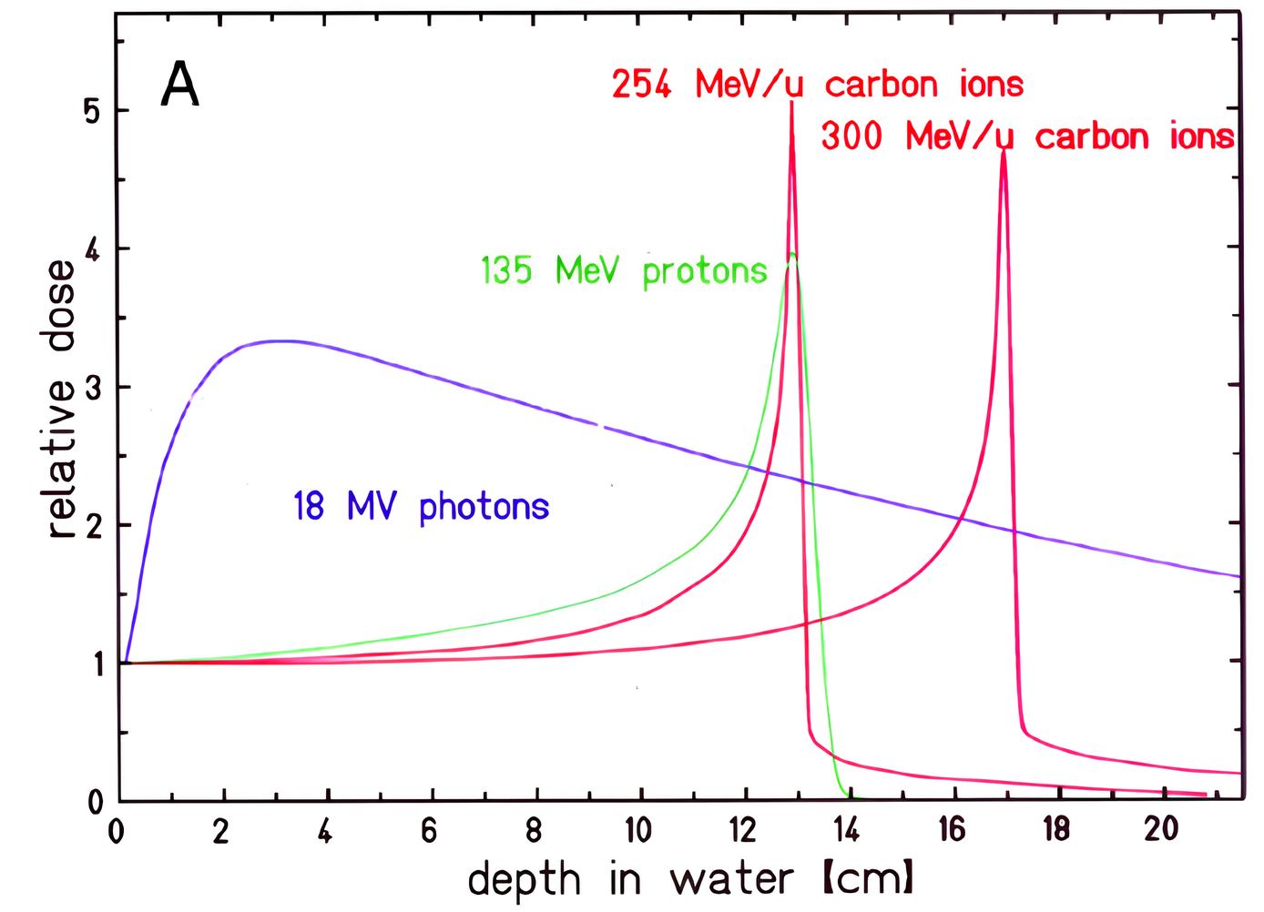
Hadrontherapy application
Radiotherapy: a method of cancer treatment
Dose = Energy deposited per unit mass
Healthy tissues
Tumor
Healthy tissues
Conventional radiotherapy with X-rays
Kraan, A. C. (2015). Range verification methods in particle therapy: underlying physics and Monte Carlo modeling. Frontiers in oncology, 5, 150.
Robin Molle – robin.molle@diamfab.com – Réseau Semi-conducteur 2026
Notes:
+ scientifique pour pic de bragg

Slide 5
Hadrontherapy application
Radiotherapy: a method of cancer treatment
Dose = Energy deposited per unit mass
Healthy tissues
Tumor
Healthy tissues
Hadrontherapy = Radiotherapy with ions
Kraan, A. C. (2015). Range verification methods in particle therapy: underlying physics and Monte Carlo modeling. Frontiers in oncology, 5, 150.
Robin Molle – robin.molle@diamfab.com – Réseau Semi-conducteur 2026
Notes:
+ scientifique pour pic de bragg

Slide 6
Hadrontherapy application
Radiotherapy: a method of cancer treatment
Dose = Energy deposited per unit mass
Healthy tissues
Tumor
Healthy tissues
Hadrontherapy = Radiotherapy with ions
Online control in hadrontherapy
Kraan, A. C. (2015). Range verification methods in particle therapy: underlying physics and Monte Carlo modeling. Frontiers in oncology, 5, 150.
Robin Molle – robin.molle@diamfab.com – Réseau Semi-conducteur 2026
Notes:
+ scientifique pour pic de bragg

Slide 7
FLASH THERAPY: an innovative radiotherapy
Gray (Gy) : energy per unit of mass
1 Gy = 1 J/kg
FLASH therapy
Ultra High Dose Rate
FLASH therapy X :
Dose RATE: >10 kGy/s
FLASH therapy proton :
DOSE RATE: >100 Gy/s
Advantages of FLASH:
better preservation of healthy tissues for the same effectiveness at the tumor level
delivery of the entire dose in a fraction of a second
reduction in the number of sessions and treatment time
Conventional radiotherapy:
Dose rate: ~2 Gy/min = 0.03 Gy/s
Robin Molle – robin.molle@diamfab.com – Réseau Semi-conducteur 2026

Slide 8
DIAMMONI PROJECT CONTEXT
Online control in hadrontherapy
DIAMMONI
FLASH therapy
Ultra High Dose Rate
Diamond
Semi-conductor detector
Robin Molle – robin.molle@diamfab.com – Réseau Semi-conducteur 2026

Slide 9

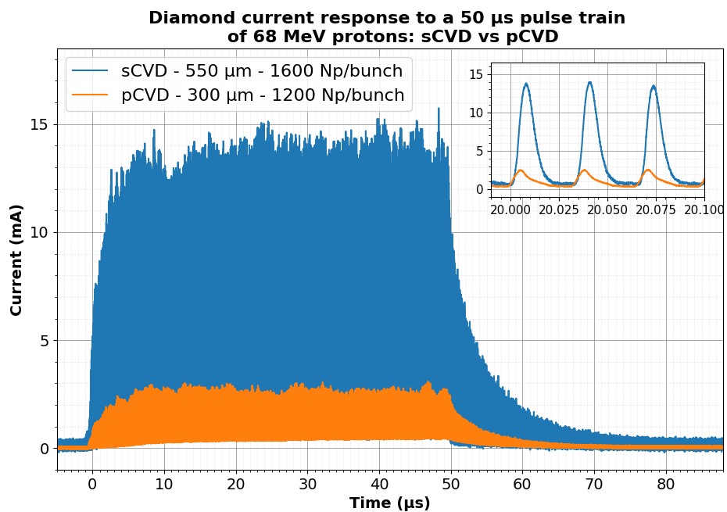
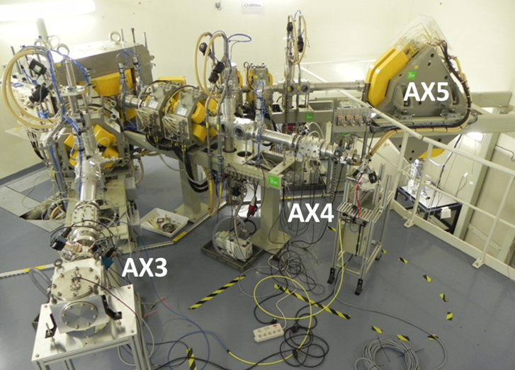
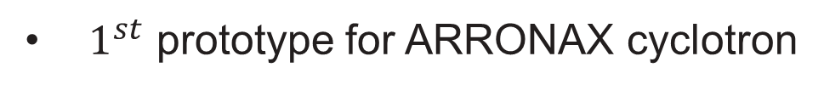
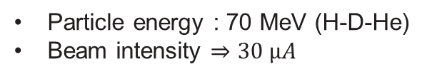
DIAMMONI detector
DIAMMONI detector : a radiation detector for light ion beams at high flux and fluences (40→ 250 MeV)
$1^{st}$ prototype for ARRONAX cyclotron
ARRONAX cyclotron :
Particle energy : 70 MeV (H-D-He)
Beam intensity $⇒30 µA$
ARRONAX beam
Beam structure :
Train duration : 50µs (« dt »)
Bunch duration : 4ns ON, ~29ns OFF
ARRONAX AX casemate
Robin Molle – robin.molle@diamfab.com – Réseau Semi-conducteur 2026

Slide 10
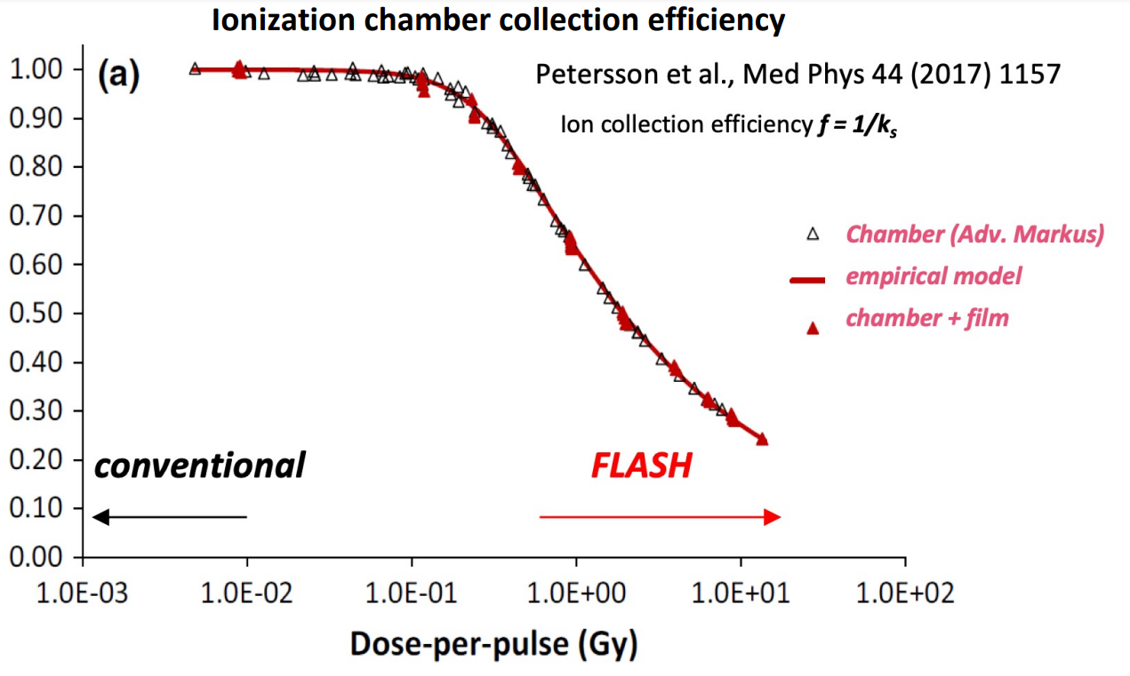

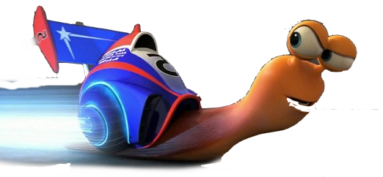
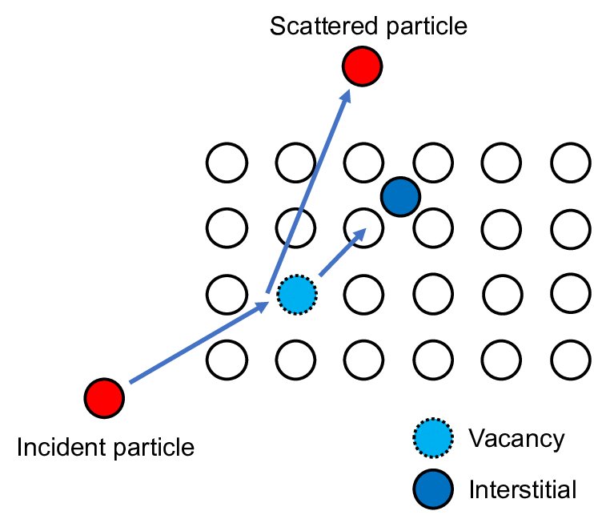


Flux relate to the speed of delivery
Flux response
Loss of linearity ?
Diamond
Semi-conductor detector
Fluence response
Damaging ?
Fluence relate to the history of the device
Robin Molle – robin.molle@diamfab.com – Réseau Semi-conducteur 2026

Slide 11



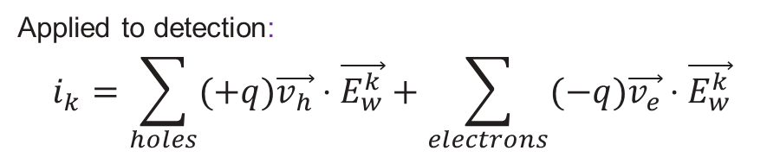

Solid State ionizing Chamber
Ionizing particle
Readout electronic
Diamond
Schokley-Ramo theorem :
$$i_{k}=q\vec{v}⋅\vec{E_{w}^{k}}$$
$$\vec{E}$$
$E_{w}^{k}$ : weighting field
+
Applied to detection:
$$i_{k}=\sum_{holes}{(+q)\vec{v_{h}}⋅\vec{E_{w}^{k}}}+\sum_{electrons}{(−q)\vec{v_{e}}⋅\vec{E_{w}^{k}}}$$
+
-
Ramo, S. (1939). Currents induced by electron motion. Proceedings of the IRE, 27(9), 584-585.
Shockley, W. (1938). Currents to conductors induced by a moving point charge. Journal of applied physics, 9(10), 635-636.
Robin Molle – robin.molle@diamfab.com – Réseau Semi-conducteur 2026

Slide 12
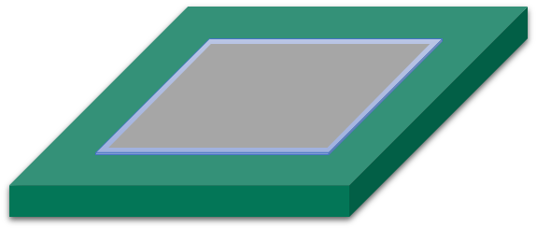
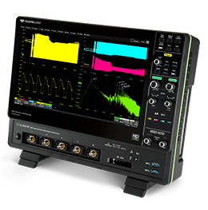
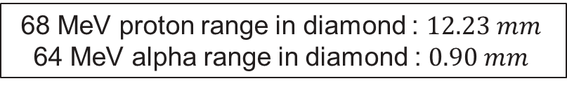

Experimental setup
68 MeV proton range in diamond : $12.23 mm$
64 MeV alpha range in diamond : $0.90 mm$
68 MeV proton beam
64 MeV helium beam
$$C_{tank}$$
HV
Fast oscilloscope
Robin Molle – robin.molle@diamfab.com – Réseau Semi-conducteur 2026

Slide 13
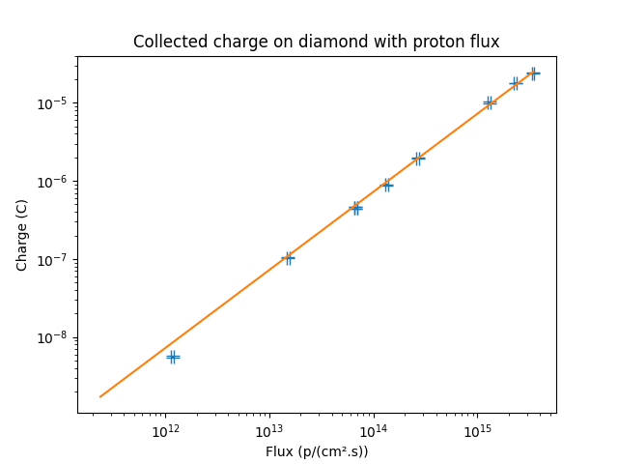
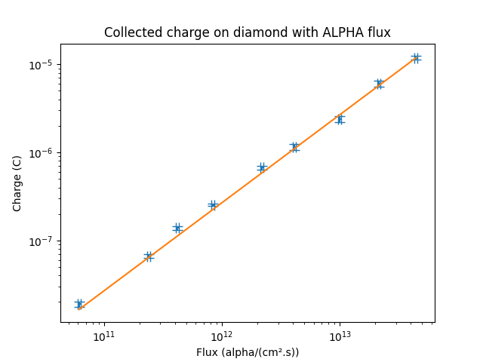
Main results in flux measurements
Protons 68 MeV
Alpha 64 MeV
1 kGy/s
FLASH proton dose rate
Beam
Robin Molle – robin.molle@diamfab.com – Réseau Semi-conducteur 2026
Diamant

Slide 14
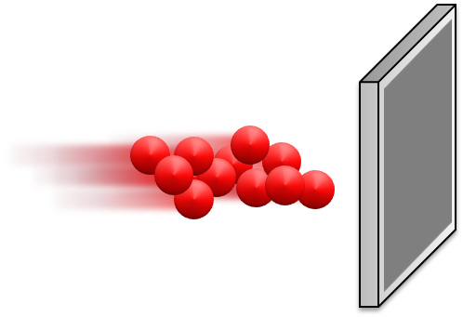
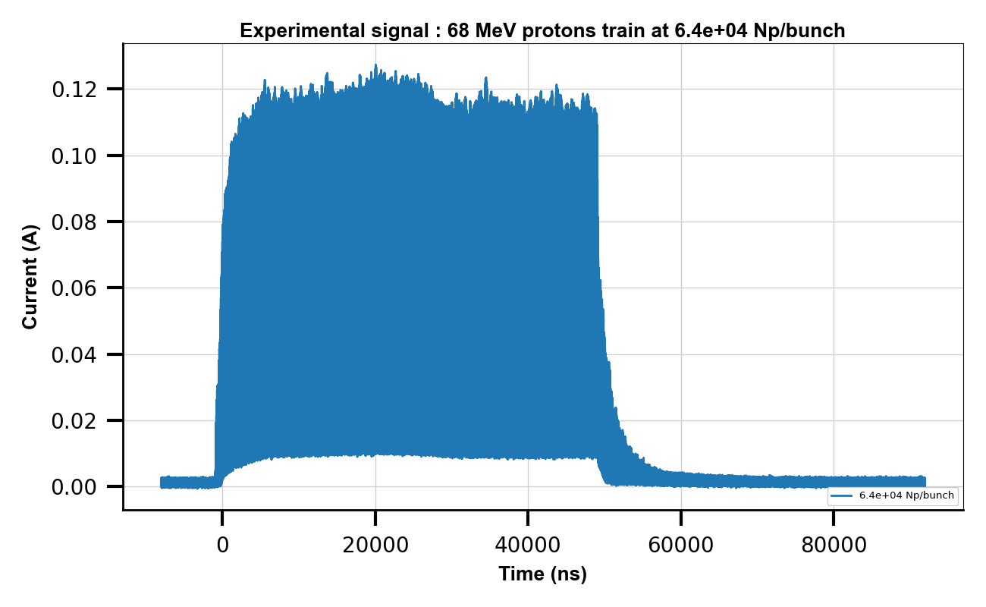
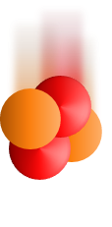
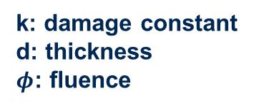
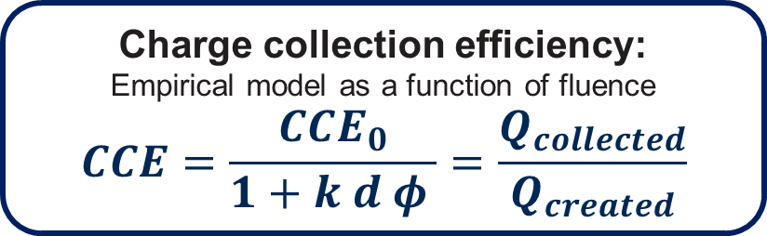
Fluence measurements
Charge collection efficiency:
Empirical model as a function of fluence
$$CCE=\frac{CCE_{0}}{1+k d φ }=\frac{Q_{collected}}{Q_{created}}$$
k: damage constant
d: thickness
$φ$: fluence
Measure the k of diamond under ions
1st method:
2nd method :
CCE calculated for each train
Irradiation & CCE measurement
CCE measurement
Irradiation
CCE
Bäni, L., Alexopoulos, A., Artuso, M., Bachmair, F., Bartosik, M., Beck, H., ... & RD42 Collaboration. (2019). A study of the radiation tolerance of poly-crystalline and single-crystalline CVD diamond to 800 MeV and 24 GeV protons. Journal of Physics D: Applied Physics, 52(46), 465103.
Robin Molle – robin.molle@diamfab.com – Réseau Semi-conducteur 2026

Slide 15
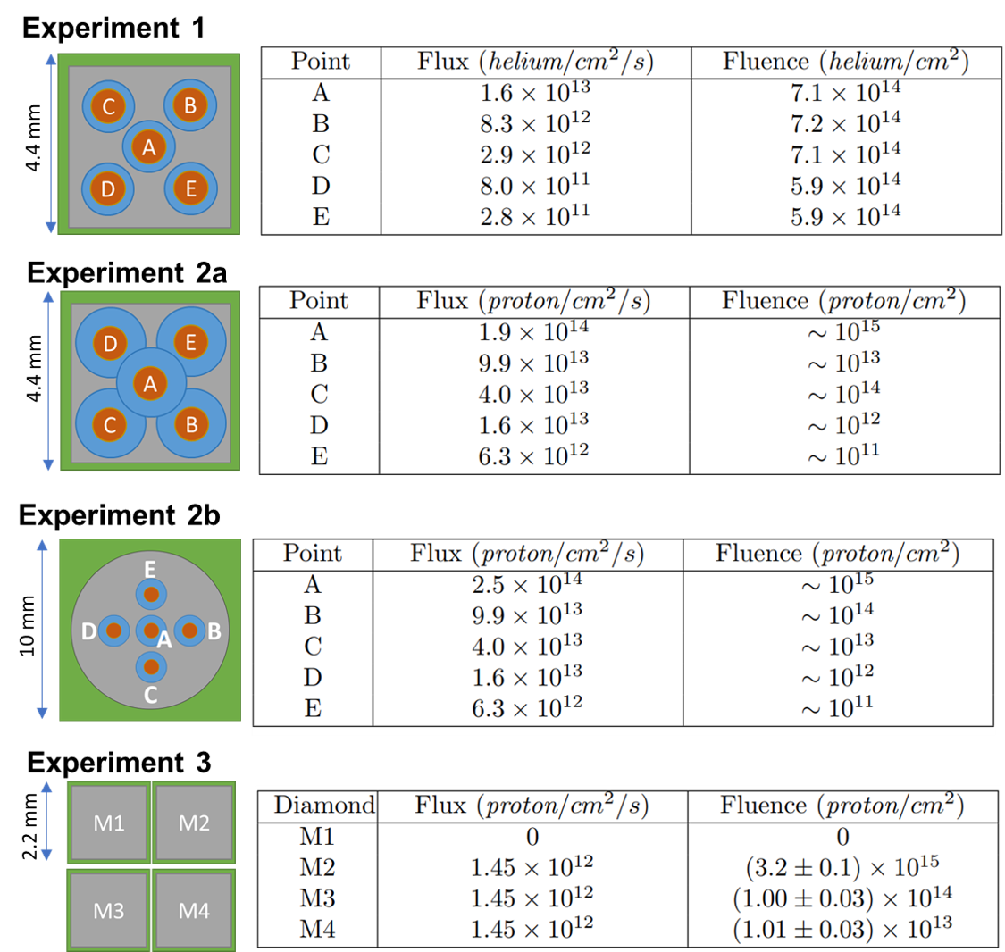
Fluence experiments
Helium
64 MeV
Single crystal CVD Diamond
sCVD
Spectroscopie alpha
XBIC - ESRF
Recuit
Raman-PL
Proton
68 MeV
Single crystal CVD Diamonds
1 diamond cut in 4
Robin Molle – robin.molle@diamfab.com – Réseau Semi-conducteur 2026

Slide 16
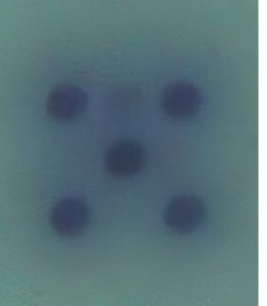
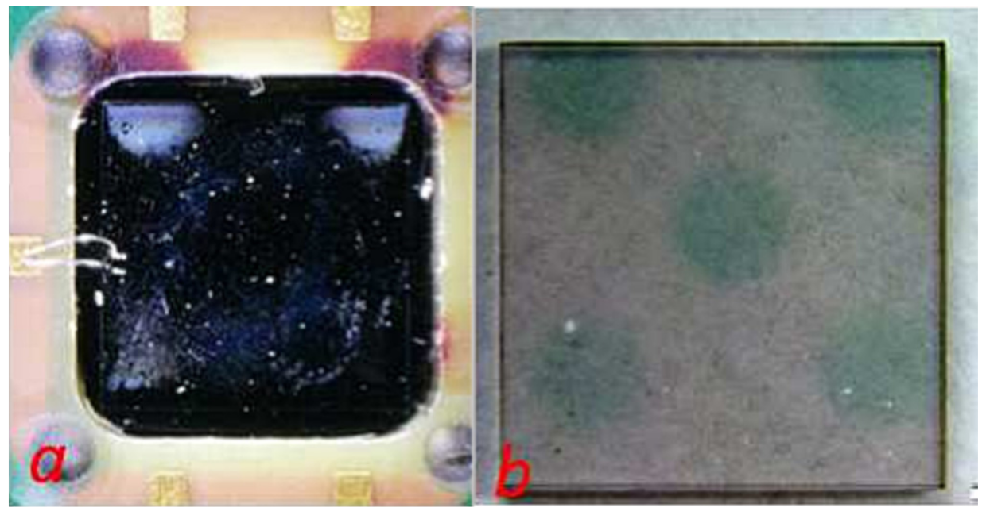
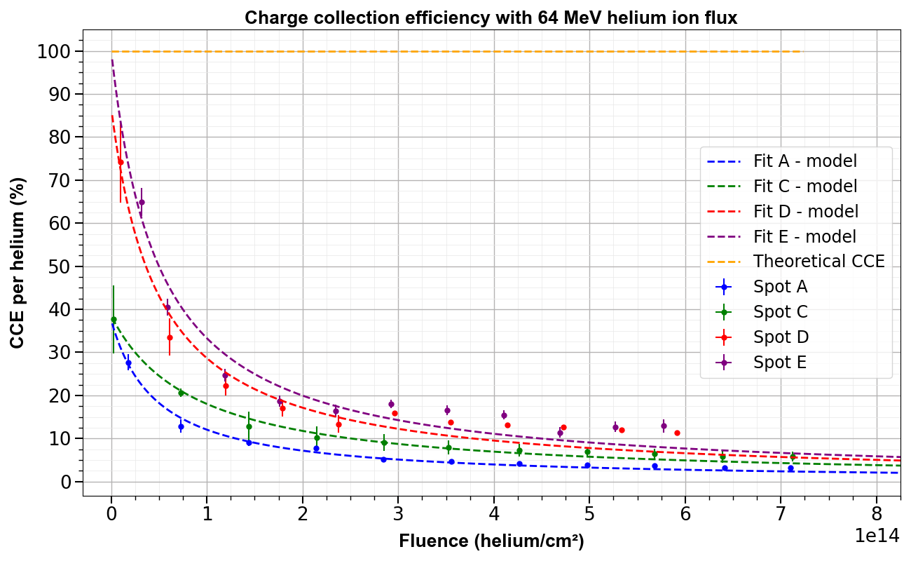

Diamond response to Helium fluence
$$k=\left(38±5\right)×{10}^{−18}cm²/p/µm$$
Robin Molle – robin.molle@diamfab.com – Réseau Semi-conducteur 2026

Slide 17
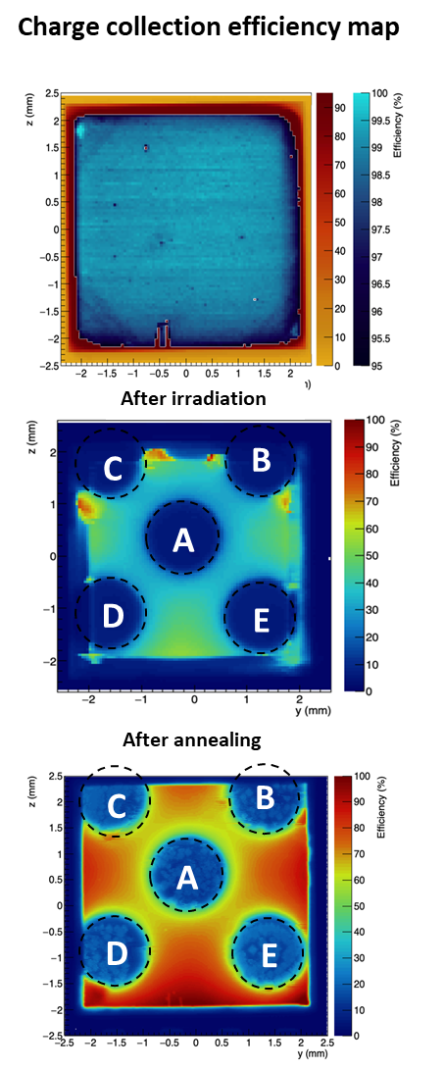


Diamond response to Helium fluence
64 MeV helium
irradiation
XBIC map
Annealing: 6h / 1000°C
XBIC map
Frenkel defects
Vacancies ➔ NV centers
XBIC map
Robin Molle – robin.molle@diamfab.com – Réseau Semi-conducteur 2026
17

Slide 18
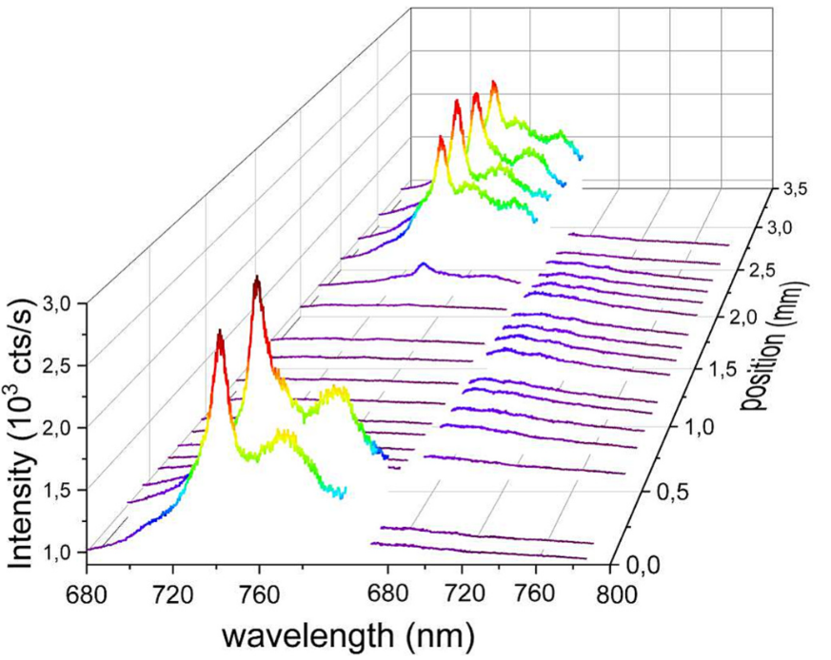
Diamond response to Helium fluence
Frenkel defects created with irradiation
Vacancies (GR1 centers) trap charge carriers
After irradiation
After annealing
After irradiation
Before annealing
Electron and hole are not equivalent with irradiation
Annealing = increase of CCE
GR1 converted with annealing in NV centers
Robin Molle – robin.molle@diamfab.com – Réseau Semi-conducteur 2026
18

Slide 19
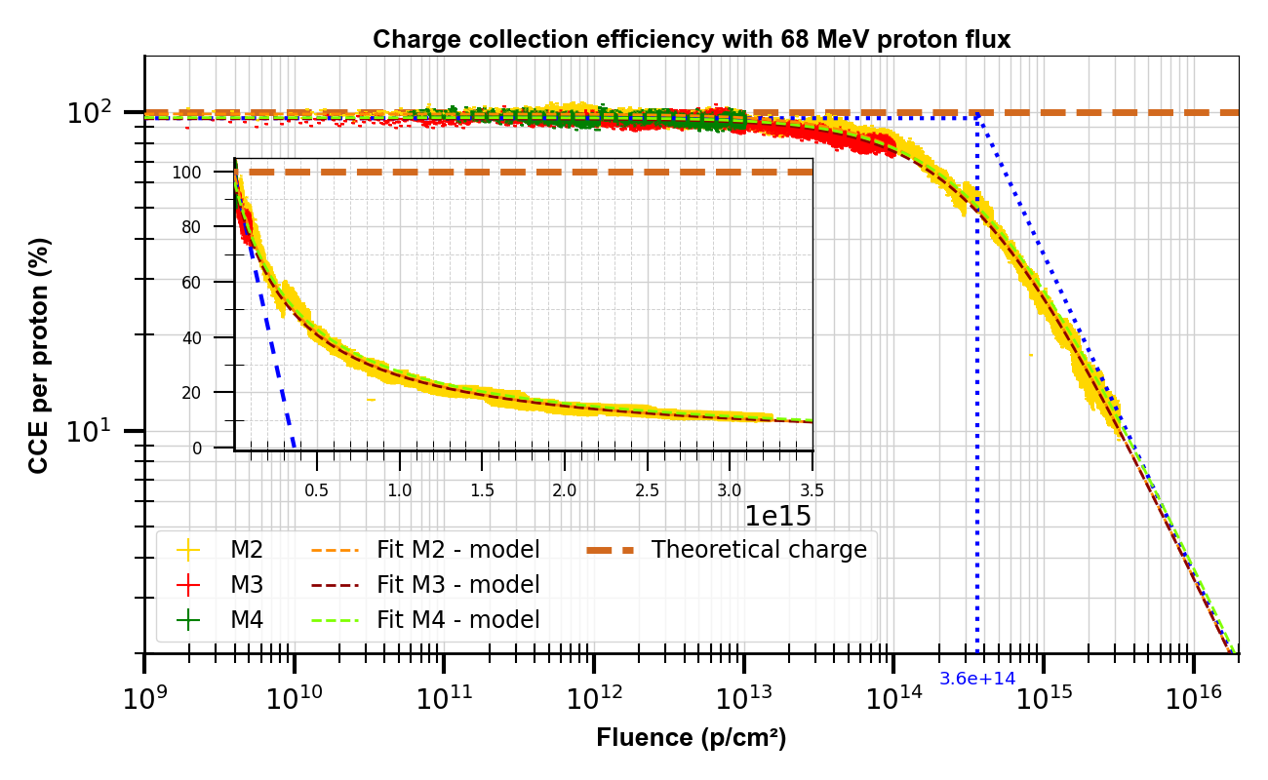

Diamond response to proton fluence
M1 = control sample
$$k=\left(18,7±0,1\right)×{10}^{−18}cm²/p/µm$$
Frenkel defects created with irradiation
Vacancies trap charge carriers
Robin Molle – robin.molle@diamfab.com – Réseau Semi-conducteur 2026

Slide 20
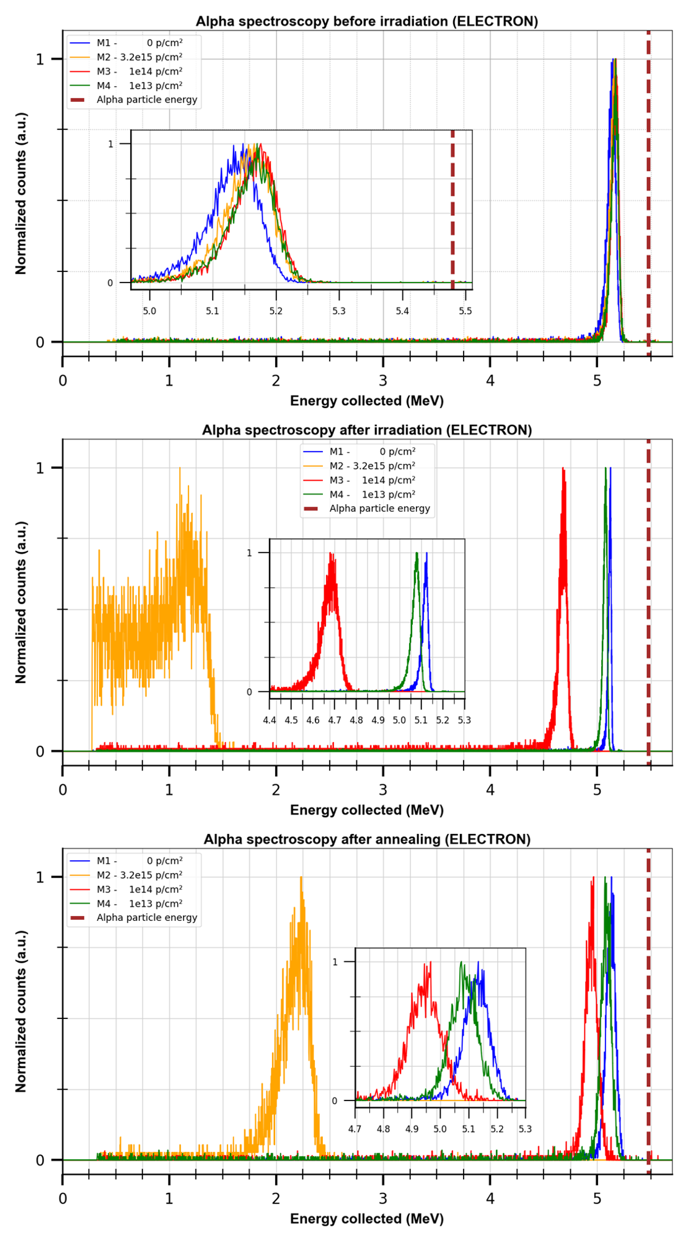
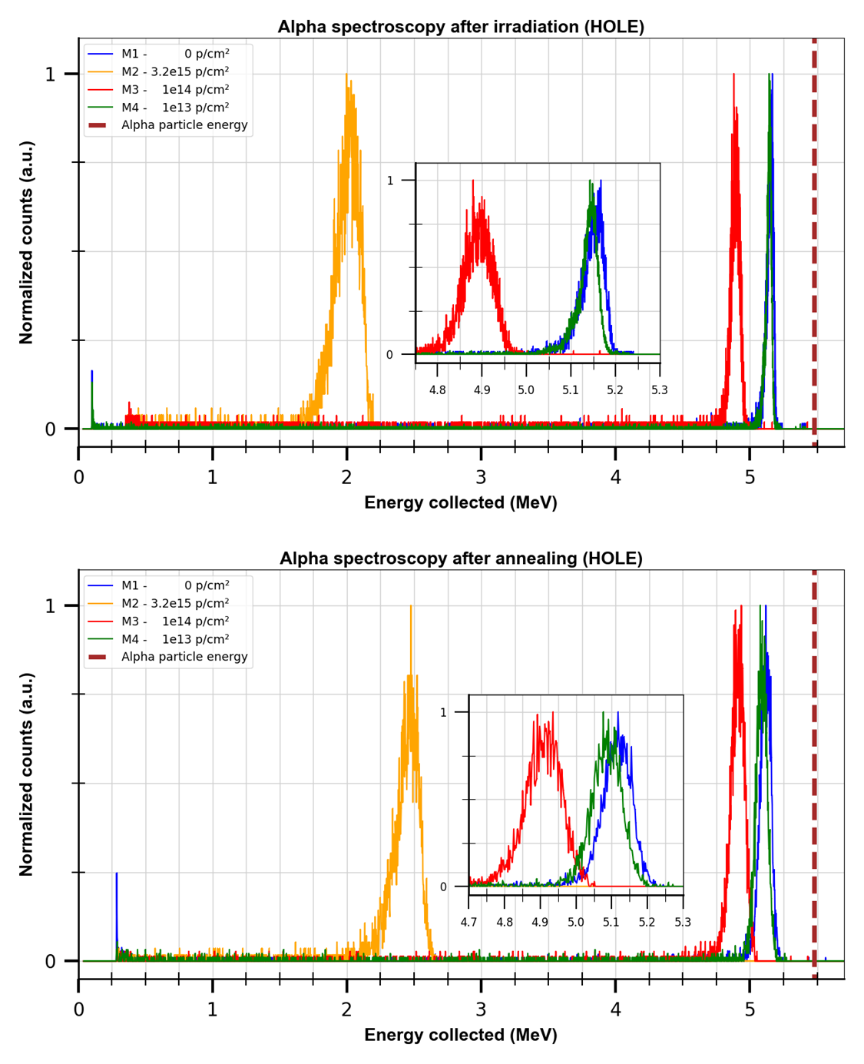
Diamond response to proton fluence
Electron and hole are not equivalent with irradiation
Annealing = increase of CCE
Robin Molle – robin.molle@diamfab.com – Réseau Semi-conducteur 2026

Slide 21
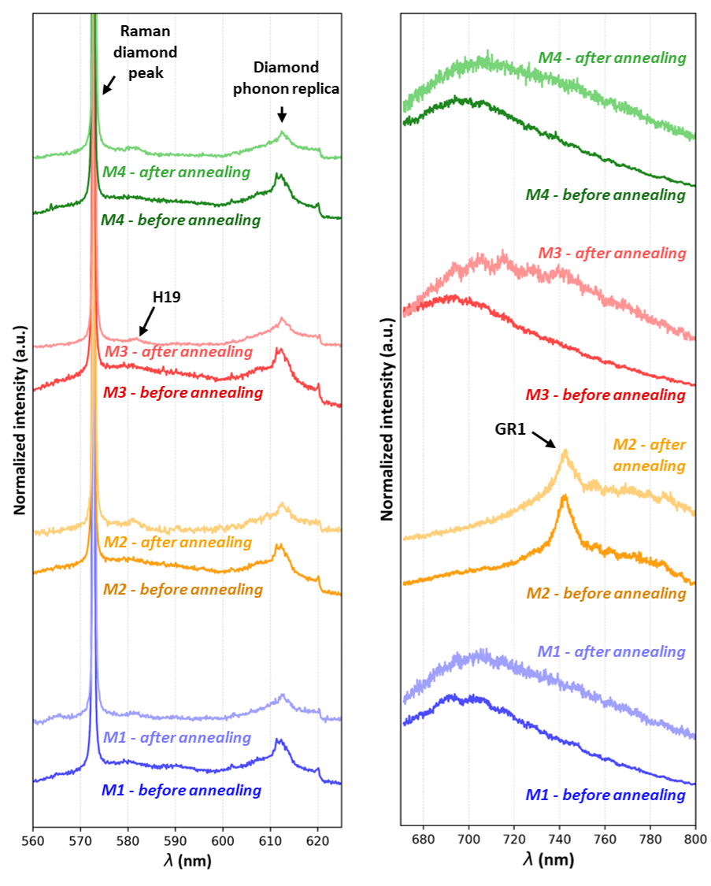
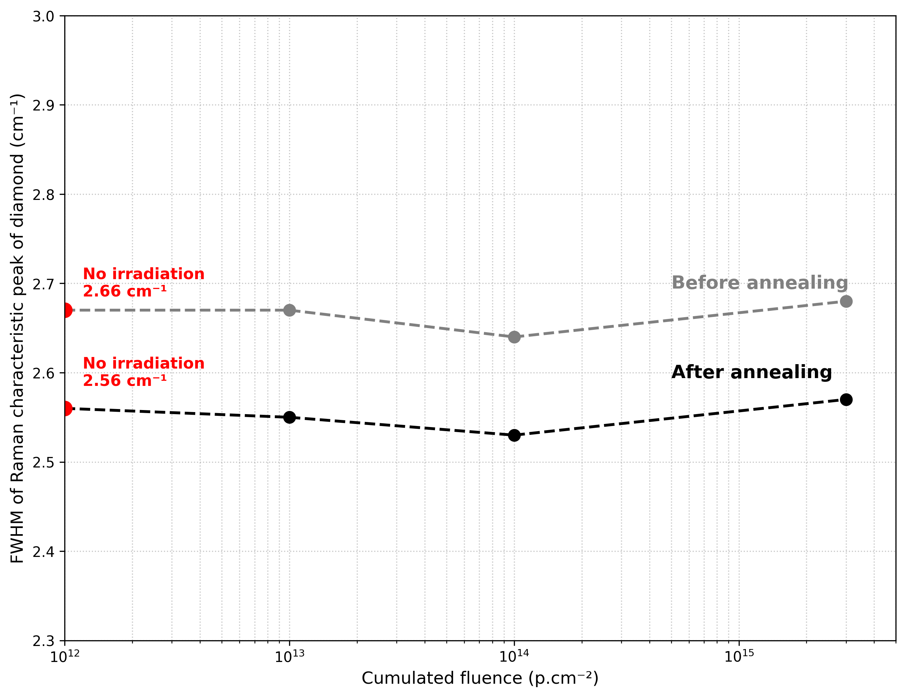
Diamond response to proton fluence
Vacancies converted with annealing in NV centers
Excellent quality of the diamond
No particular impact on FWHM of Raman diamond peak
H19 creation
NV centers creation depends on the substrate quality
Robin Molle – robin.molle@diamfab.com – Réseau Semi-conducteur 2026

Slide 22
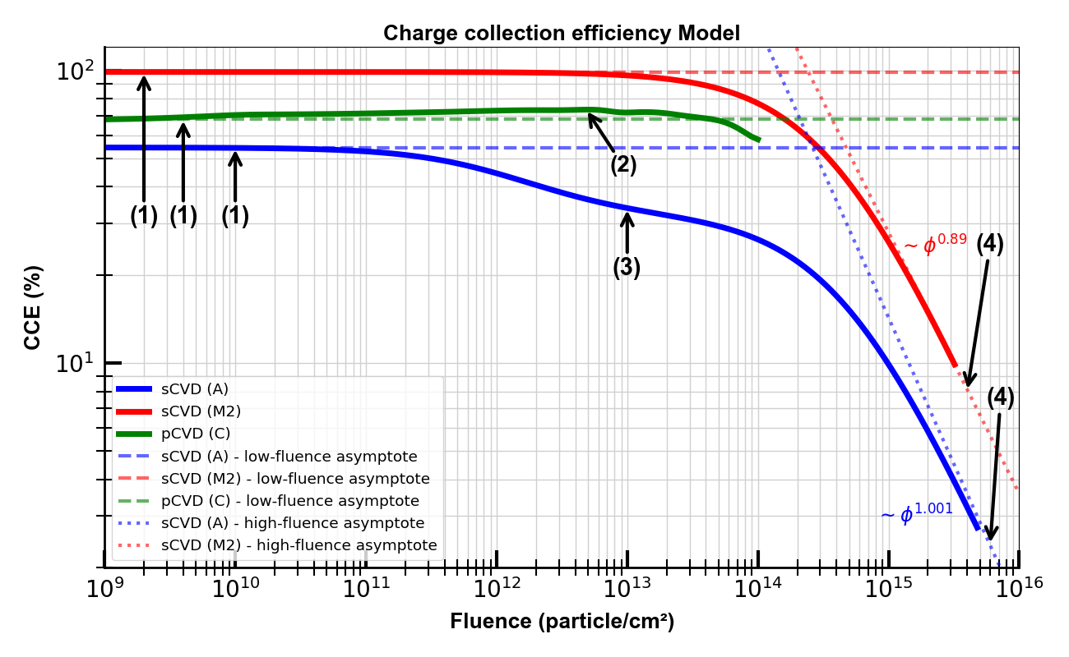
Model of CCE with fluence
Initial overall crystal quality
Trap filling
Heterogeneity of point defect distribution
Accumulation of irradiation-induced defects
Robin Molle – robin.molle@diamfab.com – Réseau Semi-conducteur 2026

Slide 23
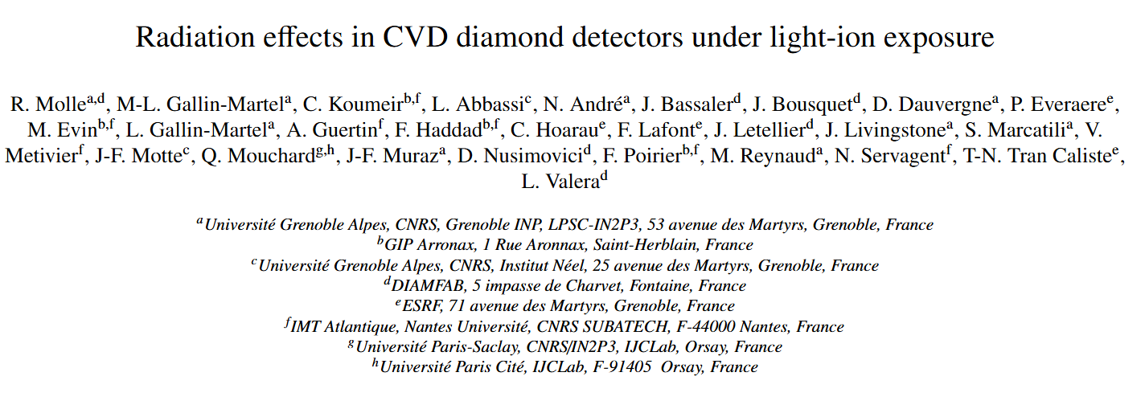
To be published
Diamond and Related Materials

Slide 24
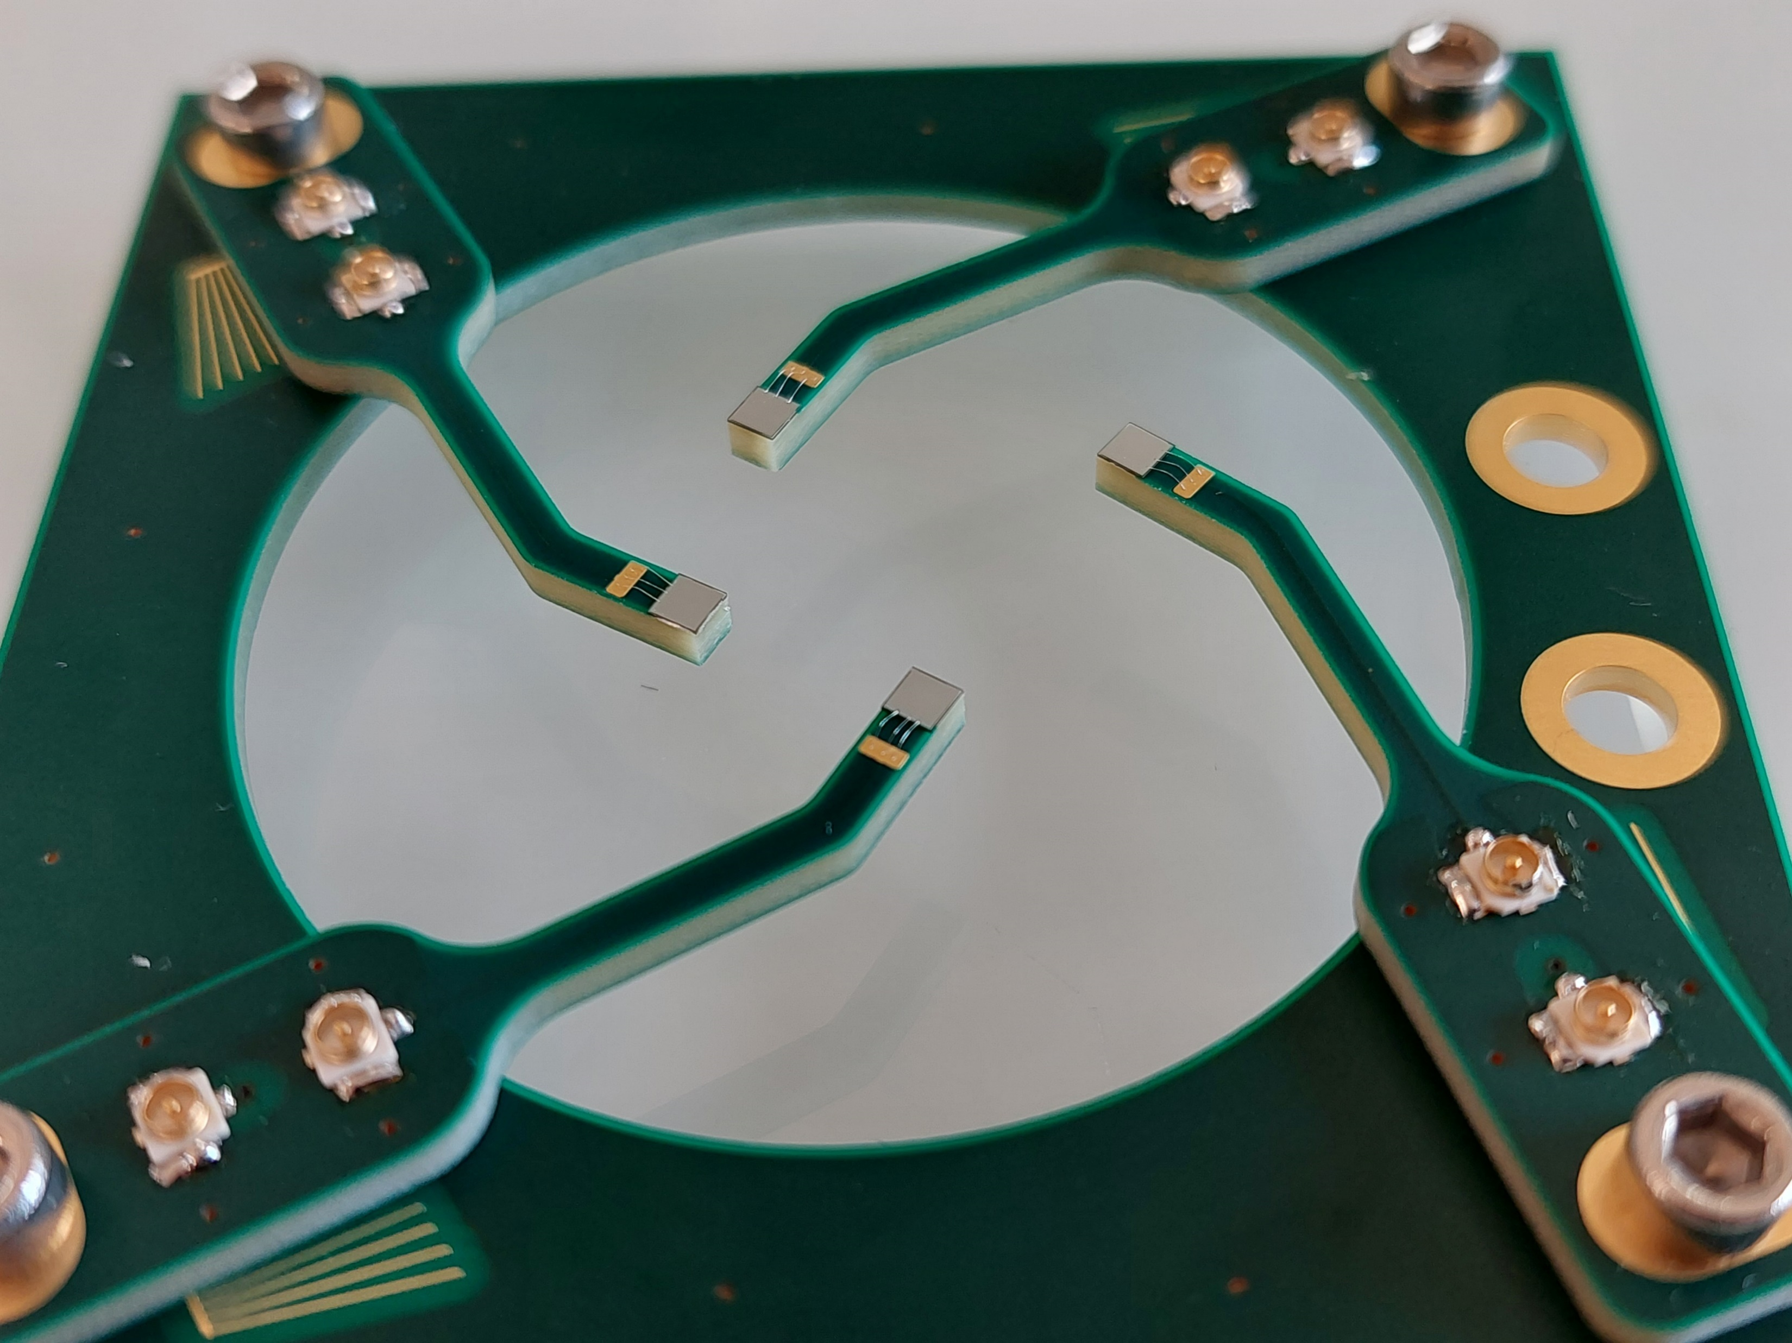
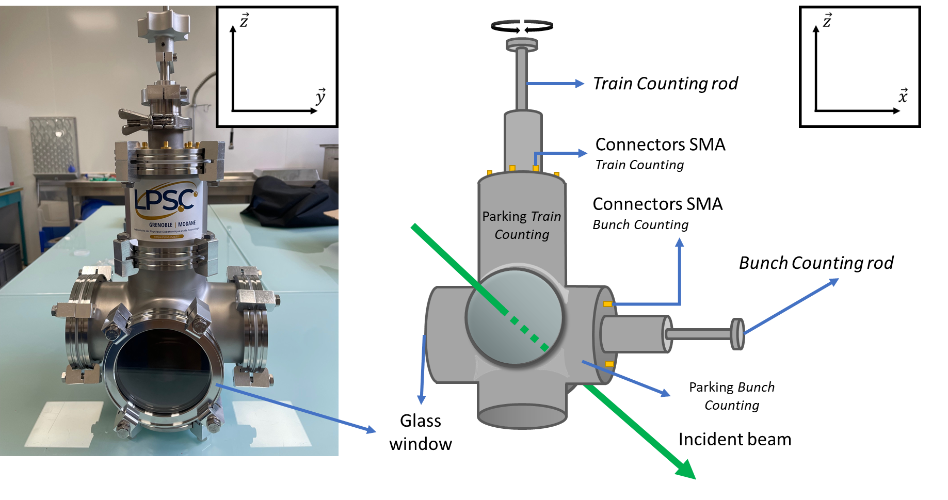
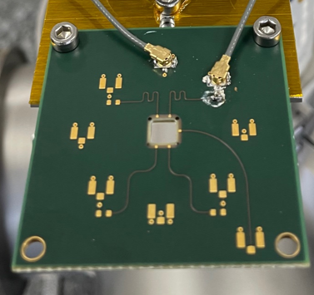
DIAMMONI detector
High intensity mode
Integrated to ARRONAX AX beamline
Low intensity mode
Robin Molle – robin.molle@diamfab.com – Réseau Semi-conducteur 2026

Slide 25
DIAMMONI detector
Two electronic boards developped for each mode:
High intensity mode
Give the charge per train
Determine the real train duration
Reconstruct the time structure of the train
Give a spatial information on the beam
Low intensity mode
Give the average number of
particle per bunch
Robin Molle – robin.molle@diamfab.com – Réseau Semi-conducteur 2026

Slide 26
Take Home message
Study of diamond radiation tolerance as a function of fluence and flux to adapt it for various applications.
Demonstration of the linearity of the diamond response with flux over a wide range of dose rates.
Modelisation of the CCE with fluence
Material study of diamond after irradiation and annealing
DIAMMONI detector is integrated in ARRONAX, and was developed in ANR DIAMMONI project.
Prospects with helium ions, and also to see for a preclinical experiments using DIAMMONI detector calibration
Robin Molle – robin.molle@diamfab.com – Réseau Semi-conducteur 2026

Slide 27
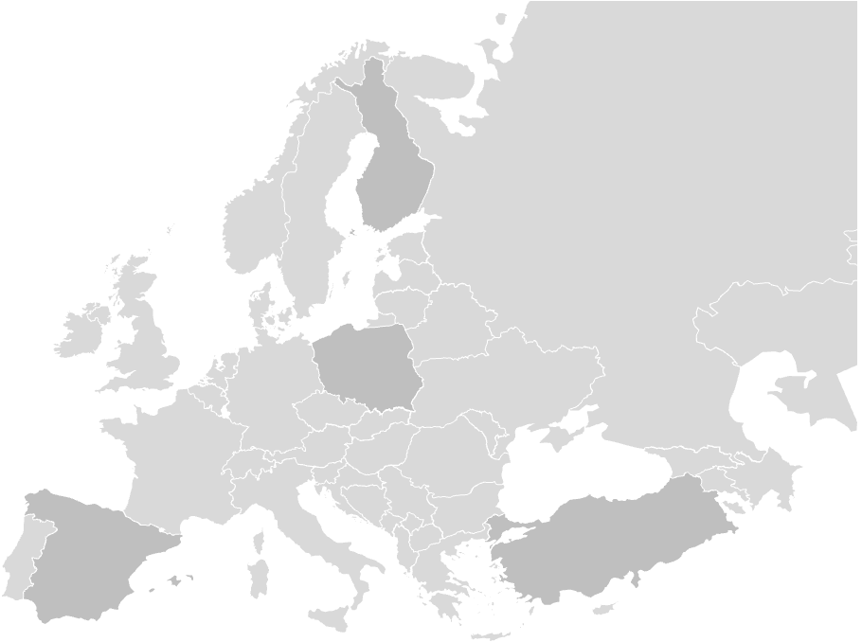
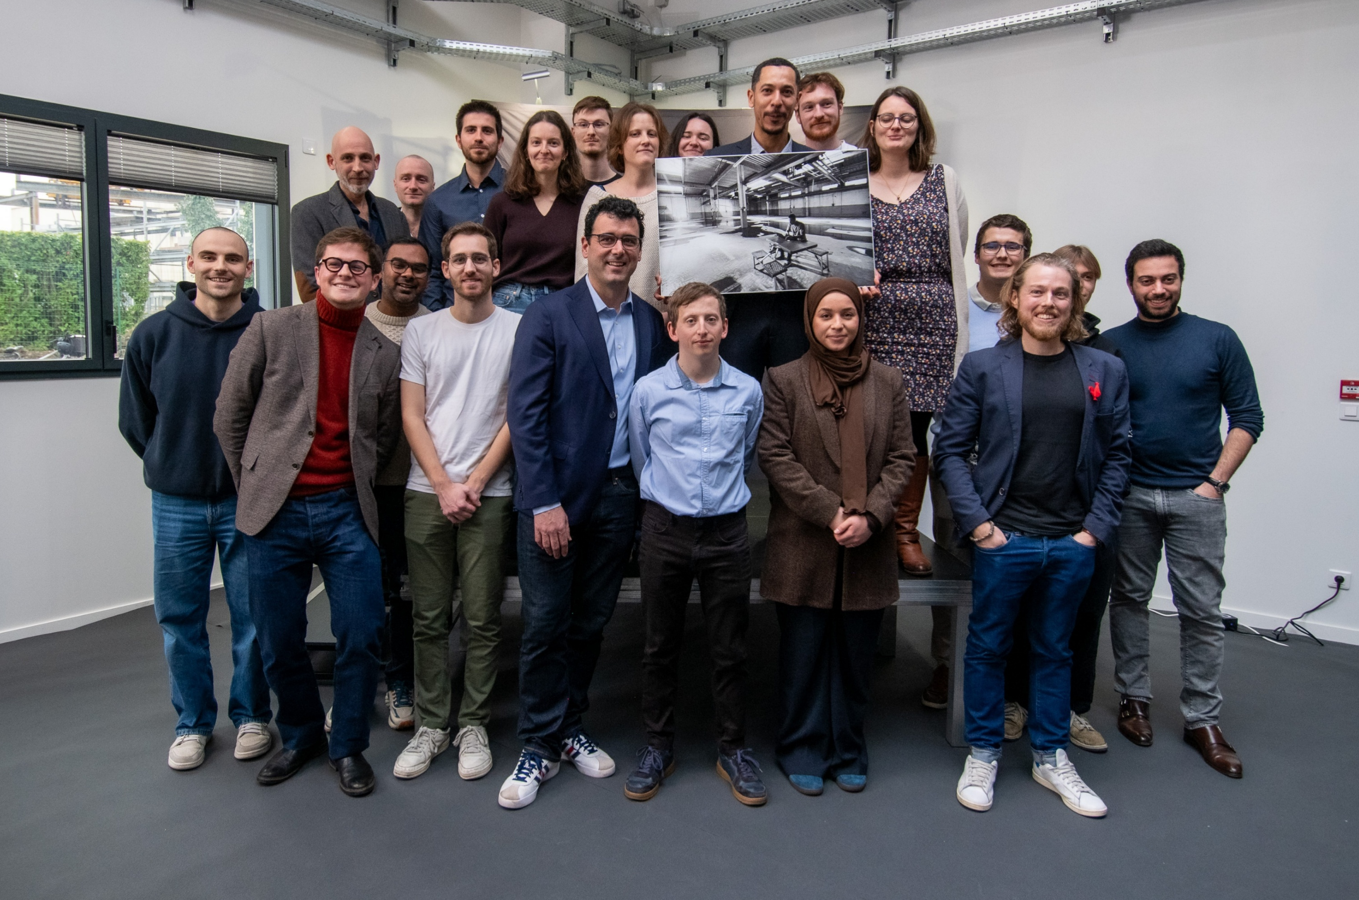

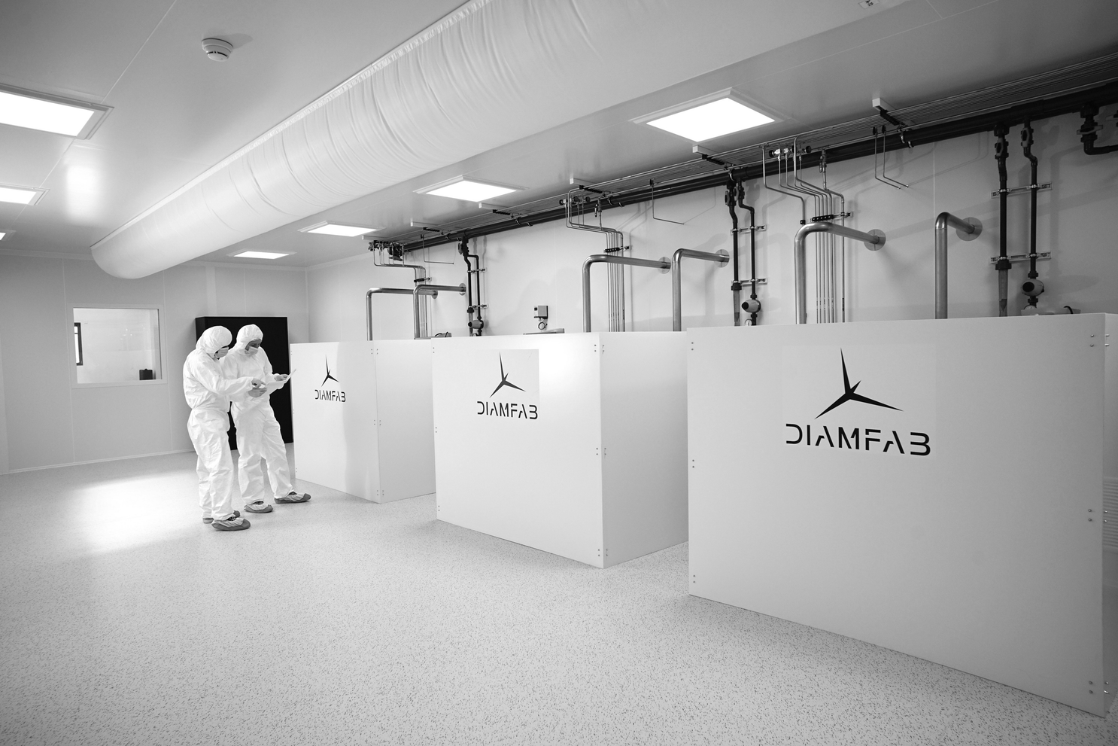
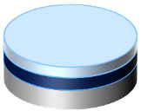
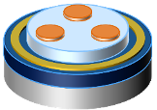
And now ?
Substrate
  Start-up created in 2019
Based on more than 30 years of
R&D developed at Intstitut Néel- CNRS
+ 8 patents and know-how
  26 People
+ 5 advisors
Diamfab unique know-how :
EPITAXY, DOPING, DEVICE DESIGN & PrOCESSING
GrenOBLE
FRANCE
  Business targeted
Power electronics
Quantum application
Hardened electronics (space, nuclear and high temperature)
High Value-added Diamond Wafer
Diamond Electronic Devices
Robin Molle
IF you want to work with us, don’t hesitate to contact me !
robin.molle@diamfab.com
Notes:
So, at Diamfab we fabricate diamond.
Our solution is based on a technology developed for more than 30 years at CNRS Grenoble and protected with 8 patents and secrets know-how.
Today, Diamfab is 26 people and 5 world recognised advisors
We target power electronics and hardened electronics market as well as quantum market
Our unique know-how is to grow electronic grade doped diamond as a semiconductor on a diamond substrate and our expertise is to design and process devices.
Therefore, we have a dual model model allowing us to offer either High value-added wafer solution or bare die devices solution

