Slide 1






PhD Day
Enhancing MBTA Efficiency and Template Banks Generation for Sub-Solar-Mass Black Hole Searches
Gaspard Joubert
Under the supervision of
Sébastien Viret
2026-04-23
1

Slide 2
Outline
  Introduction
  The sub-solar analysis
  My work
  Perspective
2

Slide 3
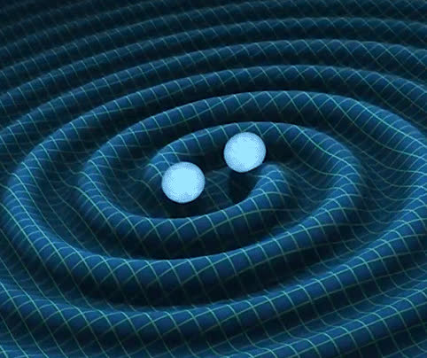
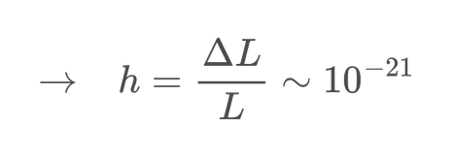
Gravitational waves (GW)
  Ripples of spacetime produced by accelerating massive objects
  Most powerful GWs produced by compact binary coalescence (CBC)
  Propagate at the speed of light
  Extremely weak signal on earth
1st indirect detection by Taylor & Hulse using pulsar
1st direct detection using interferometers
Predicted by Einstein
1916
1974
2015
3
Notes:
Predicted by Einstein in 1916
First indirect observation in 1974 by Taylor & Hulse using pulsar
First direct observation in 2015 using interferometers
Ripples of spacetime produced by accelerating massive objects
Typical sources:
- Binary black holes (BBH), Binary neutron stars (BNS), Supernovae, ...
Propagate at the speed of light
Amplitude decreases linearly with distance
Extremely weak signal

Slide 4
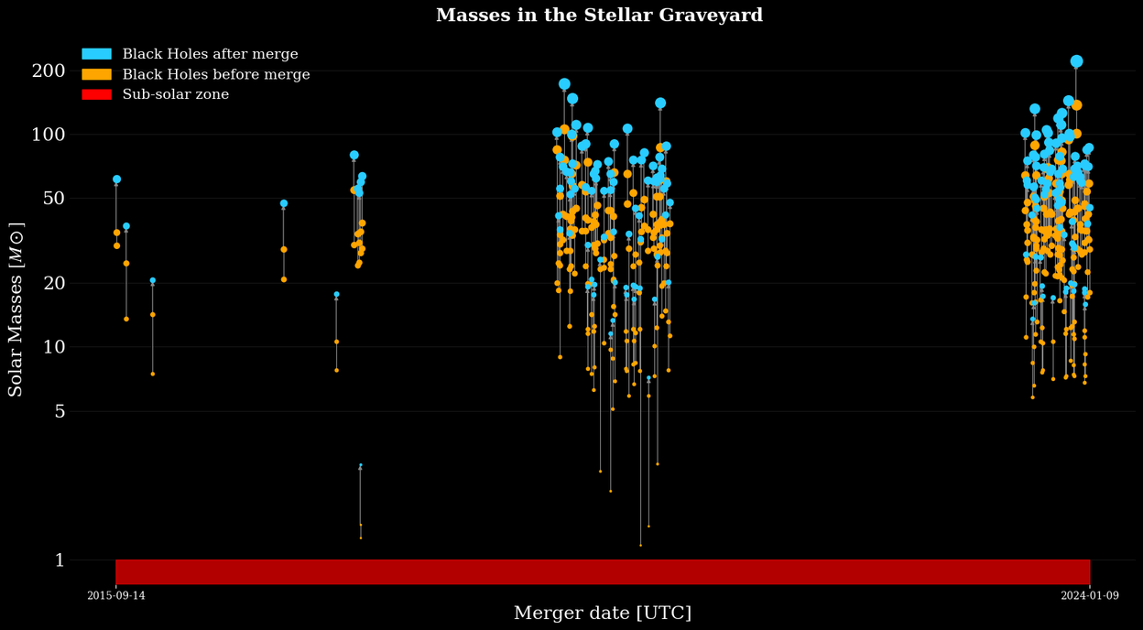

Searching for sub-solar mergers
2 types of search : All-sky and sub-solar mass black holes (SSM)
Primordial black holes (PBH) are candidates to part of the dark matter
Indicate formation mechanism alternative to usual stellar evolution
PBH cover a larger mass range but SSM detection would be unambiguous
SSM : At least one object is bellow 1 M☉, no detection yet :(
GWTC-4.0 catalog of detected merger
4

Slide 5
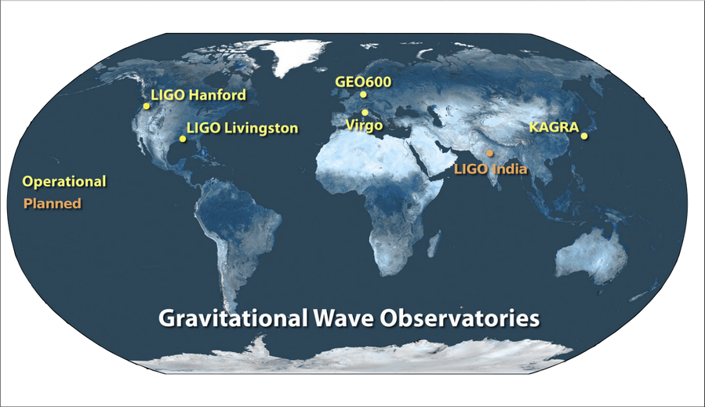
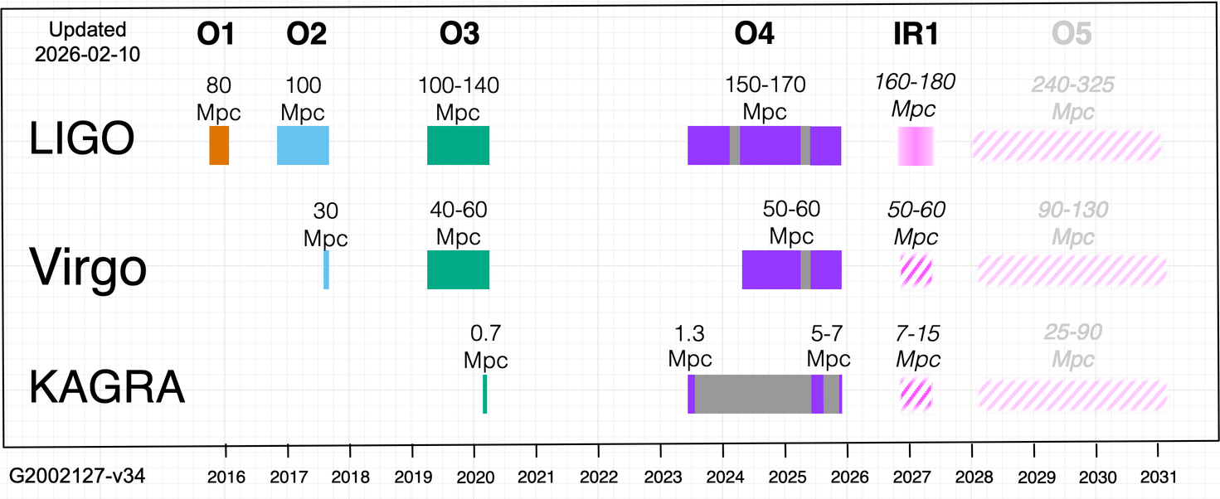
Direct detection
  Periodically interrupted for upgrades
  Range : The maximum distance we can expect to detect a determined signal
  IP2I takes part in the data analysis of the detectors.
  Now finishing the offline processing of O4b and starting O4c
Today
Map of the various detectors
A
B
C
  LIGO Virgo Kagra (LVK) collaboration
  Multiple detectors on several places
  Unlock multimessenger astronomy
B
C
Observing runs timeline
5
Notes:
max 1min30s
Pas très clair on/offline
GEO600 stop at the en of this year :(
Analysis of gravitational wave signals to assess the validity of the theory in the strong-field regime.
Provides insights into the large-scale distribution of matter in the Universe
Cosmological studies
Testing General Relativity

Slide 6
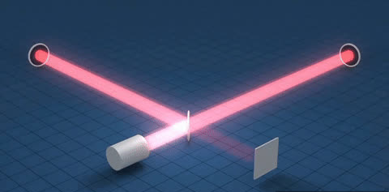
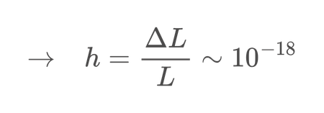
Ground based detection simplified
  Big interferometers
  Both arms having the same length
  When a gravitational waves passes through : both arms not the same length anymore
  Interference
  We can then measure the variation of the length
Detectors length : 4km
→ Not enough to detect GW
Adding Fabry-Perot to extend arms length :
effective distance 1200km
→ Enough to detect GW
6
Notes:
-18 m → ~1000 fois plus petit qu’un proton
−21 m → ~1 million de fois plus petit qu’un proton

Slide 7
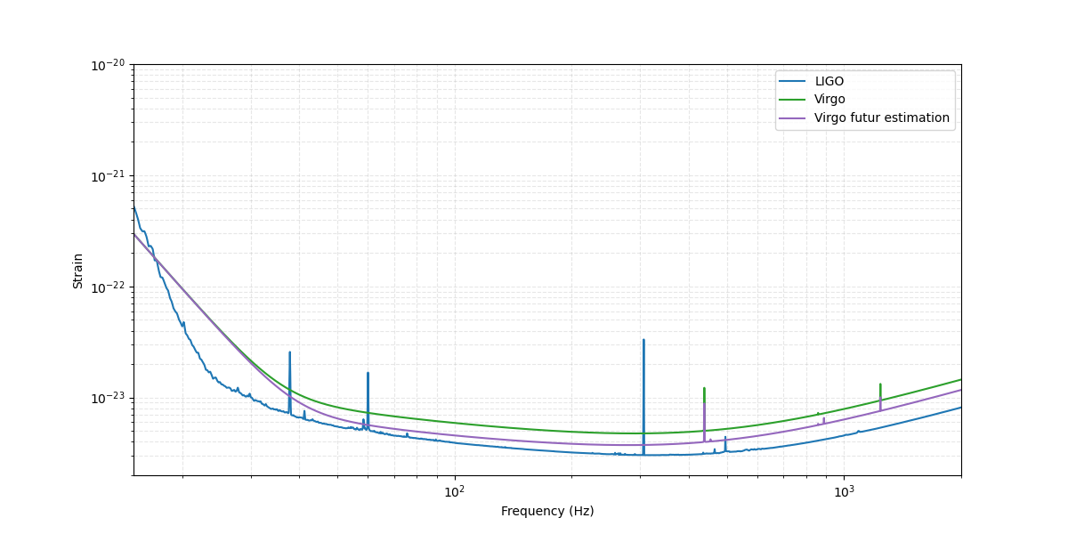
Sensitivity of the various detectors
Tectonic activities
Thermal noise
Noise from suspensions
Shot noise
  Signal “drown” in noise
  We need method to extract signal from noise
  Various sources of noise :
Terrestrial, instrumental, unknown, ...
Estimated amplitude spectral density of the noise
7
Notes:
SNR
frequency range
sensitivity

Slide 8
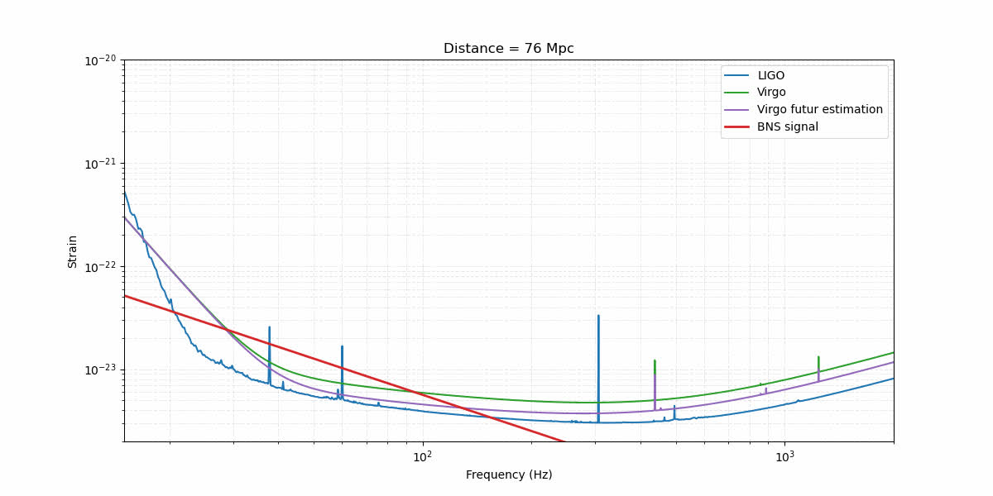
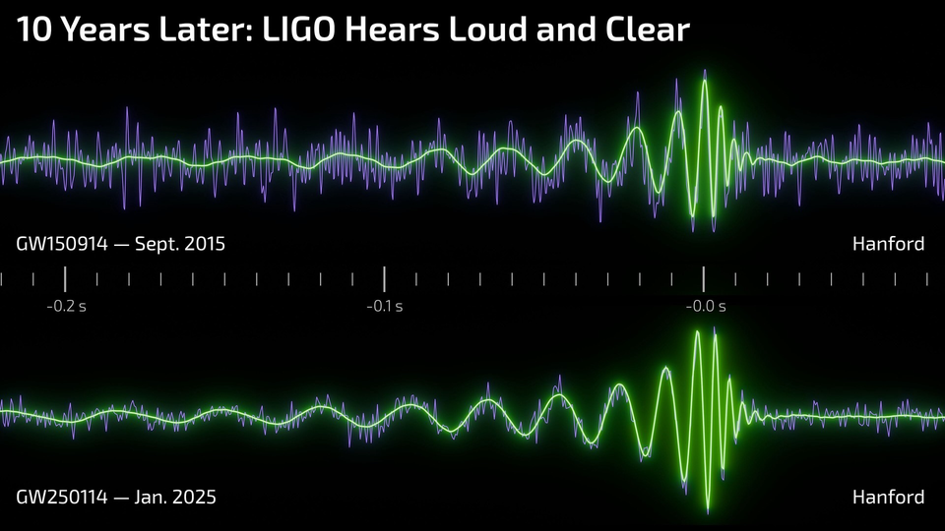
Sensitivity of the various detectors
  Signal “drown” in noise
  We need method to extract signal from noise
  Various sources of noise :
Terrestrial, instrumental, unknown, ...
Estimated amplitude spectral density of the noise with a 1.4M⊙, 1.4M⊙ binary neutron star merger
2 look alike signal taken 10 years apart
8
Notes:
SNR
frequency range
sensitivity

Slide 9
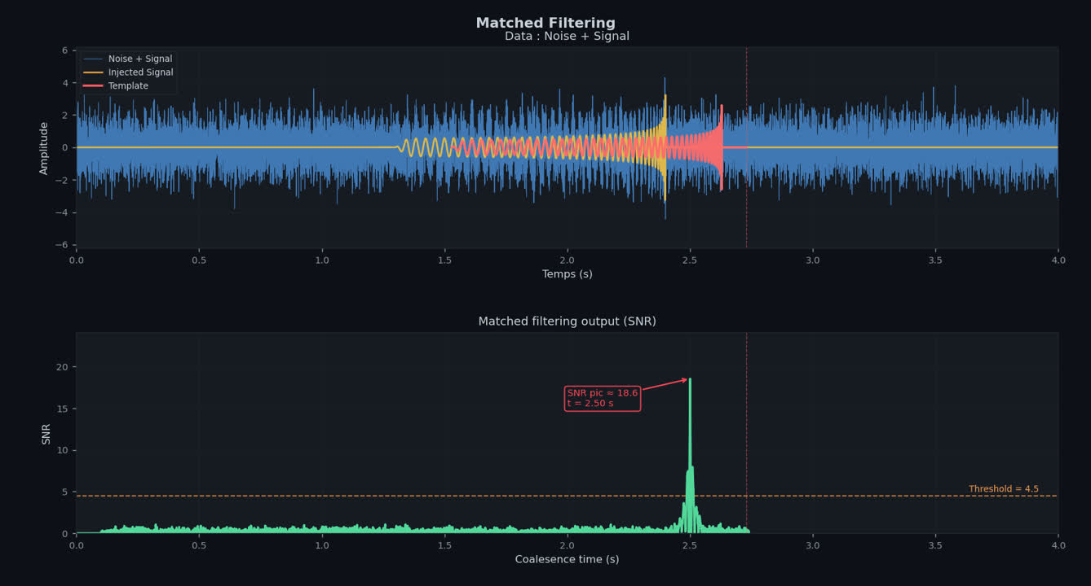
Detection principle
Matched filtering (MF)
Goal: detect weak signals buried in noise
  Try to maximizes signal-to-noise ratio (SNR)
  Optimal method for Gaussian, stationary noise
  Compare data with a bank (VT) of hundred of thousands theoretical templates
  Templates = theorical expected waveforms
  Compute correlation between data and templates between 2 frequency bands
The 3 main CBC search pipelines are based on MF (MBTA, gstLAL and PyCBC)
Exemple of matched filtering on data
9
Notes:
I work on the offline part

Slide 10
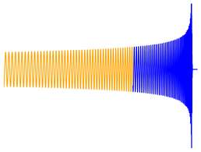
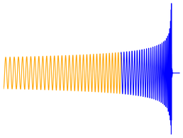
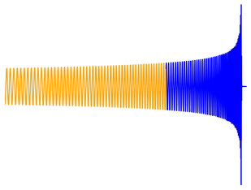
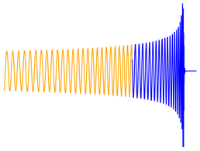
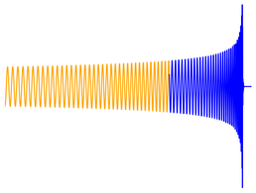
MultiBand Template Analysis (MBTA)
Multiband Template Analysis : Divide the analysis into 2 frequency bands on which the computing is done
→ Reduce the number of template needed by a factor ~13
– Real template low frequency bank (RT LF bank) going from 45Hz to 120Hz
– Real template high frequency bank (RTHF bank) going from 120Hz to 1024Hz
Once the MF is done for the RTs, the template corresponding in the VT bank is then find using a matching table
→ Drasticaly decrease the computing ressources needed
Template treiggered in the LF band
Template treiggered in the HF band
LF Real templates
Matching file
Virtual templates
HF Real Templates
Corresponding template in the full frequency band (VT)
10

Slide 11
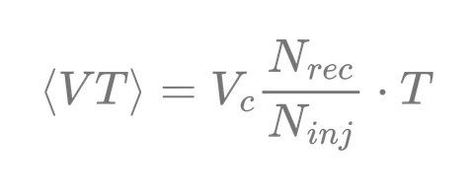
Sensitive Hyper-Volume
The sensitive hyper-volume or <VT> quantifies the sensitivity of a detector over a given observation period
→ How much volume of the Universe is effectively probed.
  How to quantifies the <VT>
  We take the maximum distance we can reach with our detectors
  We generate theorical signal using population models inside the associated volume
  We inject these simulated signals into the data strain
  We look at how many signal we recover
Number of recovered injections
Total observation time
Astrophysical covolume
Total number of injections
11
Notes:
https://arxiv.org/pdf/1712.00482
Because of the very low number of signal, We add simulated signals (injections) into real data to test the pipeline’s ability to recover events under realistic noise conditions.
The volume-time VT quantifies the sensitivity of a detector over a given observation period
→ How much volume of the Universe is effectively probed.
Practical Estimation
Inject simulated signals into real data
Compute the recovery fraction:
Real datas contain very low number of signals
To tests pipeline, we add simulated signals (injections)
Most of them are pruned due to their too low amplitude.
The rest is injected into real data to test the pipeline’s ability to recover events under realistic noise conditions.
If a pipeline detect an injections and respect some critera → The injections is considered recovered

Slide 12
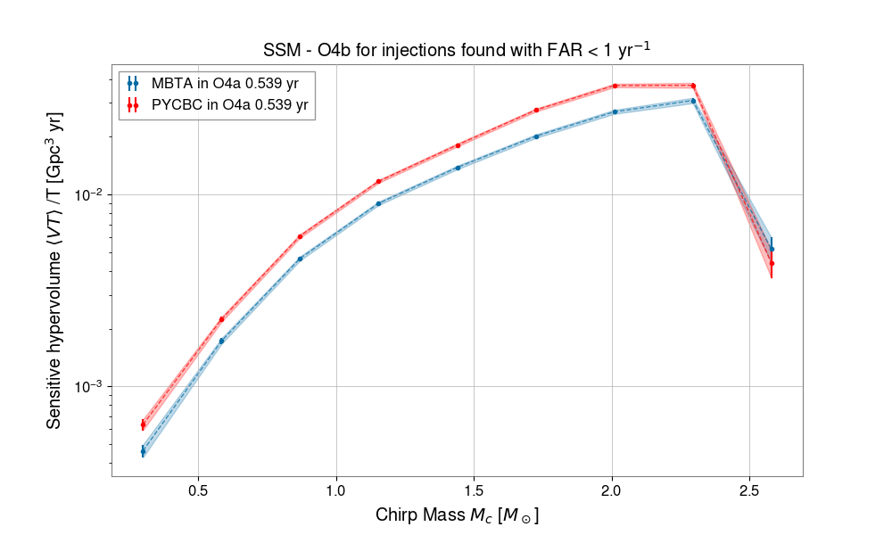
SSM MBTA efficiency problem
Results from the O4a SSM publication
MBTA is less sensitive on injections wrt PyCBC and GstLAL
End of parameter space
From the previous VT formula, every values are the same except for the number of detection.
We tried to have a better signal reconstruction to increase MBTA sensitivity
Looking at various hypothesis
The theorical model (approximant) use to generate our bank
The frequency bands
O4a SSM injections
Preliminary
Search for CBCs with SSM Components in Data from The First Part of LVK Fourth Observing Run
12
Notes:
Mais O3 on était aussi sensible
List of hypothesis :
Change in approximant
Change in low frequency for filtering and RT bank
Number of passes for injections

Slide 13
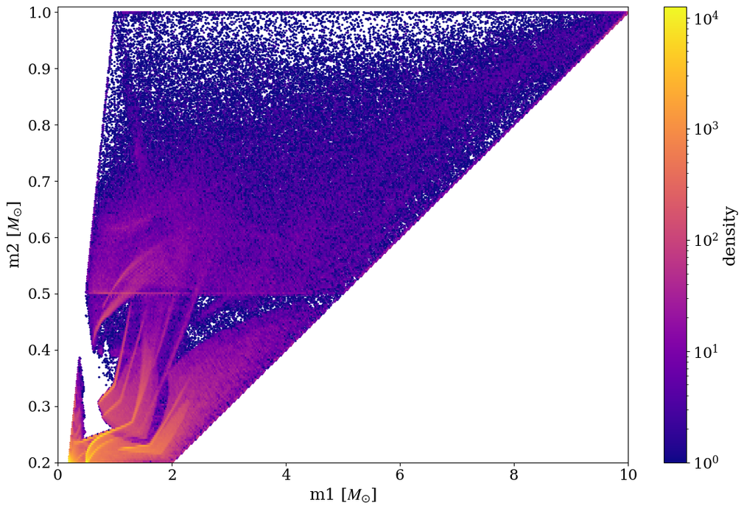
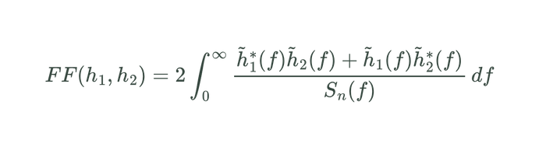
SSM banks generation
SSM Virtual template (VT) bank
  Template banks are constructed to be able to cover a certain parameter space
  Map the space such that the distance between 2 templates represents the mismatch
  Bank performance metric: Minimal Match (MM) :
– Computes the fitting factor between injections and bank Templates
– Take the best fitting factor found for each injections.
– Example: MM = 0.97 → recover at least 97% of the SNR
  Millions of template are needed → computationally heavy
SSM VT bank containing 2282654 templates
13

Slide 14
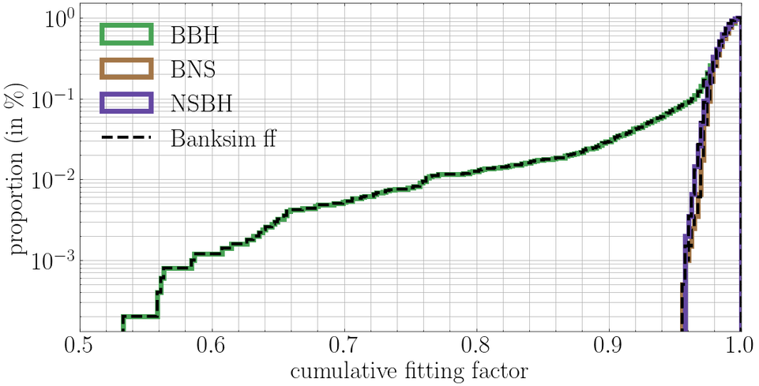
Algorithm principle
Producing and testing new template banks is computationaly heavy, we developed tools to speed up those stages
Rely on 2 ideas :
  The vectorization of the computation
  The preselection of templates candidates
This algorithm can be used to test banks coverage/miminal match (and determine matching file)
When comparing our algorithm with the reference algorithm on 9000 injections on a ~850000 templates bank :
Banksim ~30 Hours, our algorithm ~1.5 Hours
And consistent results
Figure 4. Comparison between our algorithm and Banksim algorithm.
14

Slide 15


Banks verification
Template with Mcs compatible (put in cache)
VT_n
This algorithm can also be used to generate banks
Templates matching
New method to generate RT banks directly from the VT bank :
  Take a point in the VT bank
  Do the match between the template and all the presected ones
  All templates with a matching above threshold is deleted
If enough maches : we go in a region near the previous point
Template with Mcs compatible
VT_n+1
Advantages :
→ Can work in N bands
→ The matching file is done by construction
Disadvantages :
→ Over estimate the number of template needed
If not enough maches : we go in another region
Template with Mcs compatible
VT_n+1
Diagram of the algorithm principle
15
Notes:
The fitting factor can be vectorized and computed by batches using FFT’s libraries like pyFFTW
There is a strong correlation between the chirp mass of the template and the injections and their fitting factor. So we only need to compute some of them
When comparing our algorithm with Banksim (the reference algorithm) on 9000 injections on a ~850000 templates bank :
Banksim ~30 Hours, our algorithm ~1.5 Hours
And consistent results

Slide 16
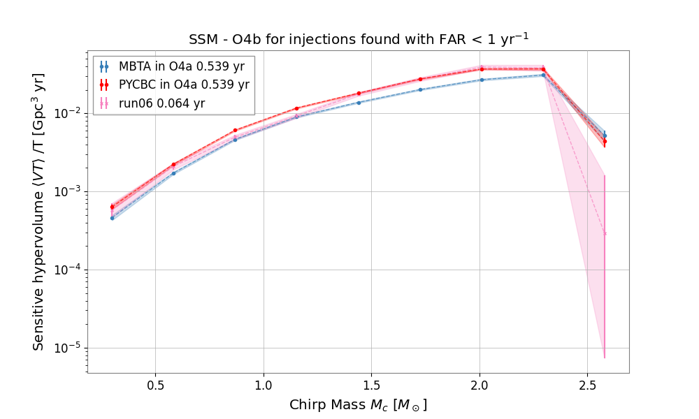
Configuration chosen for o4b
End of parameter space
- Change in approximant for Mtot > 4
- VT bank generated from 45Hz to 1024Hz
- RTs banks generated from 35Hz to 1024Hz with a cut at 105Hz
- But we filter from 35Hz to 512Hz
→ Performances similar to PyCBC’s
Preliminary
Volume Time (VT) for BBH for various configurations
16

Slide 17
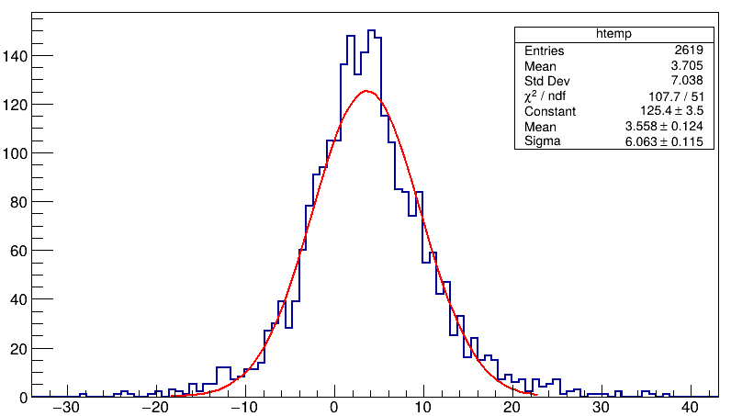
Going lower using 3 bands
New RT made from the original VT
Frequency cuts : [35, 63, 120, 1024] to have ~1/3 of the SNR in each
Analysis on a subset of the bank/injections with chirp mass [0.5, 0.9]
Frequency bands | Total number of templates
2 bands starting at 35Hz | 366k templates
3 bands starting at 35Hz | 192k templates
3 bands starting at 30Hz | 266k templates
Preliminary
Expected increase between 35Hz and 30Hz (in%)
Problem while looking into the RT-VT table. Too few template in each band. If a MF output is above a threshold, needs to look every RT linked
17

Slide 18
Perspective
18

Slide 19
Complete o4b SSM study
End of parameter space
Finish the O4b offline analysis
Preliminary
Volume Time (VT) for BBH in different configurations
19

Slide 20
Going lower using 3 bands
New RT made from the original VT
Frequency cuts made to have ~1/3 of the SNR in each of the 3 bands
Analysis on a subset of the bank/injections with chirp mass [0.5, 0.9]
Frequency bands | Total number of templates
2 bands starting at 35Hz | 366k templates
3 bands starting at 35Hz | 192k templates
3 bands starting at 30Hz | 266k templates
Expected increase between 35Hz and 30Hz (in%)
Problem while looking into the RT-VT table. Too few template in each band. If a MF output is above a threshold, needs to look every RT linked
→ needs to change the algorithm or add a machine learning for detection
20

Slide 21
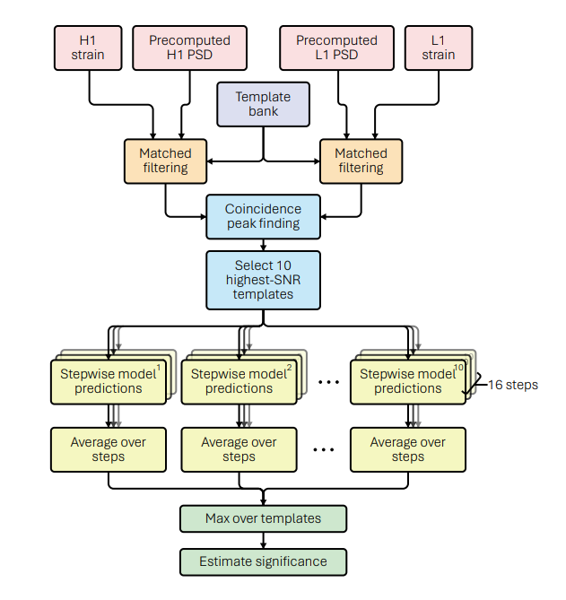
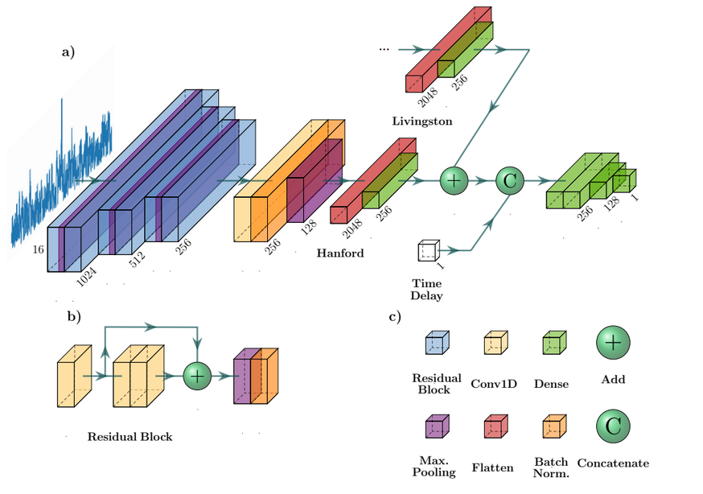
Matched filtering / Machine learning pipeline
New pipeline try to introduce machine learning into search using the MF output → Works well
But matched filtering still heavy, needs shorter template and a bigger bank (actually ~250 000 template)
MBTA divide into 2 bands, using shorter template and ‘small’ template banks
Flowchart of the search pipeline
Searching for binary black hole mergers with deep learning in Advanced LIGO’s third observing run - Damon Beveridge & Al.
21
High level architecture of the neural network
A binary neutron star merger search pipeline powered by deep learning - Alistair McLeod & Al.

Slide 22
Thank You
22

Slide 23
Back-up
23

Slide 24
Computational cost for various runs
 | Total CPU hours (increase vs cfg A) | CPU Efficiency (%) | max RSS (GB)
config A (run04) | 114 K | 62% | 8.9
config B1 one pass (run05_b1) | 173 K (+52%) | 86% | 17.9
config B1 two passes (run05_b2) | 252 K (+121%) | 84% | 18.1
config C (run06) | 133 K (+17%) | 79% | 14.4
Config C seems to be the best trade of between sensitivity gain and CPU cost
24

Slide 25
Various configuration for O4a
MBTA O4a configuration:
→ Same “VT” bank as PyCBC (but uses 2 bands – so different RTs)
→ Starts filtering from 45Hz
→ Use SpinTaylorT4 for filtering
→ Filtered BBH and BNS in 1 pass with 16 seconds spacing
GstLAL O4a configuration
→ Very different template bank built with IMRPhenomD and Manifold algorithm
→ TaylorF2 + SEOBNRv4_ROM for filtering
→ Starts filtering from 45Hz (+ 128s cut-off in template duration)
→ Filtered BBH and BNS in 2 different passes
PyCBC O4a configuration
→ (Almost) same geometric template bank
→ Use TaylorF2 + SEOBNRv4_ROM (Mtot > 4M_sun) for filtering
→ Starts filtering from 30Hz (+ 1008s cut-off in template duration)
→ Filtered BBH and BNS in 2 different passes
25

Slide 26
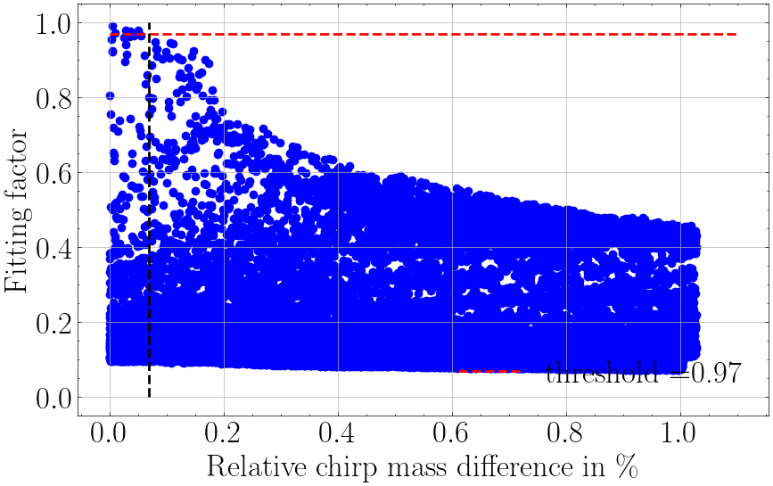
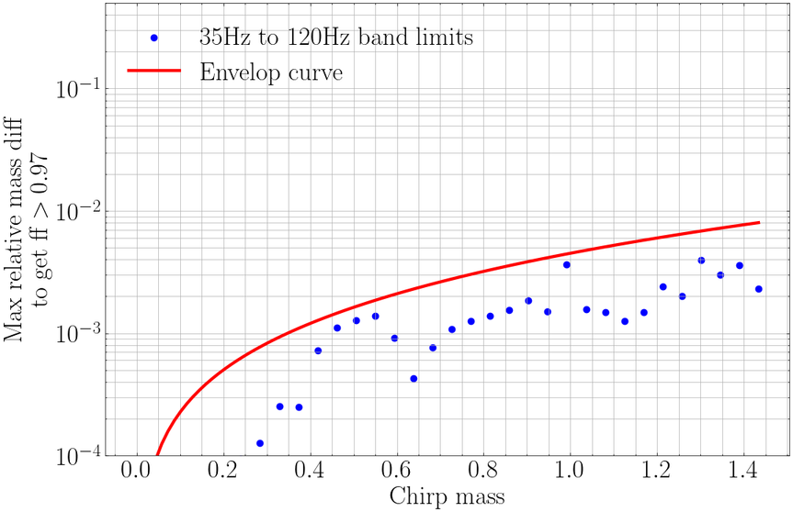
Banks production problem
Producing and testing new template banks is computationaly heavy, we developed tools to speed up those stages
New algorithm for RTs production
~0.071
Rely on 2 ideas :
  The fitting factor can be vectorized and computed by batches using FFT’s libraries like pyFFTW
  The preselection of templates candidates
There is a strong correlation between the chirp mass of the template and the injections and their fitting factor. So we only need to compute some of them
Fitting factor bewteen templates wrt their relative chirp mass difference.
~0.71%
26
Candidates envelop wrt the chirp mass of the injection.

Slide 27
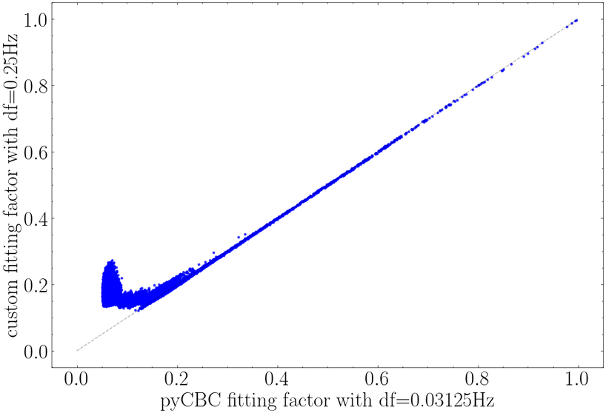
Algorithm others optimization
Other optimizations :
  A first computation using a coarser frequency resolution. Small difference appear in in low ff region, but not problematic as we’re looking only at high FF values.
→ Reduce the time needed to generate and compute the match :
  Once the best match is found, a second computation using a higher sampling frequency is done to have a precise result.
Figure 3. Scatter plot of our ff computation with a coarser resolution wrt pycbc’s match function with a higher resolution.
27

Slide 28
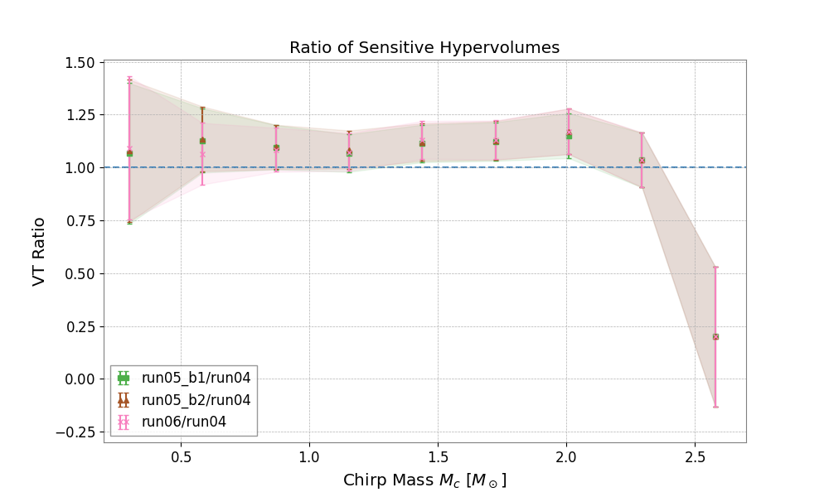
Various runs wrt to configuration A (run04)
End of parameter space
  Increase of sensitivity except for the last bin
  run05 and run06 have a better sensitivity than run04 as expected and seem equivalent
Relative configuration comparison,
all results obtained on O4b same data
Ratio of VT of the various configuration for BBH wrt configuration A
28

Slide 29
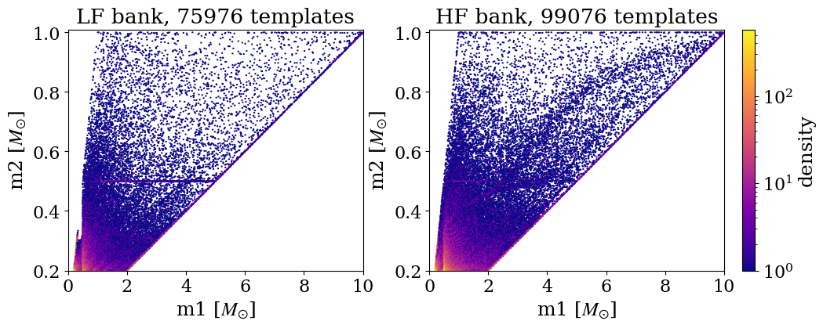
SSM real template banks
MBTA’s SSM LF and HF banks
29

Slide 30
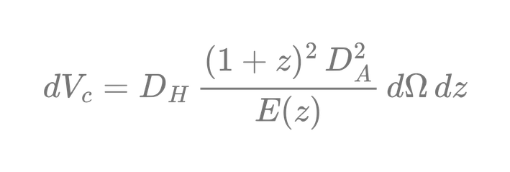
Hyperspace volume parameters
Condition for a detected signal :
  In a +-0.2s window from an injections
  SNR > 7
  FAR (False alarm rate) < 1 per year
Comoving volume :
The comoving volume is a volume that expands with the Universe and define by :
30

Slide 31
31

Slide 32
online presentation link
https://canva.link/7i4mdgauqj1g5sb
32

