Slide 1






Ph.D Day IP2I 2026
Cosmological implication of the joint observation of Gravitational Waves and Type Ia Supernovae
Léo Zimmermann
(Supervised by V.Sordini & M.Rigault)
Institut des 2 infinis de Lyon

Slide 2
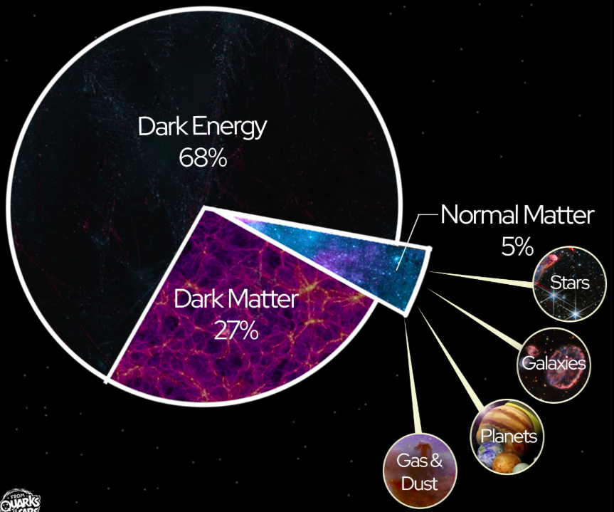
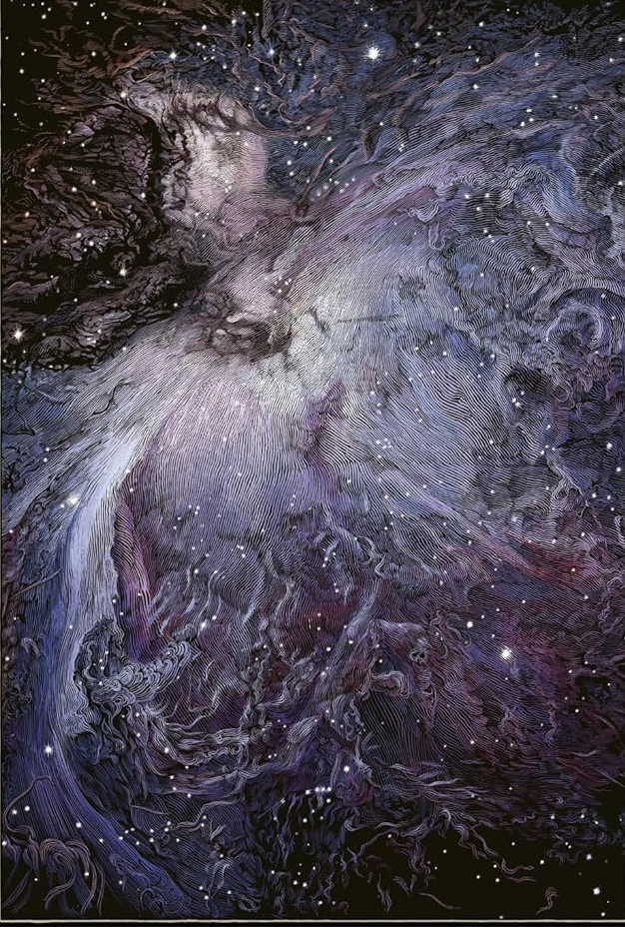
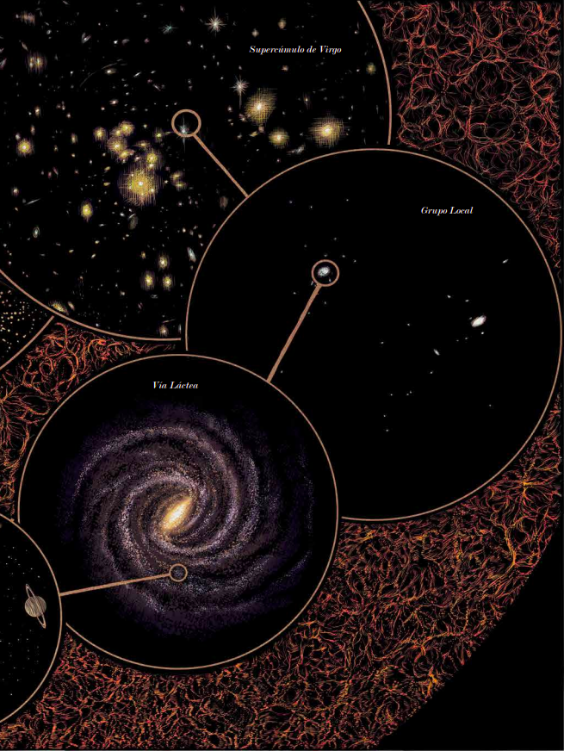
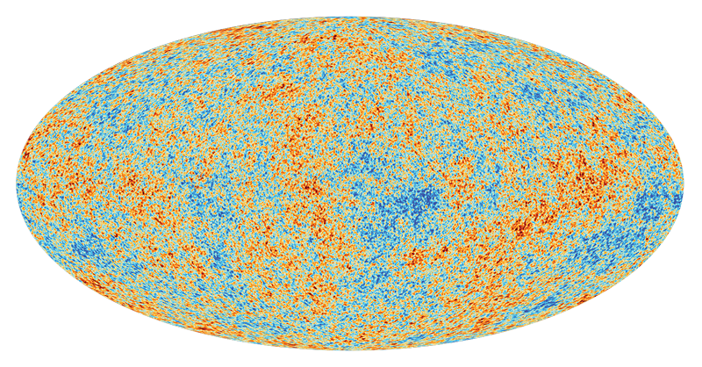

ΛCDM Model | Concordance model
3 hypothesis :
Gravitation well describe by general relativity
Large scale are homogenous and isotropic
Universe fild with baryon and Cold Dark Matter
6 Parameters for a flat Universe
Léo Zimmermann
Ph.D day | 04/26 | Lyon
1

Slide 3
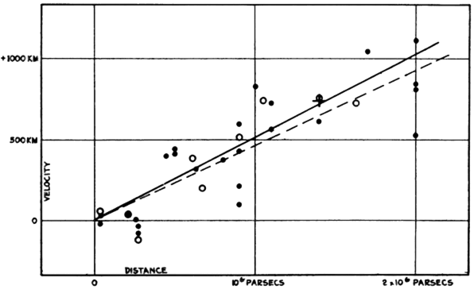

ΛCDM Model | Expansion !
Credit : Hubble 1929
At low redshift :
Léo Zimmermann
Ph.D day | 04/26 | Lyon
2

Slide 4
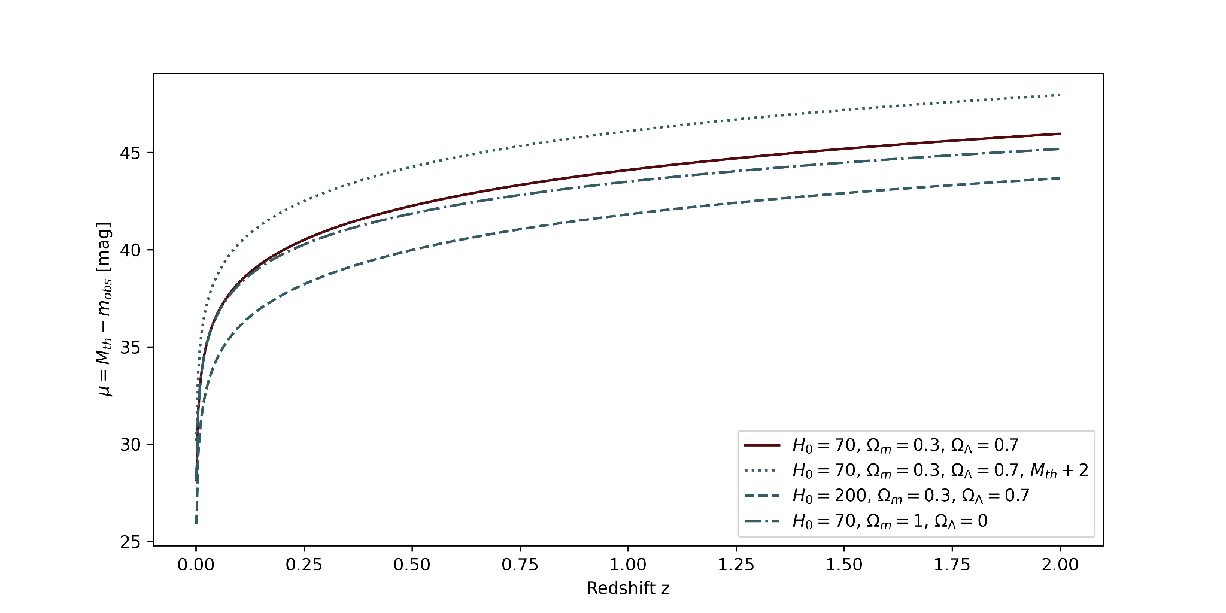
ΛCDM Model | Expansion !
µ = m_{obs} - M_{th}
Léo Zimmermann
Ph.D day | 04/26 | Lyon
3

Slide 5
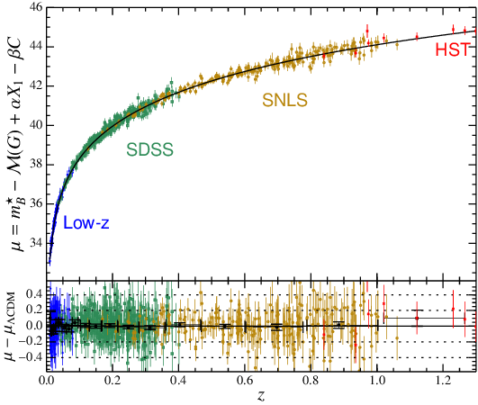
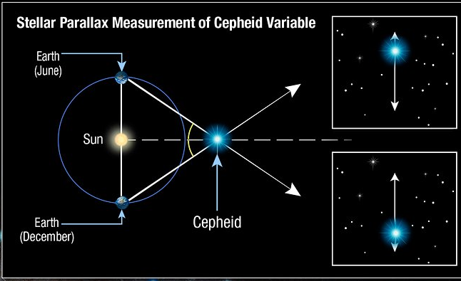
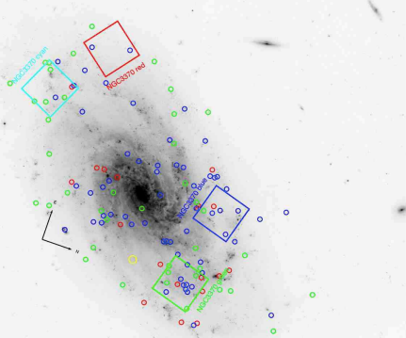
Measuring H₀ using Type Ia supernovae | SH0ES
Calibrates the PL (Period-Luminosity) relation.
Credit : Henrietta Leavitt
Measured M_{B} of SnIa.
Measured H₀.
Distance
Geometry
Calibrators (Not necessarily cepheids).
SnIa
Parallaxes
Cepheids
Hubble diagram
Distance
Credit : https://www.researchgate.net
<M_{B}>
H₀ = 73.04 ± 1.04 km·s⁻¹·Mpc⁻¹
Léo Zimmermann
Ph.D day | 04/26 | Lyon
4

Slide 6
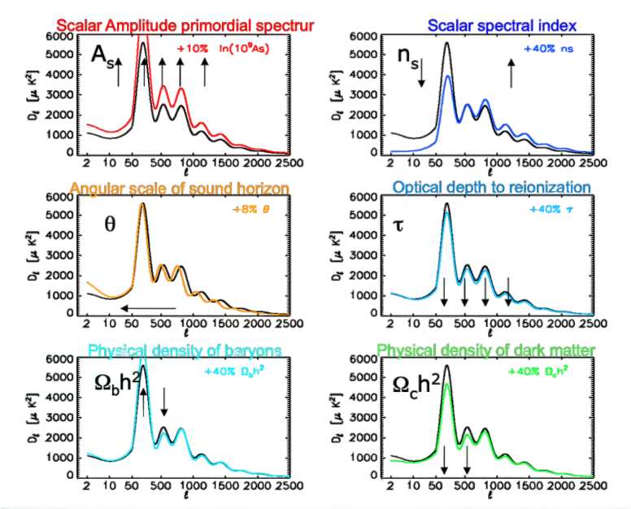
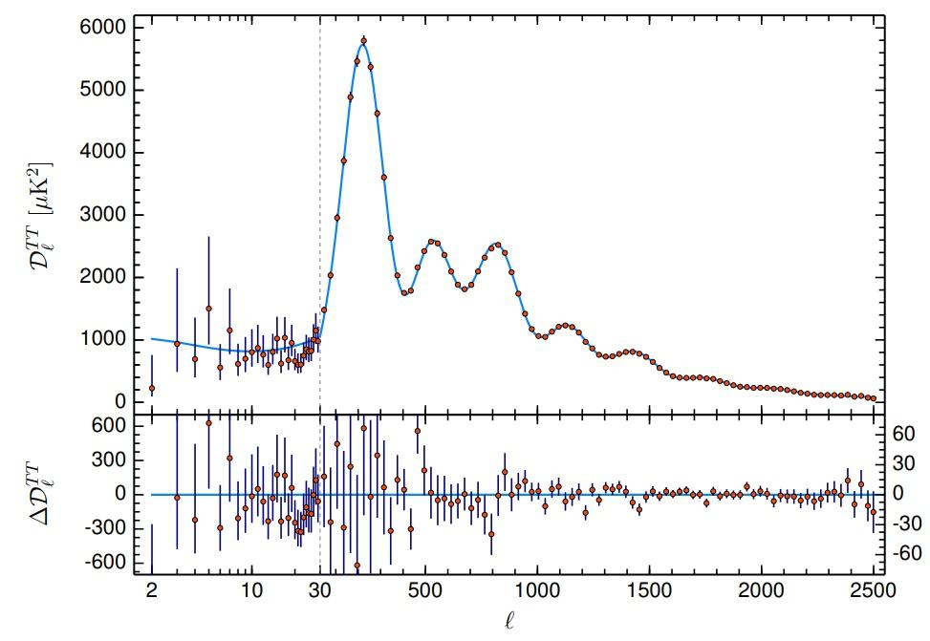
Measuring H₀ using CMB | Planck collaboration
Credit : https://arxiv.org/pdf/1807.06209
z ~ 1100
The model
contrains H₀
H0 = 67.4 ± 0.5 km·s⁻¹·Mpc⁻¹
~ Based on ΛCDM ~
z ~ 0
Léo Zimmermann
Ph.D day | 04/26 | Lyon
5

Slide 7
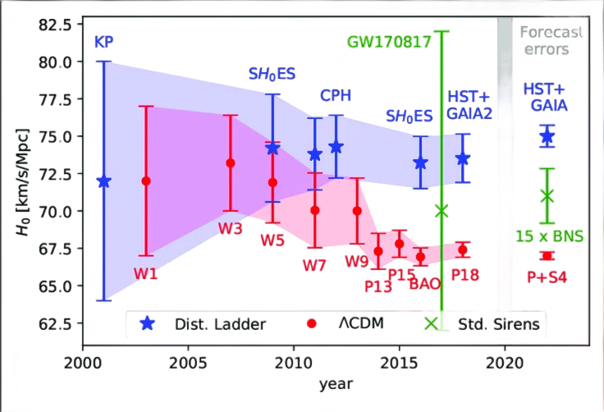
Hubble Tension
Léo Zimmermann
Ph.D day | 04/26 | Lyon
6

Slide 8
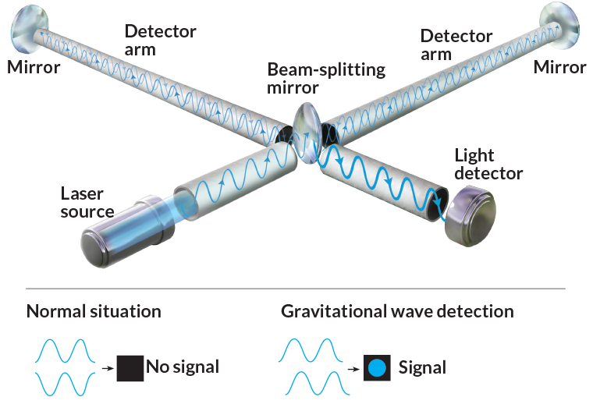
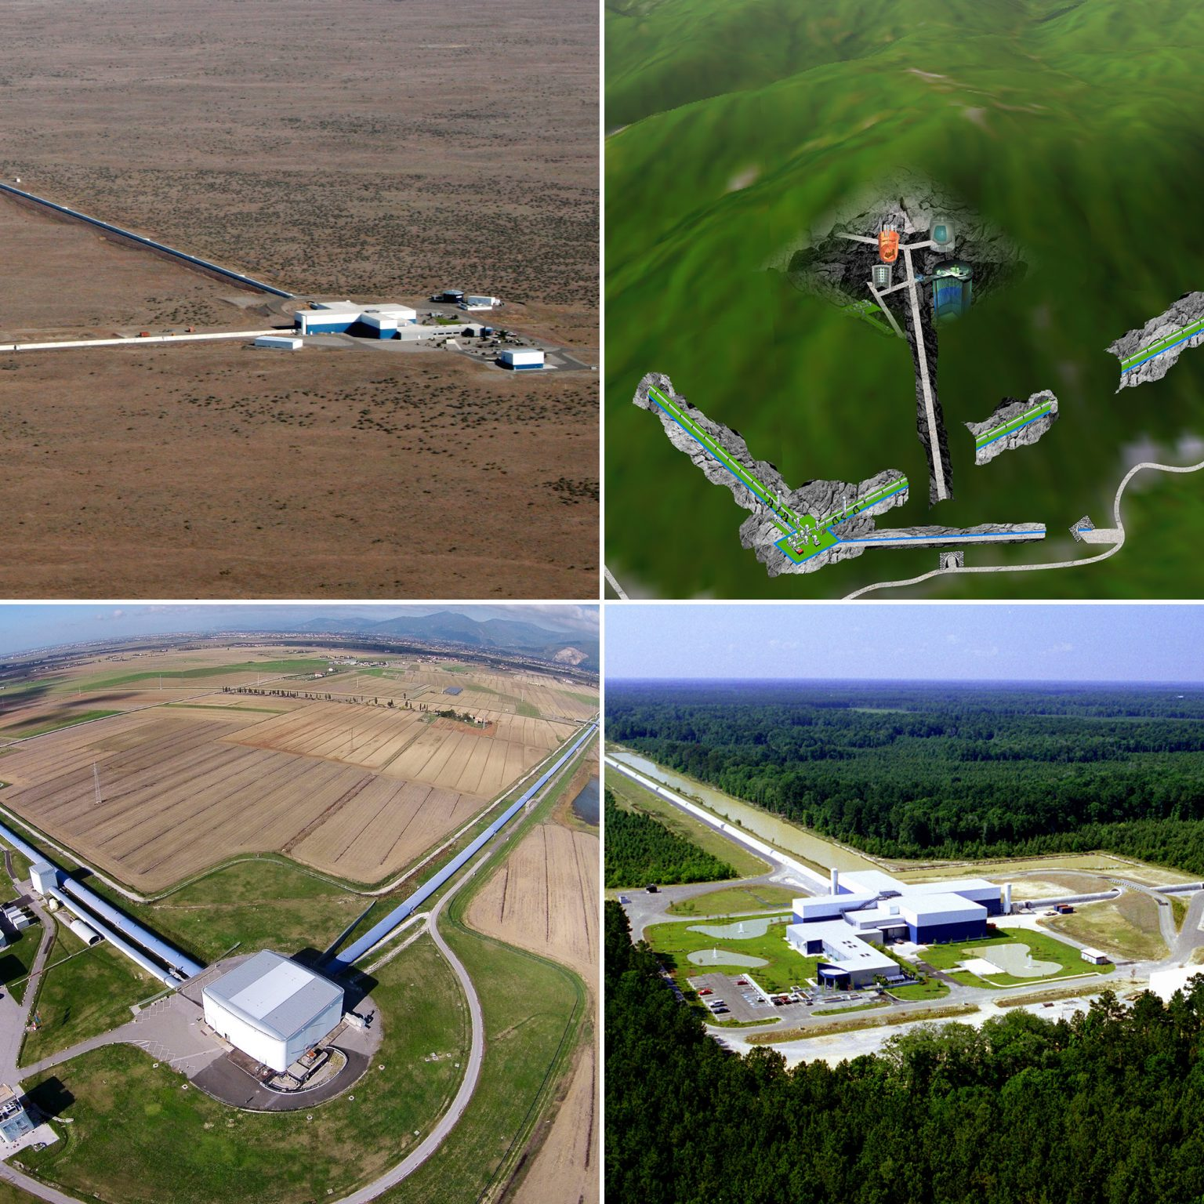
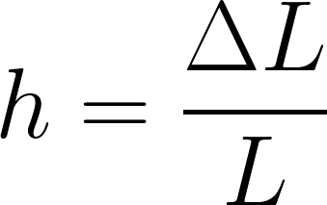
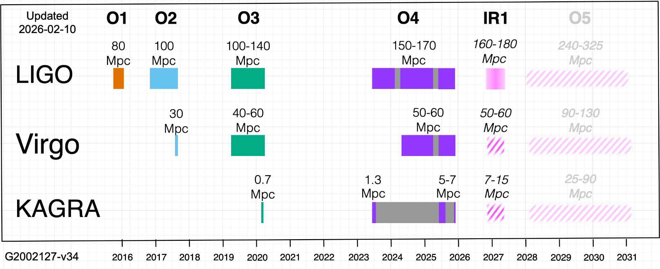
Gravitational waves
LIGO
Hanford
KAGRA
Virgo
LIGO
Livingston
My PhD
Léo Zimmermann
Ph.D day | 04/26 | Lyon
7

Slide 9
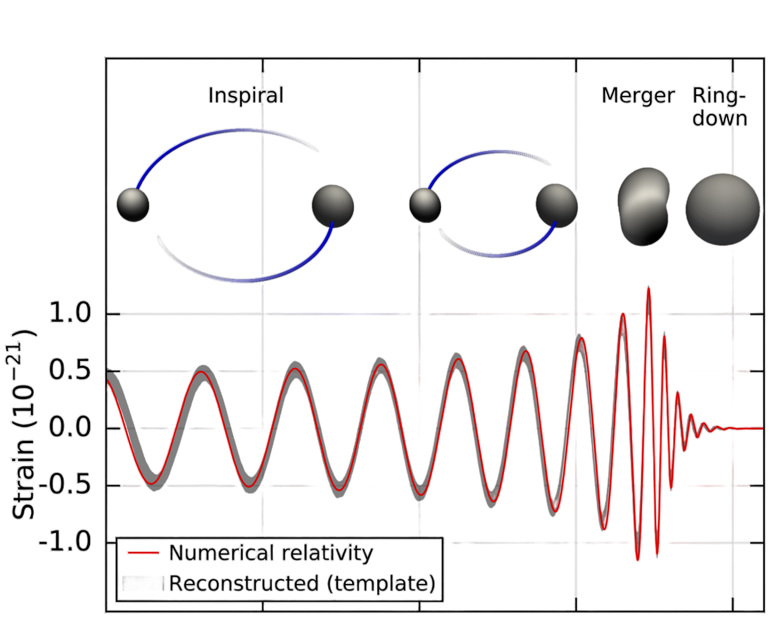
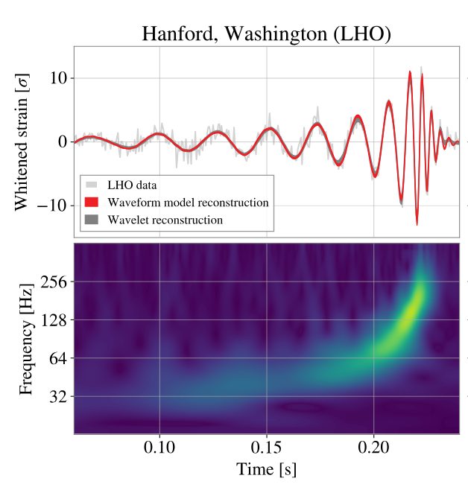
Gravitational waves
Time
∝ M/d_{L}
Time (s)
Léo Zimmermann
Ph.D day | 04/26 | Lyon
8

Slide 10
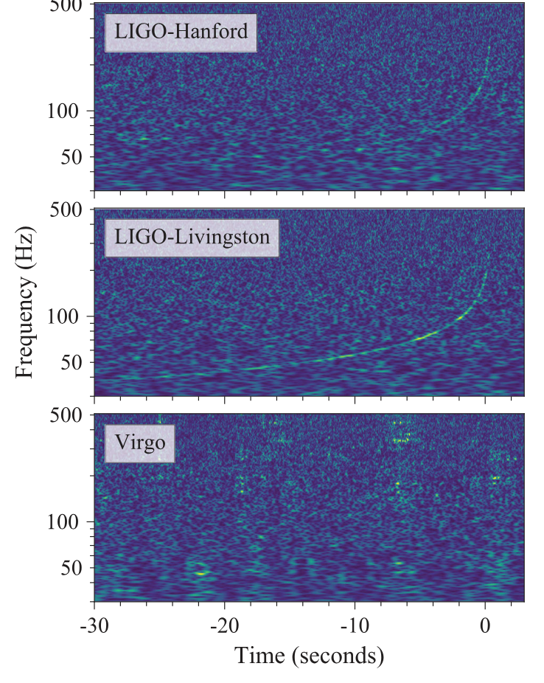
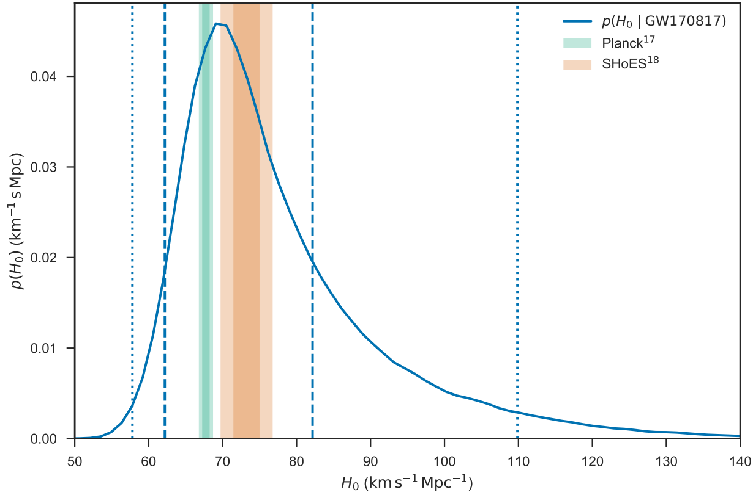
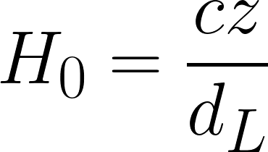
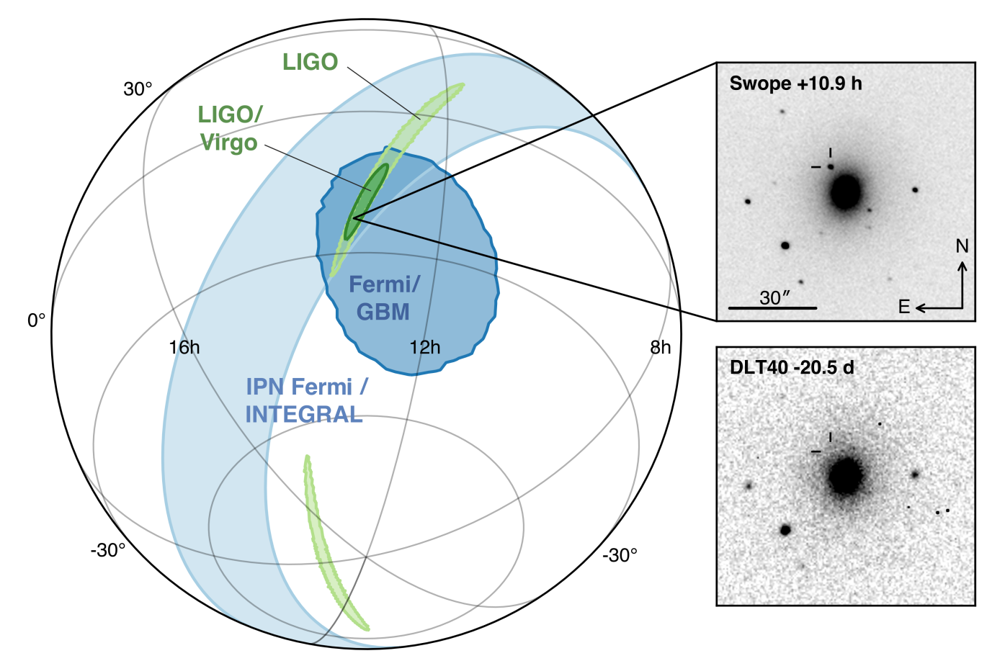
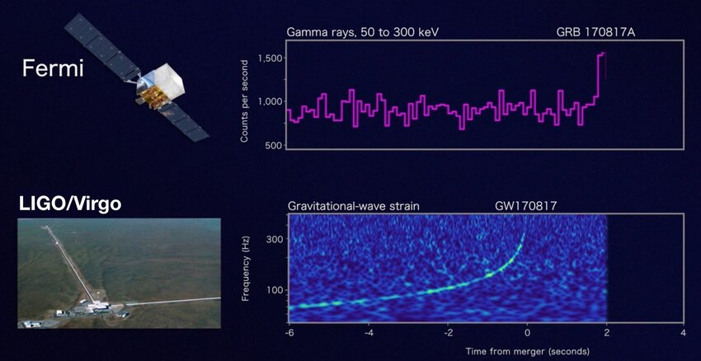
Measuring H₀ using GW | Bright Siren
GW signal → d_{L}
Credit : https://arxiv.org/abs/1710.05835
Credit : https://arxiv.org/abs/1710.05832
EM counterpart → z
3 detectors for sky location
H₀ = 70₋₈⁺¹² km·s⁻¹·Mpc⁻¹
Léo Zimmermann
Ph.D day | 04/26 | Lyon
9

Slide 11
Measuring H₀ using GW | Bright Siren
GW signal → d_{L}
Only 1 detection !
Credit : https://arxiv.org/abs/1710.05835
Credit : https://arxiv.org/abs/1710.05832
EM counterpart → z
3 detectors for sky location
H₀ = 70₋₈⁺¹² km·s⁻¹·Mpc⁻¹
Léo Zimmermann
Ph.D day | 04/26 | Lyon
10

Slide 12
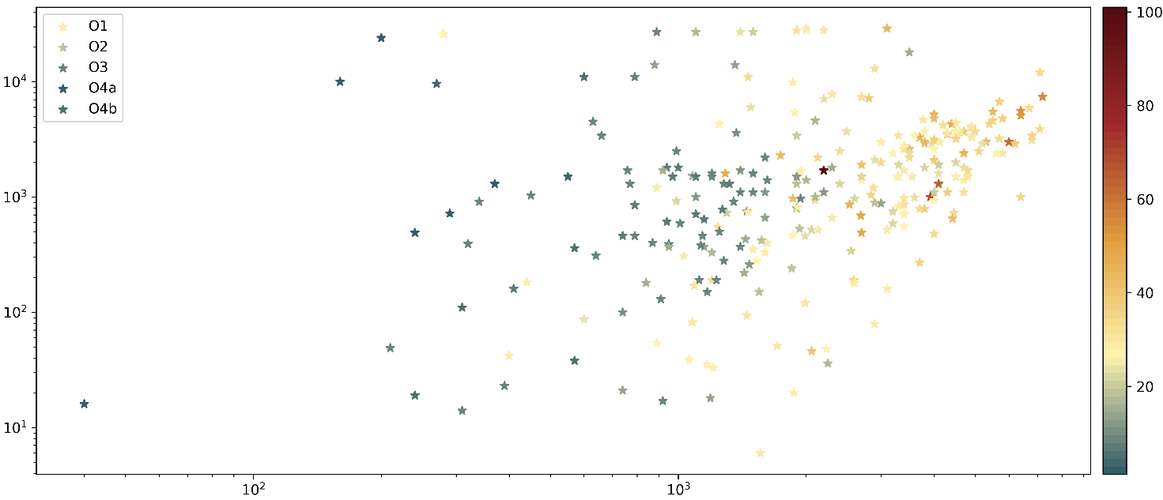
Measuring H₀ using GW | Dark Siren
Precision on sky localisation
Masses [M☉]
BNS
Luminosity distance [Mpc]
Léo Zimmermann
Ph.D day | 04/26 | Lyon
11

Slide 13
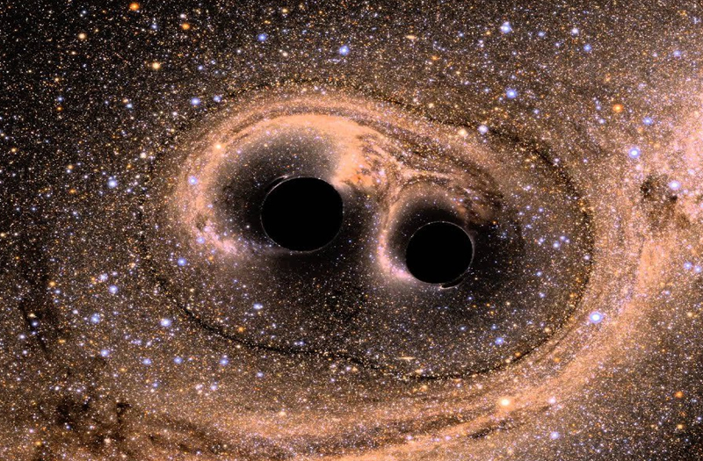
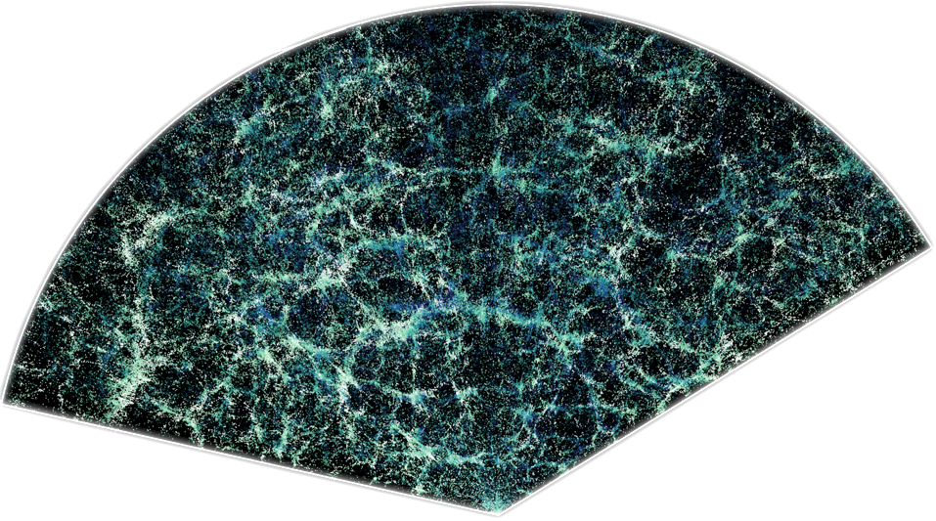
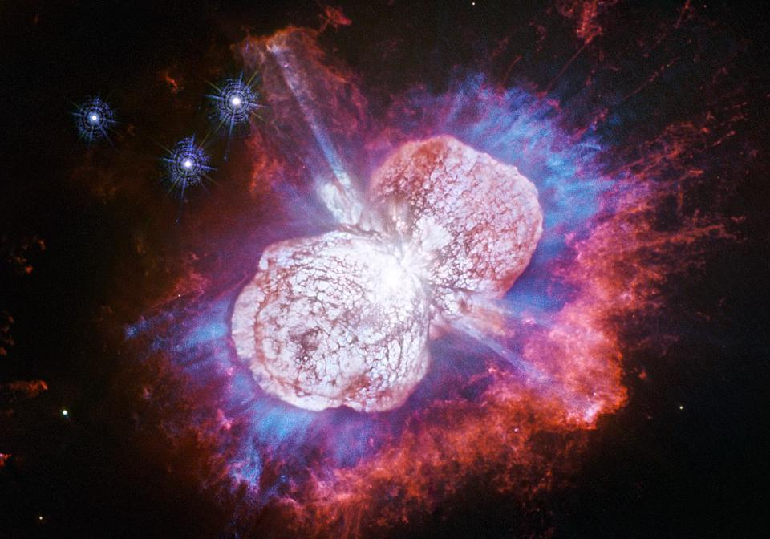
Using SN Ia and GW to constrain H₀
GWs :
Distances in Mpc, about 20% errors.
Large Localisation error, best location 9deg² 90% confident level.
d_{L}
= H₀
d_{L}/h
Type Ia supernovae :
Distances in Mpc/h.
  Biased tracer of the density field.
No error on location
Léo Zimmermann
Ph.D day | 04/26 | Lyon
12

Slide 14
Thesis project outlines
Handle noise and detect events
Increase precision of SNIa
Study the noise of Virgo detector
Study iDQ efficiency
Contributed to GWTC-5 papers
  GWTC-5 : Methods
  GWTC-5 : Result
Simulate GW events
Investigate a new method to standardise SN Ia
Simulation of SN Ia spectra
1st-2nd year
1st-2nd year
Combining the probes
Use ‘Flip’ package to generate and fit density fields of SN Ia and GWs.
Define a likelihood function.
Fit the density fields and get H₀.
3rd year
Léo Zimmermann
Ph.D day | 04/26 | Lyon
13

Slide 15
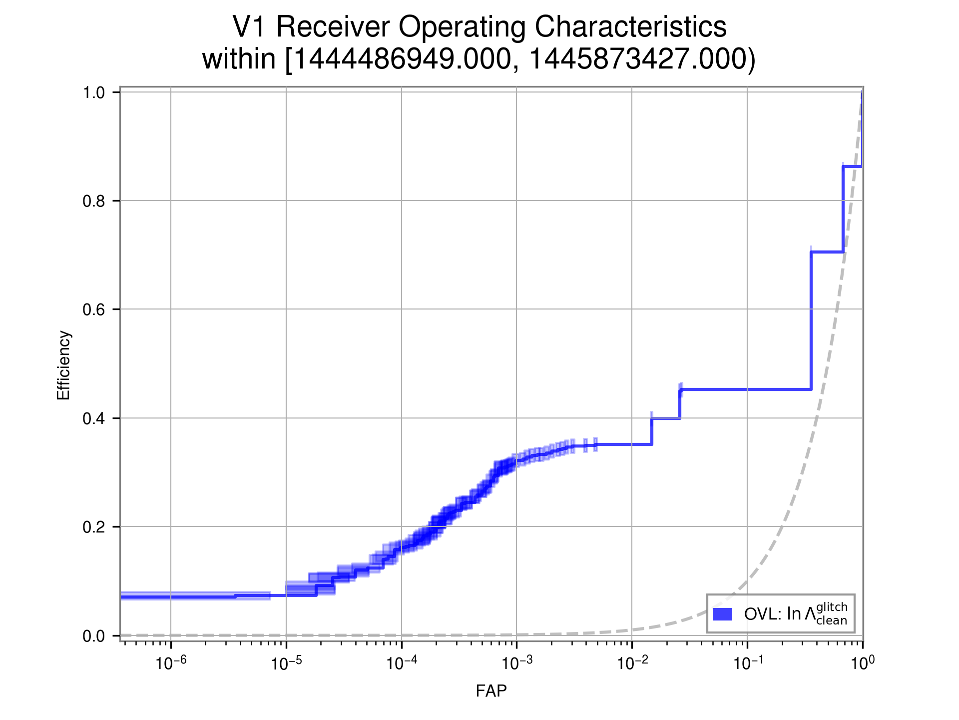
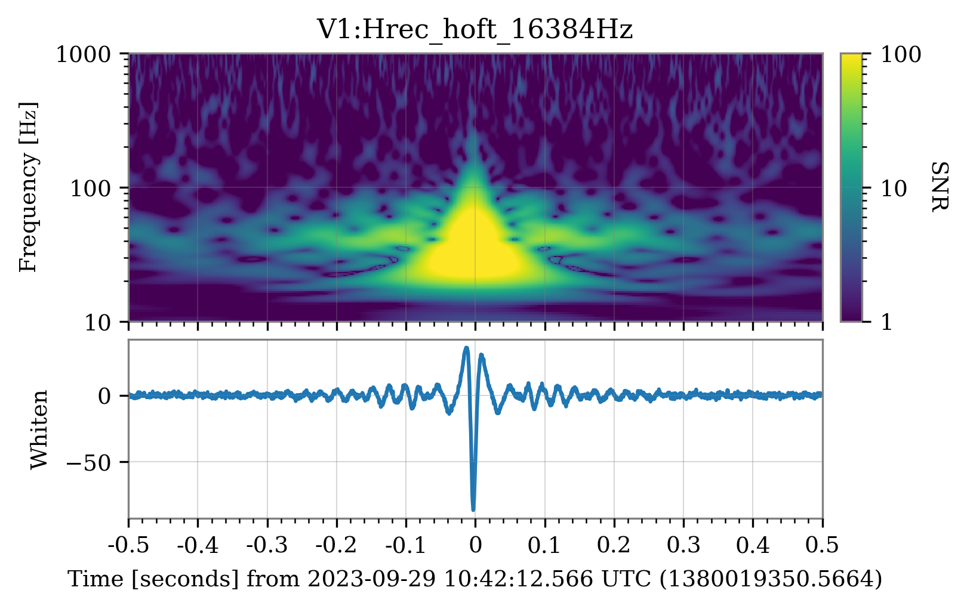
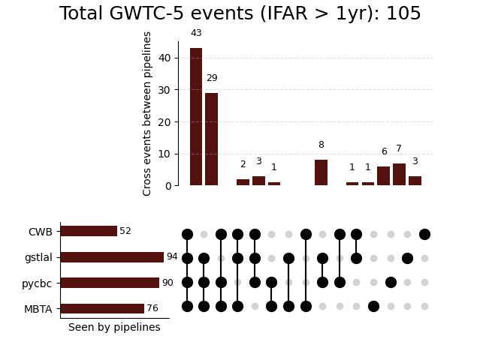
Gravitational waves studies
iDQ
25 minutes glitches
Detection
- - - Random classification
—- iDQ classification
—- Perfect classification
True positive
Fraction of False positive
Léo Zimmermann
Ph.D day | 04/26 | Lyon

Slide 16
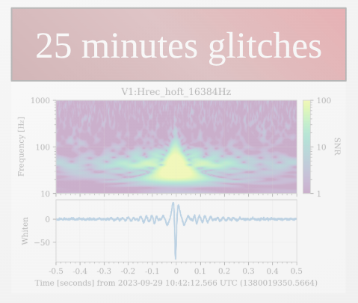
Gravitational waves studies
iDQ
Detection
- - - Random classification
—- iDQ classification
—- Perfect classification
True positive
Fraction of False positive
Léo Zimmermann
Ph.D day | 04/26 | Lyon

Slide 17
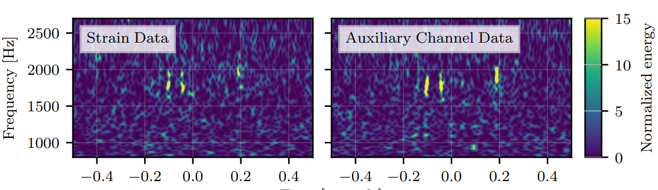
Inference Data Quality : iDQ
We measured GW signal in the Strain data h(t).
We measure numerous other channel to check the behavior of the detectors
Correlation !!
Léo Zimmermann
Ph.D day | 04/26 | Lyon
14

Slide 18
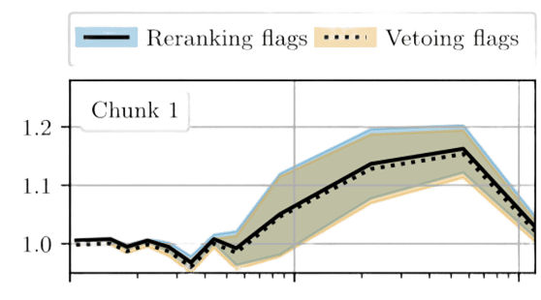
iDQ Performance
- - - Random classification
—- iDQ classification
—- Perfect classification
Credit : https://arxiv.org/abs/2204.03091
Efficiency
iDQ / no iDQ
True positive
Masses [M☉]
iDQ is used by pycbc as an additional information on GW signals.
Better detection efficiency while using iDQ !
Fraction of False positive
Léo Zimmermann
Ph.D day | 04/26 | Lyon
15

Slide 19
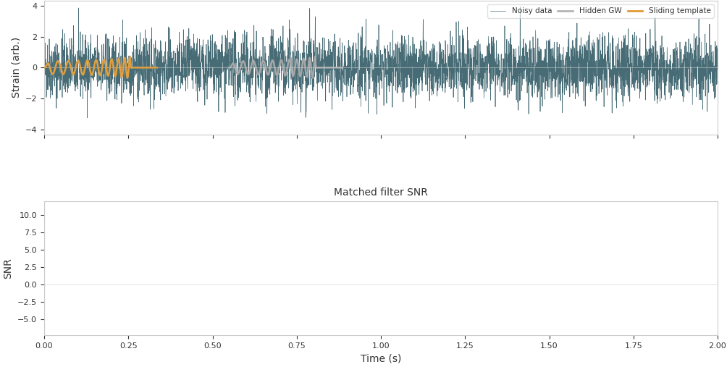
Gravitational waves detection | Match filtering
Léo Zimmermann
Ph.D day | 04/26 | Lyon
16

Slide 20
Type Ia supernovae studies
Léo Zimmermann
Ph.D day | 04/26 | Lyon

Slide 21
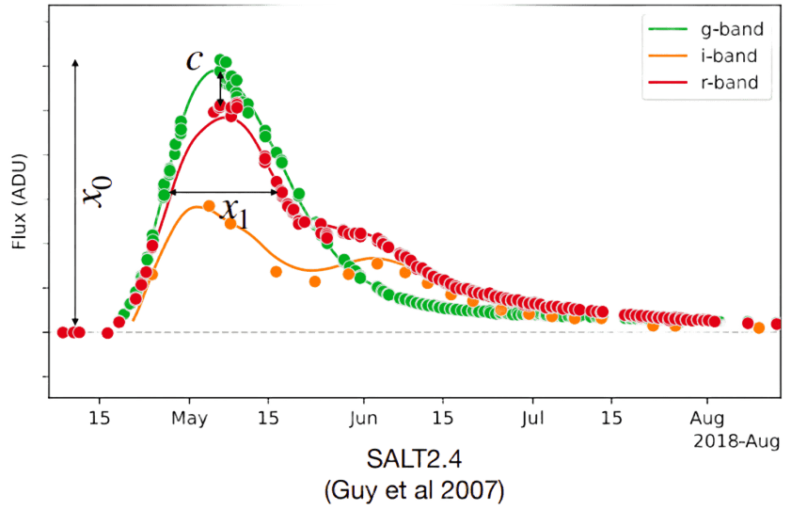
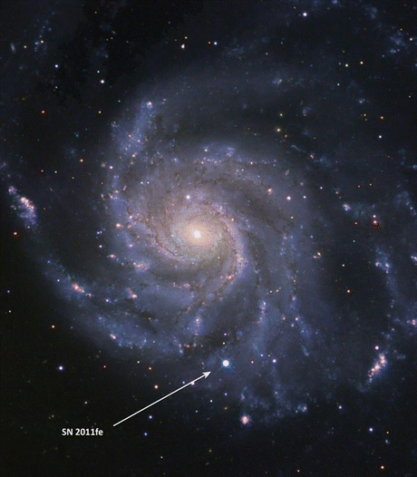
Type Ia supernovae
Credit: ZTF DR2
Léo Zimmermann
Ph.D day | 04/26 | Lyon
19

Slide 22
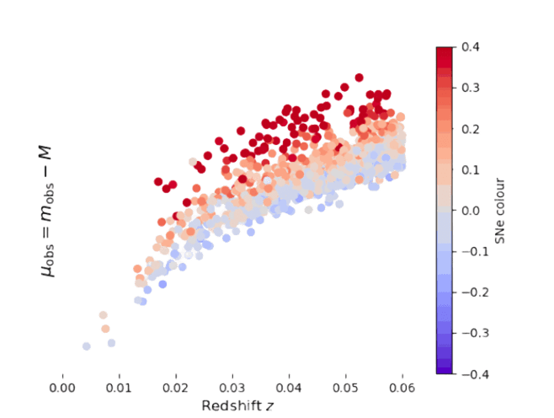
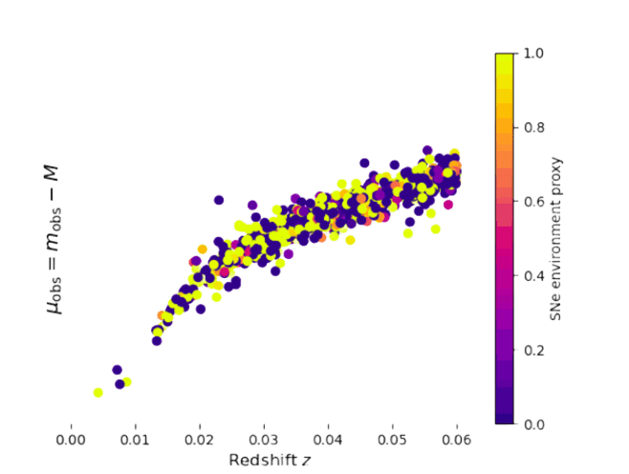
Type Ia photometric standardisation
Standardisation
~ 0.4 mag scatter
~ 0.15 mag scatter
Léo Zimmermann
Ph.D day | 04/26 | Lyon
20

Slide 23
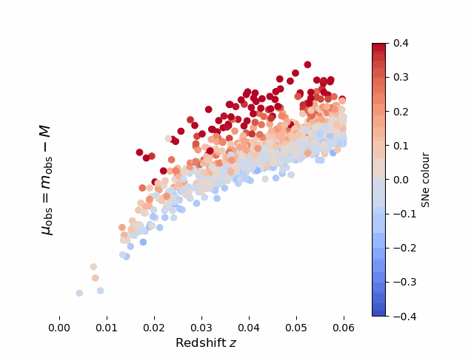
Type Ia photometric standardisation
Tripp formula (1998, empirical) :
µ = m_{obs} - βc + αx₁ + pγ- M
Léo Zimmermann
Ph.D day | 04/26 | Lyon
21

Slide 24
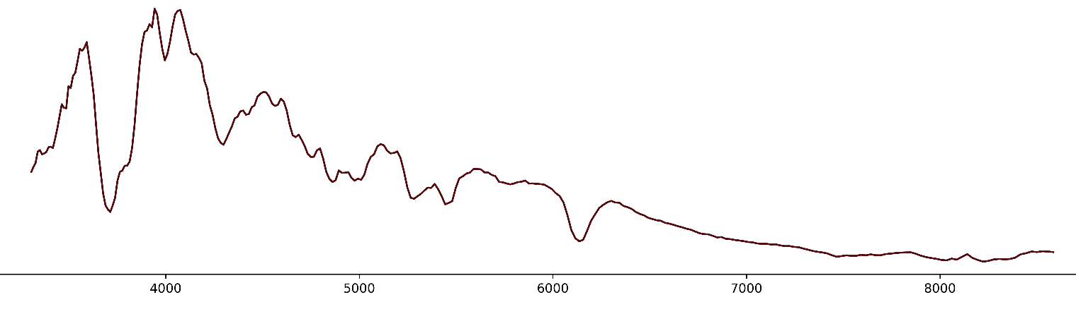
AutoEncoder on Type Ia supernovae data
Precision on H₀
σ_{H0} / H₀
18. 6 %
6.9 %
3.7 %
Scatter of ~ 0.4mag
Scatter of ~ 0.1mag
Scatter ~ 0.08mag
Read between the line
Isomap
Gaussian process
Wavelength [nm]
Léo Zimmermann
Ph.D day | 04/26 | Lyon
22

Slide 25
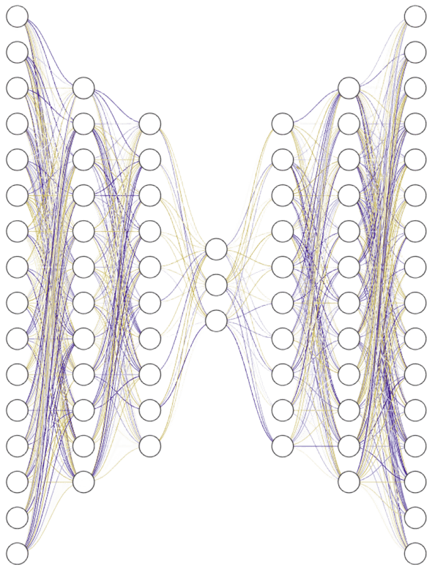
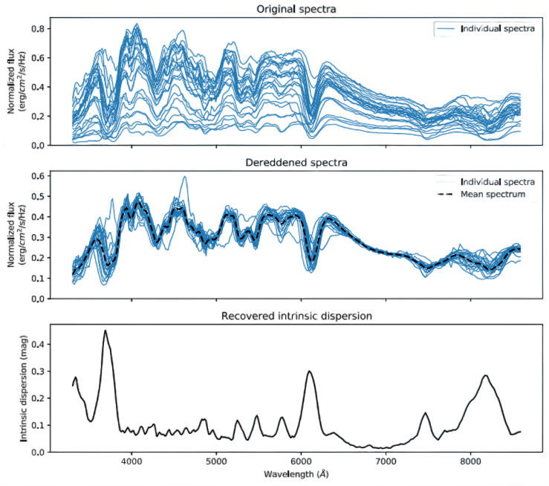
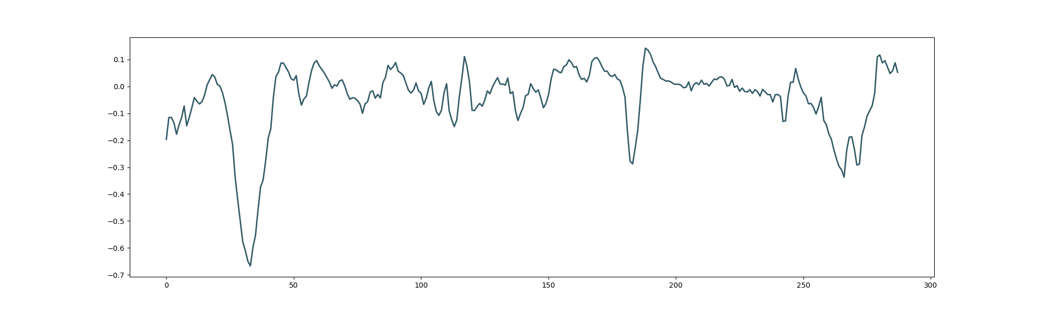
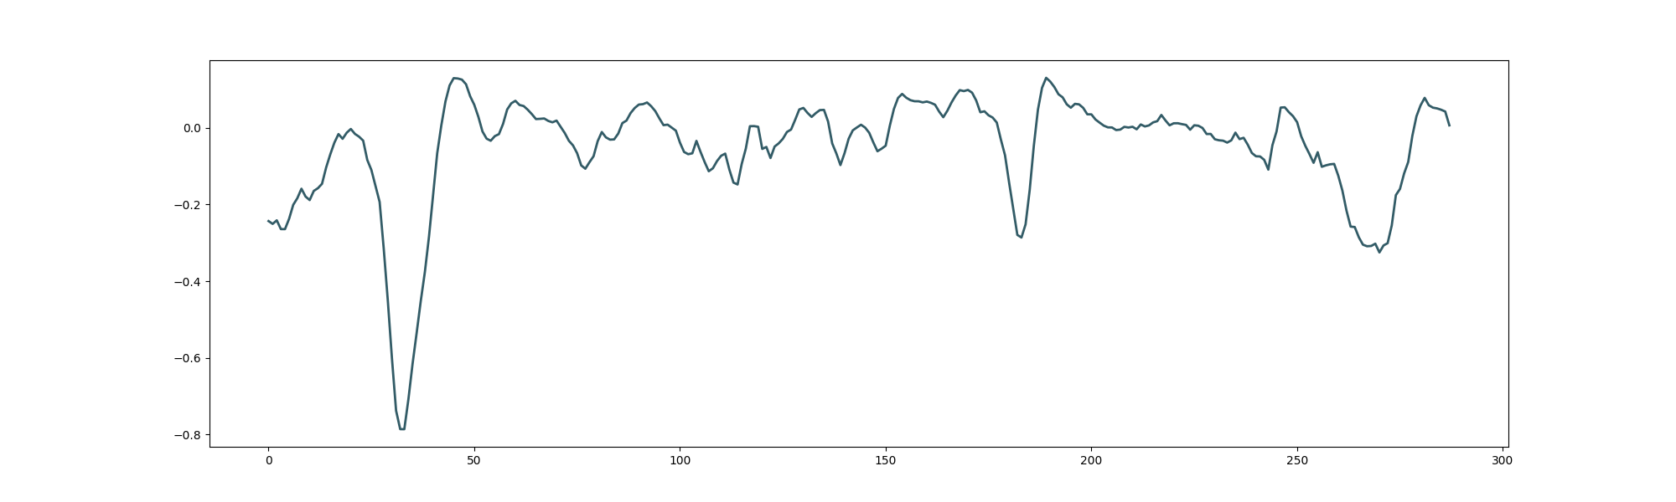
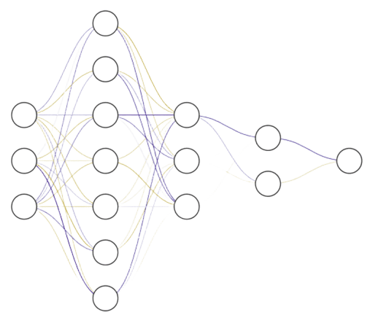
AutoEncoder on Type Ia supernovae data
Encode
Decode
RBTL technique → ΔA_{v} and Δmag
ΔA_{v}
ΔA_{v}
Distance / h !
Léo Zimmermann
Ph.D day | 04/26 | Lyon
24

Slide 26
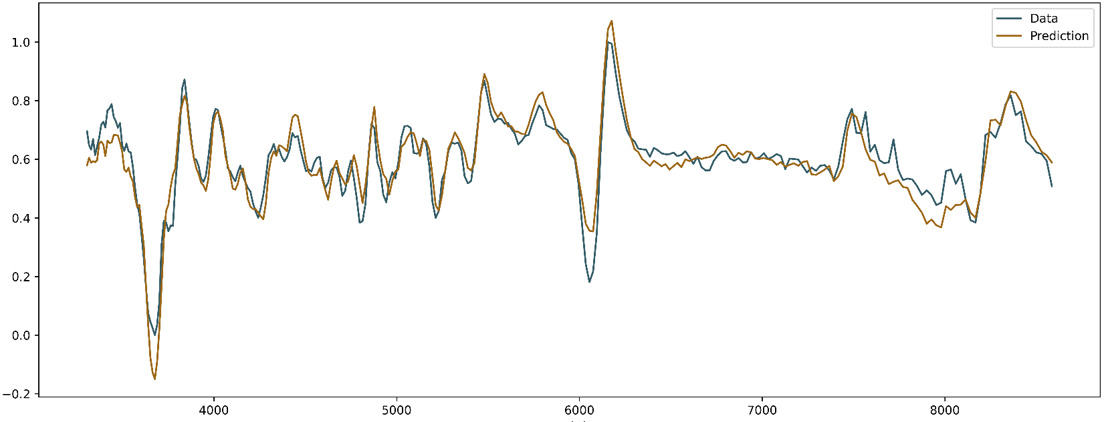
AutoEncoder on Type Ia supernovae data
Normalized spectra (AU)
Wavelength [nm]
Léo Zimmermann
Ph.D day | 04/26 | Lyon
25

Slide 27
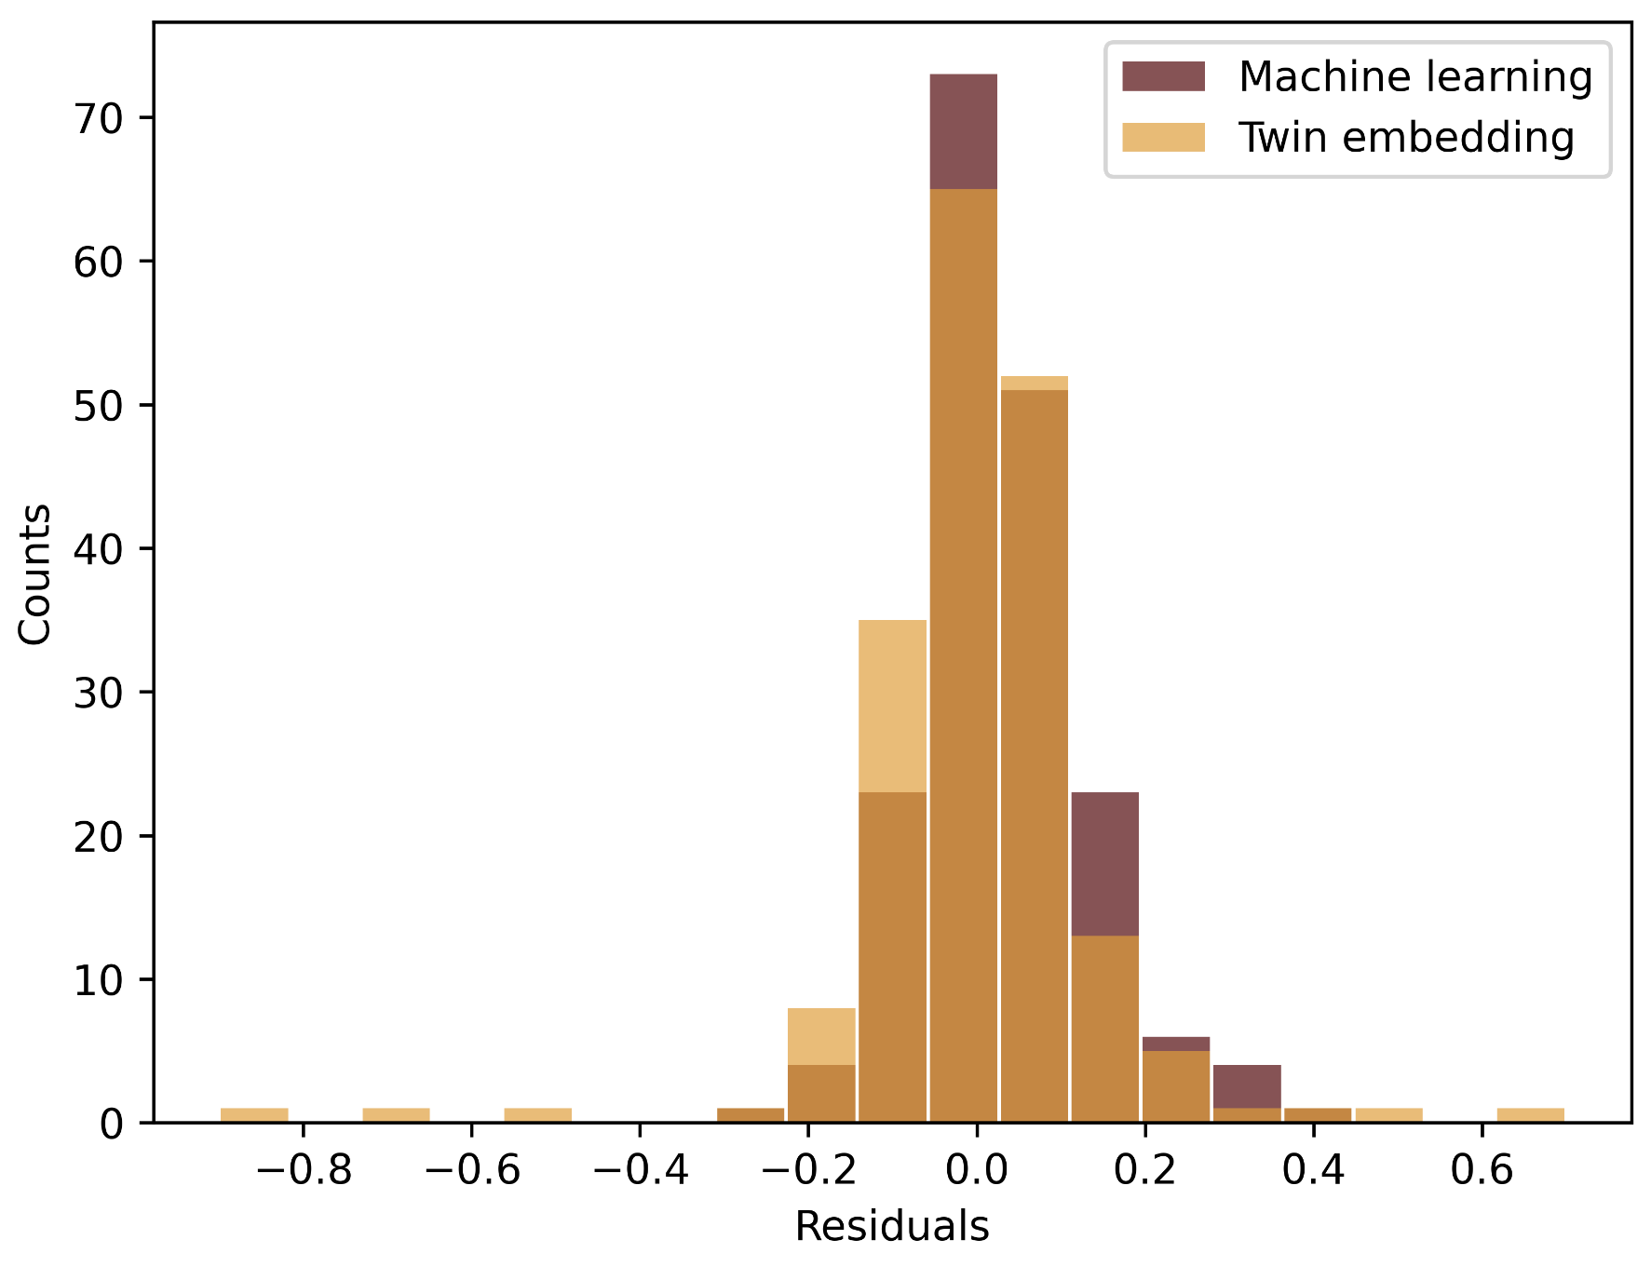
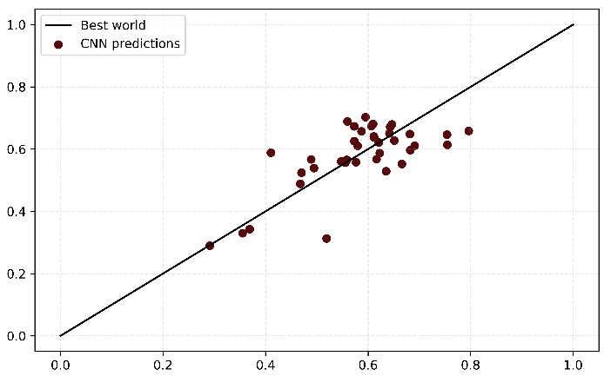
AutoEncoder on Type Ia supernovae data
0.08 scatter with Twin Embedding
0.06 with Machine Learning
Normalized predicted distance
0.06 scatter
Normalized input distance
Léo Zimmermann
Ph.D day | 04/26 | Lyon
26

Slide 28
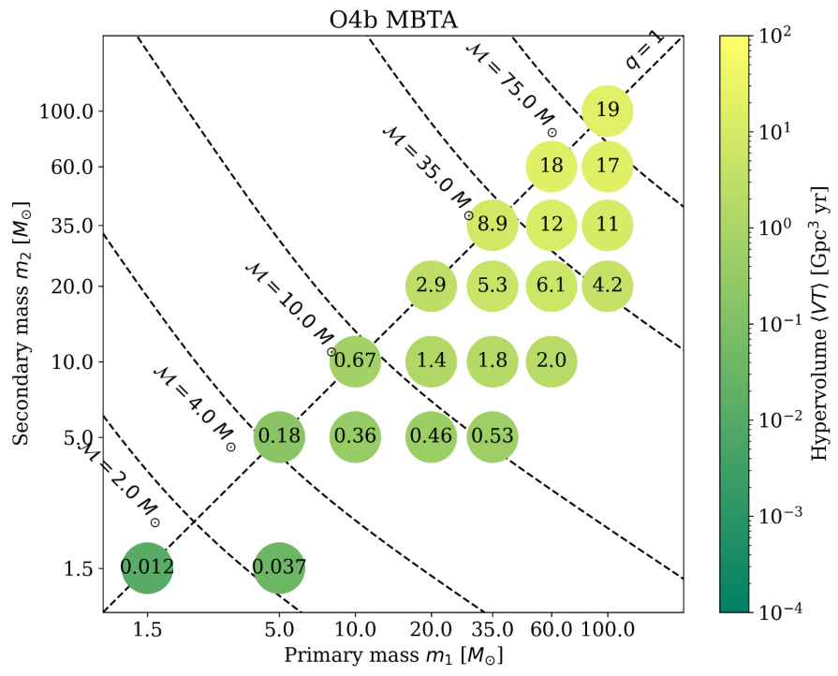
Summary Gravitational waves
iDQ :
I am the Virgo liaison
In contact with pycbc team
Tried to find the origin of the 25 minutes glitches
Searches :
I am the GWTC-5 MBTA liaison
GWTC-5 papers (and data!) release : May, 26th 2026
Léo Zimmermann
Ph.D day | 04/26 | Lyon
27

Slide 29
Summary Sn Ia
Encode
Decode
ΔA_{v}
ΔA_{v}
Distance !
Léo Zimmermann
Ph.D day | 04/26 | Lyon
28

Slide 30
Using SN Ia and GW to constrain H₀
GWs :
Distances in Mpc, about 20% errors.
Large Localisation error, best location 9deg² 90% confident level.
d_{L}
= H₀
d_{L}/h
Type Ia supernovae :
Distances in Mpc/h.
  Biased tracer of the density field.
No error on location
Léo Zimmermann
Ph.D day | 04/26 | Lyon
29

Slide 31
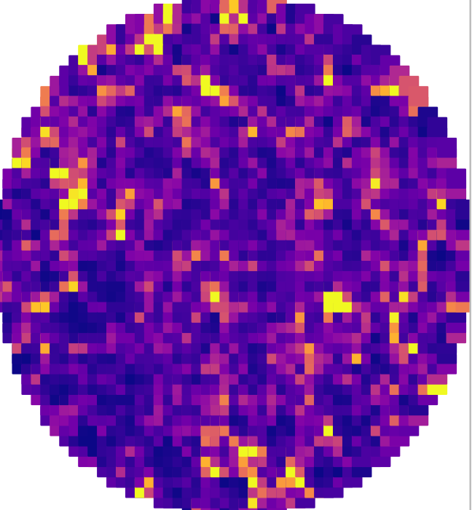

What’s next :
GW density field
373 Mpc
Sn Ia density field
H₀ = 67 km·s⁻¹·Mpc⁻¹
250 Mpc/h
GW density field
H₀ = 73 km·s⁻¹·Mpc⁻¹
342 Mpc
Léo Zimmermann
Ph.D day | 04/26 | Lyon
30

Slide 32
Ph.D Day IP2I 2026
Thanks !
Léo Zimmermann
(Supervised by V.Sordini & M.Rigault)
Institut des 2 infinis de Lyon

Slide 33
The mysterious 25 minutes glitches
Present for April 2023 - November 2025.
Last 10 ms.
Frequency ∈ [100, 200]Hz
SNR ∈ [100, 500]
4 differents technique for identification → no results
iDQ is a new technique
Léo Zimmermann
Ph.D day | 04/26 | Lyon

Slide 34

The mysterious 25 minutes glitches during O4b
P_{glitch}
Low SNR 25 minutes glitches
Usual 25 minutes glitches
Léo Zimmermann
Ph.D day | 04/26 | Lyon

Slide 35



The mysterious 25 minutes glitches during O4b
The detection is not random !
But it is in agreement with a 3-5% pollution of non 25 minutes glitches
Léo Zimmermann
Ph.D day | 04/26 | Lyon

Slide 36

Gravitational waves detection | Match filtering
Preliminary
942000 Templates !
Léo Zimmermann
Ph.D day | 04/26 | Lyon

Slide 37

MBTA Pipeline
~ 942000 Templates
50 % of the SNR is there
Low
Frequency
High
Frequency
~ 50000
~ 20000
Cut in frequency 80 Hz
50 % of the SNR is there
SUPER FAST
Léo Zimmermann
Ph.D day | 04/26 | Lyon

Slide 38

GWTC-5 data results
Data release : May, 24th 2026
Léo Zimmermann
Ph.D day | 04/26 | Lyon

Slide 39

Spectro vs photo
Léo Zimmermann
Ph.D day | 04/26 | Lyon

