Slide 1





Study of the influence of radiolysis of an aqueous solution at the interface with 316L stainless-steel
Brice Lathuilière
Under the supervision of N. Moncoffre and N. Bérerd, within the MATiCE group

Slide 2
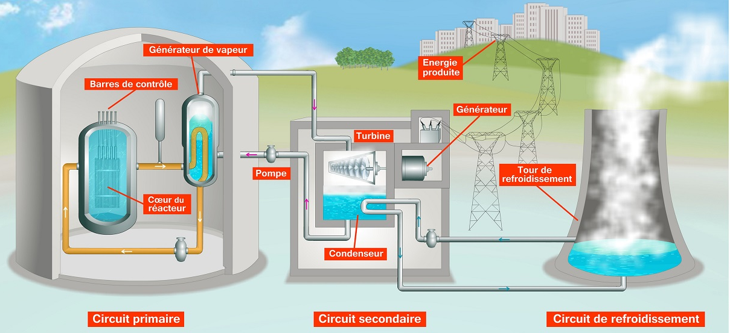
General context
Pressurized water reactor (PWR) in France
Aging of reactor vessel steels

Slide 3
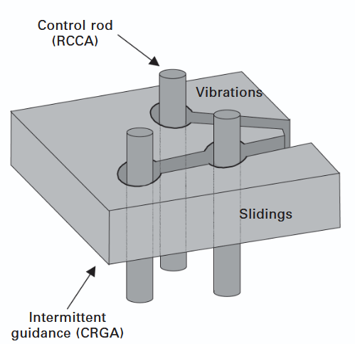
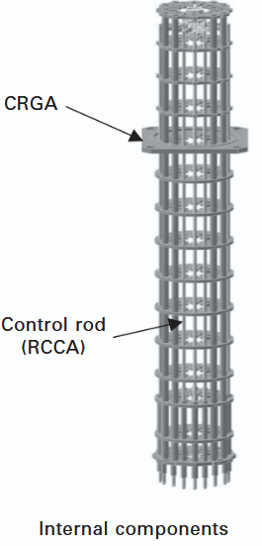
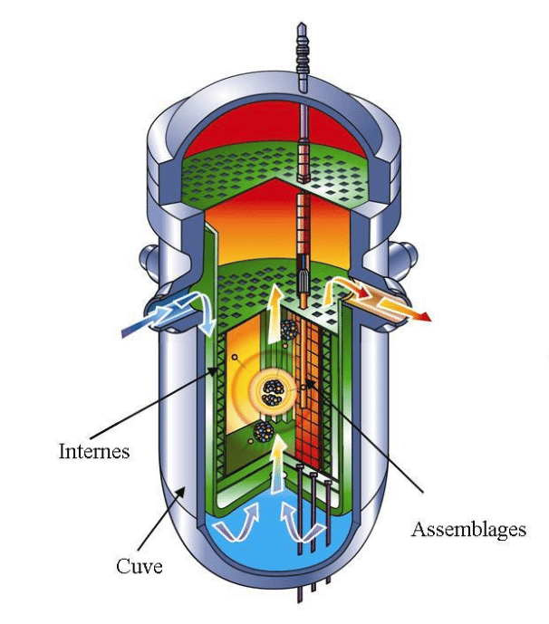
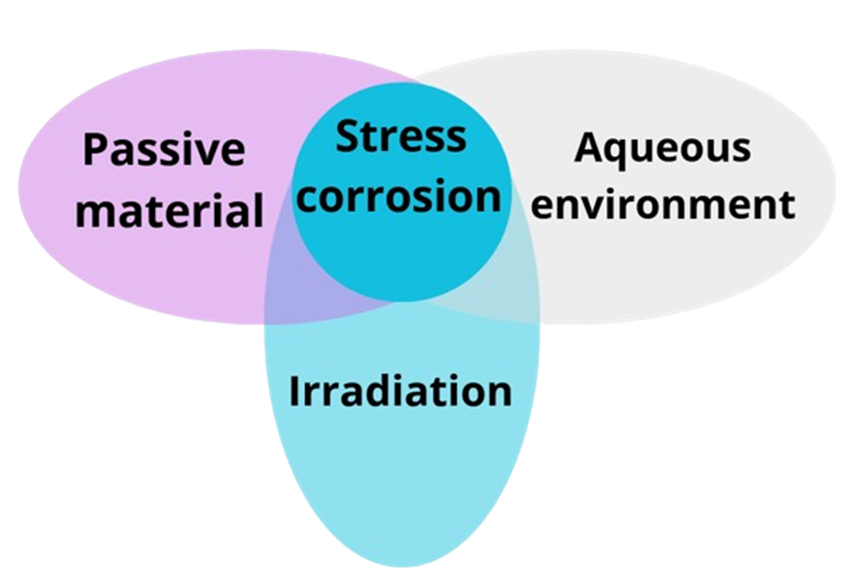
General context
Nitrited stainless steel 316L
Reactor internals
Assemblies
reactor vessel
Lectures by Jean-Luc Béchade, Emir&A thematic school, 02/2025
The control rod cladding is made of 316L stainless steel

Slide 4
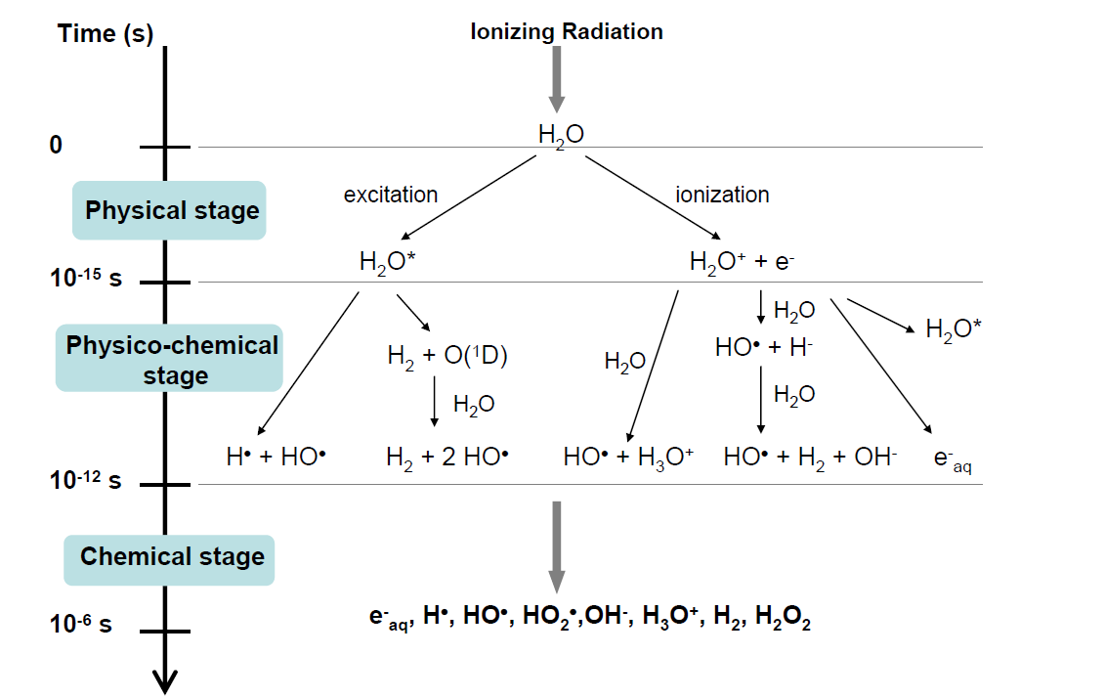
Water radiolysis
S. Le Caër, Water, 3 (2011), 235
Radiolysis Products Time∼ µs
Stable and metastable products
Short-life products

Slide 5
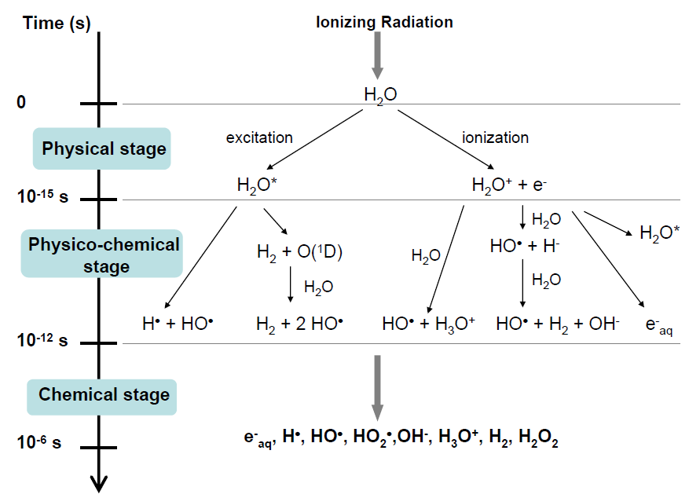
Water radiolysis
S. Le Caër, Water, 3 (2011), 235
Radiolytic yields depend on the energy deposited in water
How can the impact of these redox species be measured?
Electrochemical methods
Reducing species
Oxidizing species

Slide 6
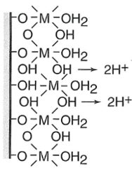
Material Study: 316L Stainless Steel
Passive film
Chromium (III) oxide layer - very dense
G. Okamoto, Corrosion science 13 (1973), 471
1
1
2
Iron hydroxide layer (low density)
2
Irradiation
Bound water
Degradation of the film
Metal
Amorphous structure Slows down oxidizing species and metal cations diffusion
Bound water→ oxidizing radicals directly within the passive film
Electrolyte
Passive layer (duplex oxide) ≈ 2-5 nm

Slide 7

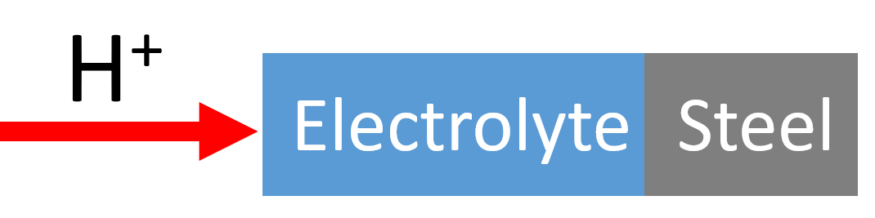
Objective of the thesis
How does the steel/solution interface evolve at the nanometric scale under extreme conditions?
Two transportable irradiation devices:
Parameters: Dose deposited at the interface
Variation of the beam energy
Variation of the irradiation time
Experimentally simulate irradiation at interfaces
Experimentally simulate irradiation at interfaces
How to study passive film under extreme conditions?
Electrochemical measurement:
Modeling of the passive film
Thickness, capacitance, resistivity profiles, passivity domain, and corrosion potential
Characterization and description of the passive film
Physicochemical characterization:
Film composition: Ion beam analysis (IBA)
Chemical speciation: X-ray photoelectron spectroscopy (XPS)
Thickness: XPS, ellipsometry and IBA

Slide 8
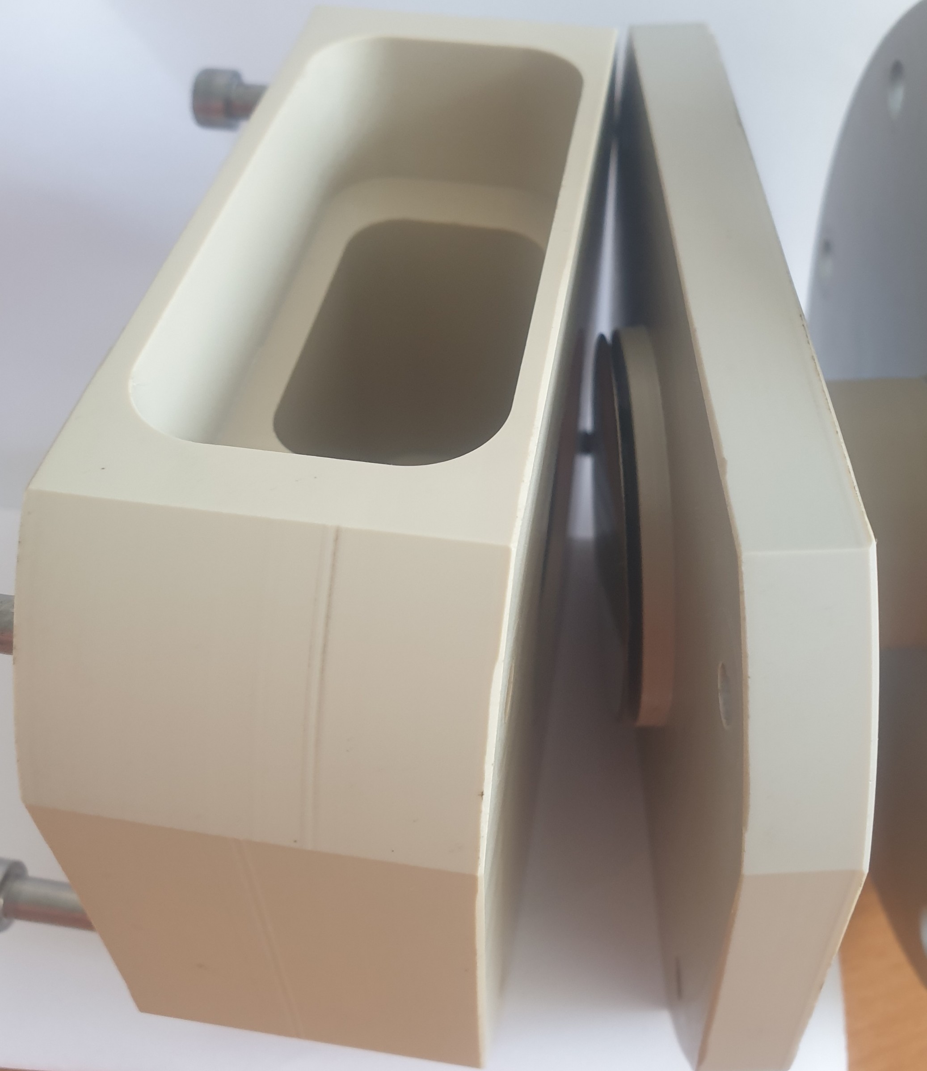
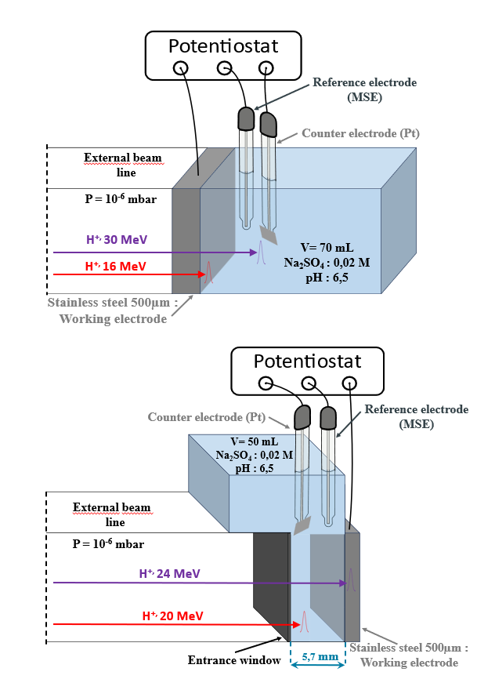

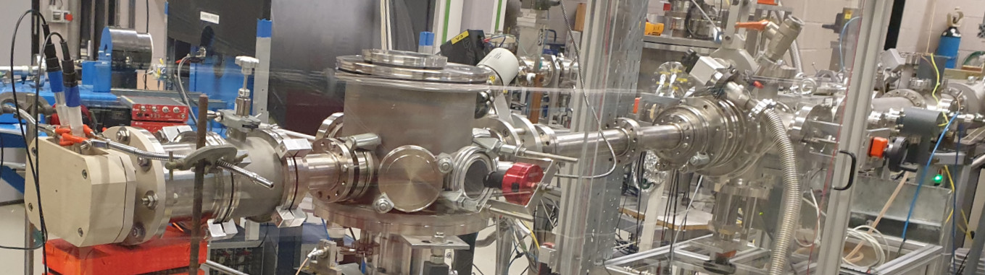
Extreme conditions simulation:
electrochemical cells
PATRICIA
Sample
Solution
H⁺
45 mm
A. Eynard
R. Fillol
PhD thesis of Philippe Martinet (2021)
Study of the effect of irradiation on the sample and radiolysis products

Slide 9

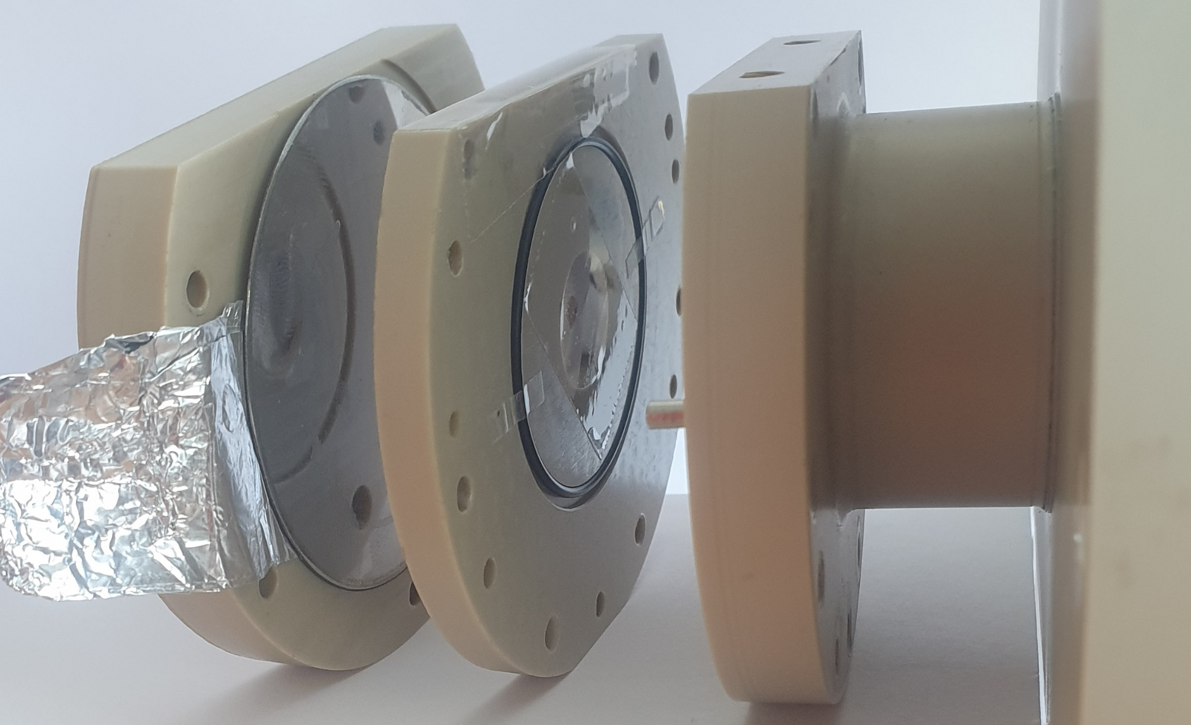

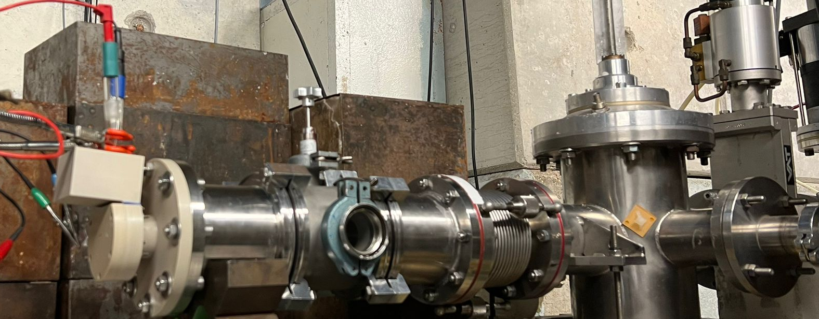
Extreme conditions simulation:
electrochemical cells
5,7 mm
Sample
RADEAU
H⁺
Solution
A. Eynard
R. Fillol
Allows selection of whether to irradiate the interface or not: study of the diffusion of radiolytic species

Slide 10
Objective of the thesis
How does the steel/solution interface evolve at the nanometric scale under extreme conditions?
Two transportable irradiation devices:
Parameters: Dose deposited at the interface
Variation of the beam energy
Variation of the irradiation time
Experimentally simulate irradiation at interfaces
How to study passive film under extreme conditions?
Electrochemical measurement:
Modeling of the passive film
Thickness, capacitance, resistivity profiles, passivity domain, and corrosion potential
Characterization and description of the passive film
Physicochemical characterization:
Film composition: Ion beam analysis (IBA)
Chemical speciation: X-ray photoelectron spectroscopy (XPS)
Thickness: XPS, ellipsometry and IBA

Slide 11
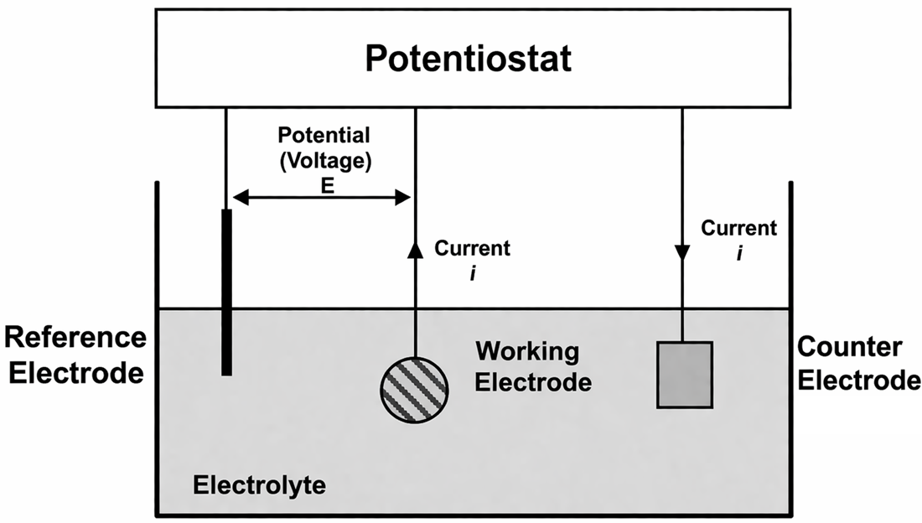
Passive film study:
electrochemical setup
Lectures by V. Vivier, SIEDERAL thematic school, 09/2024
316L stainless steel
Mercurous sulfate electrode (MSE)
Platinum electrode
Na₂SO₄ 0.02 M
Two variables: the electrochemical potential and the current density
In situ measurements of the evolution of the passive film

Slide 12
Thermodynamic and kinetic interpretation
of electrochemical measurements
Electrochemical potential measurement E_{i}:
- Linked to free enthalpy Δ_{r}G → thermodynamic parameter
- Related to the activities of chemical species a_{i} (Nernst law)
a_{Ox 1}.a_{Ox2}…
E°_{(O/R)}: standard potential of the reaction
R: ideal gas constant
T: temperature
F: Faraday constant
n: number of moles of electrons exchanged
R.T
E_{(O/R)} = E°_{(O/R)} + ln
n.F
a_{Red1}.a_{Red2}…
Spontaneous direction of the electrochemical reaction
Measurement of current density ( j ):
- Related to the kinetic of electrochemical transformations
Example of a half electrochemical reaction:
Ox + n.e⁻  Red
k_{a}: rate constant of the oxidation reaction
k_{c}: rate constant of the reduction reaction
[Red]_{el}: concentration of the reducing agent at the electrode surface
[Ox]_{el}: concentration of the oxidizing agent at the electrode surface
j = n.F.(k_{a}.[Red]_{el} – k_{c}.[Ox]_{el})
Reaction rate at the interface

Slide 13
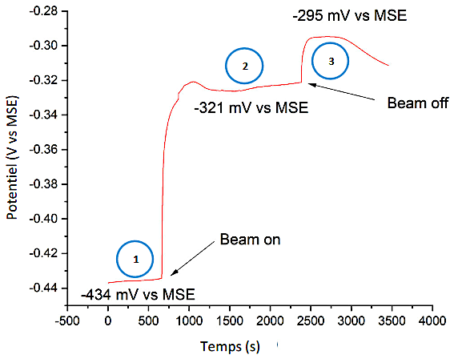
Effect of irradiation on the system’s equilibrium state as measured by the open-circuit potential
Radiolysis products (stable)
2
Steady state (kinetic equilibrium)
Potential (V vs MSE)
Radiolysis products (short-life + stable)
1
Thermodynamic equilibrium
Time (s)
B. Normand, N. Bérerd et al., Corrosion Science 176 (2020) 108945
Radiolysis products influence the system equilibrium
Notes:
Le plateau 3 peut s’explique par la présence en solution de produits de recombinaisons des radicaux, tel que H2O2.
En effet, plus la concentration d’une espèce oxydante est élevée comparativement aux autres, plus elle impose son propre potentiel standard.

Slide 14
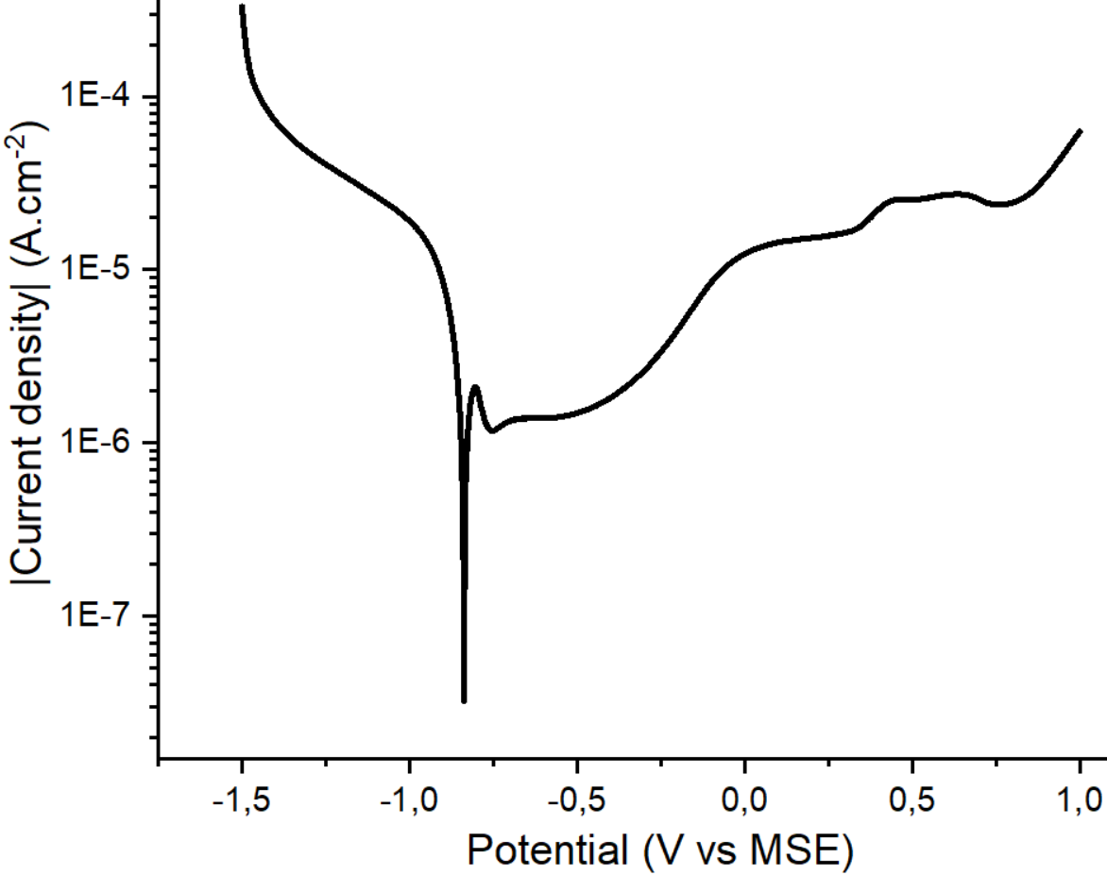
How to characterize the 316L stainless
steel/electrolyte system? : Polarisation curve
1
Water reduction
2 H₂O + 2 e⁻ → 2 OH⁻ + H₂
1
4
Passive domain
Water oxidation
2 H₂O → O₂ + 4 H⁺ + 4 e⁻
4
2
3
Corrosion protection
2
Cr → Cr³⁺ + 3 e⁻
E_{cor} = -0,84 V
2 Cr³⁺ + 3 H₂O → Cr₂O₃ _{(s)} + 6 H⁺
Dissolution in solution
3
Cr₂O₃ _{(s)} + 4 H₂O → Cr₂O₇²⁻_{(aq)}+ 8 H⁺ + 6 e⁻
What is the impact of irradiation on our system (stainless steel / aqueous solution)?

Slide 15
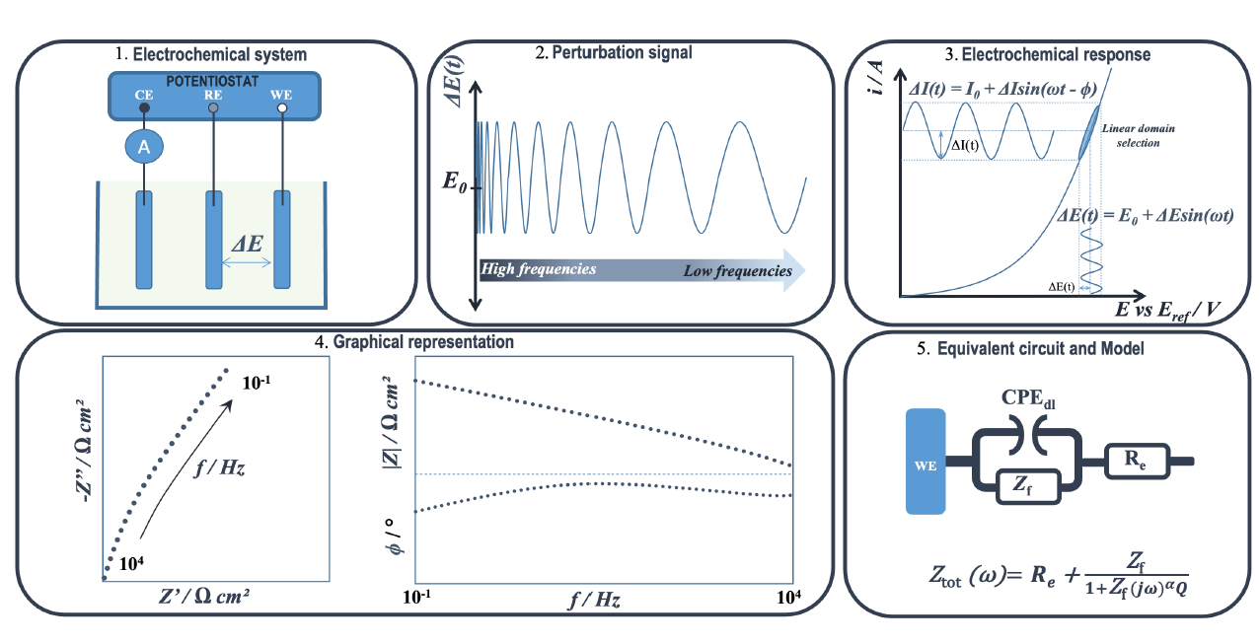
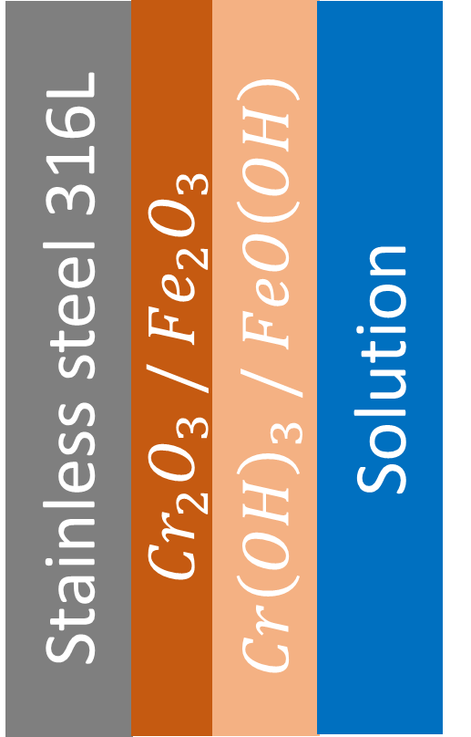

Evolution of the passive layer properties and interfacial charge-transfer kinetics using electrochemical impedance spectroscopy
Lectures by V. Vivier, SIEDERAL thematic school, 09/2024
Modeling of the film using a non-ideal capacitor ➔ CPE
Nyquist
Bode magnitude and Bode phase
Different models
In situ nanometric-scale characterization of the passive layer

Slide 16


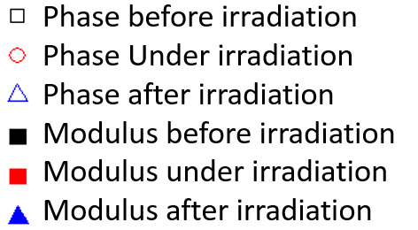


Bode plots before, during, and after irradiation: Patricia cell
Irradiation: Cyclotron at CEMHTI Orléans
H⁺, 16 MeV
Steel
Electrolyte
Which properties of the passive film can be inferred from the diagram?
Metal interface Corrosion Diffusion
Passive film <90° film no
ideal CPE

Slide 17
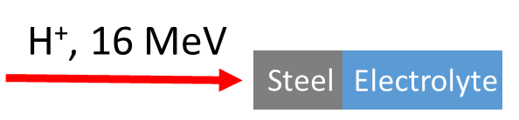
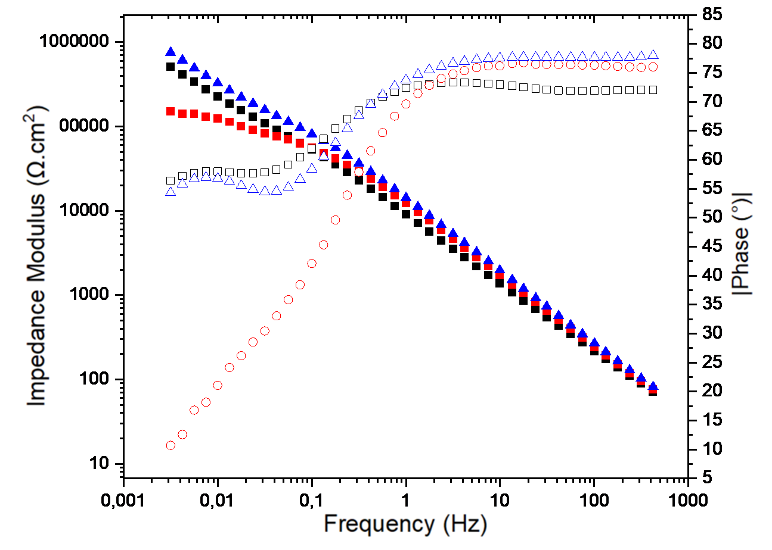
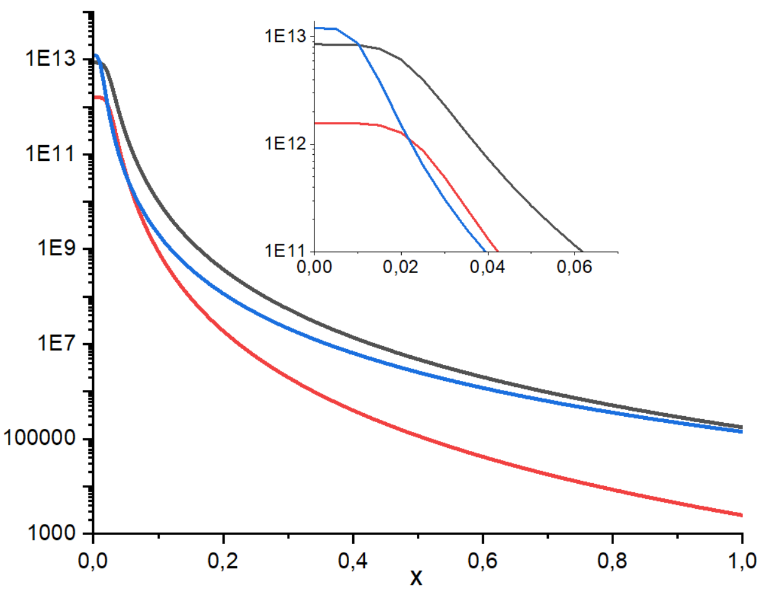

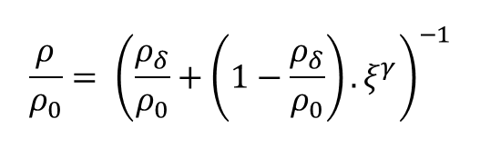



Determination of passive film properties
Irradiation: Cyclotron at CEMHTI Orléans
Power-law model for the resistivity profile of the passive film
$$\frac{ρ}{ρ_{0}}= {\left(\frac{ρ_{δ}}{ρ_{0}}+\left(1−\frac{ρ_{δ}}{ρ_{0}}\right).ξ^{γ}\right)}^{−1}$$
Before irradiation
Under irradiation
After irradiation
ρ / Ω cm
Irradiation conditions | Re (Ω.cm²) | C (F.cm⁻²) | e (nm)
Before | 217 ± 3 | (2,4 ± 0,2)e-6 | 4,4 ± 0,4
Under | 247 ± 4 | (1,2 ± 0,4)e-6 | 8 ± 3
After | 244 ± 3 | (4,2 ± 0,3)e-6 | 2,5 ± 0,2
ρ / Ω cm
Adimensionnal thickness
$δ$=0
$$δ\text{=}\text{1}$$
Adimensionnal thickness ($δ$)
Under irradiation, the passive film becomes thicker while offering more reliable corrosion protection

Slide 18
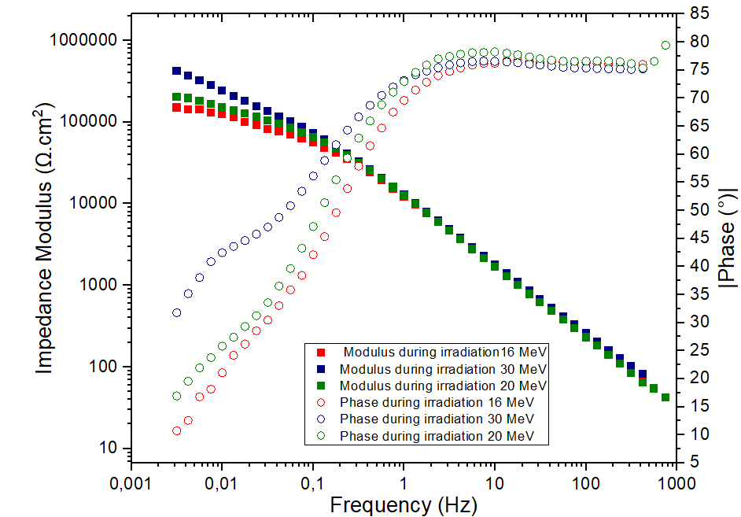
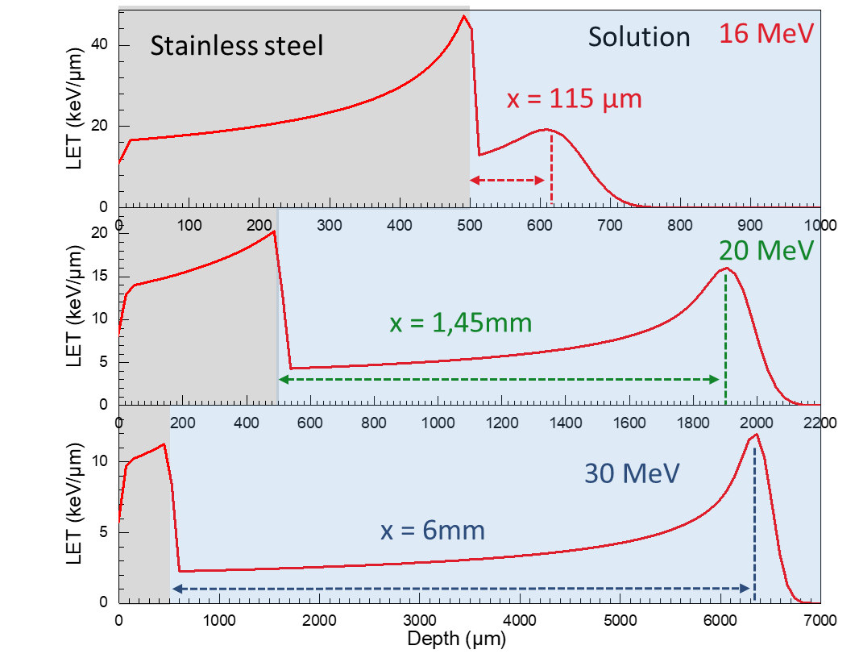
Evolution of the bode diagram with
incident proton energy
Parameters: Dose deposited at the interface
Variation of the beam energy
30 MeV
20 MeV
16 MeV
Energy deposited at the interface alters the properties of the passive film and influences the governing processes at low frequencies

Slide 19
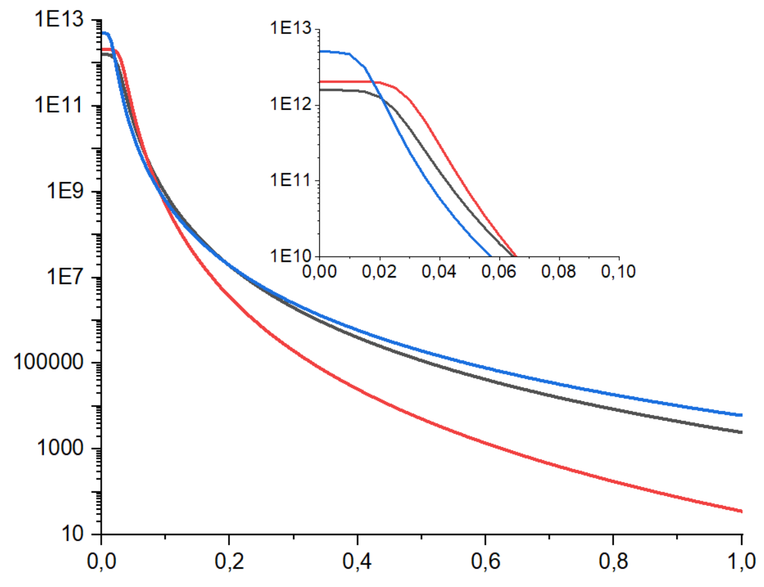
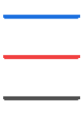



Evolution of the resistivity profile with
incident proton energy
Parameters: Dose deposited at the interface
Variation of the beam energy
LET at the interface: 11 keV/µm
LET at the interface: 22 keV/µm
LET at the interface: 44 keV/µm
ρ / Ω cm
ρ / Ω cm
Adimensionnal thickness
$δ$=0
$$δ\text{=}\text{1}$$
Adimensionnal thickness ($δ$)
Influence of the deposited dose at the interface: as the dose increases, the chromium oxide layer becomes less protective against corrosion

Slide 20
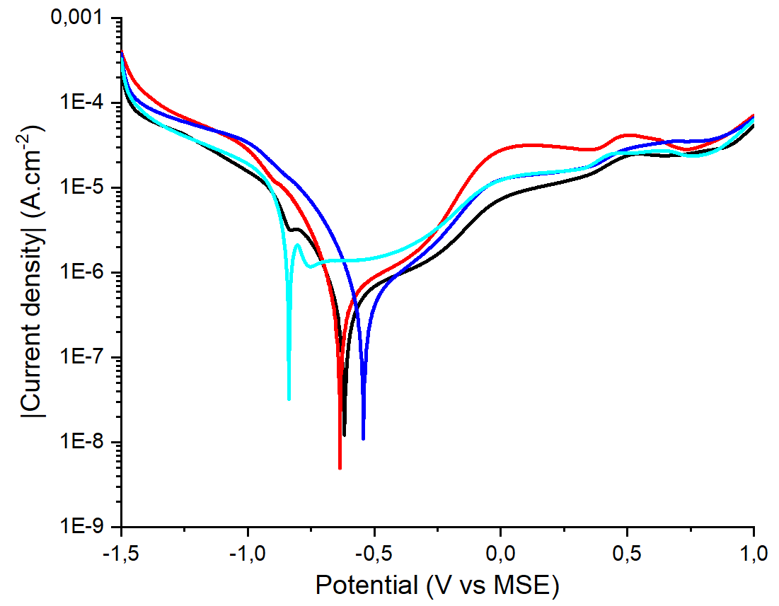
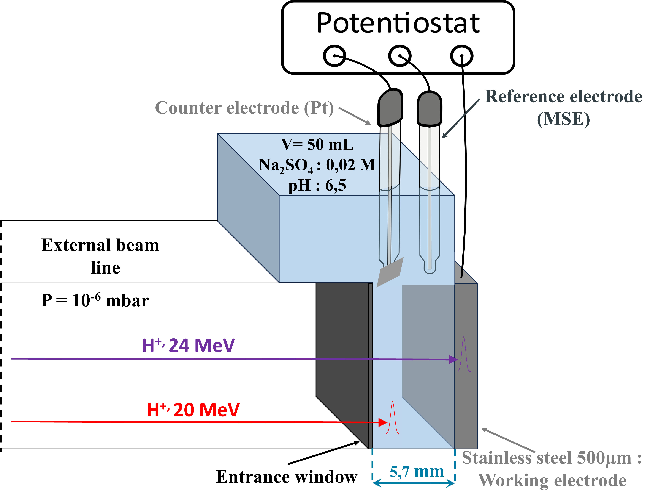
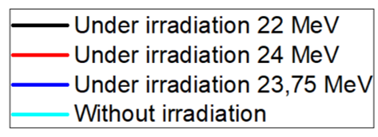
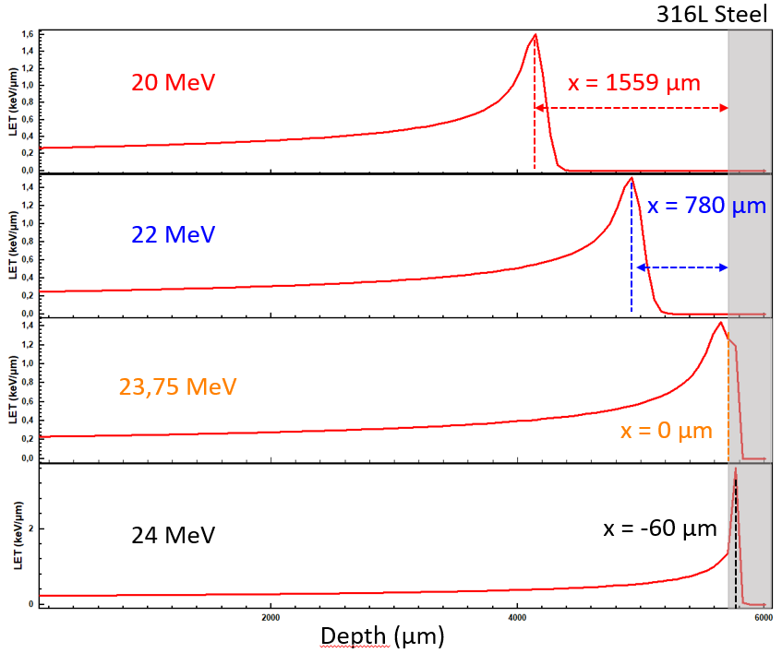
Stability of the passive film as a function
of incident proton energy
Parameters: Dose deposited at the interface
Variation of the beam energy
Passive domain
Entrance window
Under irradiation, the corrosion potential is located in the passive domain, with an increase in current density

Slide 21
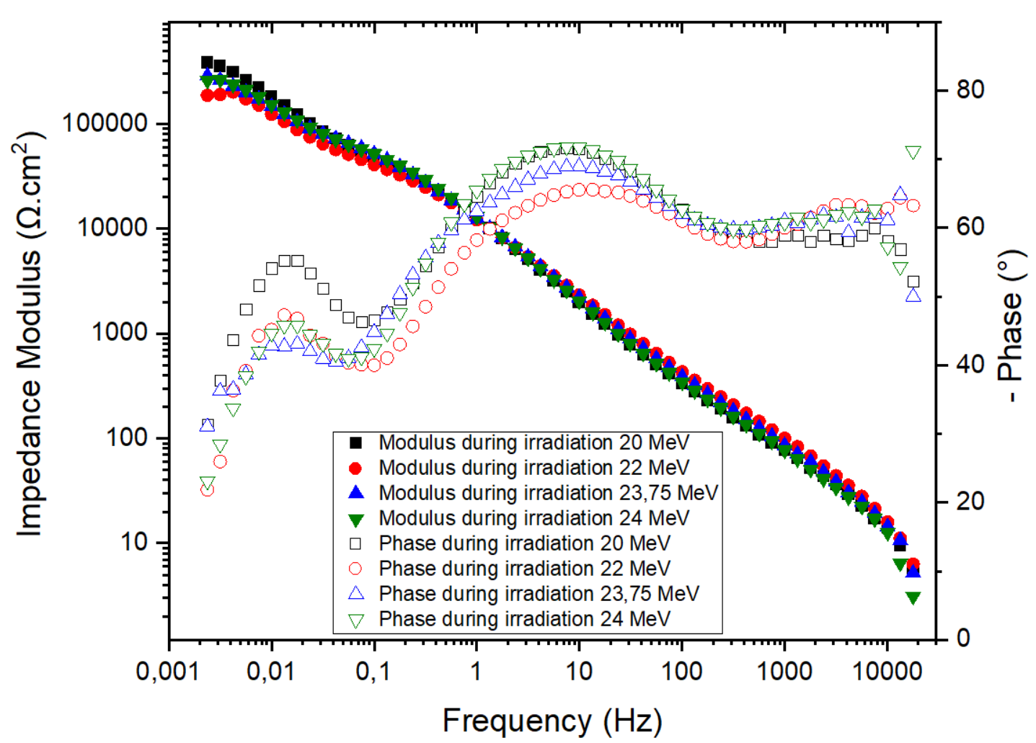
Evolution of the bode diagram with
incident proton energy
Preliminary results
Parameters: Dose deposited at the interface
Variation of the beam energy
Entrance window
Irradiation energy alters the passive film/electrolyte interface and affects the governing processes at low frequencies

Slide 22
Objective of the thesis
How does the steel/solution interface evolve at the nanometric scale under extreme conditions?
Two transportable irradiation devices:
Parameters: Dose deposited at the interface
Variation of the beam energy
Variation of the irradiation time
Experimentally simulate irradiation at interfaces
How to study passive film under extreme conditions?
Electrochemical measurement:
Modeling of the passive film
Thickness, capacitance, resistivity profiles, passivity domain, and corrosion potential
Characterization and description of the passive film
Physicochemical characterization:
Film composition: Ion beam analysis (IBA)
Chemical speciation: X-ray photoelectron spectroscopy (XPS)
Thickness: XPS, ellipsometry and IBA

Slide 23
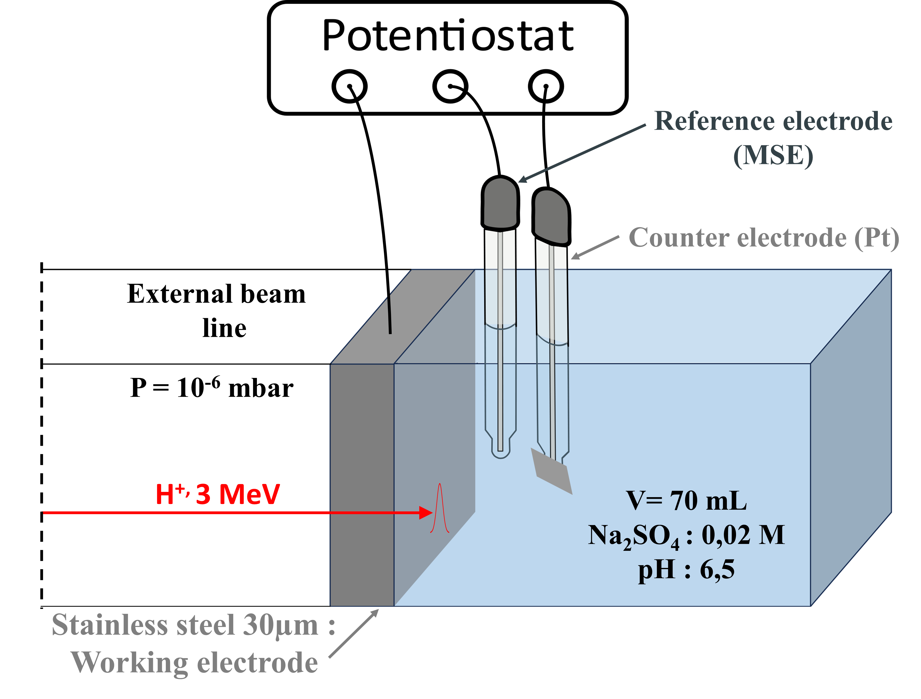
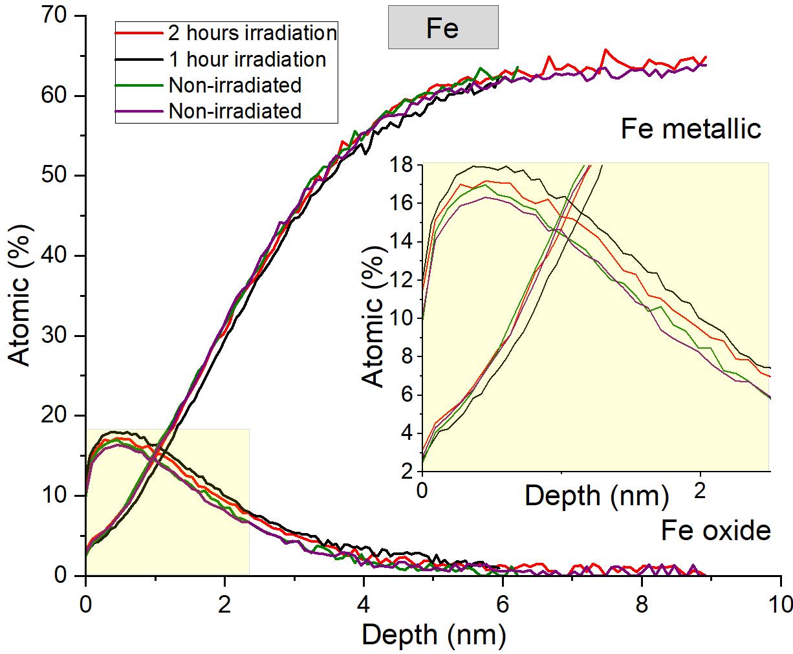
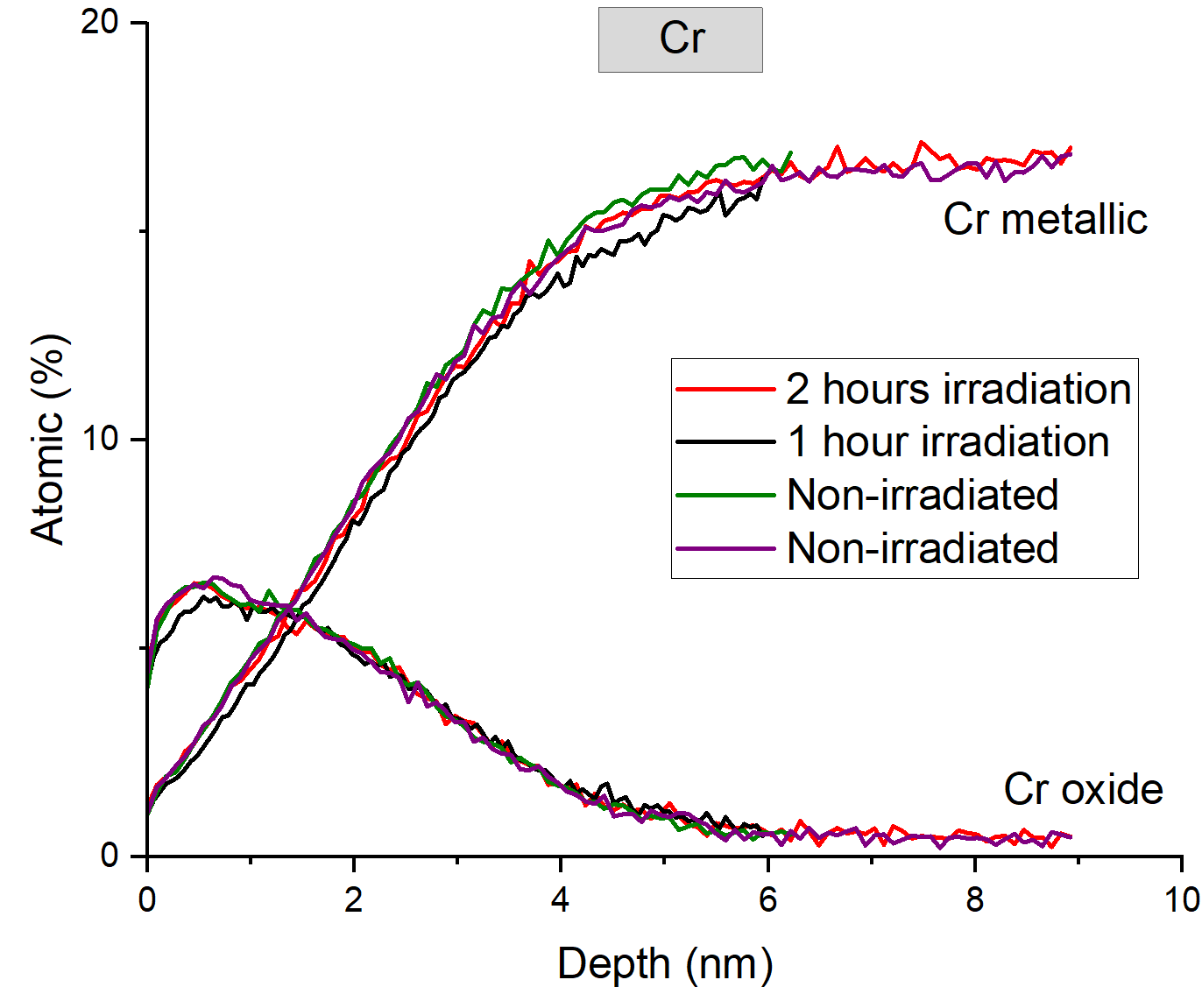
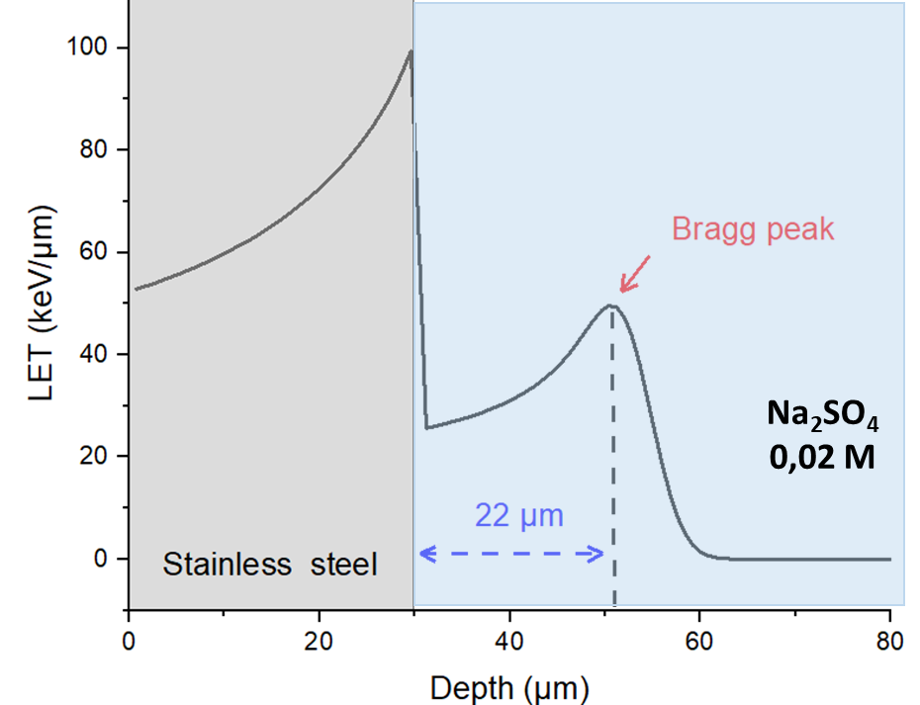
Chemical speciation of elements
in the passive film
Parameters: Dose deposited at the interface
Variation of the irradiation time
X-ray photoelectron spectroscopy
Almost no influence of irradiation dose on element chemical speciation

Slide 24
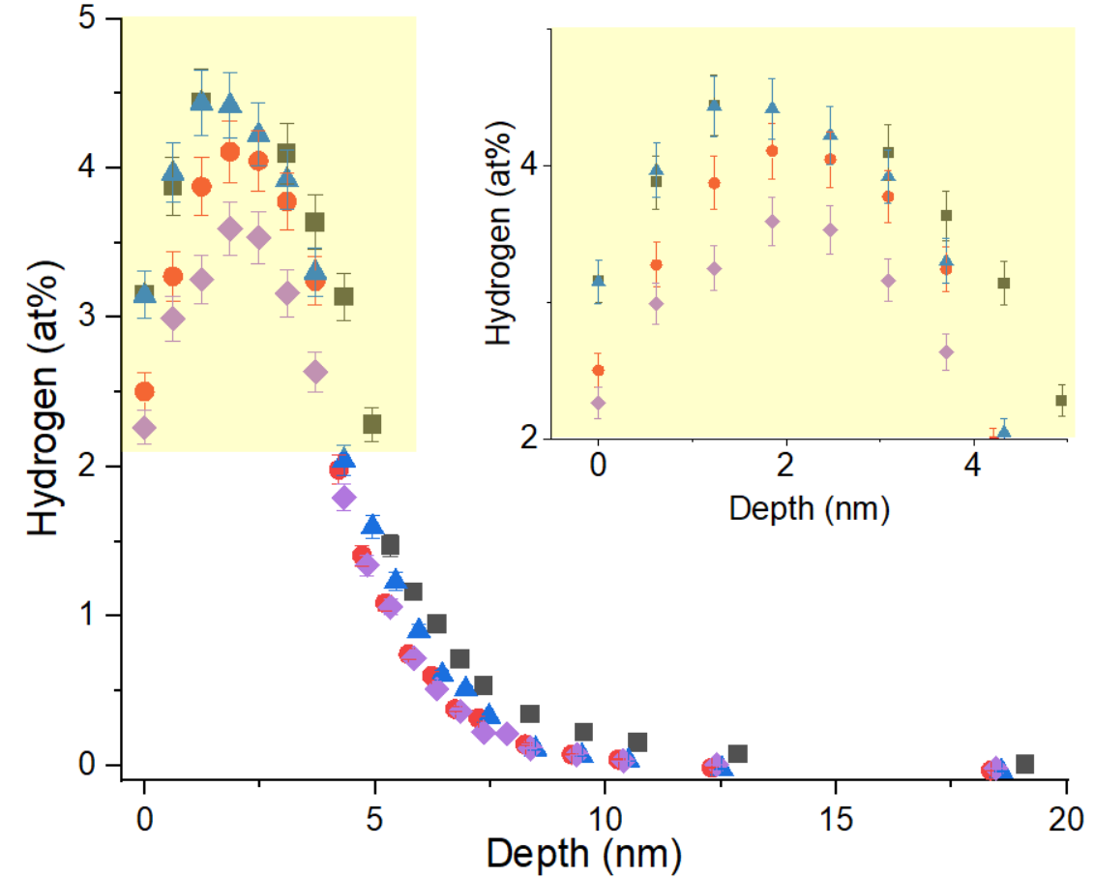
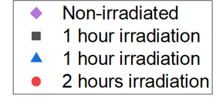
Hydrogen profile of the passive film
Parameters: Dose deposited at the interface
Variation of the irradiation time
Nuclear Resonant Reaction
Hydrogen profile
¹H(¹⁵N, αγ)¹²C
¹⁵N + p ➔ ¹⁶O * ➔ ¹²C * + α
➔
Hydrogen analysis
¹²C + γ
γ = 4,43 MeV
Resonance E (MeV) | 6,385
Width Γ (keV) | 1,8
Cross section σ_{r} ​ (mbarn) | 1650
Slight influence of irradiation dose on hydrogen concentration

Slide 25
Conclusion and perspectives
Conclusion:
Radiolysis species strongly affect corrosion mechanisms
The passive film remains stable under irradiation, although its protective properties are progressively degraded
The evolution of the passive film is strongly driven by energy deposition at the interface
Part of my first year was devoted to the development of experimental devices
Perspectives:
Further modeling of the passive film, particularly in the low-frequency domain
Further acquisition of experimental data under irradiation conditions
Physicochemical characterization of the passive film using additional analytical techniques, such as RBS, MEIS, ellipsometry, …
Implementation of pulsed radiolysis experiments to investigate short-lived radiolysis species
Modeling of passive film evolution mechanisms (Thesis, 2026)

Slide 26
Thank you for listening

