Slide 1
ALFA
Advanced, Lightweight and Fine-grained Apparatus
for e⁺e⁻ physics

Slide 2
History and status
A young project: started from scratch less than one year ago
High-level goal: develop a detector design that will become a proposal for one of the four FCC-ee detectors
  The four detectors should be sufficiently different from each other
Problem-driven approach: optimize performance
Adopt state-of-the-art (… but not futuristic) detector technologies, and technical solutions for system design
Make sure the detector is realistic and affordable
Minimize complexity and M&O cost
  Minimal number of different detector technologies
  Robust detector design, requiring minimal/no maintenance to the extent possible

Slide 3
The ALFA detector
High-performance all-MAPS Tracker
ARC (Array of RICH Cells)
  Good particle ID over large momentum range
ECAL based on GRAiNITA
  Excellent energy (and position) resolution with a cost-effective technology
Coil for 3T field
  3T not guaranteed for the Z run
  Coil dimensions are reasonable
Dual Readout HCAL in iron
  Best option for hadronic energy resolution
  Iron absorber keeps the overall detector dimension relatively compact
Muon tag
  No need of muon tracking beyond the Tracker
  Simple and cost-effective
N.B. The Luminosity Calorimeter is not shown in this sketch

Slide 4
The ALFA detector
High-performance all-MAPS Tracker
ARC (Array of RICH Cells)
  Good particle ID over large momentum range
ECAL based on GRAiNITA
  Excellent energy (and position) resolution with a cost-effective technology
Coil for 3T field
  3T not guaranteed for the Z run
  Coil dimensions are reasonable
Dual Readout HCAL in iron
  Best option for hadronic energy resolution
  Iron absorber keeps the overall detector dimension relatively compact
Muon tag
  No need of muon tracking beyond the Tracker
  Simple and cost-effective
N.B. The Luminosity Calorimeter is not shown in this sketch
Work in progress

Slide 5
The all-MAPS Tracker for the ALFA detector
Is a silicon tracker a meaningful choice for FCC-ee?

Slide 6
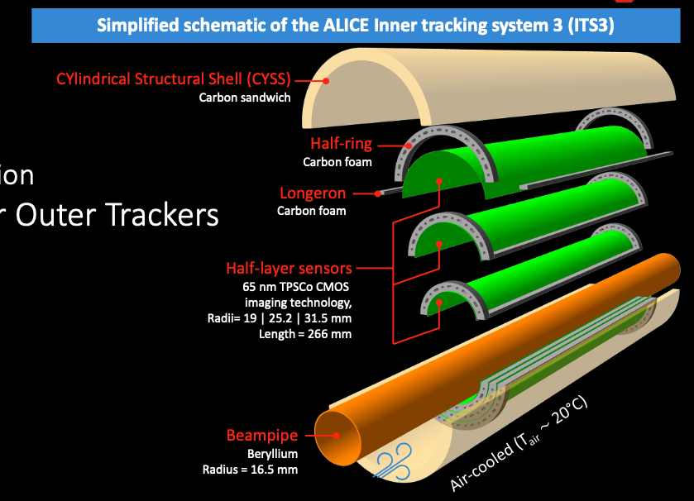
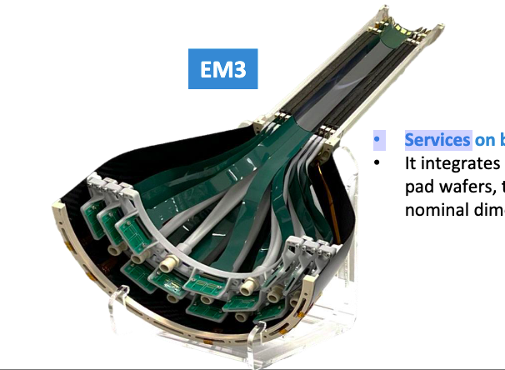
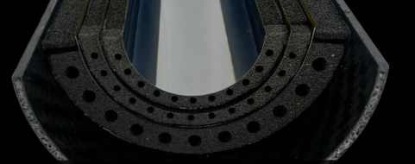
Why MAPS?
Curved MAPS are the compelling choice for the Vertex Detector
  Silicon sensors are needed to cope with the rates
  MAPS enable the smallest pixels, highest precision points
  Rates and radiation levels are not prohibitive (OK for MAPS)
  Curved MAPS with air cooling provide the lowest possible material budget
    Single sensor up to 26 cm long, with stitching
    Thinned down to 50 𝜇m (or even 30 𝜇m)
Under development for the ALICE ITS3

Slide 7
A full-MAPS Tracker
High-precision points and low mass sensors are good for the whole Tracker
Rates (and radiation levels) are lower in the Outer Tracker
A full-silicon Tracker can be made very robust
  Aim at an Outer Tracker that can work without maintenance
Can it be made sufficiently light?
  Competitive in performance with a gas detector?
Can it be made of reasonable size and cost?
  N.B. Needs to be complemented with a PID detector

Slide 8
A full-MAPS Tracker
High-precision points and low mass sensors are good for the whole Tracker
Rates (and radiation levels) are lower in the Outer Tracker
A full-silicon Tracker can be made very robust
  Aim at an Outer Tracker that can work without maintenance
Can it be made sufficiently light?
  Competitive in performance with a gas detector?
Can it be made of reasonable size and cost?
  N.B. Needs to be complemented with a PID detector
Need a sufficiently detailed design to answer these questions

Slide 9
A full-MAPS Tracker
High-precision points and low mass sensors are good for the whole Tracker
Rates (and radiation levels) are lower in the Outer Tracker
A full-silicon Tracker can be made very robust
  Aim at an Outer Tracker that can work without maintenance
Can it be made sufficiently light?
  Competitive in performance with a gas detector?
Can it be made of reasonable size and cost?
  N.B. Needs to be complemented with a PID detector
N.B. There are different flavours of MAPS
The design with small collection electrode
⟶ minimal capacitance
⟶ minimal power density
(and minimal pixel size)
is the flavour needed for an all-MAPS Tracker

Slide 10
Key ingredients: MAPS
Tentative MAPS specs (inspired by the ALICE developments)
We must have 10 μm pixels everywhere – key ingredient of the ALFA detector concept
How to exploit the low rate in the outer layers?
  Slower front-end
Time resolution of ≲ 1 μs for the VTX layers, with ≲ 40 mW/cm² of power density
  Target air cooling
Time resolution of ~ 5 μs for the OT layers, with < 20 mW/cm² of power density
  Lower power density ⟶ lower mass
  A pileup of a few Z decays cannot be a problem with the granularity of ALFA
Continuous triggerless readout ⟶ real-time event reconstruction and filtering
Defining the MAPS specs is a main objective for the next 2-3 years

Slide 11
Stitched MAPS for VTX layers
(conservative geometry)
231 mm
Wafer-size sensor
Two wafer-size sensors for L4
L4 R=32.8 mm
L3 R=26.2 mm
L2 R=19.6 mm
L1 R=13.0 mm
Beam pipe
R=11.7 mm
cos𝜗 = 0.99 (141.5 mrad)
100 mrad
Each sensor covers ½ layer in r𝜑

Slide 12
Stitched MAPS for VTX layers
(“aggressive” geometry – not realistic with current beam pipe)
254 mm
Two wafer-size sensors for L5
Wafer-size sensor
L5 R=36.2 mm
L4 R=30.1 mm
L3 R=24.0 mm
L2 R=18.0 mm
L1 R=11.9 mm
Beam pipe
R=11.7 mm
Each sensor covers ½ layer in r𝜑

Slide 13
Mechanics for VTX layers
Starting point is the mechanics of the ALICE ITS3
To be adapted for a geometry with conical boundaries
  Non trivial
Some design work started
No doubt that curved MAPS are the option to aim for
  And air cooling is a must

Slide 14
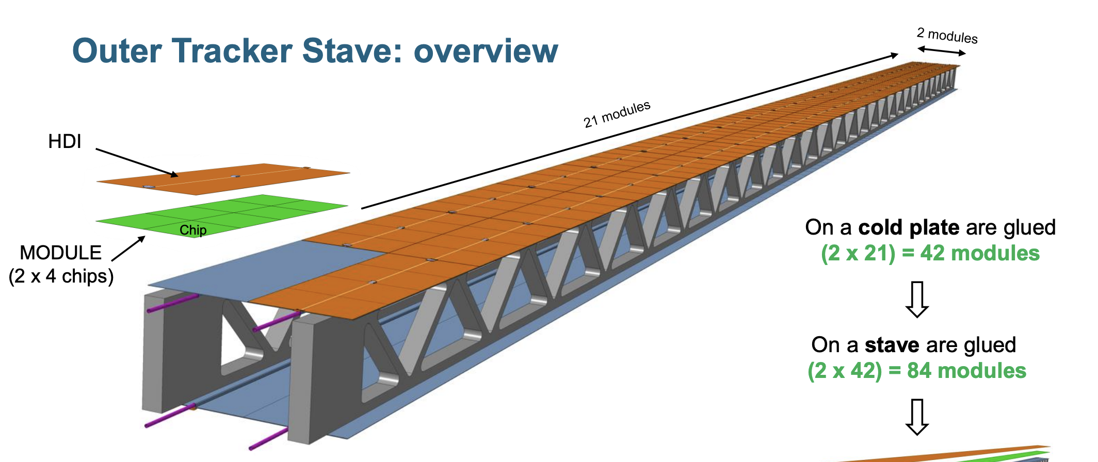
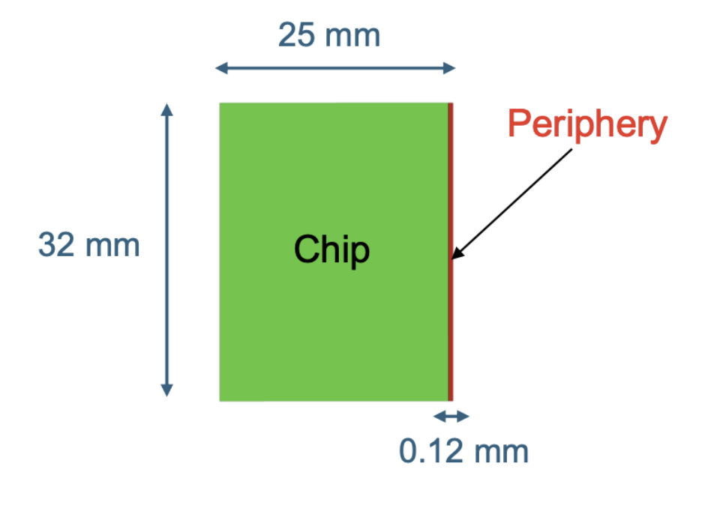
Outer Tracker (silicon, or not silicon?)
Reticle-size MAPS, bump-bonded onto a High-Density Interconnect circuit
25×32 mm² MAPS ⟶ 50×128 mm² module
Building block of the barrel staves
Industrial flip-chip process for module construction
Cope with MAPS process yield
Chip peripheries are located side by side in the center of the module
50.05 mm
128.15 mm

Slide 15
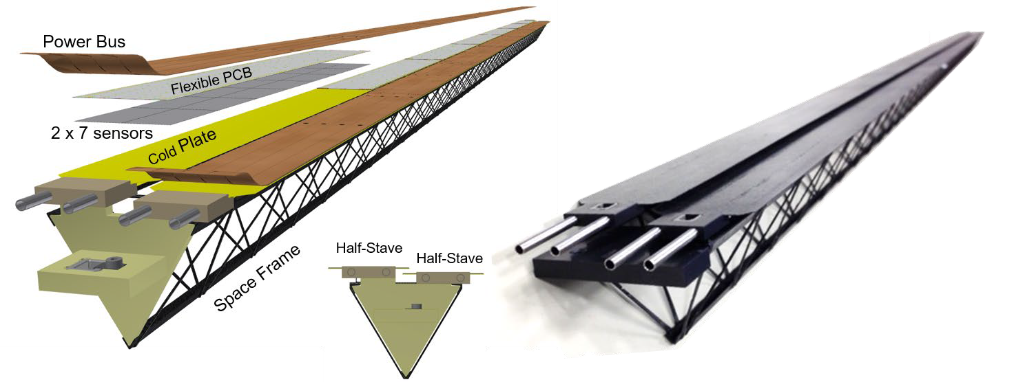
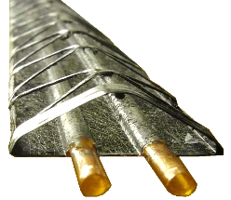
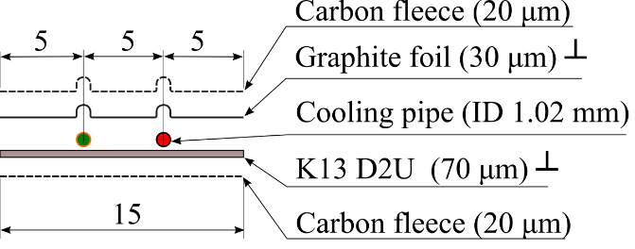
Mechanics for the Outer Tracker
Starting point is the “cold plate” invented for the ALICE ITS2
    [Corrado Gargiulo & Massimo Angeletti]
  Extremely light and efficient thermal interface
Deploy with larger size, remove space frame and couple two plates with thick foam structures in between
  Lightweight ultra-stiff mechanical structure
Use to support two active layers
  Lightweight ⟶ lightweight / 2
  The detector layout is optimized for physics and mechanics
Self-supporting structures, joined by flanges at the end (barrel)
Polyimide cooling pipes
glue
heater (chip)

Slide 16
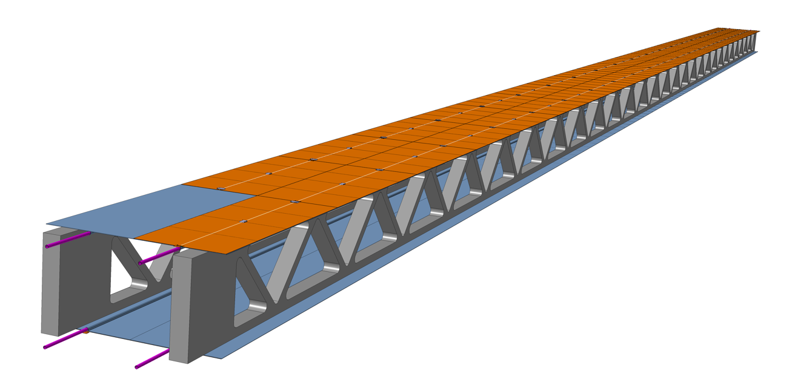
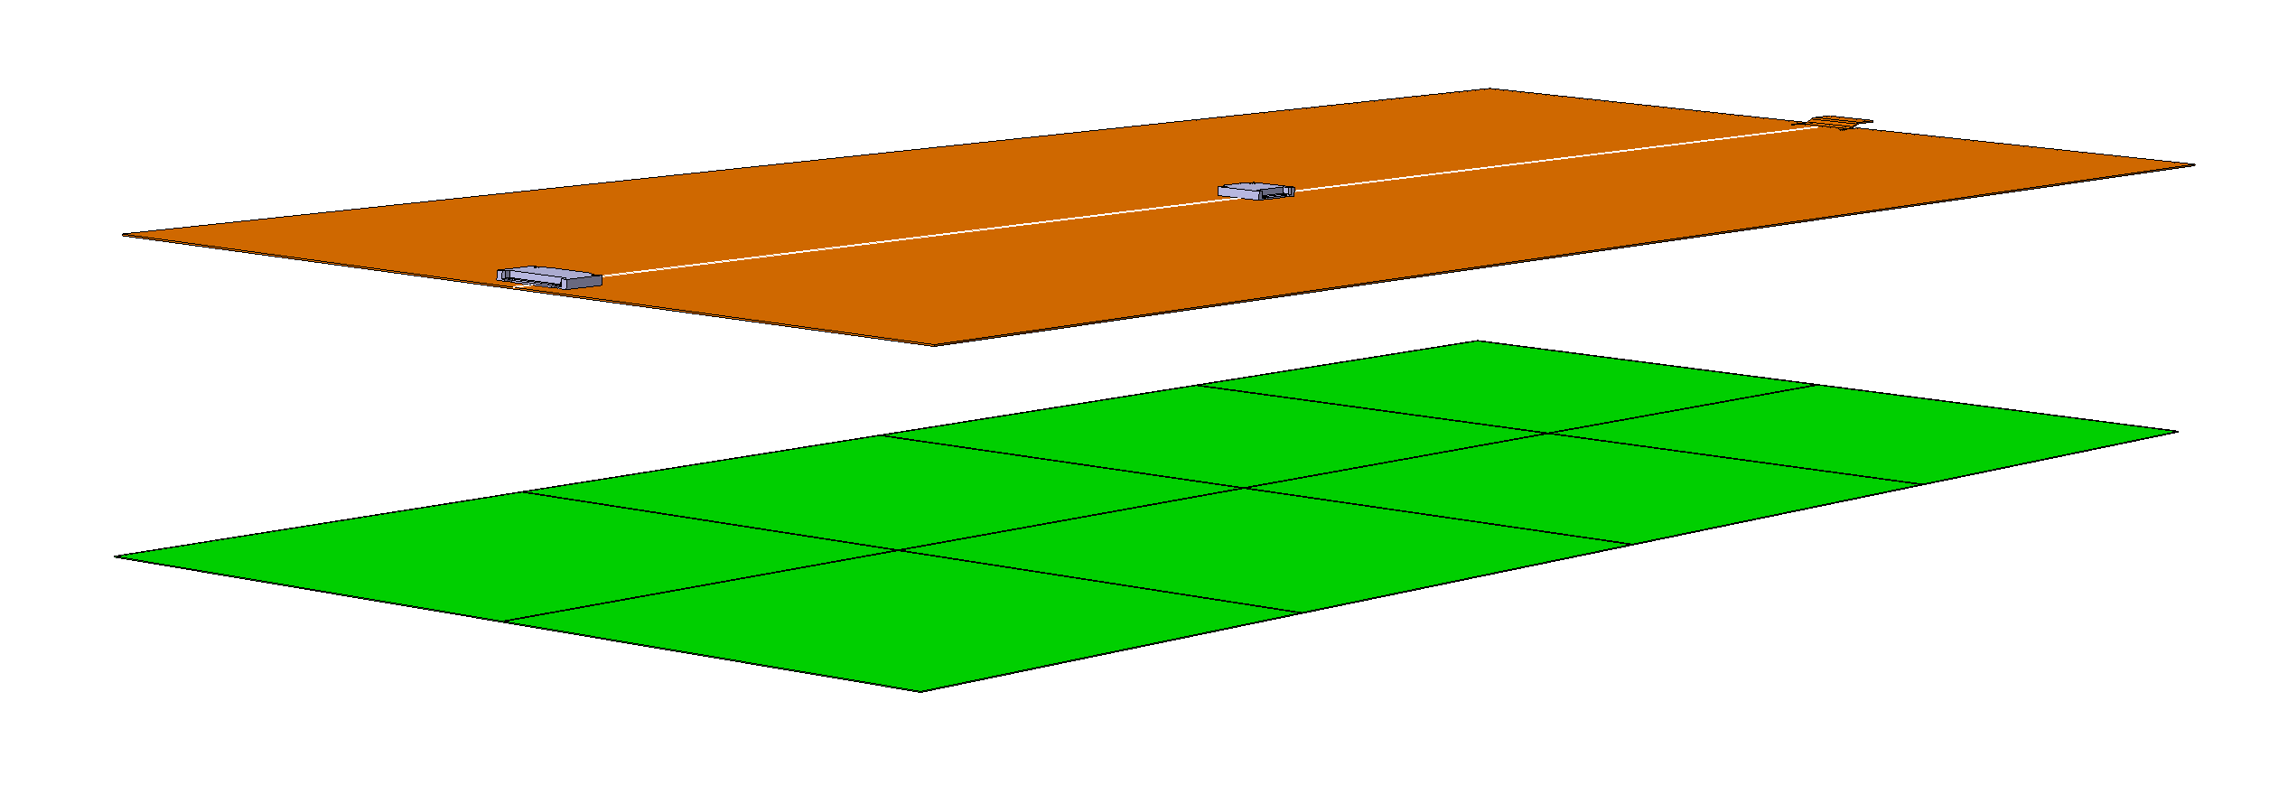
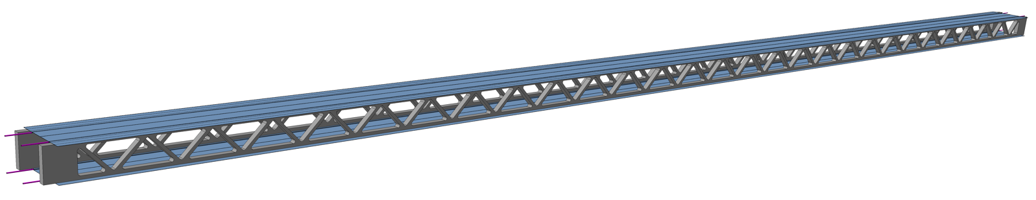
The Outer Tracker Stave
2 modules
Giada Bonini
21 modules
HDI
Chip
MODULE
(2 x 4 chips)
On a cold plate are glued (2 x 21) = 42 modules
Cold plate + modules ⟶ Module string
Two module strings + the foam structures ⟶ Stave
Two active layers
~ 10 cm (width) x 5 cm (height) x 268.8 cm (length)
~ 0.170 kg (mass)

Slide 17
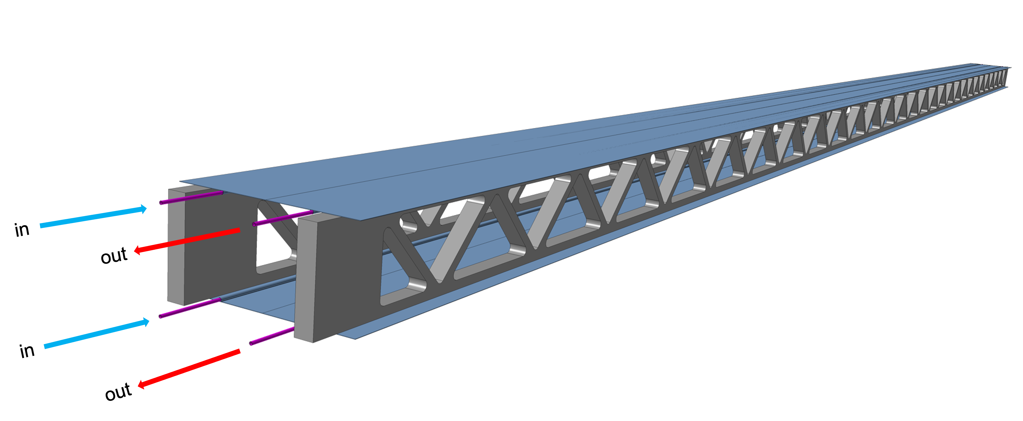
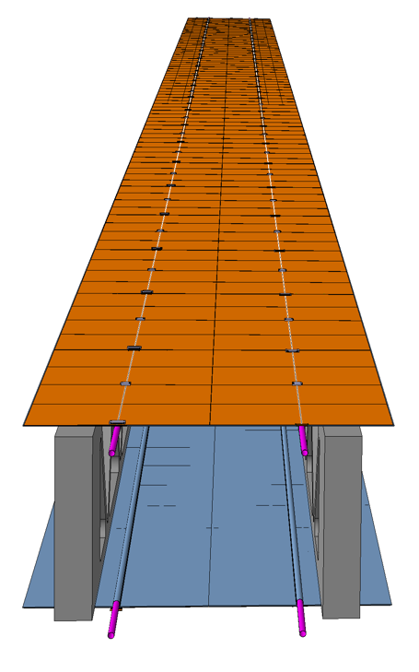
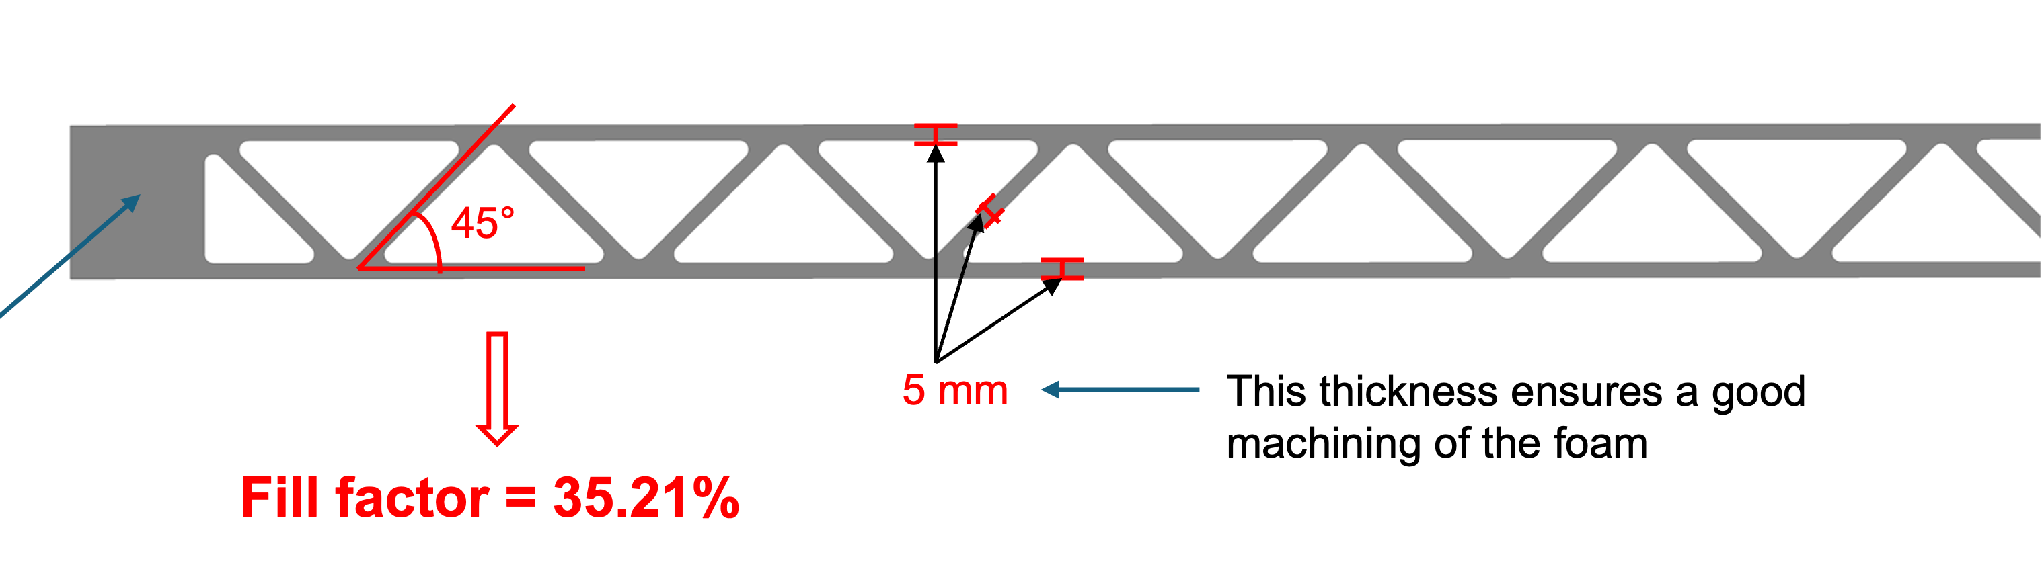
The Outer Tracker Stave
Giada Bonini
Each cold plate embeds 2 cooling pipes (straight – no bends)
The flow direction is opposite in the two pipes of a cold plate (single-phase cooling)
Cooling pipes are located under the chips periphery
Staves are supported by flanges at the two ends
15 mm
Full block
at stave ends

Slide 18
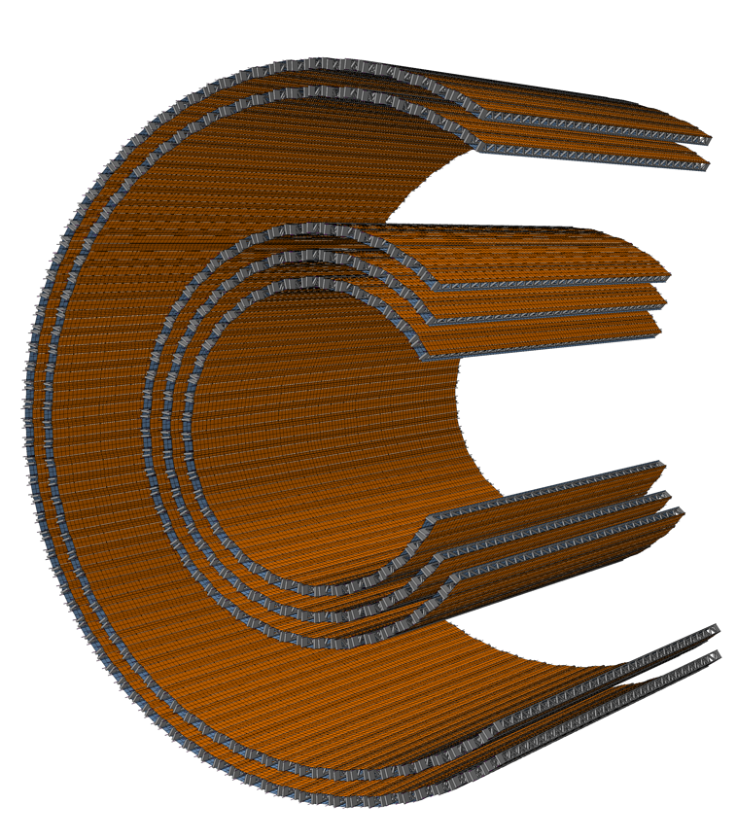
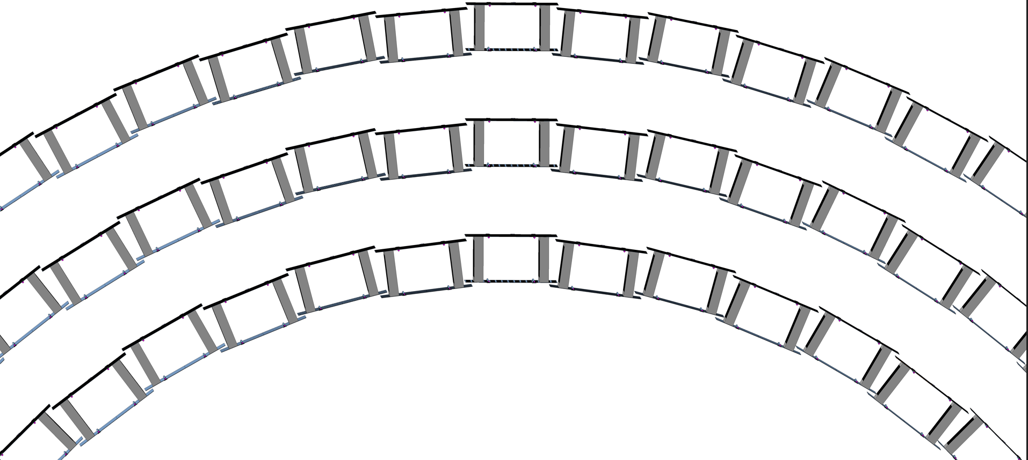
Outer Tracker layout (barrel)
Giada Bonini
Average radius (mm):
 | Lower cold plate | Upper cold plate
MID1 | 712.1 | 762.1
MID2 | 839.4 | 889.4
MID3 | 966.8 | 1016.8
OUT1 | 1603.1 | 1653.1
OUT2 | 1730.3 | 1780.3
OUT2
Outer layers
OUT1
MID3
MID2
Middle layers
MID1
Front view

Slide 19
Outer Tracker layout (barrel)
Giada Bonini
OUT2
Outer layers
OUT1
 | N. of staves | N. of modules | Silicon active surface (m²) | Power (kW)
MID1 | 48 | 4032 | 25.80 | 5.16
MID2 | 56 | 4704 | 30.11 | 6.02
MID3 | 64 | 5376 | 34.41 | 6.88
OUT1 | 104 | 8736 | 55.91 | 11.18
OUT2 | 112 | 9408 | 60.21 | 12.04
MID3
MID2
Middle layers
MID1

Slide 20
Outer Tracker cooling: fluids
Giada Bonini
Key properties:
Eco-friendly
Suitable for electronics immersion cooling
→ no damage to the sensors in case of leaks
3MTM Novec 774 will no longer be produced
Low boiling points → not optimal
OpteonTM SF10 identified as a plausible choice, taking into account all relevant thermo-physics properties

Slide 21
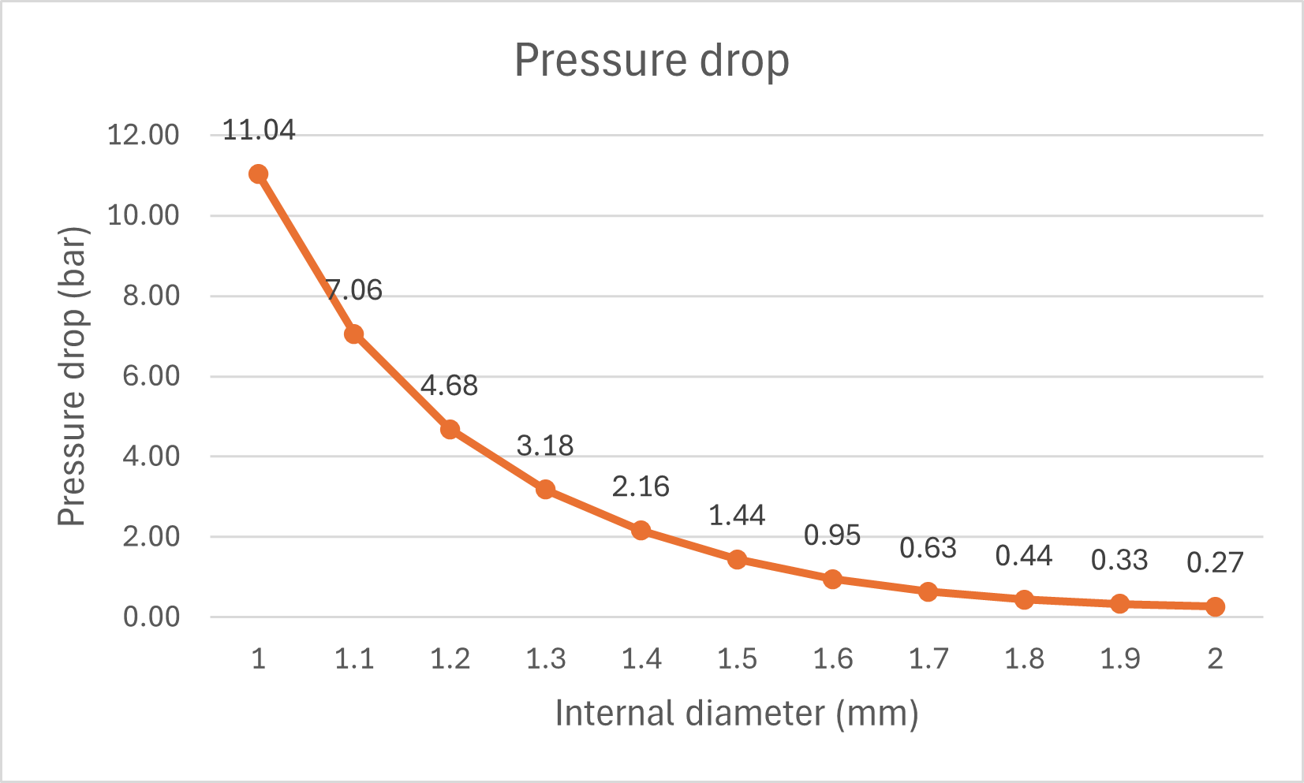
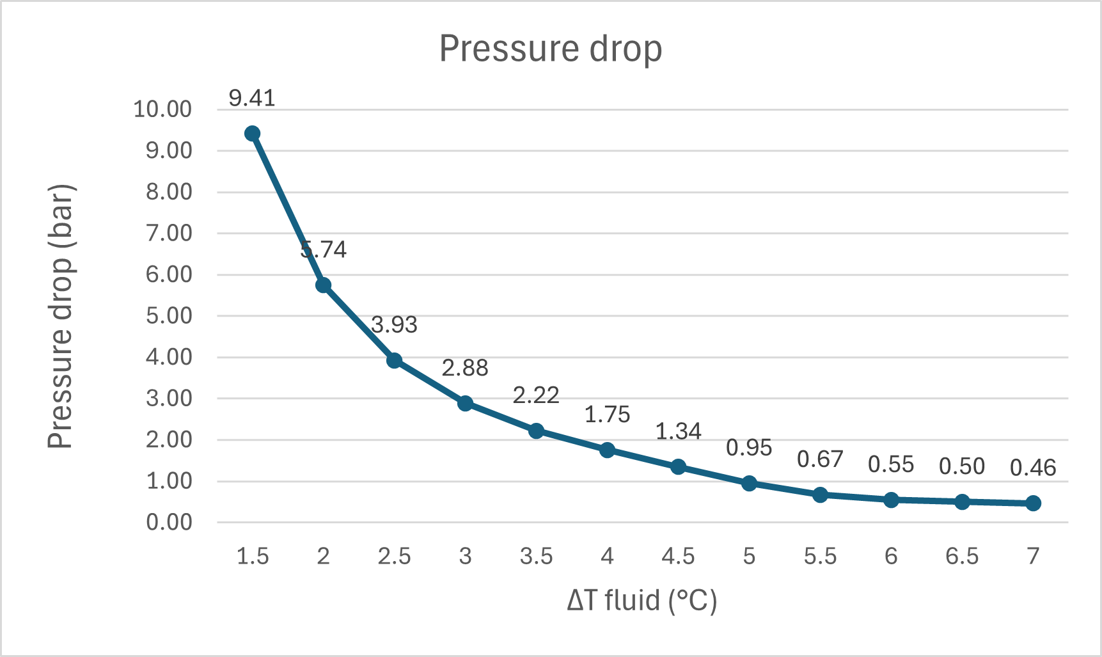
Outer Tracker cooling: sizing
Giada Bonini
Chip power density is not uniform
Power dissipated per chip: 0.161 W
Power dissipated per module: 1.29 W
Power dissipated per cold plate: 54.15 W
Pixel Power dissipation: 20 mW/cm²
Periphery Power dissipation: 50 mW/cm²
MAPS operational temperature: < 30°C
(ΔT=5°C)
(ID=1.6mm)
Nominal values chosen:
Graphics based on fluid parameters at 15°C
Pipe internal diameter: ID = 1.6 mm
Fluid in-out difference temperature: ΔT = 5°C
Pressure drop: 0.95 bar
Next step: thermal simulation

Slide 22
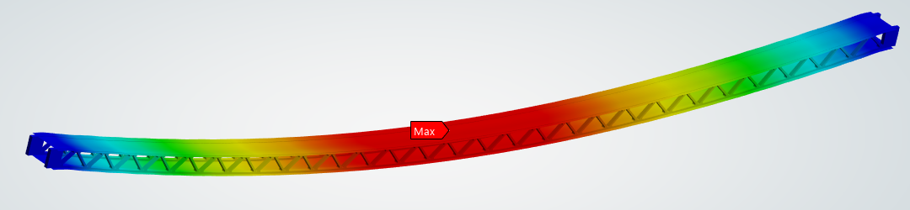
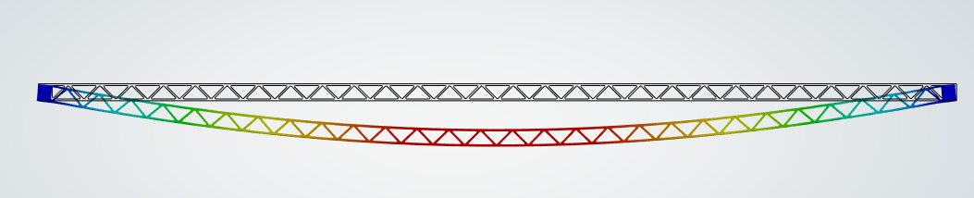
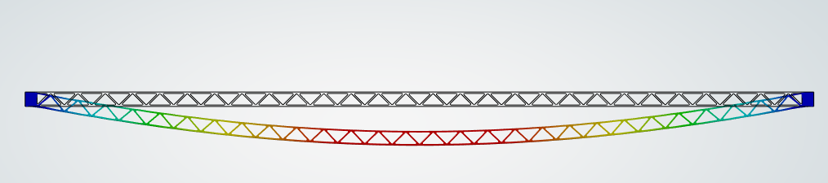
Structural analysis
Giada Bonini
Objective: evaluate stave sag under (modules + electronics + pipes + cooling fluid) weight → Total mass: ~ 0.175 Kg
Applied a distributed mass on the two cold plate surfaces to model electronic components
Applied a distributed mass on specific locations to model pipes with fluid
sag = 1.02 mm
Simple support
Simple support
sag = 0.69 mm
Clamped
Clamped

Slide 23
Outer Tracker mechanics: next steps
Thermal simulations
Construction of a 1.5 m long stave demonstrator, in collaboration with Purdue
  Material being procured
Design of the flange
…

Slide 24
Outer Tracker Stave: electronics system
Stella Orfanelli
    Key technologies:
Serial powering for delivering the required power to the modules
Aluminium interconnets (rather than copper) for power and readout
Data merging and command sharing across multiple chips
Silicon photonics readout (tbc)

Slide 25
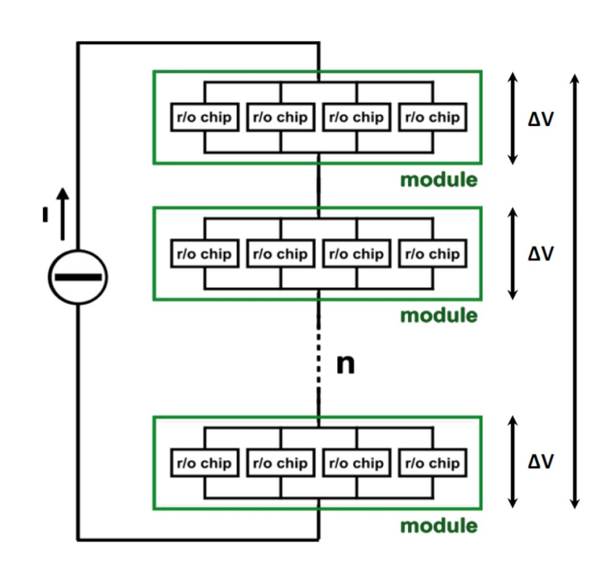
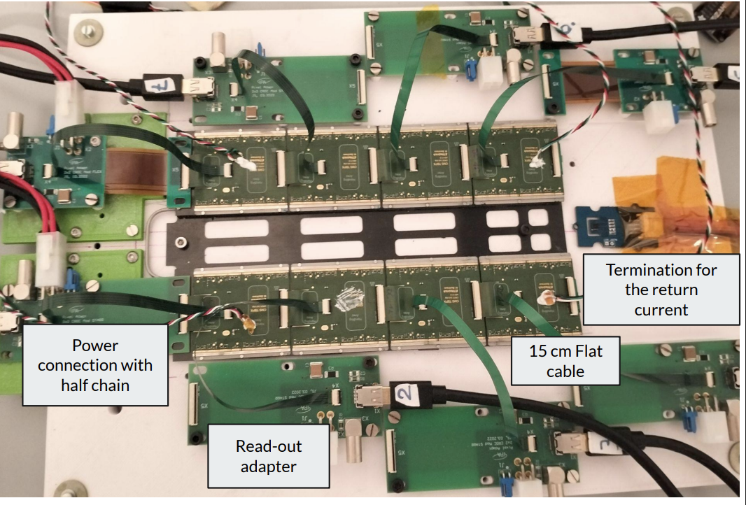
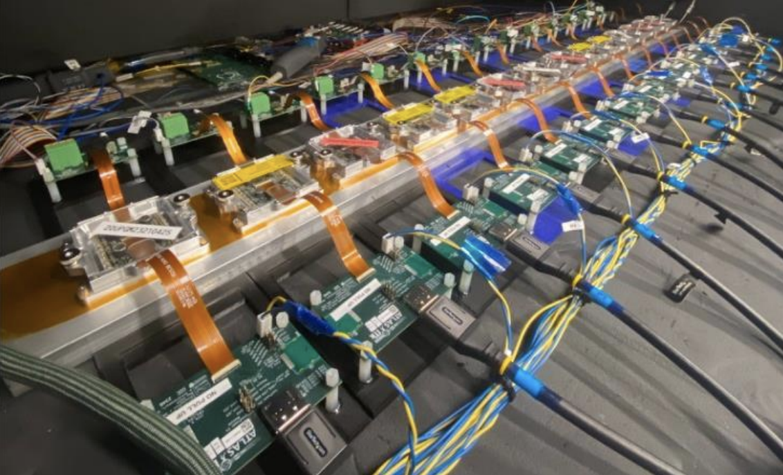
Serial powering concept
Stella Orfanelli
Modules powered in constant current chain
Demonstrated in CMS & ATLAS (5–14 modules)
Insensitive to voltage drops
Reduces cable mass & losses
Uses on-chip Shunt-LDO regulators
Failure tolerant → current redistributed
CMS barrel SP chain of 8 modules
ATLAS barrel system test

Slide 26
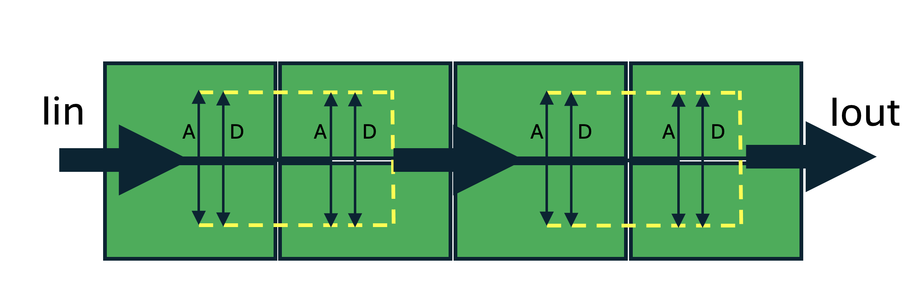
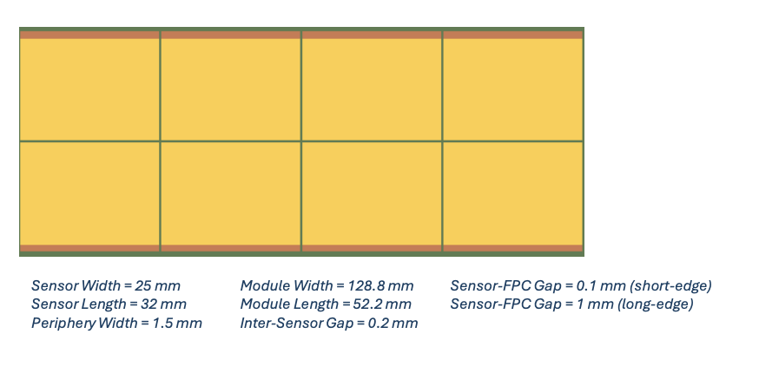
Implementing serial powering over a stave
Stella Orfanelli
Two chains of 20+22 modules
Two serial powering nodes per module
  4 MAPS per node
  Cooling pipes below the SLDO location to avoid hotspots
  Charge pump integrated on the periphery to bias the sensor (no extra bias line required)
Iin1
Iin2
Iout1
Iout2
Z=0

Slide 27
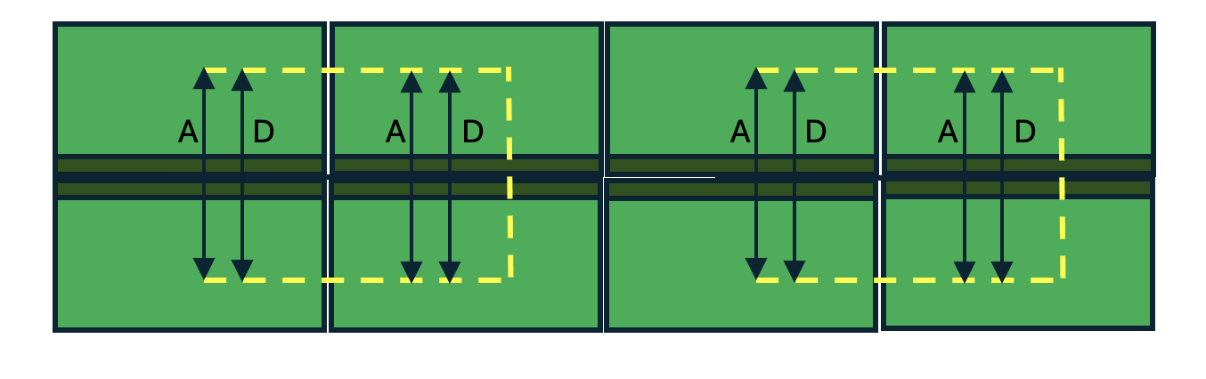
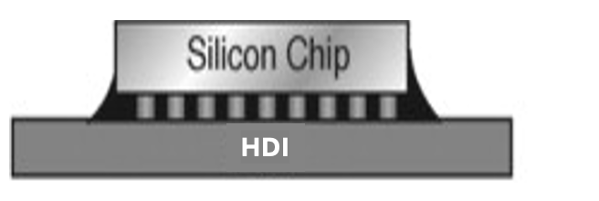
High Density Interconnect (HDI)
Stella Orfanelli
< 5% losses on the HDI
1 µm Al
Iout1=Iin2
40-50 um dielectric (PI or prepreg)
1 µm Al
Small power connector
with 2 pins (0.3 A/pin)
Iout2
Power pigtail to pass the current to the next module in series
Iin1
8-MAPS module flip-chipped on HDI
Rest of the two layers used for readout lines

Slide 28
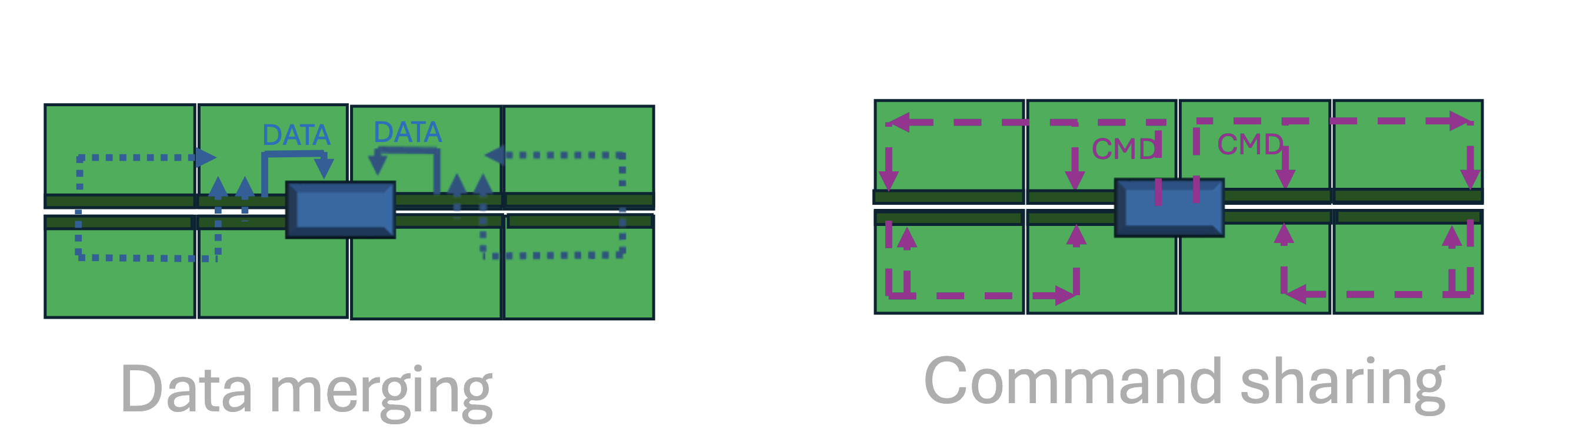
Data merging & Command sharing
Stella Orfanelli
Each node of the SP chain must have independent AC-coupled readout/command lines
Data merging and command stream (CMD) shared to reduce the number of links
2 readout diff. lines and 2 command diff. lines per 8-MAPS module → 8 pins connector
Assuming max bit rate of 1 Gbps/20 modules
  50 Mbps per module → 6 Mbps per MAPS over 5-10 cm of 1 µm Alu
  Need to keep paths short (resistive losses in 1µm are significant) - needs to be demonstrated
Command lines could potentially be slower

Slide 29
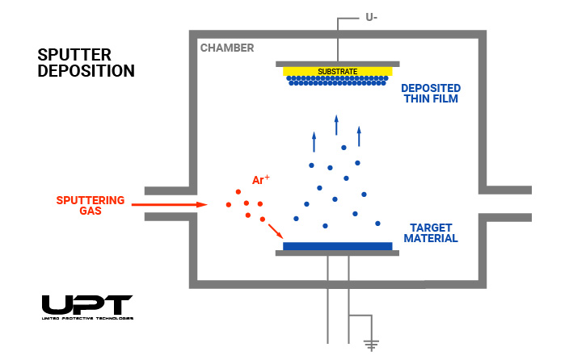
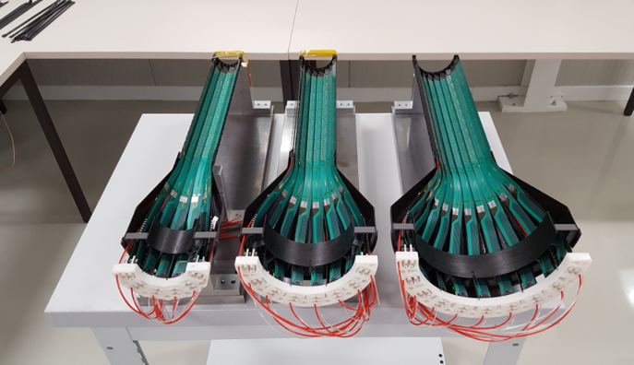
1 µm Alu – is it even possible?
Stella Orfanelli
There is no Al sheet with 1 µm thickness.
  Physical Vapour Deposition (PVD) sputtering process
  Adhesion layer: Ti/Cr (~30 nm)
  Proven in industry (nm-scale films)
ALICE is using it for a two-layer flex with 25 µm Aluminium thickness and 50 µm Kapton.
Next steps: kick-off R&D with CERN workshop on the optimisation of the HDI stack

Slide 30
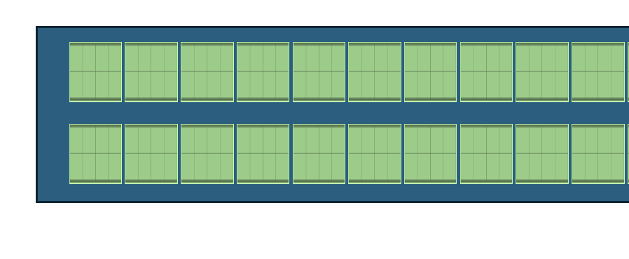
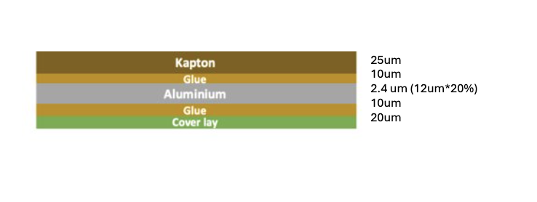
Readout flex
Stella Orfanelli
Each module needs 4 differential pairs. For a chain of 20 modules:
  80 pairs in a flex for lines of 50 Mbps over < 1.5m
~3.2 cm flex width with 20-30% fill factor (part of the layer used for traces)
Effective metal thickness ~2.4 µm
No reference plane (to validate)
128 cm
5 cm
12.8 cm

Slide 31
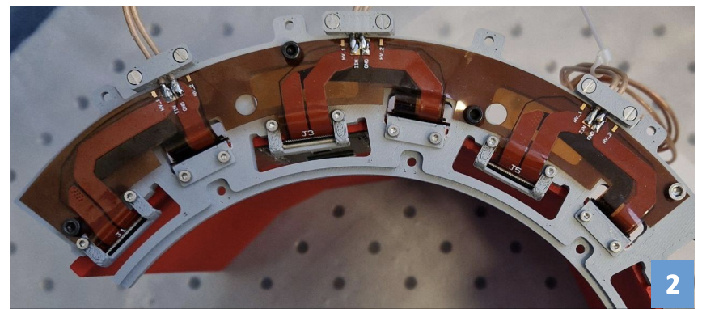
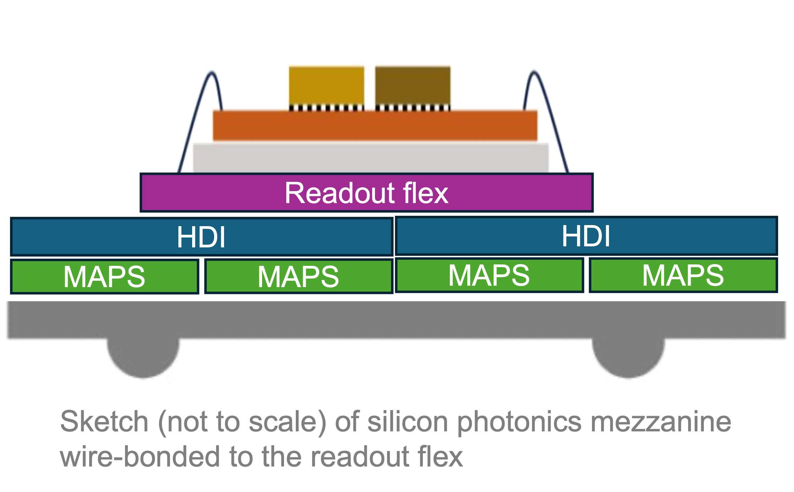
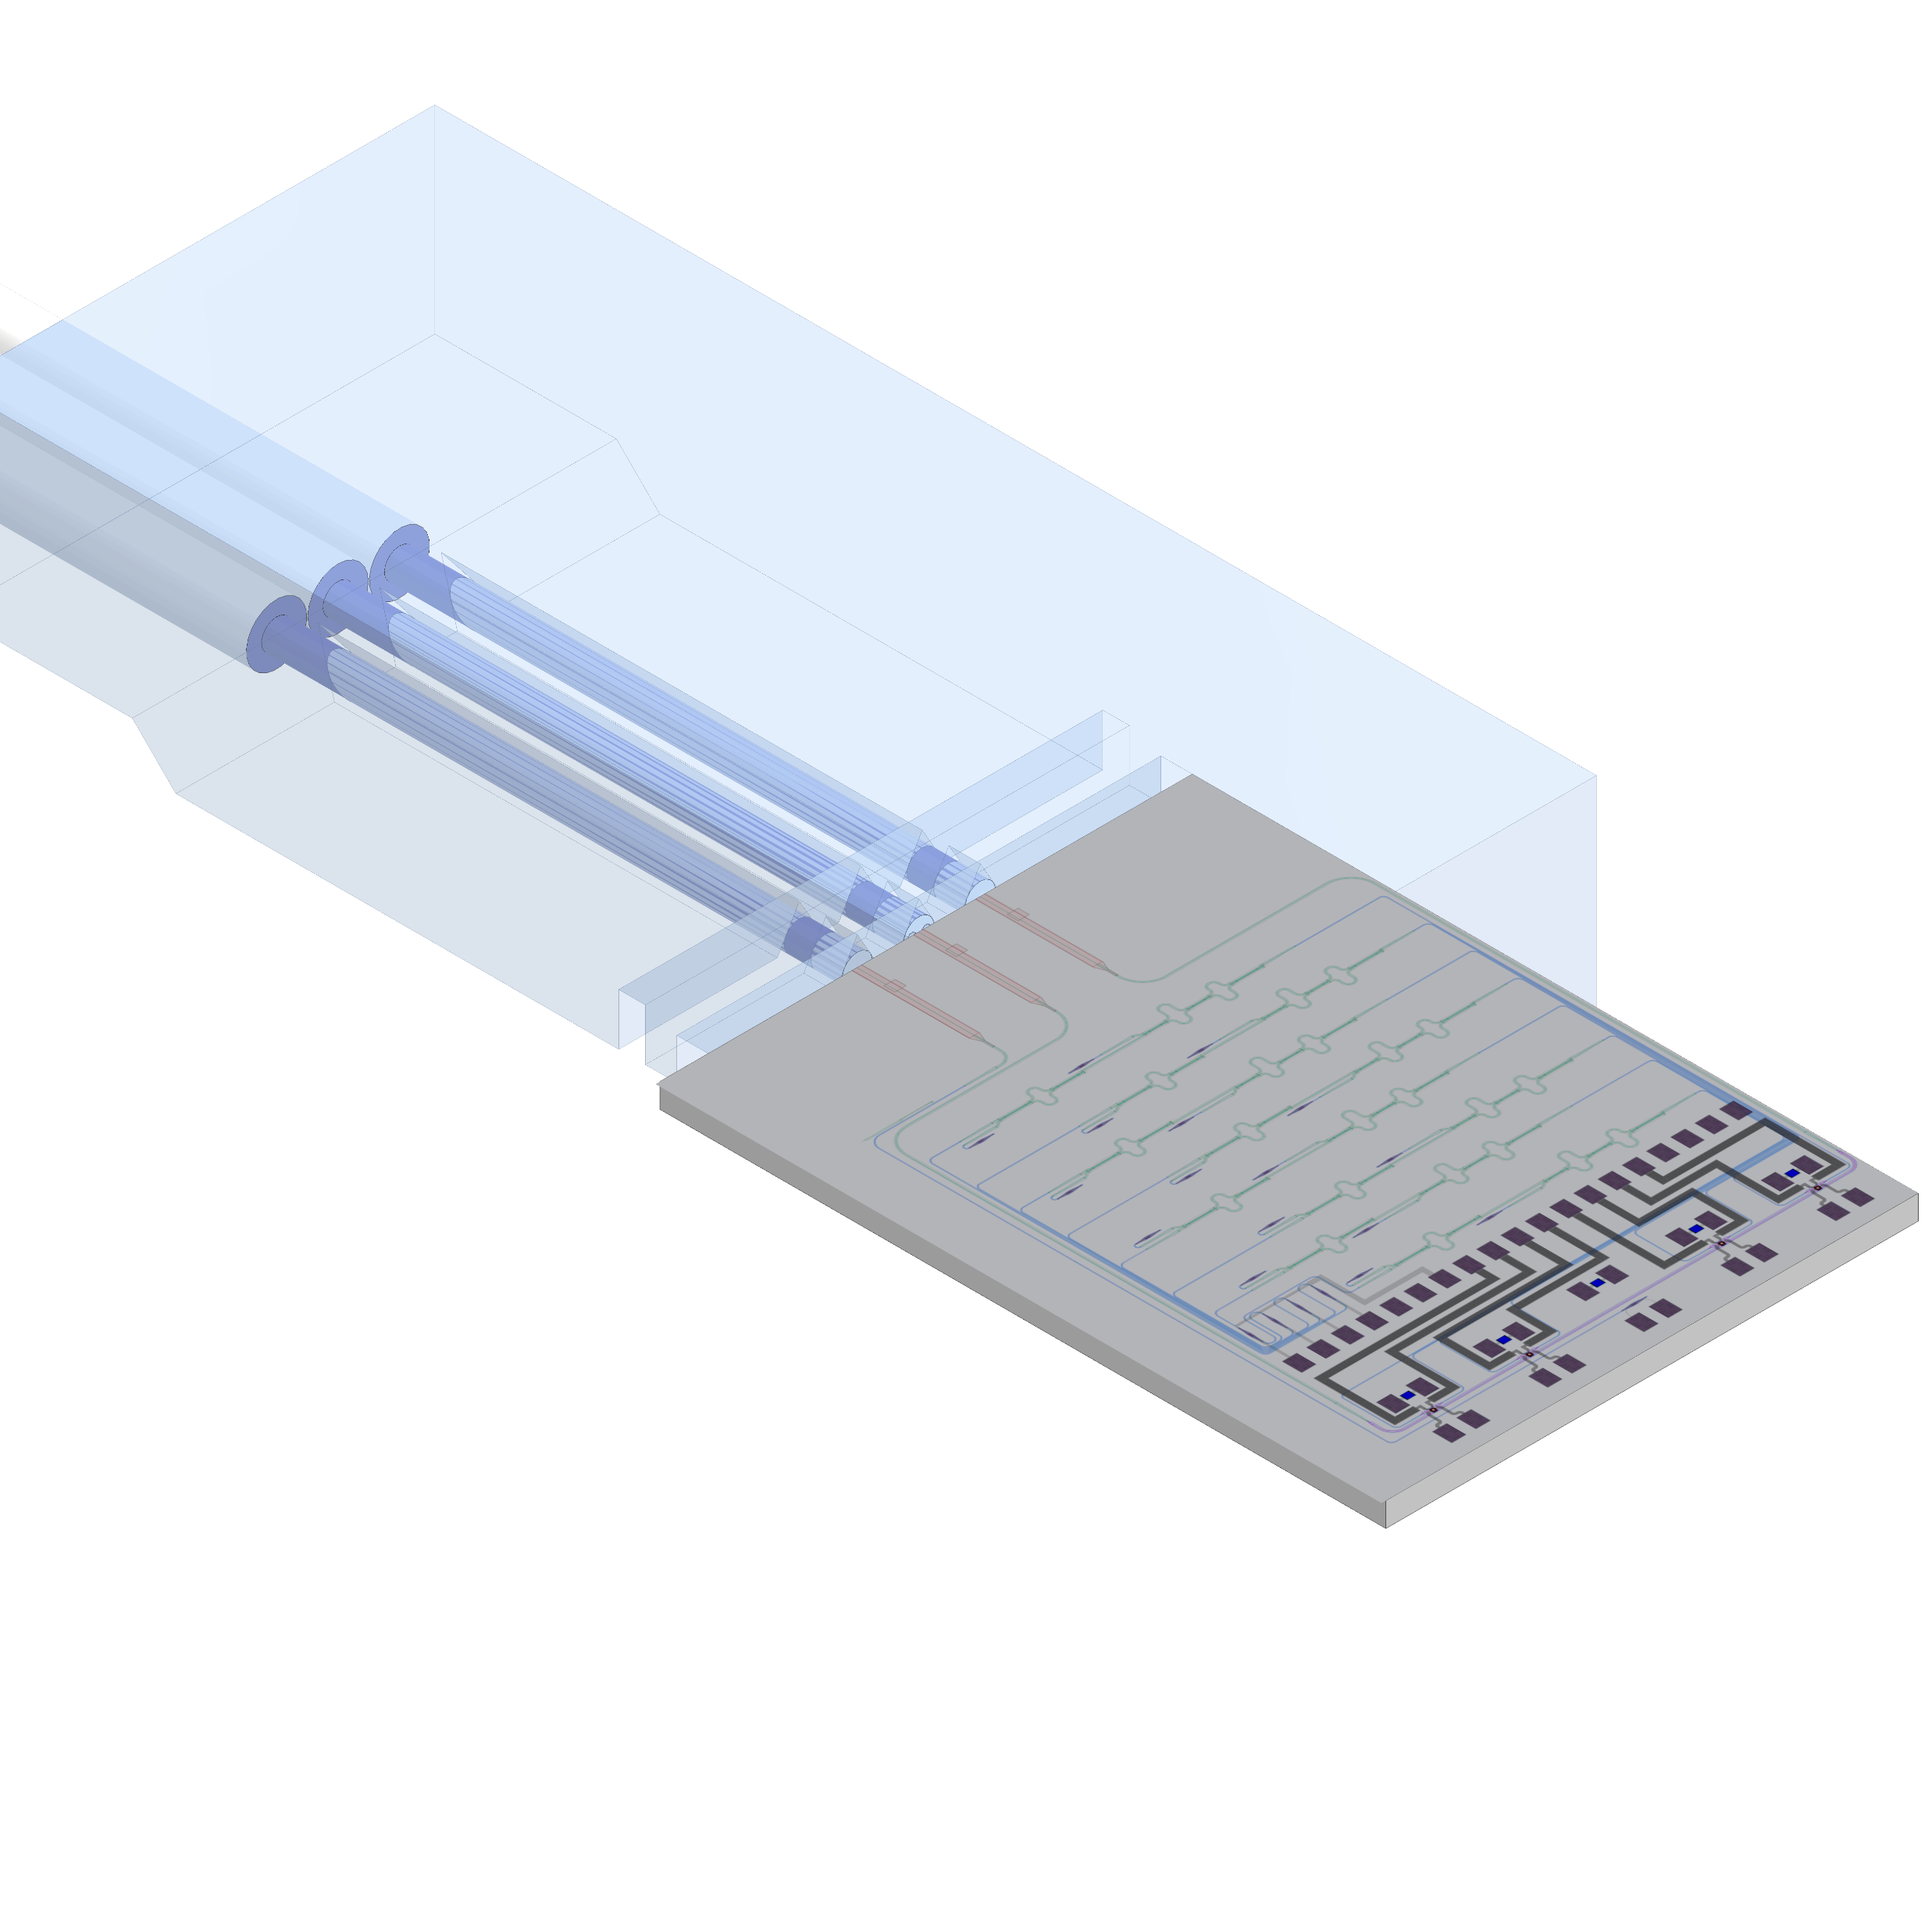
End of stave services
Stella Orfanelli
One layer Alu flex on the flange to connect to two Copper-Cladded Alu (CCA) wires AWG26 for each Serial Power Chain of 0.6A
Silicon photonics integrated circuits (PIC) that convert electrical to optical signal (and vice versa)
  PIC pigtailed with 3 single-mode glass fibres with 125 µm diameter
  Implemented on a mezzanine wire-bonded to the readout flex
Three fibres inserted into a loose tube with an outer diameter of approximately 1 mm​
Example Alu flex for the flange of the
CMS Phase-2 Inner Tracker barrel (TBPX)
SiPh sketch from EP-ESE

Slide 32
Summary …
Stella Orfanelli
First broadbrush plan of services laid out
  Based on demonstrated concepts
  Using cutting edge technologies for very low mass services
Serial powering is fundamental to the system architecture
  Will dictate readout grouping and specs for the chip
… and next steps
Demonstrate with CERN PCB workshop and test boards:
  PVD process with 1 𝜇m Al is reliable – optimise thickness of Al and dielectric
  HDI data transmission over 1 𝜇m Al for short paths
  Long flex transmission without reference plane
Collaborate with EP-ESE towards the integration of SiPh

Slide 33
All together
1.8
1.6
1.4
1.2
1.0
0.8
0.6
0.4
0.2
N of modules | 56825
Silicon active surface (m²) | 364
Power (kW) | 72.74
N of wafers | 9471 | 28.41 | MCHF
cos𝜗 = 0.99 (141.5 mrad)
100 mrad
LumiCal
0.2 0.4 0.6 0.8 1.0 1.2 1.4 1.6 1.8 2.0

Slide 34
Nomenclature
1.8
1.6
1.4
1.2
1.0
0.8
0.6
0.4
0.2
Tracker
0.2 0.4 0.6 0.8 1.0 1.2 1.4 1.6 1.8 2.0

Slide 35
Nomenclature
1.8
1.6
1.4
1.2
1.0
0.8
0.6
0.4
0.2
Outer Tracker (OT)
Vertex Detector (VTX)
0.2 0.4 0.6 0.8 1.0 1.2 1.4 1.6 1.8 2.0

Slide 36
Nomenclature
1.8
1.6
1.4
1.2
1.0
0.8
0.6
0.4
0.2
Outer Layers
Barrel
Endcap
Middle Layers
0.2 0.4 0.6 0.8 1.0 1.2 1.4 1.6 1.8 2.0

Slide 37
But…. what about the endcaps?

Slide 38
The endcaps: from a stave to a Dee
Endcaps are always a headache
Extend the concept adopted for the barrel
Minimize added complexity (… and, obviously, mass )
Take advantage of square pixels
No design work done, yet
Just a concept - to be developed

Slide 39
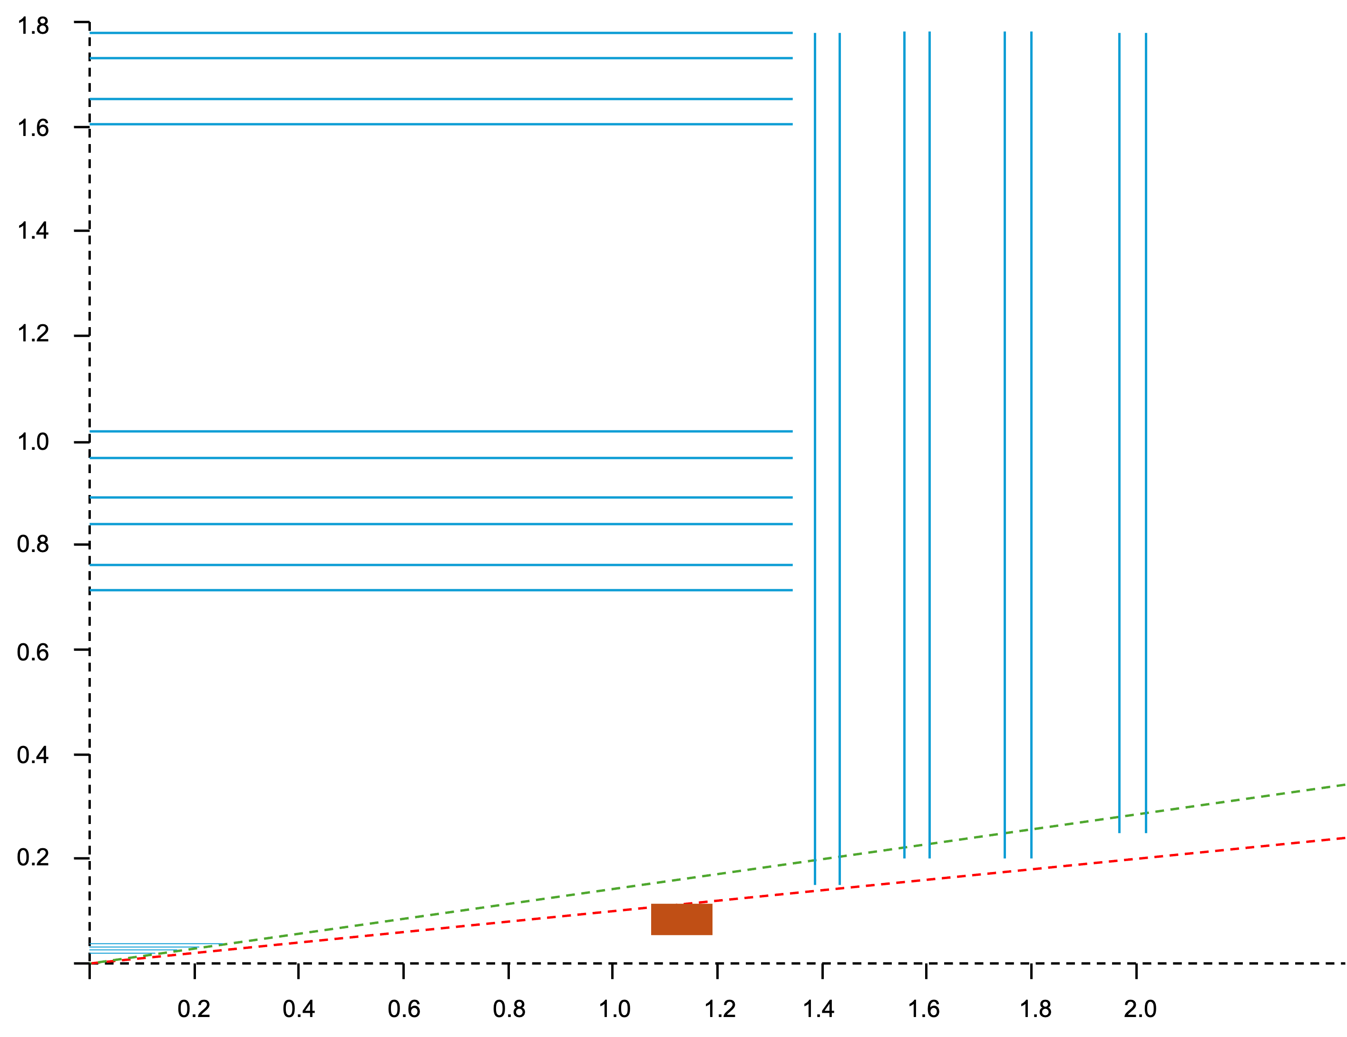
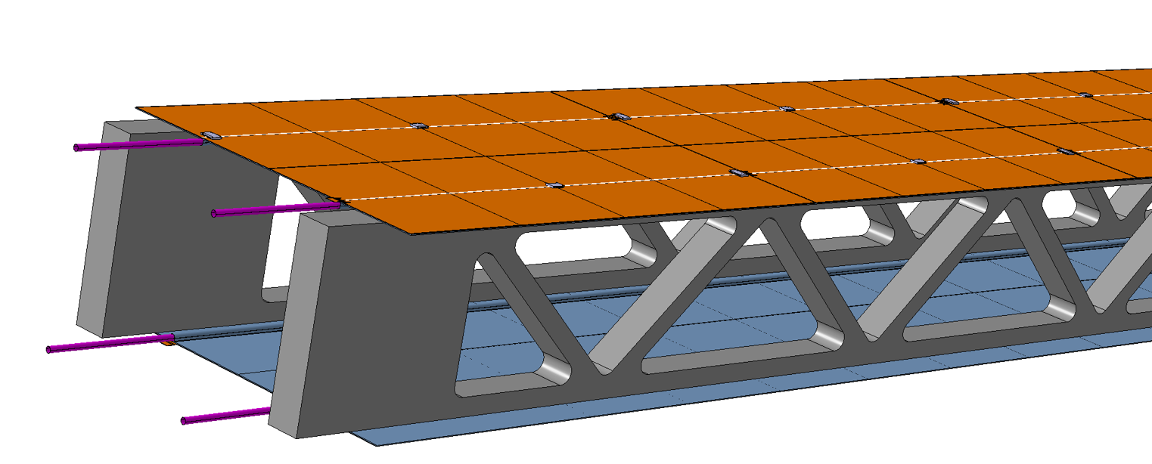
Use the same module string construction
Install on large foam structures covering a “Dee” (half disk)
Same ~ 5 cm foam thickness
One support structure carrying two active layers (many strings of different length)
Disk 1

Slide 40
Use the same module string construction
Install on large foam structures covering a “Dee” (half disk)
Varying background rates across a string
Central region will probably be “relatively hot”
Might require faster MAPS
... in worst case (yet another) slightly different flavour
Disk 1

Slide 41
Use the same module string construction
Install on large foam structures covering a “Dee” (half disk)
Too big to be glued
Probably needs elements (rails) on the foam structures
Features on the back of the cold plates to slide in the rails
Insert from the two sides and block in place
For now in the material model:
×4 density in the structures wrt barrel
Disk 1

Slide 42
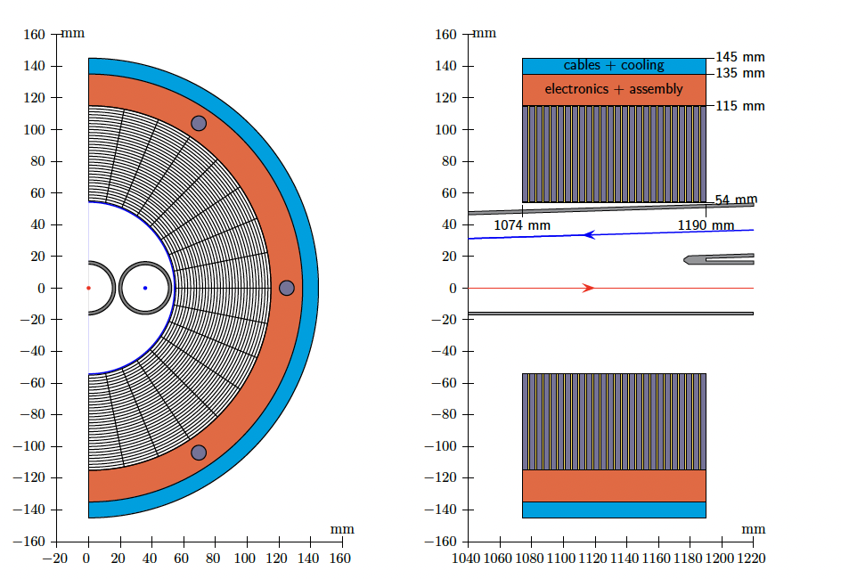
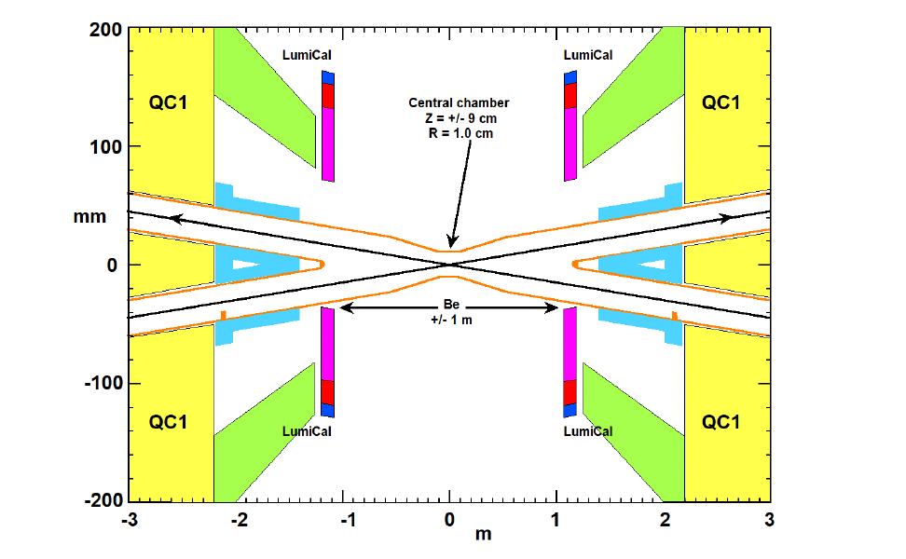
One more subdetector: the luminometer

Slide 43
One more subdetector: the luminometer
One existing concept made of W and Si-strip layers
  Inspired by the OPAL luminosity calorimeter
Attempt to position silicon strips according to the desired acceptance
  Centred around the outgoing beam direction
Cannot work in practice with the required precision
  …and it’s not the desired acceptance anyway
Acceptance needs to be defined a posteriori using physics constraints
  Like the alignment for the Tracker

Slide 44
One more MAPS-based subdetector: the luminometer
Replace Si strips with MAPS positioned as close as possible around the beam pipe(s)
Define the acceptance contour a posteriori
Small pixels are the best possible option for a precise definition of the acceptance contour
MAPS will not be the limitation
  Stability of the mechanics is key
  Offline reconstruction

Slide 45
MAPS: summary
  Aim at one single development, with some “variants”
Faster front-end for the VTX layers, designed for stitching
(b) Slower front-end for the OT barrel layers, reticle size, designed for flip-chip
(ab) Reticle size MAPS designed for flip-chip, with faster front-end for the OT endcaps
(ab’) MAPS designed for flip-chip, with faster front-end and fine-tuned size for the LumiCAL
N.B. Perhaps the speed of the front-end could be made “programmable”

Slide 46
Material estimates

Slide 47
Mass estimates (some highlights)
Silicon Module |  | Avg X/X₀ (%)
MAPS | Si | 0.0534
 | Cu | 0.0139
Bumps | Sn95Ag5 | 0.0009
HDI | Coverlay | 0.0103
 | Al | 0.0022
 | HDI prepreg | 0.0281
 | Decoupling cap | 0.0071
Connector power | LCP | 0.0003
 | Cu | 0.0006
Connector data | LCP | 0.0006
 | Cu | 0.0015
Total |  | 0.1190
Stave |  | Avg X/X₀ (%)
Cold plates | C paper | 0.0225
 | C fleece | 0.0112
 | K13D2U | 0.0577
Foam structures | ERG Duocel foam | 0.0577
Pipes | Kapton | 0.0092
Coolant | Opteon SF10 | 0.1302
FPC | Kapton | 0.0175
 | Coverlay | 0.1026
 | Al | 0.0539
 | Epoxy | 0.0118
Total |  | 0.4743

Slide 48
Mass estimates (some highlights)
 | N of staves in phi | Avg X/X₀ modules (%) | Avg X/X₀ staves (%)
OUT2 | 112 | 0.12 | 0.48
 |  | 0.12
OUT1 | 104 | 0.12 | 0.48
 |  | 0.12
MID3 | 64 | 0.12 | 0.48
 |  | 0.13
MID2 | 56 | 0.12 | 0.48
 |  | 0.13
MID1 | 48 | 0.12 | 0.48
 |  | 0.13

Slide 49
Performance
From DELPHES

Slide 50
Outline
Baseline ALFA vs CLD/IDEA: comparison of all track parameters
Baseline vs 5-layer VTX
  possible only with smaller beam pipe
Baseline vs 50 𝜇m OT pixels: p_{T} resolution
Robustness: dead middle/outer layer
Ignore coordinates in VTX: d₀/z₀ resolution
  For outward ⟶ inward reconstruction and displaced topologies

Slide 51
Baseline performance

Slide 52
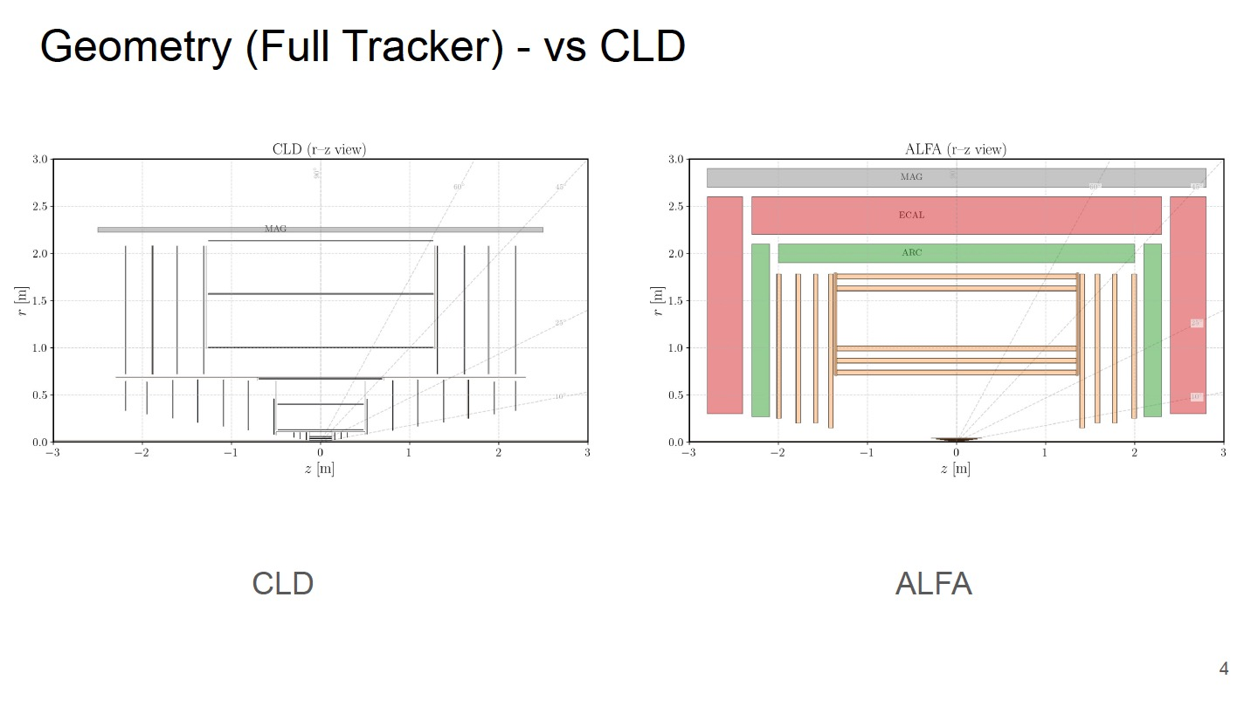
Michele Selvaggi
Based on available DELPHES cards

Slide 53
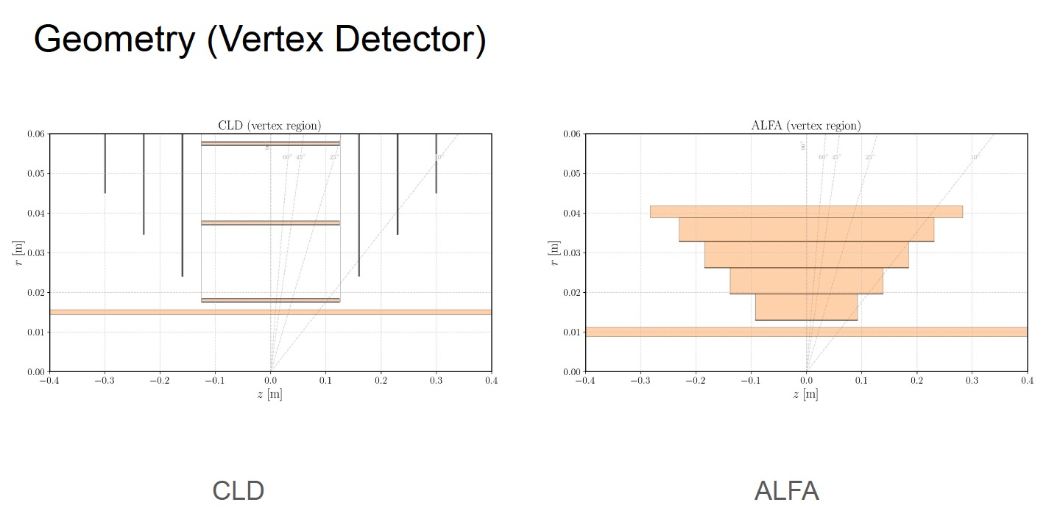
Michele Selvaggi

Slide 54
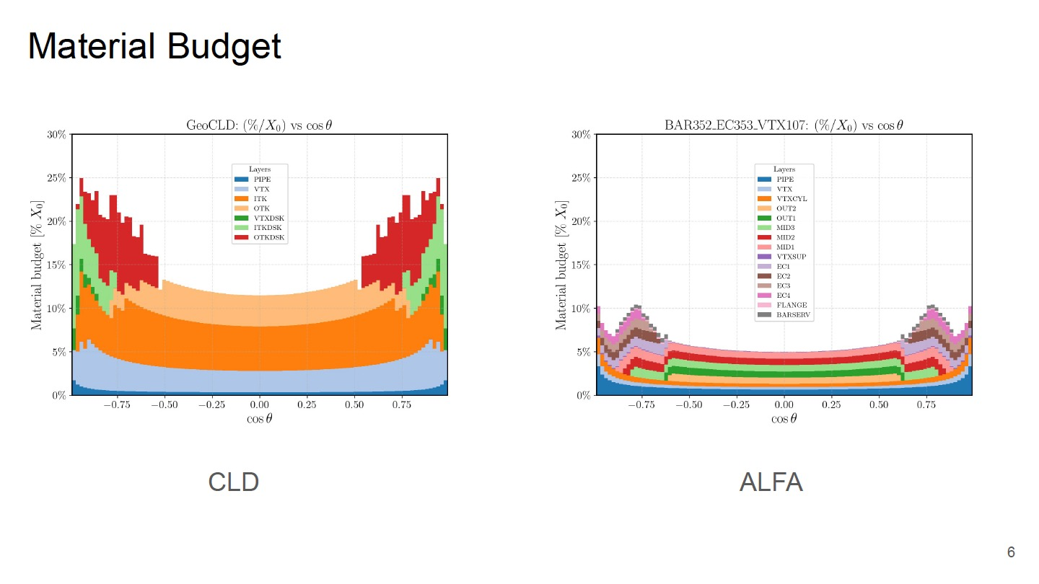
Michele Selvaggi

Slide 55
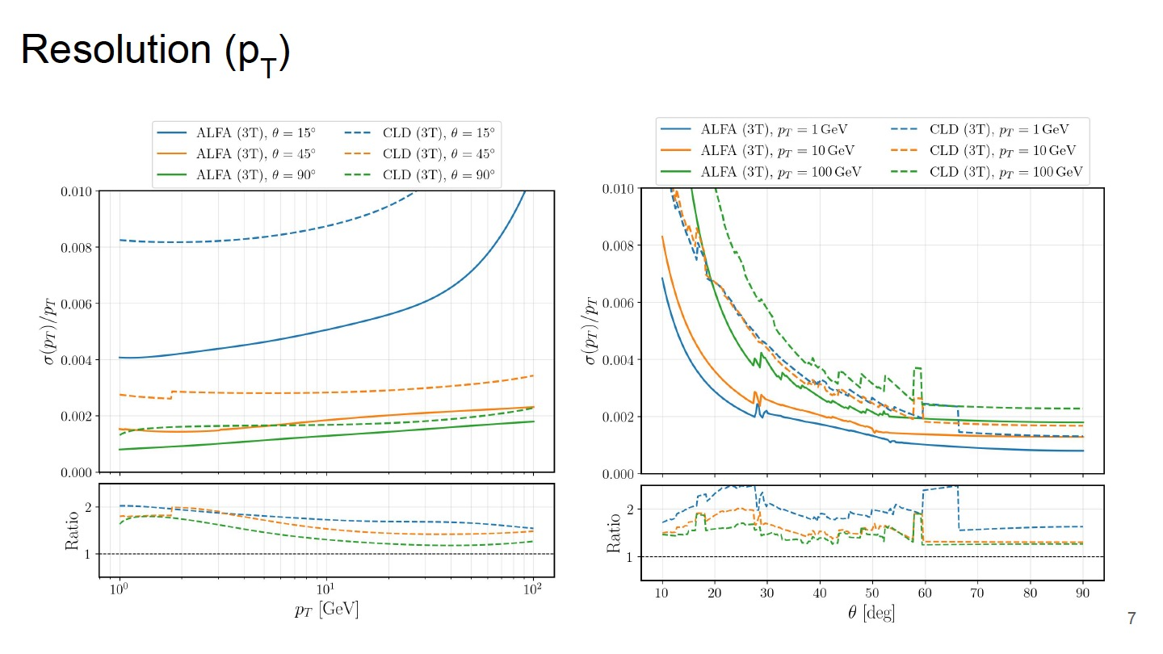
Michele Selvaggi

Slide 56
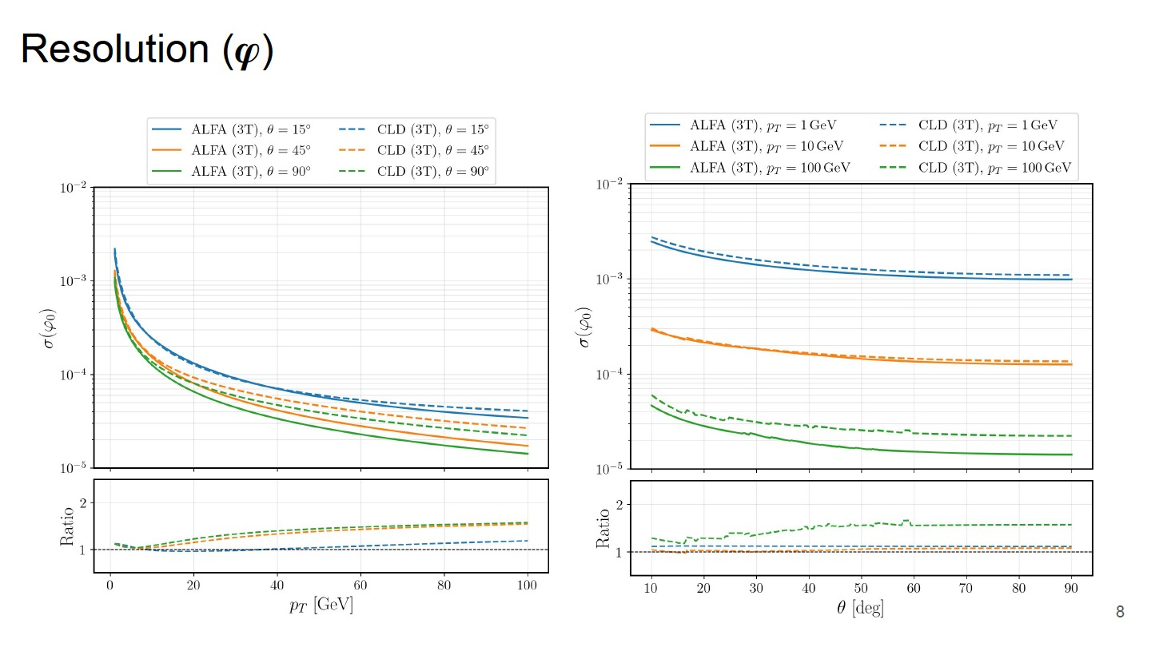
Michele Selvaggi

Slide 57
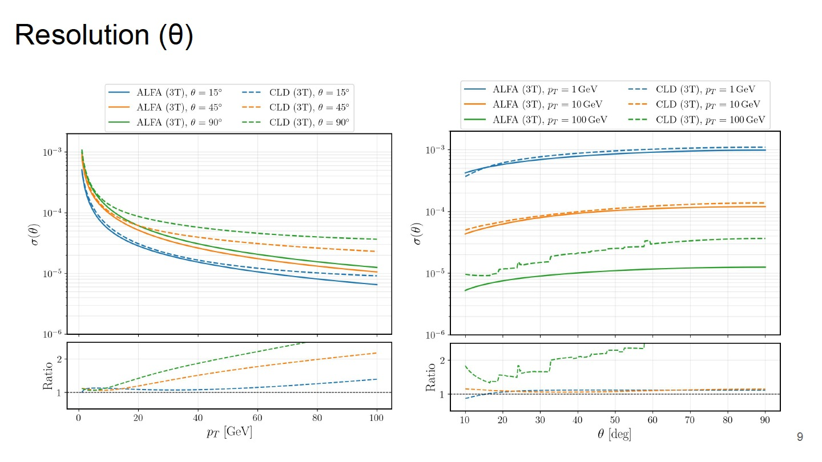
Michele Selvaggi

Slide 58
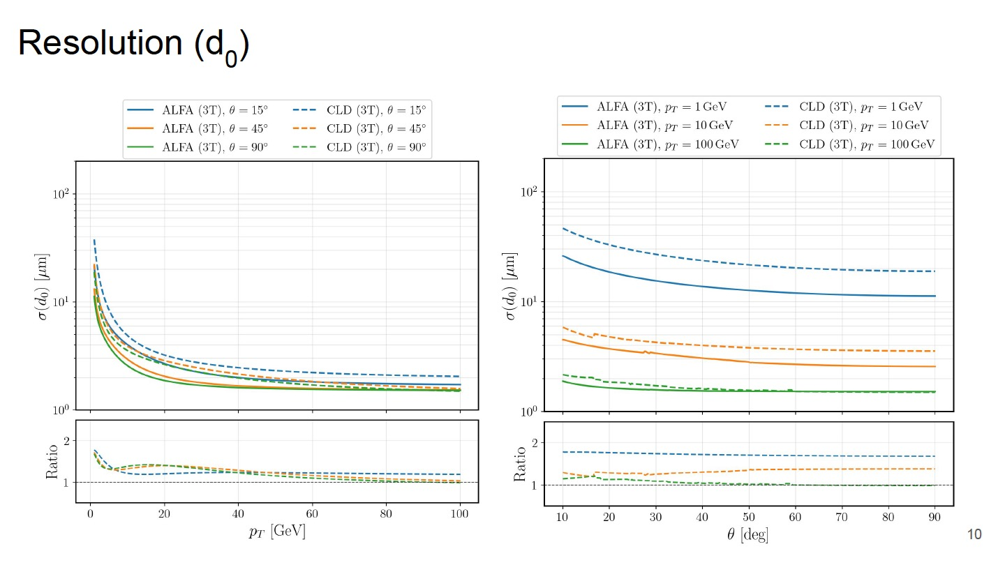
Michele Selvaggi

Slide 59
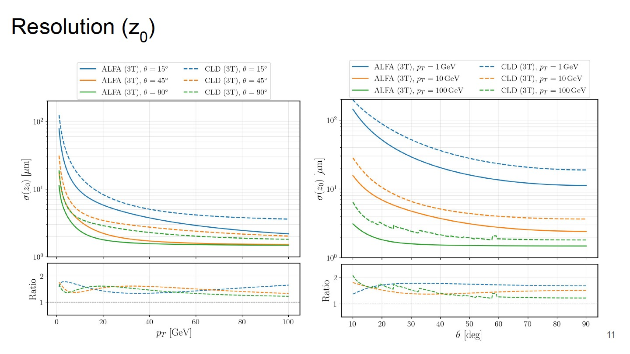
Michele Selvaggi

Slide 60
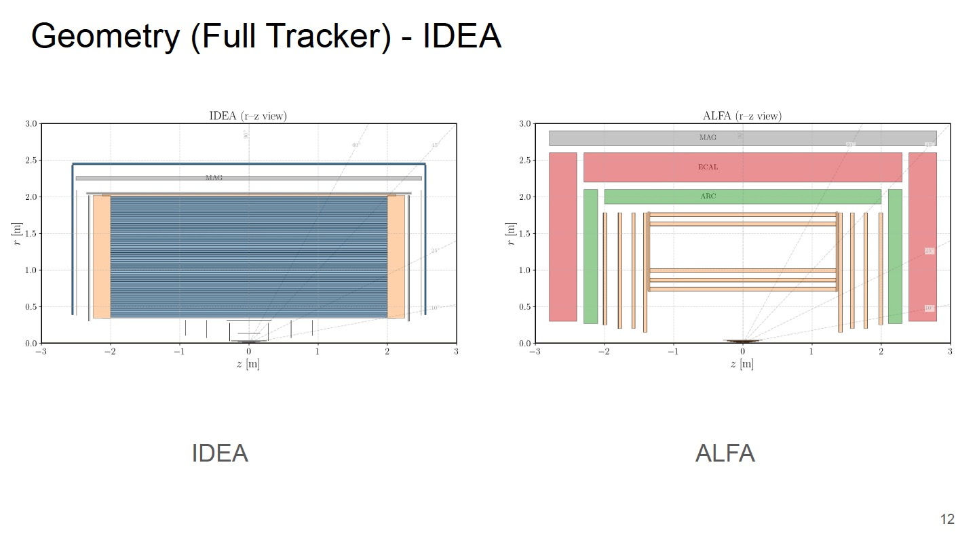
Michele Selvaggi
Based on available DELPHES cards

Slide 61
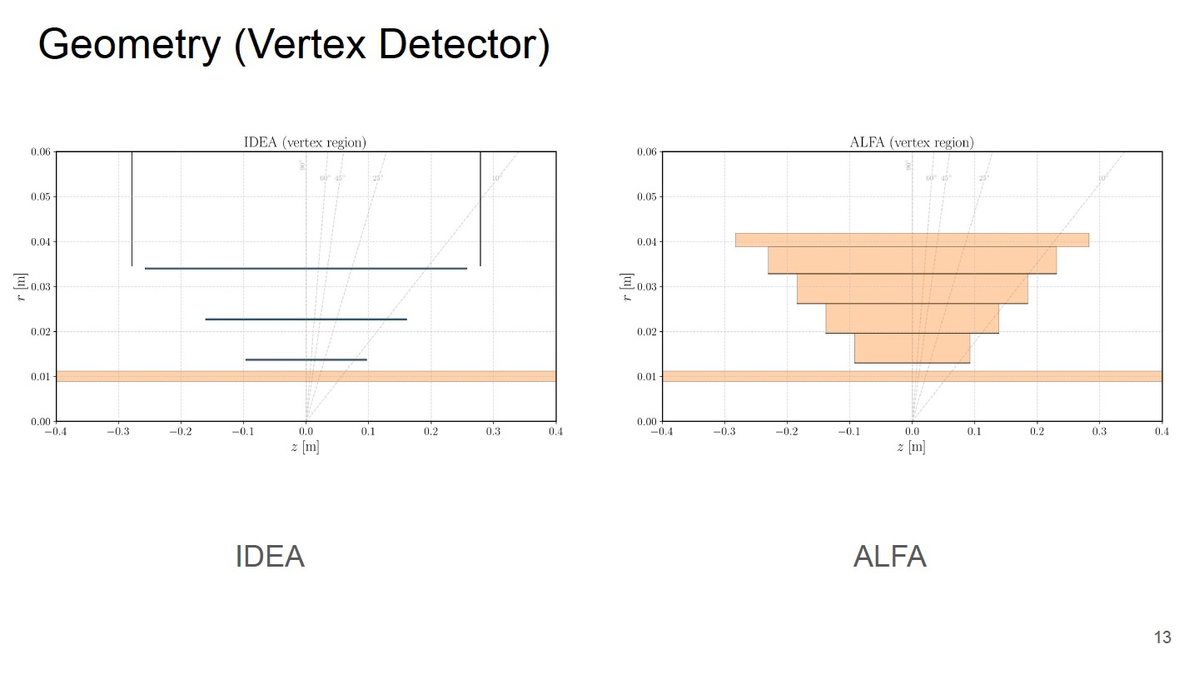
Michele Selvaggi

Slide 62

Michele Selvaggi

Slide 63

Michele Selvaggi

Slide 64

Michele Selvaggi

Slide 65

Michele Selvaggi

Slide 66

Michele Selvaggi

Slide 67

Michele Selvaggi

Slide 68
5-layer VTX
Possible only with a smaller beam pipe

Slide 69

Michele Selvaggi
5-layer VTX Baseline

Slide 70

Michele Selvaggi

Slide 71

Michele Selvaggi

Slide 72
Outer Tracker with 50 𝜇m pixels

Slide 73

Michele Selvaggi

Slide 74
One dead layer in OT
Assess robustness

Slide 75
Eduardo Ploerer

Slide 76
Eduardo Ploerer

Slide 77
Ignore coordinates in VTX
For outward ⟶ inward reconstruction and displaced topologies

Slide 78


Resolution d₀, z₀
Michele Selvaggi

Slide 79
What we have achieved
Sufficiently detailed conceptual design to demonstrate that an all-MAPS Tracker is a promising option for ALFA
  Feasible
  Affordable
  High-performance
  Robust
A lot of interesting work ahead

Slide 80
Work ahead
OT barrel
  Thermal simulations
  Flanges
  Conceptual design of assembly tooling and sequence
  Services
  Construction of stave demonstrator
  Lab tests to assess thermo-mechanical properties and validate simulations
OT endcaps
  A lot of creative design work
Electronics
  Design, fabricate and test demonstrators for HDI and flex
  Discuss and define implementation of data links
Vertex layers
  Mechanical structures and assembly procedure to be adapted to our geometry (more creative design work)
  Should be then tested with dummy elements

Slide 81
Last but not least: simulations
(…and reconstruction)
Critical goal for the next 2-3 years: define and consolidate precise specs for the MAPS
  Needs accurate simulation of the MAPS response
  Implementation of the detector geometry
  Samples of beam-induced background
Possibility of characterization of MAPS in the lab
  Joint effort on serial powering with ALICE

Slide 82

The ARC for the ALFA detector
Development started in 2021

Slide 83


ARC (Array of RICH Cells)
Lightweight and compact solution for particle ID
  20 cm radial depth, 10% X₀
Cellular design
Two radiators (gas + aerogel) to cover the full momentum range of interest
Silicon Photomultiplier array mounted on a cooling layer
The aerogel also acts as insulator between the SiPM and the gas

Slide 84

Silicon PhotoMultipliers
High photo-detection efficiency in the relevant wavelength range
Good timing performance
Compact, robust and cost-effective
High granularity (0.5 × 0.5 mm² pixels considered)
  Enables good resolution on the Cerenkov angle
High dark count rate – requires low-temperature operation

Slide 85
Radiators
Dual-radiator system (gas + aerogel) to cover a wide momentum range
A widely used gas radiator in RICH detectors is C₄F₁₀ at atmospheric pressure
  High GWP – not a good option for FCC
  Pressurized Xenon under study as alternative
Silica aerogel is an excellent choice for the low-momentum radiator in ARC
  Very low thermal conductivity (0.015 W m⁻¹ K⁻¹) also provides thermal insulation in front of the cooled SiPM modules
  Drawback: emitted photons traverse the aerogel, leading to some scattering losses

Slide 86


ARC mechanics: concept
Carbon-fibre composite vessel
  First design and FE analysis by Corrado Gargiulo (CERN EP-DT)
CF sandwich with foam core: stiff, light, suitable for a pressure vessel
12-fold rib structure for stiffness and stability (sectors)
Wall thickness ~20 mm, outer diameter 4.4 m, low material budget: 2.7% X₀

Slide 87


Performance from simulation
Serena Pezzulo
Excellent expected performance over a broad momentum range

Slide 88
Next steps: from ARC to ARC for ALFA
Adapt geometry to the ALFA dimensions
  Already ongoing
Develop the xenon option (top priority )
Revisit the cooling and electronics concept in the context of a large detector assembly
  Exploit synergies with Tracker for thermal management and system design
Develop concept for services and barrel/endcap transition
  Keeping also ECAL in mind
Study mechanical integration with neighbouring subdetectors
  Can the pressure vessel also serve as Tracker Support Tube?
  How is the ARC supported?

Slide 89


The ECAL for the ALFA detector
Based on the GRAiNITA development:
IJCLab: S. Barsuk, I. Boyarintseva, D. Breton, G. Hull, J. Lefrançois, J. Maalmi, MH.Schune
ISMA: A. Boyarintsev, I. Tupitsyna
LPClermont: H. Chanal, Y. Hou, M. Magne, S. Monteil, D. Picard, M. Yeresko
TSNUK: O. Bezshyyko, A. Dubovik, D. Klekots, A. Kotenko, N. Semkiv

Slide 90

The GRAiNITA concept
Crystal grains (ZnWO₄) immersed in a heavy transparent liquid (sodium tungstate water solution)
  Mass fraction 80% ZnWO₄, 20% heavy liquid
Light emitted by the crystal grains is collected by WLS fibres, spaced by 7 mm
Scintillator characteristic [1] | ZnWO₄
Effective Z | 61
Density (g/cm³) | 7.87
Refractive index | 2.0-2.3
Light yield (photons/MeV) | ~9000
Peak emission wavelength (nm) | 480
Decay time (μs) | 25
Radiation length (cm) | 1.2
Moliere radius (cm) | 1.98
Incoming particle
~1 mm scintillator grains (solid) in high-density transparent liquid

Slide 91
The GRAiNITA concept: advantages
Excellent energy resolution, with high transverse granularity
  ⟶ also excellent position resolution
Grains are produced with the flux method
  ⟶ cost-effective compared to homogenous crystals
Scintillator characteristic [1] | ZnWO₄
Effective Z | 61
Density (g/cm³) | 7.87
Refractive index | 2.0-2.3
Light yield (photons/MeV) | ~9000
Peak emission wavelength (nm) | 480
Decay time (μs) | 25
Radiation length (cm) | 1.2
Moliere radius (cm) | 1.98
Incoming particle
~1 mm scintillator grains (solid) in high-density transparent liquid

Slide 92


GRAiNITA: the first prototype
28 x 28 x 55 mm³ active volume
~200 grams of ZnWO₄ and heavy liquid
4 x 4 WLS fibres, spaced by 7 mm
Clear fibre at the center, for light injection
Prototype without grains
Prototype with grains

Slide 93



GRAiNITA: some achievements (highlights)
Published in JINST
arXiv:2312.07365
Test on cosmic bench
  ~400 photo-electron for ~40 MeV deposited energy
  10k p.e. per GeV ⟶ 1% contribution to stochastic term
Test beam at SPS (muons and pions)
  1% stochastic term from p.e. statistics confirmed
  Scan of prototype surface in steps of 1mm, to check for intrinsic dis-uniformities
    The observed disuniformity translates to a constant term of ~0.6%
  Check for light confinement
    75% of the scintillation light is collected by the 4 closest WLS fibres (7 × 7 mm²)

Slide 94


GRAiNITA: status and next steps
Based on results from the prototype, a stochastic term of < 2% and a constant term of < 1% seem realistic
A full-size EM calorimeter module demonstrator (17 × 17 × 40 cm³) is under construction
  25 X₀ in depth to contain 25 GeV photons
  Lateral size adequate for extensive measurements of uniformity
  Quantitative assessment of all components of the resolution
45 kg of grains

Slide 95
In parallel: studies to improve hadron energy measurement
Pulse shape discrimination
  Exploits the fact that light emission time is different for different particle types
  Requires precise reconstruction of the pulse shape
Measurement of Cerenkov light
  A small but detectable amount of Cerenkov light is produced by the grains
  Requires fast sampling in the beginning of the signal

Slide 96
Towards ECAL
Several specific issues to be addressed to develop an ECAL concept based on GRAiNITA
  Implement longitudinal segmentation in (at least) two sections
    A few ideas to be explored
  Develop a design of “the box”, adequate for a full-scale hermetic detector
  Develop an overall geometry without dead regions that minimizes adverse effects of inactive material (box walls, fibres…)
  Resolve barrel-endcap transition and routing of inner detectors services
  Overall mechanical structure, support of inner detectors
Design work to start over the Summer
Consider results of PSD and Cerenkov light R&D and start reflecting on readout electronics

Slide 97
What about HCAL?

Slide 98
HCAL in ALFA
    Only some initial considerations:
  If PSD and/or Cerenkov detection in ECAL perform as intended, the HCAL will be the limiting factor for the jet energy resolution
  A dual-readout HCAL appears to be the only option to approach the performance level set by the tracker and the ECAL
  HCAL must be located outside the solenoid, otherwise the coil dimensions become unrealistic
  The absorber should be iron, combining calorimetric function with that of the magnetic return yoke, to limit the overall detector size
Dual readout HCAL in iron

Slide 99
Dual readout HCAL
Ongoing R&D activities feature prototypes with fibres at a pitch of 1.5 mm
For the envisaged detector dimensions, this corresponds to ~75 million fibres embedded in iron, with positioning precision at the level of ~100 μm
It is not clear whether the construction of such a device is realistic
Initiate dedicated studies, starting from the engineering aspects

Slide 100
Organisational
The e-group fcc-ped-detectorconcepts-alfa has been established, as part of the FCC PED organization
If you are interested in ALFA, please register via https://gms.web.cern.ch/
Plan to start regular meetings in June, after the FCC week
  Monthly or bi-weekly, depending on the speed of the progress
Some of the meetings may be “topical”

Slide 101
Thank you!
… questions?

Slide 102
Backup material

Slide 103
Considerations on schedule

Slide 104

FCC-ee official schedule

Slide 105

Schedules: the lesson we never learn!
3 MeV test place ready
2nd SLHC-PP annual meeting, CERN 26th February 2009
For high-lumi we have a delay of 13 years (… and counting…), on top of a timeline of 8 years
Linac4 approval
CDR 2
Start for Physics
SPL & PS2 approval

Slide 106

Example of a detector: the CMS Hi-Lumi Tracker
We started in 2009, with reasonably clear ideas, and a solid collaboration already in place
The detector will (?) be ready for installation in 2030

Slide 107
Considerations on schedule
If the detectors were really to be ready for operation in 2045, we would already be late
If we want the FCC-ee timeline to slip by only a few years (rather than a few decades), it’s time to focus and start developing solid detector designs

Slide 108


Foam bars: material
Giada Bonini
The bars are made of foam with a high strength-to-weight ratio → low density and high structural rigidity.
Reticulated Vitreous Carbon (RVC) foam was considered in the model → ultra-light, highly porous carbon material with up to 97% open porosity and very low density.

Slide 109



Cold plate
Giada Bonini
High thermal conductivity carbon plate embedding ultralight polyimide cooling pipes.
The chips that need to be cooled down are glued on the cold plate and are in thermal contact with it.
The heat is transferred from the chips into the cooling pipes by the carbon substrate and is removed by the coolant flowing in the pipes.
Developed by ALICE Deployed in the ITS2

Slide 110



Cold plate: lay-up
Giada Bonini
Different carbon materials are laid-up in the plate thickness to enhance thermal performance and guarantee structure integrity.
Polyimide pipes
Modules are glued on this side
Lay-up total thickness = 0.21 mm

Slide 111

Stave: "Box beam" configuration
Giada Bonini
The "box beam" configuration provides high resistance to twisting and torque.
The flexural rigidity of the structure (EI) increases with the distance between cold plates → a value of 5 cm allows the stave to support the applied loads with an acceptable deflection
Foam bars provide continuous support to the cold plates in the longitudinal direction, preventing buckling phenomenon
10 mm
Carbon plate → high Young’s Modulus (E).
Foam bar → low density (ρ)
HIGH SPECIFIC STIFFNESS
50 mm
This offset is fixed by the position of the staves in the barrel → this value ensures a minimum distance between two adjacent staves of ~ 3 mm (in the OT innermost layer).
9.5 mm
Stave front view

Slide 112


Cold plate: materials
Carbon K13D2U Unidirectional Prepreg
Carbon fibre
Made from ultra-high thermal conductivity K13D2U fibres.
It serves as the primary thermal structure to quickly transport heat generated from the chips to the tubes.
The carbon fibres are oriented transversally to the stave, enhancing the heat spreading towards the cooling channels from the sides of the stave.
Unidirectional prepreg
Filament diameter = 11μm
Density = 120 g/m²
Thickness = 120 μm

Slide 113



Cold plate: materials
Carbon K13D2U Unidirectional Prepreg: Resin System
Unidirectional prepreg is produced by aligning continuous carbon fibres in a single, uniform direction and surrounding them with a polymer matrix → This manufacturing process creates a ready-to-mold material in sheet form.
It is used EX-1515 Cyanate Ester Resin System → it is preferable to epoxy resin for its low humidity absorption and better dimensional stability in time.
Low curing temperature: 121°C

Slide 114

Cold plate: materials
Thermal Pyrolytic Graphite
High in-plane thermal conductivity and flexibility
A Graphite foil is laid over the cooling pipes to enhances the thermal contact between the top of the cooling pipes and the plate.
It transfers and spreads the heat from the carbon fibre plate to the embedded polyimide tubes.

Slide 115

Cold plate: materials
Carbon Fleece
Continuous-strand mat made of non-oriented carbon fibres, which are finished with a chemical binder to hold the fibres securely in place.
Two carbon fleece layers encapsulate the whole plate layout to protect it, providing resistance to abrasion and peeling, and to add mechanical stiffness.
A third layer is placed between the polyimide cooling tubing and the high-thermal conductivity plate, ensuring that the cooling channels remain firmly positioned and their section remains circular.

Slide 116
Cold plate: materials
Polyimide pipes
Thermal stability: As a thermoset polymer, polyimide cannot be reshaped by heat at low temperatures (below 200°C) after it has been extruded.
Low deterioration rate: It is highly inert and compatible with most refrigerants, materials, weak acids, and solvents.
The pipes are embedded in the carbon structure → In this way their fragility and tendency to pinch and buckle under localized load does not aﬀect their use.

Slide 117


Cold plate: materials
Polyimide pipes
Kapton tubes are available in various lengths, internal diameters and wall thicknesses.
In the model, the following assumptions were made:
Internal diameter = 1.6 mm
Wall thickness = 32 μm
OTHER OPTION: PEEK pipes
PEEK provides excellent mechanical properties, chemical stability and durability, at low material budget.
3 meters long pipes are commercially available.
Minimum wall thickness available: ~100 μm

Slide 118

Cold plate: production process
Prepare carbon paper, prepreg, fleece, pipes and resin.
Prepare the substrate:
Cover mould for substrate with vaseline/teflon tape 10 micron
Place plyes of fleece-prepreg-fleece inside the bottom mould
Close the mould with the top part
Cure at ~130°C 3h → extract the substrate for next use.
A specific jig is used to produce the substrate
Prepare polyimide tubes with internal steel wire mandrel → this allows polyimide pipes to retain their shape during the process.
Pipe
Mandrel

Slide 119


Cold plate: production process
To create the entire cold plate is used another jig → this is flat on one side and has pipes grooves on the other.
Cover the mould (plate side) with a vaseline/teflon film
Cover the mould (pipe side) with Penta 111(silicon oil) and teflon
Place the impregnated substrate (previously produced) in the mould (plate side)
Place fleece on bottom mould (pipe side) and put resin
Place carbon paper on bottom mould and put resin

Slide 120




Cold plate: production process
Place tubes with mandrels in the mould
Join top and bottom mould, screw together
Rise temperature up to 60°C and apply nominal value torque screw → This value regulates the exit of excess resin
Cure 24h at Room Temperature
Finishing cleaning → cut the cold plate to give it the final dimensions.
After curing:

Slide 121


OpteonTM SF10
Giada Bonini
Alternative fluid for replacing PFCs, PFPEs, HFEs, HFCs, and HCFCs in heat transfer applications.
Zero Residue: evaporates completely without leaving films or deposits that could interfere with sensor performance (in case of leak).
Material Compatibility: compatible with most metals, plastics and elastomers, including Polyimide and Peek.
Dielectric Properties: has a low dielectric constant, making it safe even for direct immersion cooling.
Thermal Stability: with a boiling point of 110 °C and a wide operating range (from -80 °C to 60 °C), it ensures consistent heat dissipation.
Low environmental impact: OPD (Ozone Depletion Potential) = 0, GWP (Global Warming Potential) = 2.5 (100yr).
Non-flammable and low toxicity.
Does not oxidize nor degrade during storage.

