Slide 1



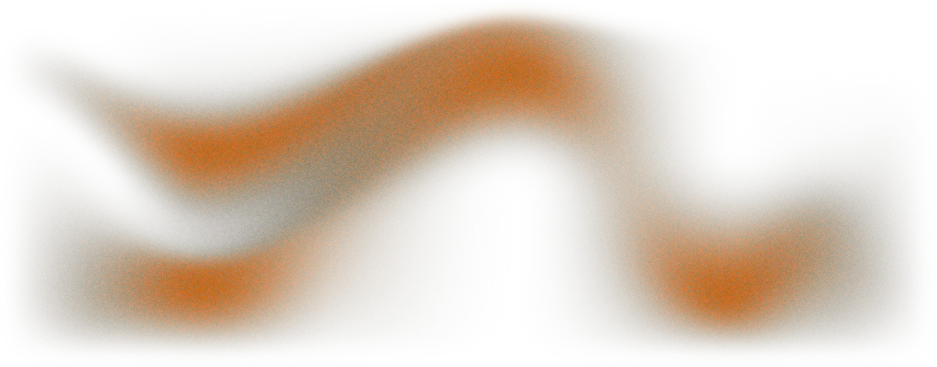
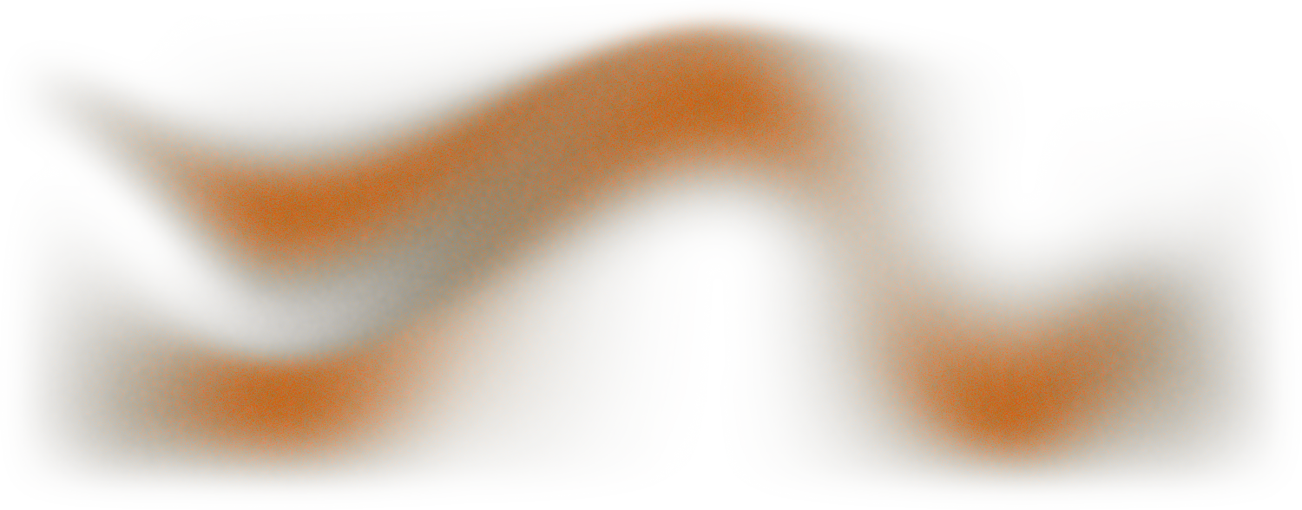
LOS Shear Cosmology
Testing Measurability with Hydrosimulated Strong Gravitational Lenses
Giacomo Queirolo
CNRS - LUPM
GGI workshop
Exploring New Frontiers in Cosmology

Slide 2
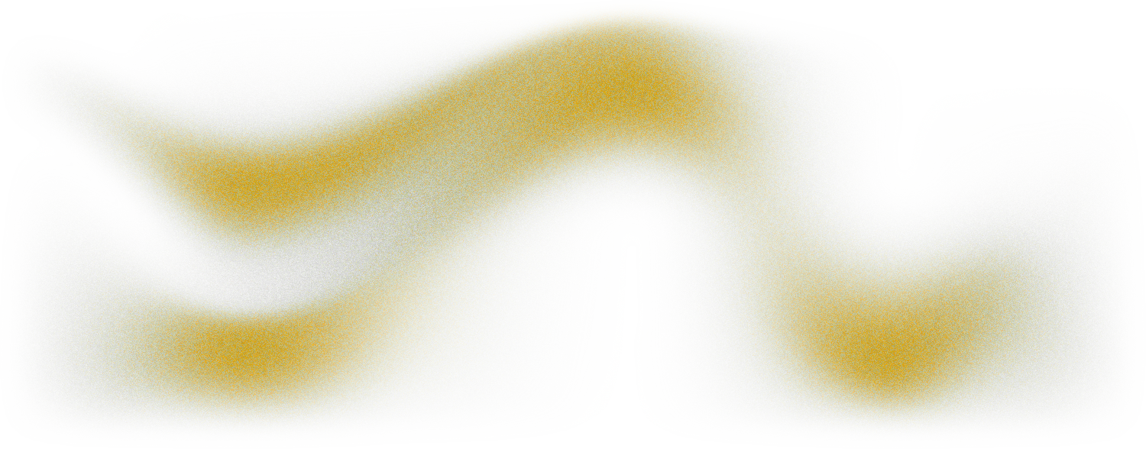
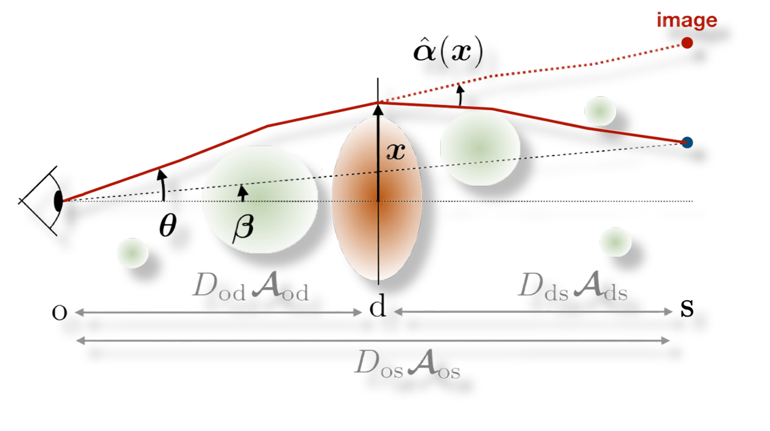

LOS Shear
This is great!
Can we actually measure it, though?
Fleury, Larena, Uzan, 2021
2

Slide 3

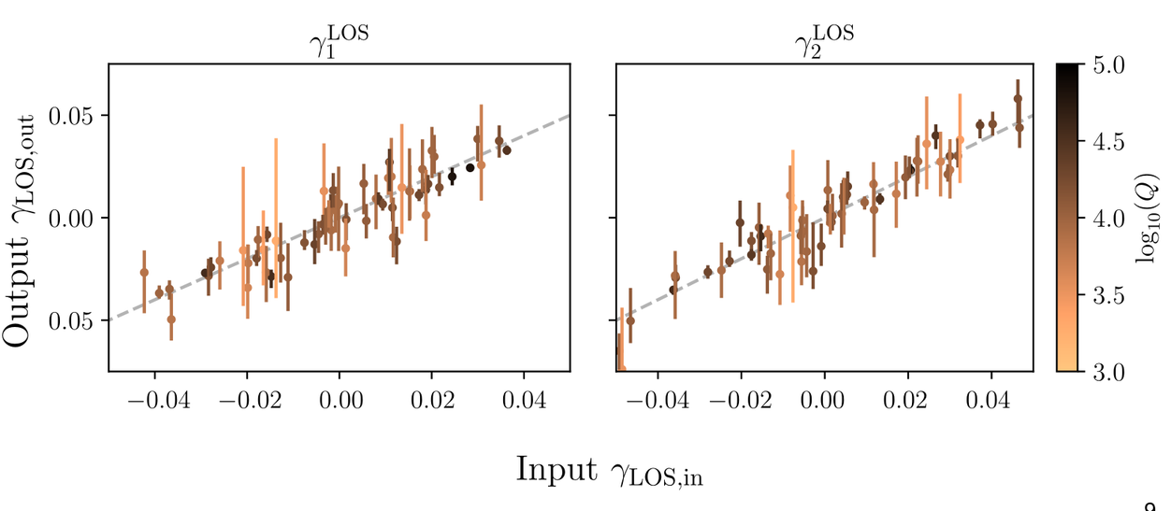


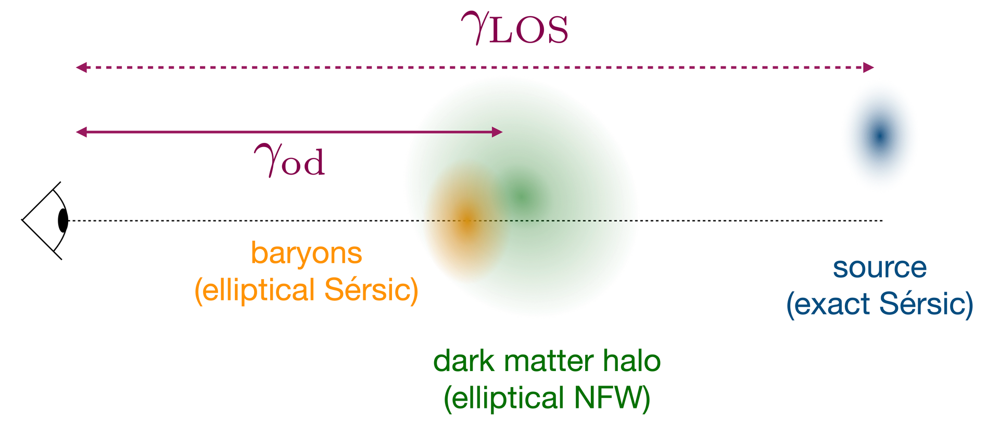
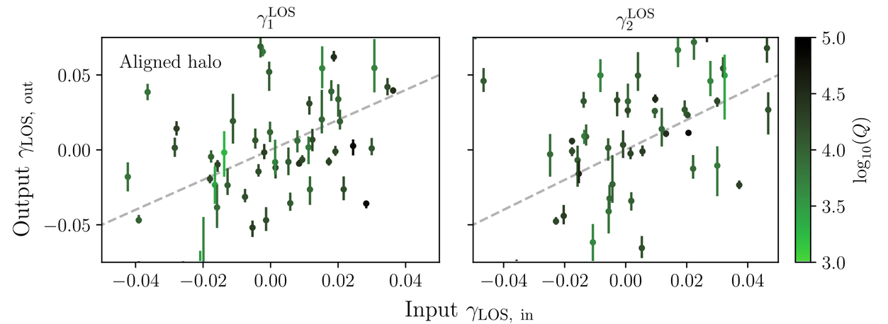
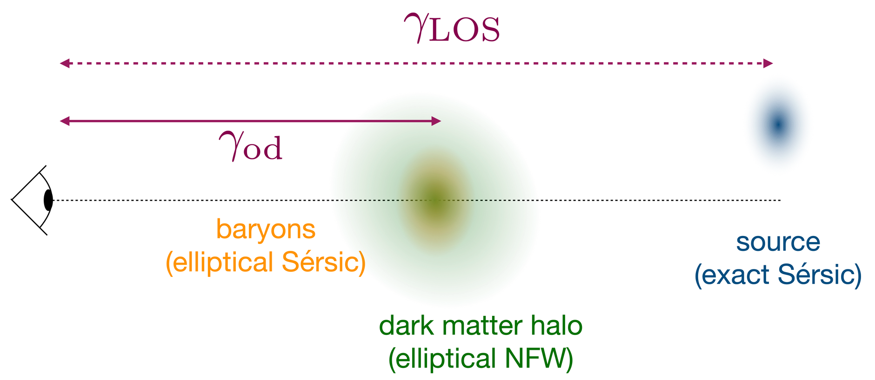
Proof of Concept
Hogg et al., 2023
With same lens model as the input simulation, we recover with
Comprehensive
model
“Aligned halo”
model
But when the model is not representative of
the real lens, we fail to recover
3
Notes:
composite analytical prof. is elliptical NFW + elliptical sersic (baryons) w different centre and ellipticity

Slide 4
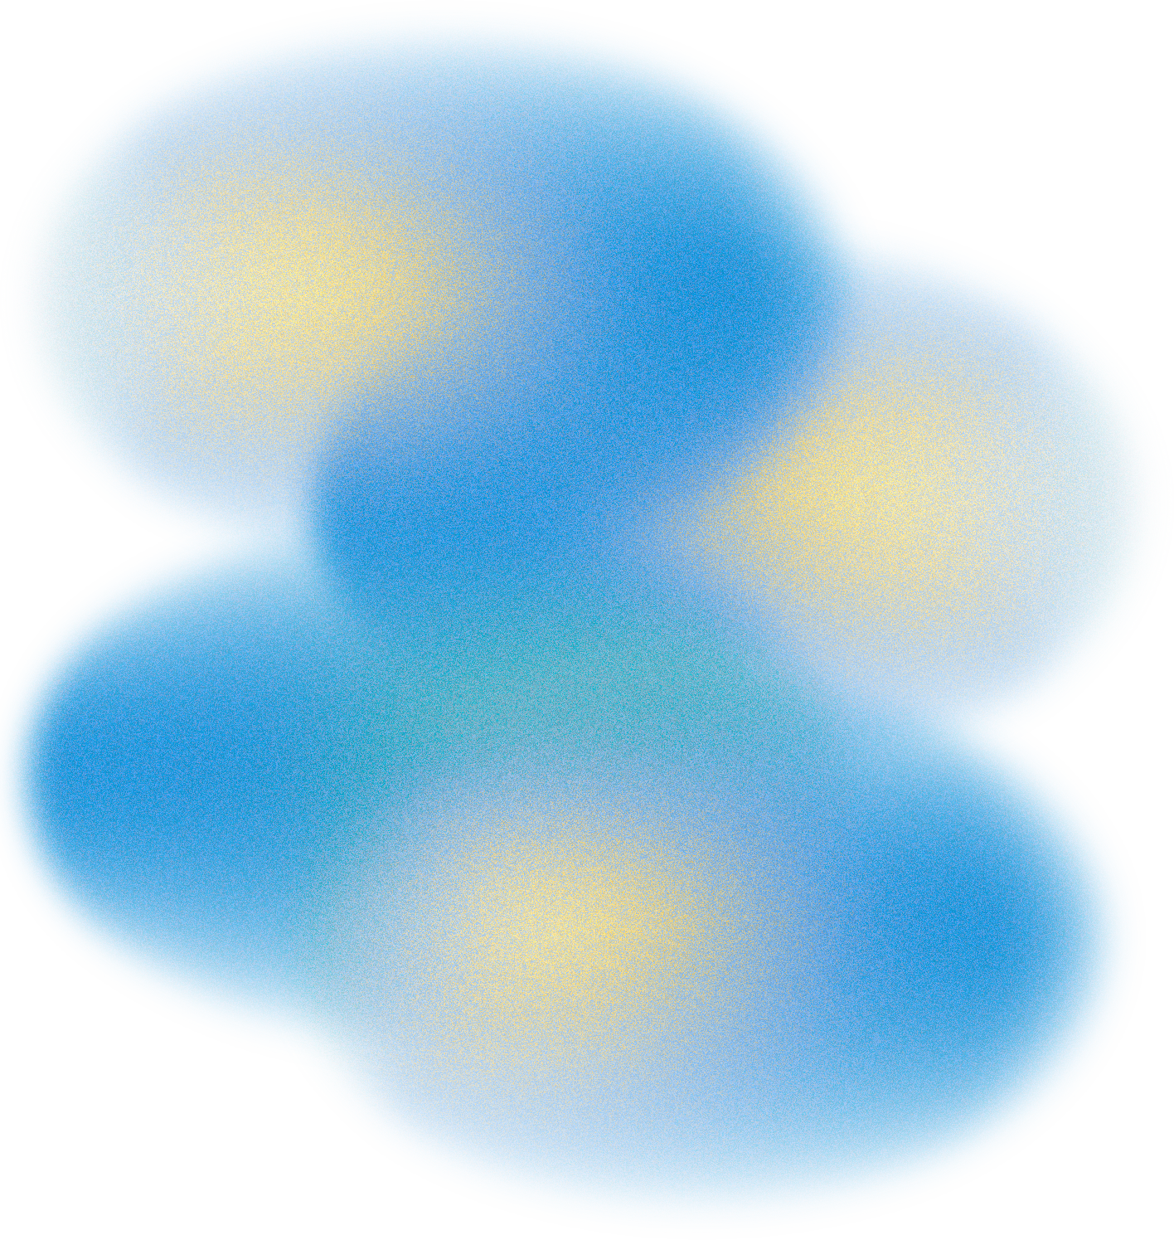
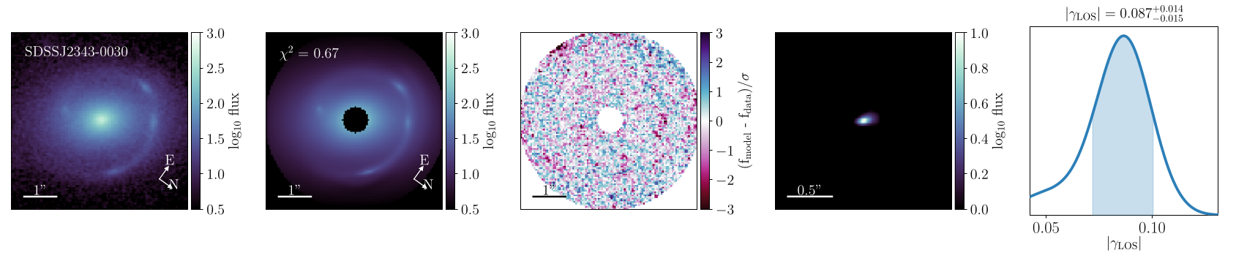



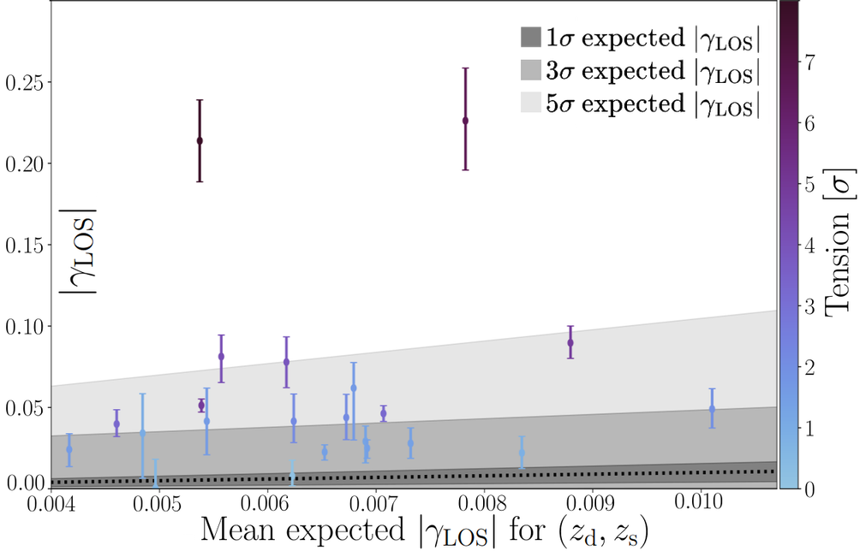
Looking at real data: Modelling Crisis
1) Modelled the SLACS Lenses with the LOS minimal model
Hogg et al., 2025 (a,b)
2) From N-body simulation, obtained the expected LOS shear
given and
Johnson et al., 2025
4

Slide 5
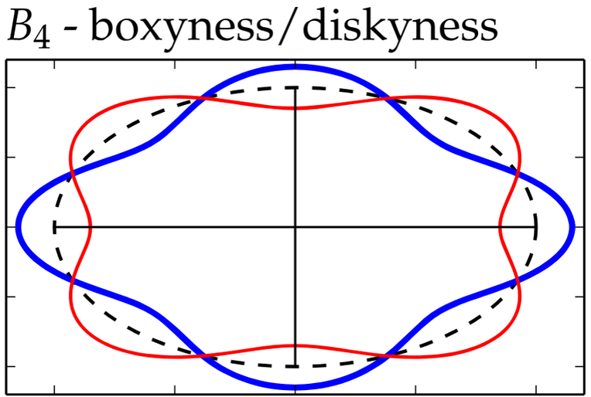
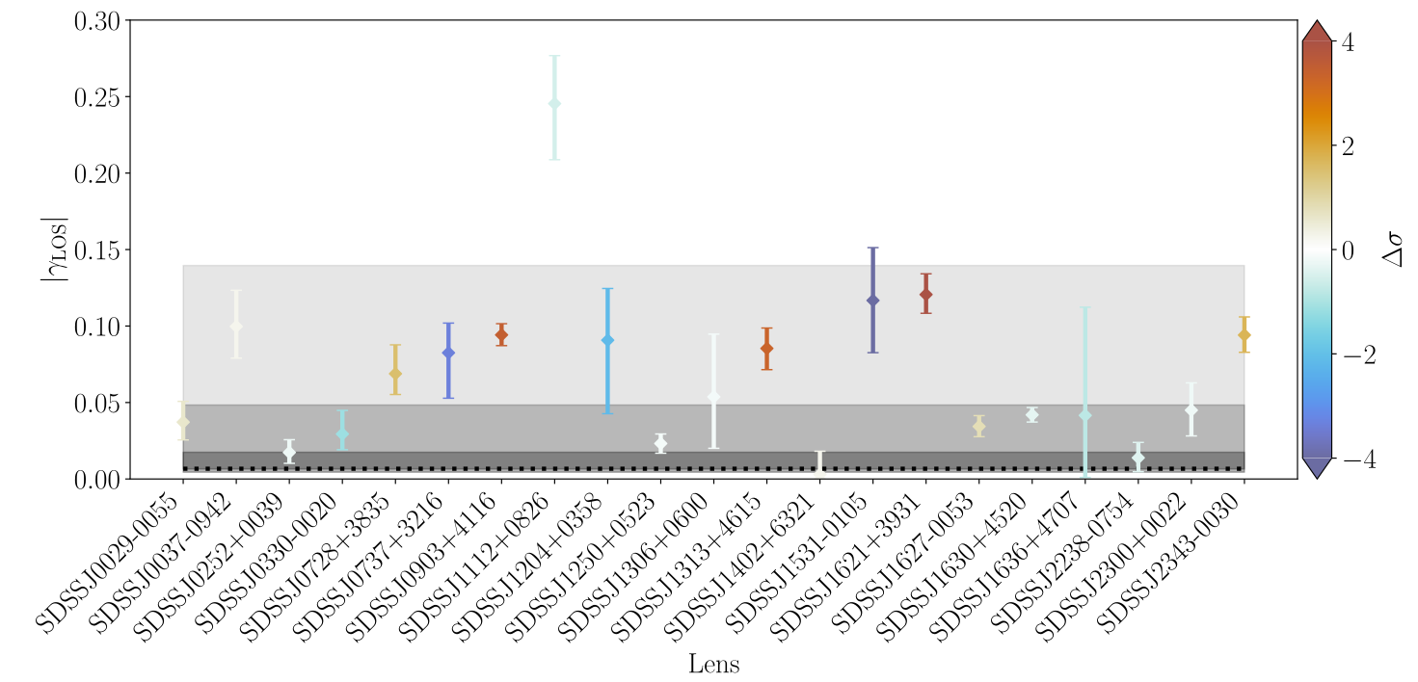
Modelling Crisis: Multipoles
A proposed solution is to account for deviation from ellipticity:
multipole distortion
in particular the multipole of order 4: “disky” vs “boxy” galaxies
Ciambur, 2015
Hogg et al., 2025 (a)
However, surprisingly, it seems not to solve the issue in all cases
Likely still needed in some cases, but no panacea
SLACS Lenses
5
Notes:
note: in the plot, redder indicat an increase in tension, and blue a decrease in tension and the grey area is the average gamma_los for all zs

Slide 6
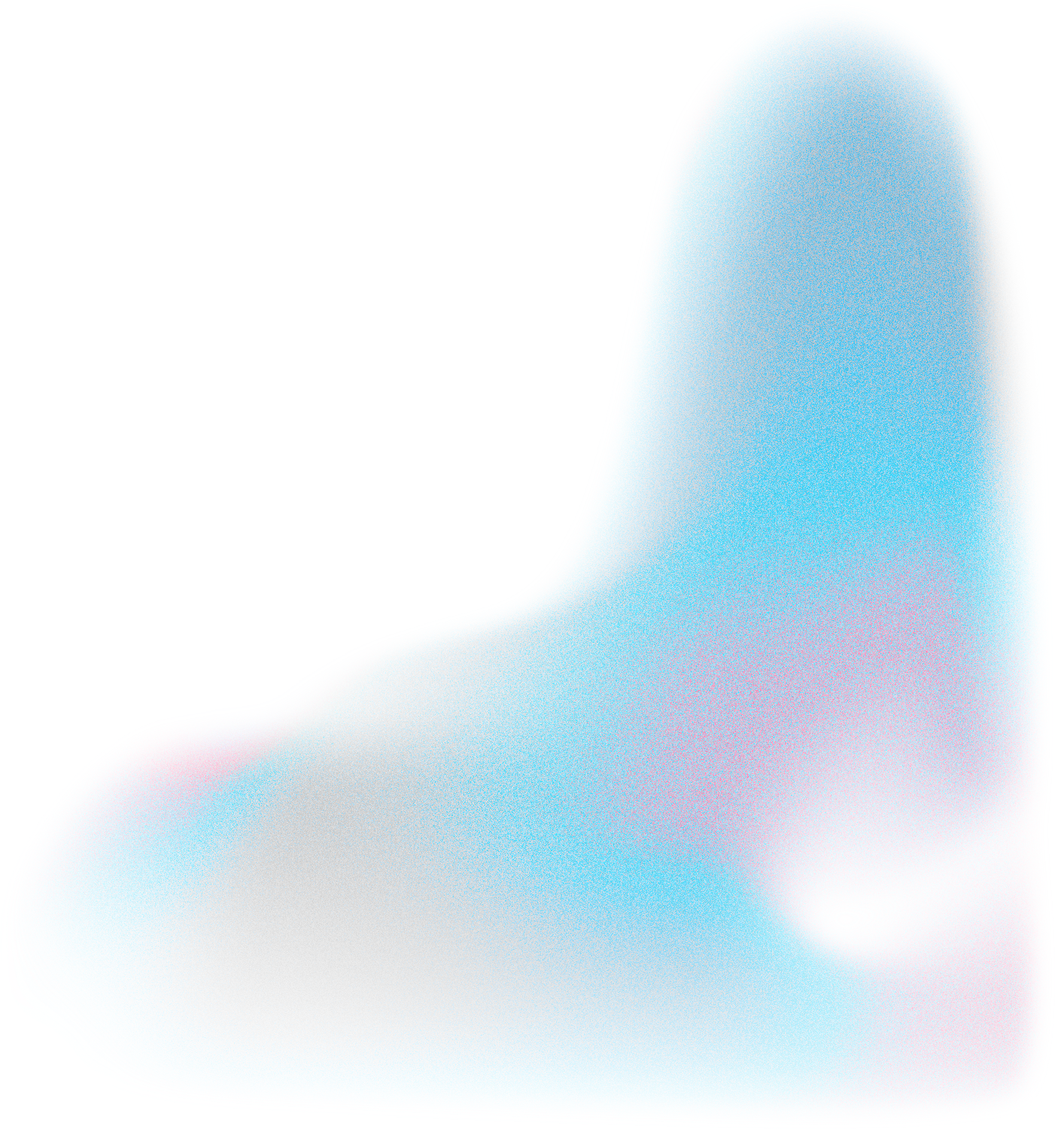


Analytical Profiles | As complex as we want Known background truth Not representative of real galaxies
Real Data | Fairly complex Unknown background truth As physically motivated as is can be
Modelling Crisis
We need to come up with “better models”: more sophisticated and accurate.
But based on what?
6

Slide 7
Generalised Scientific Issue
From Eric Linder’s Monday talk:
“We have to remember that what we observe is not nature in itself, but
nature exposed to our method of questioning.”
Werner Heisenberg 1958
Any model is only as good as the data and questions behind it
We observe a physical phenomenon, but both our data and descriptions of it are always incomplete.
How much can we trust a model? How far can we push it?
This depends on:
  what data we have: varying quality (Euclid, JWST, Roman...)
  what we want to measure: here, LOS shear, accurately and precisely
  what we know: how LOS shear affects observables; less so galaxy complexity
but we know gravity, and we assume baryonic effects can be modelled
Simulations!
7

Slide 8
Analytical Profiles | As complex as we want Known background truth Not representative of real galaxies
Real Data | Fairly complex Unknown background truth As physically motivated as is can be
Possible solution: Hydrodynamical Simulations | Fairly complex Physically motivated* Known background truth
Modelling Crisis: A New Hope
We need to come up with “better models”: more sophisticated and accurate.
But based on what?
8

Slide 9
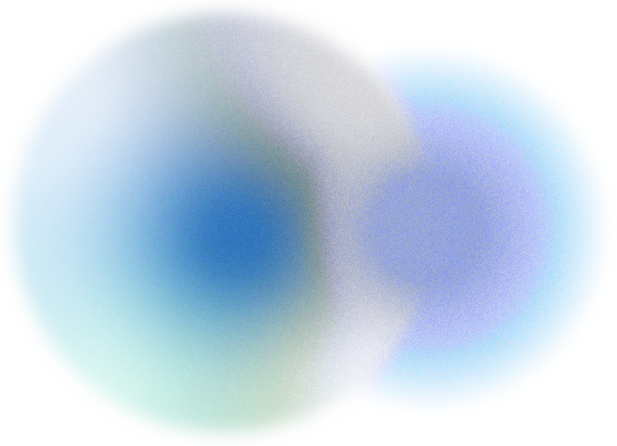
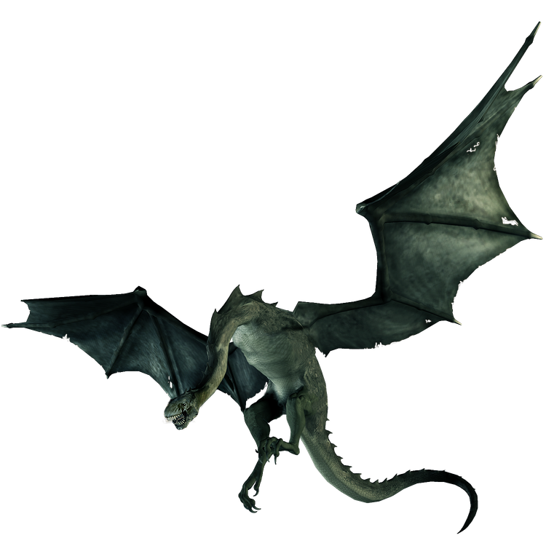

NAZGUL
Inspired by SEAGLE
(Mukherjee et al., 2019)
Mount Doom
Translator
Compute lensing maps directly from Particles
Extract Galaxies
From Hydrosimulation
(EAGLE, COLIBRE)
Iterate and tune
model complexity
Inject LOS shear effects
Model the resulting image
Compare LOS
Load and convert Particles in the correct physical coordinates
Obtain realistic mock lensed images
9

Slide 10
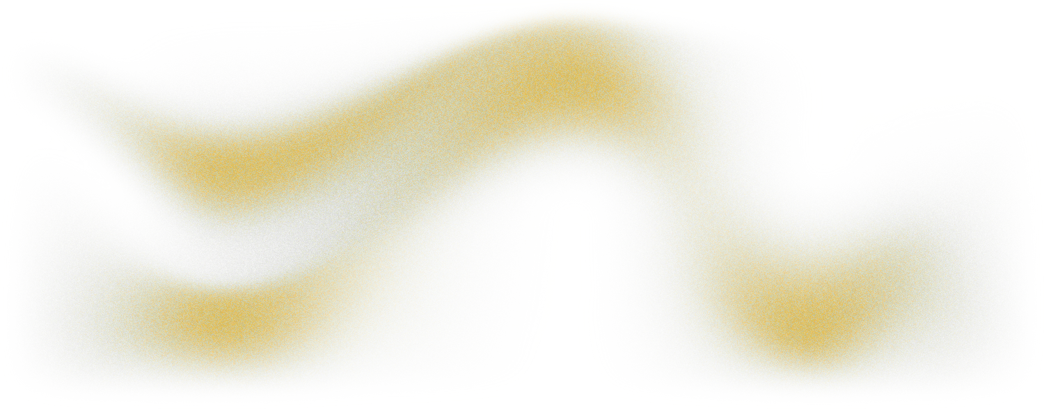
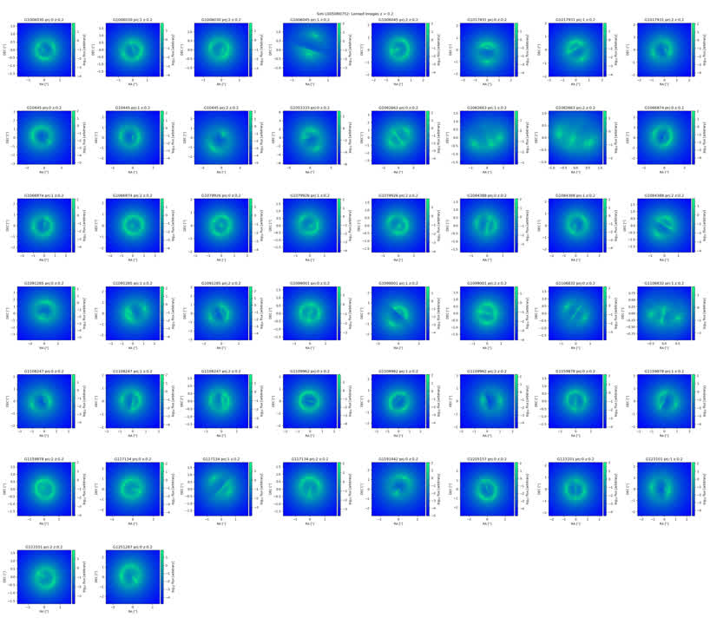
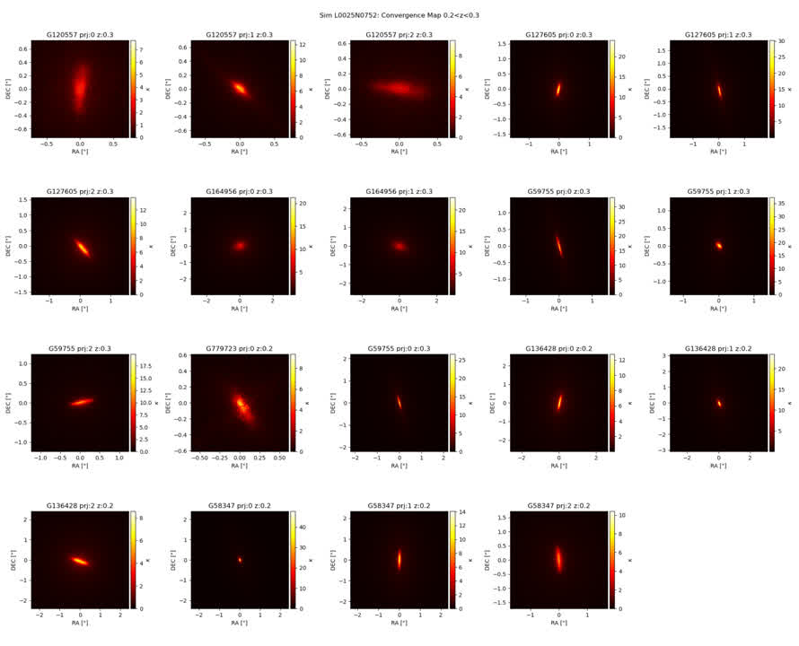


NAZGUL:
COLIBRE
Lens Systems
Box 2:
50 cMpc
~3e9 particles
~
~200 lenses
~1e5-1e6 part/gal
Box 1 :
25 cMpc
~5e8 particles
~
~20 lenses
~1e6-1e7 part/gal
Coming soon: boxes with 50cMpc and 100cMpc with same particle
resolution as box 1
10

Slide 11
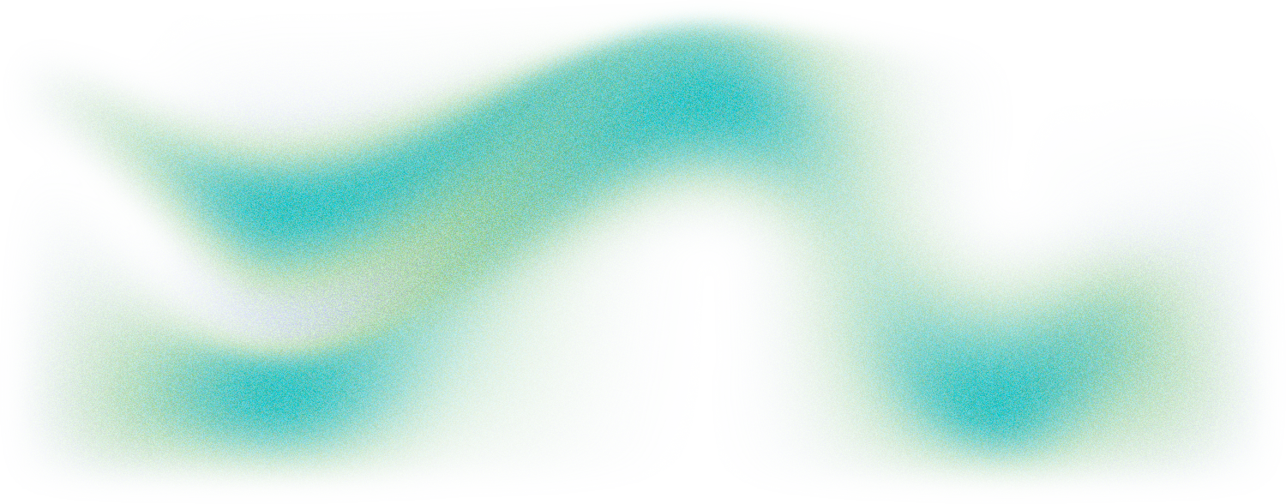
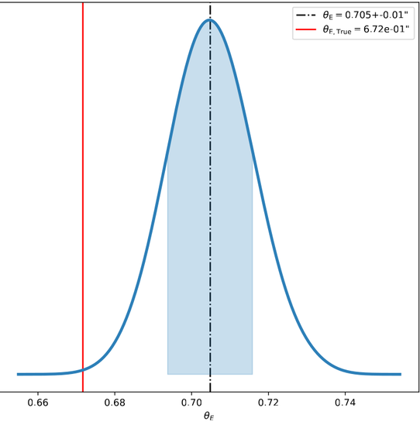
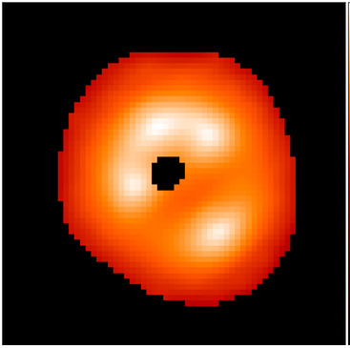
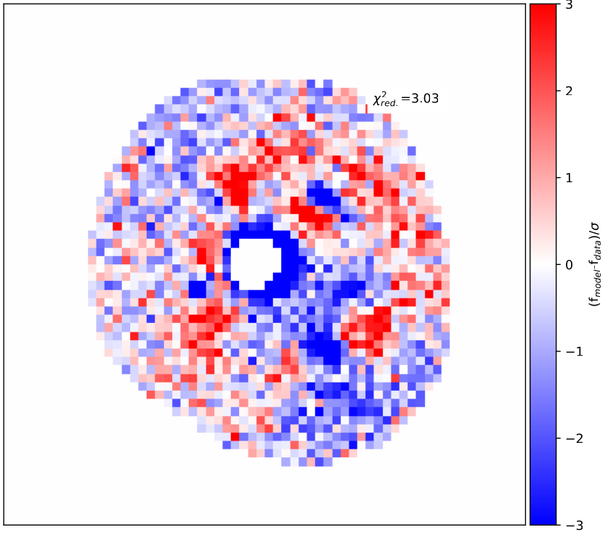
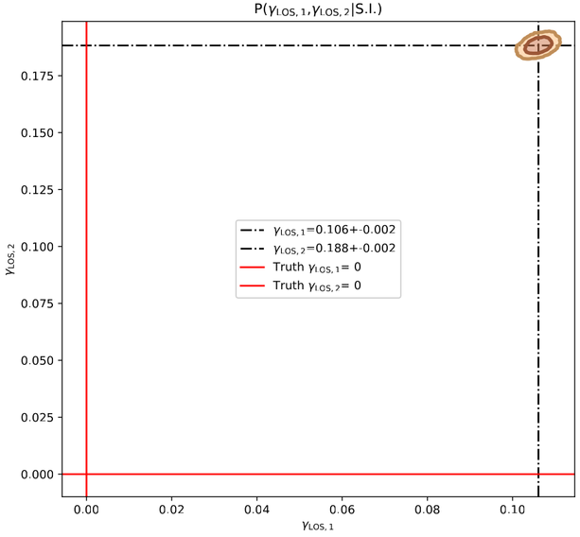
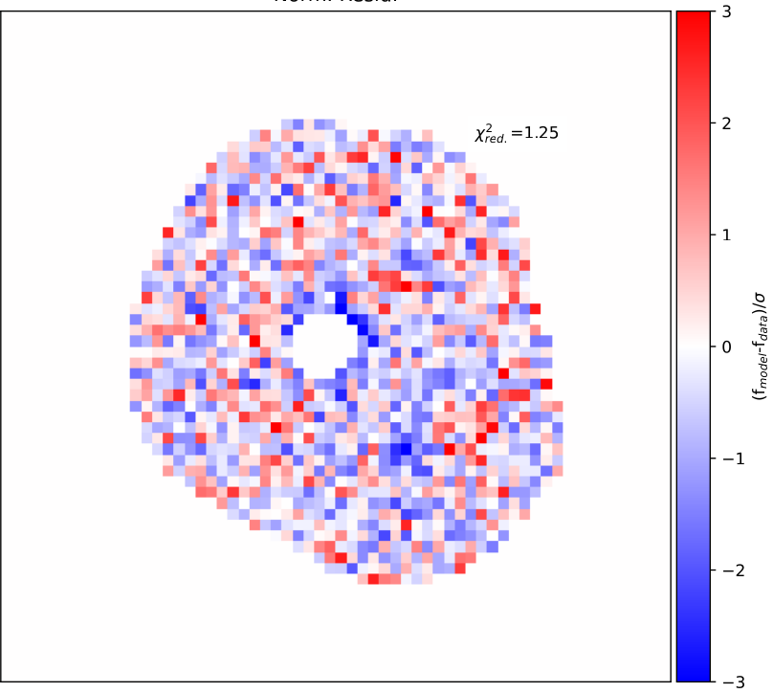
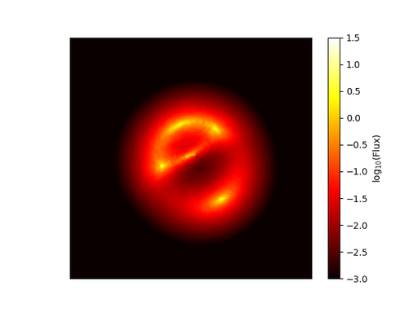
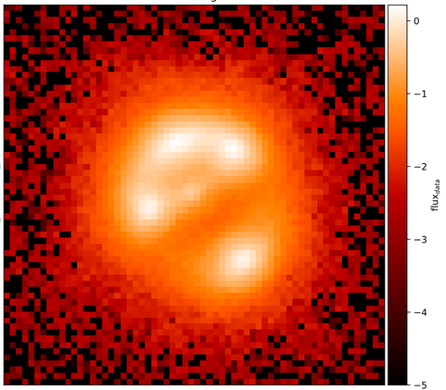
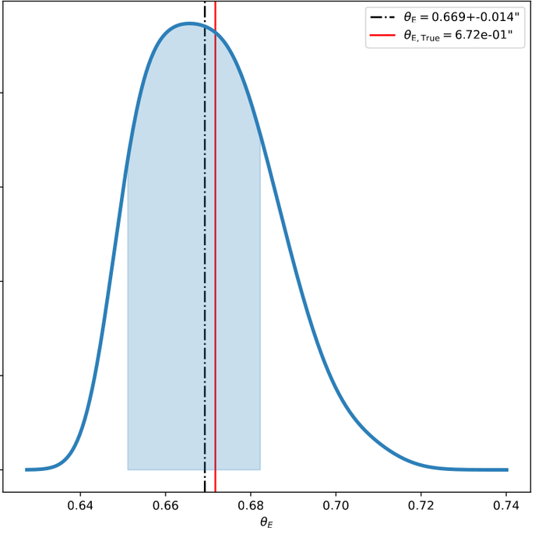
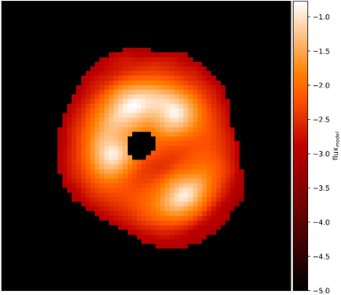
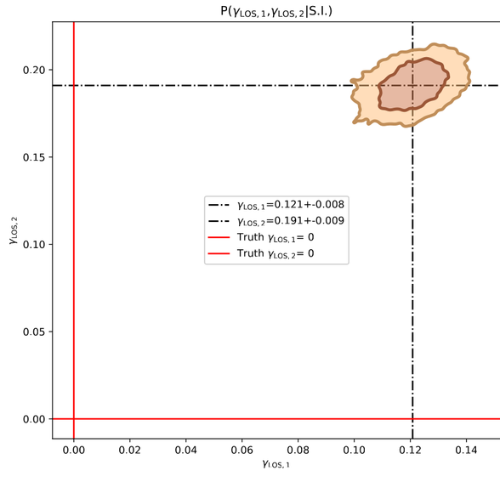
NAZGUL
Modelling results
High Resolution Mock
HST-like Observation
Parametric Model
Normalised Residual
Recover lens parameters
EPL + LOS Shear
EPL + LOS Shear+ m4 multipole
11

Slide 12
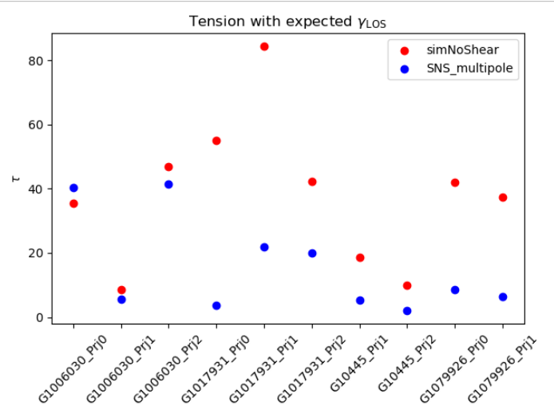
NAZGUL
Modelling results
High Resolution Mock
HST-like Observation
Parametric Model
Normalised Residual
Recover lens parameters*
EPL + LOS Shear
EPL + LOS
EPL + m4 + LOS
EPL + LOS Shear+ m4 multipole
12

Slide 13

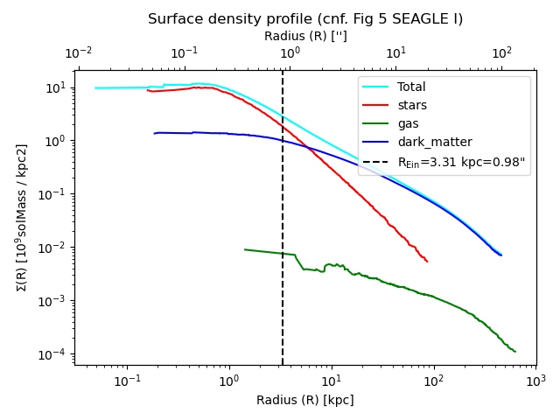
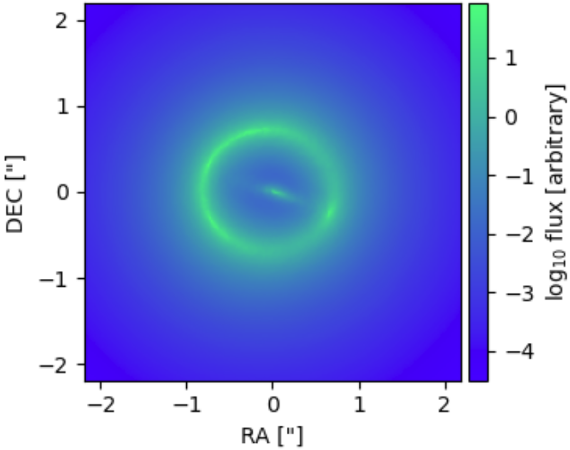
NAZGUL
Caveats
Hydrosimulated galaxies are not real(istic) lenses
Example of COLIBRE Galaxy mass profile
(not the same lens)
13

Slide 14
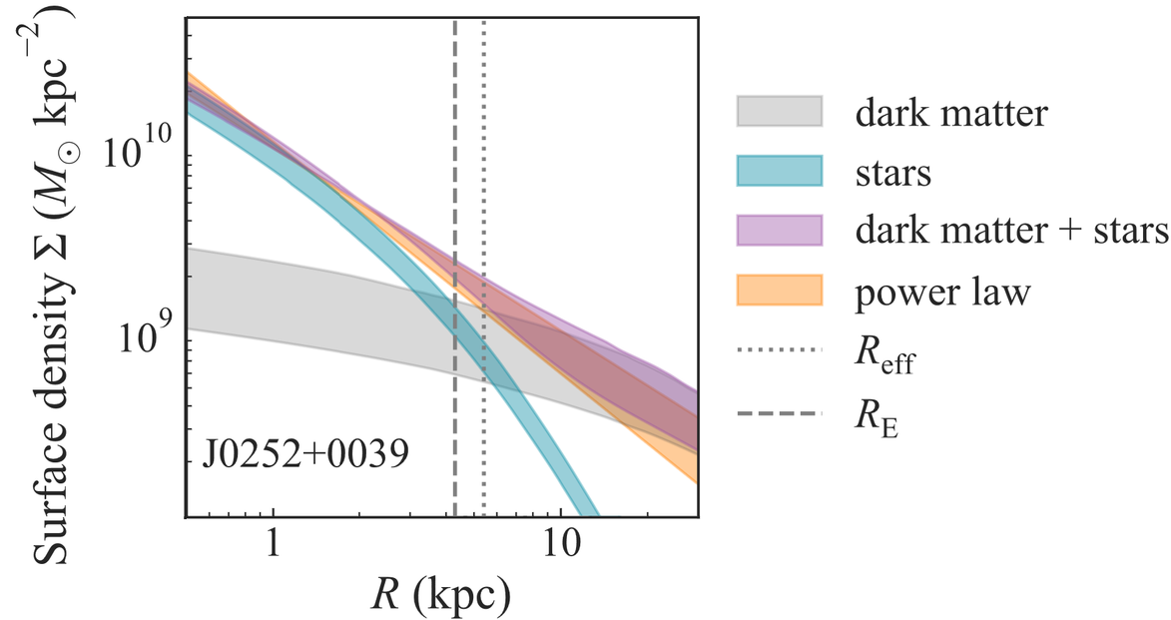
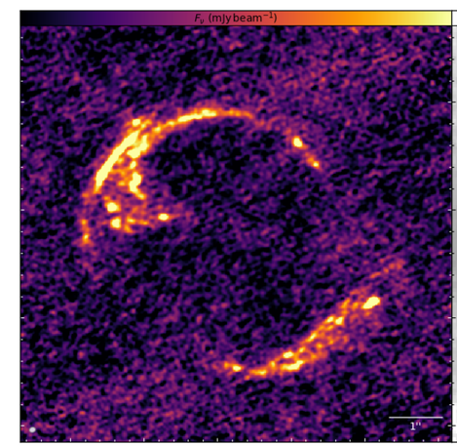
NAZGUL
Caveats
Hydrosimulated galaxies are not real(istic) lenses
Example of Real Galaxy mass profile (Shajib et al. 2021)
Example of COLIBRE Galaxy mass profile
Box 2
gravitational softening length : 350pc
Central images and radial arcs:
PJ011646
Amvrosiadis et al., 2026
14

Slide 15
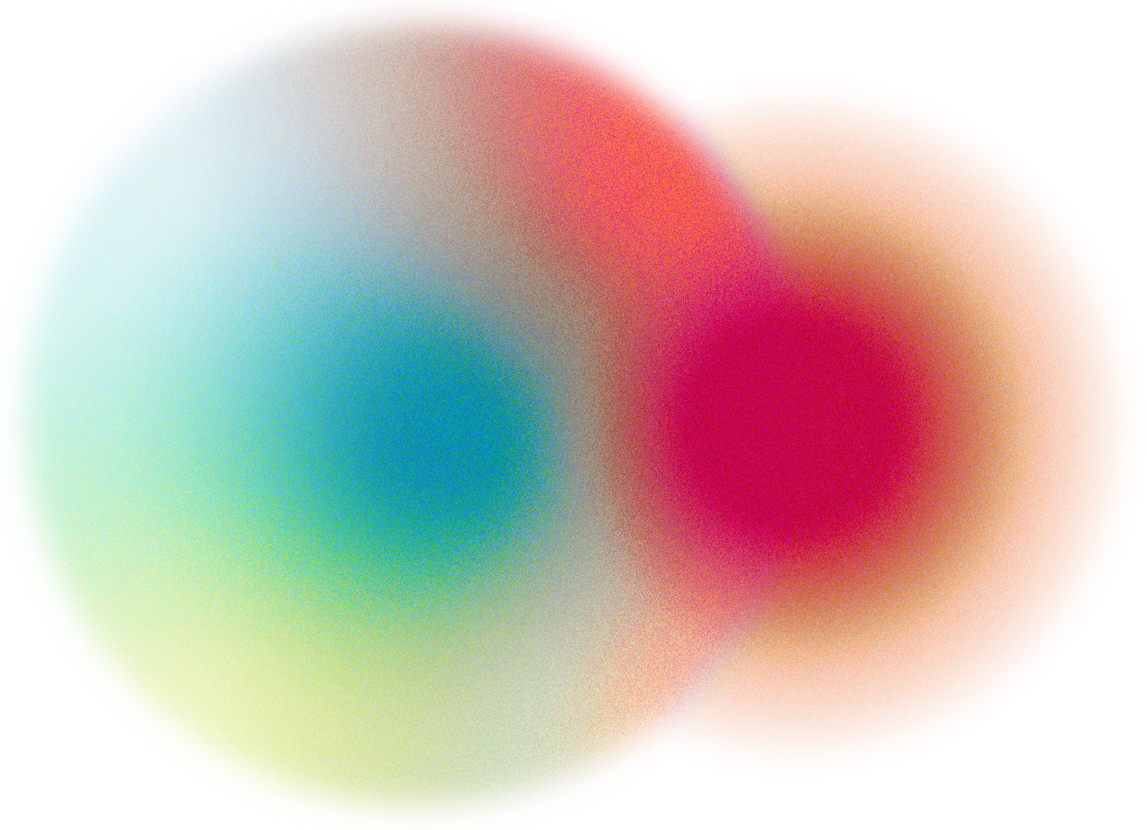
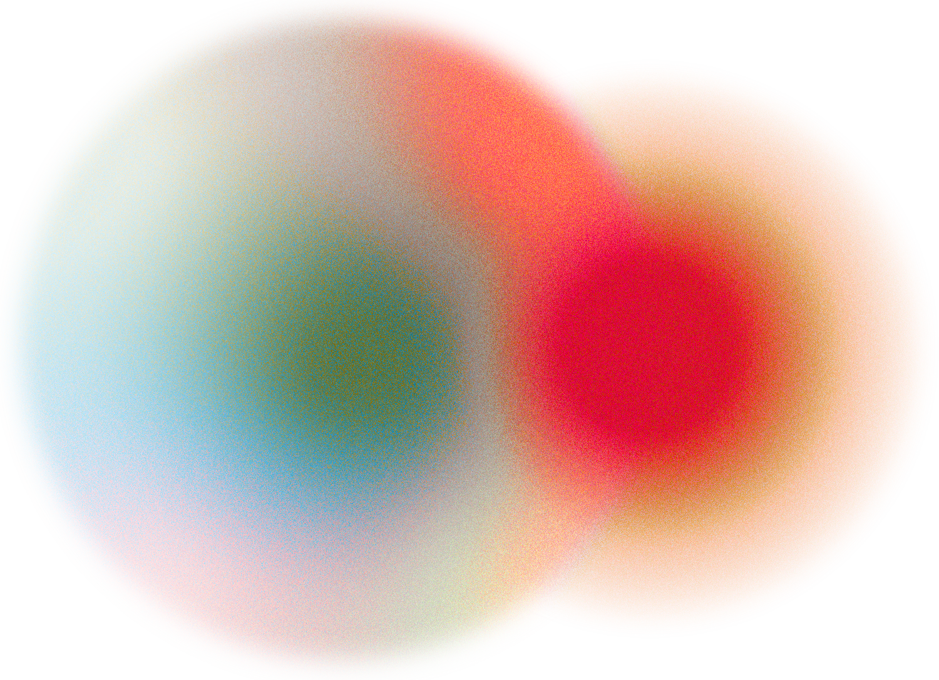
NAZGUL
Caveats - Counterarguments
“All science is built on hope”
Yours truly, Avignon, 2026
  Shear is a tidal, i.e. global, effect
  The project aims to learn how to model, not to learn what real galaxies look like
  This seemed the simplest and most consistent way to do such a test
  Future simulations will reduce the issue
Still, all conclusions from this study will have to be further tested on real data before we can fully trust them
15

Slide 16
Conclusion
Context
Strong Lenses’ LOS Shear is a promising cosmological probe
Issue
Current lens models are known to be too simple/constraining:
What are we actually measuring?
Question
How to forge a “good” model?
Method
NAZGUL: Generate realistic mock lenses from hydro-sims as
a testbed for new models
Caveats
Hydrosimulations are tricky, conclusions might not be general
Thank You!
16

Slide 17
Appendix
17

Slide 18
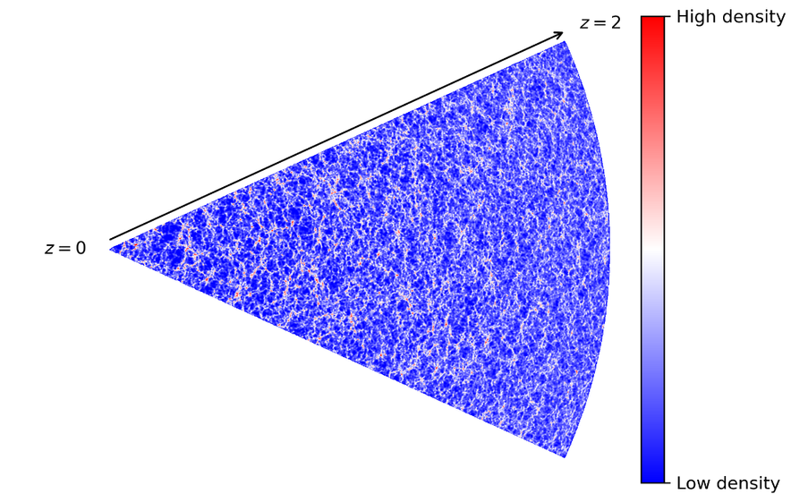
LOS Shear from N-Body Simulations
Work lead by Daniel Johnson
RayGalGroupSims
  Extract shear from exact raytraced lightpath on simulation (post-Born)
  Interpolate z between snapshots
Rasera et al., 2021
Fit for different LOS components given and
18

Slide 19
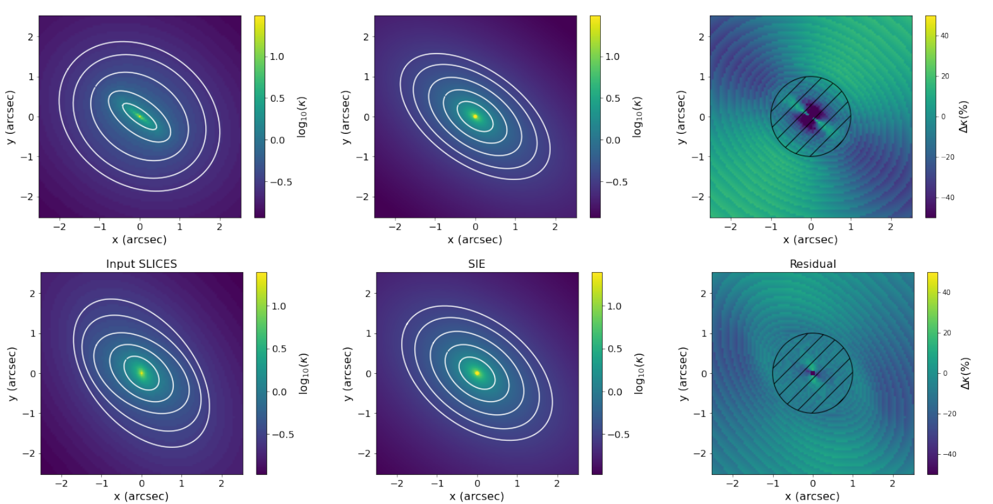
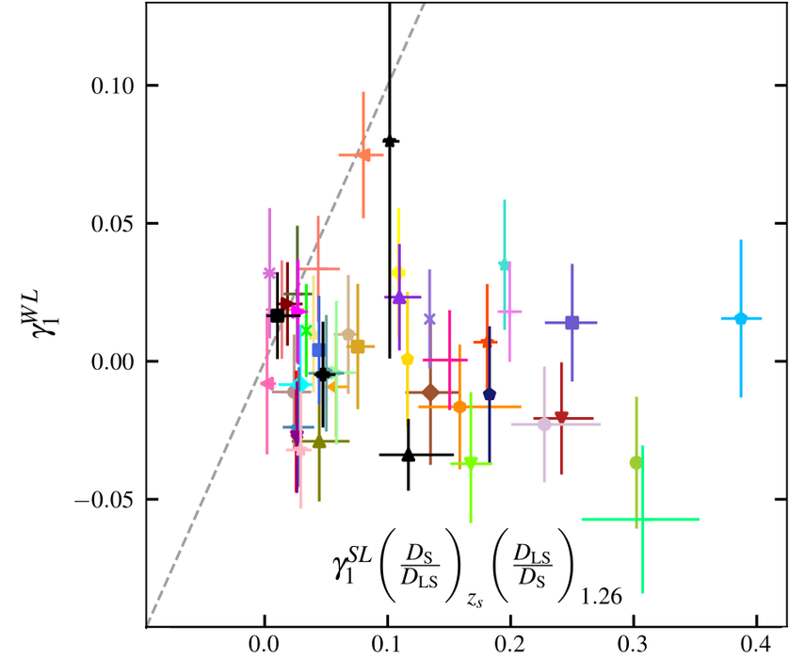
Modelling Crisis: Beyond the LOS Shear
Vyvere et al., 2022
Twists and ellipticity gradients of the mass distribution, if not taken into account, will mimic the effect of an external shear
Our models need to be complex enough and physically motivated
Etherington et al., 2024
The “external” shear measured from strong gravitational lenses is not correlated with weak lensing cosmic shear, and is usually significantly higher
19

Slide 20
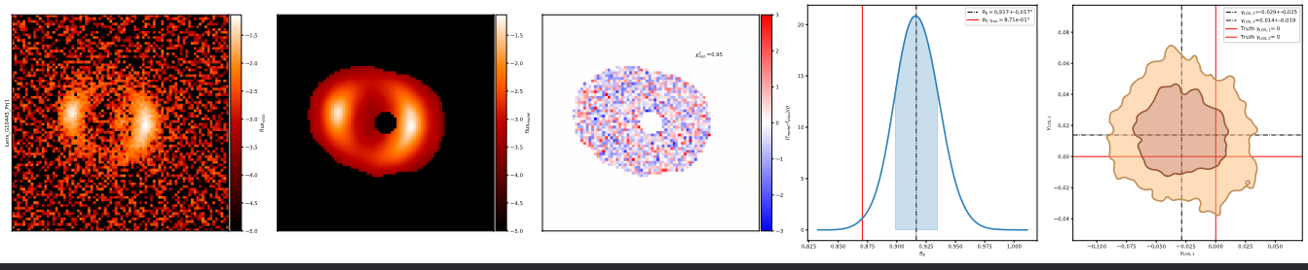
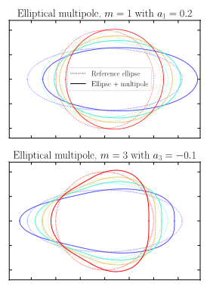
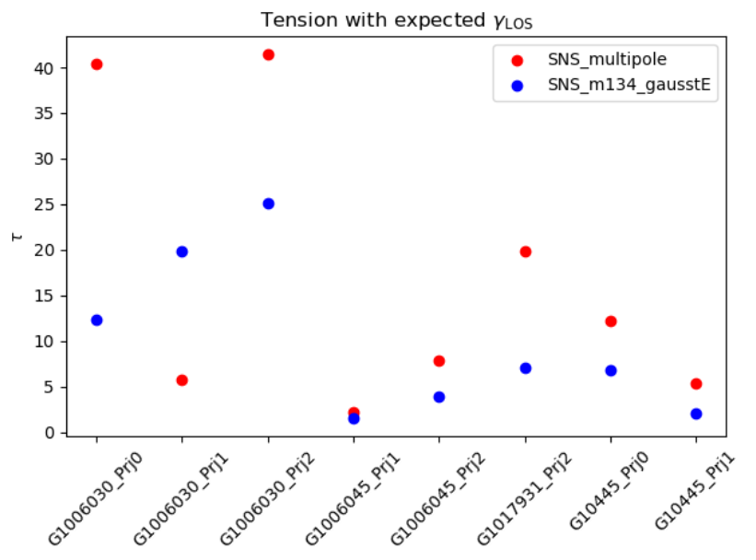
Modelling with M134 multipoles
Preliminary results
20
Paugnat & Gilman (2025)

Slide 21
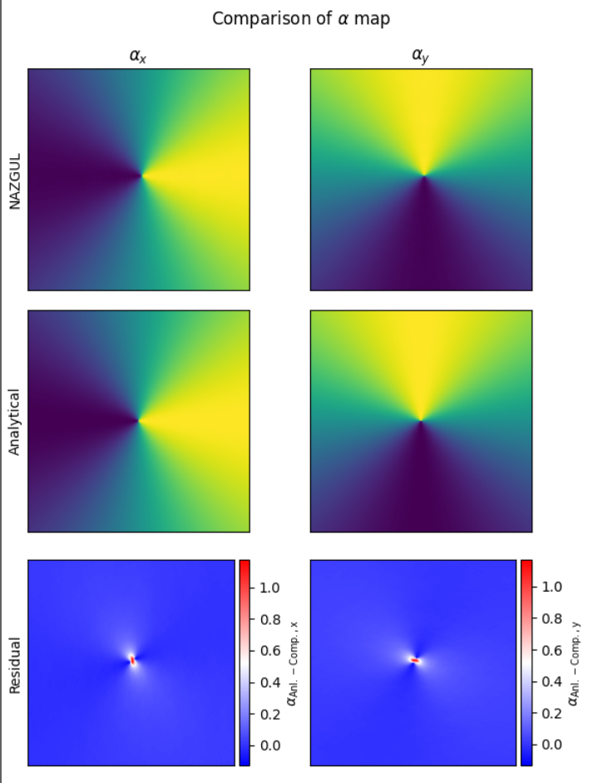
Nazgul - Verification
  Take an analytical profile (SIS)
  Sample particles (position and mass)
  Pass it to Nazgul as a “real” galaxy
  Compute the lensing maps (i.e. deflection map)
  Compare with analytical expectations
21

