Slide 1


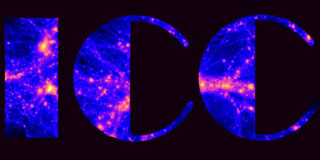
EFT-Ramses
A code to simulation the Effective Field Theory of Dark Energy
Nathaniel Woodcock
Supervisors : Baojiu Li & Sownak Bose
Durham University
GGI Workshop Florence 21/07/2026

Slide 2
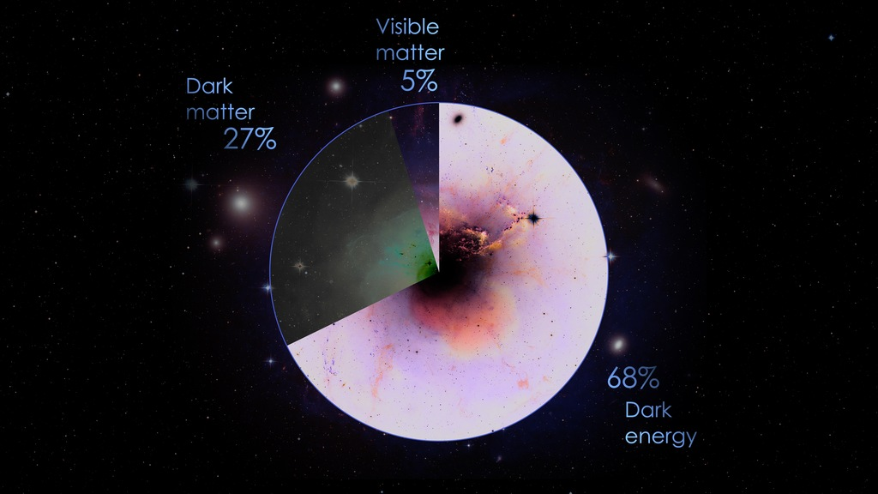
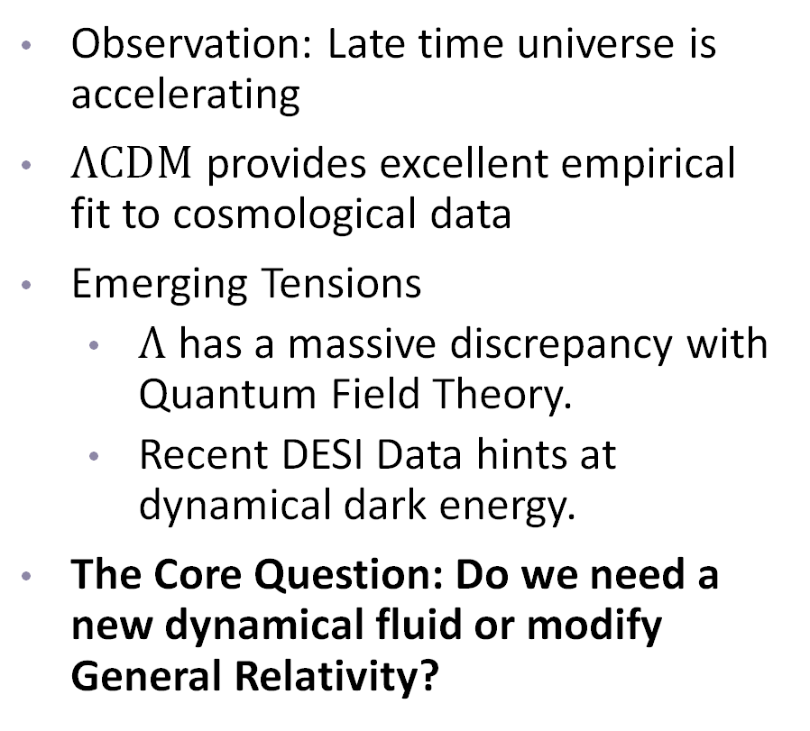
Mystery of Cosmic Acceleration
Observation: Late time universe is accelerating
$ΛCDM$ provides excellent empirical fit to cosmological data
Emerging Tensions
  $Λ$ has a massive discrepancy with Quantum Field Theory.
  Recent DESI Data hints at dynamical dark energy.
The Core Question: Do we need a new dynamical fluid or modify General Relativity?
Figure 1 – Our Universe

Slide 3
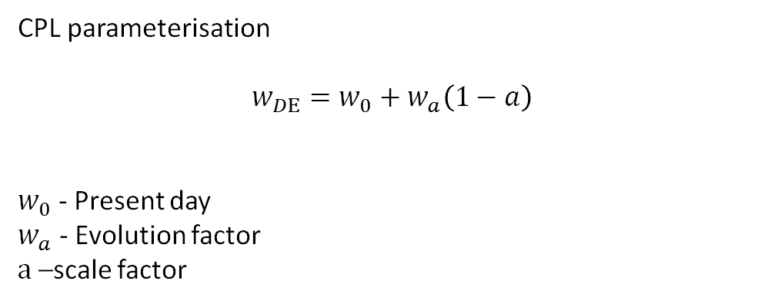
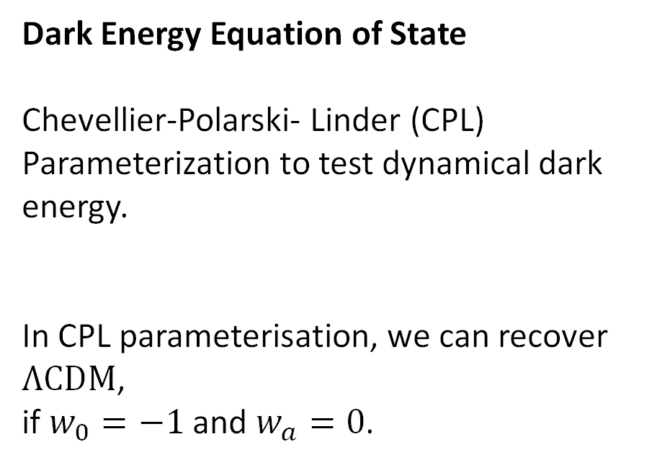
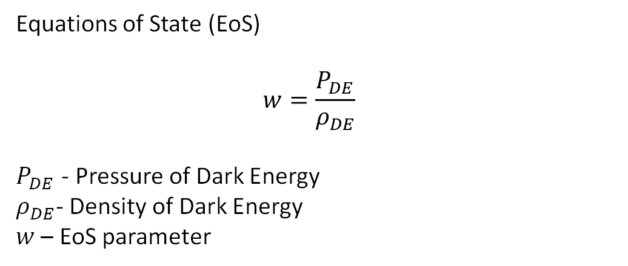
Dark Energy
Equations of State (EoS)
$$w=\frac{P_{DE}}{ρ_{DE}}$$
$P_{DE}$ - Pressure of Dark Energy
$ρ_{DE}$- Density of Dark Energy
$w$ – EoS parameter
Dark Energy Equation of State
Chevellier-Polarski- Linder (CPL)
Parameterization to test dynamical dark energy.
In CPL parameterisation, we can recover $ΛCDM$,
if $w_{0}=−1$ and $w_{a}=0$.
CPL parameterisation
$$w_{DE}=w_{0}+w_{a}\left(1−a\right)$$
$w_{0}$ - Present day
$w_{a}$ - Evolution factor
$a$ –scale factor

Slide 4
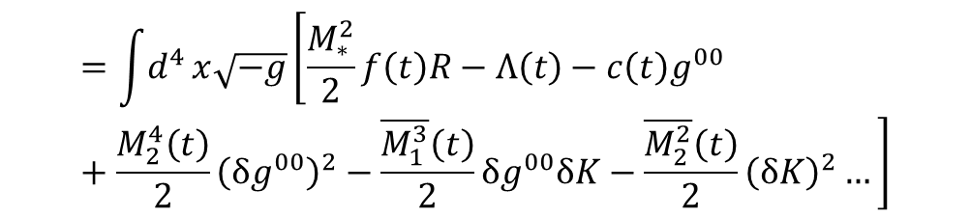
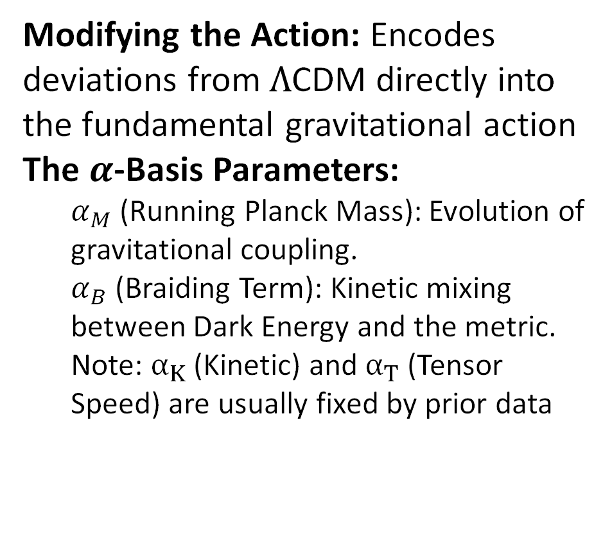

Effective Field Theory of Dark Energy
Modifying the Action: Encodes deviations from $Λ$CDM directly into the fundamental gravitational action
The $α$-Basis Parameters:
  $α_{M}$ (Running Planck Mass): Evolution of gravitational coupling.
  $α_{B}$ (Braiding Term): Kinetic mixing between Dark Energy and the metric.
  Note: $α_{K}$ (Kinetic) and $α_{T}$ (Tensor Speed) are usually fixed by prior data
EFTofDE Action
Einstein-Hilbert!
$$=\int{d^{4}}x\sqrt{−g}\left[\frac{M_{∗}^{2}}{2}f\left(t\right)R−Λ\left(t\right)−c\left(t\right)g^{00} +\frac{M_{2}^{4}\left(t\right)}{2}{\left(δg^{00}\right)}^{2}−\frac{\overline{M_{1}^{3}}\left(t\right)}{2}δg^{00}δK−\frac{\overline{M_{2}^{2}}\left(t\right)}{2}{\left(δK\right)}^{2}…\right]$$
$$S_{EFT}$$
Alpha Basis Parameters
$$α_{K}=\frac{2c+4M_{2}^{4}}{M_{∗}^{2}H^{2}}, α_{B}=−\frac{\overline{M_{1}^{3}}}{M_{∗}^{2}H}, α_{M}=\frac{\dot{f}}{Hf}, α_{T}=\frac{\overline{M_{2}^{2}}}{M_{∗}^{2}f}$$

Slide 5
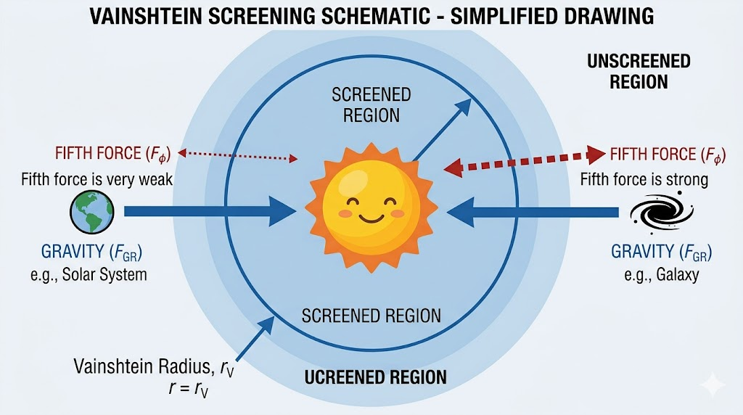
Vainshtein Screening Mechanisms
We try to explain this cosmic acceleration by introducing a ‘fifth force’
Vainshtein screening mechanism to supress this fifth force.
The screening requires supercomputers as it is highly non-linear.
Figure 2 – Illustration of Vainshtein Screening

Slide 6
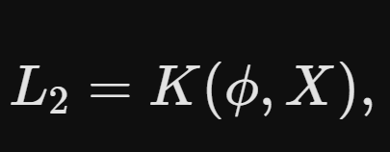
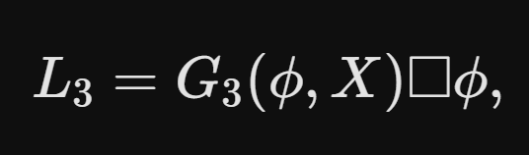
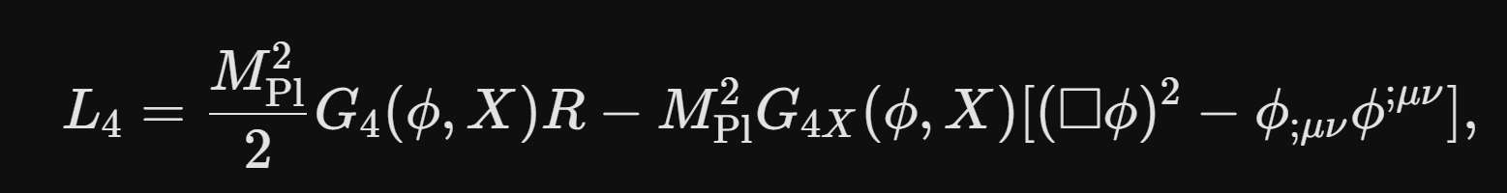
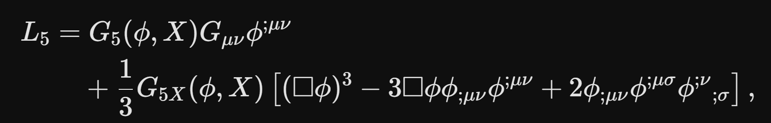
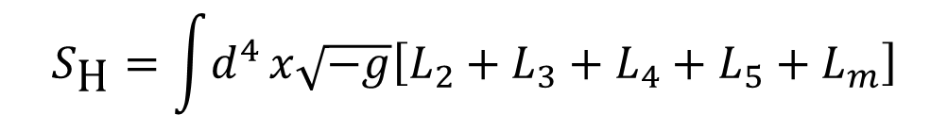
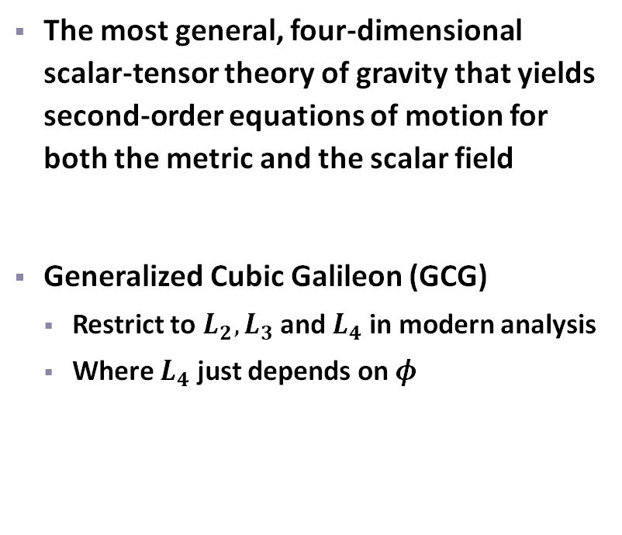
Horndeski Type Theories
The most general, four-dimensional scalar-tensor theory of gravity that yields second-order equations of motion for both the metric and the scalar field
Generalized Cubic Galileon (GCG)
  Restrict to $L_{2},L_{3}$ and $L_{4}$ in modern analysis
  Where $L_{4}$ just depends on $φ$
$$S_{\text{H}}=\int{d^{4}}x\sqrt{−g}\left[L_{2}+L_{3}+L_{4}+L_{5}+L_{m}\right]$$




Slide 7
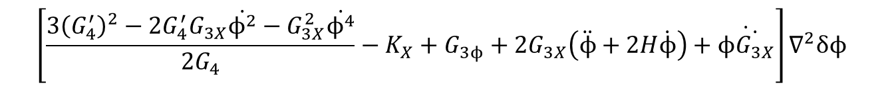
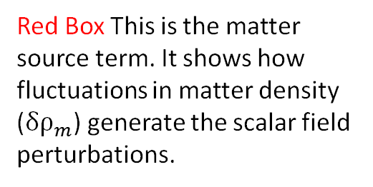

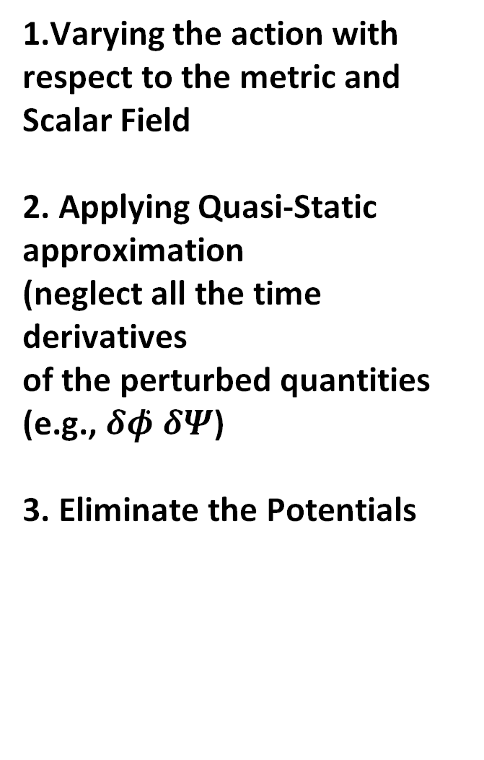
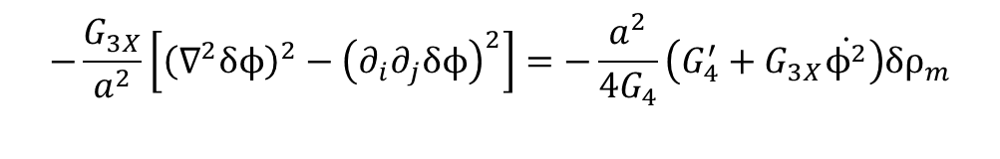
N-Body Equation
1.Varying the action with respect to the metric and Scalar Field
2. Applying Quasi-Static approximation
(neglect all the time derivatives
of the perturbed quantities (e.g., $δφ̇$ $δΨ̇$)
3. Eliminate the Potentials
Green Box (The Linear Term): This acts as a time-dependent coefficient for the linear spatial propagation $\left(∇^{2}δφ\right)$.
$$\left[\frac{3{\left(G_{4}^{′}\right)}^{2}−2G_{4}^{′}G_{3X}\dot{ϕ^{2}}−G_{3X}^{2}\dot{ϕ^{4}}}{2G_{4}}−K_{X}+G_{3ϕ}+2G_{3X}\left(\ddot{ϕ}+2H\dot{ϕ}\right)+\dot{ϕ\dot{G_{3X}}}\right]∇^{2}δϕ$$
$$−\frac{G_{3X}}{a^{2}}\left[{\left(∇^{2}δϕ\right)}^{2}−{\left(∂_{i}∂_{j}δϕ\right)}^{2}\right]=−\frac{a^{2}}{4G_{4}}\left(G_{4}^{′}+G_{3X}\dot{ϕ^{2}}\right)δρ_{m}$$
Blue Box (The Non-Linear / Vainshtein Term): This combination of second derivatives is the signature of cubic Galileon interactions.
Red Box This is the matter source term. It shows how fluctuations in matter density ($δρ_{m}$) generate the scalar field perturbations.

Slide 8
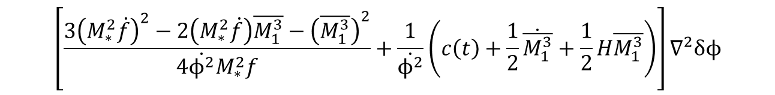
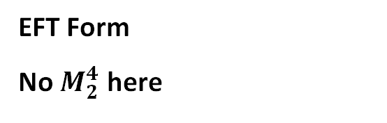
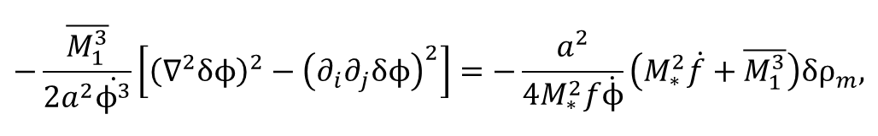
N-Body Equation in the EFT
$$\left[\frac{3{\left(M_{∗}^{2}\dot{f}\right)}^{2}−2\left(M_{∗}^{2}\dot{f}\right)\overline{M_{1}^{3}}−{\left(\overline{M_{1}^{3}}\right)}^{2}}{4\dot{ϕ^{2}}M_{∗}^{2}f}+\frac{1}{\dot{ϕ^{2}}}\left(c\left(t\right)+\frac{1}{2}\dot{\overline{M_{1}^{3}}}+\frac{1}{2}H\overline{M_{1}^{3}}\right)\right]∇^{2}δϕ$$
EFT Form
No $M_{2}^{4}$ here
$$−\frac{\overline{M_{1}^{3}}}{2a^{2}\dot{ϕ^{3}}}\left[{\left(∇^{2}δϕ\right)}^{2}−{\left(∂_{i}∂_{j}δϕ\right)}^{2}\right]=−\frac{a^{2}}{4M_{∗}^{2}f\dot{ϕ}}\left(M_{∗}^{2}\dot{f}+\overline{M_{1}^{3}}\right)δρ_{m},$$
$$\frac{1}{\dot{ϕ^{2}}}\left[\frac{1}{2}\left(ρ_{DE}+P_{DE}\right)+M^{2}\left(H^{2}\left(1+α_{B}\right)\left(α_{M}−α_{B}\right)−\dot{H}α_{B}−H\dot{α_{B}}\right)\right]∇^{2}δϕ$$
$$α−basis Form$$
$$−\frac{M^{2}H\left(α_{M}−2α_{B}\right)}{2a^{2}\dot{ϕ^{3}}}\left[{\left(∇^{2}δϕ\right)}^{2}−{\left(∂_{i}∂_{j}δϕ\right)}^{2}\right]=−\frac{a^{2}H}{2\dot{ϕ}}\left(α_{M}−α_{B}\right)δρ_{m}$$

Slide 9

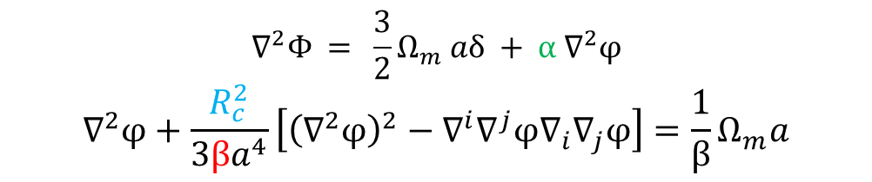
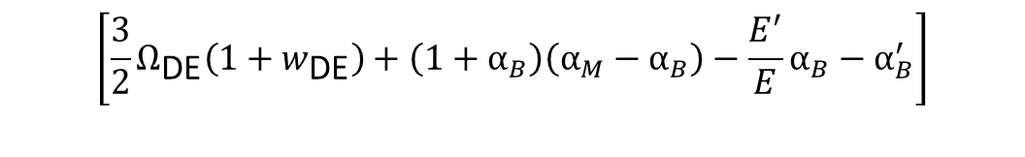

Master Vainshtein Equation
A wide array of Horndeski-type theories studied in the literature can be unified into a single “master“ Vainshtein equation
“master“ Vainshtein equation
$$∇^{2}Φ = \frac{3}{2}Ω_{m} aδ + α ∇^{2}φ$$
$$∇^{2}φ+\frac{R_{c}^{2}}{3βa^{4}}\left[{\left(∇^{2}φ\right)}^{2}−∇^{i}∇^{j}φ∇_{i}∇_{j}φ\right]=\frac{1}{β}Ω_{m}a$$
EFTofDE Background Parameters
In this form we can simulate wide array of models (including EFT) such as:
Dvali-Gabadadze-Porrati (sDGP & nDGP)
Cubic Scalar Galileon (csG)
Cubic Vector Galileon (cvG)
Generalised Cubic Covariant Galileon (GCCG)
$$R_{c}^{2}=\frac{α_{M}−2α_{B}}{E^{2}\left(α_{M}−α_{B}\right)}$$
$$β=−\frac{2}{3\left(α_{M}−α_{B}\right)}×$$
$$\left[\frac{3}{2}Ω_{\text{DE}}\left(1+w_{\text{DE}}\right)+\left(1+α_{B}\right)\left(α_{M}−α_{B}\right)−\frac{E^{′}}{E}α_{B}−α_{B}^{′}\right]$$
$$α=α_{B}−α_{M}$$

Slide 10
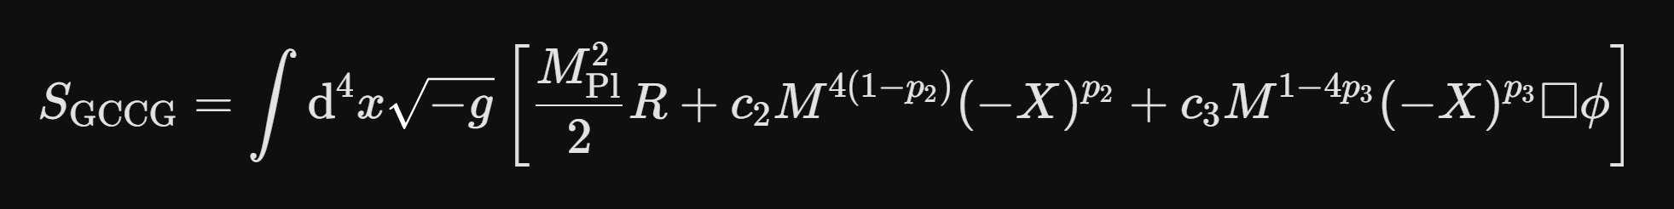



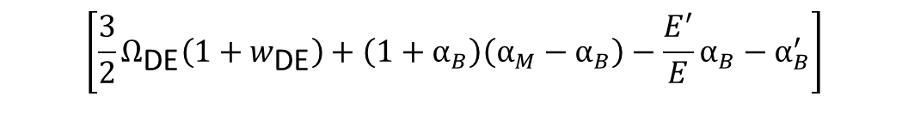

Example: GCCG Model
Since we have already introduced the implementation of the EFTofDE parameterisation, we can make use of the fact that the GCCG model can be treated as a special case of the EFTofDE.
EFTofDE Background Parameters
$$R_{c}^{2}=\frac{α_{M}−2α_{B}}{E^{2}\left(α_{M}−α_{B}\right)}$$
$$α_{B}=−sqΩ_{DE}E^{−\left(s+2\right)}=α$$
$$β=−\frac{2}{3\left(α_{M}−α_{B}\right)}×$$
$$α_{M}=0$$
$$\left[\frac{3}{2}Ω_{\text{DE}}\left(1+w_{\text{DE}}\right)+\left(1+α_{B}\right)\left(α_{M}−α_{B}\right)−\frac{E^{′}}{E}α_{B}−α_{B}^{′}\right]$$
s = param_bg_1 Background Parameter
q = param_pt_1 Modified Gravity parameter
$$α=α_{B}−α_{M}$$

Slide 11
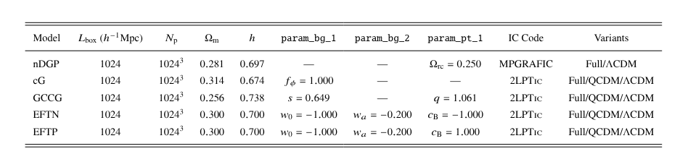
Simulation Overview: EFT-Ramses
EFT-Ramses (Extension to ECOSMOG)
param_bg_i = background parameters
param_pt_i = Modified Gravity Parameters
Adaptive Mesh Refinement (AMR): Dynamically increases grid resolution strictly in high-density regions to accurately resolve the highly non-linear Vainshtein screening mechanism.

Slide 12
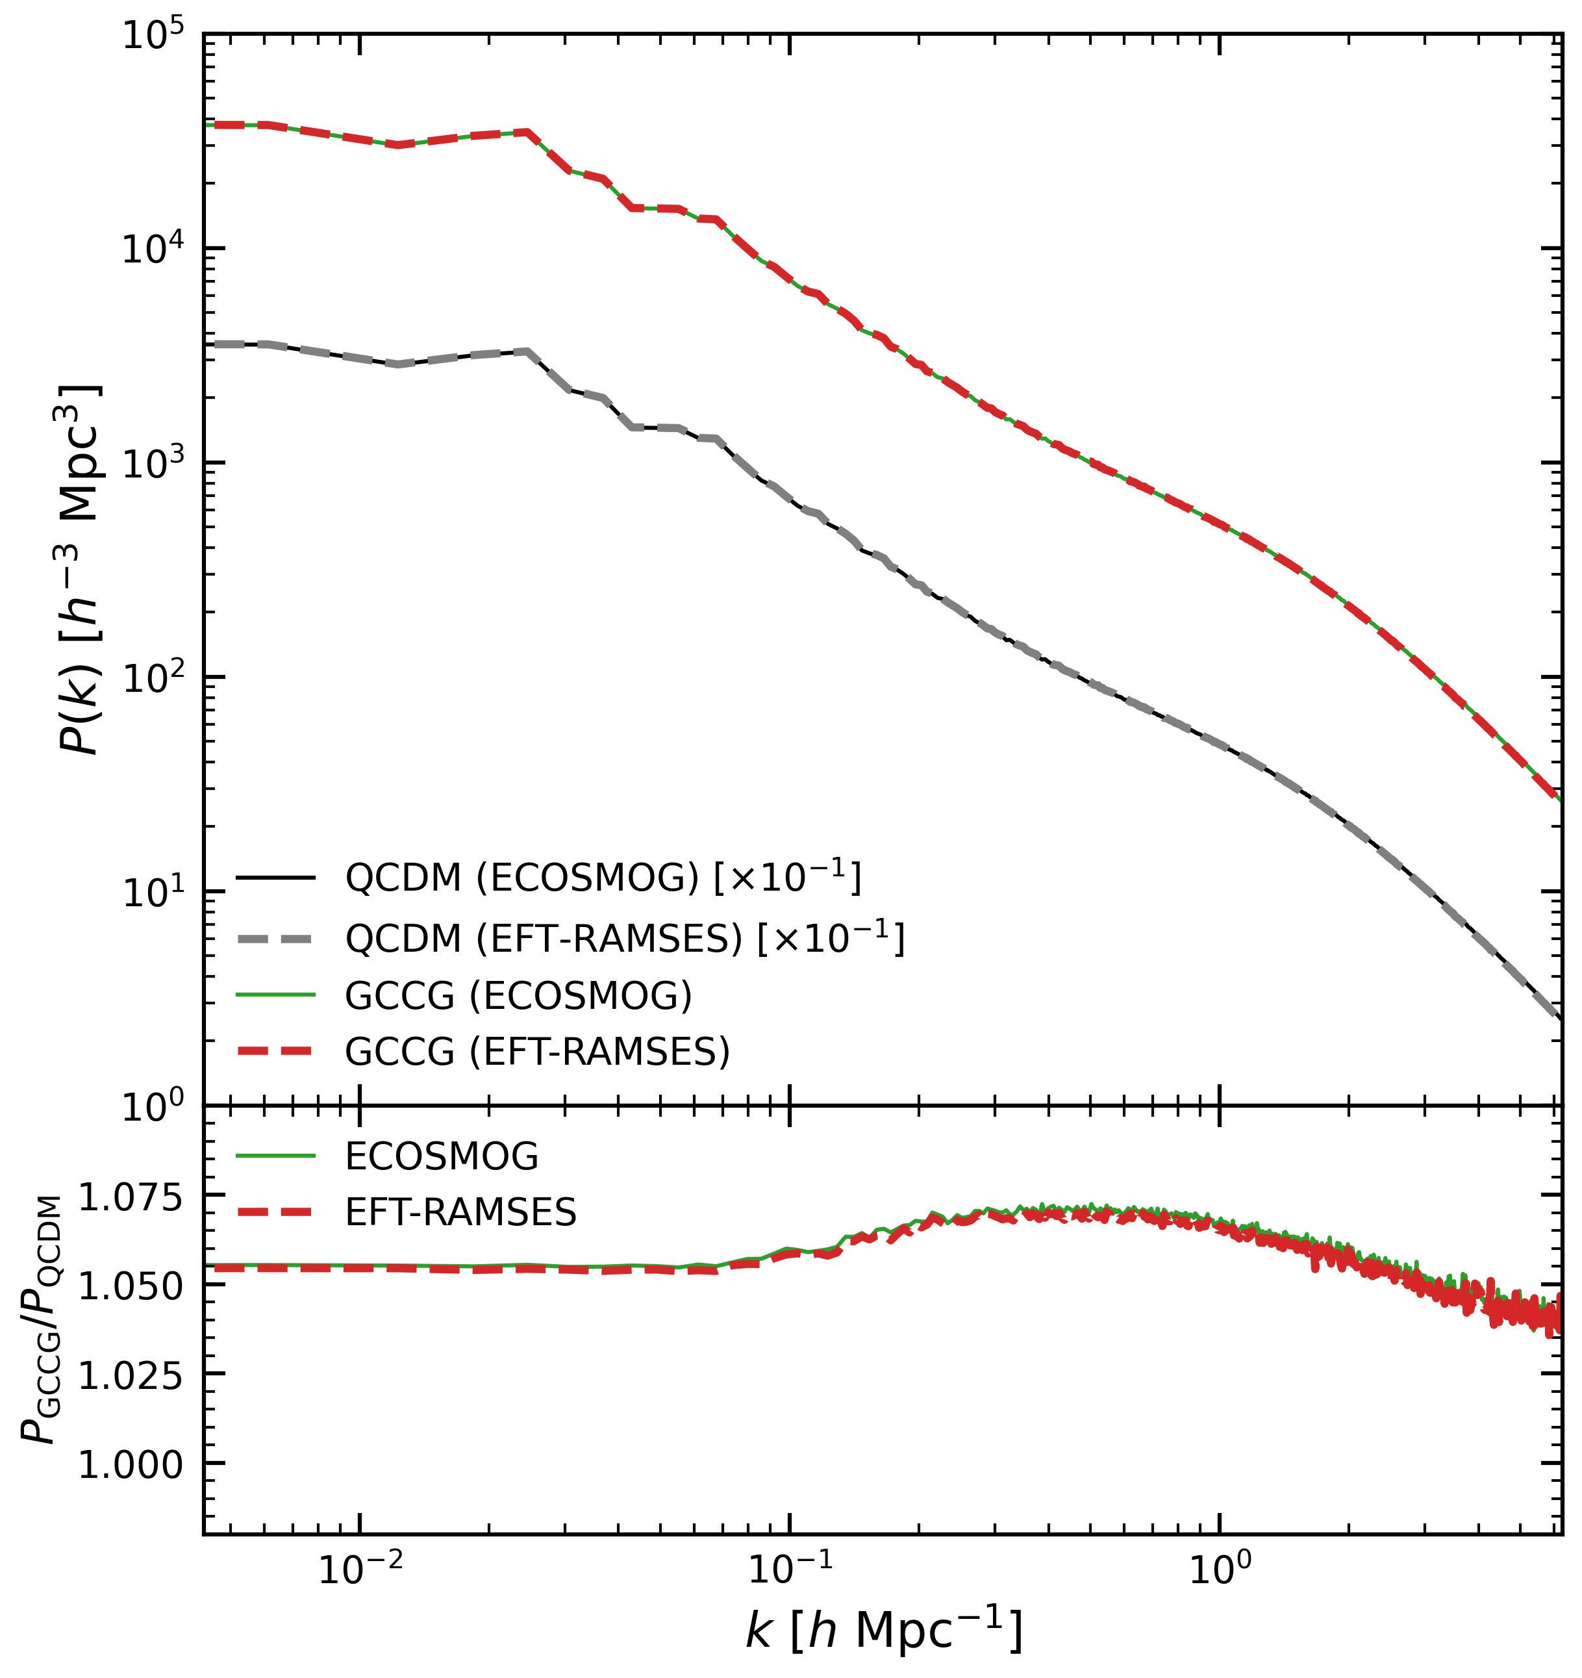
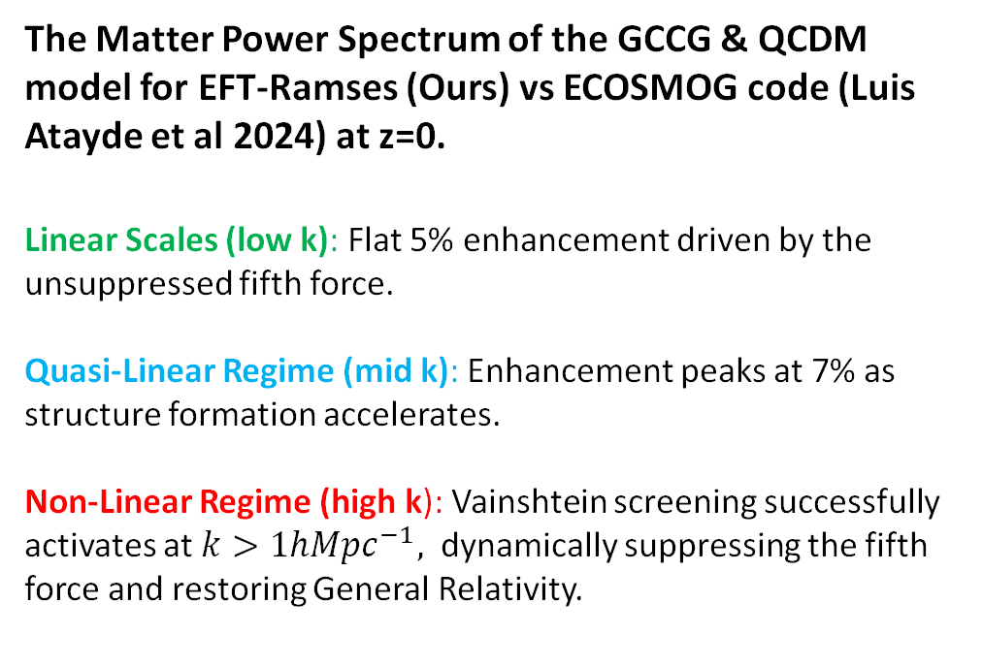
GCCG
The Matter Power Spectrum of the GCCG & QCDM model for EFT-Ramses (Ours) vs ECOSMOG code (Luis Atayde et al 2024) at z=0.
Linear Scales (low k): Flat 5% enhancement driven by the unsuppressed fifth force.
Quasi-Linear Regime (mid k): Enhancement peaks at 7% as structure formation accelerates.
Non-Linear Regime (high k): Vainshtein screening successfully activates at $k>1hMpc^{−1},$ dynamically suppressing the fifth force and restoring General Relativity.
Power Spectra P(k) for GCCG
EFT-Ramses vs ECOSMOG code

Slide 13
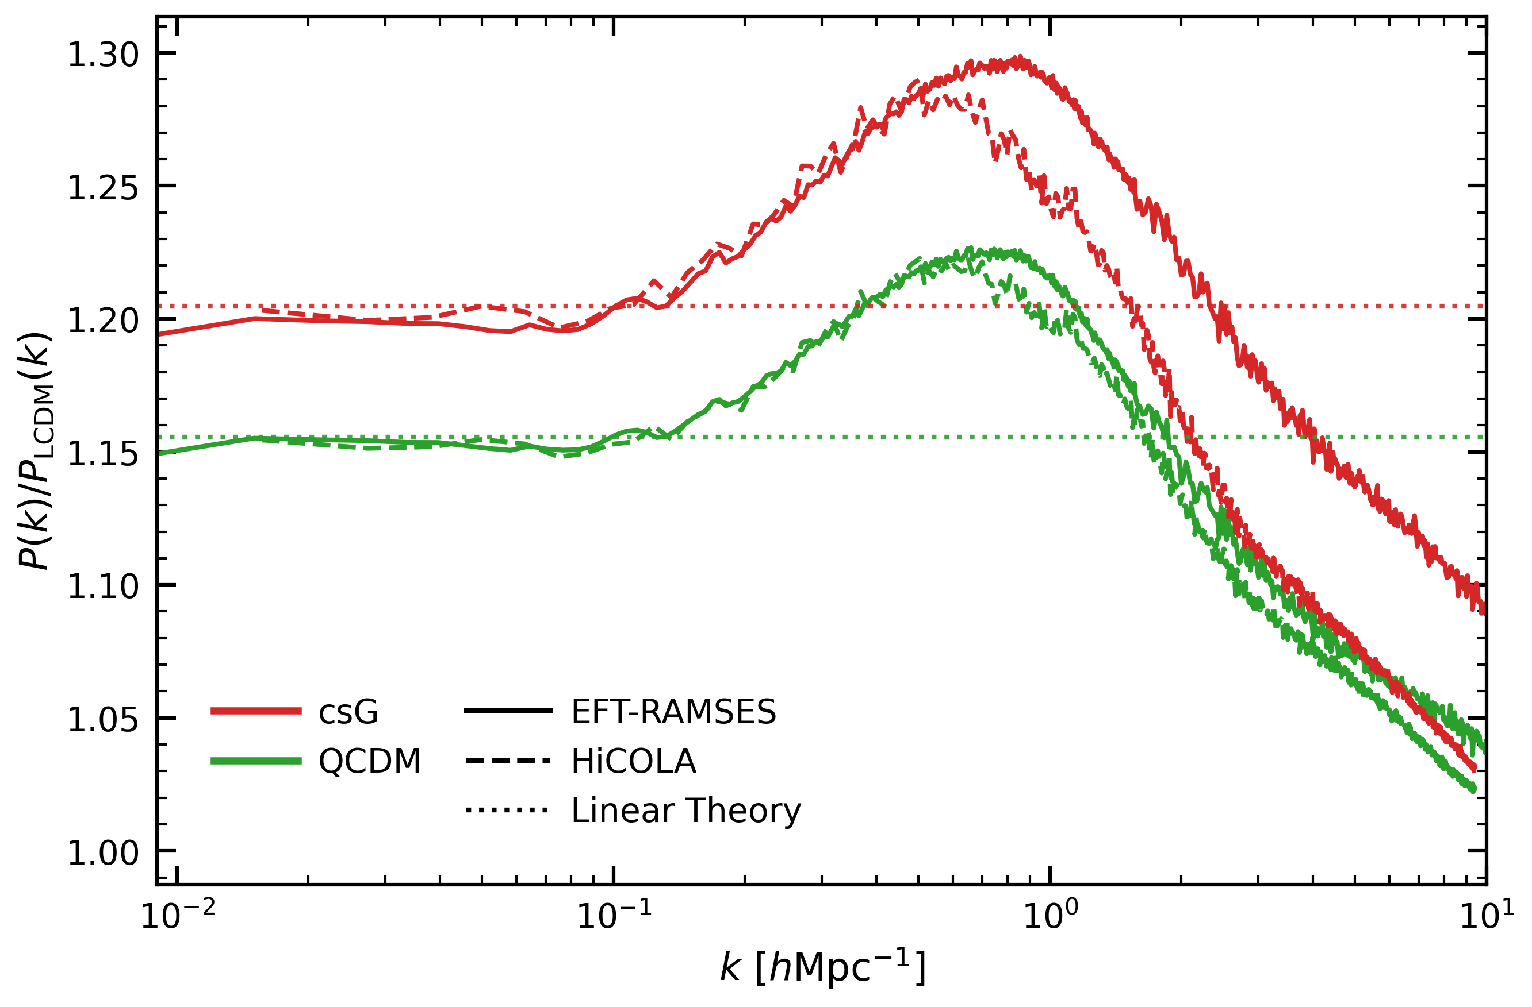
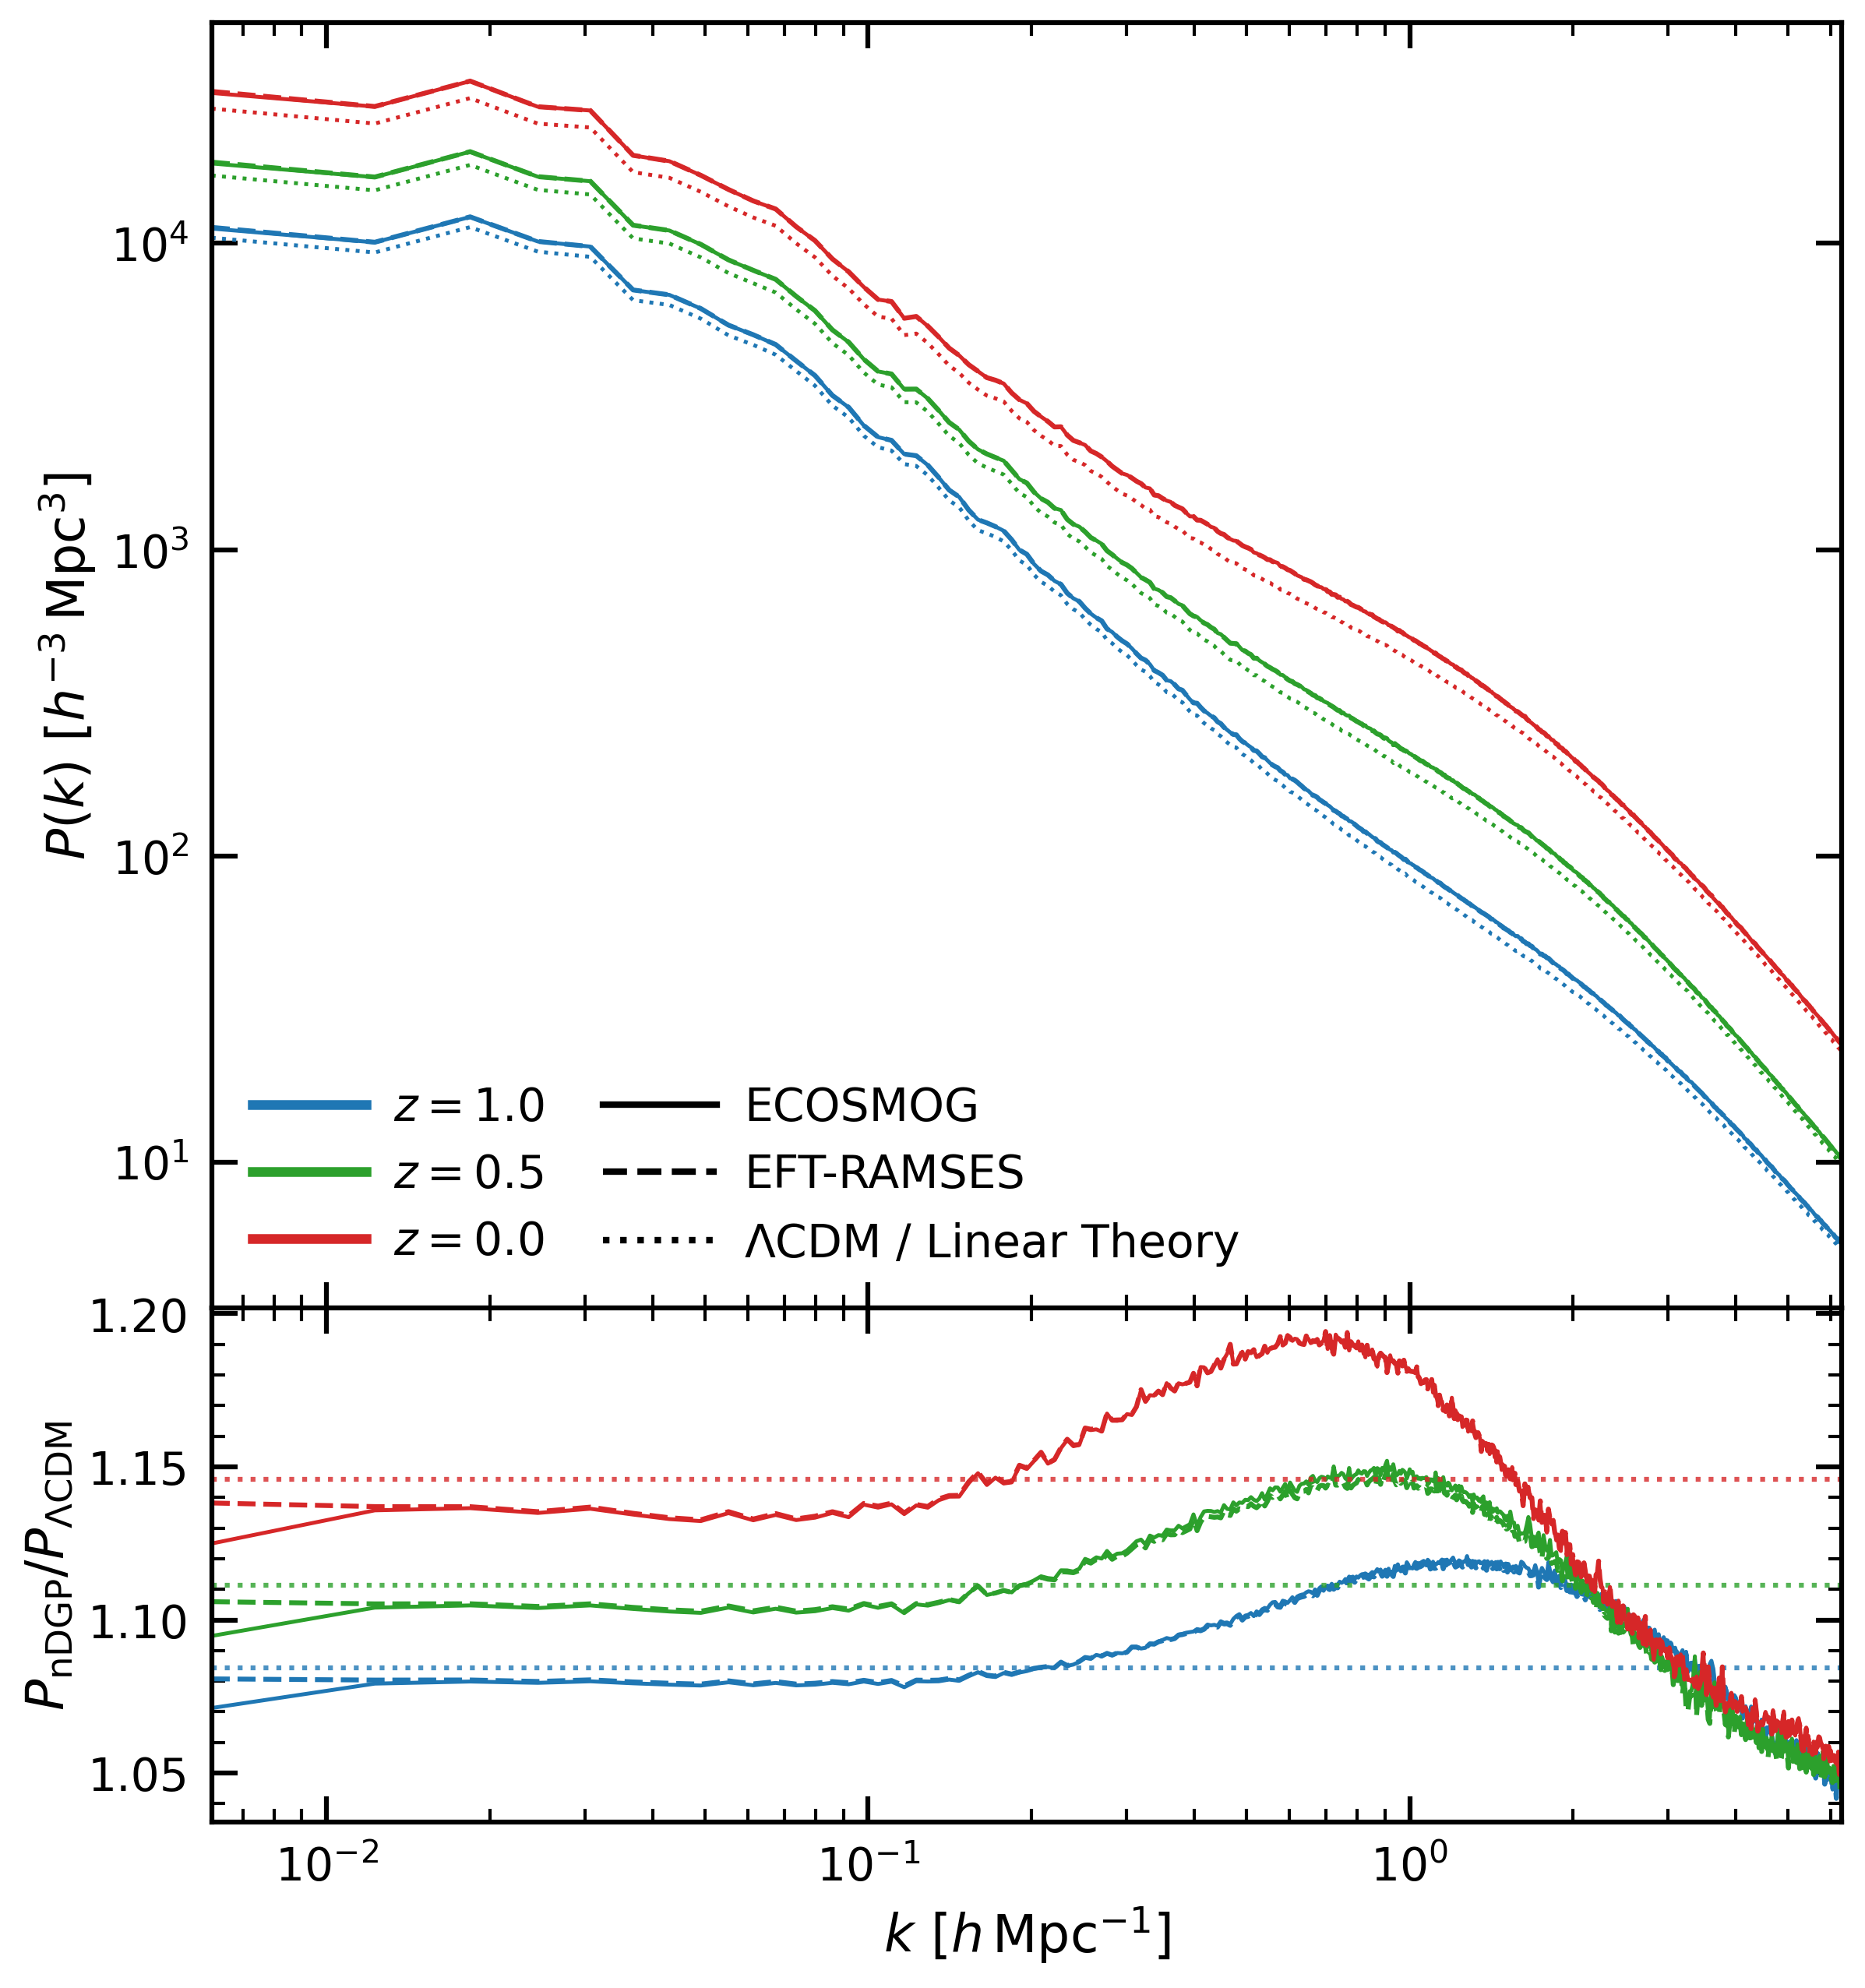
Cubic Galileon & nDGP Model
Power Spectra Enhancement P(k)/P(LCDM)
cG
EFT-Ramses vs HiCOLA
Power Spectra Enhancement P(k)/P(LCDM) for
nDGP
EFT-Ramses vs HiCOLA

Slide 14
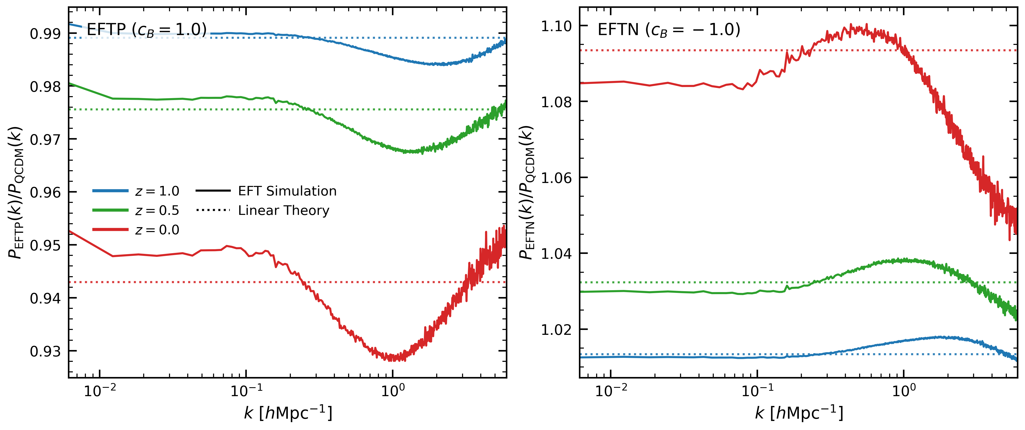
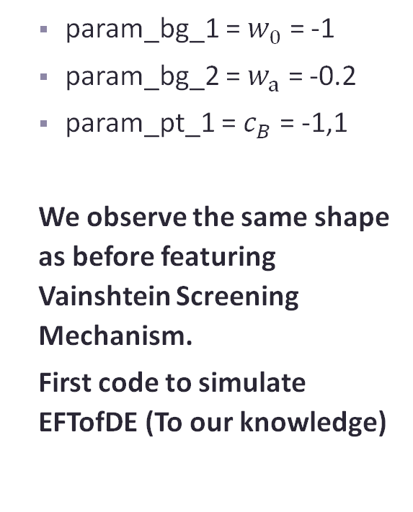
EFTofDE
  param_bg_1 = $w_{0}$ = -1
  param_bg_2 = $w_{a}$ = -0.2
  param_pt_1 = $c_{B}$ = -1,1
  We observe the same shape as before featuring Vainshtein Screening Mechanism.
  First code to simulate EFTofDE (To our knowledge)
Non-linear matter power spectrum enhancement wrt to QCDM for EFTofDE at different redshifts (z)

Slide 15
Conclusions
EFT-RAMSES successfully embeds the generic Effective Field Theory of Dark Energy (EFTofDE) into a high-resolution, non-linear N-body pipeline.
https://github.com/nat-woodcock/EFT-Ramses/tree/main
The code has been rigorously validated against independent baselines, achieving sub-percent accuracy in capturing the highly non-linear Vainshtein screening mechanism for a wide array of modified gravity models.
This framework provides a universal, model-agnostic engine essential for interpreting the high-precision Large Scale Structure data from upcoming Stage-IV surveys (DESI, Euclid, LSST).

Slide 16
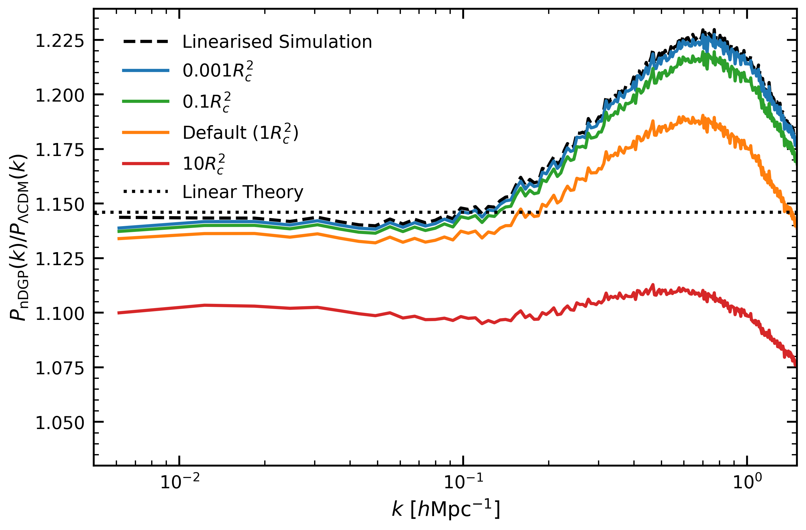
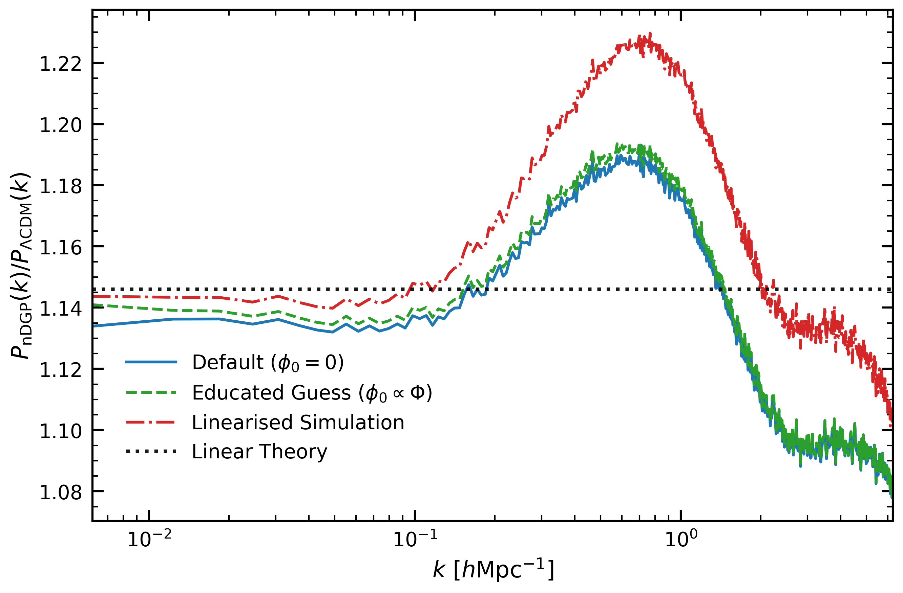
Useful Plots for Large Scale Mismatch

