Slide 1




Coupled Dark Energy & Dark Matter for DESI:
An Effective Guide to the Phantom Divide
Can quintessence mimic phantom crossing without a phantom field?
Stefan Antusch (Basel) · Stephen F. King (Southampton) * · Xin Wang (Padova) arXiv:2604.08449 · April 2026

Slide 2
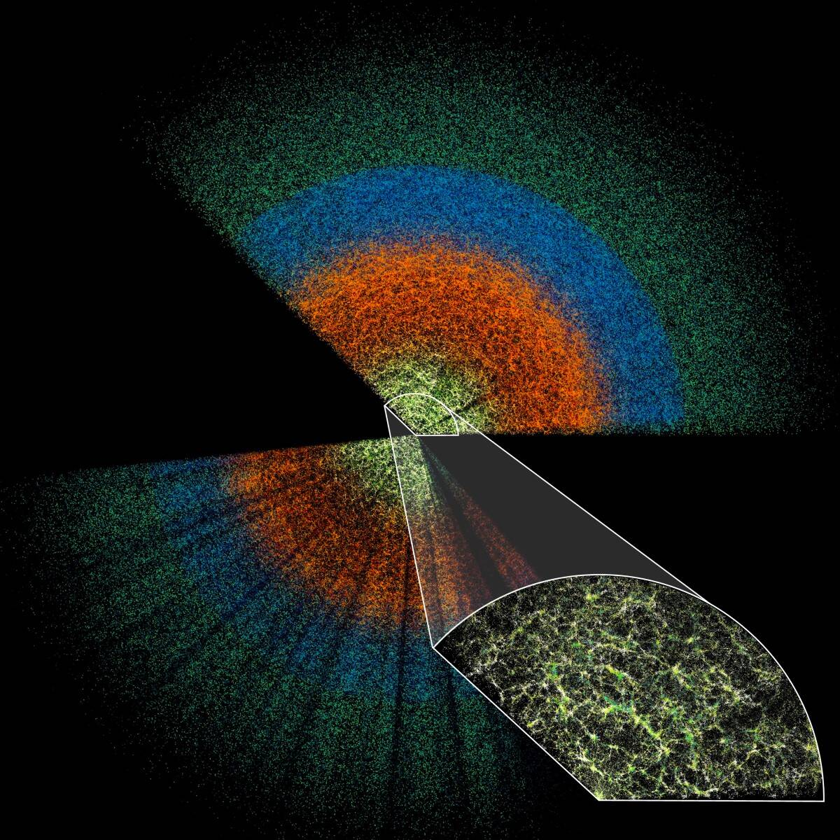
DESI measures redshifts for tens of millions of galaxies and quasars
It reconstructs the BAO feature in galaxy correlation functions and power spectra for both transverse and radial directions
Tracing the BAO ruler from CMB to late times depends on DE and DM, and provides evidence for dynamical DE

Slide 3


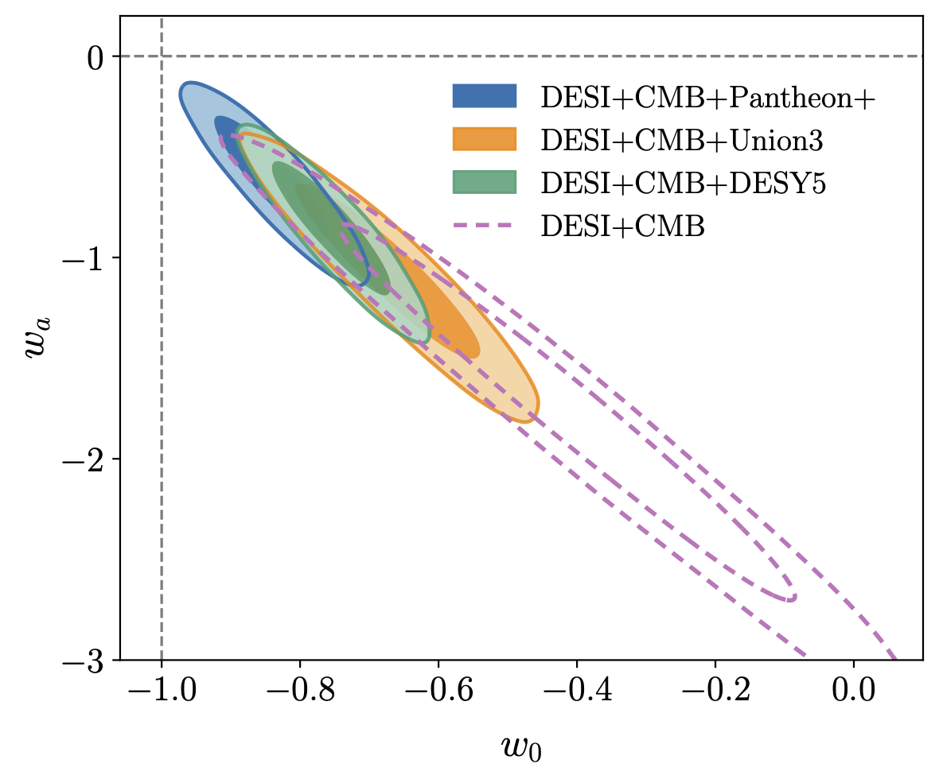
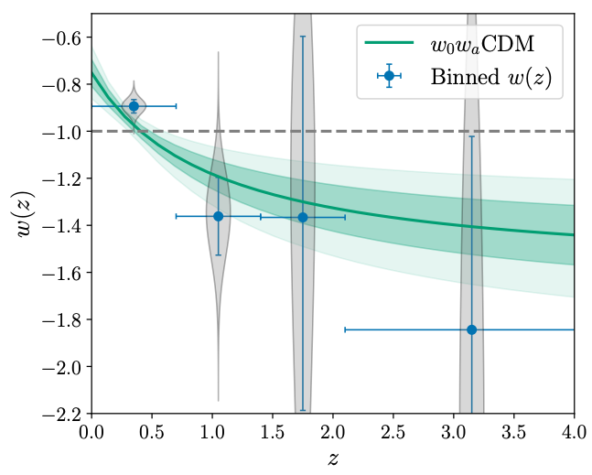

Dynamical Dark Energy
DESI DR2 2503.14738
Assuming CPL parametrisation
Binned data shows w(z) which appears to cross the phantom divide (w=-1)

Slide 5
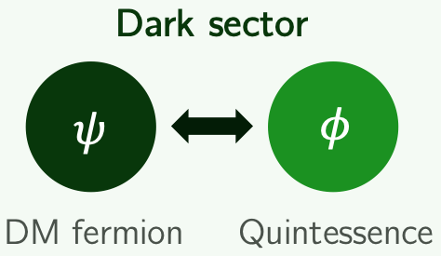

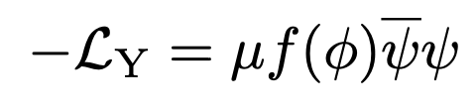

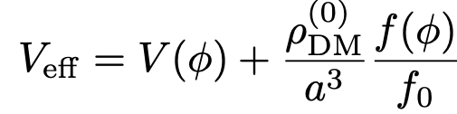
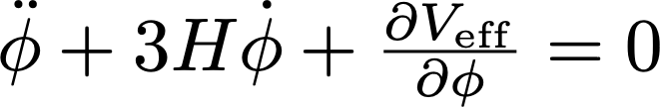
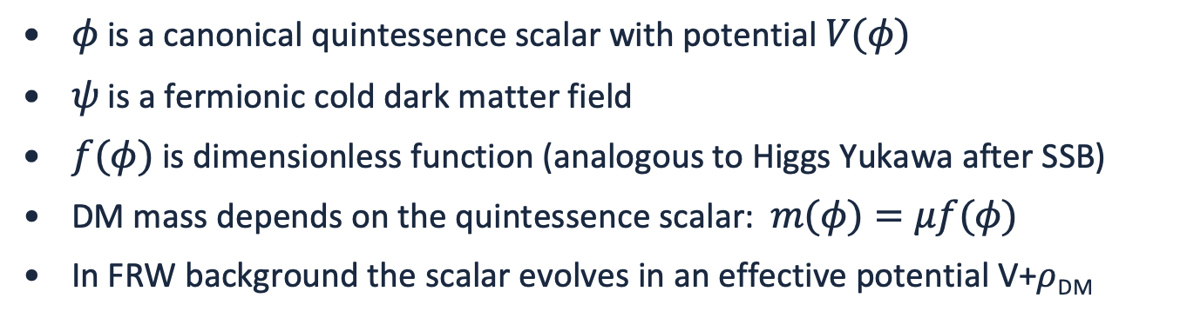
L.Amendola, astro-ph/9908023; Farrar,Peebles, astro-ph/0307316J; Khoury,A.Weltman, astro-ph/0309300
The Model: Quintessence Coupled to Dark Matter
$φ$ is a canonical quintessence scalar with potential $V(φ)$
$ψ$ is a fermionic cold dark matter field
$f(φ)$ is dimensionless function (analogous to Higgs Yukawa after SSB)
DM mass depends on the quintessence scalar: $m(φ)=μf(φ)$
In FRW background the scalar evolves in an effective potential V+$ρ$_{DM}
Notes:
Stress the analogy with the Higgs mechanism — the DM mass depends on the field value, exactly as quark masses depend on the Higgs vev. This is well-motivated low-energy EFT.

Slide 6
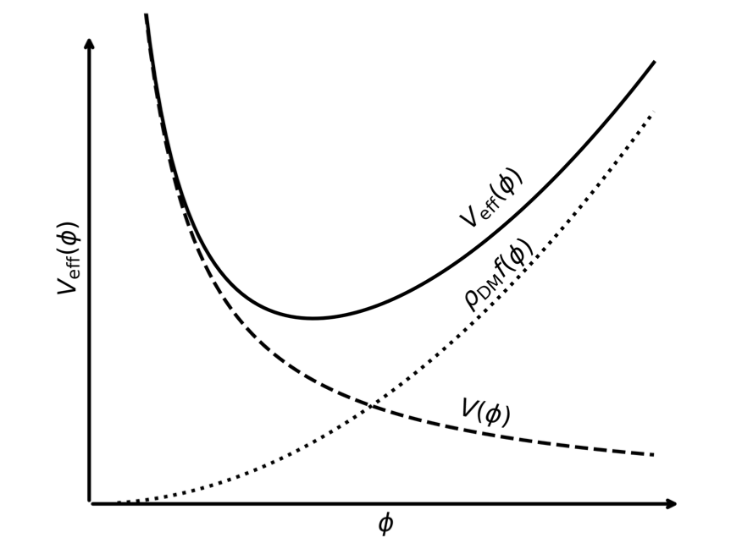
A.Chakraborty, P.K.Chanda, S.Das and K.Dutta, 2503.10806
Crucially: the slopes of V(φ) and f(φ) must be opposite in sign
Dominates in the past
Dominates today

Slide 7
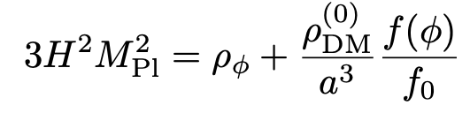
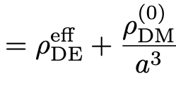
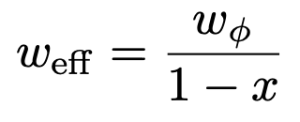
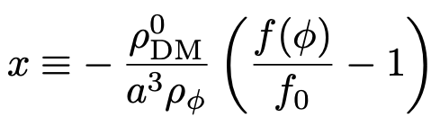
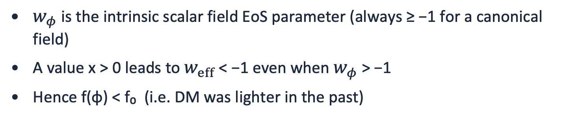
Effective Equation of State: The Key Formula
Interpreted as standard DM plus dynamical DE
Friedmann equation
$w_{φ}$ is the intrinsic scalar field EoS parameter (always ≥ −1 for a canonical field)
A value x > 0 leads to $w_{eff}$ < −1 even when $w_{φ}$ > −1
Hence f(φ) < f₀ (i.e. DM was lighter in the past)
Notes:
This is the central result of the framework. Point out: if x = 0 (no coupling), weff = wφ and no phantom crossing is possible. The DM coupling is essential.

Slide 8
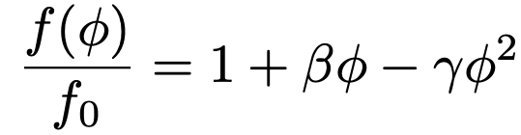

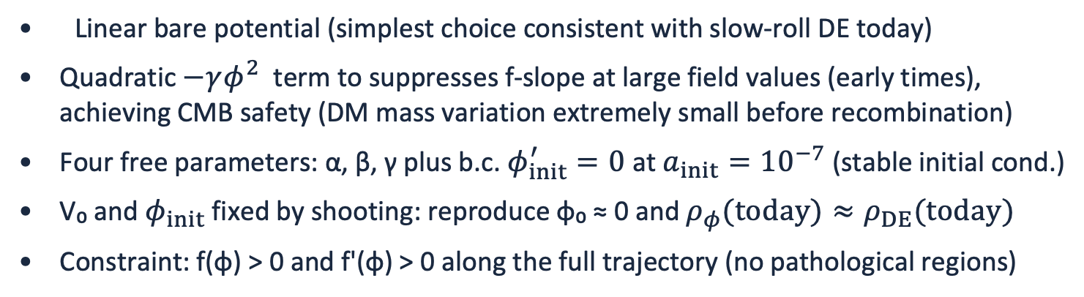
S.Antusch, S.F.King and X.Wang, 2604.08449
Minimal Phenomenological Realization
Linear bare potential (simplest choice consistent with slow-roll DE today)
Quadratic $−γφ^{2}$ term to suppresses f-slope at large field values (early times), achieving CMB safety (DM mass variation extremely small before recombination)
Four free parameters: α, β, γ plus b.c. $φ_{init}^{′}=0$ at $a_{init}={10}^{−7}$ (stable initial cond.)
V₀ and $φ_{init}$ fixed by shooting: reproduce φ₀ ≈ 0 and $ρ_{φ}(today)≈ρ_{DE}(today)$
Constraint: f(φ) > 0 and f'(φ) > 0 along the full trajectory (no pathological regions)
Notes:
Explain the logic: the exponential coupling (studied in Appendix B) fails because its local slope does not decrease toward early times. Adding a quadratic term in f(φ) provides the needed separation between β₀ (large, drives phantom crossing) and β_rec (small, CMB safe).

Slide 9
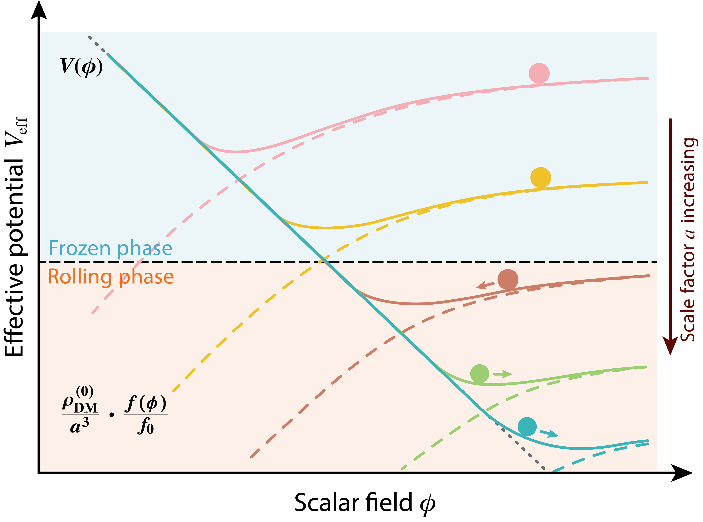
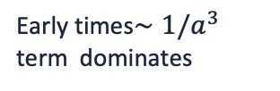
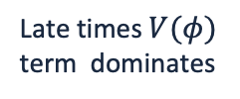
S.Antusch, S.F.King and X.Wang, 2604.08449
Early times$∼1/a^{3}$ term dominates
Field starts from a frozen phase in the early universe (robust initial condition)
Then starts to roll one way, then the other
Late times $V(φ)$ term dominates

Slide 10
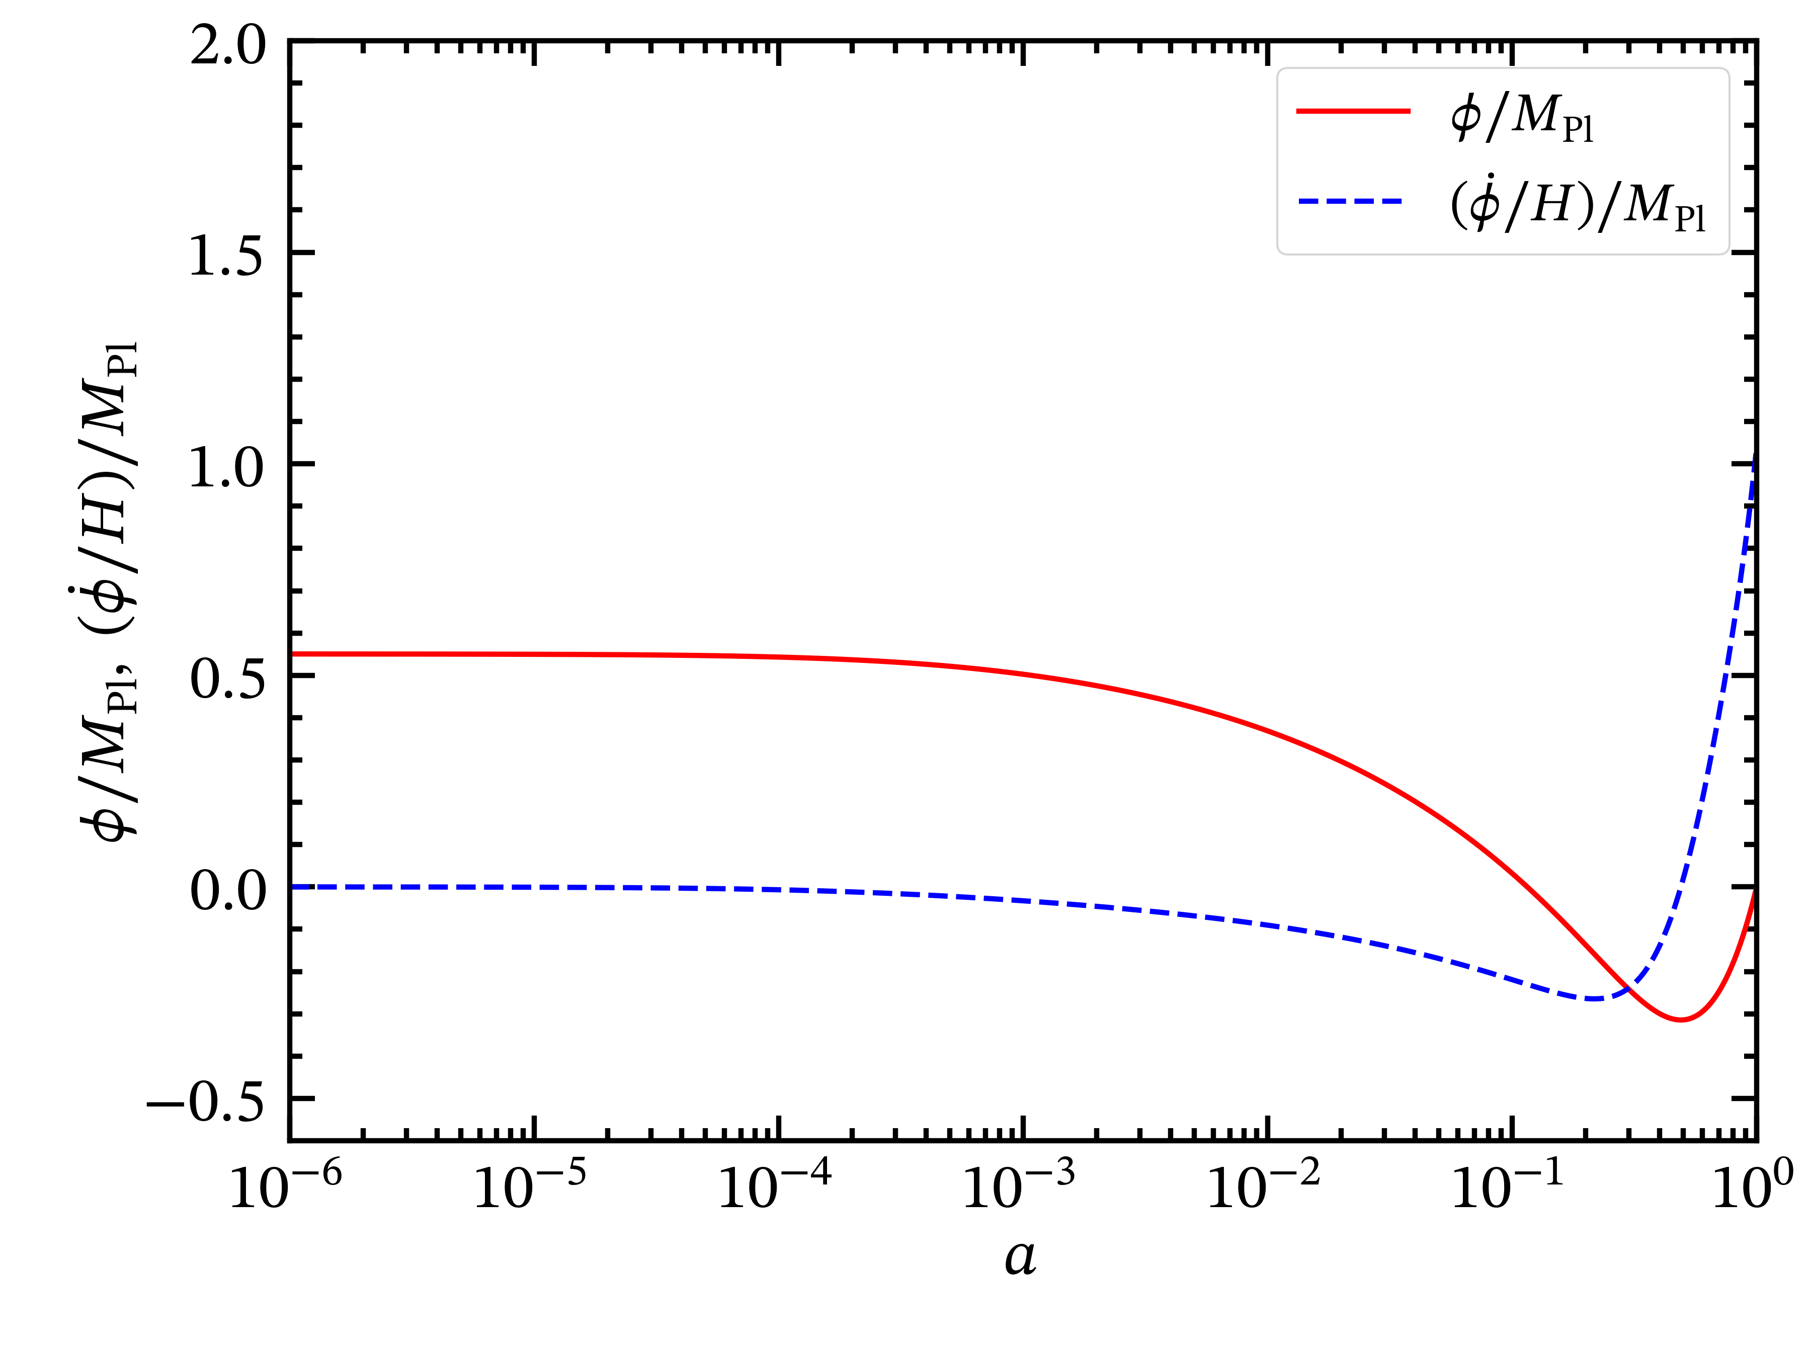





S.Antusch, S.F.King and X.Wang, 2604.08449
$φ_{init}$ fixed by shooting
$$φ_{init}^{′}=0$$
φ₀ = 0 today
Deep radiation era
Now

Slide 11
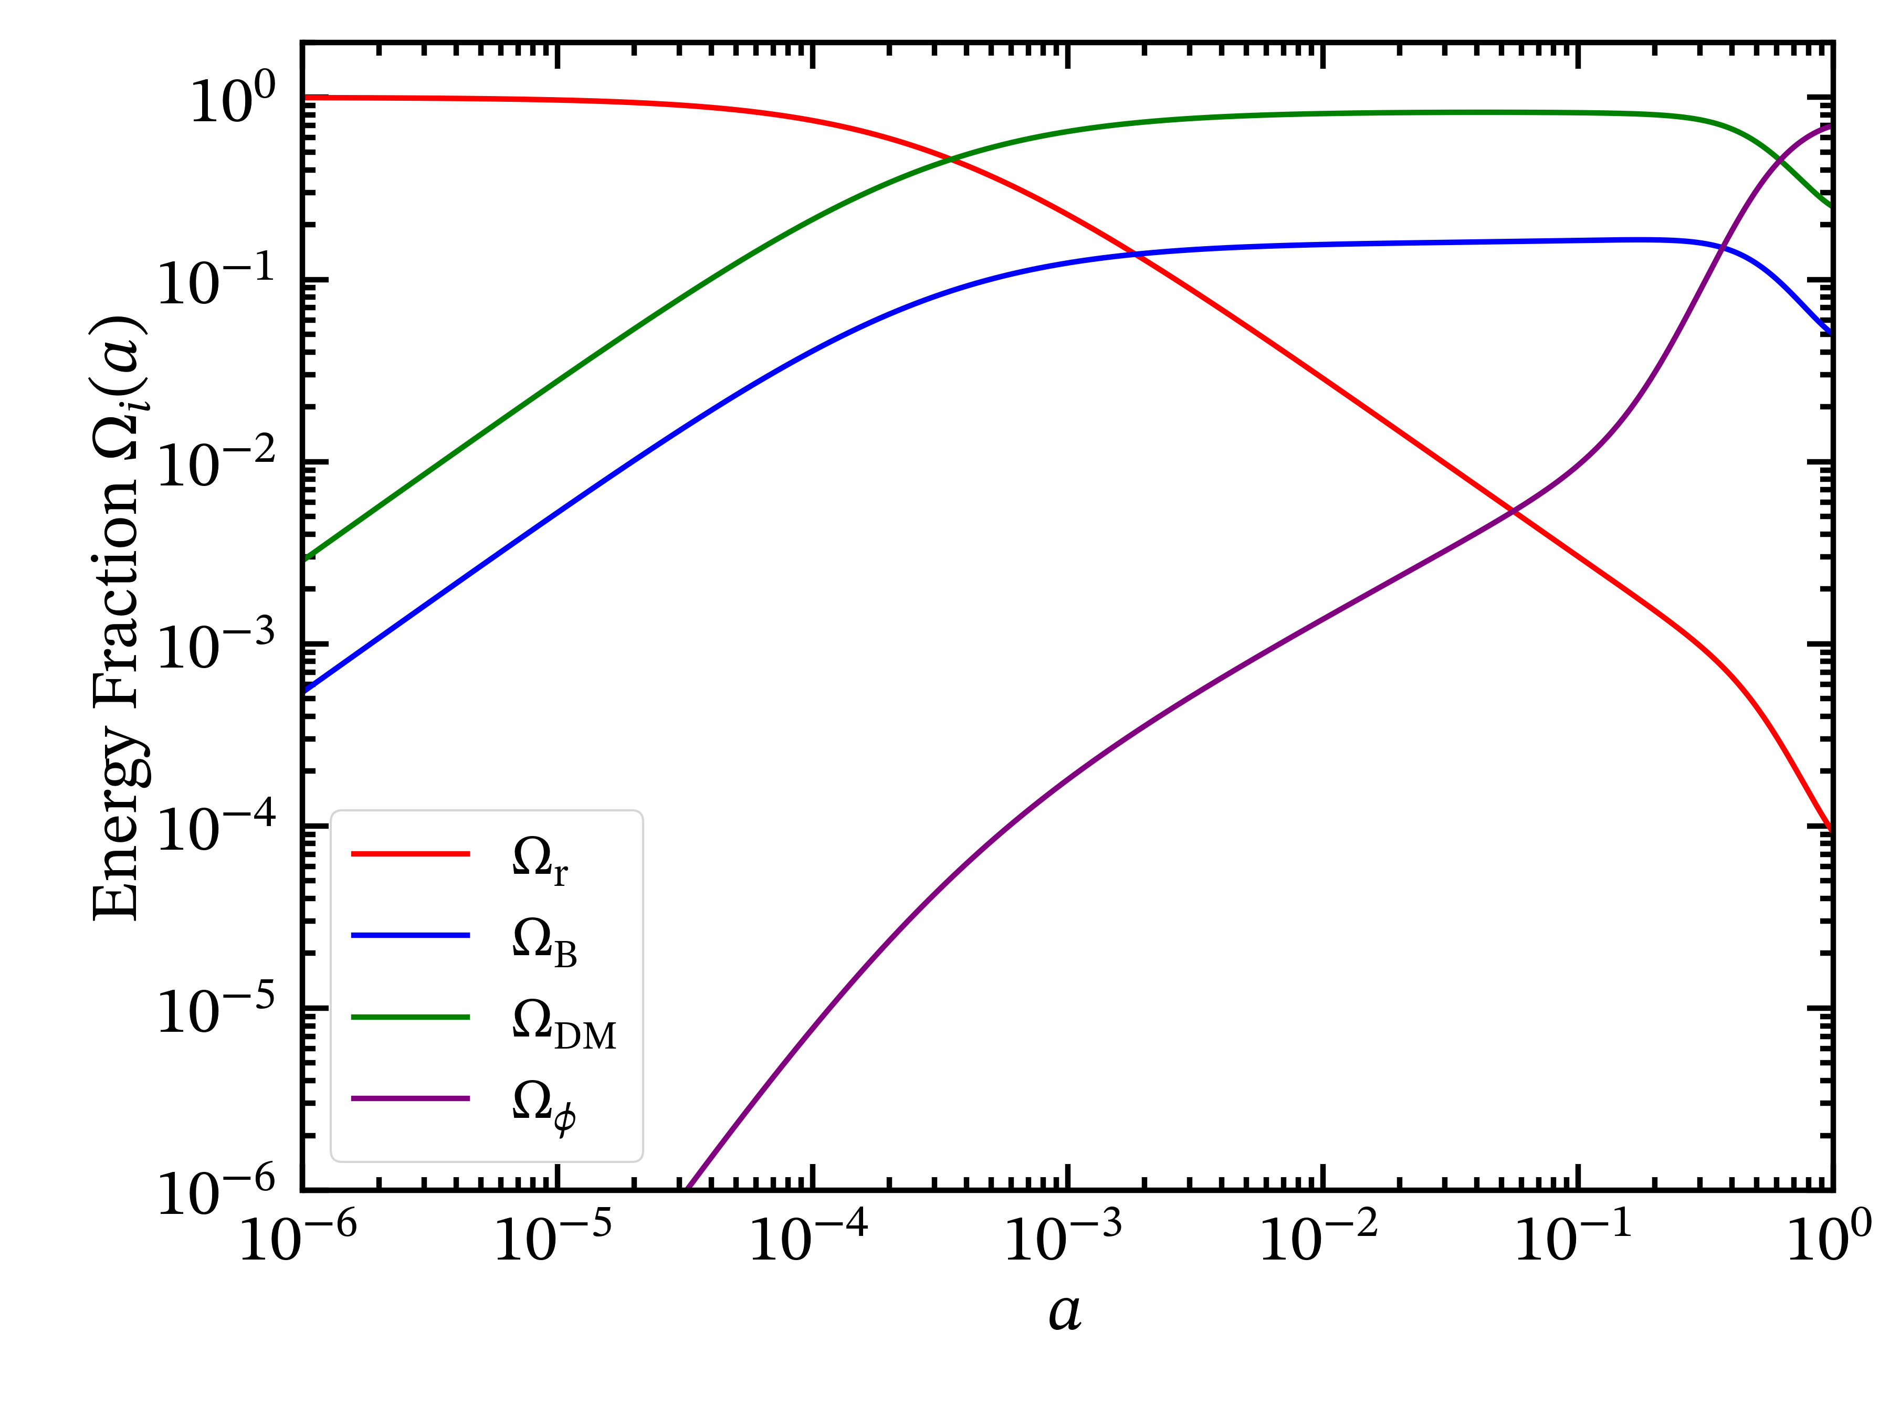
S.Antusch, S.F.King and X.Wang, 2604.08449
Scalar field energy fraction at recombination — well below the 0.0036 Planck bound
Deep radiation era
Now

Slide 12
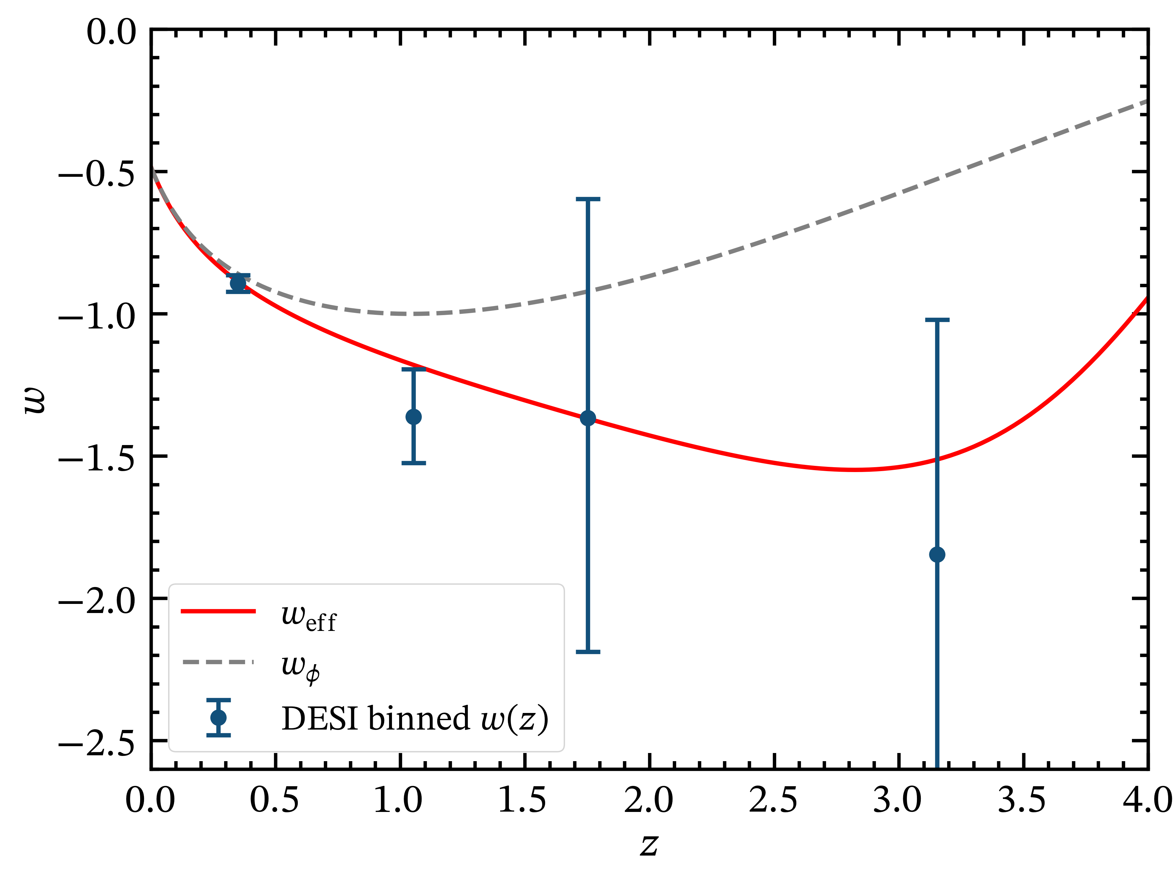
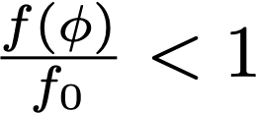


S.Antusch, S.F.King and X.Wang, 2604.08449
All DESI binned w(z) reconstruction bins fitted within 1σ
(DESI+CMB+Union3)
Phantom crossing at z ~0.5 to z~4.0

Slide 13
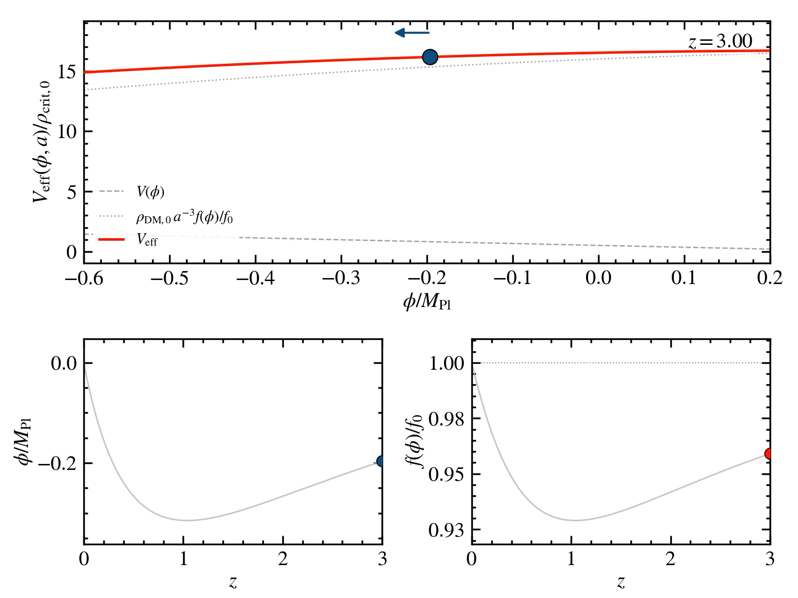
Movie by Xin Wang

Slide 14


CMB Safety: All Constraints Satisfied
Interaction strength at recombination: ε(zrec) ≈ 9.78 × 10⁻⁴ < 0.005 ✓
DM mass drift before recombination: |Δ ln m|rec ≈ 7.01 × 10⁻⁴ < 0.01 ✓
Scalar field energy fraction at recombination: Ωφ(zrec) ≈ 1.62 × 10⁻⁴ < 0.0036 ✓
Accelerated expansion today: deceleration parameter q₀ < 0 ✓
DM mass positive and monotonically varying along trajectory: f(φ) > 0, f'(φ) > 0 ✓
Scalar field remains frozen (|φ'|/MPl ≪ 1) until a ~ 10⁻³, then smoothly activates ✓
Definitions:
Notes:
These are conservative necessary conditions — a full Boltzmann perturbation analysis is future work, but the model easily clears all background-level CMB requirements. Contrast with the exponential coupling in Appendix B, which cannot satisfy ② and ③ simultaneously.

Slide 15
Summary & Conclusions
DESI DR2 prefers dynamical dark energy with apparent phantom crossing at z ~ 0.5–1
A canonical quintessence field coupled to cold dark matter via a Yukawa interaction can produce apparent phantom crossing without any phantom field
The effective equation of state weff = wφ/(1 − x) can dip below −1 when the DM was lighter in past
Viable realizations require: (1) frozen initial conditions in the deep radiation era, (2) CMB-safe coupling at recombination, (3) strong coupling active at late times
These three requirements can be simultaneously satisfied with a linear bare potential and quadratic interaction function f(φ) = f₀(1 + βφ − γφ²)
Best-fit weff evolves from ≈ −1.2 at z ≈ 1 to ≈ −0.9 at z ≈ 0.3, fitting all DESI bins within 1σ
This work provides a model-independent guide for building UV-complete dark energy models that safely navigate the phantom divide
Notes:
Strong close. The work opens a pathway to explaining the DESI signal without any ghost instabilities or exotic fields — just a well-motivated Yukawa coupling in the dark sector, analogous to the Standard Model Higgs coupling.

Slide 16
Thank You
Questions?
arXiv:2604.08449 | Antusch, King, Wang (2026)
Notes:
Acknowledge funding: STFC Consolidated Grant ST/X000583/1 (SFK), Leverhulme Trust Emeritus Fellowship (SFK), EU NextGenerationEU MODIPAC (XW). Thank collaborators for discussions: Prolay Chanda, Guo-Hong Du, William Giarè, Tian-Nuo Li.

