Slide 1
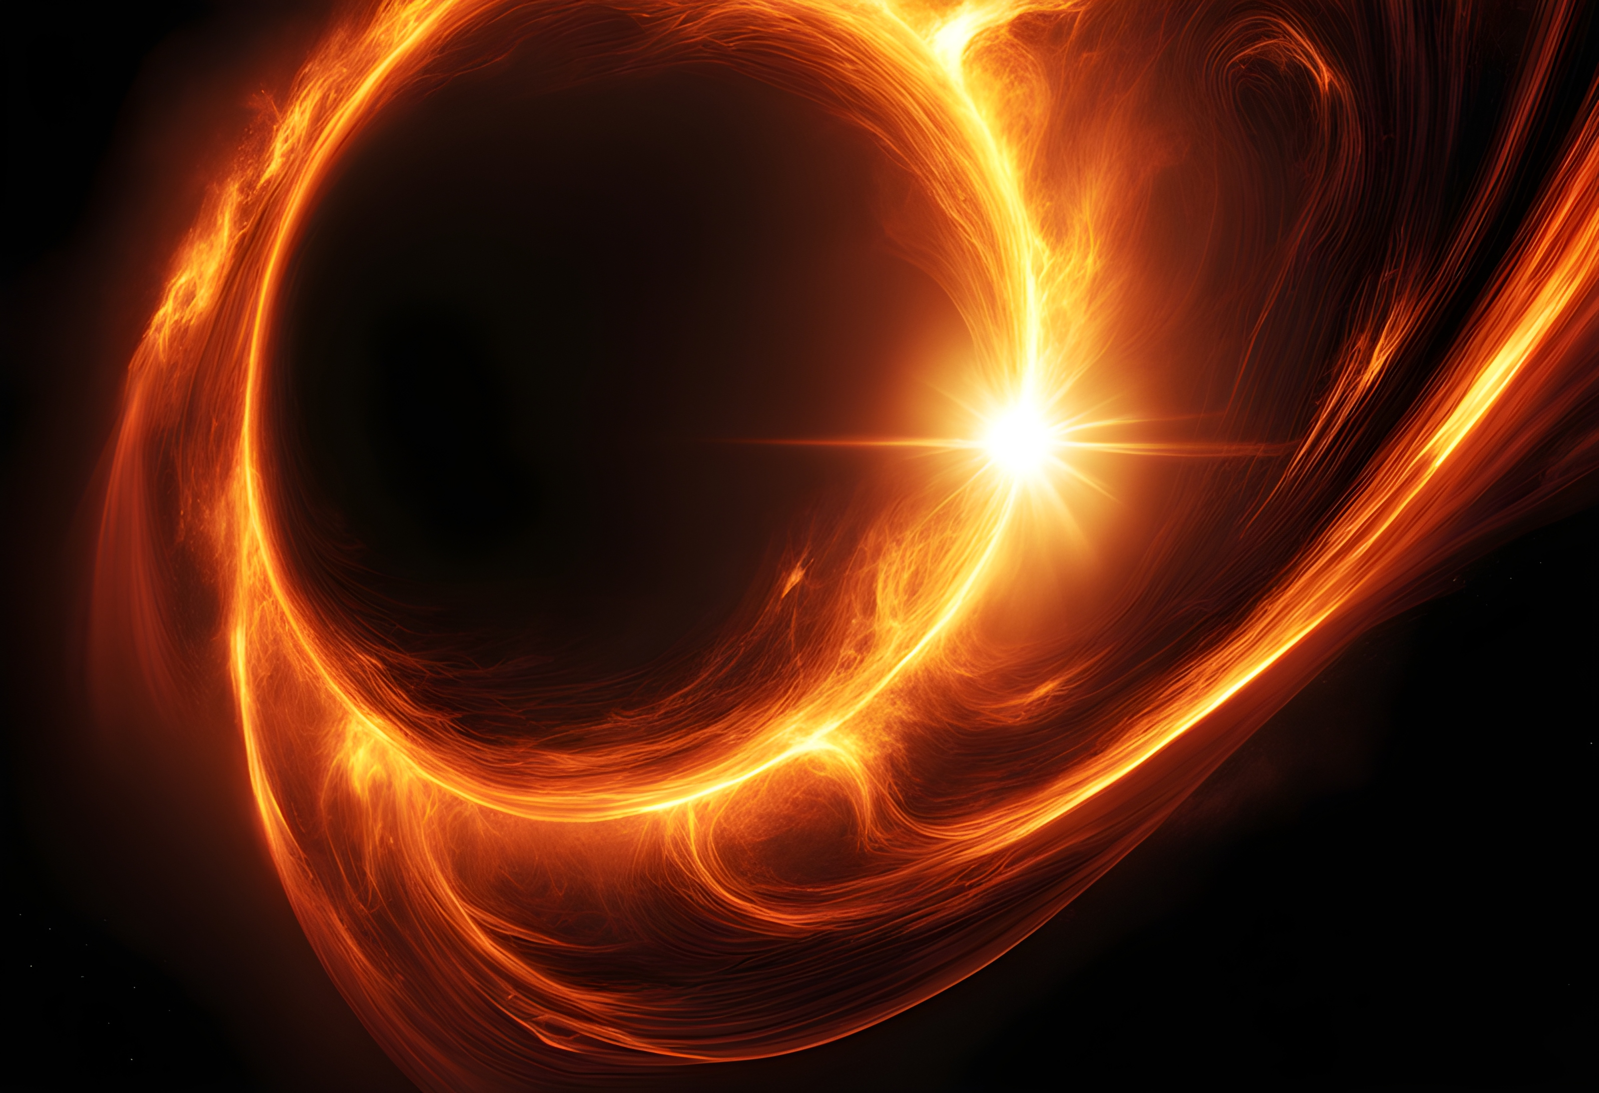
Cosmic shear with Einstein rings
Daniel Johnson
Laboratoire Univers et Particles de Montpellier (LUPM)
Notes:
Hi everyone, my name is Daniel, I’m a 2nd year PhD student at the university of Montpellier, and today I’ll be telling you about the impact of the line of sight on strong lensing, and specifically how this gives us a new cosmological observable

Slide 2
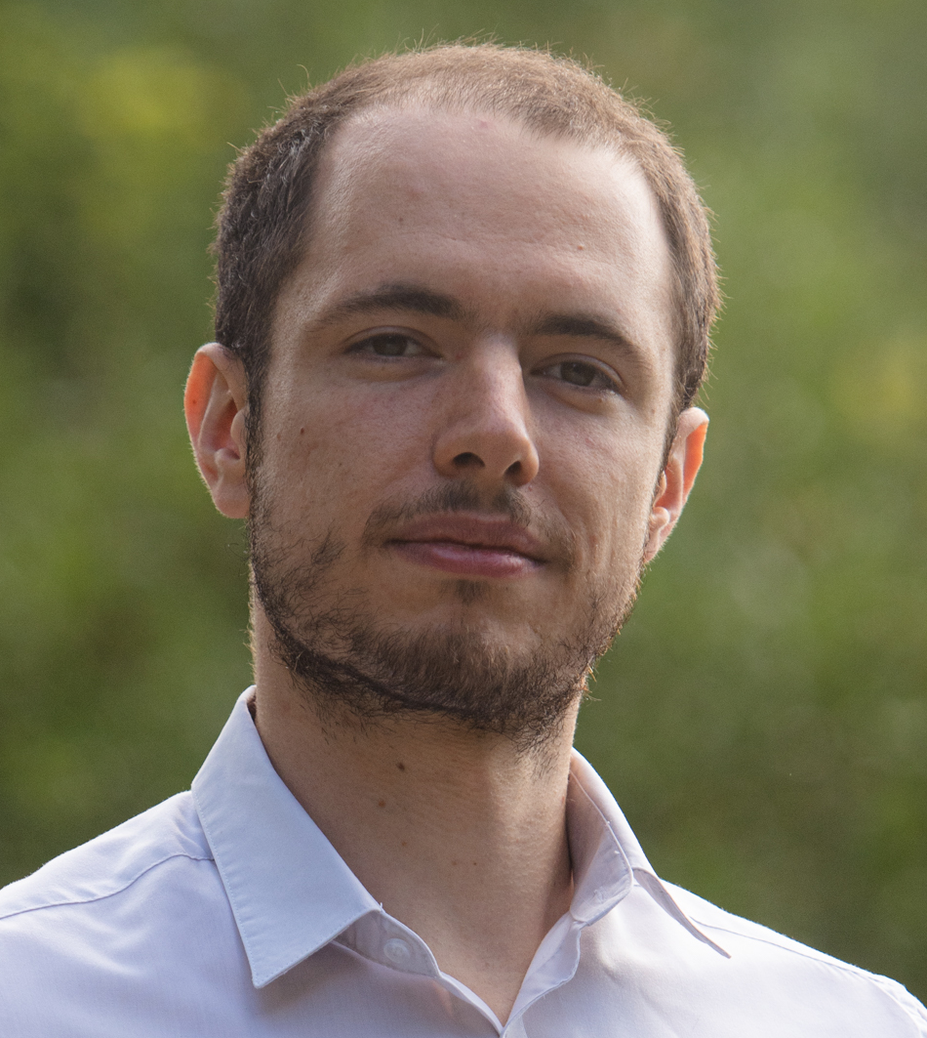
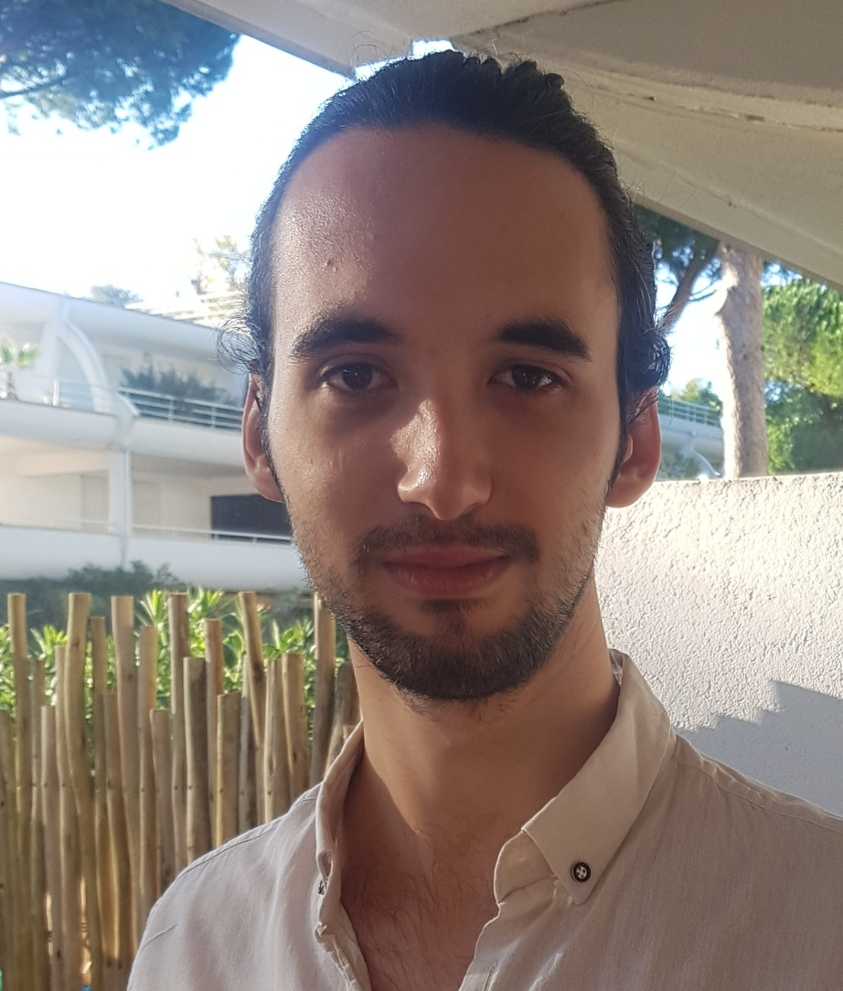

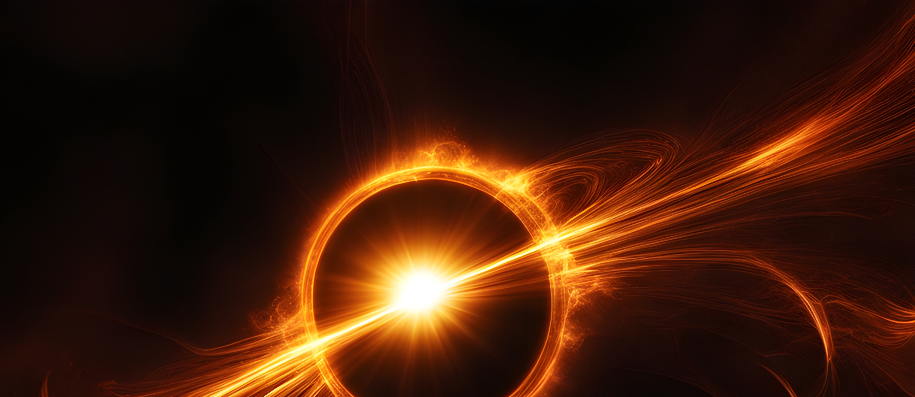


The ELROND team
Giacomo Queirolo
Theo Duboscq
Natalie Hogg
Pierre Fleury
Julien Larena
2/20
Daniel Johnson, University of Montpellier daniel.johnson@umontpellier.fr arxiv 2603.03441
Notes:
The work I’ll be presenting is of course a collaborative effort, and so I want to just say a quick thanks to the other members of my group

Slide 3
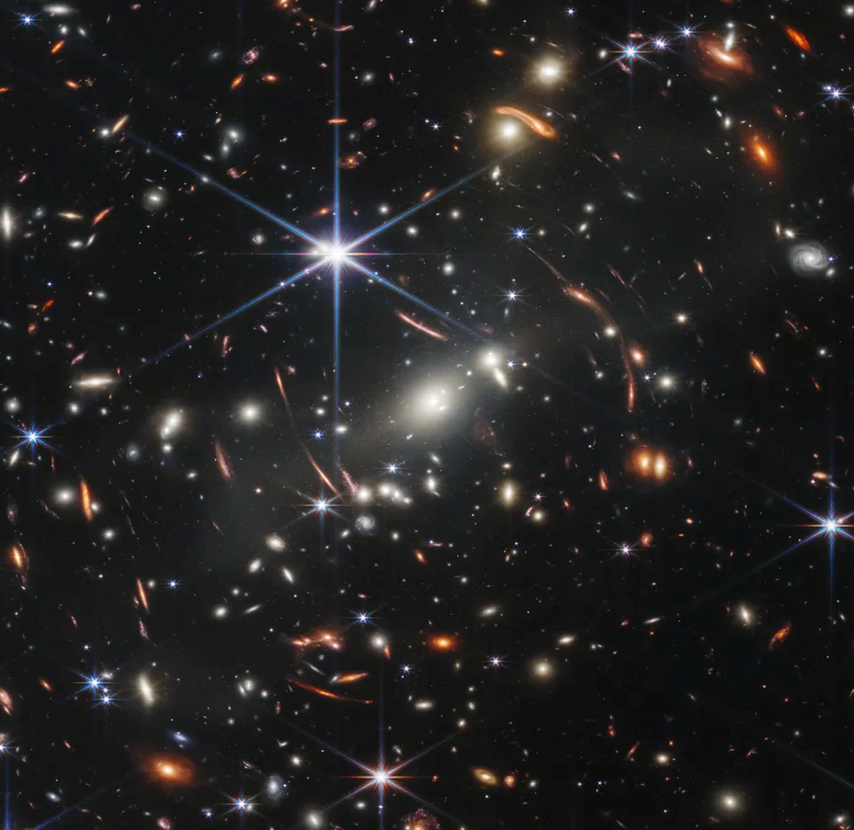
The weak lensing of strong lensing
Weak lensing
Small distortions to galaxy shapes
Detectable by correlating apparent ellipticities
Credit: JWST, NASA
Daniel Johnson, University of Montpellier daniel.johnson@umontpellier.fr arxiv 2603.03441
Notes:
Now, these effects are very analogous to those studied by weak lensers, and apply to every galaxy we observe. To first order, we can break them down into two main effects.

Slide 4
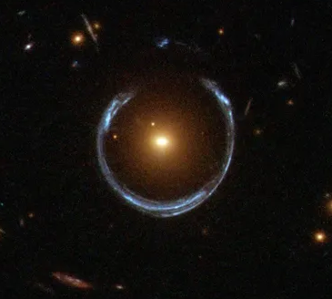
The weak lensing of strong lensing
Strong lensing
Dramatic splitting of light into multiple images, arcs or complete Einstein rings
Credit: HST, NASA
Daniel Johnson, University of Montpellier daniel.johnson@umontpellier.fr arxiv 2603.03441
Notes:
Now, these effects are very analogous to those studied by weak lensers, and apply to every galaxy we observe. To first order, we can break them down into two main effects.

Slide 5
The weak lensing of strong lensing
Weak lensing of galaxies
Daniel Johnson, University of Montpellier daniel.johnson@umontpellier.fr arxiv 2603.03441
Notes:
Now, these effects are very analogous to those studied by weak lensers, and apply to every galaxy we observe. To first order, we can break them down into two main effects.

Slide 6
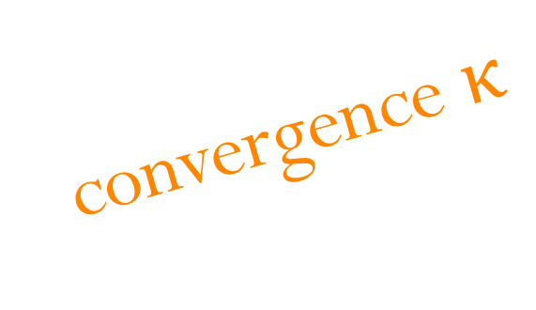
The weak lensing of strong lensing
Weak lensing of galaxies
convergence $κ$
Daniel Johnson, University of Montpellier daniel.johnson@umontpellier.fr arxiv 2603.03441
Notes:
Firstly, convergence, which uniformly rescales and hence magnifies images

Slide 7
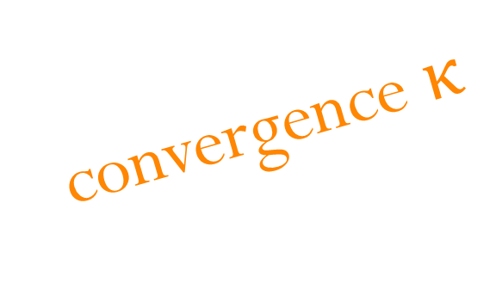
The weak lensing of strong lensing
Weak lensing of galaxies
convergence $κ$
shear γ
Daniel Johnson, University of Montpellier daniel.johnson@umontpellier.fr arxiv 2603.03441
Notes:
And secondly shear, the main effect of which is to distort the apparent shapes of objects

Slide 8
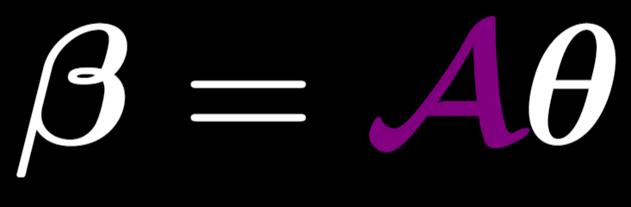
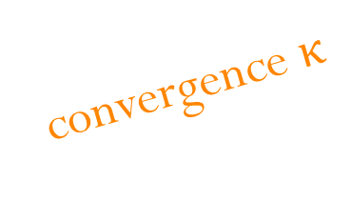
The weak lensing of strong lensing
Weak lensing of galaxies
Convergence and shear
convergence $κ$
shear γ
image position
source position
Daniel Johnson, University of Montpellier daniel.johnson@umontpellier.fr arxiv 2603.03441
Notes:
We summarise these effects into a single matrix, which we call the amplification matrix, and as you can see relates image and source positions. While the convergence is unmeasurable, correlating the shapes of many galaxies means the shear can be detected and measured.

Slide 9
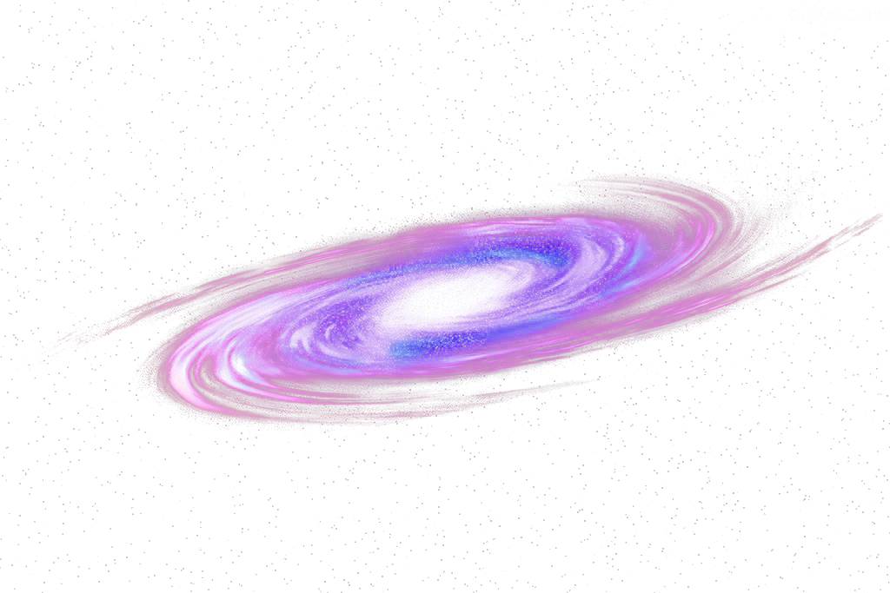
The weak lensing of strong lensing
Strong lensing in an FLRW universe
source
main deflector
observer
Daniel Johnson, University of Montpellier daniel.johnson@umontpellier.fr arxiv 2603.03441
Notes:
So, you’re all very familiar with the basic picture of strong lensing. When two galaxies are well-aligned as seen from earth,

Slide 10
The weak lensing of strong lensing
Strong lensing in an FLRW universe
source
main deflector
observer
Daniel Johnson, University of Montpellier daniel.johnson@umontpellier.fr arxiv 2603.03441
Notes:
So, you’re all very familiar with the basic picture of strong lensing. When two galaxies are well-aligned as seen from earth,

Slide 11
The weak lensing of strong lensing
Strong lensing in an FLRW universe
source
main deflector
observer
Daniel Johnson, University of Montpellier daniel.johnson@umontpellier.fr arxiv 2603.03441
Notes:
Light emitted from the source galaxy experiences a sharp deflection as it reaches the plane of the deflector galaxy,

Slide 12
The weak lensing of strong lensing
Strong lensing in an FLRW universe
source
main deflector
observer
Daniel Johnson, University of Montpellier daniel.johnson@umontpellier.fr arxiv 2603.03441
Notes:
And we might see multiple images of that source,

Slide 13
The weak lensing of strong lensing
Strong lensing in an FLRW universe
Einstein ring
source
main deflector
observer
Daniel Johnson, University of Montpellier daniel.johnson@umontpellier.fr arxiv 2603.03441
Notes:
or even a complete Einstein ring. In the simplest setup, there is the implicit assumption that the deflection is arising from galaxies or substructures explicitly accounted for in the lens model, and otherwise propagating through the background spacetime

Slide 14
The weak lensing of strong lensing
The effect of inhomogeneities
perturbations
Einstein ring
source
main deflector
observer
Daniel Johnson, University of Montpellier daniel.johnson@umontpellier.fr arxiv 2603.03441
Notes:
Of course, the real universe is a mess, and lines of sight are filled with structure

Slide 15
The weak lensing of strong lensing
The effect of inhomogeneities
perturbations
Einstein ring
source
main deflector
observer
Daniel Johnson, University of Montpellier daniel.johnson@umontpellier.fr arxiv 2603.03441
Notes:
In turn, these structures perturb the images we see. If perturbers are individually large, they might be explicitly modelled, but in many cases their effect is small, and we instead think of integrated effects.

Slide 16
The weak lensing of strong lensing
Weak lensing of strong lensing
Fleury et al. (2021)
arXiv:2104.08883
perturbations
Einstein ring
source
main deflector
observer
$$𝓐_{LOS}$$
Daniel Johnson, University of Montpellier daniel.johnson@umontpellier.fr arxiv 2603.03441
Notes:
It turns out, however, that their effects are largely degenerate with one another, and it is generally safe to think of a single line-of-sight amplification matrix acting on the images

Slide 17
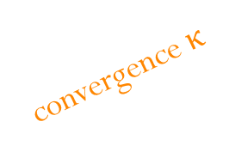

The weak lensing of strong lensing
Weak lensing of strong lensing
$$κ_{LOS}$$
A potential source of bias, e.g.
  Time delay cosmography
  Double source plane lensing
unmeasurable from imaging
Johnson, Fleury et al. (2024)
Johnson et al. (in prep)
convergence $κ$
Johnson, Collett et al. (2025)
Johnson, Fleury, Millon (2026)
Johnson, Millon et al. (in prep)
Daniel Johnson, University of Montpellier daniel.johnson@umontpellier.fr arxiv 2603.03441
Notes:
The shear, on the other hand, which you probably know as external shear, is of course also a potential source of bias in lensing measurements, but unlike the line of sight convergence, is not perfectly degenerate with modifications to the lens and source, and thus should be measurable with sufficiently good data and sufficiently complex lens models. This has been shown from simulations, and we’ve also started working to measure this in real lenses, which is something I’ll come back to at the end of this talk.

Slide 18

The weak lensing of strong lensing
Weak lensing of strong lensing
$$κ_{LOS}$$
A potential source of bias, e.g.
  Time delay cosmography
  Double source plane lensing
unmeasurable from imaging
Johnson, Fleury et al. (2024)
Johnson et al. (in prep)
convergence $κ$
Johnson, Collett et al. (2025)
Johnson, Fleury, Millon (2026)
Johnson, Millon et al. (in prep)
shear γ
$$γ_{LOS}$$
Hogg, Fleury et al. (2022)
Hogg, Johnson et al. (2025)
Hogg, Johnson et al. (2026)
Fleury, Johnson et al. (2026)
Queirolo et al. (in prep)
A potential source of bias in lens modelling (see 1, 2)
Measurable with sufficiently complex lens models!
Daniel Johnson, University of Montpellier daniel.johnson@umontpellier.fr arxiv 2603.03441
Notes:
The shear, on the other hand, which you probably know as external shear, is of course also a potential source of bias in lensing measurements, but unlike the line of sight convergence, is not perfectly degenerate with modifications to the lens and source, and thus should be measurable with sufficiently good data and sufficiently complex lens models. This has been shown from simulations, and we’ve also started working to measure this in real lenses, which is something I’ll come back to at the end of this talk.

Slide 19


The weak lensing of strong lensing
Why measure $γ_{LOS}$? Why should we care?
$γ_{LOS}$ arises from the distribution of matter on a given line of sight
Novel probe of the matter power spectrum
High snr on individual measurements, unlike weak lensing of galaxies
Different systematics, i.e. highly complementary to existing probes
Birrer et al. (2016), Line-of-sight effects in strong lensing: Putting theory into practice
arXiv:1610.01599
Daniel Johnson, University of Montpellier daniel.johnson@umontpellier.fr arxiv 2603.03441
Notes:
Now, you might be asking, why should we care? Shear has typically been thought of as a nuisance parameter, and marginalising over it works just fine.
Well, the line-of-sight shear is created by the distribution of matter on the line of sight, which means that, if it’s properly measured, it gives us a new way to probe the matter power spectrum. While in the case of weak lensing, shear is only detectable by correlating thousands of galaxy shapes, whereas for strong lensing, it seems that it is measurable for individual strong lens systems. The systematics of these measurements are completely independent of those in weak lensing, and so these measurements would be highly complementary to existing probes. This was first proposed in 2016 in this paper, and I’ll spend the rest of the talk summarising recent progress made on the topic.

Slide 20
Line-of-sight shear as a cosmological probe
The 3x2pt correlation scheme
Daniel Johnson, University of Montpellier daniel.johnson@umontpellier.fr arxiv 2603.03441
Notes:
Now, weak lensing measurements are typically combined with galaxy clustering in so-called 3x2pt studies.

Slide 21



Line-of-sight shear as a cosmological probe
The 3x2pt correlation scheme
$$\left\langle δ×δ\right\rangle$$
$$δ$$
galaxy overdensity
$$δ$$
Daniel Johnson, University of Montpellier daniel.johnson@umontpellier.fr arxiv 2603.03441
Notes:
We can correlate positions of galaxies with those of other galaxies in their vicinity

Slide 22



Line-of-sight shear as a cosmological probe
The 3x2pt correlation scheme
$$ε$$
galaxy ellipticity
$$ε$$
$$\left\langle δ×δ\right\rangle$$
$$\left\langle ε×ε\right\rangle$$
$$δ$$
galaxy overdensity
$$δ$$
Daniel Johnson, University of Montpellier daniel.johnson@umontpellier.fr arxiv 2603.03441
Notes:
We can also correlate the ellipticities of galaxies to detect shear

Slide 23

Line-of-sight shear as a cosmological probe
The 3x2pt correlation scheme
$$ε$$
galaxy ellipticity
$$ε$$
$$\left\langle δ×δ\right\rangle$$
$$\left\langle ε×ε\right\rangle$$
$$\left\langle δ×ε\right\rangle$$
$$δ$$
galaxy overdensity
$$δ$$
Daniel Johnson, University of Montpellier daniel.johnson@umontpellier.fr arxiv 2603.03441
Notes:
And we can correlate the shapes and positions of galaxies with one another, to give us a third 2pt correlation function. Each of these gives us a window to the matter power spectrum, but also come with their sources of uncertainty. Galaxies are of course biased tracers of the underlying matter distribution, and the problem of intrinsic alignments is a key source of uncertainty for weak lensing measurements.

Slide 24
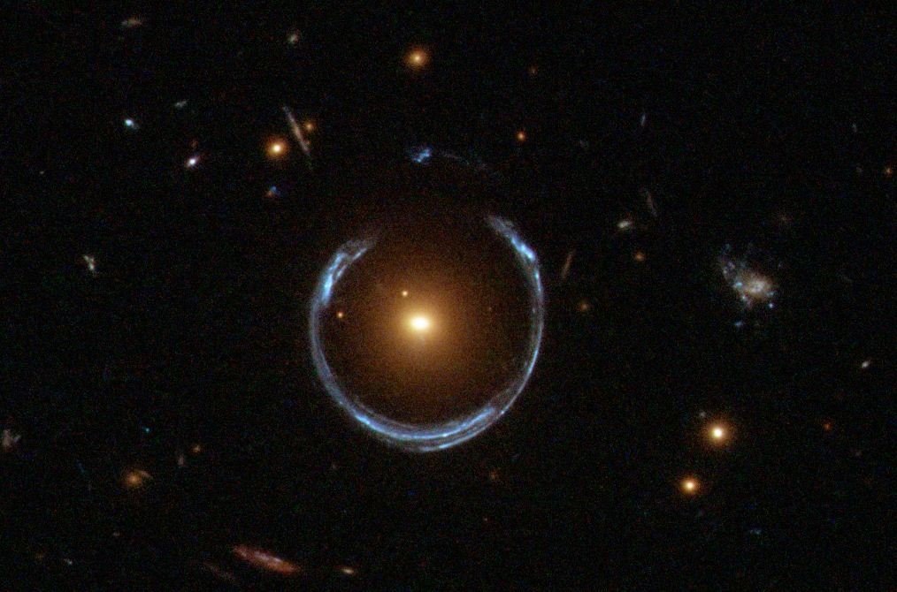

Line-of-sight shear as a cosmological probe
The 3x2pt correlation scheme
~${10}^{5}$ lenses with Euclid
$$ε$$
galaxy ellipticity
$$ε$$
$$\left\langle δ×δ\right\rangle$$
$$\left\langle ε×ε\right\rangle$$
$$\left\langle δ×ε\right\rangle$$
$$δ$$
galaxy overdensity
$$δ$$
Daniel Johnson, University of Montpellier daniel.johnson@umontpellier.fr arxiv 2603.03441
Notes:
Now, with Euclid, we should observe a couple hundred thousand strong lenses amongst 2 billion or so galaxies.

Slide 25



Line-of-sight shear as a cosmological probe
The 6x2pt correlation scheme
Fleury, Johnson et al. (2026)
arXiv:2603.03441
LOS shear
$$ε$$
$$γ_{LOS}$$
galaxy ellipticity
$$ε$$
$$\left\langle δ×δ\right\rangle$$
$$\left\langle ε×ε\right\rangle$$
$$\left\langle δ×ε\right\rangle$$
$$\left\langle γ_{LOS}×γ_{LOS}\right\rangle$$
$$\left\langle γ_{LOS}×δ\right\rangle$$
$$\left\langle γ_{LOS}×ε\right\rangle$$
$$δ$$
$$γ_{LOS}$$
galaxy overdensity
$$δ$$
Daniel Johnson, University of Montpellier daniel.johnson@umontpellier.fr arxiv 2603.03441
Notes:
The idea is that, if we can measure the shear on these galaxies, we can access 3 new 2pt correlation functions by correlating these shear measurements with those from other lenses, with the distribution of nearby galaxies, and with the ellipticities of those galaxies. Now, how well do we think we could measure this signal once we have all this Euclid data?

Slide 26
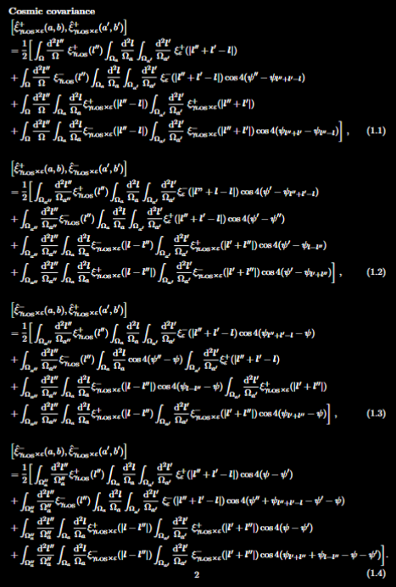
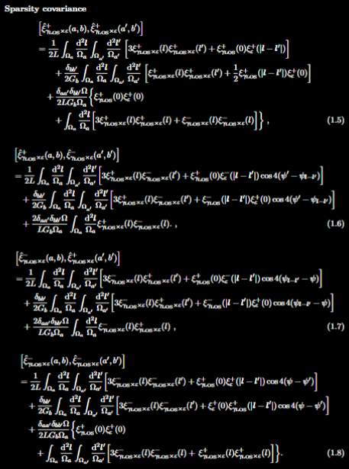
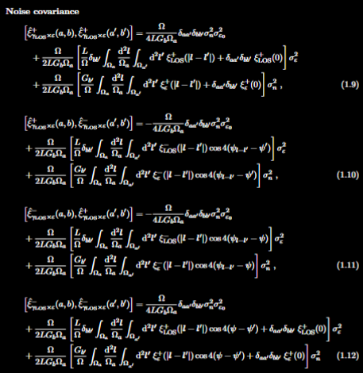
Line-of-sight shear as a cosmological probe
Covariance matrices
2/20
Daniel Johnson, University of Montpellier daniel.johnson@umontpellier.fr arxiv 2603.03441
Notes:
What the team is currently working on is the associated covariance matrices, these horrible looking things,

Slide 27
Line-of-sight shear as a cosmological probe
Covariance matrices
(21 of these)
2/20
Daniel Johnson, University of Montpellier daniel.johnson@umontpellier.fr arxiv 2603.03441
Notes:
Of which there are 18!

Slide 28

Full 6x2pt covariance matrix
$$σ_{LOS}=0.05 \\ N_{lens}={10}^{5}$$
Daniel Johnson, University of Montpellier daniel.johnson@umontpellier.fr arxiv 2603.03441
Notes:
And the signal is even stronger in the case of the shear x ellipticity. So even in the pessimistic case, there’s reason to believe the signal is observable and usable!

Slide 29
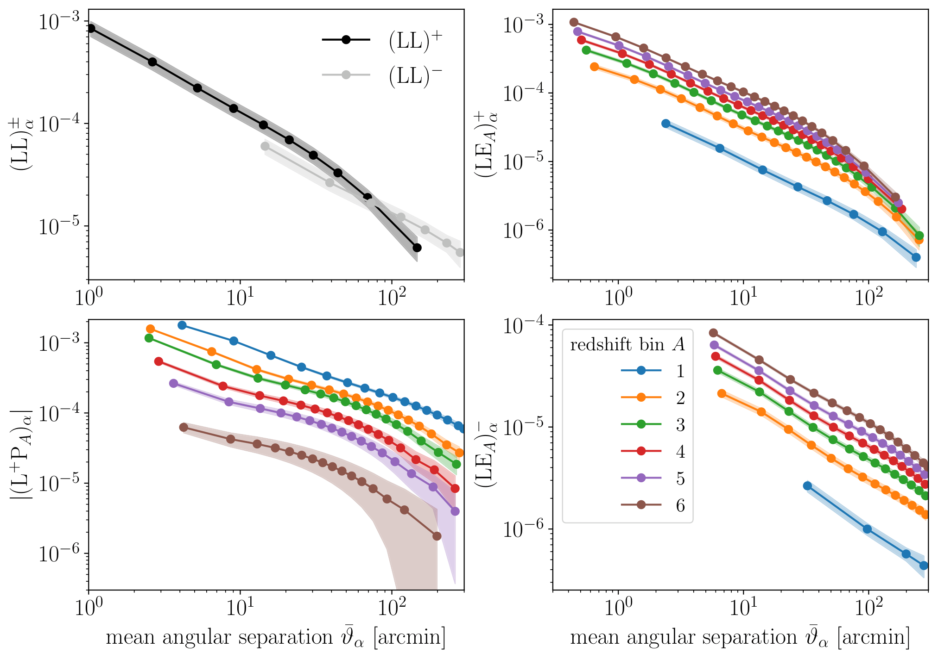

Line-of-sight shear as a cosmological probe
Forecasted
correlations
(optimistic)
$$\left\langle η_{LOS}\right\rangle =0.05 \\ N_{lens}={10}^{5}$$
Daniel Johnson, University of Montpellier daniel.johnson@umontpellier.fr arxiv 2603.03441
Notes:
In the fairly optimistic case, where we can achieve an average precision of point 0 5 on measurements of 100 000 lenses, we can tightly constrain the autocorrelation function for the line-of-sight shear across a wide range of angular scales

Slide 30
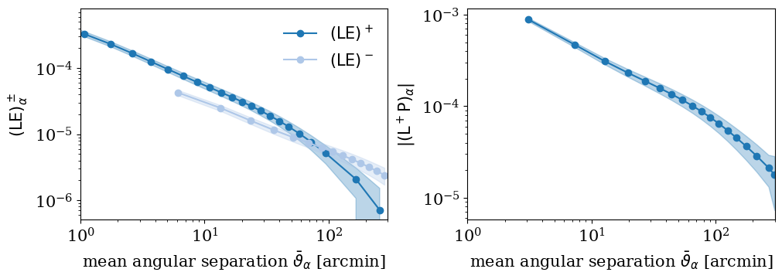

Line-of-sight shear as a cosmological probe
Forecasted correlations (conservative)
$$\left\langle η_{LOS}\right\rangle =0.1 \\ N_{lens}={10}^{4}$$
Daniel Johnson, University of Montpellier daniel.johnson@umontpellier.fr arxiv 2603.03441
Notes:
In the fairly optimistic case, where we can achieve an average precision of point 0 5 on measurements of 100 000 lenses, we can tightly constrain the autocorrelation function for the line-of-sight shear across a wide range of angular scales

Slide 31
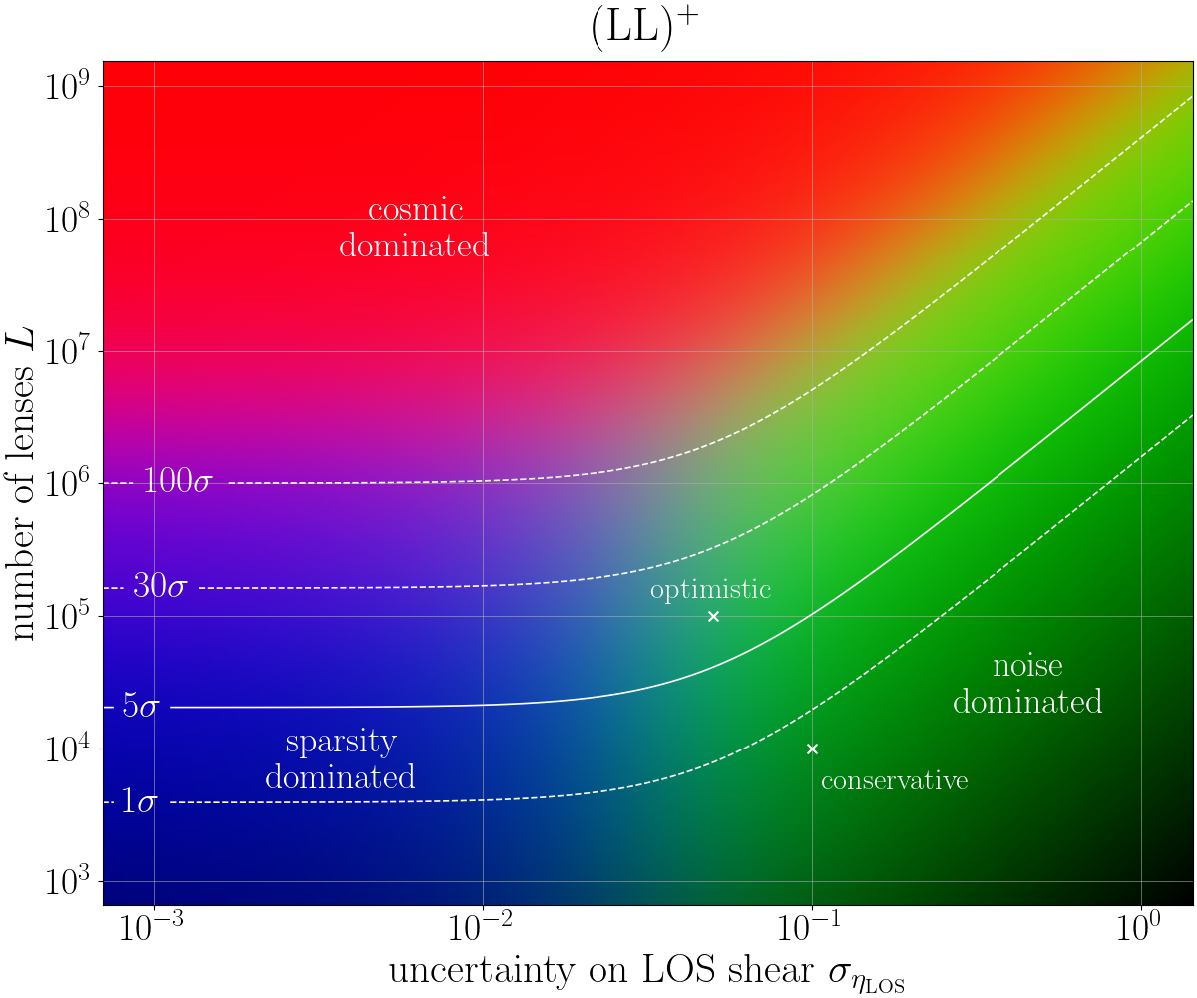
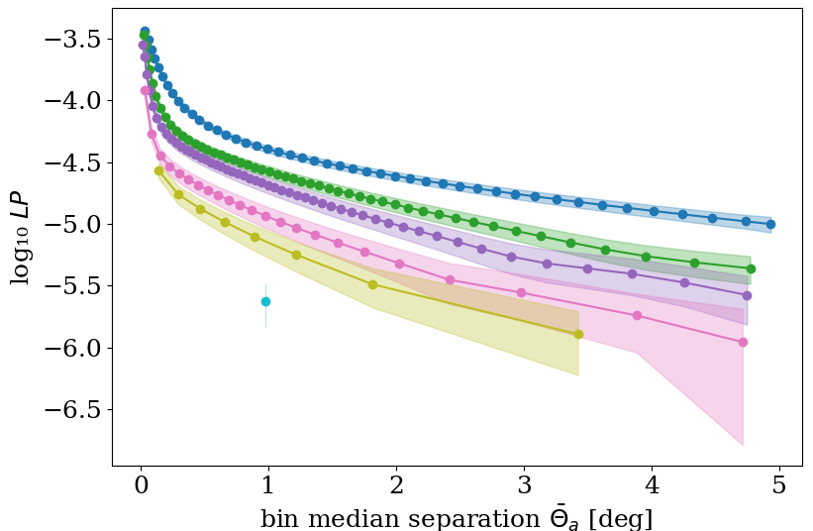
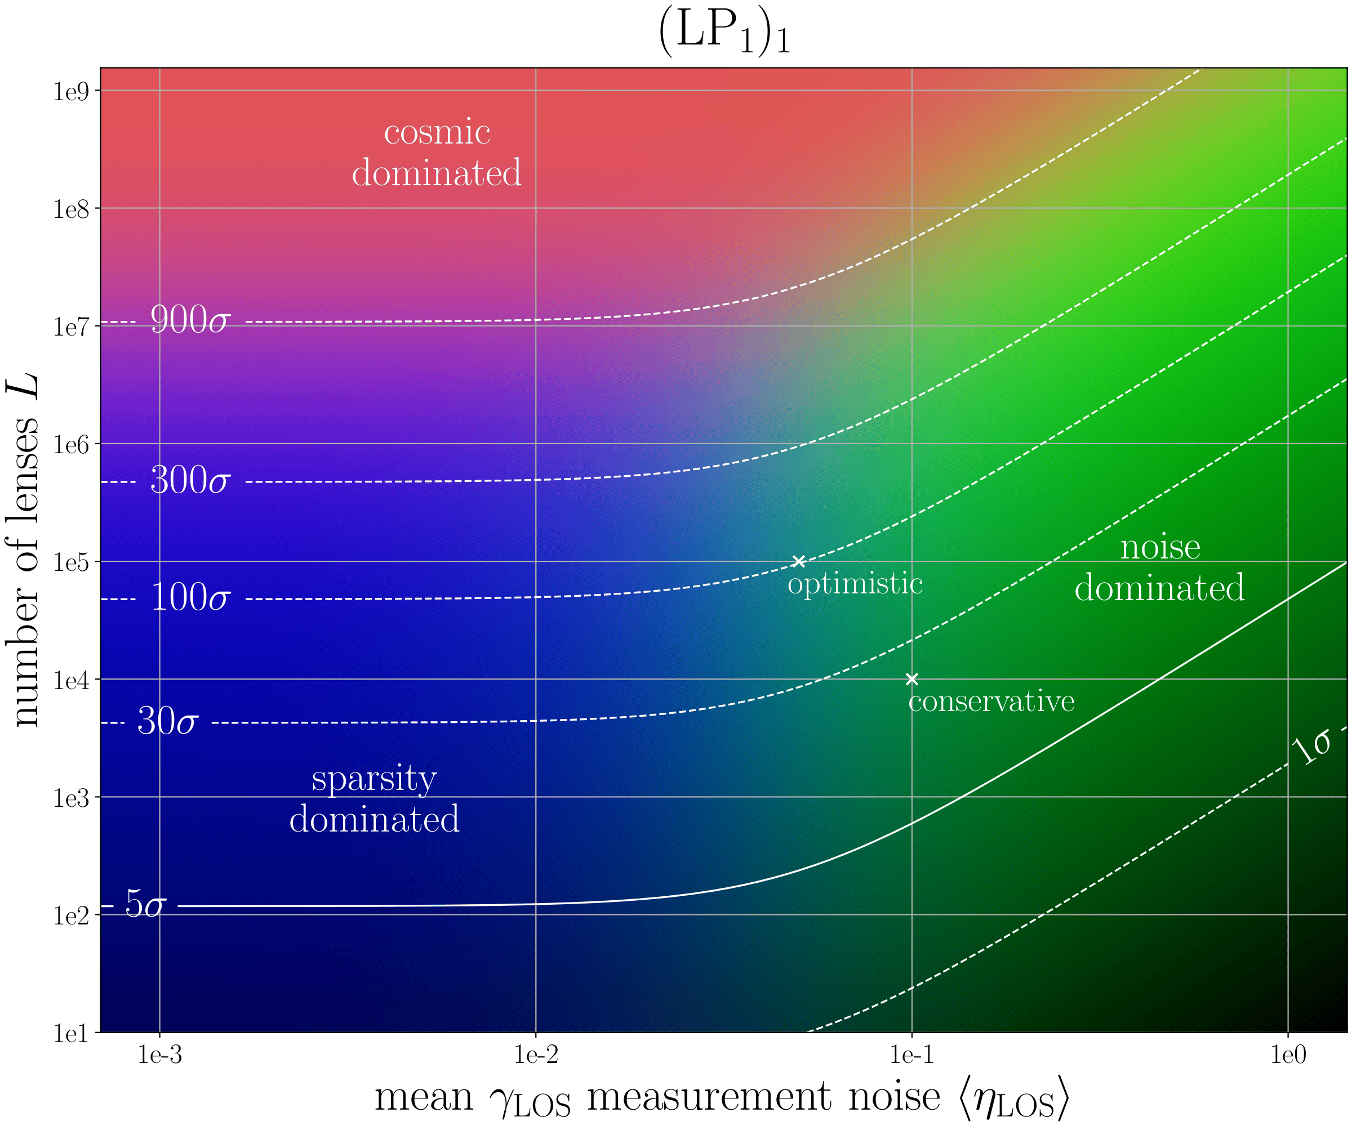
Line-of-sight shear as a cosmological probe
Signal detectability
(LL+)
5σ detection with
~10 000 lenses
Daniel Johnson, University of Montpellier daniel.johnson@umontpellier.fr arxiv 2603.03441
Notes:
For the cross-correlation between the line-of-sight shear and galaxy positions, the situation is even better, and we can split our signal up into redshift bins and get a sense of how the correlation function evolves with redshift

Slide 32
Line-of-sight shear as a cosmological probe
Signal detectability (LP)
5σ detection with ~100 lenses
Daniel Johnson, University of Montpellier daniel.johnson@umontpellier.fr arxiv 2603.03441
Notes:
For the cross-correlation between the line-of-sight shear and galaxy positions, the situation is even better, and we can split our signal up into redshift bins and get a sense of how the correlation function evolves with redshift

Slide 33
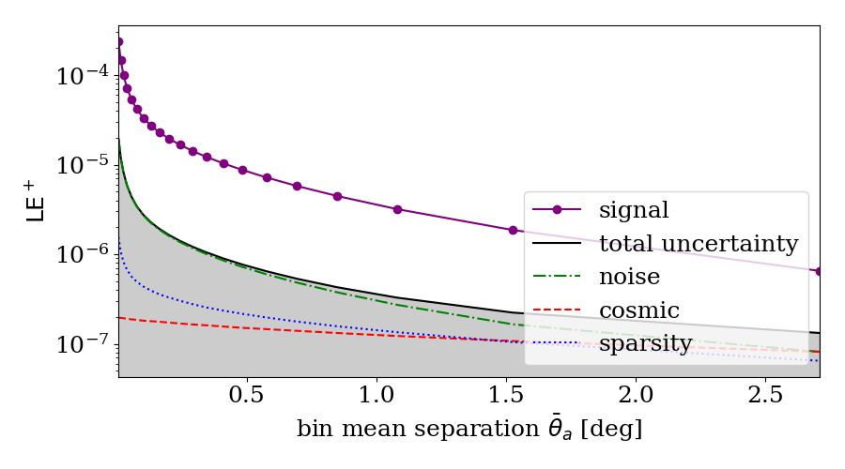

Line-of-sight shear as a cosmological probe
Sources of uncertainty
noise
$$⁡\left\langle γ_{LOS}×ε\right\rangle$$
cosmic
sparsity
2/20
Daniel Johnson, University of Montpellier daniel.johnson@umontpellier.fr arxiv 2603.03441

Slide 34
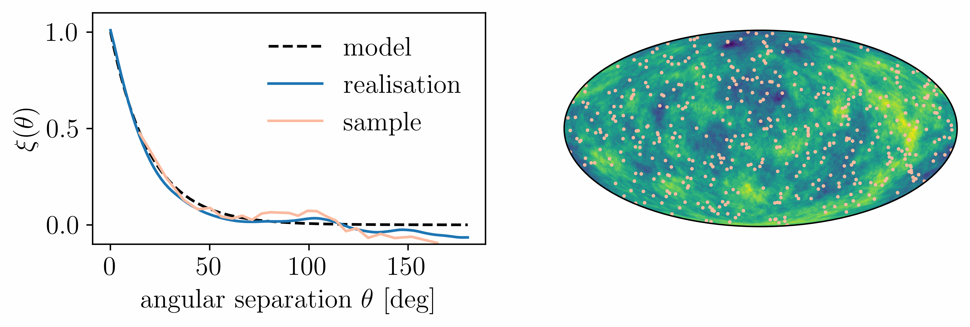

Line-of-sight shear as a cosmological probe
Sparsity covariance
Beyond $σ_{LOS}<\sim 5\%$, no real improvements without more lenses
2/20
Daniel Johnson, University of Montpellier daniel.johnson@umontpellier.fr arxiv 2603.03441

Slide 35
Line-of-sight shear as a cosmological probe
Signal detectability (LP)
5σ detection with ~100 lenses
Daniel Johnson, University of Montpellier daniel.johnson@umontpellier.fr arxiv 2603.03441
Notes:
For the cross-correlation between the line-of-sight shear and galaxy positions, the situation is even better, and we can split our signal up into redshift bins and get a sense of how the correlation function evolves with redshift

Slide 36
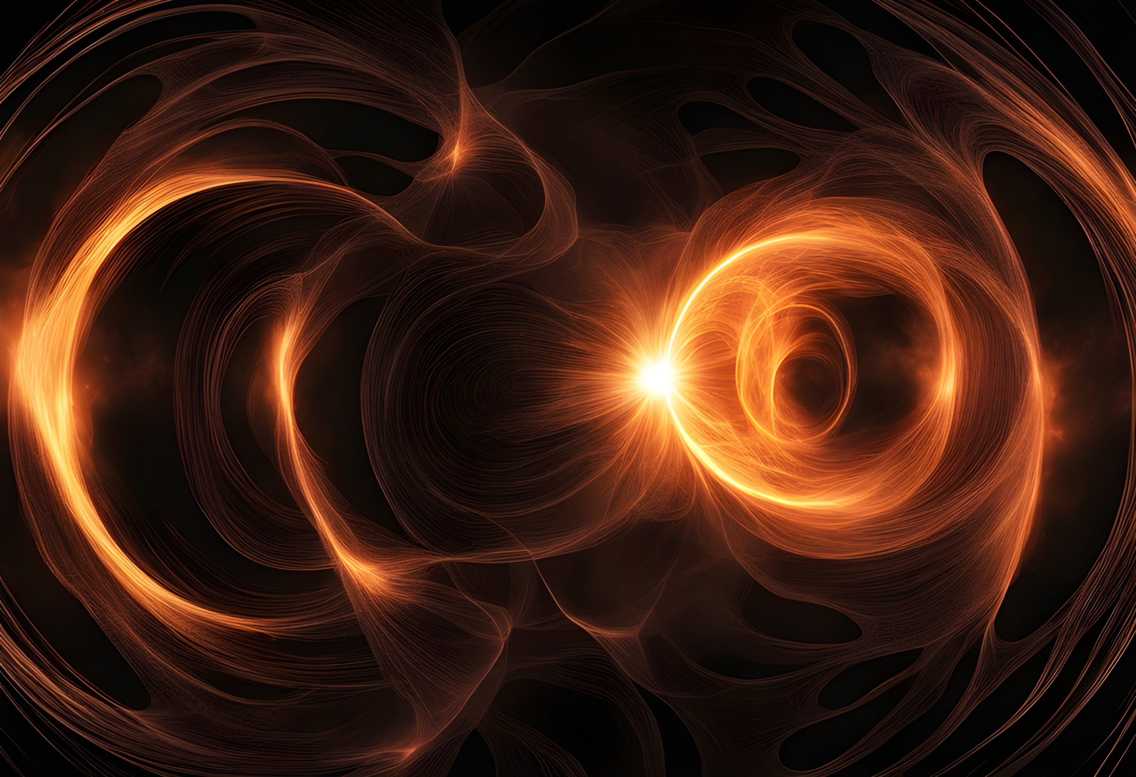

Ongoing work
Forecasting
Hogg et al. (in preparation)
We have our covariance estimate, time to forecast cosmological constraints!
How tightly does this new observable alone constrain $Ω_{M}$, $S_{8}$ etc, and how does the combinations with 3x2pt improve constraints wrt 3x2pt alone?
How much do we help with intrinsic aligments?
How sensitive are we to constraining more exotic cosmology? (WDM, FDM etc)
Daniel Johnson, University of Montpellier daniel.johnson@umontpellier.fr arxiv 2603.03441
Notes:
To summarise, measuring line of sight effects is tough, but if we manage to do it at scale, it gives us a powerful new way to constrain the matter power spectrum

Slide 37
Ongoing work
Forecasting
Hogg et al. (in preparation)
We have our covariance estimate, time to forecast cosmological constraints!
How tightly does this new observable alone constrain $Ω_{M}$, $S_{8}$ etc, and how does the combinations with 3x2pt improve constraints wrt 3x2pt alone?
How much do we help with intrinsic aligments?
How sensitive are we to constraining more exotic cosmology? (WDM, FDM etc)
Systematics
Many lenses will only have photometric redshifts, what effect will this have?
What are the selection effects for strong lens lines of sight?
Can we avoid losing information on small scales?
Etc etc
Daniel Johnson, University of Montpellier daniel.johnson@umontpellier.fr arxiv 2603.03441
Notes:
To summarise, measuring line of sight effects is tough, but if we manage to do it at scale, it gives us a powerful new way to constrain the matter power spectrum

Slide 38
Ongoing work
Forecasting
Hogg et al. (in preparation)
We have our covariance estimate, time to forecast cosmological constraints!
How tightly does this new observable alone constrain $Ω_{M}$, $S_{8}$ etc, and how does the combinations with 3x2pt improve constraints wrt 3x2pt alone?
How much do we help with intrinsic aligments?
How sensitive are we to constraining more exotic cosmology? (WDM, FDM etc)
Lens modelling
Queirolo et al. (in preparation)
Lens modelling is non-trivial. How can we avoid systematics from unmodelled complexity in our lens galaxies?
Put differently, how complex do our lens models need to be before we trust that the measured shear is accurate and unbiased?
See Giacomo’s talk!
Systematics
Many lenses will only have photometric redshifts, what effect will this have?
What are the selection effects for strong lens lines of sight?
Can we avoid losing information on small scales?
Etc etc
Daniel Johnson, University of Montpellier daniel.johnson@umontpellier.fr arxiv 2603.03441
Notes:
To summarise, measuring line of sight effects is tough, but if we manage to do it at scale, it gives us a powerful new way to constrain the matter power spectrum

Slide 39
Summary
Matter along the line of sight has a non-negligible effect on strong lens data
Ignoring or under-parameterising these effects can lead to biases
Measurements of the line-of-sight shear would provide a novel constraint on the matter power spectrum, complementary to current probes
2pt correlation functions should be well-constrainable from Euclid data
Challenges remain in avoiding degeneracies, understanding systematics and automating modelling
Watch the space!
Daniel Johnson, University of Montpellier daniel.johnson@umontpellier.fr arxiv 2603.03441
Notes:
To summarise, measuring line of sight effects is tough, but if we manage to do it at scale, it gives us a powerful new way to constrain the matter power spectrum

Slide 40
Thanks for listening!
Measuring the shear
Natalie B. Hogg, Pierre Fleury, Julien Larena, Matteo Martinelli,
Measuring line-of-sight shear with Einstein rings: a proof of concept, MNRAS 520 (2023) 04, arXiv:2210.07210
Natalie B. Hogg, Daniel Johnson,
Anowar J. Shajib, Julien Larena,
Line-of-sight shear in SLACS strong lenses I:
shear and mass model parametrisations, arXiv:2501.16292
Natalie B. Hogg, Daniel Johnson,
Anowar J. Shajib, Julien Larena,
Line-of-sight shear in SLACS strong lenses II: validation tests with an extended sample,
arXiv: 2512.05050
Etherington et al. (2024) arXiv: 2301.05244
Nightingale et al. (2022)
Shajib et al. (2021)
Tan et al. (2024)
The LOS as a source of error
Daniel Johnson, Thomas Collett, Tian Li, Pierre Fleury,
Line-of-sight effects on double source plane lenses, arXiv:2501.17153
Daniel Johnson, Pierre Fleury, Julien Larena, Lucia Marchetti,
Foreground biases in strong gravitational lensing, JCAP 10 (2024) 055, arXiv:2405.04194
Daniel Johnson, Martin Millon, Pierre Fleury, Degeneracies and modelling choices in double-plane time-delay cosmography,
arXiv:2602.02697
Wong et al. (2010) arXiv: 1011.2504
Greene et al. (2013) arXiv: 1303.3588
Collett et al. (2013) arXiv: 1303.6564
Fleury et al. (2019) arXiv: 1809.03919
Jaroszynski et al. (2014) arXiv: 1401.4108
McCully et al . (2017) arXiv: 1601.05417
daniel.johnson@umontpellier.fr
More reading…
Shear as a cosmological probe
Pierre Fleury, Julien Larena, Jean-Philippe Uzan,
Line-of-sight effects in strong gravitational lensing, JCAP 08 (2021) 024, arXiv:2104.08883
Pierre Fleury, Daniel Johnson, Theo Duboscq, Natalie Hogg, Julien Larena,
Cosmology with the line-of-sight shear, arXiv:2603.03441
Birrer et al. (2017) arXiv: 1610.01599
Notes:
If you’re interested, please do come chat to me anytime, and thank you for listening!

Slide 41



Backup slides
Weak lensing of strong lensing
Einstein ring
perturbations
source
main deflector
observer
$$𝓐_{od}$$
$$𝓐_{ds}$$
$$𝓐_{os}$$
Notes:
Now, when it comes to strong lensing, there are three amplification matrices at play, each sensitive to different components of the line of sight

Slide 42
Backup slides
Weak lensing of strong lensing
LOS effects
arXiv:2104.08883
Einstein ring
perturbations
source
main deflector
observer
$$𝓐_{LOS}≈𝓐_{od}+𝓐_{os}−𝓐_{ds}$$
Notes:
It turns out, however, that their effects are largely degenerate with one another, and it is generally safe to think of a single line-of-sight amplification matrix acting on the images

Slide 43
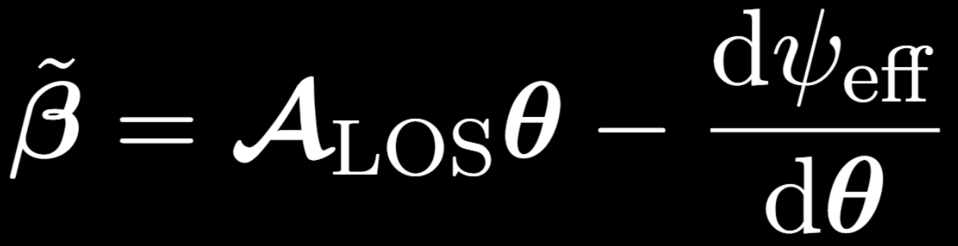
Backup slides
The minimal lens model
Fleury et al. 2021, 2104.08883
(A single main lens + tidal line-of-sight effects)
Notes:
In the presence of line of sight effects, the lens equation takes this form,

Slide 44
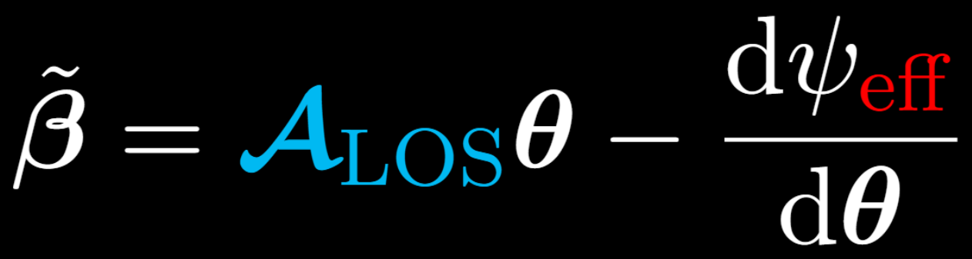
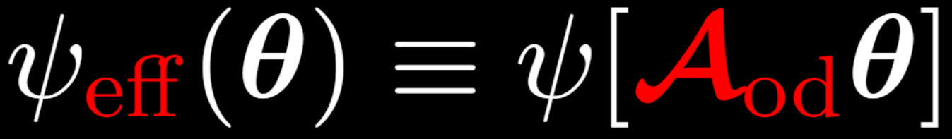
Backup slides
The minimal lens model
Fleury et al. 2021, 2104.08883
“External” convergence and shear
Foreground convergence and shear
Notes:
Where, as in the case of weak lensing, our line-of-sight matrix contains convergence and shear. Notice also that the foreground shear appears within the argument of the lens potential, but unsurprisingly its effect is just about impossible to disentangle from that of the lens itself

Slide 45
Backup slides
The effective potential
Sufficiently complicated main lens model should absorb foreground effects, but caution is needed when interpreting parameters

Slide 46
Backup slides
The effective potential
Sufficiently complicated main lens model should absorb foreground effects, but caution is needed when interpreting parameters

Slide 47
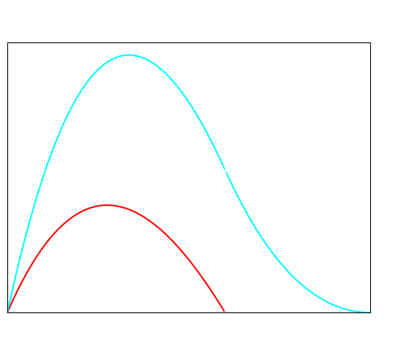



Backup slides
The weight function
$$z_{lens}$$
$$W_{LOS}$$
$$W_{od}$$
observer
source
z
foreground perturbers
main lens plane perturbers

Slide 48




Backup slides
The MSD and angular diameter distances
$$κ=0$$
observer
source
main deflector
$$D_{od}$$
$$D_{ds}$$
$$D_{os}$$
Notes:
Thus, while we might infer certain distances as though the light was passing through an FLRW background

Slide 49




Backup slides
The MSD and angular diameter distances
$$κ>0$$
observer
source
main deflector
$${\tilde{D}}_{od}=(1−κ_{od})D_{od}$$
$${\tilde{D}}_{ds}=(1−κ_{ds})D_{ds}$$
$${\tilde{D}}_{os}=(1−κ_{os})D_{os}$$

