Slide 1

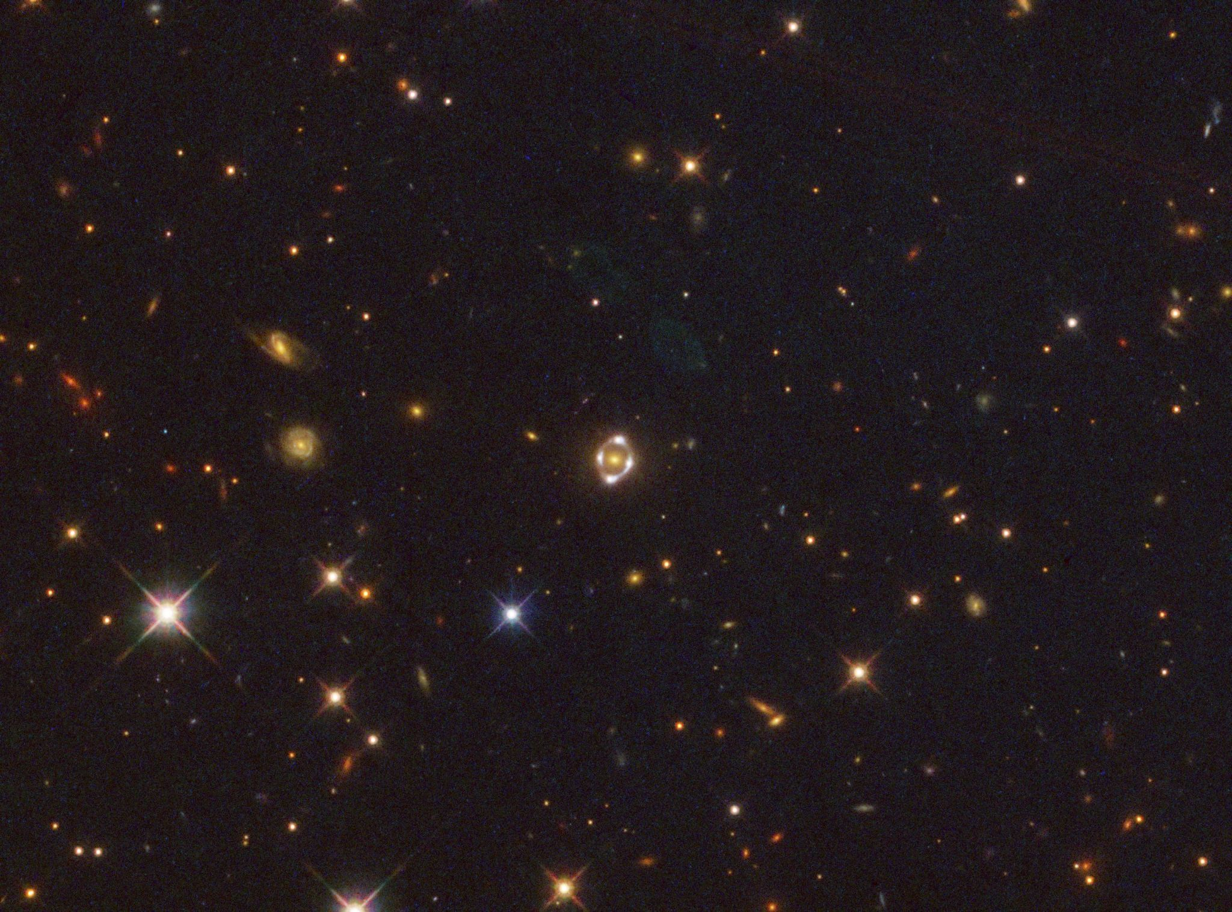
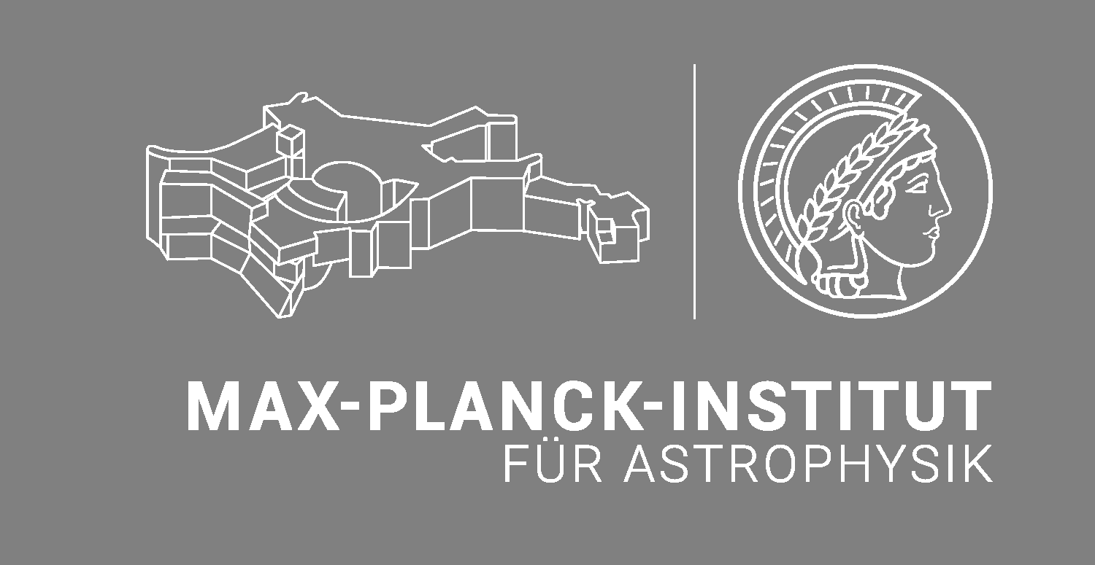

Measuring the Expansion Rate of the Universe with Strong Gravitational Lenses
Allan G. Schweinfurth (TUM/MPA)
In Collaboration with
Sherry H. Suyu (TUM/MPA), Aymeric Galan (UniGe), Stefan Taubenberger (TUM/MPA),
Alejandra Melo (ESO)
Exploring New Frontiers in Cosmology
July 6-10 2026, Galileo Galilei Institute (GGI), Florence, Italy
Image Credit: A. Galan, T. Li

Slide 2






Overview
The Hubble Tension
Strong Gravitational Lensing
Time-Delay Cosmography
Modelling of Gravitational Lenses
Outlook

Slide 3
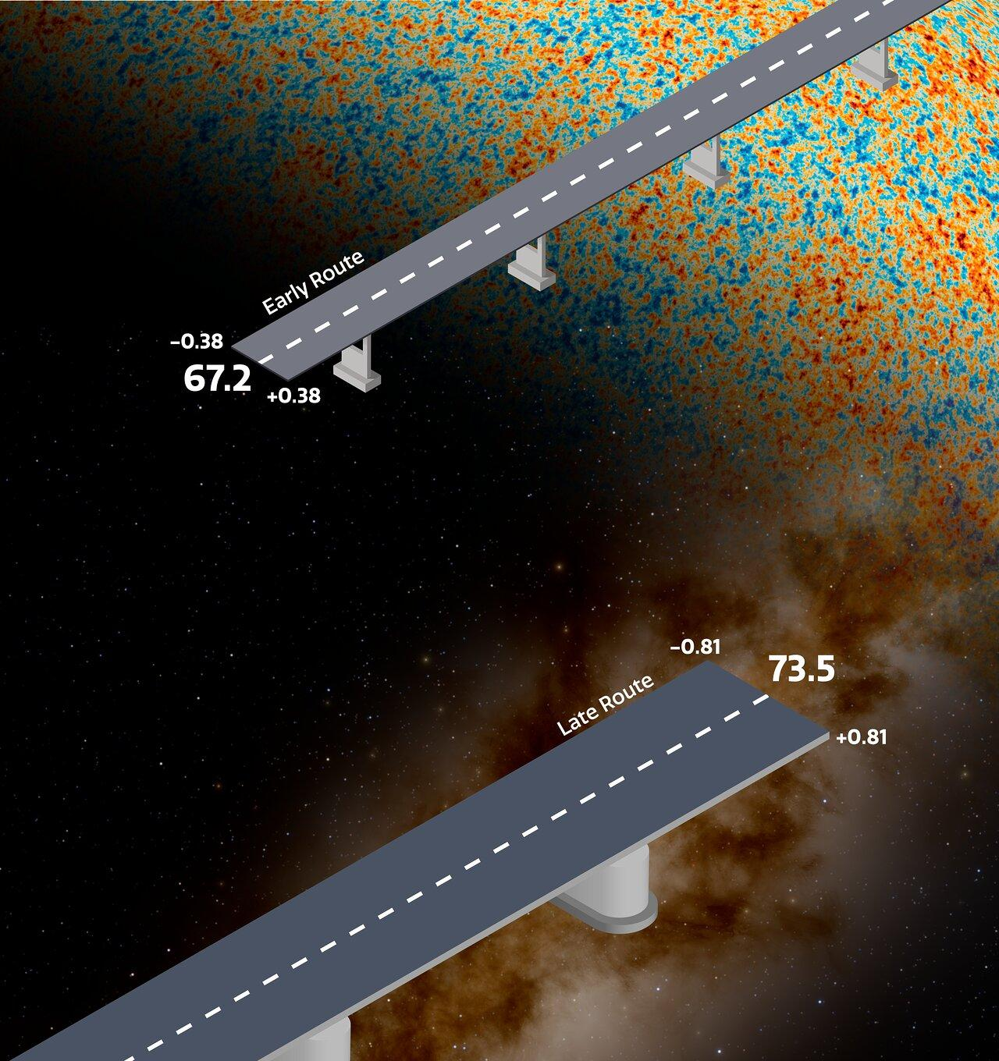
The Hubble Tension
NOIRLab/NSF/AURA/J. da Silva/J. Pollard

Slide 4
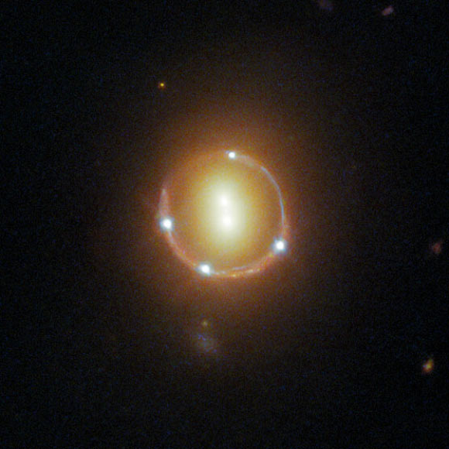
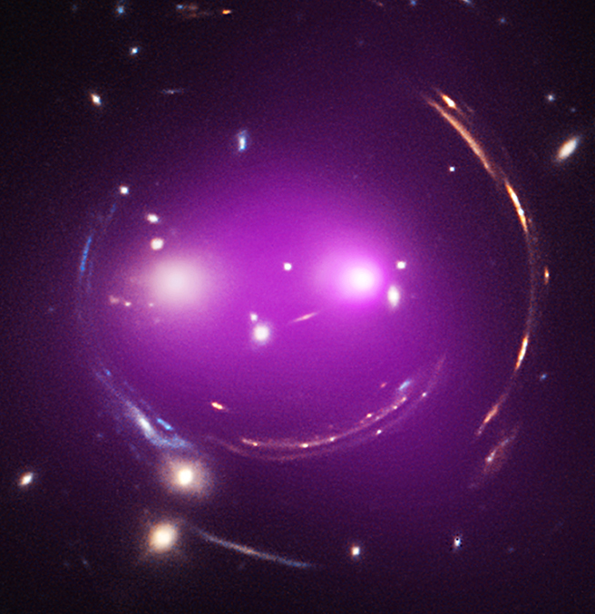
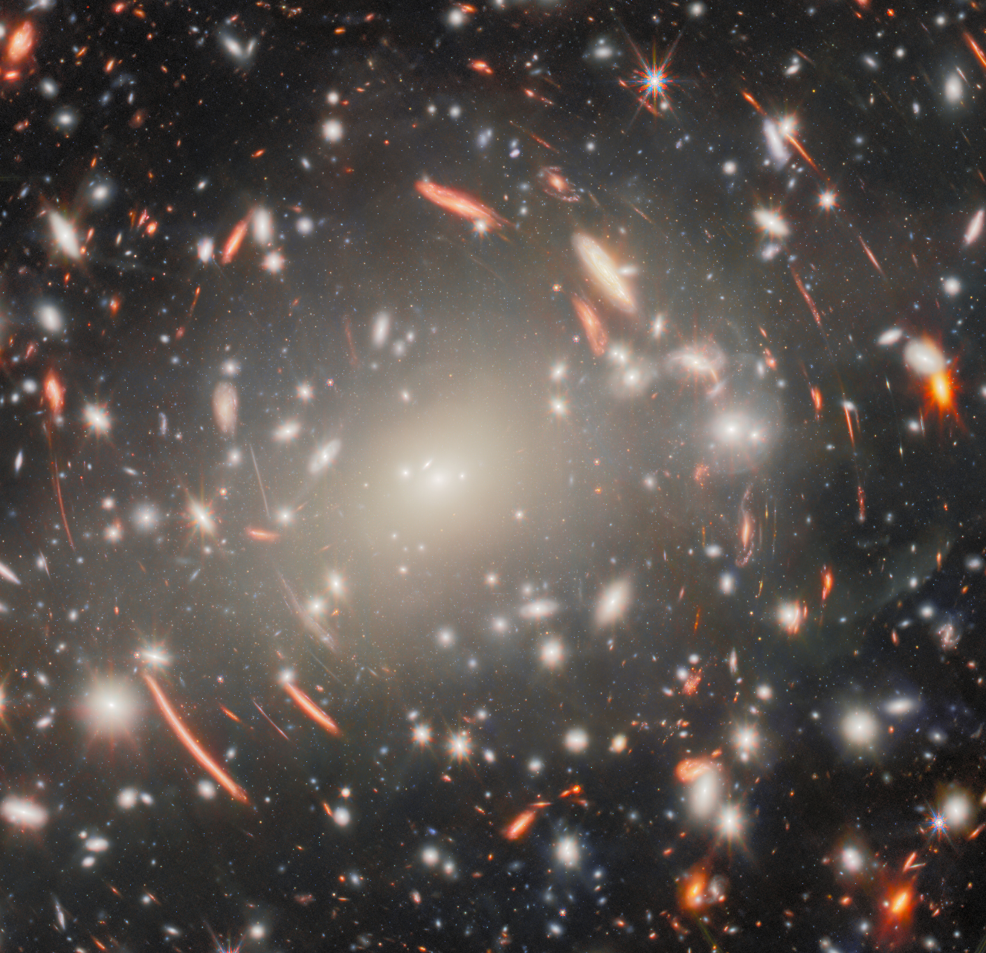

Strong Gravitational Lensing
Image Credits (L2R): [1] NASA / ESA / Hubble / T. Treu / Judy Schmidt ; [2] NASA/CXC/UA/J.Irwin et al; Optical: NASA/STScI ; [3] ESA/Webb/NASA/CSA/H. Atek and M. Zamani (ESA/Webb)
Notes:
Happens when a massive object, like a galaxy, bends and magnifies light from a more distant source, creating multiple images due to intense space-time warping.

Slide 5
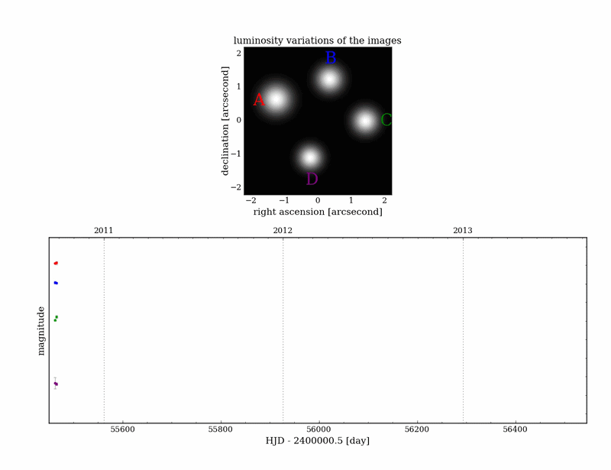
Time-Delay Cosmography
Animations courtesy of V. Bonvin (COSMOGRAIL and H0LiCoW Collaborations)

Slide 6
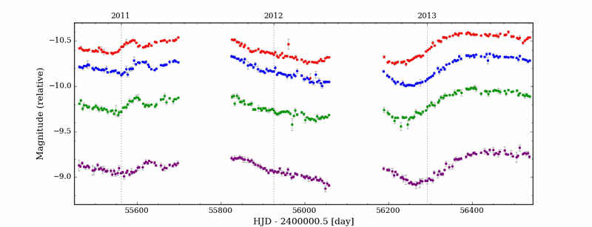
Time-Delay Cosmography
Animations courtesy of V. Bonvin (COSMOGRAIL and H0LiCoW Collaborations)

Slide 7
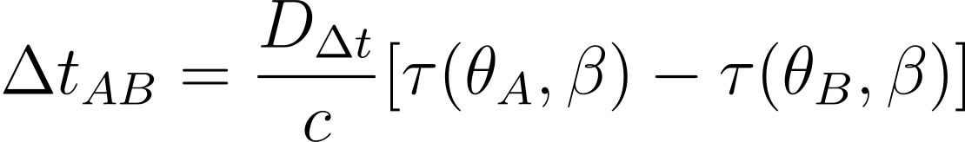
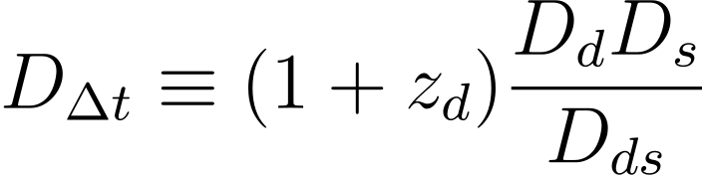
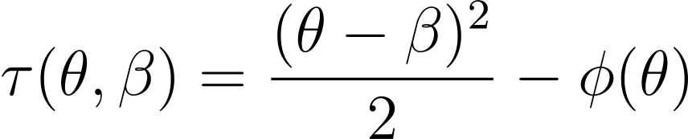

Time-Delay Cosmography
Time-Delay Distance
Fermat Potential Difference
particularly
Depends on the lens mass distribution

Slide 8
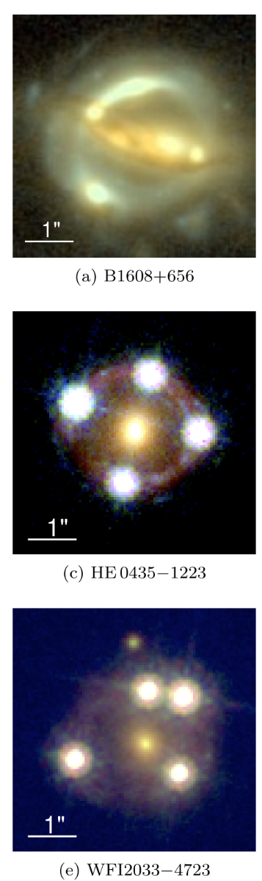
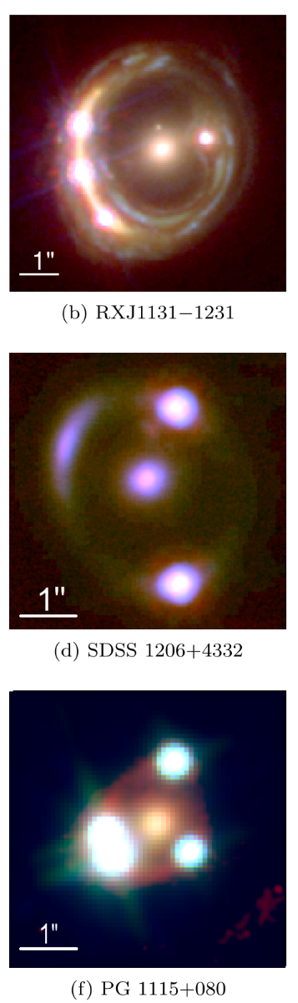
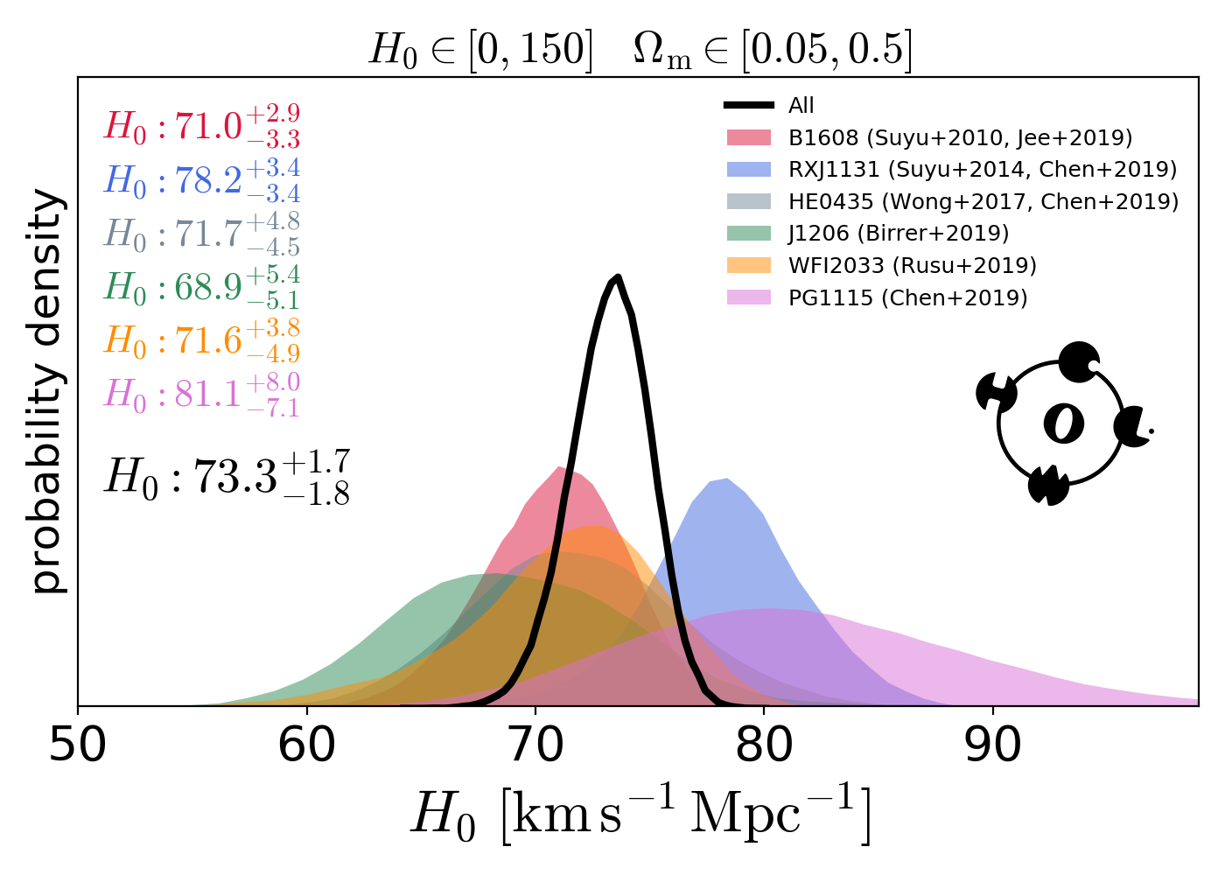
Time-Delay Cosmography
Time-Delay Cosmography provides a direct and independent measurement of H₀
Image Credit (all): H0LiCoW XIII - (Wong+2019)

Slide 9
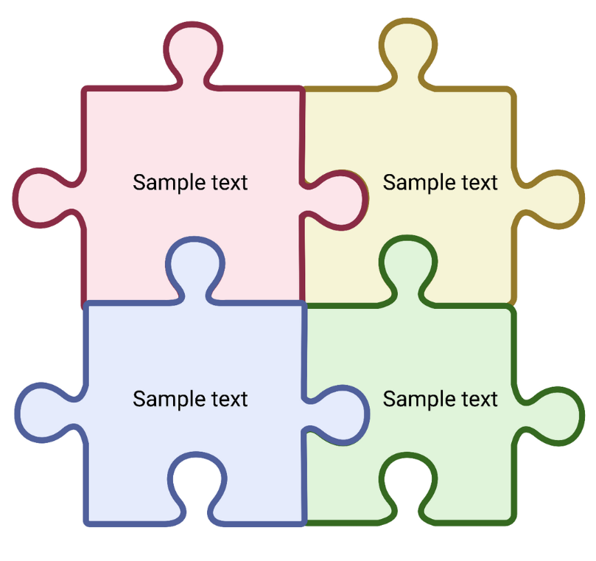
Modelling of Gravitational Lenses
Lens Model
Time Delay
Line of Sight
Kinematics

Slide 10
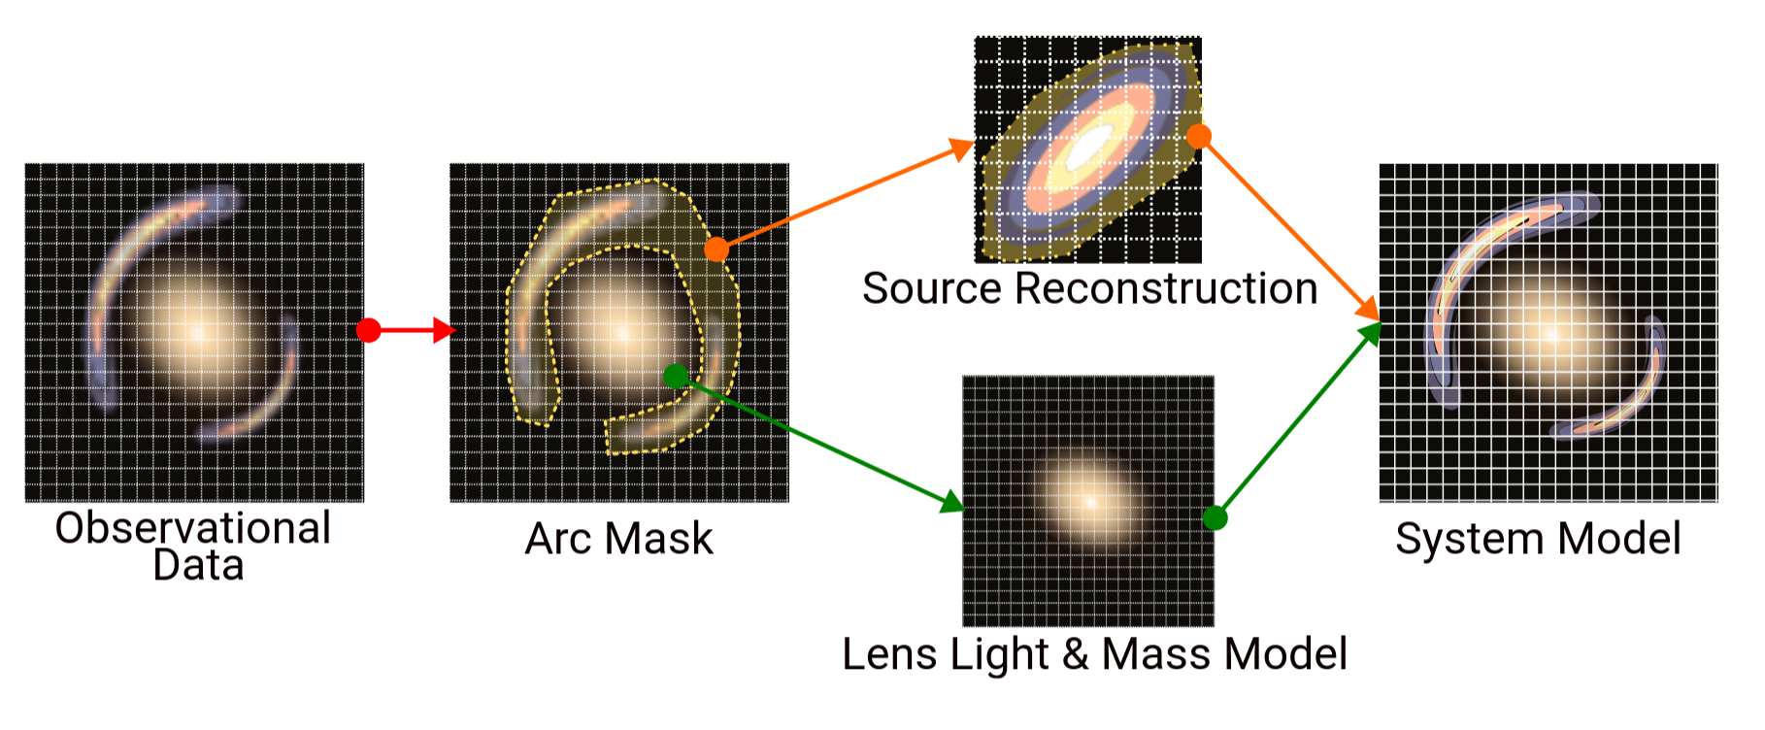

Slide 11

Modelling of Gravitational Lenses
J1537 - 3010
HST WFC3 Data (PI: Treu)
z_{l} = 0.590, z_{s} = 1.721
Discovered by Lemon+2019 and Delchambre+2019
Image Credit: A. Galan, T. Li

Slide 12
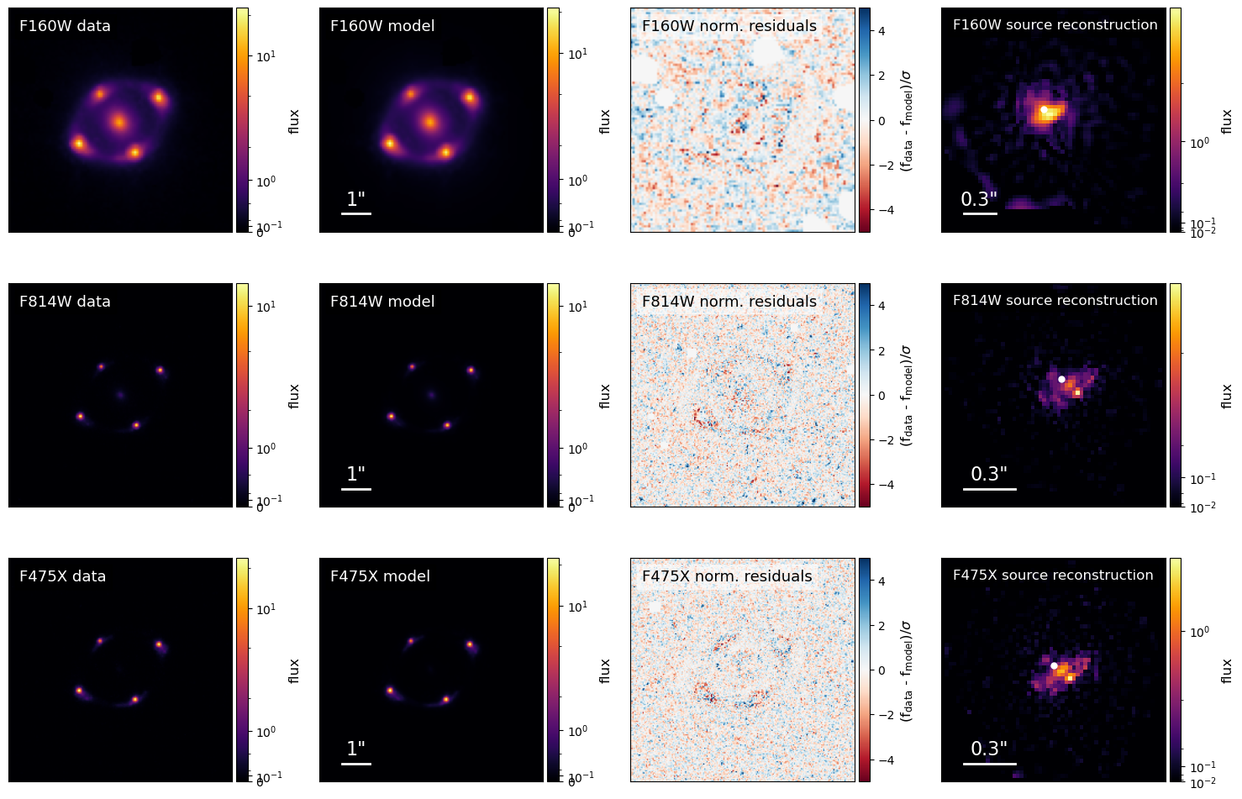
Data Model Norm. Residuals Source Reconstruction
H₀ coming soon…
value is blinded until the very end to avoid bias!
Galan & Schweinfurth + 2026 ; in prep

Slide 13
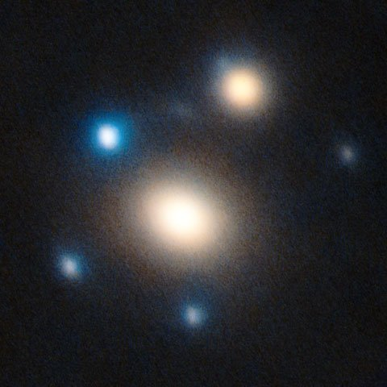
Modelling of Gravitational Lenses
SN Winny (SN 2025wny)
Large Binocular Telescope AO Data
z_{l} = 0.375, z_{s} = 2.01
Discovered by Taubenberger+2025 and Johansson+2025
First Lensed Superluminous Supernova
Ecker & Schweinfurth + 2026

Slide 14
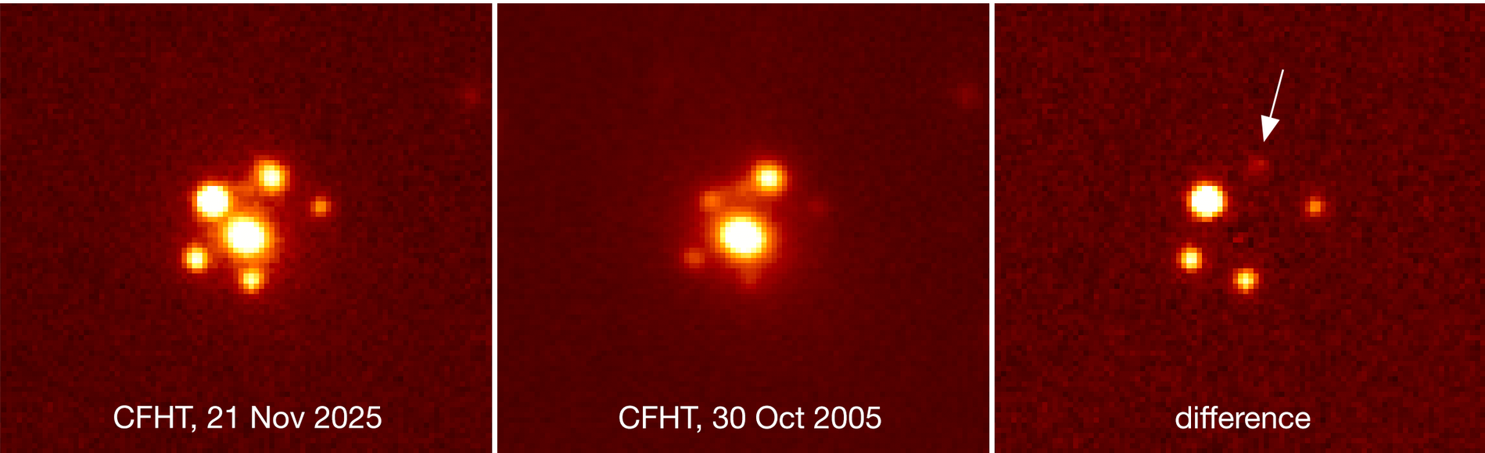
Image position only model (Not cosmography grade)
Consistent with Keck AO Model (Storfer+2026)
Naturally predicts the detected fifth image
Aryan+2025

Slide 15


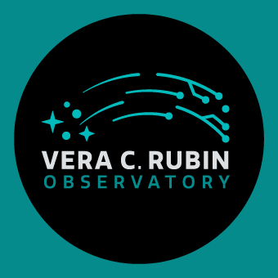
Outlook
J1537:
H₀ Unblinding -> TDCOSMO 2026
Improve modelling with JWST Data (PI: Treu)
SN Winny
Further Monitoring
HST Archival Data Modelling (PI: Goobar)
LSST and Euclid soon to increase sample of lenses!
New era for time-delay cosmography

Slide 16
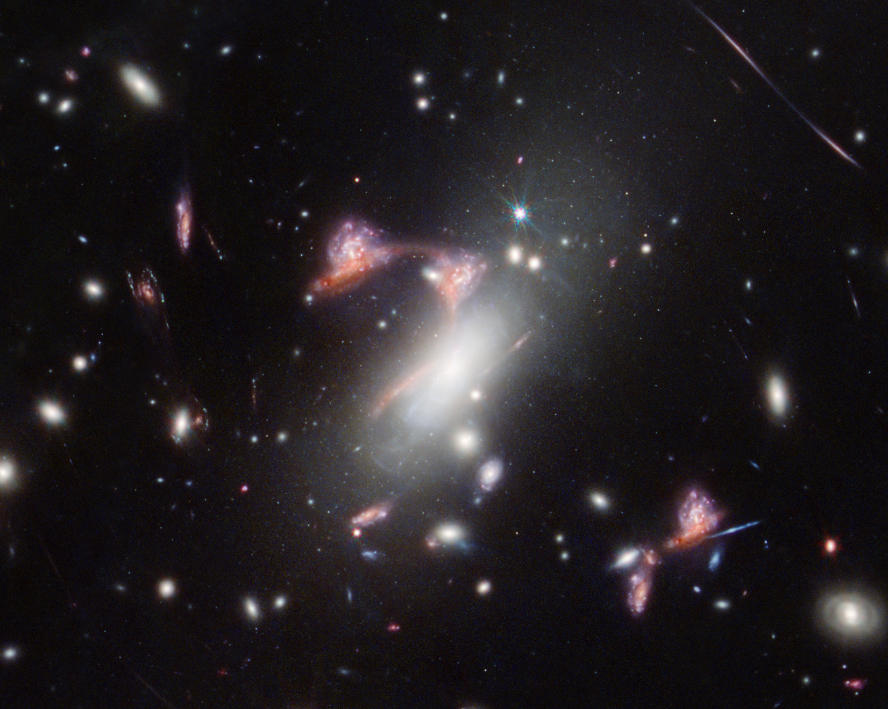

Questions
?
NASA, ESA, CSA, STScI, Vicente Estrada-Carpenter (Saint Mary's University)

